Slide 1






The Quest for Majorana Neutrinos
Stefan Schönert | TU München
59. International Winter Meeting on Nuclear Physics
January 23 – 27, 2023
Bormio, Italy

Slide 2
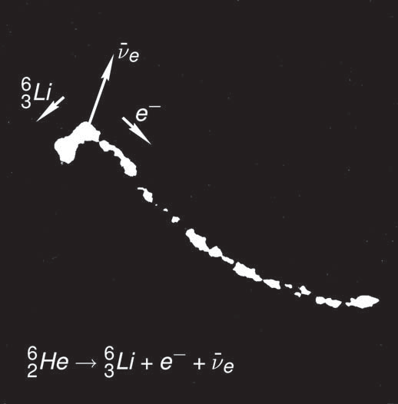
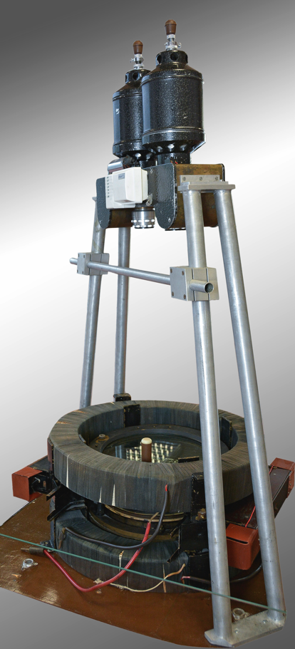
1956: The Neutrino Experiment at Debrecen
by J. Csikai and A. Szalay
discovery of neutrino particle through event-by-event reconstruction of decay kinematics

Slide 3
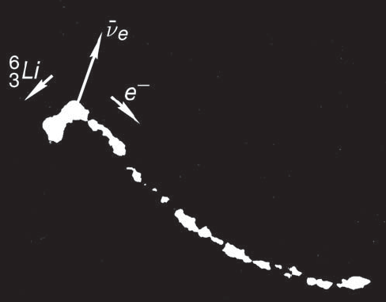
1956: The Reines-Cowan experimental concept
Source: Anti-Neutrinos from nuclear reactor core
Detection via capture on protons (H₂O):
_
ν_{e} + p ➔ n + e ⁺
_
ν_{e} travelling of many meters
e+
Beta-decays of neutron rich fission products

Slide 4
1955 Ray Davis: Attempt to detect the antineutrinos from a nuclear neactor by the
³⁷Cl (anti-ν, e⁻) ³⁷Ar reaction -
are neutrinos and anti-neutrinos identical particles?
Source: Anti-Neutrinos from nuclear reactor core
Detection via capture on bound neutrons (Cl)
ν_{e} + „n“ ➔ „p“ + e ⁻
_
if ν_{e} identical to ν_{e}
e+
Not observed!
Anti-neutrinos and neutrinos have different helicities

Slide 5
Are neutrinos and anti-neutrinos identical particles?
Today we know that
neutrinos are massive particles, thus helicity is not a good quantum number
therefore, emission of anti-neutrinos with „wrong“ helicity state possible (prop. m/E) possible
_
if ν_{e} identical to ν_{e}
e+

Slide 6
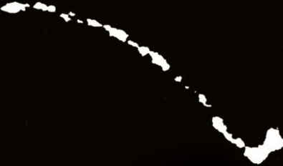

Neutrinoless Double Beta Decay (0νββ)
Today we know that
Neutrinos are massive particles, thus helicity is not a good quantum number
Therefore, emission of anti-neutrinos with „wrong“ helicity state possible (prop. m/E) possible
0νββ-decay would imply that neutrinos are Majorana particle
n
p
(Nukleons bound in core, ≈10^{–15} m)
(-)
ν_{e}
n
p

Slide 7
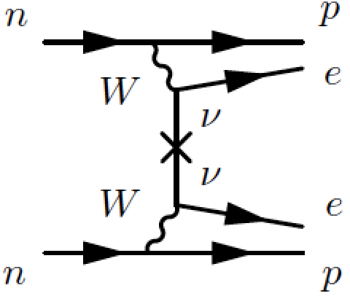
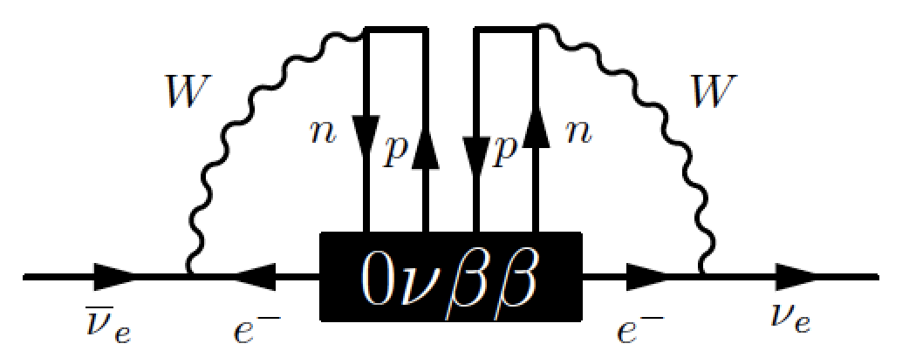

0νββ
Standard paradigm: exchange of light Majorana neutrinos
PMNS-matrix
ν-mass
Any 0νββ decay process induces a
transition, ie. an effective Majorana mass term
Schechter, Valle Phys.Rev. D25 (1982)
Numerical values tiny; other leading contributions to neutrino mass must exist
Duerr, Merle, Lindner: JHEP 1106 (2011)

Slide 8
The Quests
What is the neutrino mass scale?
Are neutrinos their own anti-particles?
Additional sterile states?
“degenerate”
“NO or IO”
“hierarchical”
mass ??
“NO”
“IO”
Is lepton number violated?
No reason for global symmetries to be exact!
[e.g Edward Witten, arXiv:1710.01791]
Why are neutrinos so much lighter than charged leptons ?
What is the origin of the matter anti-matter asymmetry ?

Slide 9
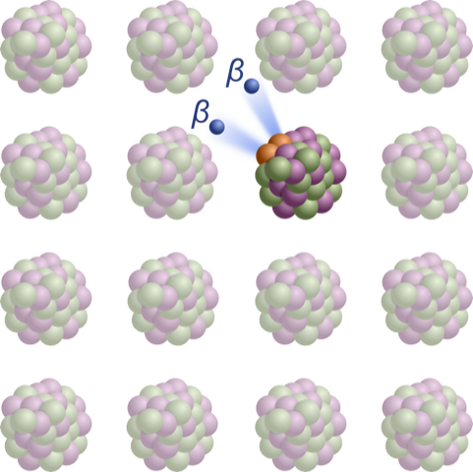
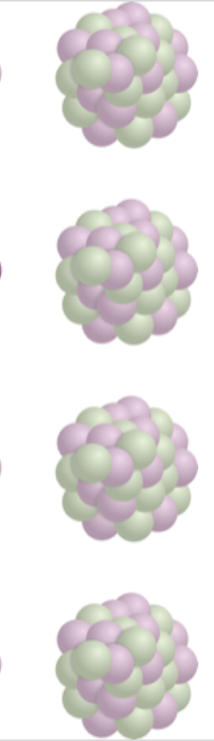
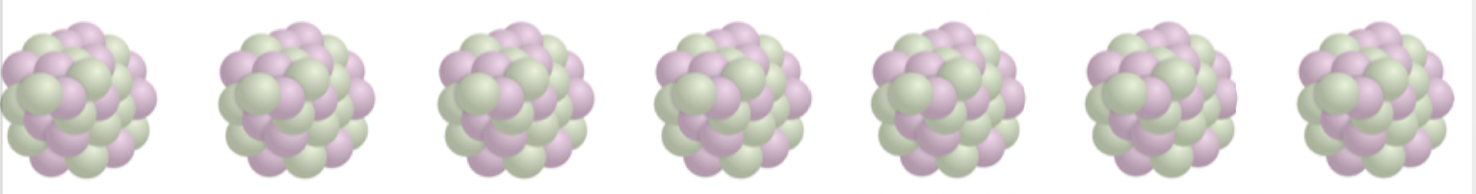
0νββ decay: Creation of (leptonic) matter without balancing emission of anti-matter
Current best sensitivity (GERDA):
  T_{½} ~10²⁶ yr
Next generation:
  T_{½} ~10²⁸ yr (x 100 increase)
Challenge:
  ~1 decay per 10⁴ Mol and year

Slide 10
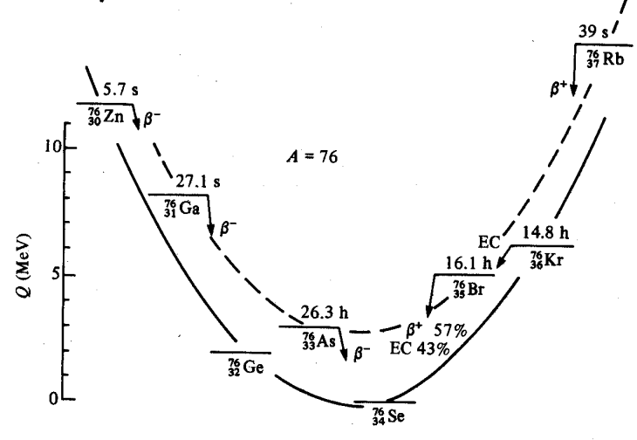
Double beta decay isotopes
odd-odd
even-even
Isotope | Nat ab. | Q_{ββ}
⁴⁸Ca | 0.19 % | 4262.96(84) keV
⁷⁶Ge | 7.6% | 2039.04(16) keV
⁸²Se | 8.7% | 2997.9(3) keV
⁹⁶Zr | 2.8% | 3356.097(86) keV
¹⁰⁰Mo | 9.6% | 3034.40(17) keV
¹¹⁶Cd | 7.5% | 2813.50(13) keV
¹³⁰Te | 34.5% | 2526.97(23) keV
¹³⁶Xe | 8.9% | 2457.83(37) keV
¹⁵⁰Nd | 5.6% | 3371.38(20) keV

Slide 11
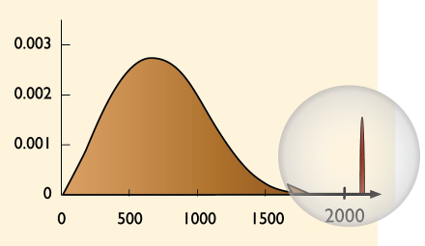
0νββ decay and neutrino mass
Expected decay rate:
Phase space integral
Nuclear matrix element
Effective neutrino mass
Elements of (complex) PMNS mixing matrix
2νββ
Ge-76:
Q_{ββ}=2039 keV
Experimental signatures:
peak at Q_{ββ}
two electrons from vertex
Discovery would imply:
lepton number violation ΔL = 2
ν’s have Majorana character
mass scale
physics beyond the standard model
arbitrary units
0νββ
Energy (keV)

Slide 12
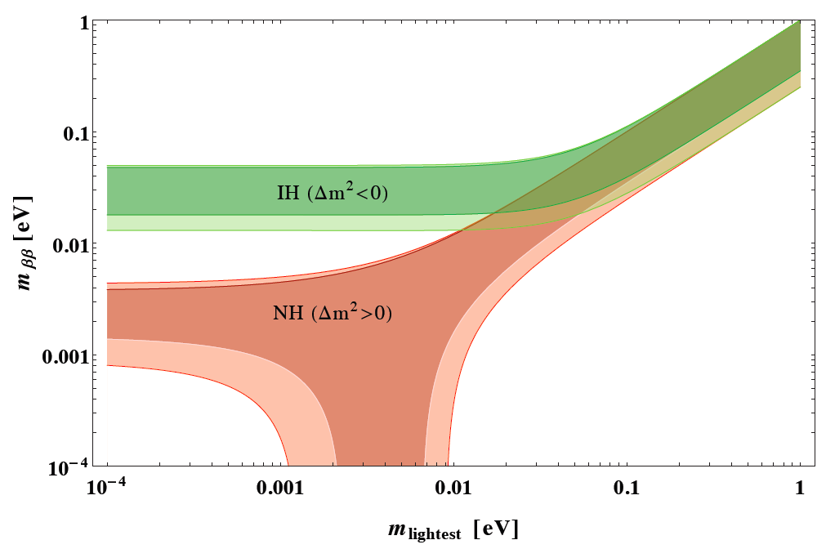
0νββ: Range of m_{ee} from oscillation experiments
m_{ee} = f(m₁, Δm²_{sol}, Δm²_{atm}, θ₁₂ , θ₁₃, α-β)
from oscillation experiments
Dell’Oro, Marcocci, Vissani, PRD 90.033005
quasi-degenerate
Goal of next
generation
experiments:
3σ CL
Negligible
errors from
oscillations;
width due to
CP phases
Lower bounds!

Slide 13
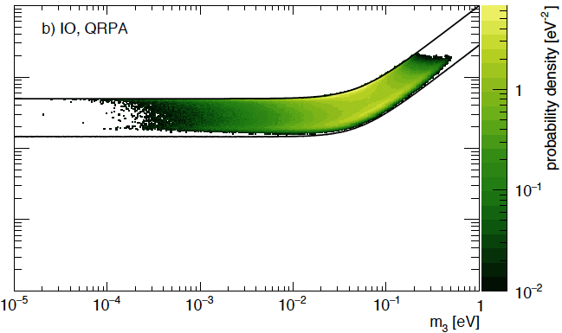
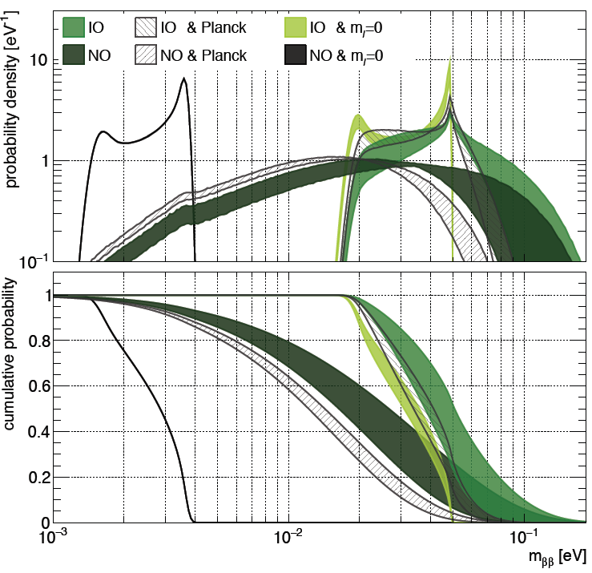
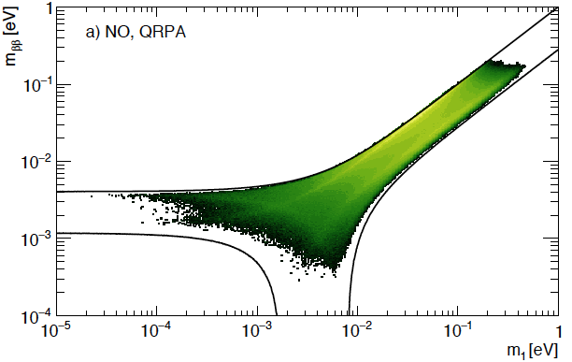
Discovery probabilities
Global Bayesian analysis including ν-oscillation, m_{β} m_{ββ}, Σ
Priors:
  Majorana phases (flat)
  m₁ (scale invariant)
Agostini, Benato, Detwiler arXiv:1705.02996

Slide 14
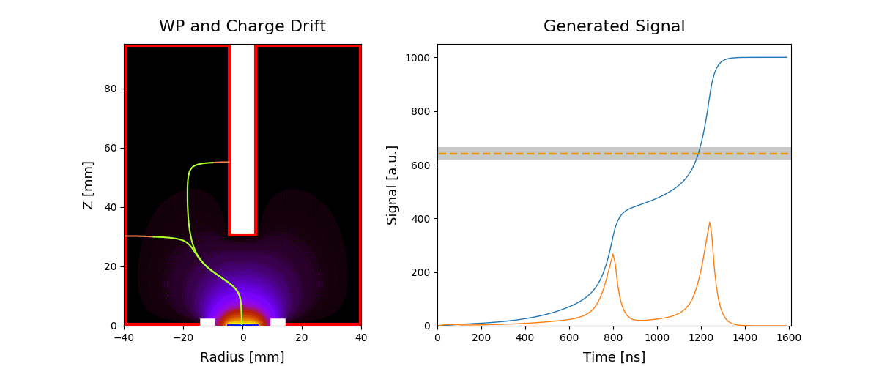
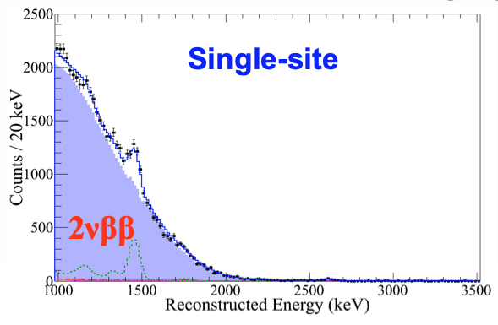
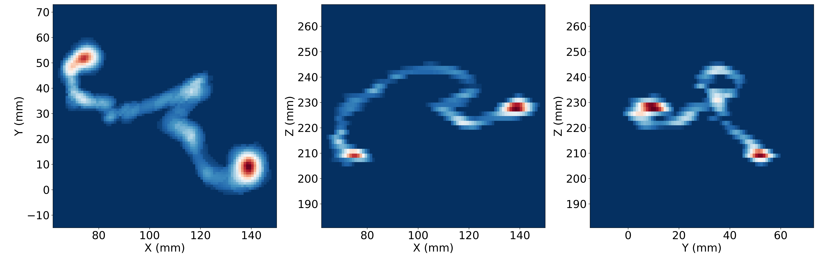

Ton-scale experiments for discovery
Need to measure half-lives of up to 10²⁸ years
One decay per ton-year of material
Need many ton-years of data
Need extreme low background rate and best possible energy resolution
Need to exploit topology information of signal and background
And, if possible, identify daughter nucleus
1e
LEGEND
EXO
NEXT
2e
Multi-site
NEXT-White data

Slide 15
The Effect of Background: Discovery sensitivity vs. exclusion limit
Ton-scale experiments aim for a discovery
Background-free: Sensitivity rises linearly with exposure
Background-limited: Sensitivity rises as the square root of exposure
=> quasi-background-free¹ operation makes most efficient use of valuable isotopes
median exclusion limit
90% confidence level
median 3σ discovery sensitivity
0.025 counts/(FWHM t y)
m_{ββ} = 18.4±1.3 meV
10 counts/(FWHM t y)
Figs. from LEGEND-1000 pCDR
Exposure [ton-years]
Exposure [ton-years]
¹ Less than one background count expected in a 4σ Region of Interest (ROI) with 10 t y exposure

Slide 16
Double beta decay isotopes
An isotope production facility at ECP (Image: TVEL)
Enrichment:
Current experiments obtain 0νββ isotopes largely from Russia
Reliable and high-quality supply chain
Some 0νββ isotopes also procured from European producer
Since the war in Ukraine, no procurement of 0νββ isotopes from Russia possible for Western countries
European producer is ramping up production capacities to suffice demands. They state that sufficient capacities will be available to fulfill demands by ton-scale experiments (⁷⁶Ge, ¹⁰⁰Mo, ¹³⁶Xe)
Additional initiatives are being pursued: e.g. ¹³⁶Xe extraction from burned nuclear fuel elements
Projects in China continue to procure 0νββ isotopes from Russia
Natural isotopic composition:
Te (34% ¹³⁰Te): Cuore, SNO+, JUNO
Xe (8.9 % ¹³⁶Xe): Darwin

Slide 17
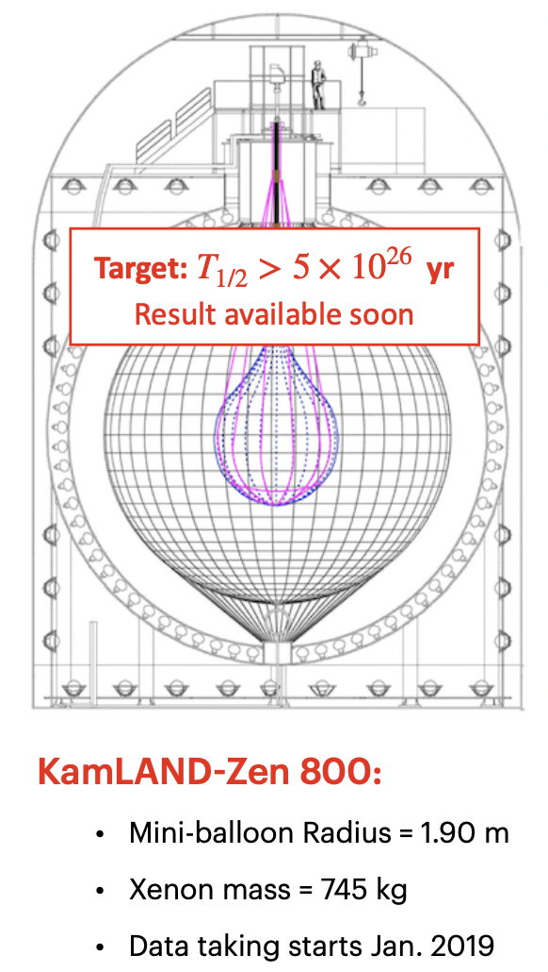
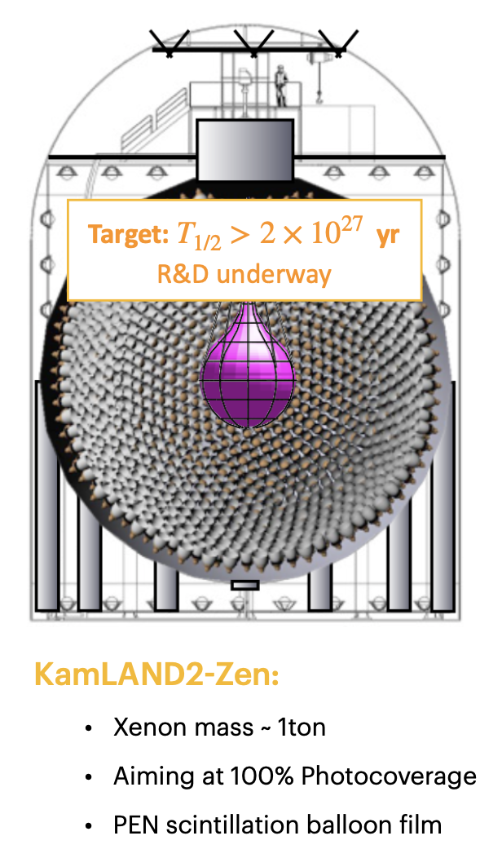
KamLAND-Zen: ¹³⁶Xe loaded liquid scintillator
present
future
KLZ-400 (completed):
Sensitivity: > 5.6 10²⁵ yr (90% C.L.)
Unconstraint fit: > 9.2 10²⁵ yr (90% C.L.)
Phase I + II: > 1.07 10²⁶ yr (90% C.L.)
KLZ 800 (ongoing):
Since 2019: data taking with 750 kg ^{enr}Xe (new balloon)
KamLAND2-Zen (future) with
1000kg+ proposed
Adopted from Aobo Li, TAUP2021

Slide 18
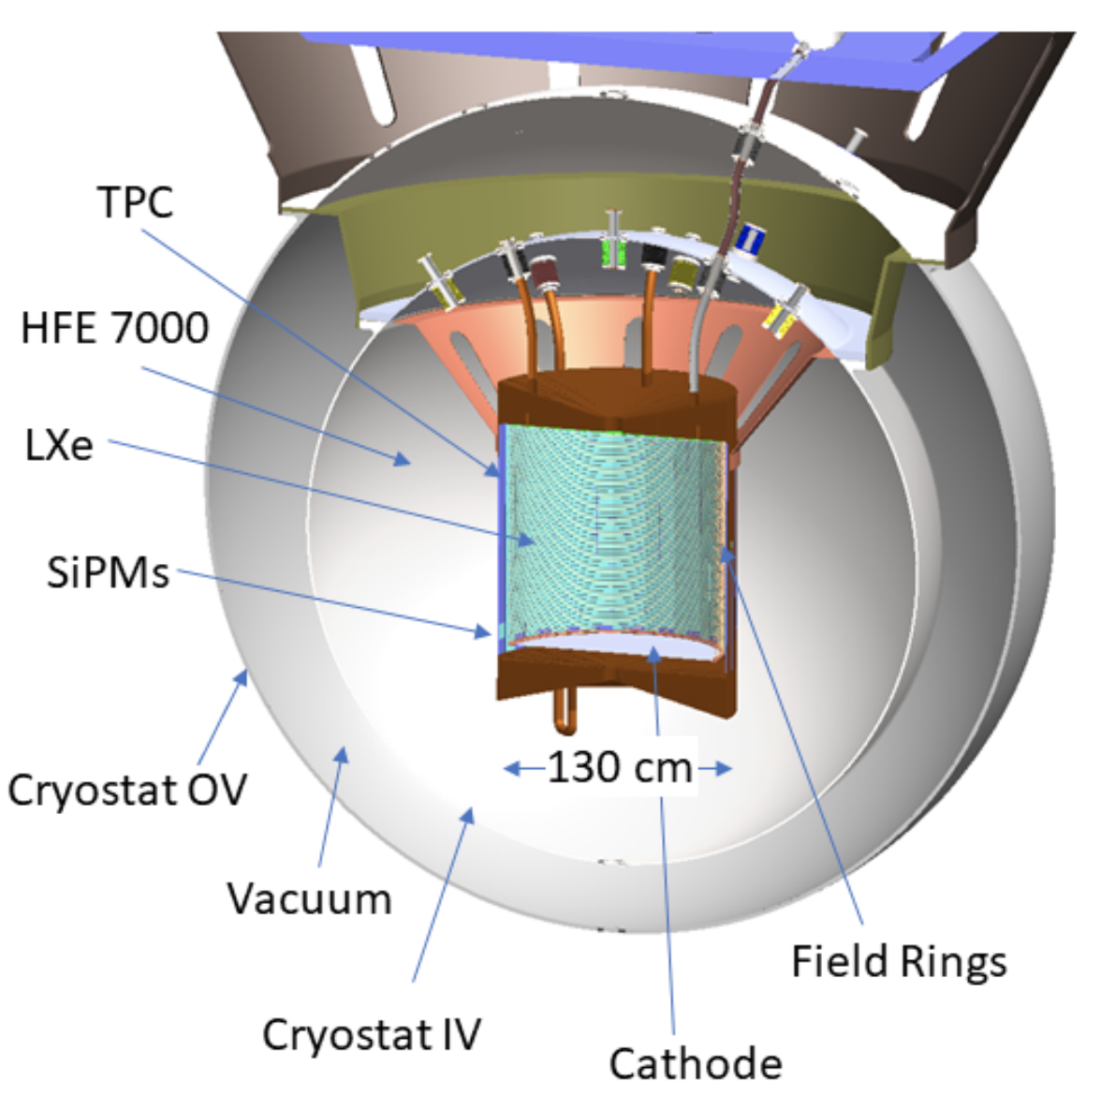
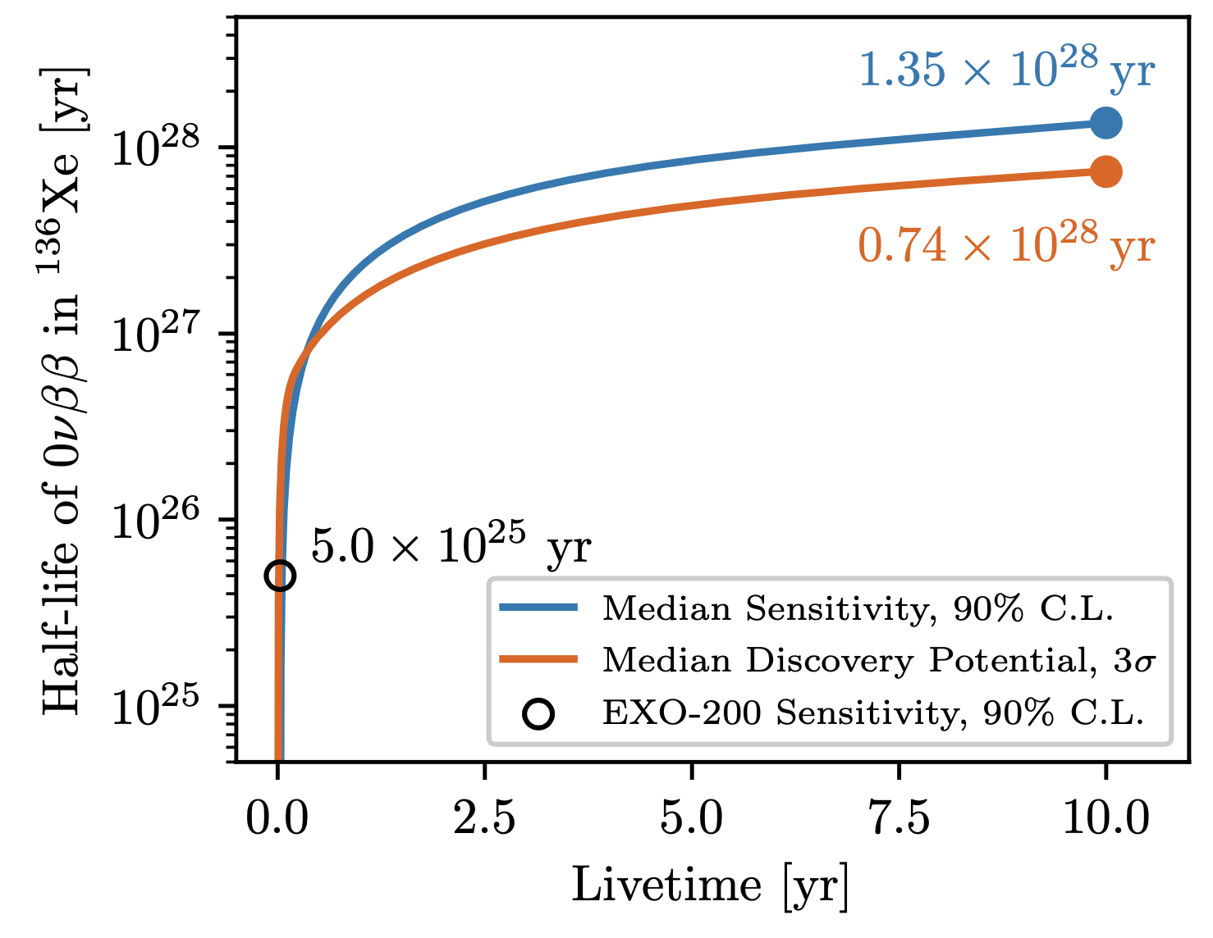
nEXO: ¹³⁶Xe single phase TPC
Single Phase Time Projection Chamber (TPC)
Filled with 5000 kg of liquid xenon Enriched to 90 % in ¹³⁶Xe
Monolithic design with single drift volume with 1.2 m drift length
Energy resolution of σ_{E} /Q_{ββ} = 0.8 %
assuming 6000 m.w.e. overburden (SNOLAB)
N.B.:
Dual-phase Xe TPCs (DM) with natural Xe also sensitive to 0νββ
LZ: >1.06×10²⁶ years at 90% CL (PANIC2021)
DARWIN: >2.4×10²⁷ (EPJC 80, 808 (2020))
Adopted from Ako Jamil, TAUP2021
pCDR: arXiv:1805.11142
Sensitivity: arXiv:2106.16243

Slide 19
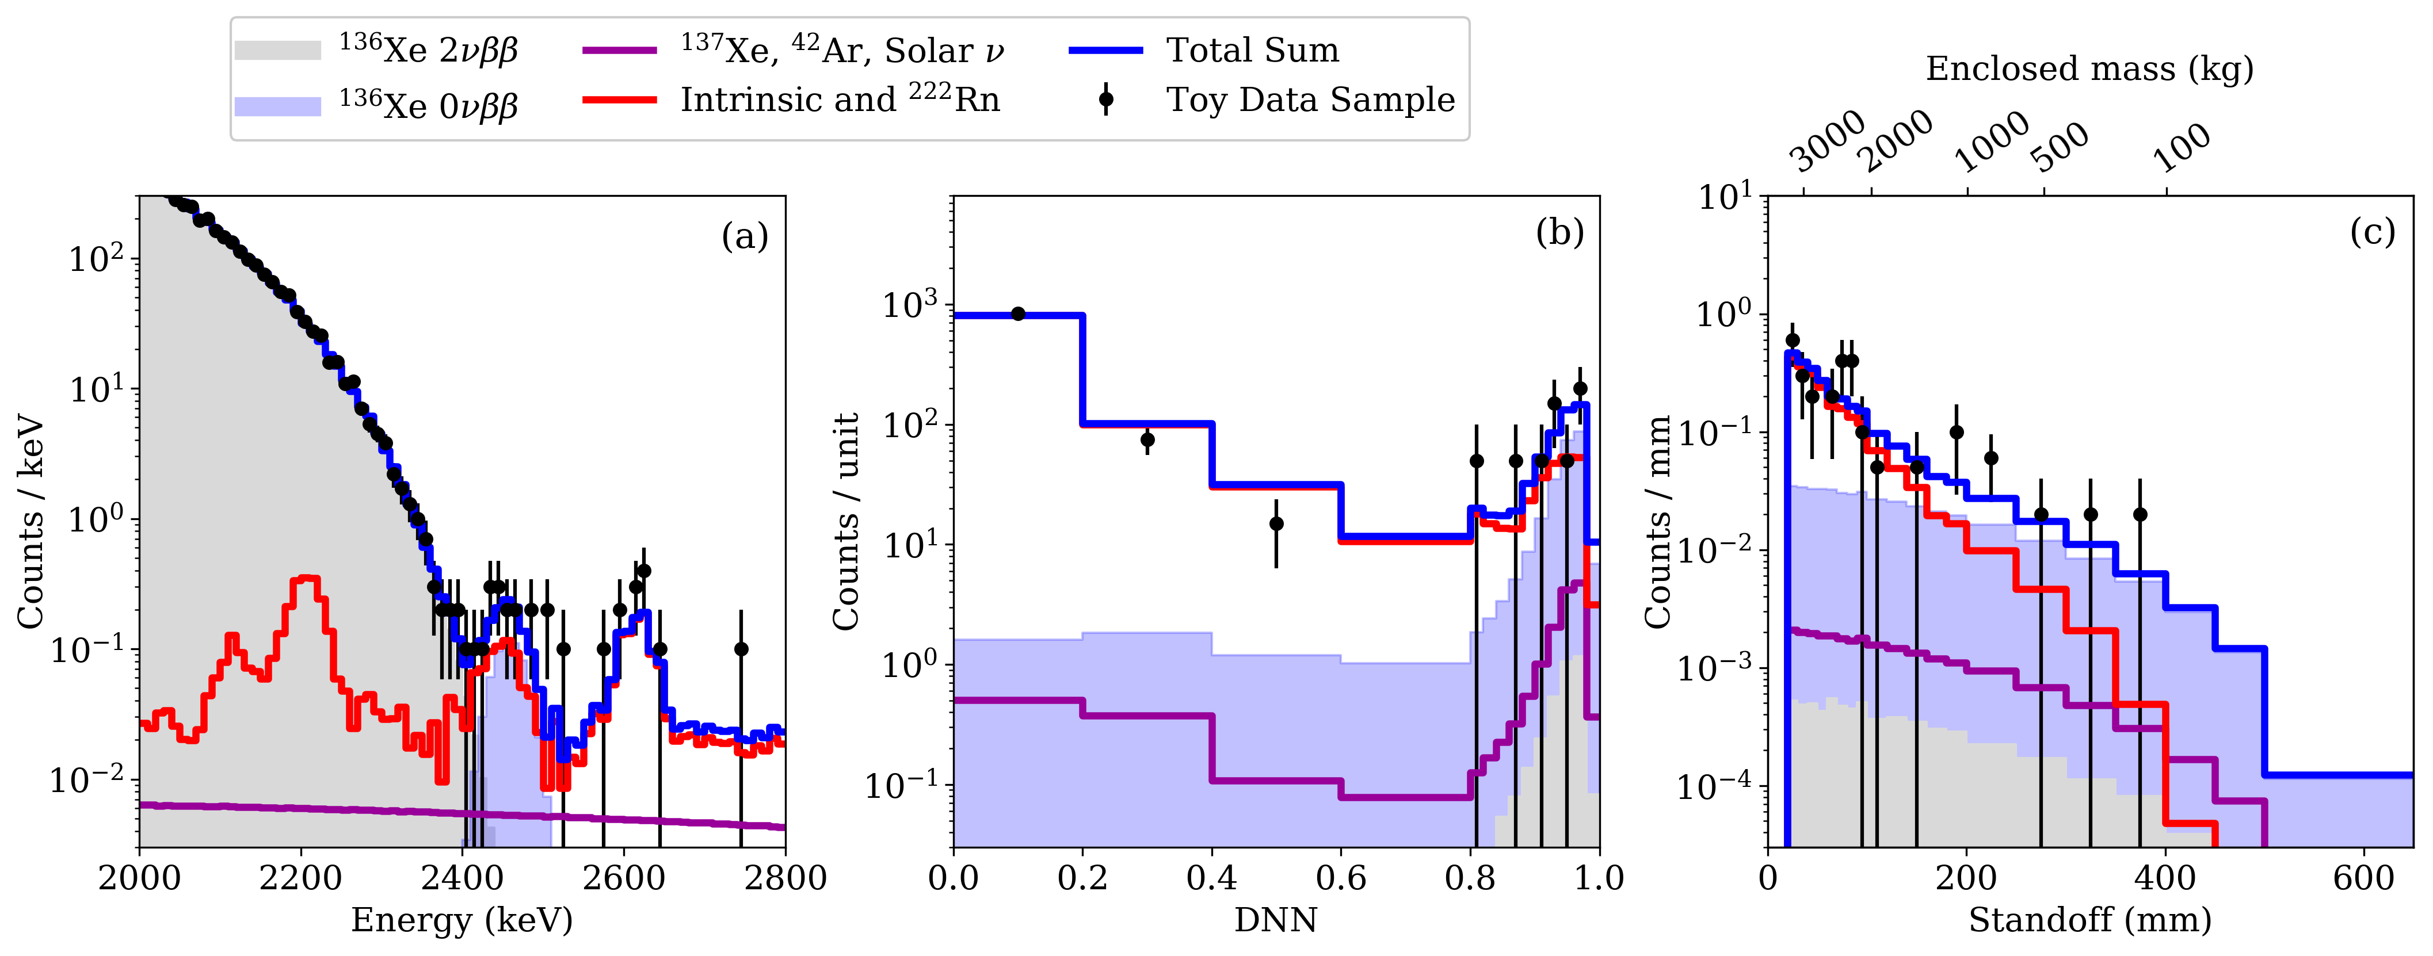
nEXO: topological info for signal and backgrounds
arXiv:2106.16243
Energy distribution of single-site like events in central 2t of LXe
Topological info between ββ and γ events
Relative distance between a deposit and the nearest surface

Slide 20

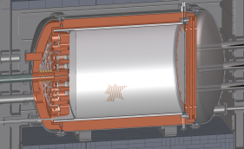
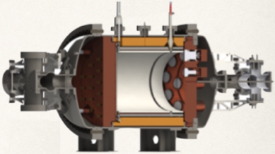
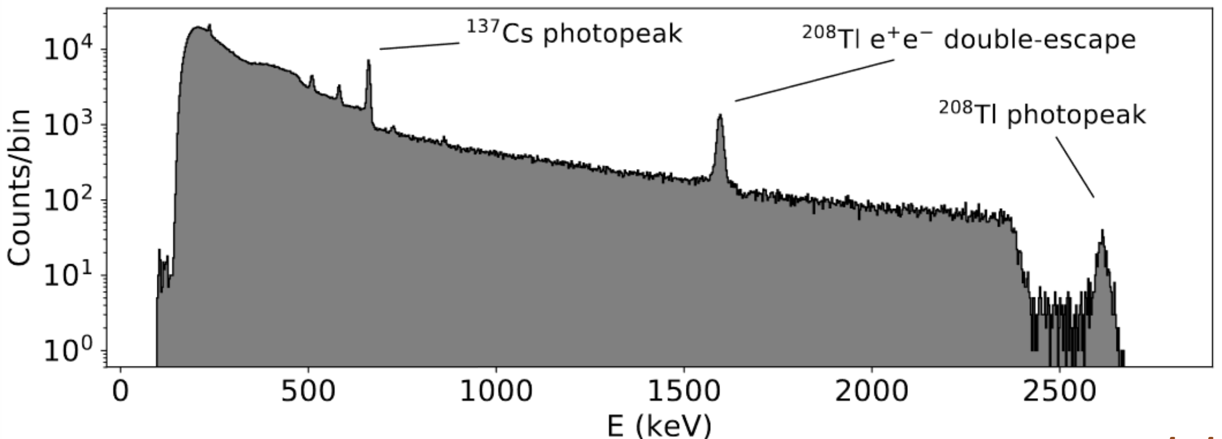
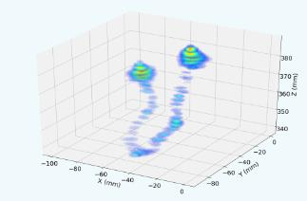
¹³⁶Xe high-pressure gaseous TPC
NEXT-100 (100 kg) 2022-2025
NEXT-NEW (5 kg) 2015-2020
HD (High-Definition)
Up to 1 ton enriched Xe gas @ 20 bar
Replacement of PMTs by SiPMs
Xe-He mixture: lower diffusion, better definition
Target sensitivity: 2×10²⁷ y (6 ton yr)
NEXT-BOLD (Barium On Light Detection)
HD including Ba-tagging by single-molecular-fluorescence imaging
Background-free operation
Target sensitivity: 8×10²⁷ y (10 ton yr)
Underground & radio-pure operations, background, 2νββ
0νββ search
ΔE< 1% FWHM
Event topological reconstruction
400 kg×y sensitivity 1×10²⁶y
Data: 2-electron event
Phys. Rev. Lett. 120, 132504 (2018)

Slide 21
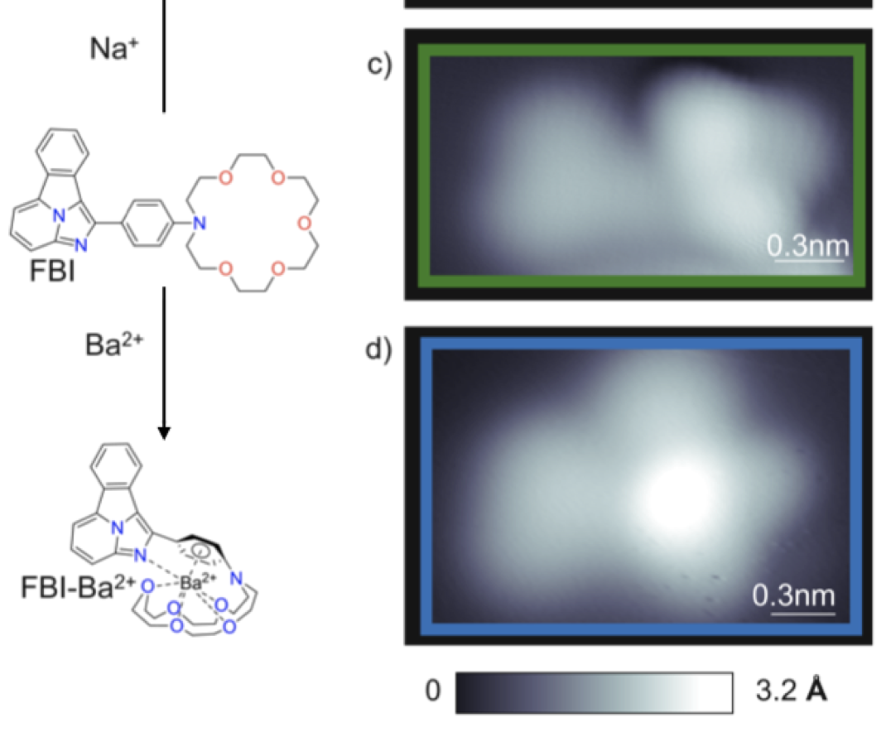

¹³⁶Xe: Barium tagging
Detection of single barium ion in coincidence with <1% FWHM energy resolution and event topology essential for background free 0νββ search in Xe (NEXT-BOLD)
NEXT pursues single molecule fluorescent imaging (SMFI) based barium tagging sensors.
R&D to date has realized molecular ion sensors that:
  Exhibit barium chelation in vacuum &
  Enable single ion sensing in xenon gas
  ON/OFF and Bi-color approaches
STM shows barium location in molecule after chelation
SMFI + high pressure microscopy enables Ba2+ detection in Xe gas
J.Phys.Conf.Ser. 650 (2015) 1, 012002; JINST 11 (2016) 12, P12011; Phys. Rev. Lett. 120 (2018) 13, 132504. Sci.Rep. 9 (2019) 1, 15097; Nature 583 (2020) 7814, 48–54; ACS Sens. (2021) 6, 1, 192–202; arXiv:2201.09099, arXiv:2109.05902
21
Courtesy M. Sorel, J. Gomez Cadenas

Slide 22
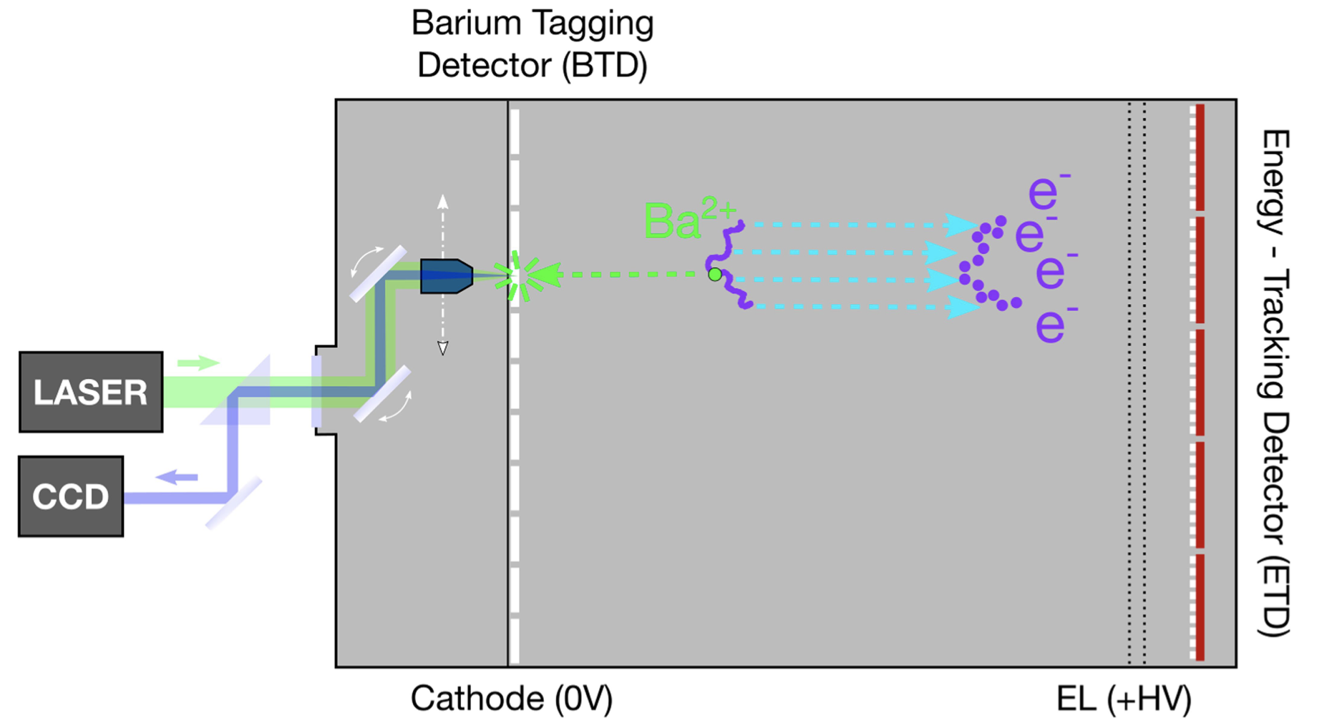
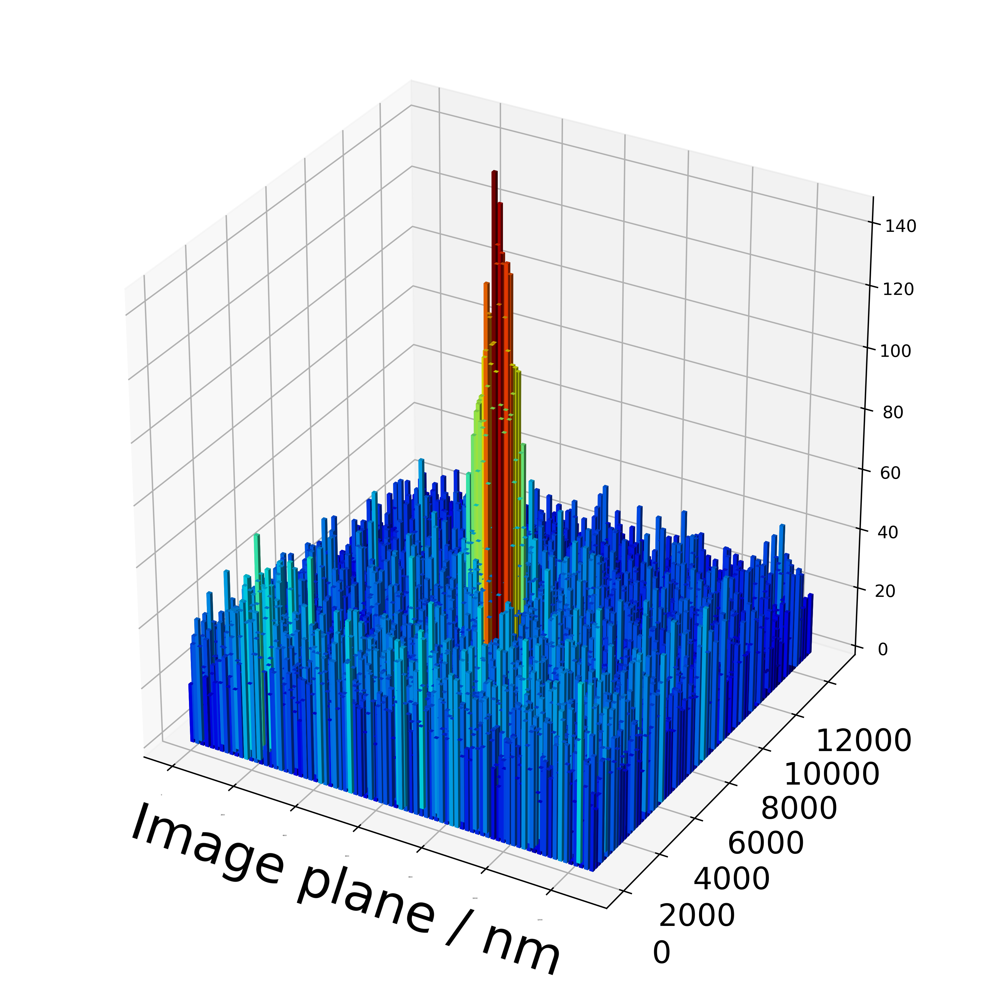
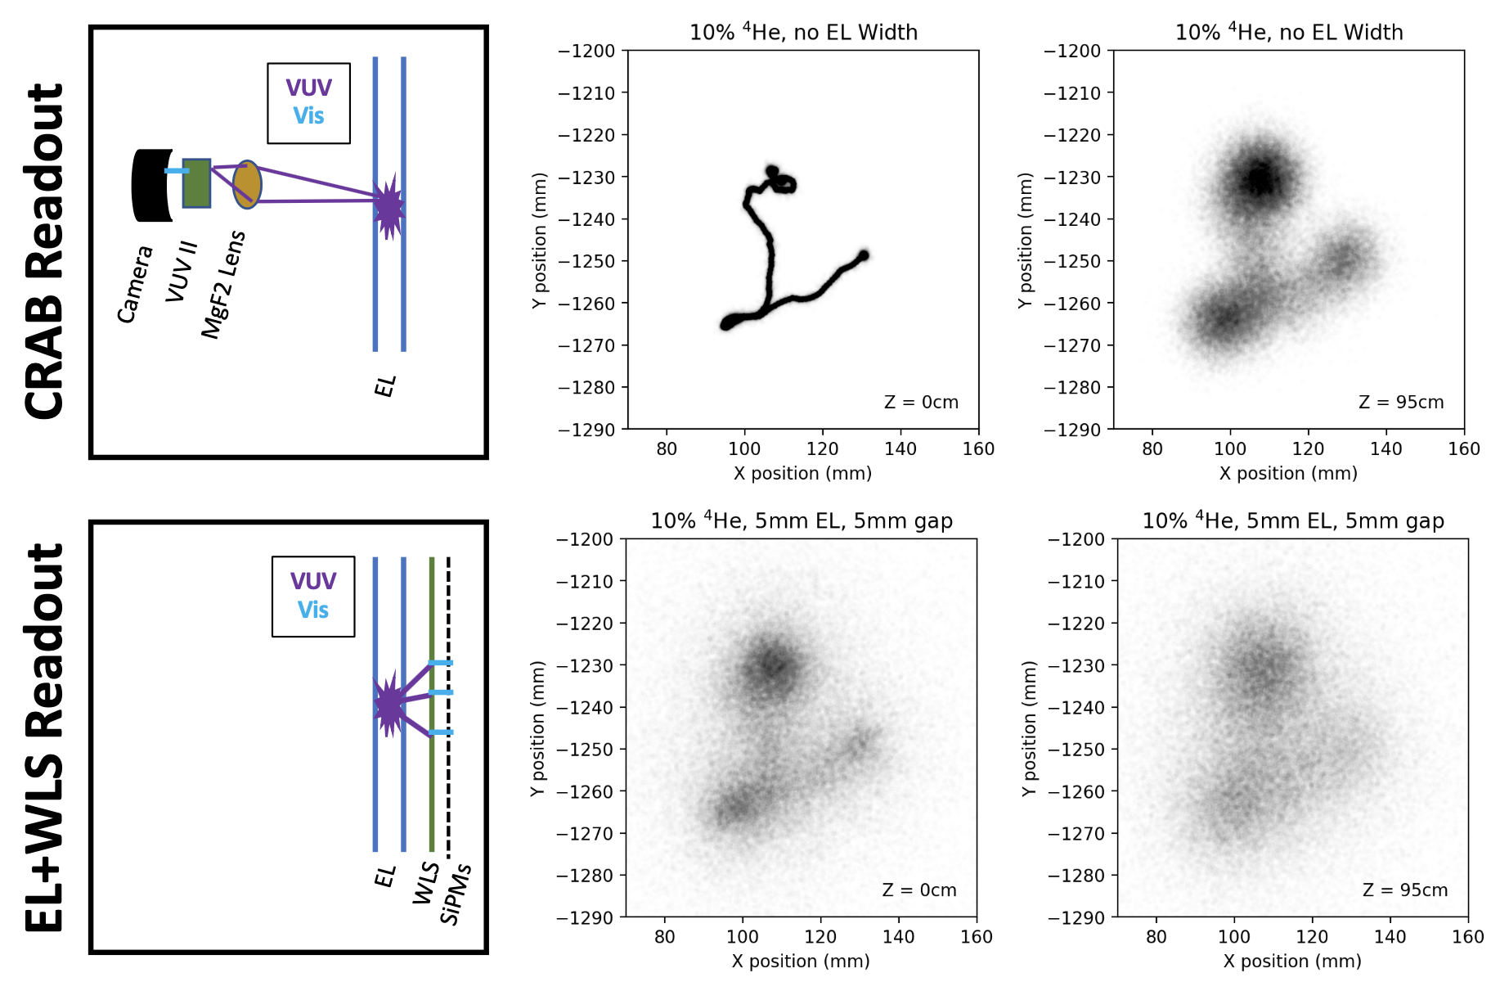
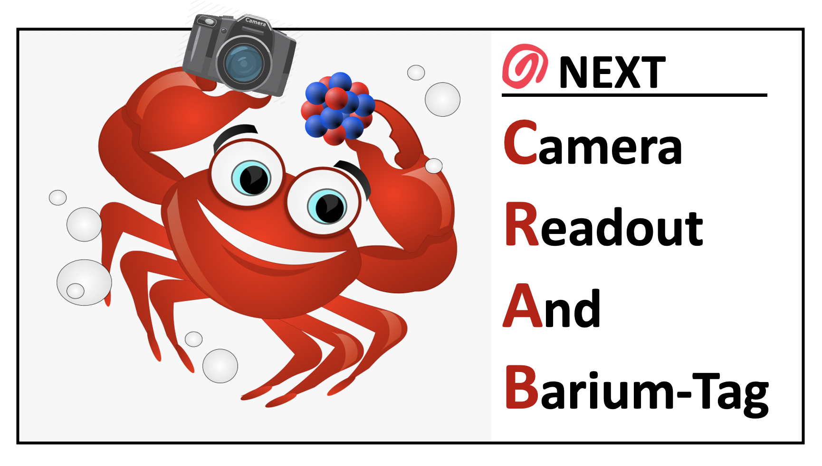
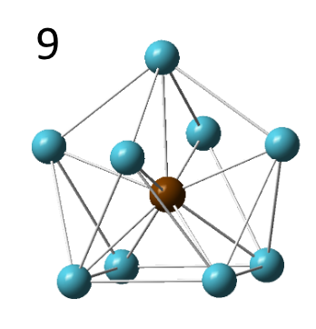
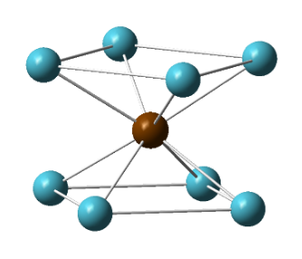
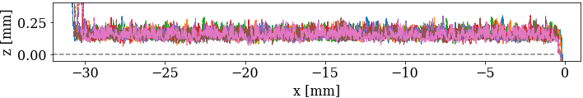
¹³⁶Xe: Barium tagging demonstrator phases
Sensor-to-ion concept (NEXT-BTD)
2. Single Ba²⁺ ion tagging w/SMFI
EL (+HV)
Ba⁺⁺ ion
10 bar Xe
Ion-to-sensor concept (NEXT-CRAB)
e
RFC
Ba²⁺
e
e
CCD
CCD
1. Direct VUV camera tracking
TPX
Cam
TPX
Cam
NEXT Data
3. RF Carpet ion transport in xenon gas
CCD
CCD
+
-
+
-
+
-
+
-
+
-
+
-
+
-
+
-
+
-
+
-
+
-
+
-
GEANT4 MC
SIMION simulation
Courtesy M. Sorel, J. Gomez Cadenas

Slide 23
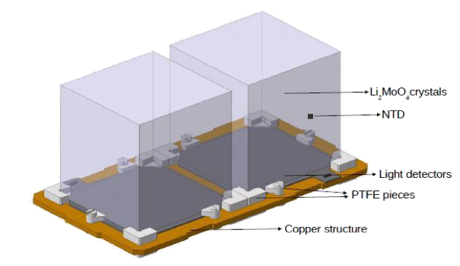
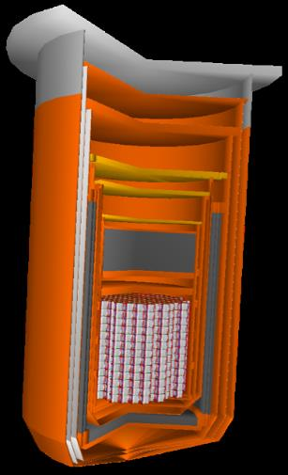
CUPID: ¹⁰⁰Mo cryogenic detectors @ LNGS
Simultaneous read out of heat and light: surface alpha rejection
Single module: Li₂¹⁰⁰MoO4 45×45x45 mm –> 280 g
57 towers of 14 floors with 2 crystals each -> 1596 crystals
240 kg of 100Mo with >95% enrichment
Bolometric Ge light detectors as in CUPID-Mo, CUPID-0
Re-use CUORE cryogenic infrastructure and shield @ LNGS
10 y discovery sensitivity 1.1×10²⁷
Heat sink
Thermometer
Crystal made
from
ββ-isotopes
Light detector

Slide 24
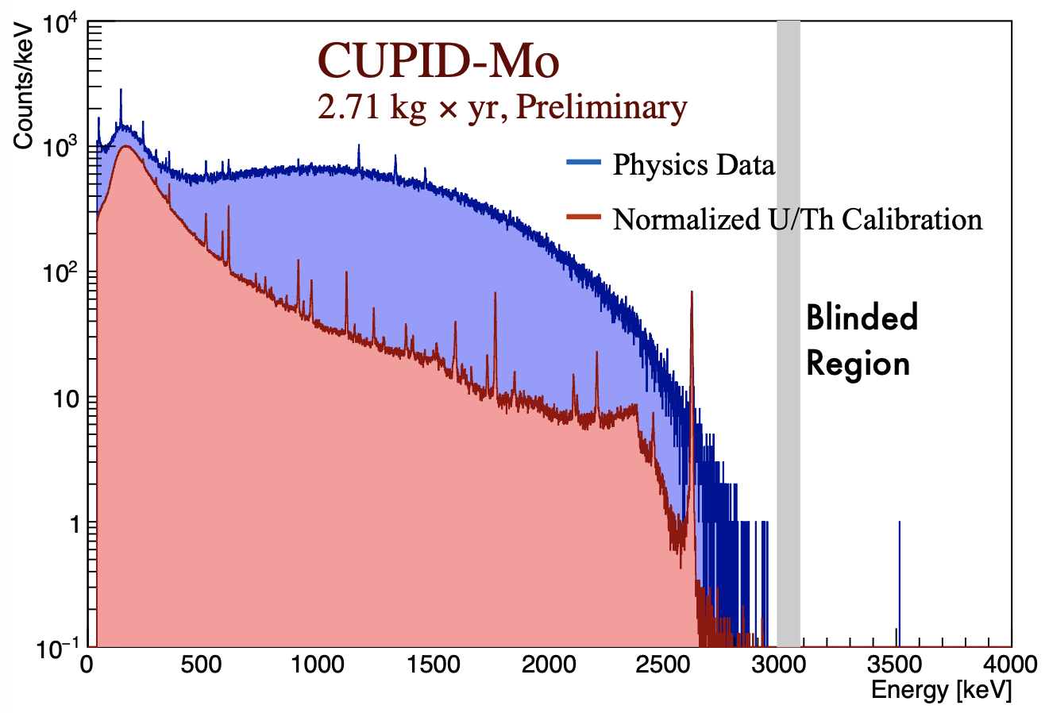
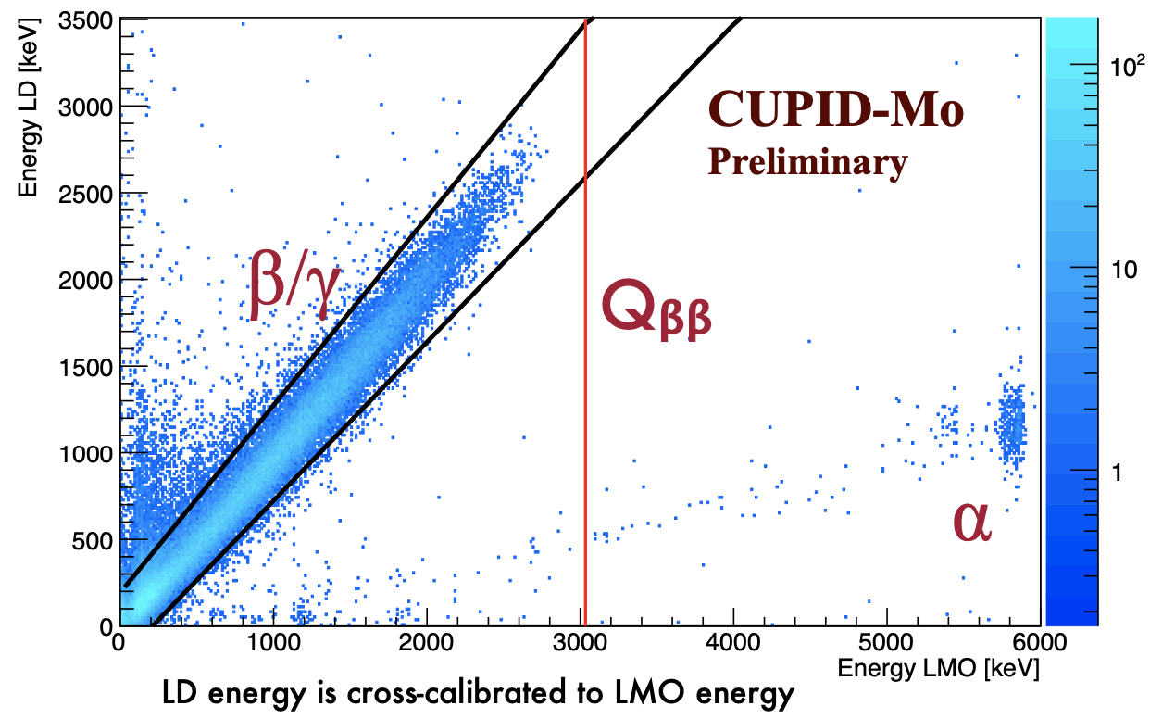
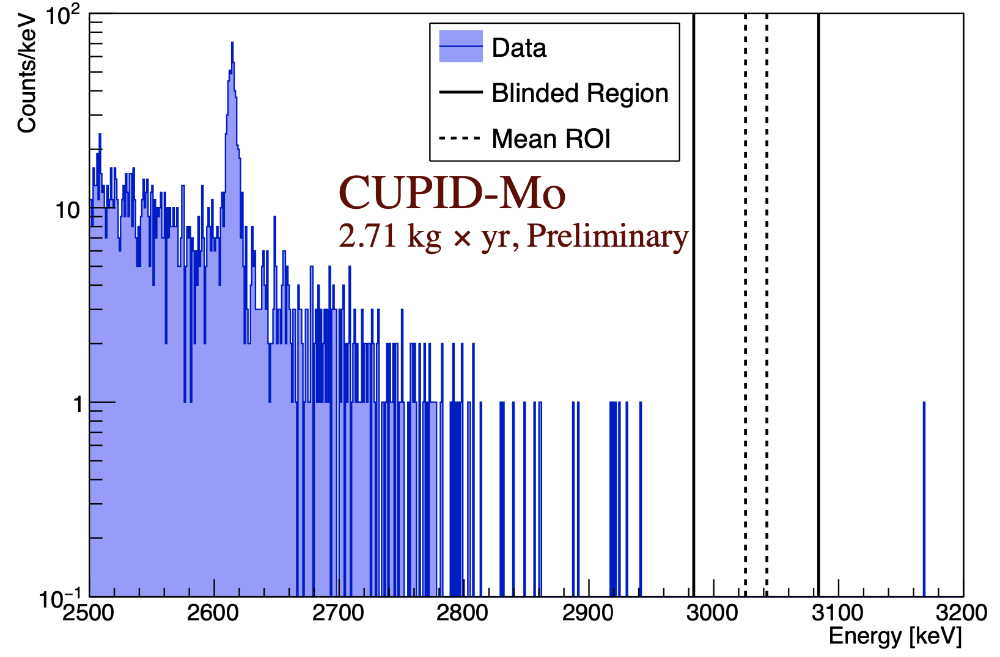
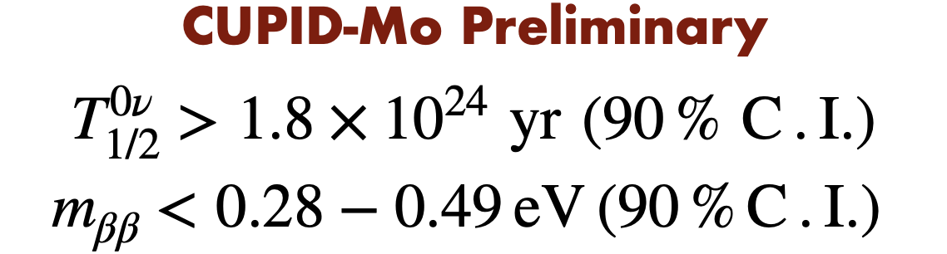
CUPID-Mo: ¹⁰⁰Mo cryogenic detectors R&D at LSM
B. Welliver, TAUP2021
ΔE (FWHM): 7.2 keV @ 2.6 MeV
Removal of surface α’s
Background-free operation in 2.7 kg yr

Slide 25
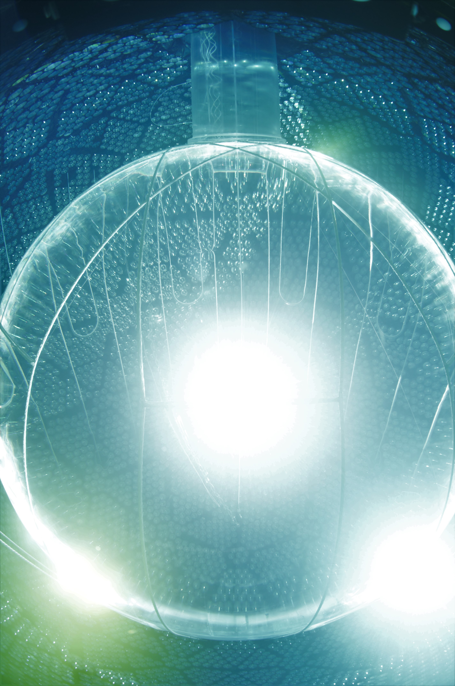
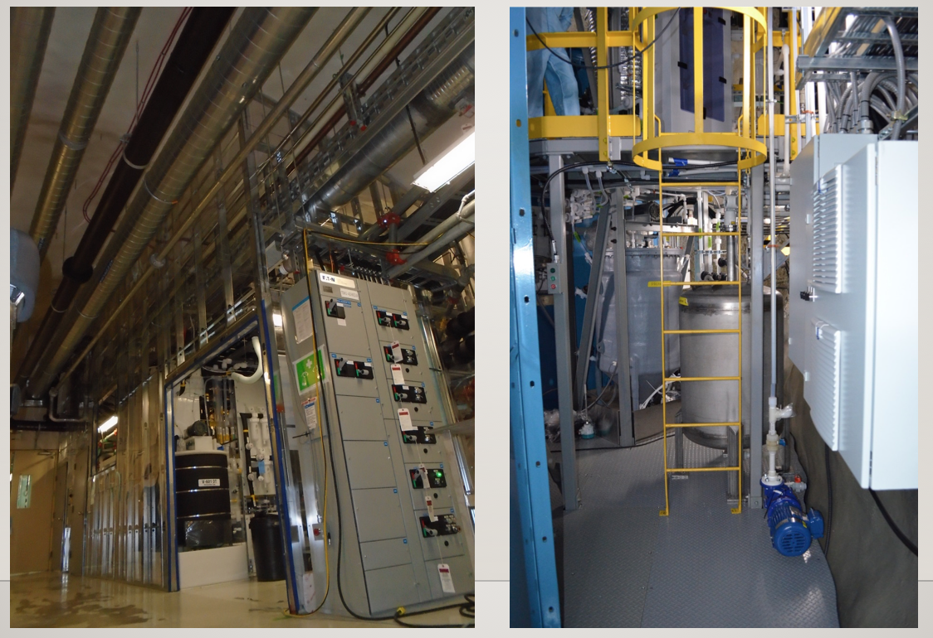
^{nat}Te-loaded liquid scintillator: SNO+
780t LS (2.2 g/L PPO in LAB)
Currently data taking with unloaded LS
  low energy ⁸B solar-n, reactor & geo anti-ν_{e}, ∆𝑚²₁₂, supernova-ν
0νββ phase: natural Te (34% ¹³⁰Te) loaded as metal organic complex (Te-diol)
Te-systems ready for operations
Full-scale Te-diol batches in 2022/23
Following demonstration of operations and approvals by SNOLAB, begin Te-loading in 2024
Original plan: load 0.5% (3.9t nat Te): T1/2 > 2⨉10²⁶ yr
R&D on higher (up to 3%) Te-loading ongoing
0.5% loading phase critical to assess performance and Te-related backgrounds
SNO+
Telluric acid purification
Te-diol synthesis
Courtesy M. Chen

Slide 26
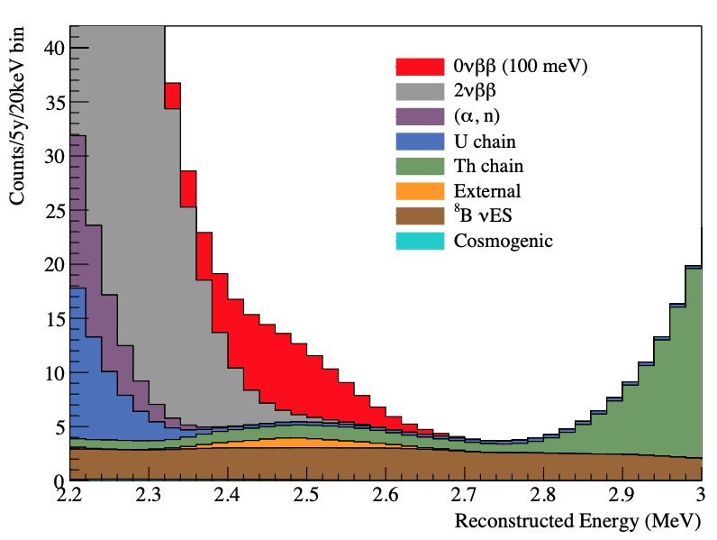
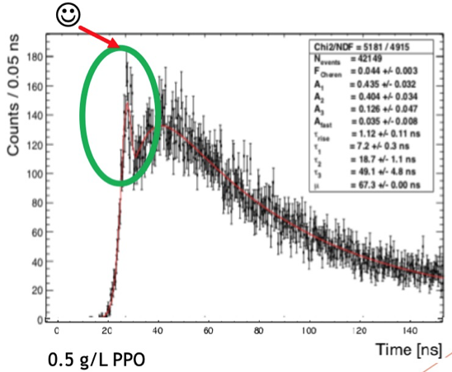
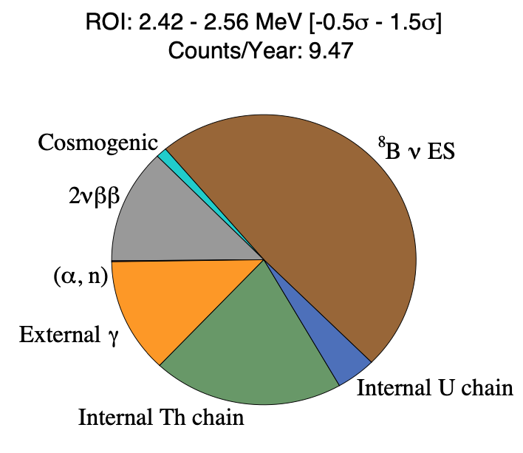
^{nat}Te-loaded liquid scintillator: SNO+
J.Wilson–LeptonPhoton21
with unloaded LAB 300 p.e./MeV;
nominal PPO loading 2g/L
Pure scintillator phase ”Te-out” measurement to test unexpected backgrounds
Staged Te-loading to assess remaining Te-backgrounds
Assess potential of suppression of solar neutrinos using directionality information
arXiv:2001.10825
Courtesy M. Chen

Slide 27

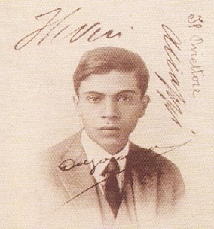

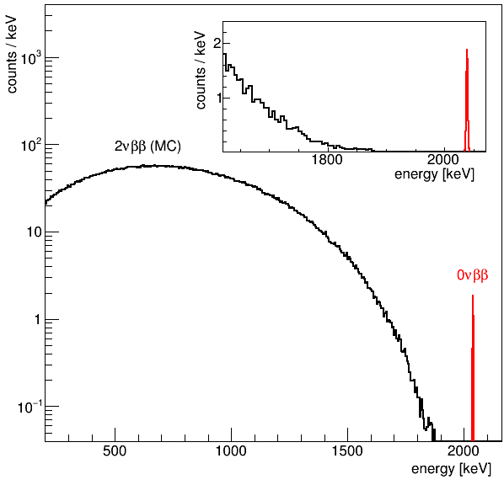
Key features of ⁷⁶Ge 0νββ searches
⁷⁶Ge -> ⁷⁶Se + 2e⁻
Q-value of ⁷⁶Ge: Q_{ββ} = 2039 keV
High purity Ge detectors ( >87% ⁷⁶Ge)
  source = detector => high detection efficiency
  high purity => no intrinsic background
  high density => 0νββ point like events
  semiconductor => ΔE ~0.1% (FWHM) at Q_{ββ}
0νββ signature:
  Point-like energy deposition in detector bulk volume
  Sharp energy peak at 2039 keV (FWHM ~ 2.5 keV)
2.5 keV
(FWHM)

Slide 28

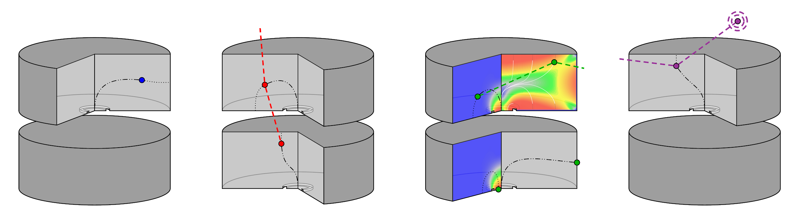

Topology discrimination
excimer creation by ionization/excitation
Ar₂*
Ar
enriched (~87% ⁷⁶Ge)
p-type bulk
Ar
VUV scintillation
weighting
potential
γ
γ
ββ
γ
β
α
thin p⁺
differentiate point-like ββ topology from:
multi-detector
interactions
multi-site/surface
interactions
interactions with partial energy depositions
2

Slide 29
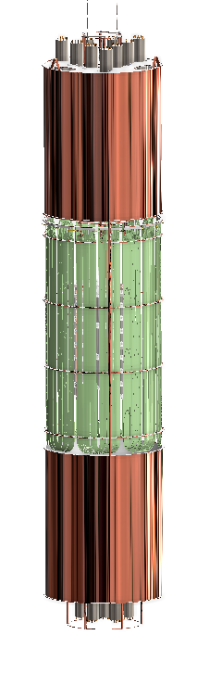


The GERmanium Detector Array experiment at LNGS
[Eur.Phys.J. C78 (2018) no.5, 388]
LNGS: rock overburden of 3500 m water equivalent
9 Top PMTs
Plastic muon veto panels
Copper shrouds
and support plates
64 m³ LAr cryostat
(4 m-diameter)
HPGe detector
strings
Fiber shroud:
WLS fibers
read out by SiPM
66 Muon veto PMTs
Inner fiber shroud
(Post-upgrade)
590 m³ water tank
(10 m-diameter)
7 Bottom PMTs

Slide 30




Background spectrum before analysis cut
largest exposure
⁷⁶Ge spectrum ever taken
5

Slide 31

Background decomposition before analysis cuts
pre-upgrade dataset
alphas, betas, gammas
two-detector hits
combined Bayesian fit to multiple datasets with Monte Carlo pdfs for nearby components
[JHEP 03 (2020) 139]
screening measurements as priors
6

Slide 32





The 2nbb energy range: LAr instrumentation not only a ‘veto’
Signal acceptance of LAr veto: 97.7%
In coincidence:
spectrum dominated by potassium
In anti-coincidence:
2νββ spectrum

Slide 33




Pulse shape discrimination
two-sided mono-parametric A/E cut for BEGe / ICPC detectors
[Budjas et al., JINST 4 (2009) P10007]
artificial neural network analysis plus consecutive risetime cut for coaxial detectors
[Eur. Phys. J. C73 (2013) 2583]
cut definition / training with ²²⁸Th calibration data
0νββ signal efficiency ~90% (~70% for coaxials)
-> ²⁰⁸Tl DEP as signal proxy
7

Slide 34



Liquid argon read-out
channel-wise (anti-)coincidence condition (PMTs/SiPMs)
sub-PE threshold, contains characteristic scintillation timing (triplet emission)
0νββ signal efficiency (1 - random coincidence rate) > 97%
lifetime ~1 µs
³⁹Ar, dark rate
8

Slide 35


Final Phase II spectrum
shape analysis in preparation
“clean” 2νββ continuum
sparse single counts at > Q_{ββ}
no alphas in BEGe / ICPC
9

Slide 36

Final GERDA result
< 1 cts in 100 kg yr and 5 keV
“primo”
(+ 2.4 sigma)
13 events
background index 5.2^{+1.6}_{-1.3}⋅10⁻⁴ cts/(keV kg yr), energy resolution ~3 keV (FWHM)
combined (data partitions, Phase I) unbinned maximum likelihood fit
[Nature 544 (2017) 47]
Frequentist: N^{0v} = 0 best fit, T_{1/2} > 1.8⋅10²⁶ yr (median sensitivity -”-) at 90% C.L.,
Bayesian: flat prior on rate, T_{1/2} > 1.4⋅10²⁶ yr at 90% C.I.
resolution tracked per detector/period
Gaussian signal on flat background
> 2.3⋅10²⁶ yr for flat prior on m_{bb}
10

Slide 37


Mass observables
e⁻
_
⁷⁶Ge
ν=ν
e⁻
⁷⁶Se
NME uncertainty
[Engel, Menéndez, Rept.Prog.Phys. 80 (2017) no.4, 046301]
three flavour oscillation parameters from [Esteban et al., JHEP 09 (2020) 178]
-> Planck+BAO: Σ < 0.12 eV
-> [Aghanim et al., arXiv:1807.06209]
-> GERDA: m_{ββ} < [0.08,0.18] eV
-> KATRIN: m_{β} < 0.8 eV (90% CL)
[Aker et al., Nature Phys. 18 (2022) 2, 160-166]
KamLAND-Zen: < [0.05,0.23] eV, CUORE:< [0.07,0.34] eV
given “standard” assumptions 0νββ decay searches constrain neutrino mass
interplay with cosmology / direct mass measurements
[Science 365 (2019) 1445]
-> m_{light} < [0.1,0.5] eV, sum < [0.2,1.5] eV, m_{b} < [0.1,0.5] eV
11

Slide 38

GERDA: first quasi background-free experiment
LEGEND
novel Ge detectors & LAr instrumentation
[Phys. Rev. Lett.
125, 252502 (2020)]
“background-free” scaling
[Science 365 (2019) 1445]
✔
<10⁻³ cts/(keV·kg·yr)
> 100 kg·yr
> 10²⁶ yr
✔
✔
[Phys.Rev.Lett. 120 (2018) 13, 132503]
all goals
surpassed
[Nature 544 (2017) 47]
[Phys.Rev.Lett. 111 (2013) 12, 122503]
first experiment with sensitivity beyond 10²⁶ yr
GERDA has finished successfully
no signal found
further results (2νββ decay, BSM physics)
-> “no neutrinos not found”
Recent publications:
Final Results of GERDA on the Search for Neutrinoless Double-β Decay, Phys. Rev. Lett. 125, 252502 (2020)
The first search for bosonic super-WIMPs with masses up to 1 MeV/c2 with GERDA , Phys. Rev. Lett. 125 (2020) 011801
Modeling of GERDA Phase II data , J .High Energ. Phys. 2020, 139 (2020)
Probing Majorana neutrinos with double-β decay, Science 365, 1445 (2019);
Improved Limit on Neutrinoless Double-β Decay of 76Ge from GERDA Phase II, Phys. Rev. Lett. 120 (2018) 132503
Background-free search for neutrinoless double-β decay of 76Ge with GERDA, Nature 544 (2017)
More at https://www.mpi-hd.mpg.de/gerda/public/index-pubgall.html
12

Slide 39



⁷⁶Ge $2νββ$ decay: $T_{1/2}^{2ν}$ = ( 2.022 $±$ 0.041) 10²¹ yr
GERDA 2022
Preliminary
GERDA 2022
Preliminary

Slide 40





$2νββ$nuclear matrix element
with
[Phys. Rev. C 85, 034316 (2012)]
[this work]
Preliminary
GERDA result:
High precision reached in the last years by several experiments

Slide 41


Combine the best from two worlds
GERDA Phase II 44.2 kg of enriched BEGe/coaxial/ICPC detectors operated in low A active LAr shield
background: | 5.2^{+1.6}_{-1.3}·10⁻⁴ cts/(keV kg yr)
T_{1/2} sensitivity: | >1.8·10²⁶ yr (90% C.L.) [accepted by Phys.Rev.Lett.]
where: | LNGS (IT)
when: | completed
Majorana Demonstrator 29.7 kg of enriched p+ point contact (PPC) detectors with low noise electronics in compact shield from underground electroformed copper
background: | (6.2 ± 0.6)·10⁻³ cts/(keV kg yr)
T_{1/2} sensitivity: | >8.3·10²⁵ yr (90% C.L.) [J. Gruzko, Nu2022]
where: | SURF (SD)
when: | completed
13

Slide 42




LEGEND: ⁷⁶Ge HPGe detectors operated in liquid argon
The LEGEND design builds on a track record of breakthrough developments
GERDA : BEGe, LAr instrumentation, cryostat in water shield, fast detector deployment, …
MAJORANA DEMONSTRATOR (MJD): PPC, EFCu, low-noise front-end electronics,…
LEGEND-200 (start 2021): Inverted-Coaxial Point Contact (ICPC) detectors, polyethylene naphthalate (PEN)…
LEGEND-1000
LEGEND-200
PPC: p-type Point Contact Ge detectors
BEGe: (modified) Broad Energy Ge detectors
EFCu: Electroformed copper
GERDA
MJD

Slide 43



LEGEND-200
64m³ LAr cryostat
Outer
fiber barrel (40 channels)
Inner
fiber barrel
(18 channels)
200 kg HPGe Detectors
(PPC, ICPC, BeGe)
WLSR

Slide 44


Innovation toward LEGEND-1000: ^{enr}Ge Detectors
MJD (PPC)
GERDA (BEGe)
LEGEND (ICPC)
well
n⁺ contact
Bulk (p-type)
groove
p+ contact
P-type detectors: Insensitive to alphas on n⁺ contact
Small p⁺ contact: Event topology discrimination
Large-mass ICPC detectors: About 4 times lower backgrounds with respect to BEGe/PPC
Proven long-term stable operation in liquid argon
Notes:
Spell out ICPC. The three detector geometries developed by the Majorana, GERDA, and LEGEND collaborations. The mass of ICPC detectors is up to a factor 3 larger than that of its predecessors.

Slide 45



Innovation toward LEGEND-1000: Ge Detectors
Event Topologies
0νββ signal candidate (single-site)
Weighting Potential and Charge Drift
Acceptance Window
Charge signal
Current signal
Shockley-Ramo Theorem:
Weighting Potential:
N.B. animation only visible in pptx

Slide 46


Innovation toward LEGEND-1000: Ge Detectors
Event Topologies
0νββ signal candidate (single-site)
Weighting Potential and Charge Drift
Acceptance Window
Charge signal
Current signal
Shockley-Ramo Theorem:
Weighting Potential:

Slide 47

Innovation toward LEGEND-1000: Ge Detectors
Event Topologies
0νββ signal candidate (single-site)
γ-background (multi-site)
Weighting Potential and Charge Drift
Weighting Potential and Charge Drift
Acceptance Window
Charge signal
Acceptance Window
Current signal
Shockley-Ramo Theorem:
Weighting Potential:
N.B. animation only visible in pptx

Slide 48
Innovation toward LEGEND-1000: Ge Detectors
Event Topologies
0νββ signal candidate (single-site)
γ-background (multi-site)
Weighting Potential and Charge Drift
Weighting Potential and Charge Drift
Acceptance Window
Charge signal
Acceptance Window
accepted
rejected
Current signal
Shockley-Ramo Theorem:
Weighting Potential:

Slide 49


Innovation toward LEGEND-1000: Ge Detectors
Event Topologies
Surface-β-background ⁴²K (⁴²Ar) on n+ contact
α-background on p+ contact
Weighting Potential and Charge Drift
Acceptance Window
Weighting Potential and Charge Drift
Charge signal
Acceptance Window
rejected
Current signal
rejected
Shockley-Ramo Theorem:
Weighting Potential:
49

Slide 50


LEGEND-200 status
atmospheric LAr
wavelength-shifting reflector
large volume HPGe detectors, part of isotope material procured from european vendor, improved electronics
improved light yield and photo collection, optically active materials
successful upgrade of
LNGS infrastructure
commissioning ongoing,
physics data taking
starting
HPGe detector array, light read-out
140 kg array

Slide 51

LEGEND-200 status
atmospheric LAr
wavelength-shifting reflector
large volume HPGe detectors, part of isotope material procured from european vendor, improved electronics
improved light yield and photo collection, optically active materials
successful upgrade of
LNGS infrastructure
commissioning ongoing,
physics data taking
starting
HPGe detector array, light read-out
140 kg array

Slide 52

Commissioning performance: LAr instrumentation
Photo-electron spectrum of single SiPM array (9 SiPM read out in parallel)

Slide 53
Commissioning performance: pulse shape discrimination
DEP
FEP
A/E cut is set to the standard value of 90% DEP (=0ββ proxy) acceptance.

Slide 54


LEGEND-1000
evaluated as strongest amongst competitors in DOE portfolio review 2021
site selection (LNGS vs. SNOLAB) & CD-1/CD-3A in 2023
unambiguous discovery
concept for LEGEND-1000 at LNGS

Slide 55


Sensitivity m_{ββ}
Agostini, Detwiler, Benato, Menendez, Vissani
“Testing the Inverted Neutrino Mass Ordering with 0νββ Decay”
arXiv: 2107.09104
Inverted ordering: m_{ββ} > 18.4 ± 1.3 meV
M ➜ 4 many-body methods, each with specific systematics (soon also ab initio)
Multiple, different set of calculations for each many-body method and isotope
LEGEND will fully test inverted ordering and a large part of the normal ordering space
Discovery sensitivity <18.4 meV for 3/4 many-body methods & 12/15 calculations

Slide 56

Summary
Major progress in the preparation of ton-scale experiments over last few years
Experiment design for discovery (not limit setting)
Will fully explore IO and large part of NO
Several DBD isotopes and techniques are required, given NME uncertainties and confirmation in case of discovery
Formidable experimental challenges to acquire ton yr exposure quasi background free – or compensate with huge mass (Te)
North-American – European convergence on portfolio of experiments(LEGEND, nEXO, CUPID) contingent on funding: LEGEND is the current front-runner after DOE portfolio review; breakthrough on Ba-tagging by NEXT
Asia: KL2Z, Amore, CDEX, JUNO
Availability of DBD isotopes from Western supplier
Cosmology reach

Slide 57
EXTRA slides

Slide 58



The European and North-American Process
https://science.osti.gov/np/nsac
https://arxiv.org/abs/1910.04688
https://agenda.infn.it/event/27143/
DOE NP Portfolio Review July 2021
CUPID
LEGEND-1000
nEXO
“The international stakeholders in neutrino-less double beta decay research do agree in principle that the best chance for success is an international campaign with more than one large ton-scale experiment implemented in the next decade, with one ton scale experiment in Europe and the other in North America. “
“We recommend the timely development and deployment of a U.S.-led ton-scale neutrinoless double beta decay experiment.”
Oct 2019: Roadmap document for the APPEC SAC on the future 0νββ decay experimental programme in Europe
0νββ town meeting London
Roadmap update 2022, town meeting in Berlin, June 2022
Outcome: Realize international portfolio LEGEND-1000, nEXO and CUPID with European partners
LEGEND-1000 was evaluated extremely positively at the Portfolio review. Now being funded by DOE to move to the next step, CD-1

Slide 59



Complementarity of LHC and 0νββ decay
0νββ
Probing the TeV scale with same-sign di-leptons in 0νββ and LHC:
Biswal, Dev, 1701.08751
Ramsey-Musolf et al., 1508.04444
“eV = TeV”
See also: Hirsch et al., 1511.03945

Slide 60

^{nat}Te-loaded liquid scintillator: JUNO
20 kt LS (LAB, 2.5 g/L PPO, 3 mg/L Bis-MSB)
Main goals: neutrino mass ordering with reactor neutrinos, geo-, solar, atm-nu’s
After completion of mass ordering (~2030) upgrade for 0nbb search with ^{nat}Te or ¹³⁶Xe
Huge target mass (100 t scale) and aspired low background
High PMT coverage => 1200 p.e./MeV
Reported R&D results on Te-diol based LS:
  Best performance so far with 0.6% Te-loading
  NO measurable difference in attenuation length compared to purified LAB (A.L. > 20m)
  NO degradation after 6 months
  Relative light output: 60%~70% w.r.t un-loaded LS
Ambition: towards exploration of normal mass ordering
Courtesy Y. Wang

Slide 61

^{nat}Xe: Darwin
Primary goal: direct dark search
Large mass of a candidate isotope:
3.5 t of ¹³⁶Xe in active target mass (8.9% abundance in natural xenon)
Excellent energy resolution:
expect ~0.8% σ at Q-value of 2.5 MeV as demonstrated by XENON1T (Eur. Phys. J. C 80, 785 (2020))
Main potential backgrounds: ²²²Rn, ⁸B neutrinos, ¹³⁷Xe from cosmogenic activation, 2νββ decays
Courtesy K. Valerius

Slide 62

⁷⁶Ge: LEGEND-1000 - a discovery experiment for 0νββ of ⁷⁶Ge
Quasi-background-free¹ search for 0νββ decays of ⁷⁶Ge at Q_{ββ} = 2039.06 keV
ICPC: Inverted-Coaxial Point Contact
WLS: Wavelength-shifting
UGLAr: Underground Liquid Ar
¹ Expected number of background counts is much lower than 1 in the FWHM at full exposure

Slide 63


⁷⁶Ge: CDEX-300ν @ CJPL
Adaptation of LEGEND concept
1725m³ LN₂ for shielding and Cooling;
Φ1.5m*8m copper tube filled with LAr and immersed into LN₂ for cooling;
Enriched Ge array in LAr media for cooling and active LAr shielding.
1st 100kg >86% ⁷⁶GeO₂ in CJPL, 2nd 100kg ready in the first half of 2023; 3rd 100kg: under preparation;
Enriched BEGe detectors: First batch (30-40 detectors) at CJPL in 2023
H13m
LN₂
φ13m

Slide 64

Isotope masses, efficiencies, sensitive background & exposure and backgrounds
⁷⁶Ge
¹³⁶Xe
^{nat}Te
¹⁰⁰Mo
⁸²Se
Agostini, Benato, Detwiler, Menendez, Vissani, arXiv:2202.01787

Slide 65

Sensitive background and exposure for recent and future experiments
Agostini, Benato, Detwiler, Menendez, Vissani, arXiv:2202.01787

Slide 66
Comparison of m_{ββ} sensitivities
Agostini, Detwiler, Benato, Menendez, Vissani
“Testing the Inverted Neutrino Mass Ordering with 0νββ Decay”
Phys. Rev. C 104, L042501(2021)
Inverted ordering: m_{ββ} > 18.4 ± 1.3 meV
M ➜ 4 many-body methods, each with specific systematics (soon also ab initio)
Multiple, different set of calculations for each many-body method and isotope

Slide 67
Summary & Outlook
Major progress for preparation of ton-scale experiments over last two years
Experiment design for discovery (not limit setting)
Will fully explore IO and large part of NO
Several DBD isotopes and techniques required, given NME uncertainties
Formidable experimental challenges to acquire ton yr exposure quasi background free – or compensate with huge mass (Te)
North-American – European convergence on portfolio of experiments contingent on funding: current front-runners are LEGEND-1000, nEXO and CUPID; breakthrough R&D on Ba-tagging by NEXT
Asia: KL2Z, Amore, PandaX, JUNO
Availability of DBD isotopes from Western supplier
How to go to bottom of NO? Assess performance of ton-scale experiments first. All have the potential to increase exposure and reduce further backgrounds
Courtesy C. Wiesinger

Slide 68

Discovery sensitivities of current- and next-generation 0νββ-decay experiments
Agostini, Benato, Detwiler, Menendez, Vissani, arXiv:2202.01787

