Slide 1

Nonlinear diffusion of gluons
Georg Wolschin
Heidelberg University
Institut für Theoretische Physik
Philosophenweg 16
D-69120 Heidelberg

Slide 2
Topics
Introduction
An analytical model for the thermalization of bosons and fermions
2.1 Derivation of the nonlinear boson diffusion equation (NBDE)
2.2 Exact solution of the nonlinear equation
Application to gluons at LHC energies
3.1 Thermalization via inelastic scattering in an underoccupied system
3.2 Thermalization in an overoccupied system; gluon condensation?
3.3 Comparison with a numerical QCD-based thermalization model
4. Epilog: Thermalization and condensate formation in ultracold atoms
5. Summary and Conclusion

Slide 3
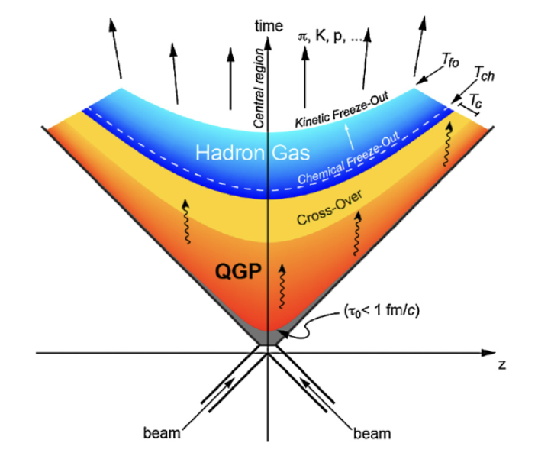

1. Intro: Quark-gluon plasma (QGP) formation in RHI collisions
Local kinetic equilibration (thermalization) time:
Gluons τ_{eq}^{g} ≈ 0.1 fm/c
Valence quarks τ_{eq}^{q} ≈ 1 fm/c
Baryon stopping occurs on a similar timescale
Thermalization is a sufficient precondition for the subsequent hydrodynamic treatment of expansion and cooling
Start of the hydrodynamic expansion
τ_{i} ≈ 0.1 - 0.2 fm/c
Interaction (freezeout) time:
τ_{int} ≈ 5 - 8 fm/c in Pb-Pb @ LHC energies
Most of the light hadrons (π±, K±,..) are produced at the phase boundary, but heavy quarks and quarkonia emerge in the initial stages
Pre-equilibrium phase, τ_{eq}< 1 fm/c
© B. Hippolyte
© CERN

Slide 4
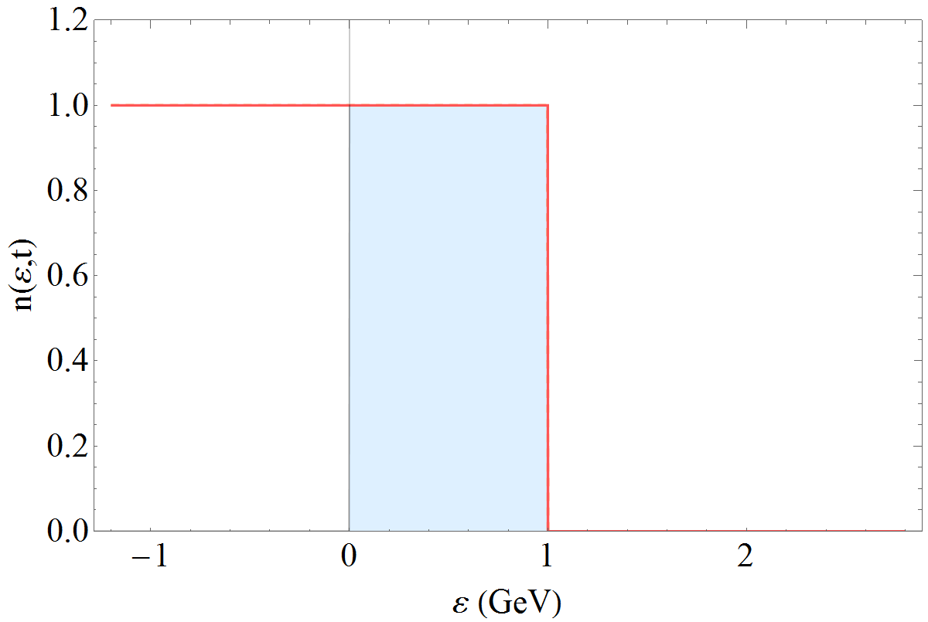
Fast thermalization of valence quarks
Video: The fermionic solution of the nonlinear diffusion equation at LHC energies with antiparticle creation
Antiparticle creation
T= 510 MeV: initial central temperature in a central √s_{NN}= 5.02 TeV Pb-Pb collision
(Analytical solutions, agree with
the numerical results)
Dirac sea
T. Bartsch and GW, Ann. Phys. 400, 21 (2019)
Based on GW, PRL 48, 1004 (1982)
The total particle number (particles + antiparticles) is conserved

Slide 5


2. An analytical model for thermalization
2.1 Derivation of the nonlinear diffusion equation
Quantum Boltzmann collision term for bosons/ fermions, ergodic approximation
Here: elastic collision kernel
3
4
<V²₁₂₃₄>
1
2
The Bose-Einstein/ Fermi-Dirac distributions are stationary solutions

Slide 6

Derivation of the nonlinear equation
Write the collision term in form of a Master equation (ME) with gain- and loss term
with the transition probability (
accordingly)
Introduce the density of states g_{j} = g(ε_{j}); omit ±
W is peaked at ε₁ = ε₄
. Obtain an approximation to the ME through a Taylor
expansion of n₄ and g₄n₄ around ε₁ = ε₄ to second order.

Slide 7
Introduce transport coefficients via moments of the transition probability (x=ε₄-ε₁)
and arrive at the nonlinear partial differential equation for the distribution of
the occupation numbers
Dissipative effects are expressed through the drift term , , diffusive
effects through the diffusion term
In the limit of constant transport coefficients, the nonlinear diffusion equation
for the occupation-number distribution of bosons/ fermions becomes
GW, Physica A 499, 1 (2018); A 597, 127299 (2022)

Slide 8
The Bose-Einstein/Fermi-Dirac distributions n±_{eq} (ε) are stationary solutions
of this equation with the equilibrium temperature
Fluctuation-dissipation relation (FDR)
Thermalization of Gluons:
Through elastic collisions, the nonlinear evolution can push a
fraction of particles from the thermal cloud into the gluon condensate
in overoccupied systems (no condensate formation in underoccupied
systems).
Inelastic collisions thermalize the system without condensate
formation. This process appears to be faster, so BEC formation is unlikely in
relativistic heavy-ion collisions if inelastic collisions are predominant.
The nonlinear boson diffusion equation (NBDE) properly accounts for the
thermalization in both cases provided the boundary condition n (ε = μ ≤ 0) → ∞
at the the singularity is introduced.

Slide 9





2.2 Exact solution of the nonlinear equation
The solution of the NBDE for massless gluons with ε=p can be written as the logarithmic derivative
of the time-dependent partition function
which is an integral over Green’s function G (p, x, t) of the linear diﬀusion equation
and an exponential function that contains an integral over the initial conditions
Here, A_{i}(x) = ∫ n_{i}(y) dy is the indeﬁnite integral over the initial distribution n_{i}.
(The integration constant drops out when taking the logarithmic derivative of the partition function.)

Slide 10


For a solution without boundary conditions, Green’s function G_{free}(p; x; t) is a single Gaussian
Include boundary conditions for bosons at the singularity p = µ, with µ_{i} < 0 for elastic collisions as determined from particle-number conservation, and µ = 0 for inelastic collisions. This requires a new Green’s function that equals zero at p = µ
Z(µ, t) = 0 and lim_{p↓µ}n(p, t)=∞ ∀ t as needed, and the momentum range is restricted to
p ≥ µ.
To conserve particle number during the time evolution for elastic scatterings, a time-varying chemical potential µ(t) is introduced. Once µ(t) reaches zero in the overoccupied case, condensate formation would start. Particle number is not conserved in the inelastic case with μ = 0.

Slide 11

Equilibration time for bosons vs. fermions
An explicit expression for the bosonic equilibration time at Q_{s} follows from an
asymptotic expansion of the error functions occuring in the analytical solutions
for theta-function initial distributions with boundary ε_{i}
with argument z_{b} at the boundary ε_{i} = Q_{s} for n_{i}⁰= 1
Deviations from the thermal solution thus scale with
and the equilibration time in a Bose system becomes for n_{i}⁰= 1
The difference is enlarged by the corresponding color factors, C_{F} = 4/3 for quarks, C_{A} = 3 for gluons.

Slide 12
Equilibration time for bosons vs. fermions
An explicit expression for the bosonic equilibration time at Q_{s} follows from an
asymptotic expansion of the error functions occuring in the analytical solutions
for theta-function initial distributions with boundary ε_{i}
with argument z_{b} at the boundary ε_{i} = Q_{s} for n_{i}⁰= 1
0
0
1
ε(GeV)
Deviations from the thermal solution thus scale with
and the equilibration time in a Bose system becomes for n_{i}⁰= 1
GW, Physica A 499, 1 (2018)
The difference is enlarged by the corresponding color factors, C_{F} = 4/3 for quarks, C_{A} = 3 for gluons.

Slide 13
3. Application to gluons at LHC energies
If the chemical potential vanishes as in case of inelastic collisions, the equilibrium temperature T and the initial occupation were found to be related by Blaizot et al.[*] as
T = [15n_{i}⁰/(4π⁴)]^{1/4}Q_{s}, yielding T = 600 MeV for Q_{s} = 1 GeV/c and n_{i}⁰≃3.37 assuming conserved energy density and an initial theta-function distribution. These values are characteristic for a central Pb-Pb collision at √s_{NN} = 5 TeV.
This corresponds to an overoccupied system: There are more gluons in the initial distribution than the equilibrium distribution at temperature T can accommodate. (The boundary between over- and underoccupied systems is at n_{i}^{c} ≃0.154 for a theta-fct initial distribution.)
For elastic scatterings in overoccupied systems, surplus gluons are pushed into the gluon
condensate [*].
In case of inelastic scatterings, gluons can split in underoccupied systems, and merge in
overoccupied ones to reach equilibrium. Here: Concentrate on inelastic collisions because these dominate thermalization in relativistic heavy-ion collisions.
[*] J.-P. Blaizot et al., NPA 873, 68 (2012)

Slide 14
3.1 Thermalization via inelastic scattering in an underoccupied system
(NBDE solutions for inelastic collisions, μ=0)
Time-dependent single- particle occupation-number
distribution functions n(p,t) at t = 2 × 10⁻⁵ , 2 × 10⁻⁴ , 2 × 10⁻³ ,
0.01, 0.04 and 0.12 fm/c (decreasing dash lengths). Equilibrium
is reached instantaneously for p = 0 and is approached from
below in the IR. The dot-dashed curve is the Rayleigh-Jeans,
the dotted line the Maxwell-Boltzmann distribution.
n_{i}⁰=0.12; T = 267 MeV (solid curve, BE-distribution)
D = 0.23 GeV²/fm, v = −0.86 GeV/fm

Slide 15
3.2 Thermalization via inelastic scattering in an overoccupied system
(NBDE solutions for inelastic collisions, μ=0)
Time-dependent single- particle occupation-number
distribution functions n(p,t) at t = 2 × 10⁻⁵ , 2 × 10⁻⁴ , 2 × 10⁻³ ,
0.01, 0.04, 0.12, 0.4 and 2 fm/c (decreasing dash lengths).
Equilibrium is approached from above in the IR. The
dot-dashed curve is the Rayleigh-Jeans, the dotted line
the Maxwell-Boltzmann distribution.
n_{i}⁰=3.37; T = 600 MeV (solid curve, BE-distribution)
D = 1.2 GeV²/fm, v = −2 GeV/fm

Slide 16
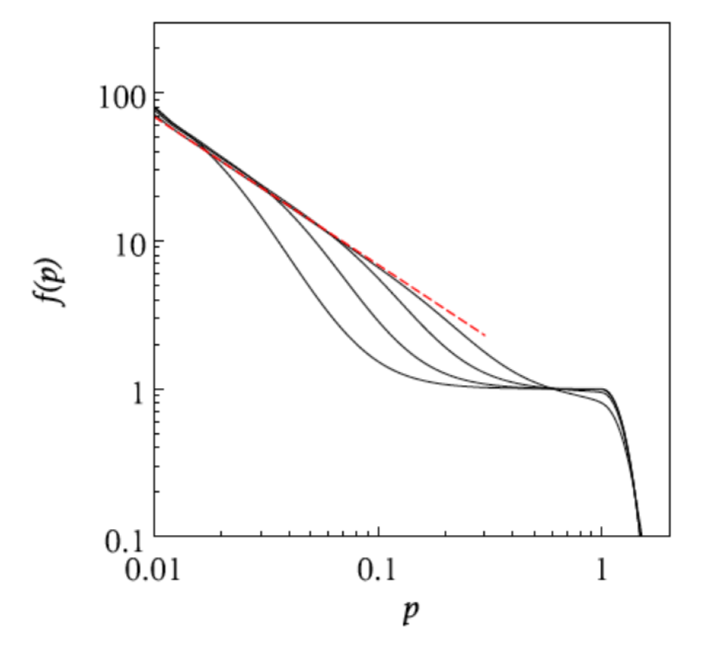
3.3 Comparison with a numerical thermalization model for μ=0, n_{i}⁰=1
(NBDE solutions for inelastic collisions vs. Blaizot et al.)
0.01 fm/c
2·10⁻⁴ fm/c
Numerical QCD-based calculations of the soft (IR) modes only
at early times t ≈ 2 × 10⁻⁴ , 8 × 10⁻⁴ , 3 × 10⁻³, 0.01 fm/c
(with n_{i}⁰=1.0, T=690 MeV) from:
J.-P. Blaizot, J. Liao, Y. Mehtar-Tani, NPA 961, 37 (2017):
This numerical model in the small-angle approximation
agrees reasonably well with the analytical NBDE-approach
in the IR
NBDE solutions: Time-dependent single- particle occupation-number
distribution functions n(p,t) at t = 2 × 10⁻⁵ , 2 × 10⁻⁴ , 2 × 10⁻³ ,
0.01, 0.04, 0.12, 0.4 and 2 fm/c (decreasing dash lengths).
n_{i}⁰=1.0; T = 600 MeV (solid curve, BE-distribution)
D = 1.2 GeV² /fm, v = −2 GeV/fm
G. Wolschin, Physica A 597, 127299, (2022)

Slide 17
4. Epilog: Thermalization and condensate formation in ultracold atoms
The nonlinear diffusion model is particularly suited to account for the thermalization of bosonic ultracold atoms,
and Bose-Einstein condensate formation in case of a deep quench (rather than gradual evaporative cooling)
Example: Deep quench in K-39 atoms, producing a highly nonequilibrium state at an initial
temperature of T_{i} = 130 nK as in the Cambridge experiment Nature Phys. 17, 457 (2021).
Time-dependent condensate formation is measured for various scattering lengths, and
compared to our model calculations:
T_{i} = 130 nK
remove 77% of the atoms,
97.5% of the energy
T_{f}= 32.5 nK
T_{i} /T_{f} = 4: infinite series terminates!
A. Kabelac and GW, Eur. Phys. J. D76, 178 (2022)

Slide 18
Time-dependent condensate formation in K-39 vapour at various interaction energies
The nonlinear diffusion model can be applied to the time-dependent Bose-Einstein condensate formation.
Here, particle number is conserved following the deep quench:
N_{i} = N_{th}(t) + N_{c} (t) = ∫ n(ε,t) g(ε) dε + N_{c} (t) ⇒ Condensate fraction ≡ N_{c}(t)/N_{i} = 1- N_{th}(t)/N_{i}
a=800a₀
a=800a₀
a=400a₀
relaxation ansatz
a=280a₀
a=140a₀
a=140a₀
a₀ = Bohr radius ≈ 0.0529 nm
a = s-wave scattering length
³⁹K Data from J.A.P. Glidden et al., Nature Phys. 17, 457-461 (2021). G Wolschin, EPL 140, 40002 (2022)

Slide 19
5. Summary and Conclusion
From the quantum Boltzmann collision term, a nonlinear partial
differential equation for the time-dependent occupation-number distribution
in a finite Fermi/ Bose system is derived.
The nonlinear diffusion equation is solved analytically for bosons including
the boundary conditions at the singularity
The solution is applied to the fast thermalization of gluons in relativistic heavy-ion
collisions
Thermalization through inelastic collisions with μ = 0 occurs faster than
equilibration via elastic collisions (and condensate formation in overoccupied
systems)
The model can successfully be applied to thermalization and time-dependent
BEC formation in ultracold atoms
⇒ No BEC formation in relativistic collisions expected

Slide 20

Thank you for your attention !
© A. Chibihi

