Slide 1
Machine Learning for Thermodynamic Observables in Lattice Field Theories
Lena Funcke
MITP Workshop on Machine Learning Techniques in Lattice QCD

Slide 2
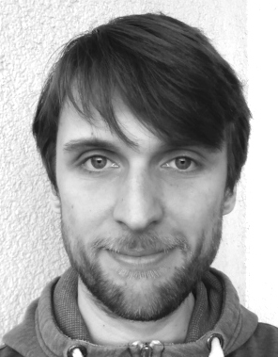
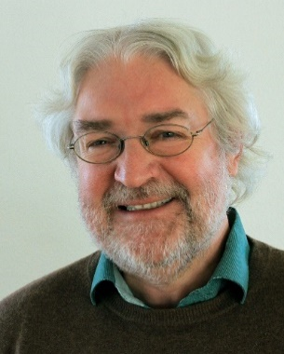
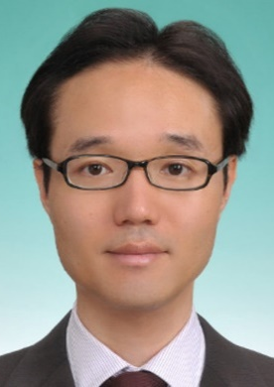
In collaboration with
Kim Nicoli Christopher Anders Tobias Hartung Karl Jansen
(TU Berlin) (TU Berlin) (University of Bath) (DESY)
Nicoli, Anders, LF, Hartung, Jansen, Kessel, Nakajima, Stornati,
Phys. Rev. Lett. 126 (2021) 3, 032001
Pan Kessel Shinichi Nakajima Paolo Stornati
(TU Berlin) (TU Berlin, RIKEN) (DESY, HU Berlin)

Slide 3
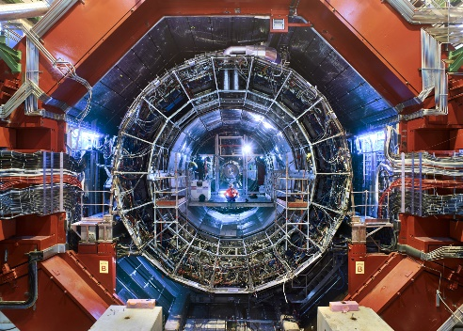
Overview: why ML for lattice gauge theories?
Numerical computations
Theoretical models
Experiments
Lattice QCD
high-precision computations
computational issues
Tensor networks &
quantum computing
topological $θ$-terms,
chemical potentials…
Machine learning
efficient sampling,
thermodynamic observables…
3+1D QCD and Higgs theory
“real world”
quarks, gluons, Higgs…
1+1D Schwinger model
QCD toy model
$θ$-term, confinement…
1+1D $φ^{4}$ theory
Higgs toy model
symmetry breaking…
Observables
free energy,
entropy, pressure…
LHC & cosmology
heavy-ion collisions,
early-universe physics…
(Image credit: ALICE Collaboration / CERN)

Slide 4
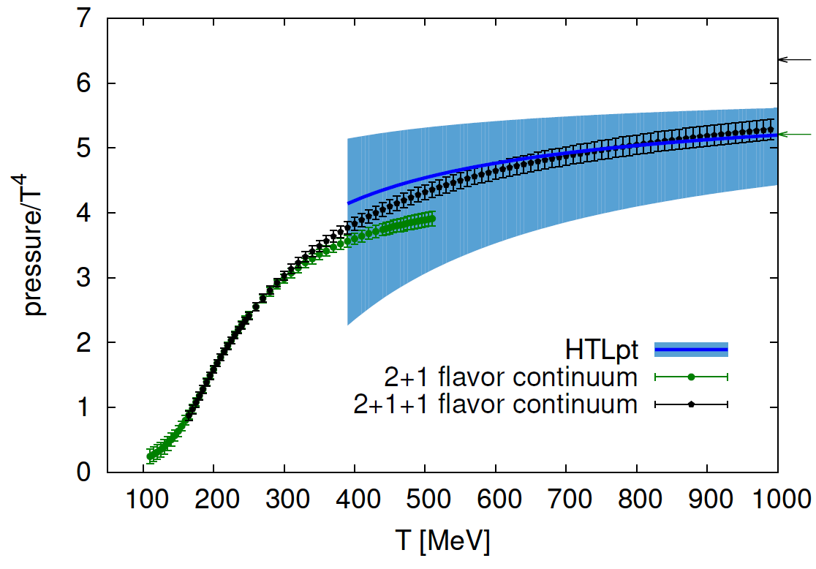
Motivation: what are the problems of MCMC?
compute observables: $\left\langle O\right\rangle =\frac{1}{Z}∫Ɗ\left[φ\right]O\left[φ\right]e^{−S\left[φ\right]}≈\frac{1}{N} \sum_{i=1}^{N}{O[φ_{i}}]$
sample histories in path integral: $φ_{i}∼p\left(φ\right)=e^{−S\left(φ\right)}/Z$
Goal
Monte Carlo: draw samples from distribution $p\left(φ\right)$
Markov chain: next sample depends on existing one
MCMC
critical slowing down $→$ hard to tackle phase transitions
no direct access to $Z$ $→$ reweighting for $F=−T ln\left(Z\right)=−PV$
integration through phase space $→$ large statistical errors
Problems
(Image credit: Borsanyi et al., 2016)

Slide 5
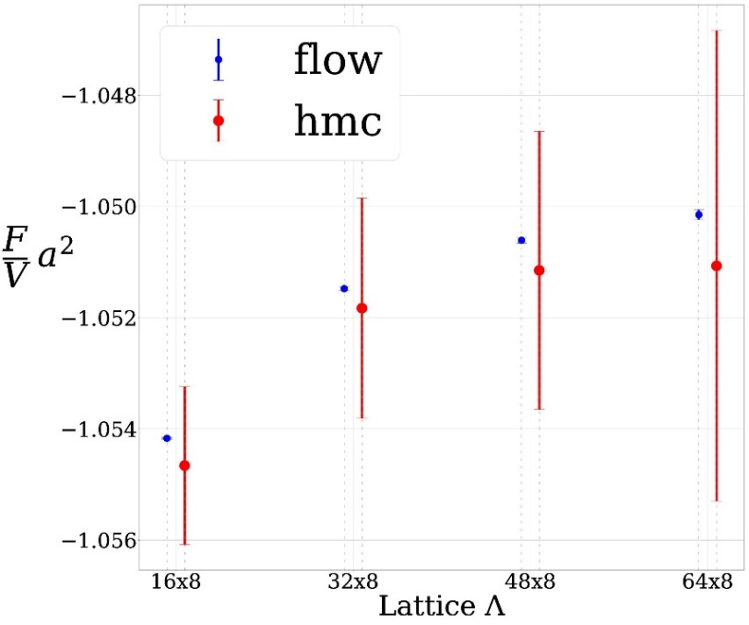
Goal: tackling these problems with machine learning
MCMC: critical slowing down, no direct access to $Z$
flow $q_{θ}\left(φ\right)$: trained to approximate path integral distribution
(Albergo, Kanwar, Shanahan, 2019; Kanwar, …, Rezende, Shanahan, 2020)
State of art
optimize of $q_{θ}\left(φ\right)$ with respect to $θ$
efficiently sample from $q_{θ}\left(φ\right)$
generate uncorrelated configurations
Flow
compute $F=−T\ln{Z}$ with sampling from $q_{θ}\left(φ\right)$
estimate observables not directly accessible with MCMC
Our work

Slide 6
Starting point: deep neural networks
$y^{L}\left(x\right)=σ(W^{L}x+b^{L})$,
input: $x∈ℝ^{n}$, output: $y^{L}∈ℝ^{m}$
Layers
weights: $W^{L}∈ℝ^{m,n}$, bias: $b^{L}∈ℝ^{m}$
$b^{L}=0$ due to $ℤ_{2}$ symmetry: $φ↔−φ$
activation function: $σ\left(x\right)=tanh⁡(x)$
Parameters
neural network: $g_{θ}\left(x\right)=\left(y^{L}∘y^{L−1}∘…∘y^{1}\right)\left(x\right)$
odd network: $g_{θ}\left(−x\right)=−g_{θ}\left(x\right)$
deep network: $L \text{≳} 10$
Network
(Image credit: Kavlakoglu, www.ibm.com)

Slide 7
Starting point: normalizing flows
generative models: built from neural networks
normalizing flows: subclass of generative models
Flows
prior distribution: $q_{z}=𝒩(0,1)$
neural network: $g_{θ}\left(z\right)=\left(y^{L}∘y^{L−1}∘…∘y^{1}\right)\left(z\right)$
coupling layers: $y^{l}$ applied to samples $z∼q_{z}$
Input
flow
$$q_{z}$$
final distribution: $q_{θ}\left(φ\right)=q_{z}\left(g_{θ}^{−1}\left(φ\right)\right){\left|\frac{dg_{θ}}{dz}\right|}^{−1}$
samples: $φ=g_{θ}\left(z\right)∼q_{θ}$ obtained from applying $g_{θ}\left(z\right)$to $z$
Output
$$q_{θ}$$

Slide 8
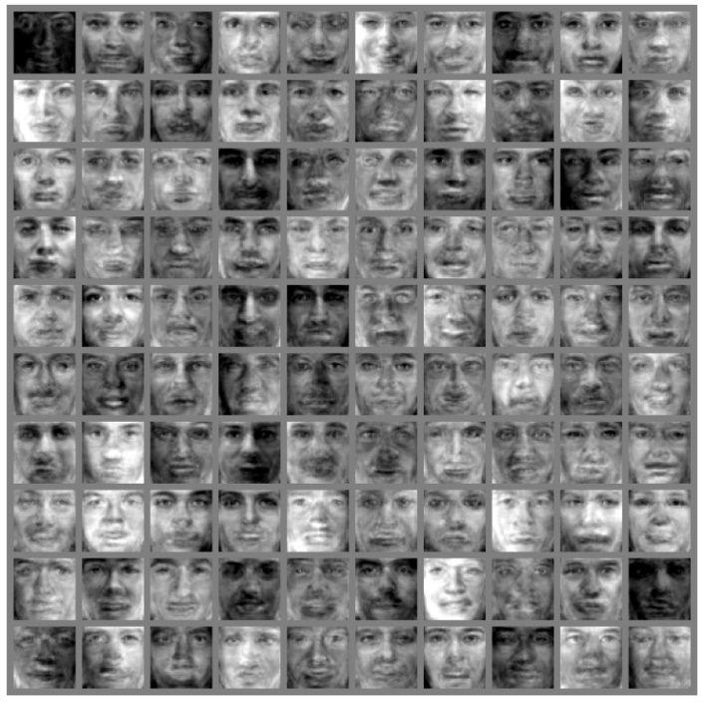
Technical details: NICE architecture
Non-linear Independent Component Estimation (NICE)
$q_{θ}\left(φ\right)=q_{z}\left(g_{θ}^{−1}\left(φ\right)\right){\left|\frac{dg_{θ}}{dz}\right|}^{−1}$requires: $g_{θ}\left(z\right)=\left(y^{L}∘…∘y^{1}\right)\left(z\right)$ invertible, $\left|\frac{dg_{θ}}{dz}\right|$efficiently evaluable
Architecture
split layers: $y^{l}=(y_{u}^{l}$, $y_{d}^{l}$), where $y_{u}^{l}∈ℝ^{\left|Λ\right|−k}$, $y_{d}^{l}∈ℝ^{k}$, $k∈\{1,\left|Λ\right|−1\}$
$y_{u}^{l+1}=y_{u}^{l}$, $y_{d}^{l+1}=y_{d}^{l}+m(y_{u}^{l}$), invertible: $y_{u}^{l}=y_{u}^{l+1}$, $y_{d}^{l}=y_{d}^{l+1}−m(y_{u}^{l+1}$)
$\det{\frac{∂y^{l+1}}{∂y^{l}}}=\left|\begin{matrix}𝕀 & 0 \\ ∗ & 𝕀\end{matrix}\right|=1→\left|\frac{dg_{θ}}{dz}\right|=1$, trivial
Features
$m(y_{u}^{l}\text{) }\text{contains} \text{learnable} \text{parameters} θ \text{of} g_{θ}\left(z\right)$
$g_{θ}\left(z\right)$ has 6 coupling layers, $m(y_{u}^{l}$) has 5 hidden layers
Parameters
(NICE model trained on Toronto Face Dataset (TFD),
Image credit: Dinh, Krueger, Bengio, arXiv:1410.8516)

Slide 9
Training: approximating path integral distribution
$$N_{t}$$
target distribution: $p\left(φ\right)=\frac{1}{Z}\exp{\{−S\left(φ\right)\}}$
flow: $q_{θ}(φ)$ as close as possible to $p\left(φ\right)$
$$a$$
Goal
$$x$$
minimize Kullback-Leibler (KL) divergence between $q_{θ}$ and $p$:
$KL(q_{θ}|\left|p\right)=∫Ɗ\left[φ\right]q_{θ}\left(φ\right) ln\left(\frac{q_{θ}\left(φ\right)}{p\left(φ\right)}\right)=β(F_{q}−F)$
Training
variational free energy: ${βF}_{q}=𝔼_{φ∼q_{θ}}[S\left(φ\right)+\ln{q_{θ}\left(φ\right)}]$
free energy: $βF=−\ln{Z}$ with temperature $T=\frac{1}{β}=\frac{1}{aN_{t}}$
Energy
$$t$$

Slide 10
Training: approximating path integral distribution
$$N_{t}$$
Gibb’s inequality: $KL(q_{θ}|\left|p\right)=β\left(F_{q}−F\right)≥0$
$\text{m}\text{inimizing} F_{q} \text{sufficient}→$ unknown$F$ irrelevant
$$a$$
Trick
$$x$$
gradient descent: ${βF}_{q}=𝔼_{φ∼q_{θ}}\left[S\left(φ\right)+\ln{q_{θ}\left(φ\right)}\right]≡−⟨ln{\tilde{w}\left(φ\right)⟩}$
un-normalized importance weight: $\tilde{w}\left(φ\right)=\exp\left\{−S\left(φ\right)\right\}/q_{θ}\left(φ\right)$
Minimizing
approximated partition function: $Z=∫Ɗ\left[φ\right]q_{θ}\left(φ\right)\tilde{w}(φ)$
Monte-Carlo estimate: $\hat{Z}=\frac{1}{N} \sum_{i=1}^{N}{\tilde{w}(φ_{i})}$, $φ_{i}∼q_{θ}$
Sampling
$$t$$

Slide 11
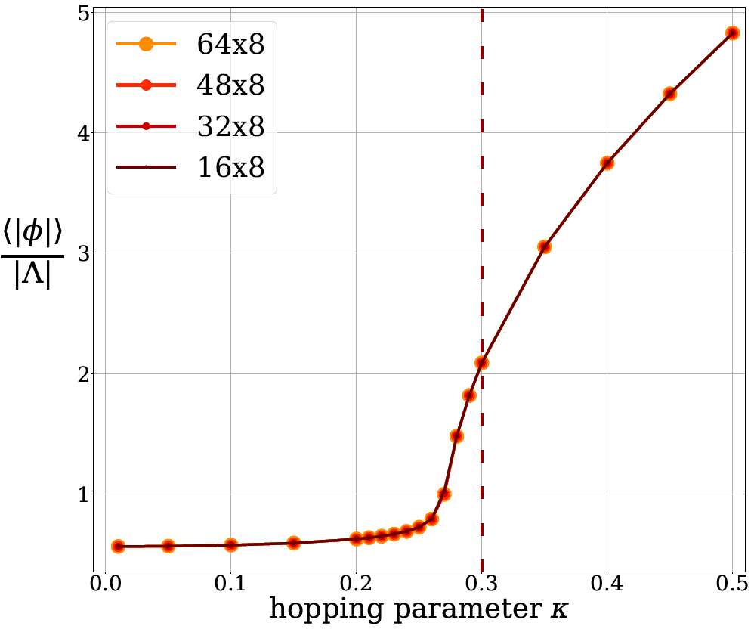
The model: $φ^{4}$ real scalar field theory
$S=\sum_{x∈Λ}{−2κ}\sum_{\hat{μ}=1}^{2}{φ\left(x\right)φ\left(x+\hat{μ}\right)+\left(1−2λ\right)φ{\left(x\right)}^{2}+λφ{\left(x\right)}^{4}}$
invariant under $ℤ_{2}$ transformations: $φ↔−φ$
Action
absolute magnetization: $\left\langle \left|φ\right|\right\rangle$
free energy: $F=−T\ln{Z}=−PV$
Observables
spontaneous symmetry breaking: $\left\langle \left|φ\right|\right\rangle ≠0$
for $λ=0.022$, $κ \text{≲} 0.3$, and different $\left|Λ\right|=N_{x}×N_{t}$
Transition

Slide 12
MCMC results: critical problem
no direct estimate of $Z$ and $F=−T ln(Z)$
only differences: ${ΔF}_{t,0}=F_{t}−F_{0}=−T\ln{\frac{Z_{t}}{Z_{0}}}$,
${\frac{Z_{t}}{Z_{0}}=\frac{1}{Z_{0}}∫D\left[φ\right]e^{−S_{0}\left(φ\right)}\frac{e^{−S_{t}\left(φ\right)}}{e^{−S_{0}\left(φ\right)}}=𝔼}_{p_{0}}\left[\frac{\exp{(−S_{t})}}{\exp{(−S_{0})}}\right]$
MCMC
starting point: $F_{0}≡F(κ=0)$ known analytically
target: $F_{t}≡F(κ=0.3)$ beyond critical point
Trajectory
small overlap of $p_{0}$ and $p_{t}$: use${ΔF}_{t,0}={ΔF}_{t,i_{k}}+…+{ΔF}_{i_{1},0}$
integration through phase space $→$ large statistical errors
Problem
(Image credit: Borsanyi et al., 2016)

Slide 13
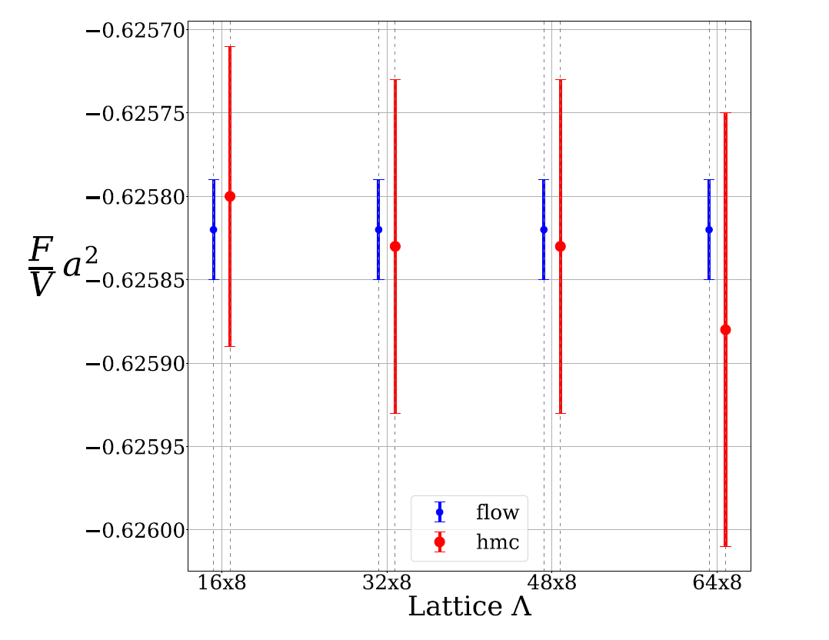
MCMC vs. flow results: before critical point
$κ=0.2$, $λ=0.022$
different volumes $V=N_{x}×N_{t}$
Parameters
Hybrid Monte Carlo (HMC) algorithm
4 Markov chains from $F_{0}$ to $F_{t}$
MCMC
$ℤ_{2}$ symmetry: $g_{θ}\left(−z\right)=−g_{θ}\left(z\right)$
no starting point needed
Flow

Slide 14
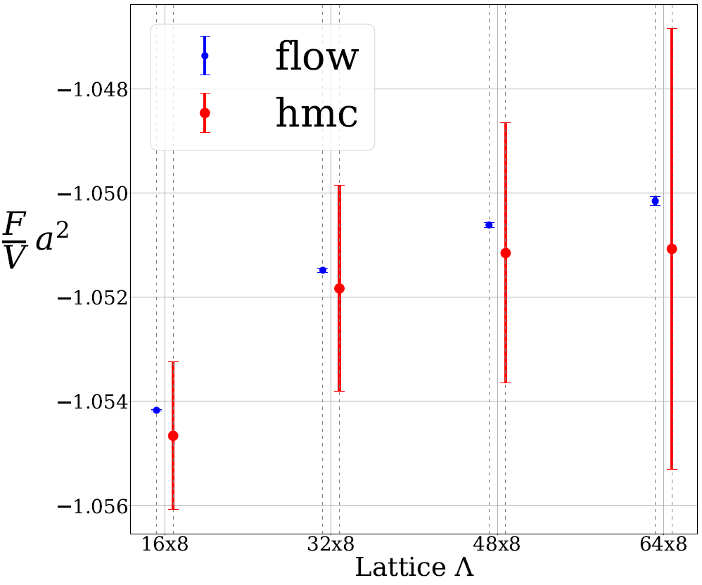
MCMC vs. flow results: after critical point
$κ=0.3$, $λ=0.022$
different volumes $V=N_{x}×N_{t}$
Parameters
14 Markov chains from $F_{0}$ to $F_{t}$
crossing critical region $→$ larger errors
MCMC
similar error bars as before
independent of point in parameter space
Flow

Slide 15
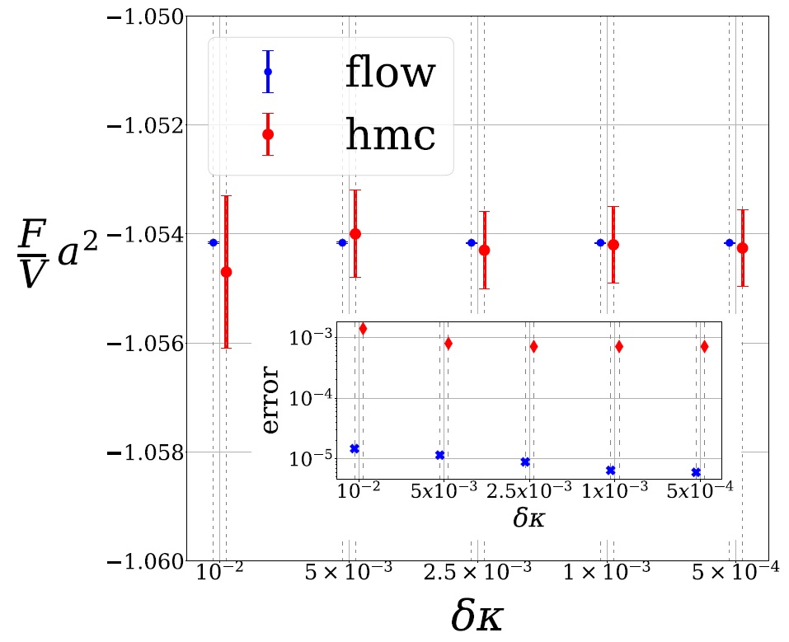
MCMC results: systematic errors
error increases with step size $δκ$
integrated autocorrelation time decreases with $δκ$
finite-T QCD: $F_{0}$approximated $→$ additional error
MCMC

Slide 16
Flow results: systematic errors
Kullback-Leibler divergence:
$KL(q_{θ}|\left|p\right)=∫Ɗ\left[φ\right]q_{θ}\left(φ\right) ln\left(\frac{q_{θ}\left(φ\right)}{p\left(φ\right)}\right)=β(F_{q}−F)$
Reminder
$βF_{q}≡{\left\langle C\right\rangle }_{q}≡−{\left\langle \ln{\tilde{w}}\right\rangle }_{q}≡−{\left\langle S\left(φ\right)+ln{q_{θ}\left(φ\right)}\right\rangle }_{q}$
$KL(q_{θ}|\left|p\right)=\frac{1}{2}Var_{q}\left(C\right)+𝒪\left(𝔼_{q}\left[{\left|w−1\right|}^{3}\right]\right)≠0$
Flow
bias due to imperfect training: $∼N^{−1}$
error of estimator $β\hat{F}=−\ln{\frac{1}{N}}\sum_{i=1}^{N}{\tilde{w}(φ_{i})}$: $σ∼N^{−1/2}$
Errors

Slide 17
MCMC vs. flow results: computational costs
no training
sequential sampling
costs
(when) can ML beat MCMC?
MCMC
training costs
up-front training: $∼$20 hours
parallel sampling: $<1$ minute for 5.6M samples
Flow
sampling costs
ML could beat MCMC when crossing critical points
further optimization by hyperparameter tuning, etc.
samples
Prospects

Slide 18
Summary: ML for thermodynamic observables
MCMC: critical slowing down, no direct access to $Z$
flow $q_{θ}\left(φ\right)$: trained to approximate path integral distribution
(talks by Danilo Rezende on Monday and Gurtej Kanwar on Thursday)
Motivation
computation of $F=−T\ln{Z}$ with sampling from $q_{θ}\left(φ\right)$
estimation of observables not directly accessible with MCMC
no integration through parameter space $→$ critical points
Our work
extensions: larger lattices, gauge fields, fermions, higher dimensions
long-term goal: scaling to lattice QCD calculations
Future
(Image credit: ALICE Collaboration / CERN)

Slide 19
Backup: derivation of $KL(q_{θ}|\left|p\right)∼\frac{1}{2}Var_{q}\left(C\right)$
$KL(q_{θ}|\left|p\right)=𝔼_{q}\left[\ln{\frac{p}{q}}\right]=−𝔼_{q}\left[\ln{w}\right]$ $≥0$ due to: $\sum_{i}^{N}{p_{i}\log{p_{i}}}≥\sum_{i}^{N}{p_{i}\log{q_{i}}}$
$𝔼_{q}\left[\frac{p}{q}\right]=𝔼_{q}\left[w\right]=∫D\left[φ\right]p\left(φ\right)=1$
Divergence
$KL(q_{θ}|\left|p\right)=𝔼_{q}\left[w−1\right]+\frac{1}{2}𝔼_{q}\left[{\left(w−1\right)}^{2}\right]+{𝒪(𝔼}_{q}[{\left(w−1\right)}^{3}])=\frac{1}{2}𝔼_{q}\left[{\left(w−1\right)}^{2}\right]+{𝒪(𝔼}_{q}[{\left(w−1\right)}^{3}])$
$𝔼_{q}\left[C\right]=−𝔼_{q}\left[\ln{\tilde{w}}\right]=𝔼_{q}\left[\ln{w}+\ln{Z}\right]=−\ln{Z}+KL(q_{θ}|\left|p\right)=−\ln{Z}{+𝒪(𝔼}_{q}{[\left(w−1\right)}^{2}])$
Expansion
$Var_{q}\left(C\right)=𝔼_{q}\left[{\left(C−𝔼_{q}\left[C\right]\right)}^{2}\right]=𝔼_{q}\left[{\left(−\ln{\tilde{w}}+\ln{Z}{+𝒪(𝔼}_{q}{[\left(w−1\right)}^{2}])\right)}^{2}\right]=𝔼_{q}[{\left(w−1\right)}^{2}]{+ 𝒪(𝔼}_{q}{[\left(w−1\right)}^{3}])$
Result: $Var_{q}\left(C\right)=2KL(q_{θ}|\left|p\right){+ 𝒪(𝔼}_{q}{\left[w−1\right]}^{3}$)
Variance
$$−\ln{\tilde{w}}+\ln{Z}=−\ln{w}≈\left(w−1\right)+…$$

Slide 20
Backup: analytical solution for $κ=0$
partition function: $Z=∫D\left[φ\right] exp [−S\left(φ\right)]$
$Z=\prod_{x∈Λ}{∫dφ\left(x\right) exp [−\left(1−2λ\right)φ{\left(x\right)}^{2}−λφ{\left(x\right)}^{4}]}$
$$κ=0$$
analytical solution:
$∫{\exp{(−ax^{4}−bx^2)dx}}=\sqrt{\frac{b}{4a}}exp{\left(\frac{b^{2}}{8a} \right)K}_{\frac{1}{4}}\left(\frac{b^{2}}{8a}\right)$
Integral
free energy: $ZF=−T\left|Λ\right|\ln{z}(λ)$
with $z\left(λ\right)=\sqrt{\frac{1−2λ}{4λ}}exp{\left(\frac{{\left(1−2λ\right)}^{2} }{8λ} \right)K}_{\frac{1}{4}}\left(\frac{{\left(1−2λ\right)}^{2}}{8λ}\right)$
Result

Slide 21
Backup: systematic errors for flow
bias due to imperfect training:
$𝔹\left[−β\hat{F}\right]=−\frac{1}{2N}𝔼_{q}\left[{\left(\tilde{w}−𝔼_{q}\left[\tilde{w}\right]\right)}^{2}\right]/𝔼_{q}{\left[\tilde{w}\right]}^{2}+𝒪(N^{−2})∼N^{−1}$
Bias
variance of estimator $β\hat{F}=−\ln{\frac{1}{N}}\sum_{i=1}^{N}{\tilde{w}(φ_{i})}$:
$Var\left[β\hat{F}\right]=\frac{1}{N}𝔼_{q}{\left(\tilde{w}−𝔼_{q}\left[\tilde{w}\right]\right)}^{2}{\left(𝔼_{q}\left[\tilde{w}\right]\right)}^{2}$ $→σ∼N^{−1/2}$
Variance
bias due to imperfect training is subleading
agrees with results from numerical experiments
Comparison

Slide 22
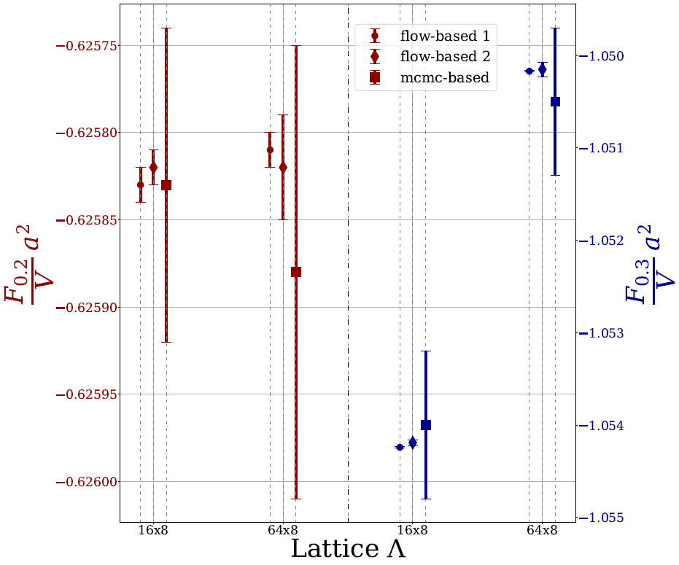
Backup: no mode-dropping for generative model
all modes of $p(φ)$ should be captured by $q_{θ}\left(φ\right)$
no mode-dropping $→$no underestimation of $Z$
Goal
use: $𝔼_{φ∼p}\left[{\tilde{w}}^{−1}\left(φ\right)\right]=\frac{1}{Z}∫D\left[φ\right]e^{−S\left(φ\right)}\frac{q_{θ}\left(φ\right)}{e^{−S\left(φ\right)}}=\frac{1}{Z}$
LHS: estimated using a single Markov chain
Method
flow-based 1: plug estimate $\hat{Z}$ into $\hat{F}=−T\ln{\hat{Z}}$
flow-based 2: $\hat{F}=−T\ln{\frac{1}{N}}\sum_{i=1}^{N}{\tilde{w}(φ_{i})}$ with $φ_{i}∼q_{θ}$
Result

Slide 23
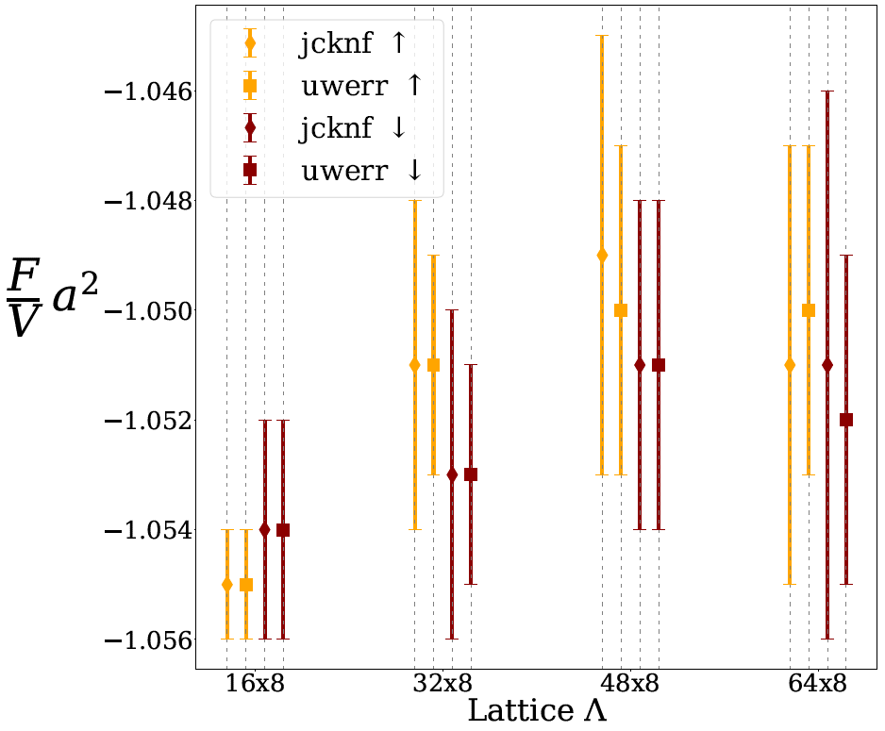
Backup: no mode-dropping for MCMC
ensure sufficient overlap of distributions $p_{i}$ and $p_{i+1}$ in:
$𝔼_{p_{i}}\left[\frac{\exp{(−S_{i+1})}}{\exp{(−S_{i})}}\right]=\frac{1}{Z_{i}}∫D\left[φ\right]e^{−S_{i}\left(φ\right)}\frac{e^{−S_{i+1}\left(φ\right)}}{e^{−S_{i}\left(φ\right)}}=\frac{Z_{i+1}}{Z_{i}}$
Goal
estimate $\frac{Z_{i}}{Z_{i+1}}$ by exchanging $p_{i}$ with $p_{i+1}$ above
cheap consistency check: run a single Markov chain
Method
MCMC-based 1: $\frac{Z_{i+1}}{Z_{i}}$(up)
MCMC-based 2: $\frac{Z_{i}}{Z_{i+1}}$ (down)
Result

Slide 24
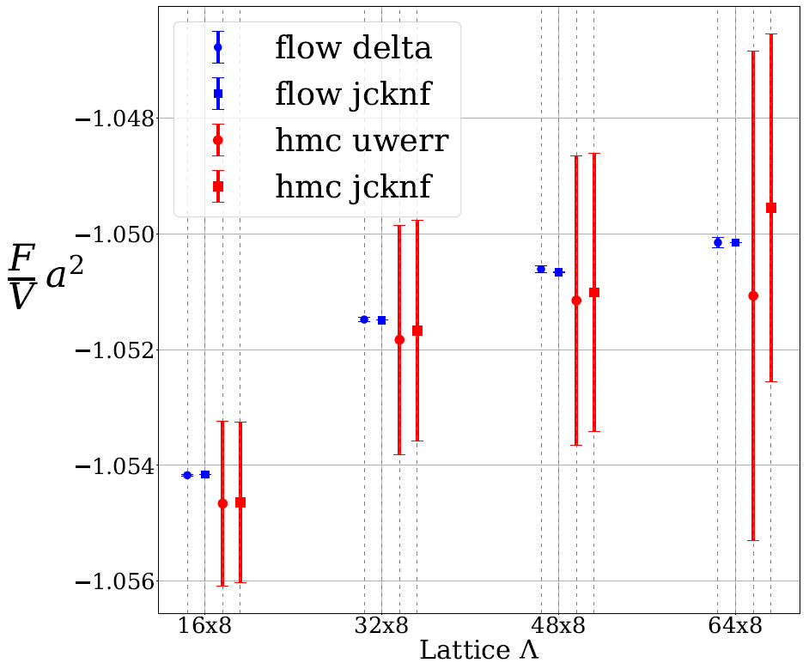
Backup: details on MCMC experiments
HMC algorithm with overrelaxation
sign of field configuration is flipped every ten steps
MCMC
14 Markov chains
5k thermalization steps
400k estimation steps
Chains
configurations: 5.6M = 14 x 400k
errors: uwerr and jackknife methods
(Wolff, 2004; Gattringer, Lang, 2009)
Results

Slide 25
Backup: details on flow experiments
$g_{θ}\left(z\right)\text{: }\text{6 }\text{coupling} \text{layers}\text{, }m(y_{u}^{l}\text{)}\text{:}\text{ 5 }\text{hidden} \text{layers}\text{, }\text{1000 }\text{neurons} \text{each}$
$\text{split} \text{input}\text{:} y_{u} \text{and} y_{d}\text{, }\text{with} \text{checkerboard} \text{partitioning}$
$\text{consecutive} \text{coupling} \text{blocks}\text{:} \text{alternati}\text{ng} \text{partitioning}$
Network
$\text{initial} \text{learning} \text{rate}\text{: }5×{10}^{−4}$
$\text{patience}\text{: 3}\text{k} \text{steps}$
Parameters
$\text{ReduceLROnPlate}\text{a}\text{u} \text{learning} \text{rate} \text{scheduler} \text{of} \text{PyTorch}$
$\text{train} \text{flow} \text{for}\text{ 1}\text{M} \text{steps} \text{using}\text{ 8}\text{k} \text{mini}\text{−}\text{batch}$
errors: delta and jackknife methods
(Gattringer, Lang, 2009; Nowozin, 2018)
Training

