Slide 1

Physics Opportunities with the Gamma Factory
MITP Workshop
November 30-December 4, 2020
Concluding Remarks
D. Budker
https://indico.mitp.uni-mainz.de/event/214/

Slide 2


Parity violation in relativistic ions
Laser cooling @ RHIC, SPS, & LHC
Optical stochastic cooling
GF Atomic
Max S. Zolotorev
1941-2020

Slide 3


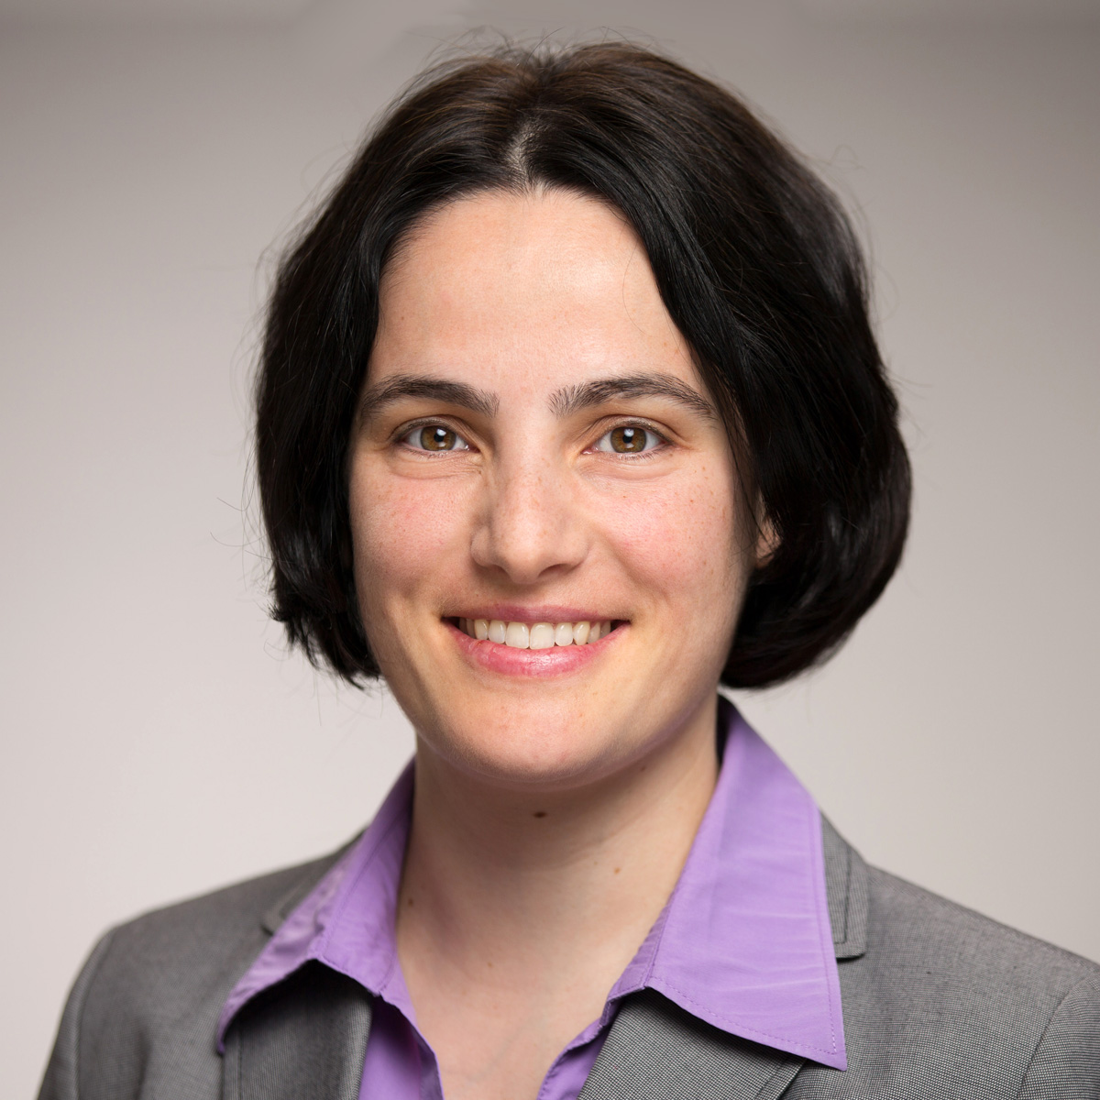
Happy birthday, Adriana!

Slide 4
duality
Light Source ⬌ Giant Ion Trap
GF : opportunities for Atomic, Nuclear, and Applied Physics
4

Slide 5
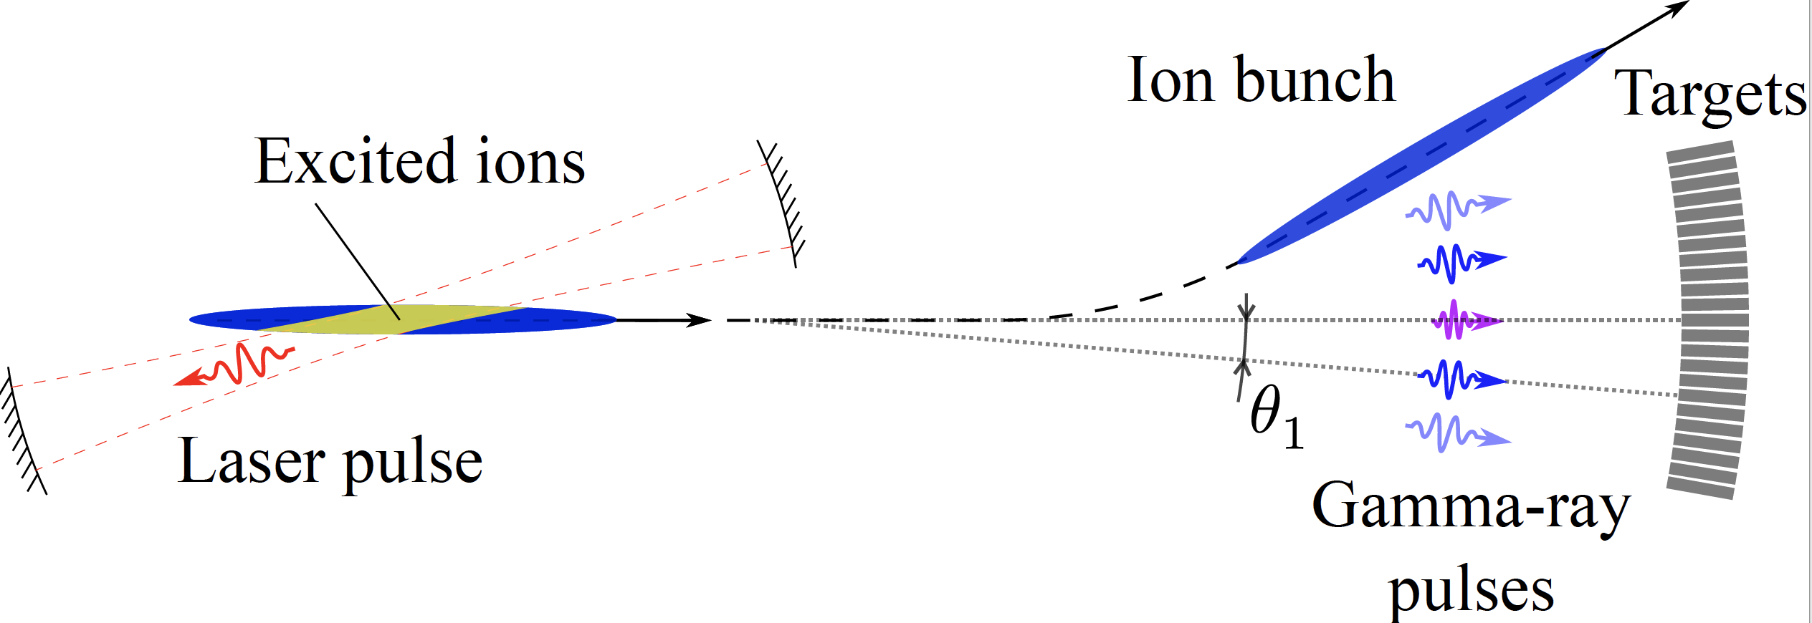
Fixed-target experimental configurations
Parallel Spectroscopy

Slide 6
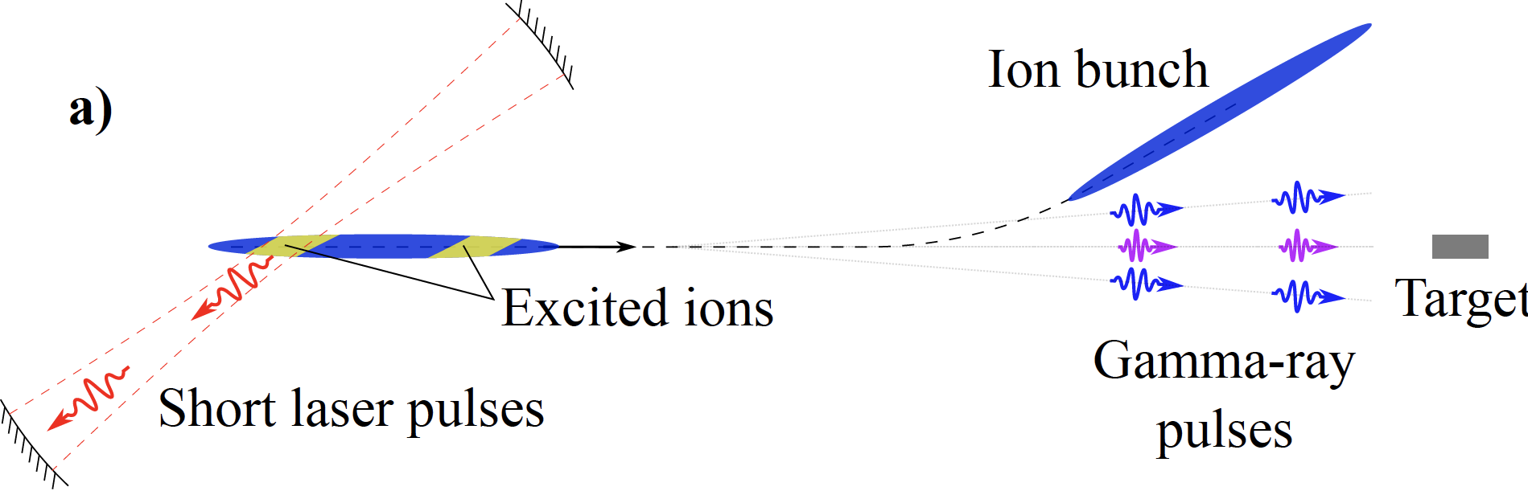
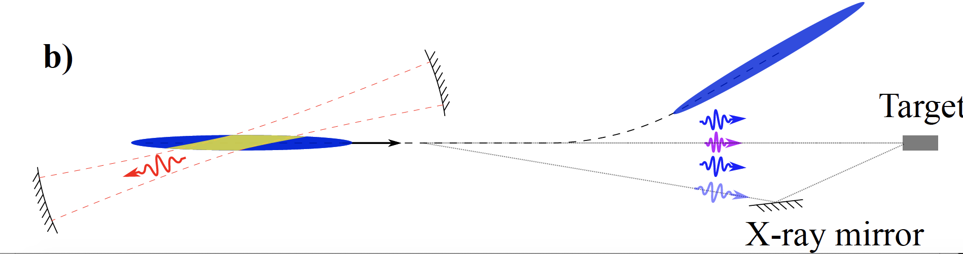
Fixed-target experimental configurations
Pump-Probe Spectroscopy

Slide 7

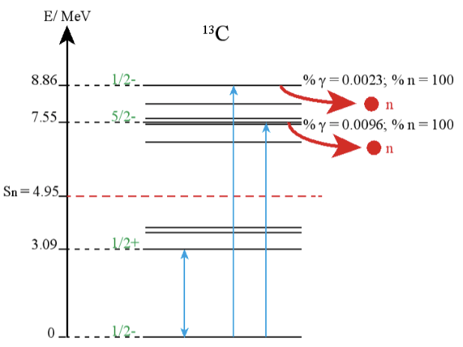

(Some) Open Questions
Polarization survival (nuclear and electronic)
Laser cooling ultrarelativistic beam
Precision gamma polarimetry
Can we make progress with gamma lasers ?
Can we make use of twisted gammas?
Physics-target priorities
https://indico.mitp.uni-mainz.de/event/214/

Slide 8
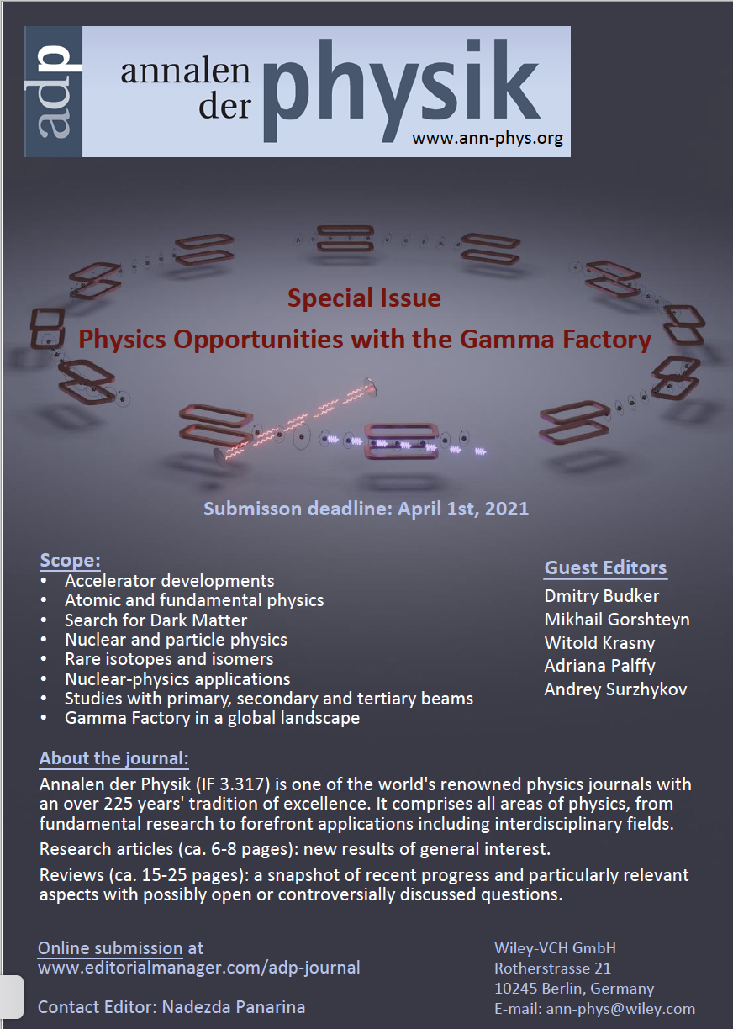
AdP (since 1799); IF = 3.3
Not “proceedings”
Research Articles or Reviews
Interest: by December 15th
Contribution coordination
Submit m/s by April 1, 2021
Submission category:
'Gamma Factory’
Fees and open access
https://indico.mitp.uni-mainz.de/event/214/

Slide 9
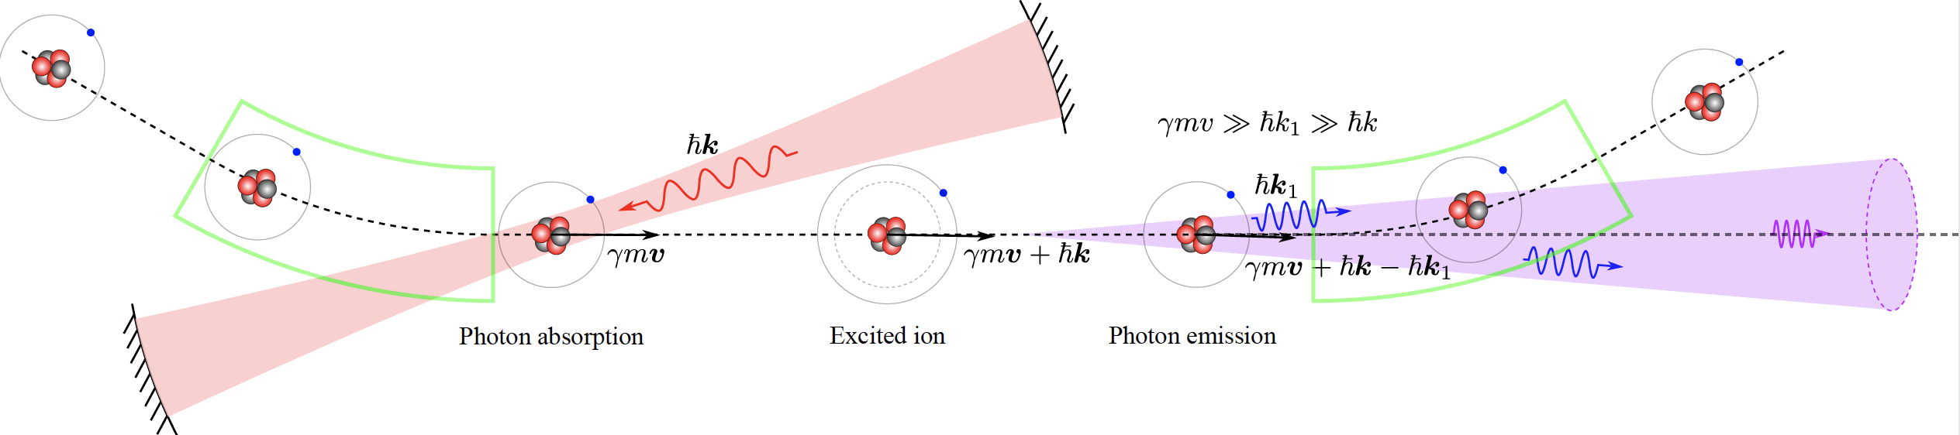
Thank you!!!!
https://indico.mitp.uni-mainz.de/event/214/
9

