Slide 1

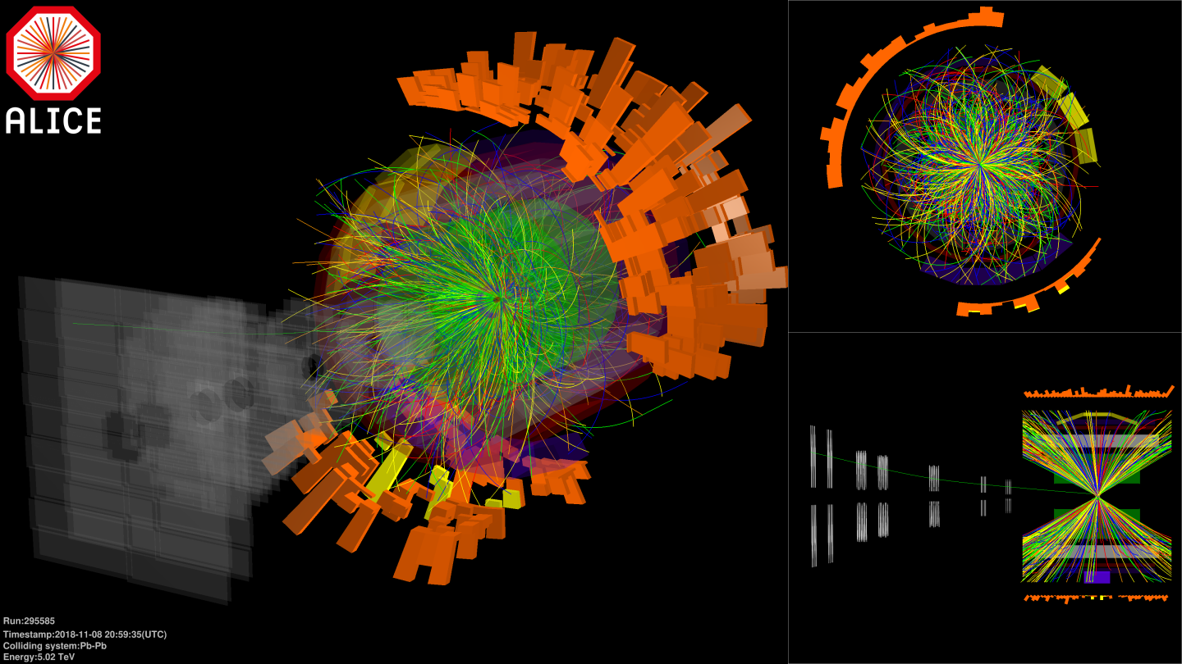
Dilepton production in heavy-ion collisions
Harald Appelshäuser
Goethe Universität Frankfurt
58th International Winter Meeting on Nuclear Physics
January 20-24, Bormio, Italy

Slide 2
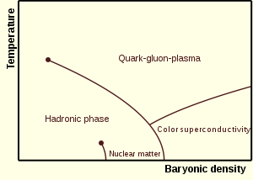
Quark-Gluon Plasma
Lattice QCD:
Matter exists in a phase of de-confined quarks and gluons, the QGP, at ε > 1 GeV/fm³
Transition temperature:
T_{c} = 155 ± 10 MeV at μ_{B} = 0
SM prediction, based on fundamental QCD properties
Filled the early universe in the first few μs after the Big Bang
QGP can be produced and studied in collisions of heavy-ions
QCD phase diagram can be scanned by variation of the collision energy
arXiv:1407.6387
arXiv:1309.5258

Slide 3
Quark-Gluon Plasma
What is the initial temperature?
What is the equation of state of QGP?
What is the order of the phase transition?
Is there a critical point?
How is chiral symmetry restored?
...need a probe that is soft and penetrating

Slide 4
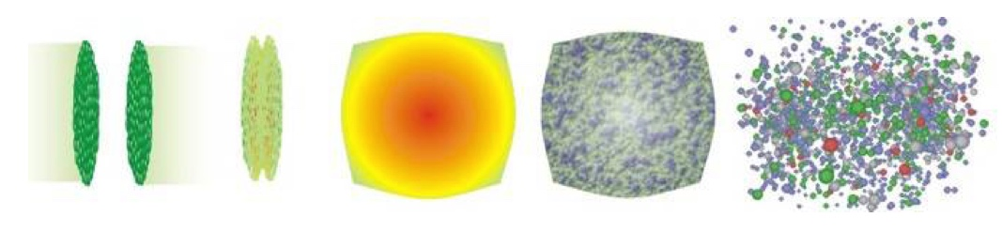
Photons and dileptons
leave the system without strong FSI
are produced at all stages of the collison
→ messengers of QGP bulk properties and in-medium properties of hadrons
each process that produces a real photon can also produce a dilepton
the inverse is not true: e.g. qq→γ*→l⁺l⁻, ππ→ ρ(γ*)→l⁺l⁻
γ
γ
γ
γ
e⁺
e⁺
e⁺
e⁺
γ*
e⁻
γ*
e⁻
γ*
e⁻
γ*
e⁻
hard scattering
qq→gγ, qg→qγ
thermal QGP
(T > T_{c})
thermal hadronic
(T < T_{c})
hadronic decays
(π,η,η‘,ω,ρ,ϕ,J/ψ,cc,bb)
_
_

Slide 5
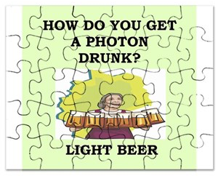
Photons puzzle
from
Wenqing Fan
Quark Matter 2019
PHENIX
PRC 94, 064901
Direct photons (at RHIC) show:
large yields (indicative of early emission)
large collectivity (i.e. v₂, indicative of late emission)
Hard to reconcile in models
„Direct-photon puzzle“
Early and late emission times of photons are not separable
Worst case: Early QGP radiation could be outshined by late hadronic processes

Slide 6
Dileptons
Dilepton yield: space-time integral over thermal emission rate:
mass dependence allows
separation of collision stages
Favors dileptons over photons
R. Rapp Acta Phys.Polon. B42 (2011)
hadronic
QGP
But: α_{EM}!
T_{c}

Slide 7
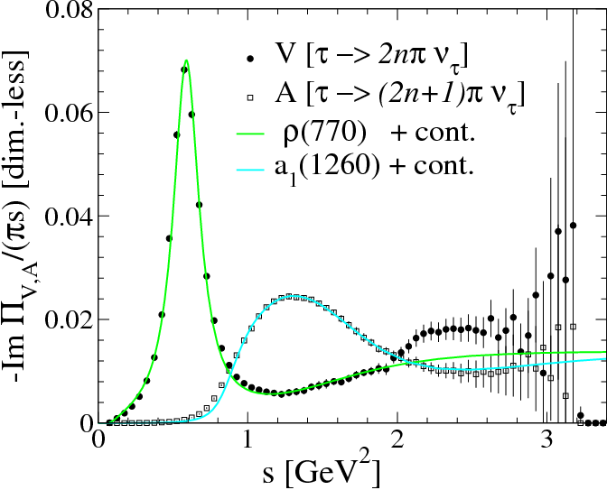
EM spectral function
Dilepton yield: space-time integral over thermal emission rate:
V and A spectral function in vacuum:
chiral symmetry breaking
Spectral functions change in medium:
key to chiral symmetry restoration
  The messenger: ρ-meson modification
  cτ_{ρ} = 1.3 fm
ALEPH, EPJ C4 (1998) 409

Slide 8
Chiral symmetry restoration
CSR ←→ vector-axialvector degeneracy (ρ-a₁)
  Axial-vector experimentally inaccessible (a₁→πγ)
Vector spectral function in medium exhibits ρ – melting
Towards CSR: connection to axial vector requires constraints from theory (LQCD, sum rules)
→ Possible at μ_{B}=0
P. Hohler, R. Rapp, Phys. Lett. B731 (2014) 103

Slide 9
SPS – ρ-melting
Dielectron yield in A-A shows significant low-mass excess over hadronic decays
CERES, PLB 666 (2008) 425
CERES
0-7% Pb-Au √s_{NN}=17.6 GeV

Slide 10
SPS – ρ-melting
Dielectron yield in A-A shows significant low-mass excess over hadronic decays
Excess is compatible with strong in-medium modifications of the ρ-meson, well described by hadronic many-body theory
CERES, PLB 666 (2008) 425
CERES
0-7% Pb-Au √s_{NN}=17.6 GeV
CERES
0-7% Pb-Au √s_{NN}=17.6 GeV

Slide 11
SPS – ρ-melting
Dielectron yield in A-A shows significant low-mass excess over hadronic decays
Excess is compatible with strong in-medium modifications of the ρ-meson, well described by hadronic many-body theory
Confirmed by high-precision dimuon data – ρ-melting established
CERES, PLB 666 (2008) 425
NA60, EPJ C61 (2009) 711
CERES
0-7% Pb-Au √s_{NN}=17.6 GeV
CERES
0-7% Pb-Au √s_{NN}=17.6 GeV

Slide 12
Early temperature
In the Intermediate Mass Range (IMR, 1.1 < m_{ee} < 3 GeV/c²):
- thermal radiation from QGP
  - structureless („dual“) spectral function allows most direct temperature determination from exponential in m_{ee,} no blue shift
  complicated by large physical background from charm

Slide 13
NA60 – QGP radiation
NA60 EPJ C59 (2009) 607
Thermal radiation in the IMR discovered by NA60
Experimental separation from charm using silicon vertex trackers
Rapp, v.Hees PLB 753 (2016) 586
Exponential fit yields
  T=205±12 MeV, i.e. > T_{c} (no blue shift!)
Thermal radiation dominated by QGP
Consistent with initial temperature
T_{i}=235 MeV

Slide 14
Hadronic radiation - HADES
Large enhancement in Au-Au at √s_{NN} = 2.42 GeV
Excess compatible with hadronic thermal radiation and a strong medium modification of the ρ
Exponential fit yields T = 71.8 ± 2 MeV
HADES Nature Phys. 15 (2019) 1040

Slide 15
Excitation function
Large enhancement in Au-Au at √s_{NN} = 2.42 GeV
Excess compatible with hadronic thermal radiation and a strong medium modification of the ρ
Exponential fit yields T = 71.8 ± 2 MeV
Energy dependence of temperature measurement may reveal
a plateau in the caloric curve, suggesting 1st order phase transition
Systematic beam energy scan is important
Rapp, v.Hees PLB 753 (2016) 586
HADES Nature Phys. 15 (2019) 1040
NA60 EPJ C59 (2009) 607
HADES Nature Phys. 15 (2019) 1040

Slide 16
RHIC Beam Energy Scan (BES)
STAR arXiv:1810.10159
STAR arXiv:1810.10159
STAR measures Au-Au in fixed-target and collider mode in 3.5 < √s_{NN} < 200 GeV
Results from BES1 available
BES2 ongoing

Slide 17
Mapping the QCD phase diagram with dileptons
T. Galatyuk, Quark Matter 2018
Detailed mapping of the QCD phase diagram with dileptons expected in this decade

Slide 18
Mapping the QCD phase diagram with dileptons
T. Galatyuk, Quark Matter 2018
Detailed mapping of the QCD phase diagram with dileptons expected in this decade
What happens at the energy frontier?

Slide 19
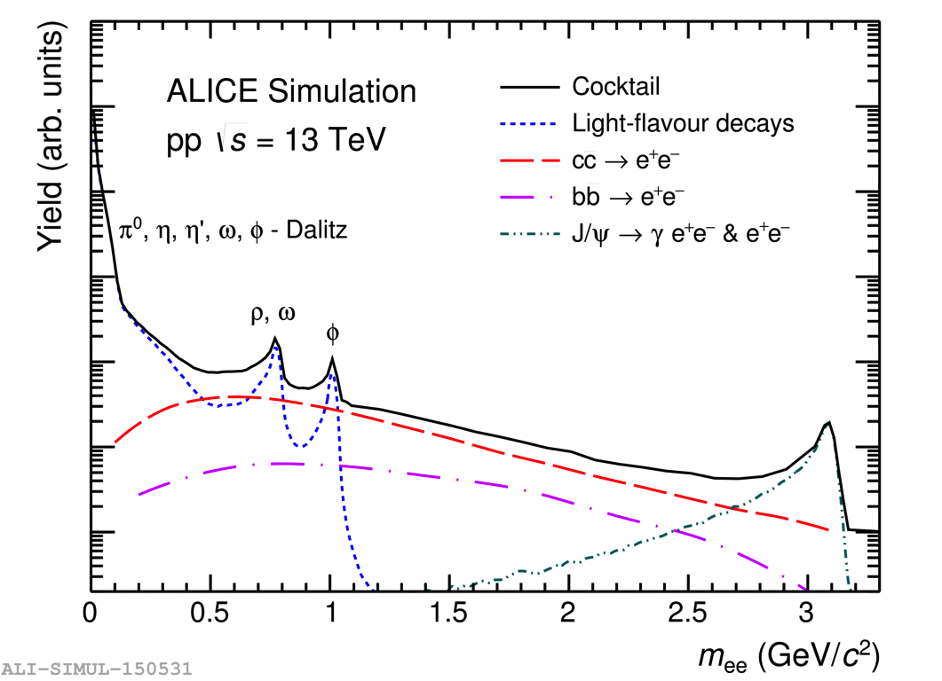
Dielectrons at the LHC
Pb-Pb at the LHC is the largest, hottest and longest-lived system
μ_{B} = 0 provides most direct link of data to first-principle QCD
Experimental challenges:
Large combinatorial and physical backgrounds
-
cc
-
bb

Slide 20
The boone and bain of heavy quarks
HF production dominates the dielectron spectrum at the LHC over a wide range in mass
(Soft) HF cross sections not very precisely measured
Requires carefuly study of pp and p-Pb and Pb-Pb at the same √s_{NN}
Additional experimental means are needed to separate HF dielectrons from prompt sources
Dielectrons turn into a complementary probe to study HF physics at the LHC
-
cc
-
bb

Slide 21
Dielectrons from charm and beauty
D
PYTHIA
_
ν_{e}
K⁺
B
e⁻
_
D⁰
_
c c
D ← B
e⁺
D⁰
p_{T,e} > 0
p_{T,e} > 0.2 GeV/c
K⁻
ν_{e}
1
0.9
0.8
0.7
Typical single-electron low-p_{T,e} cut preserves most of the heavy-flavour cross-section at mid-rapidity
p_{T,e}>0.2/p_{T,e}>0
0 1 2 3 4 5 6 7 8 9 10
p_{T} (GeV/c)

Slide 22
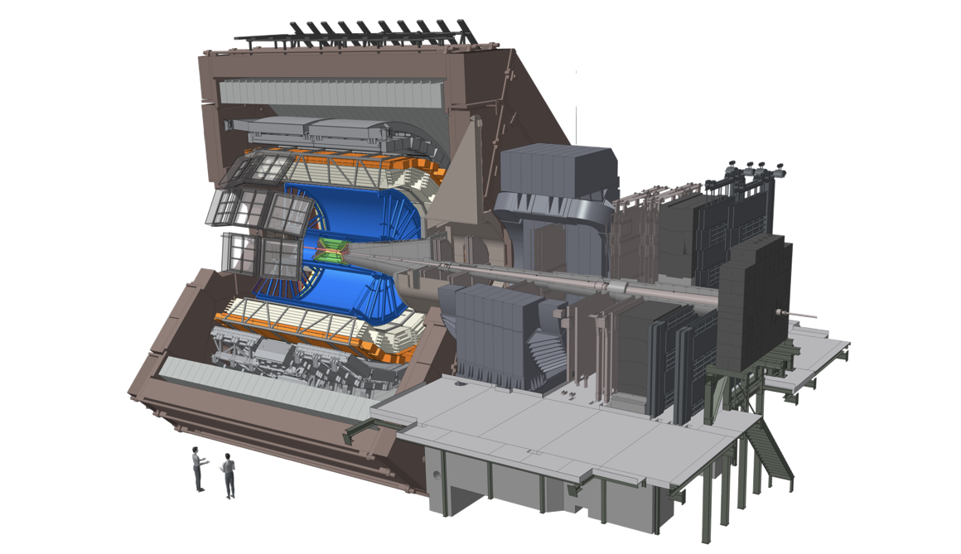
ALICE at the LHC
Time of Flight
Time Projection Chamber
Inner Tracking System
Since 2009 (LHC Run 1 and 2):
Pb-Pb at 2.76 and 5.02 TeV
p-Pb at 5.02 and 8 TeV
pp at 0.9, 2.36, 2.76,
5.02, 7, 8, 13 TeV
Xe-Xe at 5.44 TeV

Slide 23
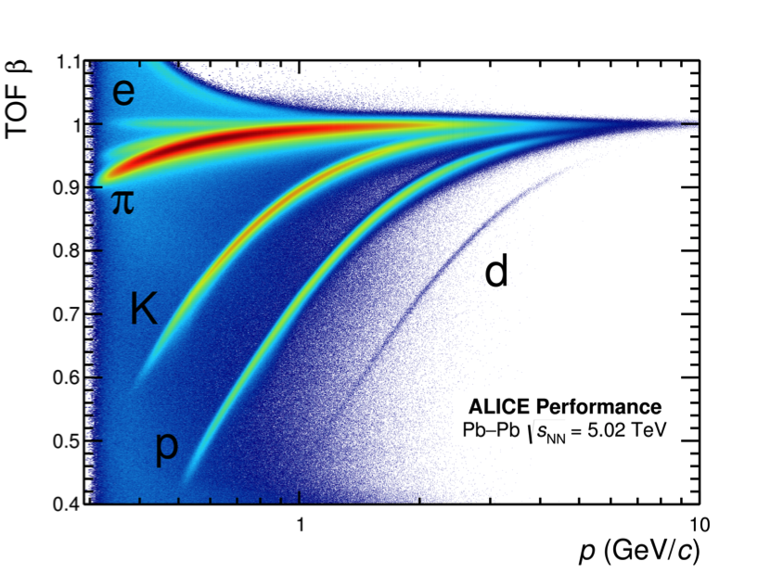
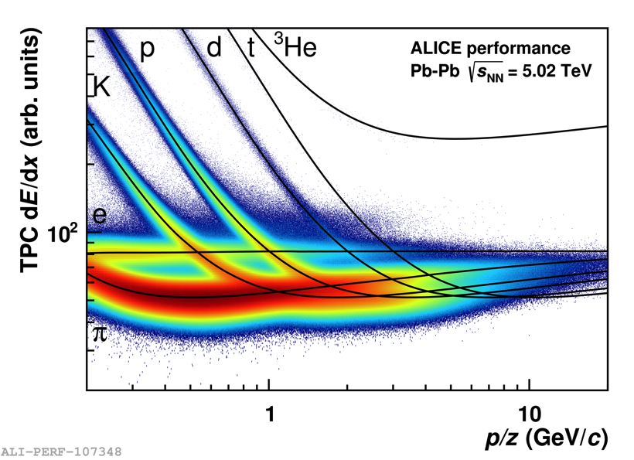
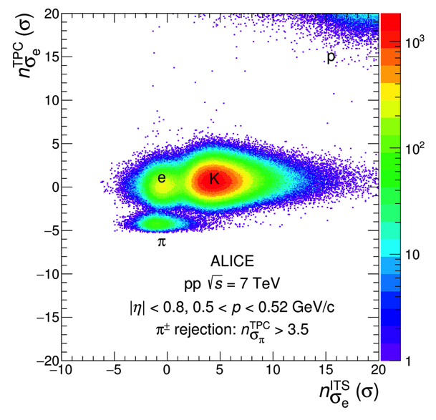
Electron reconstruction with ALICE
TPC
TOF
ITS
JHEP 1809 (2018) 064
Excellent electron ID at low p_{T}
Unique at the LHC

Slide 24
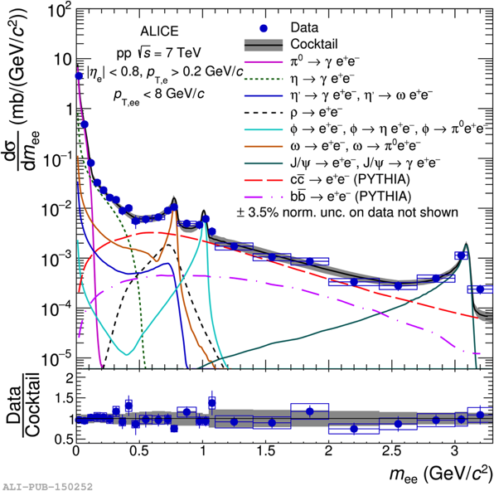
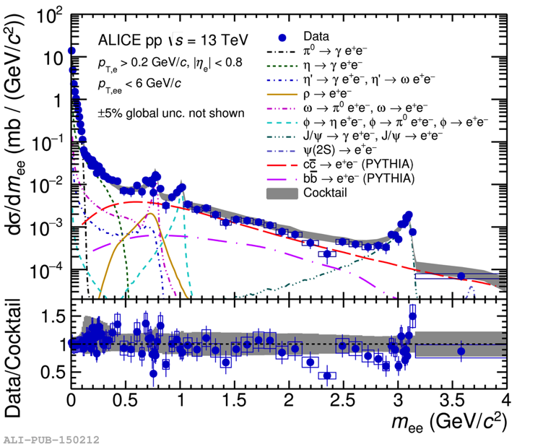
Vacuum reference – pp
S. Scheid (ALICE) QM2019
ALICE, JHEP 1809 (2018) 064
ALICE, PLB 788 (2019) 505
Dielectron production (p_{T,e} > 0.2 GeV/c) in minimum bias pp is well described by hadron decays
Important baseline for Pb-Pb
Dominant contribution (m_{ee} > 0.5 GeV/c) is from heavy-flavor decays

Slide 25
Heavy-flavour cross sections in pp
S. Scheid (ALICE) QM2019
Charm and beauty cross sections can be extracted from a template fit to data

Slide 26
Heavy-flavour cross sections in pp
S. Scheid (ALICE) QM2019
PYTHIA and POWHEG give systematically different results
→ access to different production mechanisms
Compatible with FONLL calculations

Slide 27
Nuclear initial state – p-Pb
S. Scheid (ALICE) QM2019
Study possible nuclear effects, i.e. shadowing, on heavy-flavour production
HF cocktail: cross section from pp, scaled by N_{coll}
Good agreement between data and cocktail within uncertainties
→ no sizeable initial-state effects

Slide 28
R_{pPb}
S. Scheid (ALICE) QM2019
Direct comparison of pp and p-Pb diminishes cocktail uncertainty
Scaling with <N_{coll}> in the IMR
At low mass, light hadrons dominate (no <N_{coll}> scaling)
Compatible with R_{pPb} of cocktails
(with charm from PYTHIA)

Slide 29
R_{pPb}
ALICE arXiv:1910.14399
S. Scheid (ALICE) QM2019
Direct comparison of pp and p-Pb
diminishes cocktail uncertainty
Scaling with <N_{coll}> in the IMR
At low mass, light hadrons
dominate (no <N_{coll}> scaling)
Compatible with R_{pPb} of cocktails
Compatible with R_{pPb} of single electrons from heavy flavours
(with charm from PYTHIA)

Slide 30
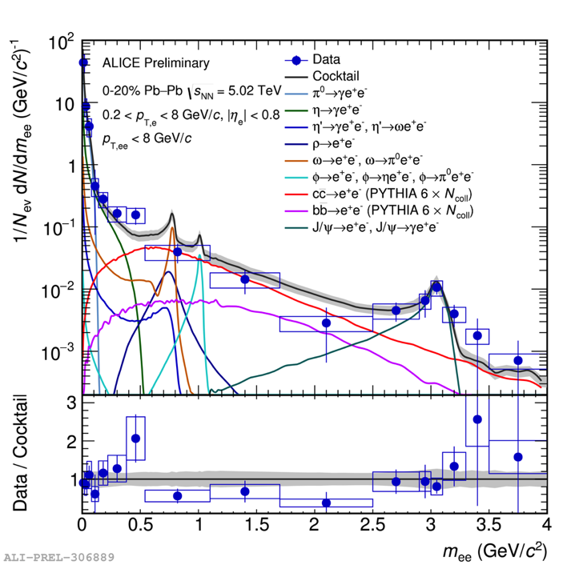
Pb-Pb from 2015
Indication for low-mass enhancement around 0.5 GeV/c
Consistent with hadronic many-body model and strong ρ-modification

Slide 31
Pb-Pb from 2015
Indication for low-mass enhancement around 0.5 GeV/c
Consistent with hadronic many-body model and strong ρ-modification
R_{AA} reveals suppression in the IMR
S. Scheid (ALICE) QM2019
(with charm from PYTHIA)

Slide 32
Pb-Pb from 2015
Indication for low-mass enhancement around 0.5 GeV/c
Consistent with hadronic many-body model and strong ρ-modification
R_{AA} reveals suppression in the IMR
Reason presumably final-state suppression of heavy flavors (aka HF jet quenching)
Possible thermal radiation in the IMR requires more statistics and new experimental methods
ALICE, arXiv:1910.09110
S. Scheid (ALICE) QM2019
(with charm from PYTHIA)

Slide 33
Topological separation of dielectron sources
_
ν_{e}
K⁺
e⁻
_
D⁰
_
c c
e⁺
D⁰
K⁻
ν_{e}

Slide 34
Topological separation of dielectron sources
ALICE, JHEP 1809 (2018) 064
_
ν_{e}
K⁺
e⁻
_
D⁰
_
c c
e⁺
D⁰
DCA
NA60
Eur.Phys.J. C59 (2009)
K⁻
ν_{e}
DCA_{ee} allows to separate prompt from delayed dielectron sources:
DCA_{ee}(prompt) < DCA_{ee}(charm) < DCA_{ee}(beauty)

Slide 35
Topological separation of dielectron sources
η,ρ,ω,ϕ mass region
ALICE, JHEP 1809 (2018) 064
J/ψ mass region
DCA_{ee} allows to separate prompt from delayed dielectron sources:
DCA_{ee}(prompt) < DCA_{ee}(charm) < DCA_{ee}(beauty)

Slide 36
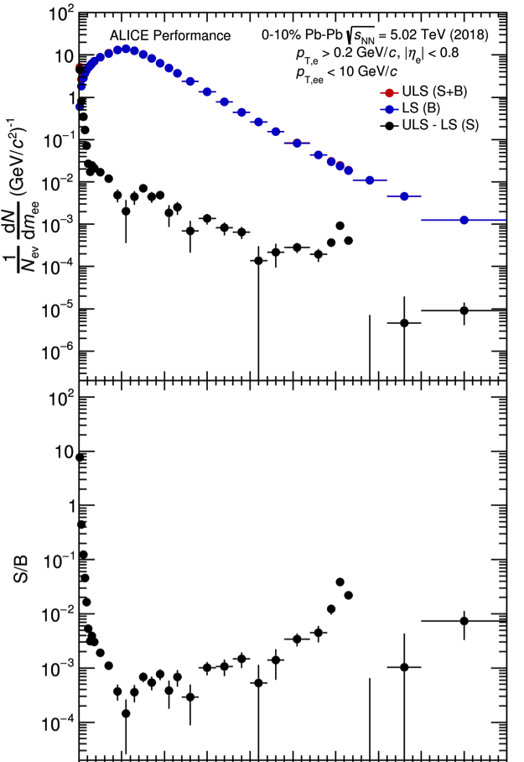

Pb-Pb in 2018
D. Sekihata (ALICE) QM2019
Pb-Pb run in November 2018 –
6-7 times more statistics in central collisions

Slide 37
Heavy ions at the LHC in Run 3 and 4
Run 2: L_{Pb-Pb} = 1.0 nb⁻¹
Run 3: L_{Pb-Pb} = 6.0 nb⁻¹
Run 4: L_{Pb-Pb} = 7.0 nb⁻¹
ALICE strategy for Run 3 + 4:
50 kHz Pb-Pb interaction rate (now <10 kHz)
Experiment upgrades (LS2)
Collect L_{Pb-Pb} = 13 nb⁻¹ (3 nb⁻¹ at B = 0.2 T)
ALICE physics goals
Heavy-flavour mesons and baryons (down to very low p_{T}) → mechanism of quark-medium interaction and hadronization of heavy quarks
Charmonium states → dissociation/regeneration as tool to study de-confinement and medium temperature
Di-leptons from QGP radiation and low-mass vector mesons → χ symmetry restoration, initial temperature and EOS
High-precision measurement of light and hyper-nuclei → production mechanism and degree of collectivity
→ Need MB readout at highest possible rate no dedicated trigger possible

Slide 38
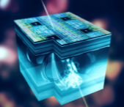
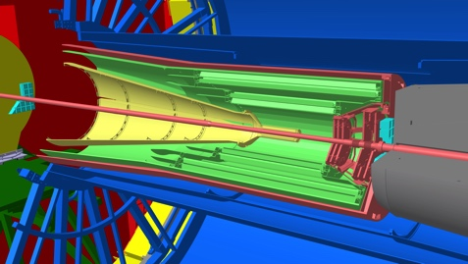
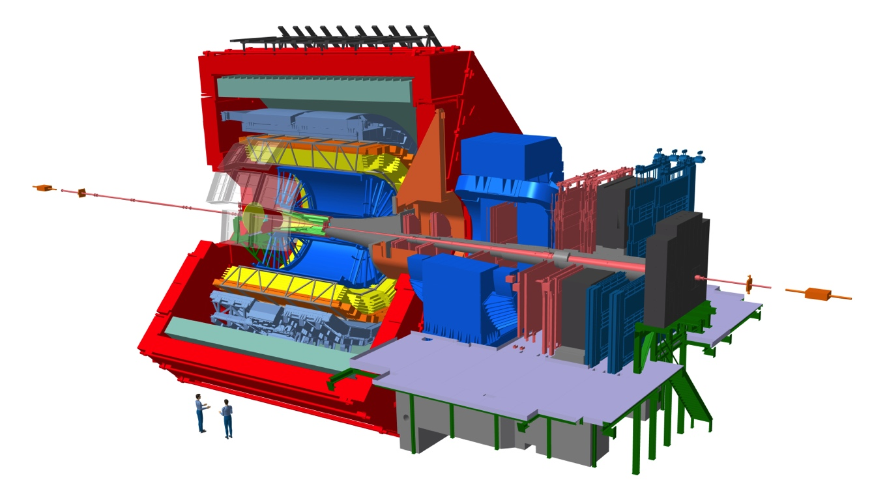
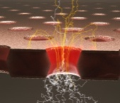

ALICE in Run 3 and 4
New Inner Tracking System (ITS)
Complementary Metal-Oxide-Semiconductor (CMOS) Monolithic Active Pixel Sensor (MAPS) technology
Improved resolution, less material, faster readout
New Muon Forward Tracker (MFT)
CMOS Pixels, MAPS technology
Vertex tracker at forward rapidity
New TPC Readout System
ROCs with Gas Electron Multiplier (GEM) technology
New electronics (SAMPA), continuous readout
New Fast Interaction Trigger (FIT) Detector
Centrality, event plane
FoCal proposal (Run 4)
Measure forward direct photons
Readout upgrade
TOF, TRD, MUON, ZDC, Calorimeters
Integrated Online-Offline system (O²)
Record MB Pb-Pb data at 50 kHz

Slide 39
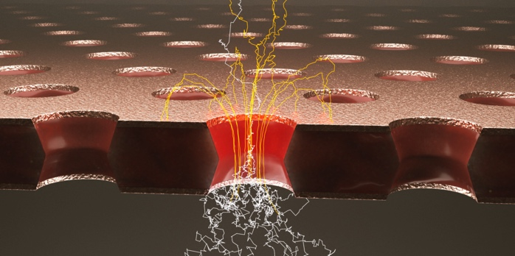
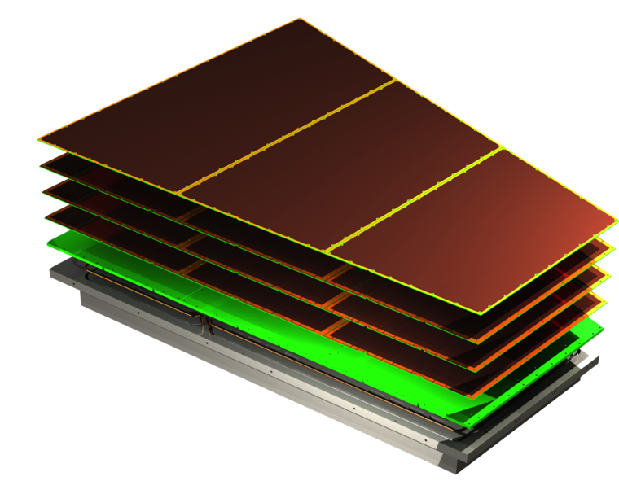
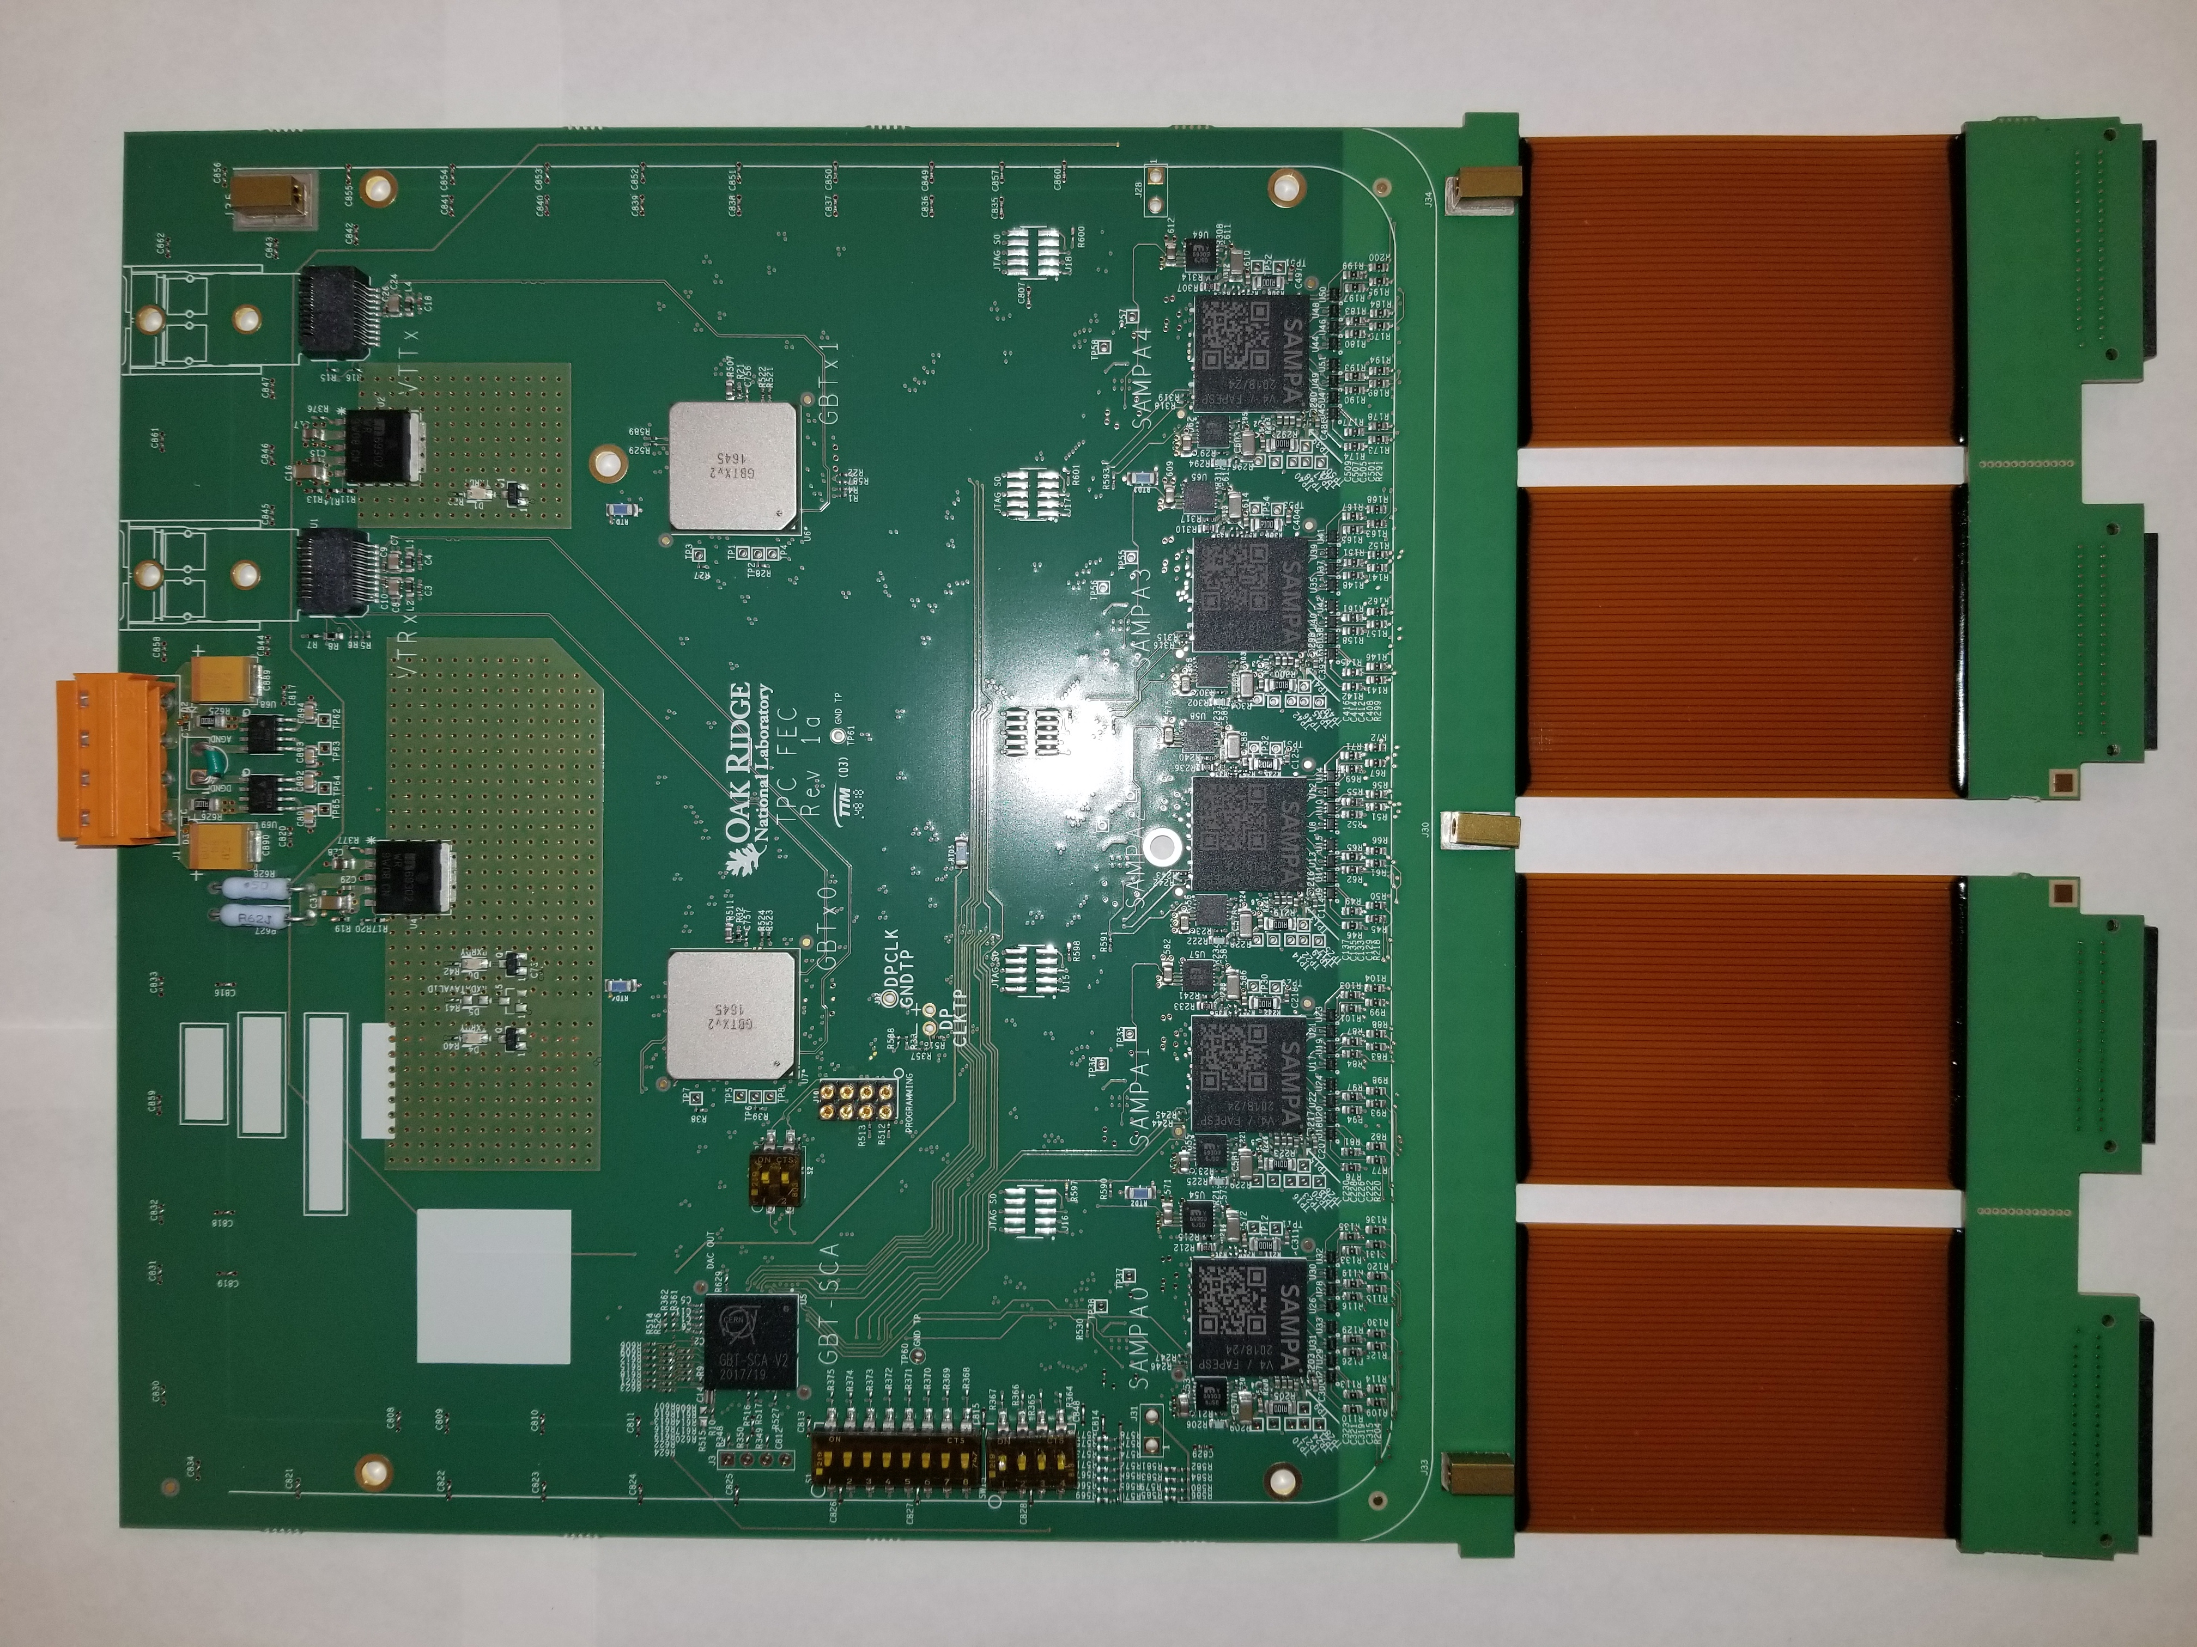

ALICE TPC Upgrade
TPC Upgrade requirements
Continuous readout at 50 kHz in Pb-Pb (was 0.5-1 kHz)
Unprecedented challenges in terms of loads and performance
new Readout Chambers with GEMs
new Frontend Electronics

Slide 40
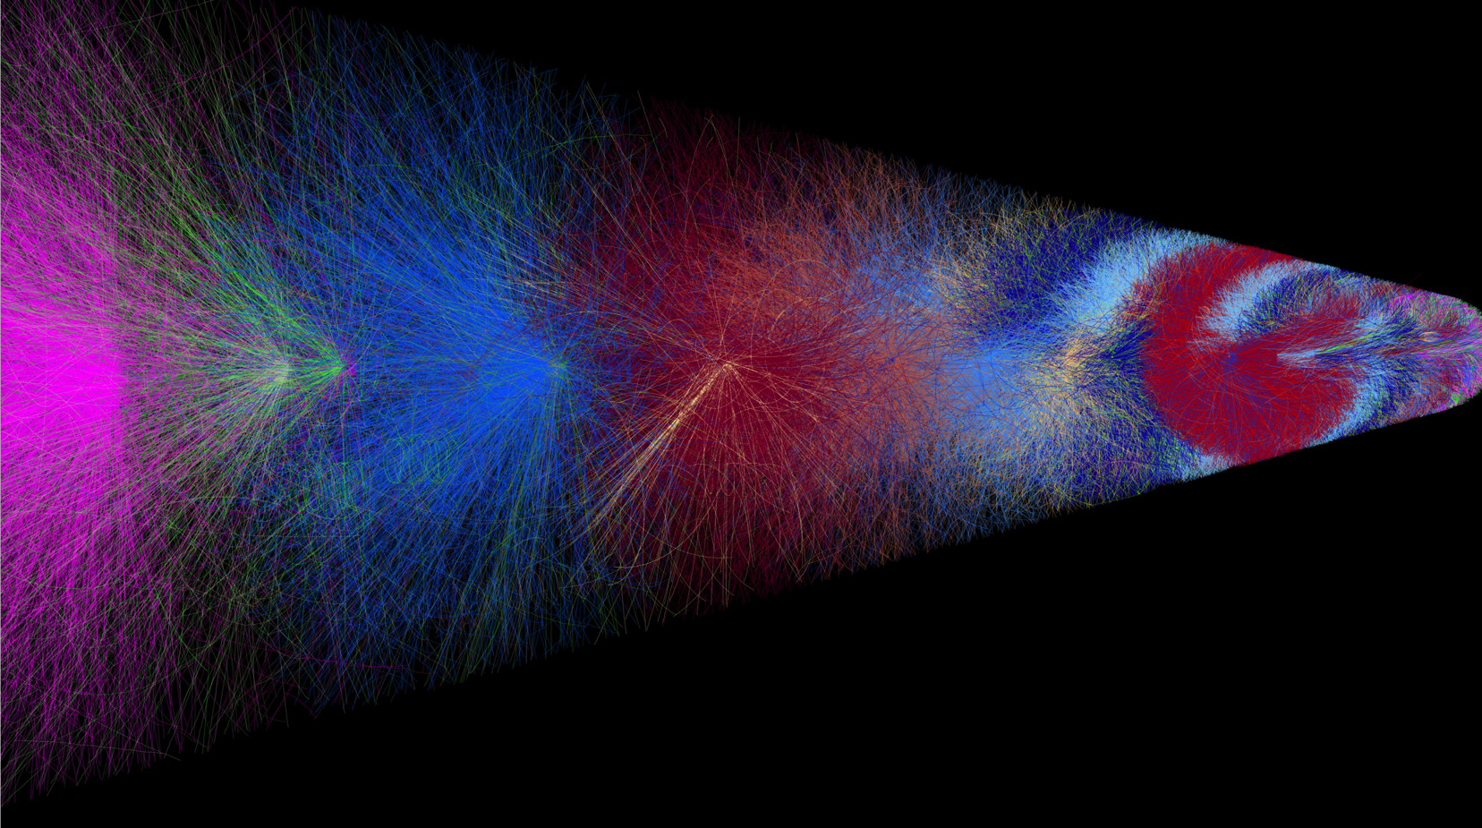

TPC operation at 50 kHz

Slide 41
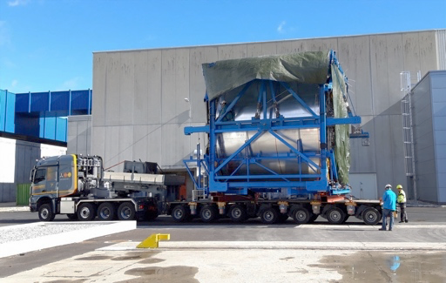
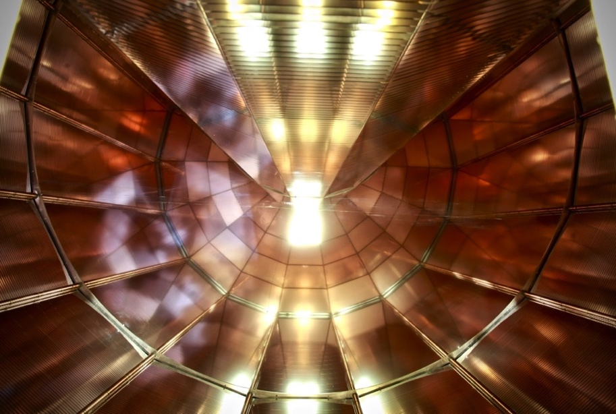
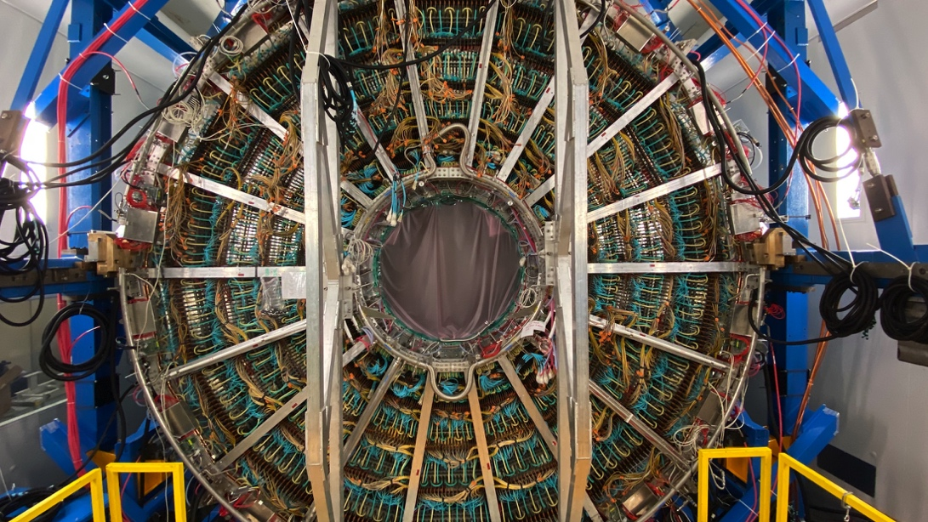
ALICE TPC upgrade
MWPC-based readout chambers replaced by GEM detectors
New Front-End Electronics and services installed

Slide 42
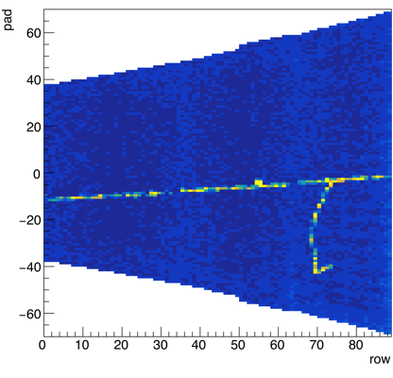
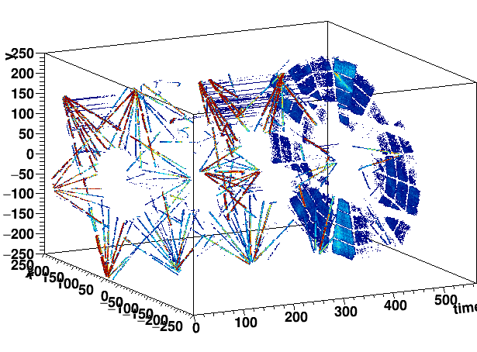
ALICE TPC pre-commissioning
TPC pre-commissioning ongoing
Full functionality validated with laser and cosmic tracks

Slide 43
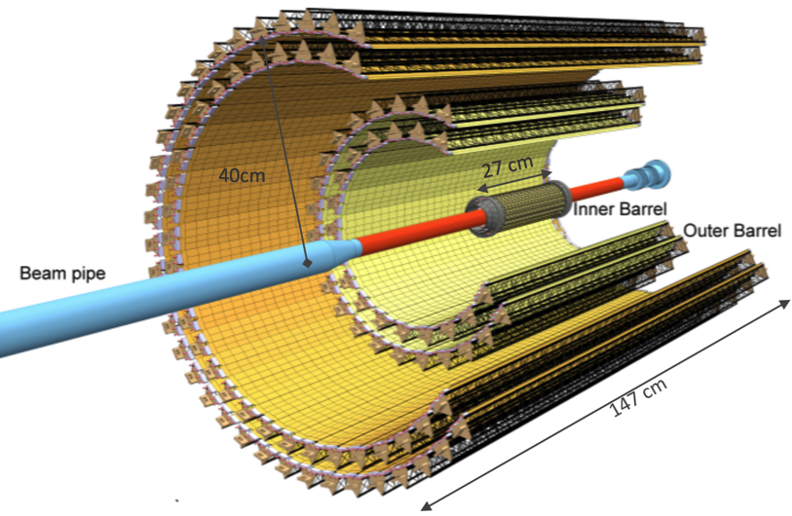
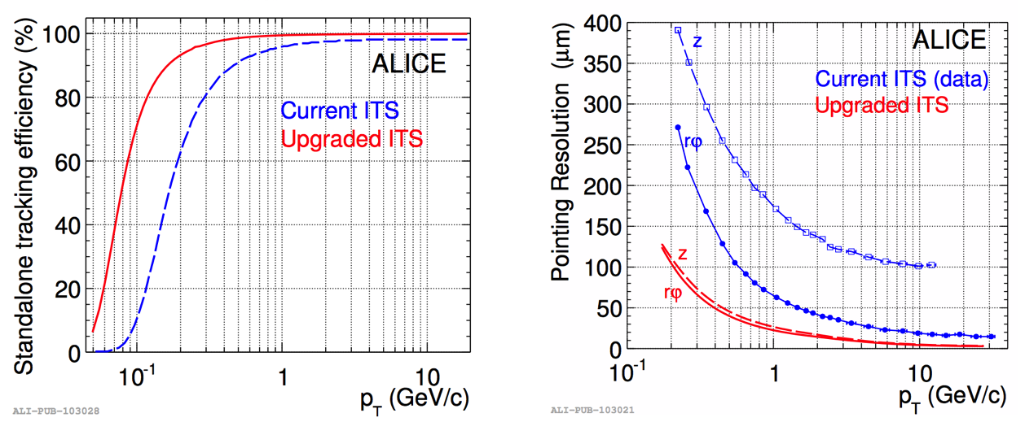
New ITS
10 m² active silicon area, 12.5×10⁹ pixels
Closer to IP: 39 mm ⟶ 22 mm
Thinner (X₀ for innermost layers): ~1.14 % ⟶ ~0.30 %
Smaller pixels: 50 × 425 μm² ⟶ 27 × 29 μm²
Granularity: 20 ch/cm³ ⟶ 2000 pixels/cm³
Readout rate: 1 kHz ⟶ 100 kHz
New-ITS performance
Improved tracking efficiency
Improved tracking resolution
Pointing resolution ×3 better in transverse plane (×6 along beam) → significant improvement in DCA_{ee}

Slide 44
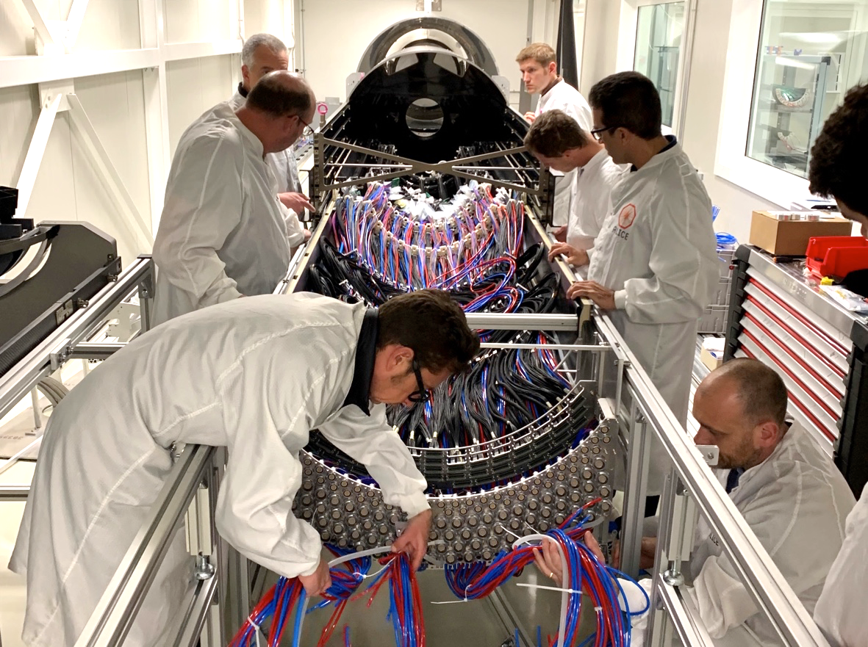
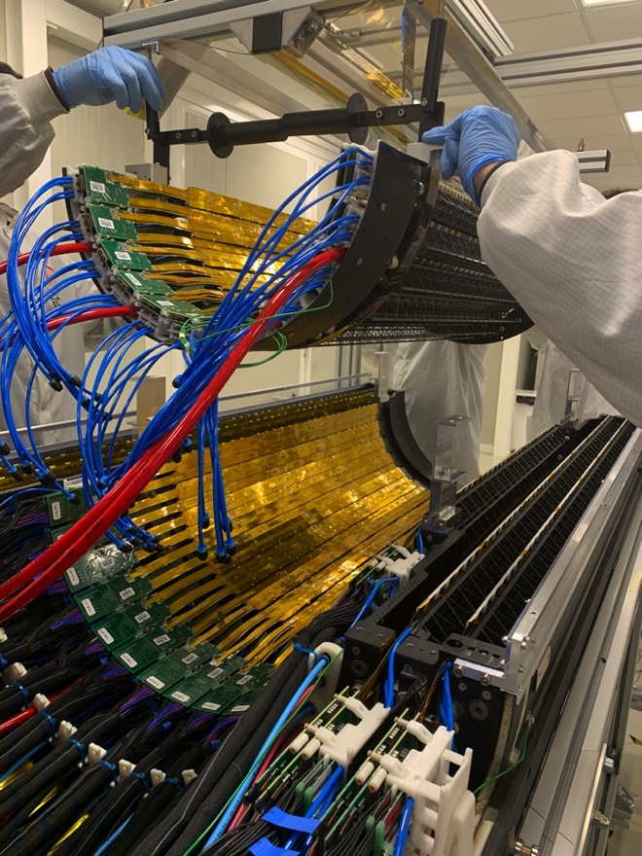
ITS installation

Slide 45
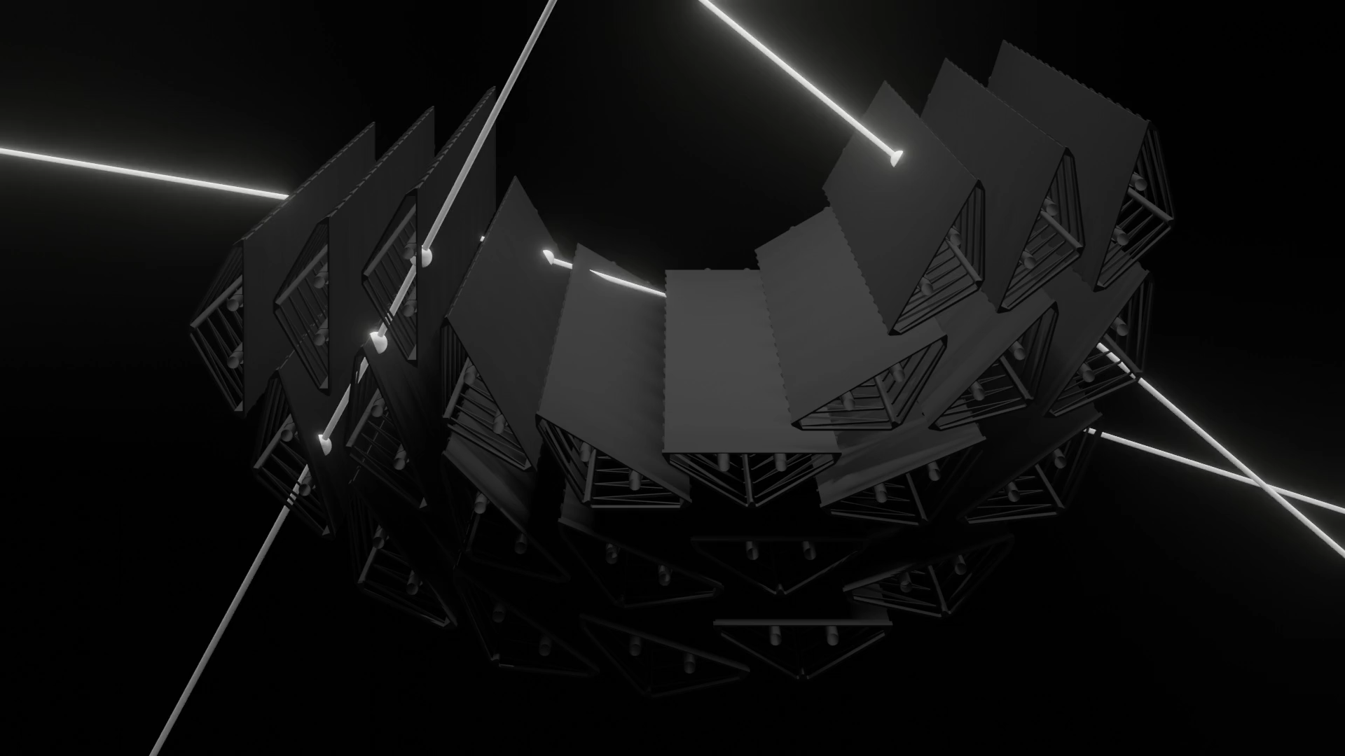
ITS pre-commissioning

Slide 46
Low-mass dielectrons in Run 3 and 4
Pb-Pb running in Run 3 and Run 4:
10 nb⁻¹ (80 B minimum bias collisions) at B = 0.5 T
3 nb⁻¹ (25 B minimum bias collisions) at B = 0.2 T
dedicated for low-mass dielectron studies
  Electron tracking and PID down to 75 MeV/c
  → Improve signal efficiency and background rejection
→ increase acceptance to low m_{ee} and p_{T,ee}
  Separation of prompt dielectrons from charm and beauty with new ITS

Slide 47
Dielectron mass spectrum in Run 3
Z. Citron et al., CERN Yellow Rep. Monogr. (2019) 1159
3 nb⁻¹ at low B
0-10%
3 nb⁻¹ at low B
0-10%

Slide 48
pp at 13 TeV with low B-field

Slide 49
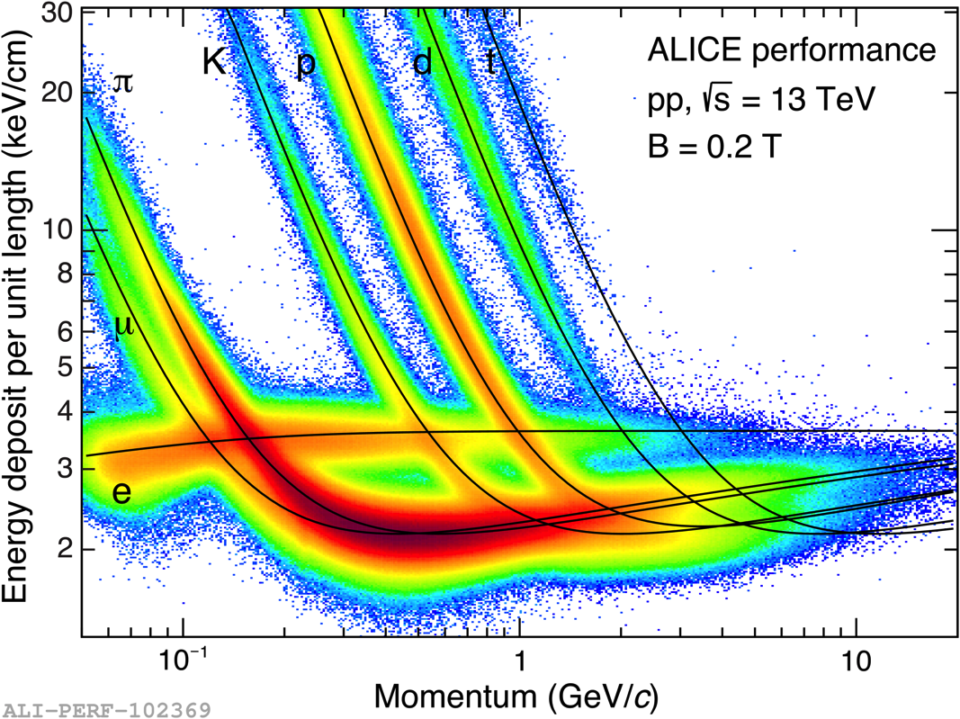
pp at 13 TeV with low B-field
Dedicated campaigns in Run2 with reduced solenoid field (0.5 T → 0.2 T)
Test case for Run3
Significantly improved acceptance for low p_{T} electrons

Slide 50
pp at 13 TeV with low B-field
Dedicated campaigns in Run2 with reduced solenoid field (0.5 T → 0.2 T)
Test case for Run3
Significantly improved acceptance for low p_{T} electrons
Allows dedicated studies of very soft dileptons at low mass in pp
Lowering p_{T,e} cutoff from 0.2 to 0.75 GeV/c extends pair acceptance to p_{T,ee} = 0 for m_{ee} > m_{π}

Slide 51
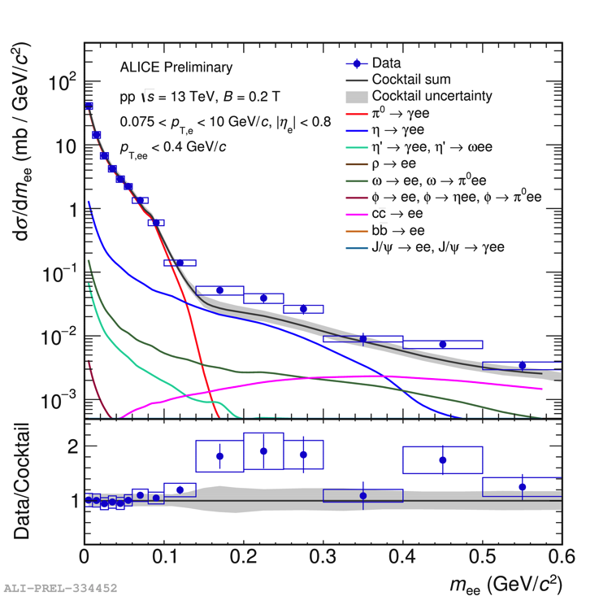
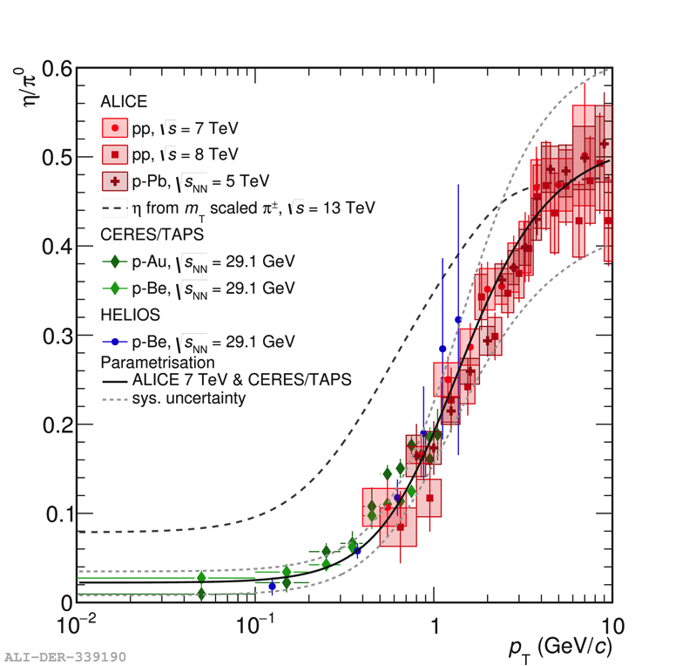
pp at 13 TeV with low B-field
Dielectron enhancement observed in m_{π} < m_{ee} < 0.5 GeV/c²
S. Scheid (ALICE) QM2019

Slide 52

pp at 13 TeV with low B-field
Dielectron enhancement observed in m_{π} < m_{ee} < 0.5 GeV/c²
Not seen in previous analysis at full field
ALICE, Phys.Lett. B788 (2019) 505

Slide 53
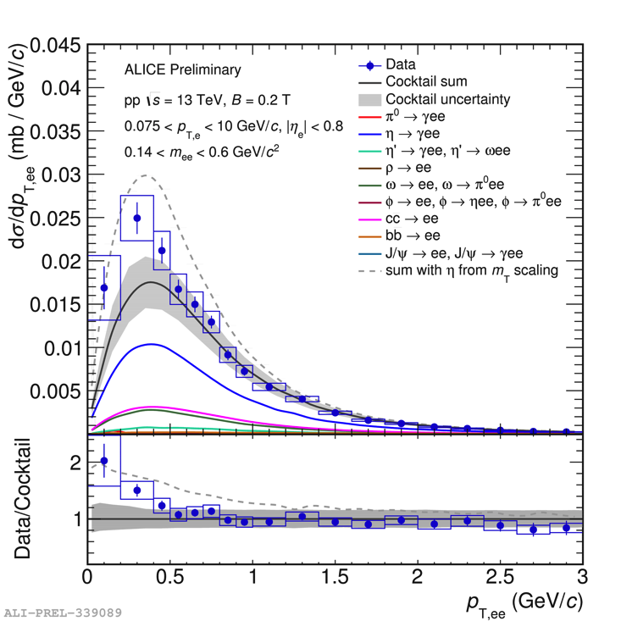
pp at 13 TeV with low B-field
Dielectron enhancement observed in m_{π} < m_{ee} < 0.5 GeV/c²
Not seen in previous analysis at full field
Enhancement is very soft
Reminiscent of Soft Photon Puzzle
S. Scheid (ALICE) QM2019

Slide 54
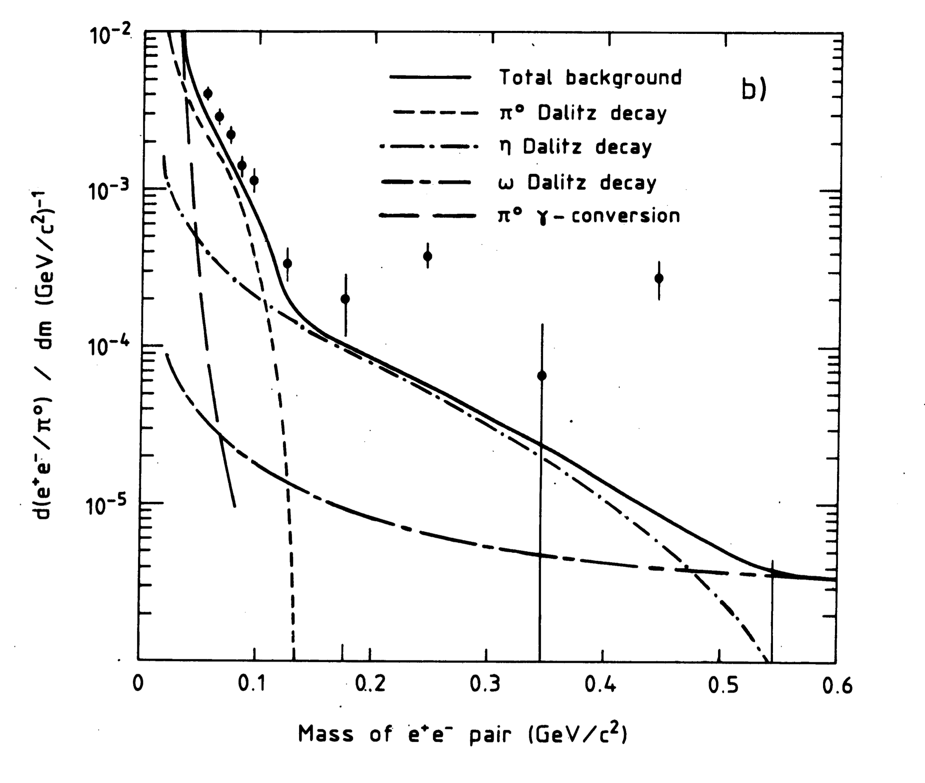
Soft photon puzzle
A. Belogianni et al., PLB 548 (2002) 129
1980s: excess of low p_{T} photons and dileptons observed in hadronic collisions
Not explained by conventional Bremsstrahlung
Possible explanations:
Cold Quark-Gluon Plasma
Pion Liquid
Quark Synchrotron Radiation
Soft parton annihilation
...new ALICE data will shed light on long-standing mystery
AFS Experiment at ISR
L. van Hove, Annals Phys. 192 (1989) 66
E. Shuryak, PLB231 (1989) 175
G.W. Botz, P. Haberl, O. Nachtmann, Z. Phys. C67 (1995) 143
V. Cerny, P. Lichard, J. Pisut, Z. Phys. C31 (1986) 163

Slide 55
Summary
Dileptons are tough, but unique to study many aspects of hot and dense matter in heavy-ion collisions
A large body of data exists
Complementary experimental campaigns ongoing or under preparation – a lot more to come in this decade
QGP studies with dileptons will have a bright future

Slide 56
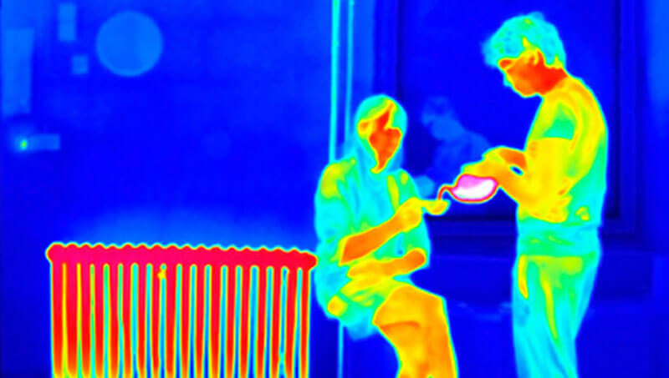
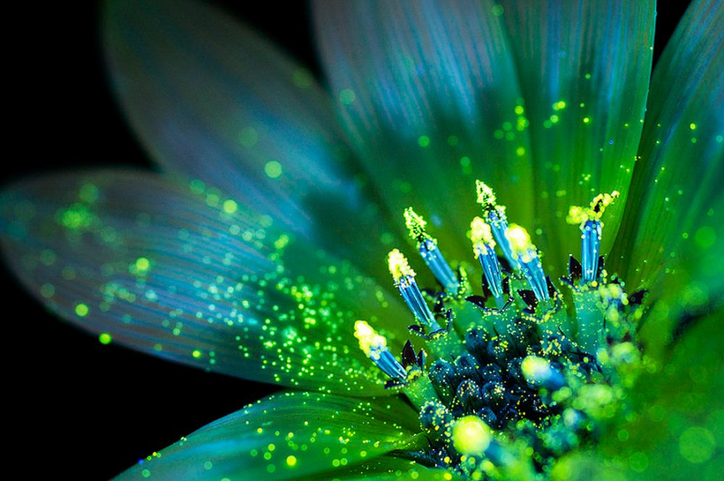
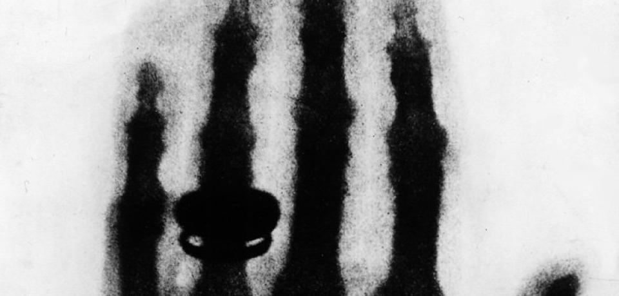
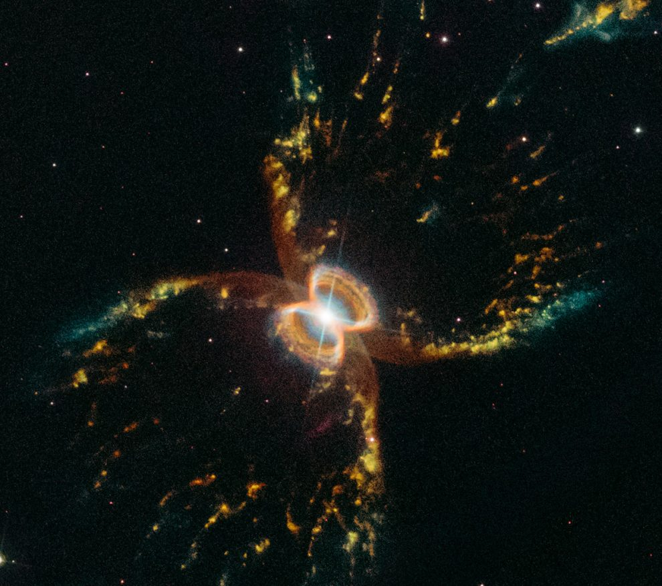
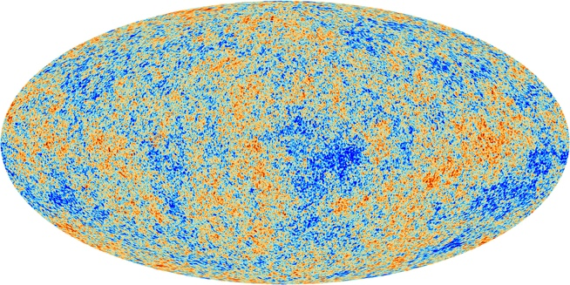

Slide 57
Backup

Slide 58
Quark-Gluon Plasma
Analysis of secondary hadrons reveals that they are produced in thermal equilibrium, i.e. their yields follow an exponential behaviour with mass
Statistical hadronization models allow extraction of freeze-out parameters
e.g. in Pb-Pb at √s_{NN} = 2.76 TeV:
T_{cf} = 156.5 ± 1.5 MeV, μ_{B} = 0.7 ± 3.8 MeV

Slide 59
Quark-Gluon Plasma
Statistical hadronization analyses of produced hadrons at different collision energies establishes a freeze-out curve in the QCD phase diagram
At small μ_{B} (i.e. high collision energies) the freeze-out temperature coincides with LQCD prediction

Slide 60
Quark-Gluon Plasma
Statistical hadronization analyses of produced hadrons at different collision energies establishes a freeze-out curve in the QCD phase diagram
At small μ_{B} (i.e. high collision energies) the freeze-out temperature coincides with LQCD prediction
The emerging picture:
A thermalized deconfined state of Quarks and Gluons with T>T_{c} is produced in HIC, the QGP. Pressure gradients drive expansion and cooling, until the critical temperature is reached and hadrons are formed, according to an equilibrium distribution. Yields of stable hadrons do not change at T<T_{c}, but further collectivity is built up, governed by hydrodynamics.

Slide 61
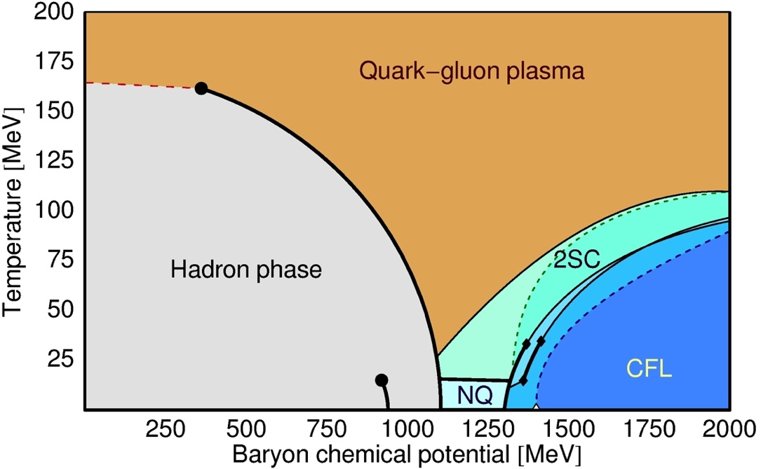
Quark-Gluon Plasma
Lattice QCD:
Matter exists in a phase of de-confined quarks and gluons, the QGP, at ε > 1 GeV/fm³
Transition temperature:
T_{c} = 155 ± 10 MeV at μ_{B} = 0
Filled the early universe in the first few μs after the Big Bang
QGP can be produced and studied in collisions of heavy-ions
QCD phase diagram can be scanned by variation of the collision energy

Slide 62
Chiral symmetry restoration
CSR ←→ vector-axialvector degeneracy
Vector spectral function in medium: ρ – melting → mechanism confirmed by NA60
Towards CSR:
  Axial-vector experimentally inaccessible
  Requires constraints from theory (LQCD, sum rules) → Possible at μ_{B}=0
  Requires experimental access to M_{ee}~p_{T,ee}-~T region
H. van Hees, R. Rapp, Nucl. Phys. A806 (2008)

Slide 63
Low mass: chiral symmetry restoration
LQCD: chiral transition region (T = 130-170 MeV) in confined phase
  observable via in-medium properties of hadrons, i.e. the ρ-meson:
  J^{P} = 1⁻, cτ = 1.3 fm
  thermal radiation in the low mass region (m_{ee} < 1 GeV/c²)
J. Borsanyi et al.,
JHEP 1009 (2010)

Slide 64
Excess mass spectrum and QGP temperature
ALICE LoI J. Phys. G41 (2014)
excess spectrum
Fit to the IMR makes precise determination of T_{eff} possible
Fit to the IMR makes precise determination of T_{eff} possible

Slide 65
Flow of QGP radiation
ALICE LoI J. Phys. G41 (2014)
3 nb⁻¹ at low B
40-60%
excess spectrum
Statistical precision of v₂ measurement: 0.01-0.02

Slide 66
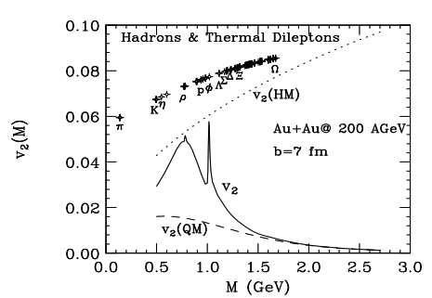
Space-time evolution
Transverse momentum spectra contain information on collective radial and elliptic flow (T_{eff} and v₂)
Mass dependence gives access to EoS of QGP
NA60, EPJ C61 (2009) 711
Chatterjee, Srivastava, Heinz, Gale PRC 2008

