Slide 1




Exploring towards the neutron-rich limit of nuclei, and beyond
Takashi Nakamura
Tokyo Institute of Technology
57th International Winter Meeting on Nuclear Physics
21-25, Jan. 2018, Bormio, Italy

Slide 2
Contents
Introduction
– Clustering and Hierarchical Structure
Towards the neutron drip line
Dineutron/Multi-neutron clusters in neutron-rich nuclei
  Spectroscopy of Super-heavy Boron isotopes
  Spectroscopy of Super-heavy Oxygen isotopes
RIB Facilities in the Near Future
Summary and Outlook

Slide 3
Existence of human beings depends
on a subtle balance of Nature
Triple α Reaction
Detour for the synthesis of element ¹²C
(C was not produced in the Big Bang due to the A=5,8 gaps)
E
285keV
Hoyle state
93keV
0⁺
α
⁸Be
⁸Be+α
7.65MeV
α
α
α＋α
γ
1x10⁻¹⁶s
Semi-stable
2⁺
7.37 MeV
γ
α
α
0⁺
¹²C

Slide 4
α-Cluster
K.Ikeda, N.Takigawa, H.Horiuchi,Prog.Theo.Phys.Suppl.464.(1968).
M.Freer, Rep. Prog. Phys. 70, 2149 (2007).
α
α
α
α
α
93keV
285keV
7.65MeV
α
3α
α+⁸Be
α
α
α
α
7.27MeV
Excitation Energy
¹²C_{gs}
¹²C
IKEDA Diagram
Near Threshold →Clustering
Mass Number (4A)

Slide 5

Clustering: Key to understand hierarchy in quantum world?
Systems with
EM interactions
＋
}
Nucleus
Electron
→Atom cluster→Molecule made of atom clusters
Molecule
＋
O
C
Charge=0
Systems with Strong interactions
ー
O
＋
Interatomic force <<
Nucleus-atom int.
n
p
Nucleus: ← nucleons
→Upper Hierarchy
Nucleus
p
p
e
e
n
n
Atom
e
p
¹²C
n
p
n
e
n
p
e
e
Nuclear force <<
Strong force by gluon
Nucleus
n
3 quraks
→Color charge=0
(Neutralization)
→Nucleon (Cluster)
p
p
p
n
n
p
n
p
n
Hadron
n
p
P
proton
Hadron
qq
meson
Quark
q
Quark
q
q
q
q
q
q
q

Slide 6




Semi-Hierarchy: Clustering and Hierarchy of Matter
Ex→Larger
Ex→Larger
A=const. N/Z→Larger
Quark
Hadron
Hadron
N/Z$≫∞$
0←Color Charge
0← S, T
0←S
E_{x}
E_{x}
E
Hoyle State
Neutron Halo
N+$\overline{K}$
Λ(1405)
α
α cluster
⁹Li+2n
n
Hadron Molecule
3α
n
N
α
α
N/Z>2
¹¹Li(3p+8n)
dineutron cluster
E_{x}
E_{x}
E
u
Λ
s
Nucleus
N/Z$\sim 1$
Nucleus
d
Hadron
¹²C(gs)
¹¹B(5p+6n)
Threshold: Clustering near Threshold → Semi-Hierarchy
Degree of Freedom：Neutralization of Charge, Spin(S), Isospin(T)

Slide 7
Towards the neutron drip line
-- Current Frontier --

Slide 8
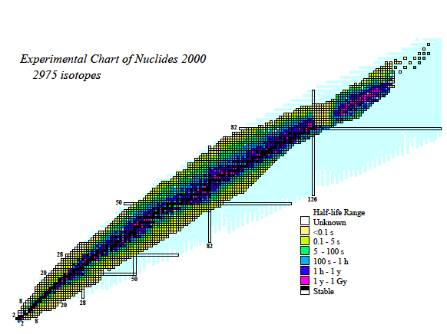
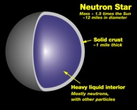
Towards the neutron-rich limit
Where is the boundary of existence of nuclei?
Nuclear Chart
How the nuclear properties (shell, collectivity) change?
New Phenomena due to weak binding, change of surface
Neutron Halo/Skin
Dineutron, Neutron droplet
Neutron Matter
Proton drip line
New Paradigm
82
Origin of matter
(Nuclear Astrophysics)
r-process
Proton Number Z
50
126
Unexplored : >6000 nuclides
Neutron drip line
82
28
20
50
8
28
2
20
2
8
n-star
Neutron Nubmer N

Slide 9
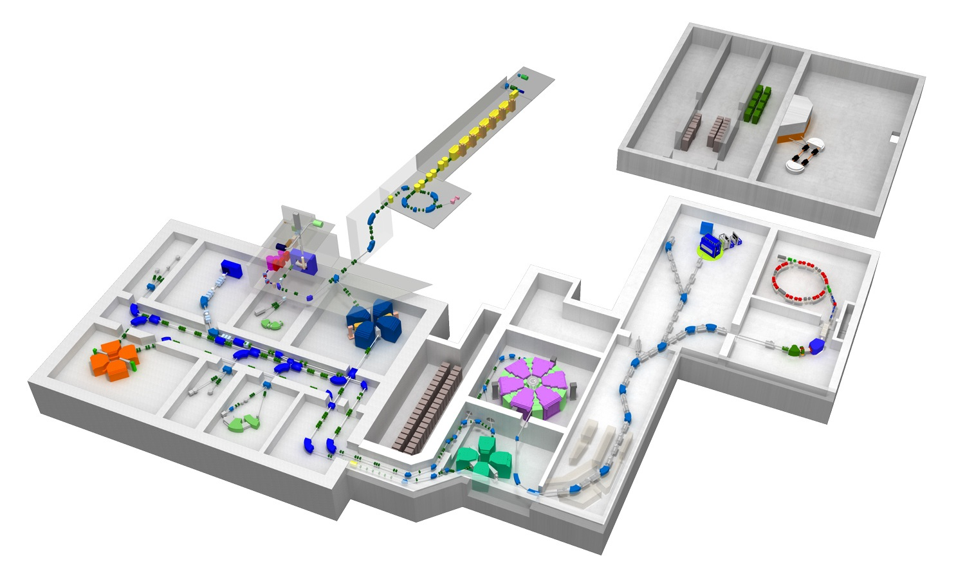
RI Beam Factory (RIBF) at RIKEN
The 3rd-generation RI-beam facility → High-intensity RI-beams
2007~
K.Morita et al.
ECR
Nh (Nihonium)
RILAC
113
CSM
GARIS &
GARIS2
SCRIT
RILAC2
SAMURAI
AVF
ZeroDegree
RIPS
Rare RI Ring
RRC
SRC
SLOWRI
SHARAQ
fRC
KISS
BigRIPS
In-Flight RI Separator
with large acceptance
IRC
Production of RI beams:
Fragmentation/ Inflight Fission
SRC: World Largest Cyclotron (K=2500 MeV)
High-Intense Heavy Ion Beams up to ²³⁸U at 345MeV/u
eg. ⁴⁸Ca: ~700pnA (~4x10¹²pps) ~10 times compared to 2008
²³⁸U: ~70pnA (~4x10¹¹ pps) ~10³ times compared to 2007

Slide 10
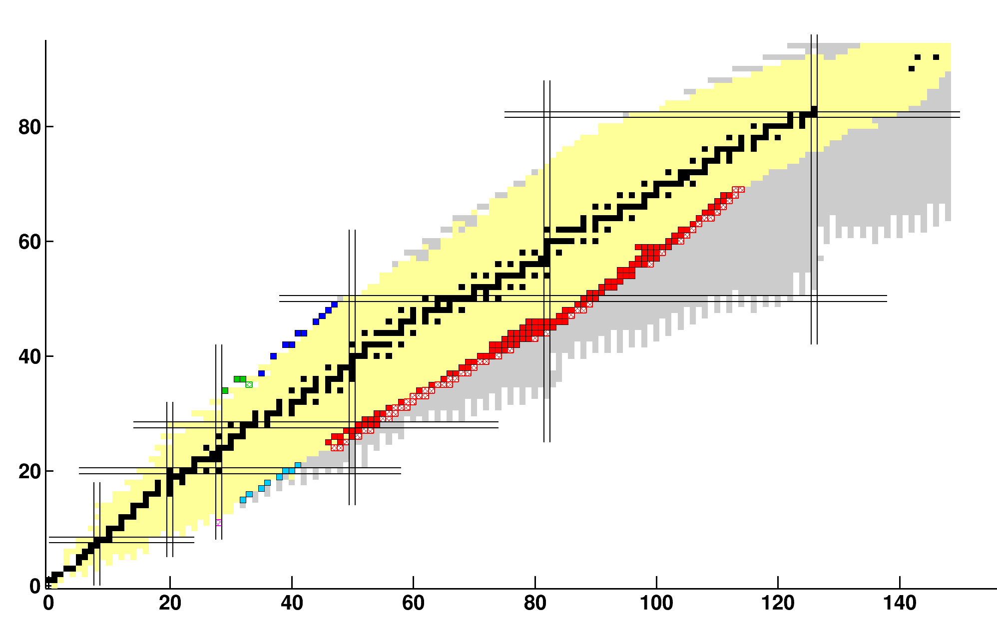
New Isotopes observed at RIBF (2007-2018)
As of July 2018
Slide By Naoki Fukuda
194 New isotopes: Observed
(140 New isotopes: Confirmed and Published)
140 new isotopes
140 new isotopes
Proton Number Z
Tarasov et al.
⁶⁰Ca
10 nuclides ¹²⁴Xe
3 nuclides
⁷⁸Kr
Proton number
119 nuclides
In-flight fission of ²³⁸U
Under confirmation
Under confirmation
8 nuclides
⁷⁰Zn
194 new isotopes in near future
(more 54 isotopes to be confirmed)
1 nuclide
⁴⁸Ca
Neutron Number N
O.B. Tarasov et al.,
Phys. Rev. Lett. 121, 022501 (2018).
Neutron number

Slide 11
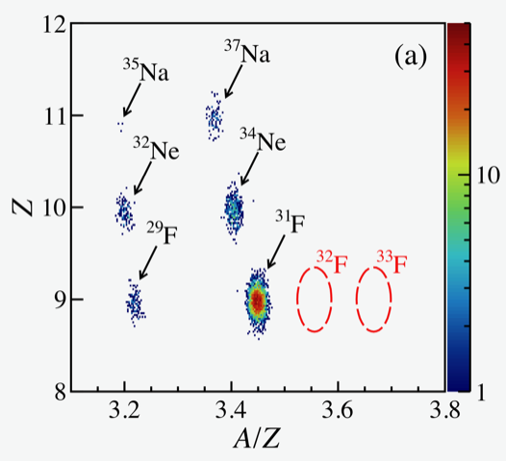
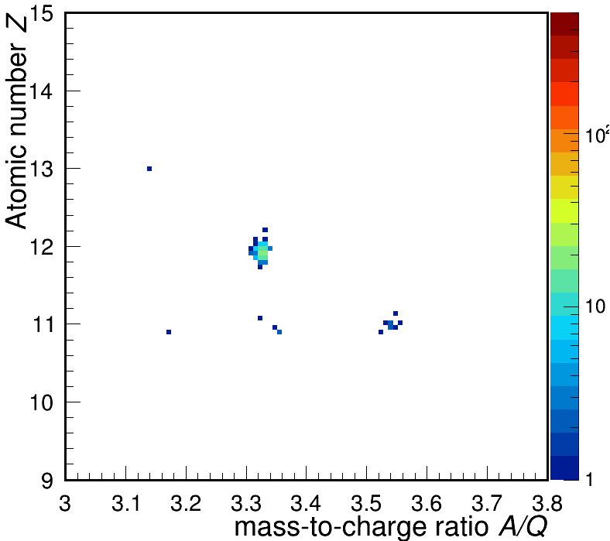
Where is the neutron drip line?
⁴⁸Ca(345MeV/nucleon)+Be
D.S. Ahn et al.
⁴⁸Ca+Be
N.Fukuda
et al.
⁴⁰Mg
³⁹Na
Ca
K
Ar
Cl
Preliminary
Preliminary
S
P
Si
N=28
Al
Mg
⁴³Al
Na
N=20
⁴⁰Mg
Ne
N=16
³⁷Na
³⁹Na(new)
F
³¹F
³⁴Ne
O
N
²⁴O
Established only up to Z=8
C
²²C
→Z=10 (N.Fukuda et al., in preparation)
B
Be
Li
Neutron drip line
He
H
H.Sakurai et al., PLB448, 180 (1999)
T. Baumann et al., Nature 449, 1022 (2007)
Notes:
11

Slide 12
Evolution Towards the Stability Limit
Where is the neutron drip line?
What are characteristic features of drip-line nuclei?
How does nuclear structure evolve towards the drip line?
Shell Evolution?
Ca
Deformation?
K
Ar
Halo?
Cl
S
Drip Line?
Continuum?
New correlation?
P
N=28
Si
Al
N=20
Mg
Na
Ne
³⁷Mg
N.Kobayashi et al.,
PRL 112, 242501 (2014).
F
O
³¹Ne
N
TN et al., PRL 112, 142501 (2014).
²⁸O
Deformation Driven Halo
C
²⁶O
B
N=16
Oxygen Anomaly
Be
Li
¹⁹B
Neutron drip line
1n halo known
He
¹¹Li
Dineutron
2n halo known
H
⁶He
4n halo/skin
Notes:
12

Slide 13
Dineutron and Multi-neutron clusters in neutron-rich nuclei

Slide 14
Multi-neutron correlation (neutron cluster) near drip line
Ordinary Nuclei
Neutron-rich Nuclei
Beyond drip line
S_{n}<1MeV
-1MeV<S_{n}<0MeV
V
S_{p}
continuum
~S_{n}~8MeV
continuum
Threshold
p
n
p
n
p
n
Weakly bound/unbound nuclei --- Threshold → Clustering (Semi-Hierarchy)
Halo Nuclei
Weakly Unbound Nuclei
Halo Nucleus
⁹Li
n
⁴n: “Tetra neutron” E_{4n}=0.83±0.65(stat)±1.25(syst) MeV
K.Kisamori et al., PRL116, 052501 (2016)
¹¹Li
n
²⁶O: “Weakly Unbound 2n” ²⁴O+2n E_{2n}= 0.018±0.003(stat)±0.004(syst) MeV
Y.Kondo et al., PRL116,102503(2016).
S_{2n}=0.37MeV

Slide 15
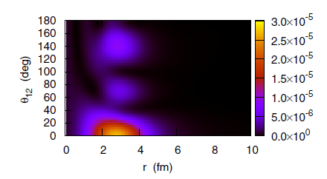
Dineutron?
A.B.Migdal
Strongly correlated “dineutron”
on the surface of a nucleus
Sov.J.Nucl.Phys.238(1973).
n
n
Dineutron:
@ Low-dense Neutron skin/halo?
/Inner crust of Neutron star?
Unbound
a= -18.7 fm
n
n
S=0, T=1
M.Matsuo
PRC73,044309(2006). A.Gezerlis, J.Carlson, PRC81,025803(2010)
s-wave scattering length
neutron-star
Possible dineutron site
2n Halo Nuclei?
2n weakly-unbound nuclei?
n
θ₁₂ (deg)
⁹Li
n
²⁴O
²⁶O
n
¹¹Li
n
r (fm)
Hagino, Sagawa,
PRC93,034330(2016)
S_{2n}=0.37MeV
S_{2n}= −0.018(5) MeV
T.Nakamura PRL96, 252502 (2006).
Kondo, TN et al., PRL116,102503(2016).

Slide 16
What happens if there are ‘multiple’ dineutrons?
n
n
²⁴O
n
²⁴O+4n
²⁶O+2n
n
??
²⁸O
²⁸O
~18 keV
Dineutron-cluster?
Dineutron-condensation?
α+⁸Be
7.65MeV
3α
Hoyle state
α
93keV
285keV
¹²C(0⁺₂)
α
α
alpha-cluster
alpha-condensation?
¹²C
A.Tohsaki, H.Horiuchi, P.Schuck,G.Ropke,
PRL 87, 192501 (2001).

Slide 17
Experiments of Super-heavy B & O isotopes
Ca
K
Ar
Cl
S
P
Si
N=28
Al
Mg
N=20
Na
Ne
N=16
³⁷Mg
F
O
³¹Ne
N
²⁹Ne
C
B
²⁶O
Oxygen Anomaly
Be
²⁵O
²⁸O
Li
²¹B
1n halo known
He
¹¹Li
Dineutron
H
2n halo known
⁶He
4n halo/skin
Notes:
17

Slide 18
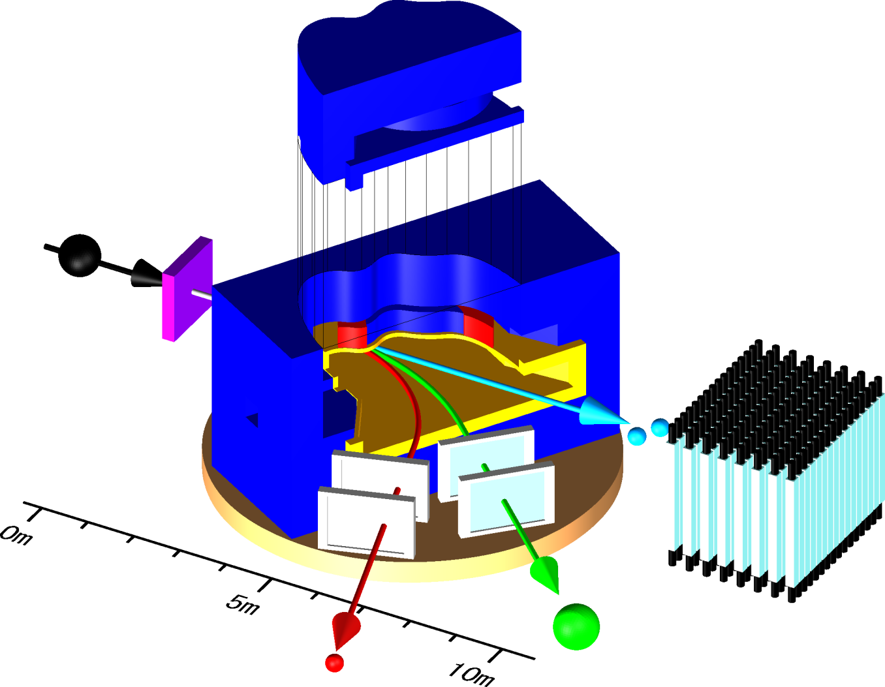
SAMURAI
Superconducting Analyzer for MUlti-particle from RAdio Isotope Beam
Kinematically Complete measurements by detecting multiple particles in coincidence→ Powerful tool for nuclei near and beyond the driplines.
Large momentum acceptance
Bρ_{max} / Bρ_{min} ~ 2 – 3
Good Momentum Resolution
Δp/p~ 1/1000
→A/ΔA>100 (>5σ)
Large Bending Angle (~60deg)
+4 Tracking Detectors
T.Kobayashi NIMB 317, 294 (2013)
Large angular acceptance for n
+-8.8 deg (H) x +-4.4 deg(V)
(~50% coverage < E_{rel} ~ 5MeV)
TN, Y.Kondo, NIMB 376, 156 (2016).
Moderate Erel Resolution
ΔE = 200 keV (σ) at E_{rel}=1MeV
Stage: Rotatable (-5 -- 95 degrees)
→Variety of Physics Opportunities
Superconducting
Magnet
(3T, 2m dia. Pole
80cm gap)
RI beam
from BigRIPS
Target
rotatable
Neutron(s)
Proton
Heavy Ion

Slide 19
Spectroscopy of Super-heavy Boron isotopes
Sylvain Leblond,
Miguel Marques
Nigel. A. Orr
& SAMURAI Collaboration
S. Leblond, M.Marques, N.A.Orr et al., Phys. Rev. Lett. 121,262502(2018).
F
O
N
C
B
Be
Li
1n halo known
He
²⁰B
²¹B
2n halo known
H
4n halo/skin candidates
¹⁹B: Dripline
2n halo,S_{2n}=93(560)keV
4n halo?, S_{4n}~1.5 MeV

Slide 20
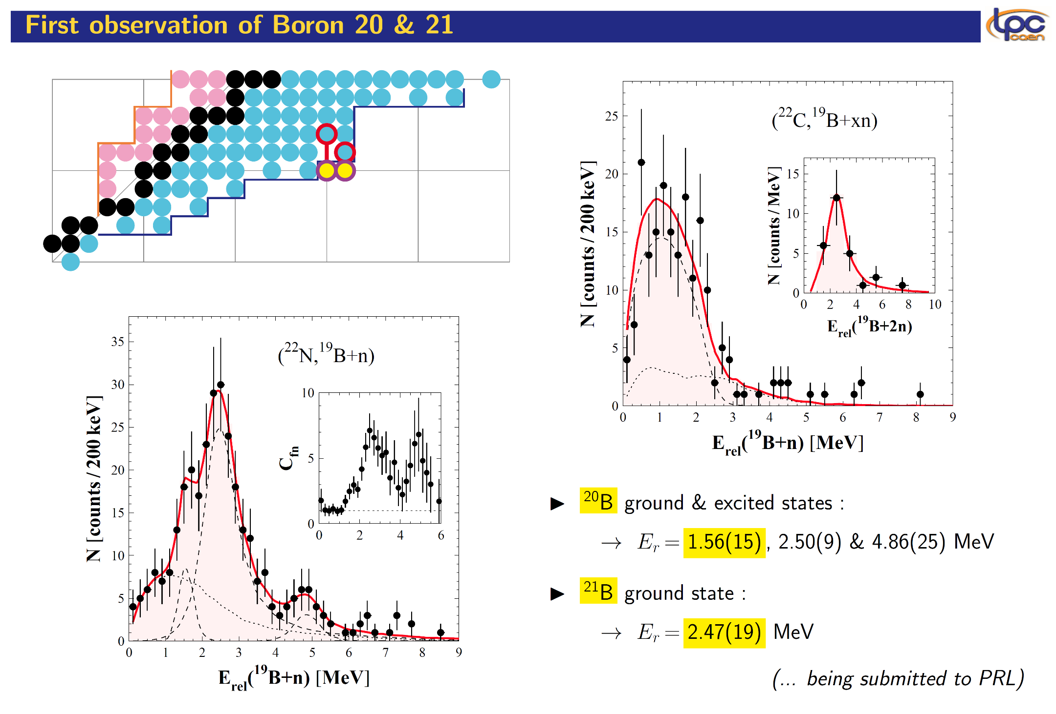
@SAMURAI at RIBF
S. Leblond, M.Marques, N.A.Orr et al.,
PRL121,262502(2018).
²²C (-1p-1n)→²⁰B?
230 MeV/u
²²C (-1p)
→²¹B
¹⁹B (drip-line ¹⁵B+4n)
²²N (-2p) →²⁰B
230 MeV/u
Slide by Miguel Marques
²¹B= ¹⁹B+2n or ¹⁷B+4n or ¹⁵B+6n ?

Slide 21
Spectroscopy of Super-heavy Oxygen isotopes
--Barely Unbound 2n emitter ²⁶O
& 4n emitter ²⁸O
Yosuke Kondo, TN
& SAMURAI Collaboration
Y. Kondo, TN et al., Phys. Rev. Lett. 116, 102503, (2016).
F
O
N
C
Oxygen Anomaly
B
²⁶O
Be
²⁸O
Li
1n halo known
He
2n halo known
H
²⁴O: Dripline
Doubly Magic Nucleus
N=16: New magic number
4n halo/skin candidates

Slide 22
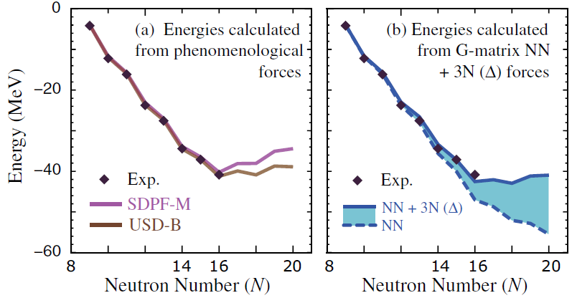
Study of unbound nuclei ²⁵⁻²⁸O at SAMURAI
Spokesperson Yosuke Kondo
Experimental study of unbound oxygen isotopes towards the possible double magic nucleus ²⁸O
T. Otsuka et al., PRL105, 032501 (2010).
²⁴Ne
²⁵Ne
²⁶Ne
²⁷Ne
²⁸Ne
²⁹Ne
³⁰Ne
³¹Ne
³²Ne
²³F
²⁴F
²⁵F
²⁶F
²⁷F
²⁸F
²⁹F
³⁰F
³¹F
Drip line
Drip line
²²O
²³O
²⁴O
²⁵O
²⁶O
²⁷O
²⁸O
Z=8
²¹N
²²N
²³N
N=20
²⁰C
²²C
Oxygen Anomaly
²¹C
3N force: significant at N>16
¹⁹B
N=16?
G. Hagen et al., PRL108, 242501(2012).
H. Hergert et al., PRL110, 242501(2013).
S.K.Bogner et al., PRL113, 142501(2014).
7５0keV
?
²⁵O+n
x
Continuum Effect:
A.Volya, V.Zelevinski, PRL94,052501(2005).
K. Tsukyiyama, T. Otsuka, PTEP2015, 093D01 (2015).
?
²⁴O+2n
²⁶O
nn correlations:
L.V. Grigorenko et al., PRL111,042501(2013).
K. Hagino, H. Sagawa PRC89,014331(2014).
E. Lunderberg et al.PRL108, 142503 (2012)
C. Caesar et al.PRC88, 034313 (2013).
Notes:
Again, this is the nuclear chart.
One of the important problem of nuclear physics is the location of the drip line, which is strongly affected by the nuclear structure.
The neutron drip line regularly evolves with increase of proton number like this dashed line.
But anomalous behavior can be seen at Z=8.
This anomalous behavior may be due to the shell evolution.
So, it is very interesting to investigate towards 28O, which has Z=8 and N=20.

Slide 23
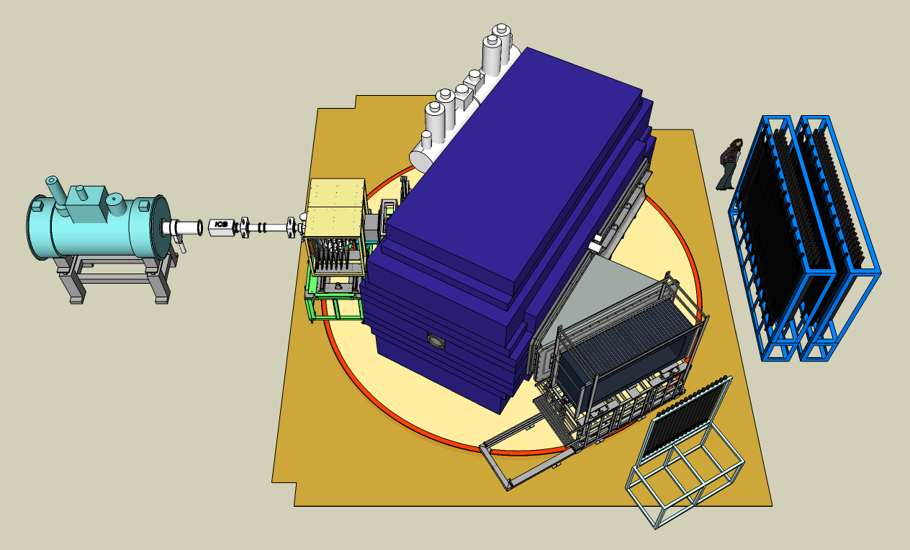
Experimental Setup at SAMURAI at RIBF
C target
(1.8g/cm²)
MWDC
Ionization
Chamber
Superconducting
Dipole Magnet
(B=3.0T)
NEBULA
n
2Plastics
2 MWDCs
n
²⁷F ~210MeV/u
(from BigRIPS)
DALI2
MWDC
Hodoscope
²⁴O

Slide 24
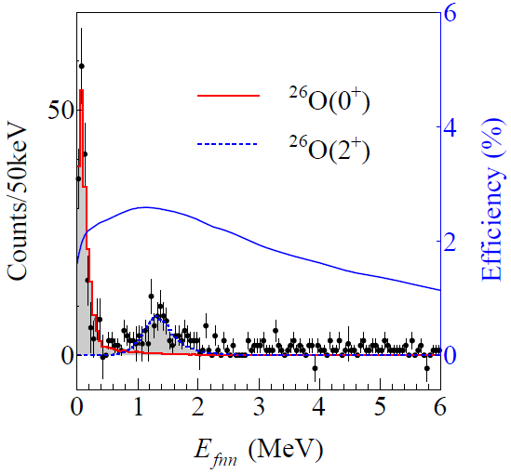
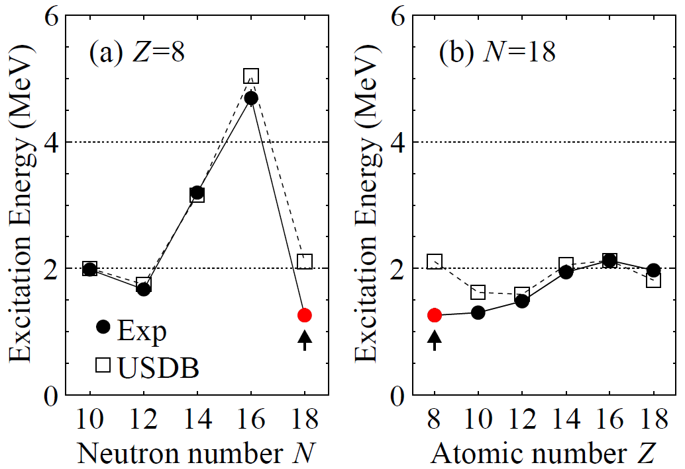
Results of ²⁶O
²⁷F+C→²⁶O→²⁴O+2n
²⁴O
²⁶O
²⁶O
Decay Energy (MeV)
Ground state (0⁺)
5 times higher statistics than previous study
18±3(stat)±4(syst)keV
Finite value is determined for the first time
1st excited state (2⁺)
Observed for the first time
1.28^{+0.11}_{-0.08}MeV
N=16 shell closure (²⁴O) is confirmed
USDB cannot describe 2⁺ energy at ²⁶O
  →effects of
  pf shell?, continuum?
  2n Correlations?, 3N force?
Y. Kondo et al., Phys. Rev. Lett. 116, 102503, (2016)

Slide 25
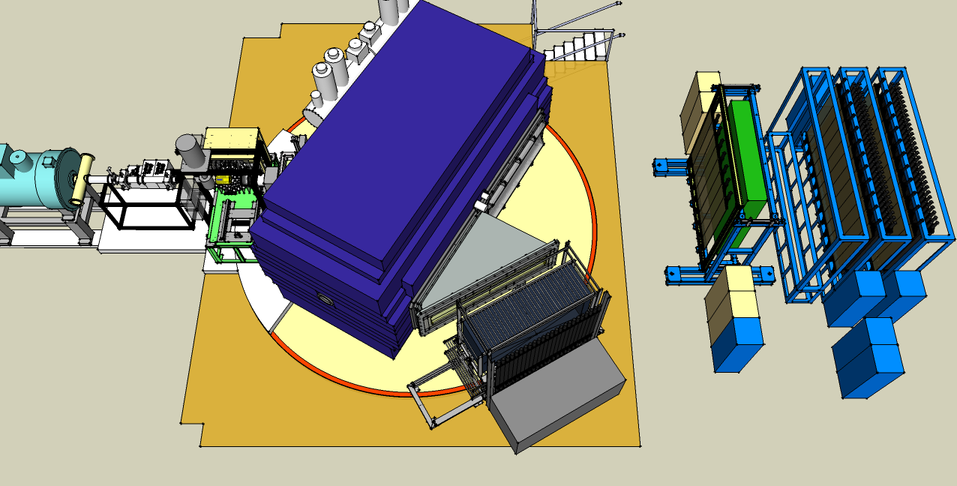
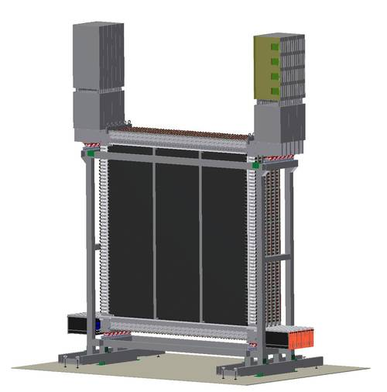
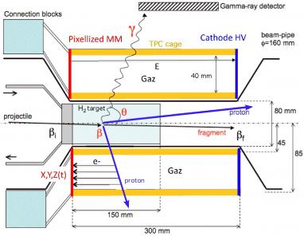
²⁸O measurement @ RIBF-SAMURAI
Towards ²⁸O (doubly magic nucleus?)
Slide by Y. Kondo
MINOS
Superconducting
Dipole Magnet
(B=2.9T)
MWDC
NeuLAND
NEBULA
2Plastics
n
2 MWDCs
DALI2
n
NeuLAND
MINOS
n
²⁹F
(from BigRIPS)
MWDC
n
Hodoscope
²⁴O
NeuLAND+NEBULA
→ ~ 50% efficiency for 1n
15cm thick LH2

Slide 26
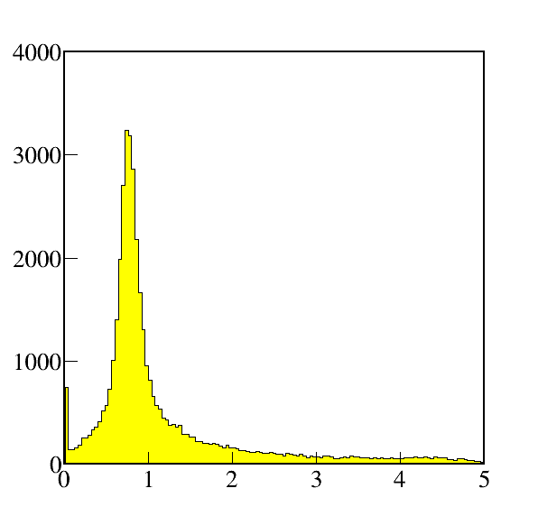
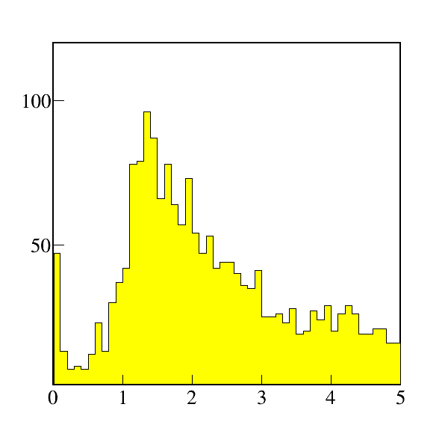
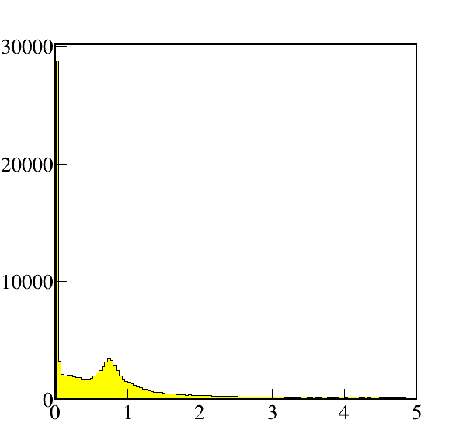
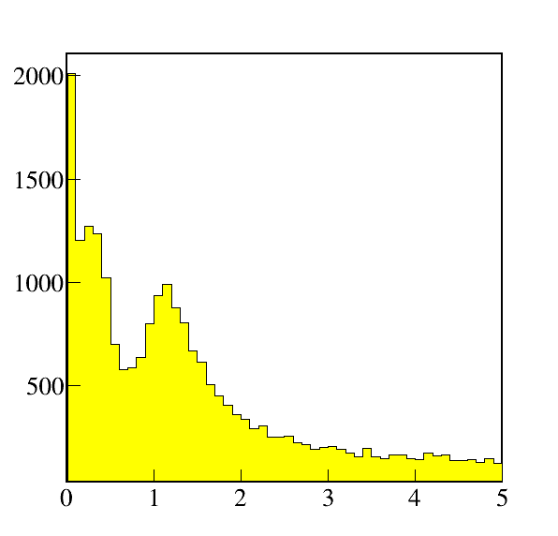
Preliminary decay energy spectra
(subsystems, 1n/2n coincidence)
²⁶Ne
²⁸Ne
²⁷Ne
²⁹Ne
³⁰Ne
³¹Ne
²⁵F
²⁶F
²⁷F
²⁸F
²⁹F
³⁰F
²⁴O
²⁵O
²⁶O
²⁷O
²⁸O
²⁹Ne+¹H→²⁴O+n+X
²⁹Ne+¹H→²⁴O+2n+X
Includes
²⁷O→²⁴O+n(+2n)
²⁶O→²⁴O+n(+n)
²⁵O→²⁴O+n
Includes
²⁷O→²⁴O+2n(+n)
²⁶O→²⁴O+2n
Counts/40keV
Counts/100keV
E_{decay}(²⁴O+n) (MeV)
E_{decay}(²⁴O+2n) (MeV)
²⁶Ne
²⁷Ne
²⁸Ne
²⁹Ne
³⁰Ne
³¹Ne
²⁹F+¹H→²⁴O+n+X
²⁹F+¹H→²⁴O+2n+X
²⁵F
²⁶F
²⁷F
²⁸F
²⁹F
³⁰F
Includes
²⁸O→²⁴O+n(+3n)
²⁷O→²⁴O+n(+2n)
²⁶O→²⁴O+n(+n)
²⁵O→²⁴O+n
Includes
²⁸O→²⁴O+2n(+2n)
²⁷O→²⁴O+2n(+n)
²⁶O→²⁴O+2n
²⁴O
²⁵O
²⁶O
²⁷O
²⁸O
²⁶O(2⁺)+2n
?
?
Counts/40keV
0.75MeV
²⁵O+3n
Counts/100keV
²⁴O+4n
0.018MeV
²⁶O(0⁺)+2n
²⁷O+n
²⁸O
E_{decay}(²⁴O+n) (MeV)
E_{decay}(²⁴O+2n) (MeV)
Slide by Y.Kondo

Slide 27
RIB facilities in the near future

Slide 28
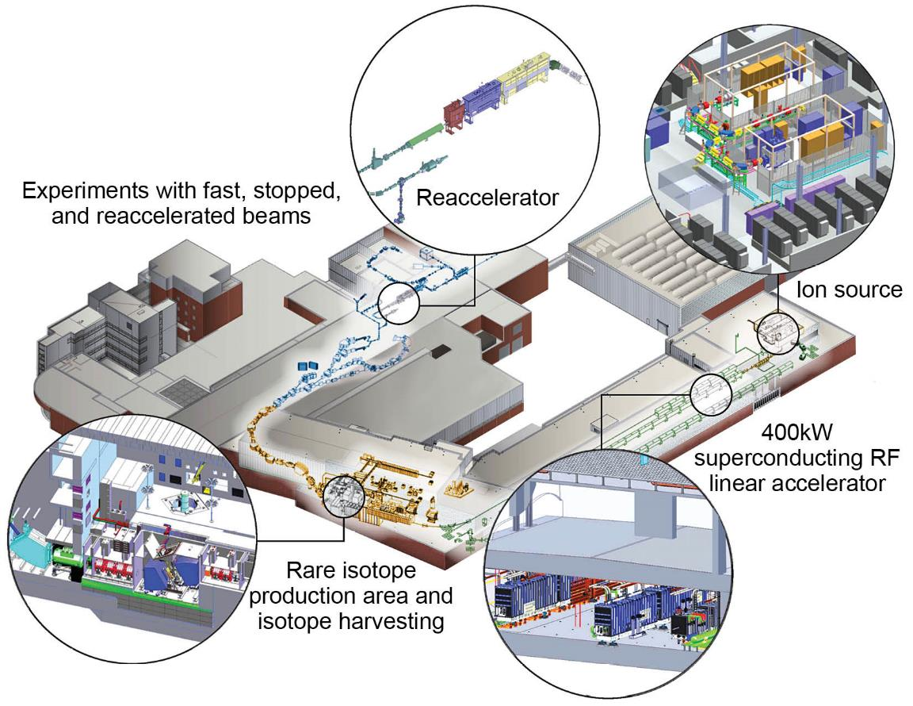
FRIB: Facility for Rare Isotope Beams (730M USD)
To be Completed June 2022 (possible early completion in 2021) at MSU
²³⁸U with energies of at least 200 MeV/u and 400 kW power
To be Extended Farther
towards the Driplines
∼1/week
Slide by Brad Sherrill
Notes:
Updated graphic 9/18/18 – ST
No Updates 7/7/17 - CB
No changes 1/24/18 – CB

Slide 29
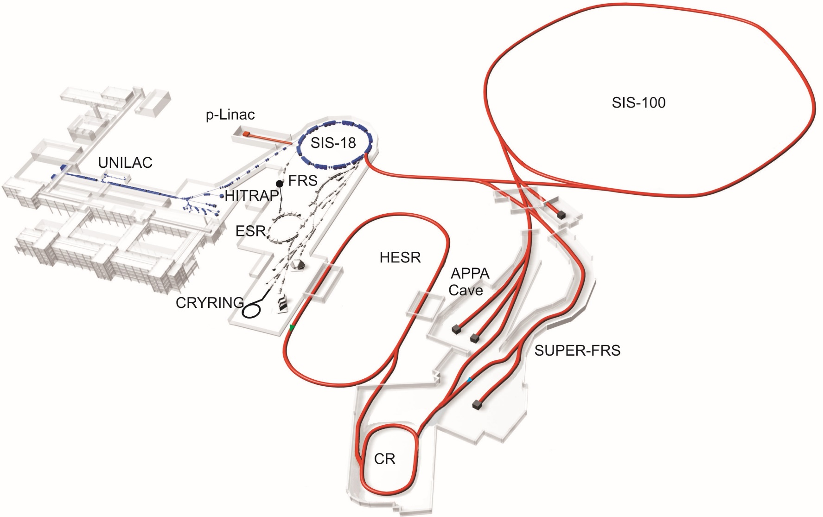
FAIR (MSV)
Modularized Start Version
Completion: 2025
Highest-intensity beams: Very neutron-rich heavy nuclei accessible
High beam energy
Storage rings
Novel instrumentation
New experimental methods
Slide by Tom Aumann

Slide 30
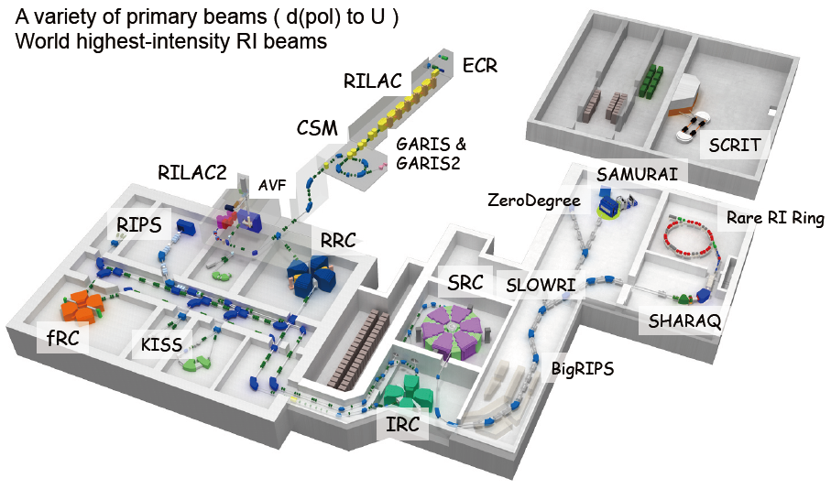
RIBF: Facility upgrade in the near future
New RF cavities
of RRC (2018)
new cavities give higher voltages
at a low frequency of 18MHz
More intense U beams
at SRC
70 → 200 pnA
RILAC upgrade (2019-)
28GHz ECR
Super-conducting RF cavities
More intense beam for
SHE(119th and 120th)
Ca-Zn beams at SRC
“SHE”
A
Installation of Charge-Stripper Rings
(202X-)
U beams at SRC 200pnA → 2pμA
“Exotic Nuclei”

Slide 31
Summary and Outlook
Key Questions
  Clustering and Hierarchical structure
  Semi-Hierarchy near Threshold
Dineutron/Multi-neutron clusters
Spectroscopy of Super-heavy Boron →First Observation of ^{20,21}B
S.Leblond, M. Marques et al., PRL121,262502 (2018).
Spectroscoy of Super-heavy Oxygen →Barely Unbound 2n emitter ²⁶O
Y. Kondo, TN et al., PRL 116, 102503 (2016).
→²⁶O(0⁺_{gs}): Very weakly unbound 2n states → Correlation? Continuum?
²⁶O(2⁺): Found for the first time at E_{rel}=1.28(11) MeV → Shell Evolution?
^{27,28}O : Experiment Successfully Done: Preliminary Results
Near Future: Variety of spectroscopies along n-drip line
4n, 6n… states? → n₂ cluster?
More Experiments at RIBF
FRIB in operation in 2022
FAIR in operation in 2025
Clustering
Threshold/Dripline
Semi-Hierarchy/Hierarchy
Universality?
Review on RIB Physics: T.Nakamura, H.Sakurai, H.Watanabe, Prog. Part. Nucl. Phys. 97, 53 (2017).

Slide 32
Day-one Collaboration
Tokyo Institute of Technology: Y.Kondo, T.Nakamura, N.Kobayashi, R.Tanaka, R.Minakata, S.Ogoshi, S.Nishi, D.Kanno, T.Nakashima, J. Tsubota, A. Saito
LPC CAEN: N.A.Orr, J.Gibelin, F.Delaunay, F.M.Marques, N.L.Achouri, S.Leblond, Q. Deshayes
Tohoku University : T.Koabayshi, K.Takahashi, K.Muto
RIKEN: K.Yoneda, T.Motobayashi ,H.Otsu, T.Isobe, H.Baba,H.Sato, Y.Shimizu, J.Lee, P.Doornenbal, S.Takeuchi, N.Inabe, N.Fukuda, D.Kameda, H.Suzuki, H.Takeda, T.Kubo
Seoul National University: Y.Satou, S.Kim, J.W.Hwang
Kyoto University : T.Murakami, N.Nakatsuka
GSI : Y.Togano
Univ. of York: A.G.Tuff
GANIL: A.Navin
Technische Universit¨at Darmstadt: T.Aumann
Rikkyo Univeristy: D.Murai
Universit´e Paris-Sud, IN2P3-CNRS: M.Vandebrouck

Slide 33
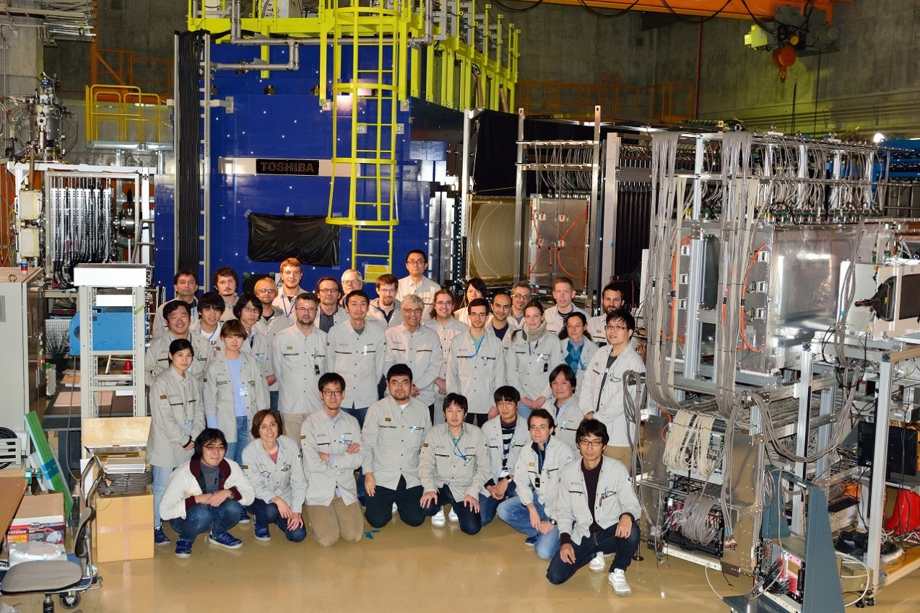
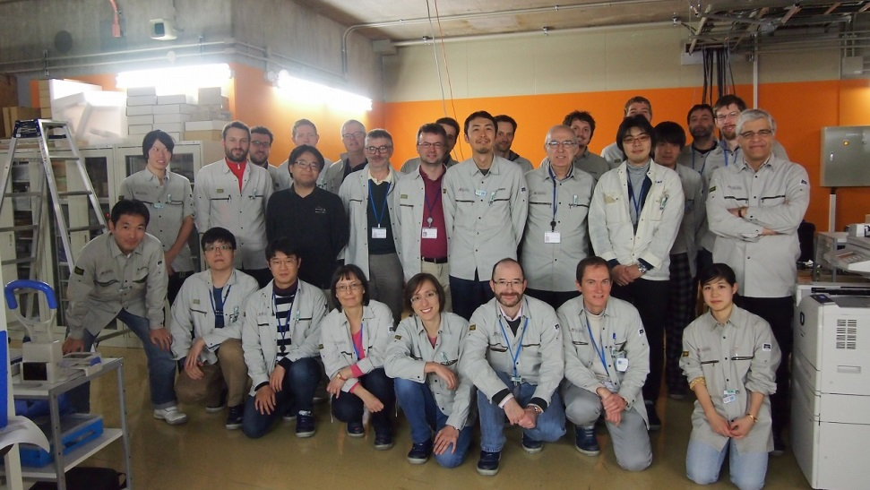
SAMURAI21 collaboration—^{27,28}O
Y.Kondo, T.Nakamura, N.L.Achouri, H.Al Falou, L.Atar, T.Aumann, H.Baba, K.Boretzky, C.Caesar, D.Calvet, H.Chae, N.Chiga, A.Corsi, H.L.Crawford, F.Delaunay, A.Delbart, Q.Deshayes, Zs.Dombrádi, C.Douma, Z.Elekes, P.Fallon, I.Gašparić, J.-M.Gheller, J.Gibelin, A.Gillibert, M.N.Harakeh, A.Hirayama, C.R.Hoffman, M.Holl, A.Horvat, Á.Horváth, J.W.Hwang, T.Isobe, J.Kahlbow, N.Kalantar-Nayestanaki, S.Kawase, S.Kim, K.Kisamori, T.Kobayashi, D.Körper, S.Koyama, I.Kuti, V.Lapoux, S.Lindberg, F.M.Marqués, S.Masuoka, J.Mayer, K.Miki, T.Murakami, M.A.Najafi, K.Nakano, N.Nakatsuka, T.Nilsson, A.Obertelli, F.de Oliveira Santos, N.A.Orr, H.Otsu, T.Ozaki, V.Panin, S.Paschalis, A.Revel, D.Rossi, A.T.Saito, T.Saito, M.Sasano, H.Sato, Y.Satou, H.Scheit, F.Schindler, P.Schrock, M.Shikata, Y.Shimizu, H.Simon, D.Sohler, O.Sorlin, L.Stuhl, S.Takeuchi, M.Tanaka, M.Thoennessen, H.Törnqvist, Y.Togano, T.Tomai, J.Tscheuschner, J.Tsubota, T.Uesaka, H.Wang, Z.Yang, K.Yoneda
Tokyo Tech, Argonne, ATOMKI, CEA Saclay, Chalmers, CNS, Cologne, Eotvos, GANIL, GSI, IBS, KVI-CART, Kyoto Univ., Kyushu Univ., LBNL, Lebanese-French University of Technology and Applied Science, LPC-CAEN, MSU, Osaka Univ., RIKEN, Ruđer Bošković Institute, SNU, Tohoku Univ., TU Darmstadt, Univ. of Tokyo
88 Participants
25 Institutes

Slide 34
Backup

Slide 35
RI-Beam Facilities
GSI/FAIR
ISOLDE
GANIL
3rd Generation (In-flight)
BLUE: Under Construction
HIAF
RAON
RCNP
NSCL/FRIB
RIBF
Notre Dame
Argonne
The only 3rd generation
in operation
FSU
TRIUMF
TAMU
“3rd Generation: Wider capabilities for advanced RI Science, compared to 2nd generation facilities,
in terms of RI-beam intensities, PID resolutions, and experimental methods/techniques…
T.Nakamura, H.Sakurai, H.Watanabe, Prog. Part. Nucl. Phys. 97, 53 (2017).

Slide 36
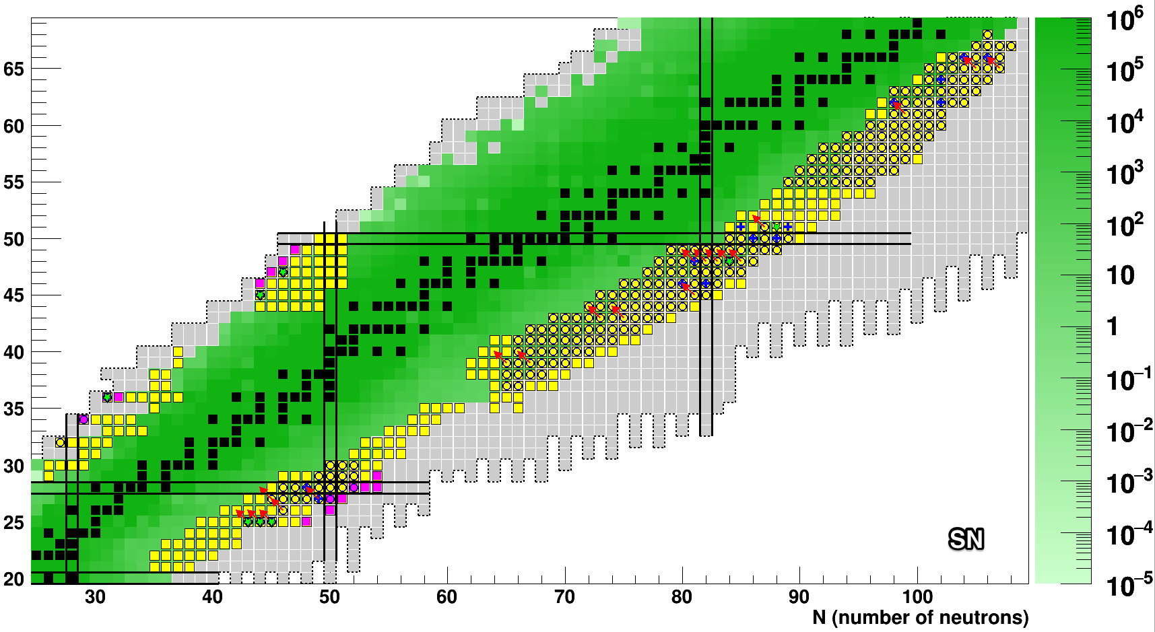
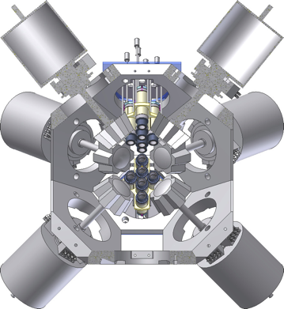
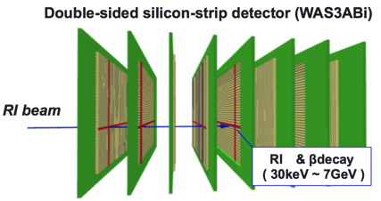
β−γ decay spectroscopy of exotic nuclei at RIBF (2012-2016)
Original Slide By Shunji Nishimura
440 Exotic nuclei Studied by EURICA(EUroball-RIKEN Cluster Array)
EURICA Data( 2012 – 2016 )
Isomer 14~
Delayed γ 37 ~
Delayed neutron 6 ~
Proton emission 3~
Next Step: Delayed Neutrons: BRIKEN
(R.Yokoyama Session FM, 26th)
New Isotopes 34
New β-decay half-life 107
(half-life 246)
J.Wu, S.Nishimura et al., PRL 118, 0722701 (2017).
G.Lorusso, S.Nishimura et al., PRL 114, 192501 (2015).
→r process
EURICA
WAS3ABi
12HPGe Clusters
Review : TN, H.Sakurai, H.Watanabe, Prog. Part.Nucl. Phys. 97, 53 (2017).

Slide 37
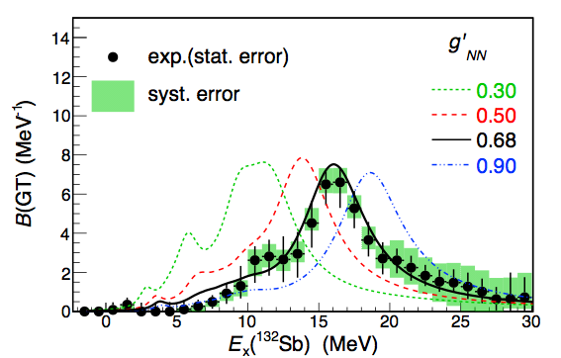
¹³²Sn(p,n) → g’_{NN} in ¹³²Sn
Direct Reaction Experiment at RIBF:
Gamow Teller Response of the Doubly-Magic Neutron-rich Nucleus ¹³²Sn
Y.Yasuda, M.Sasano, R.G.T.Zegers et al.,
PRL121, 132501 (2018).
  Current Result: g’_{NN}= 0.68±0.07 for¹³²Sn
  Close to g’_{NN} for ²⁰⁸Pb, ⁹⁰Zr (0.64)
  Constant g’_{NN} between (N-Z)/A = 0.11 – 0.24.
  Pion condensation can occur for ∼2ρ₀ (Heavy neutron-star) if constant g’_{NN} holds for N/Z>>1
π+ρ+g’ model
Continuum RPA
(Kawahigashi et. al, PRC63, 044609)
p-h residual interaction
  g’_{NN}=0.3 – 0.9
  g’_{NΔ}=0.35
Original Slide by M. SASANO

Slide 38
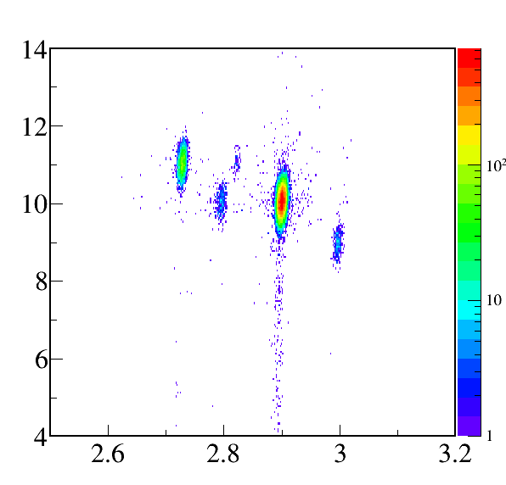
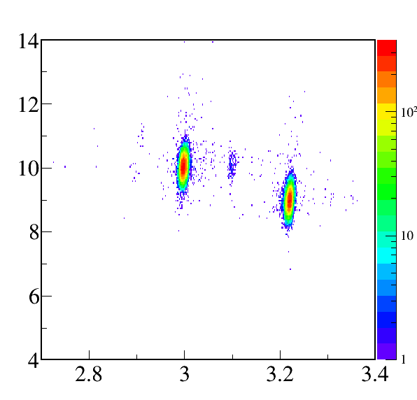
Secondary beam
²⁹Ne beam setting
(²⁷O measurement)
²⁹F beam setting
(²⁸O measurement)
²⁹Ne
8kcps
³⁰Na
³¹Ne
Z
Z
²⁷F
³⁰Ne
²⁹F
90cps
A/Z
A/Z
Slide by Y. Kondo

Slide 39
(Rf-cavity)
H.Imao Proc. of Cyclotron 2016

Slide 40
Knockout Reaction/Quasi-Free Reaction
²⁷F(¹²C,pX)²⁶O →²⁴O+2n
²⁴O
²⁴O
²⁷F
n
n
²⁶O
~210MeV/u
¹²C
p
Invariant Mass Method
²⁹F(p,pp)²⁸O →²⁴O+4n
p
n
²⁹F
²⁴O
²⁴O
p
n
²⁸O
n
p
n
Invariant Mass Method(This work): + High Yield, + Good Resolution ~ a few 100 keV
- Require Measurement of All the Decay Particles
(c.f. Missing Mass Method: - Low Yield, - Worse Resolution ~ a few MeV
+ Measurement of projectile and recoil protons only)
T.Nakamura, H.Sakurai, H.Watanabe, Prog. Part. Nucl. Phys. 97, 53 (2017).

Slide 41
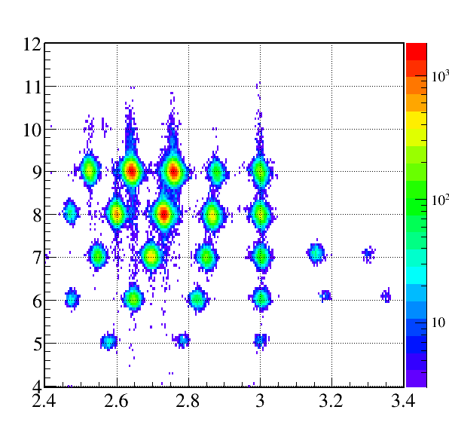
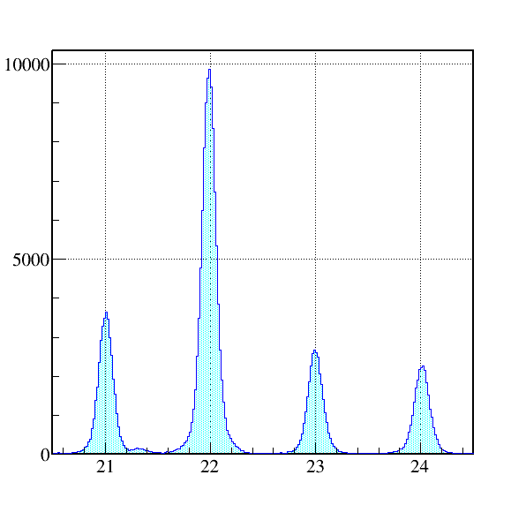
Particle identification @ SAMURAI
Z
²⁷F+C→^{A}Z
Counts
²⁷F+C→^{A}O
²²O
Perfect
separation!
²⁴O
²¹O
²³O
²⁴O
A/Z
Mass number
Clear Particle identification→ High resolving power of SAMURAI
Many Reaction Channels in One Setting →Significant By-Products
Slide by Y. Kondo

Slide 42
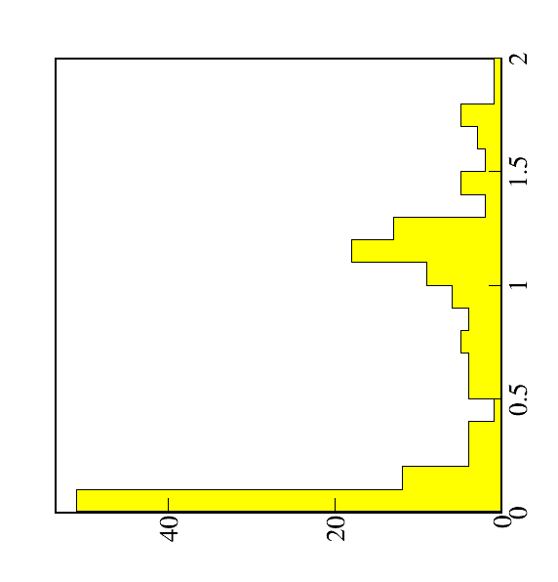
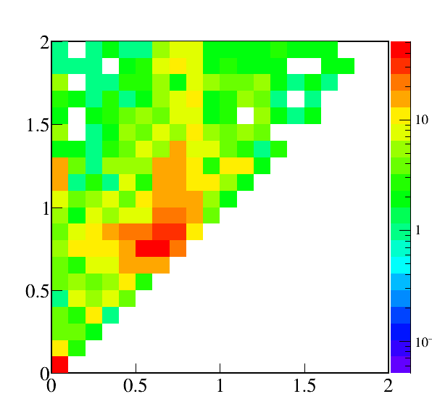
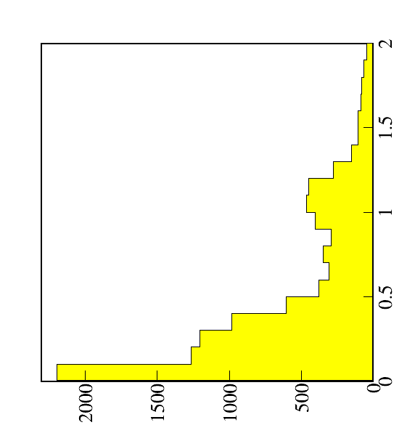
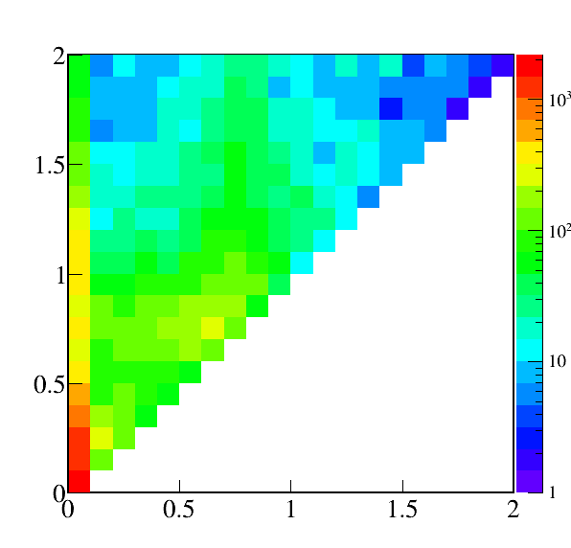
Analysis of 2n coincidence events
Gated by E_{fn1}~0
(coin. with ²⁶O_{gs})
²⁹Ne+¹H→²⁴O+2n+X
(²⁷O measurement)
²⁷O
E_{fn2} (MeV)
²⁶O_{gs}
(E_{fn1}~0, E_{fn2}~0)
n
²⁶O(0⁺)
E_{fn1}
²⁶O(2⁺)+2n
?
Counts/100keV
²⁵O+3n
²⁴O
E_{fn1} (MeV)
~1MeV
E_{fn2}
²⁴O+4n
0.018MeV
²⁶O(0⁺)+2n
²⁷O+n
²⁸O
E_{fn1}<E_{fn2}
n
²⁷O
²⁹F+¹H→²⁴O+2n+X
(²⁸O measurement)
E_{fn2} (MeV)
²⁸O?
Will be checked from analysis of 3n/4n coincidence events
²⁶O(0⁺)
Counts/100keV
E_{fn1} (MeV)

Slide 43
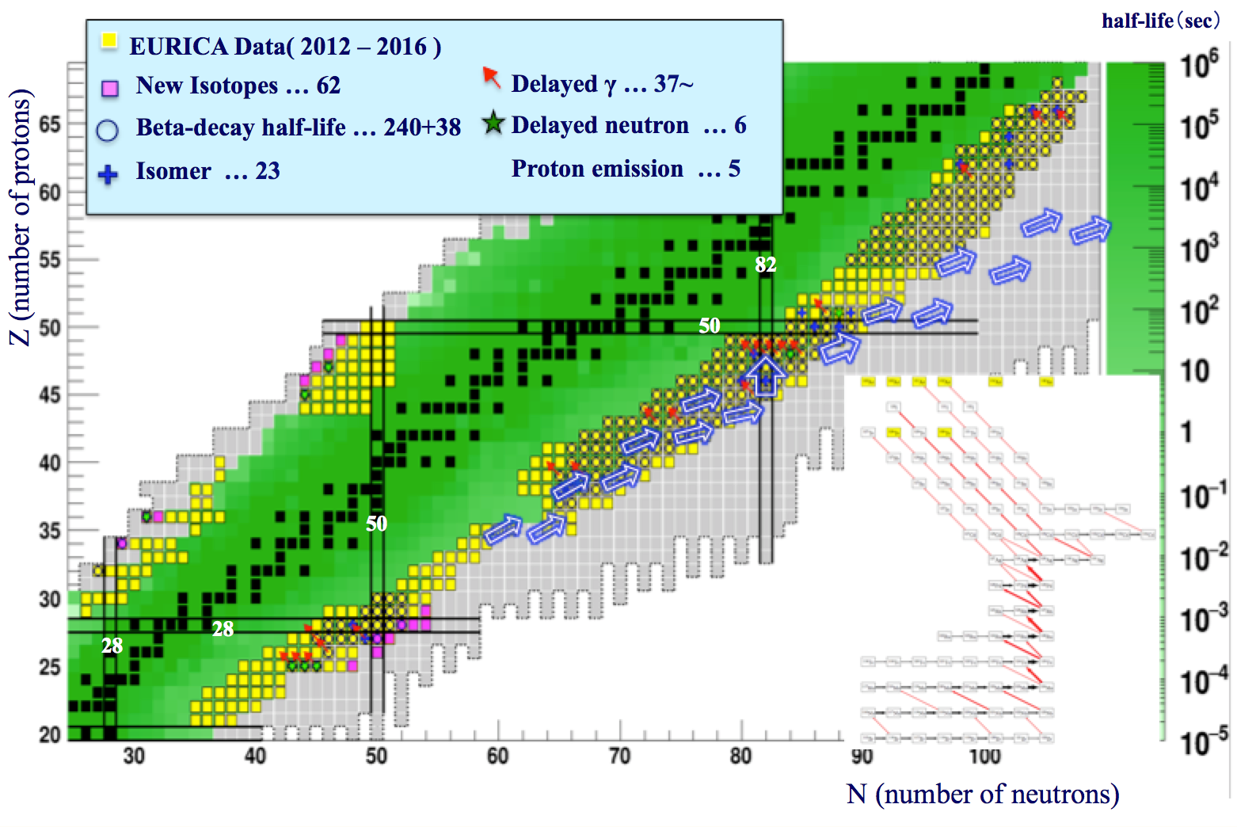

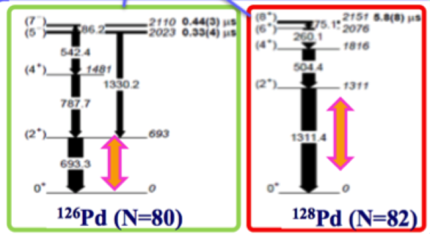
β−γ spectroscopy of exotic nuclei at RIBF (2012-2016)
Slide By Shunji Nishimura
440 Exotic nuclei Studied by EURICA(EUroball-RIKEN Cluster Array)
Next: Delayed neutrons: BRIKEN
(R.Yokoyama Session FM, 26th)
U-beam int.
= 5 ~ 10 pnA
H.Watanabe PRL111,152501(2013).
N=82 Magicity, ¹²⁸₄₆Pd₈₂∼¹³⁰₄₈Cd₈₂

Slide 44
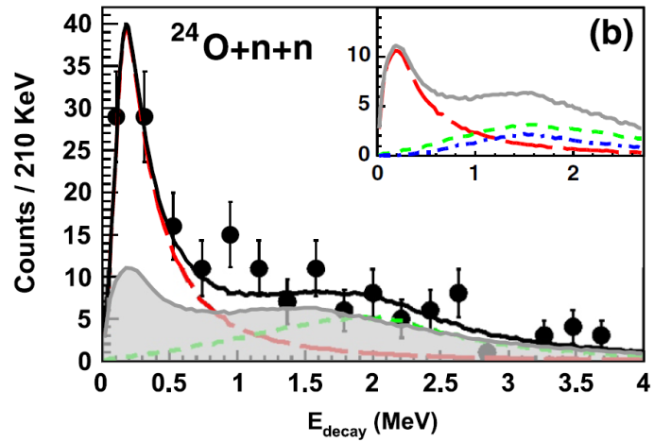
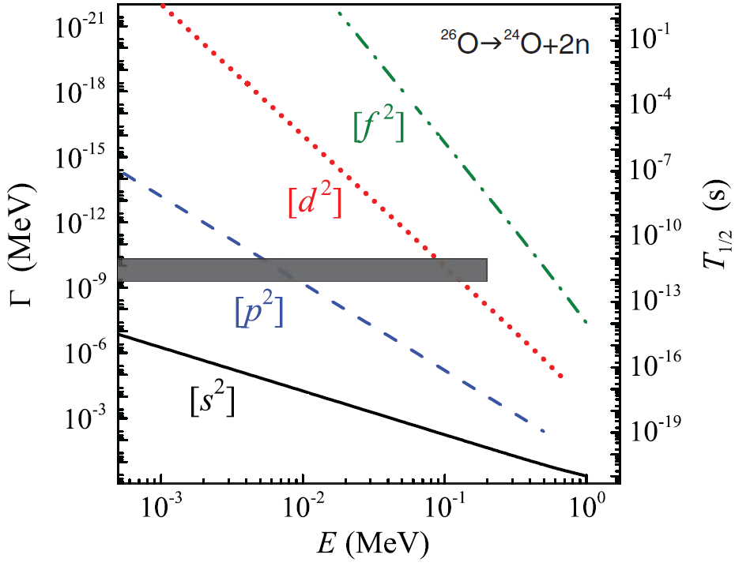
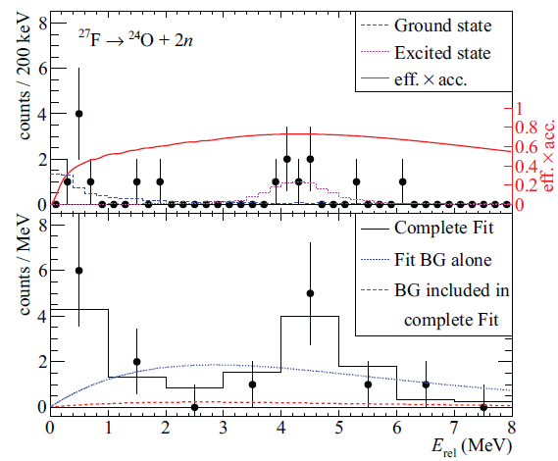
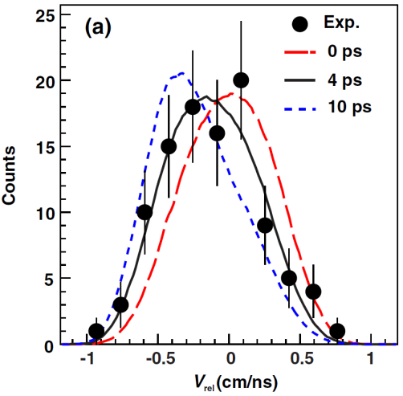
2n radioactivity of ²⁶O?
7５0keV
?
²⁵O+n
x
E. Lunderberg et al.
PRL108, 142503 (2012)
²⁶O: ²⁴O(0⁺) ⊗ (νd_{3/2})²
²⁴O+2n
²⁶O
L.V. Grigorenko et al. PRC 84, 021303 (2011)
C. Caesar et al.PRC88, 034313 (2013)
Theory
Er < 200keV
Z. Kohley et al,PRL110,152501 (2013)
T_{1/2}=4.5^{+1.1}_{-1.5}ps
(3ps systematic error)
→2n radioactivity?
Er < 120keV (95% CL)
τ < 5.7ns
Usual 1n decay
Γ~MeV or keV
Excite state at 4.2MeV?
Large uncertainty of experimental study
Only upper limit is given for the ground state energy
Large systematic error in the lifetime measurement
Excited State of ²⁶O?

Slide 45

Dineutron Cluster?
Doubly Magic
Or not?
1.28(11) MeV
(2⁺)
749(10) keV
?
Extremely weakly
UNBOUND state!
Weakly Unbound 4n
Emitter or not?
²⁵O+n
18(5) keV
0⁺
²⁴O+2n
²⁵O+ n
²⁶O
²⁷O+n
²⁸O
²⁴O+4n
²⁵O+3n
²⁶O+2n
Centrifugal
Barrier
E
E
n
n
n
²⁴O
S_{2n}= −0.018(5) MeV
²⁴O
n
Kondo et al., PRL2016
n
n
Strong 4n correlation?
Or dineutron cluster?
dineutron correlation?

Slide 46
Existence of human beings depends
on a subtle balance of Nature
Triple α Reaction
Detour for the synthesis of element ¹²C
(C was not produced in the Big Bang due to the A=5,8 gaps)
E
93keV
285keV
Hoyle state
α
0⁺
α＋α
⁸Be
⁸Be+α
7.65MeV
α
α
1x10⁻¹⁶s
Semi-stable
γ
2⁺
7.37 MeV
α
γ
α
0⁺
¹²C
Recent Progress on Triple α:
New Measurement of the Direct 3α Decay from the ¹²C Hoyle State
R. Smith et al., Phys. Rev. Lett. 119, 132502 (2017). 3α direct decay:<0.047%(95%CL)
High-Precision Probe of the Fully Sequential Decay Width of the Hoyle State in ¹²C
D. Dell’Aquila et al., Phys. Rev. Lett. 119, 132501 (2017). ”<0.043%(95%CL)

