Slide 1
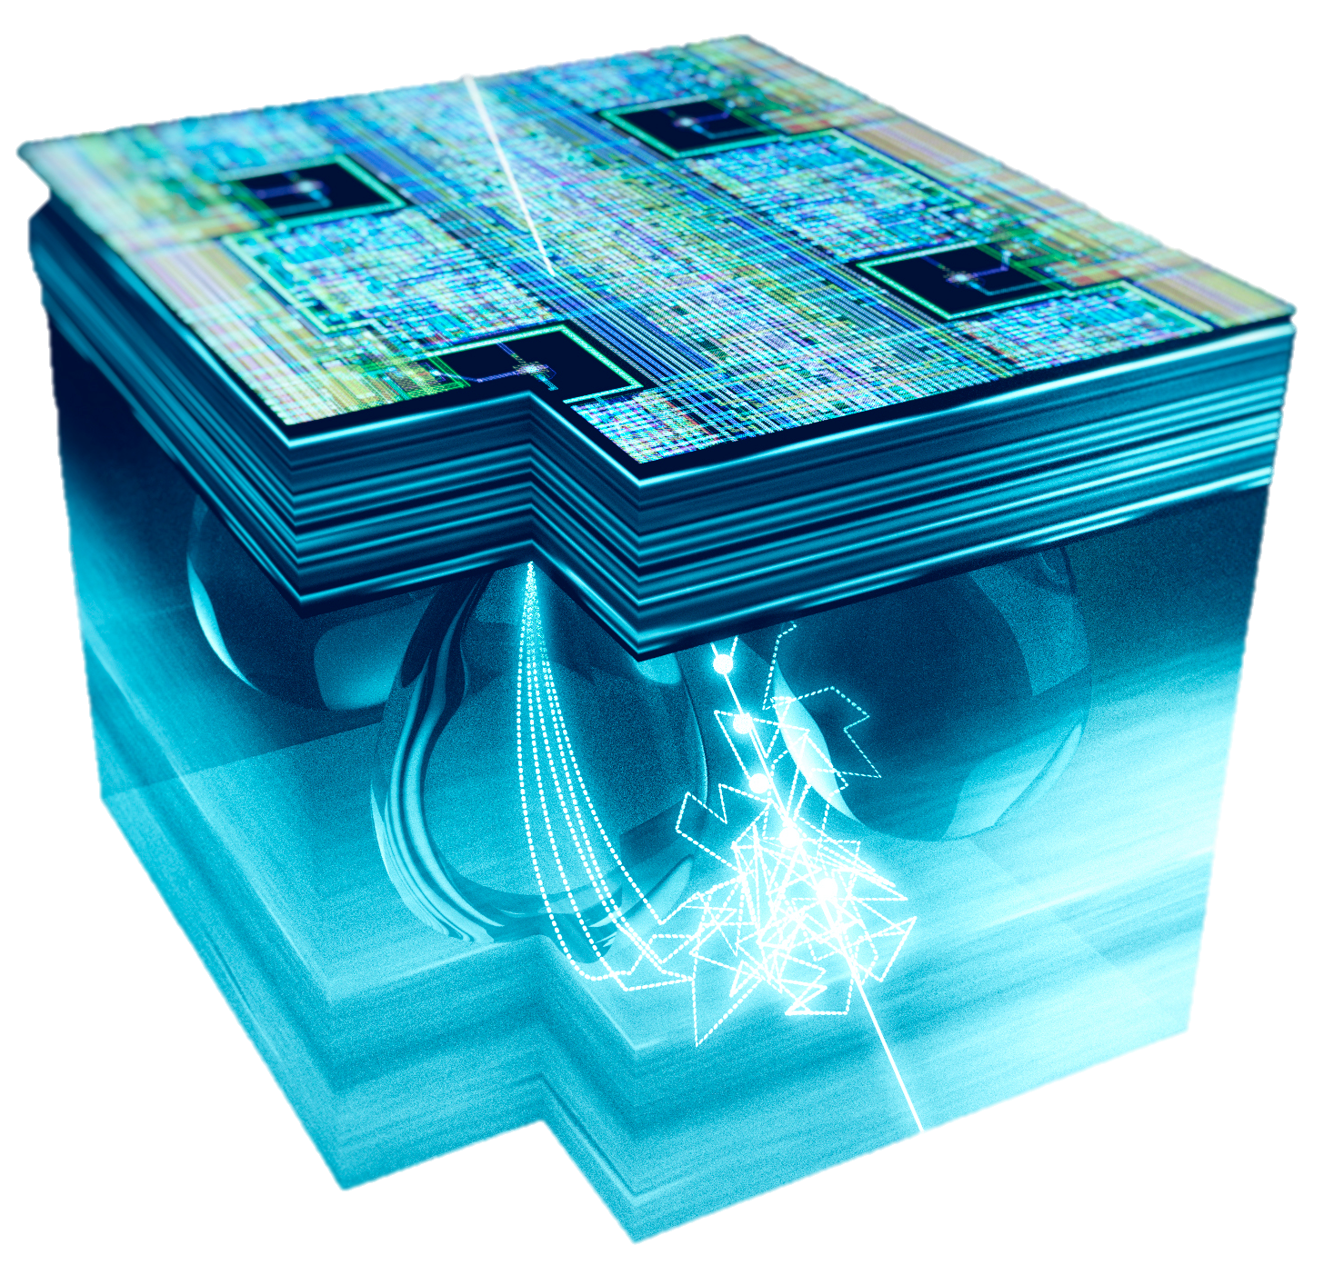
CERN – EP Department
CMOS Active Pixel Sensors
A Novel Detection Technology for Particle Physics
Luciano Musa
57th International Winter Meeting on Nuclear Physics
Bormio (Italy), January 21-25, 2018

Slide 2
Outline
CERN – EP Department
  Prelude
    Silicon detectors in HEP – a very brief historical excursus
  First Applications of CMOS pixel sensors to HEP experiments
    STAR Heavy Flavor Tracker
    ALICE Inner Tracking System
  Concepts for a future fast and lightweight heavy-ion detector
    Nearly 0-mass vertex detector
L. Musa (CERN) – International Winter Meeting on Nuclear Physics, Bormio, 8-11 Jan 2019

Slide 3

The rise of silicon detectors in HEP
Towards end of 1970’s: intensive R&D on devices which could measure short-lived particles (10⁻¹² - 10⁻¹³ s)
R&D at CERN^{(A)} and Pisa^{(B)} demonstrated that strip detectors (100-200μm pitch):
  high detection efficiency (>99%), good spatial resolution (~20μm) and good stability
  precise vertex reconstruction
However: fabrication of these devises was very tricky, thus limiting their availability
1980 – fabrication of silicon detectors using standard IC planar process (PIN diode ➔ μstrip detector)
J. Kemmer, et al., “Development of 10-micrometer resolution silicon counters for charm signature observation with the ACCMOR spectrometer”, Proceedings of Silicon Detectors for High Energy Physics, Nucl. Instr. and Meth. 169 (1980) 499.
First use of silicon strips detectors by NA11(CERN SPS) and E706 (FNAL)
NA11 (1981): 6 planes (24 x 36mm²): resistivity 2-3 kΩcm, thickness 280μm, pitch 20μm
(B) E706 (1982): 4 planes (3x3 cm²) + 2 planes (5x5cm²)
(A)
(B)
Erik Heine, Joseph Kemmer and Gherard Lutz: 2017 EPS prize for “Outstanding Contributions to HEP” (pioneering the development of silicon μstrip)
L. Musa (CERN) – International Winter Meeting on Nuclear Physics, Bormio, 8-11 Jan 2019

Slide 4
The rise of silicon detectors in HEP
The next step forward came with the advent of the VLSI technology that allowed coupling ASIC amplifier chips directly to the detectors
1990s - LEP, first silicon vertex detectors were installed in DELPHI and ALEPH experiments, then OPAL and L3
1989 - first DELPHI vertex detector, consisting of two layers of single-sided strip detectors
Projective geometry ➔ ambiguity at high multiplicities (high occupancy)
This started to become apparent already at DELPHI:
High number of ambiguities ➔ reconstruction efficiency suffered a lot, especially in the forward direction
Not usable close to IP in hadron colliders (LHC) or HI experiments at SPS
Another problem at (very) high particle load ➔ degradation of the sensor by the high radiation dose
This implies starting with a very large signal-to-noise ratio, which can only be obtained with detector with small capacitance
L. Musa (CERN) – International Winter Meeting on Nuclear Physics, Bormio, 8-11 Jan 2019

Slide 5
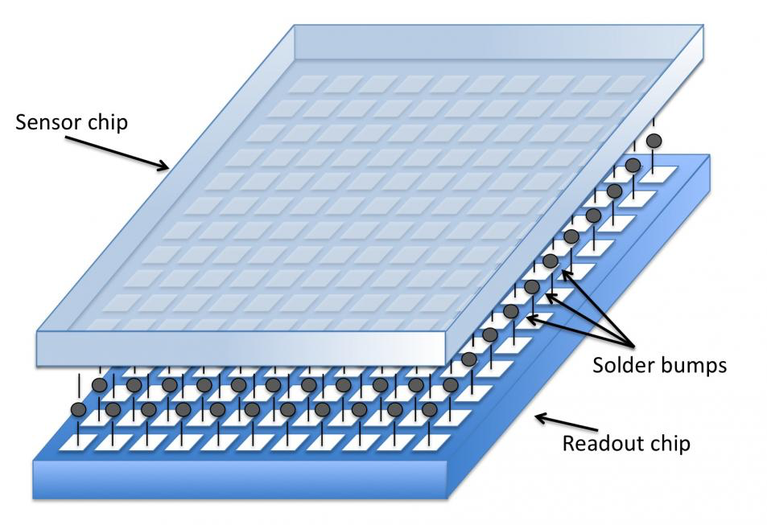
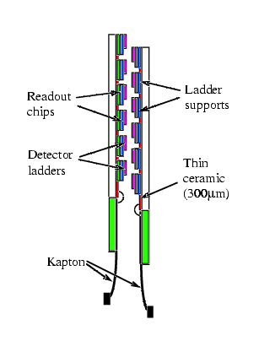
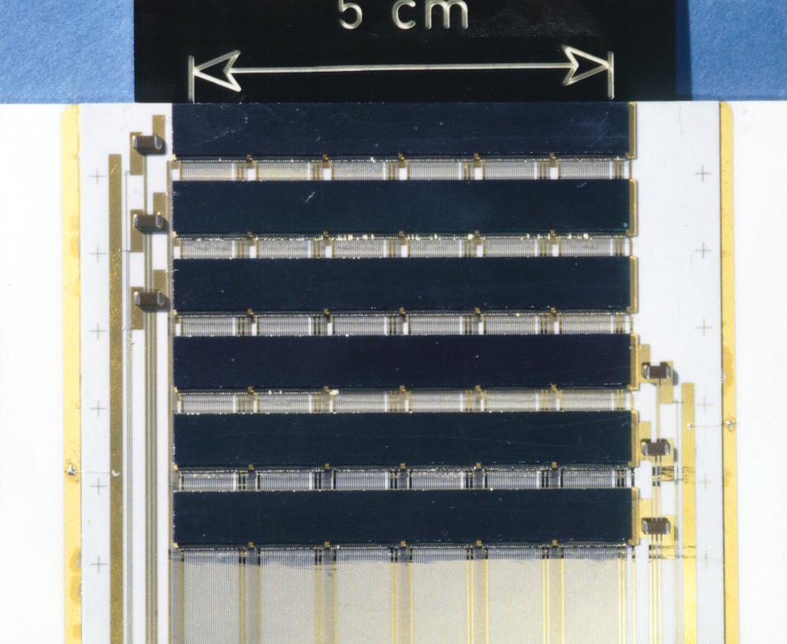
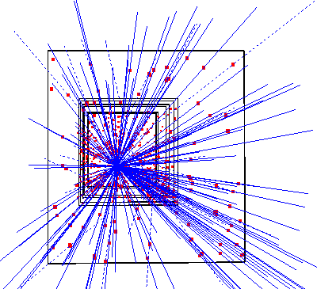
The Inception of Silicon Pixel Detectors
“The silicon micropattern detector: a dream?”
E.H.M Heijine, P. Jarron, A. Olsen and N. Redaelli , Nucl. Instrum. Meth. A 273 (1988) 615
“Development of silicon micropattern detectors”
CERN RD19 collaboration, Nucl. Instrum. Meth. A 348 (1994) 399
1995 – First Hybrid Pixel detector installed in WA97 (CERN, Omega facility)
1996/97 – First Collider Hybrid Pixel Detector installed in DELPHI (CERN, LEP)
Hybrid pixel detector
CERN – WA97 Experiment (1995)
5 x 5 cm² area
7 detector planes
~0.5 M pixels
Pixel size 75 x 500 μm²
1 kHz trigger rate
Omega2 chip
E. Heijne, E. Chesi
Work carried out by RD19 for WA97 and NA57/CERN
No-field, Pb-Pb, 153 reconstructed tracks
L. Musa (CERN) – International Winter Meeting on Nuclear Physics, Bormio, 8-11 Jan 2019

Slide 6
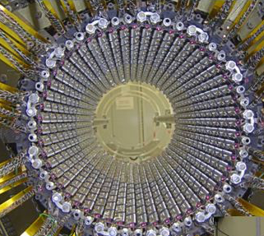
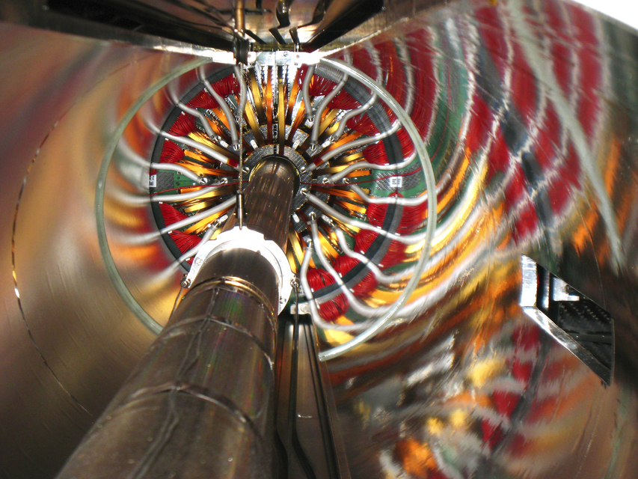
Pixel Detectors at the LHC
10 years after the first use in WA97… hybrid pixel detectors at the heart of the LHC experiments
ATLAS Pixels
CMS Pixels
ALICE Pixels
Parameters | ALICE | ATLAS | CMS
Nr. layers | 2 | 3 | 3
Radial coverage [mm] | 39 - 76 | 50 - 120 | 44 – 102
Nr of pixels | 9.8 M | 80 M | 66 M
Surface [m²] | 0.21 | 1.7 | 1
Cell size (rφ x z) [μm²] | 50 x 425 | 50 x 400 | 100 x 150
Silicon thickness (sens. + ASIC) - x/X₀ [%] | 0.21 + 0.16 | 0.27 + 0.19 | 0.30 + 0.19
L. Musa (CERN) – International Winter Meeting on Nuclear Physics, Bormio, 8-11 Jan 2019

Slide 7
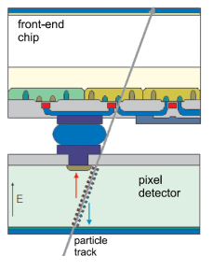
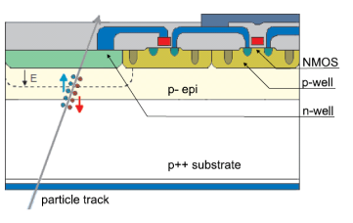
Beyond Hybrid Pixel Detectors …
Hybrid Pixel Detector
Monolithic Pixel Detector
Since the very beginning of pixel development (CERN RD 19):
dream to integrate sensor and readout electronics in one chip
Motivation to reduce: cost, power, material budget, assembly and integration complexity
N. Wermes (Univ. of Bonn)
N. Wermes (Univ. of Bonn)
Several major obstacles to overcome:
CMOS generally not available on high resistivity silicon (needed as bulk material for the sensor)
Full CMOS circuitry not possible within the pixel area (only one type of transistor ➔ slow readout)
✔
✔
MAPS exist in many different flavors: CMOS, HV CMOS, DEPFET, SOI
The following will cover only CMOS Active Pixel Sensors (CMOS MAPS) = CMOS Active Pixel Sensors (CMOS APS)
L. Musa (CERN) – International Winter Meeting on Nuclear Physics, Bormio, 8-11 Jan 2019

Slide 8
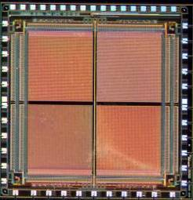
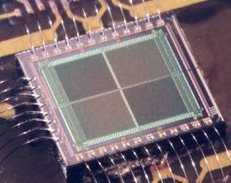
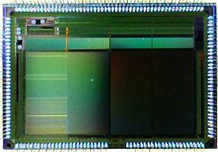
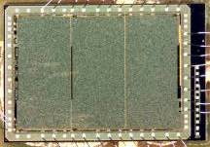
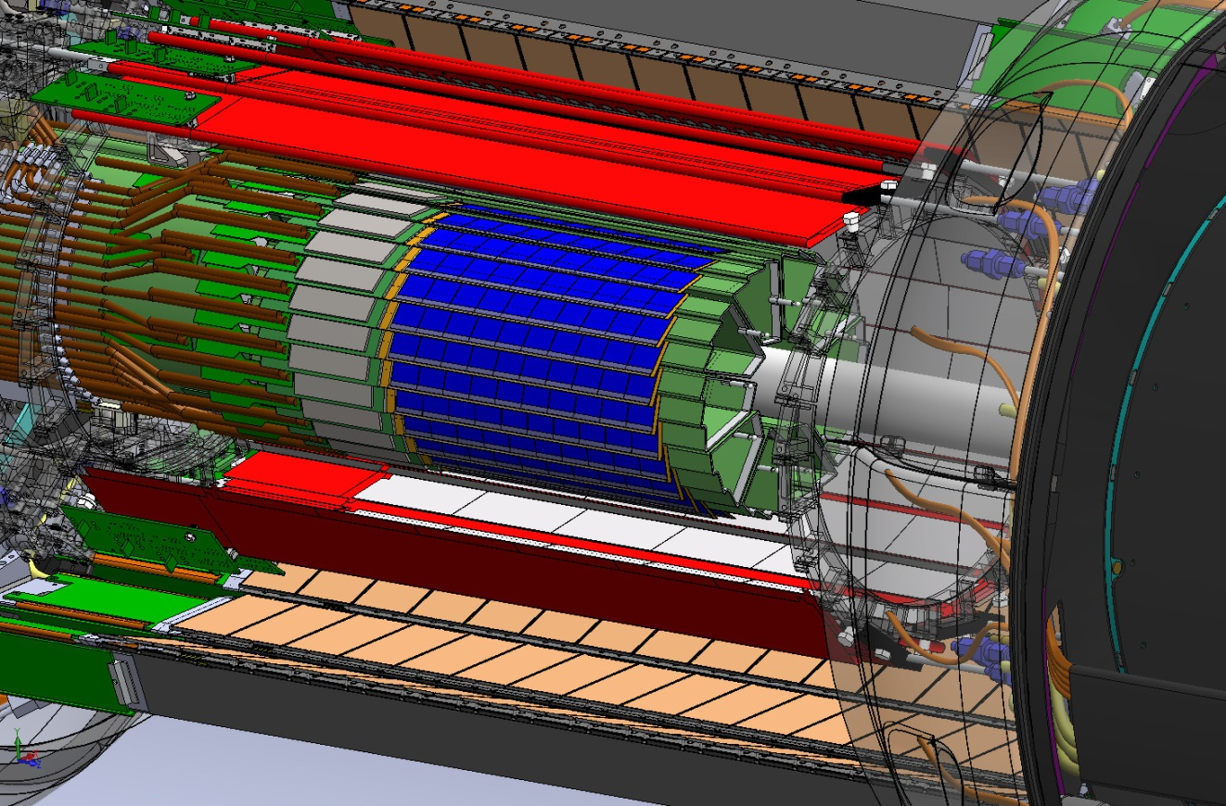
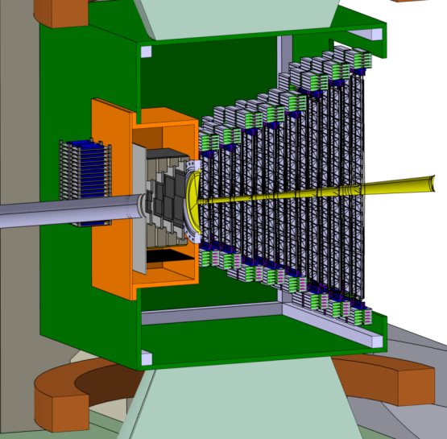
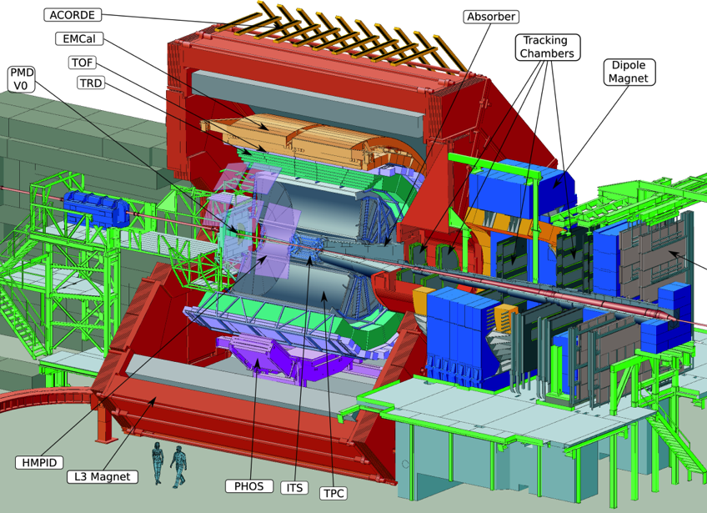
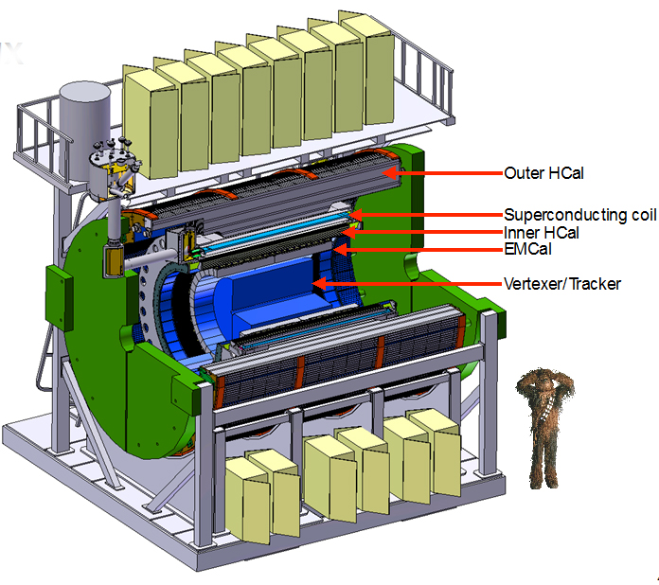
ALICE LS2 Upgrade
Owing to the industrial development of CMOS imaging sensors and the intensive R&D by HEP community
Mimosa-26
2.7 cm²
(EUDET Telescope)
Mimosa-1
Mimosa-2
Mimosa-3
. . .
Cherwell
ALPIDE
… several HI experiments have selected CMOS pixel sensors for their inner trackers and intensive R&D for ATLAS
…
2014 - First CPS Detector
STAR HFT
0.16 m² – 356 M pixels
CBM MVD
0.08 m² – 146 M pixel
ALICE ITS Upgrade (and MFT)
10 m² – 12 G pixel
sPHENIX
0.2 m² – 251 M pixel
L. Musa (CERN) – International Winter Meeting on Nuclear Physics, Bormio, 8-11 Jan 2019

Slide 9
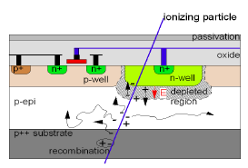
CMOS MAPS – state-of-the-art in 2010
p-type crystalline epitaxial layer hosts n-well charge collector
Signal is generated in a high-resistivity (> 1 kΩcm) epi-layer ~20μm thick (larger values possible)
~80 e-h pairs per micron
Only one transistor type in the active area (NMOS)
Use rolling shutter architecture for matrix analogue readout
Early versions with thin and low resistivity epi-layer
epi-layer not fully depleted
Charge collected (mostly) by diffusion and drift
Long charge collection time
Sensitive to radiation induced displacement damage in the epi layer (ok for applications with up to ~ 10¹² 1MeV N_{eq}/cm²)
Rolling Shutter Architecture
AMP
2
SEL = 1
rolling
shutter
TH
TH
TH
TH
TH
TH
TH
TH
2x
SUZE (Zero Suppression and Encoding)
L. Musa (CERN) – International Winter Meeting on Nuclear Physics, Bormio, 8-11 Jan 2019

Slide 10
First application to Vertex Detectors
Measurement of short-lived particles in nuclear-nuclear collisions
L. Musa (CERN) – International Winter Meeting on Nuclear Physics, Bormio, 8-11 Jan 2019

Slide 11
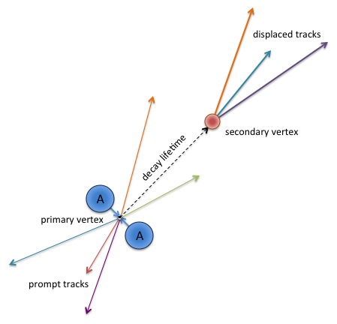
Secondary Vertex Determination
Open charm
Example: D⁰ meson
Particle | Decay Channel | cτ (μm)
D⁰ | K⁻ π⁺ (3.8%) | 123
D⁺ | K⁻ π⁺ π⁺ (9.5%) | 312
 | K⁺ K⁻ π⁺ (5.2%) | 150
 | p K⁻ π⁺ (5.0%) | 60
D⁰ reconstructed
momentum
Pointing
Angle θ
K⁻
π⁺
secondary
vertex
D⁰ flight line
~ 100 μm
A
d₀^{π}
A
d₀^{k}
Primary vertex
Analysis based on invariant mass, PID and decay topology
L. Musa (CERN) – International Winter Meeting on Nuclear Physics, Bormio, 8-11 Jan 2019

Slide 12
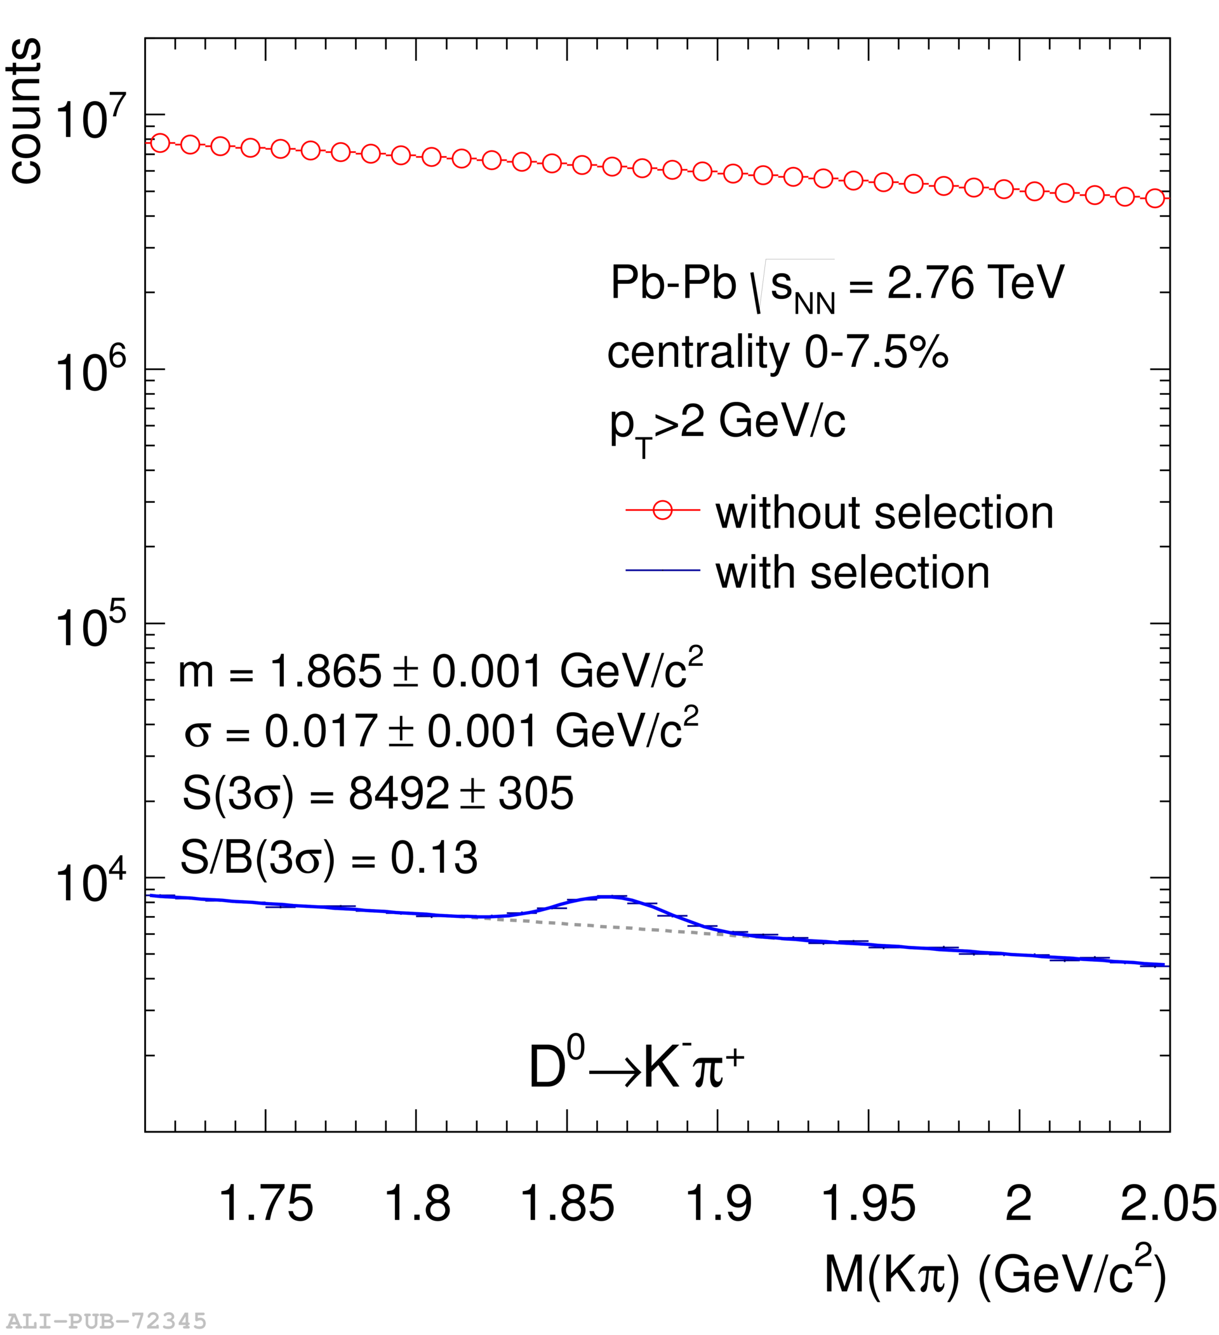
Secondary Vertex Determination
ALICE, Int. J. Mod. Phys. A 29 (2014) 1430044
Example: D⁰ meson
Pointing
Angle θ
D⁰ reconstructed
momentum
K⁻
π⁺
secondary
vertex
D⁰ flight line
~ 100 μm
Pb
d₀^{π}
Pb
d₀^{k}
Invariant mass distribution of K⁻π⁺ pairs before and after applying selection criteria on the relation between the secondary (D⁰ decay) and primary vertices
Primary vertex
Analysis based on invariant mass, PID and decay topology
L. Musa (CERN) – International Winter Meeting on Nuclear Physics, Bormio, 8-11 Jan 2019

Slide 13
What determines the Impact parameter Resolution?
Vertex projection from two points: a simplified approach (telescope equation)
expectations for the ITS upgraded 
pointing resolution = (5 ⊕ 22GeV/p⋅c) μm
From detector position error
From Coulomb scattering
first pixel layer
Δx
detector layer 2
θ_{m}
Δx
detector layer 1
r₁
r₂
r₁
r₂
perceived
vertex
Δv
true vertex
perceived
vertex
Δv
true vertex
L. Musa (CERN) – International Winter Meeting on Nuclear Physics, Bormio, 8-11 Jan 2019

Slide 14
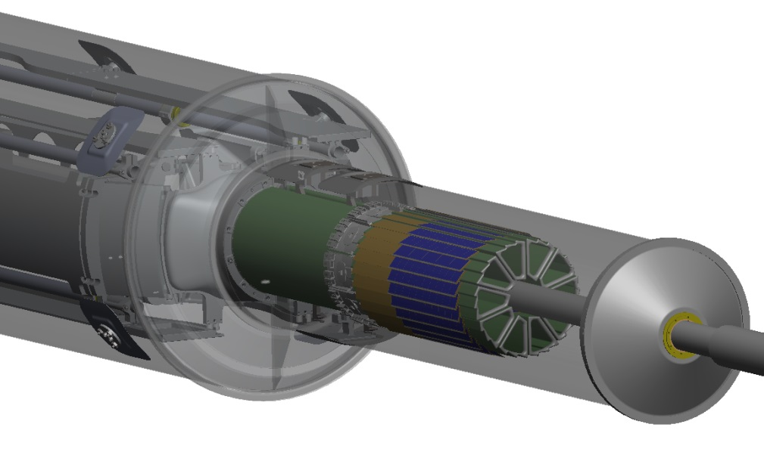
STAR Pixel Detector – First application of CMOS APS to HEP
Mechanical support with kinematic mounts (insertion side)
Key dates
3-sector prototype May 2013
Full detector Jan 2014
power ~ 160mW/cm²
2 layers
10 sectors total (in 2 halves)
4 ladders/sector
Rolling Shutter
~180μs integr. time
Ladder with 10 MAPS sensors (~ 2×2 cm² each)
RDO Buffers / Drivers
MAPS
MAPS
Aluminum conductor Ladder Flex Cable
Physics Runs in 2015-2016
2-layer kapton flex cable with Al traces
L. Musa (CERN) – International Winter Meeting on Nuclear Physics, Bormio, 8-11 Jan 2019

Slide 15
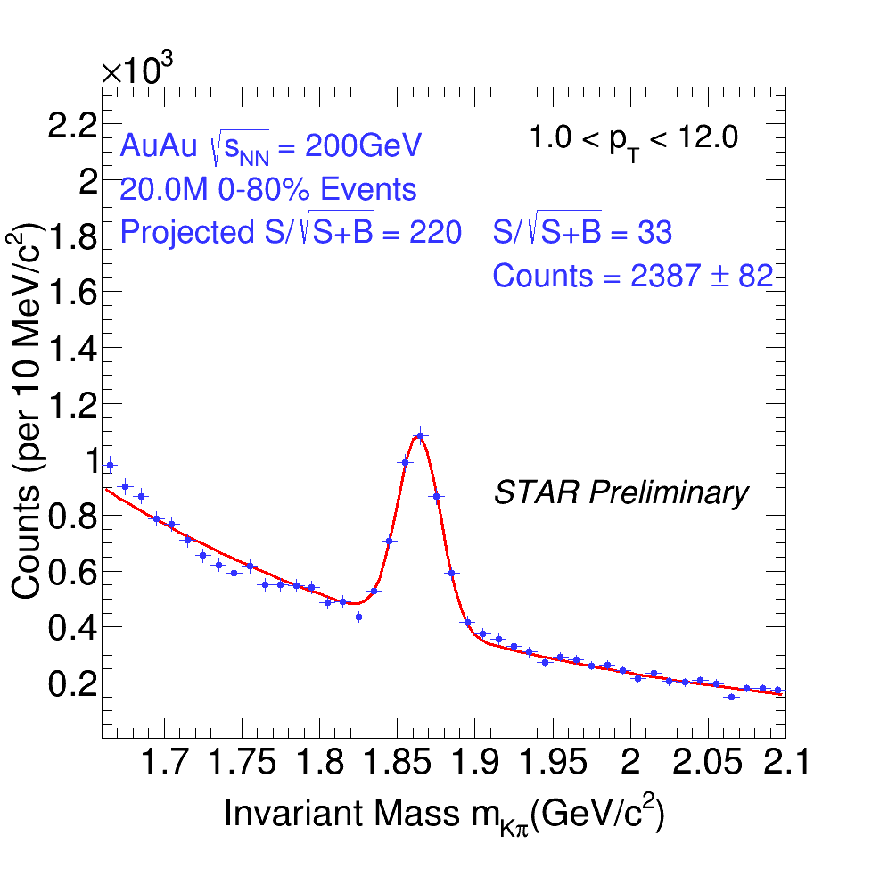
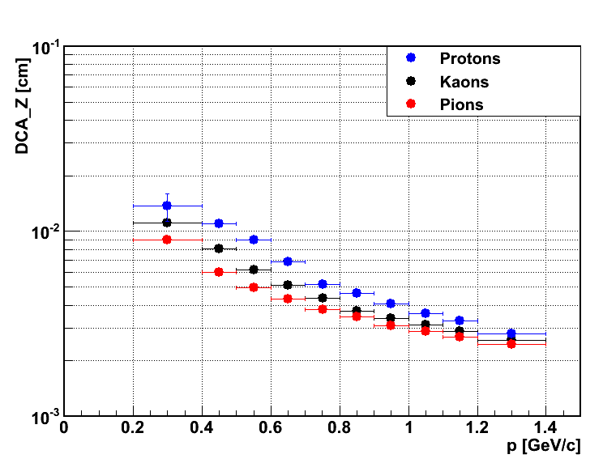
STAR Pixel Detector – Performance
46 µm
DCA pointing resolution
  46 µm for 750 MeV/c Kaons
  ~ 30 µm for p > 1 GeV/c
D⁰ → K π production in √s_{NN} = 200GeV Au+Au collisions
L. Musa (CERN) – International Winter Meeting on Nuclear Physics, Bormio, 8-11 Jan 2019

Slide 16
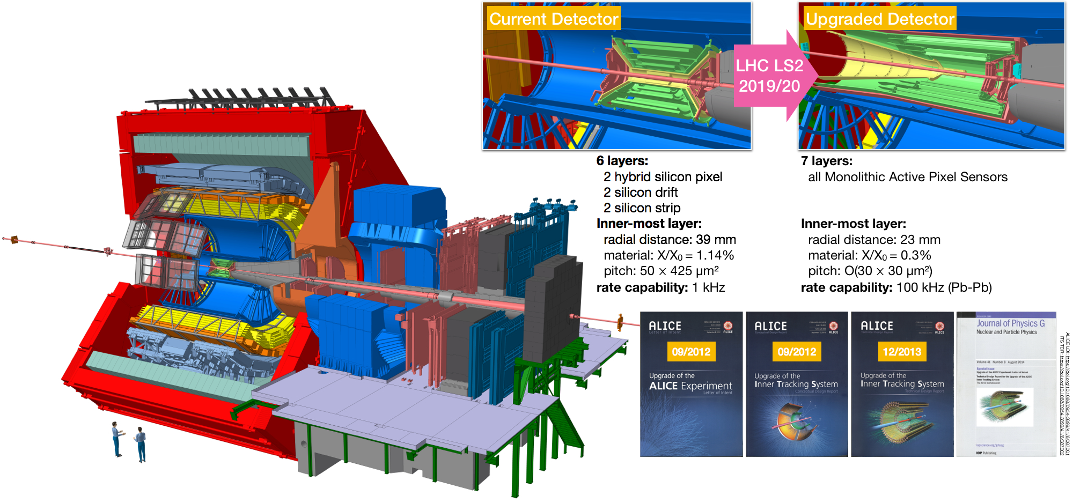
New Inner Tracking System based on CMOS sensors for ALICE
New Inner Tracking System (ITS)
CMOS Pixels
g improved resolution, less material, faster readout
Novel MAPS technology
|B| = 0.5 T
L. Musa (CERN) – International Winter Meeting on Nuclear Physics, Bormio, 8-11 Jan 2019

Slide 17
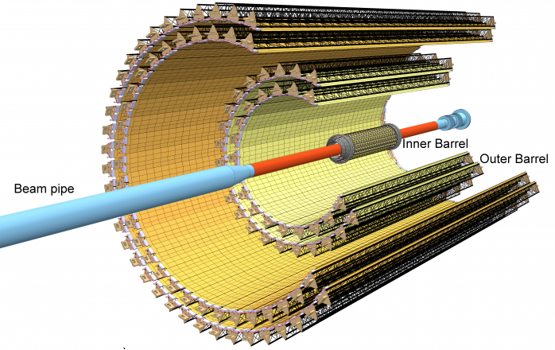

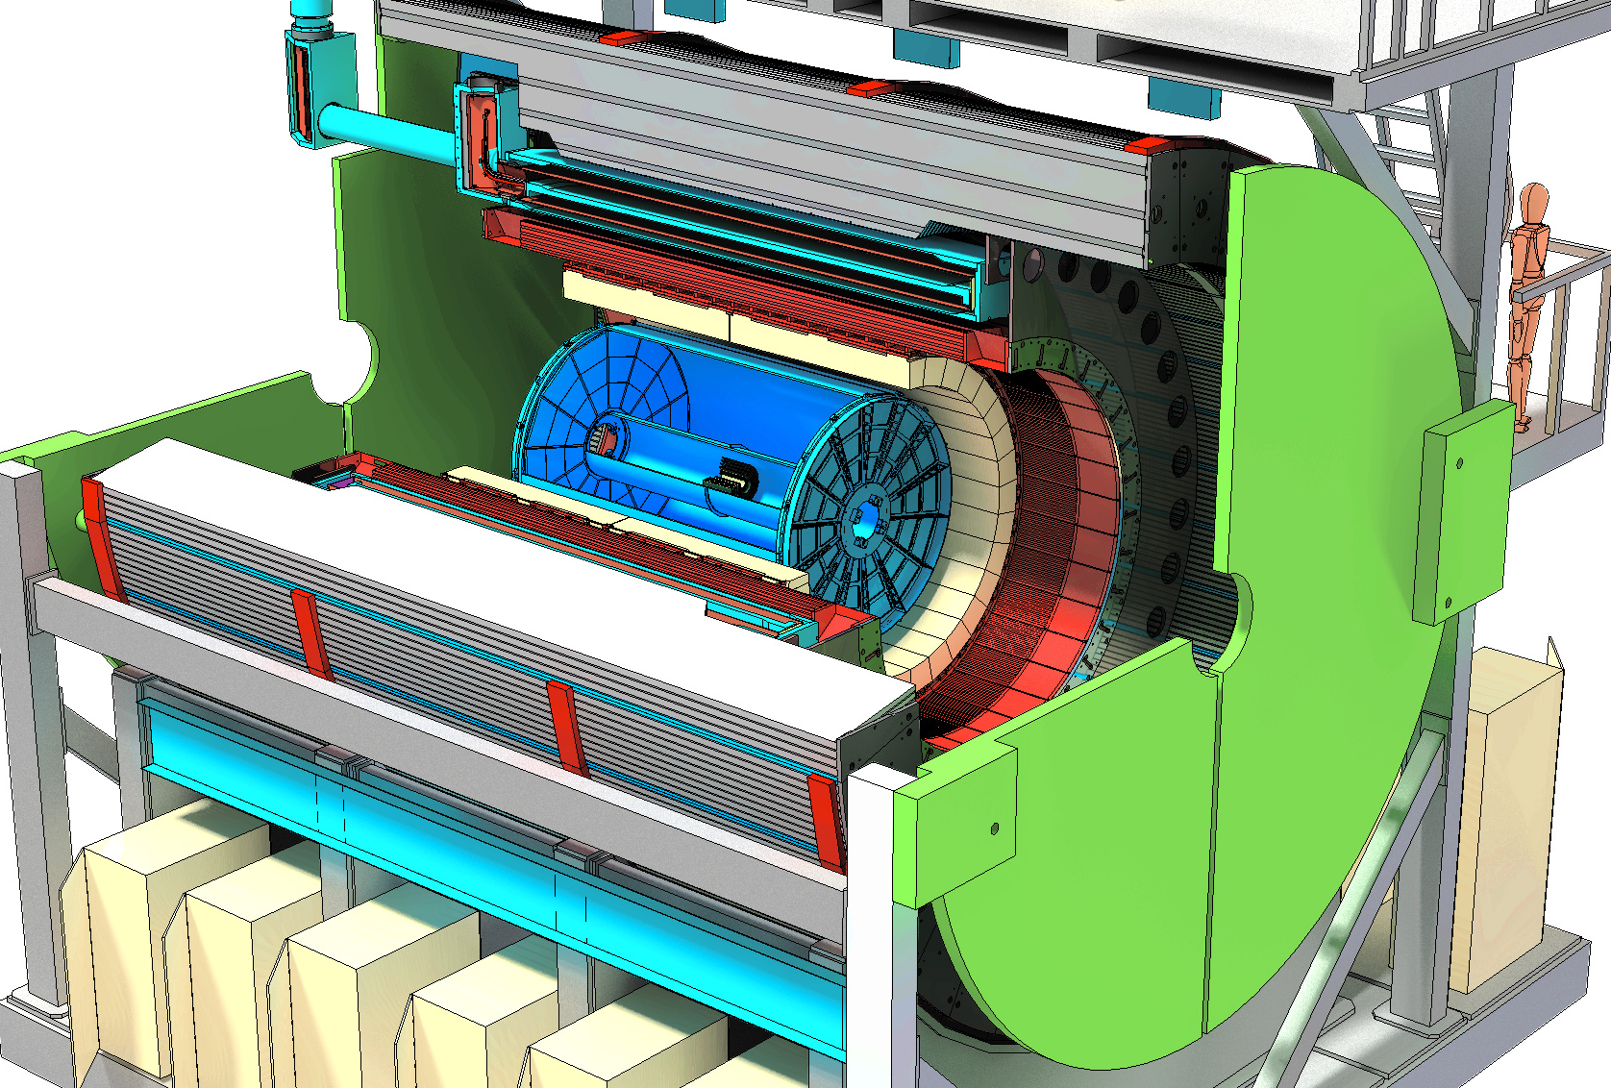
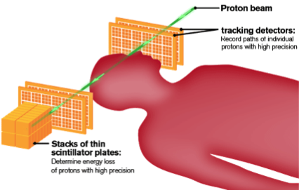
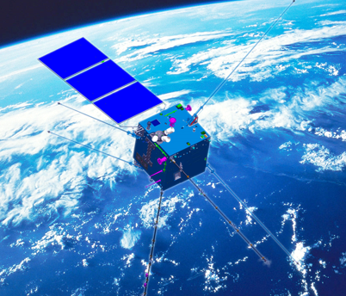
A new ITS: closer to IP, thinner, higher position resolution
Closer to IP: 39mm  22mm
Thinner: ~1.14%  ~ 0.3% (for inner layers)
Smaller pixels: 50μm x 425μm  27μm x 29μm
Increase granularity: 20 chan/cm³  2k pixel/cm³
Faster readout: x 10² Pb-Pb, x 10³ pp
10 m² active silicon area: 12.5 G-pixels, σ ≈ 5μm
40cm
147 cm
New ITS
ALPIDE (ALICE Pixel Detector) - Developed for the ALICE upgrade (ITS and MFT)
1.5 ≤ η ≤ 1.5
will be used (or it is proposed) for several other HEP detectors and non HEP applications
NICA MPD (@JINR)
sPHENIX (BNL)
proton CT (tracking)
CSES – HEPD2
…
L. Musa (CERN) – International Winter Meeting on Nuclear Physics, Bormio, 8-11 Jan 2019

Slide 18
A new ITS: closer to IP, thinner, higher position resolution
Impact parameter resolution
Tracking efficiency (ITS standalone)
Pointing Resolution
Tracking efficiency
pions
X 6
x 3
Total weight
1.4 grams
~40 μm at p_{T} = 500 MeV/c
L. Musa (CERN) – International Winter Meeting on Nuclear Physics, Bormio, 8-11 Jan 2019

Slide 19
ALICE CMOS Pixel Sensor
CMOS Pixel Sensor using 0.18μm CMOS Imaging Process
collection electrode
28 μm
N_{A} ~ 10¹⁶
2 x 2 pixel
volume
Artistic view of a SEM picture of ALPIDE cross section
N_{A} ~ 10¹³
N_{A} ~ 10¹³
N_{A} ~ 10¹⁸
C_{in} ≈ 5 fF
N_{A} ~ 10¹⁸
pixel capacitance ≈5 fF (@ V_{bb} = -3 V)
Q_{in} (MIP) ≈ 1300 e a V ≈ 40mV
High-resistivity (> 1kΩ cm) p-type epitaxial layer (25μm) on p-type substrate
Small n-well diode (2 μm diameter), ~100 times smaller than pixel => low capacitance (~fF)
Reverse bias voltage (-6V < V_{BB} < 0V) to substrate (contact from the top) to increase depletion zone around NWELL collection diode
Deep PWELL shields NWELL of PMOS transistors
➔ full CMOS circuitry within active area
L. Musa (CERN) – International Winter Meeting on Nuclear Physics, Bormio, 8-11 Jan 2019

Slide 20
ALICE CMOS Pixel Sensor
Blank Wafers QA at TMEC (SRP and XSEM measurements)
1 kΩcm
Wafer thickness 97.22μm
High-res epi: 25.28μm
L. Musa (CERN) – International Winter Meeting on Nuclear Physics, Bormio, 8-11 Jan 2019
20

Slide 21
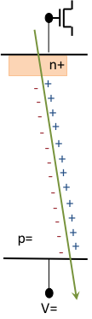
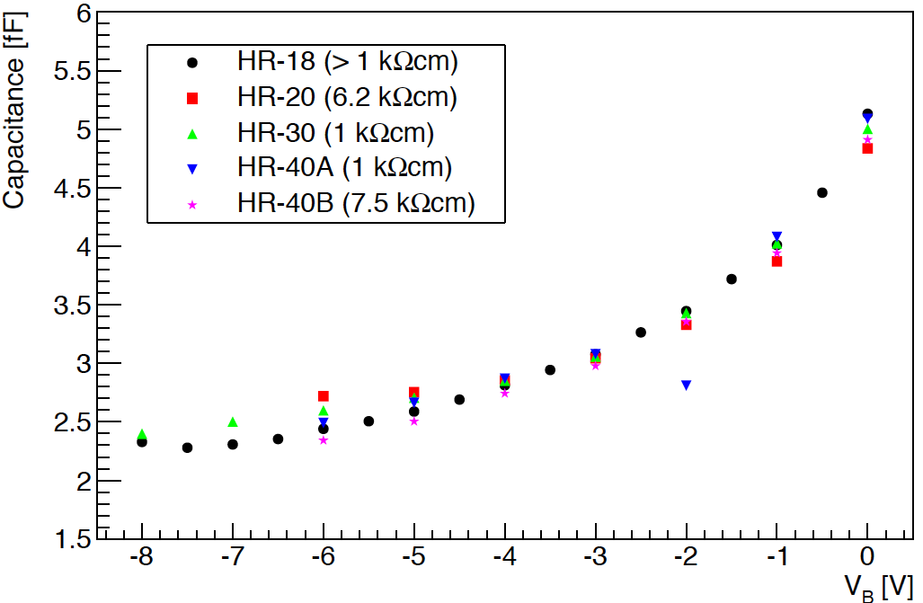
ALICE CMOS Pixel Sensor
Low capacitance ➔ large S/N at low power
Explorer chip (ALICE R&D)
NWELL DIODE output signal = Q /C
Minimize spread of charge over many pixels
minimize capacitance:
 small diode surface
 large depletion volume
Silicon strip capacitance: > 10 pF (~1.5 pF / cm)
Hybrid pixel capacitance: ~300 fF
MAPS “small electrode” pixel capacitance: < 5 fF
C_{d} = 1fF: 1300 e⁻ ➔ 200mV (almost a digital signal)
L. Musa (CERN) – International Winter Meeting on Nuclear Physics, Bormio, 8-11 Jan 2019

Slide 22
ALICE PIxel DEtector (ALPIDE)
1024 pixel columns
AMP
COMP
130,000 pixels / cm² 27x29x25 μm³
charge collection time <30ns (V_{bb} = -3V)
Max particle rate: 100 MHz/cm²
fake-hit rate: < 1 Hz/ cm²
power : ≈300 nW /pixel (<40mW/cm²)
THR
zero suppression
zero suppression
zero suppression
zero suppression
signal processing circuitry integrated in pixel matrix
512 rows
Matrix Layout
Pixel Layout
Bias, Data Buffering, Interface
50μm thick
4 pixels
pads over matrix
pixel matrix
periphery
L. Musa (CERN) – International Winter Meeting on Nuclear Physics, Bormio, 8-11 Jan 2019
4 pixels

Slide 23
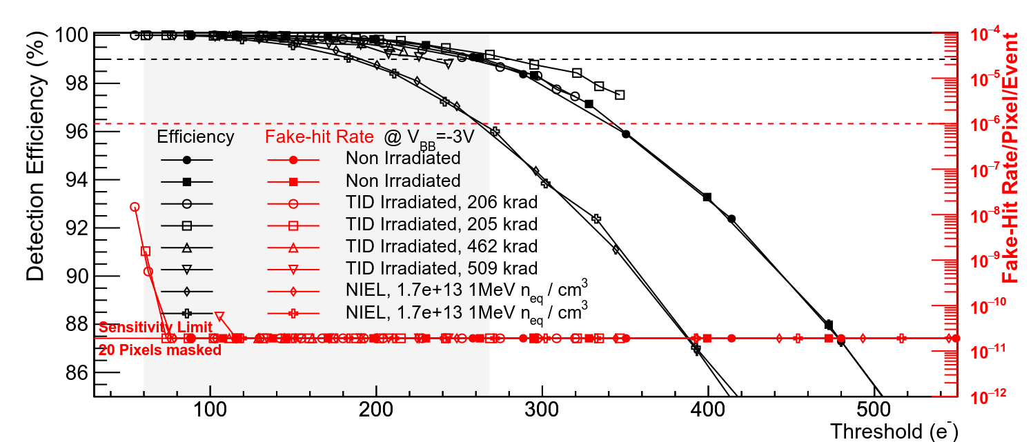
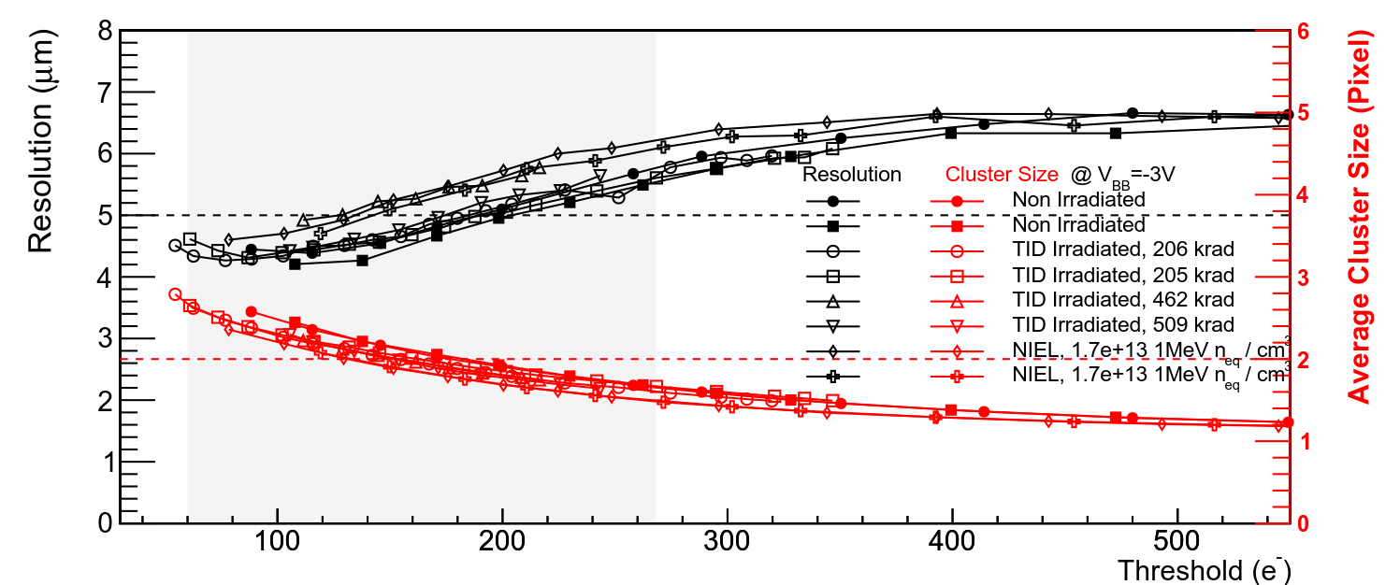
ALICE PIxel DEtector (ALPIDE)
99%
6 GeV/c π
Large operational margin with only 10 masked pixels (0.002%), fake-hit rate < 2 x 10⁻¹¹ pixel/event
Non irradiated and TID/NIEL chips similar performance
10x lifetime NIEL
Non irradiated
Nucl. Phys. A 967 (2017) 900-903
Nucl. Phys. A 967 (2017) 900-903
6 GeV/c π
5 μm resolution @ 200 e⁻ threshold
Chip-to-chip negligible fluctuations
L. Musa (CERN) – International Winter Meeting on Nuclear Physics, Bormio, 8-11 Jan 2019

Slide 24
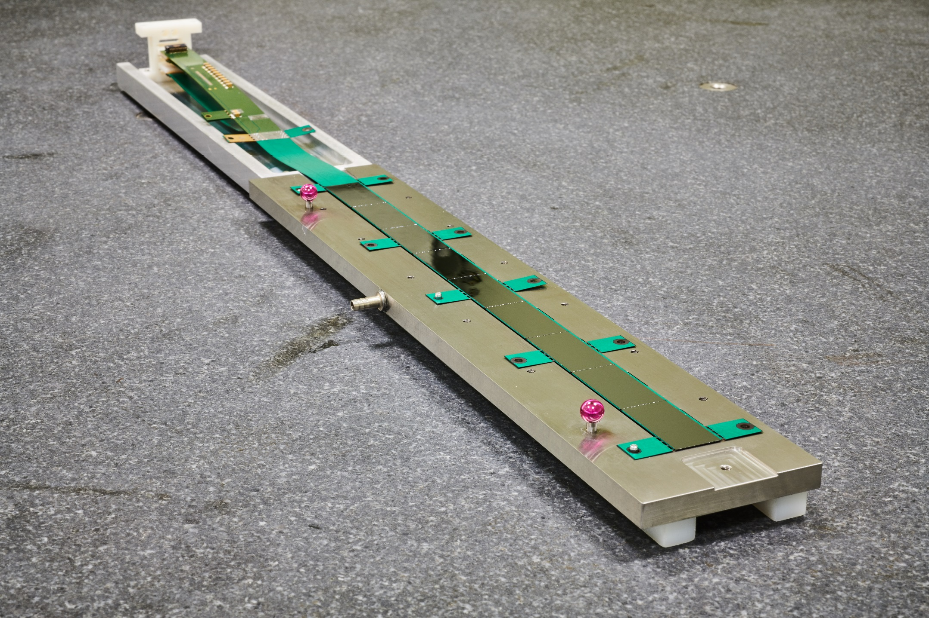
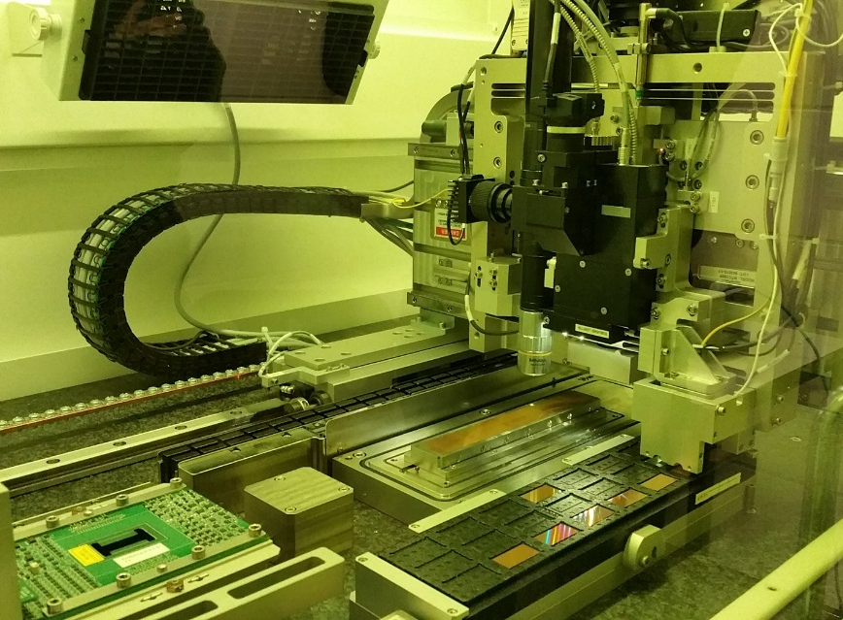
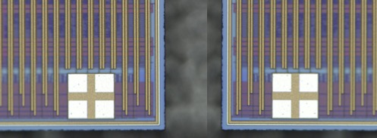
ALICE PIxel DEtector (ALPIDE)
Sensor test and HIC assembly
using ALICIA machine
Inner Barrel is built at CERN
ALICIA - High-precision automated machine
150 µm
Sensors
100 µm
pixel matrix
pixel matrix
L. Musa (CERN) – International Winter Meeting on Nuclear Physics, Bormio, 8-11 Jan 2019

Slide 25
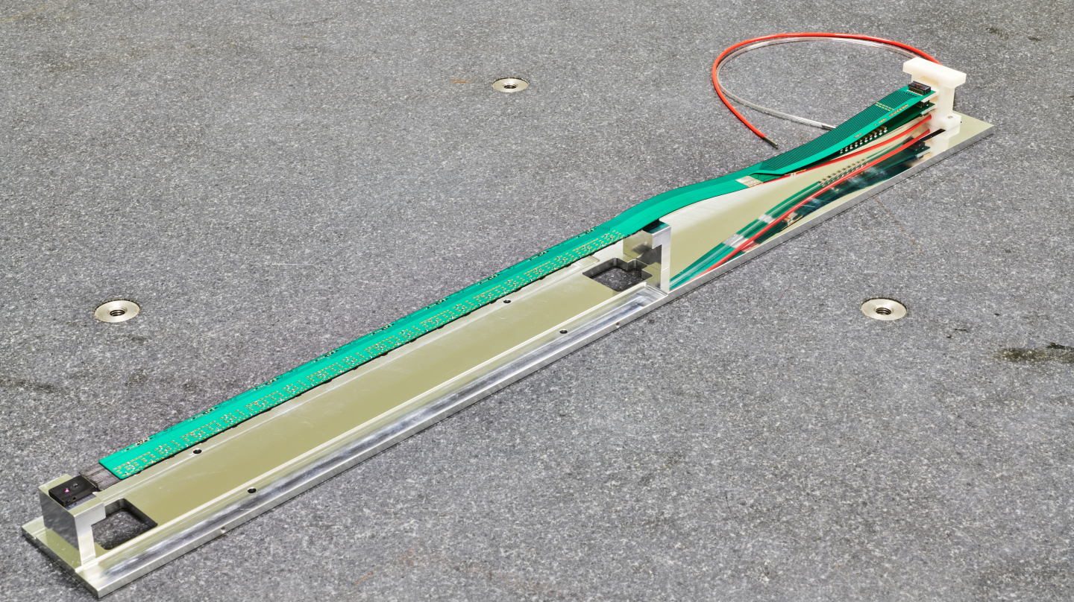
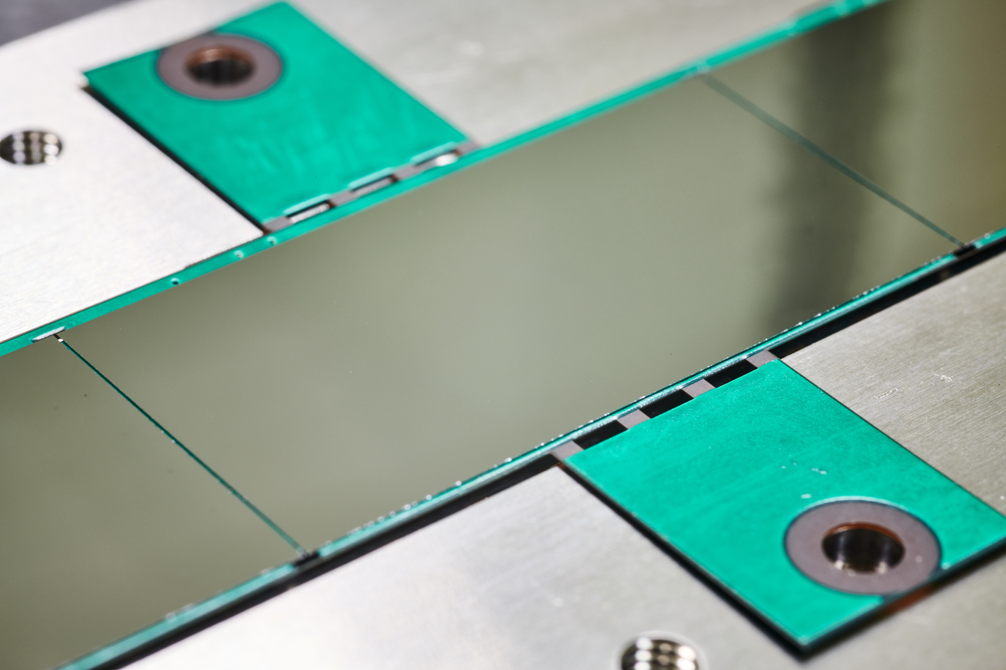
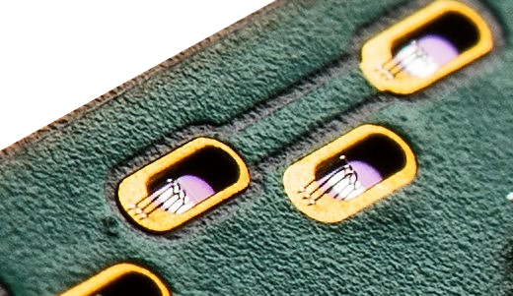
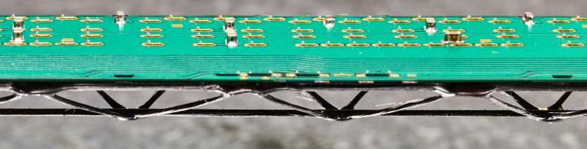
ALICE PIxel DEtector (ALPIDE)
L. Musa (CERN) – International Winter Meeting on Nuclear Physics, Bormio, 8-11 Jan 2019

Slide 26
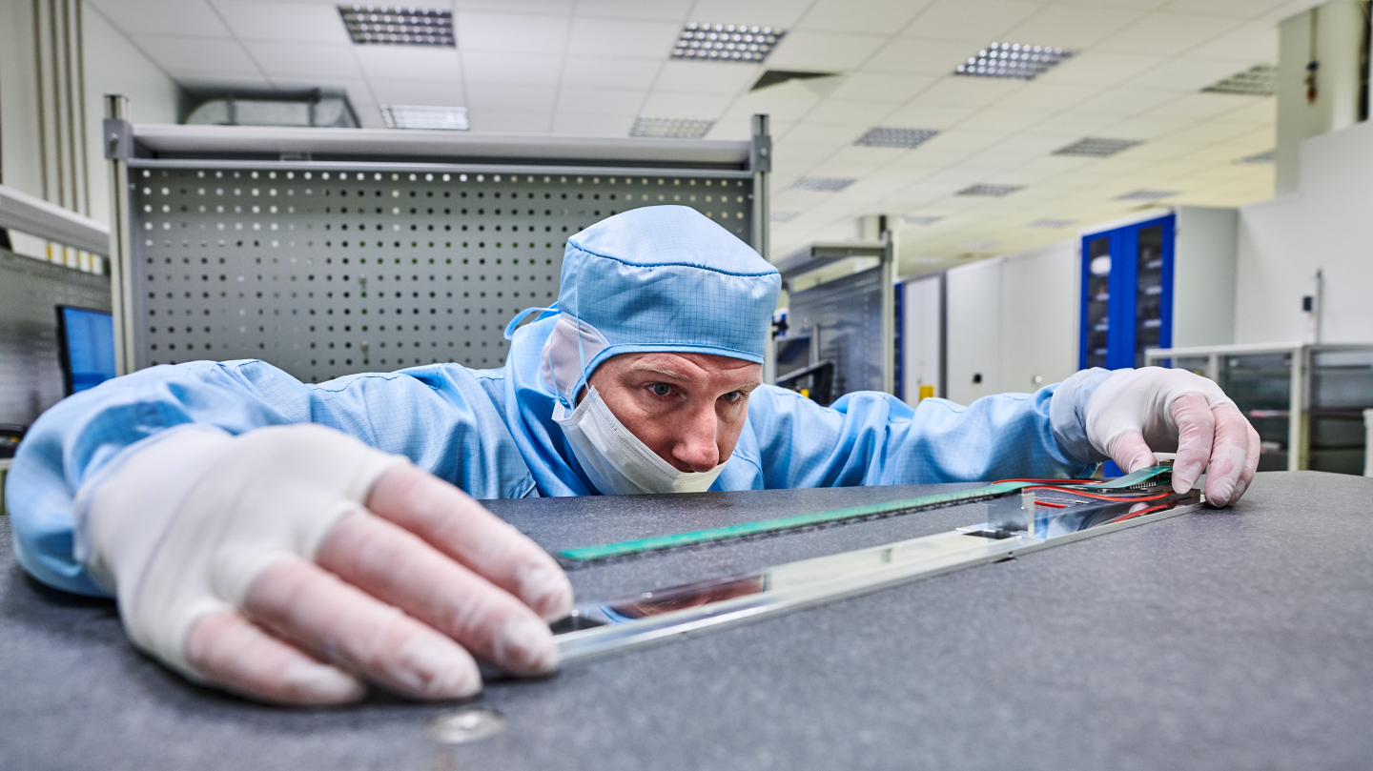
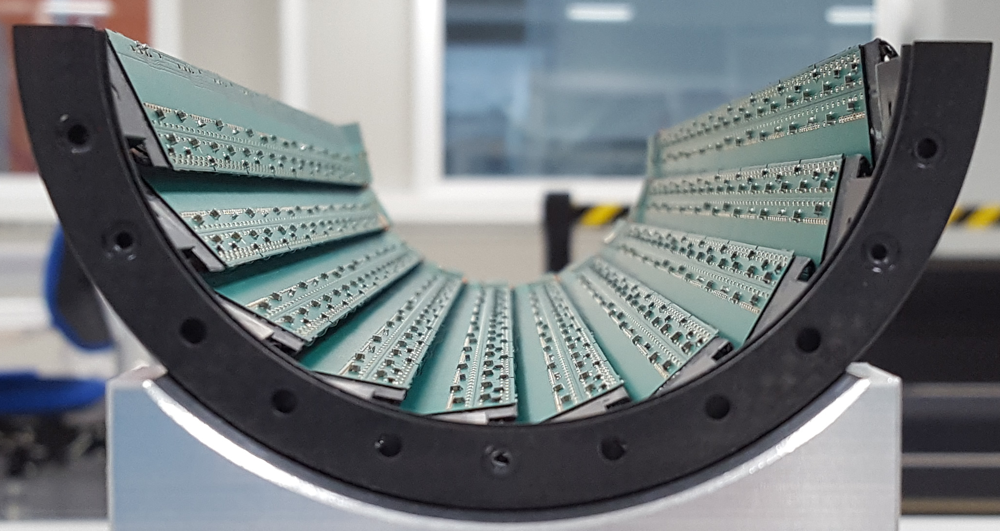
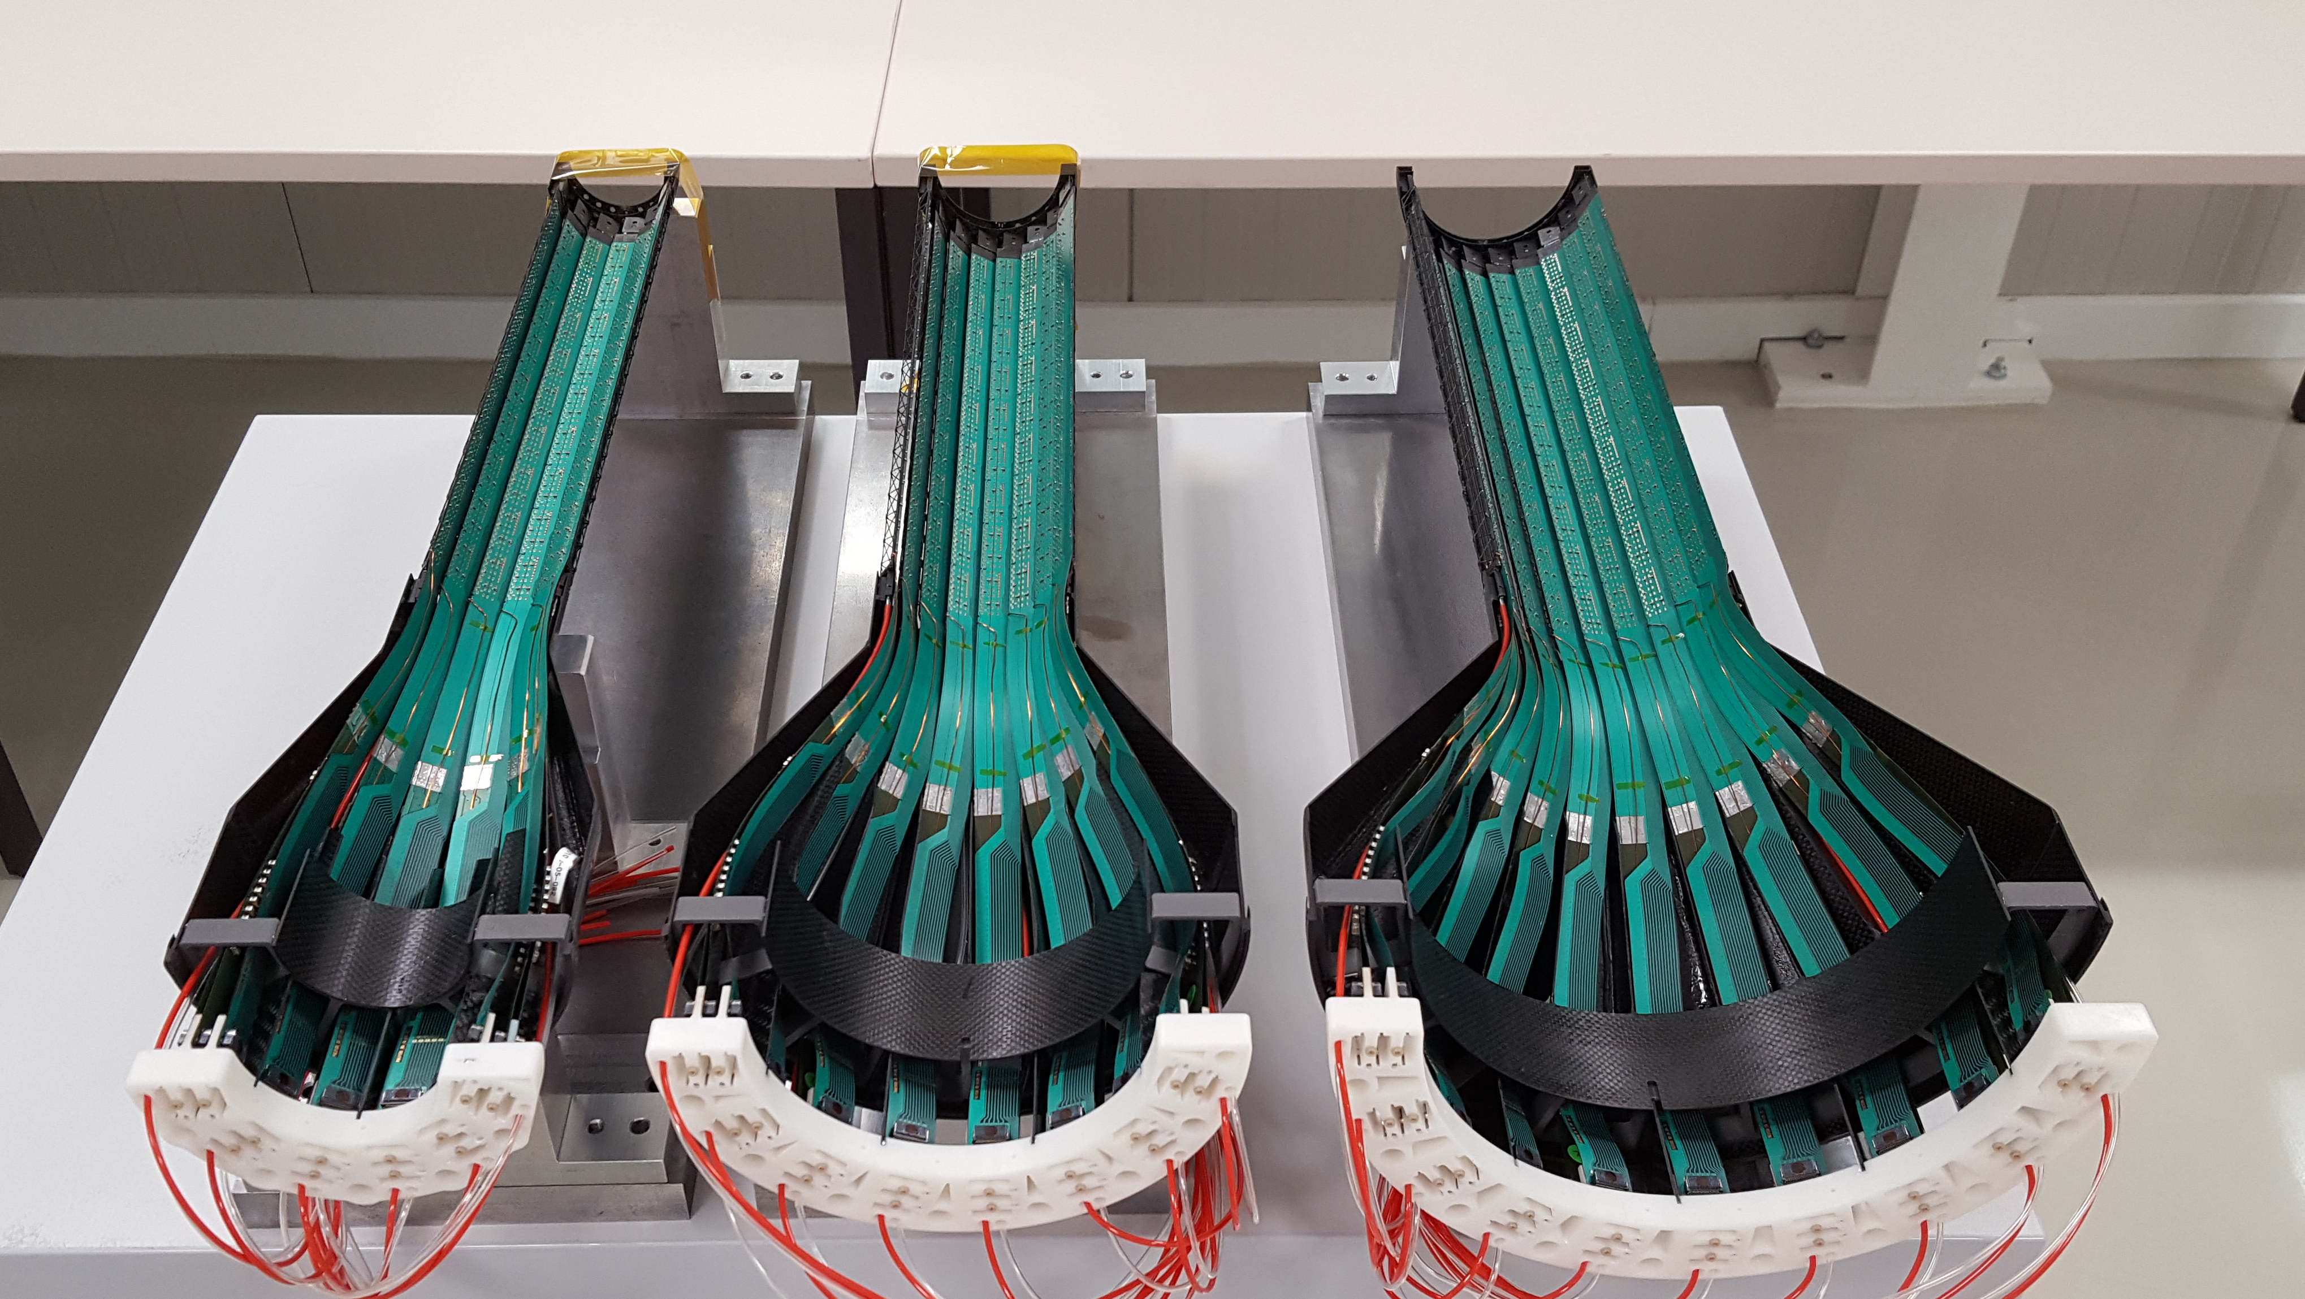
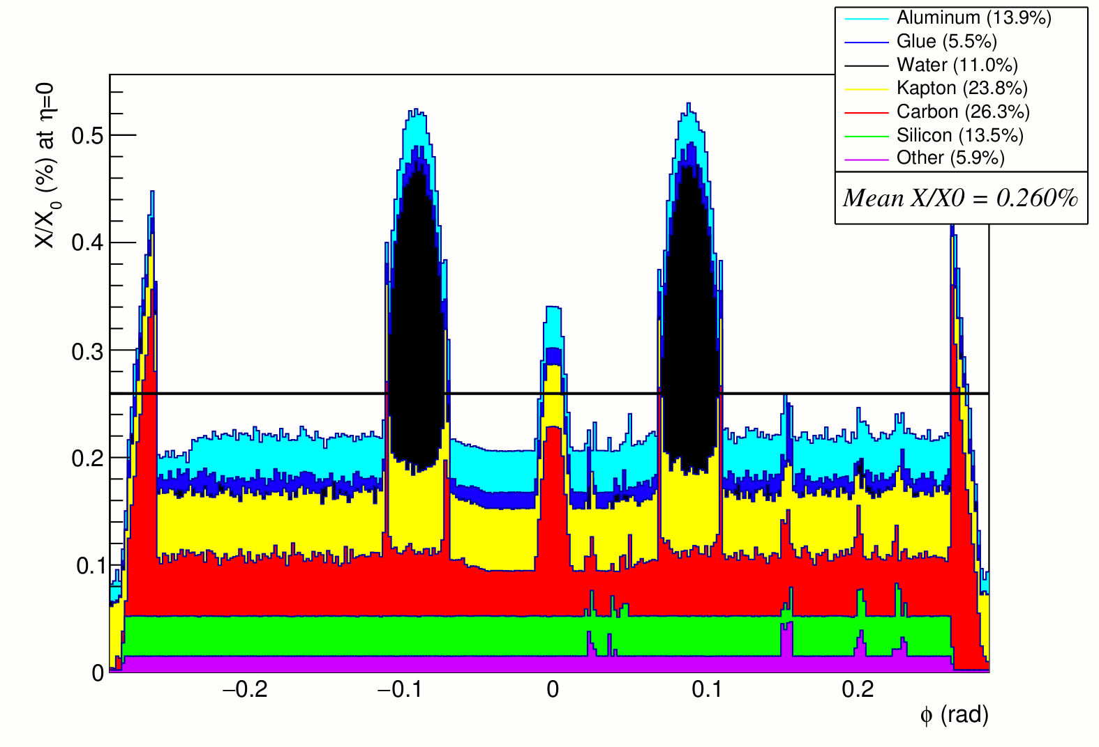
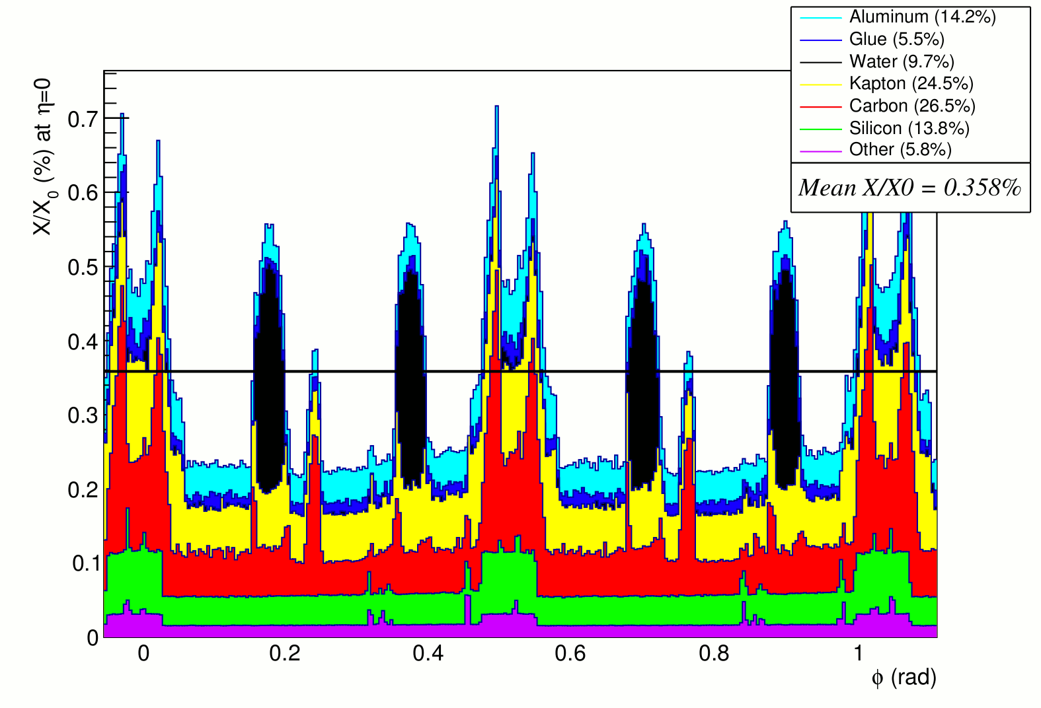
ALICE PIxel DEtector (ALPIDE)
Inner Barrel Production completed and all layers assembled
Inner half-barrel
Material budget
Single stave, perpendicular tracks
Tilted staves with overlap, inclined tracks
L. Musa (CERN) – International Winter Meeting on Nuclear Physics, Bormio, 8-11 Jan 2019

Slide 27
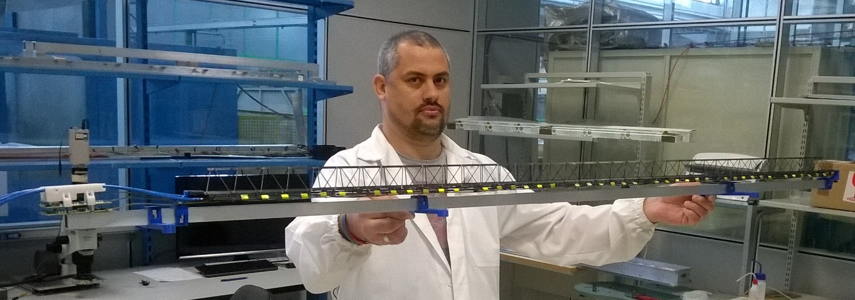
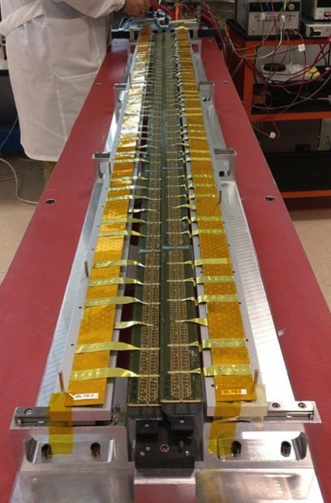
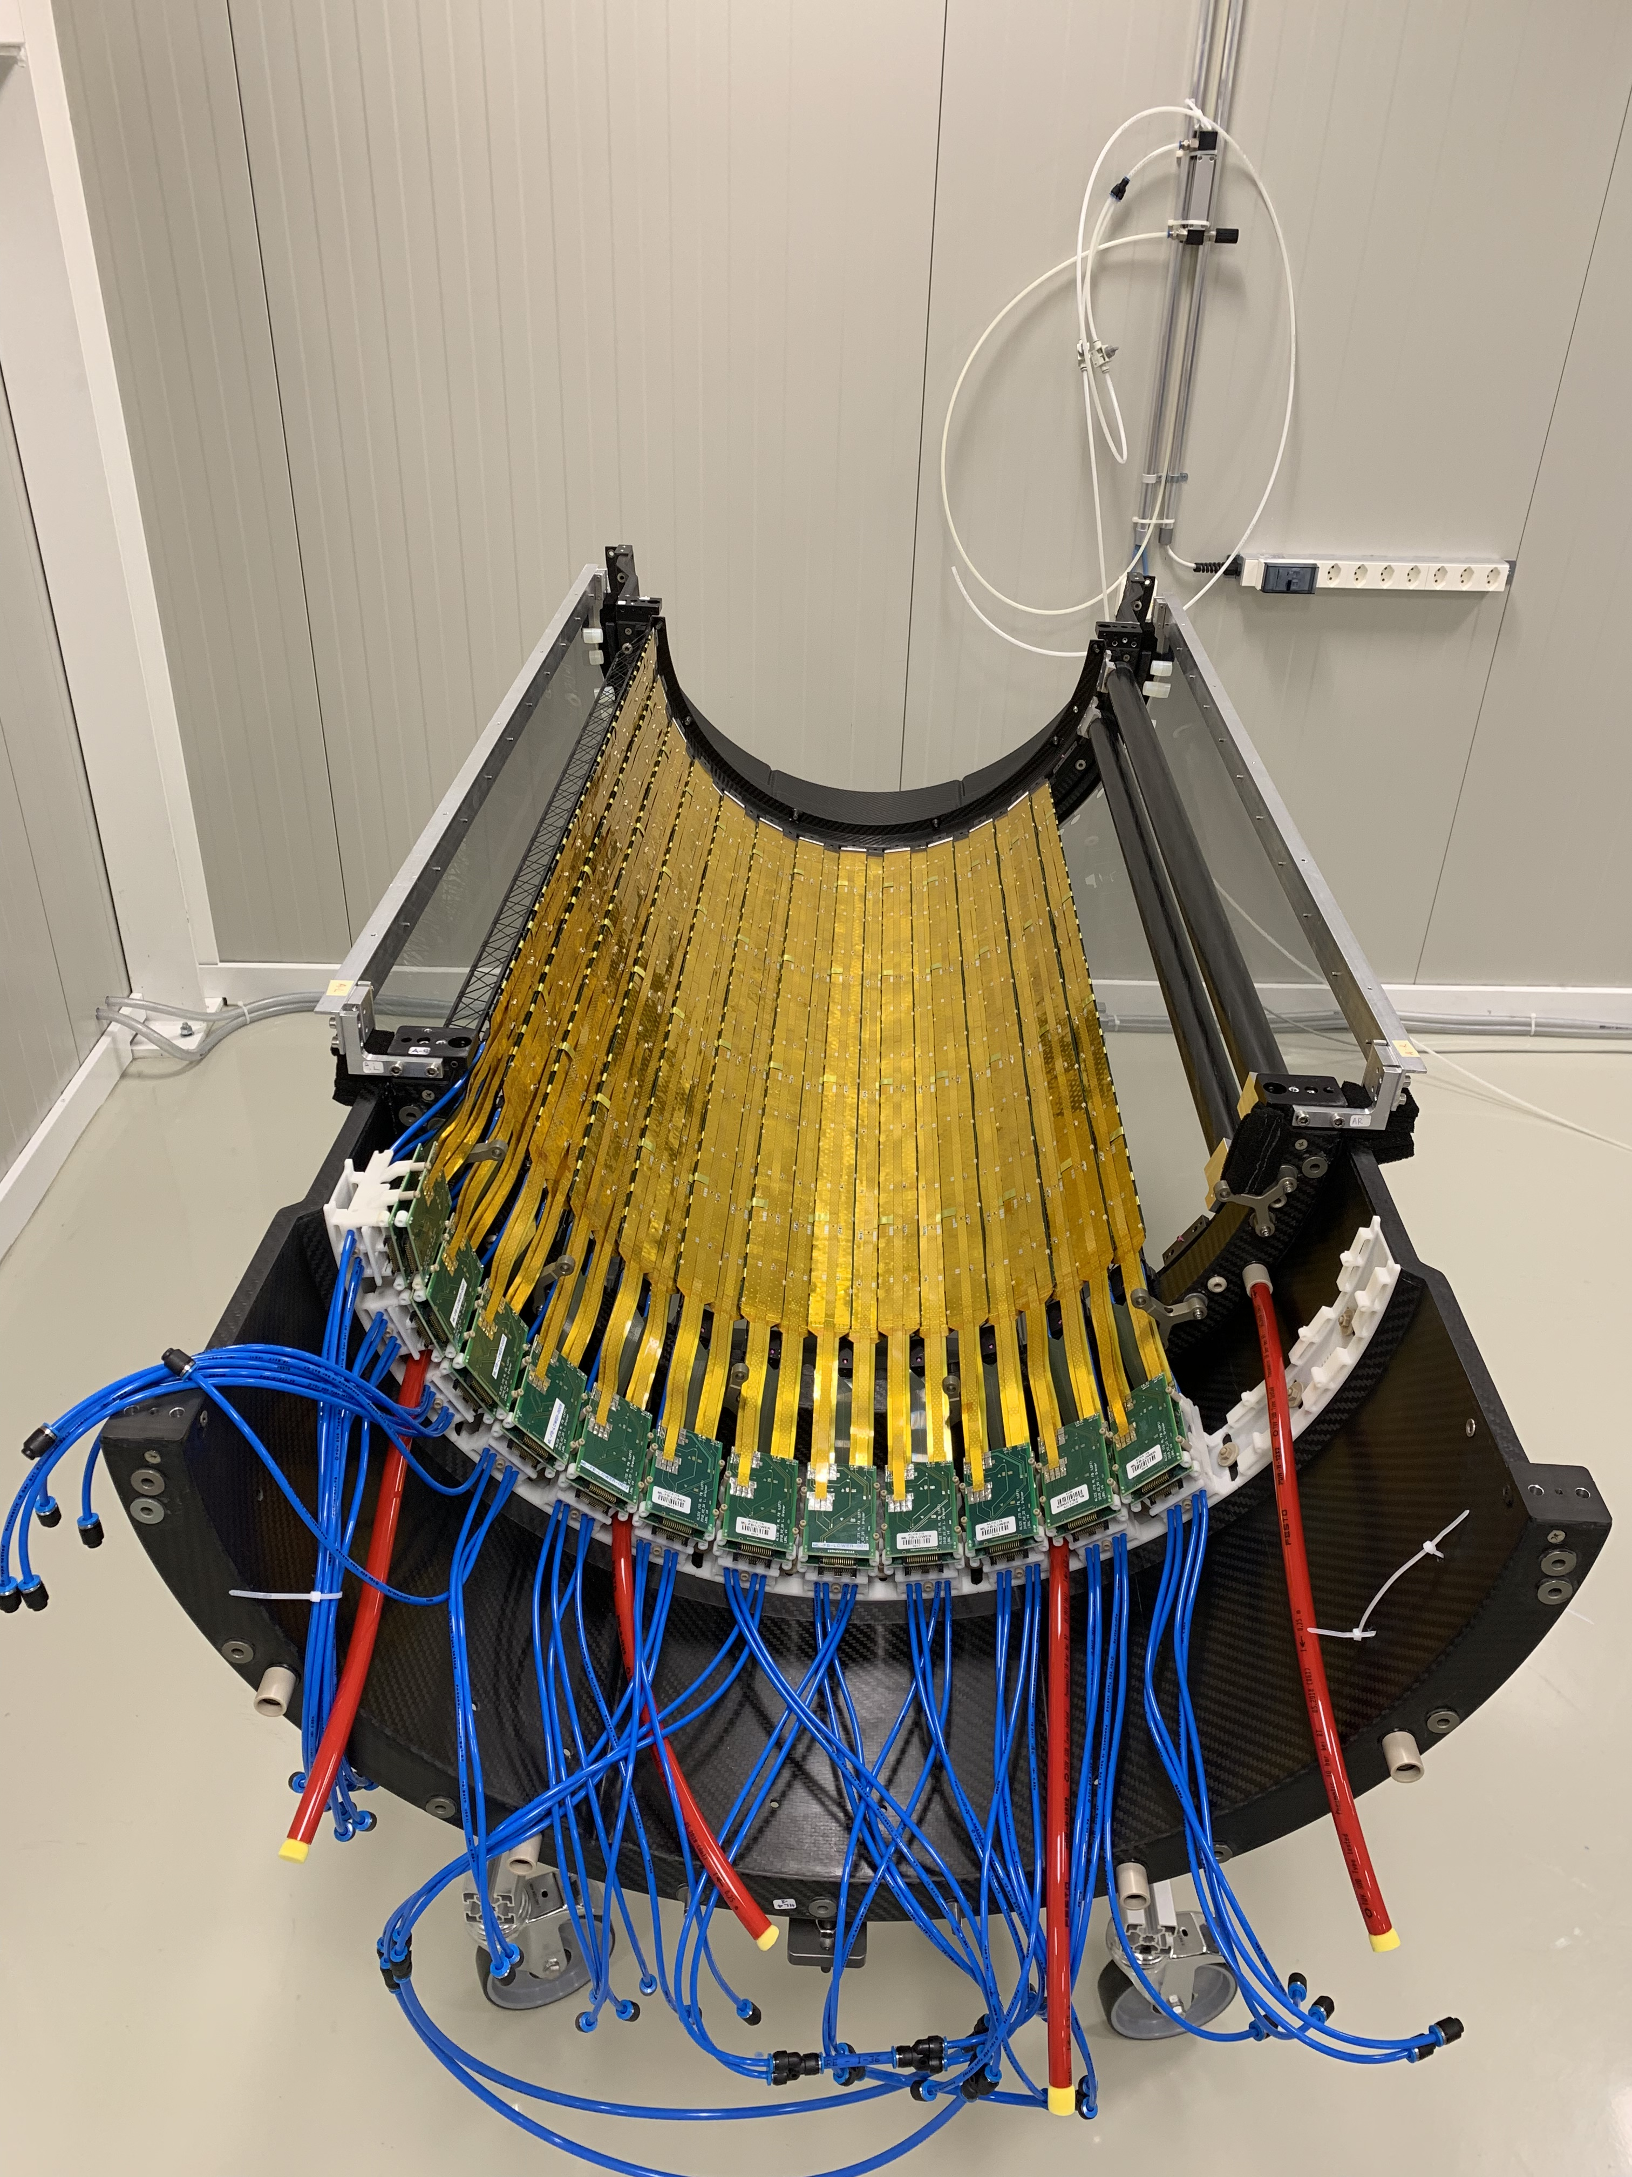
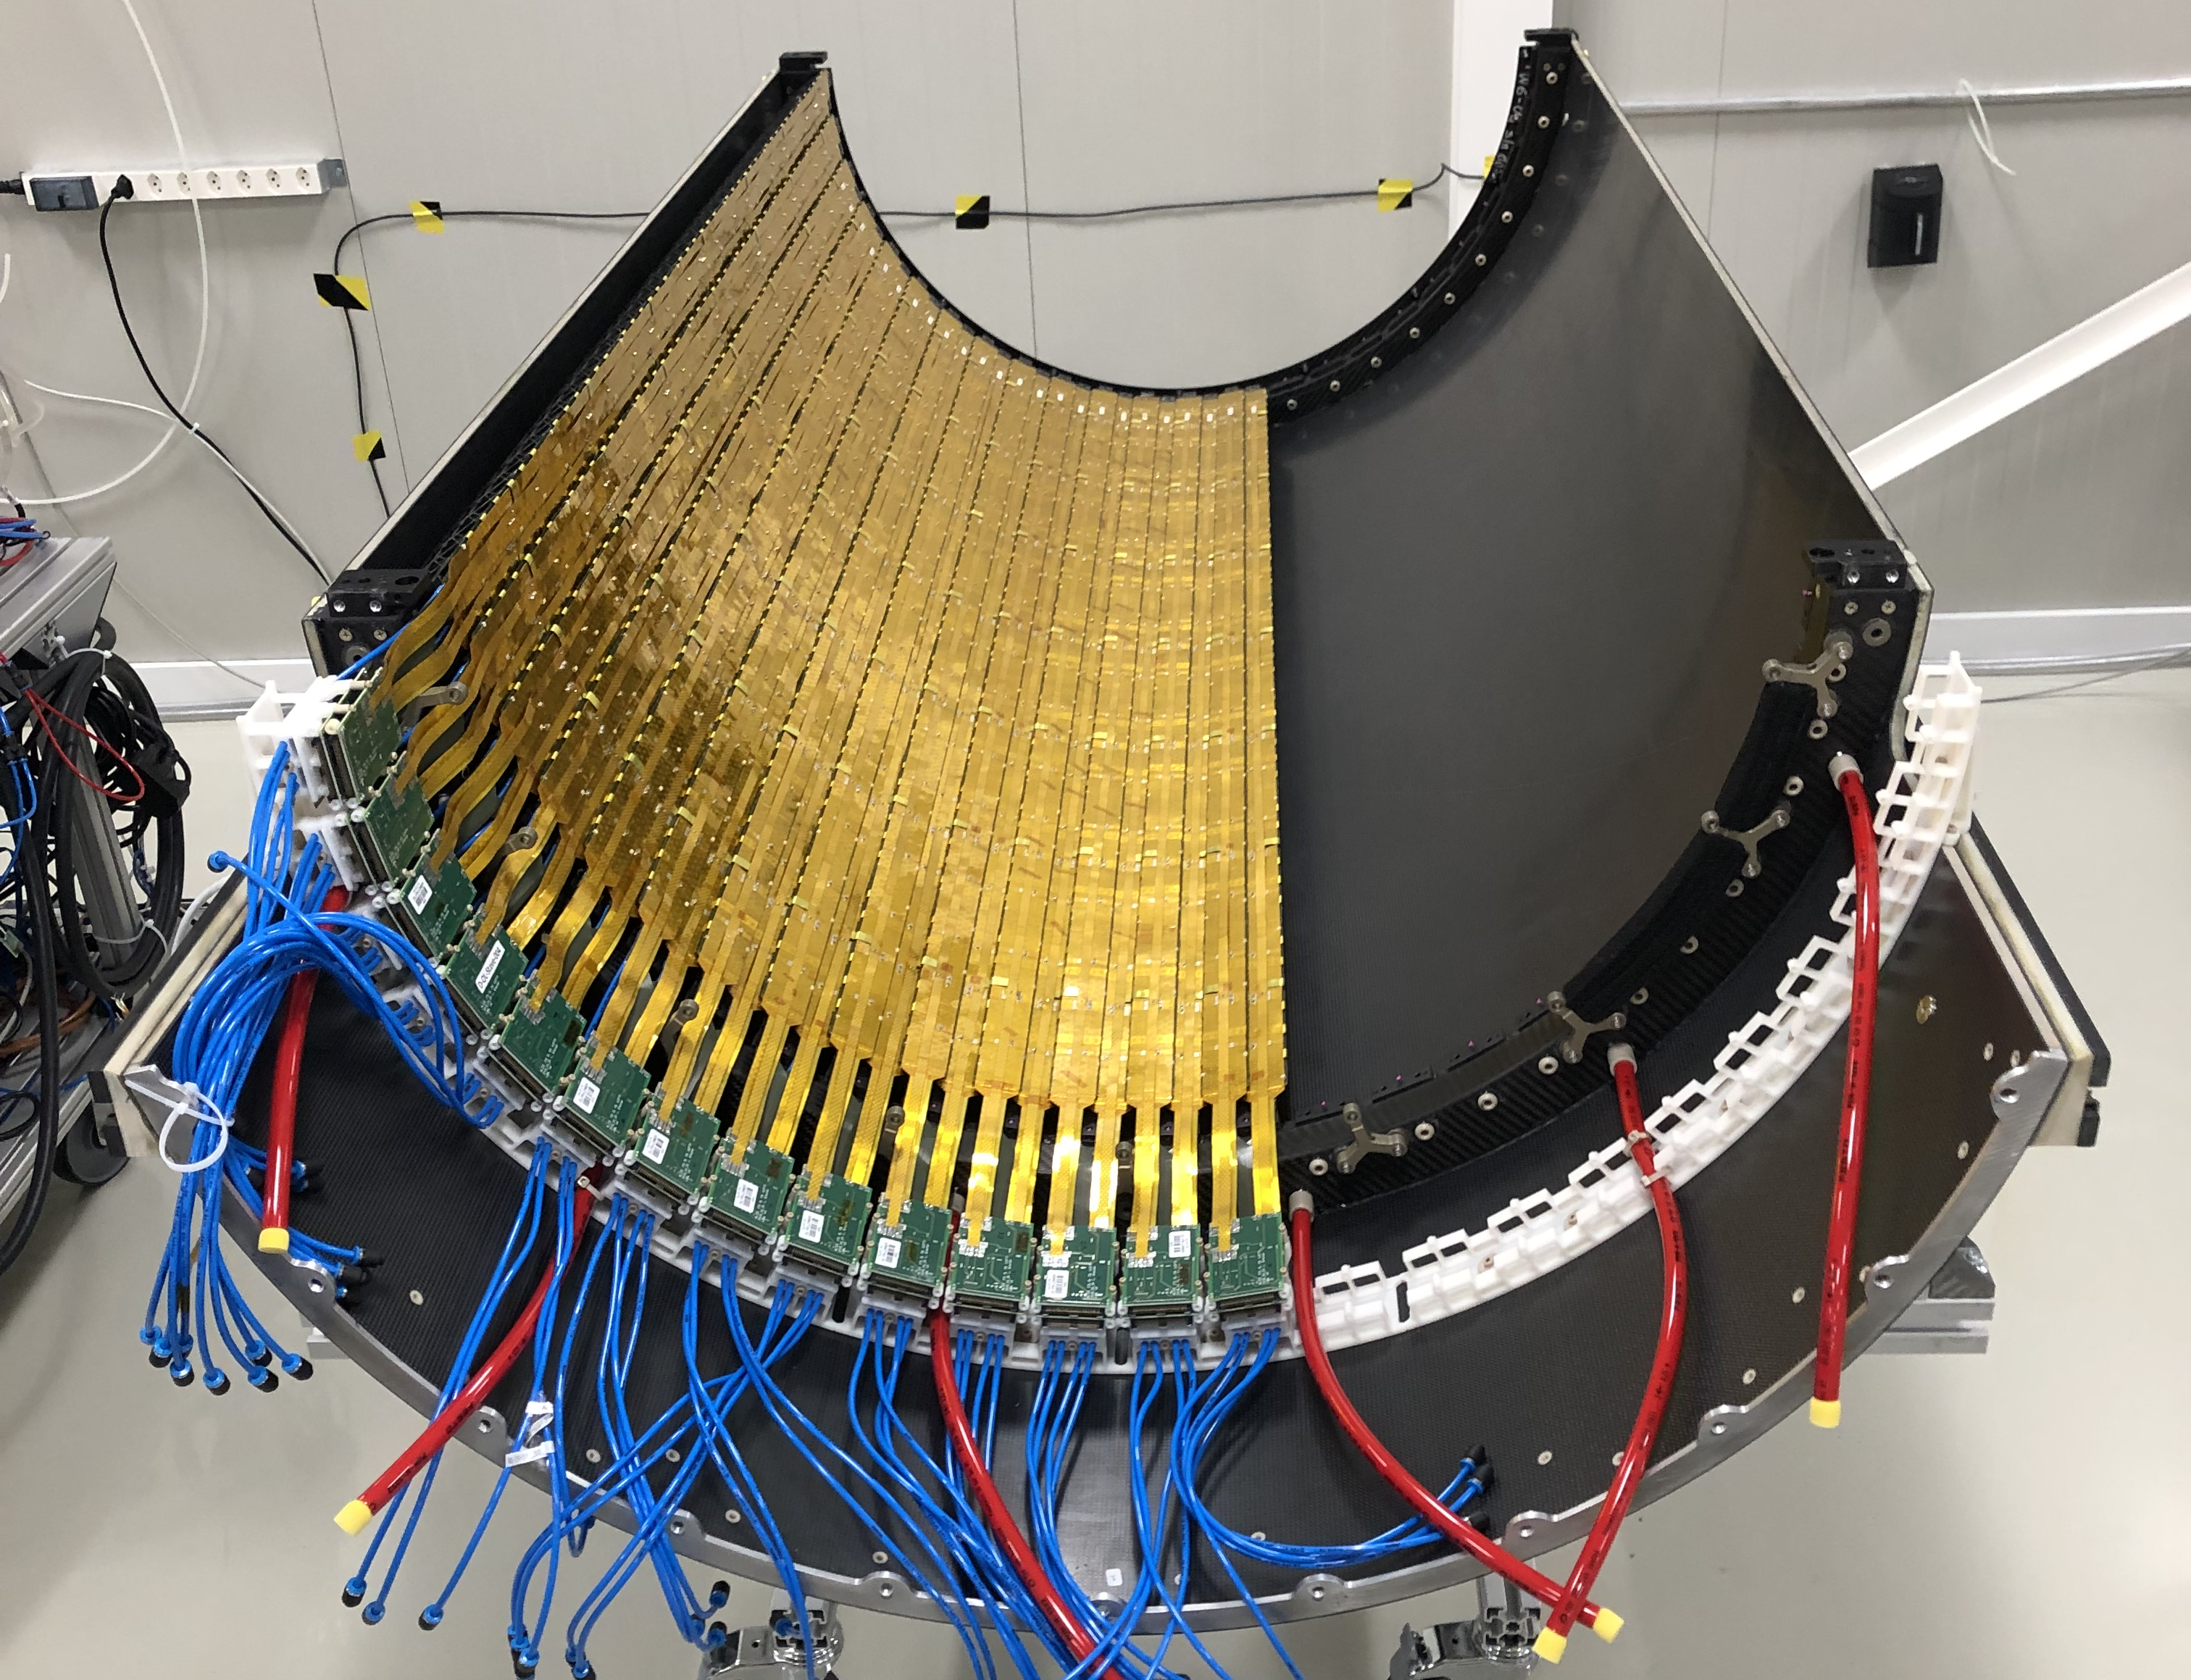
ALICE PIxel DEtector (ALPIDE)
102 Million pixel, average noise uniform ~ 5e
Layer-4
Layer-6
L. Musa (CERN) – International Winter Meeting on Nuclear Physics, Bormio, 8-11 Jan 2019

Slide 28
Ultra-lightweight Vertex Detector
Approaching 0-mass detector
L. Musa (CERN) – International Winter Meeting on Nuclear Physics, Bormio, 8-11 Jan 2019

Slide 29
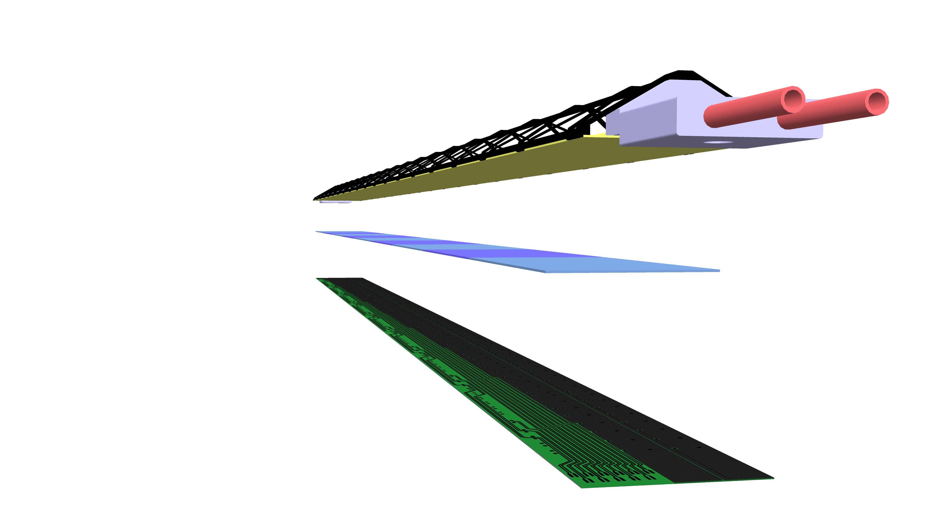
ALICE ITS2 Material Budget
ITS2
Flex Printed Circuit
40 cm
9 Pixel Sensors
Cold Plate
Space Frame
Cooling Pipe
147 cm
Silicon 14%
Inner half-barrel
Single stave, perpendicular tracks
Tilted staves with overlap, inclined tracks
L. Musa (CERN) – International Winter Meeting on Nuclear Physics, Bormio, 8-11 Jan 2019

Slide 30
Can we further reduce the material budget?
How to further reduce material budget?
Eliminate active cooling …
… replace with low forced air flow (< 3 m/s)
viable for power densities below 20mW/cm²
Eliminate electrical substrate
Possible if sensor covers the full stave length
Cooling Ducts
Space Frame
Cold Plate
9 Pixel Sensors
Flex Printed Circuit
ALPIDE Chip: pixel matrix power 7mW/cm² … … the rest (~33mW/cm²) is dissipated by the peripheral circuitry
a Can we put the circuit periphery at the periphery of the detector?
pixel matrix
periphery
L. Musa (CERN) – International Winter Meeting on Nuclear Physics, Bormio, 8-11 Jan 2019

Slide 31
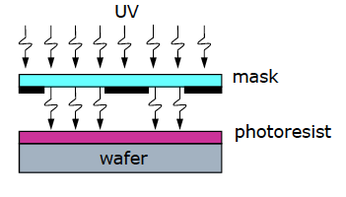


Stitching allows the fabrication of wafer scale sensors
CMOS photolithographic process
defines wafer reticles size
Typical field of view O(2 x 2 cm²)
Reticle is stepped across the wafers to create multiple identical images of the circuit(s)
staves built by tiling several sensors
Stitching allows fabrication of sensors larger than the reticle size
14cm
27cm
Courtesy: R. Turchetta, Rutherford Appleton Laboratory
L. Musa (CERN) – International Winter Meeting on Nuclear Physics, Bormio, 8-11 Jan 2019

Slide 32


Ultra-thin curved silicon chips
Can we exploit flexible nature of thin silicon ?
Silicon Genesis: 20 micron thick wafer
Chipworks: 30µm-thick RF-SOI CMOS
Ultra-thin chip (<50 um): flexible with good stability
van den Ende DA et al. Mechanical and electrical properties of ultra-thin chips and flexible electronics assemblies during bending.
Mircoelectron reliab (2014), http://dx.doi.org/10.1016/j.microrel.2014.07.125
L. Musa (CERN) – International Winter Meeting on Nuclear Physics, Bormio, 8-11 Jan 2019

Slide 33





Vertex Detector (innermost 3 layers)
Truly cylindrical vertex detector
Beampipe
IR 16 mm
ΔR 0.5mm
0.05% x/X₀ per layer
Pipe: r ≈ 16mm , ΔR = 0.5mm
L0: r ≈ 18mm , L1: r ≈ 24mm. L2: r ≈ 30 mm
Layers supported by high-thermal conductive carbon foam
Open cell carbon foam
Open cell carbon foam
L. Musa (CERN) – International Winter Meeting on Nuclear Physics, Bormio, 8-11 Jan 2019

Slide 34

ITS3 – System Integration
Detector and service integration similar to ITS2
L. Musa (CERN) – International Winter Meeting on Nuclear Physics, Bormio, 8-11 Jan 2019

Slide 35

Tracking Performance
R. Shahoyan - 2018
B = 0.5 Tesla
IT outside BP
IT inside BP
1.6cm
2.8cm
IT (L₀ , L₁, L₂)
beam pipe (BP)
Pointing resolution (pions): ≈ 10 μm @ 1 GeV/c, <50μm @ 200 MeV/c
IT inside BP
L. Musa (CERN) – International Winter Meeting on Nuclear Physics, Bormio, 8-11 Jan 2019

Slide 36
Concluding Remarks
The use of CMOS imaging technologies opens new opportunities
Ultra-lightweight vertex detectors, large area tracking detectors and digital calorimeters
  a Drastic reduction of power consumption and material budget
  enhanced performance (spatial and time resolution)
  a reduction of power consumption and material budget
  large cost saving due to low production costs wrt to conventional silicon strip and hybrid pixel technologies
Based on this technology, a concept for a nearly massless vertex detector (x/X₀ <0.05%) has been developed by ALICE experiment for the study of heavy-flavor and low-mass dileptons in nuclear-nuclear collisions at the LHC
L. Musa (CERN) – International Winter Meeting on Nuclear Physics, Bormio, 8-11 Jan 2019
36

Slide 37
Thank You
L. Musa (CERN) – International Winter Meeting on Nuclear Physics, Bormio, 8-11 Jan 2019

Slide 38


ALICE PIxel DEtector (ALPIDE)
3 in pixel Multi Event Buffers
In-pixel Pulsing (Analog/Digital)
Pixel masking
C_{det}~2.5 fF @ -3 V_{bb}
C_{in}~1.6 fF
max hit rate (limited by input node)
~ 100 MHz / cm²
Analog front-end continuously active, acts as an analogue delay line (~1 µs peaking time)
Global threshold for discrimination => binary pulse OUT_D
Digital in-pixel circuitry with three hit storage registers (multi event buffer)
Global shutter (STROBE) latches the discriminated hits in next available register
L. Musa (CERN) – International Winter Meeting on Nuclear Physics, Bormio, 8-11 Jan 2019

Slide 39




ALICE PIxel DEtector (ALPIDE)
Thresholds and Noise
Noise Map
S-curve scan using internal charge injection circuit
keep comparator threshold fixed
inject varying charges
extract threshold and noise from error-function fit
noise in electrons
Noise
Thresholds MAP
thresholds in electrons
Thresholds
L. Musa (CERN) – International Winter Meeting on Nuclear Physics, Bormio, 8-11 Jan 2019

Slide 40
ALICE PIxel DEtector (ALPIDE)
Reception test at CERN
Comparison between full stave and stand-alone chip
100 million pixels
L. Musa (CERN) – International Winter Meeting on Nuclear Physics, Bormio, 8-11 Jan 2019

Slide 41




ALICE PIxel DEtector (ALPIDE)
Detector Construction and Assembly
Module: till March/April 19
Staves: till Jul/Aug 19
Apr ‘19
Aug ‘19
Commissioning on ground with final services full detector operation 24/7
May ‘20
Installation
6-month Global Commissioning
Feb ‘21
L. Musa (CERN) – International Winter Meeting on Nuclear Physics, Bormio, 8-11 Jan 2019

Slide 42




What’s next? - Future R&D opportunities using CMOS technologies
High-Granularity Digital Calorimeter Prototype
R&D in the context of FoCal in ALICE
4 x 4 x 10 cm³ prototype
Extremely compact design
Small Moliere radius (RM = 10.5 ± 0.5mm)
Prototype based on MIMOSA pixel chip
24 layers (1 X₀ W + MIMOSA23)
39M pixels, 30μm pitch
Beam tests from 2 to 250 GeV/c (DESY, CERN PS & SPS)
Cosmic muons
Preparing next generation prototype with ALPIDE
Very good energy linearity and resolution
Extremely good position resolution
L. Musa (CERN) – International Winter Meeting on Nuclear Physics, Bormio, 8-11 Jan 2019

