Slide 1
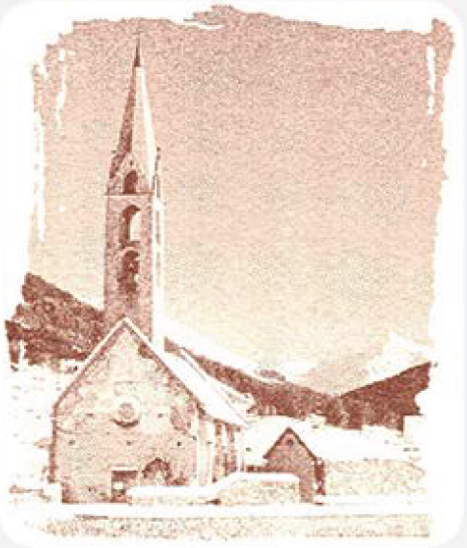
Local equilibration of fermions and bosons
Georg Wolschin
Heidelberg University
Institut für Theoretische Physik
Philosophenweg 12-16
D-69120 Heidelberg

Slide 2
Topics
Introduction
An analytical model for the equilibration of fermions and bosons
2.1 Linear relaxation ansatz
2.2 Derivation of the nonlinear diffusion equation
2.3 Exact solution of the nonlinear equation
Application to fermions: Baryons and quarks
4. Application to bosons: Evaporative cooling of cold quantum gases
5. Summary and Conclusion

Slide 3
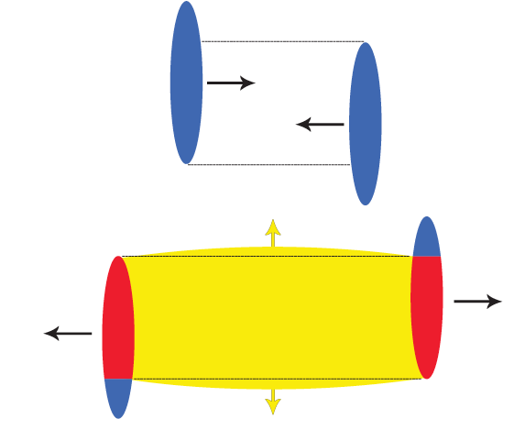
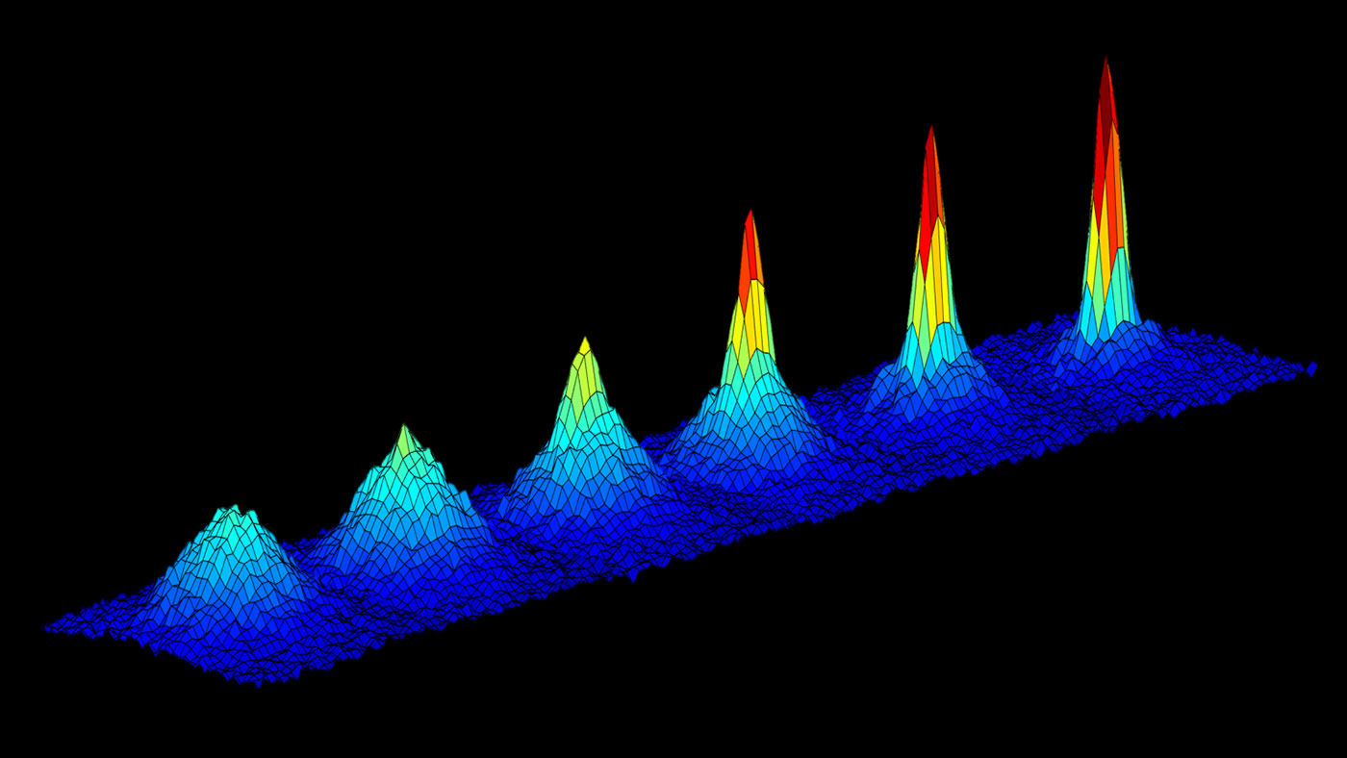
Introduction
1.1 Relativistic heavy-ion collisions (schematic)
Interaction time (freeze-out time) τ_{int} ≈ 5-10 fm/c
Initial stages of the collision:
Local equilibration time of quarks towards the
FD-distribution
τ⁻_{eq} ≈ 1 fm/c
Short local equilibration time of gluons in the
fireball (yellow) towards the BE-distribution
τ⁺_{eq} ≈ 0.1 fm/c
1.2 Cold quantum gases
Local equilibration of the thermal cloud
from which the Bose-Einstein condensate emerges
during evaporative cooling
τ⁺_{eq} ≈ 3 ms
© NASA CAL

Slide 4
2. An analytical model for the local equilibration
2.1 Relaxation ansatz
The system relaxes from the initial nonequilibrium distribution n₀(ε)
towards the Bose-Einstein/ Fermi-Dirac distribution
according to the linear equation
with the solution
Apply this to a bosonic or fermionic cold quantum gas (CQG), or to the fast local
equilibration in relativistic heavy-ion collisions for quarks and gluons,
with a appropriate initial conditions n₀(ε).
4

Slide 5

Example 1: Linear relaxation ansatz for a bosonic
cold quantum gas
1 ms
6 ms
Bosons equilibrate quickly towards
a Bose-Einstein distribution.
(τ_{eq} ~ 9x faster for
bosons than for fermions)
.
T= 8 peV ≈ 90 nK < T_{c}
= - 4.3 peV, τ⁺_{eq} = 3.6 ms
(from the nonlinear model)

Slide 6
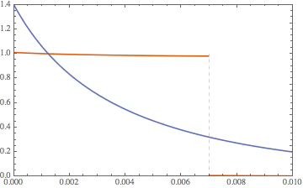
Video: Relaxation ansatz for bosons (CQG)
n_{rel} (ε,t)
ε (neV)
T= 8 peV ≈ 90 nK < T_{c}
= - 4.3 peV,
τ⁺_{eq} = 3.6 ms
The time evolution is discontinuous at ε _{t}
BEC formation not included, only thermal relaxation
The evolution equation is linear
.

Slide 7
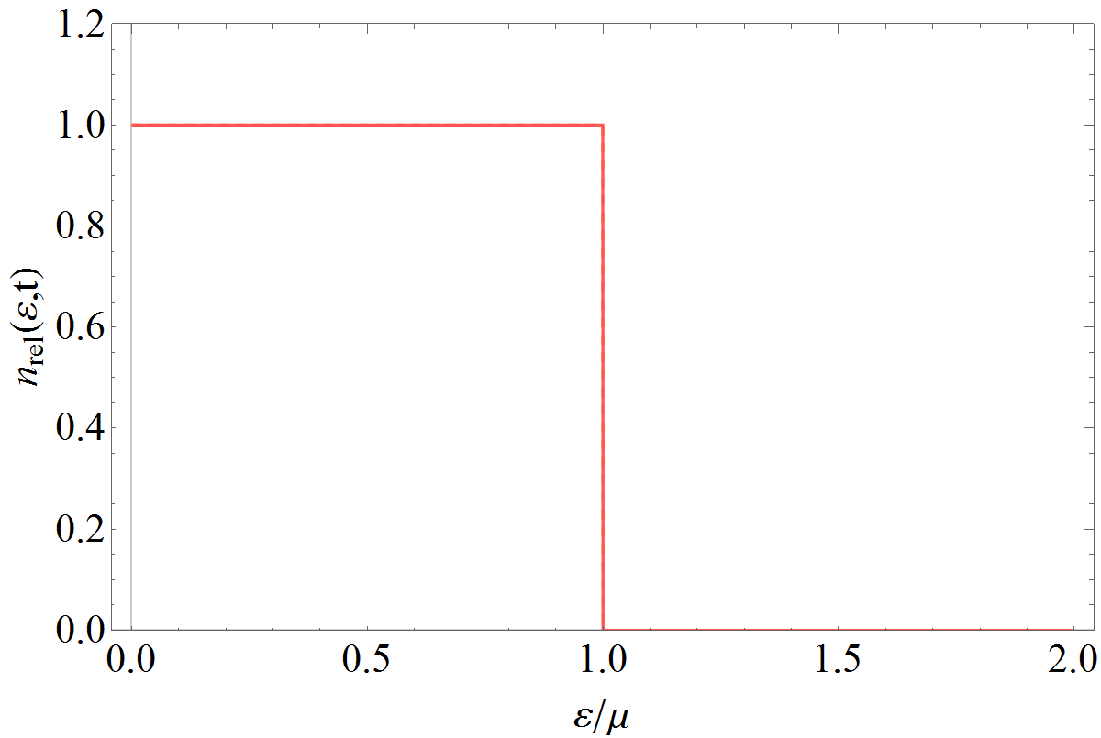
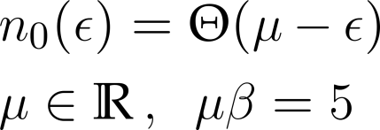
Example 2: Video relaxation ansatz for fermions
The evolution equation is linear, the distribution discontinuous at ε_{F}

Slide 8
2.2 Derivation of the nonlinear diffusion equation
Boltzmann collision term for bosons/ fermions
The Bose-Einstein/ Fermi-Dirac distributions are stationary solutions
8

Slide 9

Derivation of the nonlinear equation
Write the collision term in form of a Master equation (ME) with gain- and loss term
with the transition probability (
accordingly)
Introduce the density of states g_{j} = g(ε_{j}); omit ±
W is peaked at ε₁ = ε₄
. Obtain an approximation to the ME through a Taylor
expansion of n₄ and g₄n₄ around ε₁ = ε₄ to second order.

Slide 10
Introduce transport coefficients via moments of the transition probability (x=ε₄-ε₁)
and arrive at the nonlinear partial differential equation for the distribution of
the occupation numbers
Dissipative effects are expressed through the drift term , diffusive
effects through the diffusion term
In the limit of constant transport coefficients, the nonlinear diffusion equation
for the occupation-number distribution of bosons/ fermions becomes

Slide 11
The Bose-Einstein/Fermi-Dirac distributions n±_{eq} (ε) are stationary solutions
of this equation with the equilibrium temperature
(the drift is towards the infrared region).
Bosons: The nonlinear evolution pushes a certain fraction of particles from
the thermal cloud into the condensate, provided T is below T_{c}.
The nonlinear diffusion equation can also be written in the form of a continuity
equation
with the probability current

Slide 12



2.3 Exact solution of the nonlinear equation
a) The transformation
reduces the nonlinear diffusion equation to a linear Fokker-Planck equation for P(ε,t)
b) Alternatively, the linear transformation
yields the nonlinear Burgers‘ equation for w(ε,t)
It can be solved using Hopf‘s transformation

Slide 13
This reduces Burgers‘ equation to the heat equation
Solving it and transforming back results in the final solution
Where Z±(ε,t) is the generalized (time-dependent) partition function
Here, n₀(y) is the (arbitrary) initial condition.
This analytical solution is well-suited to replace the linear relaxation ansatz.
The integrals can be solved in closed form for schematic initial conditions.
GW, Physica A 499, 1 (2018)

Slide 14
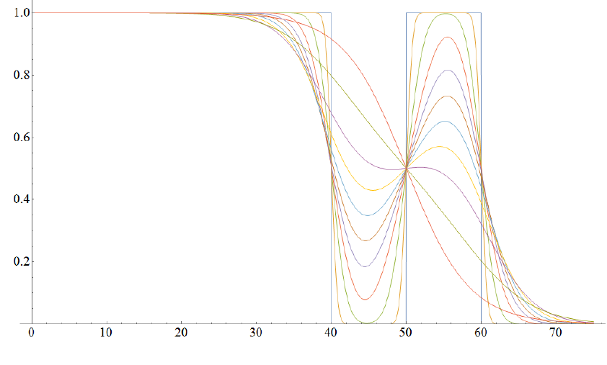
3. Application to fermions: Baryons
n (ε,t)
Analytical solutions
for baryons (MeV
energies)
T = - D/v = 4 MeV
τ_{eq}⁻ = 3.2·10⁻²³ s
ε (MeV)
Occupied states
in the continuum
GW, Phys. Rev. Lett. 48, 1004 (1982);
Using a different method recalculated analytically in
T. Bartsch and GW, Annals of Physics 400, 21 (2019).

Slide 15
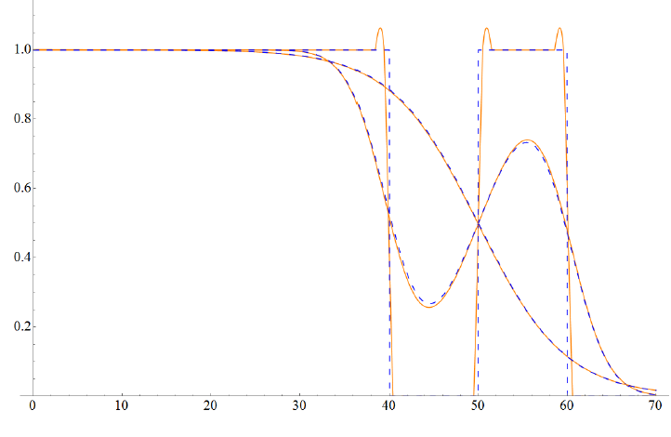
Equilibration in a Fermi system: MeV-scale energies (baryons)
n (ε,t)
Comparison of analytical (dashed) and numerical (solid) solutions
T = - D/v = 4 MeV
τ_{eq}⁻ = 3.2·10⁻²³ s
ε (MeV)
Occupied states in the continuum
T. Bartsch and GW, Annals of Physics 400, 21 (2019)

Slide 16
The fermionic analytical solution at LHC energies (quarks)
with antiparticle creation
Antiparticle creation
Analytical solutions
for quarks
T = - D/v = 510 MeV
τ⁻_{eq} = 0.9 fm/c
Dirac sea
t = 0.003 – 0.6 fm/c
(Analytical solutions agree with the numerical results)

Slide 17
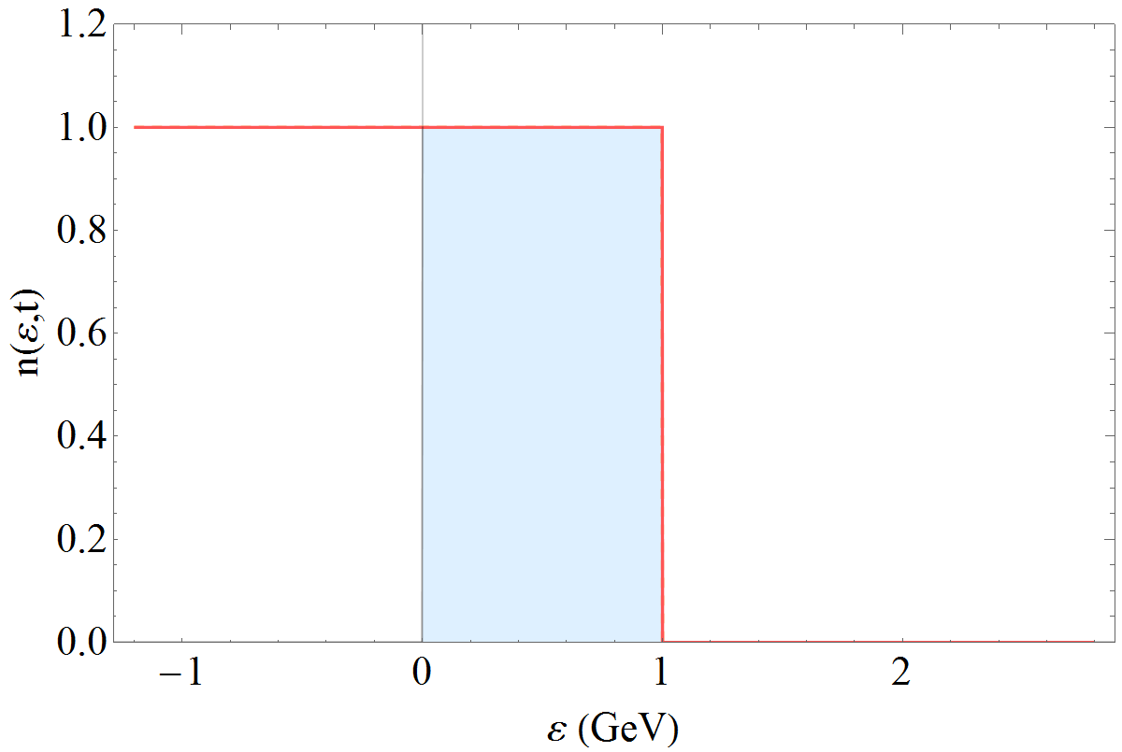
Video: The fermionic solution at LHC energies with antiparticle creation
Antiparticle creation
T = - D/v
= 510 MeV
τ⁻_{eq} = 0.9 fm/c
Dirac sea
(Analytical solutions, agree with the numerical results)
The total particle number (particles - antiparticles) is conserved

Slide 18


Equilibration time for bosons vs. fermions
An explicit expression for the bosonic equilibration time follows from an
asymptotic expansion of the error functions occuring in the analytical solutions
with argument z_{b} at the boundary x_{b} = ε_{t}
Deviations from the thermal solution thus scale with
and the equilibration time in a Bose system becomes for N_{i} = 1

Slide 19
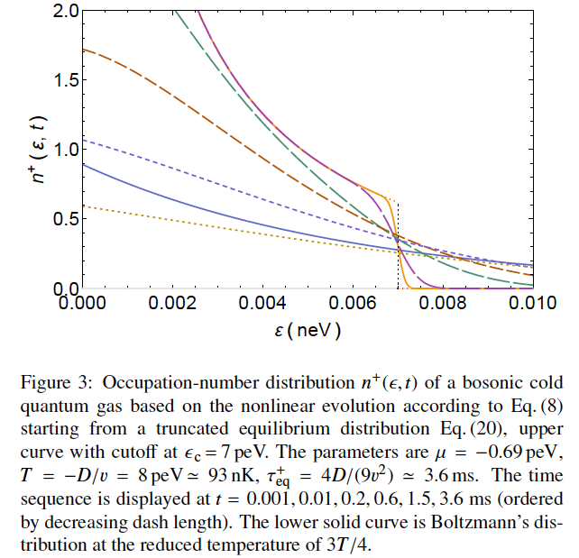
4. Application to CQG: Evaporative cooling
GW, Europhys. Lett. 123, 20009 (2018)

Slide 20
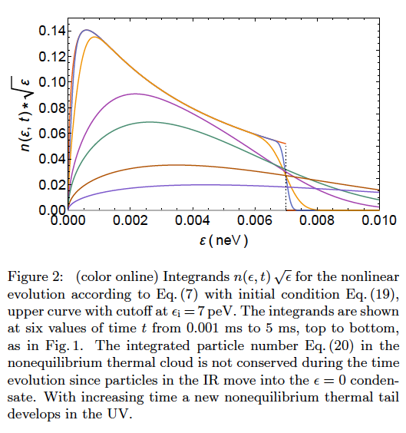
Integrands for an initial truncated BE distribution
The particle content in the thermal cloud is reduced with time because particles move into the condensed state.
The discontinuity at ε = ε_{t}
disappears and a thermal
tail develops within the
equilibration time τ_{eq} .
The evolution equation is nonlinear
GW, Europhys. Lett. 123, 20009 (2018)

Slide 21
5. Summary and Conclusion
From the fermionic/bosonic Boltzmann collision term a nonlinear partial
differential equation for the time-dependent occupation-number distribution
in a finite Fermi/ Bose system is derived.
The nonlinear diffusion equation is solved analytically for fermions
and bosons.
The solution is applied to relativistic heavy-ion collisions, and to
cold quantum gases.
The local equilibration time in a Bose system is calculated analytically
within the nonlinear model, and is found to be ~ one order of magnitude
shorter for bosons than for fermions due to the statistical properties.

Slide 22
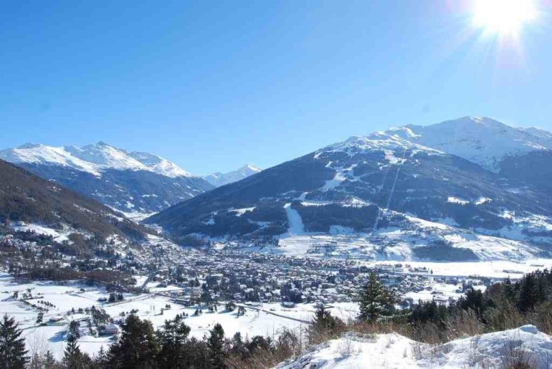

Thank you for your attention !

