Slide 1


AWAKE, the Advanced Proton Driven Plasma Wakefield Acceleration Experiment at CERN
Edda Gschwendtner, CERN
57th International Winter Meeting on Nuclear Physics
21 – 25 January 2019, Bormio, Italy

Slide 2
Outline
Plasma Wakefield Acceleration
AWAKE, The Advanced Wakefield Experiments
AWAKE Results
What’s Next

Slide 3
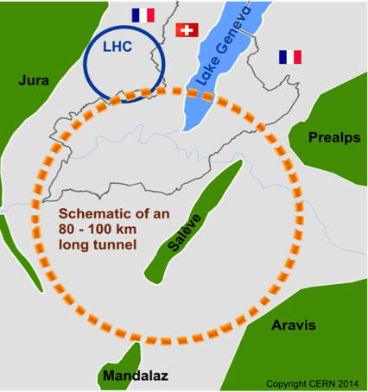

Discover New Physics
Accelerate particles to even higher energies
→ Bigger accelerators: circular colliders
Future Circular Collider: FCC
Limitations of conventional circular accelerators:
For hadron colliders, the limitation is magnet strength. Ambitious plans like the FCC call for 16 T magnets in a 100 km tunnel to reach 100 TeV proton-proton collision energy.
For electron-positron colliders: Circular machines are limited by synchrotron radiation in the case of positron colliders. These machines are unfeasible for collision energies beyond ~350 GeV.

Slide 4
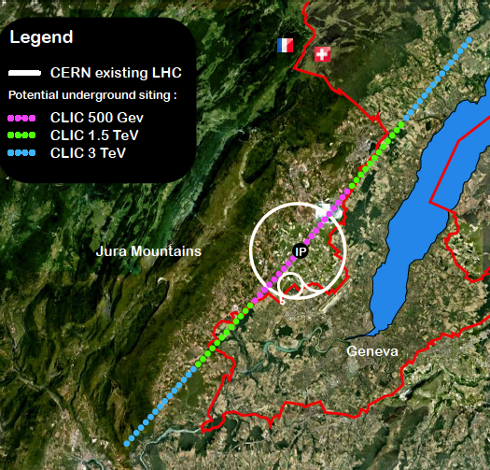
Discover New Physics
Linear colliders are favorable for acceleration of low mass particles to high energies.
CLIC, electron-positron collider with 3 TeV energy
→ 48 km
Limitations of linear colliders:
Linear machines accelerate particles in a single pass. The amount of acceleration achieved in a given distance is the accelerating gradient. This number is limited to 100 MV/m for conventional copper cavities.
Notes:
Either increase size
Or develop new technique
Access new particles in > TeV range
Precision measurements as much increased rates w.r.t. LHC

Slide 5
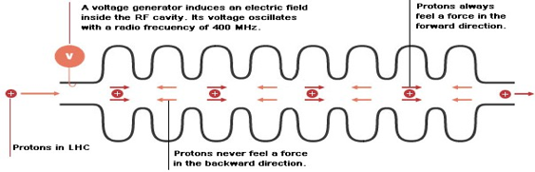
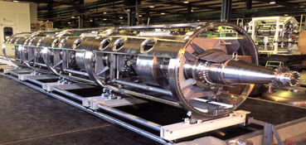
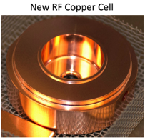
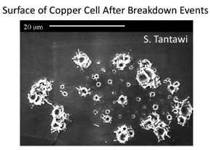
Conventional Acceleration Technology
Radiofrequency Cavities
LHC Cavity
  (invention of Gustav Ising 1924 and Rolf Wideroe 1927)
Very successfully used in all accelerators (hospitals, scientific labs,…) in the last 100 years.
Accelerating fields are limited to <100 MV/m
  In metallic structures, a too high field level leads to break down of surfaces, creating electric discharge.
  Fields cannot be sustained, structures might be damaged.
➔ several tens of kilometers for future linear colliders

Slide 6
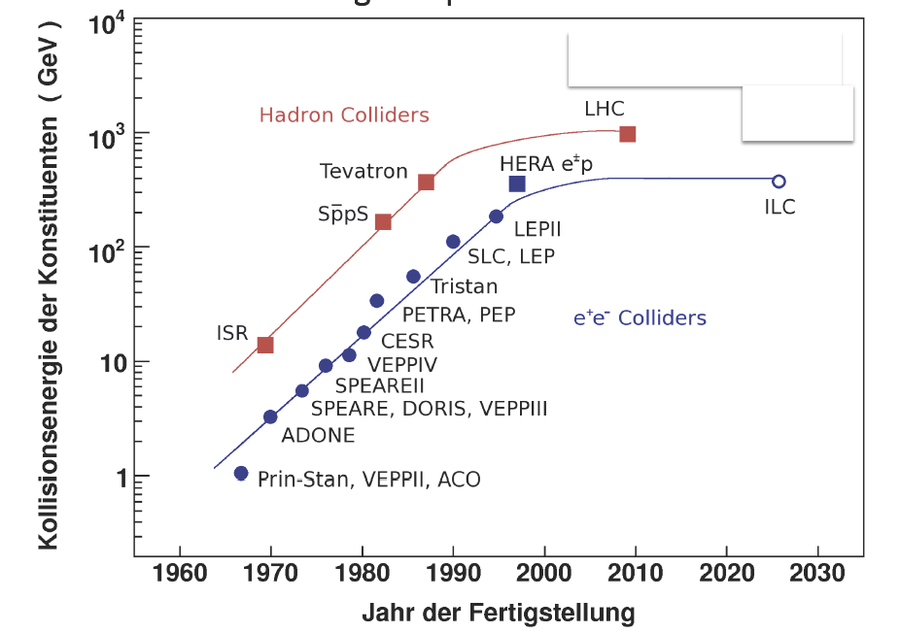
Saturation at Energy Frontier for Accelerators
Livingston plot
➔ Project size and cost increase with energy
Notes:
Livingston plot

Slide 7
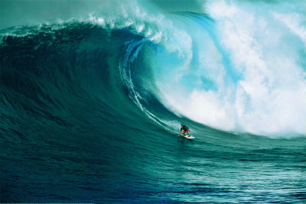
Plasma Wakefield Acceleration
➔Acceleration technology, which obtains ~1000 factor stronger acceleration than conventional technology.
Notes:
→Technological breakthrough leads to scientific breakthrough
Having a look at nature with new tools has unlocked many of nature’s secrets, and in particle physics the key tools are the accelerators.
➔New Technology required to accelerate particles

Slide 8
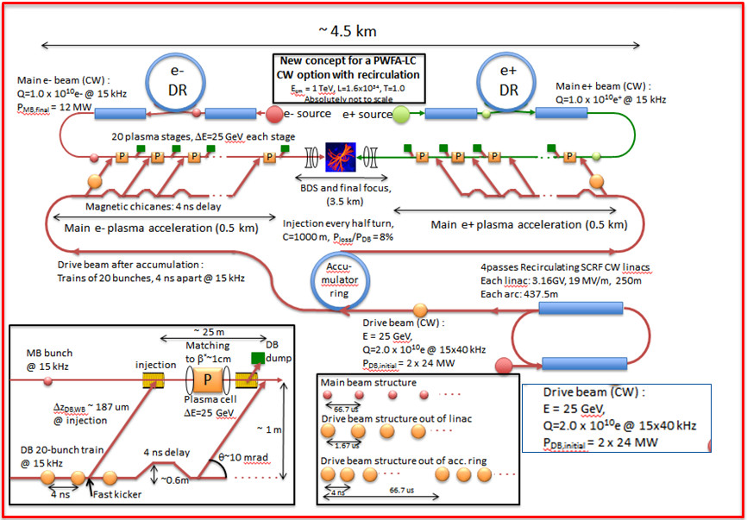
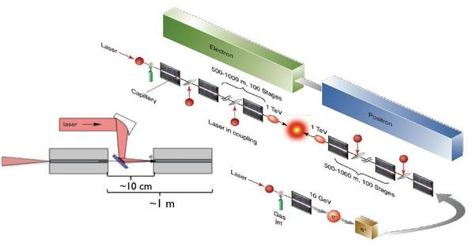
Plasma Based Linear Colliders
C. B. Schroeder et. al. Phys. Rev. ST Accel. Beams 13, 101301
E. Adli et. al.,arXiv:1308.1145 [physics.acc-ph]
In 2011 and 2013, the plasma acceleration groups from Berkeley and SLAC put forward white papers for laser and beam-driven plasma-based linear colliders. → 3 TeV in ~5km.

Slide 9
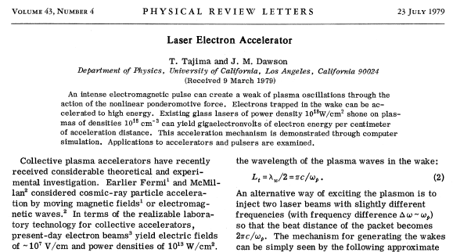
Seminal Paper 1979, T. Tajima, J. Dawson
Use a plasma to convert the transverse space charge force of a beam driver into a longitudinal electrical field in the plasma

Slide 10
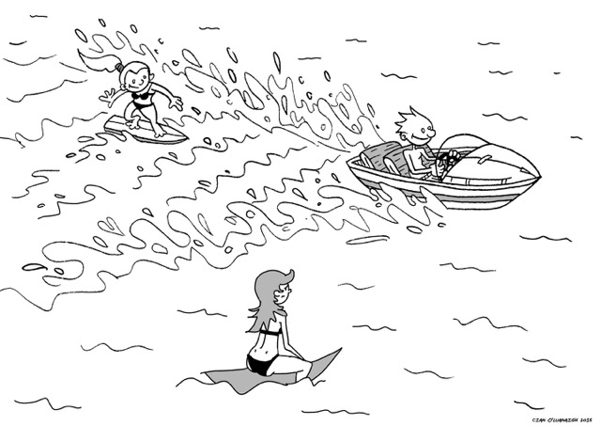
How to Create a Plasma Wakefield?
accelerated particles (surfers)
drive beam (boat)
waves
plasma (lake)

Slide 11
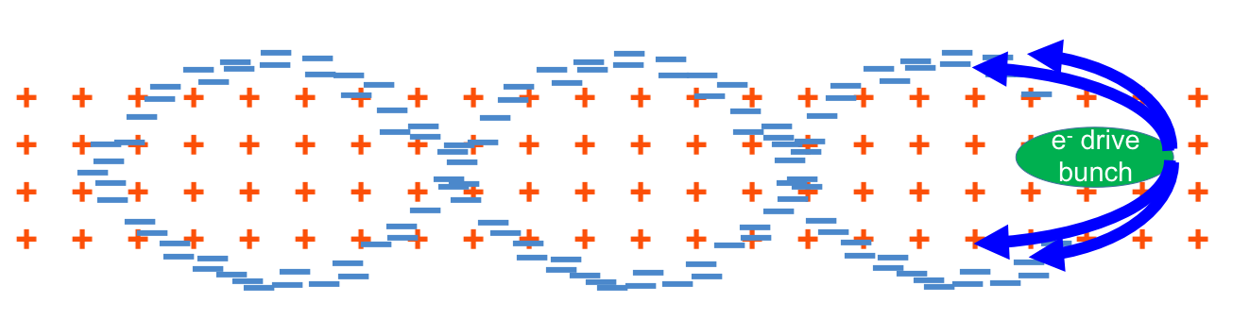
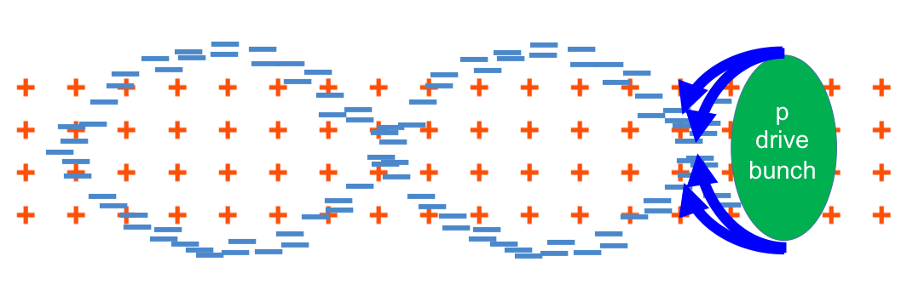
Principle of Plasma Wakefield Acceleration
Different ways to excite the wakes - most commonly used:
Laser bunches
Electron beams
- Protons bunches (first time done at CERN)
Plasma wave/wake excited by relativistic particle bunch
Plasma e⁻ are expelled by space charge force
Plasma e⁻ rush back on axis
Ultra-relativistic driver – ultra-relativistic wake → no dephasing
Acceleration physics identical for LWFA, PWFA
plasma wavelength λ_{pe}

Slide 12
Plasma Baseline Parameters
Plasma is already ionized or “broken-down” and can sustain electric fields up to three orders of magnitude higher gradients → order of 100 GV/m.
A plasma of density n_{pe} is characterized by the plasma frequency
n_{pe} e²
c
ω_{pe}
ω_{pe}
=
➔
k_{pe} =
√
m_{e} ε₀
ω_{pe}
… unit of plasma [m]
c
c
= 0.2mm ➔ k_{pe} = 5 mm⁻¹
Example: n_{pe} = 7x10¹⁴ cm⁻³ (AWAKE) ➔ ω_{pe} = 1.25x10¹² rad/s ➔
ω_{pe}
This translates into a wavelength of the plasma oscillation
c
10¹⁵ cm⁻³
λ_{pe}
=
2π
➔
λ_{pe}
≈
1 mm
ω_{pe}
√
n_{pe}
λ_{pe} = 1.2 mm
→ Produce cavities with mm size!

Slide 13
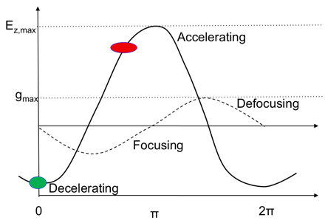
Where to Place the Witness Beam (Surfer)?
Accelerating for e⁻
e⁻
Decelerating for e⁻
Focusing for e⁻
Defocusing for e⁻
Maximum accelerating electric field reached with drive beam of N and σ_{z}:
MV
N/(2 x 10¹⁰)
E_{acc}=
110
m
(σ_{z} / 0.6mm)²
Examples of accelerating fields for different beam parameters and plasma parameters fields:
N = 3x10¹⁰, σ_{z} = 300µm, n_{pe}= 7x10¹⁴ cm⁻³ ➔ E_{acc} = 600 MV/m
N = 3x10¹⁰, σ_{z} = 20µm, n_{pe}= 2x10¹⁷ cm⁻³ ➔ E_{acc} = 15 GV/m

Slide 14
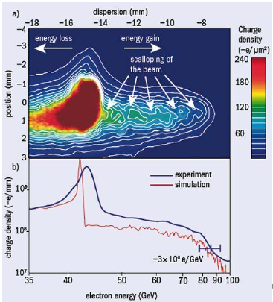
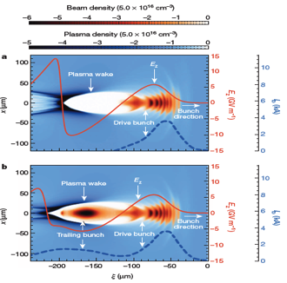
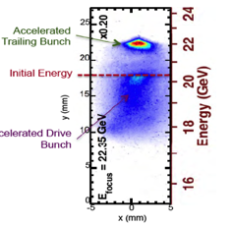
Experimental Results
SLAC Experiment, I. Blumenfeld et al, Nature 455, p 741 (2007)
  Gaussian electron beam with 42 GeV, 3nC @ 10 Hz, σ_{x} = 10µm, 50 fs
  Reached accelerating gradient of 50 GeV/m
  Accelerated electrons from 42 GeV to 85 GeV in 85 cm.
High-Efficiency acceleration of an electron beam in a plasma wakefield accelerator, M. Litos et al., doi, Nature, 6 Nov 2014, 10.1038/nature 13992
  1.7 GeV energy gain in 30 cm of pre-ionized Li vapour plasma
  6 GeV energy in 1.3 m of plasma
  Total efficiency is <29.1%> with a maximum of 50%.
  Final energy spread of 0.7 % (2% average)
• Electric field in plasma wake is loaded by presence of witness bunch
• Allows efficient energy extraction from the plasma wake
Notes:
If transformer ratio is 2 and E+ = 42 GV/85cm, then E- is 25 GV/m -> would mean particles of 42-21 = 21 GeV after plasma gave energy to particles at 84 GeV

Slide 15
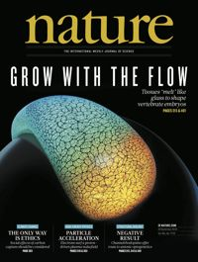
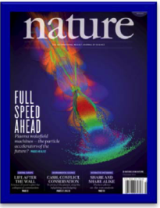
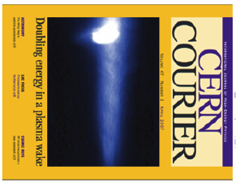
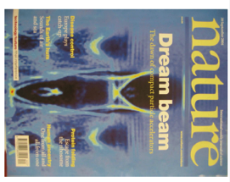
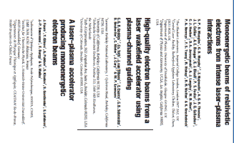
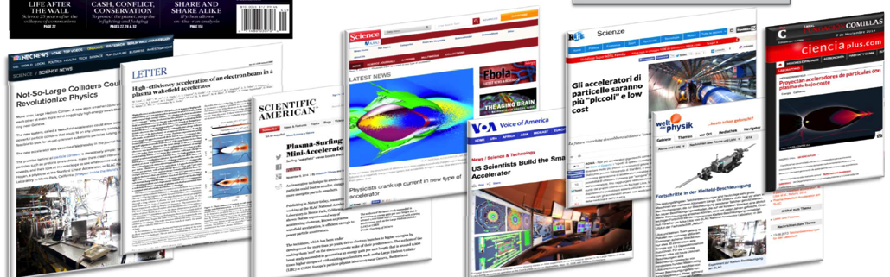
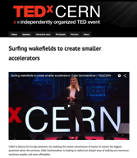
Many, Many Electron and Laser Driven Plasma Wakefield Experiments…!
Now first Proton Driven Plasma Wakefield Experiment

Slide 16
Beam-Driven Wakefield Acceleration: Landscape
Facility | Where | Drive (D) beam | Witness (W) beam | Start | End | Goal
AWAKE | CERN, Geneva, Switzerland | 400 GeV protons | Externally injected electron beam (PHIN 15 MeV) | 2016 | 2020+ | Use for future high energy e-/e+ collider. Study Self-Modulation Instability (SMI). Accelerate externally injected electrons. Demonstrate scalability of acceleration scheme.
SLAC-FACET | SLAC, Stanford, USA | 20 GeV electrons and positrons | Two-bunch formed with mask (e⁻/e⁺ and e⁻-e⁺ bunches) | 2012 | Sept 2016 | Acceleration of witness bunch with high quality and efficiency Acceleration of positrons FACET II preparation, starting 2018
DESY-Zeuthen | PITZ, DESY, Zeuthen, Germany | 20 MeV electron beam | No witness (W) beam, only D beam from RF-gun. | 2015 | ~2017 | Study Self-Modulation Instability (SMI)
DESY-FLASH Forward | DESY, Hamburg, Germany | X-ray FEL type electron beam 1 GeV | D + W in FEL bunch. Or independent W-bunch (LWFA). | 2016 | 2020+ | Application (mostly) for x-ray FEL Energy-doubling of Flash-beam energy Upgrade-stage: use 2 GeV FEL D beam
Brookhaven ATF | BNL, Brookhaven, USA | 60 MeV electrons | Several bunches, D+W formed with mask. | On going |  | Study quasi-nonlinear PWFA regime. Study PWFA driven by multiple bunches Visualisation with optical techniques
SPARC Lab | Frascati, Italy | 150 MeV | Several bunches | On going |  | Multi-purpose user facility: includes laser- and beam-driven plasma wakefield experiments

Slide 17
High Energy Plasma Wakefield Accelerators
Drive beams:
Lasers: ~40 J/pulse
Electron drive beam: 30 J/bunch
Proton drive beam: SPS 19kJ/pulse, LHC 300kJ/bunch
Witness beams:
Electrons: 10¹⁰ particles @ 1 TeV ~few kJ
To reach TeV scale:
Electron/laser driven PWA: need several stages, and challenging wrt to relative timing, tolerances, matching, etc…
  effective gradient reduced because of long sections between accelerating elements….
Plasma cell
Plasma cell
Plasma cell
Plasma cell
Plasma cell
Plasma cell
Witness beam
Drive beam: electron/laser
Proton drivers: large energy content in proton bunches → allows to consider single stage acceleration:
  A single SPS/LHC bunch could produce an ILC bunch in a single PDWA stage.
Plasma cell
Witness beam
Drive beam: protons

Slide 18
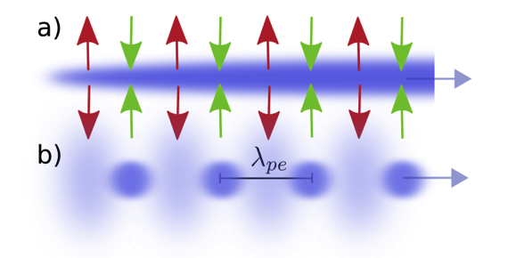
Seeded Self-Modulation of the Proton Beam
  In order to create plasma wakefields efficiently, the drive bunch length has to be in the order of the plasma wavelength.
  CERN SPS proton bunch: very long! (σ_{z} = 12 cm) → much longer than plasma wavelength (λ = 1mm)
N. Kumar, A. Pukhov, K. Lotov,
PRL 104, 255003 (2010)
Self-Modulation:
Bunch drives wakefields at the initial seed value when entering plasma.
  Initial wakefields act back on the proton bunch itself. → On-axis density is modulated. → Contribution to the wakefields is ∝ n_{b} .
Density modulation on-axis → micro-bunches.
  Micro-bunches separated by plasma wavelength λ_{pe}.
  drive wakefields resonantly.
plasma
vapour
laser
proton bunch
micro-
bunch
AWAKE: Seeding of the instability by
Placing a laser close to the center of the proton bunch
Laser ionizes vapour to produce plasma
Sharp start of beam/plasma interaction
→ Seeding with ionization front
⇒ Seeded self-modulation (SSM)
Notes:
the first protons in the plasma create a wake which acts back onto the proton bunch. The proton bunch feels the focusing and defocusing fields of the plasma waves and the protons start to radially move towards, and away from the axis periodically creating this microbunch structure. The protons bunch is also subjected to the accelerating and decelerating fields but the velocity change is so little that this does not affect the bunch structure.

Slide 19
Outline
Plasma Wakefield Acceleration
AWAKE, The Advanced Wakefield Experiments
AWAKE Results
What’s Next

Slide 20
AWAKE at CERN
Advanced WAKEfield Experiment
Proof-of-Principle Accelerator R&D experiment at CERN to study proton driven plasma wakefield acceleration.
Final Goal: Design high quality & high energy electron accelerator based on acquired knowledge.
Approved in August 2013
First beam end 2016

Slide 21

AWAKE
AWAKE Collaboration: 18+3 Institutes world-wide:
Collaboration members:
University of Oslo, Oslo, Norway
CERN, Geneva, Switzerland
University of Manchester, Manchester, UK
Cockcroft Institute, Daresbury, UK
Lancaster University, Lancaster, UK
Max Planck Institute for Physics, Munich, Germany
Max Planck Institute for Plasma Physics, Greifswald, Germany
UCL, London, UK
UNIST, Ulsan, Republic of Korea
Philipps-Universität Marburg, Marburg, Germany
Heinrich-Heine-University of Düsseldorf, Düsseldorf, Germany
University of Liverpool, Liverpool, UK
ISCTE - Instituto Universitéario de Lisboa, Portugal
Budker Institute of Nuclear Physics SB RAS, Novosibirsk, Russia
Novosibirsk State University, Novosibirsk, Russia
GoLP/Instituto de Plasmas e Fusão Nuclear, Instituto Superior Técnico, Universidade de Lisboa, Lisbon, Portugal
TRIUMF, Vancouver, Canada
Ludwig-Maximilians-Universität, Munich, Germany
Vancouver
Glasgow
Novosibirsk
Manchester
Oslo
Korea
London
Hamburg, Greifswald
Dusseldorf
Munich
CERN
Lisbon
Associated members:
University of Wisconsin, Madison, US
Wigner Institute, Budapest
Swiss Plasma Center group of EPFL

Slide 22



AWAKE Timeline
 | 2013 | 2014 | 2015 | 2016 | 2017 | 2018 | 2019 | 2020 | 2021 | 2022/23/24
Proton and laser beam-line
Experimental area
e⁻ source and beam-line
Study, Design,
Procurement, Component preparation
Installation
Data taking
Data taking
AWAKE RUN 1
Long Shutdown 2
24 months
Commissioning
AWAKE RUN 2
AWAKE++: After Run 2: kick-off particle physics driven applications
Modification, Civil Engineering and installation
Study, Design,
Procurement, Component preparation
Phase 1
Studies, design
Fabrication
Installation
Commissioning
Phase 2
AWAKE Run 1: Proof-of Concept
2016/17: Seeded Self-Modulation of proton beam in plasma
2018: Electron acceleration in plasma
AWAKE Run 2: proposed for after LS2:
achieve high-charge bunches of electrons accelerated to high energy, about 10 GeV, while maintaining beam quality through the plasma and showing that the process is scalable.
Notes:
Mandate from Freddy: to write the design report for Run 2.

Slide 23
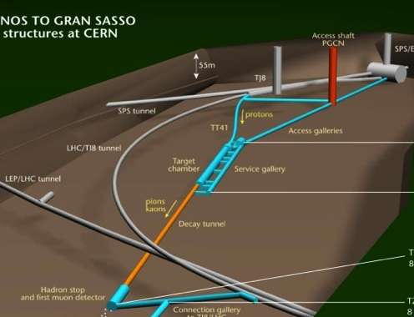
AWAKE at CERN
AWAKE
~50m
Control
room
protons
SPS
~1000m
AWAKE experiment
LHC
~1100m
beam dump
AWAKE installed in CERN underground area
Notes:
Application: add your fitness certificate
Have also an iron man with us.

Slide 24
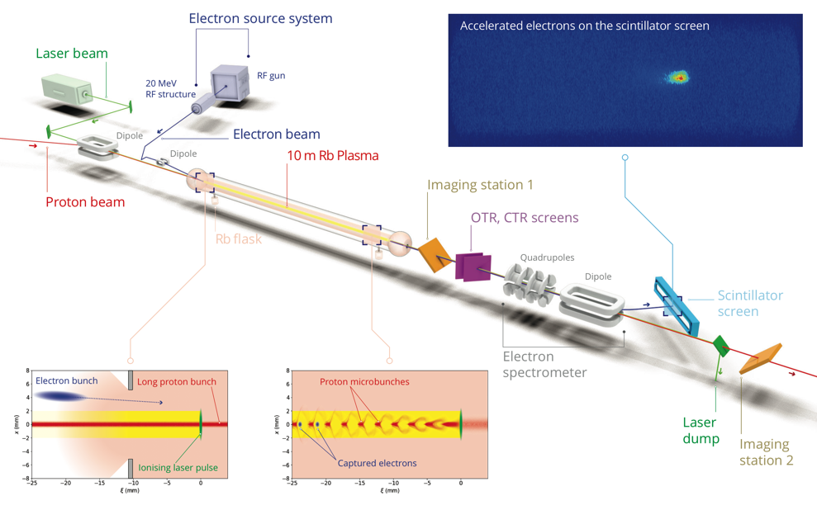
AWAKE Experiment

Slide 25
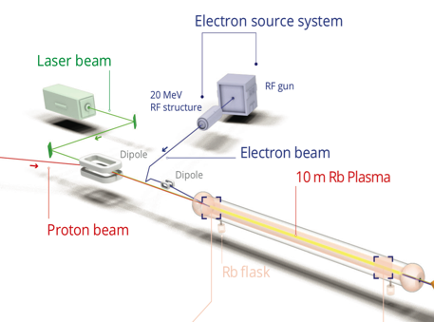
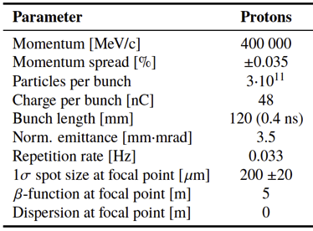
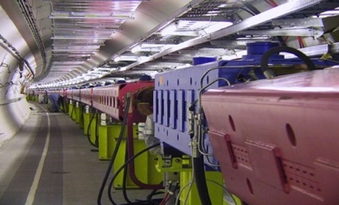
AWAKE Proton Beam Line
Plasma linear theory: k_{pe} σ_{r} ≤ 1
With σ_{r} = 200 µm
k_{pe} = ω_{pe} /c = 5 mm⁻¹
➔ n_{pe} = 7x10¹⁴ cm⁻³
The AWAKE beamline is designed to deliver a high-quality beam to the experiment. The proton beam must be steered around a mirror which couples a terawatt class laser into the beamline.
Further downstream, a trailing electron beam will injected into the same beamline.
750m proton beam line

Slide 26
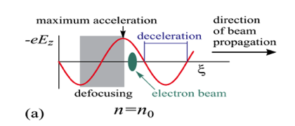
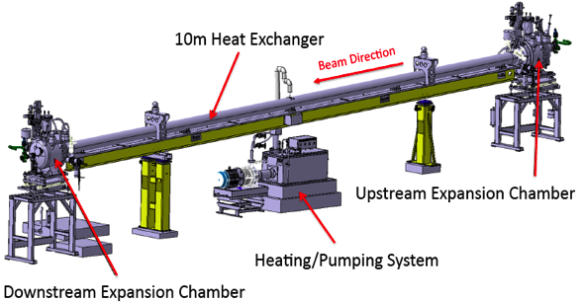
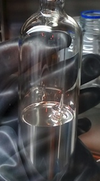
AWAKE Plasma Cell
10 m long, 4 cm diameter
Rubidium vapor, field ionization threshold ~10¹² W/cm²
Density adjustable from 10¹⁴ – 10¹⁵ cm⁻³ ➔ 7x 10¹⁴ cm⁻³
Requirements:
  density uniformity better than 0.2%
    Fluid-heated system (˜220 deg)
    Complex control system: 79 Temperature probes, valves
  Transition between plasma and vacuum as sharp as possible
Plasma density profile
few cm
10 m
few cm
Plasma density
Circulation of Galden HT270 at 210 [°C] in plasma cell
Notes:
Ionization potential Φ_{Rb} = 4.177eV
There was one acceptable solution found, which relies on the following physics principle. If gas expands through an aperture to an infinite volume, the length of the ramp is in the order of the opening of the aperture. Of course we cannot make an infinte expansion volume, but what is possible is to cool the expansion volume below the condensation point of rubidium so that the rubidium sticks as soon as it touches the wall. Simulations showed that in this case the vapour density drops within 2 orders of magnitudes in a few cm. Which is not optimum but acceptable.

Slide 27
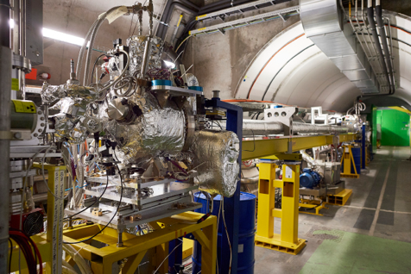
AWAKE Plasma Cell
Plasma cell in AWAKE tunnel
Notes:
.

Slide 28
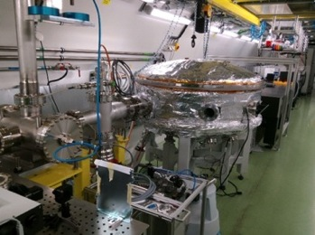
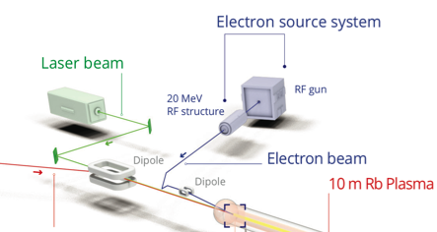
Laser and Laser Line
AWAKE uses a short-pulse Titanium:Sapphire laser to ionize the rubidium source.
→ Seeding of the self-modulation with the ionization front.
The laser can deliver up to 500 mJ in a 120 fs pulse envelope.
Laser beam
e-source laser
Diagnostic laser
Laser, compressor in laser room
Notes:
Diagnostic beam line (“virtual plasma”)
λ = 780 nm
t pulse = 100-120 fs,
E ≈ 5 mJ
Laser beam line to electron gun (installed in 2017)
λ = 260 nm
t pulse = 0.3-10 ps
E = 0.5 mJ

Slide 29
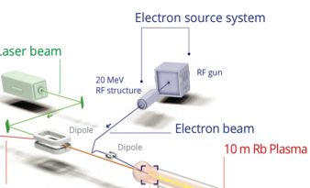
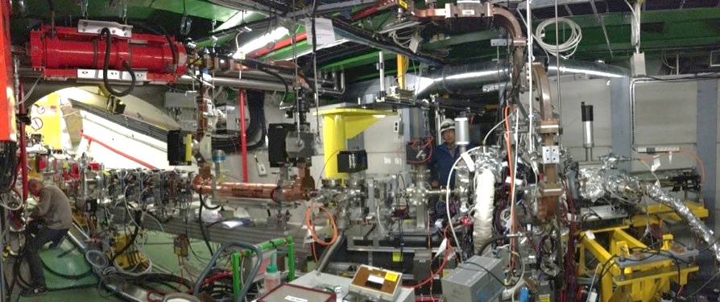
Electron Beam System
Laser beam
e-source laser
Laser line
Transfer line
Diagnostics and booster structure
Electron source
A Photo-injector originally built for a CLIC test facility is now used as electron source for AWAKE producing short electron bunches at an energy of ~20 MeV/c.
A completely new 12 m long electron beam line was designed and built to connect the electrons from the e-source with the plasma cell.
Challenge: cross the electron beam with the proton beam inside the plasma at a precision of ~100 µm.
Notes:
→ Laser on Cs₂Te cathode produces electron bunch with σ ~2ps, ~650pC. → 2.5 cell RF-gun accelerates to 5.5MeV → 30 cell travelling wave structure accelerates up to 20 MeV → 18m long beam line to plasma cell.

Slide 30
Outline
Plasma Wakefield Acceleration
AWAKE, The Advanced Wakefield Experiments
AWAKE Results
What’s Next

Slide 31
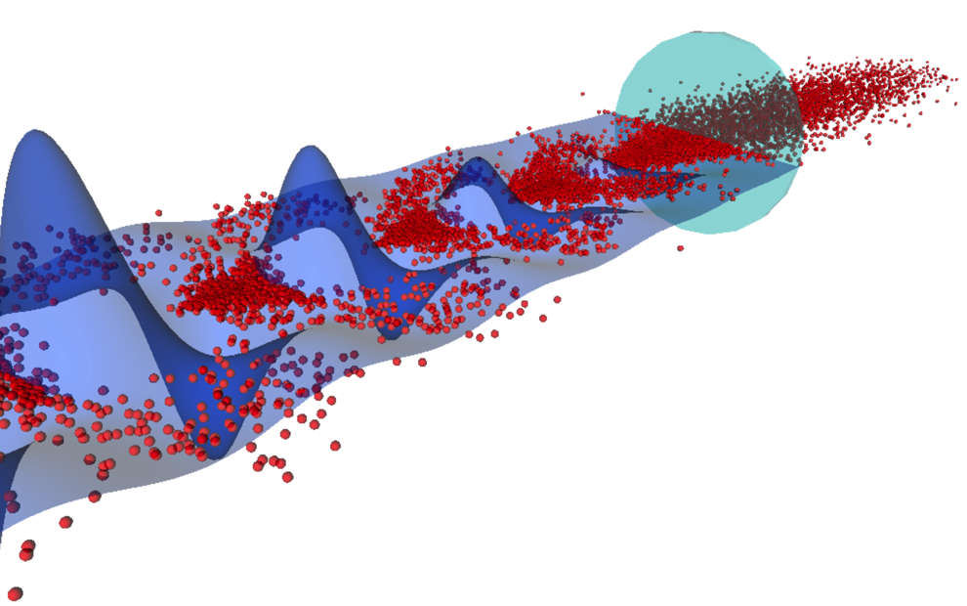
Seeded Self-Modulation Results
Short laser pulse
No plasma
Wake potential
protons
λ_{p} = 1.2 mm
Second half of the proton bunch sees plasma
A. Petrenko, CERN

Slide 32
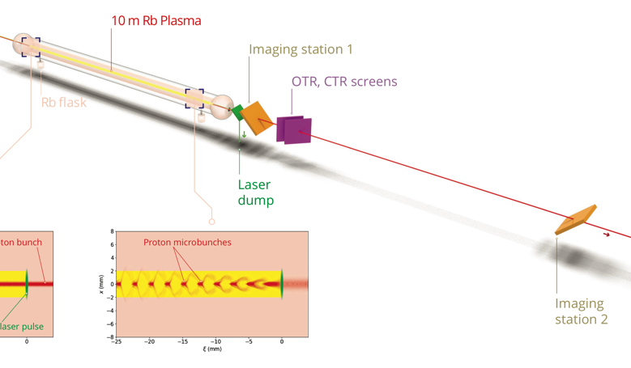
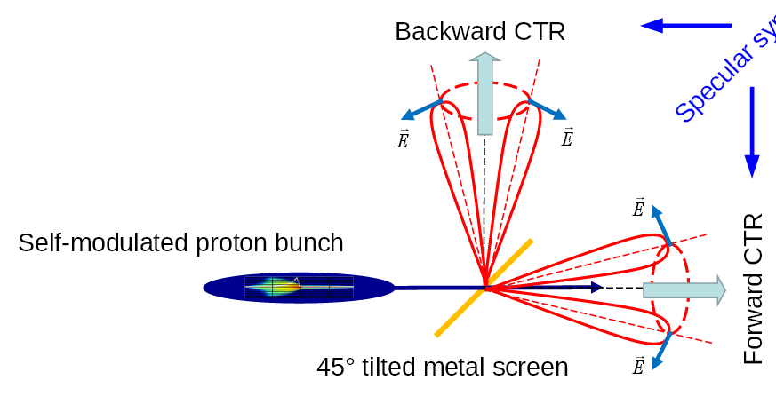
Diagnostics for Seeded Self-Modulation
Direct SSM Measurement:
Measure longitudinal structure of self-modulated proton bunch.
→ Image OTR light onto the slit of a streak camera.
→ Time resolved measurement.
Streak Camera
OTR screen
/ OTR
/ OTR
Notes:
To show the longitudinal structure of the proton bunch, we send it through a thin metal foil and image the emitted backward optical transition radiation onto the slit of a streak camera. Since the emission of the OTR is instantaneous, we can get a longitudinal proton density image. In case there is no plasma present, we expect to see a uniform density over this timescale, but if the bunch self-modulates we expect to see periodically regions of high and low proton density.

Slide 33

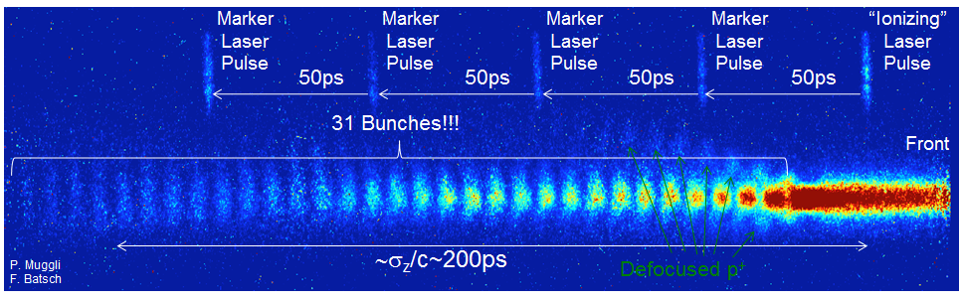
Results: Direct Seeded Self-Modulation Measurement
AWAKE preliminary
AWAKE
collaboration
Effect starts at laser timing → SM seeding
Density modulation at the ps-scale visible
Micro-bunches present over long time scale from seed point
Reproducibility of the µ-bunch process against bunch parameters variation
Phase stability essential for e⁻ external injection.
→ 1st AWAKE Milestone reached
    E. Adli et al. (AWAKE Collaboration), ‘Experimental observation of proton bunch modulation in a plasma, at varying plasma densities’. PRL (in print).
Notes:
To show the longitudinal structure of the proton bunch, we send it through a thin metal foil and image the emitted backward optical transition radiation onto the slit of a streak camera. Since the emission of the OTR is instantaneous, we can get a longitudinal proton density image. In case there is no plasma present, we expect to see a uniform density over this timescale, but if the bunch self-modulates we expect to see periodically regions of high and low proton density.
5 sets of 10 events each
Possible because: marker laser pulse synchronized with ionization laser pulse at the ps time scale.
----
The main idea of this diagnostics is to image the micro-bunches and from that determine the modulation frequency,
We see again the timing between the proton and the laser bunch, where the laser is as sketched in the middle of the proton bunch like indicated in this schematic drawing here. If we look at an event where there was a high power laser shot and rubidium we can see that after the laser pulse the proton beam distribution changes visibly. If we look at the integrated profile the number of protons drops, which is what one expects, because part of the protons defocus and we are imaging through a slit. It becomes really interesting when we go to slower timescales, meaning zooming into this picture here. In this picture we can see the periodic density modulation of the proton bunch and the formation of what I called micro bunches before. Summing up, the timing between the laser and the protons is at the picosecond scale, we see an effect on the proton bunch after the laser bunch- how it should be and we see a density modulation at the pico-second scale.

Slide 34
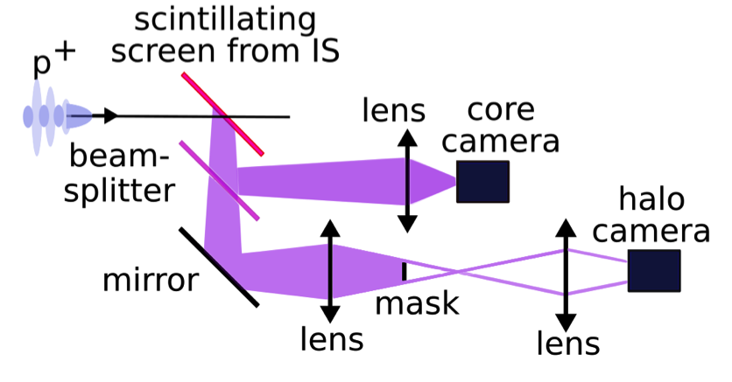
Diagnostics for Seeded Self-Modulation
Indirect SSM Measurement:
Measure time integrated transverse bunch distribution.
Image protons defocused by the strong plasma wakefields
Scintillation light from screen measured with digital camera.
Imaging station
Notes:
To show the longitudinal structure of the proton bunch, we send it through a thin metal foil and image the emitted backward optical transition radiation onto the slit of a streak camera. Since the emission of the OTR is instantaneous, we can get a longitudinal proton density image. In case there is no plasma present, we expect to see a uniform density over this timescale, but if the bunch self-modulates we expect to see periodically regions of high and low proton density.

Slide 35
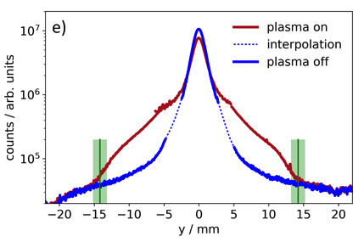
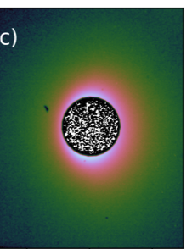
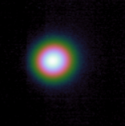
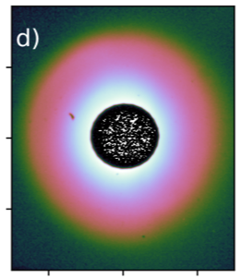
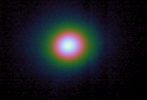
Results: Indirect Seeded Self-Modulation Measurement
Combination of core and halo image projections
From the radial distribution of the defocused protons, we learn about the transverse effects of SSM
Core camera
Halo camera
no plasma
AWAKE preliminary
plasma
Protons are defocused by the transverse wakefield (SSM) and form a halo
Proton density in core decreases, proton density at large radii increases (appearance of halo).
Protons get defocused up to a maximum radius of 14.5 mm for a plasma density of 7.7e14/cm³.
Halo symmetric ⇒ no hose instability.
Estimate of the transverse wakefields amplitude (∫W_{per}dr)
    M. Turner et al. (AWAKE Collaboration), ‘Experimental observation of plasma wakefield growth driven by the seeded self-modulation of a proton bunch’. PRL (in print)
Notes:
Here I show images of the imaging stations, once if there is no plasma and SM and then the next one where we turned on the high power laser, and the difference is clearly visible. We can see the defocused protons. It becomes even clearer when we combine the projections of those two images and compare them. We see that charge that used to be in the core moves out radially to form a halo. This image is ment to show the halo, so it is on a log scale and the small area here corresponds to the area in the wing. From the maximum radius we can show that the transverse wakefields must have reached a level higher than the initial seed fields and since the halo is symmetric there is no sign that the non-axis symetric mode which is known as the hose instability developed

Slide 36
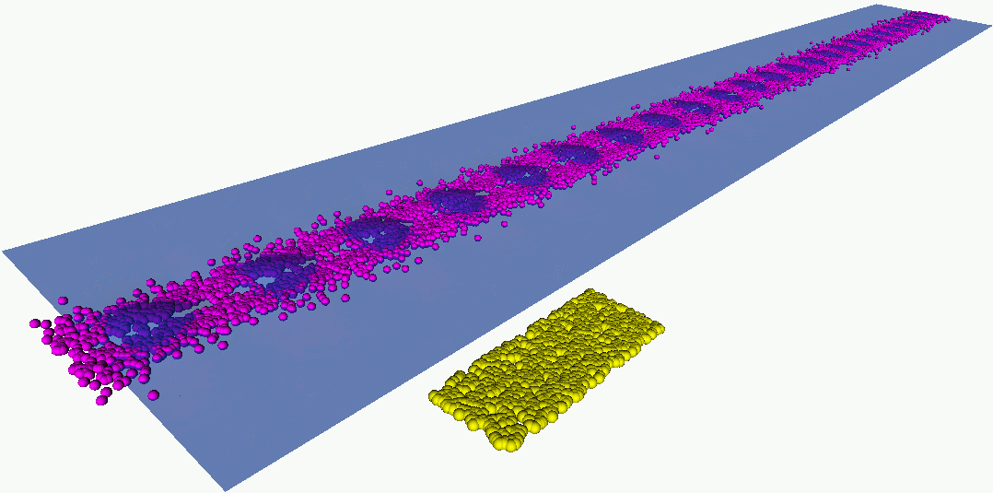

Electron Acceleration Results 2018
Electron acceleration after 10m:
What we expect with the AWAKE Run 1 setup:
with baseline parameters: ~1.6 GeV
protons
electrons
Beams are co-propagating in this direction close to the speed of light
A. Petrenko, CERN
A. Caldwell et al., AWAKE Coll., Nucl. Instrum. A 829 (2016) 3

Slide 37

Electron Acceleration – Injection into Plasma
Challenge:
During the Seeded Self-Modulation the proton bunch distribution evolves.
Short density ramp at the entrance of the plasma → change of wakefield phase
rb
Laser pulse
Notes:
To avoid losing the low energy electrons, instead of injecting them colinear, we cross the electron and proton bunch at a defined location inside the plasma, where we hope that they are trapped after the wakefield phase stopped to evolve strongly. Experimentally this crossing is challenging because the radial size of the bunches is on the order of 100um and cannot have any bunch diagnostics inside the plasma.

Slide 38

Electron Acceleration – Injection into Plasma
Challenge:
During the Seeded Self-Modulation the proton bunch distribution evolves.
Short density ramp at the entrance of the plasma → change of wakefield phase.
Instead of injecting bunches co-linear → cross the electron and proton bunch at a defined location inside the plasma.
rb
Laser pulse
e⁻
p⁺
Notes:
To avoid losing the low energy electrons, instead of injecting them colinear, we cross the electron and proton bunch at a defined location inside the plasma, where we hope that they are trapped after the wakefield phase stopped to evolve strongly. Experimentally this crossing is challenging because the radial size of the bunches is on the order of 100um and cannot have any bunch diagnostics inside the plasma.
The numbers in May were roughly:
Momentum: 19 MeV/c
Bunch charge 0.6 nC
Bunch length: 2 ps
Bunch size focus (?): Chiara mentioned that she believes it is around 650 um but it is not something we measured
Emittance: 14 mm mrad
Energy spread 0.5 % sigma

Slide 39


Electron Acceleration – Injection into Plasma
Challenge:
During the Seeded Self-Modulation the proton bunch distribution evolves.
Short density ramp at the entrance of the plasma → change of wakefield phase.
Instead of injecting bunches co-linearly → cross the electron and proton bunch at a defined location inside the plasma.
rb
Laser pulse
e⁻
p⁺
Beam screens
May Run 2018: electron beam:
19 MeV
14mm mrad
650 pC at source
FWHM = 5.2 ps.
electrons
protons
Notes:
To avoid losing the low energy electrons, instead of injecting them colinear, we cross the electron and proton bunch at a defined location inside the plasma, where we hope that they are trapped after the wakefield phase stopped to evolve strongly. Experimentally this crossing is challenging because the radial size of the bunches is on the order of 100um and cannot have any bunch diagnostics inside the plasma.
The numbers in May were roughly:
Momentum: 19 MeV/c
Bunch charge 0.6 nC
Bunch length: 2 ps
Bunch size focus (?): Chiara mentioned that she believes it is around 650 um but it is not something we measured
Emittance: 14 mm mrad
Energy spread 0.5 % sigma

Slide 40


Electron Acceleration Diagnostics
camera
scintillator screen Lanex, 1m x 6cm
Spectrometer:
Dipole: B = 0.1 - 1.5 T, Magnetic length = 1m
→ detect electrons with energies ranging from 30MeV - 8.5 GeV
Electrons will be accelerated in the plasma. To measure the energy the electrons pass through a dipole spectrometer and the dispersed electron impact on the scintillator screen.
The resulting light is collected with an intensified CCD camera.
Notes:
If we accelerate electrons, we measure their energy with an imaging spectrometer. Depending on the current setting in the magnet we can detect electrons with energies ranging from 30 MeV to 8.5 GeV. The spectrometer setup is fully commissioned and ready to detect accelerated electrons as fearghus explains in his proceedings for this conference.

Slide 41


Electron Spectrometer Image Analysis
camera
Optical line corrections
1000 mm
Background subtraction
Charge response calibration
Screen and camera calibrated at the CLEAR Facility at CERN
60 mm
Position ← → Energy conversion
Notes:
Charge response corrected for AWAKE system (optical system, camera position)
Charge response: 6.9 ± 2.1 x 10⁶ CCD counts/pC.

Slide 42

Electron Acceleration Results I
Results from May 2018 Run
Event at n_{pe} =1.8 x 10¹⁴ cm⁻³ with 5%/10m density gradient.
Acceleration to 800 MeV.
Accelerated bunch charge of 0.2pC → Capture efficiency not yet optimized.
➔ recent measurements factor 50-100 higher capture efficiency!!
E. Adli et al. (AWAKE Collaboration), Nature, doi:10.1038/s41586-018-0485-4 (2018)
Notes:
656 pC at the source, we measure 0.2pC → less than a permille.
Lot of loss in the electron line.
400pC at electron source.

Slide 43

Electron Acceleration Results II
Consecutive electron injection events at n_{pe} = 1.8 x 10¹⁴cm⁻³.
Quadrupole scan performed over this period.
Stability crucial for further development.
E. Adli et al. (AWAKE Collaboration), Nature, doi:10.1038/s41586-018-0485-4 (2018)
Notes:
400MeV to 700 MeV

Slide 44

Electron Acceleration Results III
Acceleration up to 2 GeV has been achieved.
Charge capture decreases with plasma density n_{pe}.
E. Adli et al. (AWAKE Collaboration), Nature, doi:10.1038/s41586-018-0485-4 (2018)
Notes:
Heating the downstream (FIG. 1; right side)
ask to a higher temperature than the upstream (left
side)
ask creates a positive density gradient and vice
versa. Plasma density gradients have been shown in simulation
to produce signicant increases in the maximum
energy attainable by the injected electrons [26

Slide 45





Electron Acceleration Results III
Acceleration up to 2 GeV has been achieved.
Charge capture decreases with plasma density n_{pe}.
E. Adli et al. (AWAKE Collaboration), Nature, doi:10.1038/s41586-018-0485-4 (2018)
Notes:
Heating the downstream (FIG. 1; right side)
ask to a higher temperature than the upstream (left
side)
ask creates a positive density gradient and vice
versa. Plasma density gradients have been shown in simulation
to produce signicant increases in the maximum
energy attainable by the injected electrons [26

Slide 46
Outline
Plasma Wakefield Acceleration
AWAKE, The Advanced Wakefield Experiments
AWAKE Results
What’s Next

Slide 47


AWAKE Run 2
Proposing Run 2 for 2021 after CERN Long Shutdown 2
Goals:
Accelerate an electron beam to high energy (gradient of 0.5-1GV/m)
Preserve electron beam quality as well as possible (emittance preservation at 10 mm mrad level)
Demonstrate scalability of the AWAKE concept (R&D plasma sources)
Proposal: X-band electron source
RF gun
Bunch compression, increased acceleration
e⁻ spectrometer
Laser
e⁻ (~100 fs, > 20 MeV)
e⁻ emittance
measurement
Optimized
SPS
protons
~8m plasma
>10m plasma
Proton
beam
dump
Proton diagnostics
BTV,OTR, CTR
Laser
dump
SSM
Acceleration
E. Adli (AWAKE Collaboration), IPAC 2016 proceedings, p.2557 (WEPMY008)

Slide 48


Application: Fixed Target Experiments
Fixed target test facility: Use bunches from SPS with 3.5 E11 protons every ~5sec, → electron beam of up to O (50GeV), 3 orders of magnitude increase in electrons
deep inelastic scattering, non-linear QED, search for dark photons a la NA64
NA64 experiment: ~3x10¹² electrons on target
Projected sensitivities to the dark photon visible mode

Slide 49


Application: Fixed Target Experiments
protons
SPS
Install in the current AWAKE facility, empty old CERN Neutrinos to Gran Sasso Area
Baseline scenario (based on AWAKE Run 2 parameters)
50 m long plasma accelerator
33 GeV/c electrons, ∆E/E = 2%, ~100 pC
For 100 m accelerator: 53 GeV/c e, ∆E/E=2%, ~130 pC
AWAKE experiment
LHC
~1100m
dump
NA64-like experiment
e-
≈ 5-20 m
n_{plasma} = 7e14/cm^3,
400 GeV/c
protons
Plasma
Plasma cell
≈ 50-100 m (depending on the energy needed)
p-beam
dump

Slide 50
Application: Colliders
50

Slide 51

Application: Colliders
Using the SPS or the LHC beam as a driver, TeV electron beams are possible → Electron/Proton or Electron/Ion Collider
  PEPIC: LHeC like collider: E_{e} up to O (70 GeV), colliding with LHC protons → exceeds HERA centre-of-mass energy
  VHPeC: choose E_{e} = 3 TeV as a baseline and with E_{P} = 7 TeV yields √s = 9 TeV. → CM ~30 higher than HERA. Luminosity ~ 10²⁸ − 10²⁹ cm⁻² s⁻¹ gives ~ 1 pb−1 per year.
LHC, p 7 TeV
PEPIC
protons 7 TeV
SPS, p 450 GeV
plasma accelerated electrons, 50-70 GeV
plasma
VHEeP: A. Caldwell and M. Wing, Eur. Phys. J. C 76 (2016) 463
51

Slide 52
Summary
Many encouraging results in the plasma wakefield acceleration technology. Plasma wakefield acceleration is an exciting and growing field with a huge potential.
AWAKE: Proton-driven plasma wakefield acceleration interesting because of large energy content of driver. Modulation process means existing proton machines can be used.
AWAKE has for the first time demonstrated proton driven plasma wakefield acceleration of externally injected electrons.
AWAKE Run 1 was a proof-of-concept experiment. → DONE!
Aim of AWAKE Run 2 starting 2021 after CERN’s Long Shutdown 2 is to achieve high-charge bunches of electrons accelerated to high energy, about 10 GeV, while maintaining beam quality through the plasma and showing that the process is scalable.
Use the AWAKE scheme for particle physics applications such as fixed target experiments for dark photon searches and also for future electron-proton or electron-ion colliders.

