Slide 1


Probing the structure of weak
interactions
D.Zakoucky, Nuclear Physics Institute ASCR, Rez near Prague
Experimental project WISArD (Weak-Interaction Studies with ³²Ar Decay) online at ISOLDE/CERN
Motivation - Standard Model of electro-weak interactions and beyond
  Sensitive variables, experimental principle
Experimental project
  WISArD facility
  Status, online experiment, results
Summary & Outlook

Slide 2
Standard Model of electro-weak interactions
General form of Hamiltonian with 5 possible interaction types and coupling constants C_{i ,} C’_{i} (parity conserving and violating) defining their properties
Standard model – first formulated by Lee & Yang, 1956; experimentally observed parity violation by Wu et al., 1957 :
C_{V}=1 (CVC)
C_{A}=-1.27 (g_{A}/g_{V}=-1.26976 from n-decay)
C_{V}΄=C_{V} & C_{A}΄=C_{A} (maximal parity violation)
C_{S}=C_{S}΄=C_{T}=C_{T}΄=C_{P}=C_{P}΄=0 (only V- and A-currents)
no time reversal violation
BUT: How precise is 0 ???? (C_{S,} C_{T})
experimental evidence ⎢C_{T}⁽΄⁾/C_{A} ⎢< 0.09 ; ⎢C_{S}⁽΄⁾/C_{V} ⎢< 0.07 (95%CL) After 60 years of efforts !!!
Scalar
Vector
Tensor
Axial Vector
Pseudoscalar non-relativistic
Famous V-A character
of interaction

Slide 3
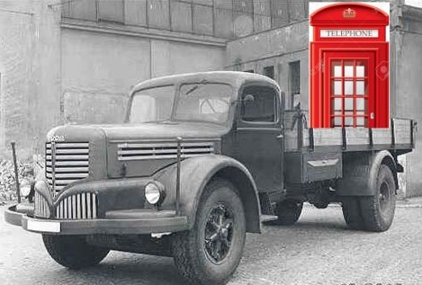
Standard Model and beyond
Mobile phone , type ~1950’s
Standard Model :
old theory, nevertheless works very well
- too many ‘parameters’ (masses, fine structure constant,
Fermi constant, Weinberg angle, …)
- number of not-well understood features (e.g. parity violation,
baryon-antibaryon asymmetry, unification with gravitation, etc.)
Successful theory but a “low” energy approximation of more
fundamental theory, there is surely new physics beyond SM (e.g. neutrino oscillations !)
Search for this physics beyond the SM - at high energy colliders, neutrino physics, atomic physics (parity violation), nuclear β-decay (correlations)
High E: search for “exotic” particles whose exchange could create possible Scalar or Tensor-type interactions (e.g. charged Higgs,..)
High-energy and low-energy experiments are complementary – it is useful to test the SM in different energy domains
correspondence of High x Low-energy searches :
sensitivity of low-energy searches (limits on the strength of the forbidden interaction) can be related to the lower mass limits of the hypothetical exotic bosons (responsible for the interaction) searched for in high-energy physics

Slide 4
Low energy search
Principle:
find the variables/signatures which are sensitive to the character of the interaction and perform precise
measurements that can reveal the presence of “forbidden” interaction or set the upper limits for its strength
correlations in β-decay – search for new exotic S- and T-interactions
(β-ν, β-nucleus correlations ; nuclear recoil measurement, Doppler effect measurement, ...)
β-ν correlation in β-decay - a parameter (sensitive to both Scalar, Tensor interaction)
can simultaneously study both “forbidden interactions” – Scalar in Fermi decays, Tensor in Gamow-Teller decays
Difficulty to directly detect neutrinos ⇒ study recoil nuclei instead of neutrinos
⇓
direct measurement of the shape of energy spectrum of nuclei recoiling after β-decay (WITCH)
measurement of the shape of proton spectrum from β-delayed proton decay (WISArD)

Slide 5
β-ν correlations (search for Scalar & Tensor weak interactions)
e⁺
nucleus
θ
ν_{e}
(assuming maximal P-violation and T-invariance for V- and A-interactions)
a_{GT} and a_{F} independent of nuclear matrix elements

Slide 6


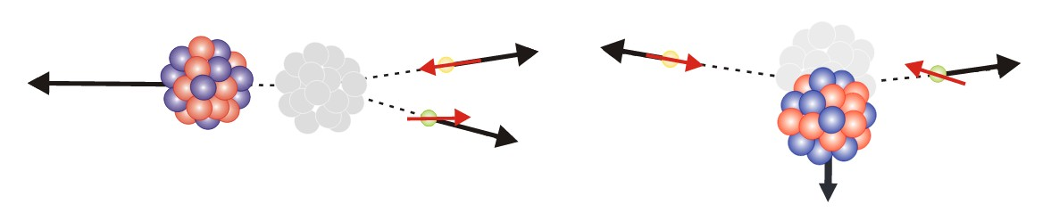
β-ν correlations
β-decay : super-allowed 0⁺ → 0⁺ Fermi transition
Spins of β and ν have to be antiparallel (couple to 0)
Momenta are parallel for vector and antiparallel for scalar interaction
Vector interaction
(included in SM)
High energy of recoil nucleus, moving opposite to emitted particles
Scalar interaction
(beyond SM)
Very small energy of recoil nucleus
We need to find the way to determine the recoil nucleus energy - because this is very different for vector (SM allowed) and scalar (SM forbidden) interaction -
and precisely measure it

Slide 7
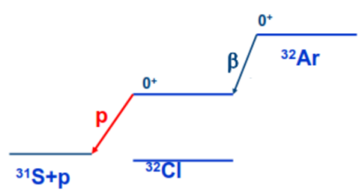
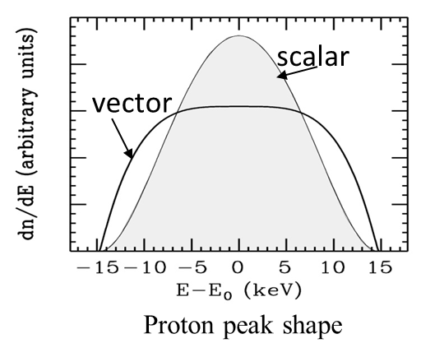
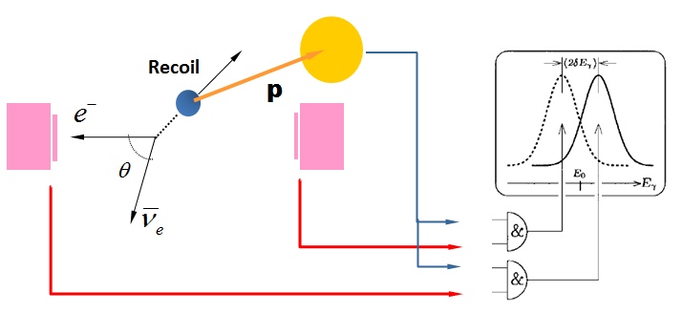
β-delayed proton decay (case of ³²Ar)
³²Ar decays by β-decay to the ³²Cl which subsequently decays by proton decay to ³¹S
Interested in super-allowed Fermi β-decay ³²Ar→ ³²Cl to Isobaric Analog State followed by the proton decay
³²Cl → ³¹S
Protons are emitted from the moving nucleus ³²Cl recoiling after previous β-decay ⇒ energy of protons is Doppler shifted
Significant difference between the effect of Doppler shift on proton energy between scalar β-decay (small recoil energy) and vector β-decay (high recoil energy)
⇓
Shape of proton spectrum reflects energy spectrum of recoil nuclei after the β-decay (and that is sensitive to the scalar x vector character of the weak interaction)
Precise measurements of proton spectra in coincidence with positrons can search for deviations from the shape of allowed vector decay and look for admixture of a “forbidden” scalar one
Detection of particles at extreme angles 0 and 180° ⇒ energy shifts rather than broadened width ⇒ improved sensitivity

Slide 8
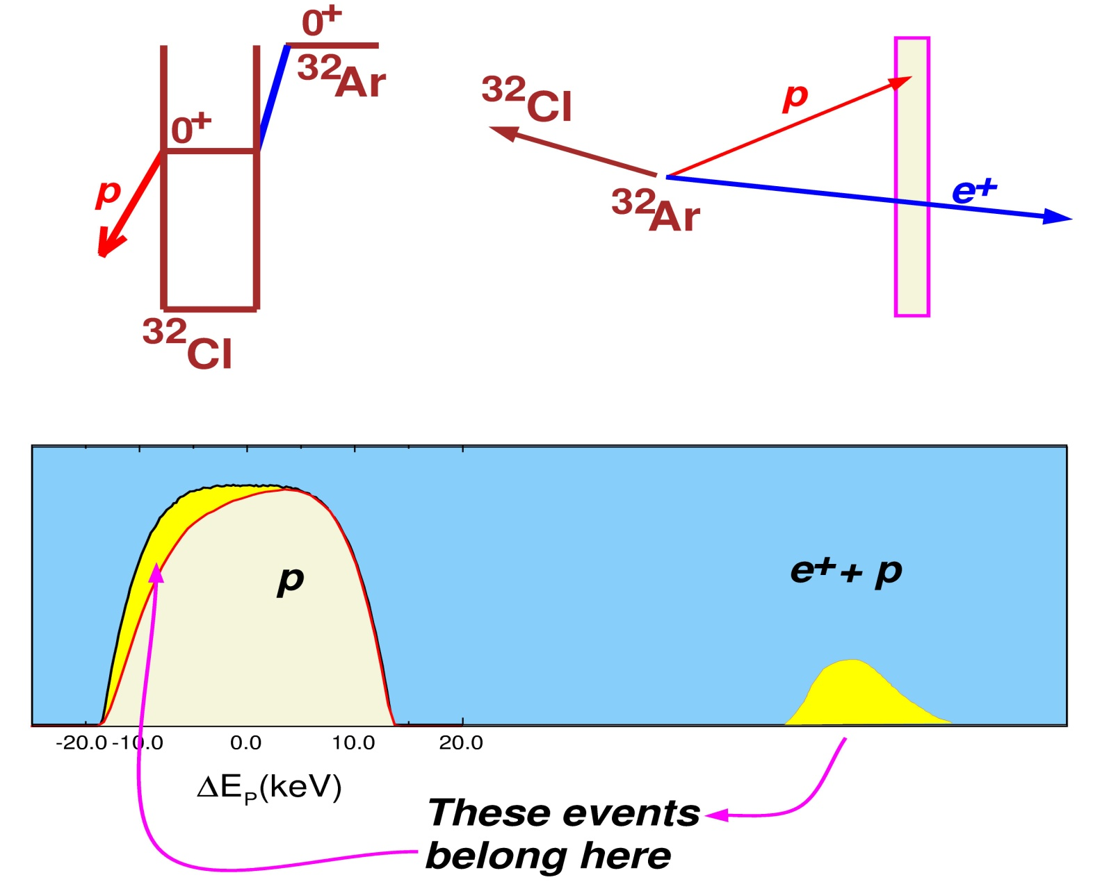
Problem: summing of protons and positrons
Our experimental method relies on the precise study of the peak shape – must avoid (or control) possible processes distorting the peak shape
⇓
differentiate between positrons and protons in the detectors (avoid summing which causes distortions in the peak shape !!)
⇓
best is to spatially divide positron and
proton tracks (and therefore use different detectors for e⁺ and p )
⇓
strong magnetic field
⇓
WISArD

Slide 9
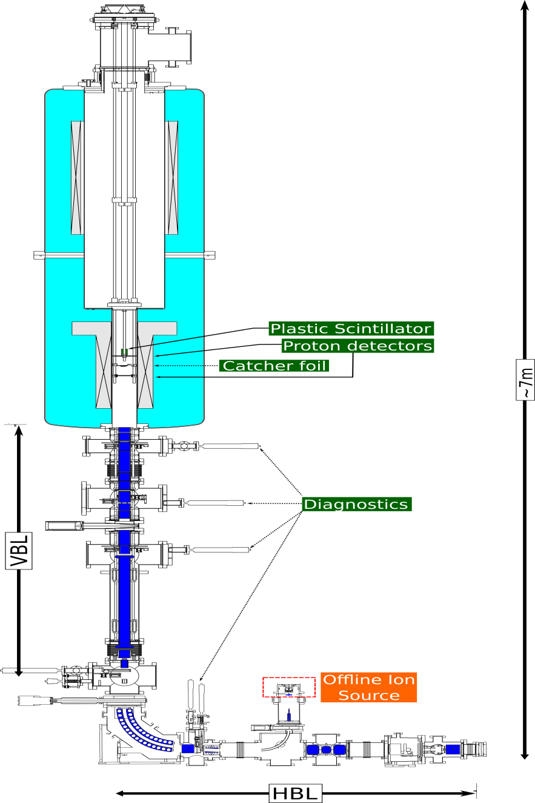
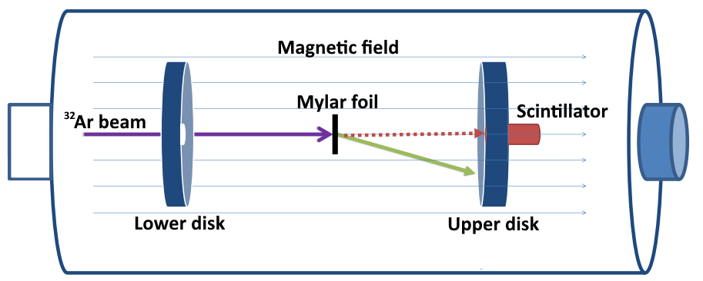
WISArD (Weak-Interaction Studies with ³²Ar Decay)
Principle of the experiment
Whole setup in the magnetic field (up to 9T)
³²Ar ions implanted into the mylar foil
Positrons from the β-decay detected by the narrow forward detector placed on axis
Protons from the subsequent p-decay of ³²Cl detected by arrays of Si detectors in forward and backward direction
Spiraling positrons cannot reach the proton detectors placed off axis

Slide 10
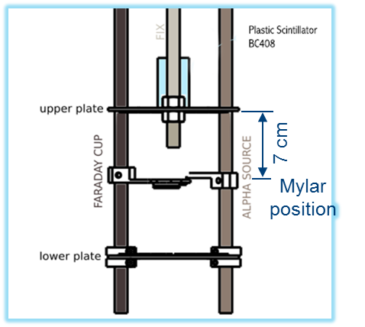
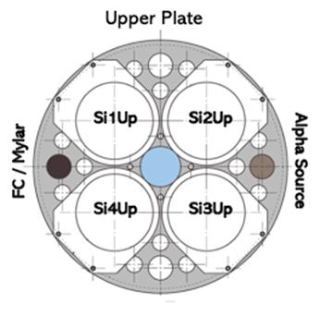
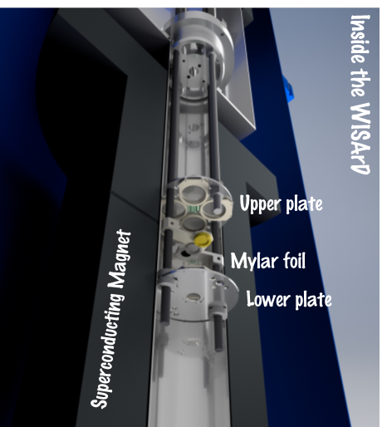
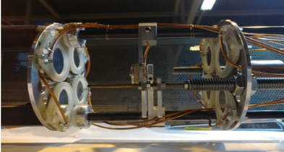
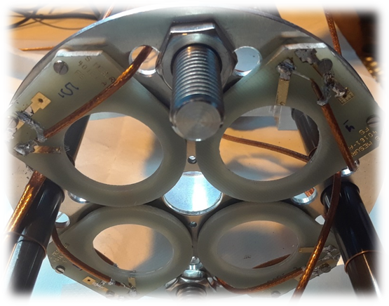
WISArD (Weak-Interaction Studies with ³²Ar Decay)
³²Ar ions implanted into the 6mm wide and 100μm thick mylar foil
Positrons detected by the cylindrical forward plastic scintilator detector (BC-408): 5cm long, 2 cm in diameter; SiPM readout
Protons detected by 8 surface 300µm thick Si detectors with 30mm diameter arranged in 2 disks in forward and backward direction, off axis (so spiralling positrons cannot reach them)
Preamps GANIL/Bordeaux design, inside magnet, not cooled
Setup in the bore of superconducting magnet with field up to 9T, length 2.6m

Slide 11

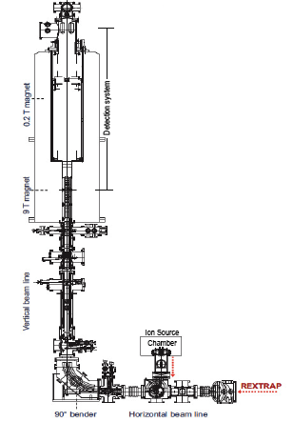
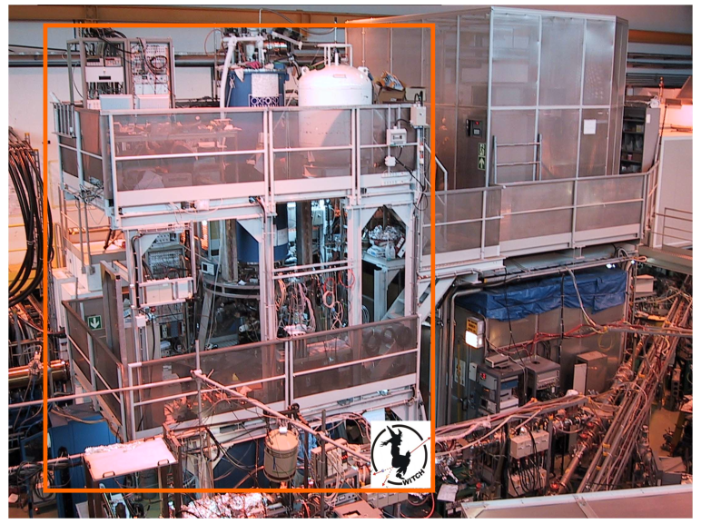



WISArD (Weak-Interaction Studies with ³²Ar Decay)
Notes:
Research of new physics beyond the Standard Model at low energies by measuring the beta-neutrino angular correlation, a_{βν}
The new WISArD experiment reutilises the former WITCH superconducting magnet at ISOLDE. The proton and positron detection in the same or in the opposite hemisphere of the superconducting magnet will allow the determination of the Doppler shift on the protons emitted because vector and scalar currents has different angular distributions between the two emitted leptons: angular correlations peaked at 0° for the vector current and at 180° for the scalar current

Slide 12


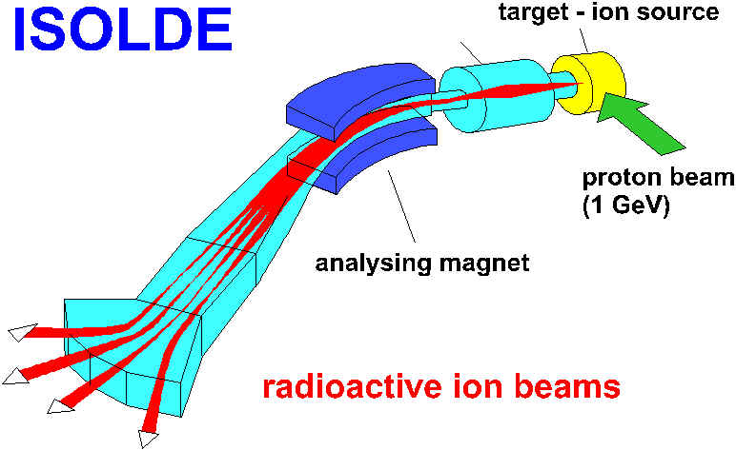
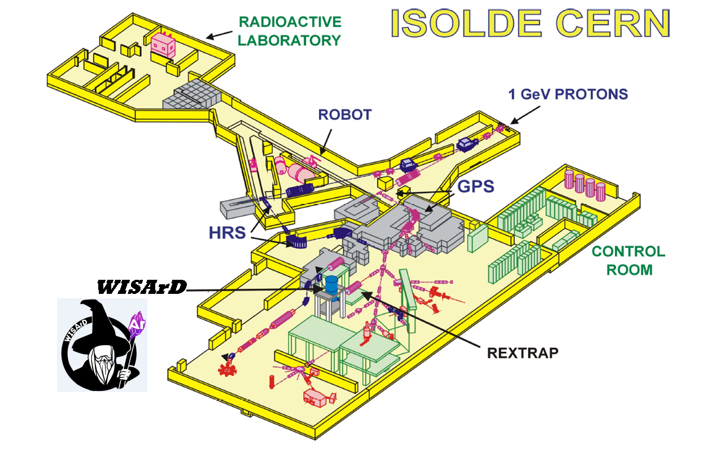
ISOLDE (Isotope Separator OnLine Device)
∼2μA proton 1.4GeV beam from PS booster hitting thick target
2 mass separators General Purpose Separator and High Resolution Separator provide pure beams
beam of 1⁺ ions, energy 30-60keV
WISArD online proof-of-principle experiment: - November 2018, latest run before the CERN shutdown
- HRS, CaO nanostructured target
- 1.5 μA proton 1.4GeV beam
- 4T mgt. field, 1300 ³²Ar ions/s at the setup

Slide 13
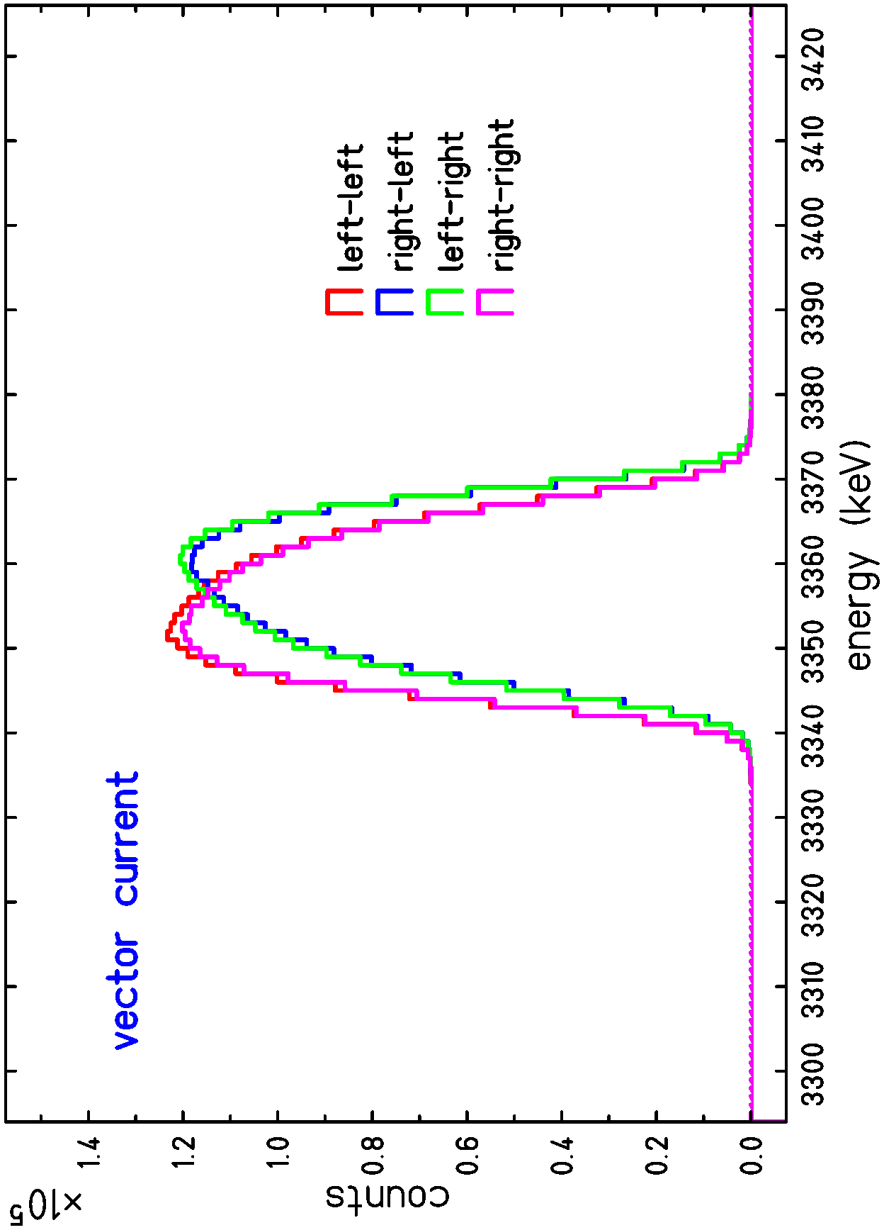
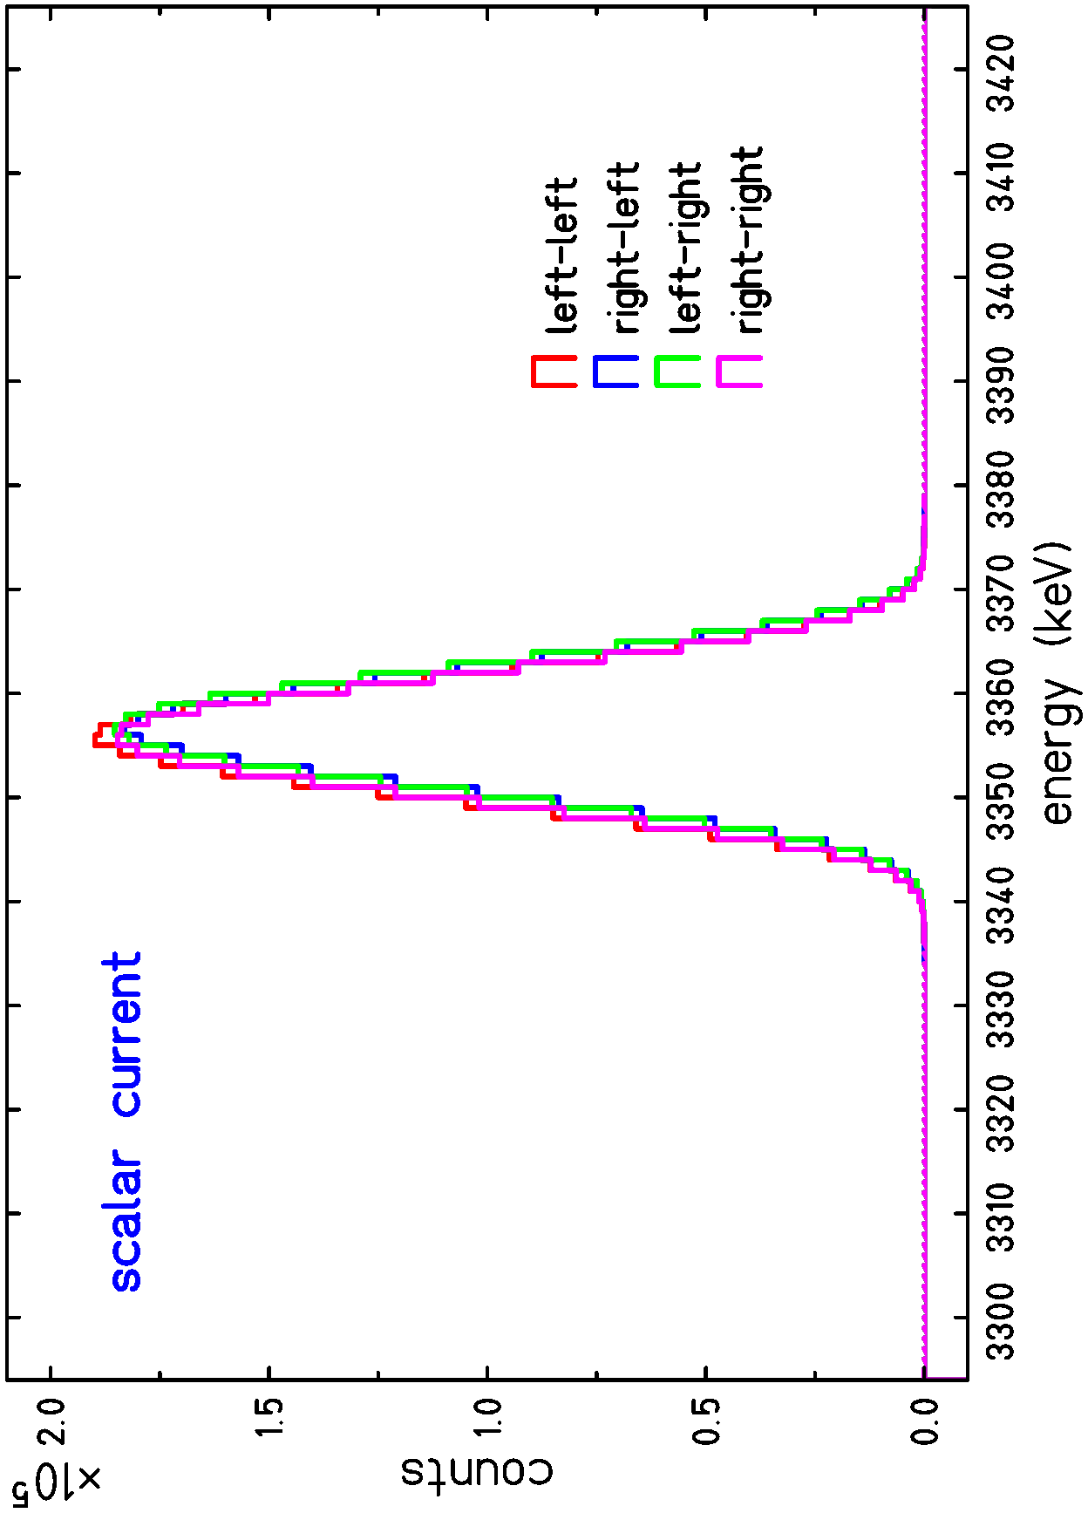
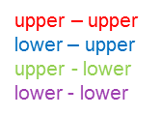
β-delayed proton decay of ³²Ar - simulations
Proton spectra in coincidence with positrons for the “Fermi peak” simulated by GEANT4

Slide 14
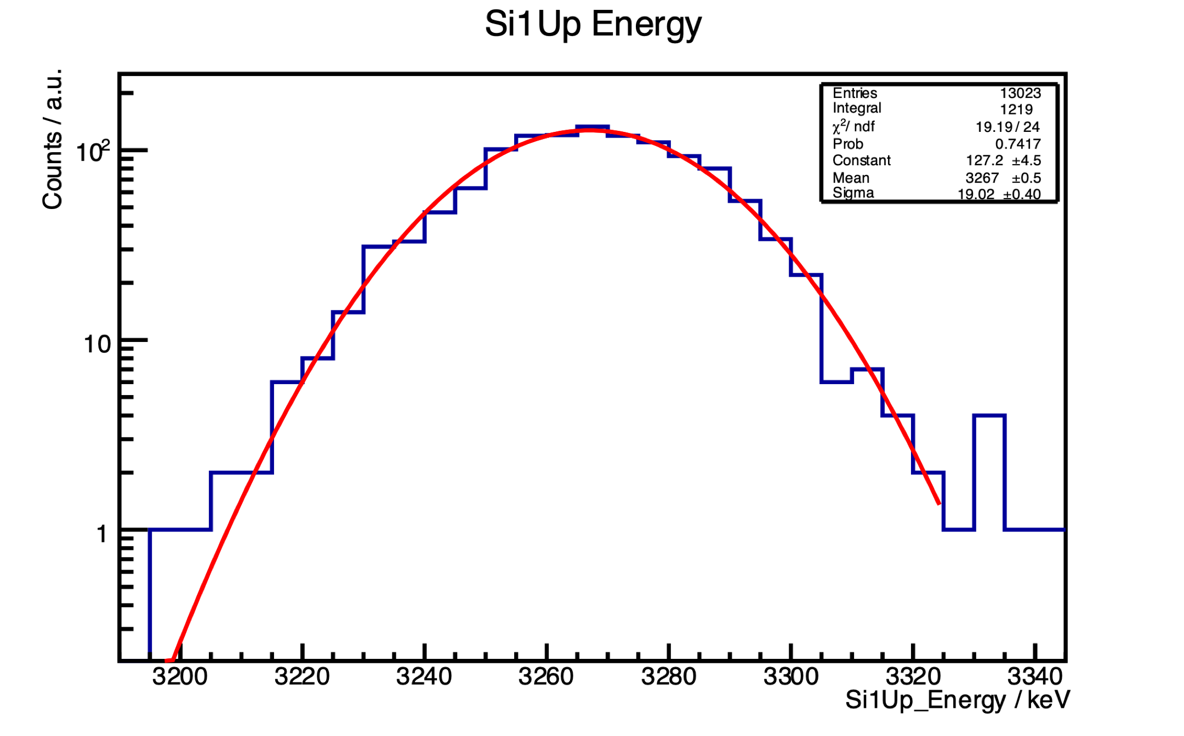
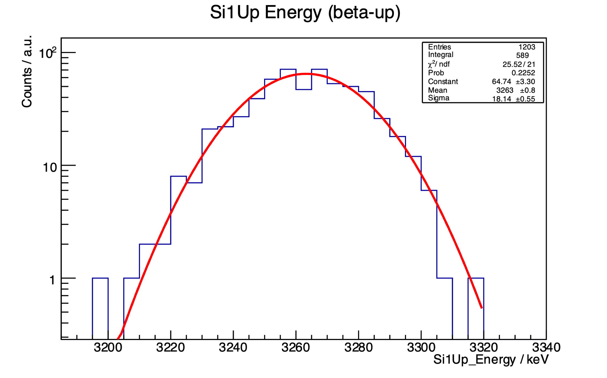
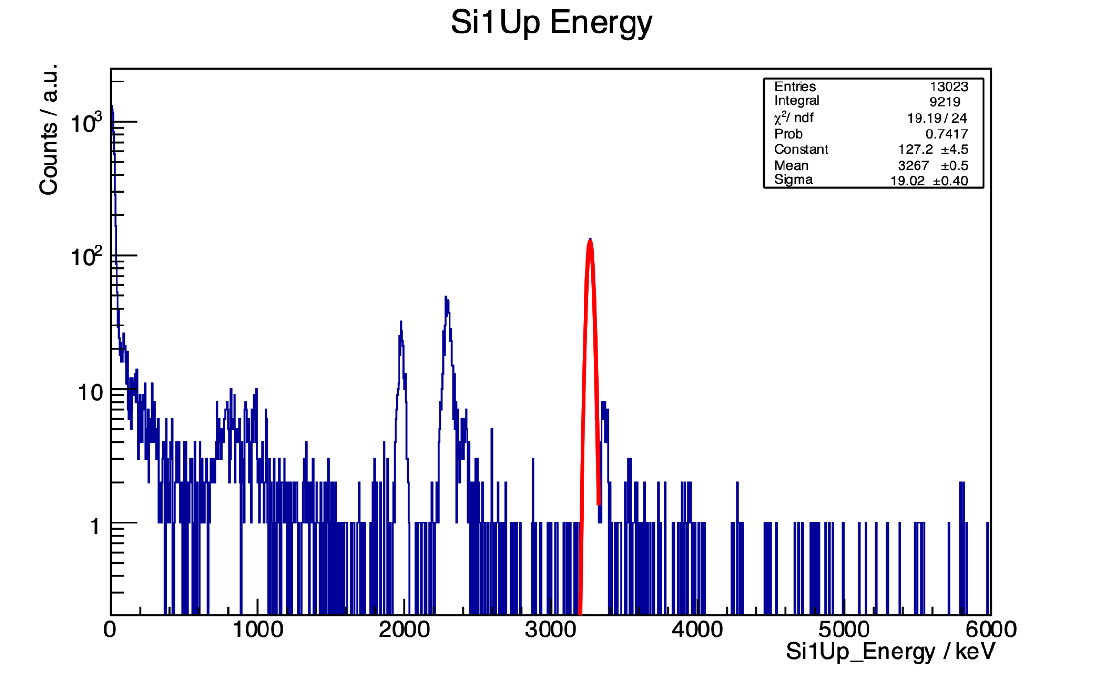
Online experiment - β-delayed proton decay of ³²Ar
Proton peak (from the IAS in ³²Cl after the Fermi β–decay of ³²Ar)
Full peak : centroid proton energy 3267 keV
Coincidence peak (protons and positrons in the same (upward) direction: centroid proton energy 3263 keV
Positron up → recoil nucleus down → proton emitted upwards from downwards moving nucleus → lower energy

Slide 15
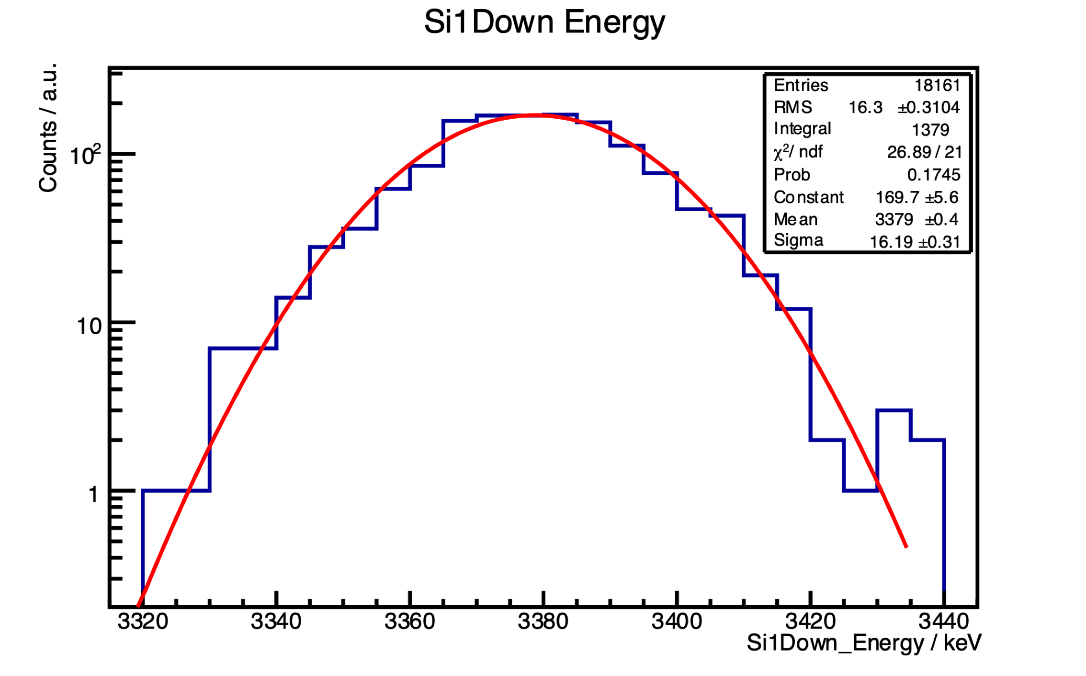
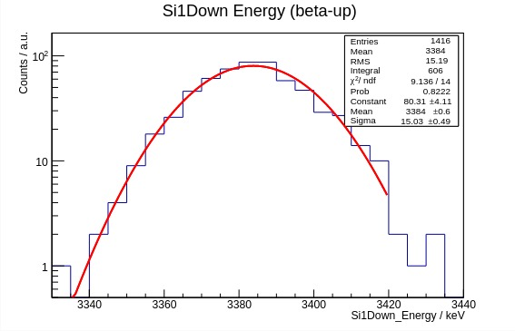
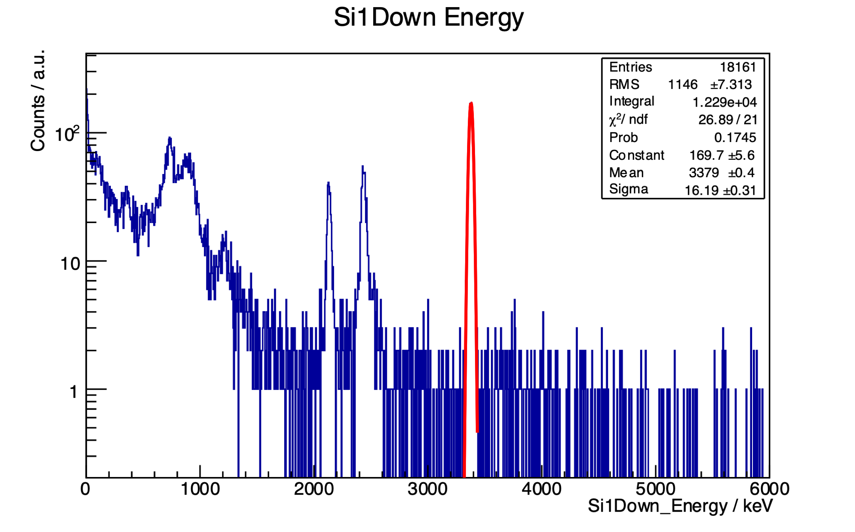
Online experiment - β-delayed proton decay of ³²Ar
Proton peak (from the IAS in ³²Cl after the Fermi β–decay of ³²Ar)
Full peak : centroid proton energy 3379 keV
Coincidence peak (protons downward and positrons in upward direction): centroid proton energy 3384 keV
Positron up → recoil nucleus down → proton emitted downwards from downwards moving nucleus → higher energy

Slide 16
Summary & outlook
precision measurement of the a_{βν} is a sensitive tool to search for the scalar component of weak
interactions using the Doppler energy shift of the β-delayed protons emitted in decay of ³²Ar
new experimental setup WISArD at ISOLDE/CERN has been proposed :
designed, constructed, installed and commissioned
successful proof-of-principle experiment performed, expected Doppler shifts of proton peaks observed
full data analysis and simulations are ongoing, systematic effects under investigation
problems were identified and during the long CERN shutdown will be worked on
Goal :
Accomplish the main purpose of the WISArD experiment - real precision measurement with ³²Ar, getting statistics for proton spectrum with a good resolution and perform simulations with comparable precision, obtain good accuracy for a parameter => improve the limits for scalar interaction
new and better detectors and preamplifiers, cooling of detectors+preamps to improve resolution
aim: with a FWHM = 5 keV → Δa ≈ 0.1% (competitive with LHC)
design and install downward annular beta detector (with hole to allow the ion beam to go through)
use of solid catcher foil or trapping? – reduce absorption in catcher foil for upward particles
use of scintillators or silicon detectors for positrons?
improve the beam tuning and diagnostics to increase the intensity of incoming beam (our own offline source)
usable nuclei: ²⁰Mg, ²⁴Si, ²⁸S, ³²Ar, ³⁶Ca…, but only for ³²Ar the beam intensity is feasible today (maybe ²⁰Mg)
not restricted only to scalar interaction – possible search for tensor interactions in GT transitions

Slide 17








WISArD Collaboration
D. Zakoucky^{1 ,} V. Araujo-Escalona², P. Alfaurt³, P. Ascher³, D. Atanasov², B. Blank³, L. Daudin³, X. Fléchard ⁴, M. Gerbaux³, J. Giovinazzo³, S. Grévy³, T. Kurtukian Nieto³, E. Liénard ⁴, L. Nies⁵, G. Quéméner ⁴, M. Roche³, N. Severijns², S. Vanlangendonck², M. Versteegen³, P. Wagenknecht²
¹NPI Rez (Czech Republic)
²KU Leuven (Belgium)
³CEN Bordeaux-Gradignan (France)
⁴LPC Caen (France)
⁵II Physics Institute, Uni Giessen (Germany)

Slide 18
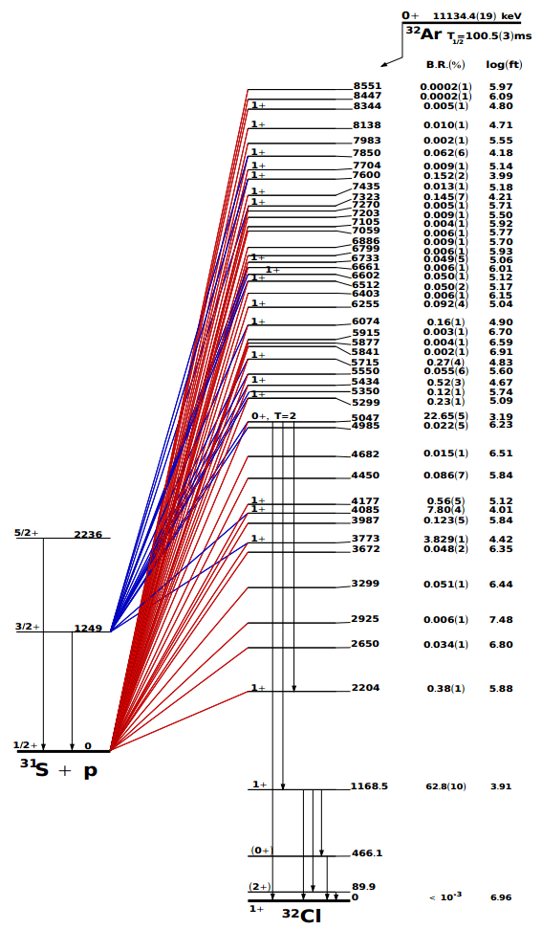
β-delayed proton decay of ³²Ar

Slide 19
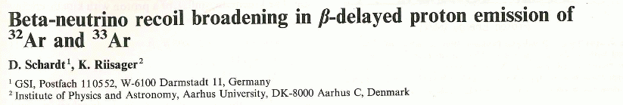
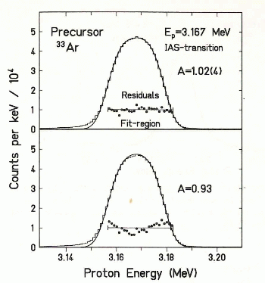
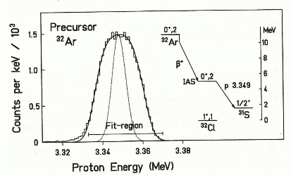
First experiment with β-delayed proton decay of ³²Ar at ISOLDE
ZPA 345 (1993) 265
Set-up: cooled silicon detector
³²Ar
³³Ar
a = 1.00(8)

