Slide 1
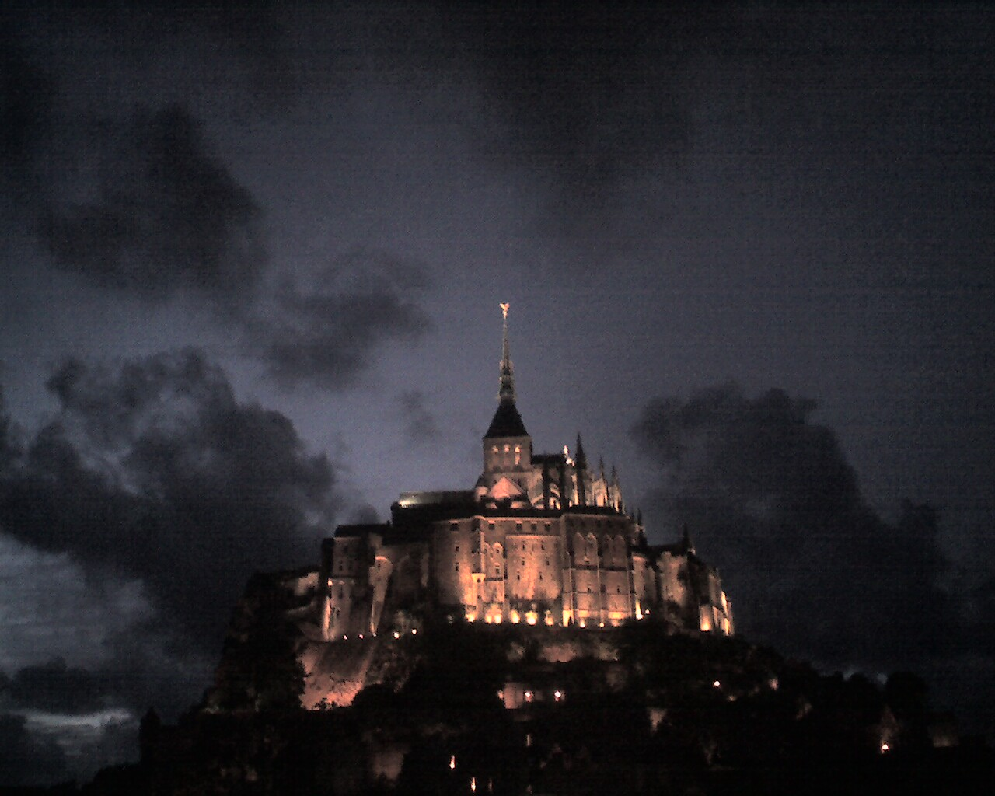
V2.0
“The Bridge between HEP & Hadrodynamics”
or
“Finding New Dynamics by Judgments”
Motto: Impact of Non-perturbative QCD on CP Violation in Many-Body Final States of Flavor Transitions
Ikaros Bigi, Notre Dame du Lac
Mainz, Jan.2019
(a) In the previous summer I had fallen down several times close to my hotel in Munich, the reception & close to my room there.
Now my speaking is worse; one example:
I confuse the names of `Wolfenstein’ vs. `Wilson(ian)’
(b) My suggestions outside fundamental dynamics
  -- Mainz has several wonderful churches with organ recitals
  -- Excellent museum of art
  -- If you are a fan of `food culture’, you understand that Mainz is
  on the correct side of the Rhein river, namely the left one.
Picture taken by
IIB in France !

Slide 2
V2.0
“The Bridge between HEP & Hadrodynamics
or
“Finding New Dynamics by Judgments”
Motto: Impact of Non-perturbative QCD on CP Violation in Many-Body Final States of Flavor Transitions
Ikaros Bigi, Notre Dame du Lac
Mainz, Jan.2019
experimenters
theorists
Picture taken by
IIB in France !

Slide 3
Manifestation of a divine being through something both simple & striking: local symmetries & their tools !
Fitting the data vs. Information inside the data
1st step: models
2nd step: model-independent analyses – indeed, true progress

Slide 4
Manifestation of a divine being through something both simple & striking: local symmetries & their tools !
Fitting the data vs. Information inside the data
1st step: models
2nd step: model-independent analyses – indeed, true progress
3rd step: best fitted analyses often do not give the best
information about the underlying dynamics;
data are the referees – in the end !
crucial: collaborations of experimenters & theorists with
correlations & judgments !
Prof. Mannelli from Pisa once assured me that he does not entertain the illusion that theorists can speak the truth all the time -- speaking in good faith is all he expects from theorists!

Slide 5
* Manifestation of a divine being through something both simple & striking: local symmetries & their tools !
Fitting the data vs. Information inside the data
1st step: models
2nd step: model-independent analyses – indeed, true progress
3rd step: best fitted analyses often do not give the best
information about the underlying dynamics;
data are the referees – in the end !
crucial: collaborations of experimenters & theorists with
correlations & judgments !
Prof. Mannelli from Pisa once assured me that he does not entertain the illusion that theorists can speak the truth all the time -- speaking in good faith is all he expects from theorists!
Goal for this century (& this WS):
establish the existence of ND (New Dynamics) & their features
Tools:
  -- probe many-body non-leptonic FS
  -- collaboration of HEP & MEP/Hadrodynamics from
different `cultures’ – not trivial at all !

Slide 6
(My) Plan:
Introduct:Wilsonian OPE, broken U- & V-spin symmetries
Quark Masses in Quantum Field Theories (QFT)
Consistent Parameterization of the CKM Matrix
3- & 4-body Final States in Beauty & Charm Mesons
Challenges for Beauty & Charm & Strange Baryons
Summary: Need Collaboration of HEP & MEP/Hadrodynamics
The slides I think are very important see the symbol
*

Slide 7
(I) Introduction:Wilsonian OPE,broken U- & V-spin symmetries
(I.1) Wilsonian Operator Product Expansion (OPE)
About `our’ history:
If QCD were solved, the L(μ) could be moved down to the scale μ = 0
in the terms of physical hadrons rather than quarks & gluons. Their amplitudes could be described with pole masses as observables.
However, that is `Utopian’! Thus one has to use quarks & gluons going down to μ ~ several x Λ_{QCD}, i.e., 0.7 – 1 GeV;
effective Lagrangians are functions of μ. `We’ need more tools.

Slide 8
*
(I.1) Wilsonian Operator Product Expansion (OPE)
About `our’ history:
If QCD were solved, the L(μ) could be moved down to the scale μ = 0
in the terms of physical hadrons rather than quarks & gluons. Their amplitudes could be described with pole masses as observables.
However, that is `Utopian’! Thus one has to use quarks & gluons
going down to μ ~ several x Λ_{QCD}, i.e., 0.7 – 1 GeV;
effective Lagrangians are functions of μ. `We’ need more tools.
One is the `Operator Product Expansion’.
Almost all invoke OPE -- often without using Wilsonian prescription!
However, “not all OPE’s are created equally!”
Shifman & collaborators had emphasized applying OPE is subtle:
the Wilsonian OPE stops at ~ 1 GeV, not sizably lower.
arXiv: hep-ph/9703290 (BSU):
effective Lagrangian T(H -> f) = … Σ_{i} c_{i}(μ) <f|O_{i}(μ)|H >
with “soft” < μ < “hard”; μ demarcation between long- & short-distance forces

Slide 9
(I.1) Wilsonian Operator Product Expansion (OPE)
About `our’ history:
If QCD were solved, the L(μ) could be moved down to the scale μ = 0
in the terms of physical hadrons rather than quarks & gluons. Their amplitudes could be described with pole masses as observables.
However, that is `Utopian’! Thus one has to use quarks & gluons
going down to μ ~ several x Λ_{QCD}, i.e., 0.7 – 1 GeV;
effective Lagrangians are functions of μ. `We’ need more tools.
One is the `Operator Product Expansion’.
Almost all invoke OPE -- often without using Wilsonian prescription!
However, “not all OPE’s are created equally!”
Shifman & collaborators had emphasized applying OPE is subtle:
the Wilsonian OPE stops at ~ 1 GeV, not sizably lower.
It is one thing to draw diagrams, while another thing is understand the underlying dynamics, like non-perturbative QCD with some accuracy.
Quote of Marinus (~468 AD student of Proklos, Neoplatonist Philosopher):
“Only being good is one thing – but good doing it is the other one!“

Slide 10
Again going back about `history’:
SU(3)_{flavor} [not SU(3)_{color}] in the world of quarks:
-- `constituent’ quarks: m_{u} ~ 0.33 GeV ~ m_{d}, m_{s} ~ 0.5 GeV;
pointed out by (this `pope’) Lipkin: broken SU(3)_{flavor} can
be described by 3 SU(2) with I-, U- & V-spin symmetries
-- (u,d) are obviously combined for I-spin
-- broken U-spin symmetry without V-spin is `usable’ for
(strong) spectroscopy, where (s,d) are combined.

Slide 11
-- weak decays?
  A_{CP}(B⁰ -> K+π-) = - 0.082 +/- 0.006
  [τ(B⁰) = 1.52 x 10⁻¹² s, BR(B⁰ -> K+π-)=(1.96+/-0.05) x 10⁻⁵]
  1987 prediction by Uraltsev, IIB, ...: A_{CP}(B⁰ -> K+π-) ~ - 0.1
  it shows the impact of Penguin diagrams,
  but semi-quantitatively ??
  A_{CP}(B_{s}⁰ -> π+K-) = + 0.26 +/- 0.04
  [ τ(B_{s}⁰) = 1.51 x 10⁻¹² s, BR(B_{s}⁰ -> π+K-)=(0.56+/-0.06)x10⁻⁵]
  - Can we predict this connection (with the 2018 data)?

Slide 12
-- it had been suggested by Lipkin in 2005 to use U-spin sym.
b
s
b
d
B⁰ -> K+π-
u
B_{s}⁰ -> π+K-
u
u
u
d
d
d s
s
s
`Popes’ know our world is not perfect; in this case of Lipkin:
τ(B_{d}) ≈ τ(B_{s}):
A_{CP}(B_{d} -> K+π-)/A_{CP}(B_{s}-> π+K-) = 1, Γ(B_{s}-> π+K-)/Γ (B_{d}->K+π-) = 1
12/60

Slide 13
-- it had been suggested by Lipkin in 2005 to use U-spin sym.
b
s
b
d
B⁰ -> K+π-
u
B_{s}⁰ -> π+K-
u
u
u
d
d
d s
s
s
`Popes’ know our world is not perfect; in this case of Lipkin:
τ(B_{d}) ≈ τ(B_{s}):
A_{CP}(B_{d} -> K+π-)/A_{CP}(B_{s}-> π+K-) = 1, Γ(B_{s}-> π+K-)/Γ (B_{d}->K+π-) = 1
Δ= A_{CP}(B_{d} -> K+π-)/A_{CP}(B_{s}-> π+K-) + Γ(B_{s}-> π+K-)/Γ (B_{d}->K+π-) = 0
A_{CP}(B_{d} -> K+π-)/A_{CP}(B_{s}-> π+K-) = - Γ(B_{s}-> π+K-)/Γ (B_{d}->K+π-)
      to get opposite signs in the SM is obvious
13/60

Slide 14
-- it had been suggested by Lipkin in 2005 to use U-spin sym.
b
s
b
d
B⁰ -> K+π-
u
B_{s}⁰ -> π+K-
u
u
u
d
d
d s
s
s
`Popes’ know our world is not perfect; in this case of Lipkin:
Δ= A_{CP}(B_{d} -> K+π-)/A_{CP}(B_{s}-> π+K-)+ Γ(B_{s}-> π+K-)/Γ (B_{d}->K+π-) = 0
A_{CP}(B_{d} -> K+π-)/A_{CP}(B_{s}-> π+K-) = - Γ(B_{s}-> π+K-)/Γ (B_{d}->K+π-)
LHCb Collab. PRL 110 (2013) 221601:
A_{CP}(B_{s}-> π+K-)= + 0.27±0.04±0.01 , A_{CP}(B_{d}->K+π-)= - 0.080±0.007±0.03
2013: ∆_{LHCb} = - 0.02 ± 0.05 ± 0.04
“These results allow a stringent test of the validity of this relation … in the SM given” (`Lipkin rule’)
-- indeed, ∆_{LHCb} is consistent with zero
-- ∆_{LHCb} is consistent with ~ 0.1 as expected for direct CPV for 2-body FS
14/60

Slide 15
-- it had been suggested by Lipkin in 2005 to use U-spin sym.
b
s
b
d
B⁰ -> K+π-
u
B_{s}⁰ -> π+K-
u
d
u
u
d
d s
s
s
Δ= A_{CP}(B_{d} -> K+π-)/A_{CP}(B_{s}-> π+K-)+ Γ(B_{s}-> π+K-)/Γ (B_{d}->K+π-) = 0
LHCb Collab. PRL 110 (2013) 221601:
A_{CP}(B_{s}->π+K-)= + 0.27±0.04±0.01, A_{CP}(B_{d}->K+π-)= - 0.080±0.007±0.03
2013: ∆_{LHCb} = - 0.02 ± 0.05 ± 0.04
LHCb Collab. PRD 98 (2018) 032004 (all data from the run-1):
A_{CP}(B_{s}->π+K-)= + 0.213±0.015±0.007, A_{CP}(B_{d}->K+π-)= - 0.084±0.004±0.003
2018: ∆_{LHCb} = - 0.11 ± 0.04 ± 0.03
-- ∆_{LHCb} is still consistent with zero
-- ∆_{LHCb} is consistent with ~ 0.1 as expected for direct CPV for 2-body FS
-- other lessons ?
15/60

Slide 16
-- re-scattering !
*
d s
  U-spin is sizable broken
  correlations of U-spin with V-spin due to re-scattering
b
s
b
d
B⁰ -> K⁰π⁰
u
d
u
d
u
B_{s}⁰ -> π⁰K⁰/ηK⁰
u
d
d
d
s
s
d
u s
C (B⁰ -> K⁰π⁰) = - 0.00 +/- 0.13 , S (B⁰ -> K⁰π⁰) = + 0.58 +/- 0.17
b
s
b
s
B⁺ -> Kπ/K⁺η/K⁺η’
u
u
d
u
u
d
u
u
u
u
A_{CP}(B⁺ -> K_{S}π⁺) = - 0.017 +/- 0.016 , A_{CP}(B⁺ -> K⁺π⁰) = + 0.037 +/- 0.021
A_{CP}(B⁺ -> K⁺η) = - 0.37 +/- 0.08 , A_{CP}(B⁺ -> K⁺η’ ) = + 0.004 +/- 0.011
Introduction:
1st lesson: difference between U- & V-spin is `fuzzy’
2nd lesson: we have to go well beyond 2-body FS
16/60

Slide 17
(II) Quark Masses in Quantum Field Theories (QFT)
-- With perturbative theory one applies a Green function for a free fermion field with G(p,μ) = 1/(p – m_{f}(μ))
-- the pole mass (or a cut) of the electron is very good for a scale μ=0: it is gauge independent and measurable by experiments (although using it is not trivial already).

Slide 18
(II) Quark Masses in Quantum Field Theories (QFT)
-- With perturbative theory one applies a Green function for a free fermion field with G(p,μ) = 1/(p – m_{f}(μ))
-- the pole mass (or a cut) of the electron is very good for a scale μ=0: it is gauge independent and measurable by experiments (although using it is not trivial already).
-- The situations are very different for b,c,s,d,u due to confinement to produce hadrons in the initial & final states.
-- Pole mass is gauge independent; furthermore, it is perturbative infrared in QCD.

Slide 19
(II) Quark Masses in Quantum Field Theories (QFT)
-- With perturbative theory one applies a Green function for a free fermion field with G(p,μ) = 1/(p – m_{f}(μ))
-- the pole mass (or a cut) of the electron is very good for a scale μ=0: it is gauge independent and measurable by experiments (although using it is not trivial already).
-- The situations are very different for b,c,s,d,u due to confinement to produce hadrons in the initial & final states.
-- Pole mass is gauge independent; furthermore, it is perturbative infrared in QCD.
However, it is not infrared stable non-perturbatively.
-- It is easy to apply pole mass in Feynman diagrams.
Yet pole mass depend on long distance dynamics, for what we have little control.
  -- One cannot ignore the impact of IR renormalons; I just mention that.
  Reference: M. Shifman, in “QCD & Heavy Quarks, In Memoriam
  Nikolai Uraltsev”, World Scientific; arXiv:1310.1966 [hep-th]

Slide 20
(II.1) Definitions of Quark Masses:“MS”,“kinetic”, “PS”;
`1S’,`pole mass’
-- “MS” (`modified minimal subtraction scheme’):
for μ > m_{Q} basically coincides with the running mass to
describe their production.
However, it diverges logarithmically for μ -> 0.

Slide 21
(II.1) Definitions of Quark Masses:“MS”,“kinetic”, “PS”;
`1S’,`pole mass’
-- “MS” (`modified minimal subtraction scheme’):
for μ > m_{Q} basically coincides with the running mass to
describe their production.
However, it diverges logarithmically for μ -> 0.
The `landscape’ is very different from the weak decays of H_{Q}.
-- The “kinetic scheme” regular in the IR region is the best
dm^{kin}_{Q}(μ)/dμ = -(16α_{S}/9π) – (4α_{S}/3π)(μ/m_{Q}) + O(α_{S}²)
-- The “PS (= potential-subtracted) scheme” is quite different
already in the conceptual level;
technical problems of “PS” arise at O(α_{S}⁴);
still “PS” is in the same `division’ of fundamental physics.
-- The situation is somewhat different for top quarks.
*

Slide 22
(II.1) Definitions of Quark Masses:“MS”,“kinetic”, “PS”;
`1S’,`pole mass’
*
2018 PDG review basically ignores “kinetic” & “PS scheme”,
while focus in the `1S scheme’ with m_{b}^{1S} ≈ M_{Y(1S)}/2
`par ordre du mufti‘(= no right of appeal)
It claims these schemes give us the same information about
underlying dynamics -- however, I quite disagree !
Uraltsev pointed out in 2004 (& before):
m_{b}^{1S} = m_{b}^{pole}[1 – C_{F}²(α_{S}²/π) +/- O(α_{S}³, β₀α_{S}³ log α_{S})] --
m_{b}^{1S} ≈ M_{Y(1S)}/2 is a `smart scheme’,
yet it is not well-defined at the non-perturb. level !

Slide 23
(III) Parameterization of the CKM Matrix
(III.1) Wolfenstein’s parameterization
Wolfenstein’s parameterization was very smart, easily usable, well-known & used all the time. The SM with 3 families of quarks describes the CKM matrix with 4 parameters: λ, A, ρ, η;
expansion of λ = 0.223, while A, ρ, η are 0(1).
(III.1.1) Maximal CP asymmetry ?!
It is an important item (in particular about finding the impact of ND),
but a subtle one: What does one mean by `maximal CPV’?
Short comments based on an example: Wolfenstein’s parameterization:
-- 100 % asymmetry in principle.
-- a few examples in the landscape: ρ =1, η =-1 ; ρ = -1, η ~ 3.5/-0.5 ;
ρ =-1/2, η ~ 2.5/-0.3. - it would work.
(III.1.2) `Real world
Measured values: A ≈ 0.82; however: η ≈ 0.35, ρ ≈ 0.14 not close to unity;
thus not real control over systematic uncertainties.

Slide 24
(III.2) Consistent parameterization
Need consistent parameterization of CKM matrix with more
precision [Y.H. Ahn, H-Y. Cheng, S. Oh (2011)] through O(λ⁶) !
1-λ²/2-λ⁴/8-λ⁶/16 , λ hλ⁴exp(-iδ_{QM})
-λ+λ⁵f²/2 , 1-λ²/2-λ⁴/8(1+4f²)-fhλ⁵exp(-iδ_{QM})+… , fλ²+hλ³exp(-iδ_{QM})+…
fλ³ , -fλ²-hλ³exp(-iδ_{QM}) + … , 1- λ⁴/2 f² – fhλ⁵exp(-iδ_{QM})+…
with f ~ 0.75, h ~ 1.35, δ_{QM} ~ 90º
Pattern is not so obvious as before:
(a) needs more accuracy
(b) deeper insights in flavor dynamics & QCD impacts
(c) correlations between 4 triangles, not focus `golden one’
-- maximal SM value for S(B⁰-> ψK_{S}) ~ 0.74 for indirect CPV
-- SM value S(B_{s}⁰-> ψφ) ~ 0.03 – 0.05
-- basically zero CPV for double Cabibbo suppressed decays
- hunting region for ND!

Slide 25
(IV) 3- & 4-body Final States in Beauty & Charm Mesons
(1) For experimenters it is easier to measure 2-body FS
(including narrow resonances), if one has enough data for
suppressed transitions;
for theorists to predict those & to analyze the data.
(2) However, the goal is to probe CPV: it gives only numbers.
(3) 2-body FS of suppressed non-leptonic weak decays are a
small part of charm mesons & tiny ones for beauty mesons;
  data show that;
  it is not surprising.
(4) 3- & 4-body FS are described by two-& more dimensional plots.
Price: lots of data & work both for experimenters & theorists
Prize: find existence & features of New Dynamics (ND)!

Slide 26
(IV) 3- & 4-body Final States in Beauty & Charm Mesons
(1) For experimenters it is easier to measure 2-body FS
(including narrow resonances), if one has enough data for
suppressed transitions;
for theorists to predict those & to analyze the data.
(2) However, the goal is to probe CPV: it gives only numbers.
(3) 2-body FS of suppressed non-leptonic weak decays are a
small part of charm mesons & tiny ones for beauty mesons;
  data show that;
  it is not surprising.
(4) 3- & 4-body FS are described by two-& more dimensional plots.
Price: lots of data & work both for experimenters & theorists
Prize: find existence & features of New Dynamics (ND)!
-- the situations are very different for ΔS= 1 & 2
[listen Danish colleague Buras (member of the Bavarian Academy!)
- local operators
- FS with only one & two pions

Slide 27
T(P -> a) = exp(iδ_{a}) [T_{a} +∑_{aj≠a} T_{aj} i T_{aj,a}^{resc} ]
T(P -> a) = exp(iδ_{a}) [T*_{a} +∑_{aj≠a} T*_{aj} i T_{aj,a}^{resc} ]
∆γ(a)=|T(P -> a)|²-|T(P -> a)|²=4∑_{aj≠a} T_{aj,a}^{resc} ImT*_{a}T_{aj}
Without strong re-scattering direct CP asymmetries cannot happen, even if there are weak phases.
Misha & Misha & collab.; Wolfenstein
The goal: measuring CP asymmetries probes existence &
even features of New Dynamics (ND):
they can depend only an amplitude.
∆γ(a)=|T(P -> a)|²-|T(P -> a)|²=4∑_{aj≠a} T_{aj,a}^{resc} ImT*_{a} T_{aj}

Slide 28
T(P -> a) = exp(iδ_{a}) [T_{a} +∑_{aj≠a} T_{aj} i T_{aj,a}^{resc} ]
T(P -> a) = exp(iδ_{a}) [T*_{a} +∑_{aj≠a} T*_{aj} i T_{aj,a}^{resc} ]
∆γ(a)=|T(P -> a)|²-|T(P -> a)|²=4∑_{aj≠a} T_{aj,a}^{resc} ImT*_{a}T_{aj}
Without strong re-scattering direct CP asymmetries cannot happen, even if there are weak phases.
Misha & Misha & collab.; Wolfenstein
The goal: measuring CP asymmetries probes existence &
even features of New Dynamics (ND):
they can depend only an amplitude.
∆γ(a)=|T(P -> a)|²-|T(P -> a)|²=4∑_{aj≠a} T_{aj,a}^{resc} ImT*_{a} T_{aj}
*
There are tools to deal with much more & `complex’ data:
-- unitary
-- chiral symmetry: pions [+++], kaons [++/+],
-- dispersion relations …
-- fitting the data is the 2nd step, but not the final one!

Slide 29
(IV.1) 3-body Final States in general
Dalitz plots (with pions, kaons, η & η’) probe the underlying dynamics
with two observables: without angular correlations a plot is flat,
while resonances & thresholds show their impact from their
deviations; excellent record both about strong forces & weak ones.
Four main statements:
(a) The FS are not described only by a sum of (semi-)2-body FS &
their interferences; true 3-body FS happen in the weak decays of
charm & beauty mesons.
(b) Best fitted analyses often do not give us the best information
about the underlying dynamics.

Slide 30
(IV.1) 3-body Final States in general
*
Dalitz plots (with pions, kaons, η & η’) probe the underlying dynamics
with two observables: without angular correlations a plot is flat,
while resonances & thresholds show their impact from their
deviations; excellent record both about strong forces & weak ones.
Four main statements:
(a) The FS are not described only by a sum of (semi-2-)body FS &
their interferences; true 3-body FS happen in the weak decays of
charm & beauty mesons.
(b) Best fitted analyses often do not give us the best information
about the underlying dynamics.
(c) We have broad resonances in the region of ~ 1 – 3 GeV;
scalar ones like f₀(500)/sigma, K*₀(700)/kappa etc. cannot been described with Breit-Wigner parameterization.
(d) Maybe the centers of the Dalitz plots are somewhat empty?
correlations & judgments !
Not trivial to connect the world of hadrons with the diagrams of
quarks & gluons. Re-scattering / non-perturbative forces !
30

Slide 31
`penguin’ diagrams:
b
s,d
t,c,u
g
One should not only look on diagrams
s,d
s,d
u
s,d
b
b
u
b
q
u,c
q
t
q
q
q
q
local operator with weak phase
nonlocal operator with strong phase
local operator not
needed, but it is there
b -> s c c & s u u `paint’ re-scattering
∆γ(a)=|T(P -> a)|²-|T(P -> a)|²=4∑_{aj≠a} T_{aj,a}^{resc} ImT*_{a}T_{aj}

Slide 32
`penguin’ diagrams: well-known for inclusive one --
b
s,d
t,c,u
g
One should not only look on diagrams
s,d
s,d
u
s,d
b
b
u
b
q
u,c
q
t
q
q
q
q
local operator with weak phase
nonlocal operator with strong phase
local operator not
needed, but it is there
b -> s c c & s u u `paint’ re-scattering
∆γ(a)=|T(P -> a)|²-|T(P -> a)|²=4∑_{aj≠a} T_{aj,a}^{resc} ImT*_{a}T_{aj}

Slide 33
`penguin’ diagrams: well-known for inclusive one --
about exclusive ones?
b
s,d
t,c,u
g
One should not only look on diagrams
s,d
s,d
u
s,d
b
b
u
b
q
u,c
q
t
q
q
q
q
local operator with weak phase
nonlocal operator with strong phase
local operator not
needed, but it is there
b -> s c c & s u u `paint’ re-scattering
∆γ(a)=|T(P -> a)|²-|T(P -> a)|²=4∑_{aj≠a} T_{aj,a}^{resc} ImT*_{a}T_{aj}

Slide 34
*
`penguin’ diagrams: well-known for inclusive one --
about exclusive ones?
b
s,d
t,c,u
g
One should not only look on diagrams
s,d
s,d
u
s,d
b
b
u
b
q
u,c
q
t
q
q
q
q
local operator with weak phase
nonlocal operator with strong phase
local operator not
needed, but it is there
b -> s c c & s u u `paint’ re-scattering
∆γ(a)=|T(P -> a)|²-|T(P -> a)|²=4∑_{aj≠a} T_{aj,a}^{resc} ImT*_{a}T_{aj}

Slide 35
The landscapes of hadrons
φ(1020)
a₀(1450)
K
K
K
B
K
B
K
B
K
K
K
φ(1020)
a₀(1450)
K
`effective’(=non-local) operators

Slide 36
The landscapes of hadrons
*
φ(1020)
a₀(1450)
K
K
K
B
K
B
K
B
K
K
K
φ(1020)
a₀(1450)
K
`effective’(=non-local) operators
Re-scattering is crucial to understand the underlying dynamics !
K*(892)
K*₀(700)
K
K
K
B
π
B
π
B
π
ρ(770)
f₀(500
π
π
π
`effective’(=non-local) operators
need `judgment’ about applying resonances, threshold enhancements etc. with tools like dispersion relations

Slide 37
Look at quark diagrams:
b -> s -- impact of Penguin diagrams in the SM
b
s
b
s
u
u
u
B+ -> K⁺π⁺π⁻
u
B+ -> K⁺K⁺K⁻
d
s
u
d
u
s
b -> d -- less impact of Penguin diagrams in the SM
b
d
b
d
u
u
u
B+ -> π⁺π⁺π⁻
u
B+ -> π⁺K⁺K⁻
d
s
u
d
u
s

Slide 38
*
History:
`penguin’ diagrams
s
d
t,c,u
g
d
d
One should not only look on diagrams
d
d
u
s
s
t ,c,u
u
d
d
d
d
local operator
local penguin operator for K⁰-> 2π -- with weak phase

Slide 39
(IV.2) B^{+/-} -> K^{+/-}π⁺π⁻ vs. B^{+/-} -> K+/-K+K-
*
LHCb data run-1 about rates:
BR(B+ -> K⁺π⁺π⁻) = (5.10 ± 0.29) x 10⁻⁵;
BR(B+ -> K⁺K+K-) = (3.37 ± 0.22) x 10⁻⁵;
not surprising at all
averaged CP asymmetries
ΔA_{CP}(B+ -> K⁺π⁺π⁻) = + 0.032 ± 0.008 ± 0.004 ± 0.007;
ΔA_{CP}(B+ -> K⁺K⁺K⁻) = - 0.043 ± 0.009 ± 0.003 ± 0.007;
it is okay
`regional’ CP asymmetries
ΔA_{CP}(B+ -> K⁺π⁺π⁻)|_{`regional’} = + 0.678 ± 0.078 ± 0.032 ± 0.007;
ΔA_{CP}(B+ ->K⁺K⁺K⁻)|_{`regional’} = - 0.226 ± 0.020 ± 0.004 ± 0.007;
Very surprising due to two connected points:
-- the centers of the Dalitz plots are somewhat empty
-- the differences are so huge!

Slide 40

(IV.3) B^{+/-} -> π^{+/-}π+π- vs. B^{+/-} -> π^{+/-}K+K-
*
LHCb data run-1 about rates:
BR(B+ -> π⁺π⁺π⁻) = (1.52 ± 0.14) x 10⁻⁵;
BR(B+ -> π⁺K+K-) = (0.50 ± 0.07) x 10⁻⁵;
not surprising
averaged CP asymmetries
ΔA_{CP}(B+ -> π⁺π⁺π⁻) = + 0.117 ± 0.021 ± 0.009 ± 0.007;
ΔA_{CP}(B+ -> π⁺K⁺K⁻) = - 0.141 ± 0.040 ± 0.018 ± 0.007;
maybe surprising
`regional’ CP asymmetries
ΔA_{CP}(B+ -> π⁺π⁺π⁻)|_{`regional’} = + 0.584 ± 0.082 ± 0.027 ± 0.007;
ΔA_{CP}(B+ ->π⁺K⁺K⁻) |_{`regional’} = - 0.648 ± 0.070 ± 0.013 ± 0.007;
Very surprising due to two connected points:
-- the centers of the Dalitz plots are somewhat empty
-- the differences are so huge!
underlying dynamics are not obvious

Slide 41
(IV.4) Δ C = 0 with 4-body FS
Remember the history: A_{CPV}(K_{L}->π+π-e+e-) = (13.7+/- 1.5)%
so far, no CP asymmetries has been established in charm mesons
-- SCS decays: D⁰ -> 2π⁺2π⁻/K⁺K⁻π⁺π⁻:
  Averaged CPV:
  SM ~ 0.001
  Regional CPV:
  large impact of re-scattering like ~ 0.01 or more
  like for decays of B⁺ -> light mesons, namely factor of 10
-- DCS decays: : D⁰ -> K⁺π⁻π⁺π⁻/2K⁺K⁻π⁻:
  Averaged CPV:
  basically zero for the SM
  Regional CPV:
  hunting region for ND with no SM background
  if one has large data;
  at least novel lessons about non-perturbative QCD

Slide 42
(IV.5) Δ C = 0 with 3-body FS
LHCb for DCS decays, arXiv:1810.03138 [hep-ex] about 8 TeV (not run-2)
(1a) BR(D+ -> K+K+K-) = (0.587 +/- 0.002 +/- 0.004 +/- 0.018) x 10⁻⁴
PDG2018: = (0.85 +/- 0.20) x 10⁻⁴
(1b) BR(D+ -> K+π+π-) = (4.70 +/- 0.01 +/- 0.02 +/- 0.15) x 10⁻⁴
PDG2018: = (5.19 +/- 0.26) x 10⁻⁴
(1c) BR(D_{s}⁺ -> K+π-K+) = (1.293 +/- 0.013 +/- 0.014 +/- 0.040) x 10⁻⁴;
PDG2018: = (1.27 +/- 0.13) x 10⁻⁴
Look at Feynman diagrams in Figs. 1(a), 1(b) & 1(c) on page 1 of this article:
-- Figs. 1(b) & 1(c) are okay, but incomplete.
-- however, my main problem comes from Fig. 1(a) [to put it politely]:
u
c
W
s
s
u
d
u
s

Slide 43
(IV.5) Δ C = 0 with 3-body FS
*
LHCb for DCS decays, arXiv:1810.03138 [hep-ex] about 8 TeV (not run-2)
(1a) BR(D+ -> K+K+K-) = (0.587 +/- 0.002 +/- 0.004 +/- 0.018) x 10⁻⁴
PDG2018: = (0.85 +/- 0.20) x 10⁻⁴
(1b) BR(D+ -> K+π+π-) = (4.70 +/- 0.01 +/- 0.02 +/- 0.15) x 10⁻⁴
PDG2018: = (5.19 +/- 0.26) x 10⁻⁴
(1c) BR(D_{s}⁺ -> K+π-K+) = (1.293 +/- 0.013 +/- 0.014 +/- 0.040) x 10⁻⁴;
PDG2018: = (1.27 +/- 0.13) x 10⁻⁴
Look at Feynman diagrams in Figs. 1(a), 1(b) & 1(c) on page 1 of this article:
-- Figs. 1(b) & 1(c) are okay, but incomplete.
-- however, my main problem comes from Fig. 1(a) [to put it politely]:
u
c
W
s
-- `WA’ no chance to be the leading source !
-- No referee had pointed out that ?
-- `WA’ <-> re-scattering (FSI) is misleading !
s
u
d
u
s

Slide 44
(IV.5) Δ C = 0 with 3-body FS
*
LHCb for DCS decays, arXiv:1810.03138 [hep-ex] from 8 TeV
(1a) BR(D+ -> K+K+K-) = (0.587 +/- 0.002 +/- 0.004 +/- 0.018) x 10⁻⁴
(1b) BR(D+ -> K+π+π-) = (4.70+/-0.01+/-0.02+/-0.15) x 10⁻⁴
(2) BR(D_{s}⁺ -> K+π-K+) = (1.293+/-0.013+/-0.014+/-0.040) x 10⁻⁴;
My `painting’ of the amplitudes:
u
u
s
1(b)
s
1(a)
c
s
c
u
u
d
d
d
u
d
d
d
u
s
u
s
1(c)
c
d
u
u
s
s

Slide 45
(V) Challenges for Beauty & Charm & Strange Baryons
(V.1) CP asymmetries in the decays of Λ_{b}⁰
-- First step: probe Λ_{b}⁰ -> p π-/p K- ;
no sign, but it is beyond realistic scale
-- I had suggested before to probe Dalitz plots
Λ_{b}⁰ -> Λπ+π-/ΛK+K-
-- LHCb came by with a novel idea: probe Λ_{b}⁰ -> p π-π+π-
between two planes
  Its result: CPV with 3.3 σ uncertainties with
  regional asymmetries ~ 20 % due to [p π⁻_{fast}][π⁺π⁻_{slow}] !

Slide 46
(V) Challenges for Beauty & Charm & Strange Baryons
(V.1) CP asymmetries in the decays of Λ_{b}⁰
*
-- First step: probe Λ_{b}⁰ -> p π-/p K- ;
no sign, but it is beyond realistic scale
-- I had suggested before to probe Dalitz plots
Λ_{b}⁰ -> Λπ+π-/ΛK+K-
-- LHCb came by with a novel idea: probe Λ_{b}⁰ -> p π-π+π-
between two planes
  Its result: CPV with 3.3 σ uncertainties with
  regional asymmetries ~ 20 % due to [p π⁻_{fast}][π⁺π⁻_{slow}] !
  Present data & analyses about [p π⁻_{slow}][π⁺π⁻_{fast}] ?
  No predictions – we have to learn from the (re-fined) data !
-- probe Λ_{b}⁰ -> p π-K+K- where 3 mesons are different
-- likewise Λ_{b}⁰ -> p K-π+π-[different]/pK-K+K- [complex]
-- application of QFT are subtle due to non-local interferences
-- thus decays of Λ_{b}⁰ are excellent cases of underlying
dynamics
-- no information from run-2 ?

Slide 47
(V.2) Present and future lessons Δ C = 0
-- When one goes for CPV, one cannot stop at 2-body FS:
crucial to probe 3- & 4-body FS including regional CPV.
-- On first & second steps one goes after SCS ones where the
SM predicts small CPV on the order of O(10⁻³).
-- For DCS decays the SM predicts basically zero;
hunting regions for ND.
-- One has to probe CPV in charm baryons with Dalitz plots
  SCS: Λ⁺_{c} -> p π+π- / p K+K-
  DCS: Λ⁺_{c} -> p K+π-
47/60

Slide 48
(V.3) Present and future lessons Δ S = 0
-- We know that CP asymmetries has been found & established
in the transitions of neutral strange mesons:
- indirect CPV in K⁰ -> 2π with the scale ~ 2.23 x 10⁻³ data
  ~ 3.6 x 10⁻⁶ data
- direct CPV in K⁰ ->2π with < 2.2 x 10⁻⁶ SM ?!?
~ 1.1 x 10⁻⁶ “Buras team”[”LQCD”]
- amazing established of data & analyses
- it might be beyond the SM: “Buras team”[“LQCD”].
48/60

Slide 49
(V.3) Present and future lessons Δ S = 0
*
-- We know that CP asymmetries has been found & established
in the transitions of neutral strange mesons:
- indirect CPV in K⁰ -> 2π with the scale ~ 2.23 x 10⁻³ data
  ~ 3.6 x 10⁻⁶ data
- direct CPV in K⁰ ->2π with < 2.2 x 10⁻⁶ SM ?!?
  ~ 1.1 x 10⁻⁶ “Buras team[LQCD]”
- amazing established of data & analyses
- it might be beyond the SM: “Buras team” [“LQCD”].
-- Next step for direct CP asymmetry in strange baryons
e⁺e⁻ -> J/ψ -> Λ Λ -> [p π⁺][p π⁻]
  BESIII will probe CPV by 2018/19 with below 10⁻³
-- duality violation enhanced close to thresholds ?
49/60

Slide 50
(V.3) Present and future lessons Δ S = 0
-- It is a novel `road’:
Giovanni Punzi said LHCb could do much better with run-3/4
below 10⁻⁴ !
  J/ψ -> Λ Λ -> [p π⁺][p π⁻]
-- Some details:
J/ψ -> Y Y -> [X π] [X π] with a dedicated trigger
  Measure T-odd moments
  α_{Y}^{X}=<σ_{Y} . (σ_{X} x π_{X})> , α_{Y}^{X}=<σ_{Y} . (σ_{X} x π_{X})> ,
  based on CPT invariance
  probe direct CP asymmetry <A_{CP}^{X}> = (α_{Y}^{X} + α_{Y}^{X})/(α_{Y}^{X} – α_{Y}^{X})
  without polarized Y & Y due to very narrow resonance J/ψ !
50/60

Slide 51
(V.3) Present and future lessons Δ S = 0
*
-- It is a novel `road’:
Giovanni Punzi said LHCb could do much better with run-3/4
below 10⁻⁴ !
  J/ψ -> Λ Λ -> [p π⁺][p π⁻]
-- Some details:
J/ψ -> Y Y -> [X π] [X π] with a dedicated trigger
  Measure T-odd moments
  α_{Y}^{X}=<σ_{Y} . (σ_{X} x π_{X})> , α_{Y}^{X}=<σ_{Y} . (σ_{X} x π_{X})> ,
  based on CPT invariance
  probe direct CP asymmetry <A_{CP}^{X}> = (α_{Y}^{X} + α_{Y}^{X})/(α_{Y}^{X} – α_{Y}^{X})
  without polarized Y & Y due to very narrow resonance J/ψ !
-- `hot’ item (in the world of theorists): direct CPV in K⁰->2π !
-- `hot’ item in general:
NA62: K+ -> π+ ν ν [& for the future K_{L} -> π⁰ ν ν]
  Landscape: NA48 [KTeV] & NA62 & LHCb !
51/60

Slide 52
(VI) Summary; Need Collaboration of HEP & MEP/Hadrodynamics
The Greek king Ptolemy of Egypt once approached the resident `sage’ (Euclid) with the request to be educated in `geometry’, but in a “royal way”, since he was busy with many obligations.
Whereupon Euclid replied with admirable candor:
“ There is no `royal way’ to `geometry’. ”
Likewise is there no `royal insights’ into Nature’s inner working.
Four examples from fundamental dynamics:
Two-body final states do not give `royal insights’ in general;
(b) diagrams give no `royal ones’;
(c) Wolfenstein’s parameterization of the CKM matrix is well-known
& used all the time, but it is not `royal ones’ for this century;
(d) pole masses give no `royal insights’ !

Slide 53
-- history
→ NP → HEP
flavor dynamics
-- now
→ NP → MEP/Hadrodynamics → HEP
jets,
decays of strange/ Higgs, top quarks
beauty/charm mesons & baryons direct SUSY
Dalitz plots
dispersion relations
accuracy/precision
different `landscapes’ & “cultures”: it is not easy, but important
  - pions, kaons, …, N, … vs. quarks & gluons
      - 3- & 4-body FS and regional CP asymmetries

Slide 54
Final steps need `judgment’ about applying resonances, threshold enhancements etc. with dispersion relations
-- 1st step: models;
-- 2nd step: model-independent
-- 3rd step: best fitted analyses often do not give us the best
information about the underlying dynamics –
correlations & judgments
Future lessons for LHCb/Belle 2
Yes, the data are the referees, but in the end -
theorists should not be the slaves of the data !
Ikaros Bigi, Notre Dame du Lac

Slide 55
Final steps need `judgment’ about applying resonances, threshold enhancements etc. with dispersion relations
-- 1st step: models;
-- 2nd step: model-independent
-- 3rd step: best fitted analyses often do not give us the best
information about the underlying dynamics –
correlations & judgments
Future lessons for LHCb/Belle 2
Yes, the data are the referees, but in the end -
theorists should not be the slaves of the data !
One example:
IIB & collab.:
τ(Λ_{b})/τ(B_{d}) > 0.9 1993; ~ 0.94 & > 0.88 1996
Data: τ(Λ_{b})/τ(B_{d}) = 0.77+/-0.05 1996; 0.81+/-0.05 2004; 0.94+/-0.09 2005
Ikaros Bigi, Notre Dame du Lac

Slide 56
Final steps need `judgment’ about applying resonances, threshold enhancements etc. with dispersion relations
-- 1st step: models;
-- 2nd step: model-independent
-- 3rd step: best fitted analyses often do not give us the best
information about the underlying dynamics –
correlations & judgments
Future lessons for LHCb/Belle 2
Yes, the data are the referees, but in the end -
theorists should not be the slaves of the data !
One example:
IIB & collab.:
τ(Λ_{b})/τ(B_{d}) > 0.9 1993; ~ 0.94 & > 0.88 1996
Data: τ(Λ_{b})/τ(B_{d}) = 0.77+/-0.05 1996; 0.81+/-0.05 2004; 0.94+/-0.09 2005
“Imagination created reality” – Richard Wagner
or:
“dedicated trigger”
*
Ikaros Bigi, Notre Dame du Lac

Slide 57
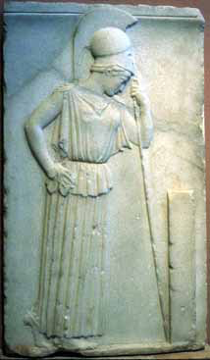
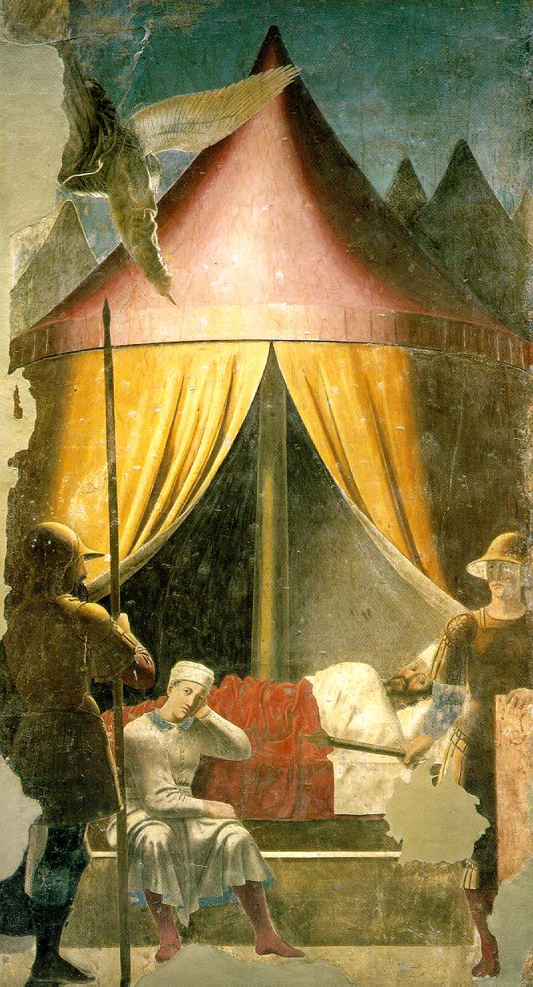
`thinking is better than power’
`dreaming in more dimensions’
Kolya Uraltsev & I had looked at this painting in person
and realized that it is symbol of collaboration.

Slide 58
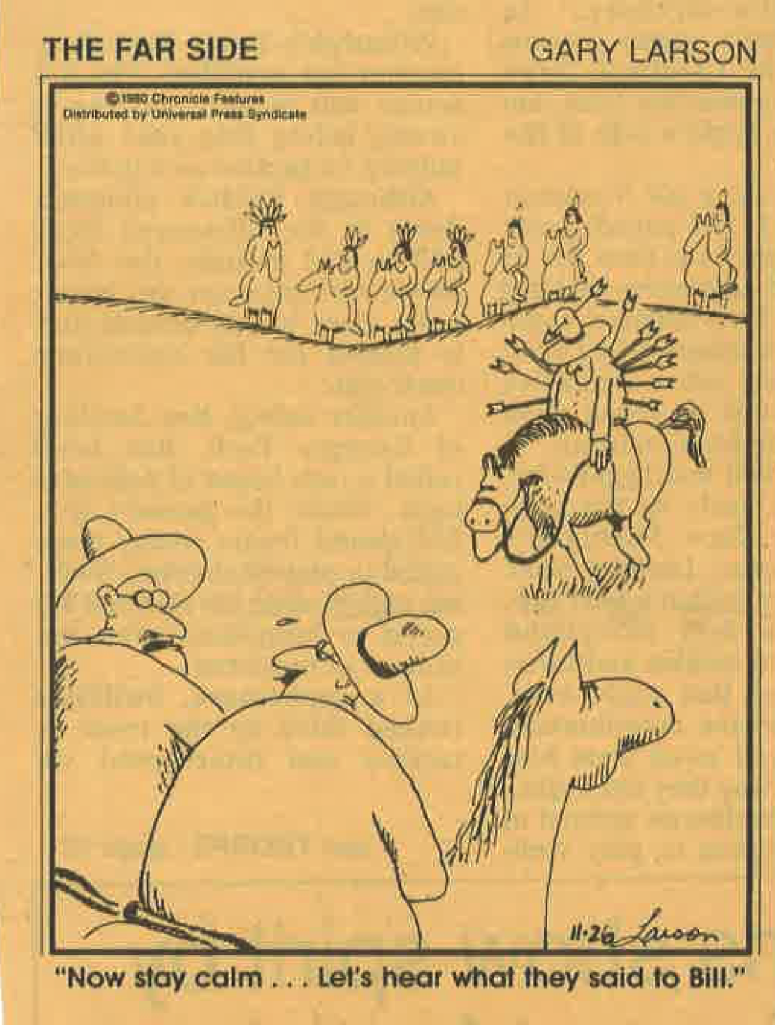
“Goals for flavor dynamics of quarks”:
`battle for supremacy’ has been decided
  goal no longer to find alternatives to CKM –
  instead to identify corrections to CKM!
Probing CP asymmetries in 3- & 4-body FS of charm & beauty
hadrons is crucial to find both existence & features of ND.
[At least it shows the impact of non-perturbative QCD.]
young & mature theorists do not like waiting (for different
reasons): results from run-2 !
waiting for run-3 & run-4: that is life.
“Now stay calm ... Let’s hear what they said to Bill.”

Slide 59
Gods speak in Riddles
? Tragic Oracles & Tragic Mis-understanding ?
LHCb (BaBar & Belle 1&2) both as a pioneer about non-pert. QCD & weak dynamics – as a team of HEP & MEP theorists
“On seeing the missile shot by a catapult which had been brought then for the first time from Sicily”, the king from Sparta in the fourth century B.C. cried out:`
By Heracles, this is the end of man’s valor.’ “
59/60

Slide 60
Very short summary:
-- `We’ need more data, but that is not enough – thinking & judgments about the impact of long distance QCD!
-- HQET [with μ = 0] = HQE [μ ~ 1 GeV > 0]
HQET: `observables’= perturb. forces + non-perturb. Forces
HQE: “observables” = “long-distance” forces + “short-distance “ ones
-- best fitted analyses do not give the best information about the
underlying dynamics
-- CP asymmetries in 3- & 4-FS is crucial to make progress about ND
∆γ(a)=|T(P -> a)|²-|T(P -> a)|²=4∑_{aj≠a} T_{aj,a}^{resc} ImT*_{a} T_{aj}
-- `Technical Challenges’ for beauty, charm & strange baryons
-- `Challenges between Cultures’ of HEP vs. MEP/Hadrodynamics
like “current quarks” vs. `pole masses of hadrons’
-- My new book will be published `soon’:
*
60/60

