Slide 1
The status of the KATRIN experiment
Magnus Schlösser for the KATRIN collaboration
Astroparticle meeting Mainz 2018
Notes:
Takaaki Kajita, Arthur B. McDonald

Slide 2
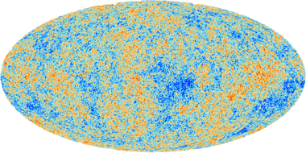
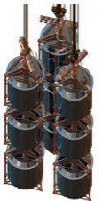
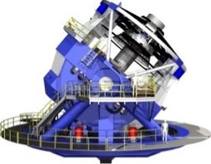
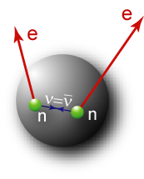
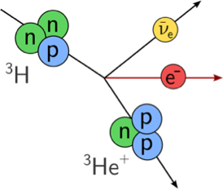
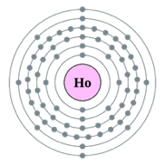
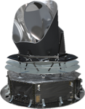



Ways to access the neutrino mass
 | Cosmology | Search for 0νββ | β-decay & electron capture
Observable
Present upper limit | 0.12 – 1 eV | 0.2 – 0.4 eV | 2 eV
Model dependence | Multi-parameter cosmological model | Majorana ν contributions other than m(ν)? nuclear matrix elements, g_{A} | Direct, only kinematics; no cancellations in incoherent sum
KATRIN → 200 meV

Slide 3
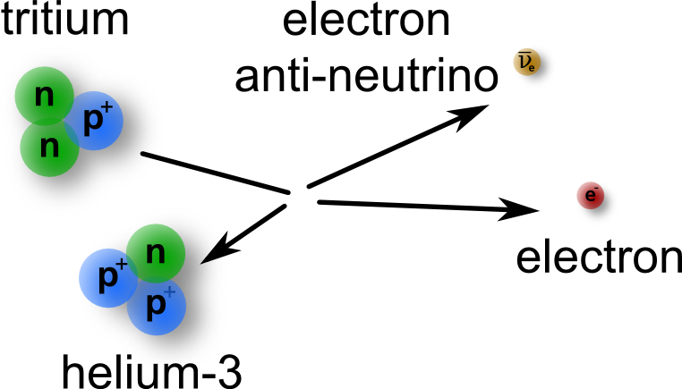
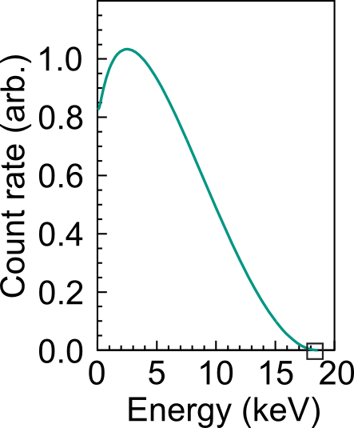
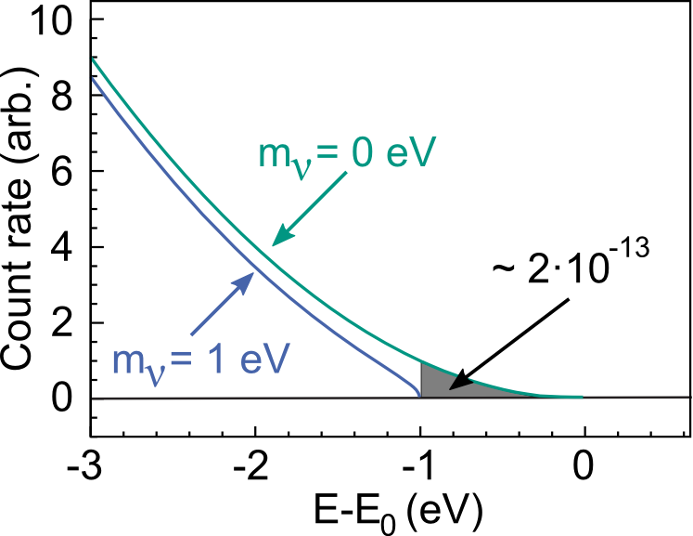
Tritium β-decay
β -electron spectrum
E₀ = 18.6 keV
T_{1/2} = 12.3 y
KATRIN’s aim: Measurement of m_{ν} with a sensitivity of 200 meV/c²

Slide 4
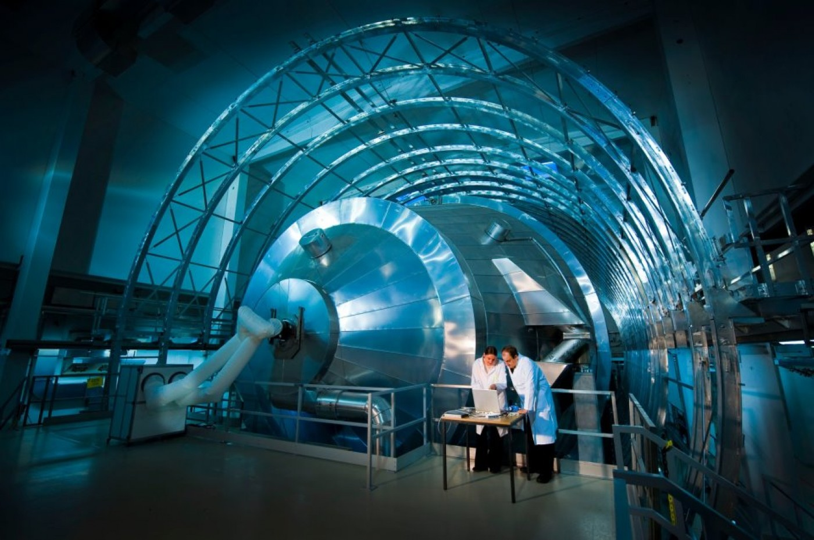
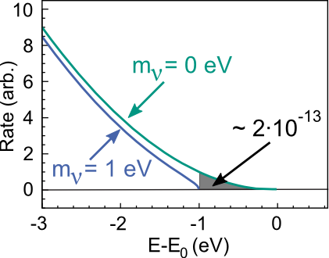
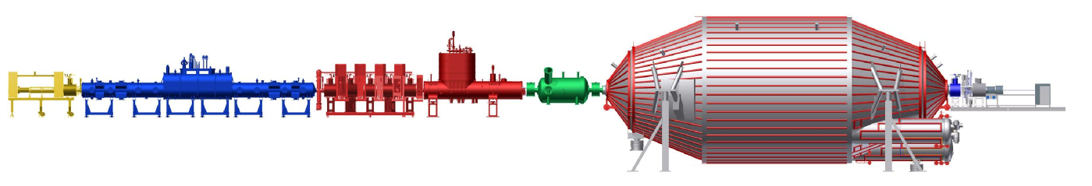
The Karlsruhe Tritium Neutrino Experiment
  ultra-stable high-luminosity windowless gaseous tritium source (10¹¹ Bq)
  high-resolution MAC-E filter with < 1 eV energy resolution
katrin.kit.edu

Slide 5
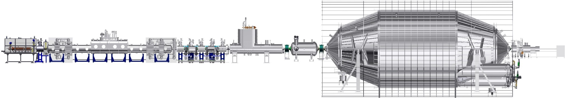
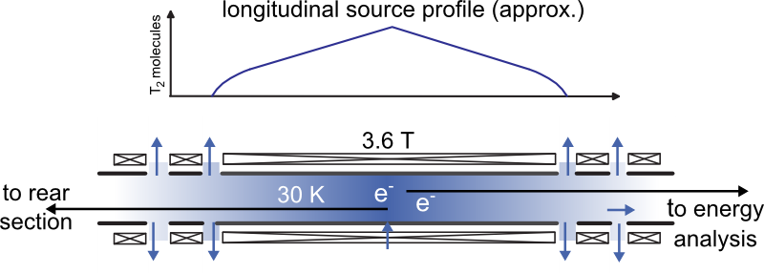
A high-luminosity, ultra-stable tritium source
T₂ retention before
spectrometers >10¹⁴
T₂ purity > 95%
Source activity 10¹¹ Bq
Source profile stable to 10⁻³ level
T₂ throughput ~ 40 g/day
Operation 24/7, 60 days/run
Necessary inventory >15 g

Slide 6
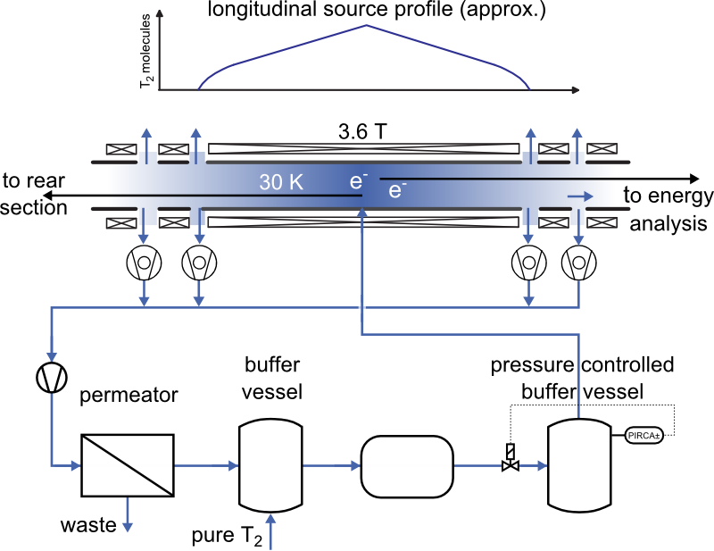
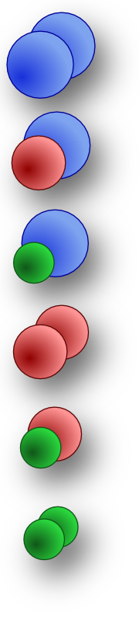
The stable tritium source
M. Babutzka et al., New J. Phys. 14 (2012) 103046
Hydrogen
isotopologues
T₂
T
DT
p
HT
D₂
p
HD
isotopic composition
measurement
H₂

Slide 7
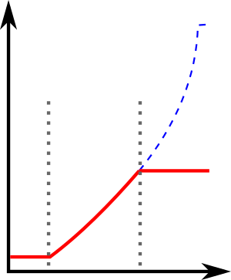
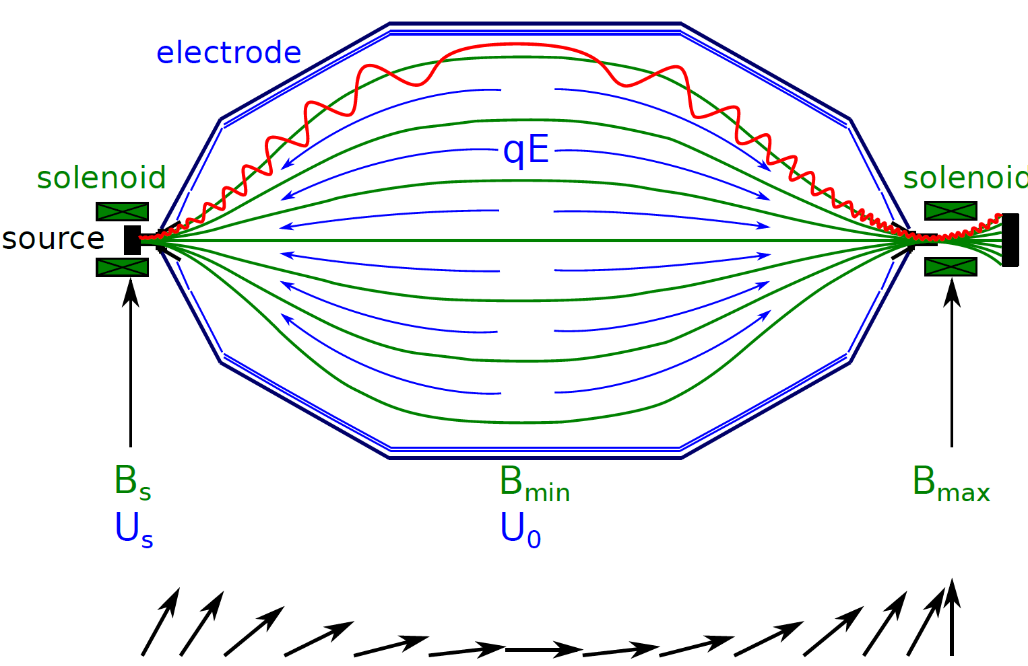


High-resolution spectrometer:
MAC-E filter
Sharp high pass filter:
Magnetic Adiabatic Collimation & Electrostatic Filter:
integrating electrostatic filter (E_{kin} > eU₀)
“clean” (analytic) response function
ΔE
analysing plane
Transmission
electrode
solenoid
solenoid
E-qU
source
detector
$$\frac{ΔE}{E}=\frac{Bmin}{Bmax}$$
→ ΔE < 1 eV at 18.6 keV
$$μ=E_{⊥}/B$$
(momentum transformation without E-field)
e.g. Kleesiek et al., 2018, arXiv:1806.00369

Slide 8
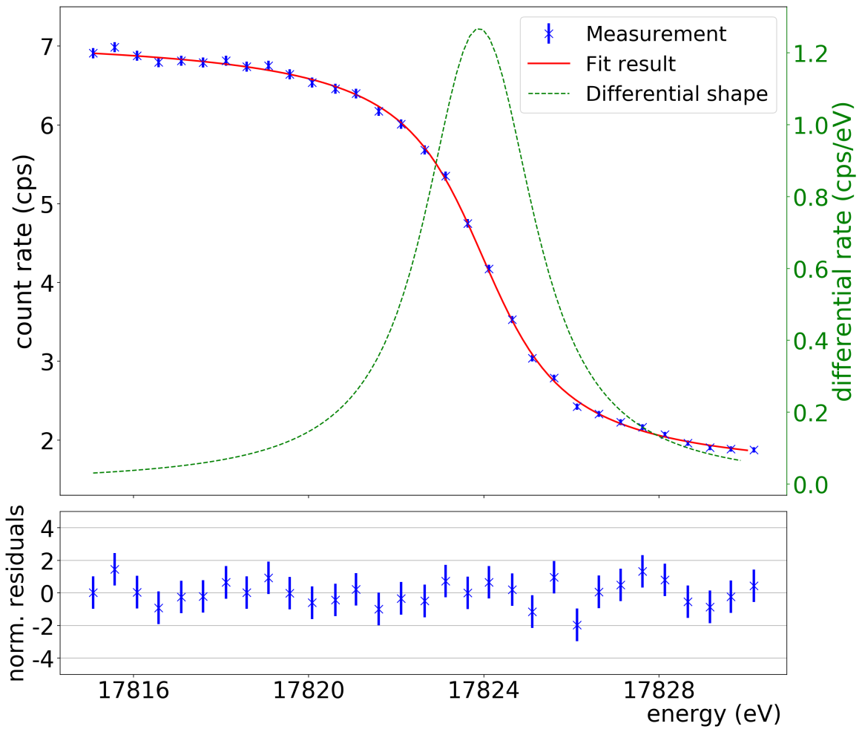
Spectroscopy of electrons from ^{83m}Kr
K-32 line (17.8 keV, Γ ~2.8 eV)
Gaseous ^{83m}Kr provides isotropic electrons for commissioning (summer 2017)
Long term HV divider calibration stability:
2 ppm over 4 years.
KATRIN collab., EPJ C 78 368 (2018)
Validation of high (<1 eV) spectroscopic resolution and energy stabilty
KATRIN collab., JINST 13 P04020 (2018)

Slide 9
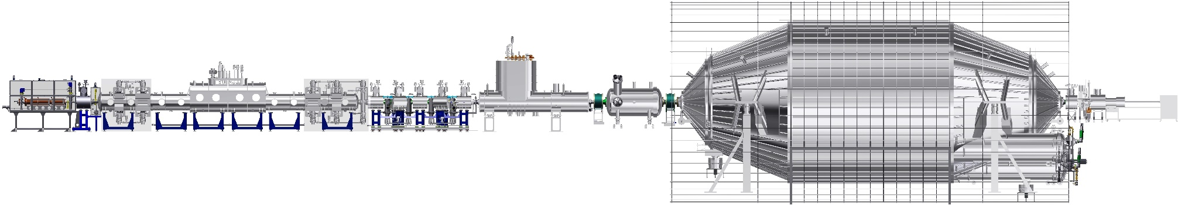
Unique Selling Points of KATRIN
KATRIN will measure the neutrino mass with 200 meV/c² sensitivity
by employing
  an ultra-stable high-luminosity windowless gaseous tritium source
  and a high-resolution MAC-E filter with < 1 eV energy resolution.
✓
✓
Inner loop buffer
vessel pressure
WGTS
Temperature
Gas
composition
Source
activity
Active regulation
Stability <0.05%
Two-phase Ne cooling
Stability <1.5mK/h @ 30 K
Raman spectroscopy
Precison <0.1% in 20 s
Not yet
demonstrated
✓
✓
✓
Priester et al.
Vacuum 116
(2015) 42
Grohmann et al.
Cryogenics 55-56,
(2013) 5
M. Schlösser et al.
J. Mol. Struct. 1044,
24 (2013) 61

Slide 10

First tritium
with KATRIN
in May / June 2018

Slide 11
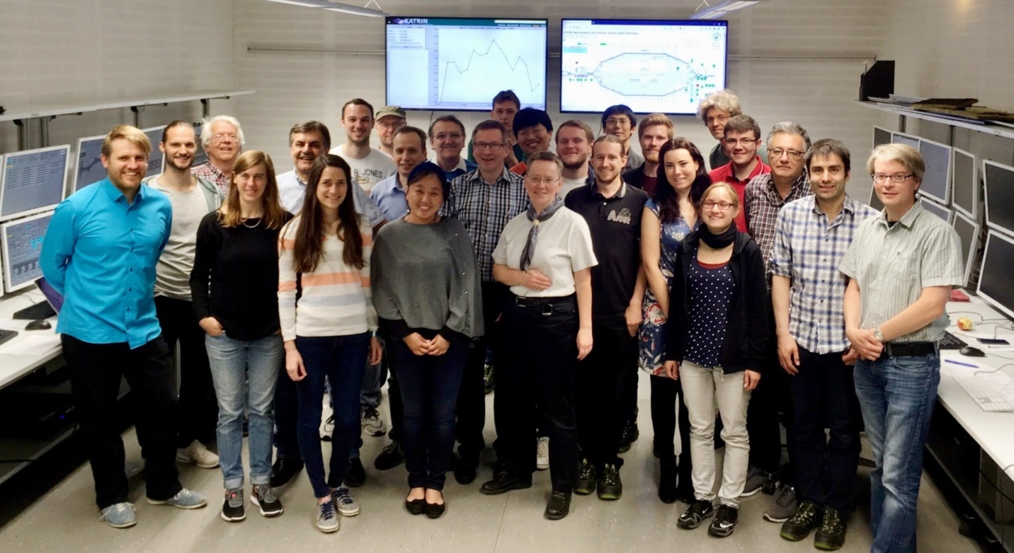
First tritium campaign May / June 2018
Motivation:
  Commissioning of system with tritium (<1% of nominal activity =
  ~500 MBq!)
  Demonstrate 0.1% global system stability
  Study beta spectrum for systematic effects and test analysis strategies
14 days of reliable operation
First tritium injection:
Friday 18 May 7:48 am UTC

Slide 12
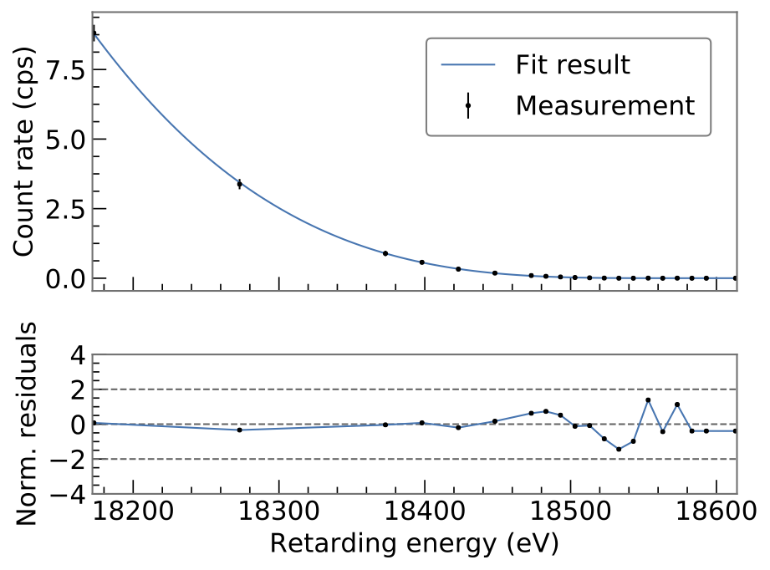
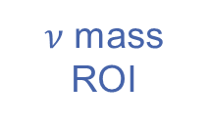
Tritium spectrum fit (example)
Single run (3h), analysis of single detector pixel
ROI extended to 400 eV
(data available up to 1600 eV)
Four (three) parameter fit (+model)
  E₀ (endpoint)
  Background
  Normalization
  m_{ν}=0 eV
Statistics only
$ν$ mass
ROI
Very good agreement of fit (includes model) with data
(shape and estimated absolute rate!)
Notes:
Chi^2/dof = 9.002/17 dof => p-value 94.02

Slide 13
Examplary fit with systematics
Here: Covariance matrix approach
Other approaches
„Nuisance“ parameters
Bayesian priors
Estimation of systematic uncertainties being investigated with different techniques

Slide 14
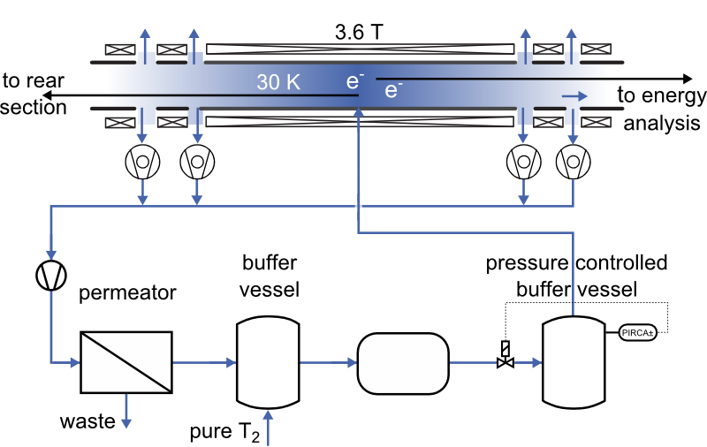

Stability during First Tritium
Hydrogen
isotopologues
Temperature
T₂
DT
HT
LARA
D₂
Buffer
pressure
Tritium fraction
HD
Prefilled gas buffer
in KATRIN loop
~ 1% DT in D₂
H₂
~ 20 000 mbar ℓ

Slide 15
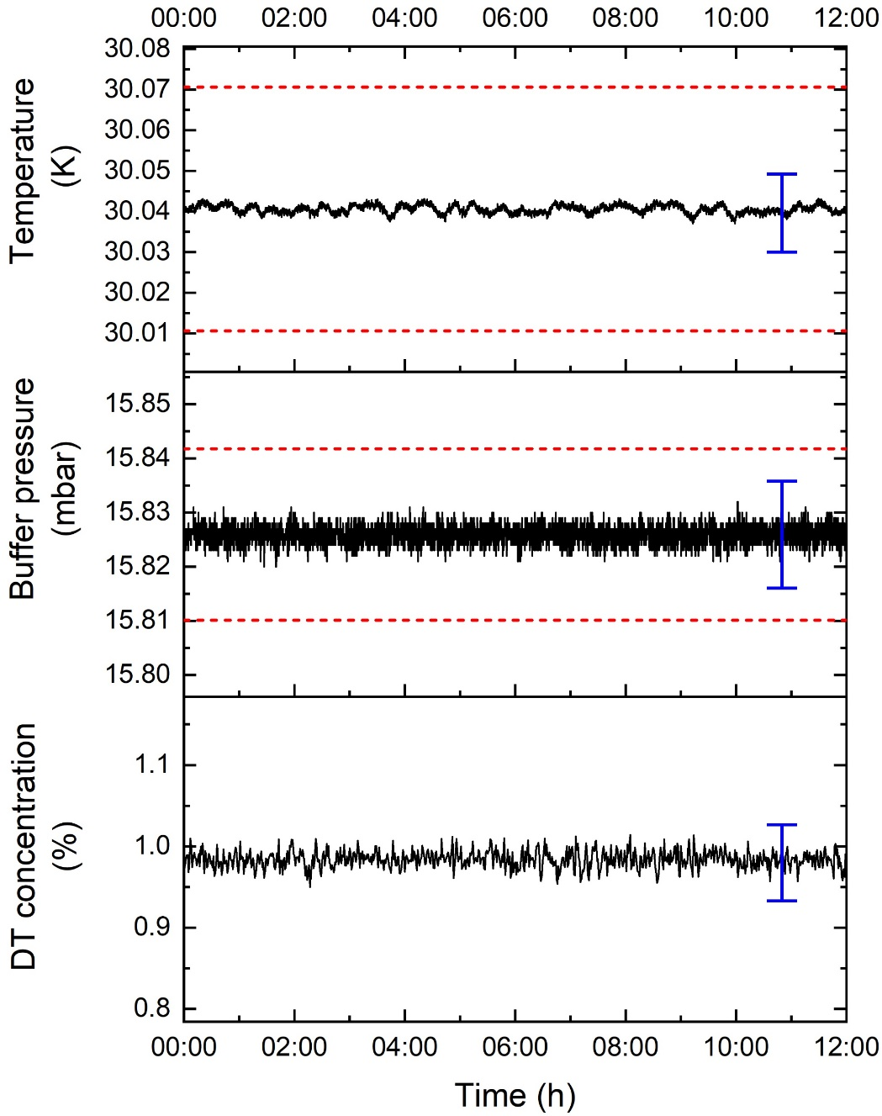
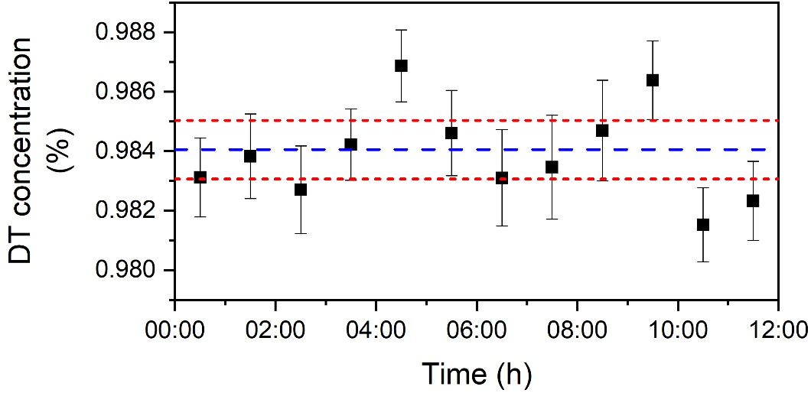
Stability of source parameters during 12 h
Blue arrow:
systematic uncertainty
Red dashed line:
± 0.1 % stability
required for neutrino mass taking
Source parameters are stable and within the specifications
Notes:
New DT data and 1h binning to demonstrate the 0.1% stability!!!

Slide 16
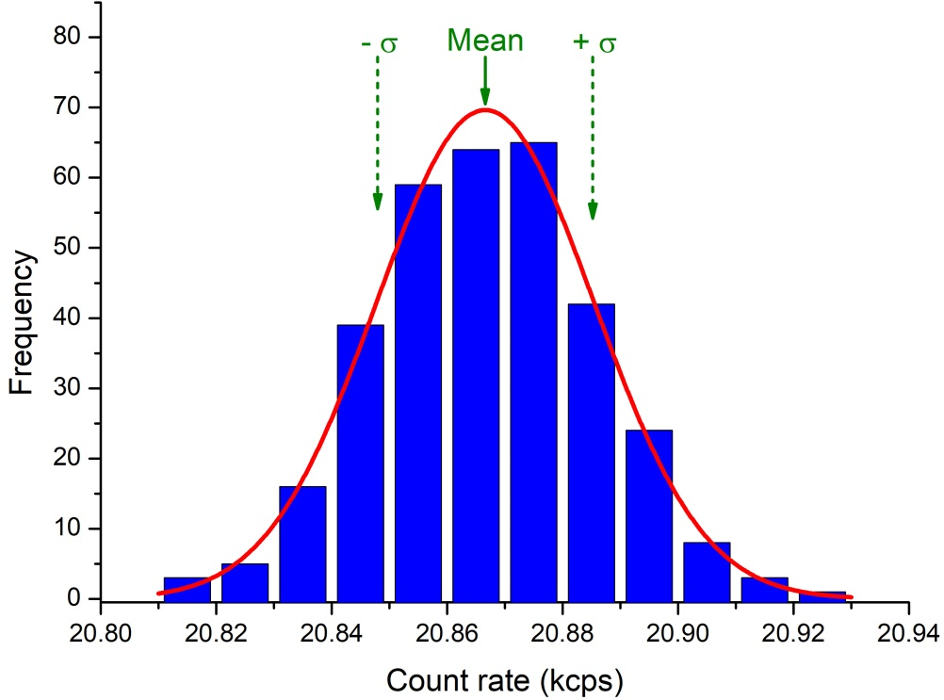
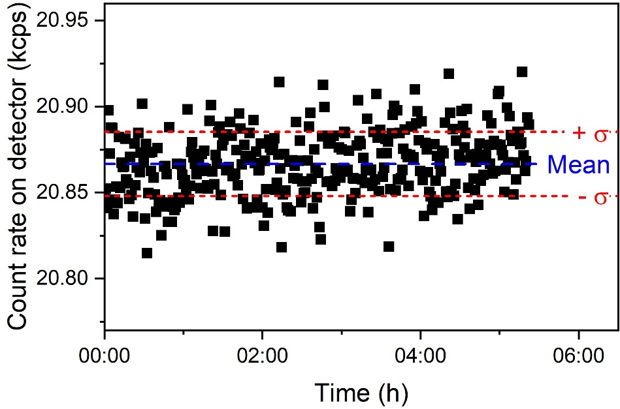

Integral rate stability for more than 5 h
Set spectrometer high-voltage to 1000 V below kinematic endpoint
➔ Constant rate expected
Rate averaged over 1 minute
Exp. 0.1 % precision at this rate $\sqrt{\text{N}}\text{=18.}\text{7} \text{cps}$.
Measured precision (1 min base)$\text{σ}\text{= 18.}\text{9} \text{cps}$.
Precision requirement achieved on minute base over 5 h!
Integral KATRIN stability on 0.1% level!
Notes:
Exchanged cps → kcps
Better readability

Slide 17
Endpoint stability
Output of fit
E₀, Bckg., Norm.
m_{ν}=0 eV
Endpoint fit parameter can be reproduced from scans with <1.5 eV
Agrees with expectation
(incl. systematics)
72 runs = 5.3 days
E₀ – <E₀> (eV)

Slide 18
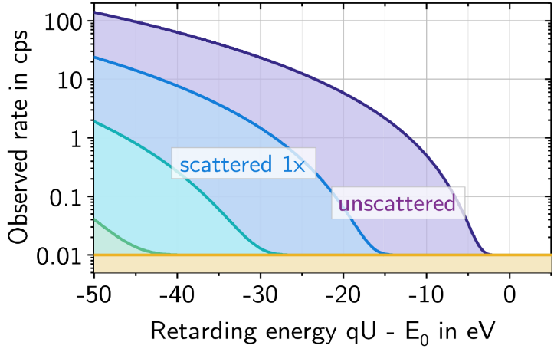
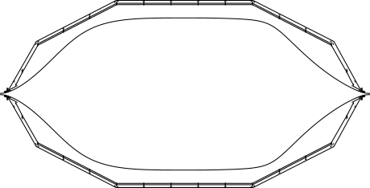
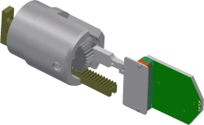
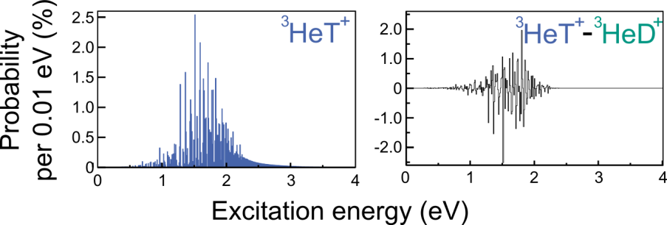
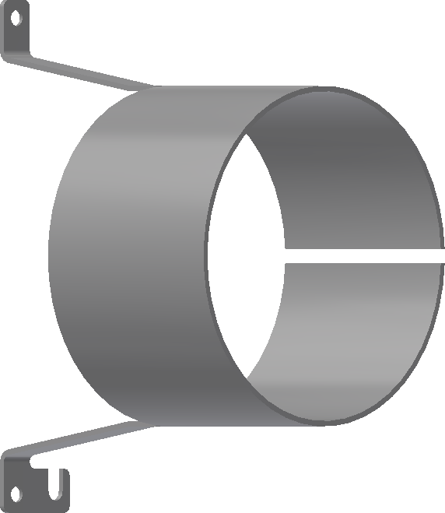


Ongoing analysis
KATRIN collaboration posters
Carsten Röttele
Source section performance
Oliver Rest
High voltage performance
Wonqook Choi
Beta spectrum analysis
Susanne Mertens
Sterile neutrinos with KATRIN
Gas model and scattering
Tritium induced
background
rate (cps)
Source
homogeneity
retarding energy qU – E₀ (eV)
Molecular final states
Cross-correlation against
other sensors
Method testing
for sterile neutrinos
search
Ion retention
Time correlated
measurements

Slide 19
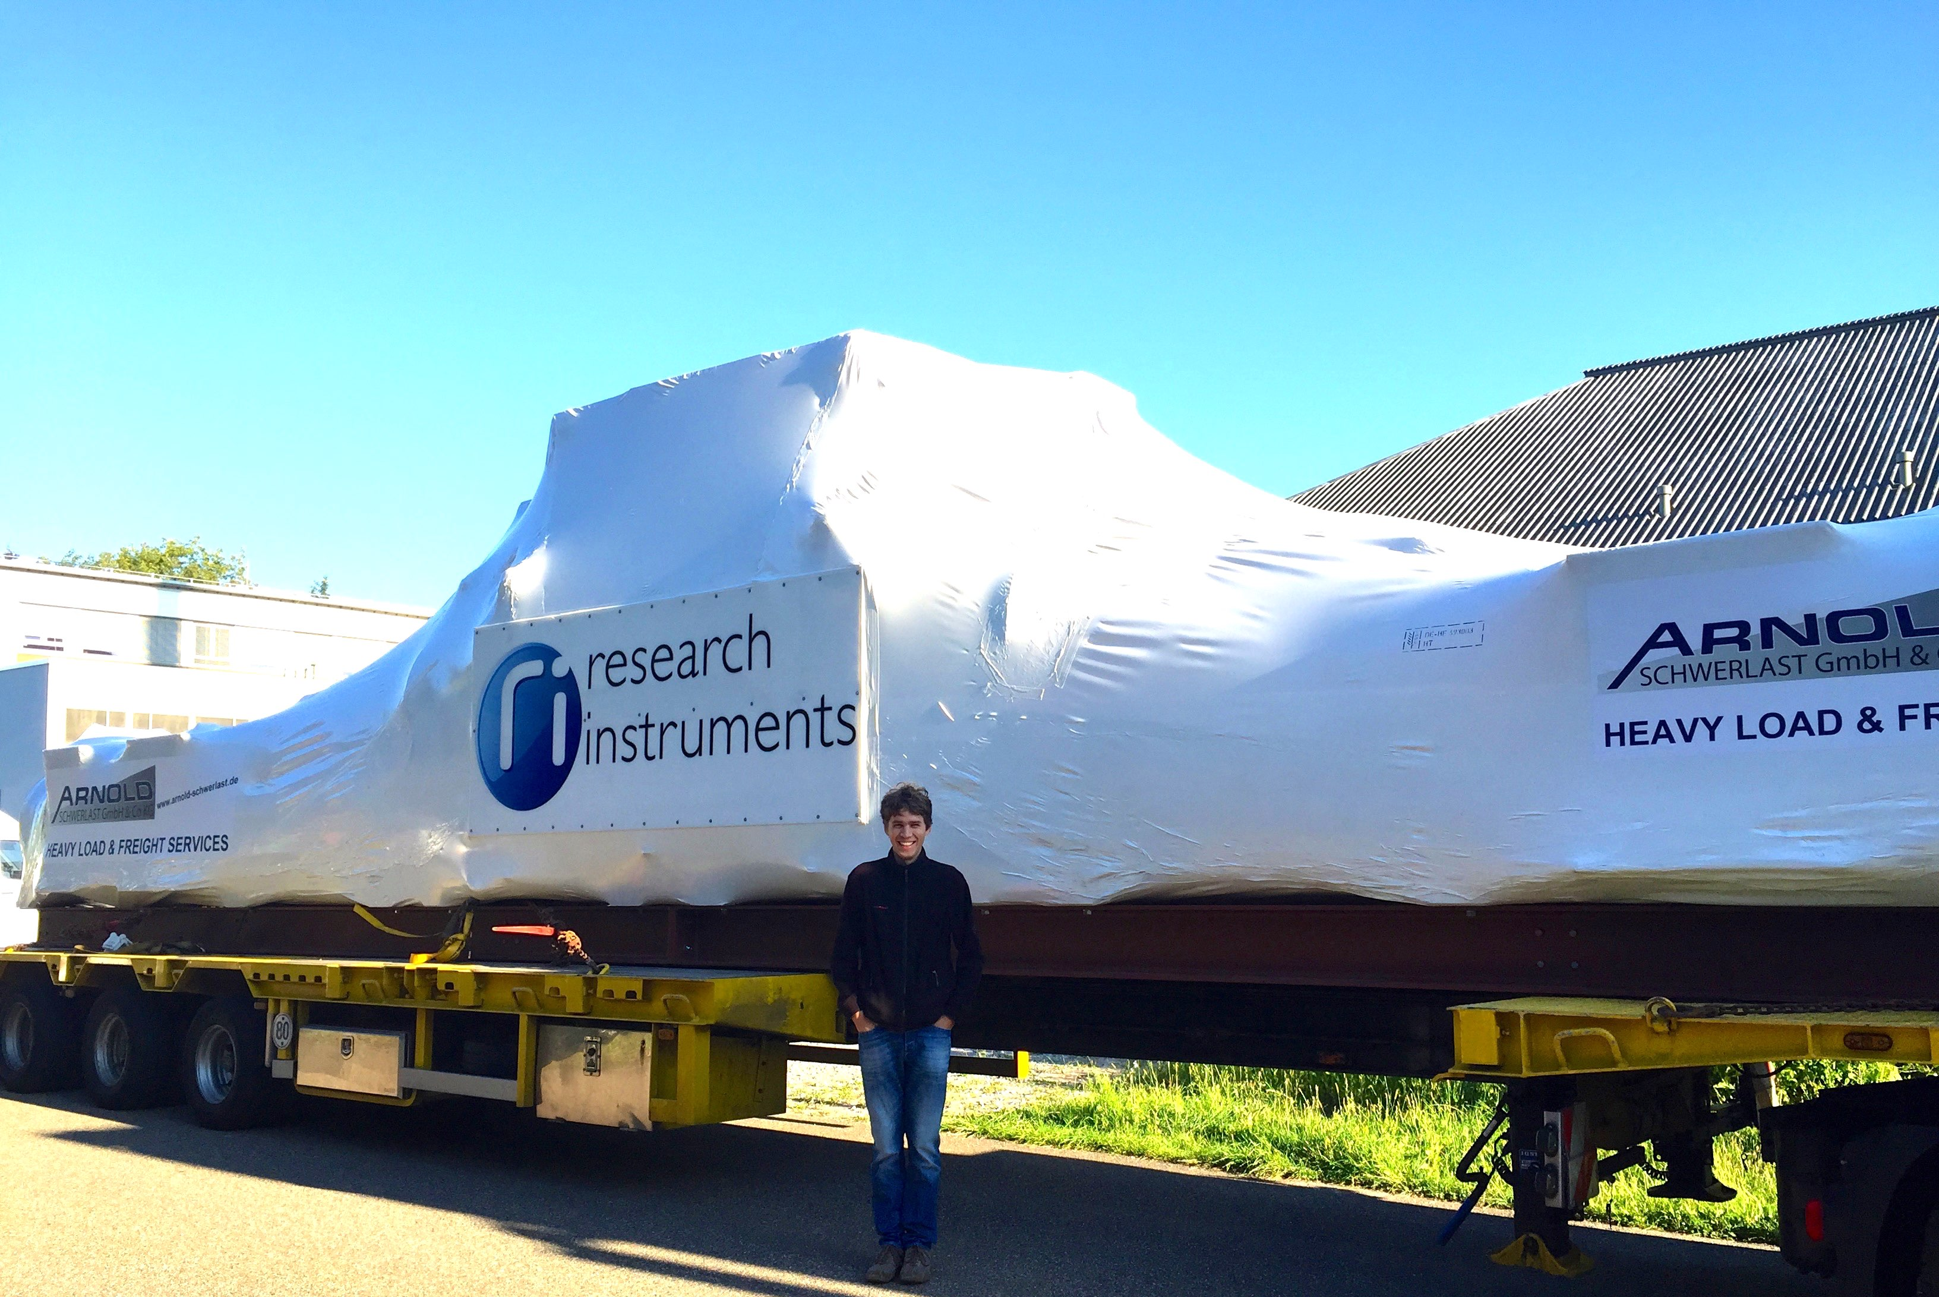
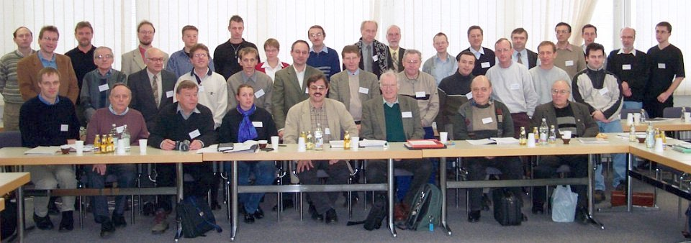
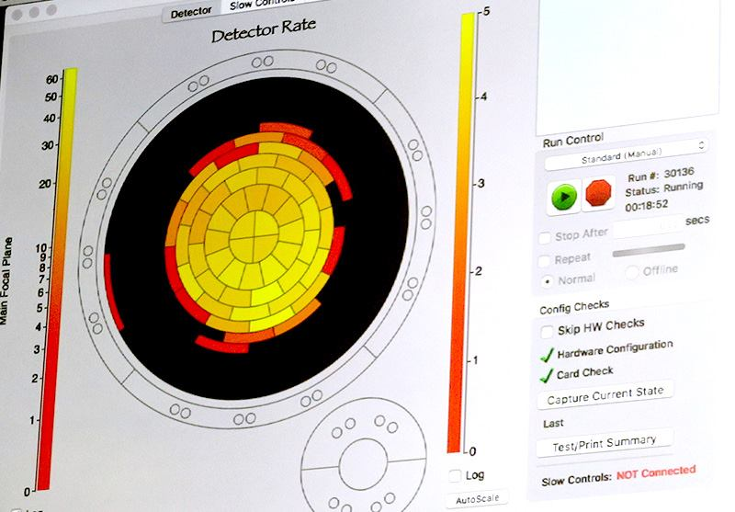
A view to the past …
2001:
Letter of Intent
(hep-ex/0109033)
2004:
Design Report
Industry contracts
for major comp.
2009-2012: Installation of main spectrometer electrode system
2015:
Last major components arrive
2006:
Main spectrometer arrives
2013-2016:
Commissioning of spectrometer and detector section
2016:
Beamline closed
FirstLight electrons!
KATRIN collaboration founded
Notes:
System and campaign was running very smooth no major stopping points
Required 0.1% stability of subsystems and integral system demonstrated
Beta-spectrum can be fitted close and far away from the designed energy range
Ongoing analysis of systematic effects and system performance
Systematic measurements with e-gun and krypton to determine source gas density accurately

Slide 20
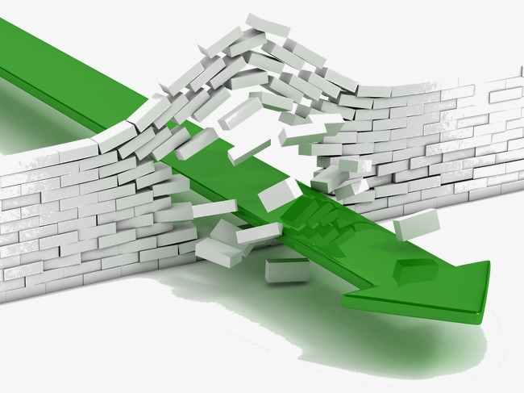
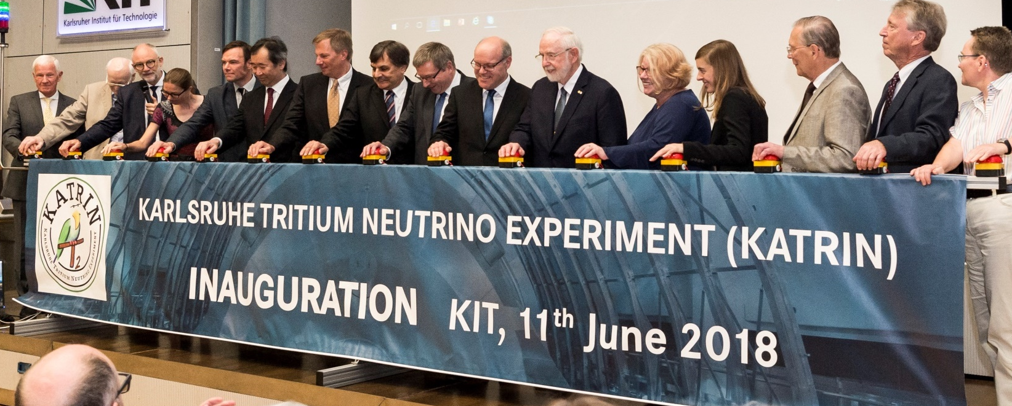
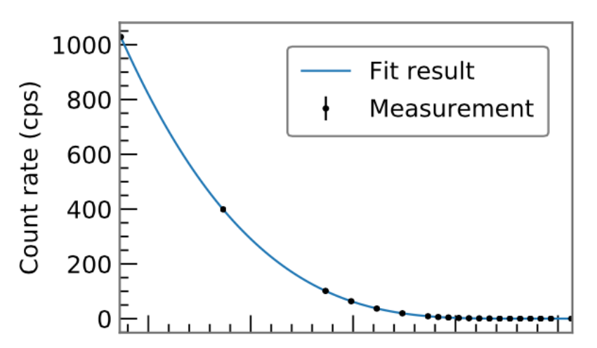
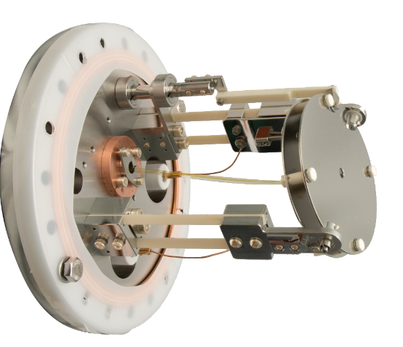
A view to the present …
2019:
Start of next tritium operation
July 2017:
Krypton run
June 11, 2018:
KATRIN inauguration
2 eV
2 eV
June 2018:
first tritium campaign
(~1% tritium in D₂-DT mixture)
Ongoing (as we speak!)
Calibration
(rear calibration systems)
Energy loss measurement
with e-gun)
overall stability
including
source temperature
gas composition
loop pressure
retardation potential
magnetic fields
Notes:
System and campaign was running very smooth no major stopping points
Required 0.1% stability of subsystems and integral system demonstrated
Beta-spectrum can be fitted close and far away from the designed energy range
Ongoing analysis of systematic effects and system performance
Systematic measurements with e-gun and krypton to determine source gas density accurately

Slide 21


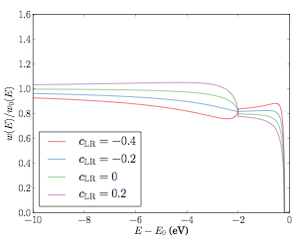
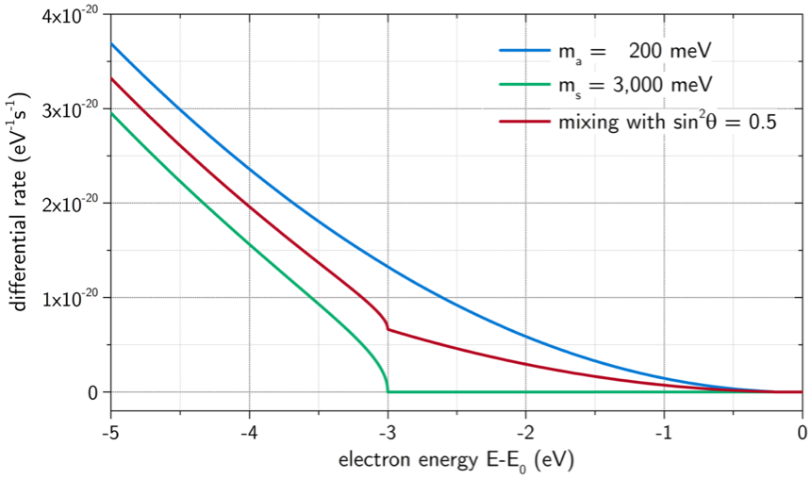

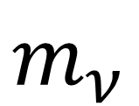
A view to the future
See talk by S. Böser
2019 - 2023
Neutrino mass scanning
R&D: new techniques
(e.g. ToF spectroscopy, CRES, microbolometers, atomic sources, …)
200 meV
< 200 meV
$$m_{ν}$$
Light sterile neutrino search
Non SM interactions
~ 1eV
m_{β} = 0.2 eV
Steinbrink et al.,
JCAP 06 (2017) 015
m_{s} = 3.0 eV
e.g.
Formaggio & Barrett,
PL B706 (2011) 68
Riis & Hannestad,
JCAP 02 (2011) 011
$ν$ oscillations!
see also:
Barry, Heeck & Rodejohann,
JHEP 1407 (2014) 081
No extra data taking required!
Notes:
System and campaign was running very smooth no major stopping points
Required 0.1% stability of subsystems and integral system demonstrated
Beta-spectrum can be fitted close and far away from the designed energy range
Ongoing analysis of systematic effects and system performance
Systematic measurements with e-gun and krypton to determine source gas density accurately

Slide 22
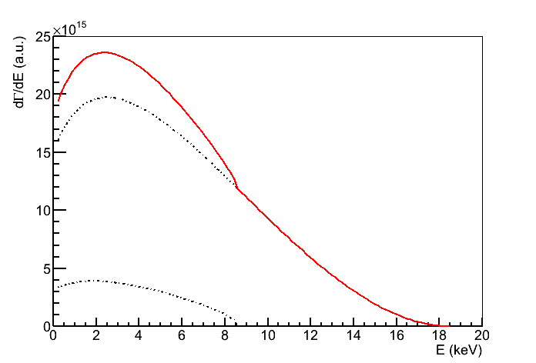
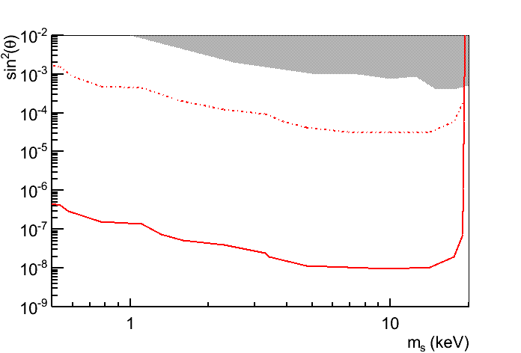
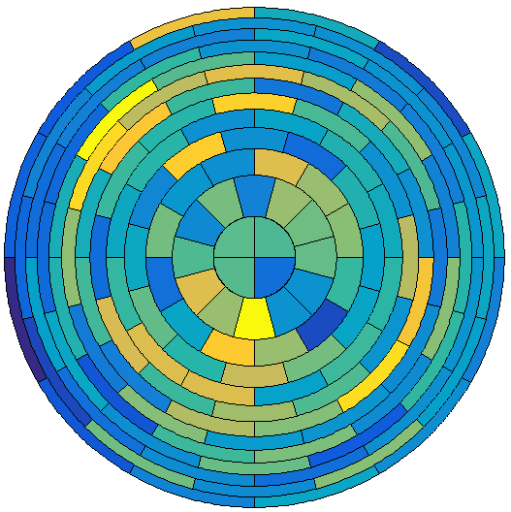
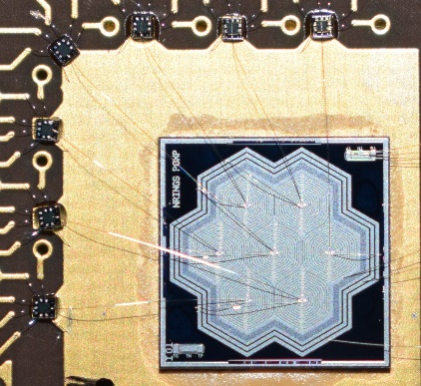

A view to the future
See poster by S. Mertens
Lab limits
S. Mertens, et. al.
Phys.Rev. D91 (2015) 4, 042005
S. Mertens, et al.
JCAP 1502 (2015) 02, 020
K. Dolde, et. al. NIM-A 848 (2017)
M. Drewes et. al.,
JCAP 1701 (2017) no.01, 025
A. Boyarsky, et al., arXiv:1807.07938
S. Mertens, TRISTAN: A novel
detector system for KATRIN to
search for keV-scale sterile neutrinos
submitted to Journal of Physic G
A. KATRIN Phase-0
(low statistics)
Signal of sterile neutrino
B. TRISTAN detector
90% CL statistical limit
~ few keV
Sterile neutrino mass (keV)
Differential
$$v_{s}?$$
Integral
TRISTAN project
~20 cm
7-pixel SDD prototype (MPP/HLL Munich)
~10 cm
Prototype test
2017 @Troitsk
Module test
2019 @KATRIN
148 pixels
KATRIN 2018
~ 3500 pixels
KATRIN ca. 2024
Notes:
System and campaign was running very smooth no major stopping points
Required 0.1% stability of subsystems and integral system demonstrated
Beta-spectrum can be fitted close and far away from the designed energy range
Ongoing analysis of systematic effects and system performance
Systematic measurements with e-gun and krypton to determine source gas density accurately
Tritium spectrum smooth
Smoking gun = kink
Differentiell mit Integral kombinieren (Integrale Messung hat “nur” MS systematics, die sehr bekannt sind! Differentiell könnte kink systeamtiken haben)
Mündlich Dark matter

Slide 23


Summary & Conclusion
$$m_{ν}$$
KATRIN is active and is successfully commissioned with tritium
Neutrino mass data taking 2019 - 2023
Future developments
Very smooth
operation
0.1 % stability
demonstrated
Beta spectrum
nicely fit-able
Systematic studies
ongoing
$m_{ν}$ > 200 meV & opportunities to look for “new physics”
R&D on KATRIN sensitivity
+ TRISTAN for keV sterile neutrinos
Notes:
System and campaign was running very smooth no major stopping points
Required 0.1% stability of subsystems and integral system demonstrated
Beta-spectrum can be fitted close and far away from the designed energy range
Ongoing analysis of systematic effects and system performance
Systematic measurements with e-gun and krypton to determine source gas density accurately

Slide 24

The KATRIN collaboration
Funding and support from: Helmholtz Association (HGF), Ministry for Education and Research BMBF (05A17PM3, 05A17PX3, 05A17VK2, and 05A17WO3), Helmholtz Alliance for Astroparticle Physics (HAP), and Helmholtz Young Investigator Group (VH-NG-1055) in Germany; Ministry of Education, Youth and Sport (CANAM-LM2011019), cooperation with the JINR Dubna (3+3 grants) 2017–2019 in the Czech Republic; and the Department of Energy through grants DE-FG02-97ER41020, DE-FG02-94ER40818, DE-SC0004036, DE-FG02-97ER41033, DE-FG02-97ER41041, DE-AC02-05CH11231, and DE-SC0011091 in the US.

Slide 26
BACKUP SLIDES

Slide 27




The Tritium Laboratory Karlsruhe
Tritium Laboratory Karlsruhe (TLK)
Commissioning 1993
Licensed for 40 g Tritium
Two missions:
  Fuel cycle for fusion reactors
  KATRIN Experiment
Karlsruhe Institute of Technology
Campus North

Slide 28


KATRIN background & sensitivity
Further background reduction measures under investigation
In addition: several mitigation strategies
M. Kleesiek
558 mcps
non-optimized
optimized scanning
energy range of spectral analysis
flux tube compression by increasing B
~240 meV
ΔE ~ 2.5 eV
TDR 2004
optimized for
10 mcps
0.38 mT
0.50 mT
0.80 mT
By Kathrin Valerius

Slide 29


Imprint of sterile neutrinos on β spectrum
Shape modification below E₀ by active (m_{a})² and sterile (m_{s})² neutrinos:
additional kink in β spectrum
at E = E₀ – m_{s}
light sterile ν, m_{s} = 3 eV
keV sterile ν, m_{s} = 10 keV
By Kathrin Valerius

Slide 30





















The Karlsruhe Tritium Neutrino Experiment
about 150 members
from 20 institutions
By Kathrin Valerius

Slide 31


Molecular decay
Atomic decay
Hydrogen isotopologues
Decay from a molecule
+ further inner excitations (rotation / vibration)

Slide 32






Raman for KATRIN
Raman suitable for monitoring of all hydrogen isotopologues …
… and other molecular impurities
Rotation
Vibration
Simultaneous detection of multiple species
Contact-free, inline gas analysis
Automated, non-stop measurements possible

Slide 33


Precision achievements
S. Fischer et al., Fusion Sci. Tech., 60(3):925–930 (2011)
Raman-measurement for > 21 days
p_{cell} = 200 mbar
laser power = 5 W
acq. time = 250 s
tritium purity > 95 %
Achieved precision better
0.1 % in 20 s acquisition

Slide 34


Systematics of tritium source
Previous experiments: m ~ 2 eV KATRIN aim: m ~ 0.2 eV
Aim: 100 x better systematics
Column density
stability in the range of 10⁻³
Electron gun
10¹¹ e⁻ /s
X-ray
detector
PIN diode
detector
Activity
Temp. stabil.
Beam
tube temp.
Activity
Gas
injection
Gas
composition
Pressure
stabil.
Raman
Spectr.

Slide 35
The closed tritium loop of KATRIN and the TLK
Tritium loops of KATRIN (STS)
Main infrastructure of TLK
Tritium
storage
T₂
T₂
1.5⋅10¹⁶ Bq/day
T₂
KATRIN
tritium loop system
Tritium
analytics
Isotope
separation
KATRIN
WGTS
HD, HT, DT,
H₂, D₂, T₂
3⋅10¹⁴ Bq/day
HTO, He, CO,
N₂, CT₄, H₂, D₂,
T₂, HD, HT, DT, …
Tritium recovery & removal
He, CO, CO₂,
N₂, H₂O, CH₄, …
Closed tritium processing needed to provide the high activity and isotopic tritium purity for KATRIN

Slide 36


The Karlsruhe Tritium Neutrino Experiment
e⁻ source
E_{kin}
high pass filter
U_{ret}
E_{kin} > U_{ret}?
Minigolfplatz Herzogenaurach
www.goblirsch-poeltl.de/minigolf/
e⁻ counter
katrin.kit.edu

Slide 37

The very first tritium spectrum
Data (Run 40263, 30 minutes)
Input parameters for model directly taken from experimental “slow control” data
No tuning!!!
Model and uncorrelated error band
(not a fit!)
Preliminary
Very good agreement of model with data
(shape and absolute rate!)

Slide 38

KATRIN Transport

Slide 39

First tritium campaign
Two week operation
  Tritium-loop was started 5th June and stopped 18th June (without interruption)
  During day - Special investigations
    ion studies
    column density effect on
    scattering
    sterile neutrino scans
    high rate investigations
    or beta spectrum scan
  During night and weekend
    beta spectrum scan
    stability measurements
KATRIN system behaved highly reliably and
all investigations could be performed successfully

Slide 41





Imprint of sterile n‘s on ß-spectrum
$$\frac{dΓ}{dE}=cos2{θ\frac{dΓ}{dE}(m_{β})}+sin2{θ\frac{dΓ}{dE}(m_{s})}$$
Characteristic
kink-like signature
and spectral distortion
Active-to-sterile
mixing amplitude
New mass eigenstate
m₁ m₂ m₃
Mass of the
sterile neutrino
By Susanne Mertens / TRISTAN

Slide 42


Challenge (1)
laboratory
overproduction
X-ray
Phase-space
90% CL
N ~ 10¹⁸
Strong constrains from astrophysics
(model-dependent)
Laboratory limits are only in the per-mil level
f
Expected signal after 3-years with full KATRIN source strength
By Susanne Mertens / TRISTAN

Slide 43






The Challenge (2)
V_{ret} = -18 kV
V_{ret} = 0 kV
10¹⁰ e/s
1 e/min
10¹¹ decays/s
10¹¹ decays/s
New detector system needed
Signature of
neutrino mass
Signature of
sterile neutrino
18597 18598 18599 18600
0 2 4 6 8 10 12 14 16 18 20
E(eV)
E(keV)
By Susanne Mertens / TRISTAN

Slide 44
Staged Approach
Stat sensitivity
@ 90% CL
10¹¹ electrons:
Reduced source strength and 7 days of measurement time
With KATRIN “as is”
Current laboratory limits
Setting a new laboratory limit
+ Proof-of-concept
10¹⁸ electrons:
Full source strength and
3 years of measurement time
With TRISTAN
Tackling the parameter space of cosmological interest
By Susanne Mertens / TRISTAN

Slide 45

TRISTAN Detector R&D
Not to scale
Capability of handling high rates (>3 x 10⁸ cps)
  O(3000) pixels, 100 kcps per pixel
Excellent energy resolution (300 eV @ 20 keV)
Low energy threshold (1 keV)
  Thin deadlayer (~10 nm)
Large pixels + low noise at high rate
(cell size ~ 3mm)
  Capacity < 0.05 pF
Minimal non-linearities
  Sophisticated readout system*
K. Dolde, S.M., D. Radford et. al. NIM-A 848 (2017)
By Susanne Mertens / TRISTAN
Notes:
This is the goal of the TRISTAN Project, which develops a new multi-pixel Si detector. First prototype detectors are being characterized and we extect to improve the current laboratory limits on keV-scale sterile neutrinos.

Slide 46

TRISTAN Detector R&D
Not to scale
Silicon drift detector design
Novelty: extremely thin entrance window (< 100 nm)
By Susanne Mertens / TRISTAN
Notes:
This is the goal of the TRISTAN Project, which develops a new multi-pixel Si detector. First prototype detectors are being characterized and we extect to improve the current laboratory limits on keV-scale sterile neutrinos.

Slide 47





Other Challenges
Spectrometer
Adiabatic transport
Tritium source
Reduce rate
Multiple scattering
Source stability (integral)
Gold Rear Wall
Auger e emission
Backscattering
Detector:
Backscattering
Energy response (differential)
Optimized magnetic field layout
Improved modelling
Combination of integral and differential mode
By Susanne Mertens / TRISTAN

