Slide 1
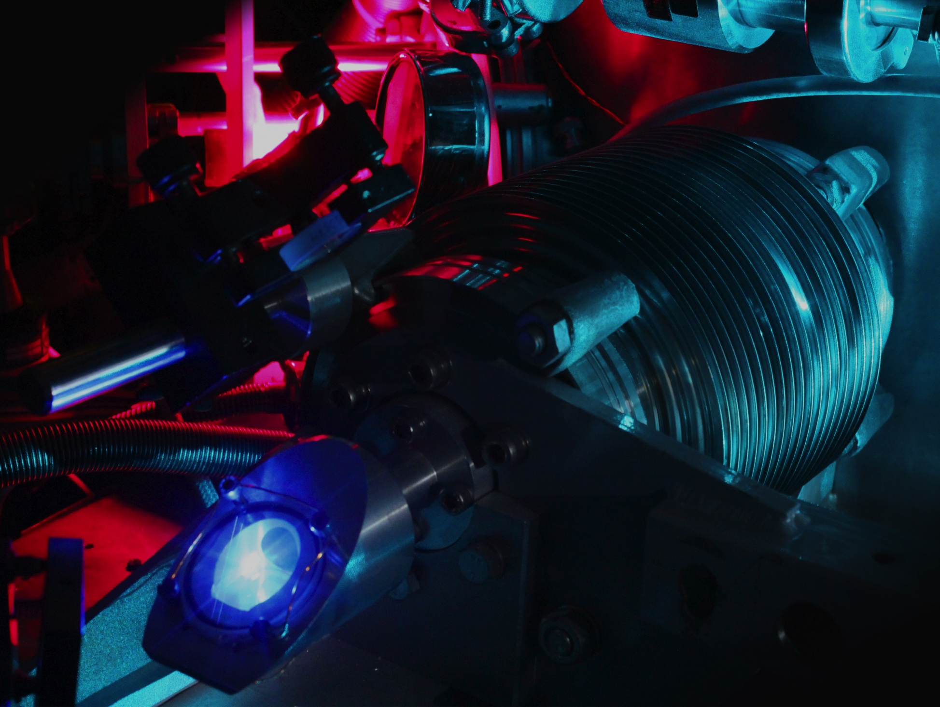
Precision spectroscopy of the 2S-nP transitions in atomic hydrogen
L. Maisenbacher, A. Beyer, A. Matveev, V. Andreev,
K. Khabarova, A. Grinin, D. C. Yost, R. Pohl,
N. Kolachevsky, T. W. Hänsch and Th. Udem
Proton radius workshop, Mainz, July 22, 2018

Slide 2
Fundamental constants and hydrogen spectroscopy
Hydrogen energy levels in SI units including relativistic, recoil, QED and finite nuclear size corrections:
Rydberg
constant
Fine
structure
constant
electron –
proton
mass ratio
RMS proton
charge radius
Determined from
H spectroscopy
Determined from
H spectroscopy
Measured with high precision
in Penning trap and atom
interferometry experiments

Slide 3
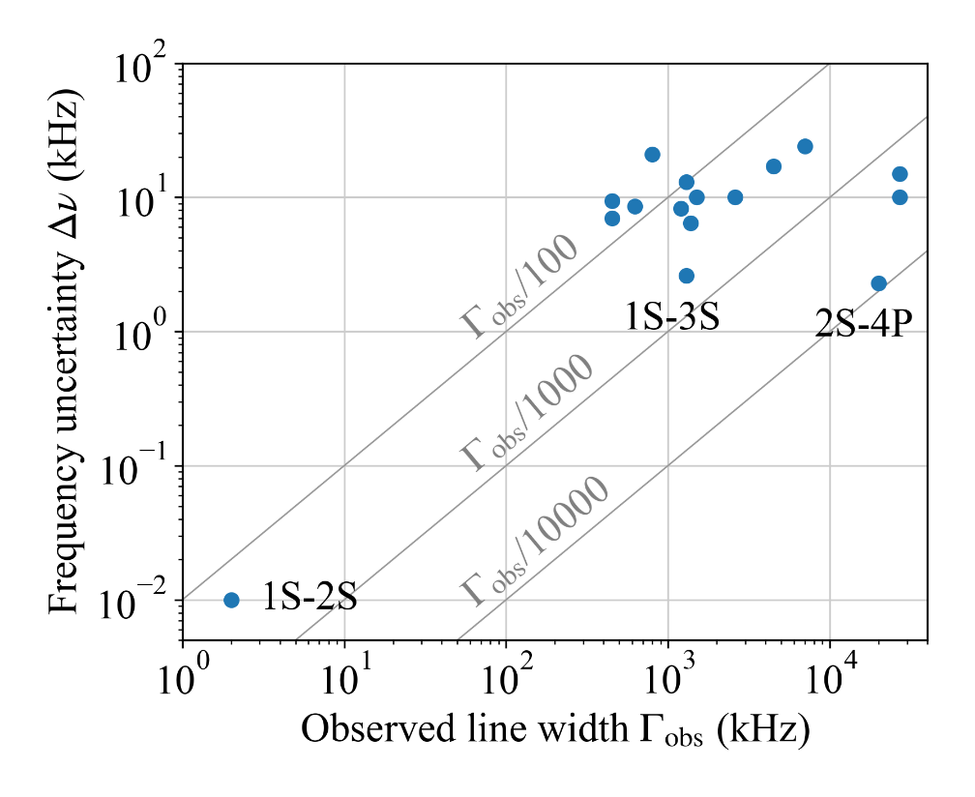
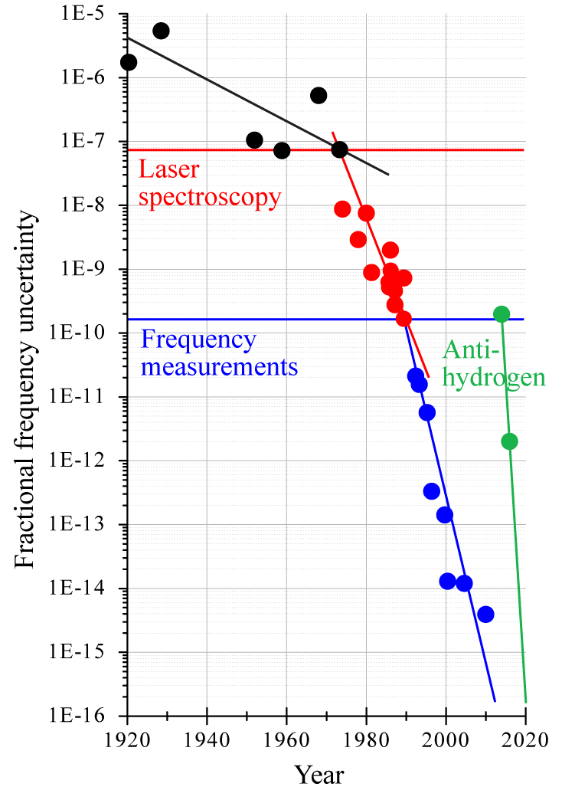
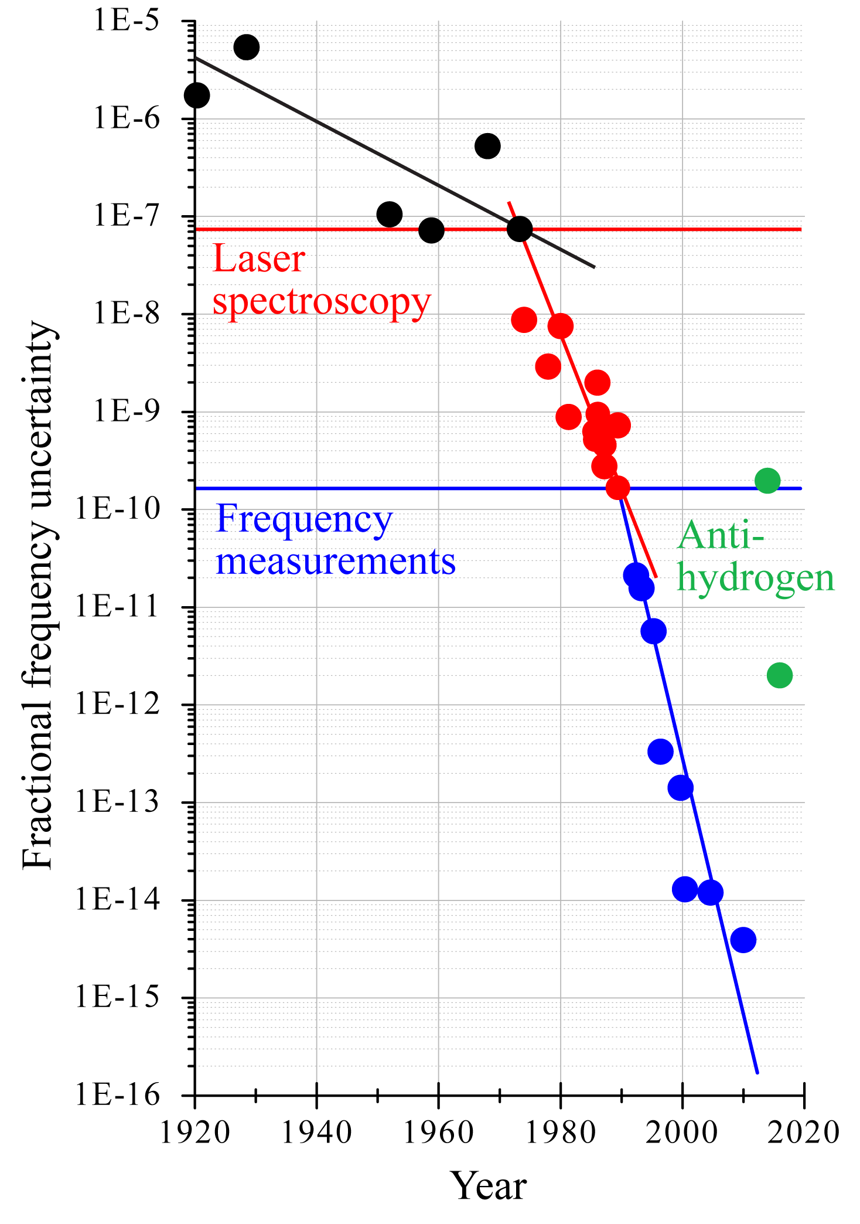
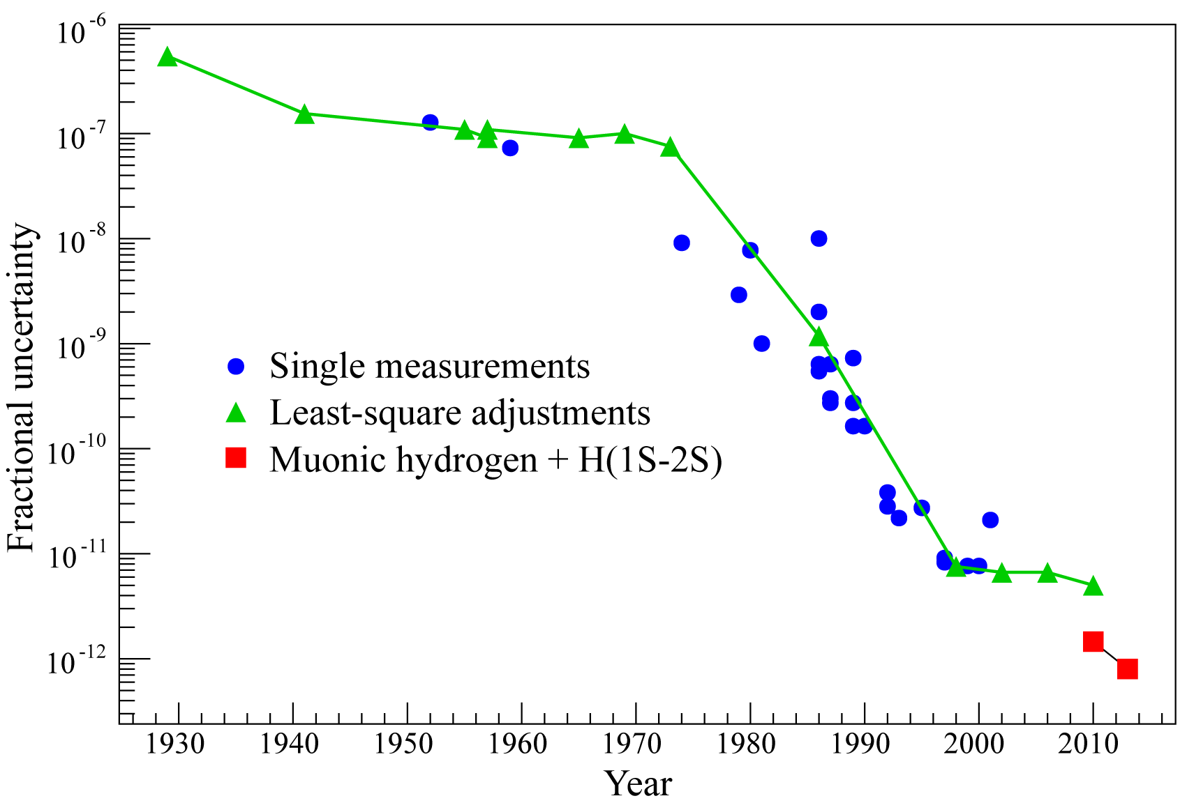
Fundamental constants and hydrogen spectroscopy
Uncertainty and line widths of
measured hydrogen transitions
Uncertainty of Rydberg constant determination over time
Progress in hydrogen spectroscopy over time
1S-2S: 1.3 Hz (natural) / 1 kHz (observed)
Other transitions: > 300 kHz
[1] C. G. Parthey et al., Phys. Rev. Lett. 107, 203001 (2011)

Slide 4
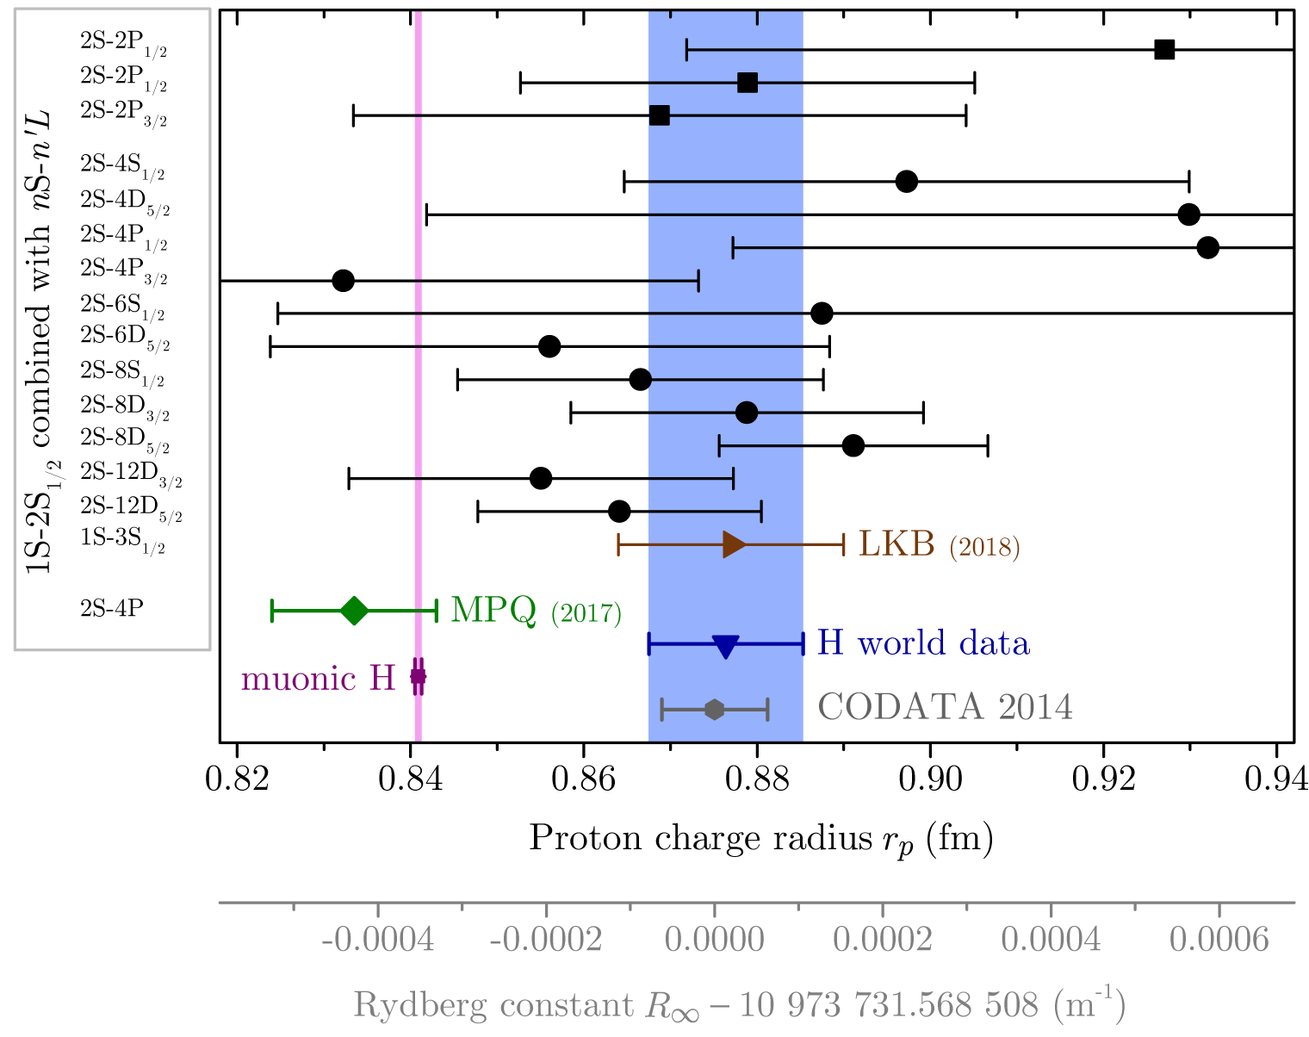
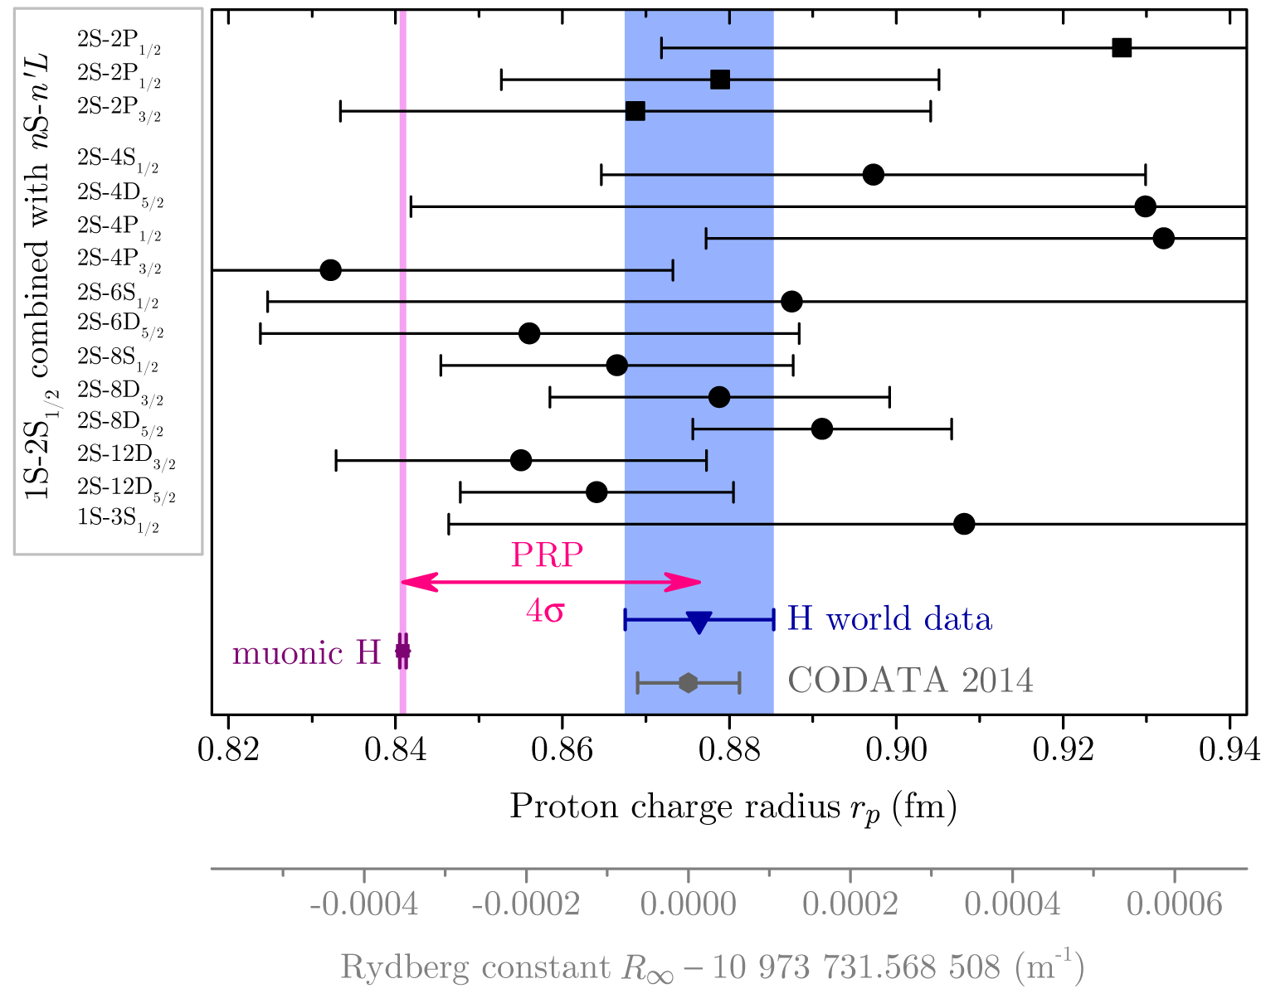
The Rydberg constant and proton size from 2S-4P
2S-4P: A. Beyer, L. Maisenbacher, A. Matveev et al., Science 358, 79 (2017)

Slide 5
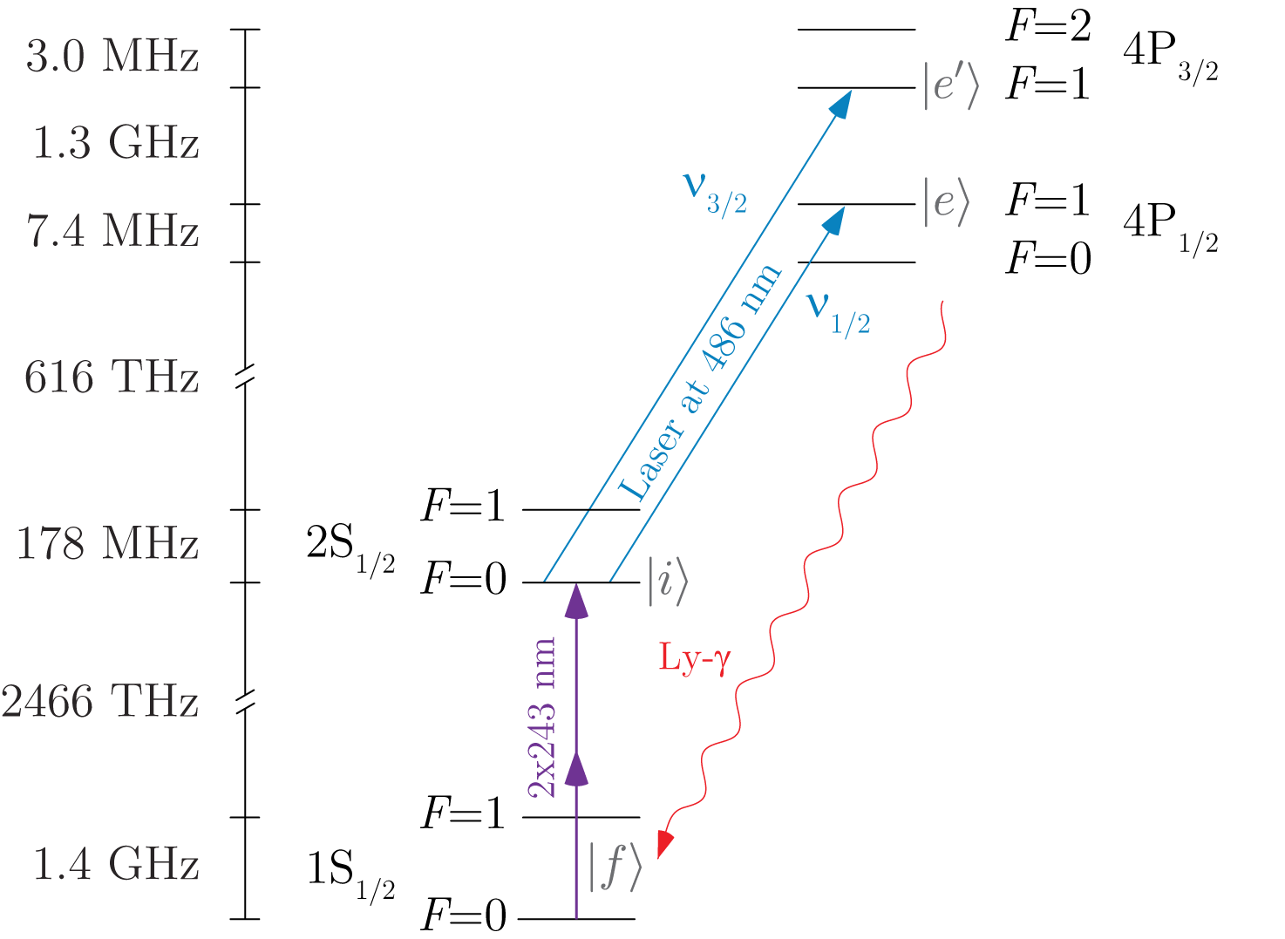
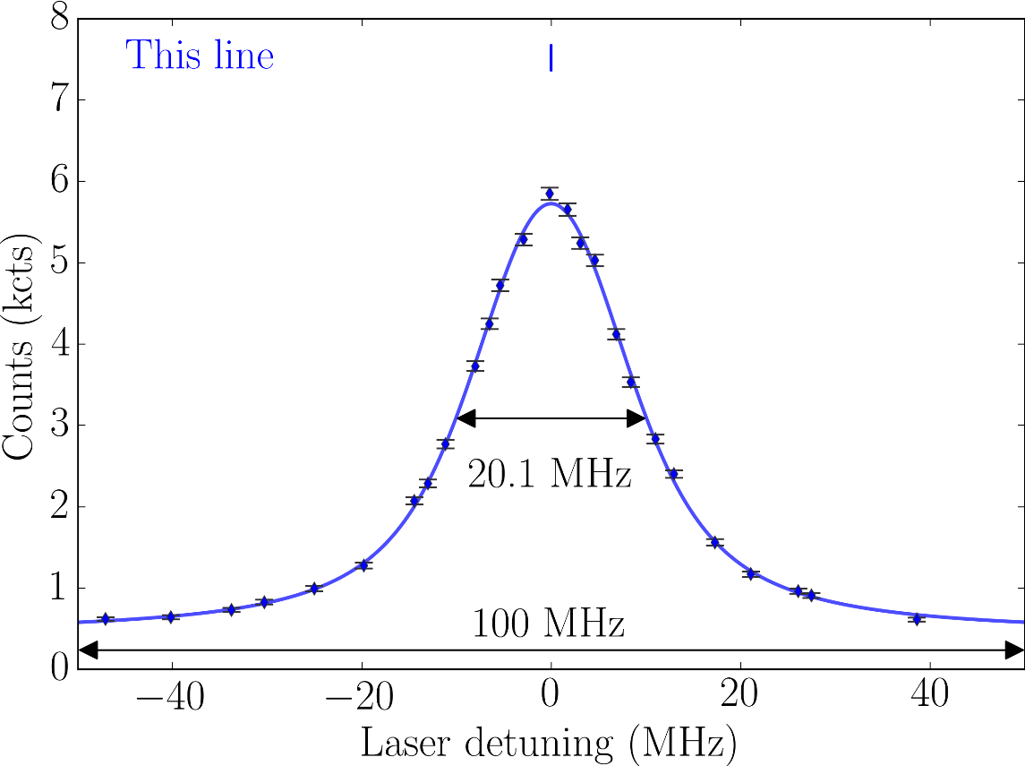
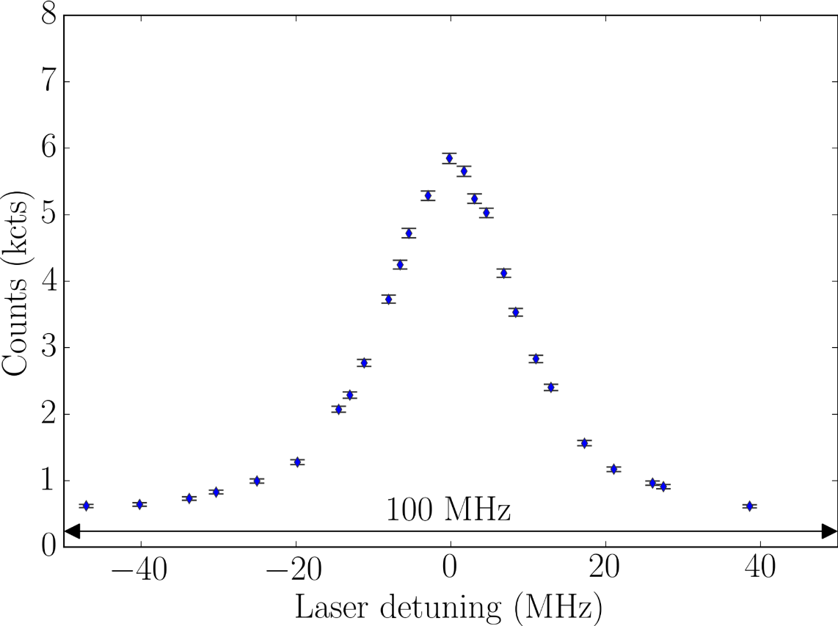
2S-4P transition
One-photon (dipole-allowed) transition, complimentary to previous two-photon measurements
Conceptually simple fluorescence spectroscopy, no saturation or ac-Stark shift
First-order Doppler shift (many MHz) needs to be suppressed
Natural line width of Γ = 12.9 MHz
Proton radius puzzle corresponds to ~9 kHz of transition frequency

Slide 6
2S-4P experimental setup

Slide 7
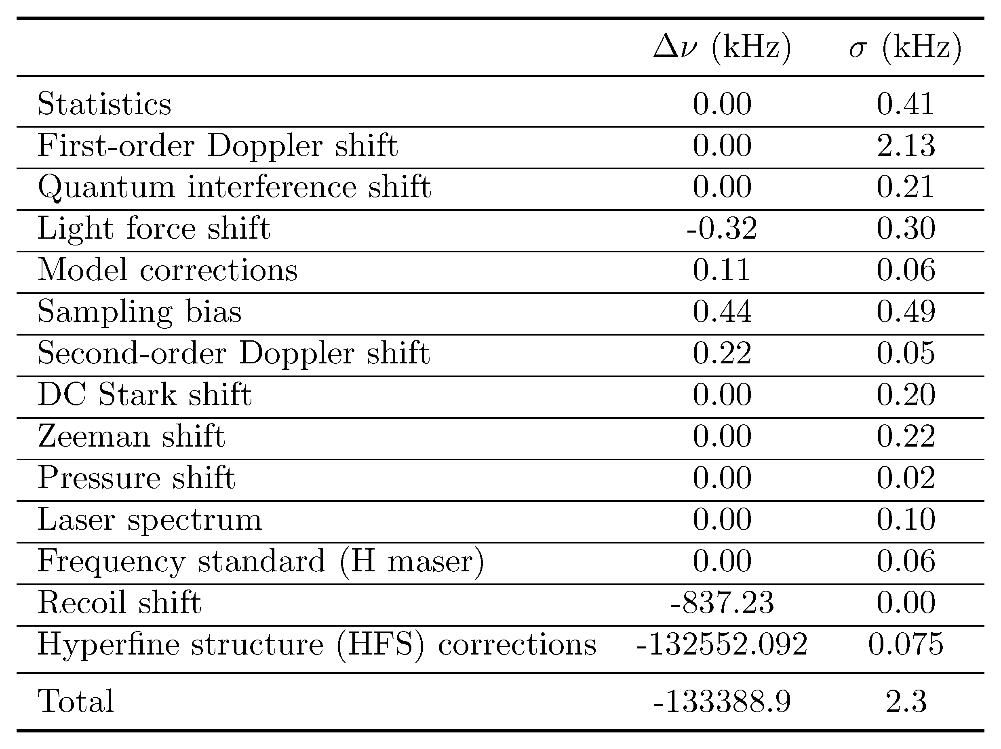
Uncertainty budget for 2S-4P (2017)
Uncertainty dominated by Doppler shift, which is measured in-situ
1
2
Corrections do not need experimental input and can be calculated with high precision
for details: see Supplementary Materials of A. Beyer, L. Maisenbacher, A. Matveev et al., Science 358, 79 (2017)

Slide 8
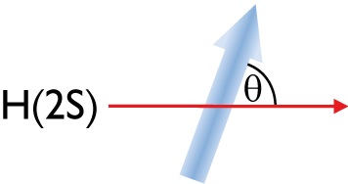
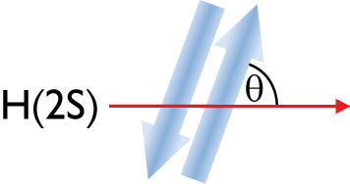
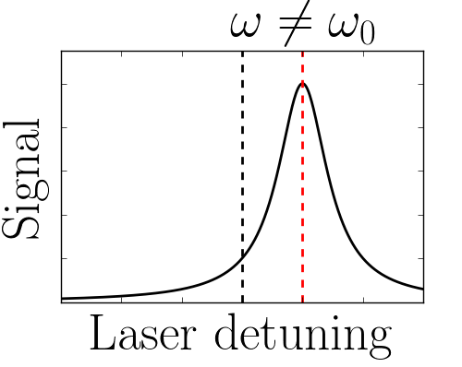
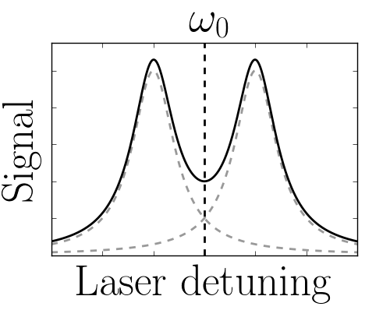
First-order Doppler shift
One-photon transition means transition frequency is shifted due to first-order Doppler shift by:
Frequency shift for
$θ=90°+δθ$ and $v =300$ m/s:
$$δθ=1°: Δω=12 \text{MHz}$$
$$δθ=1.5 \text{µ}\text{rad}: Δω=1 \text{kHz}$$

Slide 9
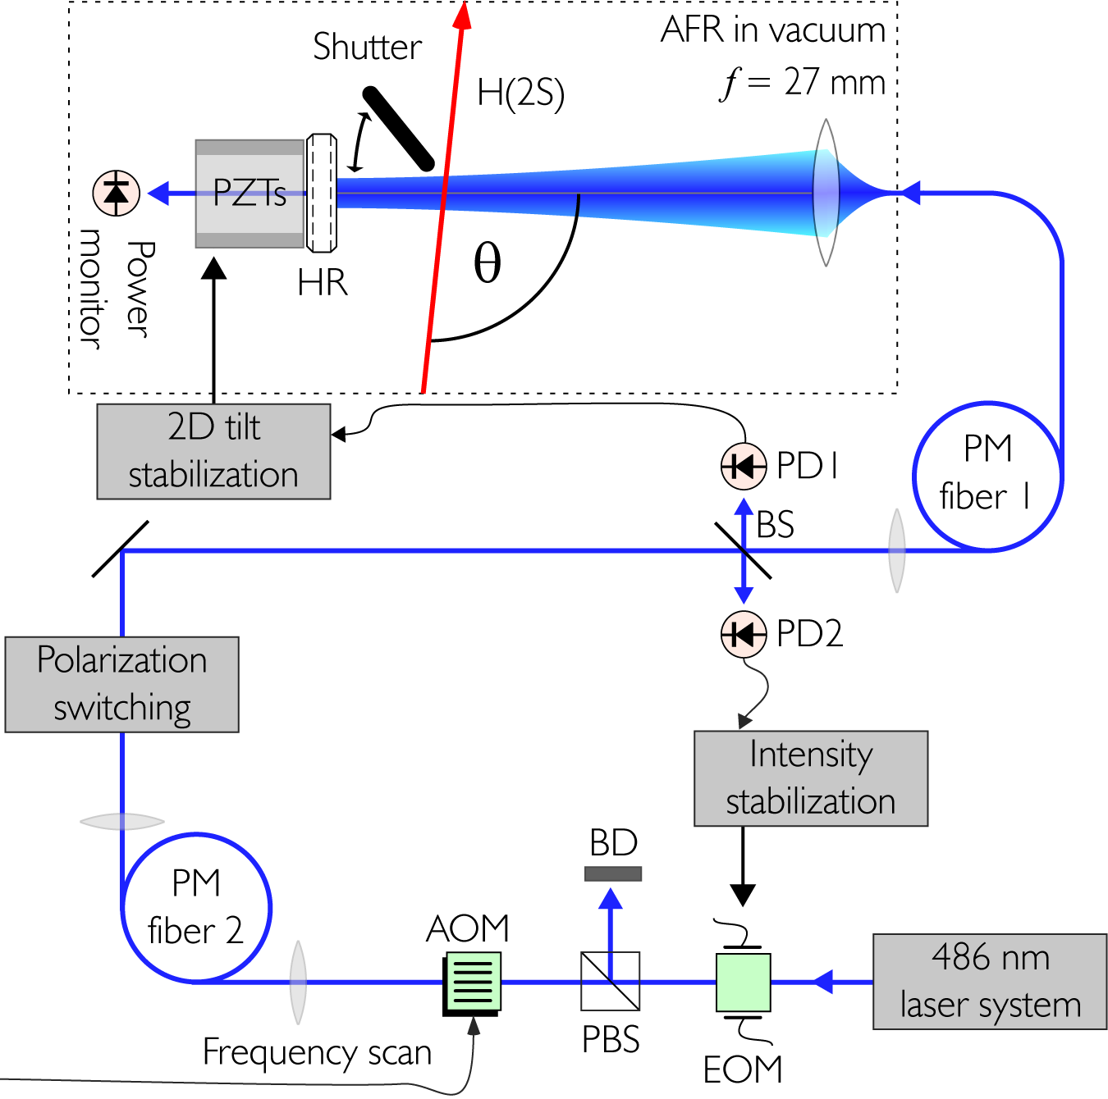
Active fiber-based retroreflector (AFR)
For perfect suppression, two antiparallel, phase-retracing laser beams with identical intensity are needed.
A. Beyer et al., Opt. Express 24, 17470-17485 (2016)
Notes:
Show experimental data of Doppler suppression!

Slide 10
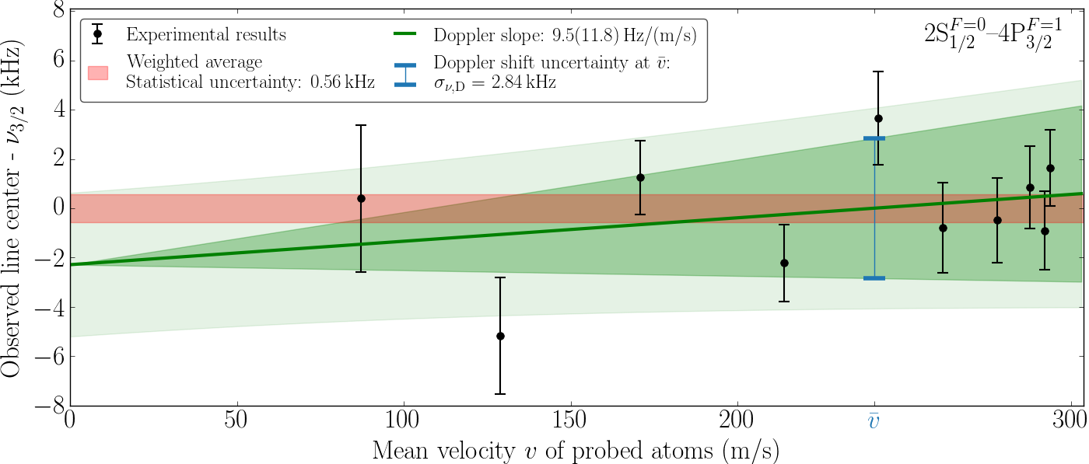
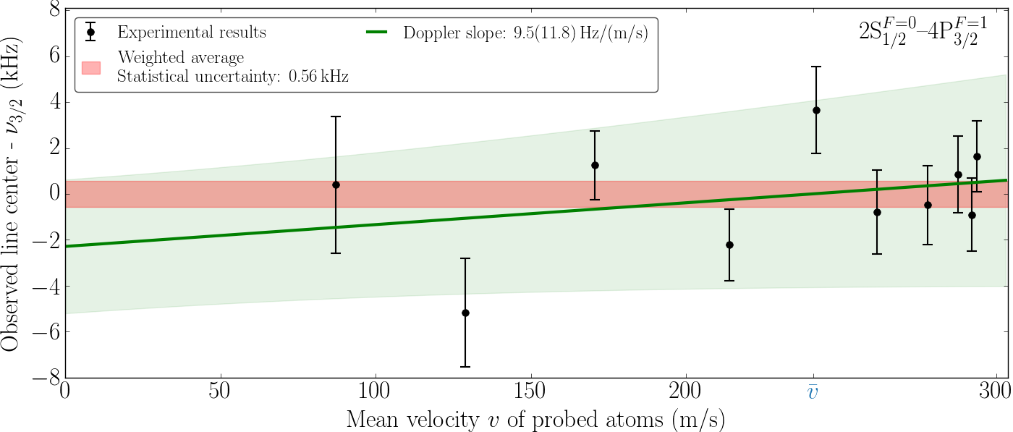
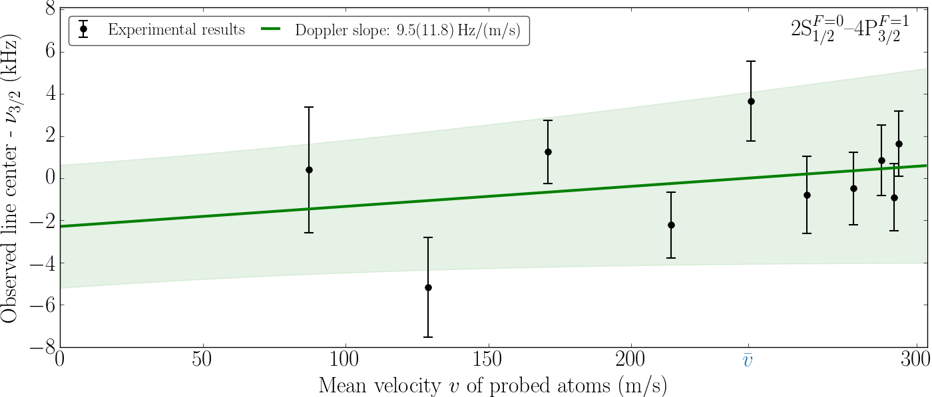
Experimental limit on Doppler shift
To verify the level of suppression of the first-order Doppler shift, we use our velocity-resolved detection.
With this, we find the residual Doppler shift to be compatible with zero, with an uncertainty of 2.8 kHz for the 2S-4P_{3/2} transition…
Notes:
Show experimental data of Doppler suppression!

Slide 11
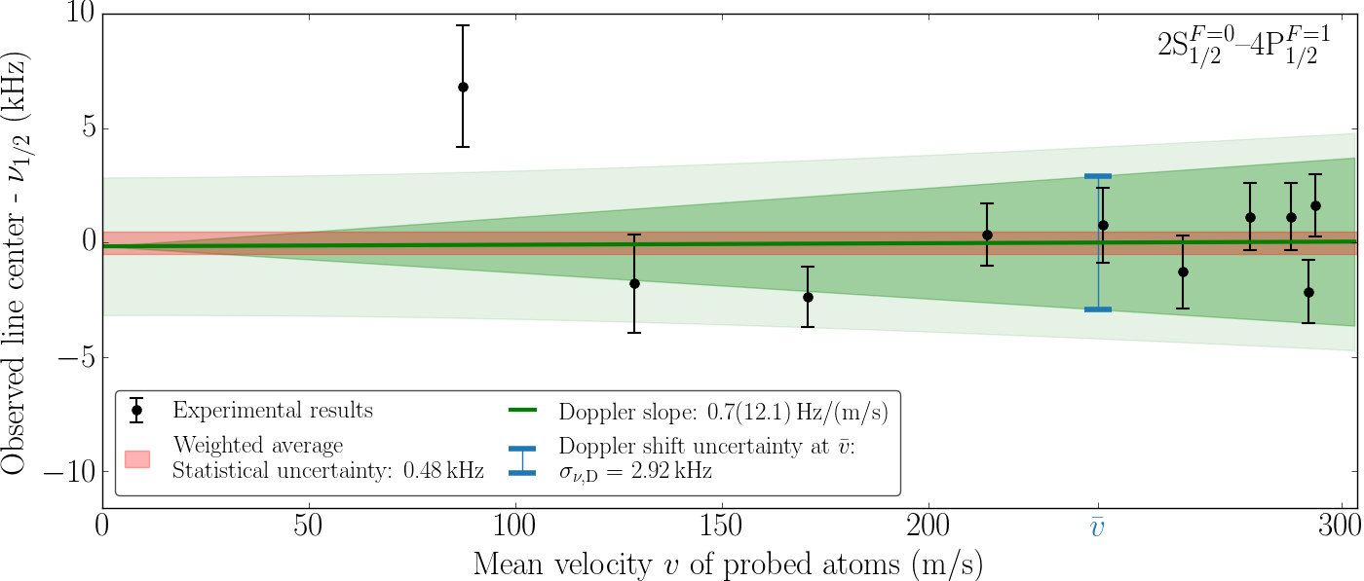
Experimental limit on Doppler shift
…and an uncertainty of 2.9 kHz for the 2S-4P_{1/2} transition.
This results in a combined uncertainty of 2.1 kHz for the 2S-4P centroid.
Notes:
Show experimental data of Doppler suppression!

Slide 12
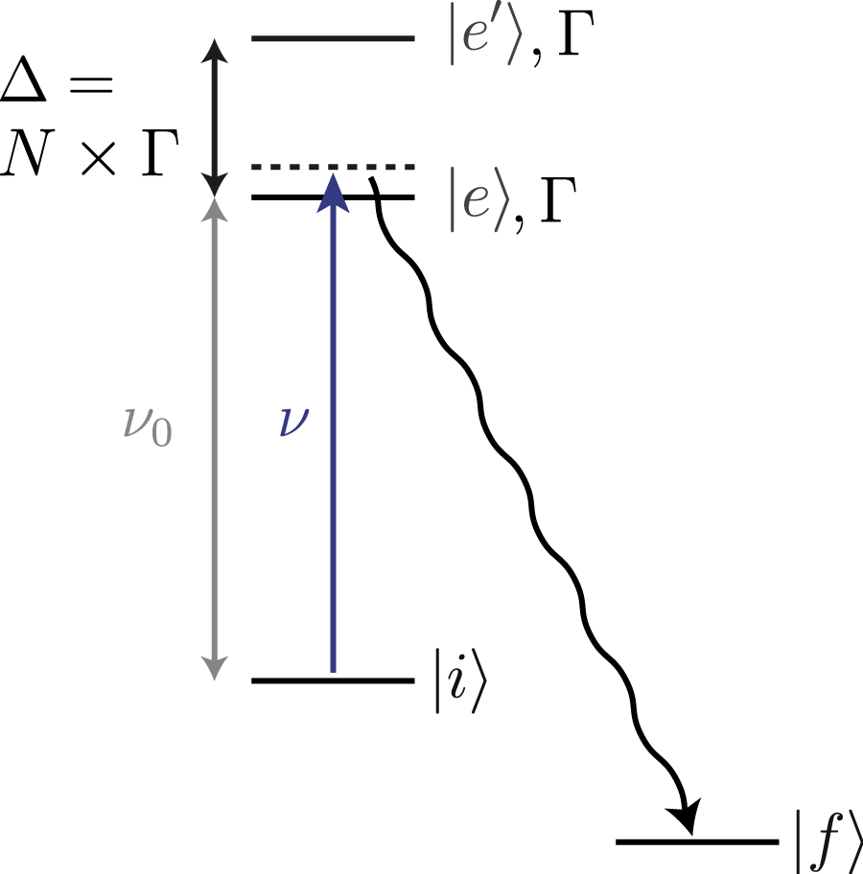
Quantum interference
Interference between the level of interest $\left.|e\right\rangle$ and a far off-resonance level $\left.|e′\right\rangle$
distorts the fluorescence line shape from its unperturbed shape:
Kramers-Heisenberg formula (perturbative):
with dipole moments
M. Horbatsch and E. A. Hessels, Phys Rev A 82, 052519 (2010)

Slide 13
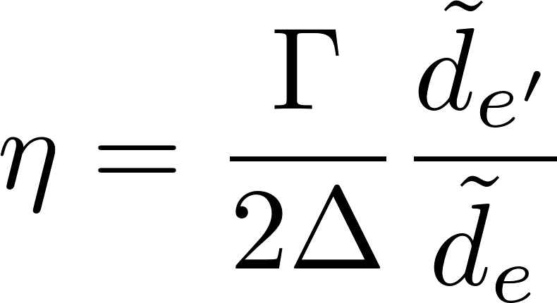
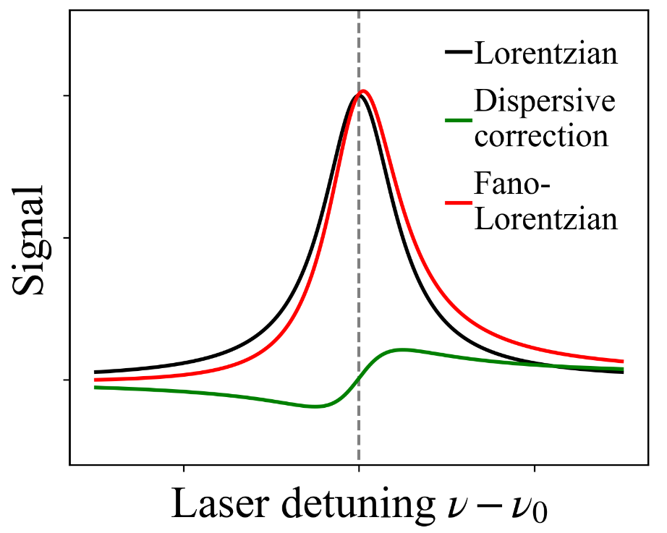
Quantum interference
Expand line shape about resonance of interest:
Lorentzian
Dispersive
correction
with asymmetry parameter

Slide 14
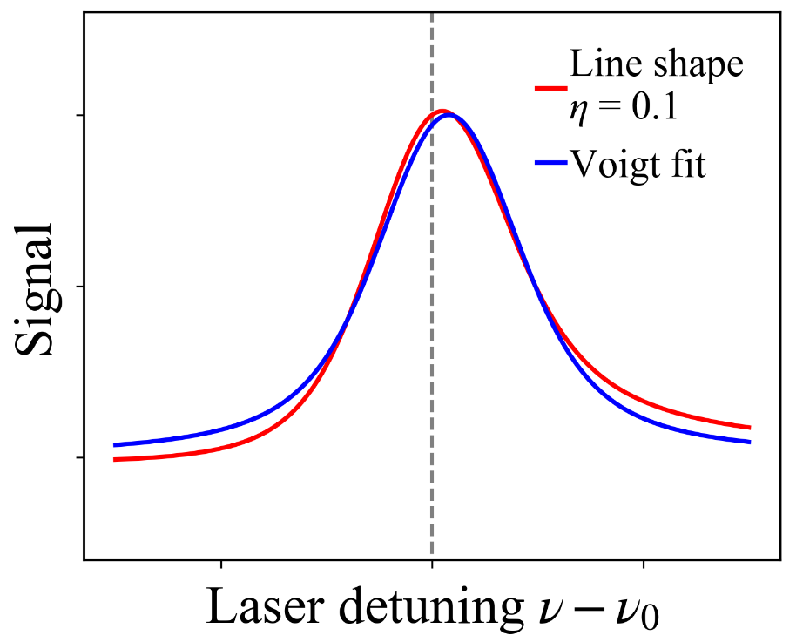
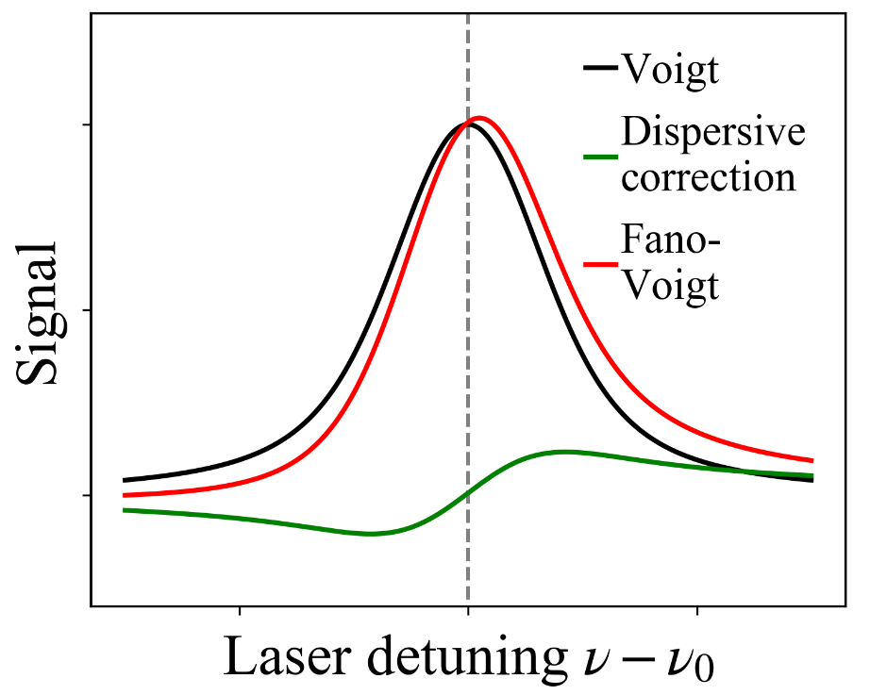
Quantum interference
Add Doppler broadening by convolving with Gaussian:
“Fano-
Voigt”
Voigt
“Dispersive” Voigt
Apparent shift
of line center:
Proportional to
line width!

Slide 15
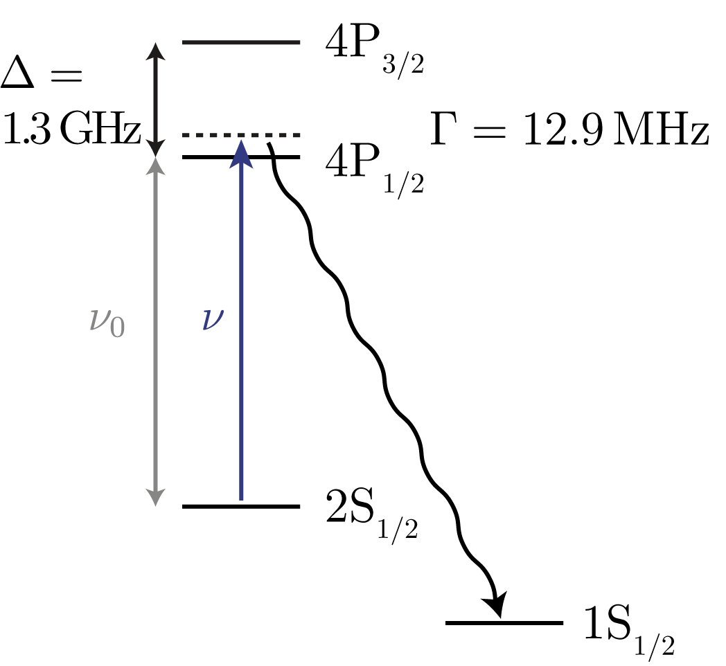
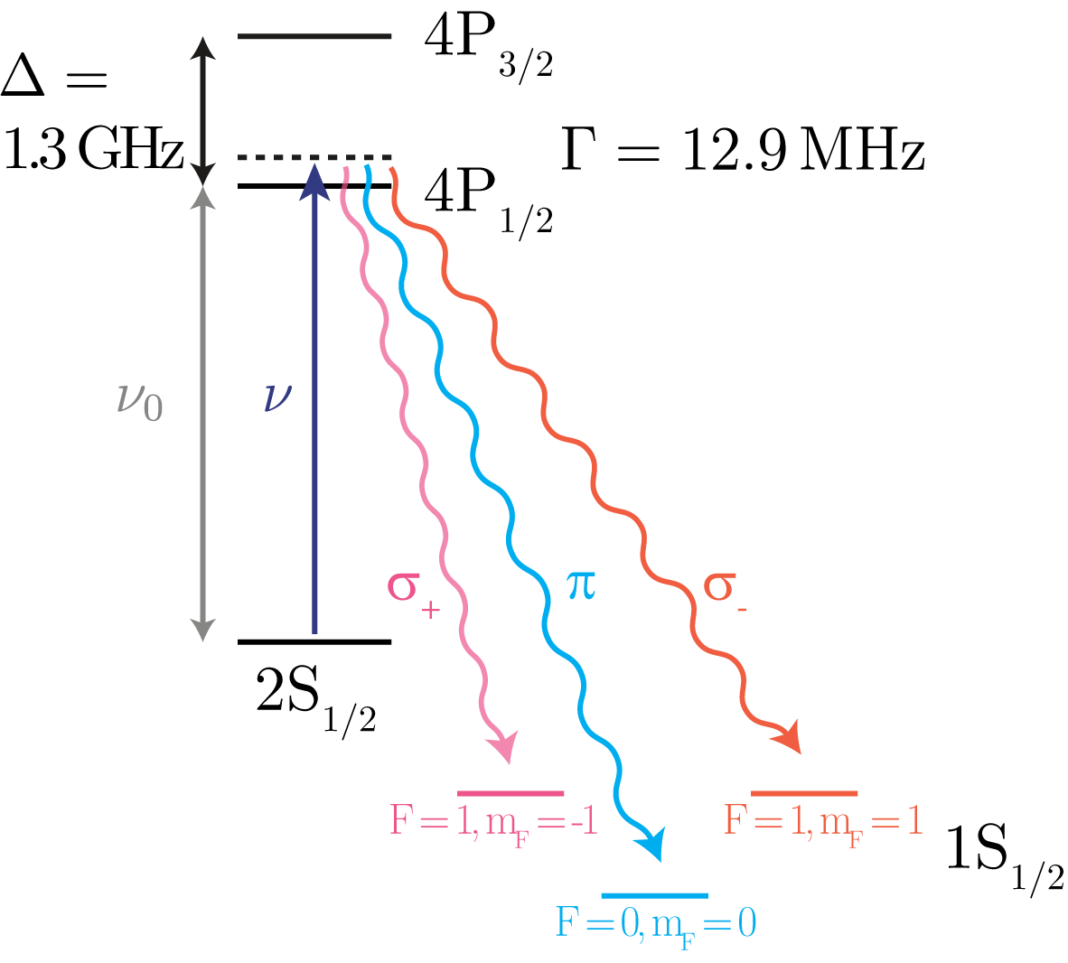
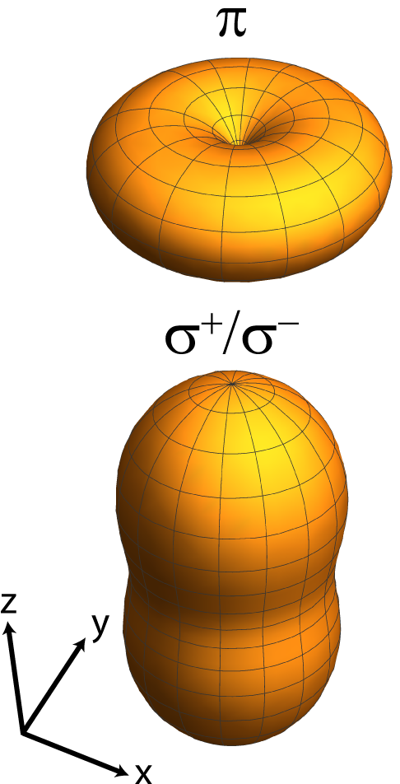
2S-4P quantum interference
Hydrogen 2S-4P
$σ_{+}$/$σ_{−}$ decay
$π$ decay

Slide 16
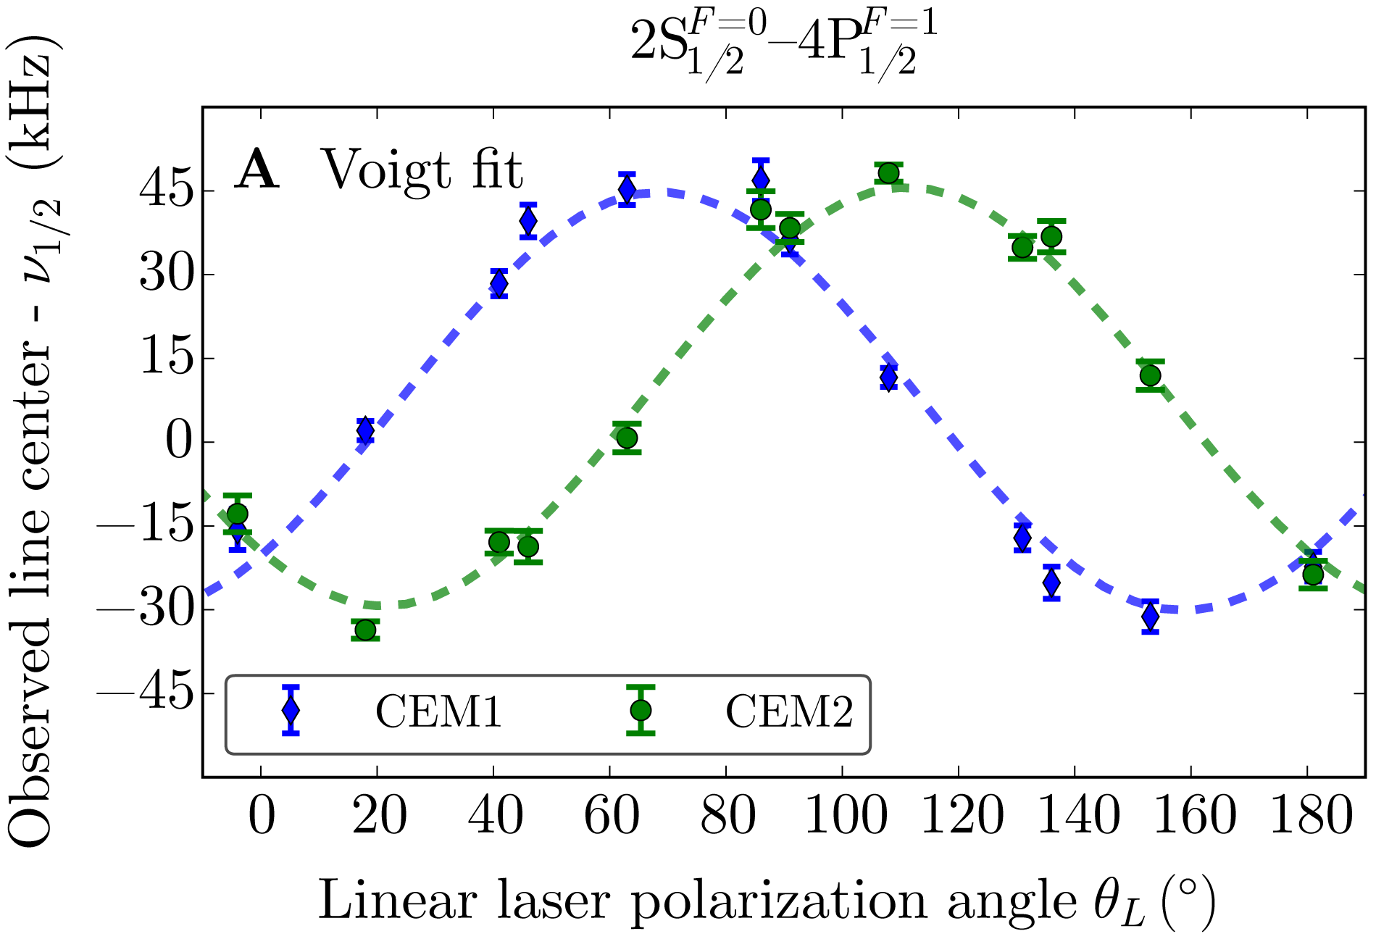
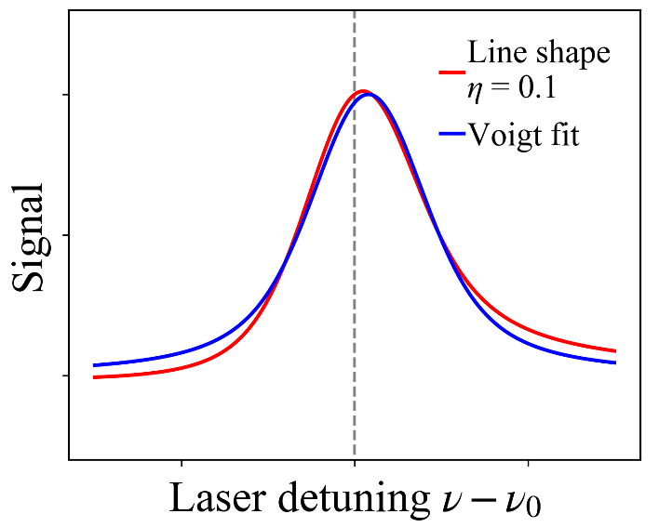
2S-4P quantum interference

Slide 17
2S-4P quantum interference
PRP

Slide 18
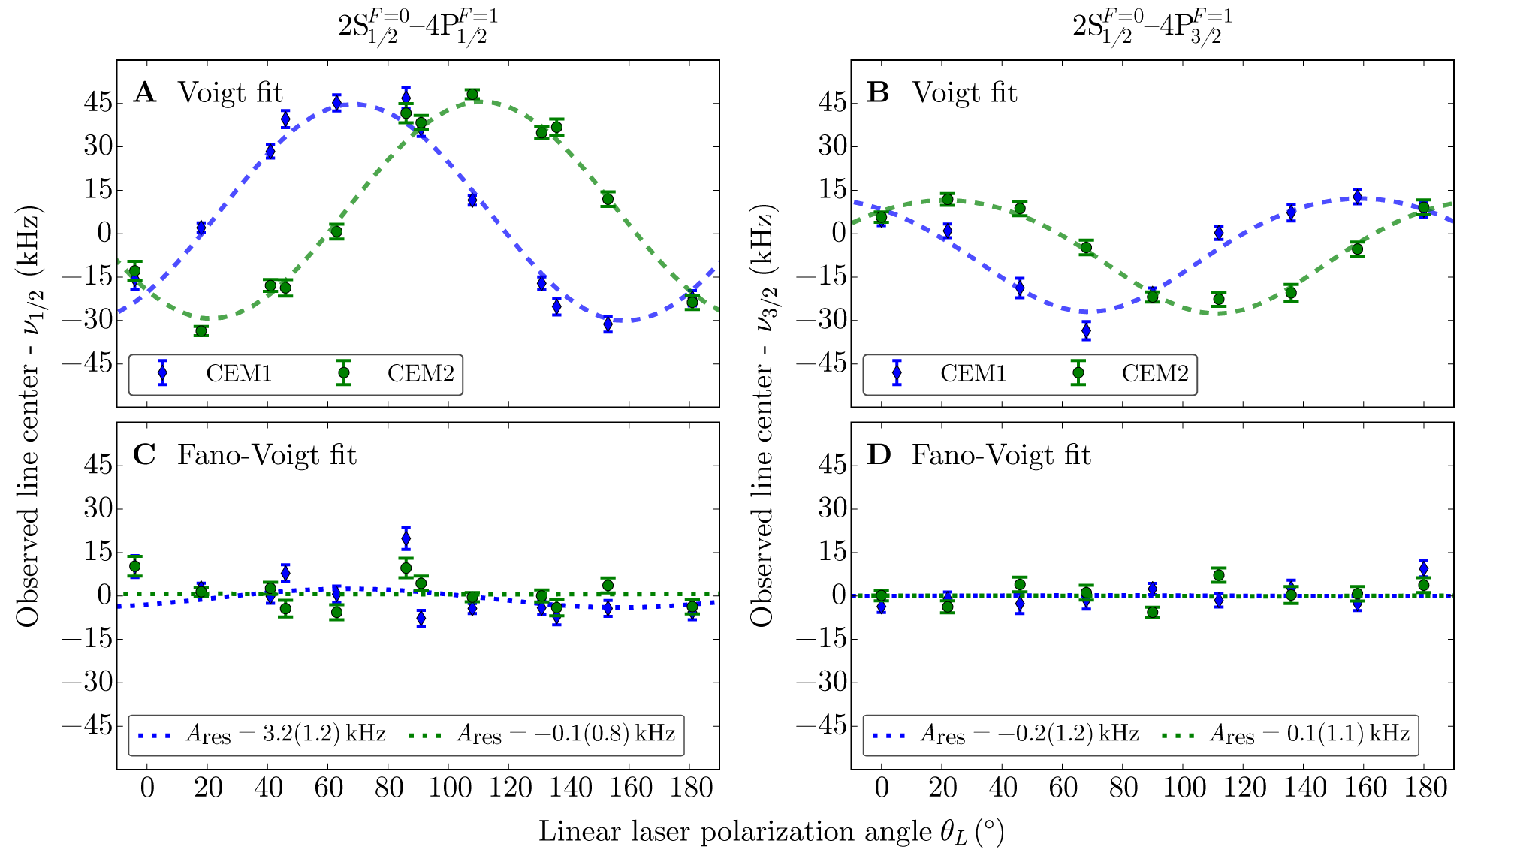
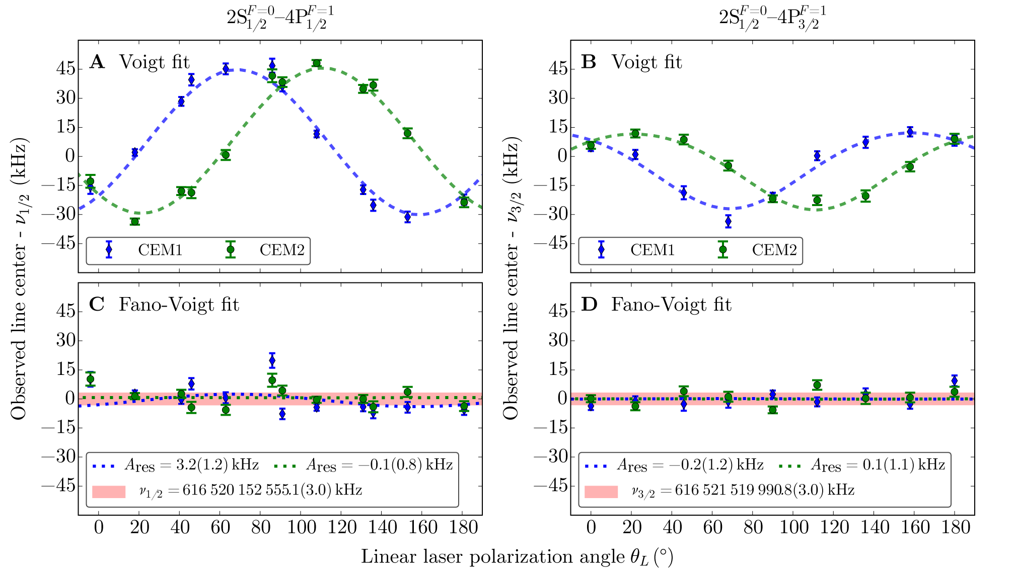
2S-4P quantum interference
PRP

Slide 19
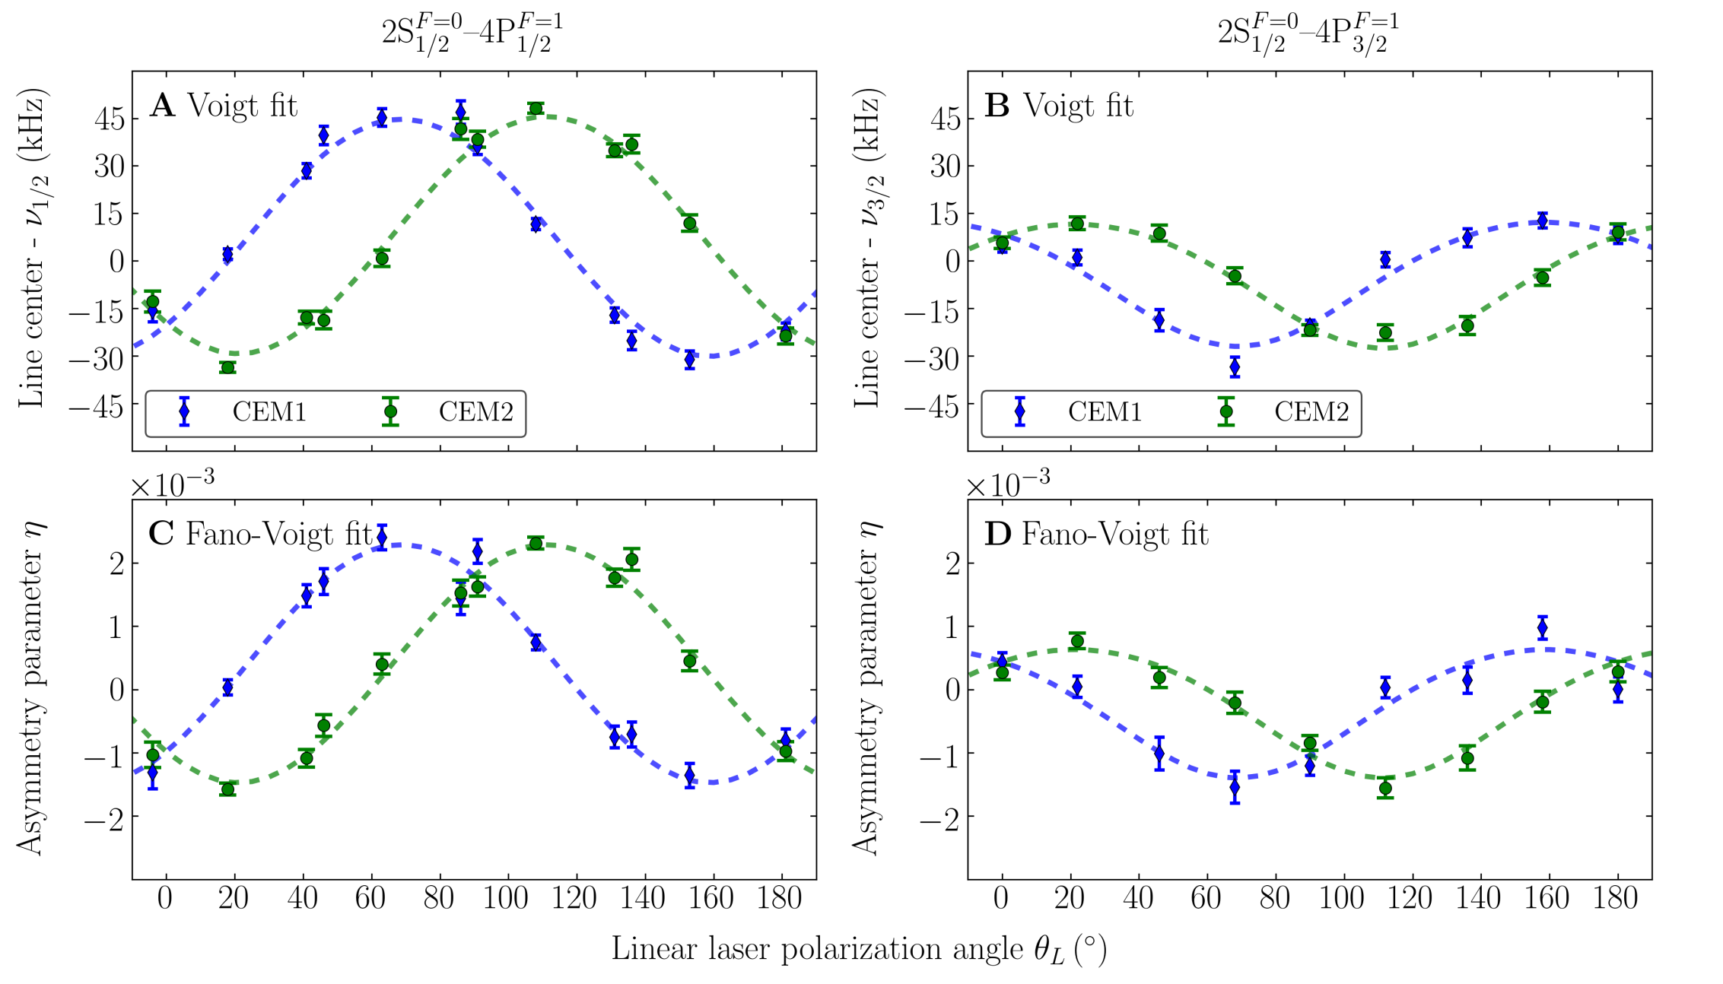
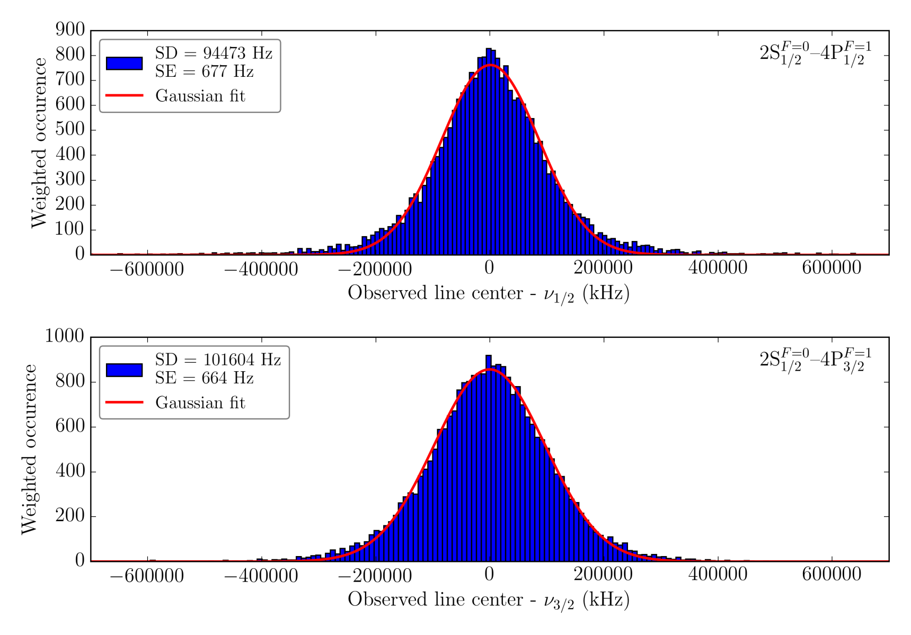
2S-4P quantum interference
PRP

Slide 20
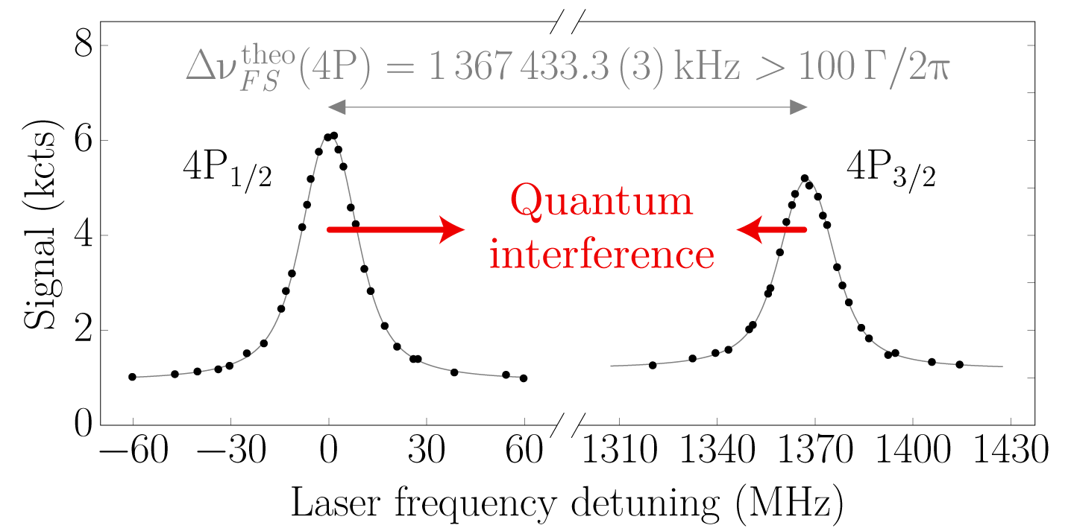
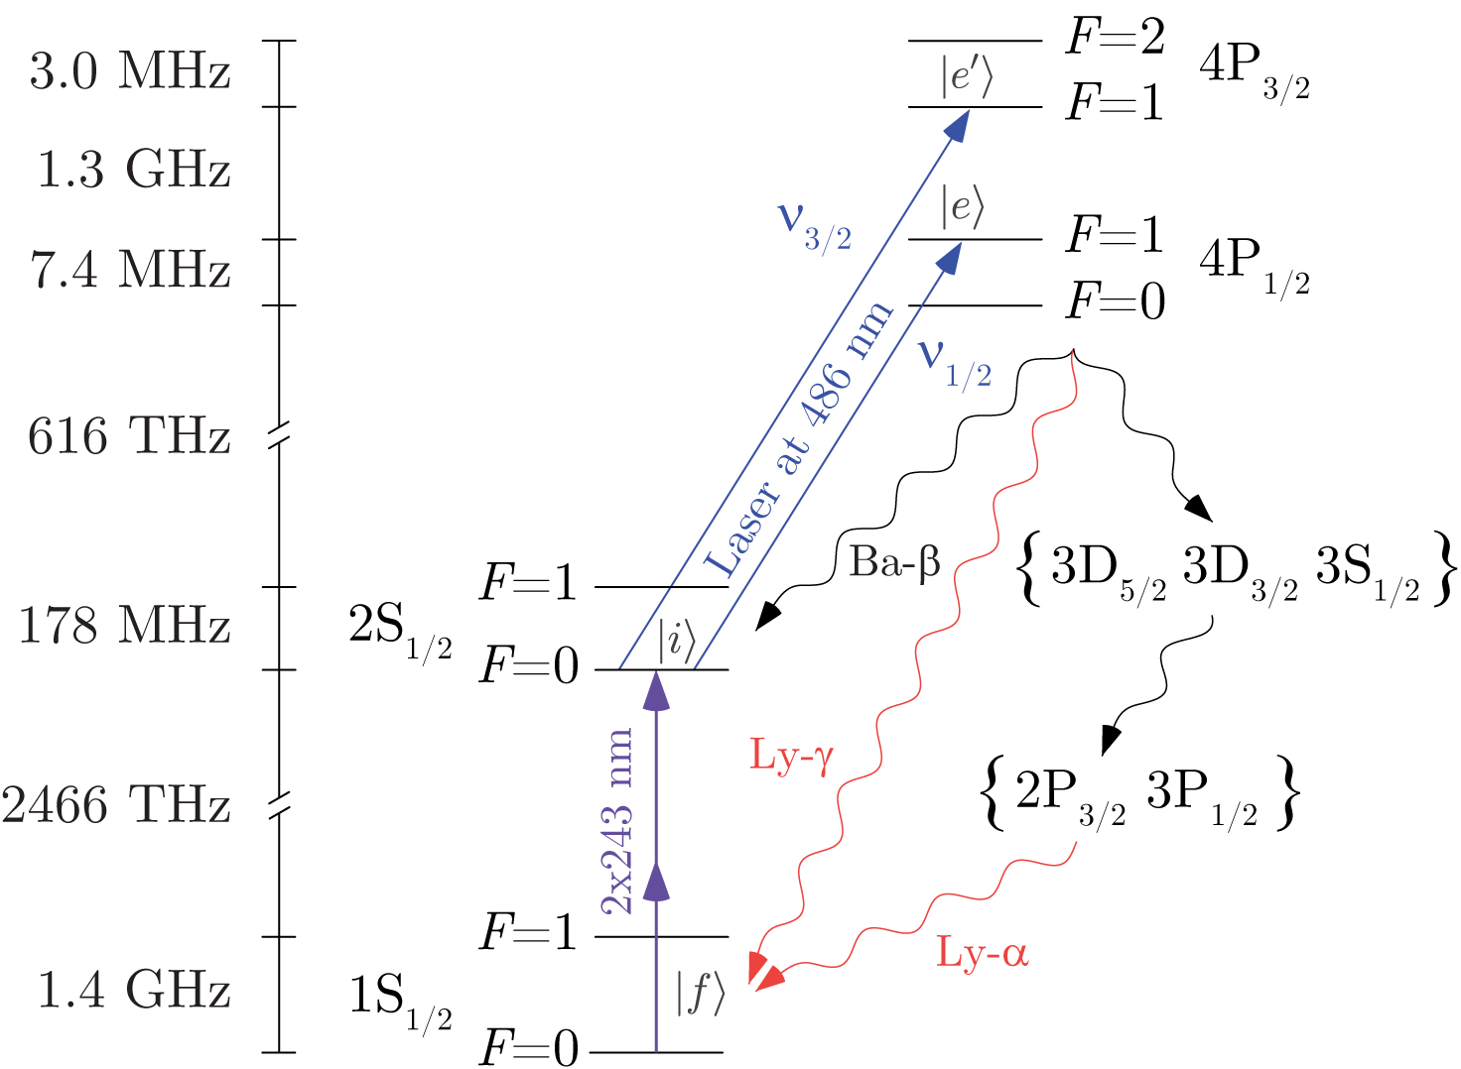
4P fine structure splitting
Difference $ν_{1/2}$ and $ν_{3/2}$ gives 4P fine structure splitting, which is very sensitive to quantum interference:
Theory prediction [CODATA2014], essentially free from finite size corrections:
Our result is in good agreement with theory prediction:
A. Beyer, L. Maisenbacher, A. Matveev et al., Science 358, 79 (2017)

Slide 21
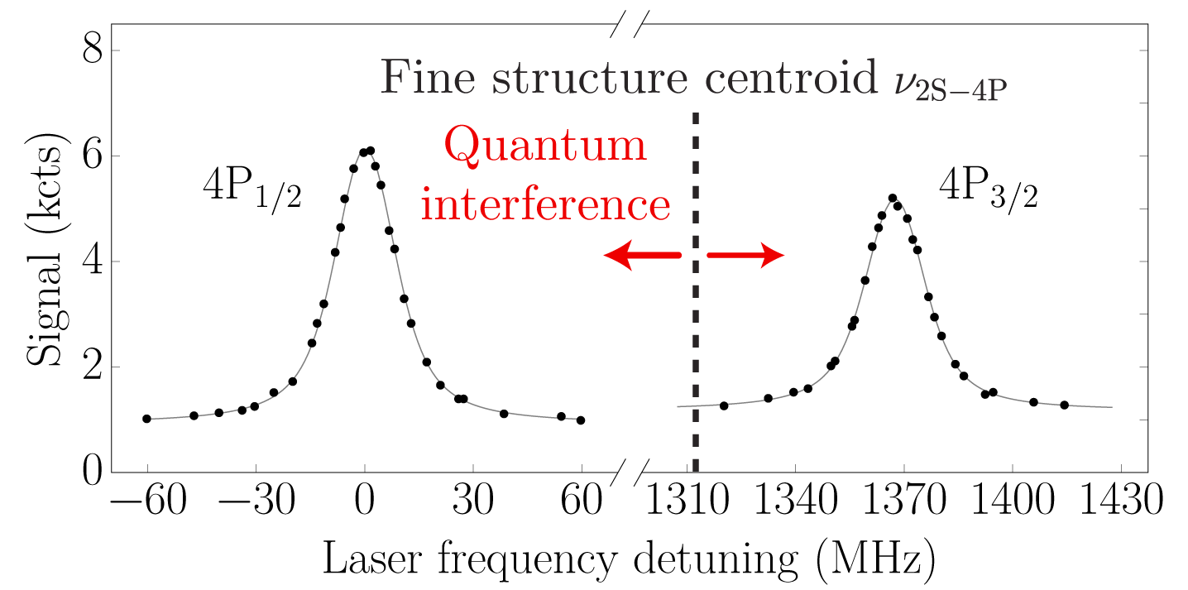
4P fine structure centroid
Fine structure centroid insensitive to quantum interference to a high degree:
The uncertainty is four times smaller than the proton radius discrepancy for the 2S-4P transition.
A. Beyer, L. Maisenbacher, A. Matveev et al., Science 358, 79 (2017)

Slide 22
Corrections at work
Line shape-dependent corrections for the 2S-4P_{1/2} transition:
Even though the line shape-dependent corrections reach up to 8 kHz, the final frequency agrees within 0.4 kHz for all line shapes considered.

Slide 23
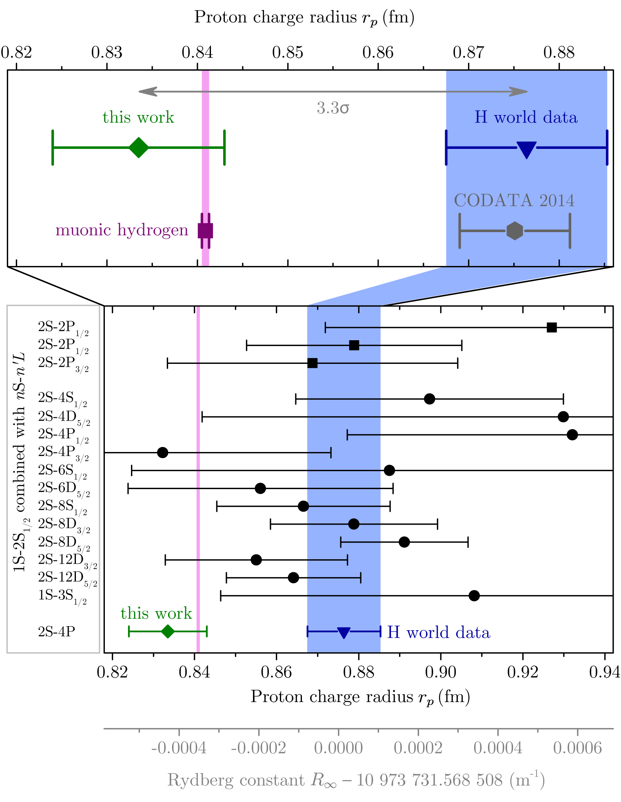
Proton radius and Rydberg constant
Use the 2S-4P fine structure centroid and 1S-2S result to extract proton radius and Rydberg constant,
leading to the most accurate determination of [$R_{∞}$, $r_{p}$] from H spectroscopy:
Other hydrogen spectroscopy projects: 1S-3S: Two-photon spectroscopy with CW laser (LKB, Paris) and frequency comb (MPQ)
See next talks!
2S-2P: Microwave separated oscillatory field method (York University, Toronto)
Disentangles Rydberg constant and proton radius
2S-8D: Two-photon spectroscopy on cold beam
(Colorado State University, Ft. Collins) Previously measured at room temperature at LKB
Consistent with muonic hydrogen value, but discrepancy of 3.3σ with H world data.
A. Beyer, L. Maisenbacher, A. Matveev et al., Science 358, 79 (2017)

Slide 24
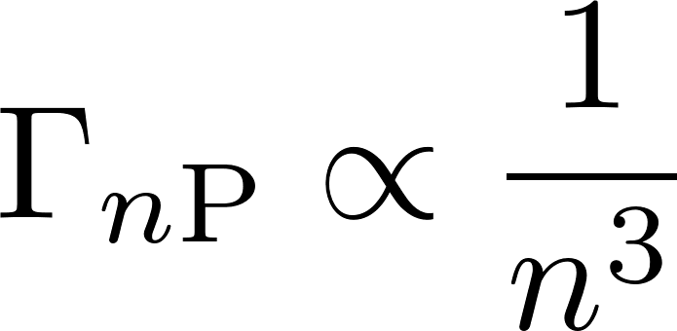
2S-nP line width
2S-4P:
Natural line width: 12.9 MHz
Observed line width: 20 MHz
(Doppler-broadened)
Natural line width Γ
of 2S-nP transitions:
2S-6P:
Natural line width: 3.8 MHz
Observed line width:
12 MHz with 2S-4P setup,
6.5 MHz with improved setup

Slide 25
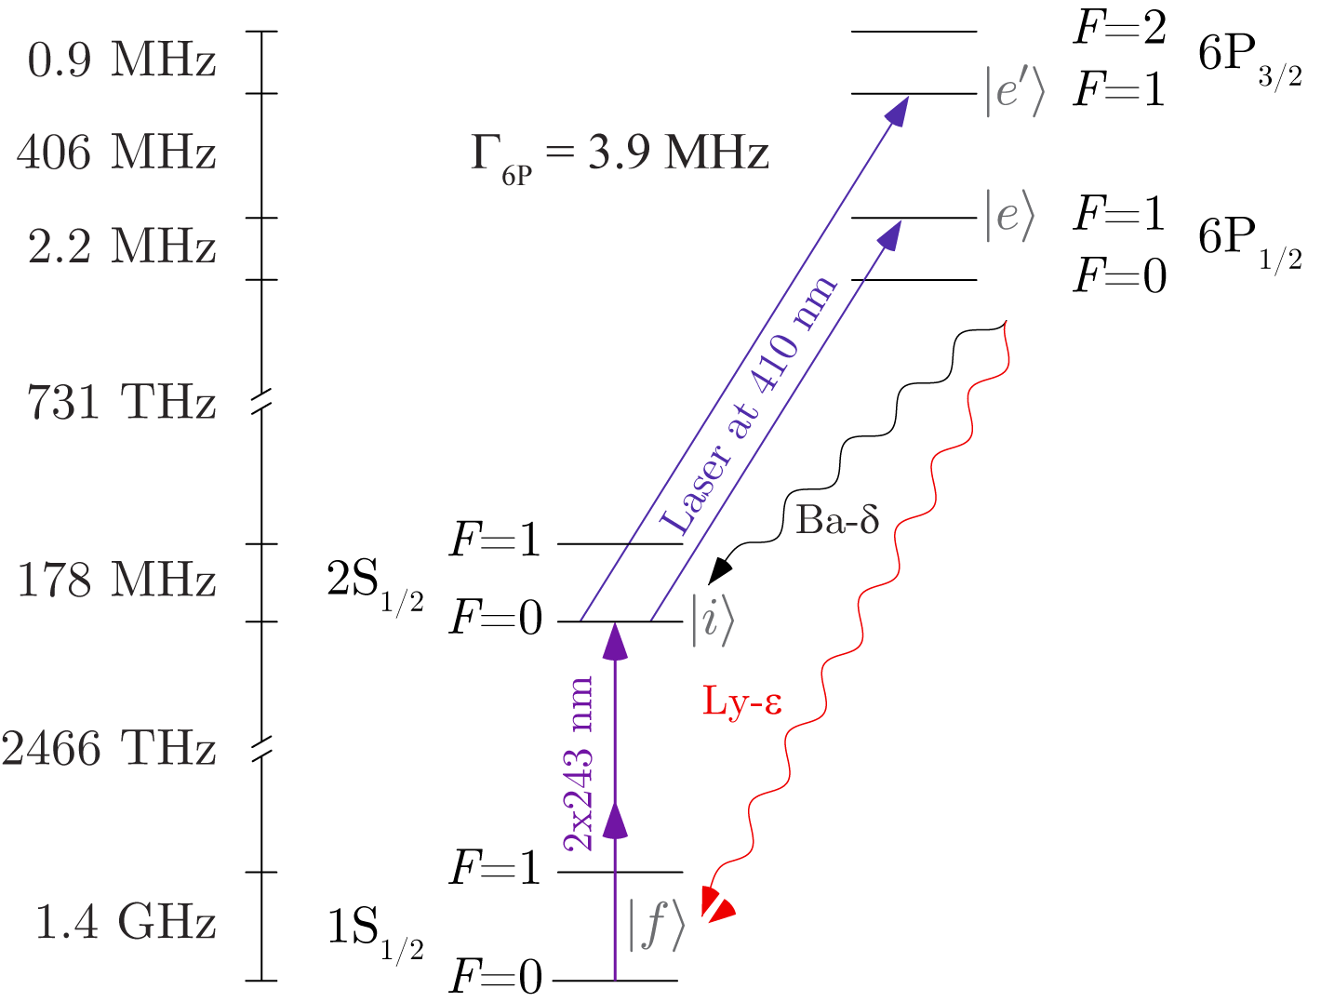
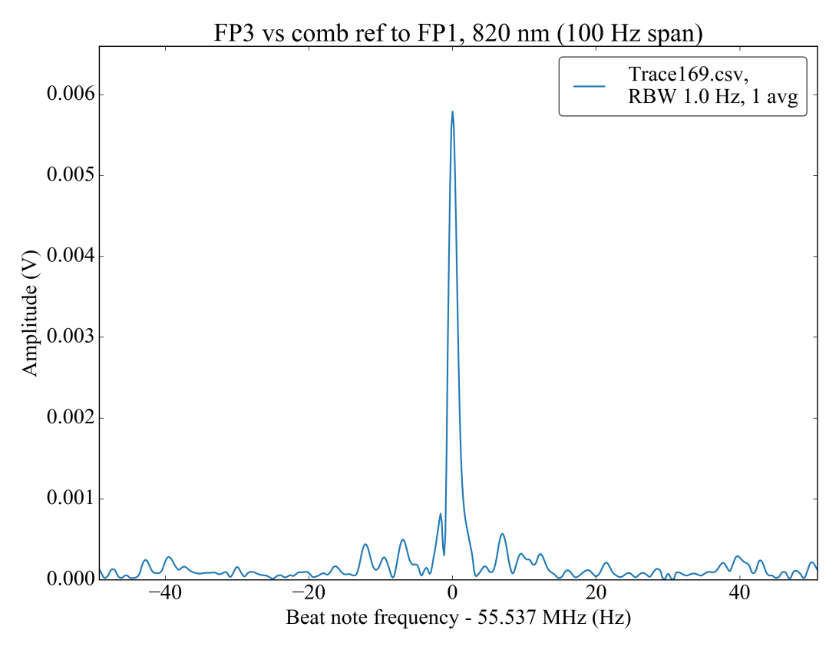
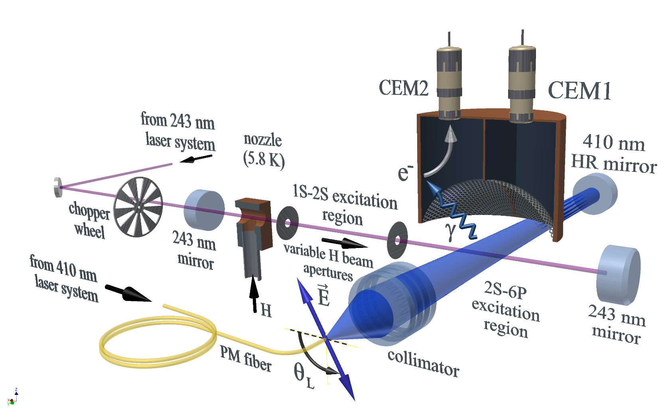
2S-6P transition
2S-6P excitation at 410 nm instead of 486 nm (2S-4P),
detect Ly-ε instead of Ly-γ, i.e. can use same detectors
1 Hz line width at 820 nm

Slide 26
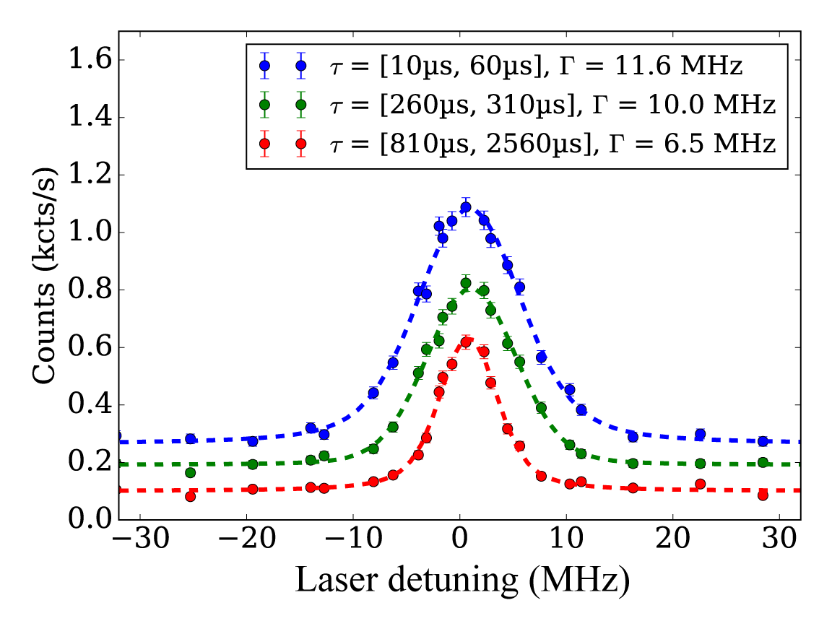
2S-6P observed line width
Improved atomic beam collimation (~ 10 mrad)
Natural line width:
Up to ~ 2.5 times narrower line width for 2S-6P than for 2S-4P measurement,
~ 15 kHz uncertainty per line scan (~ 40 s)

Slide 27
2S-6P dc-Stark shift
Dc-Stark shift coefficients up to ~ 18 times larger for 2S-6P than for 2S-4P.
2P-6P_{1/2}
dc elec. field direction | dc-Stark shift (Hz/(V/m)²)
Perpendicular to laser polarization | -1500
Along laser polarization | -1750
2P-6P_{3/2}
dc elec. field direction | dc-Stark shift (Hz/(V/m)²)
 | σ decay | π decay | All photons
Perpendicular to laser polarization | -2500 | +1200 | -280
Along laser polarization | -440 | -360 | -410
Limit from 1S-2S spectroscopy gives 0.6 V/m for different configuration,
corresponding to up to ~ 1 kHz dc-Stark shift.

Slide 28
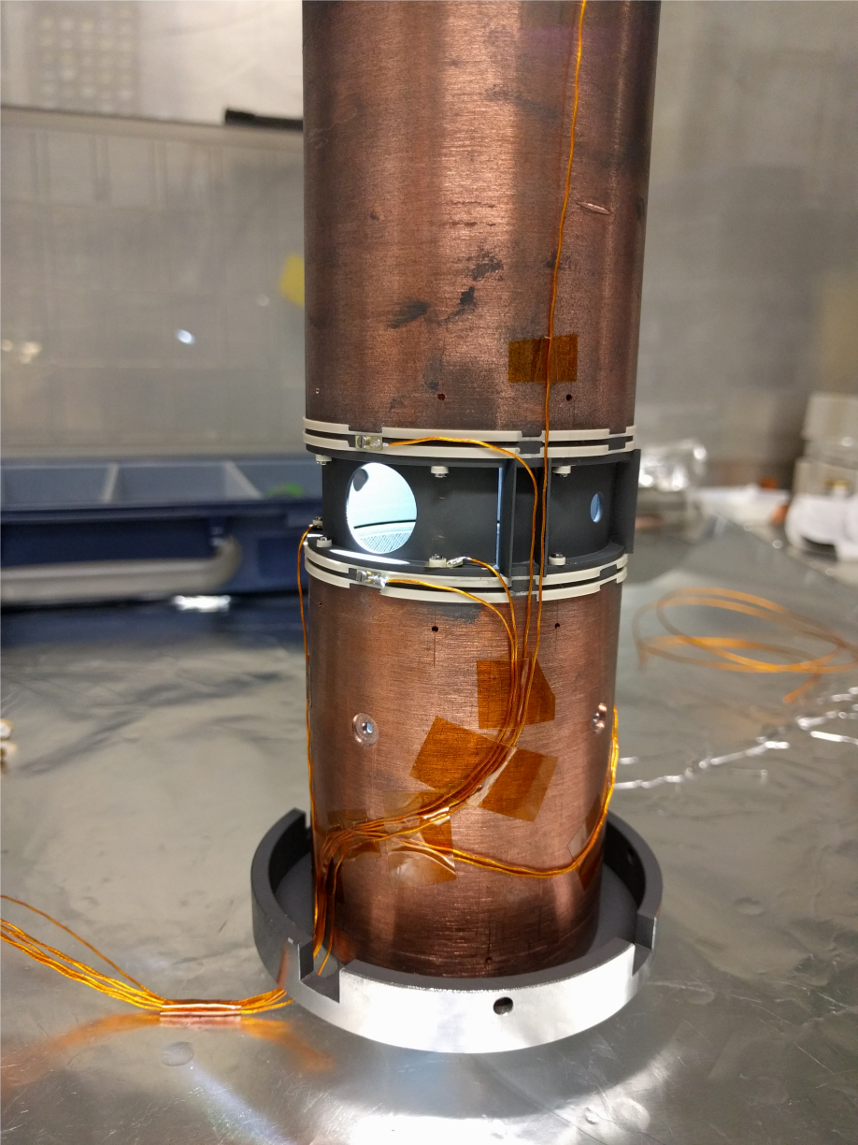
2S-6P dc-Stark shift
Detector with electrodes allows us to measure the stray electric fields.

Slide 29
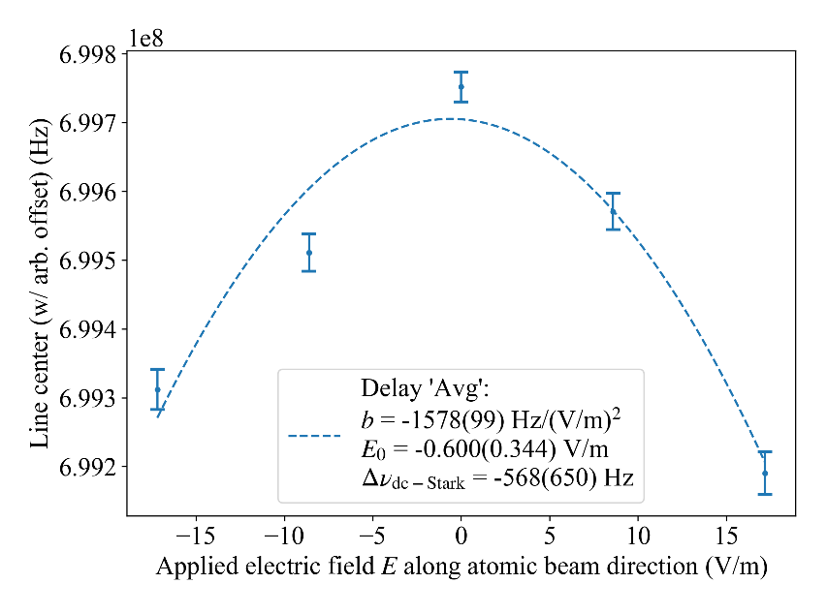
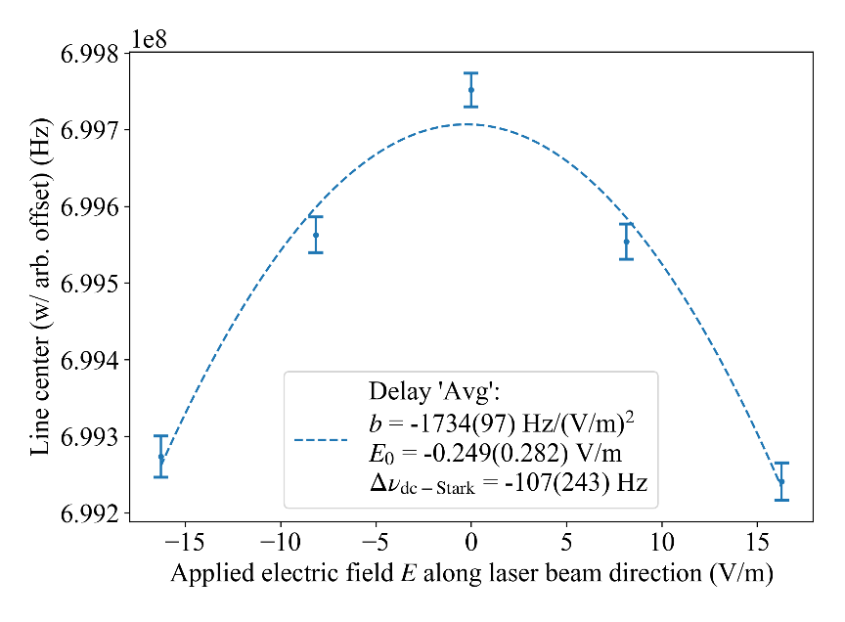
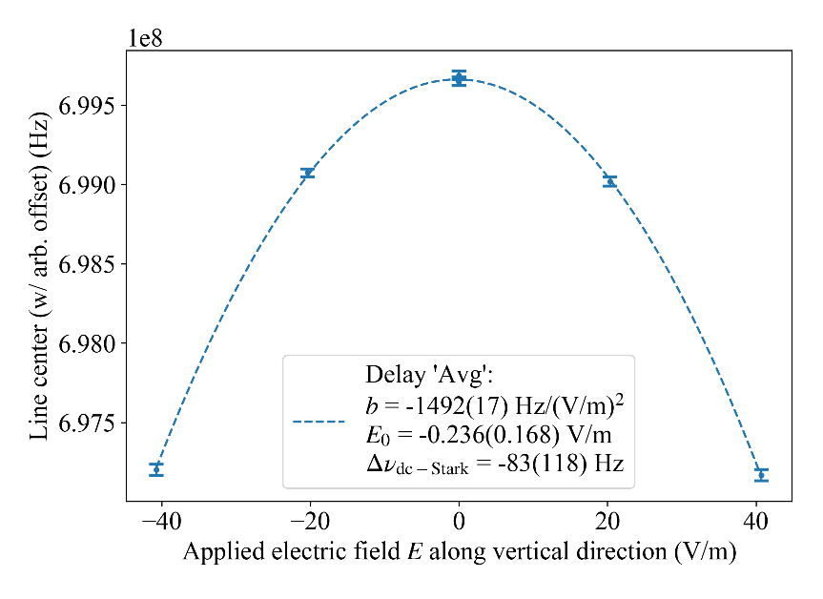
2S-6P dc-Stark shift
Measurement of dc-Stark shift of 2P-6P_{1/2} transition:
dc elec. field perpendicular to laser polarization
dc elec. field along laser polarization
dc elec. field direction | dc-Stark shift coefficient (Hz/(V/m)²) |  | Residual field (V/m)
 | Simulation | Meas.
Perpendicular to laser polarization | -1500 | 1494(17) | -0.60(0.34) -0.24(0.17)
Along laser polarization | -1750 | -1734(97) | -0.25(0.28)
Reaching dc-Stark shift below 1 kHz seems feasible!

Slide 30
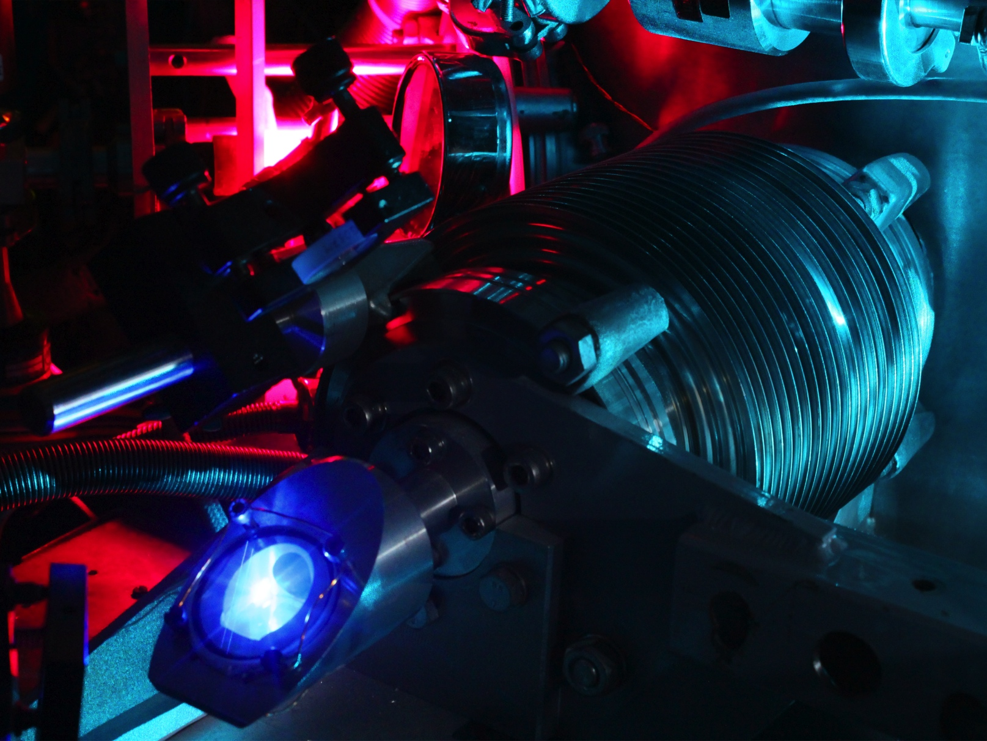
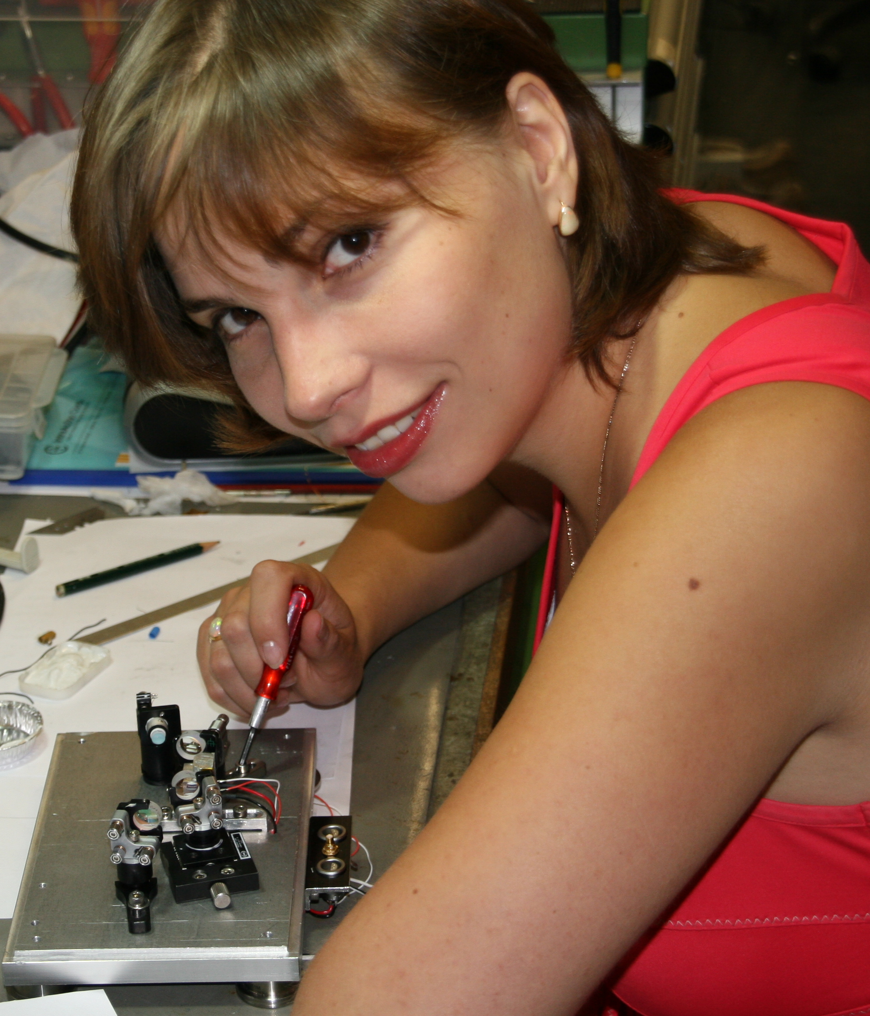
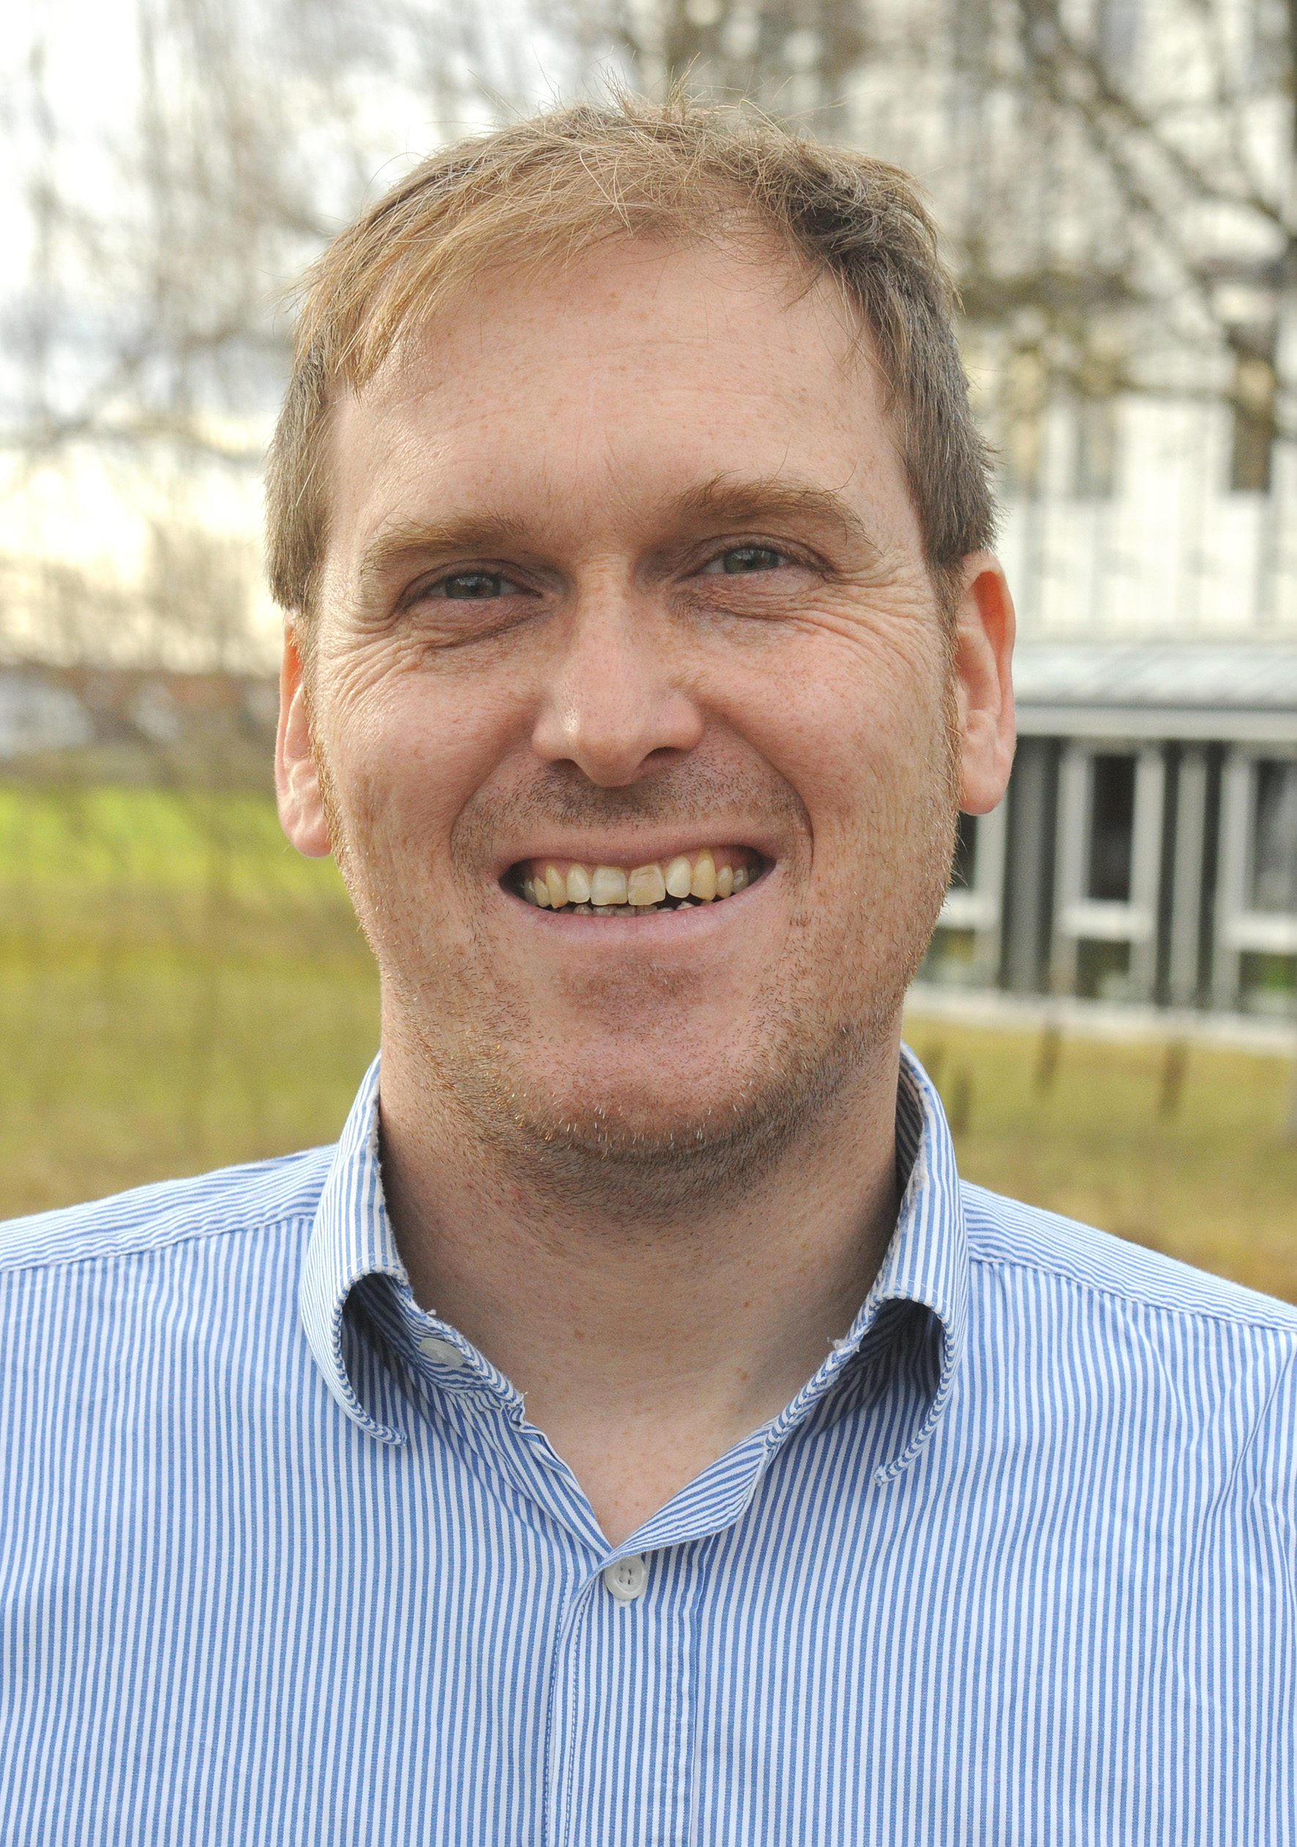
Thank you for
your attention!
MPQ hydrogen team
Vitaly
Andreev
Lothar
Maisenbacher
Arthur
Matveev
Alexey
Grinin
Ksenia
Khabarova
Randolf
Pohl
Nikolai
Kolachevsky
Theodor
W. Hänsch
Thomas
Udem

Slide 31
Time-resolved fluorescence line shape
Time-resolved fluorescence detection allows interrogation of different velocity groups of atoms, with mean velocities decreasing with delay time from 295 m/s down to 85 m/s (mean thermal velocity at 5.8 K: 300 m/s).
Width of transversal velocity distribution decreases with delay time, from 8 m/s to 2 m/s.
The observed line width ranges between 22 MHz and 17 MHz, higher than the natural line width of 12.9 MHz due to Doppler broadening (short delay times) and/or power broadening (long delay times).
For a precision of 2 kHz, the line center needs to be determined to one in 10,000 of the line width.

