Slide 1

22-26 January 2018 Bormio, Italy
56° International Winter Meeting on Nuclear Physics
Nuclear reactions in Laser-Plasmas
Sebastiana Puglia
LNS-INFN
Catania

Slide 2
Outline
Nuclear reactions @astrophysical energy
Nuclear reactions in Plasma
Fundamental open questions
Future Perspectives: Laser-Plasmas @ ELI-NP

Slide 3
Nuclear Astrophysics
Study energy generation processes in stars
Study nucleosynthesis of the elements
What is the origin of the elements?
How do stars/galaxies form and evolve?
How old is the Universe?
NUCLEAR PHYSICS
KEY for understanding

Slide 4
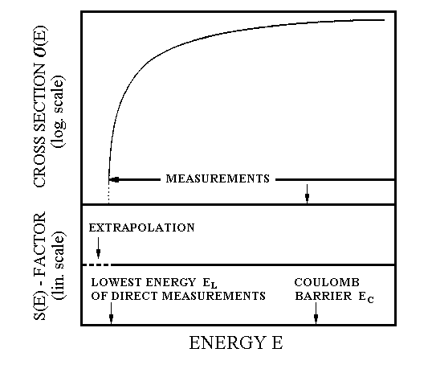
Nuclear reactions at astrophysical energies
Gamow Peak→ energy ≈ keV
Maxwell-Boltzmann
distribution
∝ exp(-E/kT)
tunnelling through
Coulomb barrier
∝ exp(- )
Main problem: presence of the Coulomb barrier between the interacting nuclei
Gamow peak
relative probability
Gamow peak
The Coulomb barrier E_{coul}, usually of the order of MeV,much higher than energy E_{kin} ~ keV
exponential decrease of the cross section
ΔE₀
kT
E₀
energy
10⁻⁹:10⁻¹² barn!!!
Extrapolation from the higher energies by using the
ASTROPHYSICAL FACTOR
S(E) = σ(E) E exp(2πη)
Astrophysical energies

Slide 5
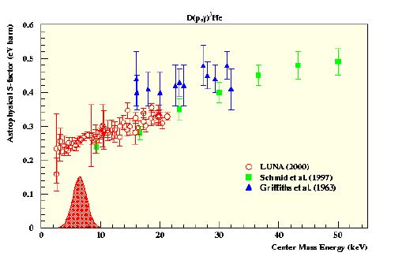
EXPERIMENTAL SOLUTIONS (uncertainties in the extrapolation)
Possible solutions to improve the signal/noise ratio:
TO INCREASE THE NUMBER OF
DETECTED PARTICLES
4 π detectors
New accelerator at high beam intensity
TO REDUCE THE BACKGROUND
Use of laboratory with natural shield - (underground physics-for instance LUNA experiment at LNGS-Italy )
The experimental technique were improved and some experiments were performed at Gamow energy.
BUT……
IN THE ULTRA-LOW ENERGY (GAMOW ENERGY) NEW EFFECT WERE DISCOVERED

Slide 6
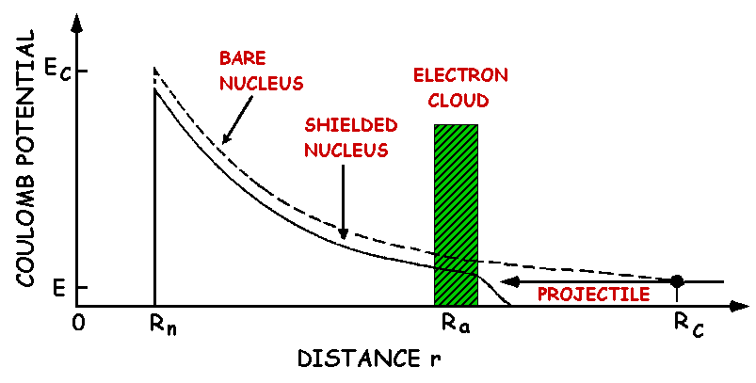
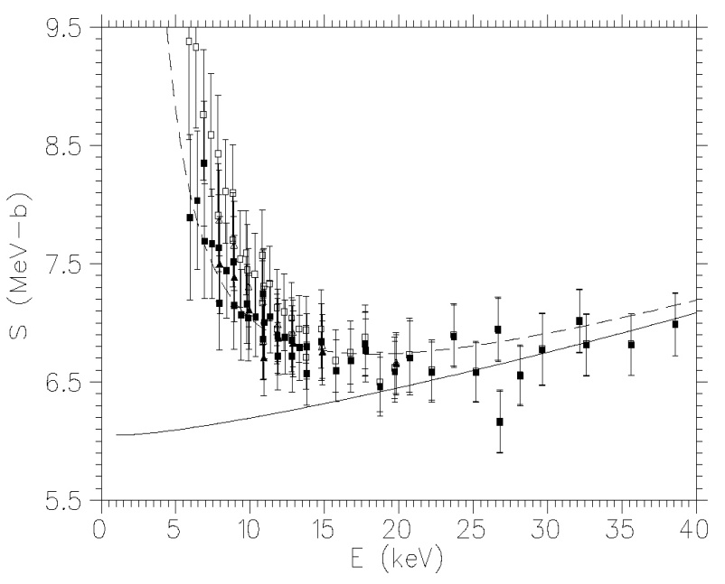
Electron screening
At astrophysical energies the presence of electron clouds must be taken into account in laboratory experiments. The atomic cloud surrounding the nucleus acts as a screening potential Ue.
³He(d,p)⁴He
Enhancement in the astrophysical S_{b}(E)-factor
Directly measured
Obtained by extrapolation
To extract from direct (shielded) measurements the bare astrophysical S_{b}(E) -factor, necessary for astrophysics EXTRAPOLATION were performed at higher energy

Slide 7
Independent measurements of bare nucleus S(E) factor and electron screening potential U_{e} are needed !!!
NEW METHODS ARE NECESSARY
to measure cross sections at never reached energies
to retrieve information on electron screening effect when ultra-low energy measurements are available.
INDIRECT METHODS ARE NEEDED

Slide 8
Main Indirect Metods
a) - Coulomb dissociation
to study radiative capture reactions
b) - Asymptotic Normalization Coefficients (Anc)
…to extract direct capture cross sections using peripheral
transfer reactions
c) – The Trojan Horse Method (THM)
to extract charged particle reaction cross sections using the quasi-free mechanism…
BUT
The electron screening effect is significantly affected by the target conditions and composition,
it is of particular importance for the measurement of cross-sections at extremely low energetic domains including plasma effects

Slide 9
Nuclear reactions in Plasma
Crucial aspects
appearence of new phenomena in Nuclear Physics in plasma

Slide 10
OPEN QUESTIONS
Usually, astrophysically relevant reactions are performed in the laboratories with both target and projectile in their ground state. However, in high temperatures plasmas (10⁸ K), an important role can be also played by the excited states.
Discussed by Bahcall and Fowler in 1969 about a possible relevant contribution of nuclear reactions between excited nuclei...(19F states)
Determining the experimental conditions that allow to evaluate the role of the excited states in the stellar environment could strongly contribute to the development of nuclear astrophysics.
The study of direct measurements of reaction rates in plasma offers this chance
The Plasma medium can influence the nuclear states (life time, strength etc.) and structure

Slide 11
LASER PLASMA
Notes:
Cpa=cipper pulser amplification

Slide 12
Electron screening in Plasma
Although it seems pratically impossible to reproduce in the laboratory the properties of stellar matter , it is possible to rescale the plasma parameters (Temperature and density) in order to make the laboratory condition similar to the ones of an astrophysical plasma.
Example:D+D reaction
The typical values of solar screening can be reproduced in alternative plasma conditions of temperature and density.
FUTURE
The availability of high-intensity laser facilities (tens of pentawatts of power ) into small volumes of matter
The opportunity to investigate nuclear reactions and foundamental interactions under extreme plasma condition
S. Ivanovski et al. Rad. Eff. end Def. in Sol. 165 (2010) 457

Slide 13
FUTURE PERSPECTIVES: Laser-Plasmas @ ELI-NP
It will be possible to study the electronic screening problem in a wide variety of cases and configurations with different purpose.
STUDY of the screening effects on low energy fusion reactions and on weakly bound nuclear state
¹¹B(³He, d)¹²C* reaction in a plasma Triple alpha scattering
(Carbon Hoyle state)
The Hoyle state plays a central role in stellar helium burning by enhancing
the production of ¹²C in the Universe, allowing for life as we know it.
For the important astrophysical consequence is mandatory to study
these topics in a plasma environment.
Through the laser-target interaction, it is possible to produce plasmas containing mixtures of ¹³C + ⁴He and ⁷Li + deuterons in order to investigate inner-plasma thermo-nuclear reactions.
Primordial nucleosinthesys
⁷Li(d,n)⁴He-⁴He
seems to be one of the most important reactions affecting the primordial CNO abundances produced during the early stage of universe
[Coc et al. Astrophysical Journal, 744 (2010) 158]
Stellar nucleosinthesys
¹³C(⁴He,n)¹⁶O
Important in the helium burning process in advanced stellar phase.
is one of the most interesting neutron sources
NEGOITA et al Romanian Reports in Physics, Vol. 68, 2016

Slide 14
Nuclear reactions in Laser-Plasmas @ ELI-NP
Layout of the experimental setup.
Target configuration: the main laser pulse impinging on B, C or Li thin foil generates a primary plasma which impacts on a second plasma slab produced through the interaction of a secondary laser pulse on a He or D2 gas jet target. The produced ions expands along a cone whose axis is normal to the target’s surface with a low emittance
Layout of the detectors configuration; the setup combine high granularity SiC charged particles detectors and a new generation of neutrons time-of-flight detectors .
Main advantages:
Preferred direction of the nuclear collisions
Use of plasma target
Direct measurement of the Cross-Sections
NEGOITA et al Romanian Reports in Physics, Vol. 68, 2016

Slide 15
NEUTRON DETECTORS
The “ideal” neutron detection module for reaction’s kinematic studies must have:
- high efficiency,
- good discrimination of gammas from neutrons,
- good timing performance for ToF neutron energies reconstruction.
AND
-it must be able to work in hard environmental conditions, like the ones established in the laser-matter interaction area.
→plastic scintillators with efficient neutron/gamma pulse shape discrimination (PSD→PPO) by using PolySiloxane
NEW PHOTO-DETECTORS based on silicon technology (Silicon PhotoMultipliers SiPM)

Slide 16
Charged particles Detectors
It is insesitive to the visible light
property foundamental to perform the experiments

Slide 17
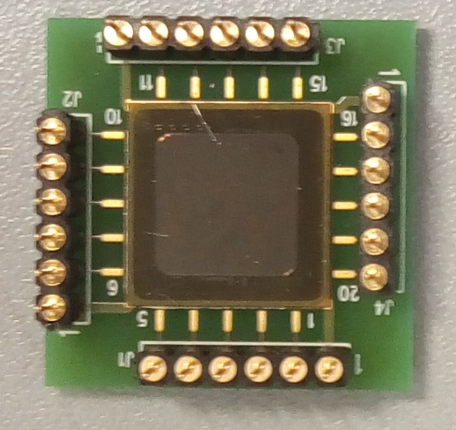
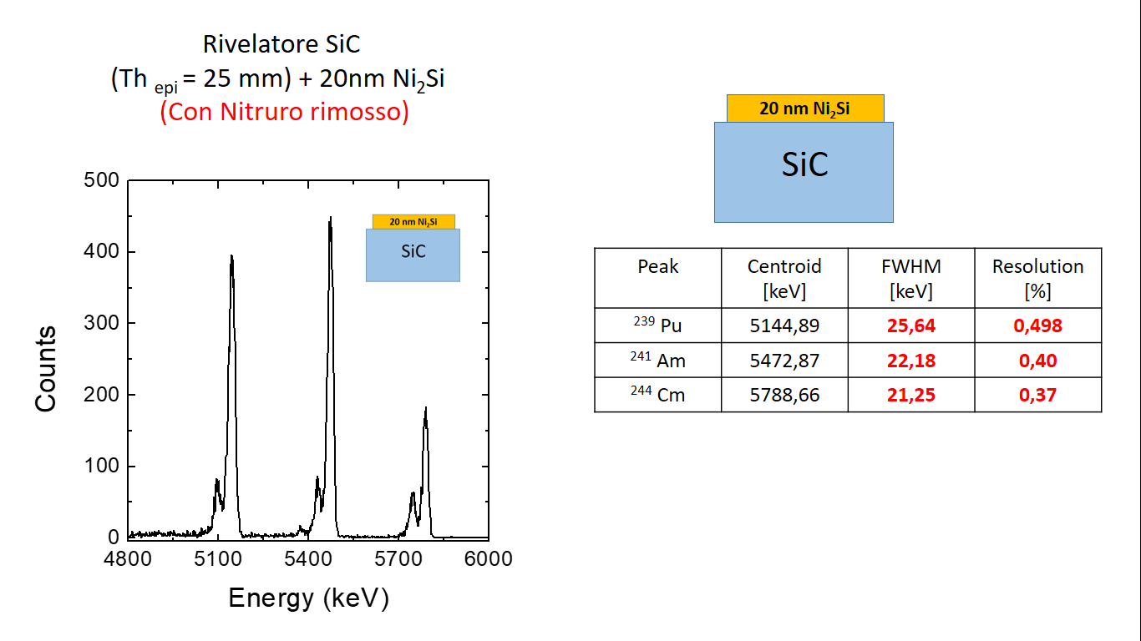
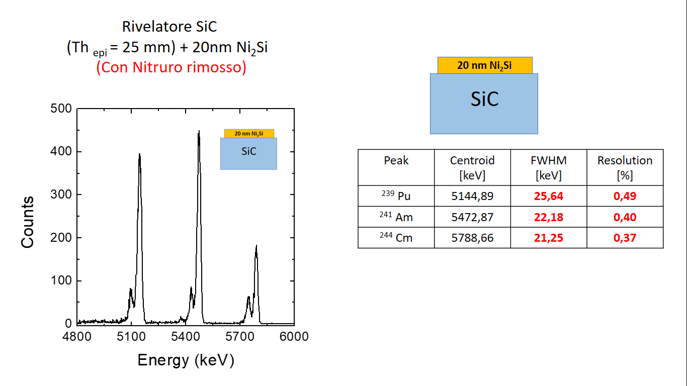
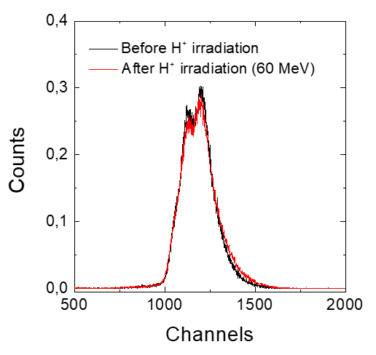
SiC: some Preliminary Results
Alpha source
SiC 10μm A= 1x1 cm²
PRELIMINARY RESULTS
60 MeV H⁺
SiC 10μm 1x1 cm²
LNS Catana line
2KGy (2.5 x 10¹² H⁺/cm²)

Slide 18
REMARKS AND CONCLUSIONS
Nuclear astrophysics problem → Nuclear physics in Plasma. Plasma is by far the most common form of matter known.
Plasma state is characterized by a complexity that vastly exceeds that exhibited in the solid, liquid, and gaseous states →
The physical properties of nuclear matter (structure, life times, reaction mechanisms etc.) could be drastically changed inside the plasma.
The aim is to prepare the program studies on nuclear physics and astrophysics, which will be conducted at the new ELI-NP Laser facility
actually is under construction in Bucharest, Romania.
Very interesting is the study of the two main detectors, which will constitute the full detections system, which will be installed at the ELI- NP facility.
- the new generation of plastic scintillators for the neutrons detection
new Silicon Carbide detectors.
They are chosen for the excellent performances and work capabilities in hard environment such as the one generated by Laser-Matter interaction.

Slide 19
Thank you !!!

