Slide 1




Initial and final state interactions in proton-lead collisions
Moritz Greif
in collaboration with
Björn Schenke, Sören Schlichting, Zhe Xu, Carsten Greiner
Phys. Rev. D 96, 091504, 2017
Bormio 2018

Slide 2
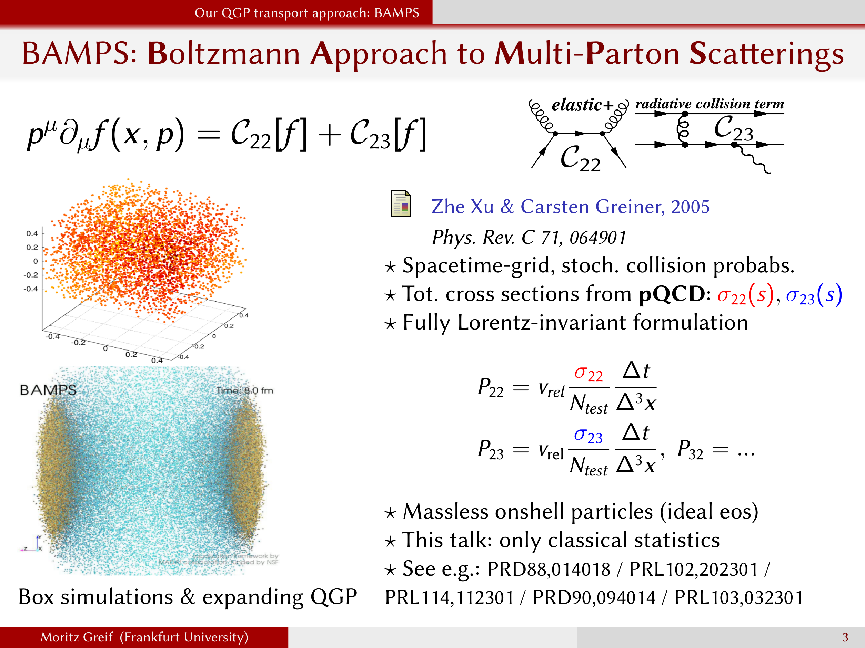
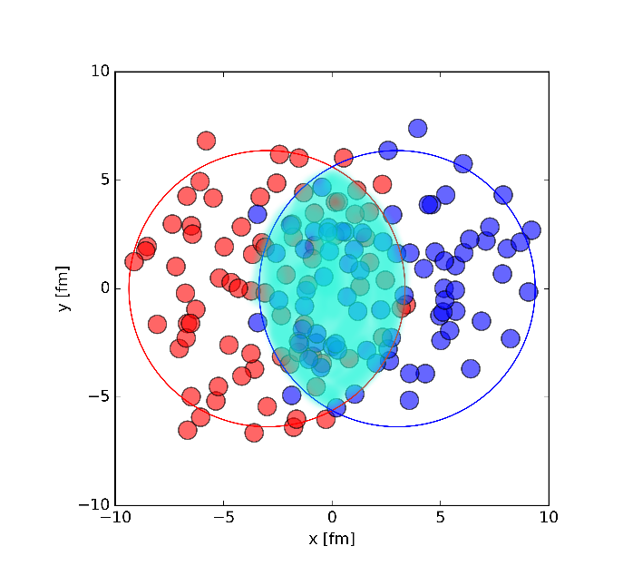
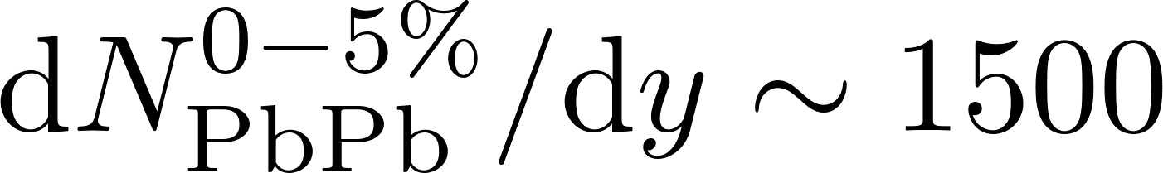
Heavy-ion collisions
Very opaque medium
Strong energyloss
Azimuthal correlations of low energy particles
Quark-Gluon Plasma (QGP)
e.g. Pb+Pb @ 5 TeV
Small momenta
Momentum asymmetry measurable:
„elliptic flow“ – hydrodynamic response to initial geometry
Large momenta due to large pressure gradient
„well understood“ ☺

Slide 3
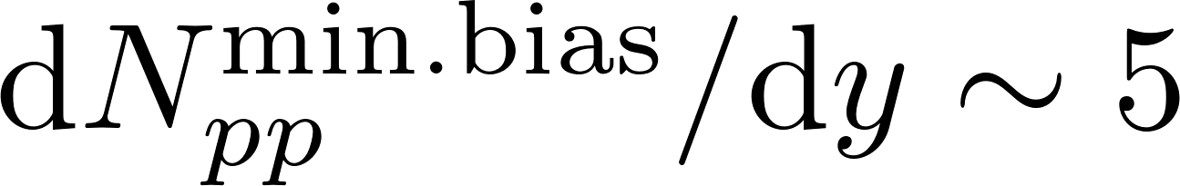
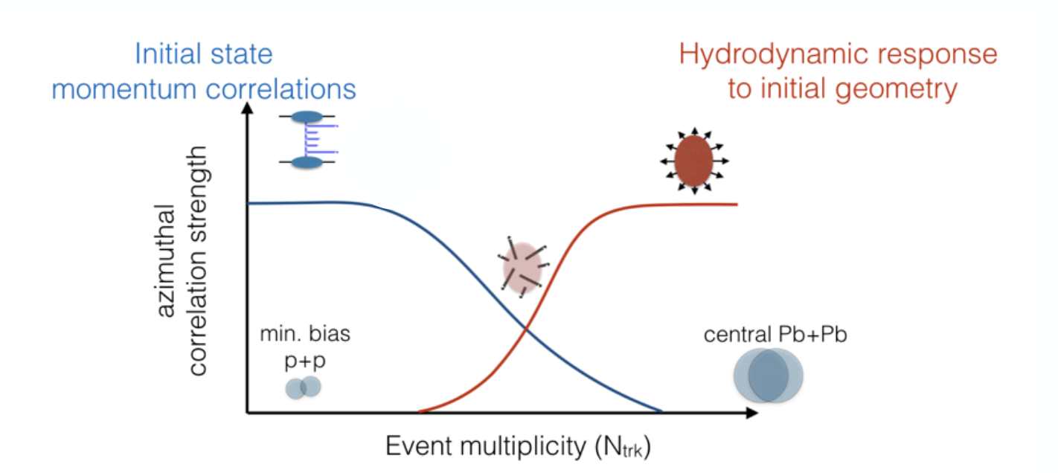
Different physics
in smaller systems (?)
Initial state momentum correlations
Proton-proton collisions
Picture by S.Schlichting

Slide 4
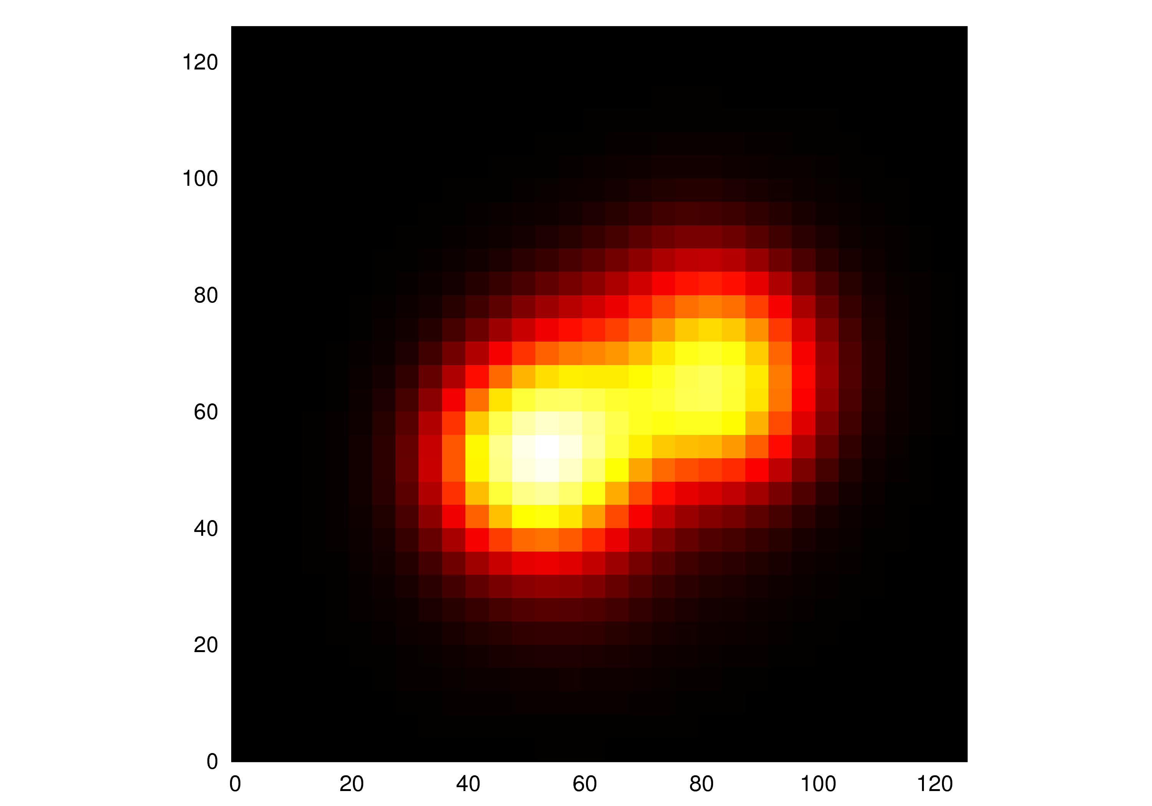
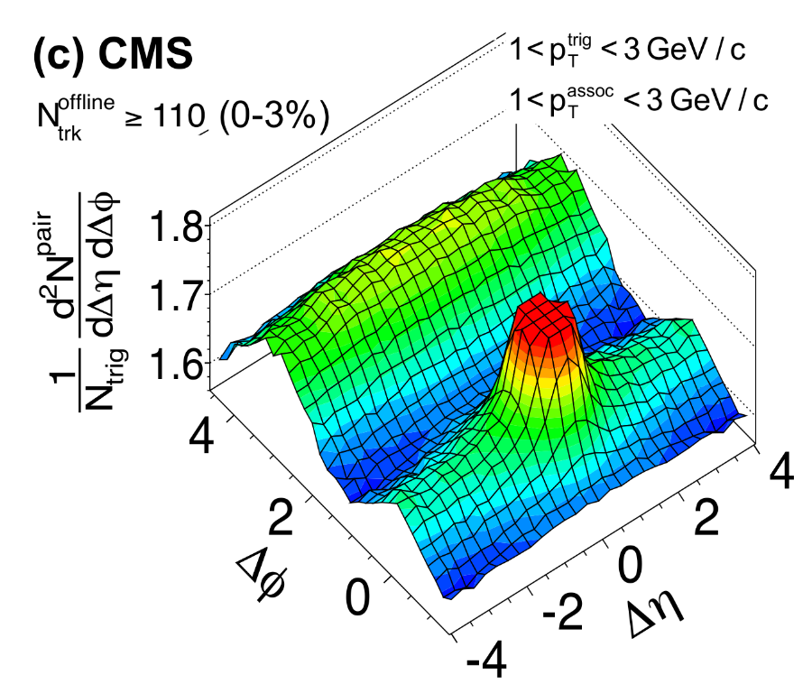

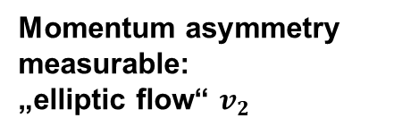
Proton-Heavy-ion (pA) collisions
Mini-QGP ?
Or only
„initial state“?
Momentum asymmetry measurable:
„elliptic flow“ $v_{2}$
Proton - Lead collision
Small momenta
Also long-range correlations:
Large momenta due to
pressure gradient ?
Initial state momentum configuration ?
Shape of hot center fluctuates event by event

Slide 5
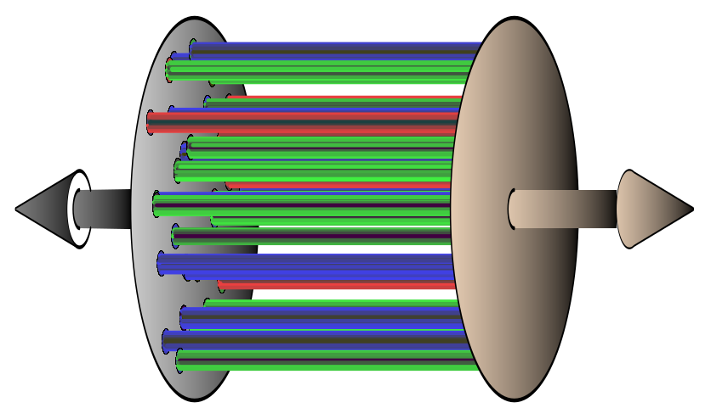

Our model
initial state with interactions (Glasma: „IP-Glasma“)
+ final state with interactions
(parton cascade: „BAMPS“)
Time:
0-0.2 fm/c
0.2 – 2 fm/c

Slide 6

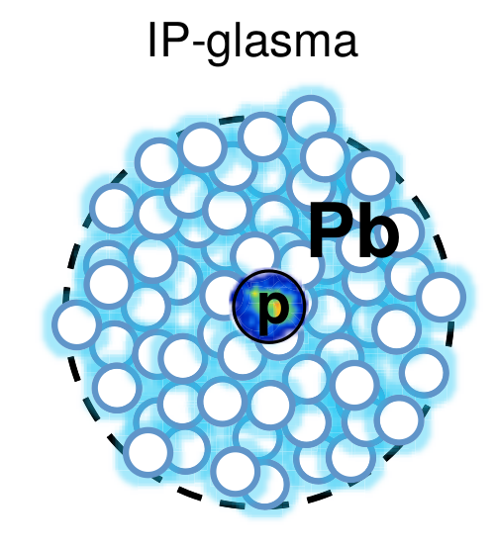
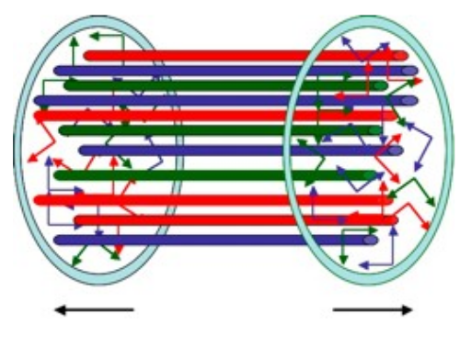
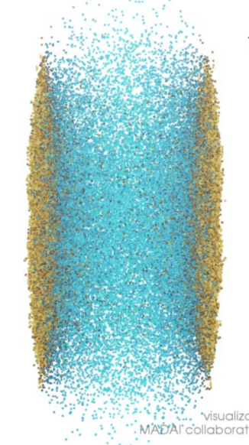
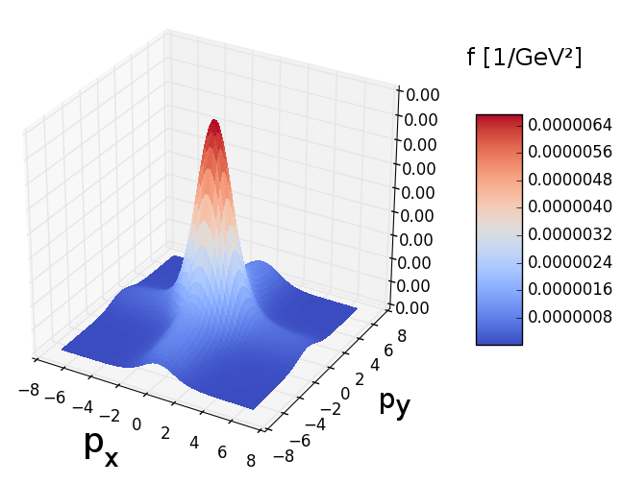
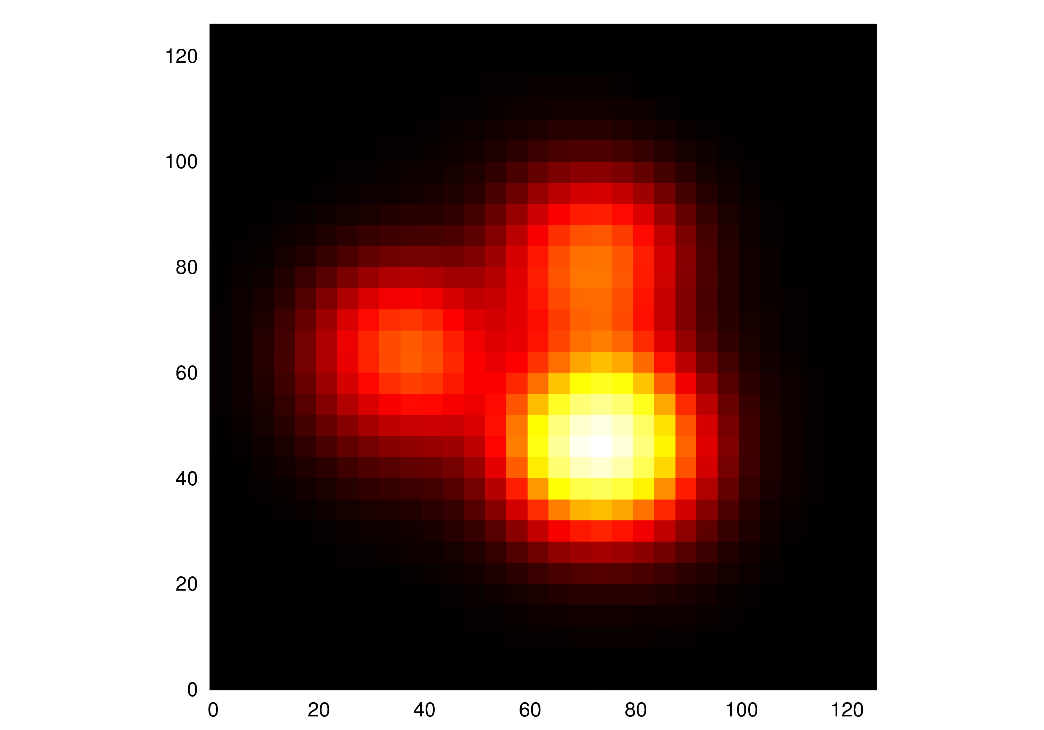



New Model: Initial + Final state interactions
Sample nucleons +
Generate „Glasma“ state
Evolve Classical Yang-Mills until free streaming
Goal
Measure $\frac{dN}{d²p d²x}$ on lattice
Observables
$$v_{2} , v_{3}$$
Run ~ $2 fm/c$
smearing
Single particle distribution function (a.u.)
Sample particles
Initial state
BAMPS
[GeV]
[GeV]

Slide 7
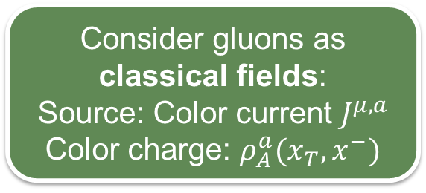
Initial state: Color Glass Condensate „CGC“
Consider gluons as classical fields:
Source: Color current $J^{μ,a}$
Color charge: $ρ_{A}^{a}(x_{T},x^{−})$
Claim
CGC:
Fundamental matter of high energy hadrons
Two sheets of color charge collide:
Gluon dominated system
IP-Sat model
(Impact parameter saturation)
Sample nucleon positions
Color charge sampled per nucleon
Proton gluon distributions constrained by HERA e+p DIS data
Kowalski & Teaney, PRD68,114005 (2003)
Schenke et al., PRL 108,252301 (2012)
A
Initially longitudinal E and B fields
B
McLerran et al., Phys.Rev. D49 (1994) 2233, 3352
D50 (1994) 2225
„Glasma“. Solved on the lattice.
(→ S.Schlichting & B.Schenke)

Slide 8
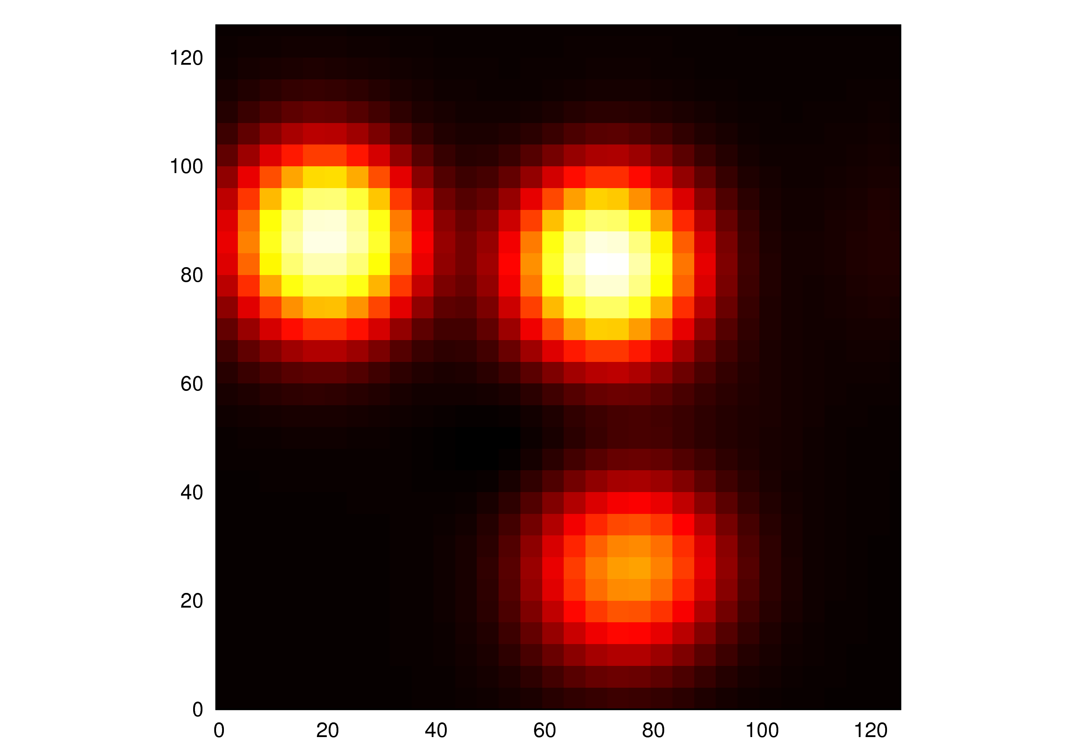
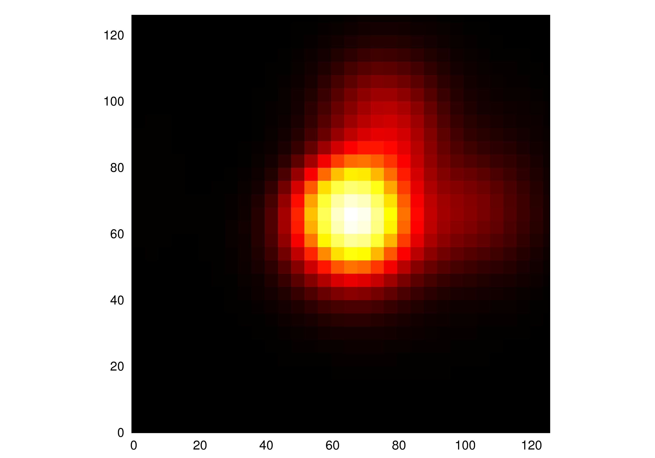
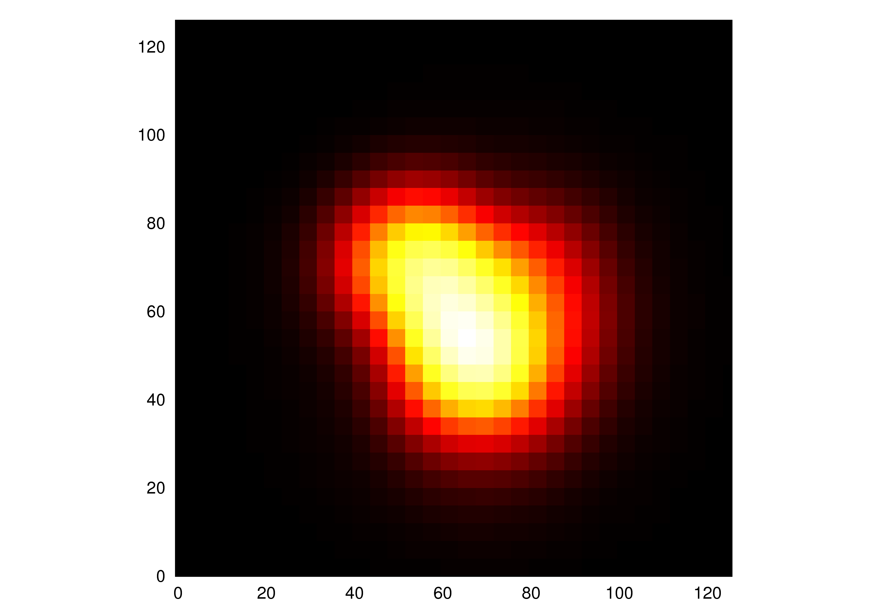
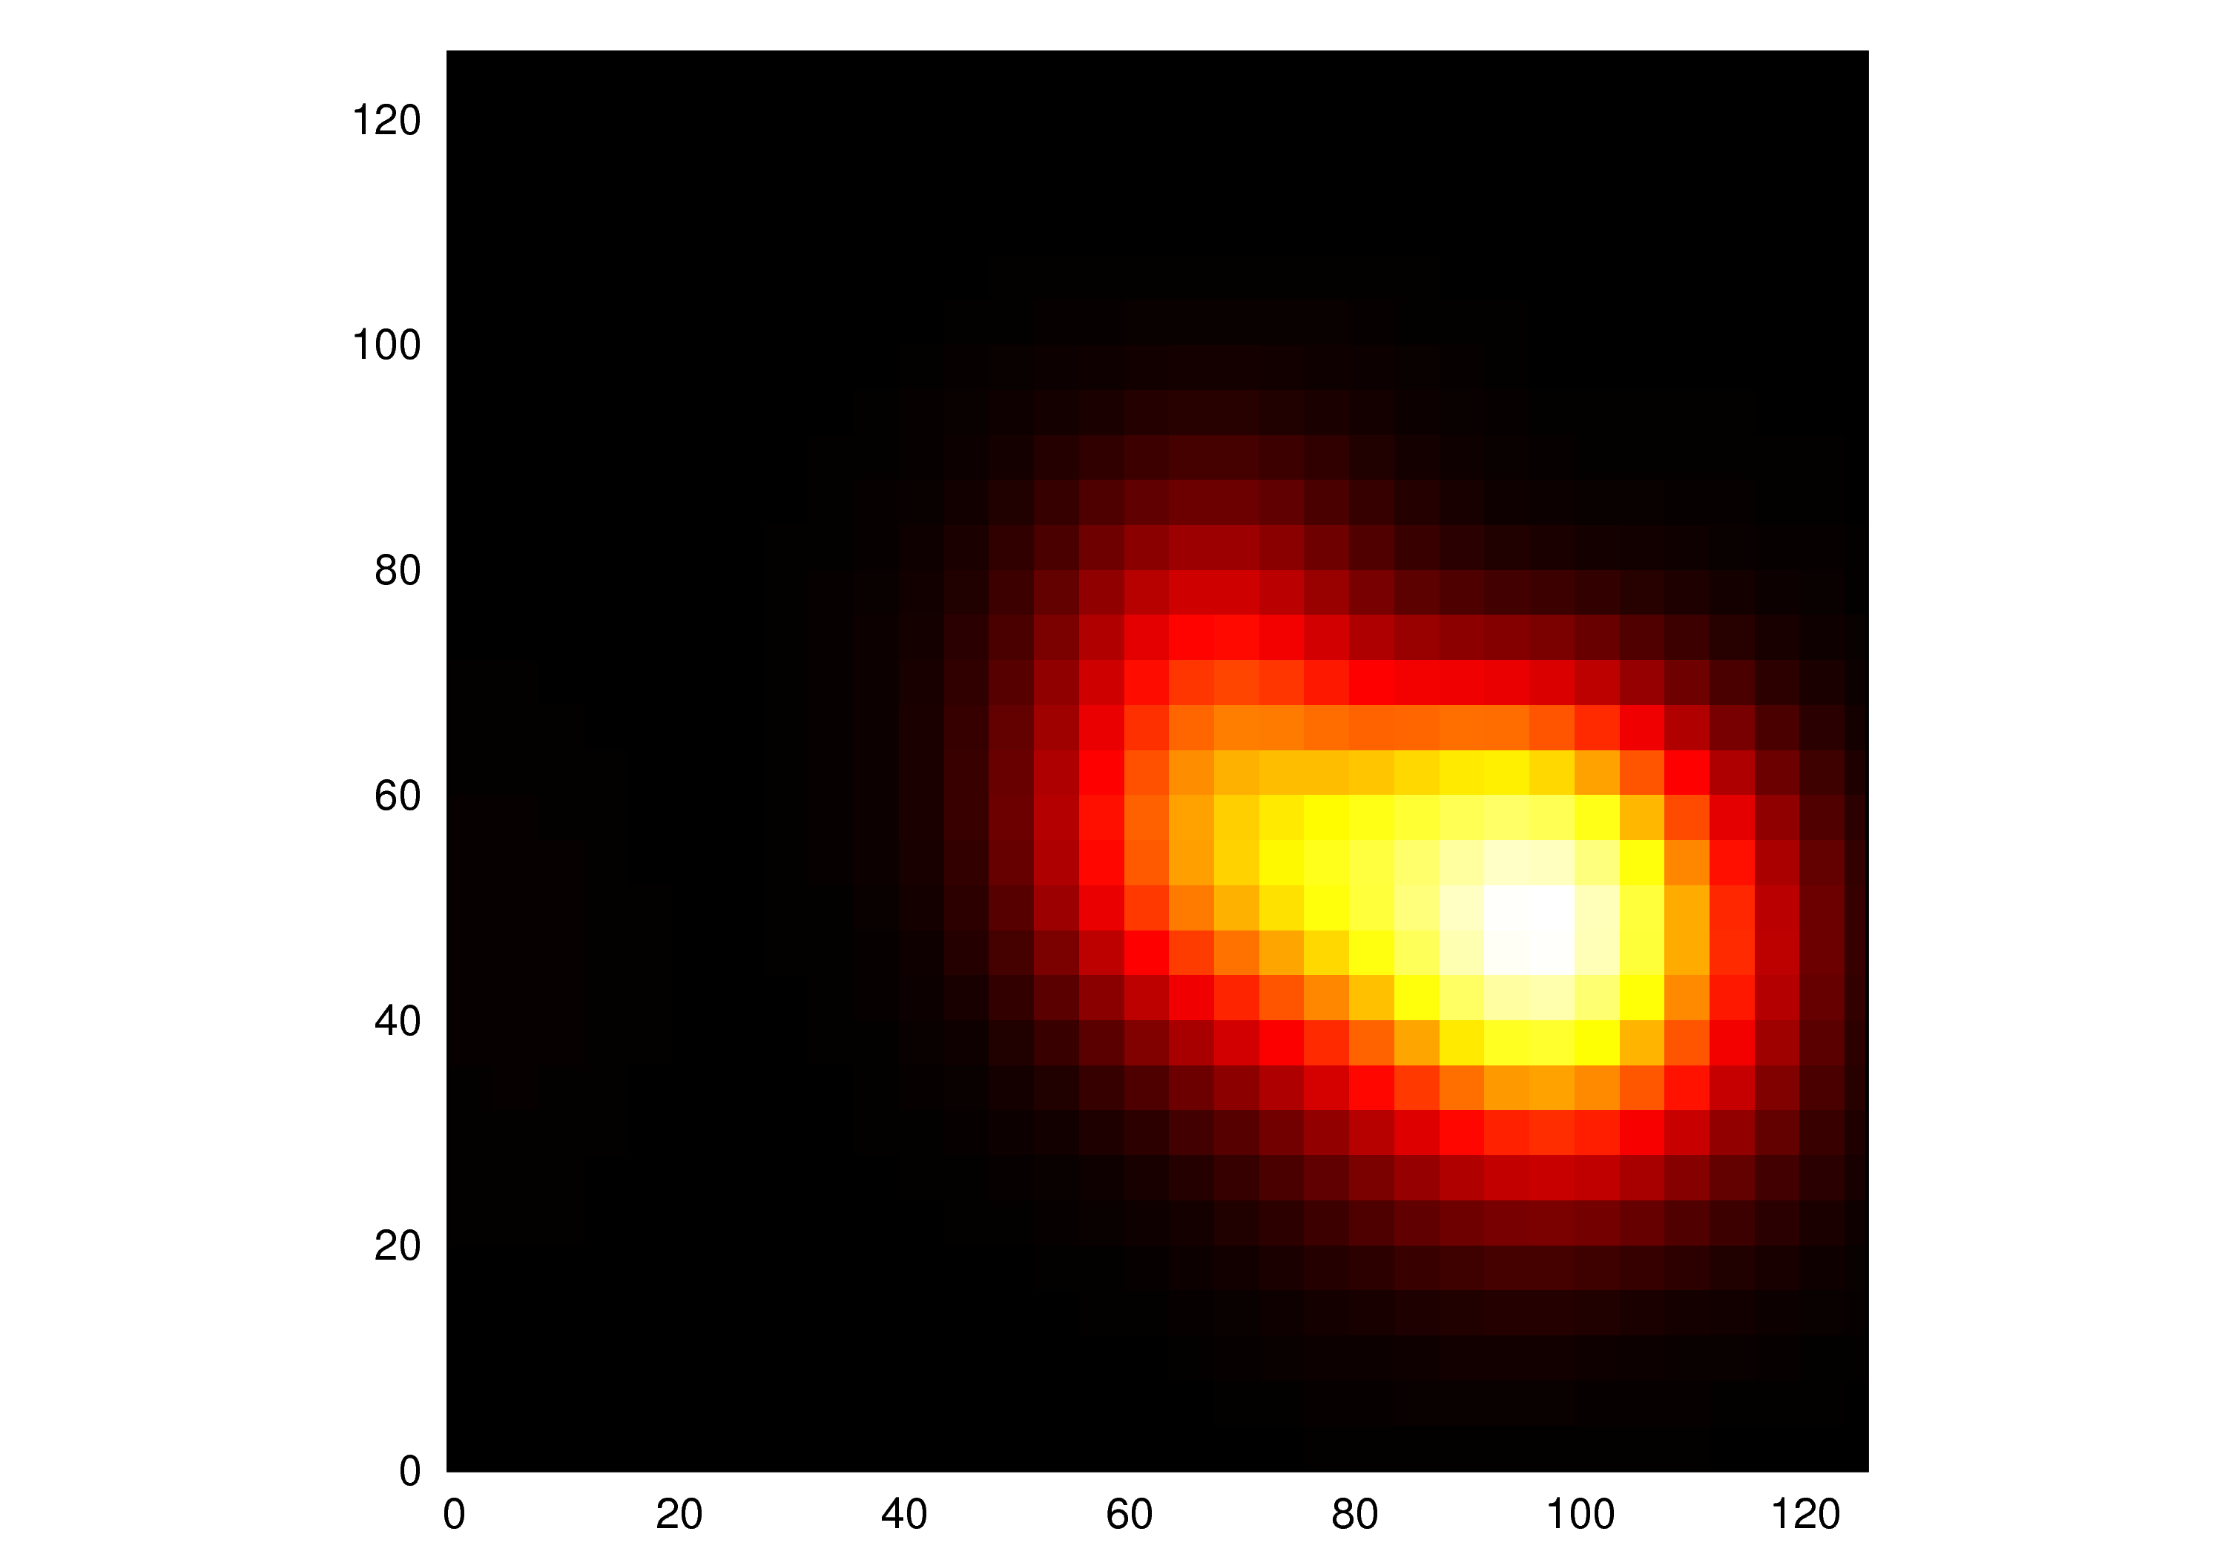
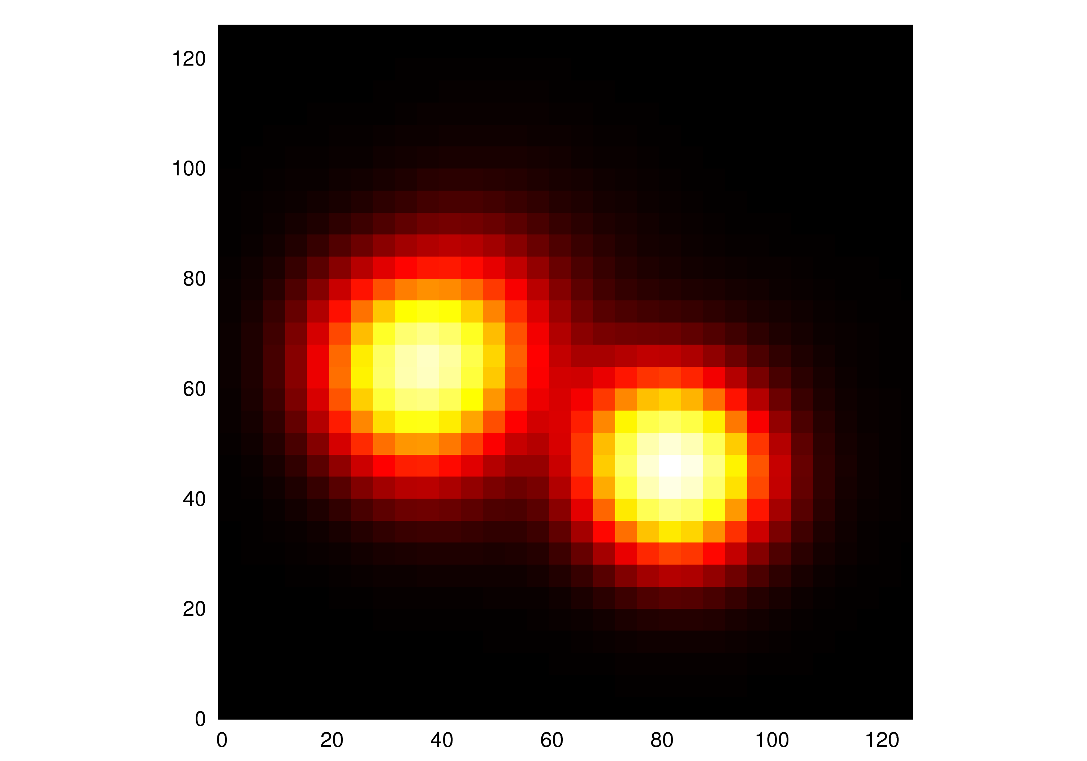
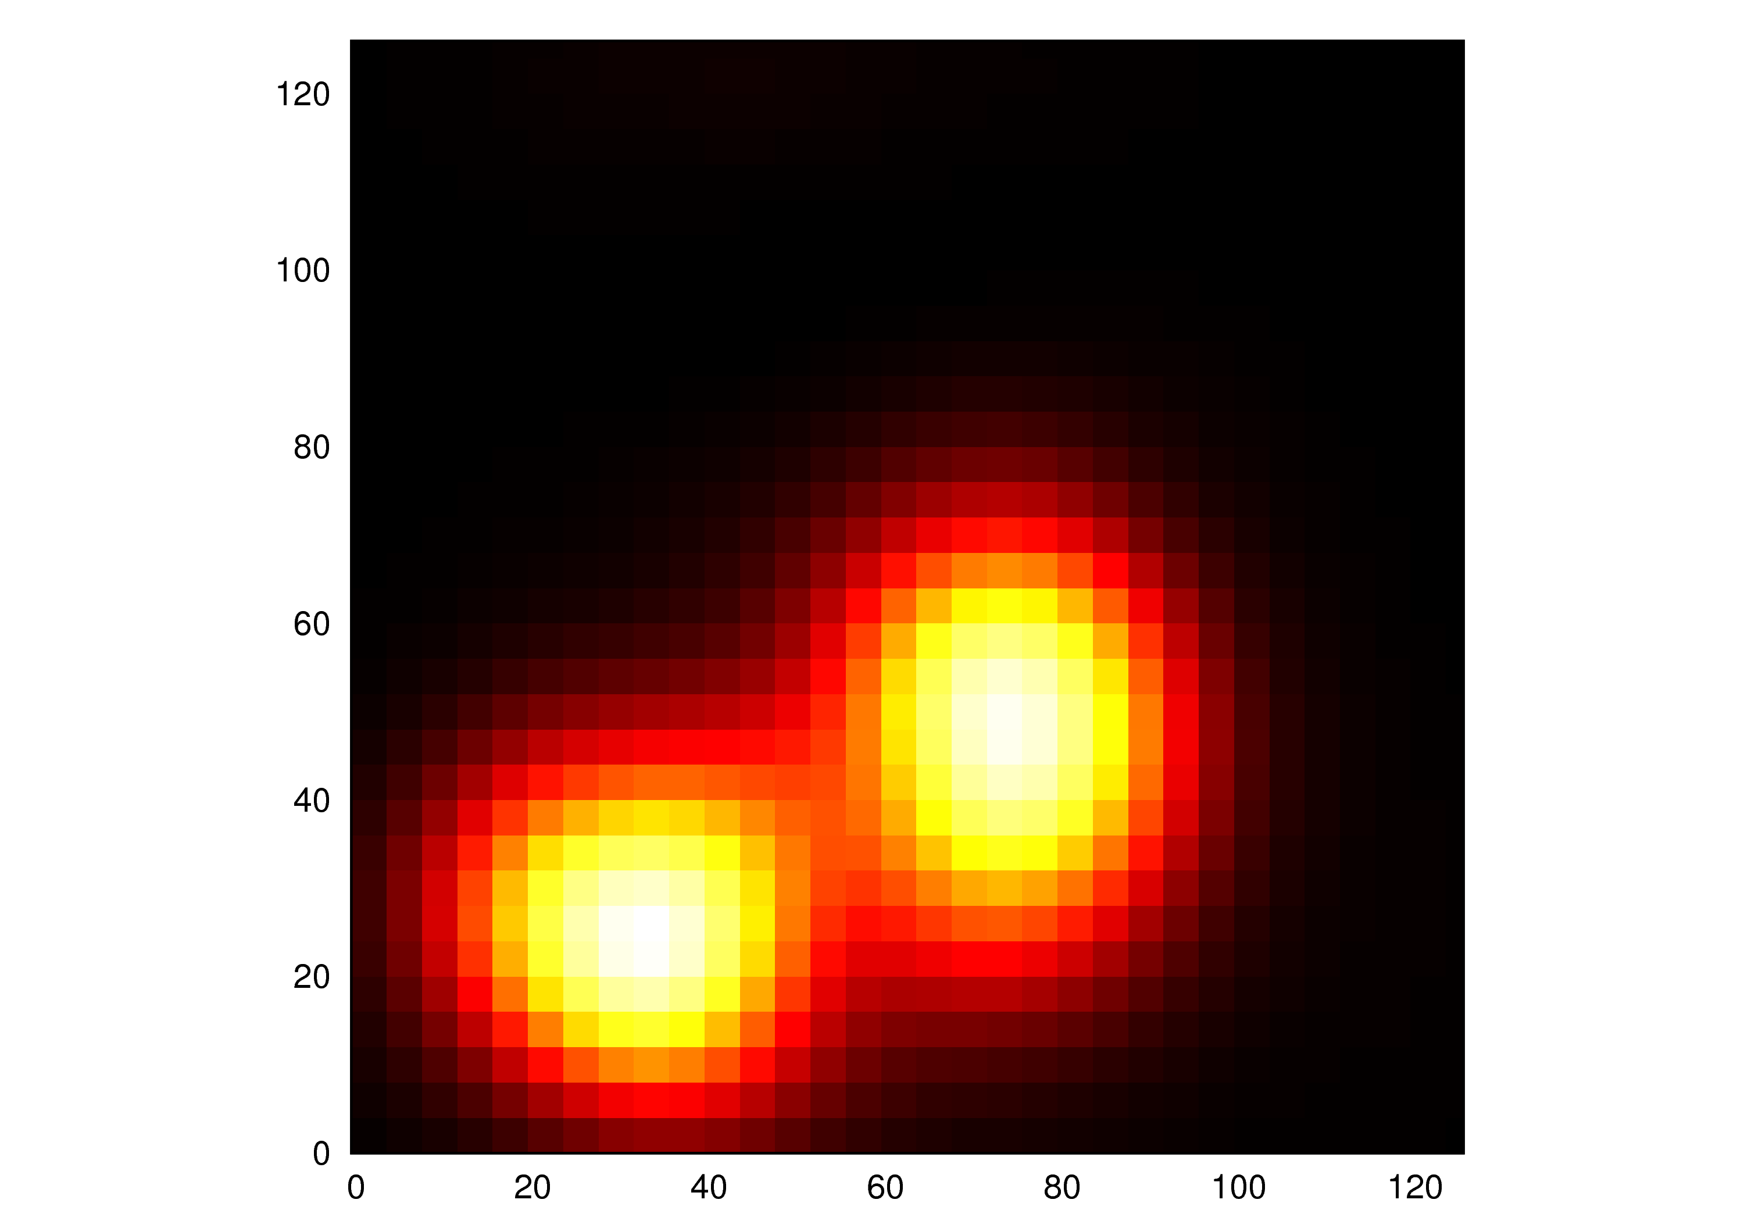
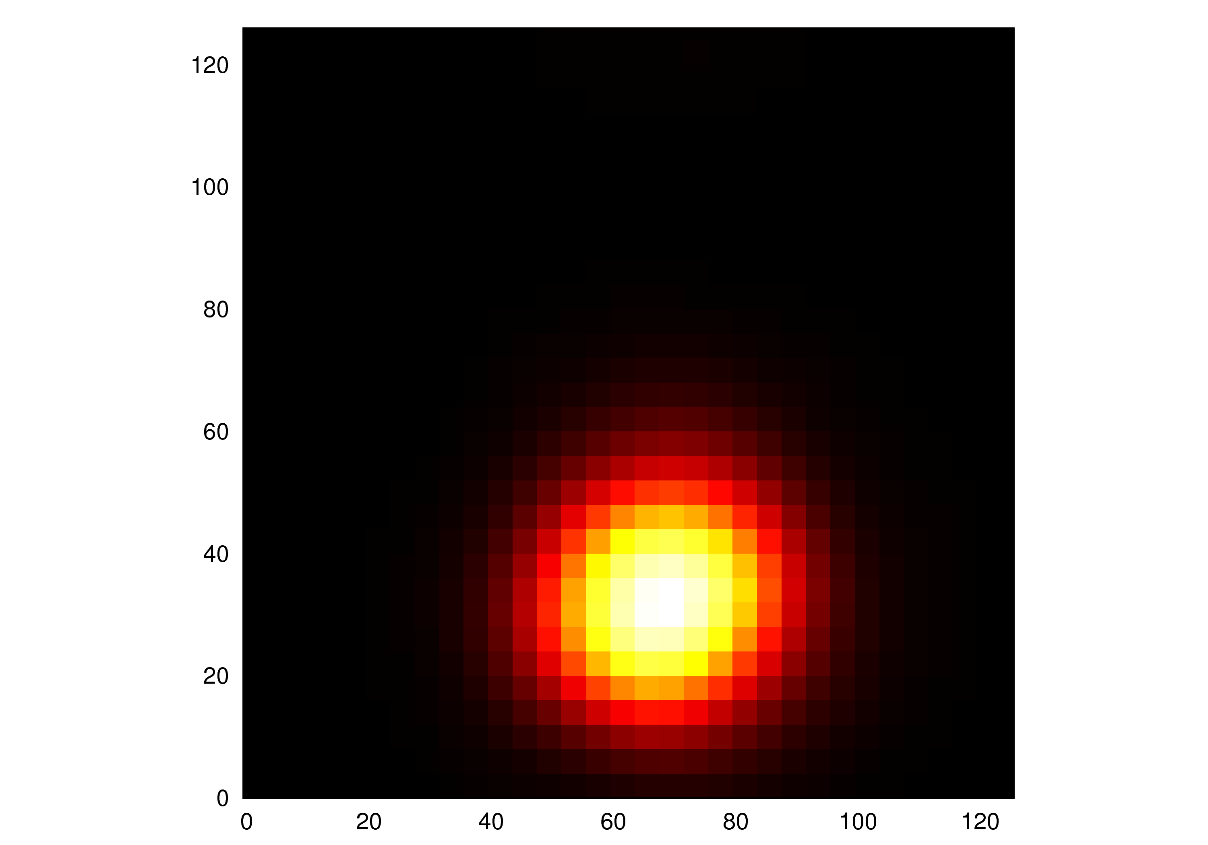
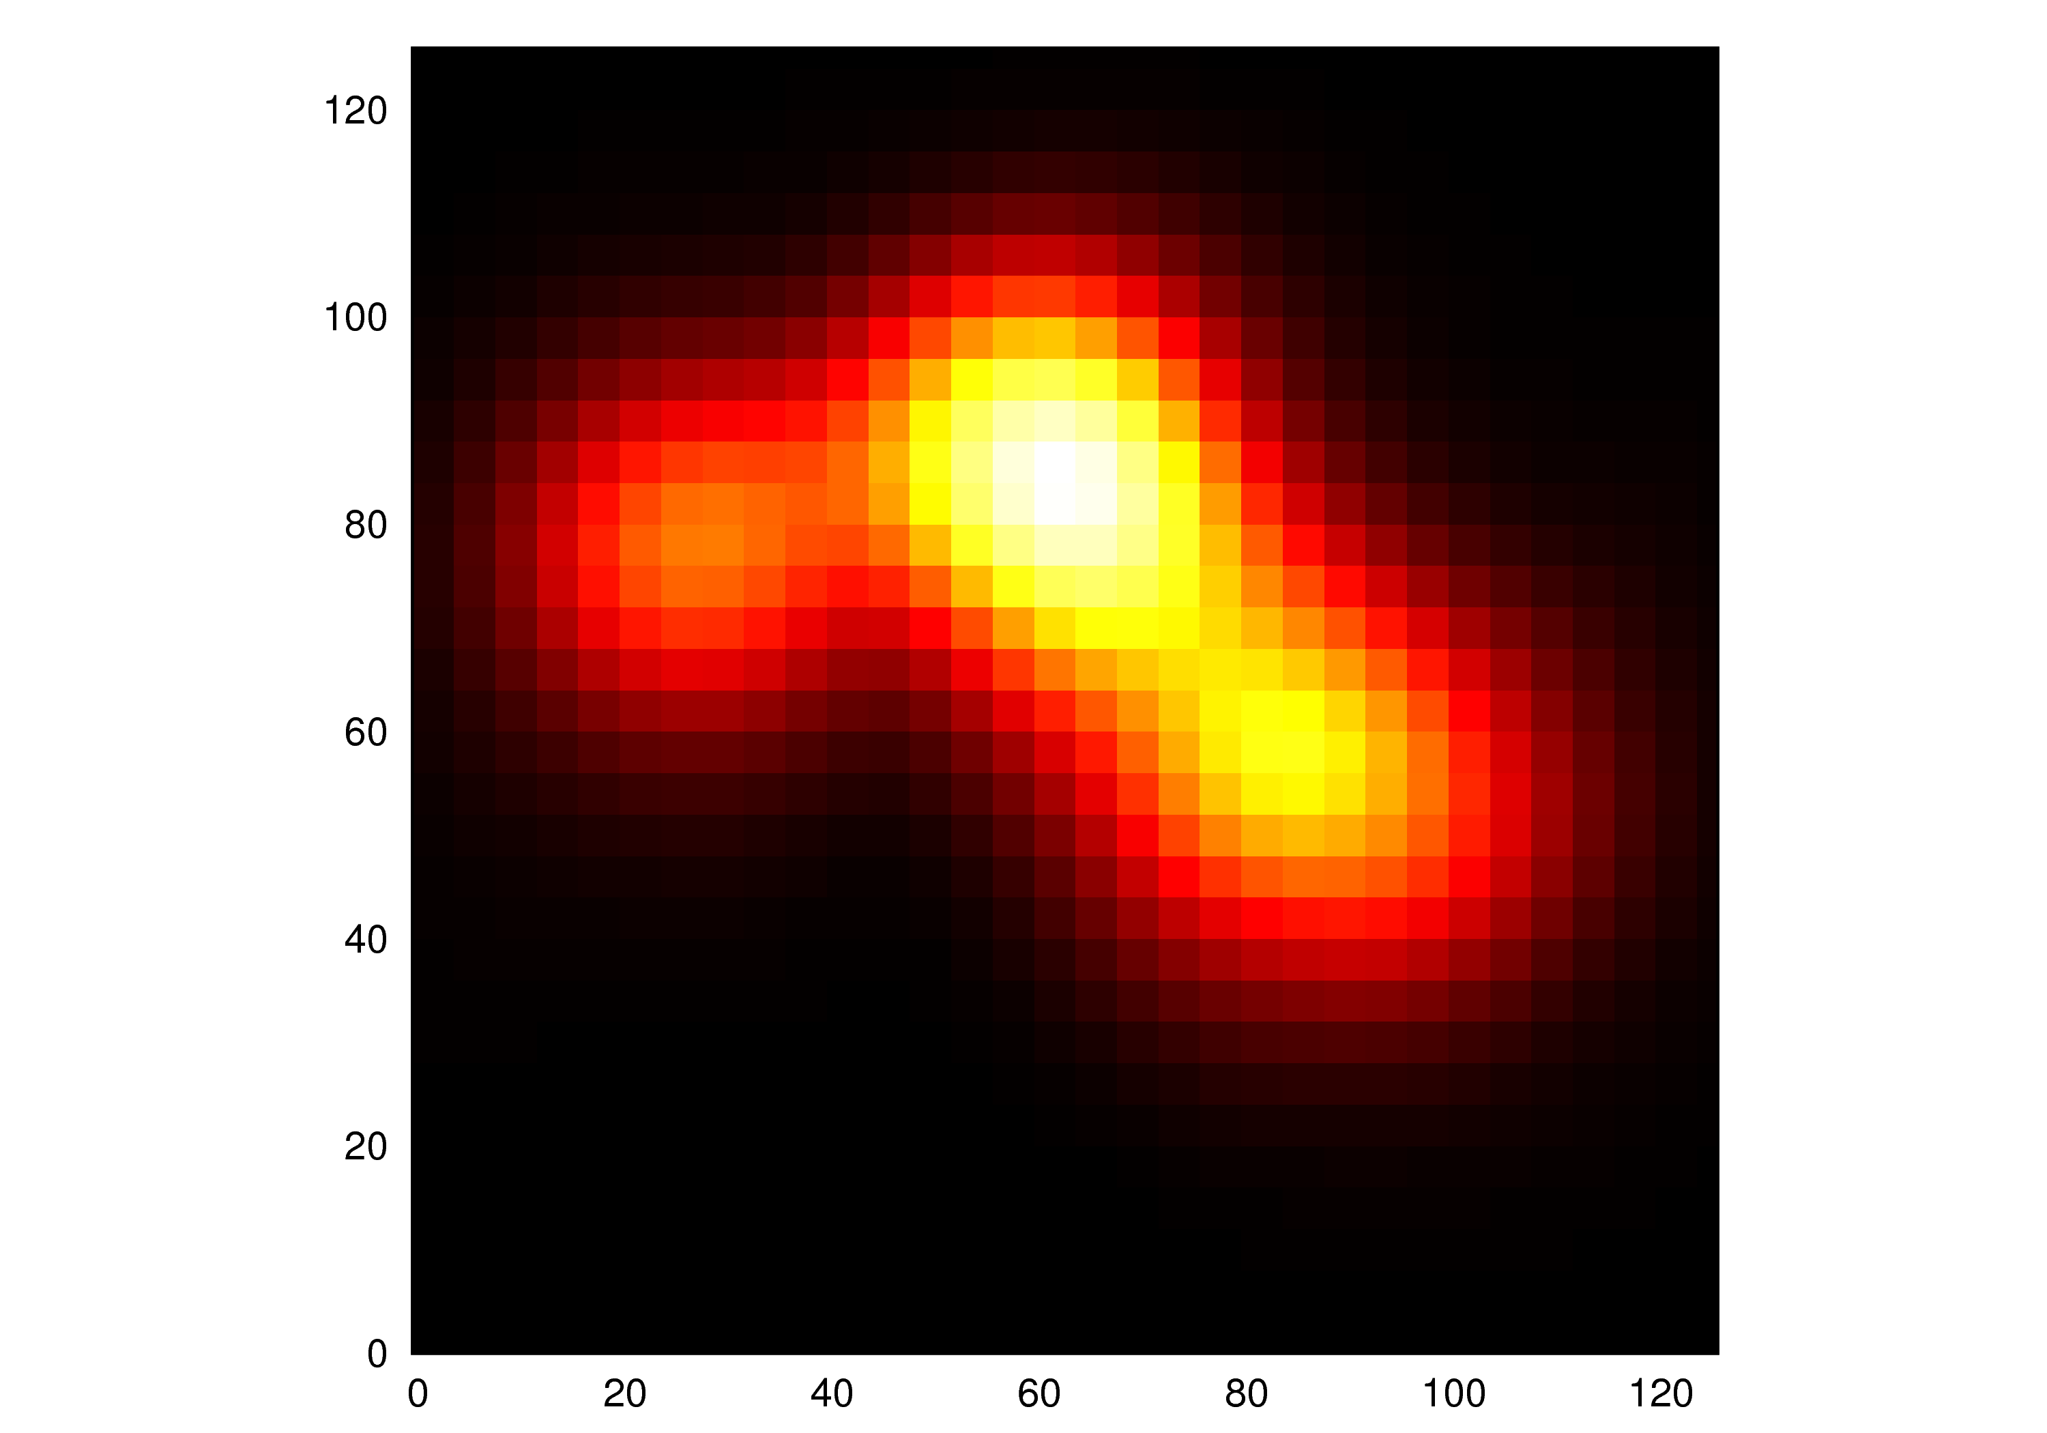
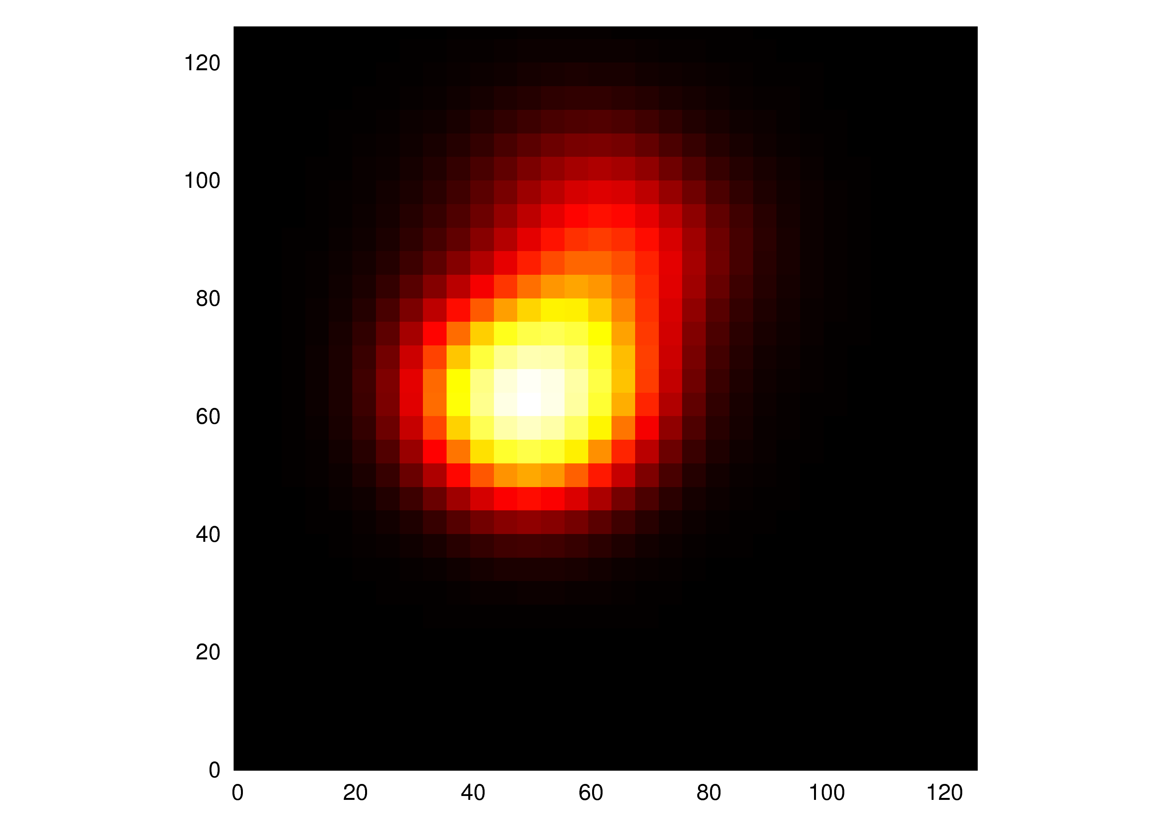
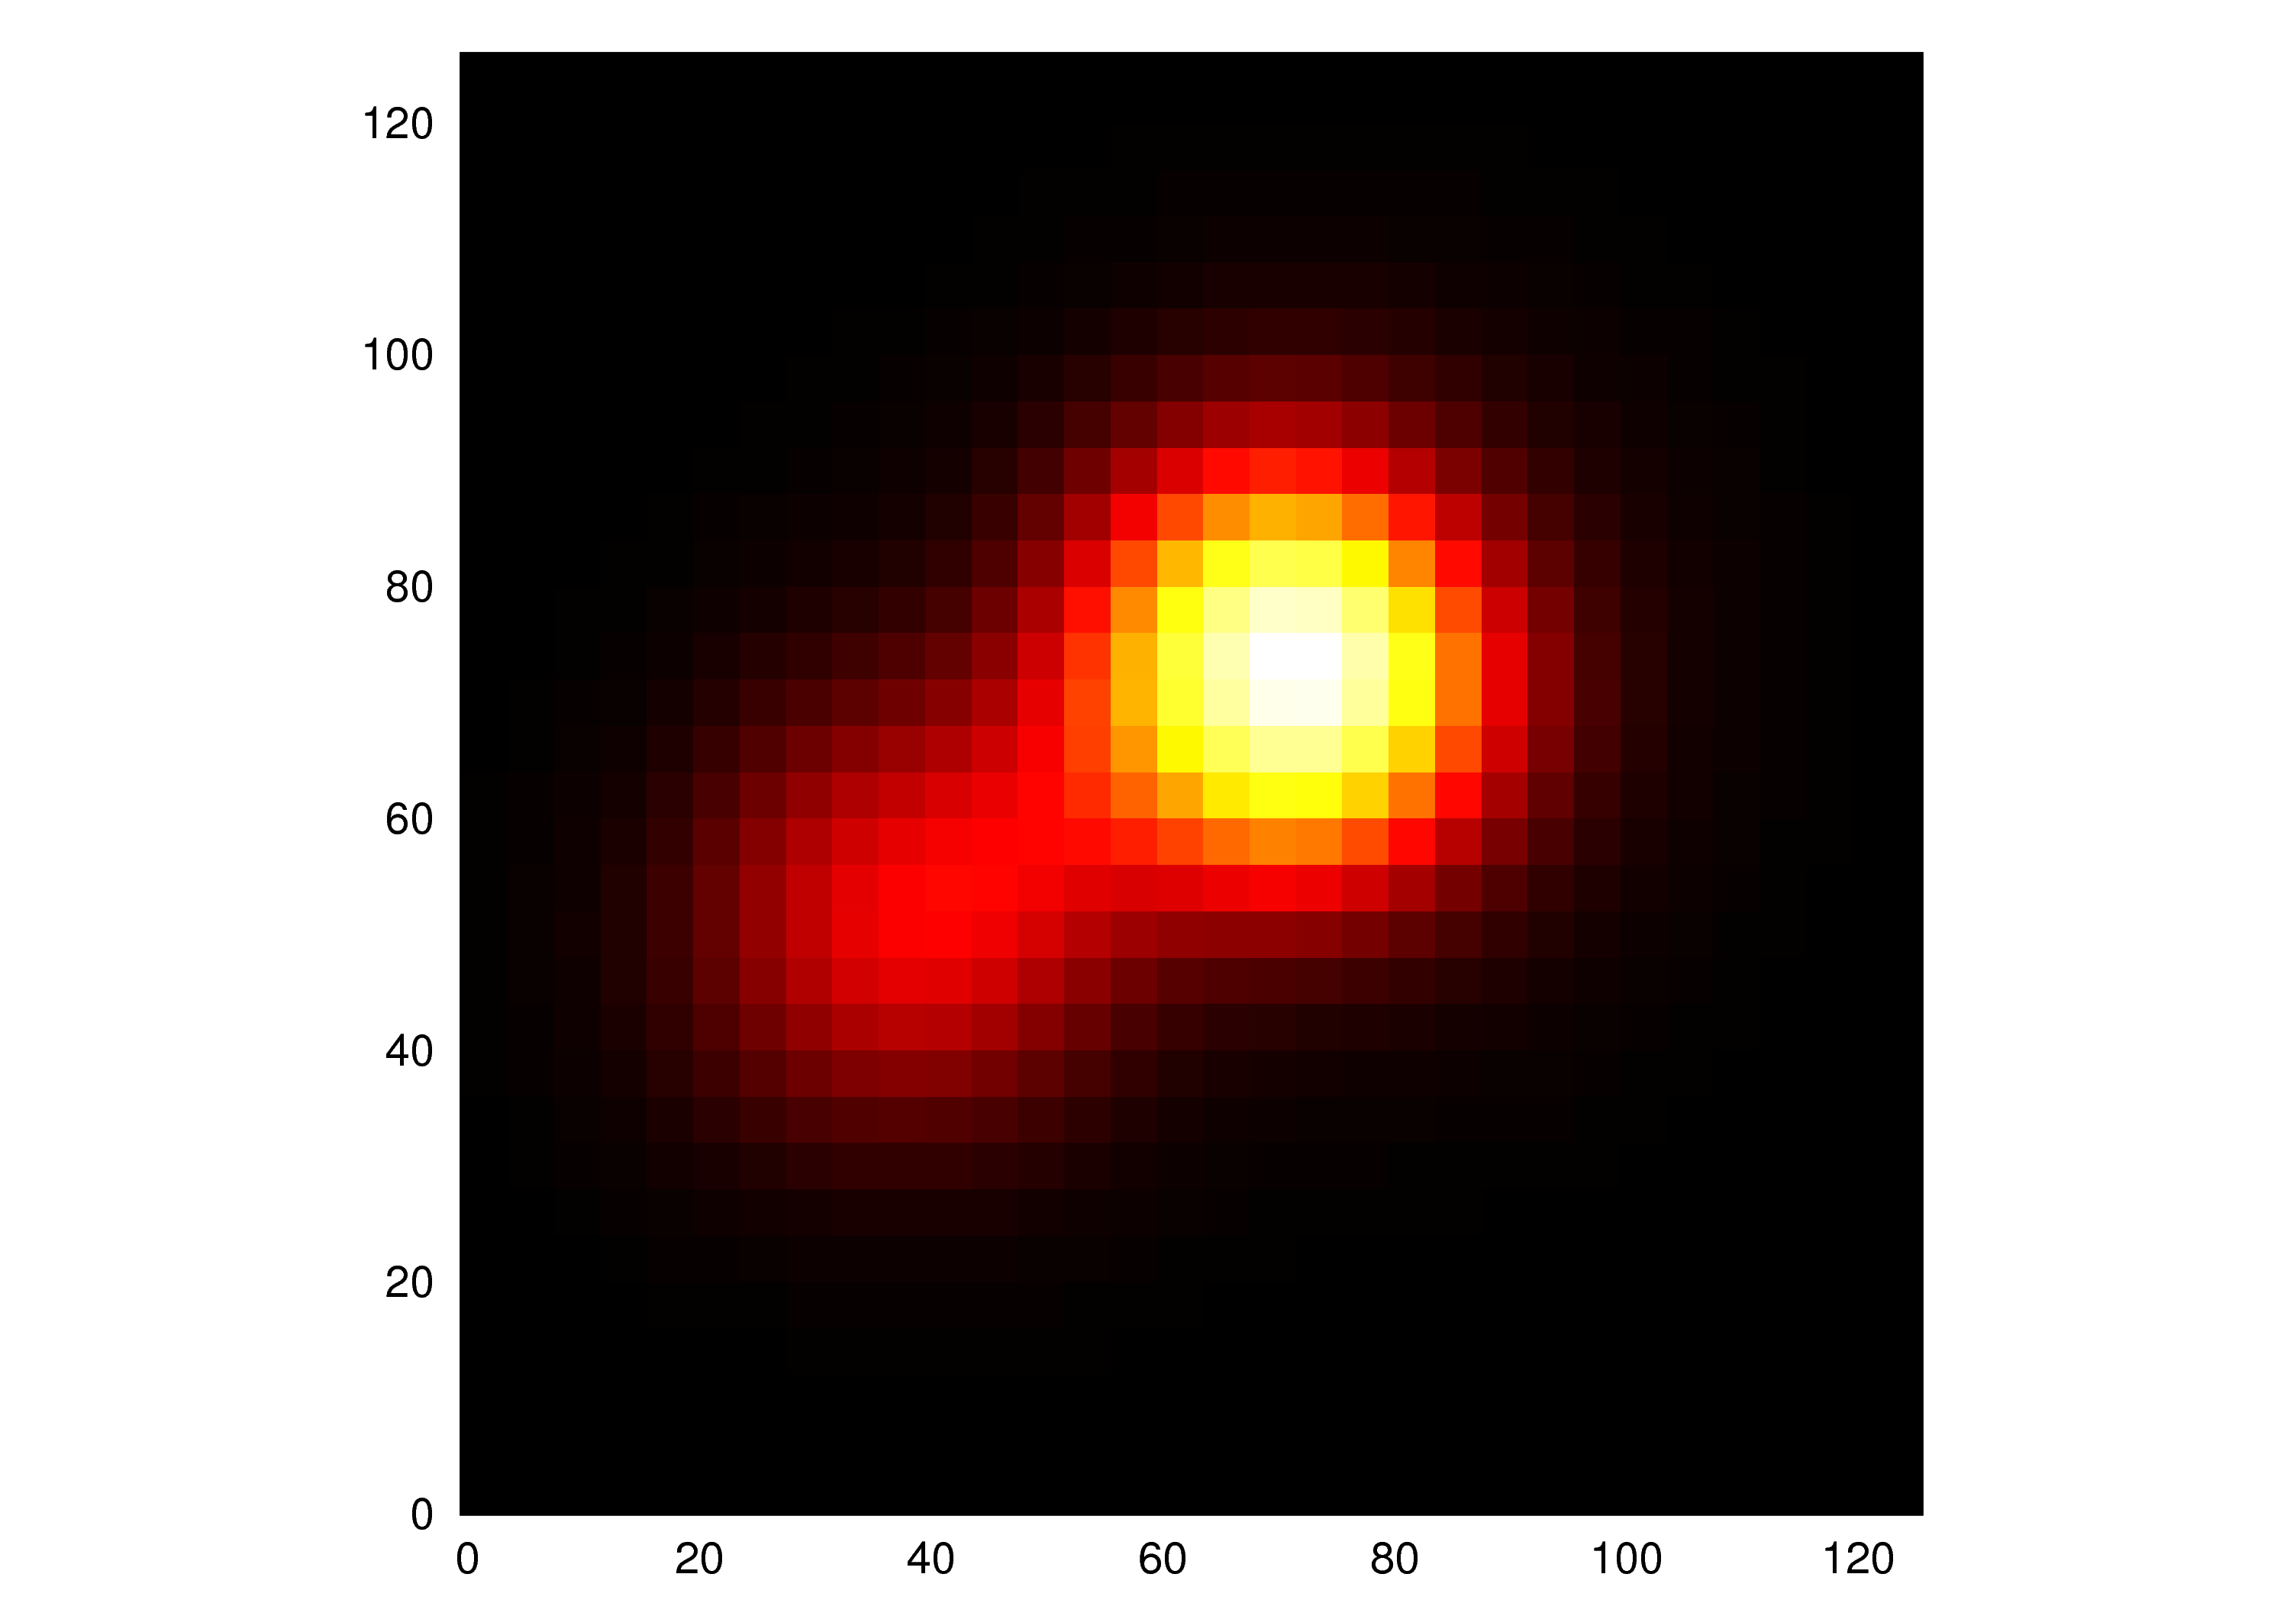
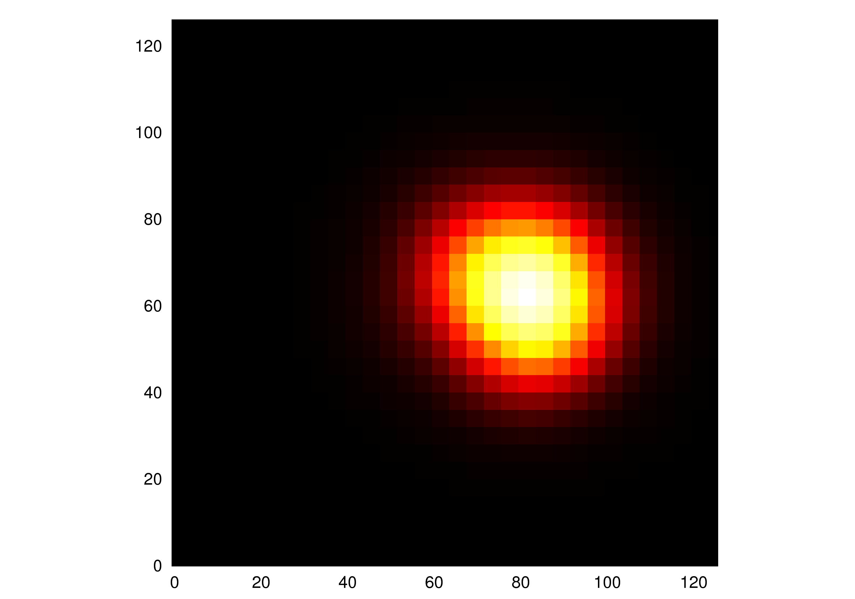

Event-by-Event: Coordinate Space Distributions
After classical Yang-Mills evolution
$$\frac{dN}{dy}(x,y)$$
3 fm
x
3 fm (lattice units)
Typically 50-100 events per multiplicity class sufficient here

Slide 9
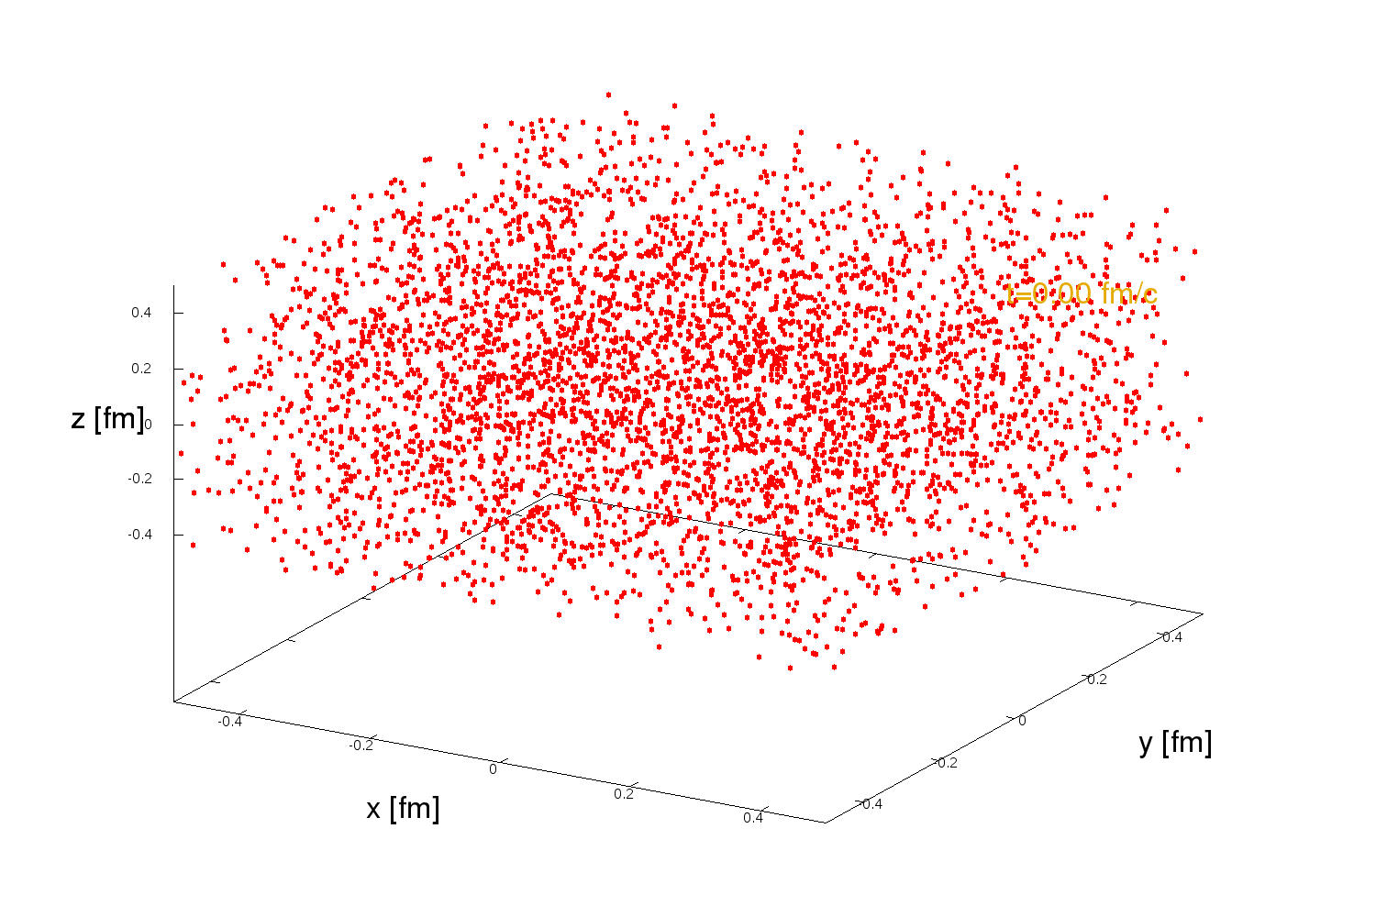

Parton cascade „BAMPS“
Solves the Boltzmann equation (numerically exact, Monte Carlo)
Single particle distribution function (a.u.)
$$"f(x,p)"$$
Quarks + Gluons
pQCD/QED cross sections
Elastic + radiative scattering
Ideal equation of state
Used as model for heavy-ion collision:
Expanding 3+1d geometry
cf. Talk of Carsten Greiner

Slide 10
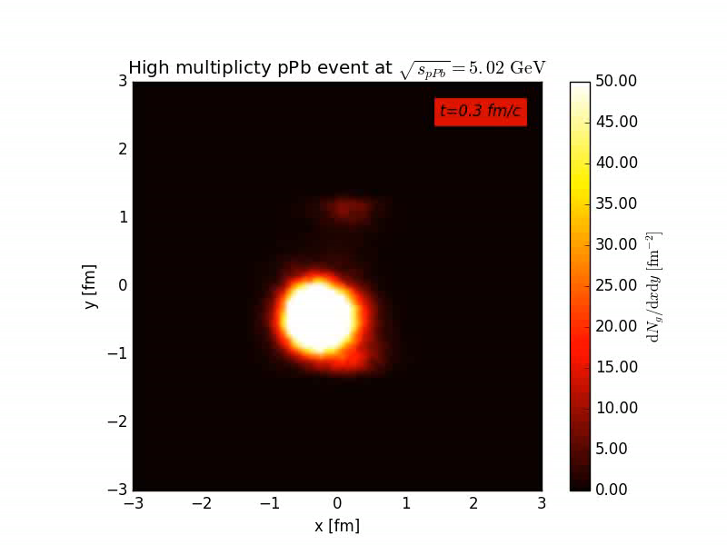
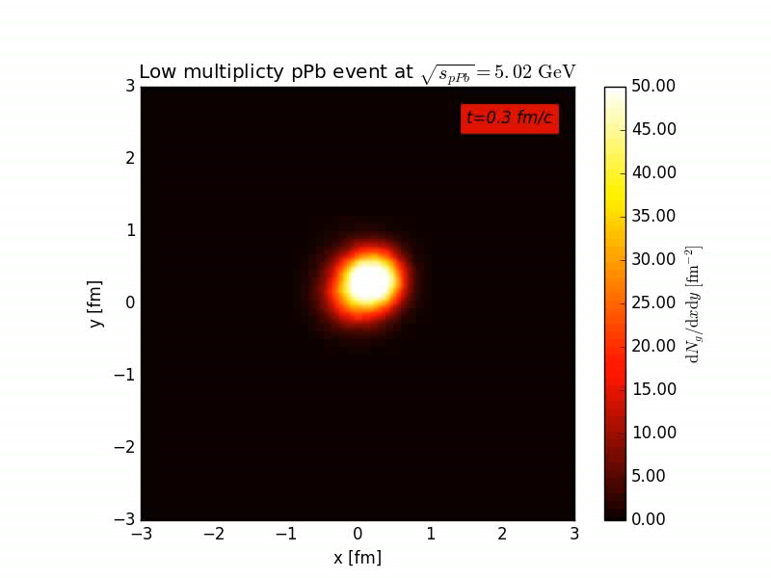
BAMPS evolution of proton-lead collision
High multiplicity:
Low multiplicity:
Pressure gradients build up flow?
Anisotropy due to initial fluctuation?
We are working more differential on 6 multiplicity classes
(Color code: particle number / transverse area)
rapidity integrated, only formed particles

Slide 11

Results
Flow observables for p+Pb

Slide 12
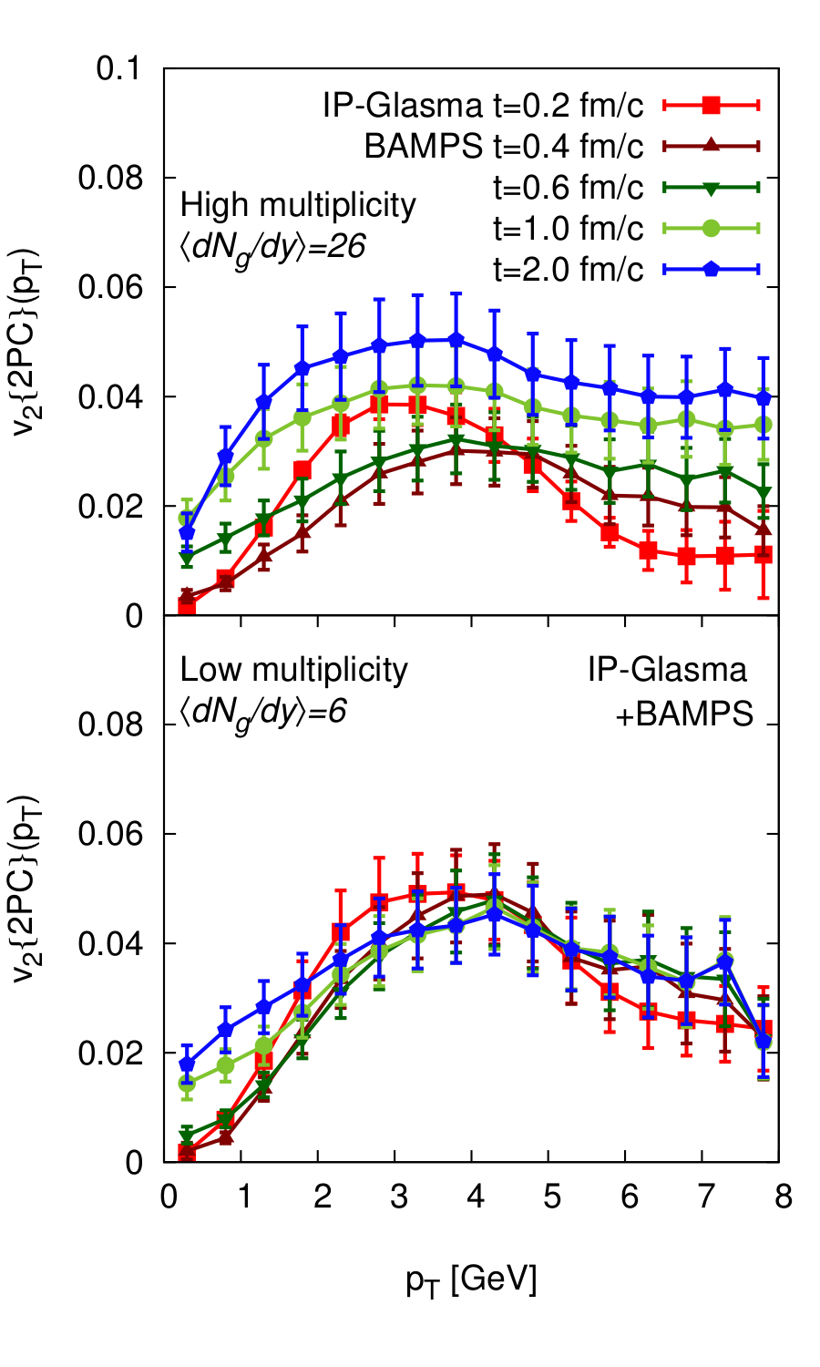
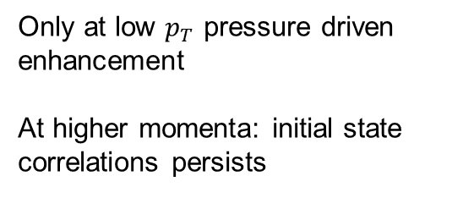
High multiplicity
Time evolution of momentum symmetry non trivial
Symmetry-axis rotates
Isotropization
Pressure driven expansion
Low multiplicity
Only at low $p_{T}$ pressure driven enhancement
At higher momenta: initial state correlations persists

Slide 13

Test: Randomize momenta
Which influence comes from geometry, which part comes from initial momentum correlations ?
This is what hydro does!
$$φ$$
Randomize initial transverse momentum direction
Keep $\left|p_{T}\right|, y, \vec{x}$ fix (from usual IP-Glasma)
Look at $v_{2}\left(2PC\right)$ and $v_{2}(eccentricity plane)$

Slide 14
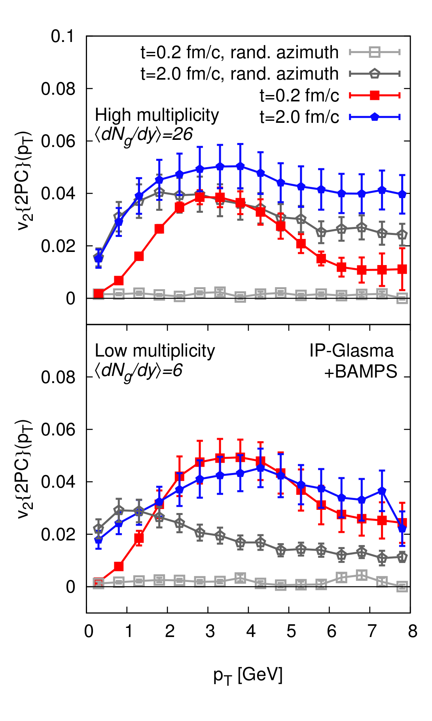
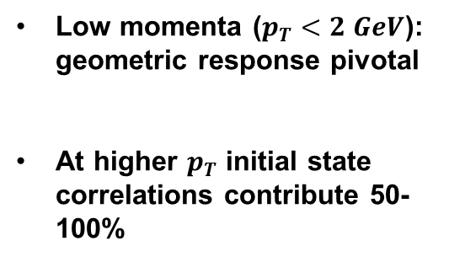
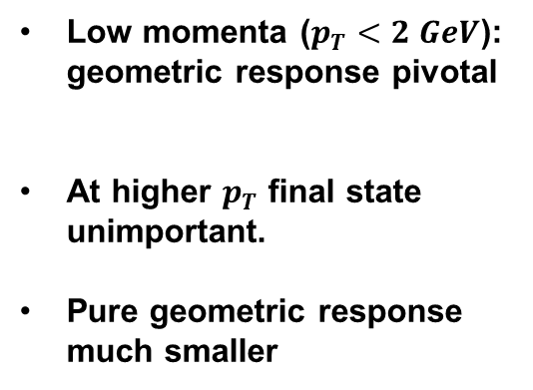
High multiplicity
Low momenta ($p_{T}<2 GeV$): geometric response pivotal
At higher $p_{T}$ initial state correlations contribute 50-100%
Low multiplicity
Low momenta ($p_{T}<2 GeV$): geometric response pivotal
At higher $p_{T}$ final state unimportant.
Pure geometric response much smaller

Slide 15
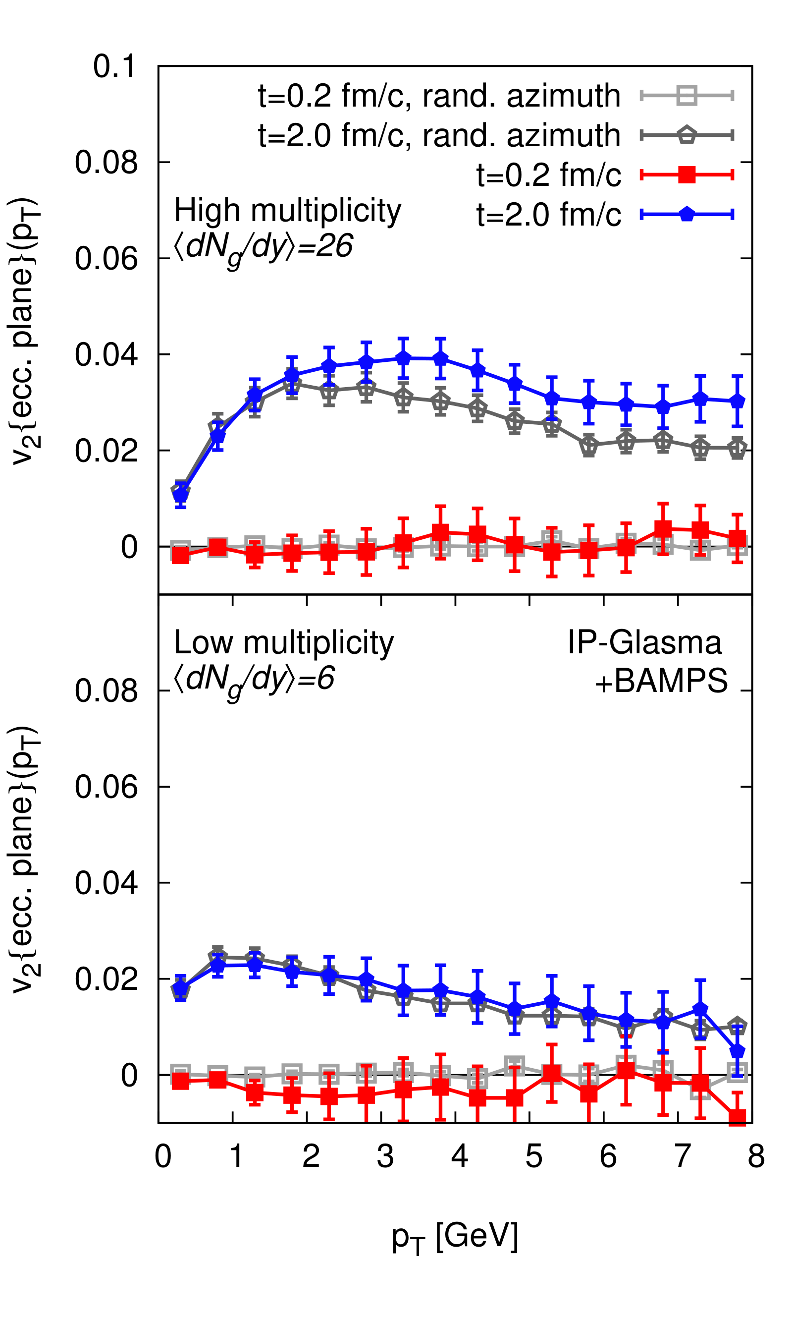
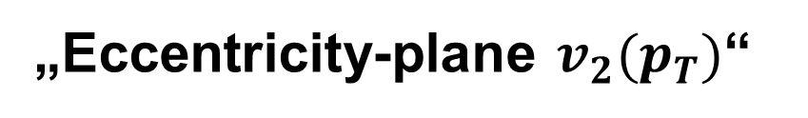
„Eccentricity-plane $v_{2}(p_{T})$“
Geometric axis of transverse density distribution
Momenta and geometry not correlated in the beginning (red curve)

Slide 16
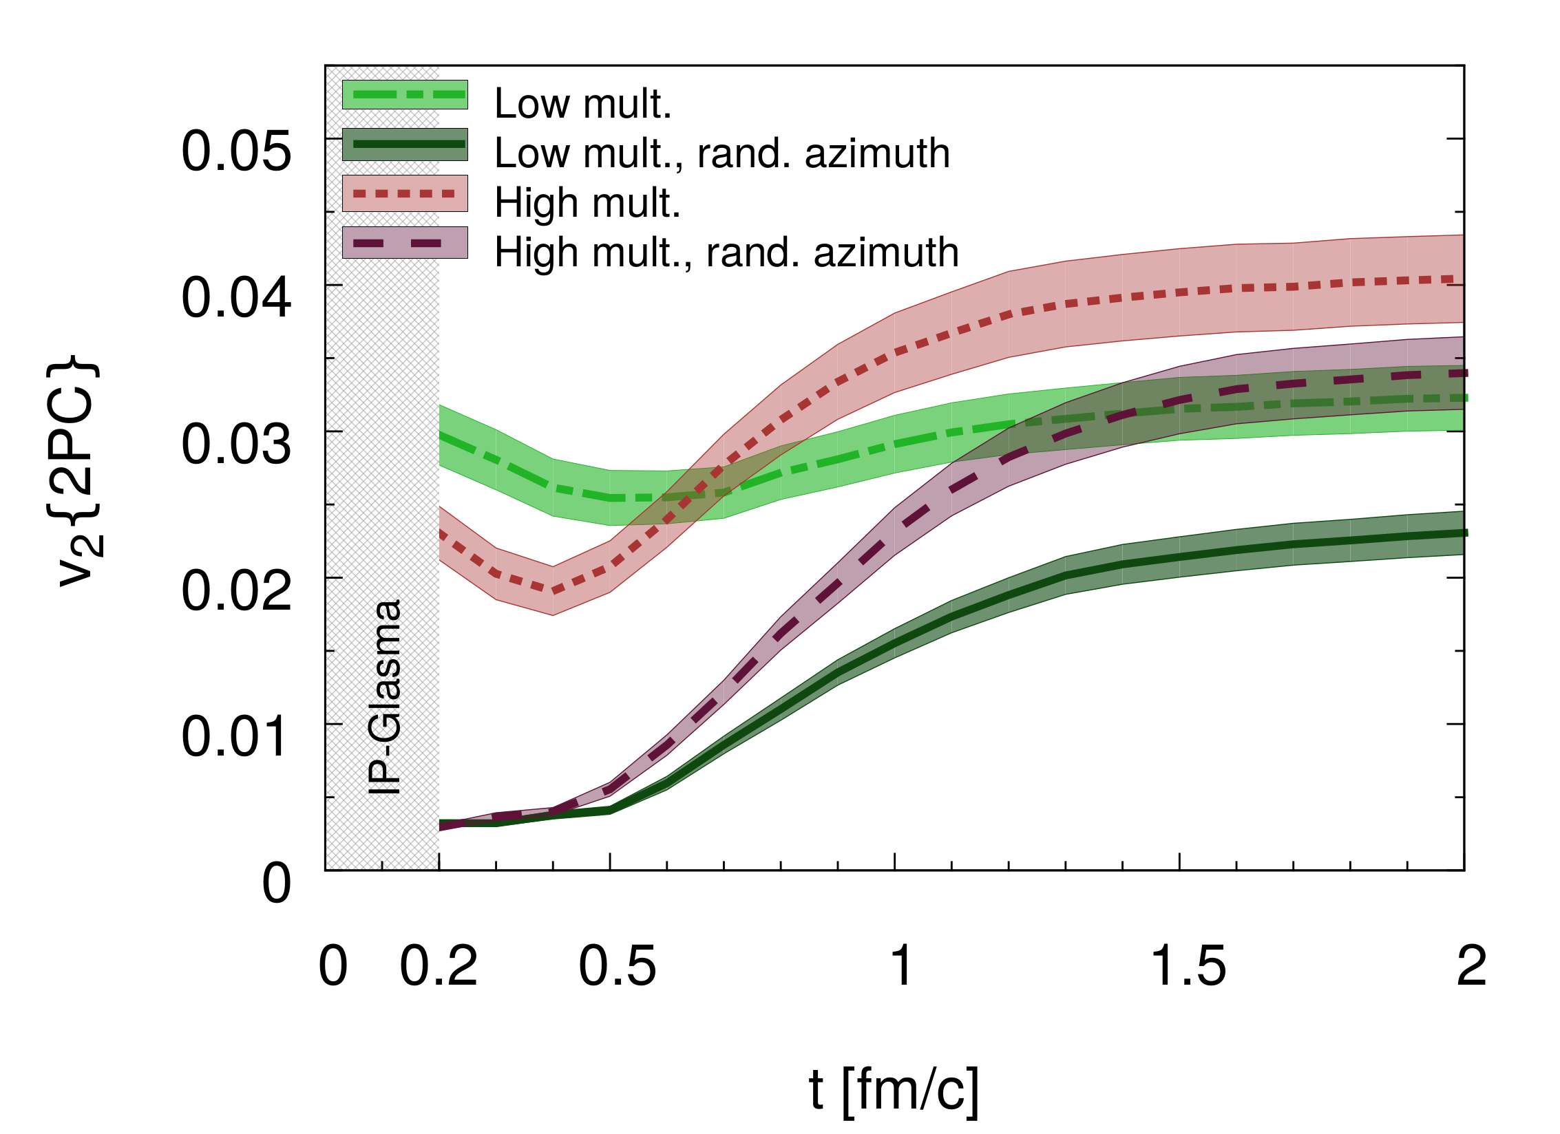
Momentum-integrated elliptic flow
Fragmentation (kkp)
Interesting dynamic behavior
Only little change

Slide 17
Conclusions & Outlook
What ?
First combined initial and final state calculation for p+Pb collisions
Initial state: IP-Glasma (Impact parameter saturation, CGC, Glasma)
Final state: BAMPS (pQCD parton cascade)
Results
Strong difference for high and low multiplicities
High Multiplicities: Large final state elliptic flow buildup
Low Multiplicities: Almost no final state elliptic flow buildup
Eccentricity plane: weak dependence on initial momenta
Future possibilities
Phys. Rev. D 96, 091504, 2017
(rapid communication)
  Systematic multiplicity scan
  Survival of flow: Hadrons and Photons ?
  3D-IP-Glasma initial state ?

Slide 18

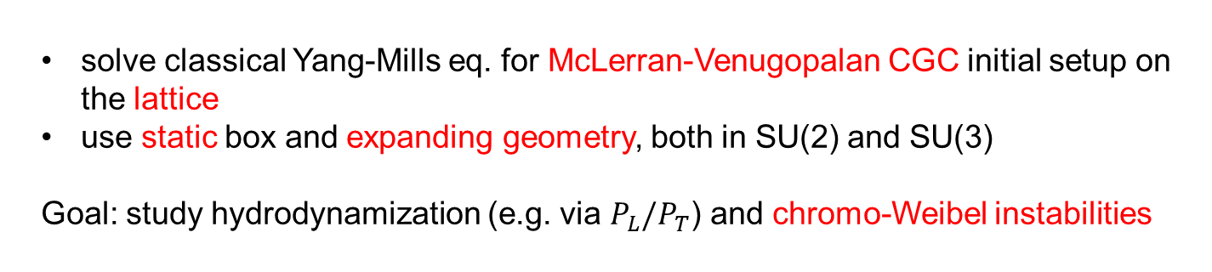
Similar work done in Frankfurt
Björn Wagenbach (group of Owe Philipsen):
solve classical Yang-Mills eq. for McLerran-Venugopalan CGC initial setup on the lattice
use static box and expanding geometry, both in SU(2) and SU(3)
Goal: study hydrodynamization (e.g. via $P_{L}/P_{T}$) and chromo-Weibel instabilities
Attems, Philipsen, Schäfer, Wagenbach, Zafeiropoulos, Acta Phys.Polon.Supp. 9 (2016) 603
Kai Gallmeister and Harri Niemi:
Comparison of dissipative Hydro and BAMPS for small (p+p, p+A) and large systems (A+A)
in a Bjorken picture (academic study)
good agreement, even for large Knudsen numbers:
densities, temperatures, fugacities, ...
minor deviations in components of shear stress tensor
no difference between large and small systems
dependence on freeze-out:
$ε_{P}$ & $v_{2}$

Slide 19
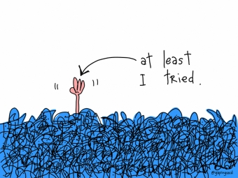
Physics Introduction
Correlations and Flow in small systems

Slide 20
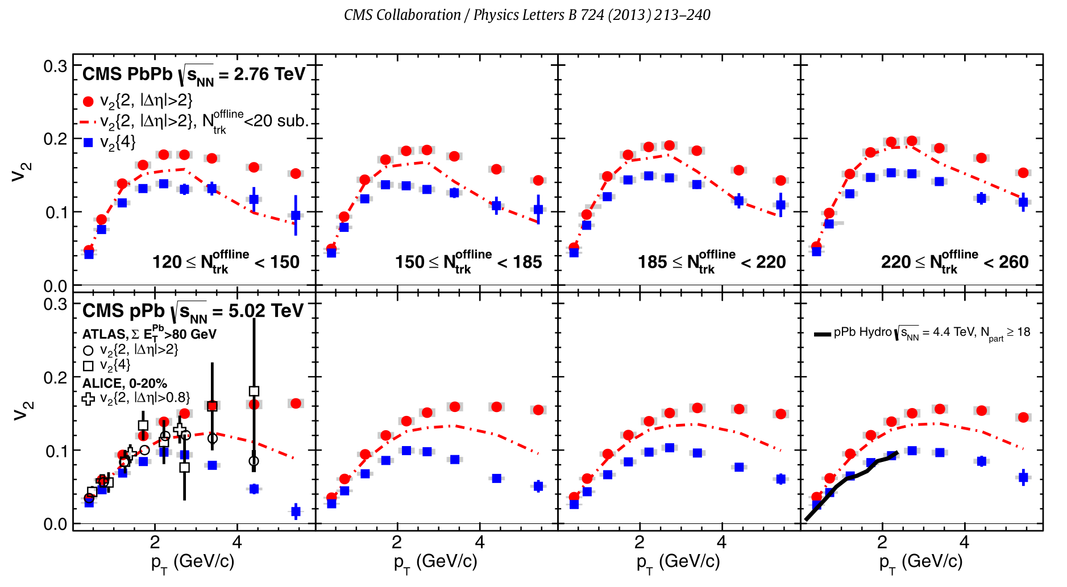
Evidence of collectivity in small systems
QGP droplets ?
Local equilibration?
Proton – Lead collisions

Slide 21
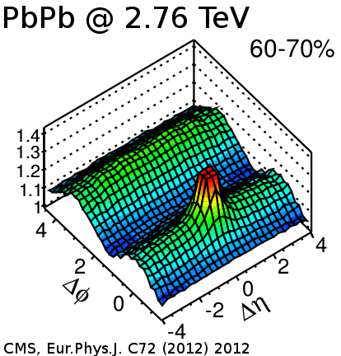
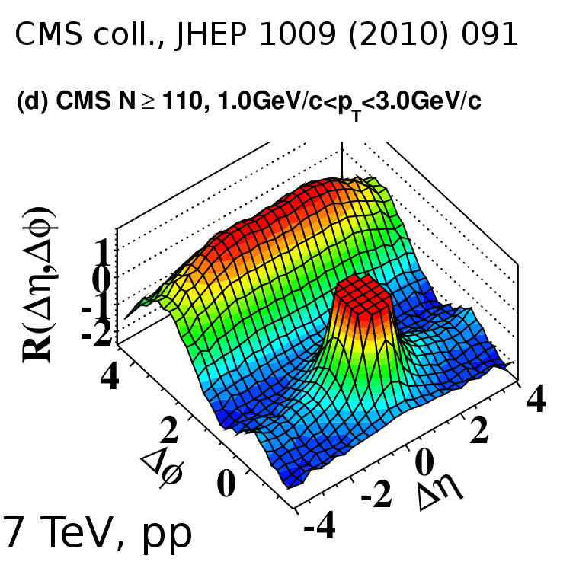

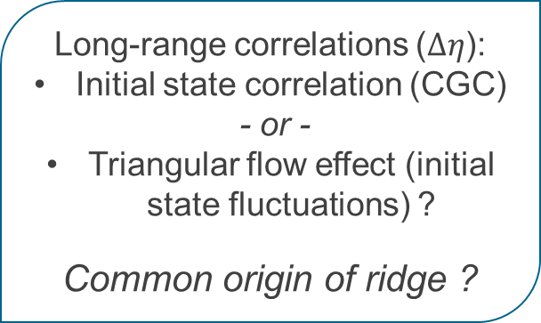
Correlations in small systems
Long-range correlations ($Δη$):
Initial state correlation (CGC)
- or -
Triangular flow effect (initial state fluctuations) ?
Common origin of ridge ?
Pictures cf. B. Schenke

Slide 22
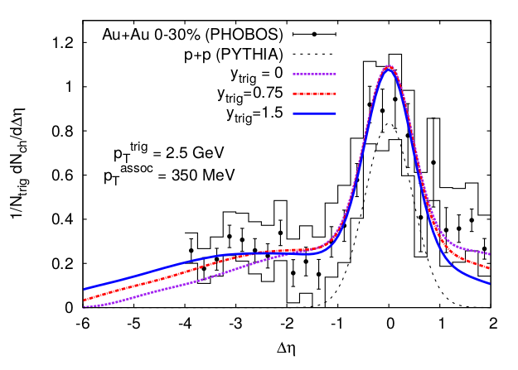
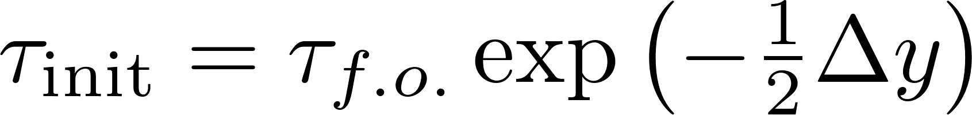
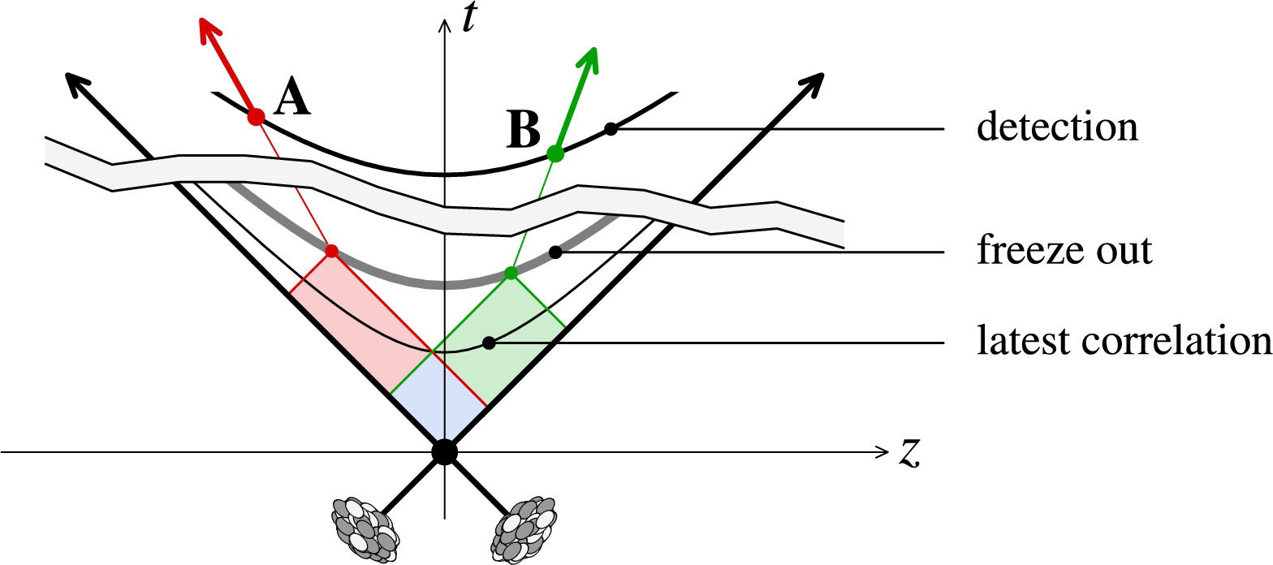
Correlations from CGC?
See also Dusling & Venugopalan, PRD 87, 094034 (2013): compare CGC to pp & pA dihadron data → quantum interference between rapidity separated gluons
Dumitru et al., PLB 697, 21, 2011

Slide 23
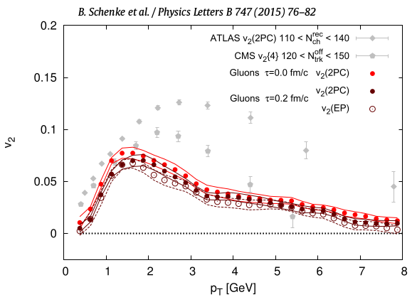
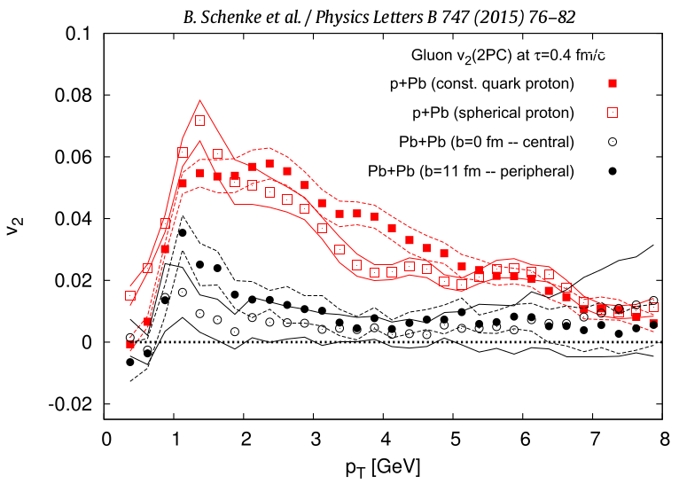


Correlations from CGC?
Schenke, Schlichting
& Venugopalan PLB 747, 76 (2015)
Initial anisotropy $v_{2}$ from IP-Glasma
Pre-equilibrium dynamics (Classical Yang Mills) generates odd harmonics
Pb+Pb needs collective flow (hydro-like). Too many uncorrelated color-field domains
p+Pb
b=0, Pb+Pb

Slide 24


Correlations in small systems from Hydro?
Hydro models challenged – but work well:
Here:
MC-Glauber initial state
(3+1)d viscous hydro + UrQMD
Shen et al., PRC95, 014906 (2017)
Hydro claims to explain ridge in pPb:
Bożek & Broniowski, PLB 718, 1557 (2013)
See also Luzum, PLB 696, 499 (2011): ridge data consistent with only collective flow
IP-Glasma + MUSIC explains $v_{n}$for p+Pb. In prep., Mäntisaari et al, 2017

Slide 25

BAMPS evolution for different multiplicities
Low multiplicity, g=2:
Low multiplicity, g=3:
Same initial Glasma state
Color code: particle number / transverse area
Rapidity integrated, only formed particles

Slide 26



High multiplicity 2-particle corr. $v_{3}$
$v_{3}:$ Measure for momentum „triangularity“

Slide 27


Low multiplicity 2-particle corr. $v_{3}$

Slide 28



Generate boost invariant initial state from discrete IP-Glasma $dN/(dyd^{2}\vec{x}d^{2}\vec{p})$
Sample $\frac{dN}{dy}∙N_{test}$ for 4 rap.units
momenta: ($64x64: p_{x} p_{y}$) for ($32x32:x y$) lattice
Check carefully (with original distribution):
  Energy density
  $v_{2}$
  $v_{3}$
observation window: midrapidity up to t~2fm/c
-2
y
2
Fill cells with $dN/d^{2}p_{T}(\vec{x})$ from CYM, $p_{z}=p_{T}\sinh{y}$
4 x
Input:
50 High Multiplicity p+Pb events @ 5 TeV
50 Low Multiplicity p+Pb events @ 5 TeV

