Slide 1
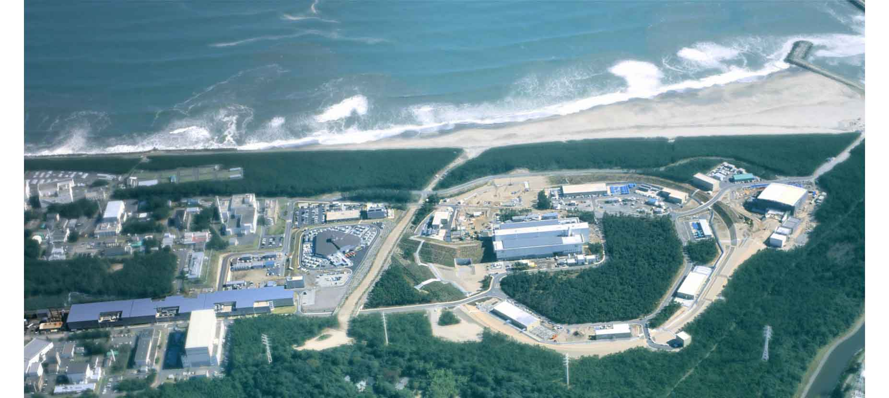
2018.1.24
Winter meeting in Bormio
Nuclear Physics
with Strangeness
Tohoku University
H. Tamura
J-PARC

Slide 2
Contents
Introduction
Charge symmetry breaking in Λ hypernuclei
- γ-ray spectroscopy of Λ hypernuclei
- Decay pion spectroscopy
- (e,e’K⁺) spectroscopy
3. Σ−p scattering
4. S = -2 systems
- Ξ and ΛΛ hypernuclei
- Ξ atomic X-rays
5. Future Plan – Challenge to the hyperon puzzle
6. Summary
J-PARC

Slide 3
Introduction

Slide 4

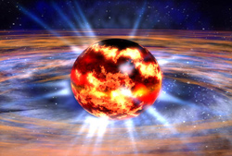
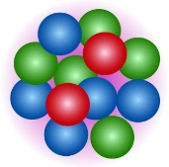
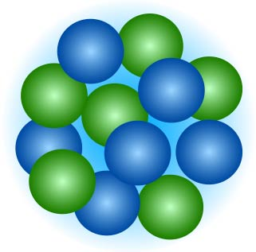
Basic questions in low energy QCD
QCD
Key questions to bridge
hadrons and nuclei to QCD
Quarks/gluons
How the hadron-hadron interactions (incl. nuclear force) should be understood?
How hadrons behave in nuclear matter?
Does hadron structure change in nuclear matter?
How are hadrons formed
from quarks and gluons?
Hadrons
How are nuclei formed from hadrons?
=> can be answered with
strangeness as a probe
How do nuclear matter properties change at higher density?
Nuclei
Neutron stars

Slide 5
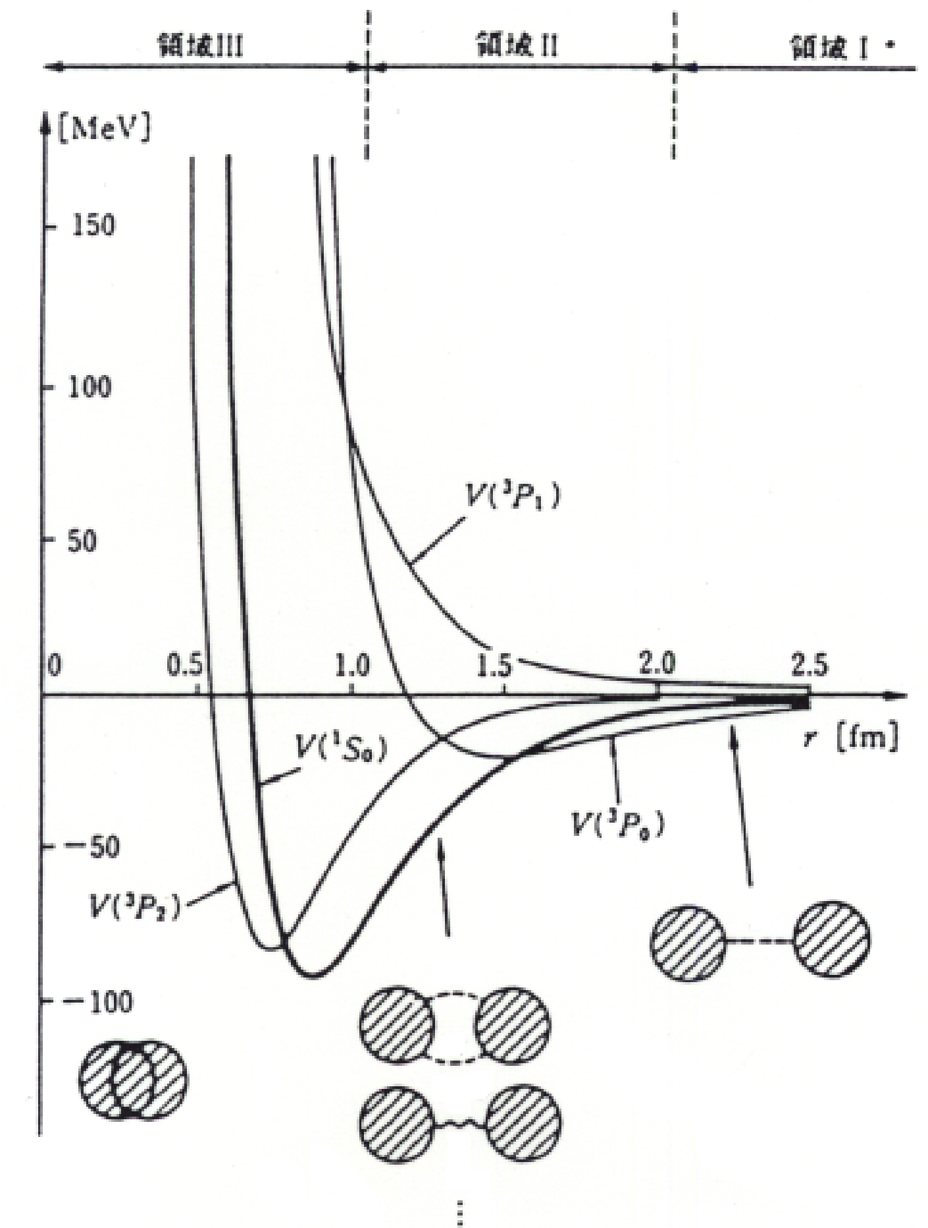

Questions in nuclear force
Origin of the repulsive core ?
The short-range strong repulsion well cancelled by the long-range strong attraction. Why?
How should we understand Baryon-Baryon forces in a unified way?
How is the high density matter in neutron stars? How are the three baryon forces necessary to understand it?
=> Give answers by extending
NN -> BB forces incl. hyperons
from textbook by Tamagaki
2π
π
h/m_{π}c = 1.4 fm
ω, ρ, σ...
Quark-gluon picture?
meson exchange picture
π
Lattice QCD

Slide 6
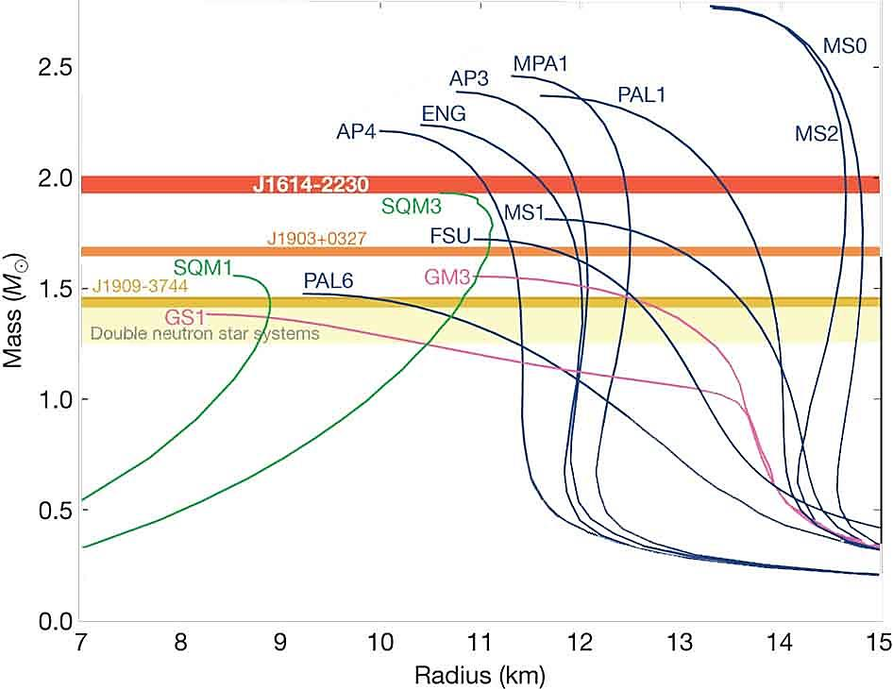
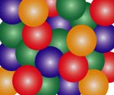
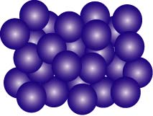
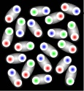
“Hyperon puzzle” in neutron stars
Hyperons (Λ at least) must appear at ρ ~ 2 ρ₀
EOS’s with hyperons or kaons too soft -> cannot support M > 1.5 M_{sun}
Heavy NS’s (~2.0 M_{sun}) were observed.
=> Unknown repulsion at high ρ
Strong repulsion in three-body force including hyperons,
NNN, YNN, YYN, YYY ?
Phase transition to quark matter ?
(quark star or hybrid star)
PSR J1614-2230 (2010) 1.97±0.04 M_{sun}
PSR J0348-0432 (2013) 2.01±0.04 M_{sun}
Ignore hyperons
M
Λ
??
n
n
p
Ξ
+Hyperons
NS mass
We need to know YN, YY, K^{bar}N interactions
both in free space and
in nuclear medium
Quark matter
NS radius (km)

Slide 7
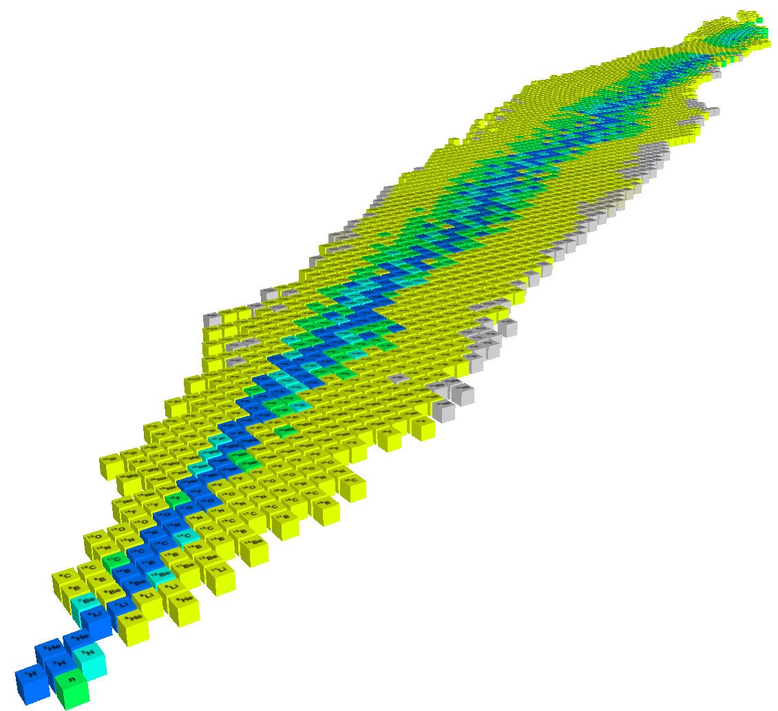
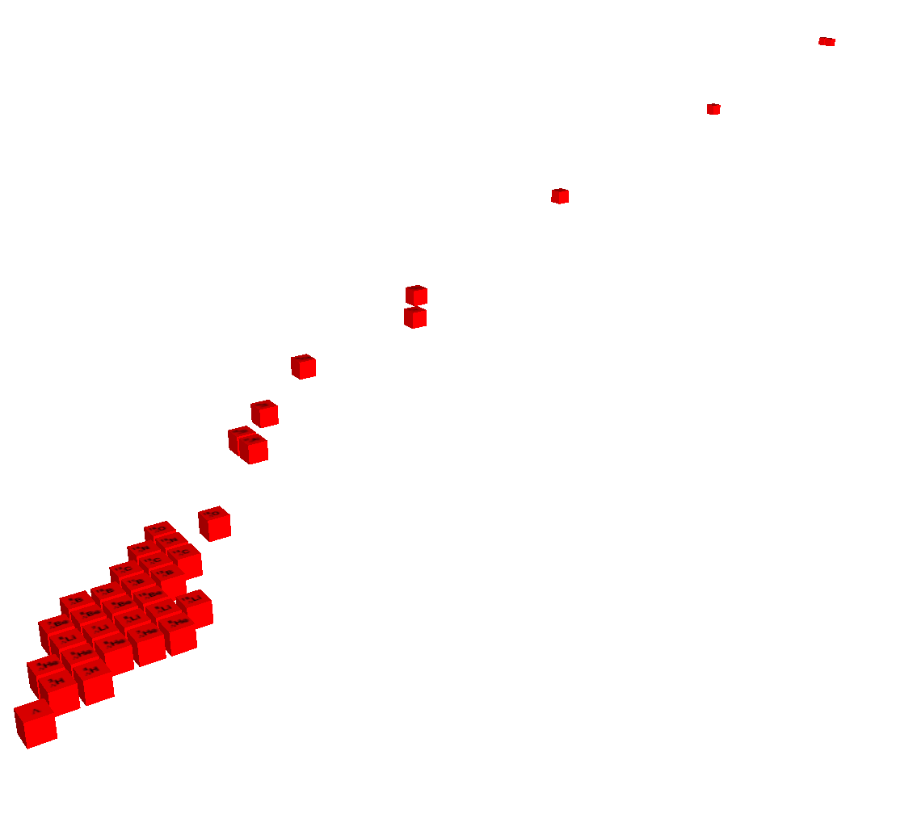
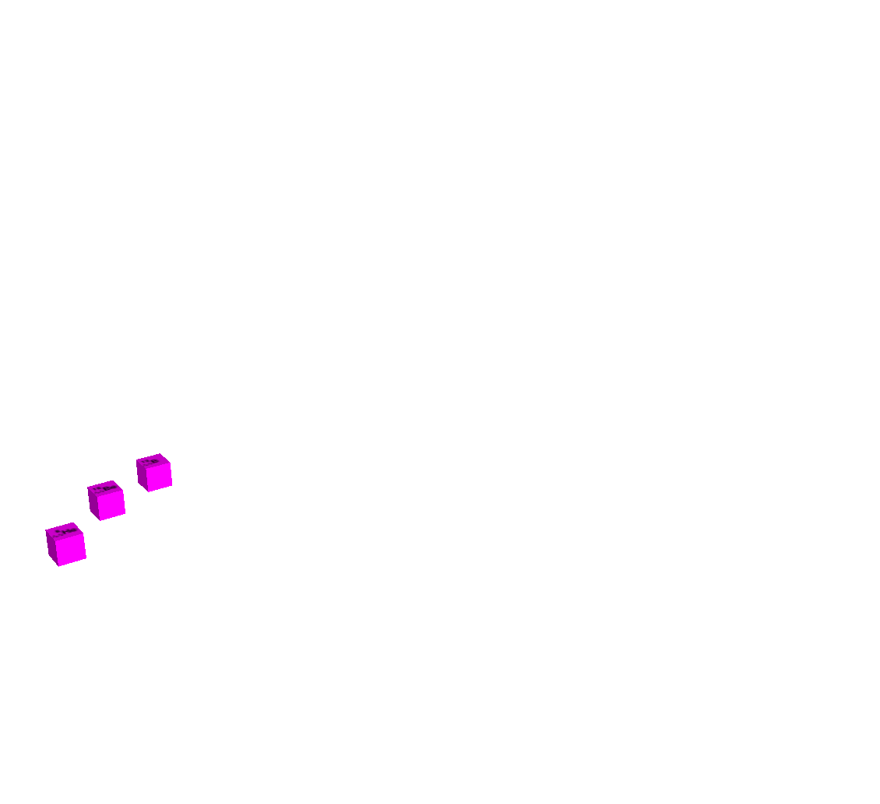




World of matter made of u, d, s quarks
Nu ~ Nd ~ Ns
Strangeness in neutron stars ( ρ > 3 - 4 ρ₀ )
“Stable”
Strange hadronic matter (A → ∞)
Higher
density
Strangeness
ΛΛ, Ξ Hypernuclei
Z
-2
Λ, Σ Hypernuclei
N
-1
0
３-dimensional nuclear chart
by M. Kaneta inspired by HYP06 conference poster

Slide 8
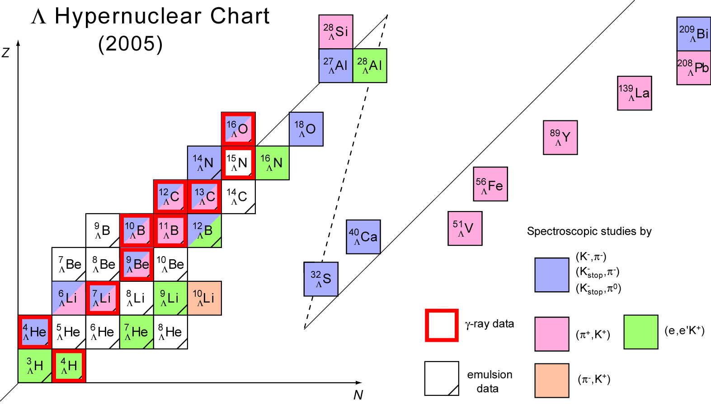
Status of Λ Hypernuclear Spectroscopy
(2017)
¹⁹ F
Λ
(K⁻, π)
(K⁻_{stop}, π⁺)
⁶ H
(e,e’K⁺)
Λ
Updated from: O. Hashimoto and H. Tamura, Prog. Part. Nucl. Phys. 57 (2006) 564.
(π, K⁺)

Slide 9
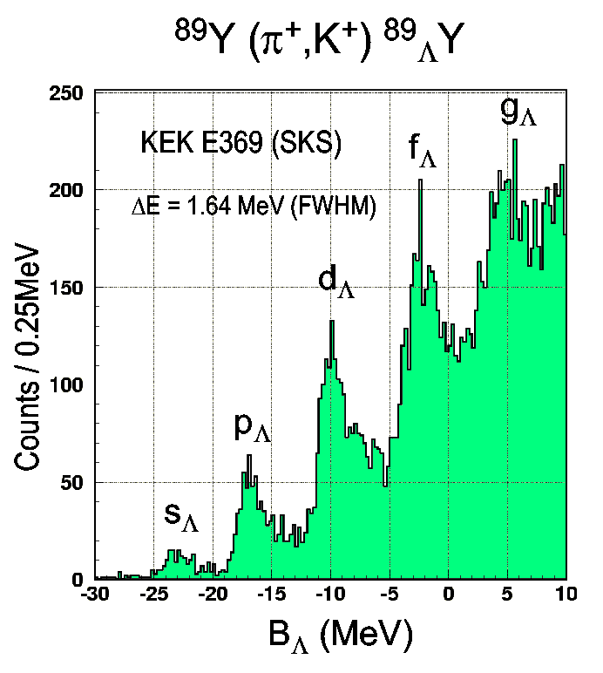
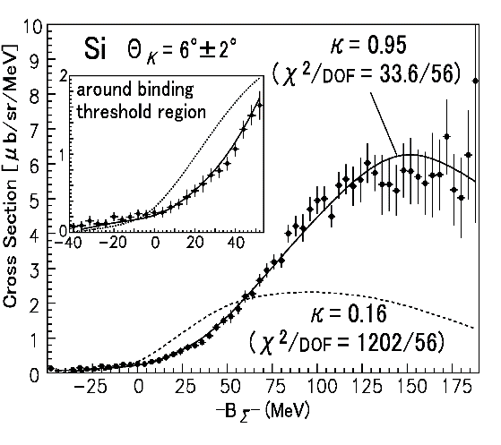
Are all hyperons bound in nuclei?
Hotchi et al., PRC 64 (2001) 044302
✔Λ Data on 40 Λ hypernuclei (³_{Λ}H to ²⁰⁸_{Λ}Pb) with ~80 excited states
U_{Λ} = -30 MeV (c.f. U_{Ν} = -50 MeV)
-> Λ should appear ρ ~ 2-3 ρ₀ in NS
ΛN-ΣN interaction needs be studied
×Σ No bound systems observed
(except for ⁴_{Σ}He)
Potential strongly repulsive U_{Σ} ~ +30 MeV.
Noumi et al., PRL 87(2002) 072301
-> Σ⁻ should not appear in NS
ΣN has a strong repulsive core
due to quark Pauli effect?
ΣN scattering experiment necessary
? Ξ No definite data existed until recently

Slide 10
Charge symmetry breaking in Λ hypernuclei

Slide 11
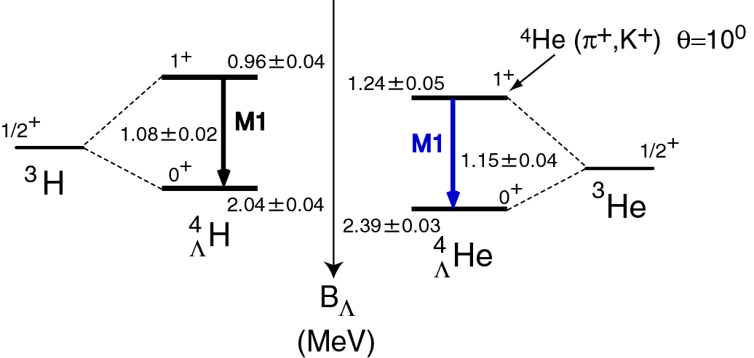
Charge Symmetry Breaking in A=4 Hypernuclei?
A large CSB in ΛN force (pΛ ≠ nΛ)?
Cannot understand such large CSB effects.
cf. B(³H) - B(³He) – EM effect ~70 keV
Old NaI data
Bedjidian et al.
PLB 62 (1976) 467
PLB 83 (1979) 252
³H + Λ
0
³He + Λ
Measured with Ge
at J-PARC
(K⁻,π⁻ )
1.09±0.02
?
?
1.15±0.04
⁴He + π⁻
⁴_{Λ}H
⁴_{Λ}He
Λ
Measured at Maniz
p
n
Old emulsion data
Experimental confirmation
of CSB is necessary
M. Juric et al. NPB 52 (1973) 1

Slide 12
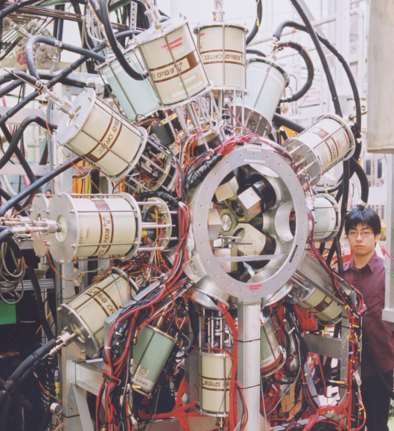
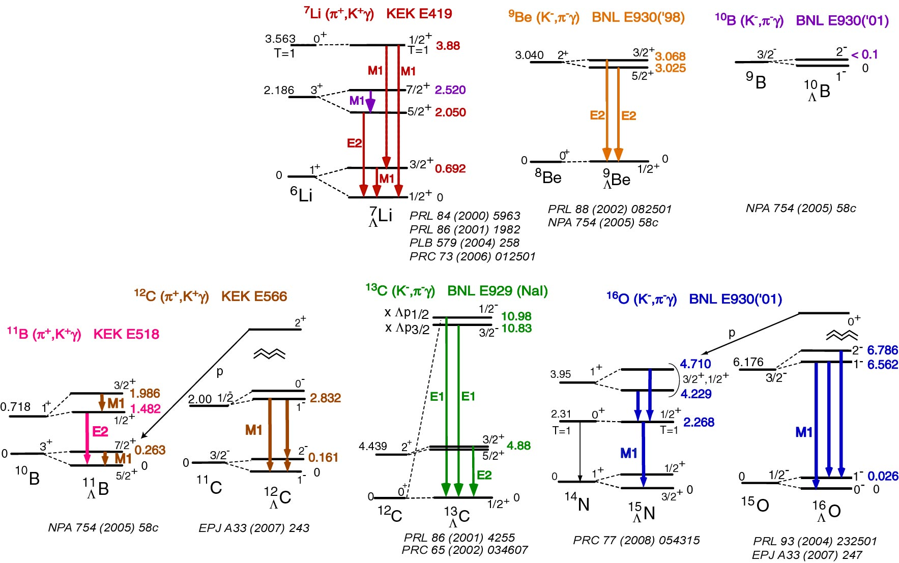
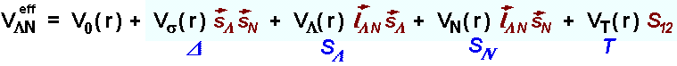
Hypernuclear γ-ray data (2015)
ΛN spin-dependent interaction strengths determined:
Δ = 0.33 (A>10), 0.42 (A<10), S_{Λ} = -0.01, S_{N} = -0.4, T =0.03 MeV
Almost all these p-shell levels are reproduced within a few 10 keV
by this parameter set. (D.J. Millener)
Feedback to BB interaction models. Nijmegen ESC08 model is
almost OK. (But ΛN-ΣN force is not well studied yet.)
=> go to s-shell and sd-shell
Hyperball:1998~
Hyperball2: 2004~
1⁻
6.050
3/2⁻
2⁻
M1
PTEP (2015) 081D01

Slide 13
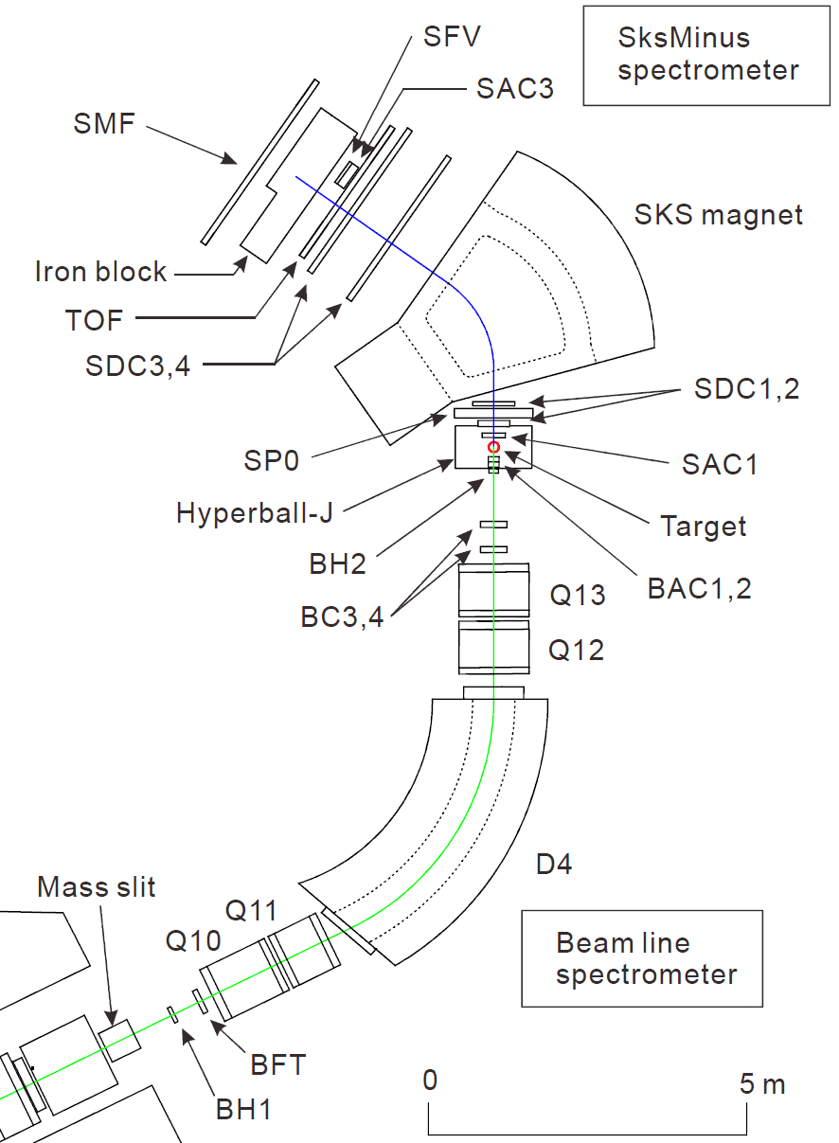
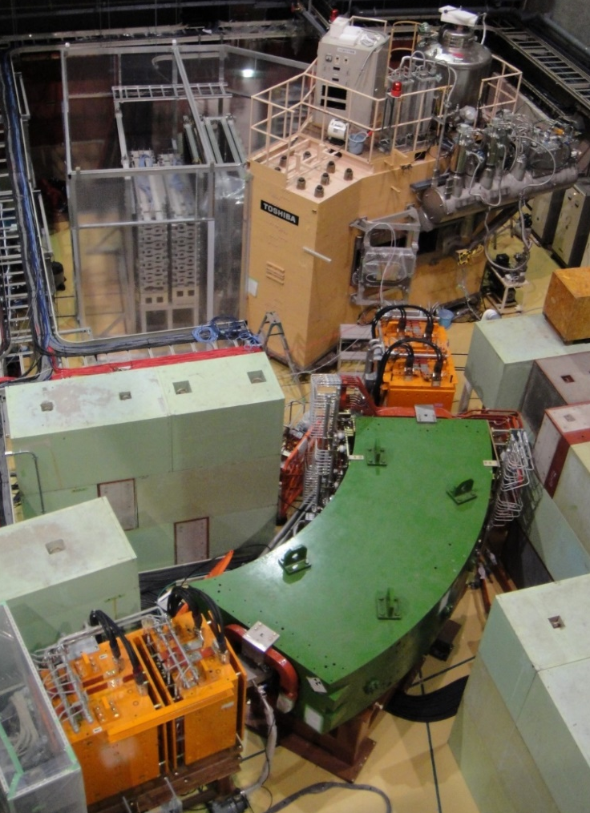
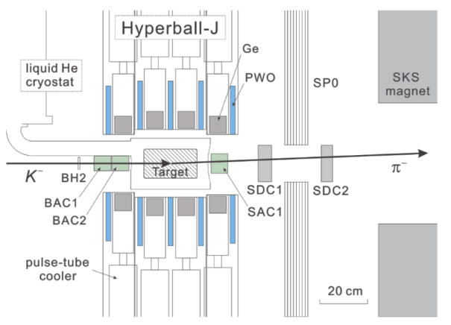
J-PARC E13 Setup
Pion spectrometer“SksMinus”
π⁻
  (2.5 T)
Tag production of hypernuclei
Detect γ-rays from hypernuclei
Ge array
“Hyperball-J”
K－
K1.8 Beamline
Spectrormeter
Notes:
この図がJ-PARCのK1.8ビームラインにおけるE13実験のセットアップとなっています。
大強度のK－ビームをこちらに配置した標的に照射して（K－,π-）反応でハイパー核を生成し、
その後に放出されるガンマ線を測定します。
（animation）
E13実験は、反応－γ同時計測実験であり、
ビームラインスペクトロメータでビームK粒子、
散乱粒子スペクトロメータ「SksMinus」を用いて散乱π粒子を運動量解析して
ハイパー核生成をタグし、
それと同時に、新しいGe検出器群「Hyperball-J」でハイパー核からのガンマ線を測定します。
Hyperball-Jの性能については本学会初日に山本が報告しました。
収量を考慮して、
4Heハイパー核については液化4He標的と運動量1.5GeV/c、
19Fハイパー核についてはHF標的と運動量1.8GeV/cを採用しました。
(animation)
本講演では、このスペクトロメータの性能について報告します。

Slide 14
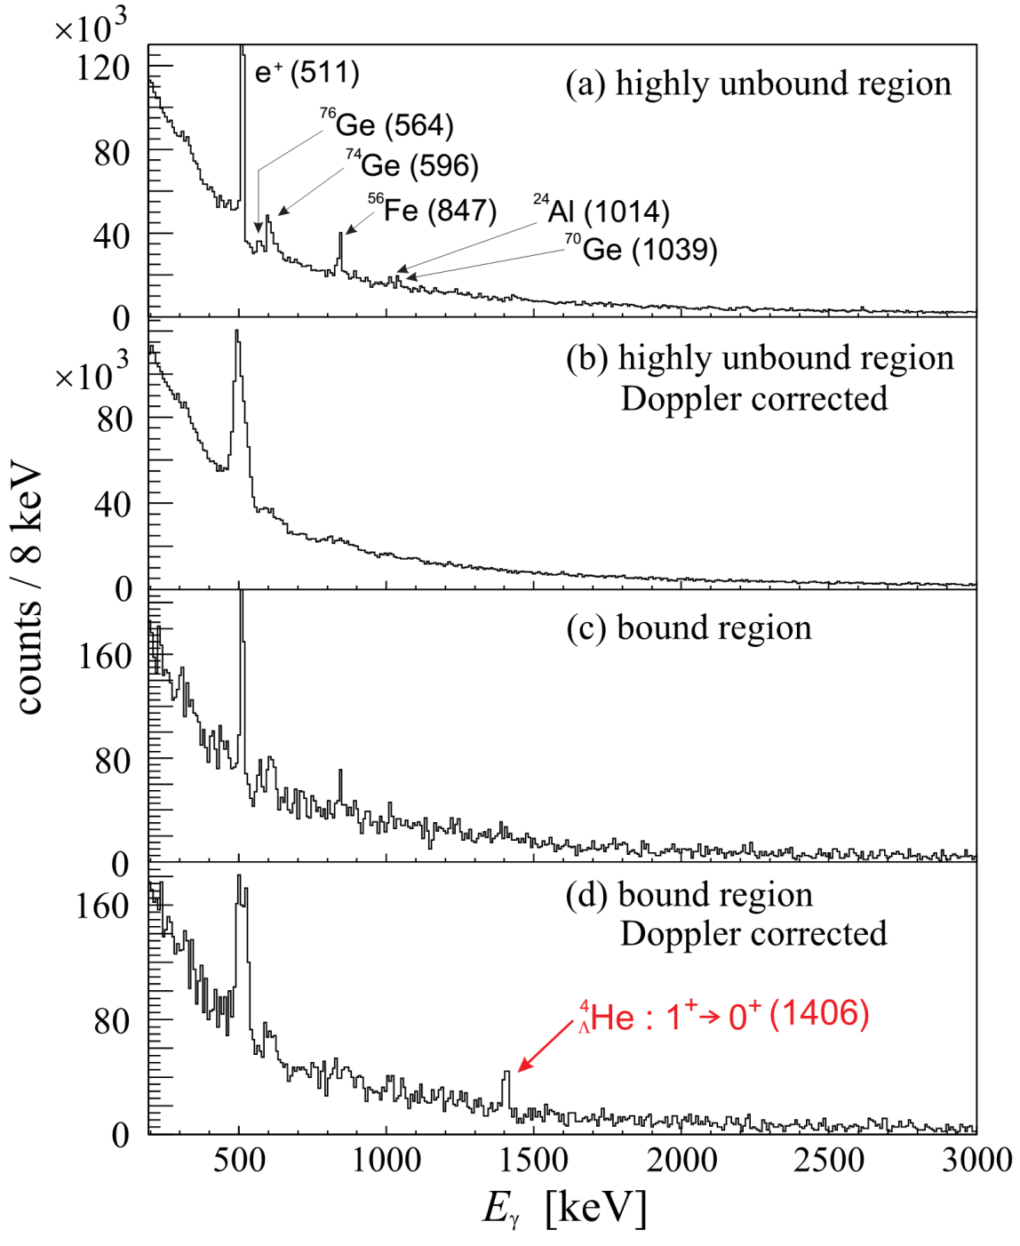
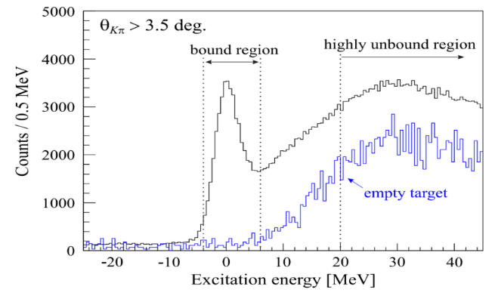
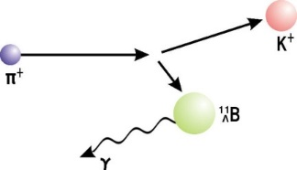

Result
⁴He(K⁻,π⁻) missing mass
⁴_{Λ}He (0⁺ + 1⁺)
Missing mass of ⁴He(K⁻,π⁻)
Doppler shift correction
γ-ray energy (keV)
A peak observed at
1406±2±2 keV

Slide 15
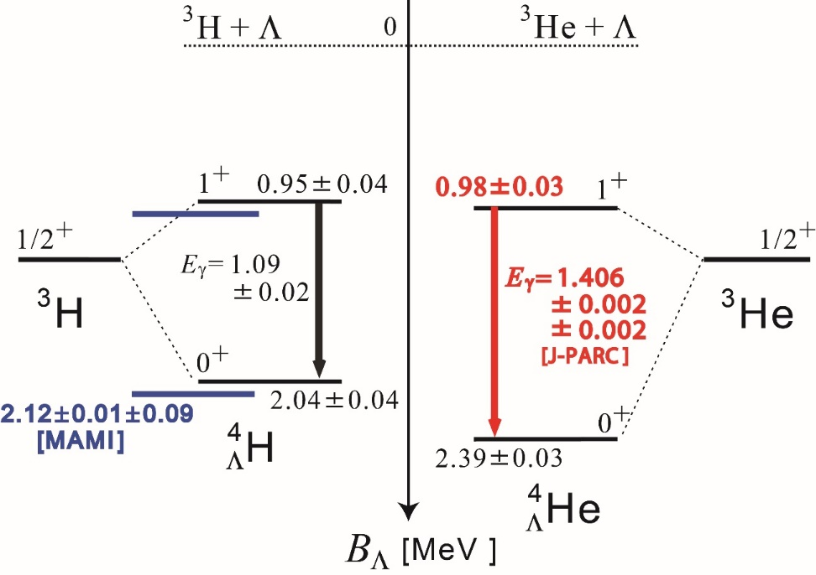
Updated energy levels of A=4 hypernuclei
T.O. Yamamoto et al.,
PRL 115 (2015) 222501
Bedjidian et al.
PLB 83 (1979) 252
etc.
⁴_{Λ}H
⁴_{Λ}He
Λ
p
n
A large CSB has been confirmed only from γ-ray data!

Slide 16
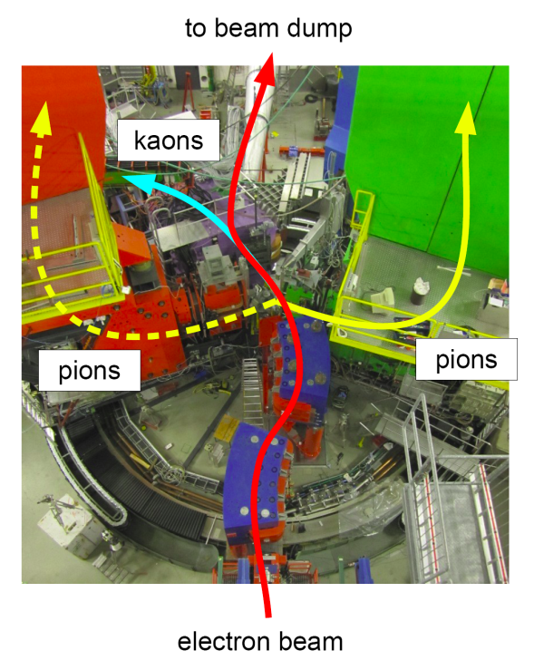
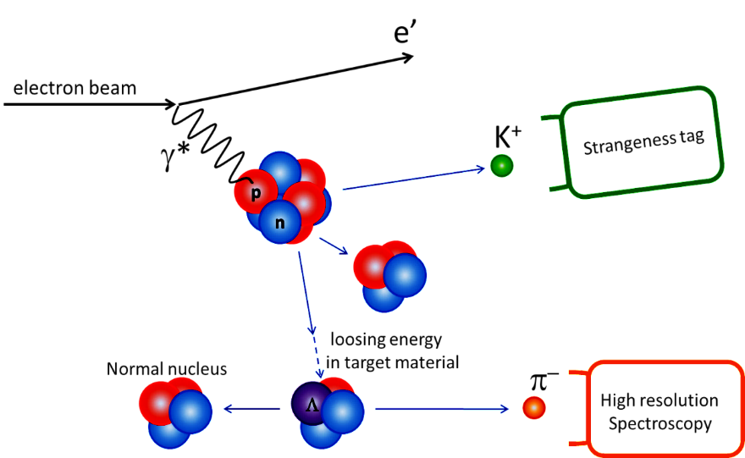
Decay-pion spectroscopy of hypernuclei with electron beams
Slide by P. Achenbach
γ∗ p -> Λ K⁺
fragmentation
~100 MeV/c
MAMI
weak decay
⁴_{Λ}H etc.
Two-body decay at rest ⇒ mono-energetic pions
An independent method for precise mass measurement

Slide 17
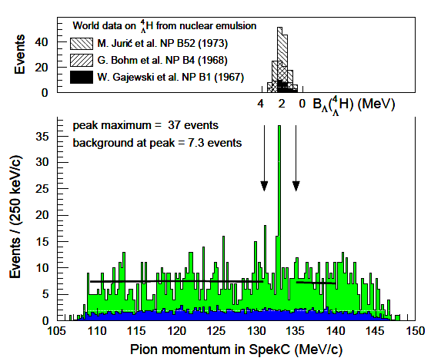
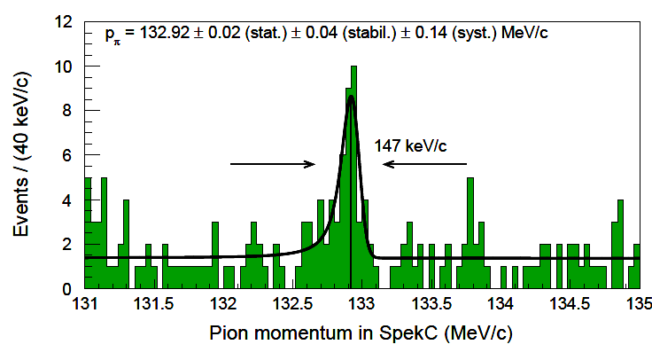
Decay-pion spectrum
Slide by P. Achenbach
Emulsion data in binding energy scale
=> B_{Λ} [ ⁴_{Λ}H ] = 2.12±0.01±0.09 MeV
Present data
⁴_{Λ}H -> ⁴He + π⁻
decays of quasi-free produced hyperon
A. Esser et al., PRL 114 (2015) 12501
accidental background
New method of precise mass measurement developed.

Slide 18

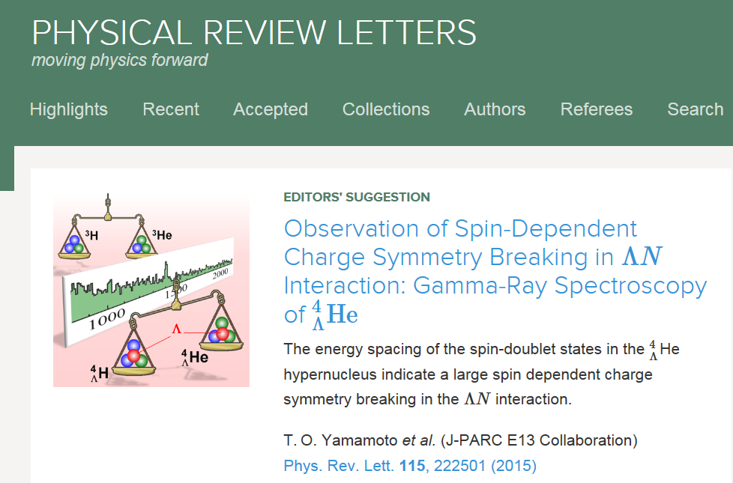
Combined Results
A. Esser et al.,
PRL 114 (2015) 12501
T.O. Yamamoto et al.,
PRL 115 (2015) 222501
ΔB_{Λ}(1⁺) : 0.03±0.05 MeV
0.11±0.09 MeV
ΔB_{Λ}(0⁺) : 0.35±0.05 MeV
0.26±0.09 MeV
B_{Λ} [ ⁴_{Λ}H(0⁺) ] is confirmed, suggesting the emulsion ⁴_{Λ}He(0⁺) data also reliable.
Large spin dependence in CSB found.
N
Λ
ΛΣ
coupling
π
Recent theories: This CSB effect is sensitive to ΛN-ΣN coupling.
Σ⁰
A. Gal, PLB 744 (2015) 352
D. Gazda and A. Gal, PRL 116 (2016) 122501
N
Λ
CSB

Slide 19
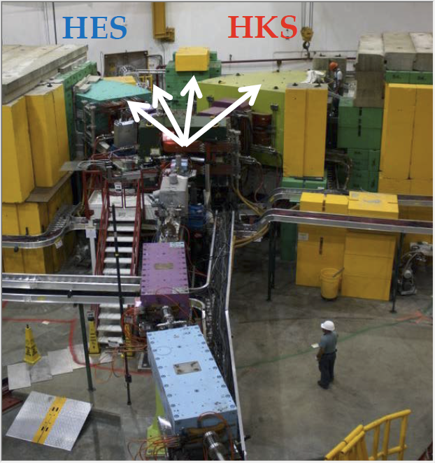
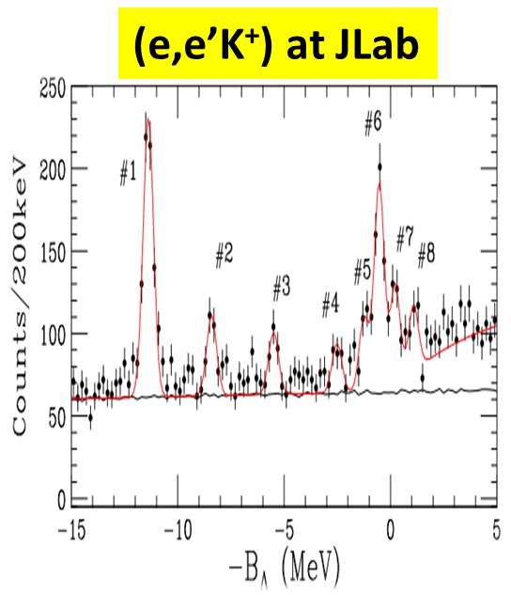
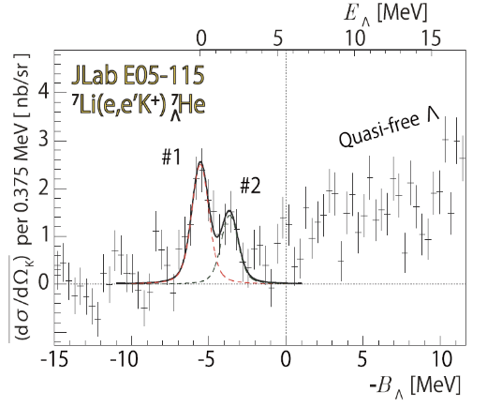
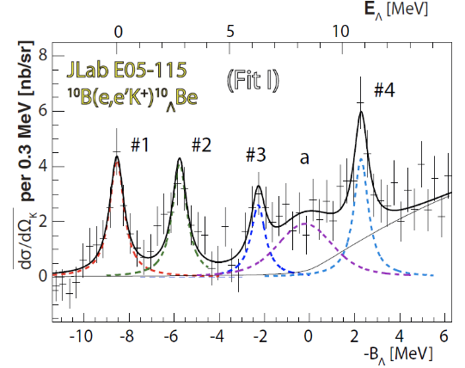
JLab (e,e’K⁺) spectroscopy
Jlab E05-115
¹²_{Λ} B
L. Tang et al.,
PRC90 (2014) 034320
ΔE = 0.5 MeV (FWHM) achieved
Jlab Hall C
Accuracy of
absolute energy
in (e,e’K⁺)
~ 100 keV
(π⁺,K⁺), (K⁻,π⁻ )
~ 1 MeV
⁷_{Λ} He
¹⁰_{Λ} Be
T. Gogami et al., PRC 94 (2016) 21302(R)
T. Gogami et al., PRC 93 (2016) 034314

Slide 20
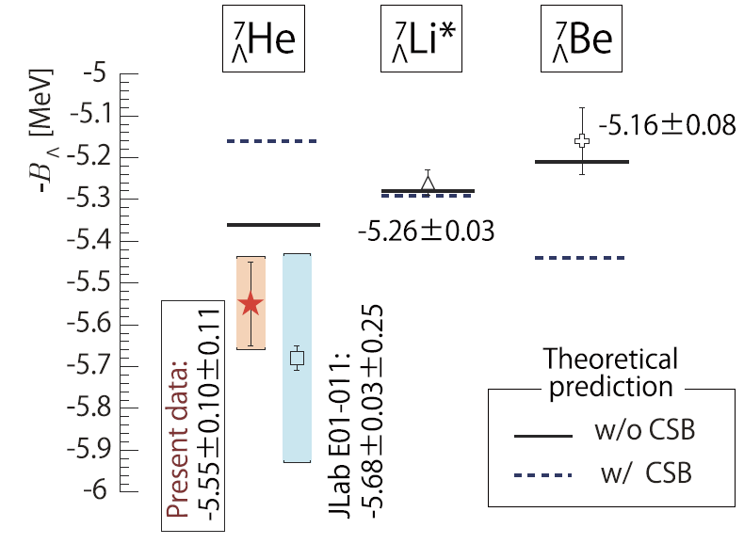
CSB in p-shell hypernuclei
A=7
Emulsion data
Emulsion + γ-ray data
FINUDA + γ-ray
Phenom. CSB int.
which accounts for A=4
(Hiyama et al.)
T. Gogami et al.
PRC 94 (2016) 21302(R)
A=12, 16
FINUDA (K⁻_{stop},π⁻) – JLab (e,e’K⁺) Nucl.Phys. A960 (2017) 165.
Suggesting rather small (~100 keV) CSB in p-shell hypernuclei
-> a key to understand the origin

Slide 21
3. Σ-p scattering

Slide 22
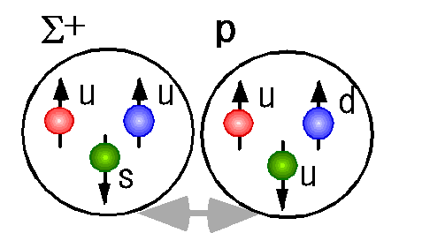
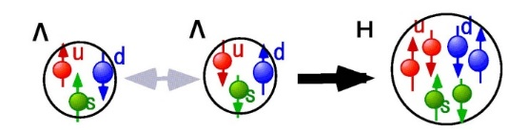
Baryon Baryon interaction by Lattice QCD
Slide by Koji Miwa
The same behavior was predicted
by Oka-Yazaki’s Quark Cluster Model
6 independent forces in flavor SU(3) symmetry
x
J-PARC E40
Strong repulsive core
8〇8 =
Σ⁺p (S=1, T=3/2)
Σ⁻p (S=0, T=1/2)
(27)
(10*)
quark Pauli effect
(10)
Ξ⁻p (T=0)
Flavor singlet (H-Channel)
J-PARC E42
(8s)
(8a)
color magnetic
interaction
(1)
Lattice QCD calc.
T. Inoue et al.
Prog. Theor. Phys. 124 (2010) 4
Weakly repulsive or attractive Core
Notes:
22
Recently, lattice QCD qualitatively supports the prediction by the QCM.
There are 6 independent force in SU(3) and 4 new appeared forces show new features.
This channel is included in Sigma+p channel and this channel is included in Sigma-p channel.
In these channel, there is small attractive pocket and large hard core.
On the other hand, these channel (Xi-p channel and H-dibaryon channel) shows weak or attractive core.
By exploring YN and YY interaction, we can obtain the understanding of the generalized BB interaction.

Slide 23
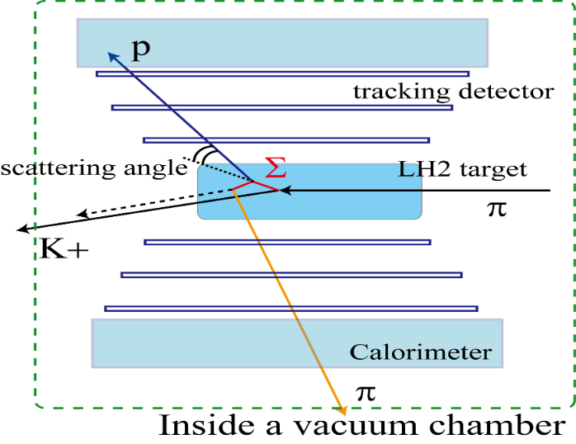
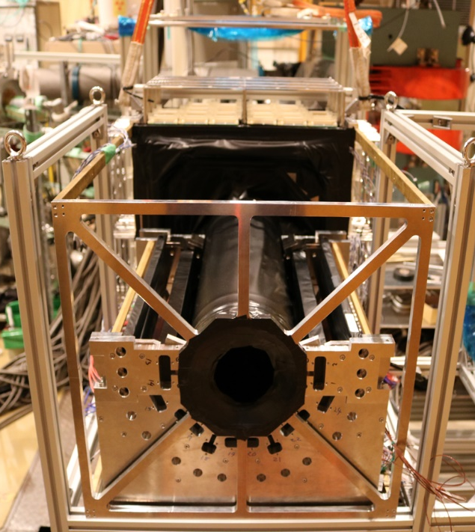
Σ±p Scattering Experiment
J-PARC E40 (Miwa et al.)
MPPC+Sci.fiber
1.3 GeV/c π⁺⁻ p -> K⁺ Σ⁺⁻ reaction
Σ⁺⁻ track not directly measured
Measure proton momentum vector
-> kinematically complete
J-PARC K1.8 line
+ KURAMA
CFT
CFT
BGO
BGO
dσ/dΩ for Σ⁺p, Σ⁻p, Σ⁻p->Λn
(p_{Σ} = 400-700 MeV/c)
=> confirm quark Paul effect
Ultra-fast fiber tracker (MPPC readout)
Calorimeter (BGO)
Liq. H₂ target

Slide 24
Expected accuracy
Slide by K. Miwa
Σ⁺p → Σ⁺p
  ds/dΩ : 2.4mb/sr isotropic (assumed)
    20,000 scattering events
    derive dσ/dΩ for 3 momentum ranges
  Σ⁻p : ±0.11 (stat.) ±0.15 (syst.) mb/sr
  Σ⁺p : ±0.15 (stat.) ±0.15 (syst.) mb/sr
  for 2.4 mb/sr
Simulation for p_{Σ} = 0.5 – 0.6 (GeV/c)
Σ⁻p → Σ⁻p
Σ⁻p → Λn
Commissioning run has started. Take data in 2018-2019
Notes:
This is expected results for three reactions.
These data are past experiment.
We will much improve the data quality.
For the Sigma+p, the cross section is quite sensitive to the phase shift value of the Pauli forbidden channel.
The models shows different cross section value depending on the phase shift value.
This precision is enough to select the models.
And also from the differential cross section at 90 degree, we will determine the phase shift value itself experimentally.
This can also make possible the direct comparison with Lattice QCD.
For all three channels, we have to also measure the angular dependence to understand
partial wave contribution with higher waves.
By measuring the cross sections with this precision, we provide good quality data to
construct the theory of BB interaction for the first time in this momentum region.

Slide 25
4. S=-2 Systems
Ξ and ΛΛ hypernuclei
Ξ atomic X-rays

Slide 26

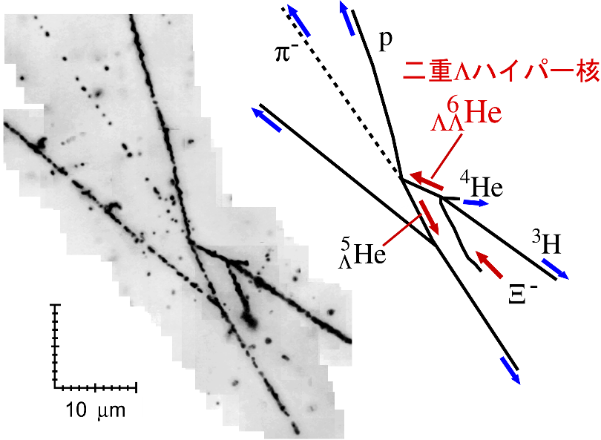
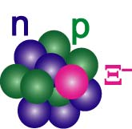
Emulsion Results (KEK E373)
Nagara event
n
Kiso event
New analysis!
p
Λ
e
α
p
⁸Li
⁸Be
α
p
d
α
⁶_{ΛΛ}He -> ⁵_{Λ}He + p + π⁻
The first clear Ξ hypernucleus
ΔB_{ΛΛ}= 0.67±0.17 MeV
=
－
H. Takahashi et al., PRL 87 (2001) 212502
K. Nakazawa et al. PTEP 2015, 033D02
Λ-Λ is weakly attractive
Ξ-N is attractive

Slide 27
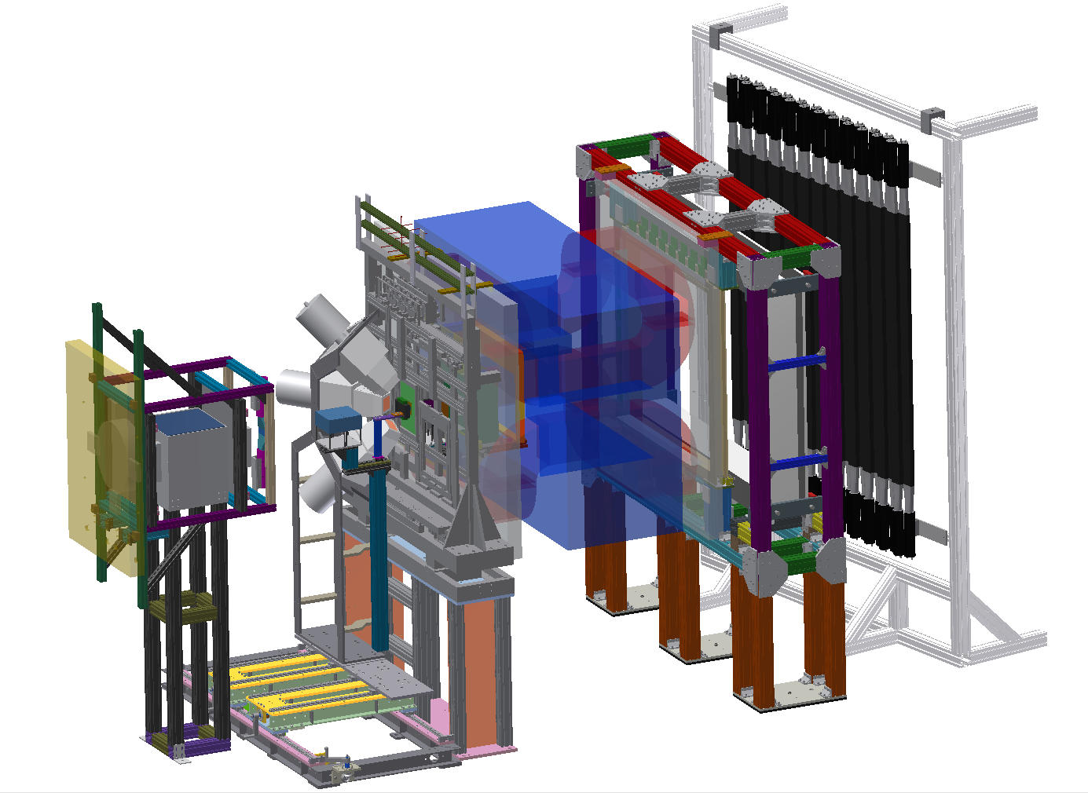
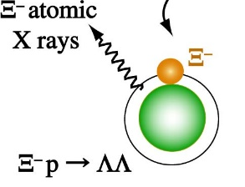

More S=-2 events with emulsion
J-PARC E07
K. Nakazawa et al.
Collect ~10² ΛΛ hypernuclear events from ~10⁴ Ξ⁻_{stop}
  Confirm ΛΛ int. and extract ΛΛ−ΞΝ effect
  More Ξ-nuclear events -> Ξ-N interaction
Measure Ξ⁻ -atomic X-rays for the first time
  Shift and width of X-rays -> Ξ-nuclear potential
  Ξ⁻ absorbed events identified from emulsion image –> no background
Data-taking (beam irradiation) finished last June.
Emulsion development and analysis under way.
emulsion
X-ray
Emulsion
Ξ⁻
K⁺
K⁻
Ge
Ge array
K⁺
TOF wall
K⁻
KURAMA spectrometer

Slide 28
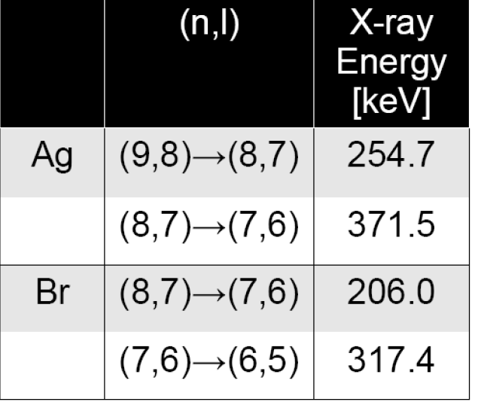
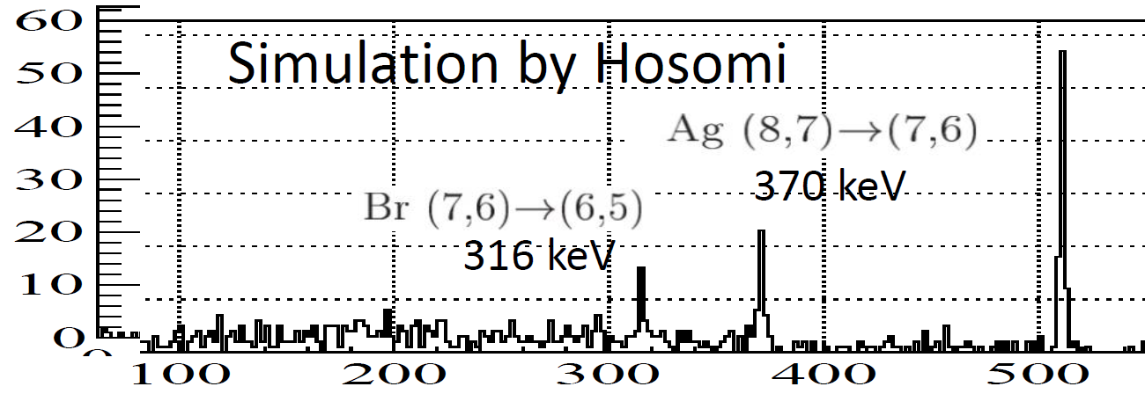
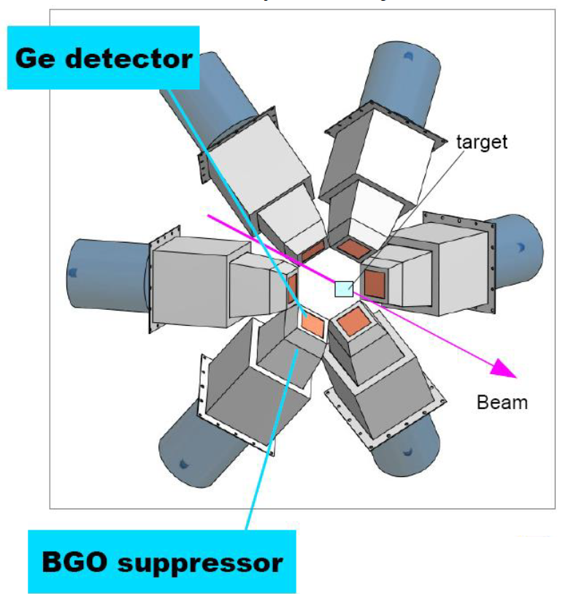
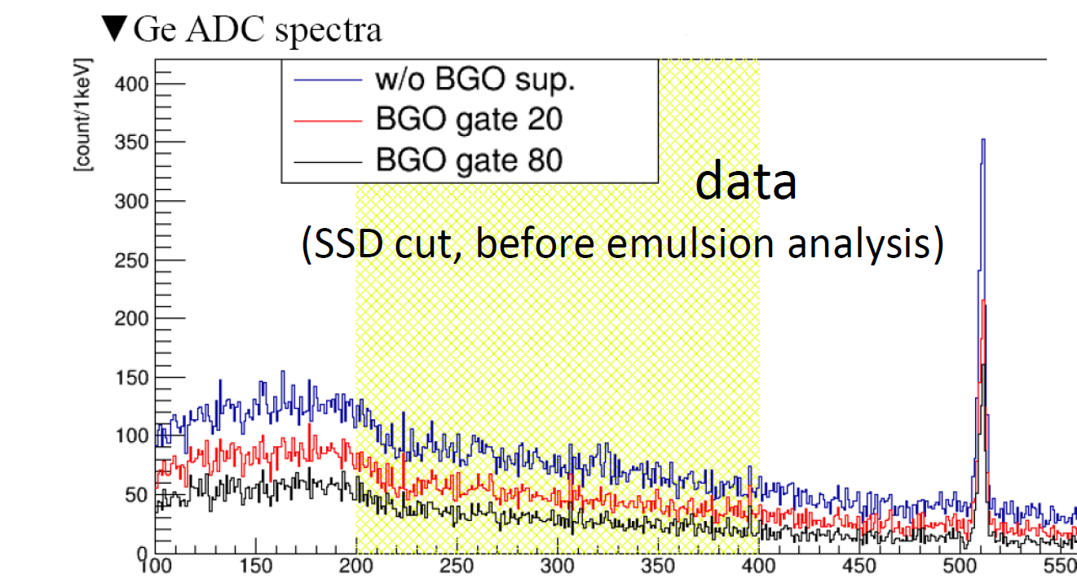
Preliminary X-ray spectrum
X-ray energy (keV)
Going to remove background
by looking at emulsion image

Slide 29
5. Future Plan
Challenge to the hyperon puzzle

Slide 30
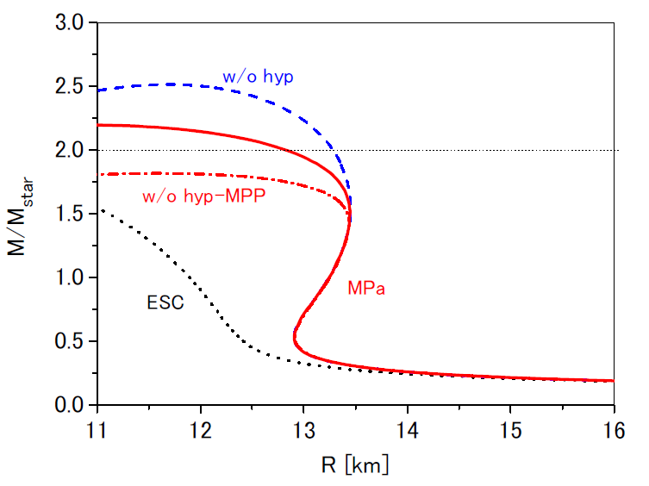
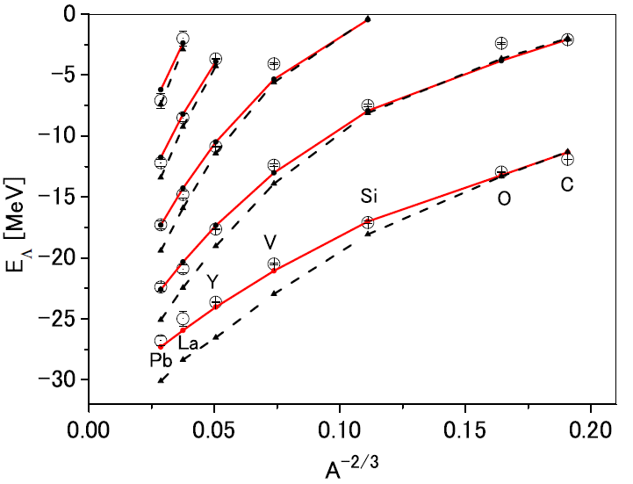
How to study density dependence of ΛN inteaction in matter?
Ab-initio calc. of nuclear binding energies => NNN repulsion necessary
Similar YNN (YYN, YYY) repulsive forces?
Experimentally approach:
Precise B_{Λ} data for wide A of Λ hypernuclei
0.1 MeV accuracy is necessary
Yamamoto, Furumoto, Rijken et al.
PRC88 (2013) 2, 022801
PRC90 (2014) 045805
determined from
HI collision data
+ 3B/4B repulsion in NNN only
g_{Λ}
f_{Λ}
d_{Λ}
+ 3B/4B repulsion
in NNN +YNN etc.
p_{Λ}
(Mpa)
s_{Λ}
MPa
-B_{Λ} [MeV]
ECS08 only
ESC08 only
(no 3B force)
Notes:
ハイペロンパズル：
高密度の中性子物質では中性子のフェルミエネルギーが高くなり、ハイペロンに転換する方がエネルギー的に得をするので、ハイペロンが混在する。現在知られているバリオン間相互作用によって予想されるハイペロンが混在する高密度核物質の状態方程式では、存在が確認されている2倍の太陽質量の中性子星の重力を支えられずブラックホールになってしまう。これは、現在の核物理の知識に重大な不足があることを示しており、この問題を称して「ハイペロンパズル」という。
ESC:バリオン間相互作用（2体力）
MPa: ESC+MPP+TBA
重い中性子星を支えられる状態方程式を実現する相互作用模型
MPP:高密度での斥力
TBA：現象論的に導入した3体引力

Slide 31


High Resolution
HN Spectroscopy
PRC64 (2001) 044302
(π⁺,K⁺) at KEK
(e,e’K⁺) at JLab
ΔE = 1.6 MeV (FWHM)
PRC90 (2014) 034320
(π⁺,K⁺) at HIHR line
at J-PARC
ΔE = 0.3 MeV (FWHM)
expected
ΔE = 0.5 MeV (FWHM)
achieved
BE accuracy < 0.1 MeV => Density dependence of ΛN int.

Slide 32

Extension Plans of J-PARC Hadron Hall
S= -1 Systems
High precision
Λ hypernuclear spectroscopy
γ-ray spectroscopy
weak decays
ΛN scattering
< 2.0 GeV/c
1.8x10⁸ pion/spill
x10 better Δp/p
S= -2 Systems
5 deg extraction
~5.2 GeV/c K⁰
Good n/K
ΛΛ, Ξ hypernuclei
H dibaryon
< 1.2 GeV/c
~10⁶ K⁻/spill
HIHR
< 2.0 GeV/c
~10⁶ K⁻/spill
KL
K1.1
< 1.1 GeV/c
~10⁵ K⁻/spill
K1.8
K1.8BR
K10
TEST BL
<10 GeV/c separated pion, kaon, pbar
~10⁷/spill K⁻
High-p
105 m
30 GeV proton
<31 GeV/c unseparated 2ndary beams (mostly pions), ~10⁷/spill
COMET
Requesting a budget…
Muon

Slide 33
6. Summary
Recent results and present status in SNP：
  γ-ray measurement for ⁴_{Λ}He(0⁺->1⁺), and decay-pion measurement for ⁴_{Λ}H-> ⁴_{Λ}He π⁻ confirmed large CSB effects in A=4 hypernuclei.
  Σ±p scattering experiment has started to confirm quark Pauli effect in BB forces.
  Ξ−nucleus bound system (Ξ⁻¹⁴N) has been observed in emulsion. A new emulsion experiment for more ΛΛ and Ξ hypernuclei + Ξ-atomic X-rays has been successfully performed.
In future, we will challenge the hyperon puzzle at the high-resolution pion beam line in the extended Hadron Hall at J-PARC as well as at JLab.

