Slide 1


Hidden and open charm exotic hadrons
Àngels Ramos
(University of Barcelona and ICCUB)
with: A. Feijoo, G. Montaña,
V. Magas, L. Tolós, E. Oset

Slide 2
Outline
Quark model hadrons vs. exotic hadrons
Baryons interpreted as meson-baryon ``molecules’’ in SU(3).
( the Λ(1405), some N*’s )
Extension to SU(4)
( the Λ_{c}(2595), the new Ω_{c} states seen recently at LHCb)
Conclusions

Slide 3
Except rare cases, quark models have successfully described:
_
Baryons: qqq states
Mesons: qq states
However, since the beginning of the millenium, an increasing amount of data collected at Belle, BaBar, LHCb and BESIII…, has provided evidence for many new states which appear to be inconsistent with the predictions of the quark model and find a better explanation as being multi-hadron states

Slide 4
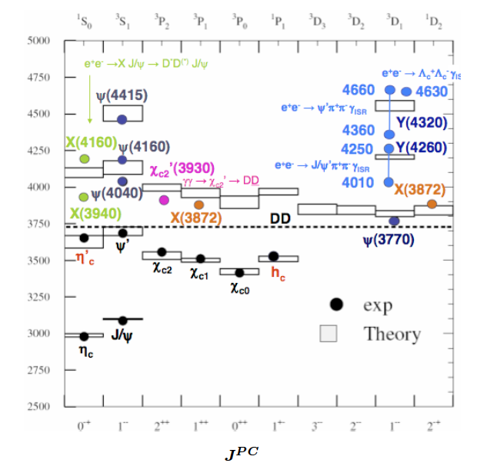
MESON SECTOR
Charmonium spectrum
Possible explanations:
tetraquark states (diquark and antidiquark),
meson-meson molecules
Hybrids: q qbar + gluon(s)
…
For a recent update, see:
F-K.Guo, Ch. Hanhart, U-G. Meissner, Q. Wang,
Q. Zhao, B-S. Zou, arXiv:1705.00141 [hep-ph]
(M Nielson, Charm 2010)

Slide 5
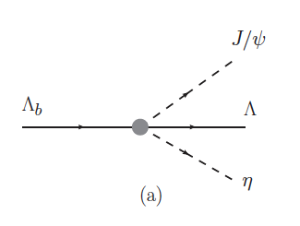
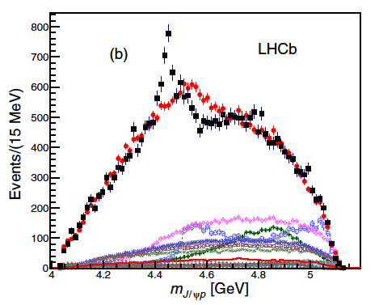


BARYON SECTOR
The LHCb pentaquarks
The interpretation of some baryons as being systems of 5 quarks (pentaquarks) has been revived by the observation of very “highly excited” nucleons by LHCb
P_{c}⁺ states:
R. Aaij et al. LHCb coll. PRL 115, 072001 (2015)
➔ the flavor content is not exotic (uud)
but the high mass and the observation from J/ψ p pairs makes these states as being candidates for pentaquarks (ccuud).
_

Slide 6
Baryons: “molecular” interpretation
Just as the nucleon-nucleon interaction generates a bound state (the deuteron!) we may also find baryonic resonances that can be interpreted as (quasi) bound systems of a baryon and a meson by virtue of and attractive interaction

Slide 7
Some examples in SU(3)

Slide 8
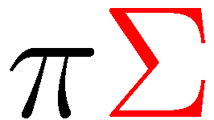

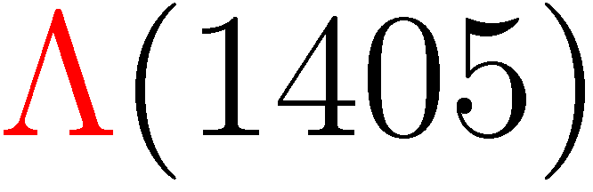
The Λ(1405)
_
The N interaction in the isospin I=0 channel is able develop a quasi-bound state, the Λ(1405), located only 27 MeV below the N threshold
K
_
K
Idea originally proposed by Dalitz and Tuan in the late 1950’s
Reformulated in terms of an effective chiral unitary theory in coupled channels by Kaiser, Siegel and Weise in 1995
Extended to the full coupled-basis by Oset and Ramos in 1998.
For ten more years (up to ~2006), plenty of theoretical work (NLO Lagrangian, s-channel and u-channel Born terms…,) finding similar features.
R. H. Dalitz and S. F. Tuan, Annals of Phys. 10 (1960) 307
N. Kaiser, P. B. Siegel, and W. Weise, Nucl. Phys. A594 (1995) 325
E. Oset and A. Ramos, Nucl. Phys. A635 (1998) 99
Oller, Meissner, Lutz, Garcia-Recio, Borasoy, Jido, …

Slide 9

Recently, the more precise SIDDHARTA measurement of the energy shift ΔE and width Γ of the 1s state in kaonic hydrogen, clarifying the inconsistency between earlier KEK and DEAR experiments, has injected a renovated interest in the field
M. Bazzi et al. Phys. Lett. B704 (2011) 113
➔ the parameters of the NLO meson-baryon Lagrangian can be better constrained
➔ better knowledge of the KbarN interaction
Y. Ikeda, T. Hyodo, W. Weise, Nucl.Phys. A881 (2012) 98
Z-H. Guo , J.A. Oller, Phys.Rev. C87 (2013) 3, 035202
M. Mai, U-G. Meissner, Nucl.Phys. A900 (2013) 51; Eur. Phys. J. A51 (2015) 3, 30
V.K. Magas, A. Feijoo, A. Ramos, Phys. Rev. C92 (2015) 1, 015206

Slide 10


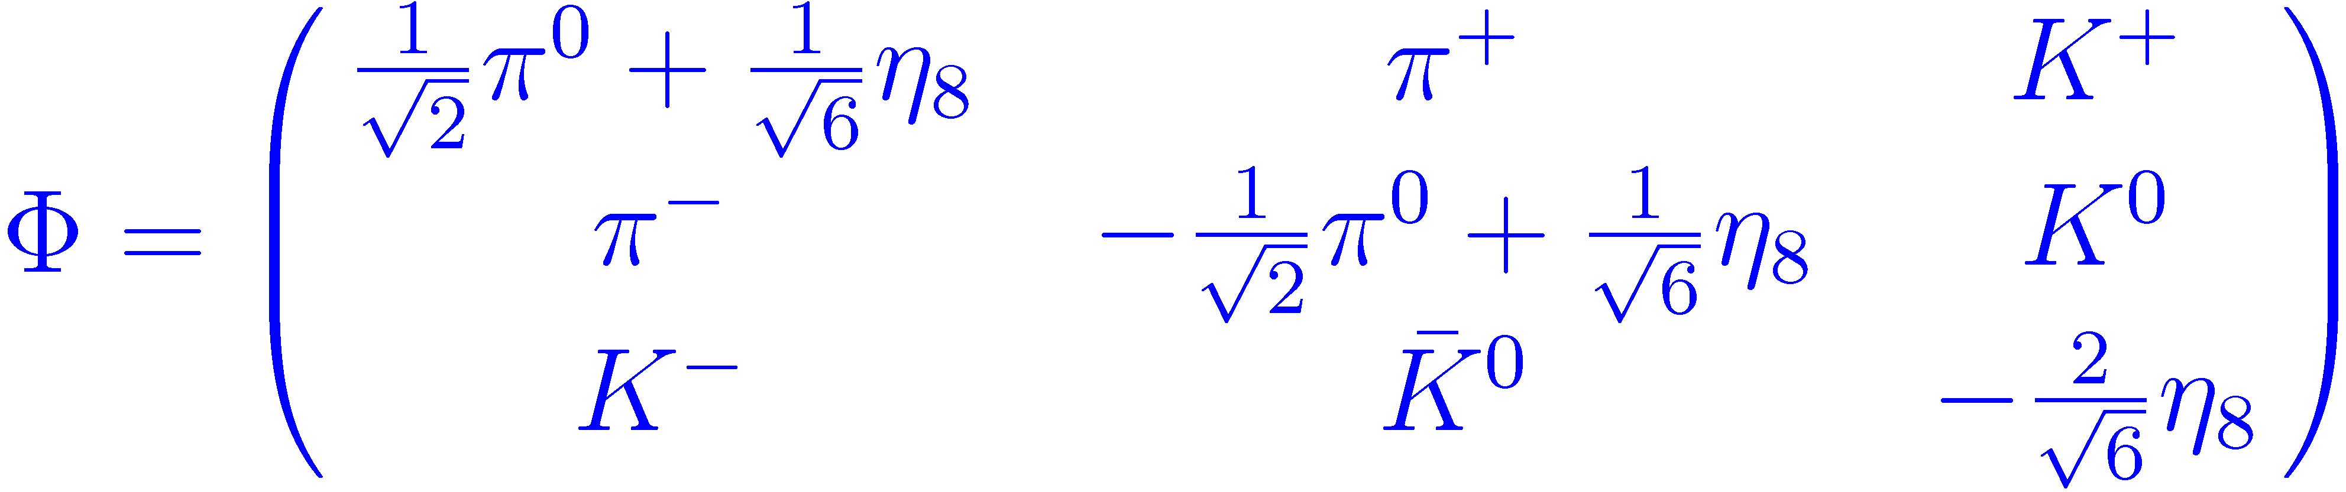



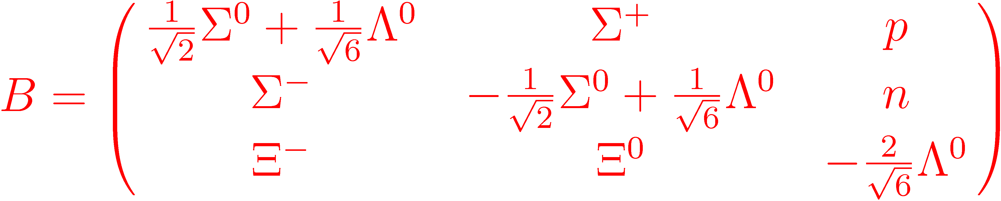
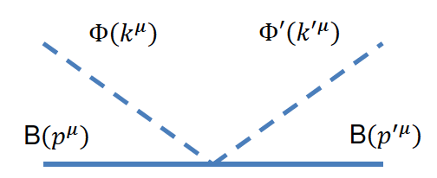

Essence of the non-perturbative chiral approach
1. Meson-baryon effective chiral Lagrangian:
Lowest order (LO), O(q)
➔ LO meson-baryon potential in s-wave (contact term):
One parameter: f

Slide 11

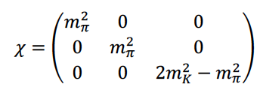
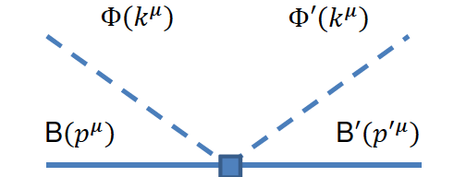

Next to leading order (NLO), O(q²)
derivative terms: d₁,d₂,d₃,d₄
explicit chiral symmetry breaking terms: b_{D}, b_{F}, b₀
➔ NLO contribution to the meson-baryon potential:
D_{ij}, L_{ij}: matrices which depend on the 7 NLO parameters: b_{D}, b_{F}, b₀,d₁,d₂,d₃,d₄

Slide 12
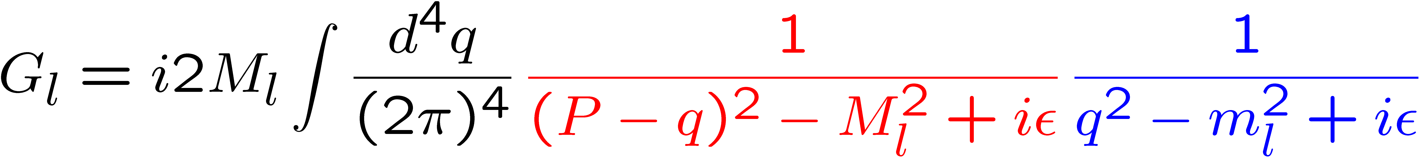
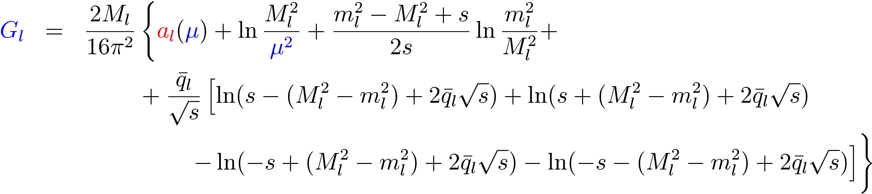
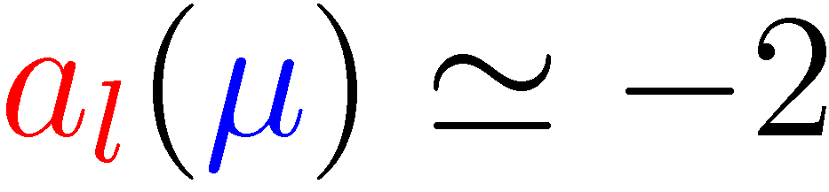
2. Unitarization:
N/D, Bethe-Salpeter…
=
+
T_{ij} = V_{ij} + V_{il} G_{l} T_{lj}
Coupled channels in S=-1 meson-baryon sector:
3. Regularization of loop function:
Dimensional regularization :
subtraction constants (to be fitted): a_{l}
“natural size (μ~700 MeV)
J.A. Oller and U.G. Meissner, Phys. Lett. B500 (2001) 263

Slide 13
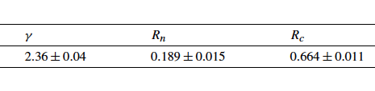
Threshold observables

Slide 14
Cross sections

Slide 15
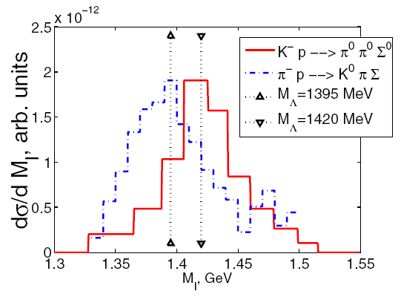
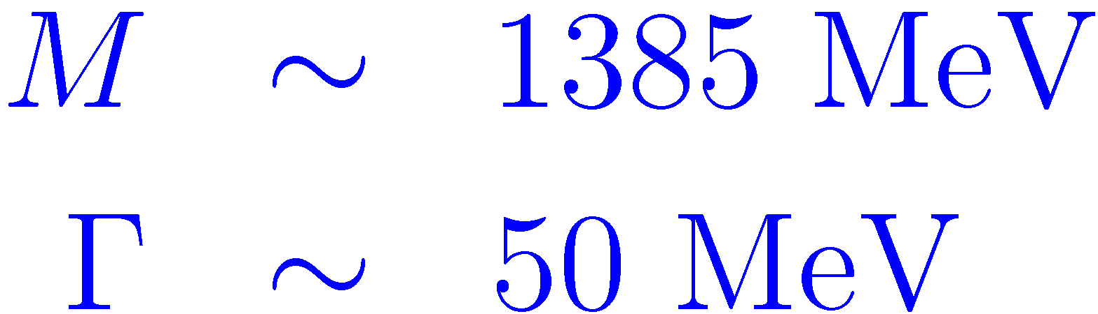
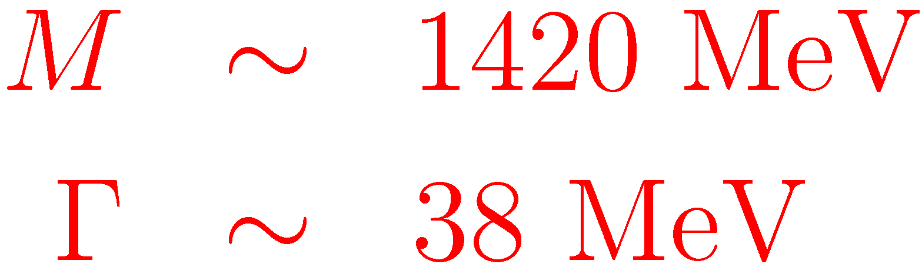
The two-pole structure of the Λ(1405)
T-matrix poles and couplings to physical states with I=0
z_{R} | 1390 - 66i | 1426 - 16i
(I=0) | |g_{i}| | |g_{i}|
πΣ | 2.9 | 1.5
ΚΝ | 2.1 | 2.7
ηΛ | 0.77 | 1.4
ΚΞ | 0.61 | 0.35
Experimental evidence
Magas, Oset, Ramos, PRL 95 (2005) 052301
π⁻p→K⁰πΣ
D.W.Thomas et al.
Nucl. Phys. B56, 15 (1973)
K⁻p → π⁰π⁰Σ⁰
S. Prakhov et al.,
Phys.Rev. C70,034605 (2004)
The Λ(1405) resonance shows different properties (position, width) in different reactions
Success of meson-baryon coupled-channel models!

Slide 16
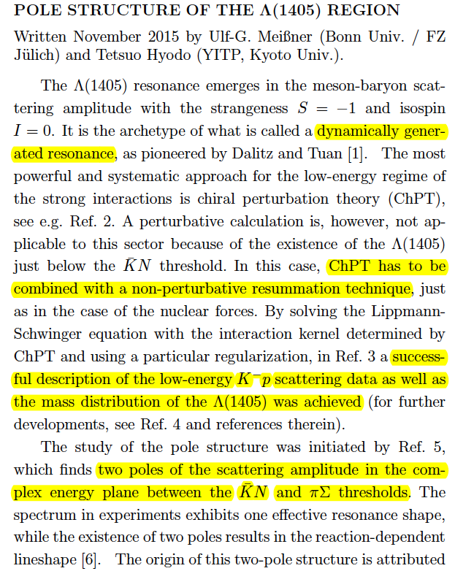
C. Patrignani et al. (Particle Data Group), Chin. Phys. C, 40, 100001 (2016).
The acceptance of the Λ(1405) as a meson-baryon quasibound state is a real success of the chiral unitary models in coupled channels!

Slide 17
Other sectors…
J^{P}=1/2⁻
S=0 → N*(1535)
N. Kaiser, P.B. Siegel, W. Weise, Phys. Lett. B362 (1995) 23
J.C. Nacher et al., Nucl. Phys. A678 (2000) 187
T. Inoue, E. Oset, M.J. Vicente-Vacas, Phys. Rev. C65 (2002) 035204
J. Nieves and E. Ruiz Arriola, Phys. Rev. D64 (2001) 116008
M.F.M. Lutz, E.E. Kolomeitsev, Nucl. Phys. A730 (2004) 110 …
S=-2 → Ξ(1620), Ξ(1690)
A. Ramos, E. Oset, C. Bennhold, Phys. Rev. Lett. 89 (2002) 252001
C. Garcia-Recio, J.Nieves, M.Lutz, Phys. Lett. B582 (2004) 49
J^{P}=3/2⁻
→ Δ(1700),Λ(1520),Σ(1670),Ξ(1820)
(Interaction of the 0⁻ pseudoscalar meson octet with the 3/2⁺ baryon decuplet)
E.E. Kolomeitsev, M.F.M. Lutz, Phys. Lett. B585 (2004) 243
S. Sarkar, E. Oset, M.J. Vicente-Vacas, Phys. Rev. C72 (2005) 015206
L. Roca, S. Sarkar, V.K. Magas and E. Oset, Phys. Rev. C73 (2006) 045208
M. Döring, E. Oset, D. Strottman, Phys. Rev. C73 (2006) 045209
M. Döring, E. Oset, D. Strottman, Phys. Lett. B639 (2006) 59
for W < 2 GeV

Slide 18
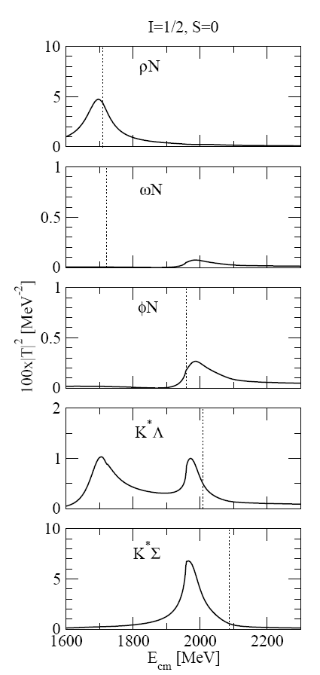
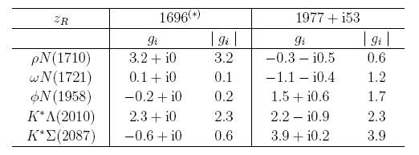
Vector meson - baryon scattering in coupled channels
E. Oset, A. Ramos, Eur.Phys.J. A44 (2010) 445-454.
N* J^{P} = 1/2⁻, 3/2⁻
We obtain a resonance, generated from the vector-baryon interaction at 1977 MeV, which couples mostly to K*Λ and K*Σ states.
The inclusion of pseudoscalar-baryon channels does not change the picture appreciably
E.J. Garzón, E. Oset, Eur.Phys.J. A48 (2012) 5

Slide 19
Anomaly in the K⁰_{S} Σ⁺ photoproduction cross section in γp → K⁰ Σ⁺
γ p → K⁰ Σ⁺
Destructive interference between K*Σ and K*Λ amplitudes, of similar size and shape.
→ Abrupt downfall of the charged cross section.
γ n → K⁰ Σ⁰
K*Σ and K*Λ amplitudes have a different size.
→ Neutral cross section retains the peak of the resonance.

Slide 20
Comparison to cross section data
R. Ewald et al. (CBELSA/TAPS Collaboration)
Phys. Lett. B713 (2012) 180-185
J^{P} = 1/2⁻, 3/2⁻
M_{R} = 1972 MeV Γ_{R} = 64 MeV
VB model adjusted to reproduce downfall:
M_{R} = 2035 MeV Γ_{R} = 125 MeV
N*(2080) (3/2-) and N*(2090) (1/2-) were in earlier PDG versions…
It is an “unavoidable” state given the attractive character and strength of the employed vector-baryon interaction.
(it appears in other VM models too:
D. Gamermann, C. Garcia-Recio, J. Nieves, L.L. Salcedo, Phys.Rev. D84 (2011) 056017.
K.P. Khemchandani, H. Kaneko, H. Nagahiro, A. Hosaka, Phys.Rev. D83 (2011) 114041)

Slide 21
Charm sector

Slide 22





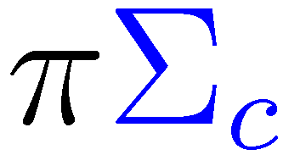


The Λ_{c}(2595)
The Λ_{c}(2595), in the C=1 sector, encounters a similar situation as the Λ(1405) in the S=1 sector
A logical approach was to extend the pseudoscalar-baryon chiral unitary method to test the nature of the Λ_{c}(2595).
Several works indeed found the Λ_{c}(2595) as a quasibound state generated dynamically from the interaction of pseudoscalar mesons with baryons in coupled channels:
J. Hofmann, M.F.M. Lutz, Nucl. Phys. A 763 (2005) 90
C. E. Jiménez-Tejero, A. Ramos and I. Vidaña, Phys. Rev. C 80, 055206 (2009)

Slide 23

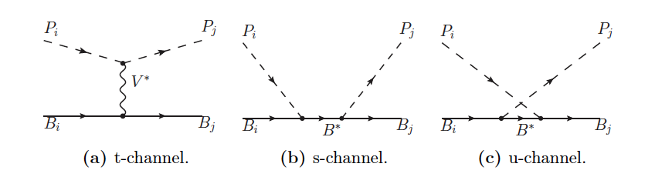


Pseudoscalar – baryon interaction model (S-wave)
The vertices are described via effective Lagrangians, obtained from the hidden gauge formalism and assuming SU(4) symmetry:
neglected (minor S-wave contribution)

Slide 24
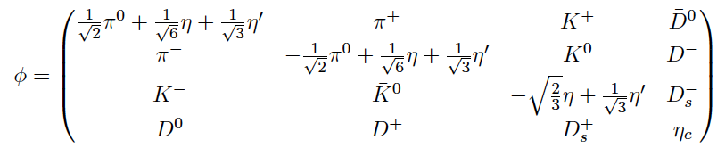
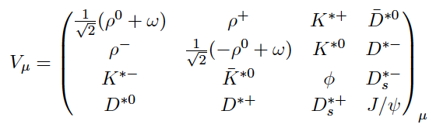
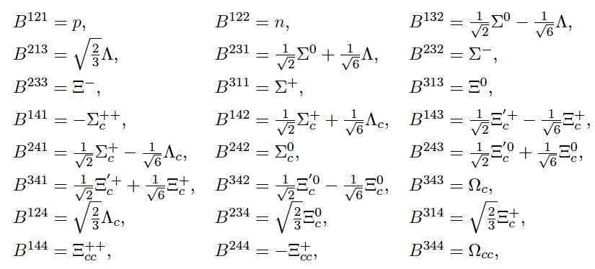

Slide 25
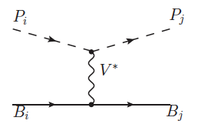
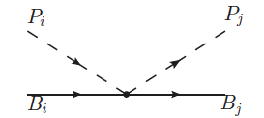

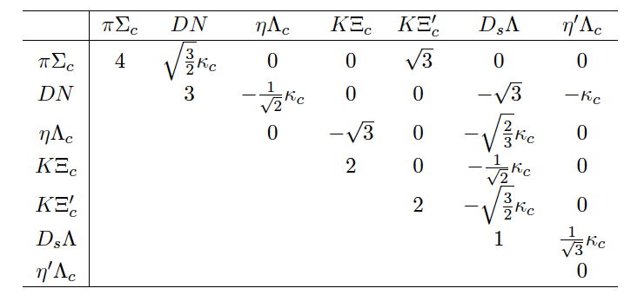
In the zero-range limit:
kernel:
Coupled channels for the Λ_{c}(2595) ( I=0, C=1, S=0, J^{P}=1/2⁻ ):
~ 1/4
(suppression factor accounting for the heavier mass of the exchanged meson)

Slide 26



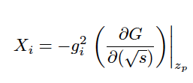

Unitarization:
N/D, Bethe-Salpether, …
=
+
(on-shell approach)
T_{ij} = V_{ij} + V_{il} G_{l} T_{lj}
Resonance:
➔ it is given by a pole of the unitarized amplitude
Compositeness:
➔ the amount of the meson-baryon component of the resonance

Slide 27
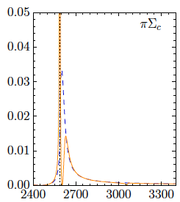

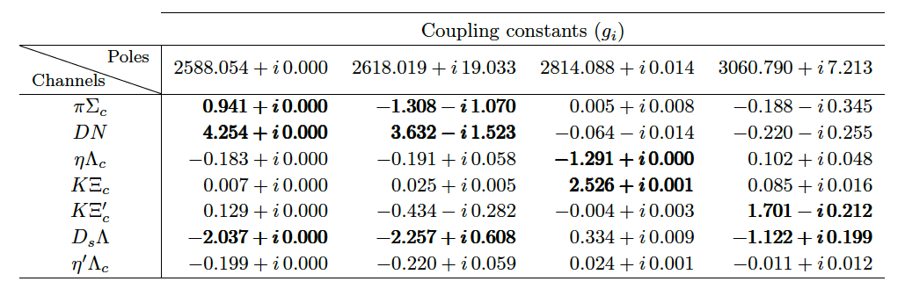
This simple model (and many others alike) generates the Λ_{c}(2595) having as a double pole structure
G. Montaña, master thesis, Barcelona 2017
I=0, C=1, S=0, J^{P}=1/2⁻

Slide 28
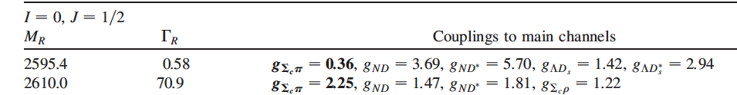
















Can we conclude that the Λ_{c}(2595) is essentially a DN bound state?
Not in this case! In dealing with hadrons with a heavy quark, one must deal with Heavy Quark Spin Symmetry (HQSS). (M_{D} ~ 1870 MeV M_{D*} ~ 2010 MeV)
➔ SU(8) model (including vector mesons and decuplet baryons):
C. García-Recio et al., Phys. Rev. D 79, 054004 (2009)
➔ coupling pseudoscalar–baryon with vector–baryon channels (Box diagrams)
W.H. Liang, T. Uchino, C.W. Xiao and E. Oset, Eur. Phys. J. A (2015) 51: 16
➔ The coupling DN – D*N plays an important role
➔ The Λ_{c}(2595) is a DN – D*N molecule!

Slide 29
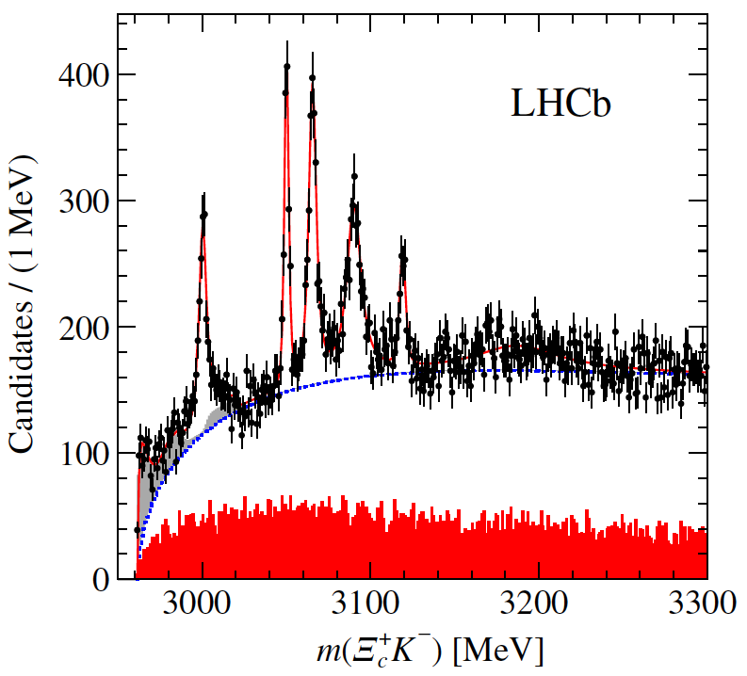
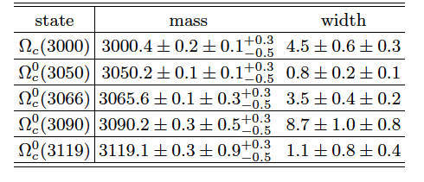
The new Ω_{c}’s seen at LHCb
R. Aaij et al. (LHCb Collaboration), Phys. Rev. Lett. 118, 182001 (2017).
C=1, S=-2
Similarly as the P_{c} pentaquarks, it is plausible that some Ω_{c}’s can be obtained by adding a uu pair to the natural ssc content
➔ the hadronization of the 5q system could lead to meson-baryon bound states.
_
_
_
➔ Moreover, the KΞ_{c} and KΞ_{c}’ thresholds, 2964 Mev and 3070 MeV, are in the energy range of interest.

Slide 30
Possible interpretation: css states
Quark models have been revisited after the LHCb discovery of the 5 Ω_{c} states decaying into K⁻Ξ_{c}⁺ pairs.
1 heavy quark (c) and 2 light quarks (ss):
➜
1P-wave orbital excitations of the ss pair w.r.t. the c quark
M.Karliner and J.L.Rosner, PRD95, 114012 (2017)[arXiv:1703.07774 [hep-ph]]
W.Wang and R.L.Zhu, PRD96, 014024 (2017) [arXiv:1704.00179 [hep-ph]]
Z.G.Wang, EPJC 77, 325 (2017 [arXiv:1704.01854 [hep-ph]]
B.Chen and X.Liu [arXiv:1704.02583 [hep-ph]]
S_{ss} = 1, S_{c} =1/2 and P-wave excitation ➔ J^{P} = 1/2⁻ (2), 3/2⁻ (2), 5/2⁻ (1)
➜
Somes states 1P-wave orbital excitations and some others 2S radial excitations
H.X.Chen, Q.Mao, W.Chen, A.Hosaka, X.Liu and S.L.Zhu, PRD95, 094008 (2017) [arXiv:1703.07703 [hep-ph]]
S.S.Agaev, K.Azizi and H.Sundu, EPL 118, 61001 (2017 [arXiv:1703.07091 [hep-ph]]
S.S.Agaev, K.Azizi and H.Sundu, EPJC77,395 (2017) [arXiv:1704.04928 [hep-ph]]
H.Y.Cheng and C.W~Chiang, PRD95, 094018 (2017) [arXiv:1704.00396 [hep-ph]]
K.L.Wang, L.Y.Xiao, X.H.Zhong and Q.Zhao, PRD95, 116010 (2017 [arXiv:1703.09130 [hep-ph]]
➔ additional J^{P} possibilities: 1/2⁺, 3/2⁺

Slide 31
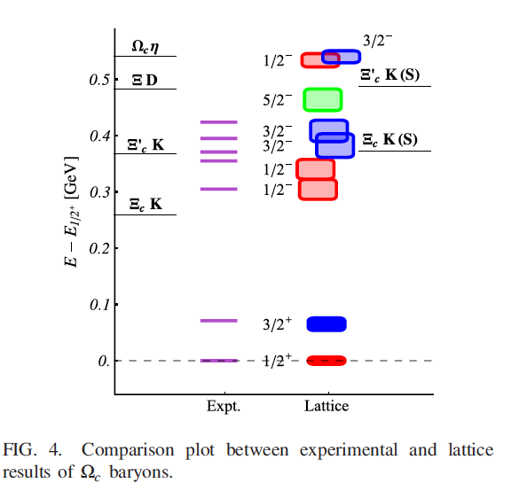
The spin-parity assignment of the 1P-wave orbital excitation quark models seems to be corroborated by a recent lattice calculation
M.Padmanath and N.Mathur, PRL119, 042001 (2017) [arXiv:1704.00259 [hep-ph]].

Slide 32
Some pentaquark-type interpretations
Chiral quark model:
constituent quarks interact with each other through one-gluon exchange and Goldstone boson exchange
H. Huang, J.Ping and F.Wang, arXiv:1704.01421 [hep-ph]
➔ The Ω_{c}(3119) can be explained as an S-wave ΞD resonance with J^{P}=1/2⁻
C.S.An and H.Chen, PRD96, 034012 (2017) [arXiv:1705.08571 [hep-ph]]
➔ Ω_{c}(3066) and Ω_{c}(3090): J^{P} = 1/2⁻ or 3/2⁻
Ω_{c}(3119): J^{P}=1/2⁻
Chiral quark soliton model:
c coupled to a “soliton”
H.C.Kim, M.V.Polyakov and M.Praszalowicz, PRD96, 014009 (2017); PRD96, 039902 (2017), [arXiv:1704.04082 [hep-ph]]
➔ Ω_{c}(3000): 1/2⁻, Ω_{c}(3066): 1/2⁻ and Ω_{c}(3090): 3/2⁻ belong to a 6
Ω_{c}(3050): 1/2⁺ and Ω_{c}(3119): 3/2⁺ belong to an exotic 15 (and have I=1!)
_

Slide 33
Our view: “molecular” interpretation
(quasi) bound system of a baryon and a meson by virtue of and attractive interaction

Slide 34
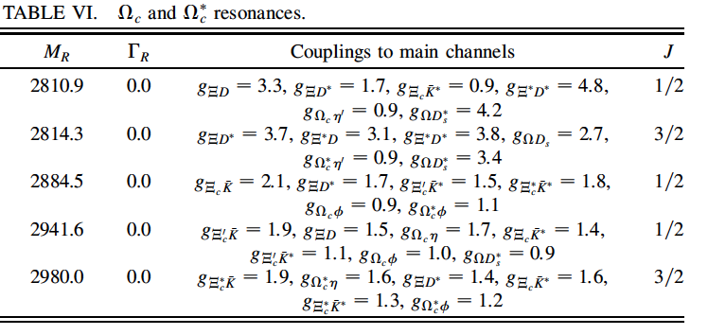
Some earlier theoretical works already gave predictions for Ω_{c} resonances being meson-baryon molecules:
SU(8) model:
O. Romanets et al., Phys. Rev. D85 (2012) 114032
But these Ω_{c} states are much more bound than the LHCb ones

Slide 35
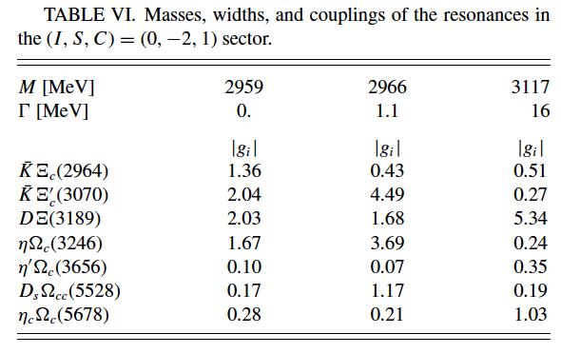
SU(4) finite range model:
J. Hofmann, M.F.M. Lutz, Nucl. Phys. A 763 (2005) 90
➔ 3 Ω_{c} states (below 2953 MeV)
C. E. Jiménez-Tejero, A. Ramos, and I. Vidaña, Phys. Rev. C 80, 055206 (2009)
The only model that gives a prediction above 3 GeV !
We have employed the above described methodology to investigate what meson-baryon molecules we predict in the C=1, S=-2 sector.

Slide 36

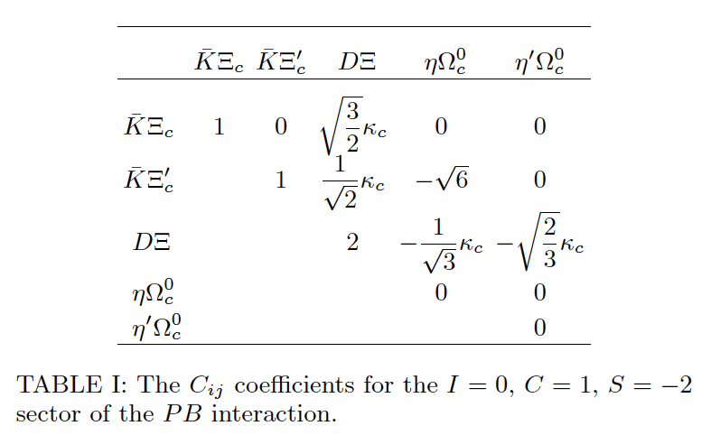
G. Montaña, A. Feijoo, A. Ramos, arXiv:1709.08737
We consider the following pseudoscalar-baryon coupled channels:
double charm
(neglected)
strong attraction in the DΞ channel

Slide 37
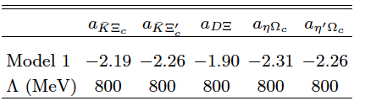

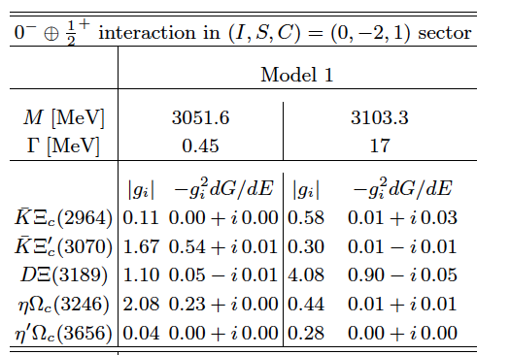

Model 1: Subtraction constants in the dimensional regularization loops chosen so as to make it coincide with cut-off loop (Λ=800 MeV)
The state at 3051 MeV mainly composed by KΞ_{c}’ and ηΩ_{c}
_
The state at 3103 MeV clearly qualifies as a DΞ bound state
➔ 10 MeV too heavy and too wide…
Exp:

Slide 38



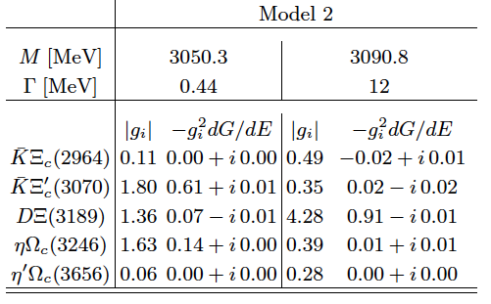
Model 2: Let the subtraction constants in the dimensional regularization loops vary to reproduce the experimental data

Slide 39
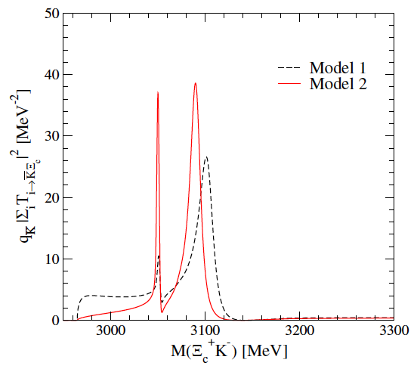

Preliminary comparison using:
The states at 3050 MeV and 3090 MeV are in very good agreement with experiment.
If these states are interpreted as pseudoscalar meson-baryon molecules, their spin-parity can be predicted to be 1/2⁻.

Slide 40

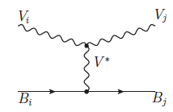
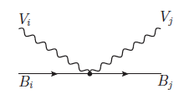


Vector – baryon interaction model
E. Oset, A. Ramos, Eur.Phys.J. A44 (2010) 445-454.
➔ kernel:
➔ coupled-channels:
➔ coefficients: the same as pseudoscalar-baryon with the transformations:

Slide 41
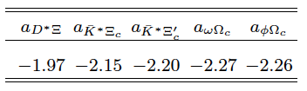
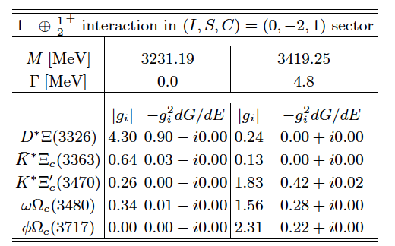
vector – baryon resonances
J^{P}=3/2⁻
These states cannot be identified with any of the seen Ω_{c} states.
The charm and beauty of strong interactions, Trento, 17-28/07/2017

Slide 42
These results are corroborated by the recent work:
(with identical diagonal amplitudes)
V.R. Debastiani, J.M. Dias, W.H. Liang and E. Oset,arXiv:1710.04231 [hep-ph].
but additional decuplet-pseudoscalar channels included!
➔ a J^{P}=3/2⁻ Ω_{c} resonance is obtained, which could be identified with the Ω_{c}(3119)
Similarly, the SU(8) model was revisited recently, employing “cut-off oriented” regularization
J. Nieves, R. Pavao and L. Tolos, arXiv:1712.00327 [hep-ph].
This model treats simultaneously: Pseudoscalar and vector mesons
1/2⁺ and 3/2⁺ baryons
➔ results are qualitatively similar to the previous works

Slide 43
Conclusions
There are quite a few baryons than can be naturally described as meson-baryon molecules, generated by the interaction of their hadronic constituents (just as the Deuteron is a bound state of two nucleons)
➔ The Λ(1405) is a well tested nice example!
The pattern is naturally reproduced in the charm sector (eg. the Λ_{c}(2595))
➔ In the Ω_{c} (C=1, S=-2) sector we have identified two states having a pseudoscalar-baryon molecular nature among the 5 Ω_{c} states measured at LHCb, and hence we can predict their spin-parity to be J^{P}=1/2⁻
A combined theoretical/experimental effort to find reactions that help in establishing the nature of hadrons, especially in the prolific charm sector, is very much needed!
e.g. experiments establishing the spin-parity of these states or observing them in different meson-baryon invariant masses, would certainly provide valuable information to help clarifying their nature.

Slide 44
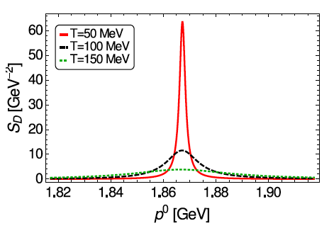
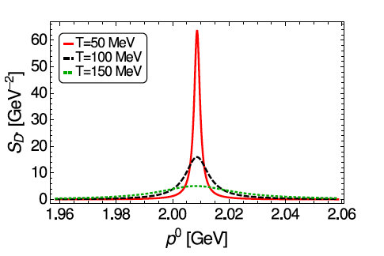
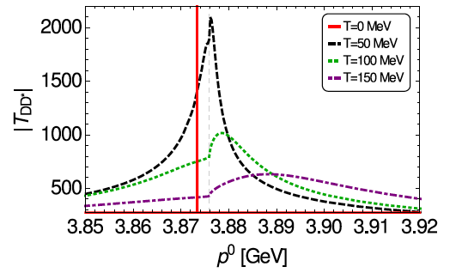
Medium effects?
The X(3872) has been claimed to be a tetraquark or a D D* molecule …
What happens when you measure it in a hot medium??
Spectral functions
D-meson
D*-meson
D D* amplitude in a hot medium
Th X(3872) melts in a hot pion gas!

Slide 45
Thank you for your attention
The charm and beauty of strong interactions, Trento, 17-28/07/2017

