Slide 1
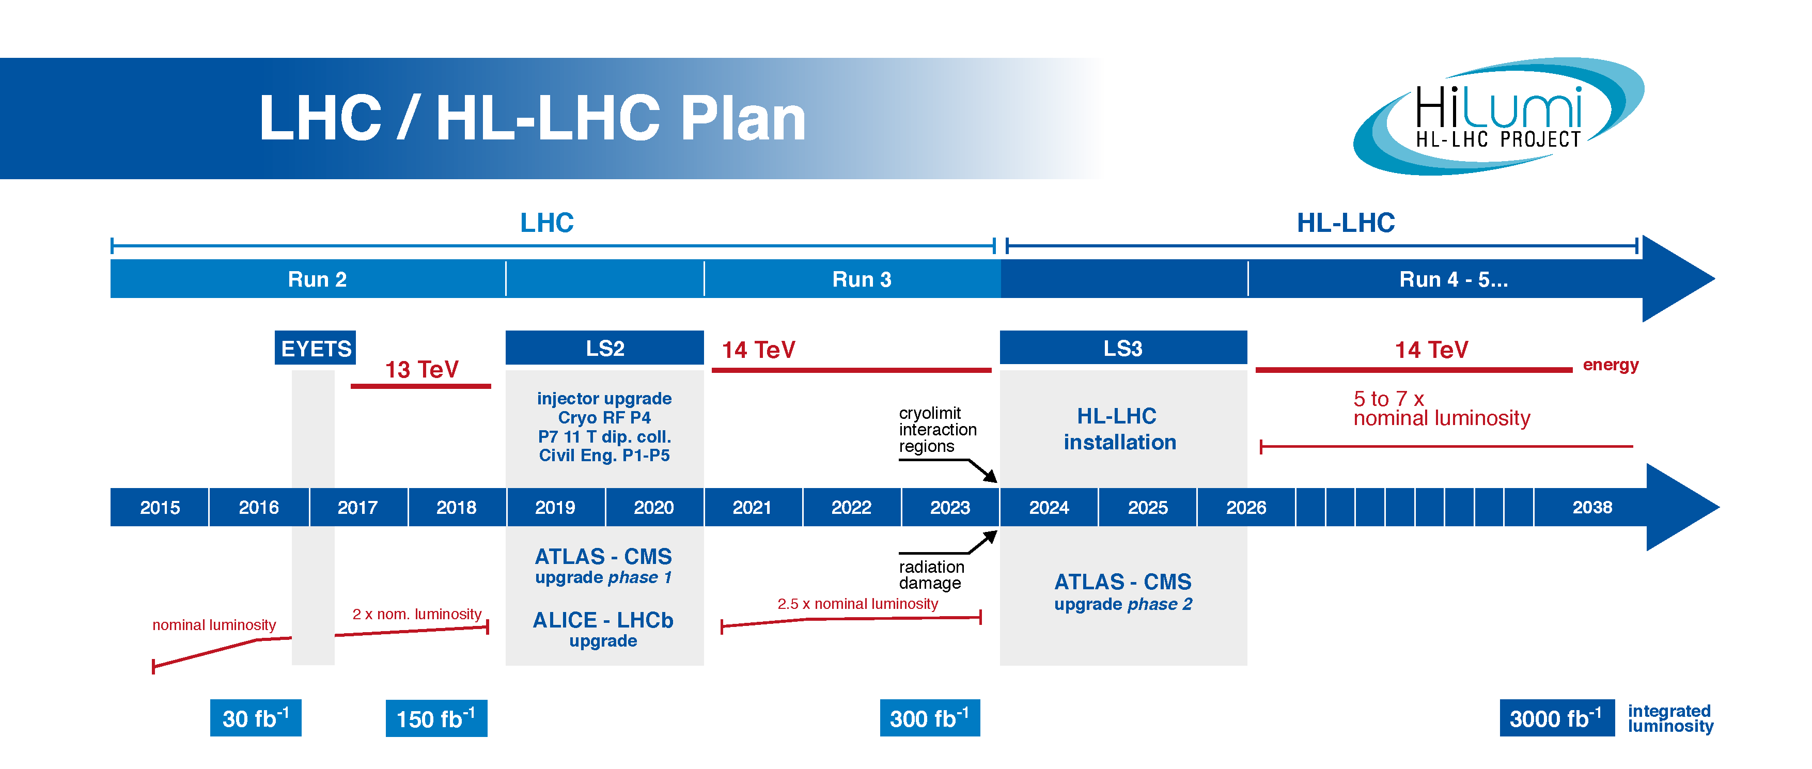
The latest developments in preparations of the LHC community for the computing challenges of the High Luminosity LHC
Dagmar Adamova (NPI AS CR Prague/Rez) and Maarten Litmaath (CERN)
The LHC performance beats any expectations in Run 2 delivering integrated luminosities larger than originally planned. Run 3 and especially Run 4 will bring even more increased luminosities and higher pileup. This will translate into much more data collected by the experiments, more complex events and this in turn will require more sophisticated physics generators, massive simulation campaigns and more complicated and longer running reconstruction.
There are concerns about the scale of computing and storage resources required to make the physics program of Run 3 and Run 4 real. Considering the costs, can the LHC community afford it?
2017: Integrated luminosity 50 fb⁻¹ Pileup μ ~ 30 to 60
2026: Integrated luminosity >300 fb⁻¹ Pileup: μ ~ 130 to 200

Slide 2
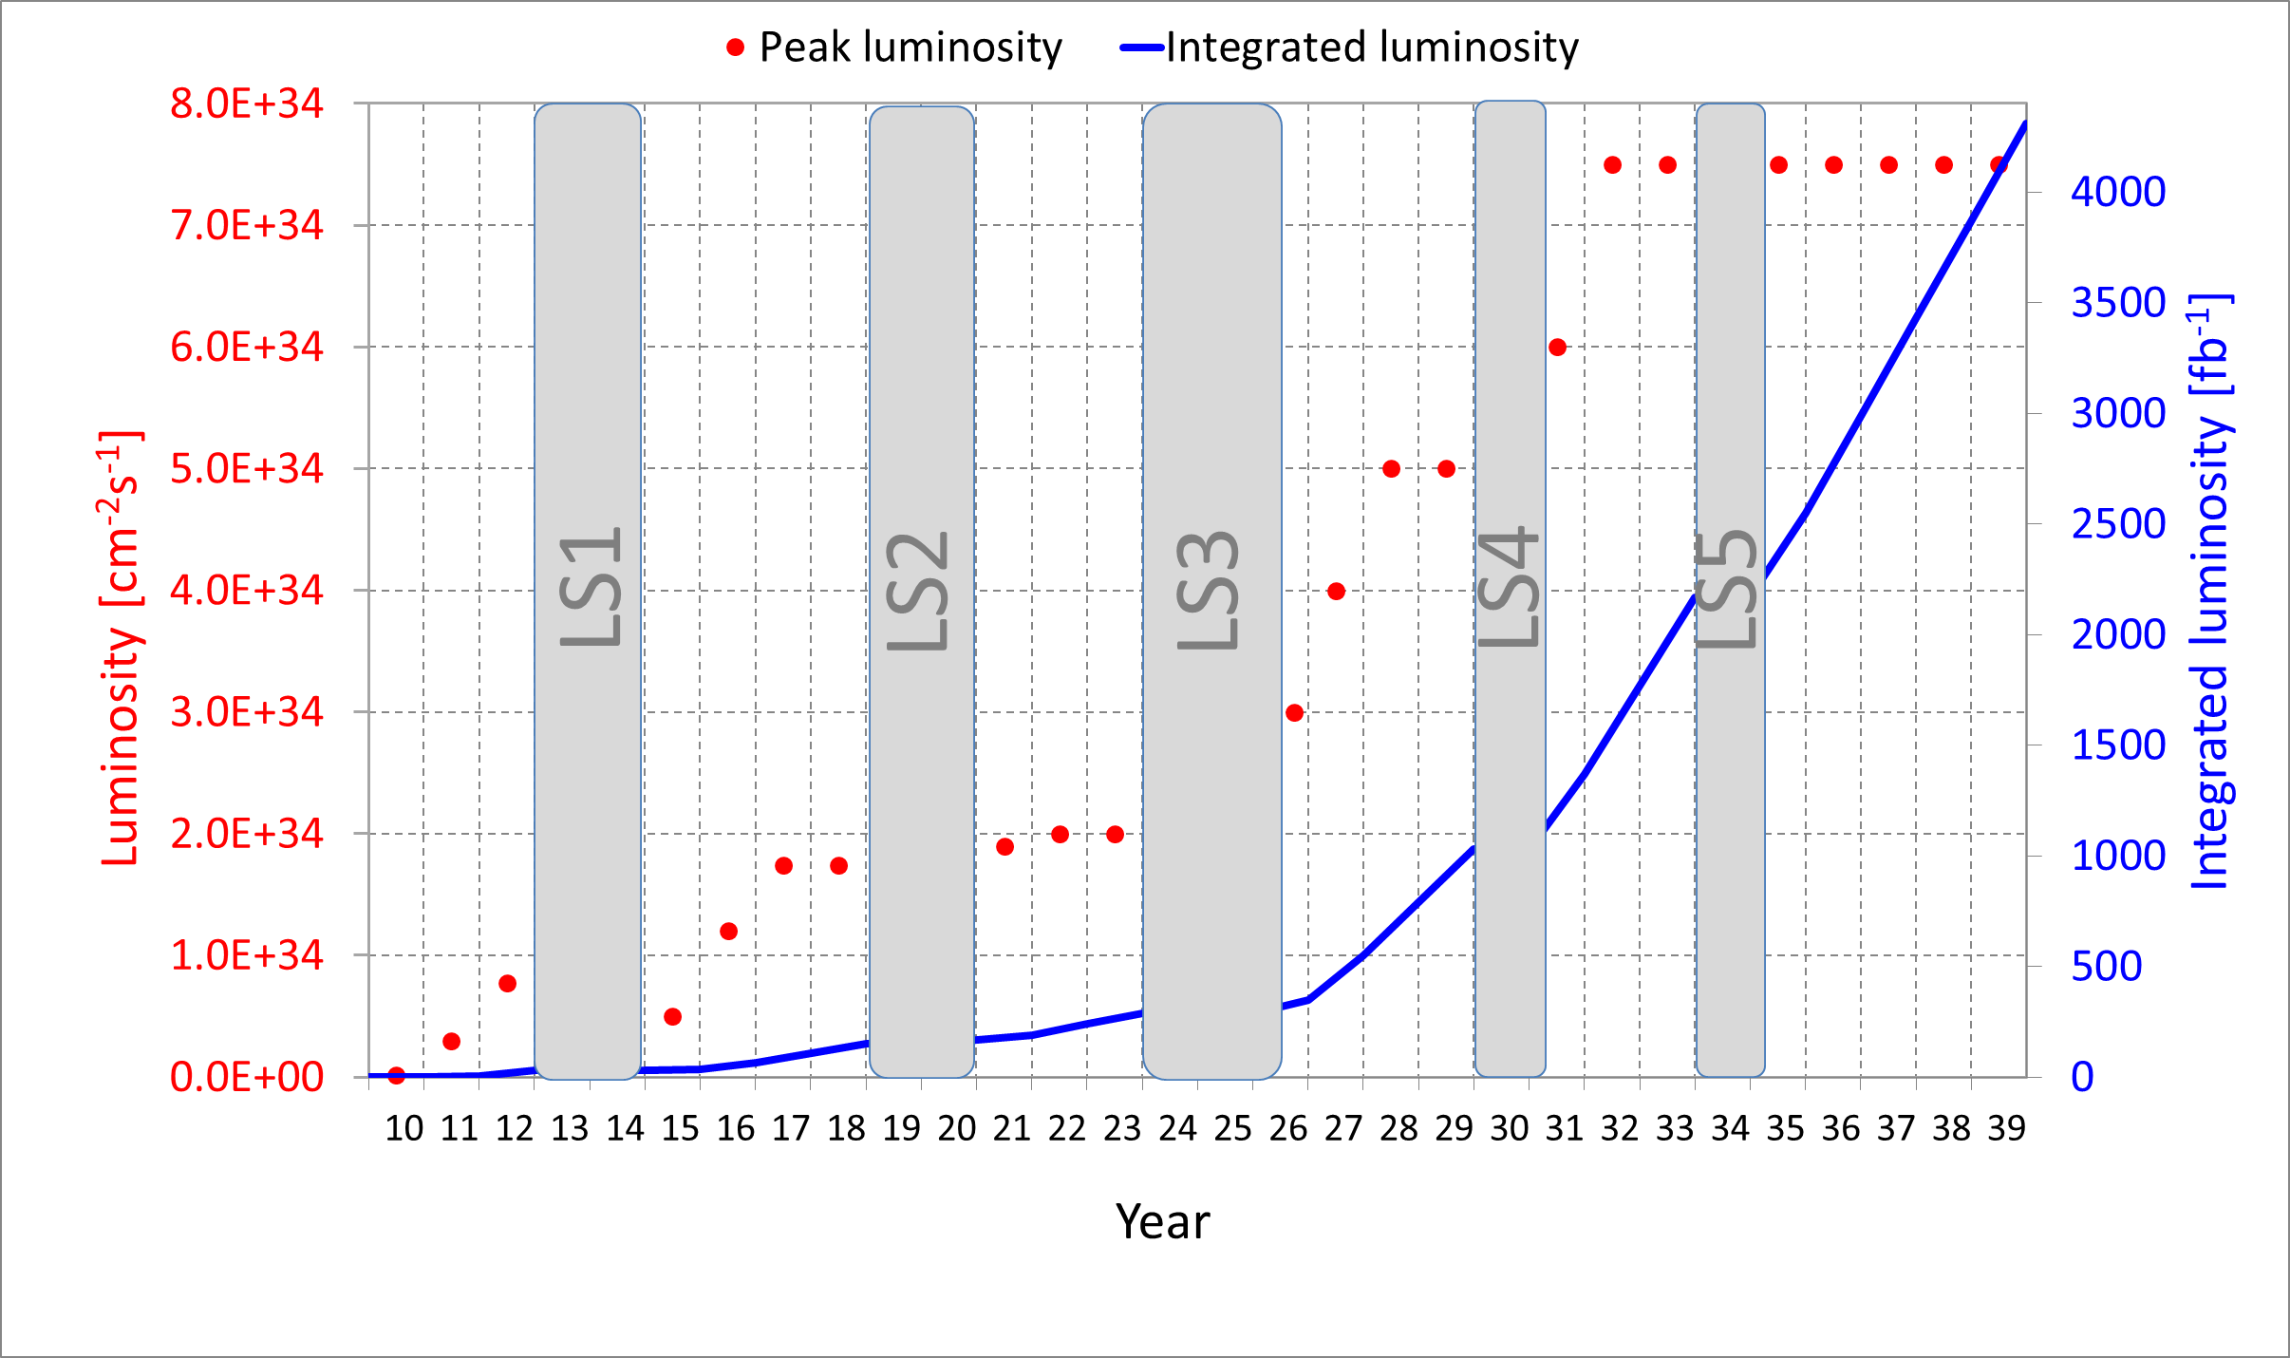
Implications for Run 3 and Run 4 based on the Run 2 experience
In 2017, in the middle of Run 2 and in the Exabyte era, the prospects of ever growing amounts of produced data especially anticipated for the HL-LHC raise concerns about management of the costs for providing the desired resource levels for HL-LHC.
The current projection of the computing needs into the HL-LHC era, taking into account the standard growth of ~20% CPU/year and ~15% in storage/year and the anticipated developments in technology, predict shortfalls of ~ 4x for CPU and ~ 7x for disk.
T0 + T1 + T2 CPU (kHS06)
x 3.7
The ultimate luminosity profile beyond Run 4
Anticipated growth in CPU resources towards Run 4
T0 + T1 + T2 disk (PB)
x 7.1
Anticipated growth in disk capacity towards Run 4
Increase of time needed for reconstruction of one event depending on the pileup (ATLAS experiment)

Slide 3

The strategy documents: giving roadmaps and timelines for work to provide capacities needed for the HL-LHC physics program
Since the end of the very successful Run 1 the LHC experiments have faced constraints in availability of CPU and storage.
A number of activities were launched to help bridge the gap, including the re-structuring of computing models, adaptation of software to fast and/or cheap CPU architectures, and speeding up simulation and reconstruction processes. These endeavours were mostly done by experiments individually except for developments in ROOT and Geant4/GeantV.
In 2017 WLCG management called for blueprint documents defining roadmaps and timelines not only common to the LHC experiments, but also relevant to other big HEP projects, to help prepare for the demands of HL-LHC and related endeavours.
The Community White Paper was delivered by the HEP Software Foundation at the end of 2017 and a WLCG Strategy document is to appear soon. Various working groups were established and the topics to pursue include:
Improving software performance and efficiency
Reducing data volume
Reducing processing costs
Reducing infrastructure and operation costs
Ensuring sustainability
“The amount of data that experiments can collect and process in the future
will be limited by affordable software and computing, not by physics”
Taken from “Community White Paper” of the HEP Software Foundation
http://hepsoftwarefoundation.org/activities/cwp.html

Slide 4
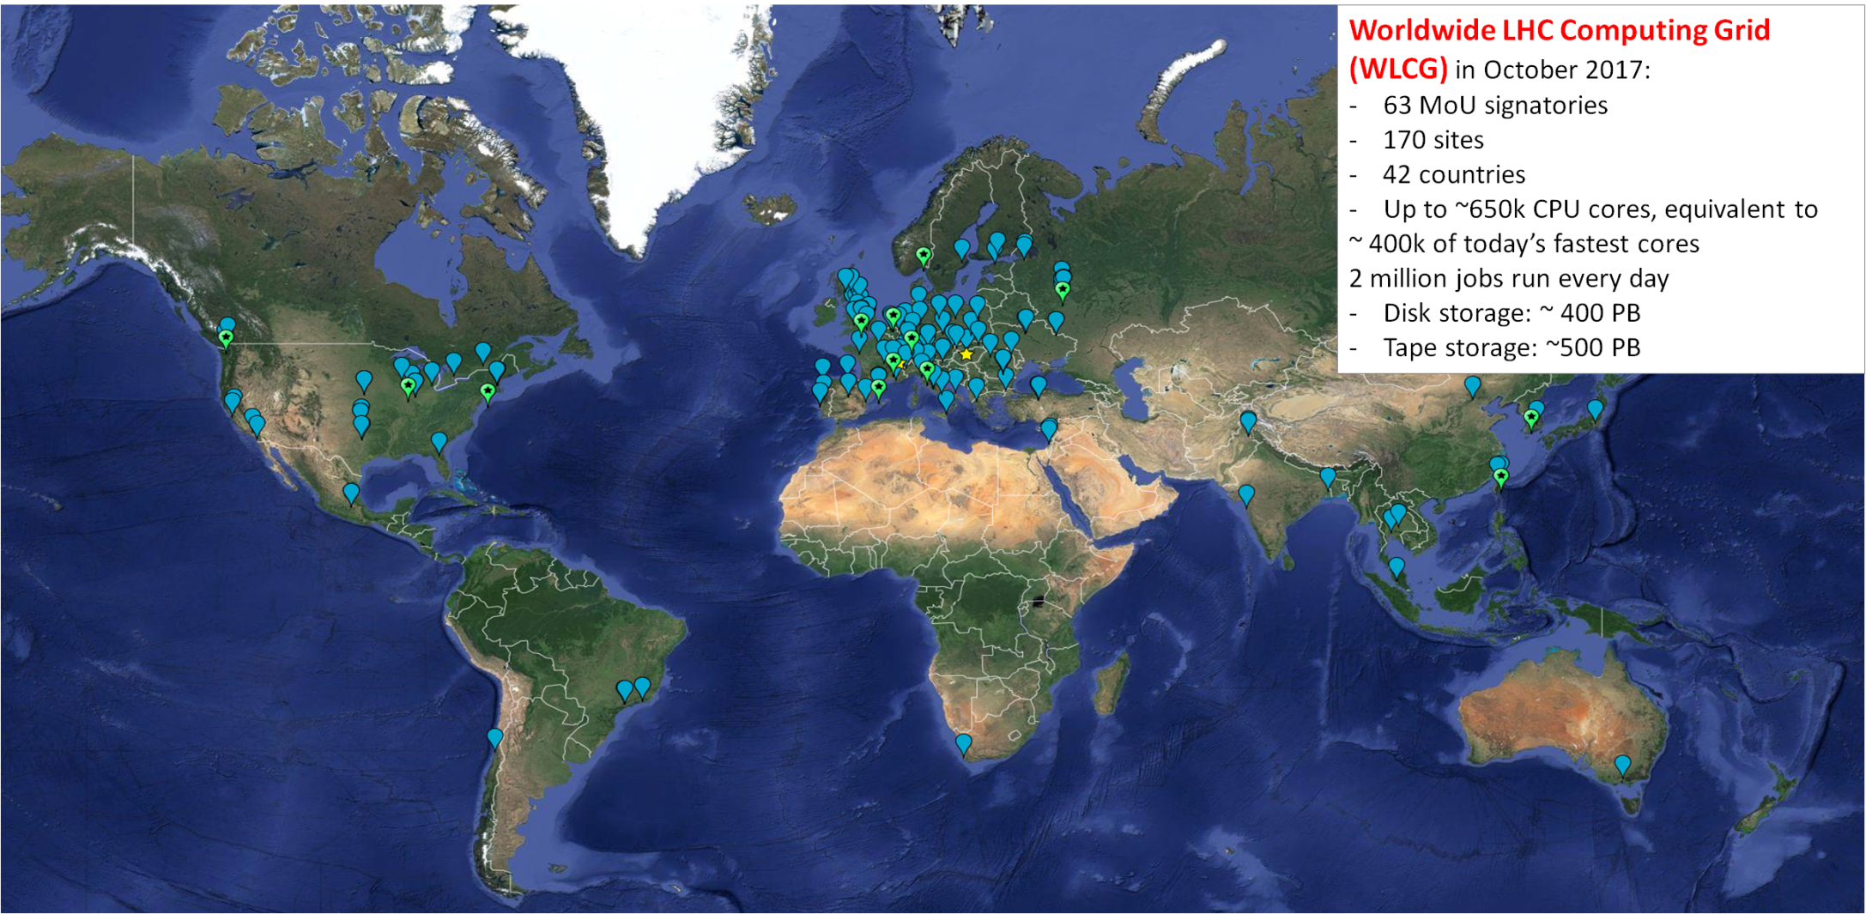
Worldwide LHC Computing Grid in 2017
The distributed computing and storage infrastructure for the LHC experiments, WLCG, has been providing a safe framework for processing of LHC data and delivery of physics results ever since the startup of the LHC operations. It will be a challenge to keep the capacity sufficient through Run 3, Run 4 and beyond !

