Slide 1
Physics with ultra-cold neutrons at the ILL
Oliver Zimmer
Institut Laue Langevin
56th International winter meeting on Nuclear Physics, 24 January 2018

Slide 2
Topics
The impossible particle and its basic properties
Search for an electric dipole moment of the neutron
Short-range gravity
Measurements of the neutron lifetime
Production of ultracold neutrons

Slide 3
… and Godfather created the neutron

Slide 4
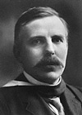
… and Godfather created the neutron

Slide 5
… and Godfather created the neutron
“Such an atom would posses striking properties. Its outer field would vanish [...] and therefore it should easily penetrate matter. The existence of such an atom is presumably difficult to observe with a spectrograph, and ...“

Slide 6
… and Godfather created the neutron
“Such an atom would posses striking properties. Its outer field would vanish [...] and therefore it should easily penetrate matter. The existence of such an atom is presumably difficult to observe with a spectrograph, and it could not be stored in a closed vessel.“
(„Nuclear Constitution of Atoms“, Proc. Royal Soc. 1920)

Slide 7
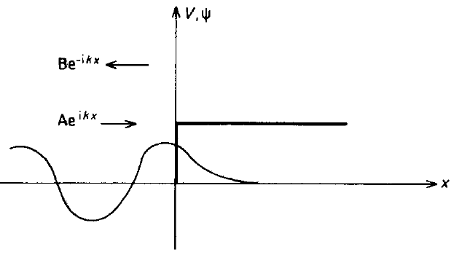


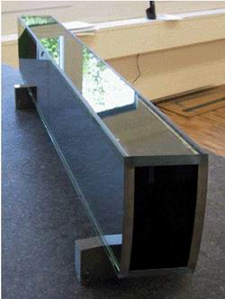
How to store it nevertheless?
Trapping potential #1:
neutron optical potential V + iW
Physical origin:
neutron wave optics
Neutron guides:
Typical values for V:
Be: 252 neV, Al: 54 neV, Ti: -49 neV
Mirror reflection under any angle of incidence
→ UCN can be trapped in “neutron bottles”

Slide 8
Trapping potential #2:
neutron gravity mgz
for Δz = 1 m: ΔE = 100 neV

Slide 9
Trapping potential #2:
neutron gravity mgz
for Δz = 1 m: ΔE = 100 neV
as good for trapping
(if bottle is tall enough):

Slide 10

Trapping potential #3:
magnetic interaction ±µB
for ΔB = 1 T: ΔE = ±60 neV
Adiabatic spin transport if
→ mT fields sufficient in typical situations
Magnetic gradient fields suppress losses due to wall collisions

Slide 11
Search for an electric dipole moment of the neutron
magnetic moment
-
EDM
+

Slide 12
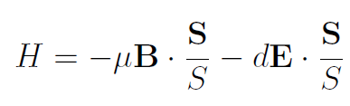
Violation of fundamental symmetries
Purcell and Ramsey, PR 78 (1950) 807
-
-
T
+
+
A non-zero particle EDM violates T (time reversal symmetry) and parity P
Assuming CPT conservation, also CP is violated, which is needed to explain the matter/antimatter asymmetry in the Universe
-
+
P
+
-

Slide 13
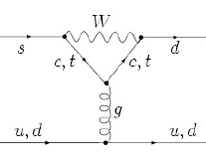
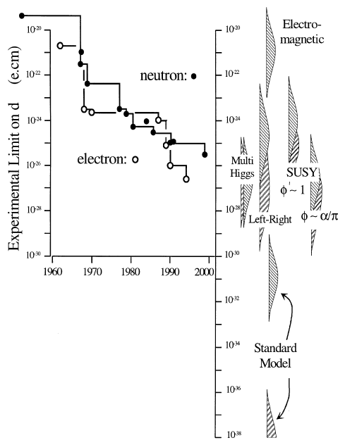
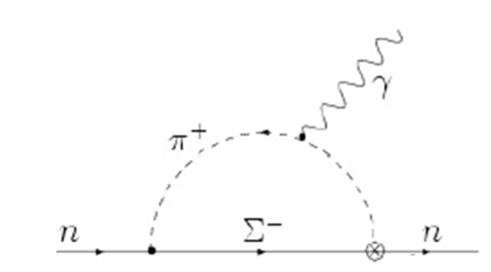
CP violation within the Standard Model (SM) is too weak to explain the matter/antimatter asymmetry in the Universe
nEDM tiny in the SM (10⁻³¹ ecm), but large in many beyond-SM theories
nEDM sensitive probe to search new fundamental forces
Pendlebury and Hinds, NIM A 440 (2000) 471

Slide 14
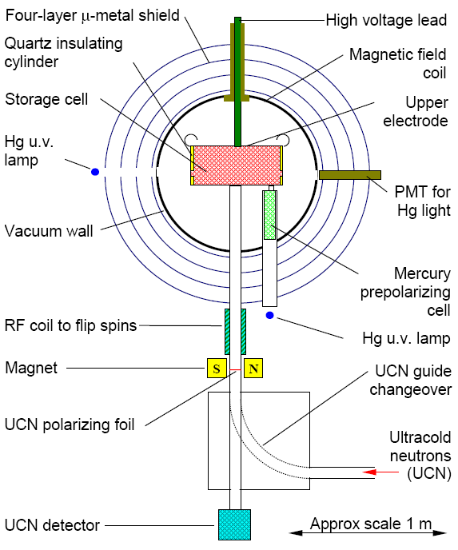
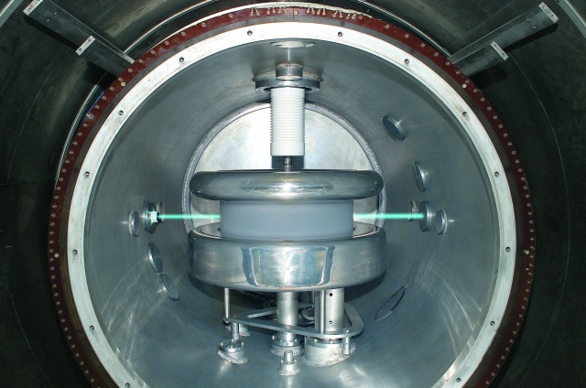
How is it measured?
RAL/SUSSEX/ILL experiment:
Ultra-cold neutrons (UCN)
trapped in an evacuated
vessel at room temperature
B₀
~ 0.5 m
Baker et al., PRL 63 (2006) 131801

Slide 15
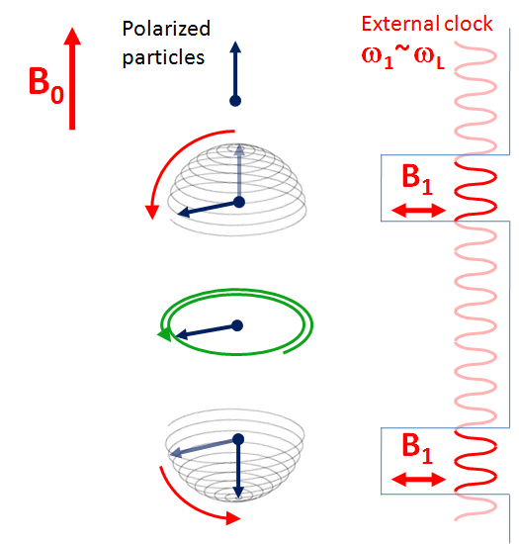
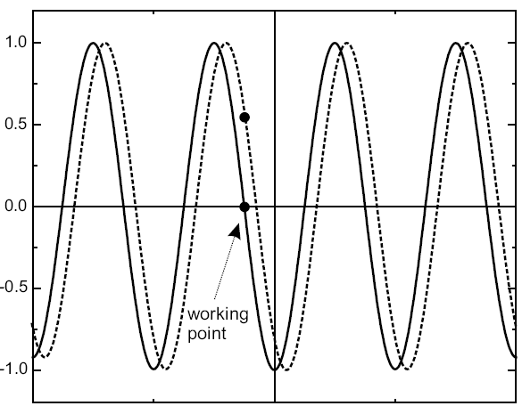
Ramsey’s method
...initially applied to particle beams
polarization
E
ω₁ - ω_{L} („detuning“)
+ final polarisation analysis
Experimental sensitivity:
EDM changes frequency:

Slide 16
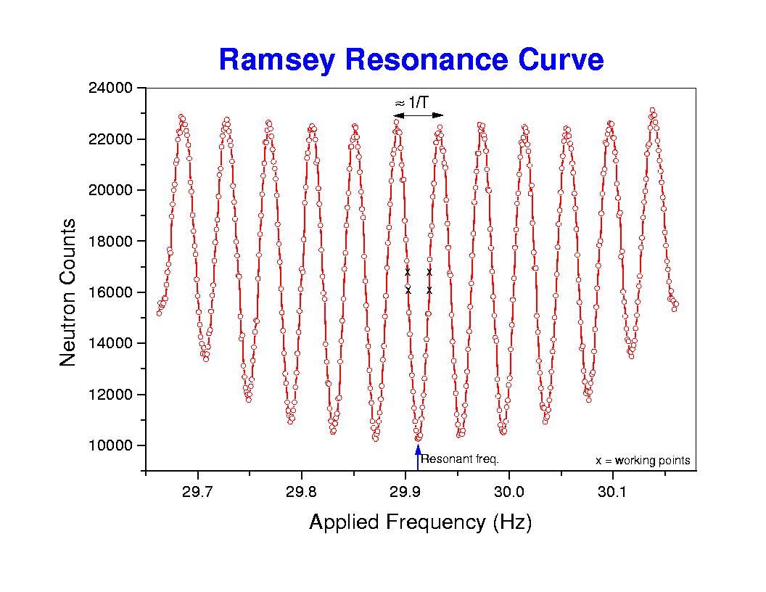
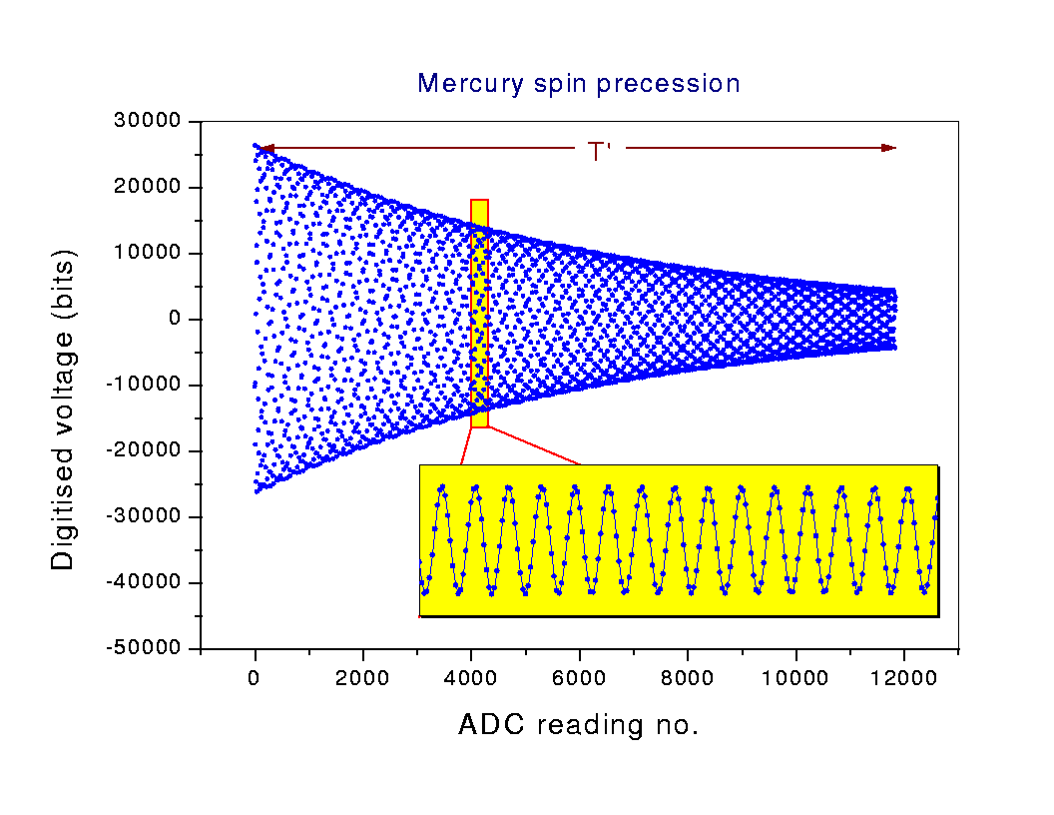
¹⁹⁹Hg co-magnetometer for correction of magnetic field drifts
Courtesy
M. v. d. Grinten
ratio of precession frequencies

Slide 17
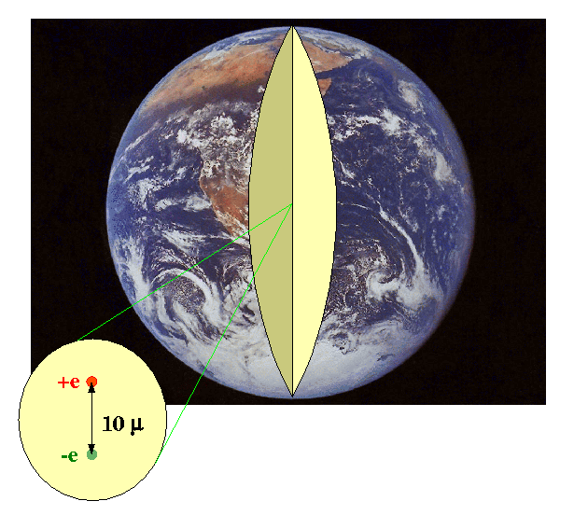
Best result so far (RAL / Sussex / ILL)
|d_{n}| < 2.9 × 10⁻²⁶ e cm (90% CL)
C.A. Baker et al., PRL 63 (2006) 131801
10⁻²² eV spin-dependent interaction
one spin precession per half year

Slide 18
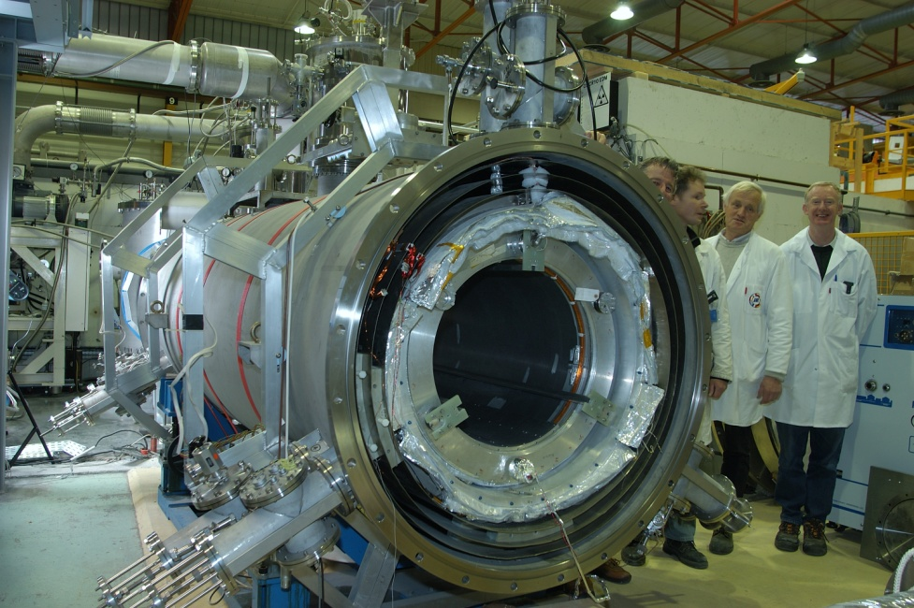
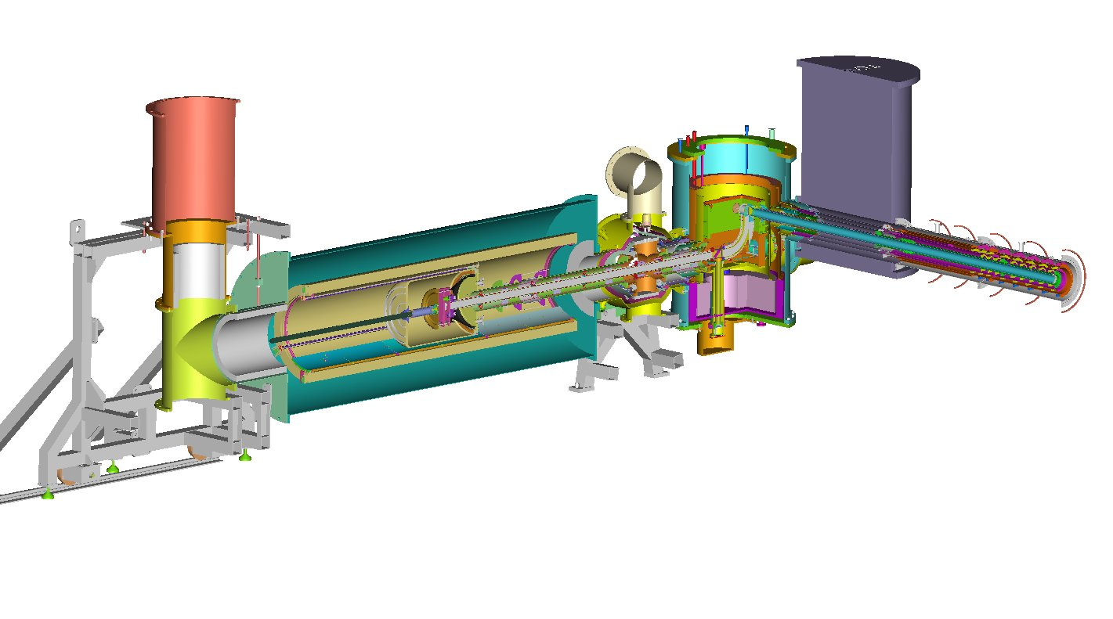
Follow-up experiment:
Cryo-EDM
(Rutherford – Sussex –
Kure – Oxford – ILL)
Accuracy goal: 10⁻²⁷ ecm
Superconducting Pb shield
HV stack
Superthermal UCN source
Storage cells
…discontinued in 2015

Slide 19
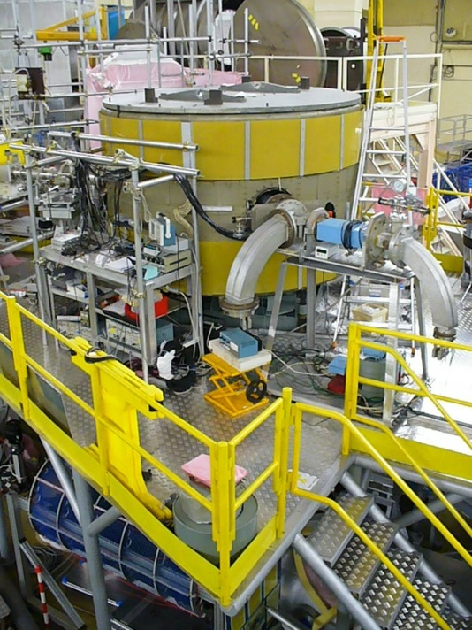
Double-chamber EDM experiment (PNPI-ILL)
E
Intermediate result:
|d_{n}| < 5.5 × 10⁻²⁶ e cm (90% CL)
A. Serebrov et al., JETP Lett. 99 (2014) 4
Experiment currently on hold
(seismic reinforcements of platform)

Slide 20
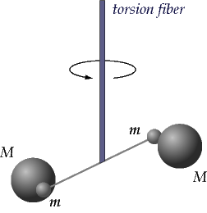
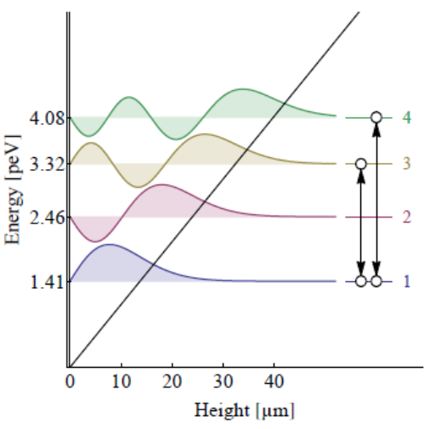
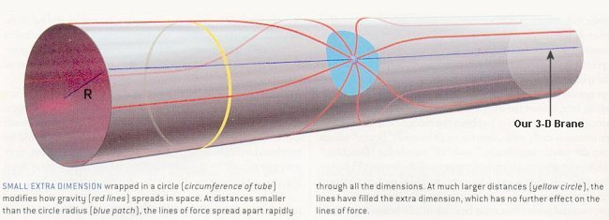
Short-range gravity
Small extra-dimensions:
Explanation why gravity is such a weak force?
Modification of gravity
with n additional dimensions at distances r < R:
New spectroscopic tool:

Slide 21
First observations (2002)
Proposal: Luschikov and Frank, JETP Lett 28 (1978) 559
Nesvizhevsky et al., Nature 415 (2002) 299

Slide 22
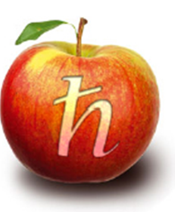
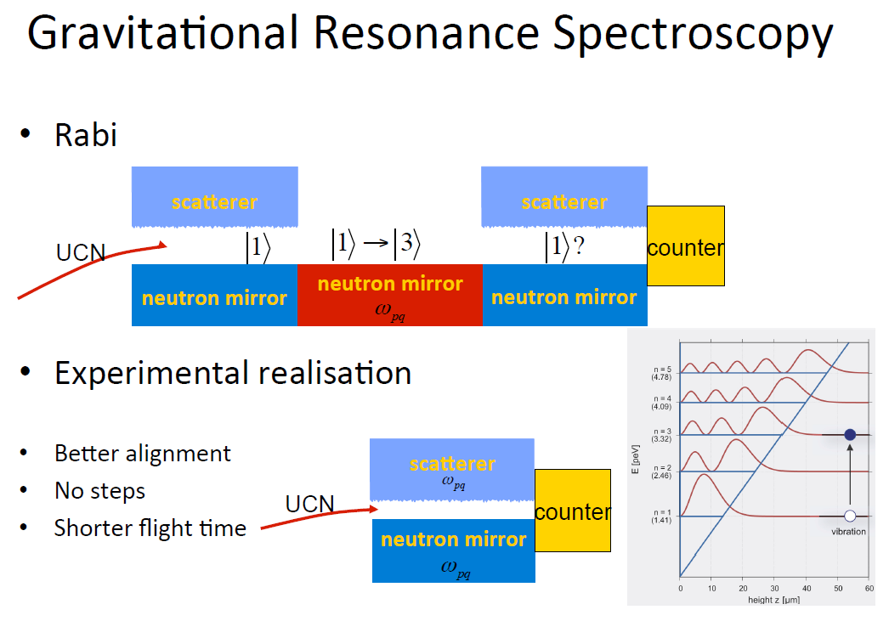
Rabi-type spectroscopy of gravity qBounce collaboration (H. Abele, T. Jenke…)

Slide 23
Latest results
Cronenberg et al., ArXiv:1512.09134 (2015)
1 ↔ 3
1 ↔ 4

Slide 24
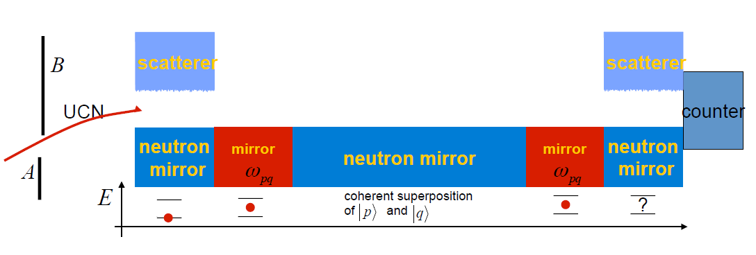
Ramsey spectrometer for gravity states
H. Abele et al., Phys. Rev. D 81 (2010) 065019
Advantages:
Long flight path → smaller uncertainty ΔE
static central mirror for free state evolution

Slide 25
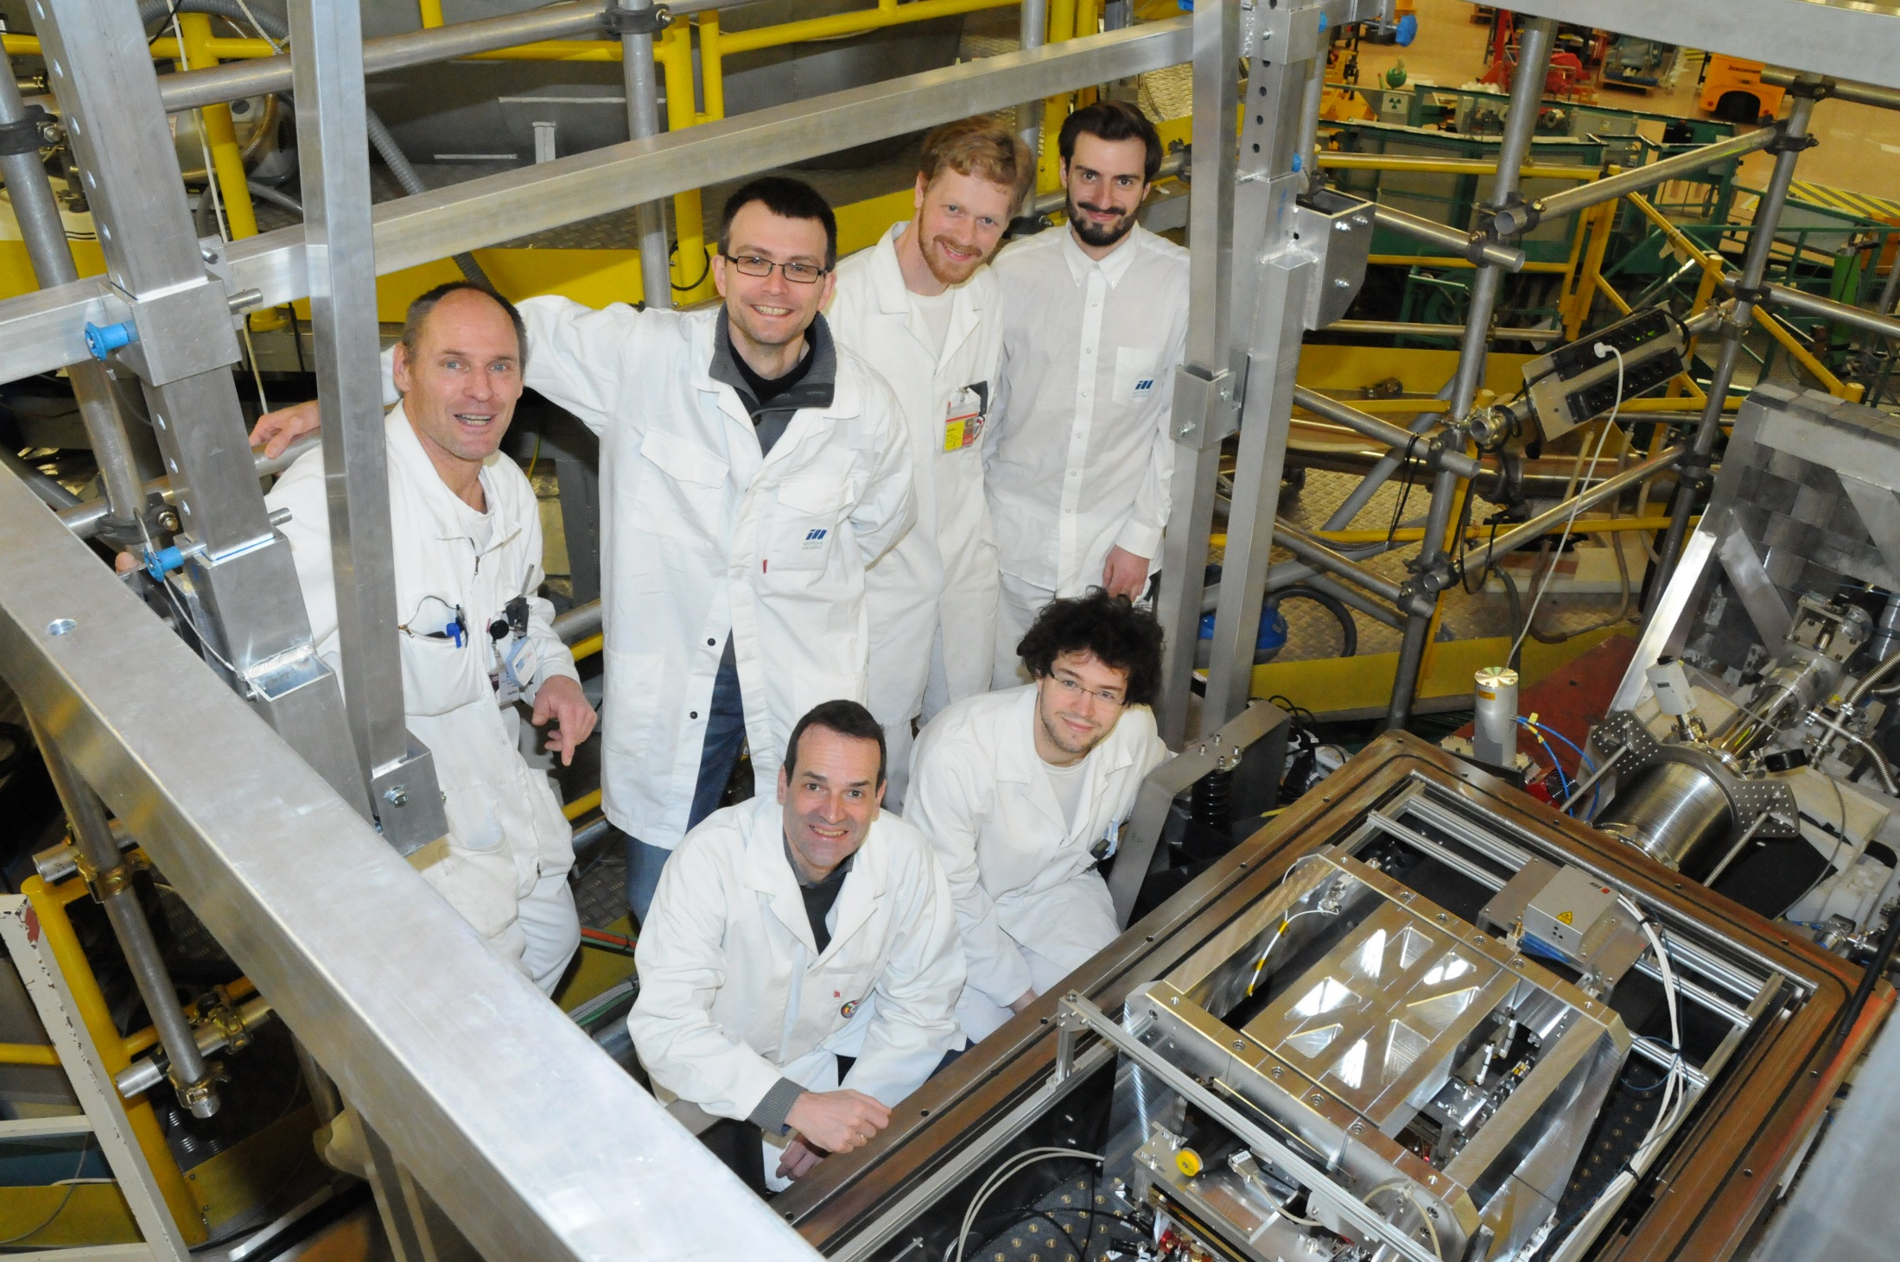
Team of happy experimentalists

Slide 26
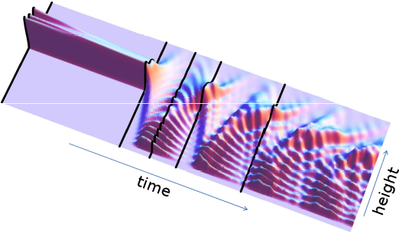
Quantum bouncing ball

Slide 27
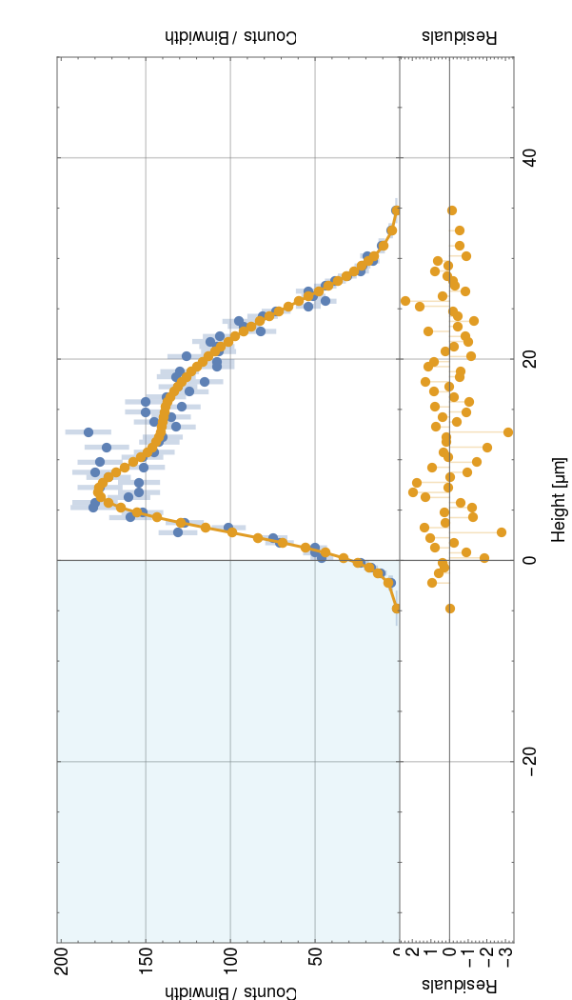
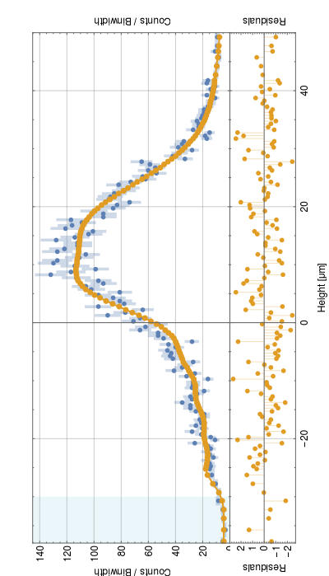
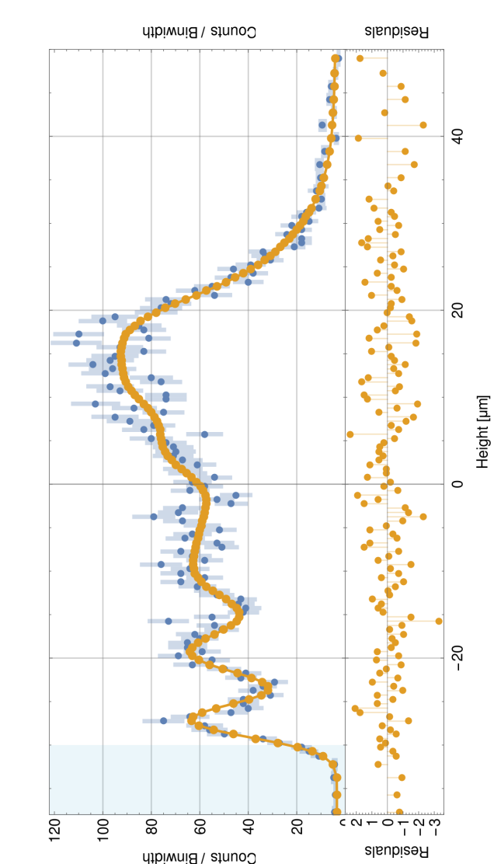
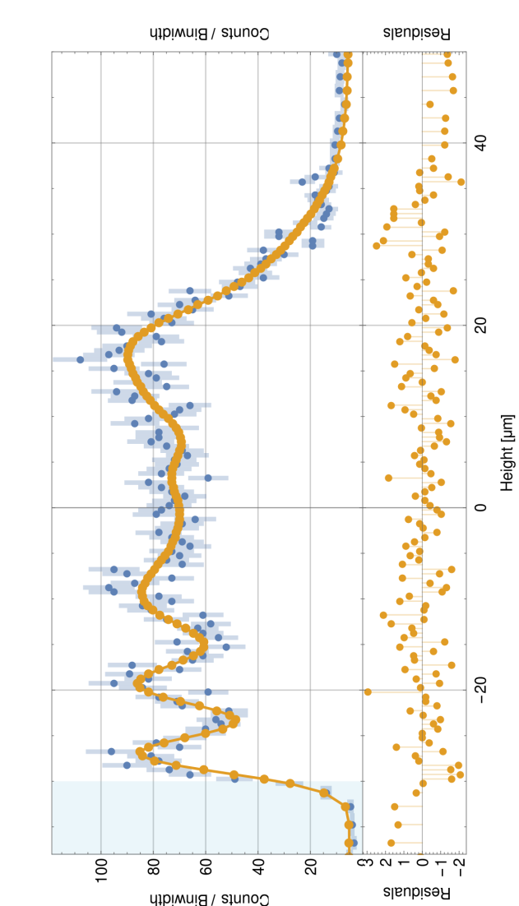
Experimental realization of
Quantum Bouncing Ball
PhD thesis of Martin Thalhammer, TU Vienna and ILL
Preliminary, to be published...

Slide 28
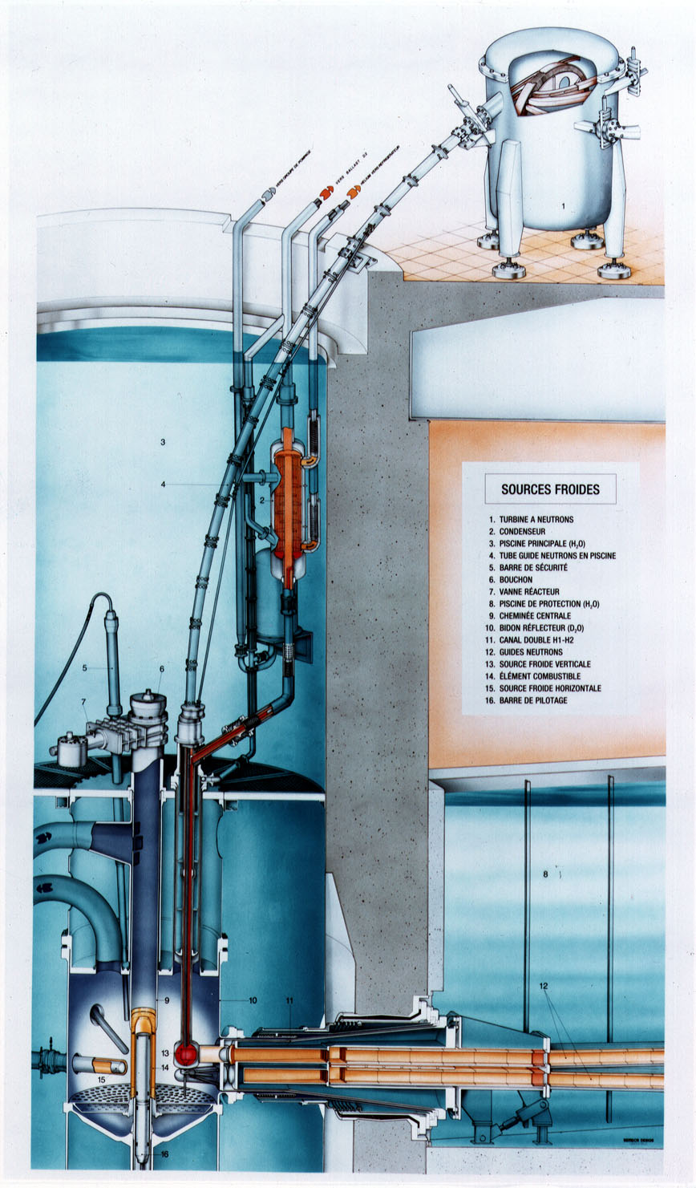
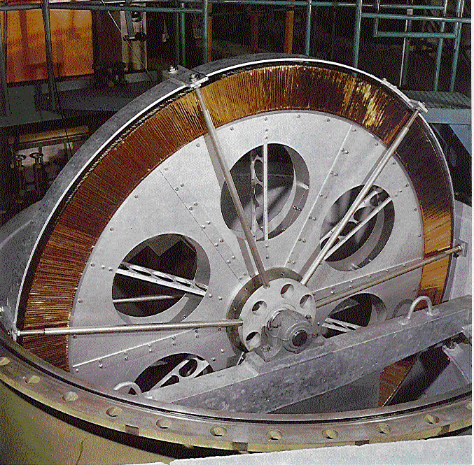
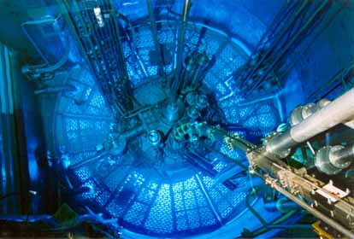
(Ultra)cold neutron
production at ILL
~ 20 cm⁻³
Neutron turbine
A. Steyerl TUM/ILL 1985
vertical
guide
cold source
reactor core

Slide 29
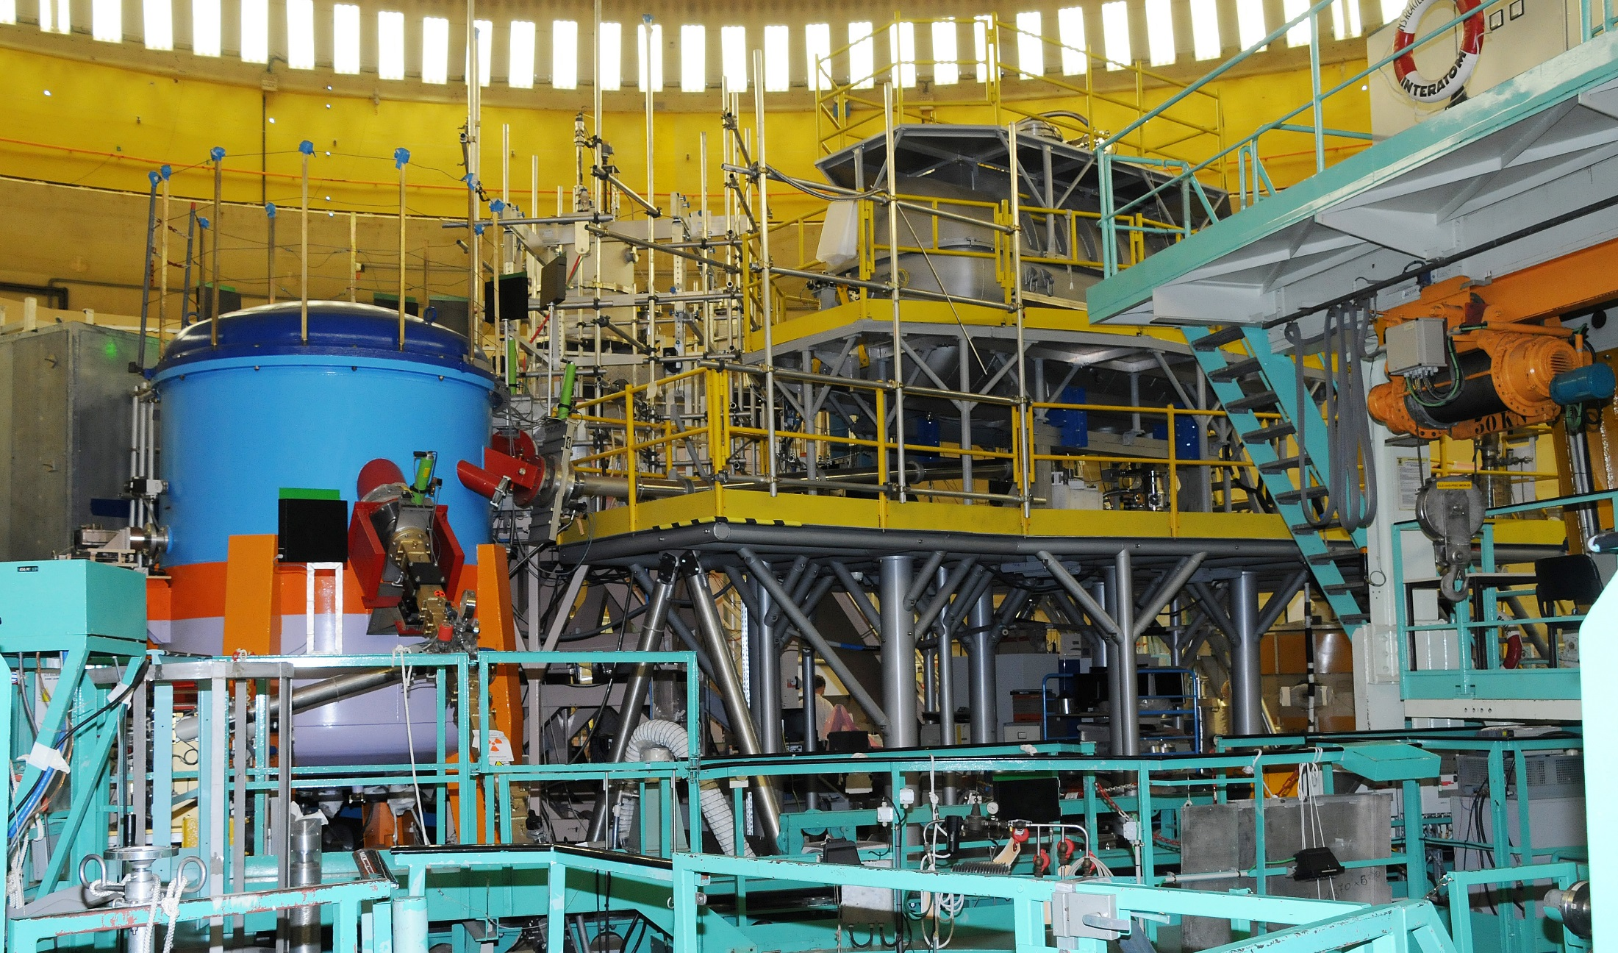
Instruments on “level D” at ILL
Neutron turbine q-Bounce Big GraviTrap

Slide 30
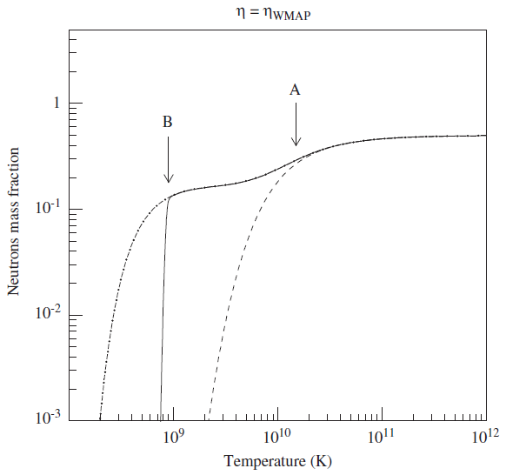
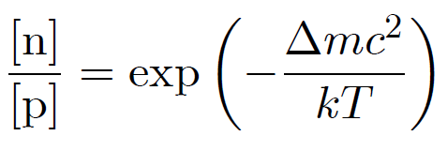
The neutron lifetime in Big Bang Nucleosynthesis
n + e⁺ ↔ p + ν
n + ν ↔ p + e
n → p + e + ν
¹H 75%
⁴He 25%
²H/¹H 25ppm
³He/¹H 10ppm
⁷Li/¹H 4×10⁻¹⁰
A. Coc, NIM A 611 (2009) 224
R.H. Cyburt et al., RevModPhys 88 (2016) 015004-1

Slide 31
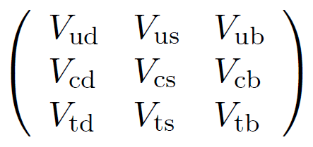
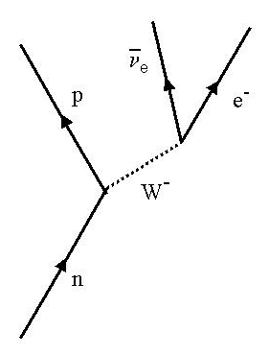
Relevance for nuclear and particle physics
g_{A} and g_{V}
(axial-vector and vector weak formfactors of the nucleon,
from neutron lifetime and beta asymmetry)
→ important cross sections
of 1st generation semileptonic weak interactions:
primordial neutrino reactions,
solar fusion,
neutrino detection...
V_{ud} determination and test of CKM unitarity
Marciano & Sirlin PRL 96 (2006) 032002
uncertainty due to radiative corrections:
→ request δτ_{n} < 0.34 s

Slide 32
Experimental situation in 2016
G. Greene and P. Geltenbort, Sci. Am. 314 (2016) 36

Slide 33
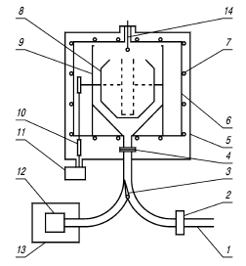
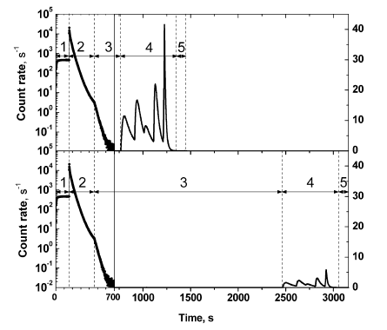
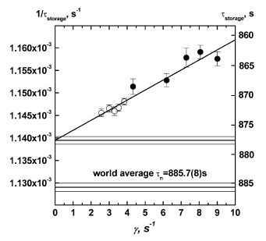
Neutron lifetime experiment GraviTrap
with low-T „fomblin“ oil coated walls
A. Serebrov et al., PLB 605 (2005) 72
UCN
878.5(8) s
Frequency of wall collisions (/s)

Slide 34
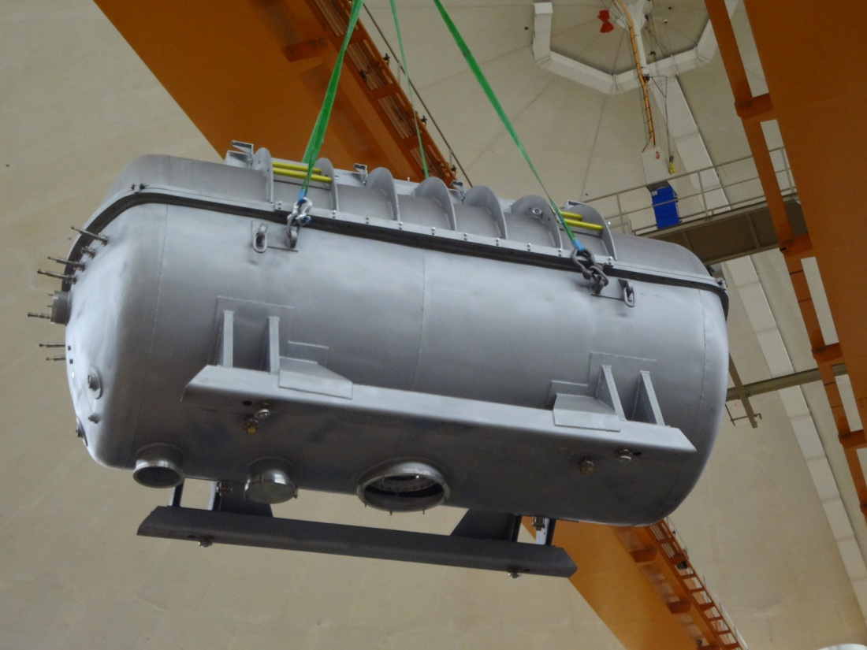
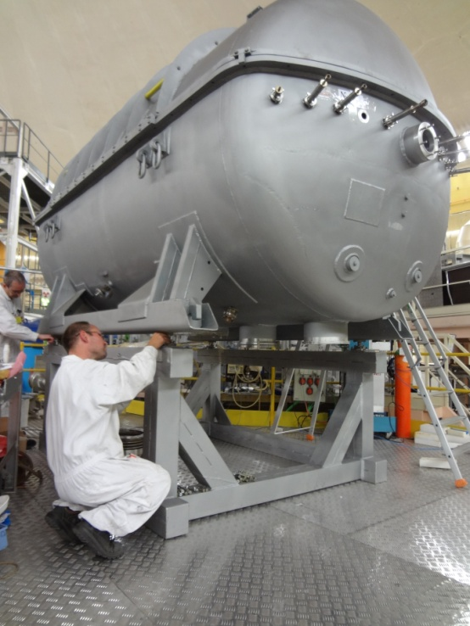
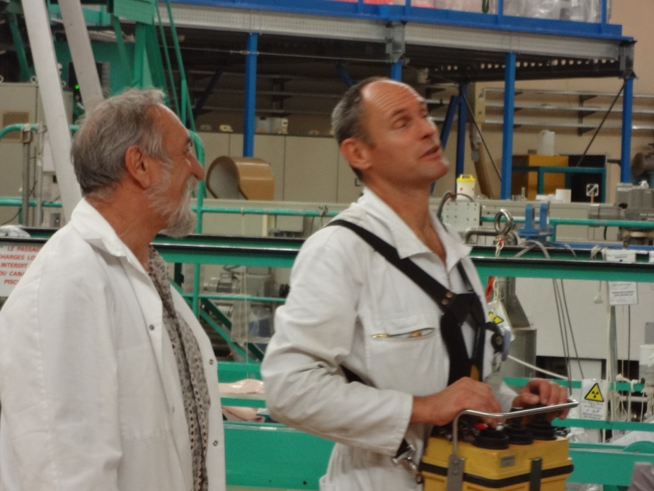
Successor experiment „Big GraviTrap“ (PNPI)
(during installation in 2014 at ILL)

Slide 35
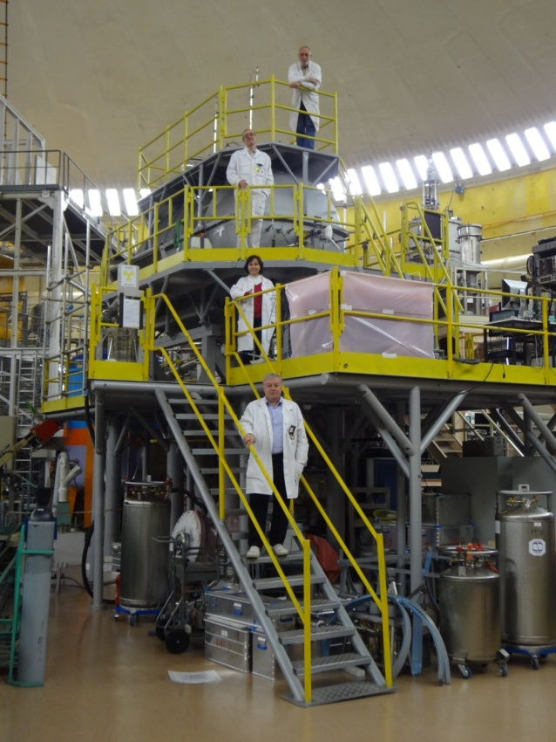
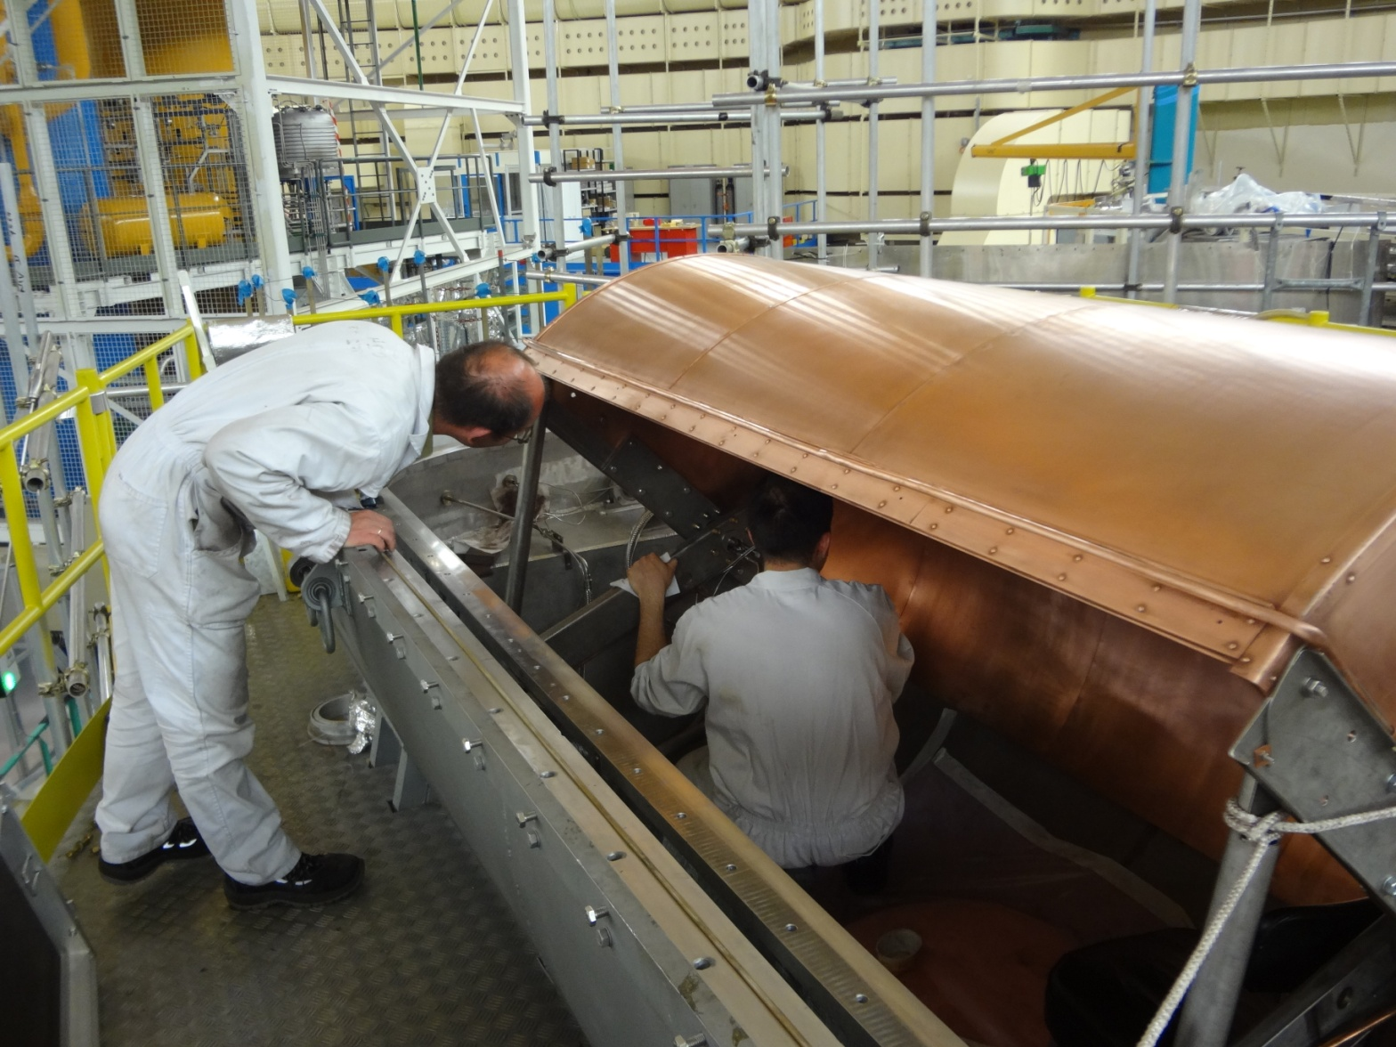
Job (installation) done...
Work on trap preparation
First result (measurements to be continued with colder trap):
Serebrov et al., arXiv:1712.05663:
τ_{n} = (881.5 ± 0.7 ± 0.6) s

Slide 36
UCNτ (“fill and kill”)
Done at the solid-deuterium
UCN source at Los Alamos
+ triple blind analysis
– no monitoring of
depolarised UCNs
Morris et al., arXiv:1610.04560:
τ_{n} = (878.8 ± 2.6 ± 0.6) s
Pattie et al., arXiv:1707.01817:
τ_{n} = (877.7 ± 0.7 + 0.3/-0.1) s

Slide 37
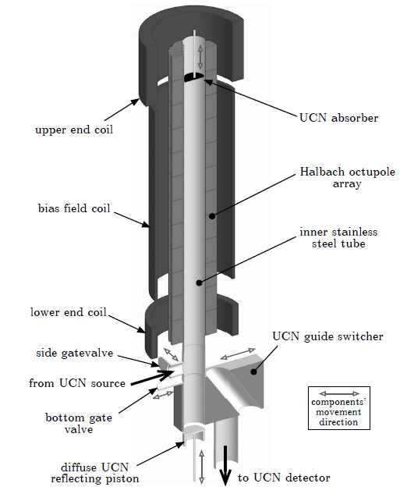
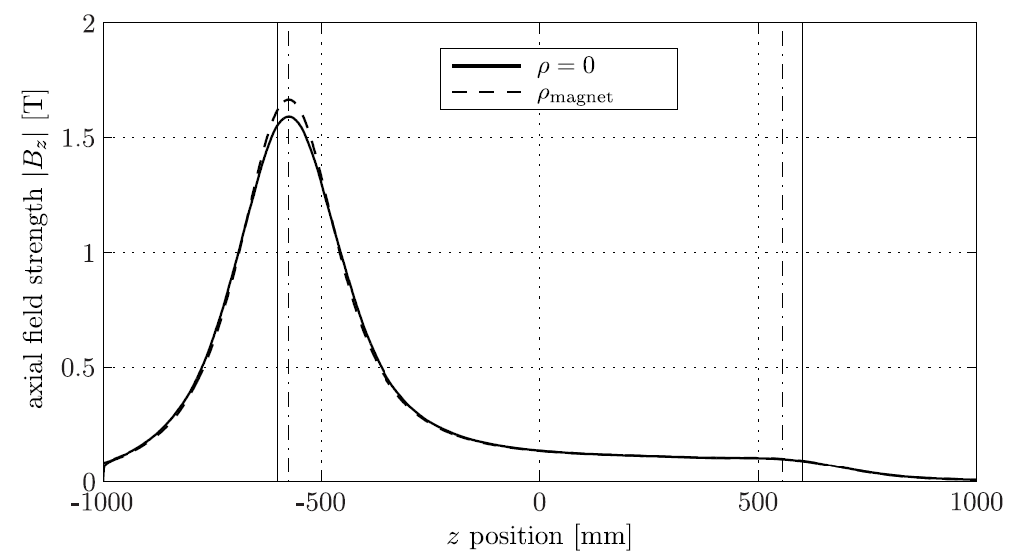
HOPE – Halbach OctuPole neutron lifetime Experiment
PhD works Loris Babin, Felix Rosenau, Fabien Lafont, Kent Leung
magneto-gravitational trap
V_{eff} ≈ 2 l
trap depth 47 neV
counting the dead & survivors
depolarisation monitoring
employs a new UCN source
mgz

Slide 38
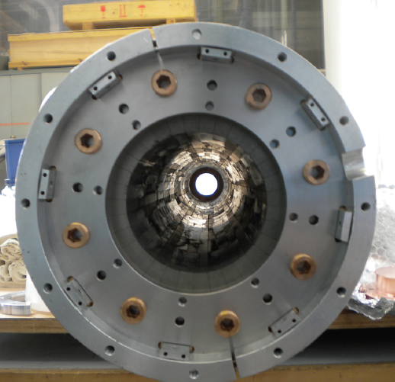
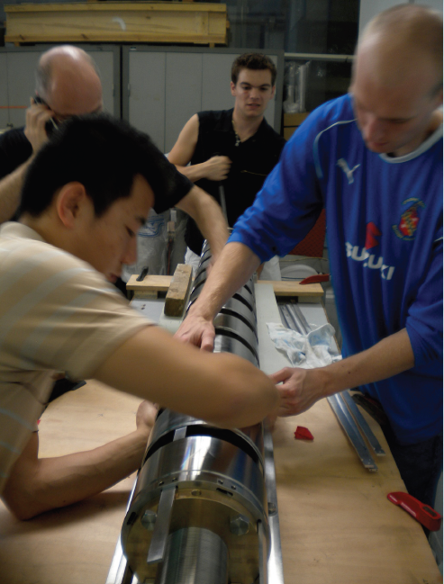
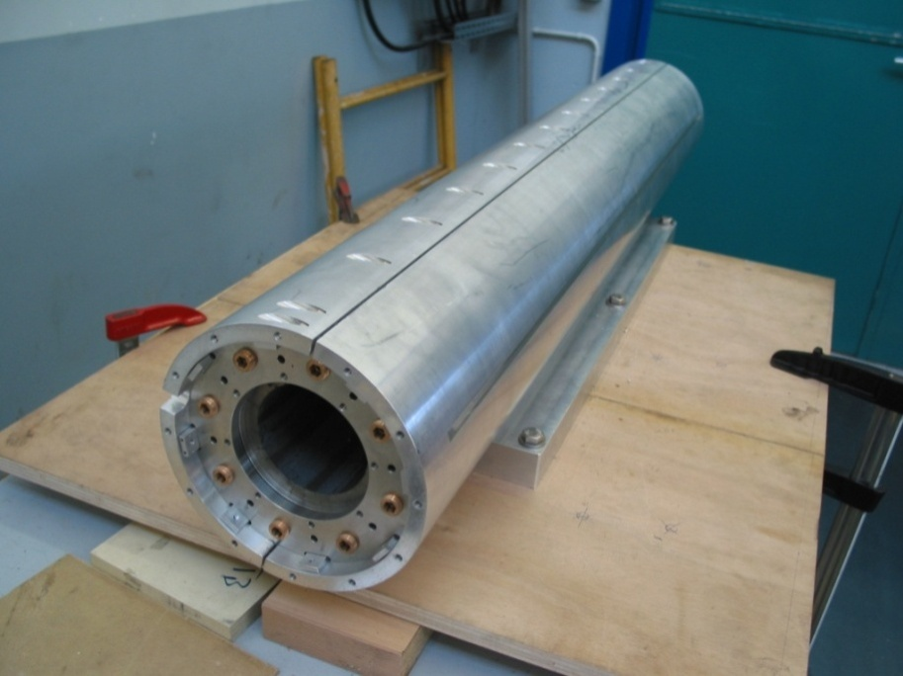
Halbach octupole radial trap
B(r) = B_{R}(r/R)³
32 magnet slices
B_{R} = 1.35 T (NdFeB)
12 8-pole modules + hands & forces = magnetic trap

Slide 39
“Next-generation” UCN sources based on neutron conversion
downscattering
E₀ + Δ
cold neutron
UCN
Phonon
E₀
solid Deuterium sD₂: superfluid helium-4:
temperature: 5 K 0.5 K (1.3 K)
spin effects para-D₂ content < 1% spin-0
UCN storage lifetime ≈ 0.15 s → τ_{n} ≈ 880 s
mesoscopic structure single crystal – crystallites homogeneous liquid
implementation in-pile in beam (in-pile)

Slide 40

UCN production in superfluid He
R. Golub, J.M. Pendlebury, PL 53A (1975) 133
ω
free neutron dispersion
1 meV
(12 K)
„phonon-roton“
dispersion
of superfluid ⁴He
7 nm⁻¹
(0.9 nm → UCN)
q
T [K] τ_{max} [s]
1 100
0.8 310
0.7 510
0.5 820
0 880
cold neutron
beam
converter
σ_{capture} (⁴He) = 0
ρ_{UCN} = Pτ
τ ⁻¹ = τ ⁻¹_{decay} +τ ⁻¹_{upscattering} +τ ⁻¹_{capture} +τ ⁻¹_{wall losses}
need T < 0.5 - 0.6 K
and low-loss walls

Slide 41

UCN accumulation and extraction?
Factor 50 missing in an experiment at ILL in the 1980‘s
→ „one cannot extract UCNs accumulated in superfluid helium“
cold beam
A.I. Kilvington et al., PL A 125 (1987) 416

Slide 42

Superfluid-He UCN source development (2004+)
2007 (TUM): First demonstration of windowless extraction of accumulated
UCNs from converter of 1st prototype source at FRM2

Slide 43


Superfluid-He UCN source development (2004+)
2007 (TUM): First demonstration of windowless extraction of accumulated
UCNs from converter of 1st prototype source at FRM2
f. l. t. r.: Hans Friedrich Wirth,
Karsten Baumann, Bea Franke

Slide 44
Superfluid-He UCN source development (2004+)
2007 (TUM): First demonstration of windowless extraction of accumulated
UCNs from converter of 1st prototype source at FRM2
PRL 99 (2007) 104801, EPJ C 67 (2010) 589

Slide 45


Superfluid-He UCN source development (2004+)
2007 (TUM): First demonstration of windowless extraction of accumulated
UCNs from converter of 1st prototype source at FRM2
2010 (ILL): 274000 UCNs extracted from 5-l converter of SUN-1 (55/ccm)
PRL 107 (2011) 134801 (PRL highlight)

Slide 46
Superfluid-He UCN source development (2004+)
2007 (TUM): First demonstration of windowless extraction of accumulated
UCNs from converter of 1st prototype source at FRM2
2010 (ILL): 274000 UCNs extracted from 5-l converter of SUN-1 (55/ccm)
2015 (ILL): 882000 UCNs from 4-l converter of 2nd prototype SUN-2 (220/ccm)

Slide 47

Superfluid-He UCN source development (2004+)
2007 (TUM): First demonstration of windowless extraction of accumulated
UCNs from converter of 1st prototype source at FRM2
2010 (ILL): 274000 UCNs extracted from 5-l converter of SUN-1 (55/ccm)
2015 (ILL): 882000 UCNs from 4-l converter of 2nd prototype SUN-2 (220/ccm)

Slide 48

Superfluid-He UCN source development (2004+)
2007 (TUM): First demonstration of windowless extraction of accumulated
UCNs from converter of 1st prototype source at FRM2
2010 (ILL): 274000 UCNs extracted from 5-l converter of SUN-1 (55/ccm)
2015 (ILL): 882000 UCNs from 4-l converter of 2nd prototype SUN-2 (220/ccm)

Slide 49

Superfluid-He UCN source development (2004+)
2007 (TUM): First demonstration of windowless extraction of accumulated
UCNs from converter of 1st prototype source at FRM2
2010 (ILL): 274000 UCNs extracted from 5-l converter of SUN-1 (55/ccm)
2015 (ILL): 882000 UCNs from 4-l converter of 2nd prototype SUN-2 (220/ccm)

Slide 50
Superfluid-He UCN source development (2004+)
2007 (TUM): First demonstration of windowless extraction of accumulated
UCNs from converter of 1st prototype source at FRM2
2010 (ILL): 274000 UCNs extracted from 5-l converter of SUN-1 (55/ccm)
2015 (ILL): 882000 UCNs from 4-l converter of 2nd prototype SUN-2 (220/ccm)
UCN ToF spectra:
Open converter
v(max) = 5.1 m/s, E|| = 144 neV
200 s accumulation
v(max) = 3.9 m/s, E|| = 81 neV

Slide 51
Superfluid-He UCN source development (2004+)
2007 (TUM): First demonstration of windowless extraction of accumulated
UCNs from converter of 1st prototype source at FRM2
2010 (ILL): 274000 UCNs extracted from 5-l converter of SUN-1 (55/ccm)
2015 (ILL): 882000 UCNs from 4-l converter of 2nd prototype SUN-2 (220/ccm)
2014+ (ILL): Design and construction of SuperSUN UCN-source user facility

Slide 52


User facility SuperSUN
under construction
Converter volume: 12 liters
Saturated UCN number: 4×10⁶ (stage I, E < 80 neV)
2×10⁷ (stage II, polarised, E < 230 neV)
Magnetic 8-pole UCN reflector (stage II)

Slide 53




First user: PanEDM experiment
TUM, ILL, PNPI, RAL,...
Peter Fierlinger
Double-chamber EDM apparatus:
… can be separated in two independent magnetically shielded rooms

Slide 54



Magnetic shields of PanEDM
Peter Fierlinger
Passive SF: > 6 Millions @ 1 mHz
SF of inner shield alone: > 70.000 @ 1 mHz, 1μT excitation
Outer shield (OS)
Inner shield
(IS)
Chamber housing
I. Altarev et al., arXiv:1501.07408
I. Altarev et al., arXiv:1501.07861

Slide 55

PanEDM @ SuperSUN
Stage I Stage II
Sensitivity (1 σ) 100 days | 1.9×10⁻²⁷ ecm | 4.2×10⁻²⁸ ecm
Limit (90% C.L.) 100 days | 3.0×10⁻²⁷ ecm | 7.0×10⁻²⁸ ecm

Slide 56

Thank you for your attention!
…and if you want to visit us,
we are here

Slide 57
The neutron and its role in cosmology and particle physics
D. Dubbers and M. G. Schmidt,
Rev. Mod. Phys. 83, 1111 (2011)

