Slide 1
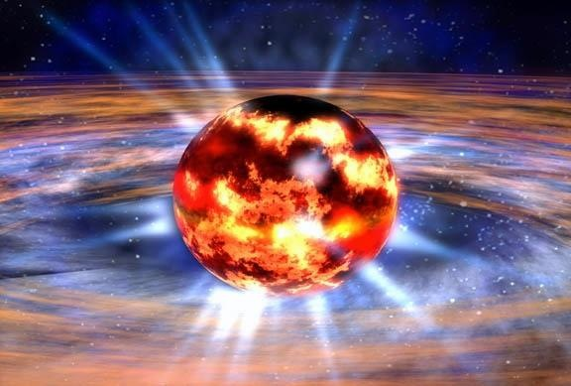
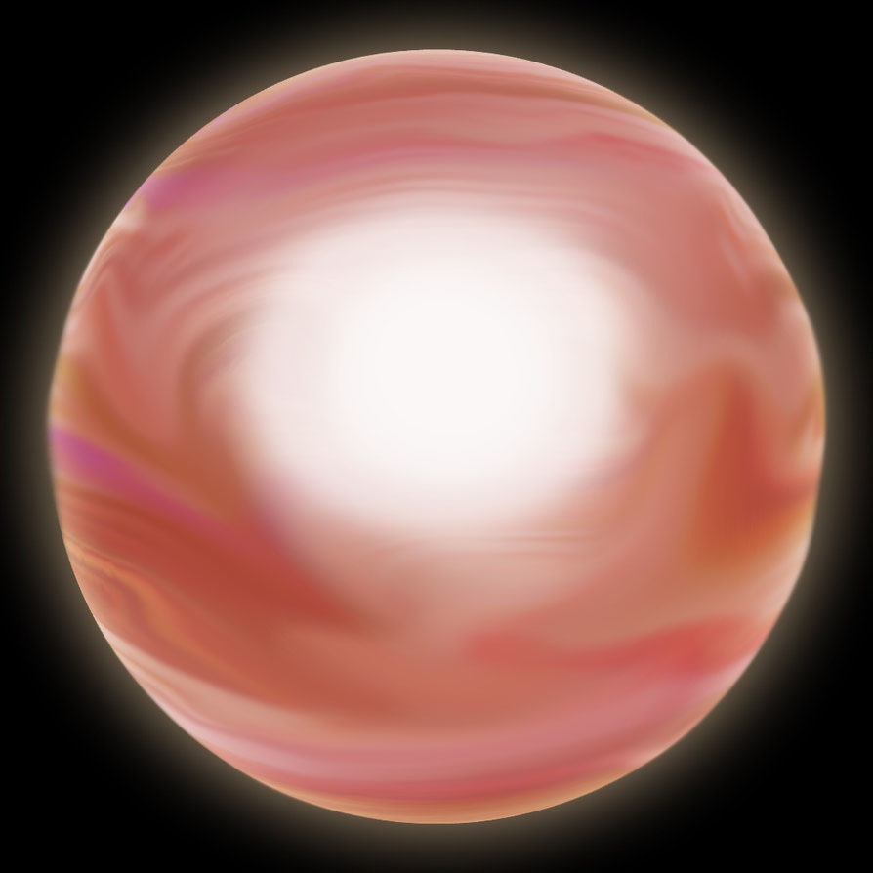




Studying the dense matter equation of state via electromagnetic observations of neutron stars
Dr anna watts, university of amsterdam

Slide 3
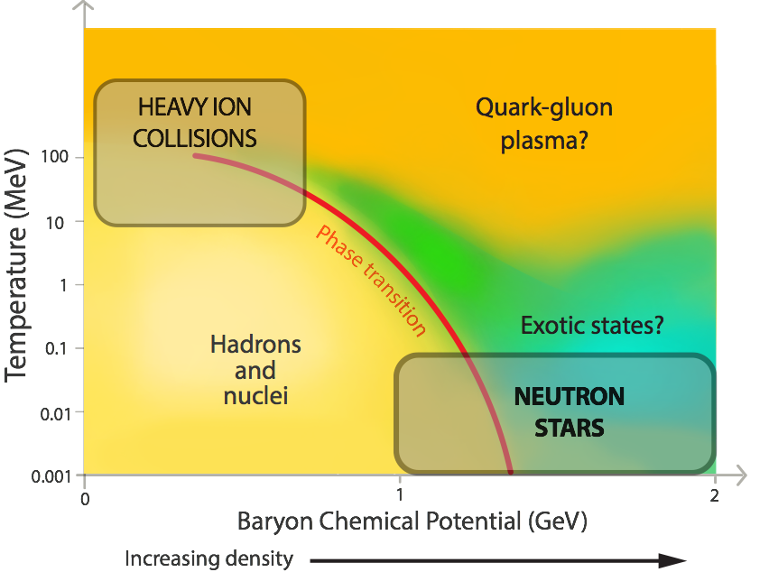
Understanding the strong force
Notes:
NS, like nuclei, are systems governed by the strong force.
Cannot calculate properties from first principles.
Resort to phenomenological models – then test test test.
Describe the various HIC/skin thickness experiments: PREX2/CREX 2016-17, FAIR from 2018 on, FRIB 2022 onwards.

Slide 4
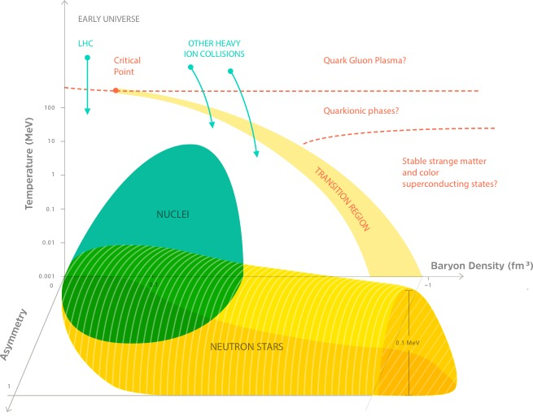
Notes:
NS, like nuclei, are systems governed by the strong force.
Cannot calculate properties from first principles.
Resort to phenomenological models – then test test test.
Describe the various HIC/skin thickness experiments: PREX2/CREX 2016-17, FAIR from 2018 on, FRIB 2022 onwards.

Slide 5
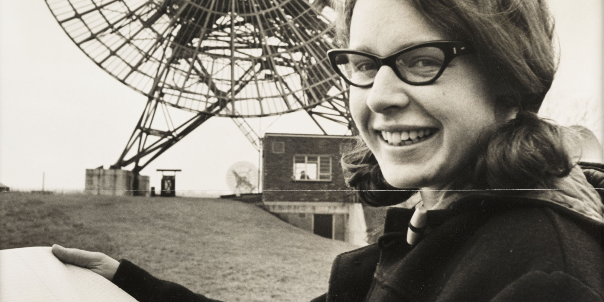
“...upon entering the faculty, each student was issued a set of tools: a pair of pliers, a pair of long-nose pliers, a wire cutter, and a screwdriver...”

Slide 6
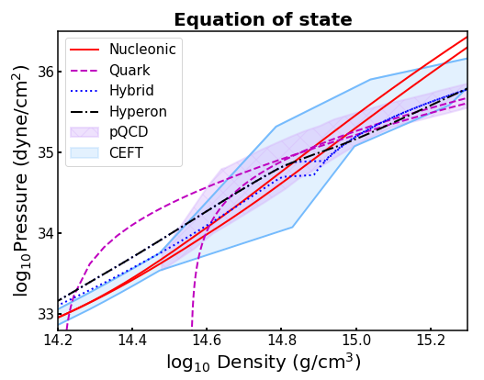
Notes:
The forces between these nuclear particles (caused by the strong force) set the stiffness of NS matter.
This is encoded in the EOS, the relation between pressure and density.
The figure shows a selection of models computed with different assumptions about the nuclear physics at the very highest densities found in NS. Nucleonic, Strange, Quark, and a family of models from Chiral EFT that are designed to fit low density lab data.

Slide 7
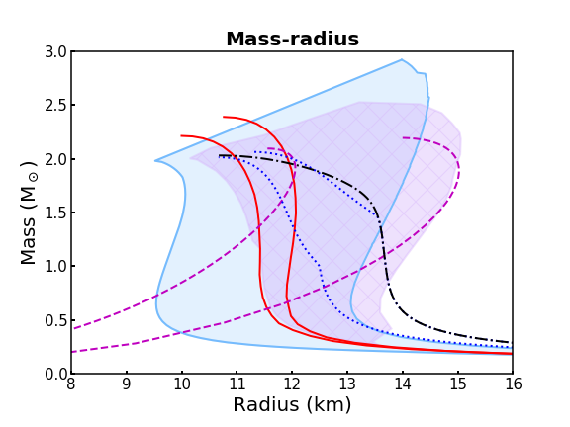

Slide 9
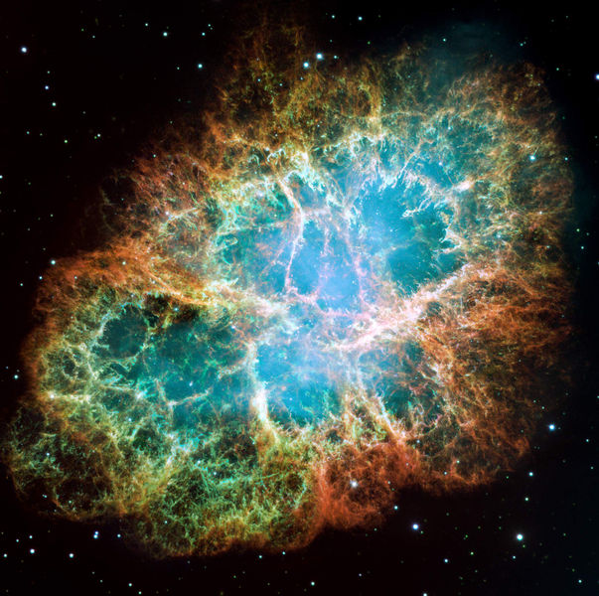
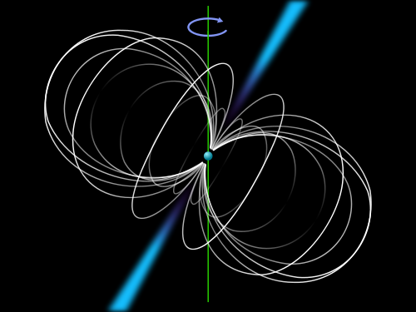

Slide 10
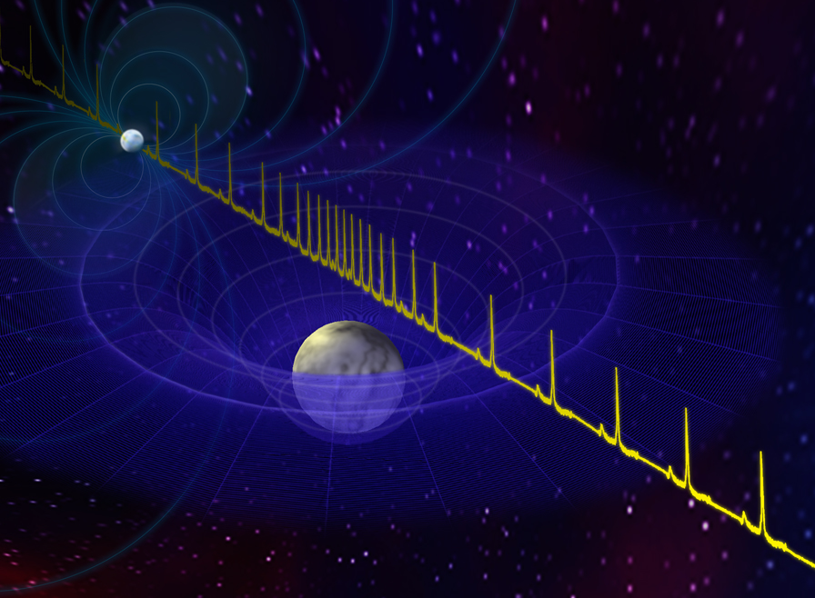
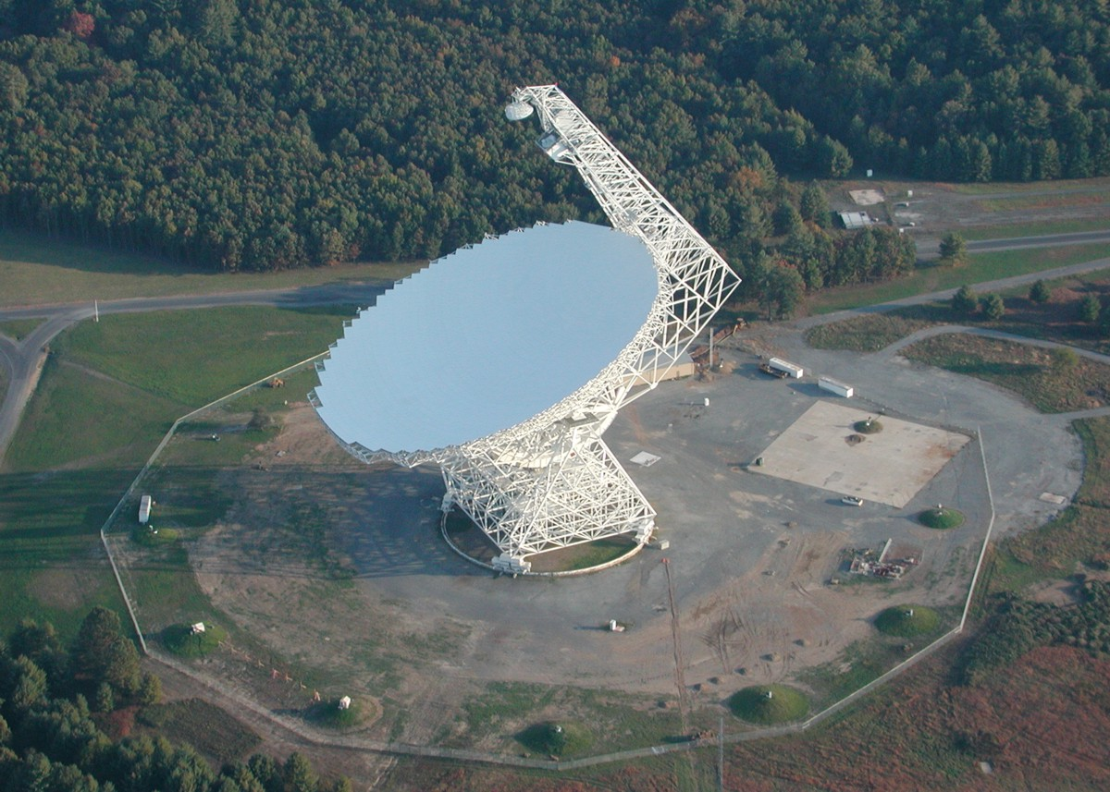
Constraints from masses
Masses can be measured very precisely for radio pulsars in relativistic binaries (if geometry is favourable), using Post-Keplerian parameters such as Shapiro delay.

Slide 11
Current mass measurements
General Relativity
Watts et al. 2015 (SKA EOS paper), see J.Antoniadis website for updates
Notes:
68% confidence intervals. Blue – LMXBs, Red – Eclipsing MSPs, Green – DNS, Magenta NS/WD binaries, Black- MSP/MS binaries, Cyan – triple pulsar. Systematic uncertainties, which may be significant, are not shown.
Demorest result – high inclination, hence Shapiro delay.
Antoniadis – no Shapiro delay, but have bright optical WD companion, use WD spectroscopy to get masses.

Slide 12
Limits from maximum mass
Two 2 solar mass neutron stars now discovered.
‘Hyperon problem’: hyperons are energetically probable but would soften EOS too much (Chen et al. 2011, Weissenborn et al. 2012).
Additional repulsive interactions (Takatsuka et al. 2008, Logoteta et al. 2013)?
Phase transition to quark matter?
General Relativity
Demorest et al. 2010, Antoniadis et al. 2013, Fonseca et al. 2016
Notes:
Grey – LMXBs, Green: eclipsing MSPs, Red: DNS, Blue NS WD companion. Apricot. MSP-MS binaries
Demorest result – high inclination, hence Shapiro delay.
Antoniadis – no Shapiro delay, but have bright optical WD companion, use WD spectroscopy to get masses.
Brings up the ‘hyperon puzzle’: ‘The presence of hyperons in neutron stars is energetically probable. However, their presence induces a strong softening of the EoS that leads to maximum masses below the observed 2 Msun. The solution of this so-called “hyperon puzzle” is not easy, and requires a mechanism that could provide additional repulsion to make the EoS stiffer. Possible mechanisms could be: 1) stiffer hyperon-nucleon and/or hyperon-hyperon interactions; 2) inclusion of three-body forces with one or more hyperons; and 3) appearance of a phase transition to quark matter ‘

Slide 13
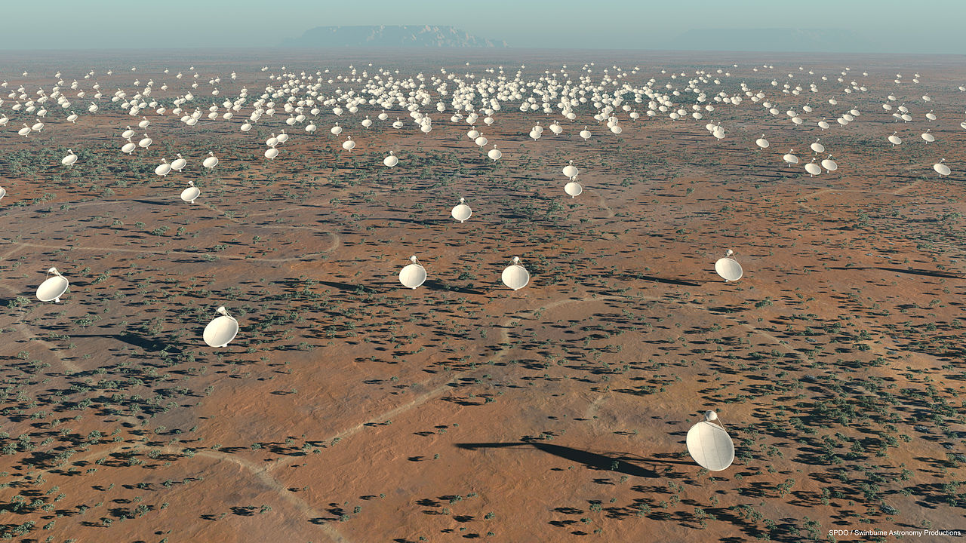
The future: Square Kilometer Array
Notes:
Eccentric or very compact orbits are needed for orbital evolution parameters, and high inclination is needed to make a Shapiro delay signal large enough to be detectable with current instruments. Only 2% of current radio pulsars have reliably measured masses. SKA will find more pulsars (including those with the necessary favourable geometries/orbits), giving factor 5-10 increase,, and better timing precision will increase fraction of pulsars for which Shapiro delay can be measured (perhaps 80% of NS/WD binaries, for example)

Slide 14
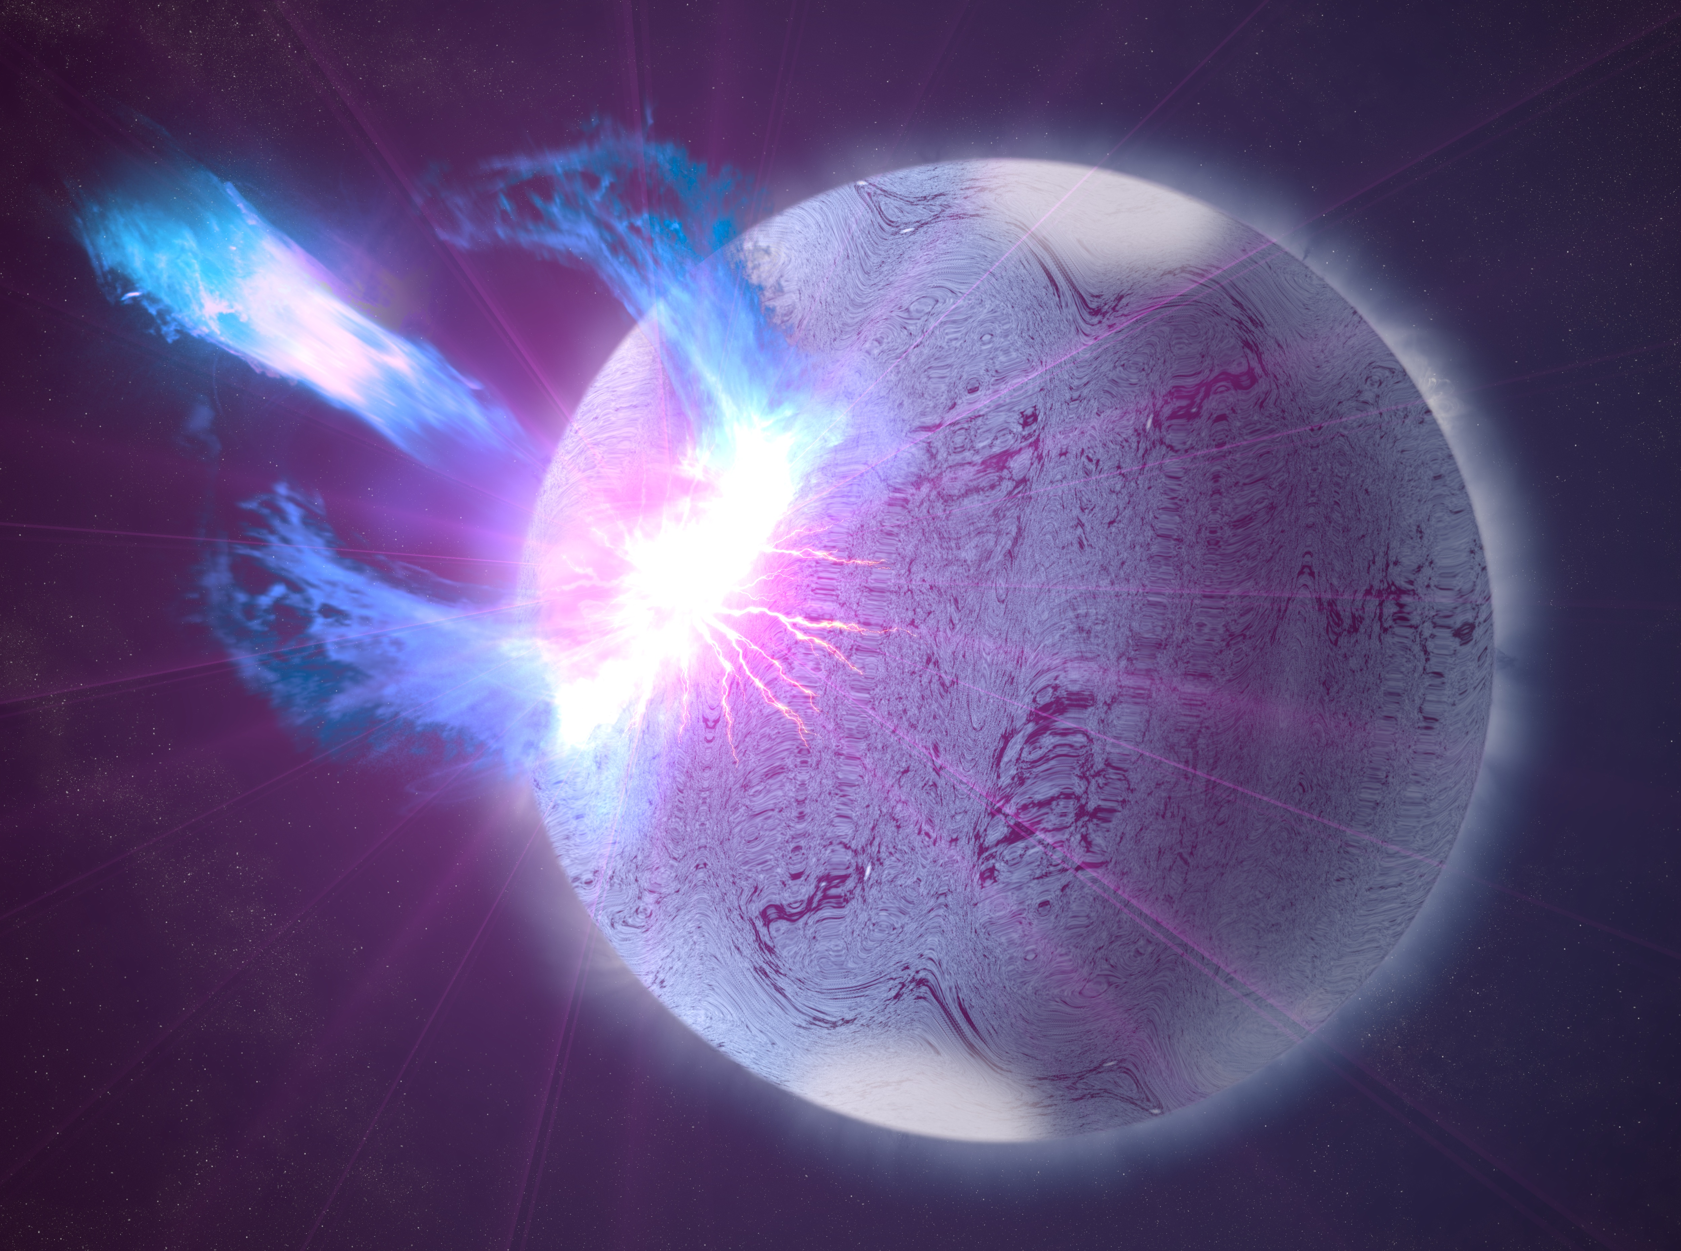
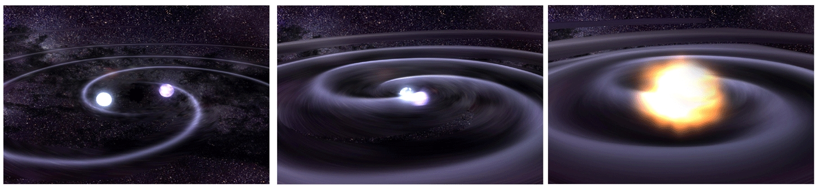
What about radius?
Gravitational waves (Cadonati tomorrow) – GRB part = EM!
Asteroseismology.
Pulsar timing – spins, moments of inertia.
X-ray spectral modelling.
Waveform (or pulse profile) modelling.
SKA: Watts et al. 2015. Burst/quiescent modelling (Miller 2013, Watts et al 2016). Magnetar seismology: Turolla, Zane & Watts 2015. GW from NS mergers Read et al. 2013, Bauswein et al. 2016
Notes:
Eccentric or very compact orbits are needed for orbital evolution parameters, and high inclination is needed to make a Shapiro delay signal large enough to be detectable with current instruments. Only 2% of current radio pulsars have reliably measured masses. SKA will find more pulsars (including those with the necessary favourable geometries/orbits), giving factor 5-10 increase,, and better timing precision will increase fraction of pulsars for which Shapiro delay can be measured (perhaps 80% of NS/WD binaries, for example).

Slide 15
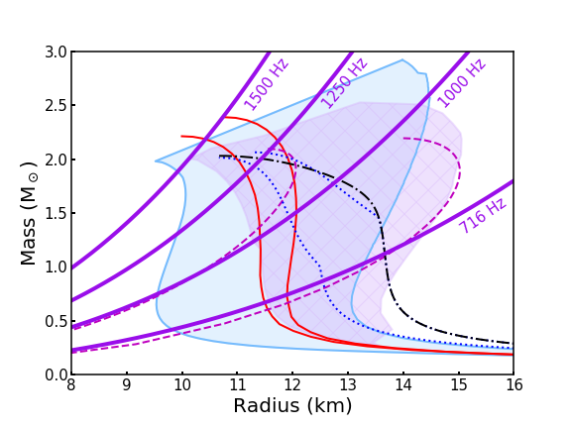
Constraints from spins
General Relativity

Slide 16
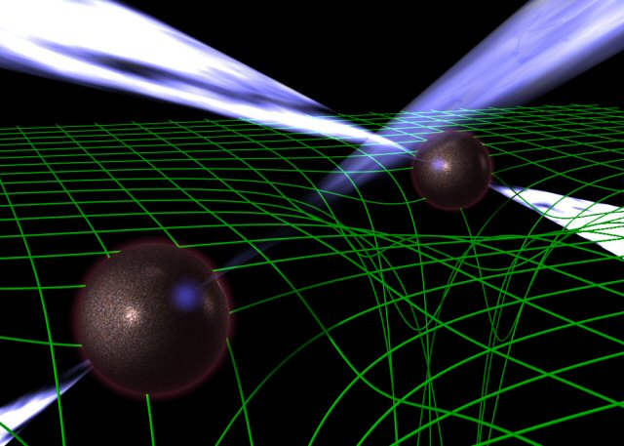
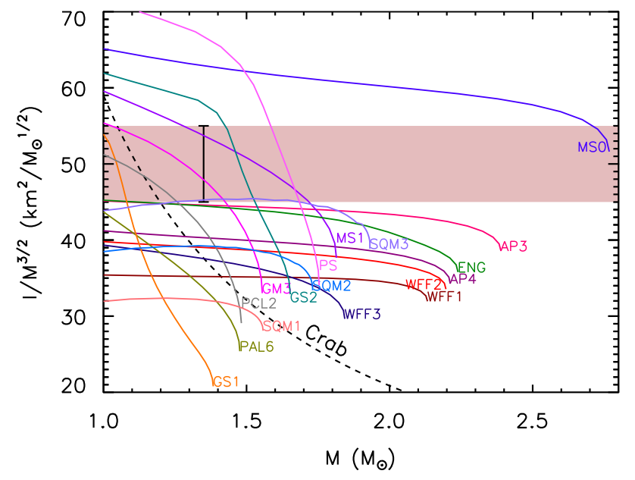
Moments of inertia
Lattimer & Schutz 2005
Requires highly relativistic binaries.
For the Double Pulsar, SKA will allow I to be measured to ±10% over next 20 years. This gives R to ±5%.
SKA may lead to discovery of other double neutron star systems with favourable parameters (see Watts et al. 2015)
Notes:
Need a highly relativistic system since effects are small. Also need very precise measurements of pulsar’s proper motion and distance (easy with VLBI capabilities of SKA) and good model of galactic potential (coming from ESA mission GAIA).

Slide 17
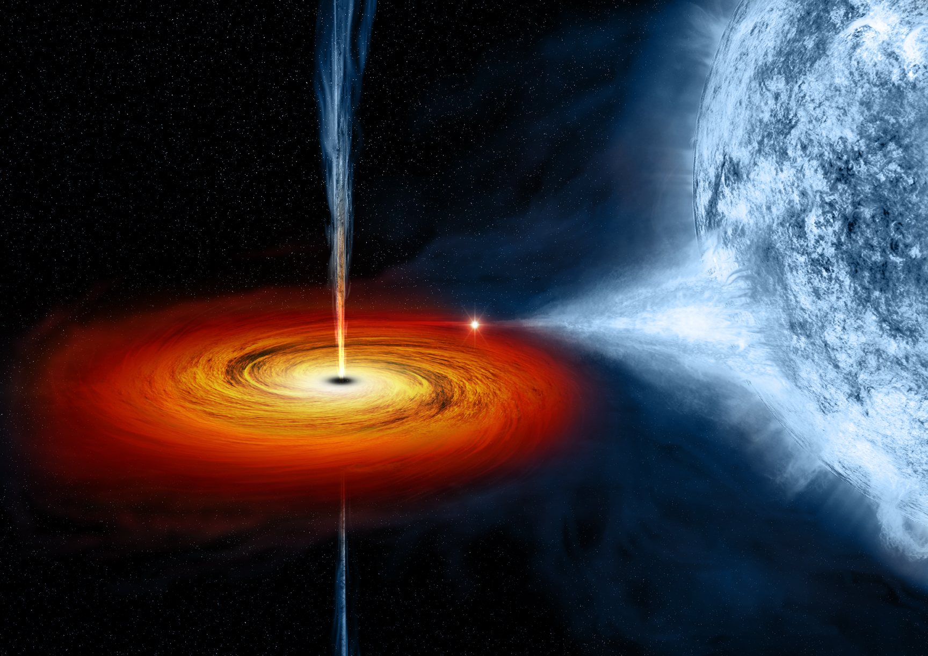
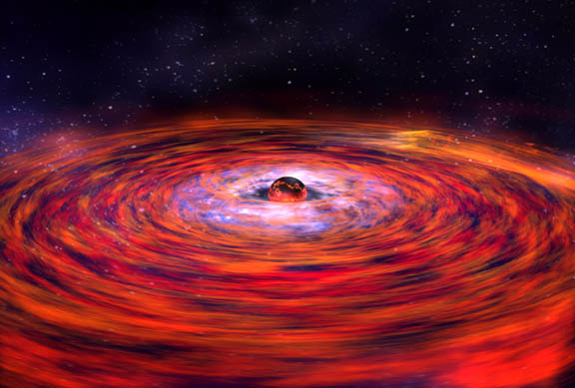
Notes:
~150 accreting NS in LMXBs, 105 are bursters.
Then about 100 HMXBs, maybe another 150-200 in SMC/LMC

Slide 18
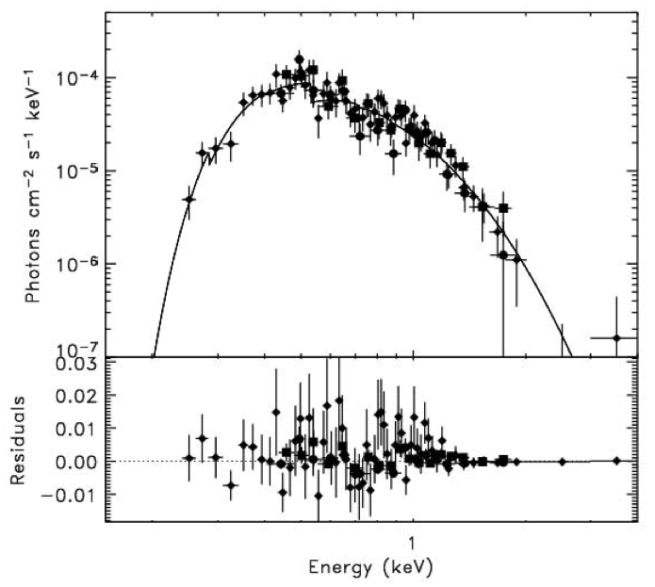
X-ray spectral modelling (quiescence)
Webb & Barret 2007
Accretion off - thermal spectrum from NS.

Slide 19
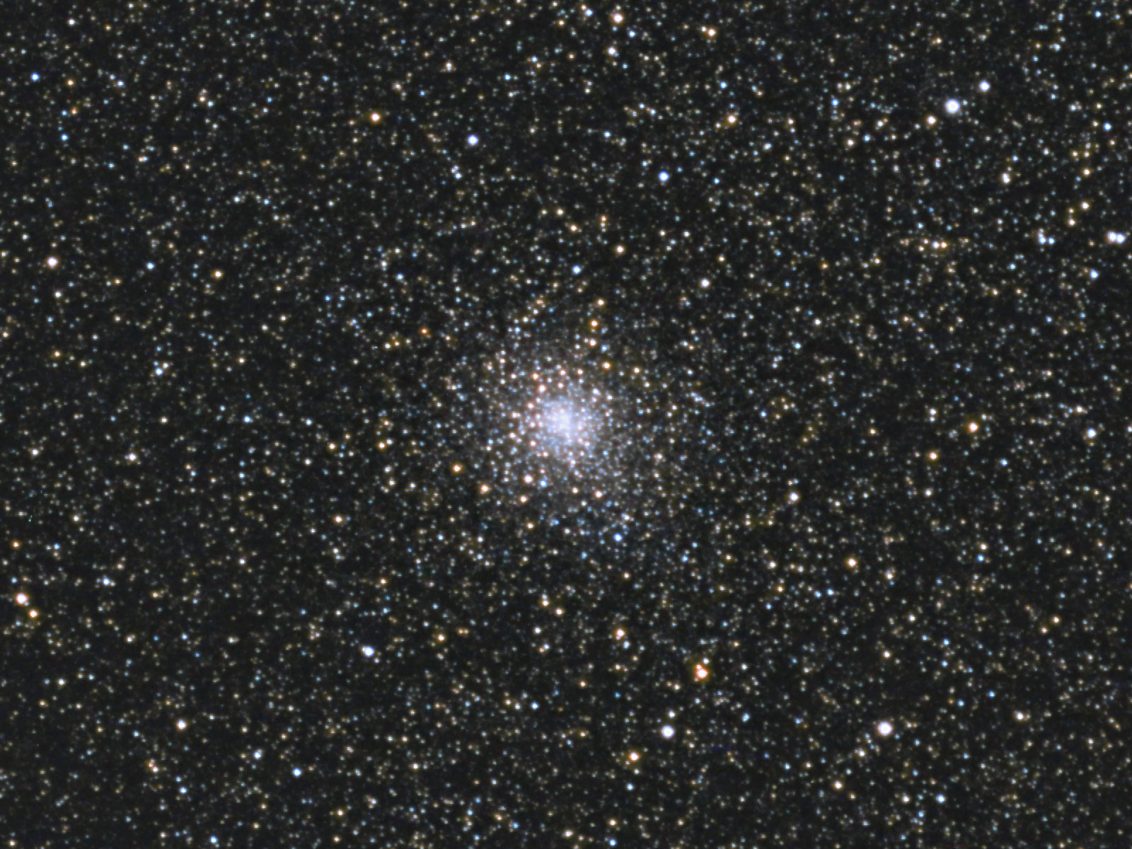
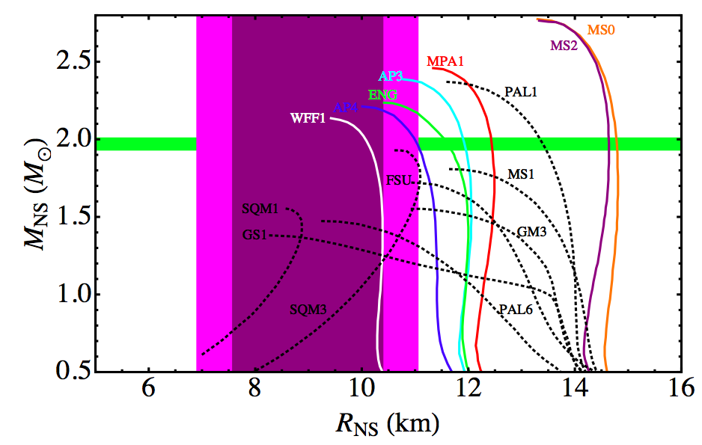
Example constraints: quiescent NS
Guillot et al. 2013
Notes:
Five quiescent LMXBs in globular clusters, assuming H atmosphere in spectral fits.
90% and 99% confidence regions shaded, taking into account uncertainties in distance, some spectral issues (not composition), and assuming constant mass.
Note that radius is pretty low, certainly lower than for the bursters. But atmospheric composition matters a lot.
If the authors had assumed helium, mass would be 14+3-8 km! Quite possible if H has slowly burned to He over long duration between outbursts.

Slide 20
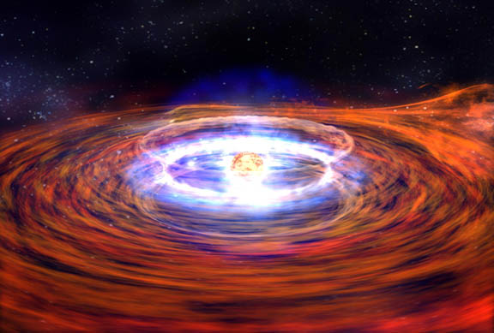

Slide 21
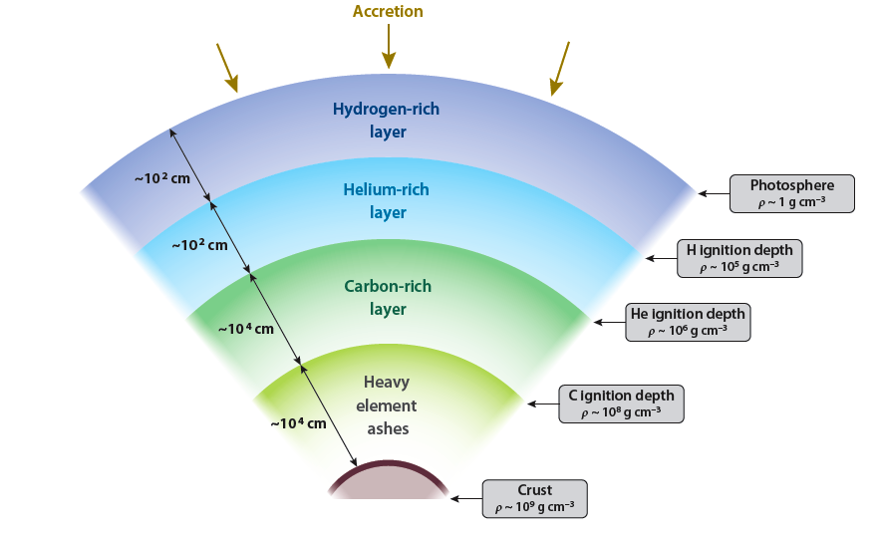
The X-ray burst mechanism
Watts 2012

Slide 22
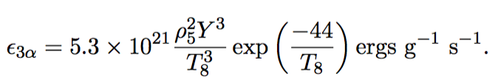

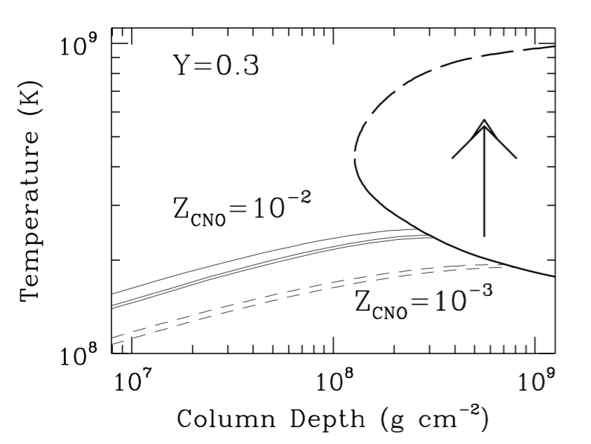
The X-ray burst mechanism
Bildsten 1998

Slide 23
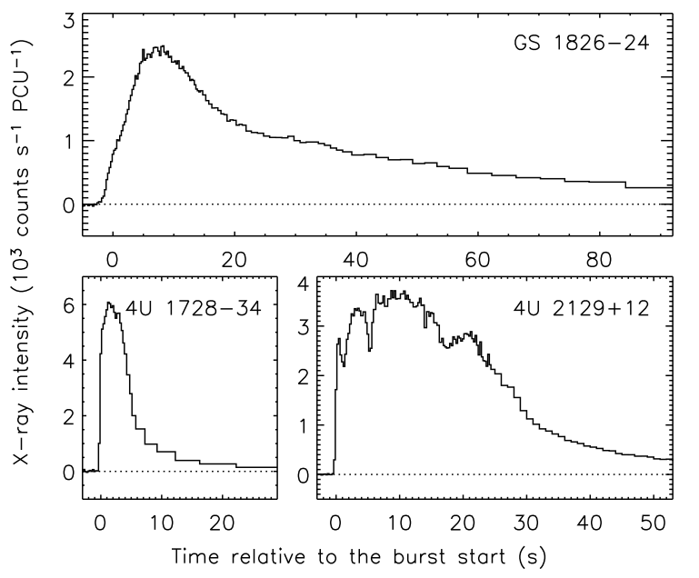
Some typical thermonuclear X-ray bursts: Galloway et al. 2008

Slide 24
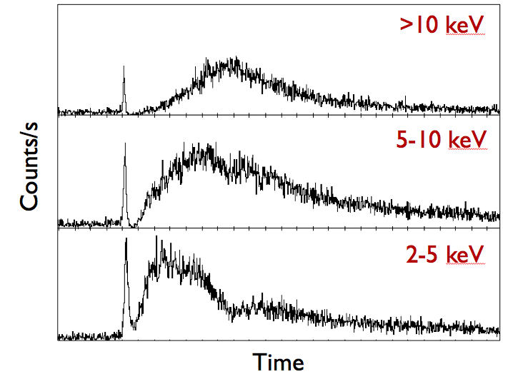
X-ray spectral modelling (bursts)
Accretion on: bright thermonuclear bursts with Photospheric Radius Expansion
Notes:
Limits from the Eddington flux if distance is known. Identify the ‘touchdown’ point and can then use the apparent size during the cooling tail of the burst as well.

Slide 25
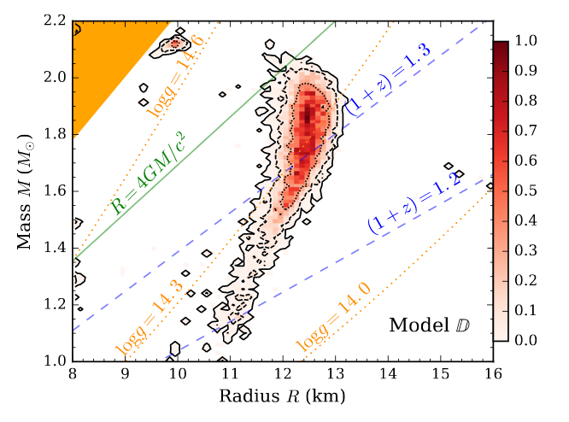
Example constraints: bursts
Nattila et al. 2017

Slide 26
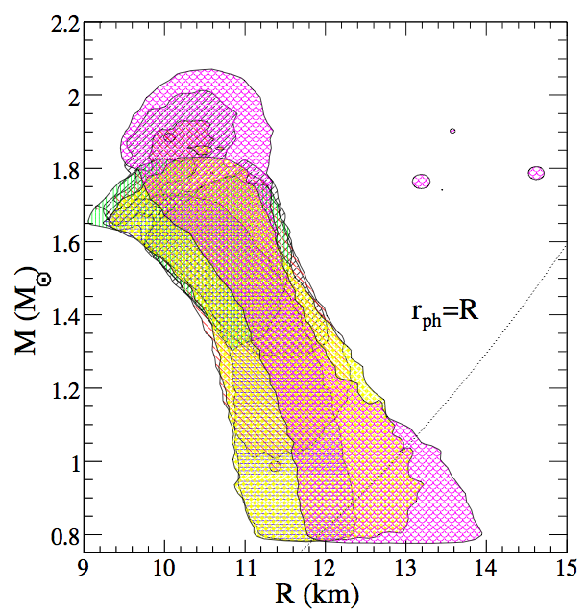
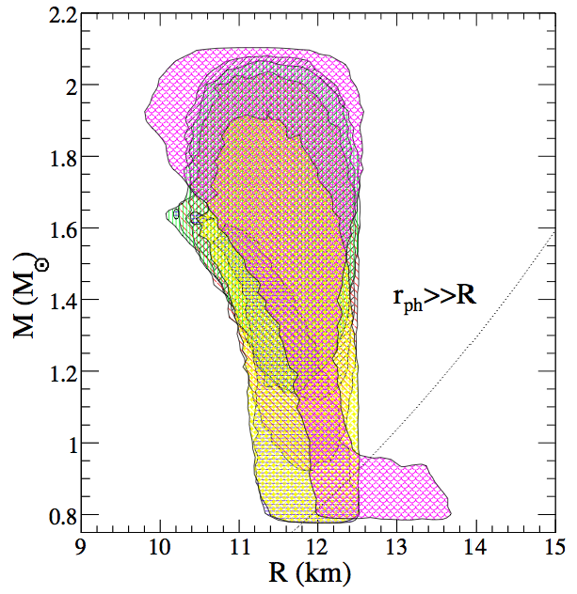
Example constraints: combined
Steiner et al. 2013
For review of X-ray spectral techniques see Miller 2013
Notes:
Combined sample of 3 qLMXBs and 3 bursters. 2 sigma confidence contours, difference comes down to where you take the photospheric radius to be. Why did they explore this? Because otherwise they get odd results for the M, R, distributions.

Slide 27
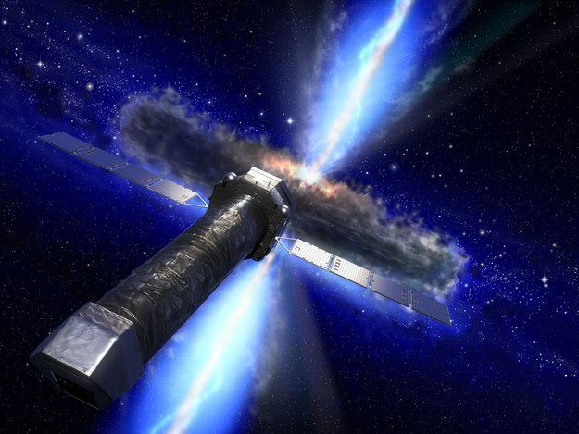
The future: Athena X-ray Observatory
Notes:
Overall, technique is difficult – many uncertainties that are difficult to sort out – composition, distance, absolute flux calibration of instrument.
That said, it has an observational future. Just selected for ESA’s L2 mission (launch 2028, cost 1 billion euros), primarily a cosmology mission.
Effective area in the 0.3-2 keV band is 10x XMM Newton, a factor of a few larger up to 10 keV.

Slide 28
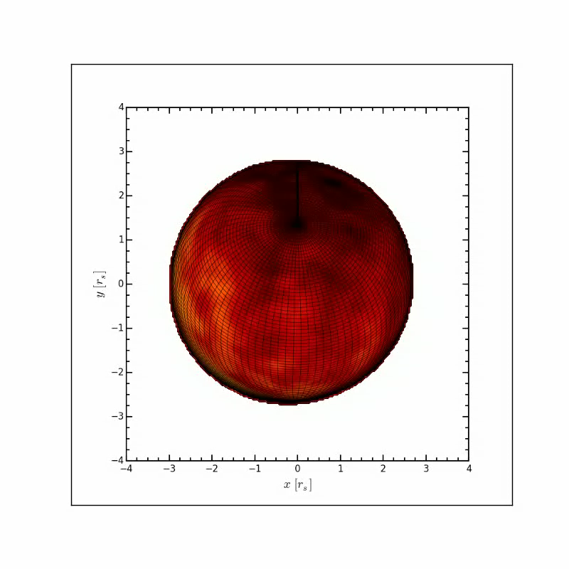
Hotspots: waveform modelling
RELATIVISTIC EFFECTS (SPECIAL AND GENERAL), WHICH DEPEND ON MASS, RADIUS, AND SPIN RATE, AFFECT (X-RAY) RADIATION FROM SURFACE

Slide 29
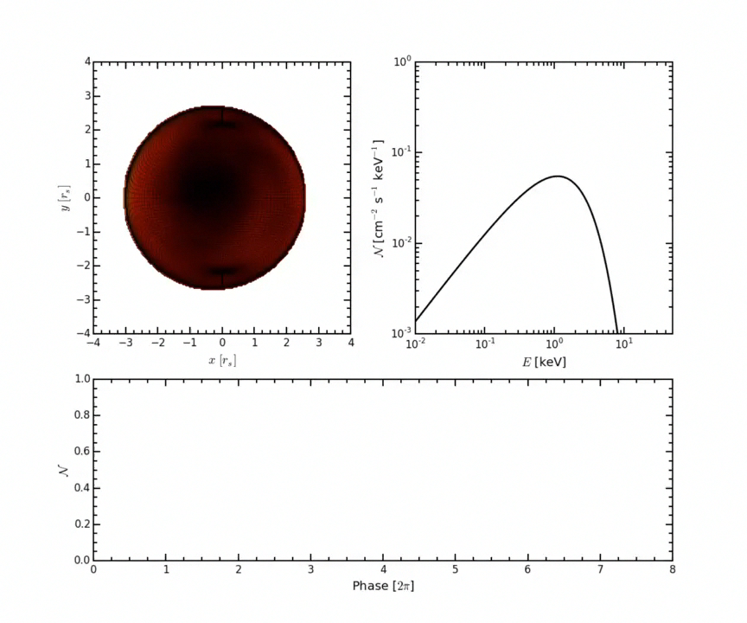
Spectrum
Pulse profile
(energy band)
BY FITTING PULSE PROFILE PROPERTIES WE CAN RECOVER MASS AND RADIUS, WITHOUT NEEDING DISTANCE.
Pechenick et al. 83, Poutanen & Gierlinski 03,Viironen & Poutanen 04, Poutanen & Beloborodov 06, Morsink et al. 07, Bogdanov et al. 07, Baubock et al. 12, 13, Lo et al. 13, Psaltis et al. 14, Miller & Lamb 15
Notes:
Accreting neutron stars have various types of surface hotspot (accretion, thermonuclear). Lower left you see sophisticated numerical simulations illustrating how such spots can arise during the thermonuclear explosion process.
As the star rotates, this gives rise to a pulsation.
GR affects spacetime around neutron star, and its effects modulate pulsation.
Relativistic effects such as lightbending, redshift, shown in this idealized graphic here (top left) encode information in the shape and energy-dependence of the pulse profile. Figure on the right shows a typical profile, with deviations from a sinusoid and variations in spectrum (color) as star rotates.
By fitting the pulse profile for M, R, we can recover M and R simultaneously.

Slide 30
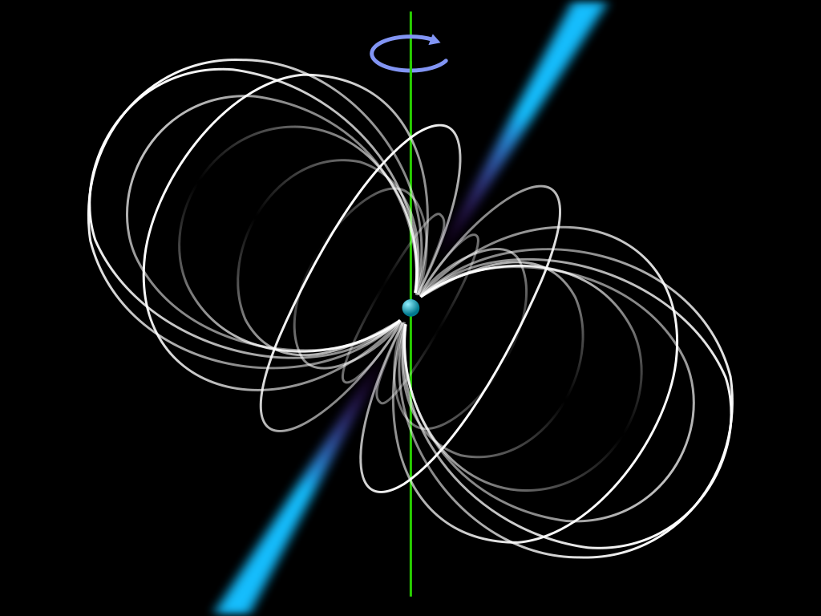
Hotspots on isolated pulsars

Slide 31
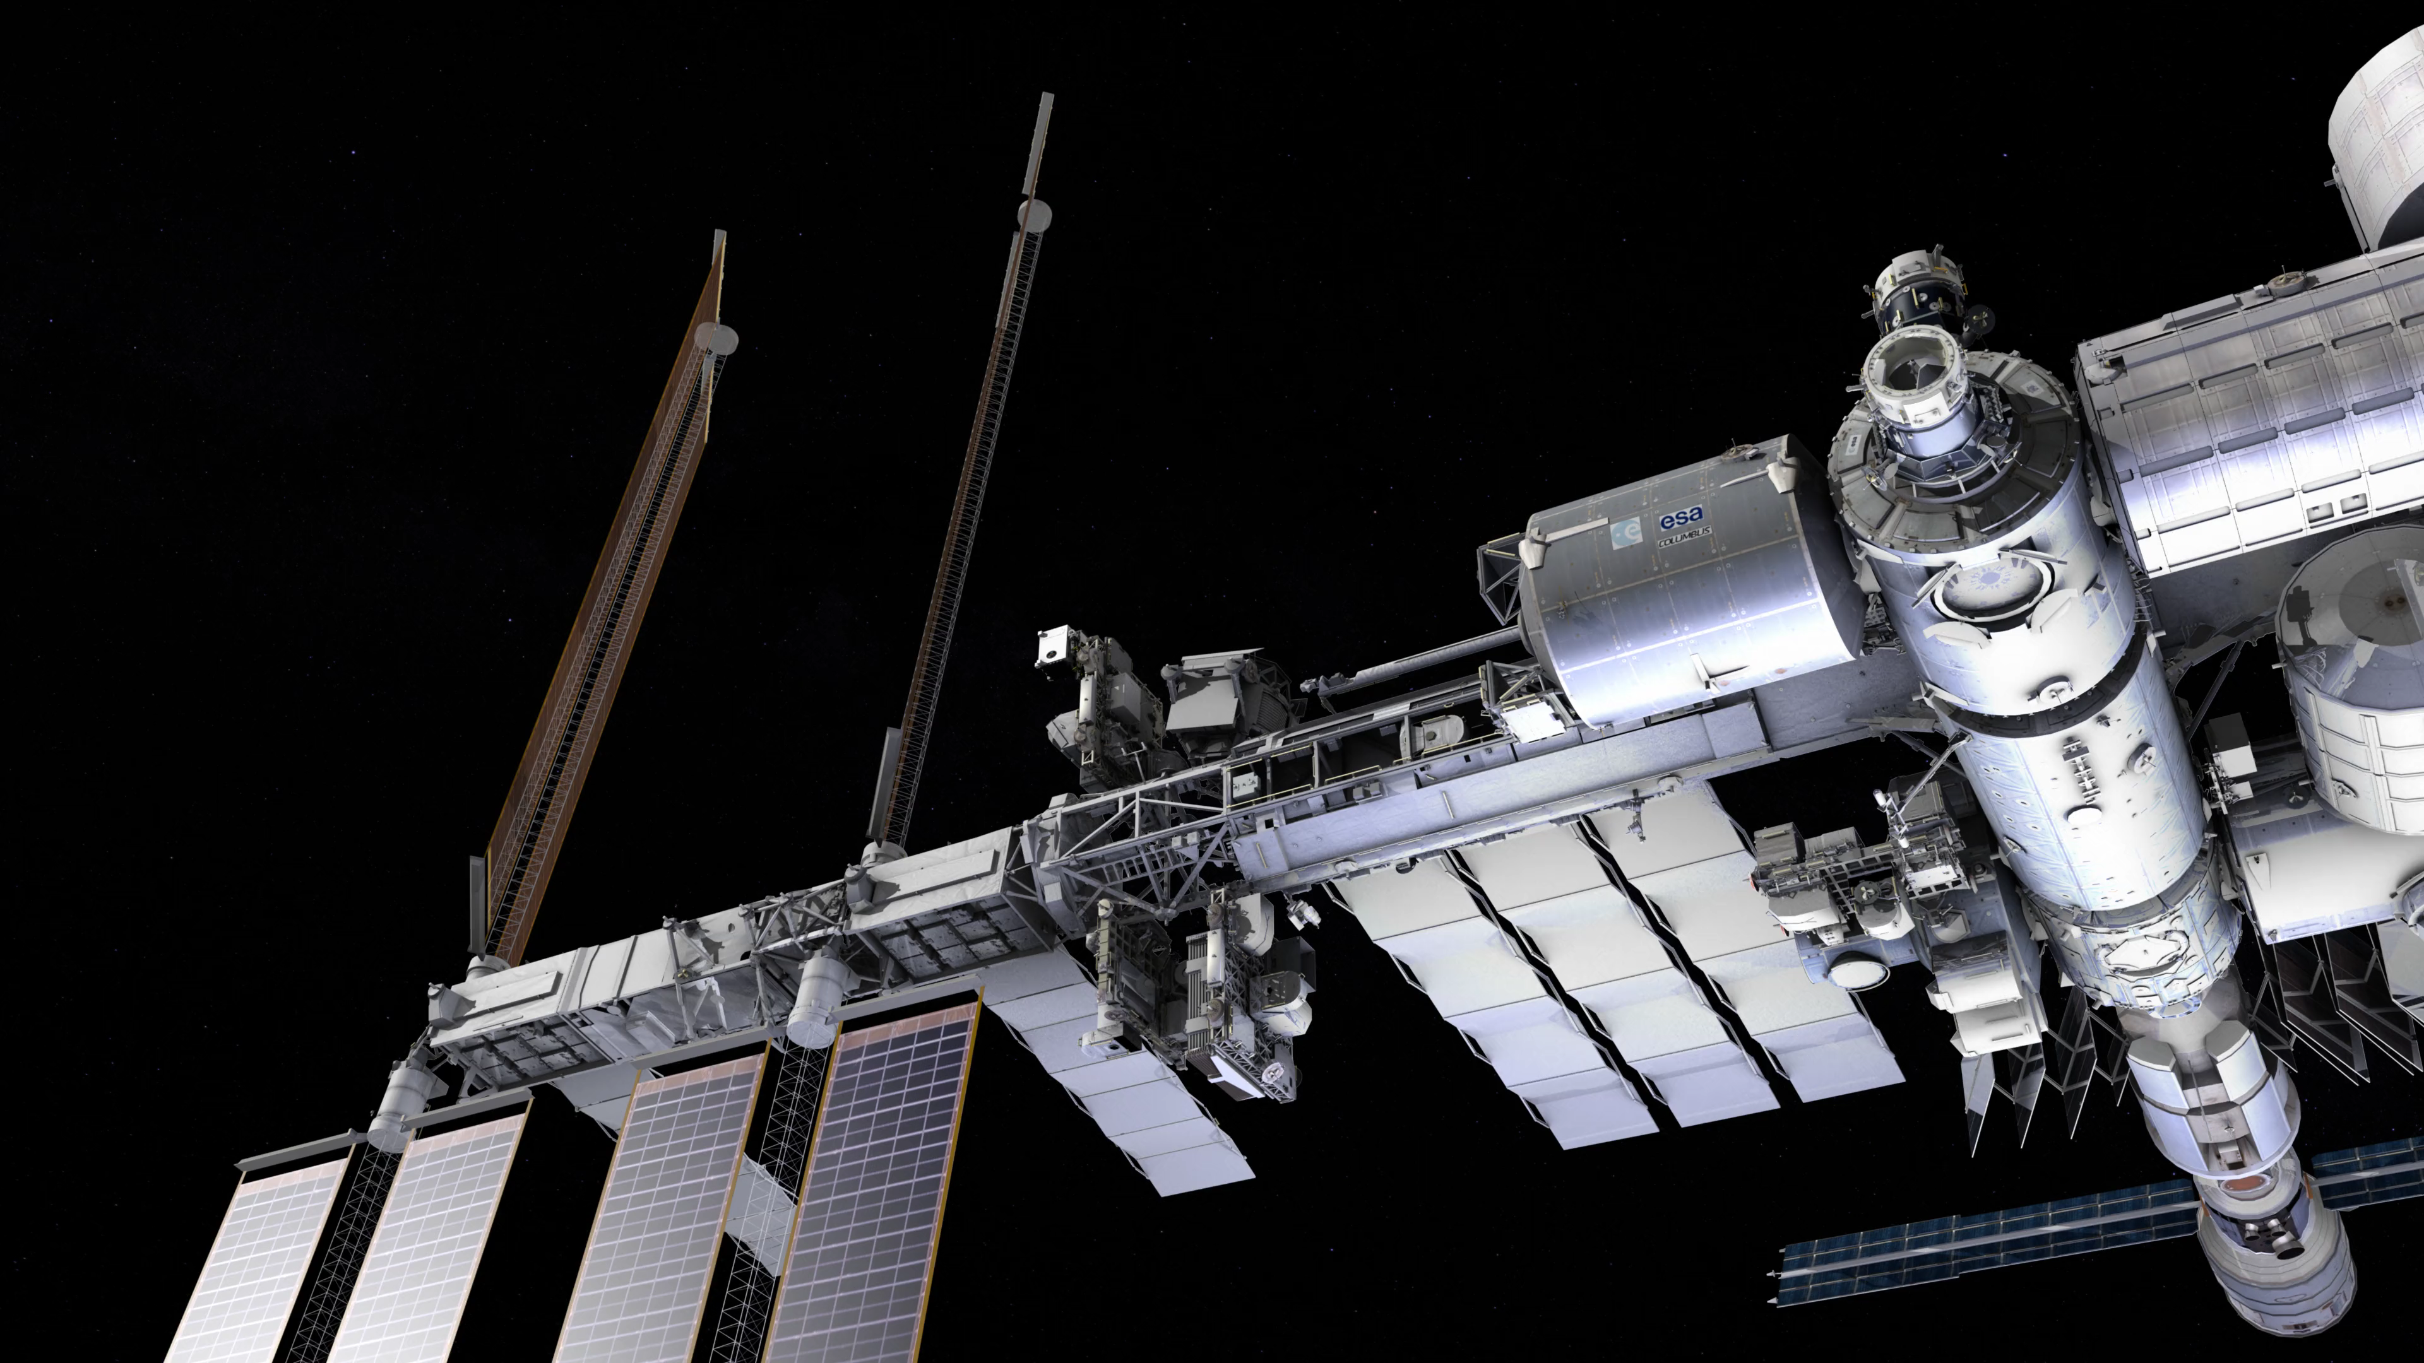
NICER: International Space Station
Notes:
NICER is a soft X-ray mission mounted on ISS in 2017, NASA Mission of Opportunity.
A few primary targets,

Slide 32
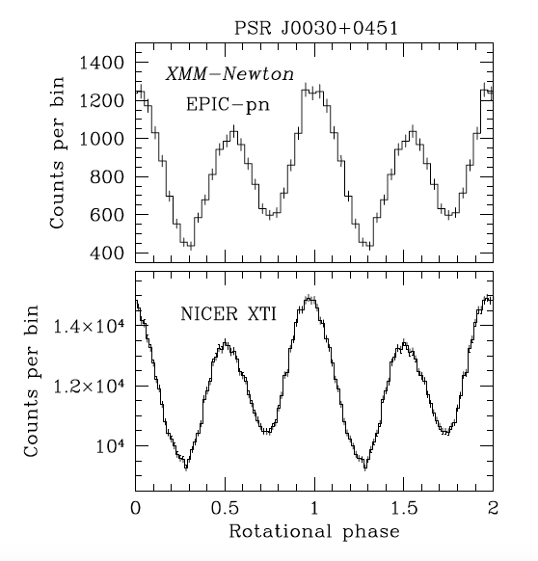
NICER: International Space Station
Notes:
NICER is a soft X-ray mission mounted on ISS in 2017, NASA Mission of Opportunity.
A few primary targets,

Slide 33
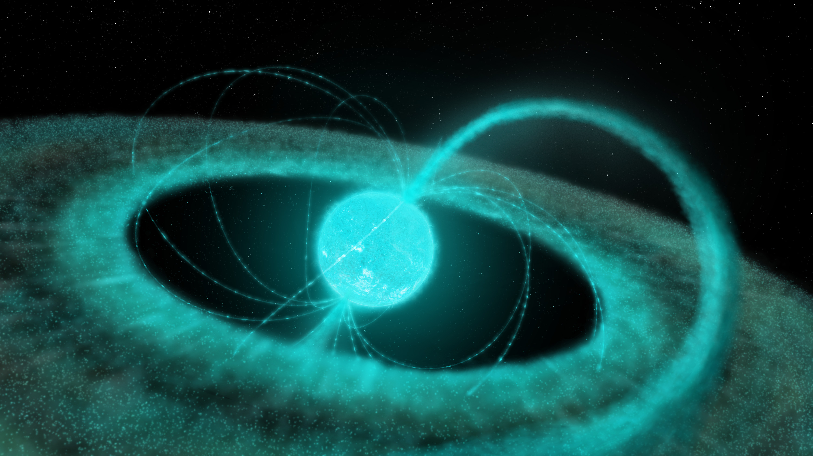
Hotspots due to accretion

Slide 34
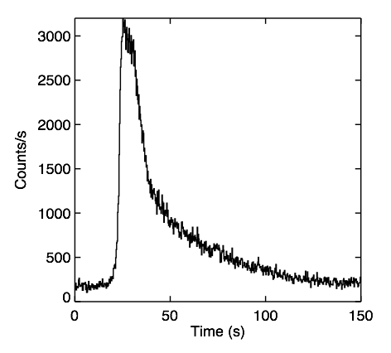
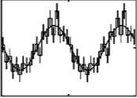
Hotspots during thermonuclear bursts
Spin axis
in some bursts anomalously bright patches form.
THESE ARE KNOWN AS BURST OSCILLATIONS
Discovered in 1996 by Strohmayer et al., for review see Watts, Ann. Rev. Astron. Astrophys. 2012

Slide 35
Pros and cons of waveform modelling
Don’t need composition or distance since comparing across rotational phase.
Many known sources, increasing chance of spanning good range of M.
For accreting sources, cross checks are possible (independent techniques applied to same source).
Surface pattern and beaming introduce uncertainty
  Isolated pulsars – details of pulsar mechanism important.
  Accreting pulsars – surface pattern, beaming in accretion funnel.
  Burst oscillations – surface pattern unknown, changeable.
Marginalise over nuisance parameters (geometry, background)
Notes:
LOFT was a candidate for ESA’s M3 launch, came second in ranking.

Slide 36
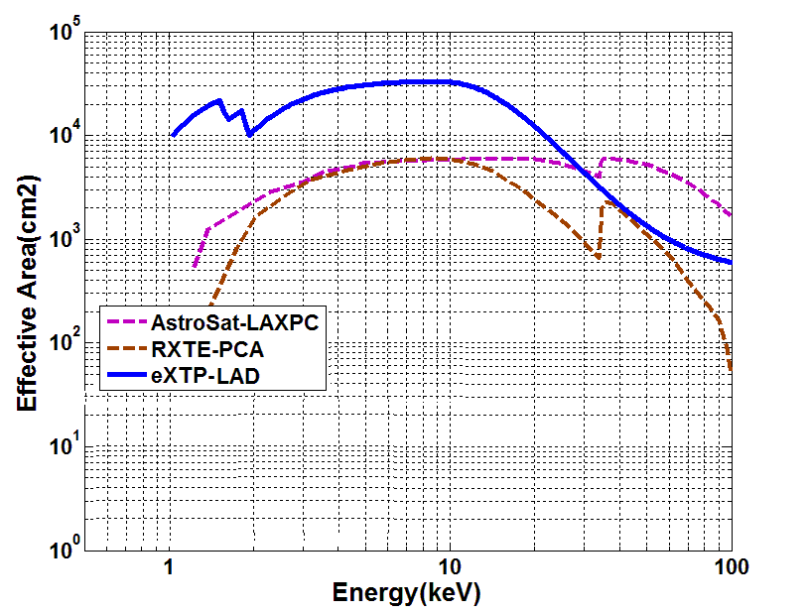
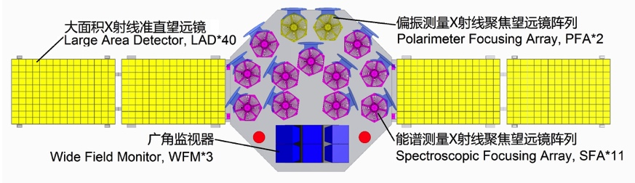
Proposed: Enhanced X-ray Timing and Polarimetry mission (eXTP)
Notes:
NICER is a soft X-ray mission due to launch to ISS in early 2017, NASA Mission of Opportunity.
One primary target,

Slide 37
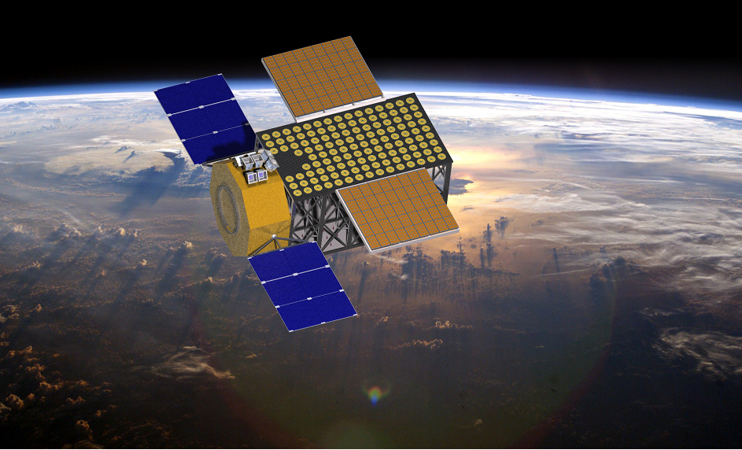


Slide 38
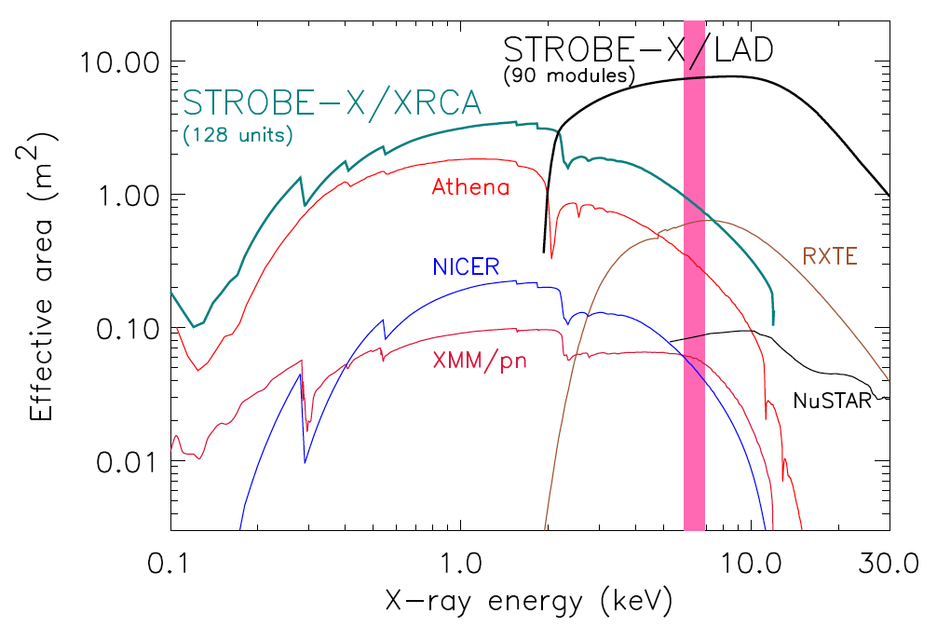

Slide 39
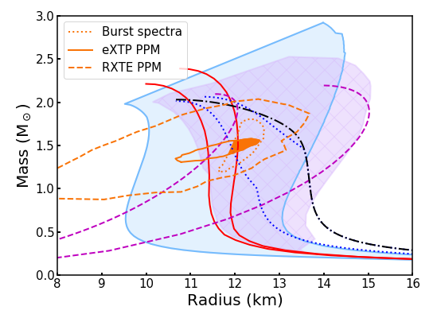
eXTP simulations
eXTP Dense Matter White Paper, Watts et al. 2018, Science China
Notes:
LOFT was a candidate for ESA’s M3 launch, came second in ranking.

Slide 40
With ~10 m² hard X-ray telescope (Watts et al. 2016 Rev. Mod. Phys).
Notes:
LOFT was a candidate for ESA’s M3 launch, came second in ranking.

Slide 41
The data and inference pipeline
Nuisance parameters e.g. geometry, pattern
Riley, Raiijmakers & Watts 2018, Raiijmakers, Riley & Watts 2018
Notes:
Getting data costs a lot of time - need to think about observing strategy!
Nuisance parameters include all of the nasty astro stuff- patterns, drifts, and so on.
‘Measure’ M, R – but these are not really data. Which ones do we make the tightest?
Then feed into EOS – do we parameterize it? How do we ensure the tightest constraints here? And actually EOS should have come in earlier.

Slide 42
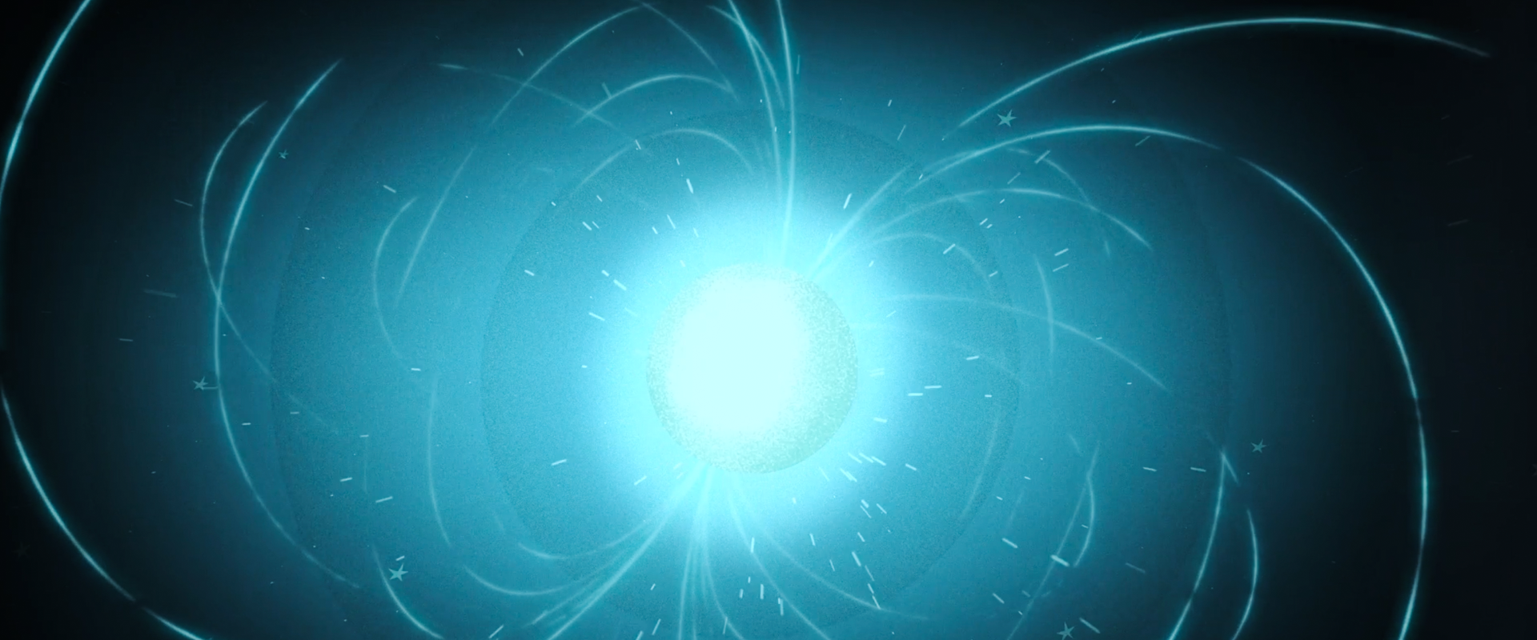
50 years of (radio) pulsars
53 years of quarks
54 years of X-ray astronomy
Notes:
Neutron stars and nueclear physics intrinsically interlinked and both young fields! Enabling technology similarly young.
Neutron stars = 50
Neutrons= 85, Quarks = 53
X-ray astronomy = 54, X-ray bursts = 42 years, Burst oscillations 21.

