Slide 1
Applications for Harvested Isotopes
Gregory Severin
Bormio 56

Slide 2
Physics
Applications
An activated beamdump??!
New “ground-breaking” accelerator
Chemist
Doctor
biologist
Dalton’s stratum
Depths of knowledge
Layer of Maxwell
We could use that to fight cancer!
Experimental Physicist
Curie-o-sphere
Fermi Level
“getting to the bottom of things”
Debris from 200 years of old experiments
Feynmann Crust
Goldstone-Higgs Colayer
Standard Model Bedrock
BSM

Slide 3
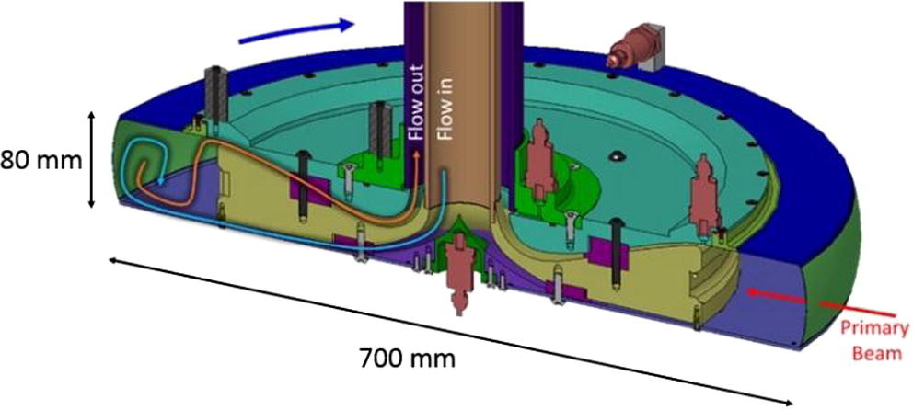
Isotope Harvesting
Beamdump Chemistry

Slide 4
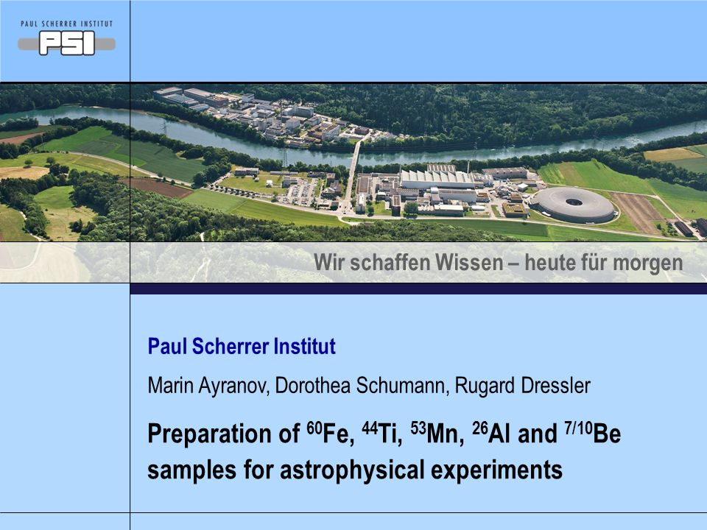
ERAWAST (PSI)

Slide 5
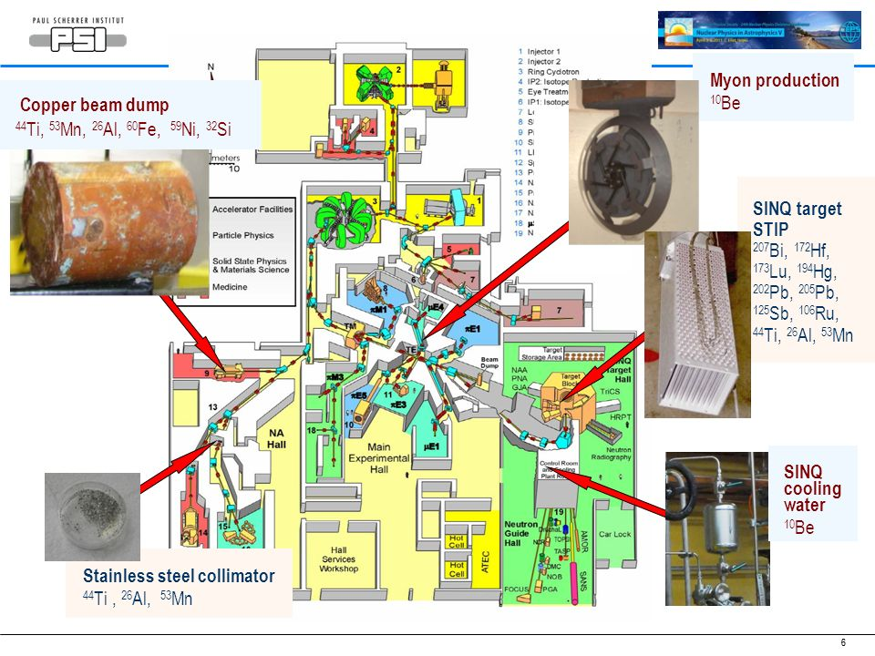

Slide 6
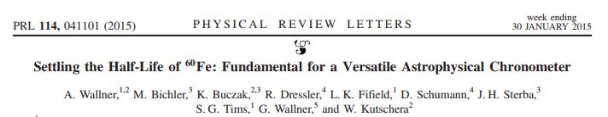
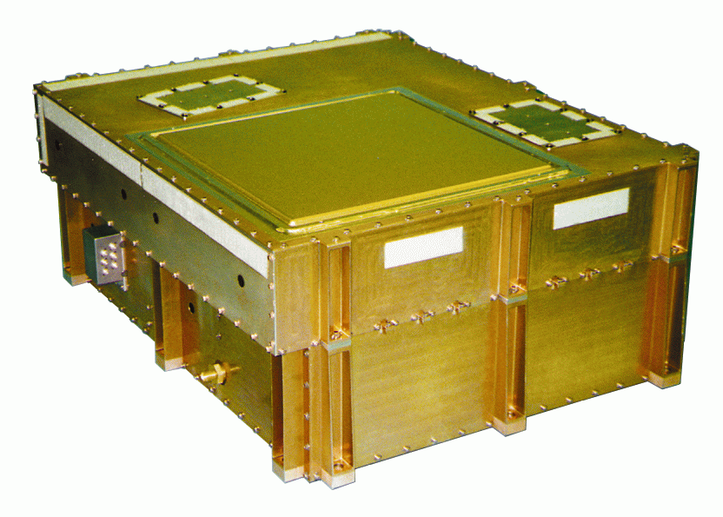
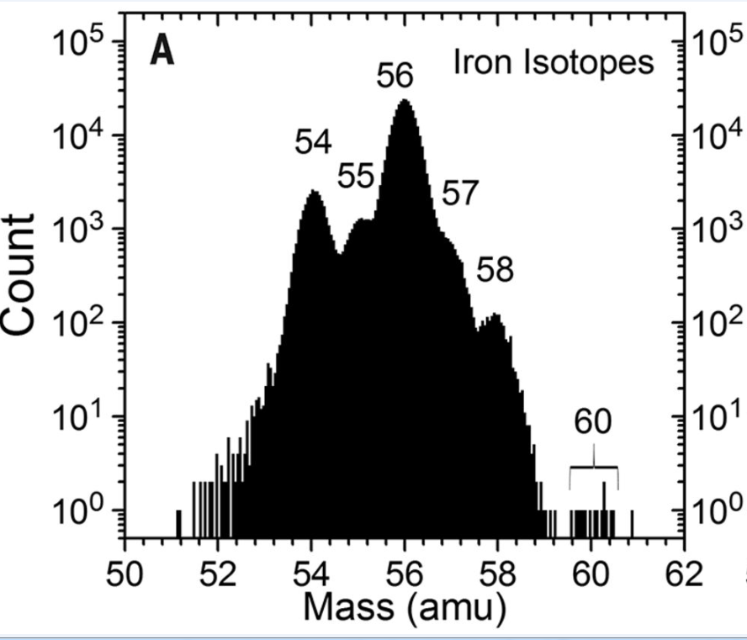
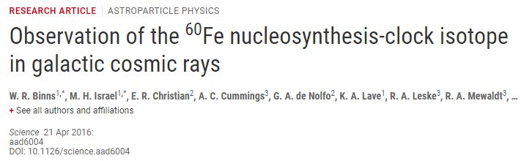
⁶⁰Fe half-life: One of many results
Half-life confirmed to be 2.6My (vs. 1.5 My)
ACE-CRIS

Slide 7
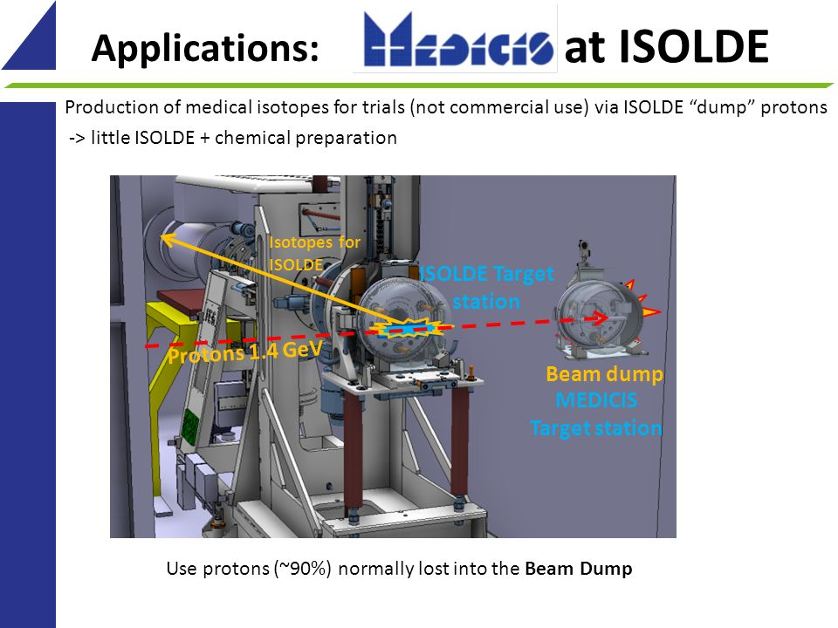
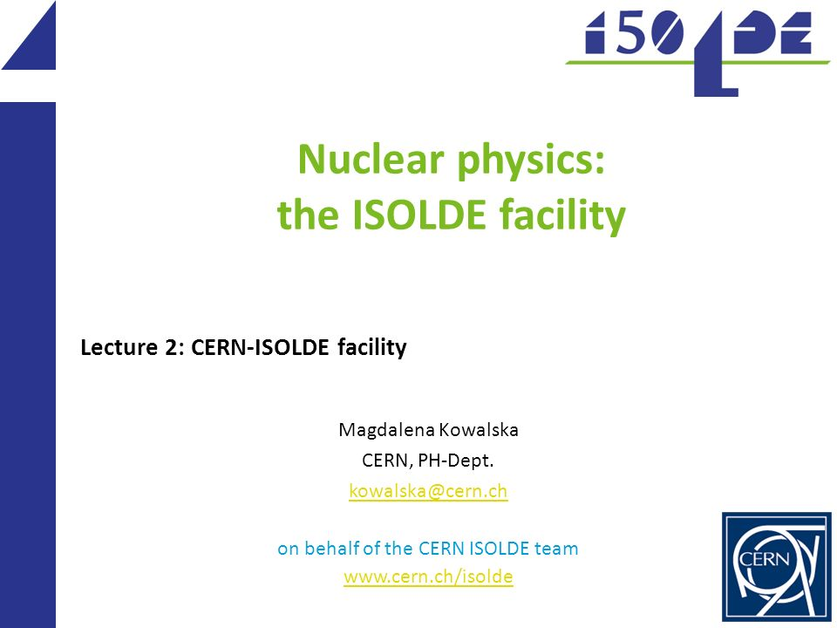
Another famous beamdump: the ISOLDE concrete wall

Slide 8
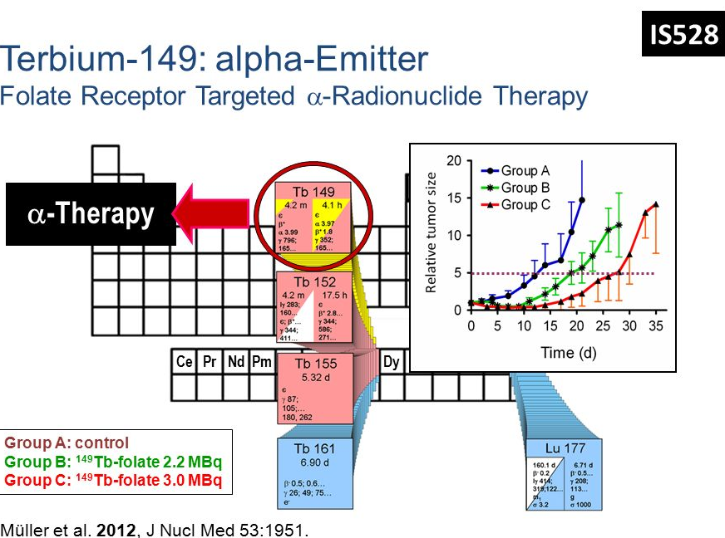
Preliminary tests of “harvesting” at ISOLDE

Slide 9
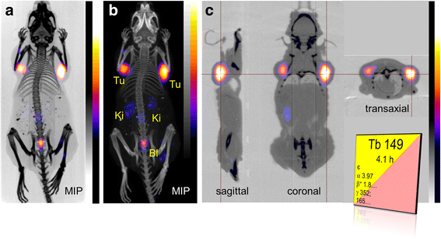
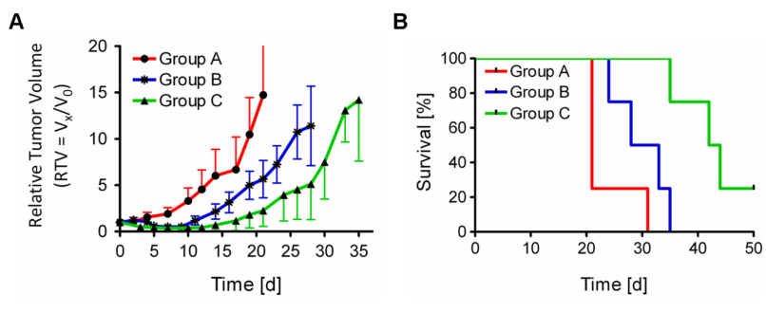
Animal Studies with ¹⁴⁹Tb
Alpha-PET with terbium-149: evidence and perspectives for radiotheragnostics, Müller et al, EJNMMI Radiopharmacy and Chemistry 2016 1:5
https://doi.org/10.1186/s41181-016-0008-2
A.Control
B.Low Dose
C.High Dose

Slide 10
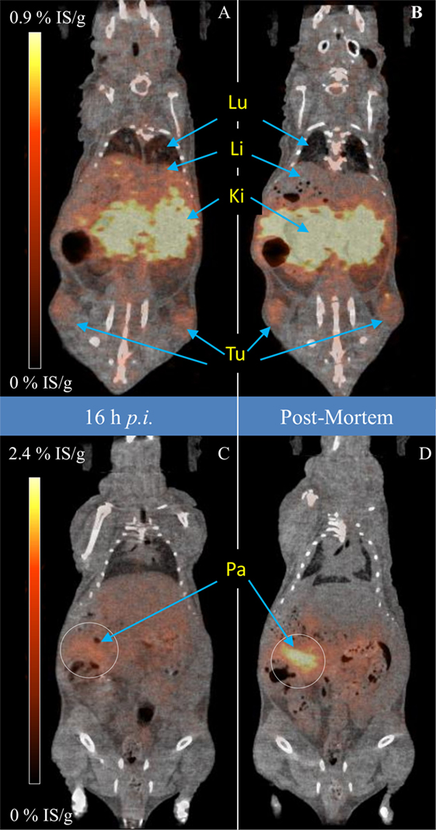
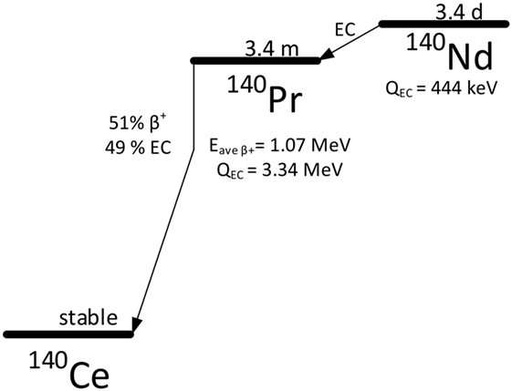
Delayed-Positron Lanthanides
Severin et al, Frontiers in Medicine 4, 2017

Slide 11
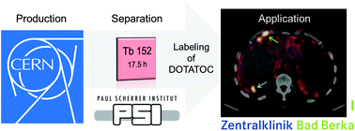
¹⁵²Tb, CERN to Hospital
DOI: 10.1039/C7DT01936J Dalton Trans., 2017, Advance Article
Clinical evaluation of the radiolanthanide terbium-152: first-in-human PET/CT with 152Tb-DOTATOC. Baum, Müller et al

Slide 12
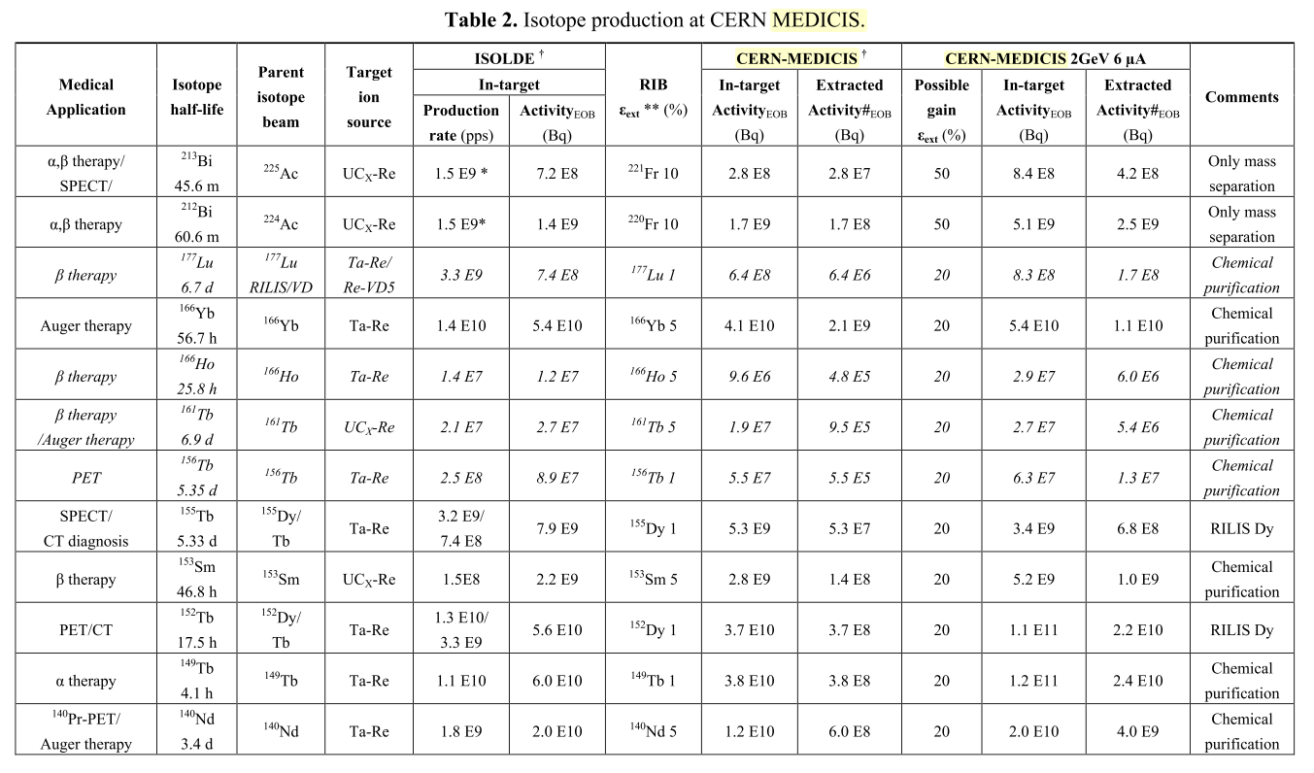
MEDICIS’ LIST

Slide 13
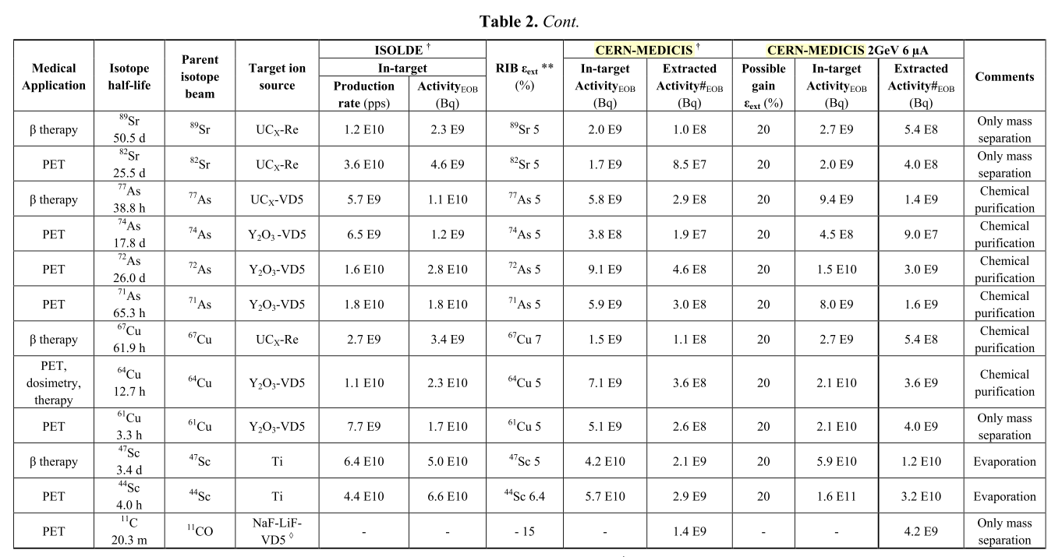
MEDICIS LIST pt. II
this is just the Medical Isotopes!
And, this is “just” spallation!

Slide 14
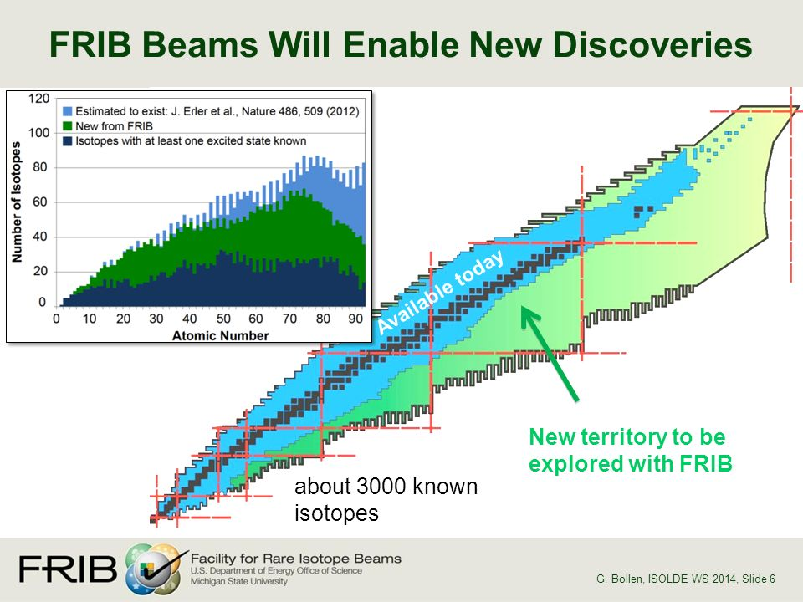
FRIB
A Heavy Ion Fragmentation Facility
“Isotope Factory”
Designed to produce 80% of all predicted isotopes
Exploration near the drip line
(but most production is near stability), (and most of the production isn’t in the target)

Slide 15
Isotope Production “in flight” (and not)
FRIB (or similar facility)
heavy-ion accelerator makes a “primary beam”
  e.g. ⁴⁸Ca²⁰⁺ 240 MeV/u ~35 puA (2 x10¹⁴ particles per second)
Primary beam hits a thin target (e.g.C) and fragments
  Reaction produces almost any nucleus with mass <50 and Z<Ti
    Probabilities for conversion are ~10⁻³ for masses near A = A₀, ~10⁻⁶ for masses below A=35
    90% of the primary beam does not react!
Fragments are still moving, and a “secondary beam” is purified based on charge-to-mass
    Unreacted primary beam is directed to a “beam blocker” where many more nuclear reactions occur.
Beam Dump
unused primary beam
secondary beam
Primary Beam

Slide 16
The FRIB beamdump
Primary Beam
For example @400kW (2x10¹⁴ pps)
⁴⁸Ca → ⁴⁷Ca
(in-target) as a secondary beam: 8x10¹¹ pps
in-beamdump: 1x10¹³ pps

Slide 17
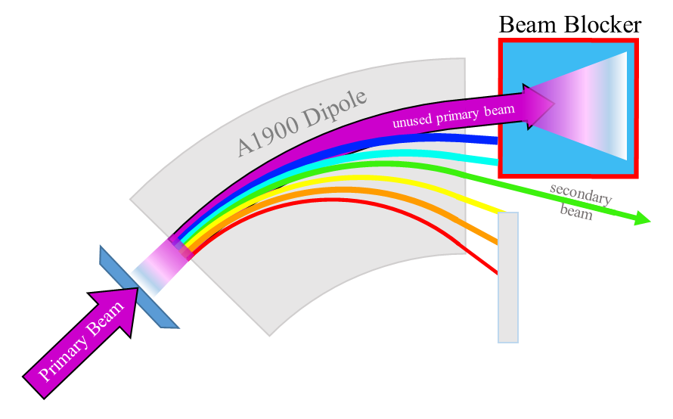
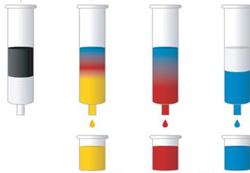
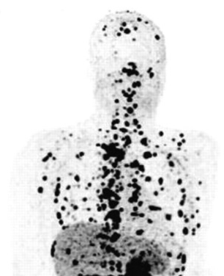
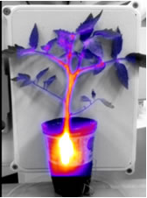
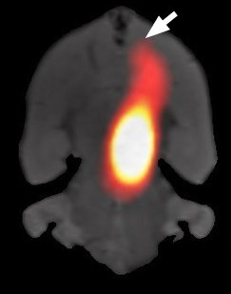
“Harvesting”
For long half-lives, if you have good chemistry, accessing isotopes is the best option
Higher yields
You don’t have to apply for beamtime
Well-suited for applications, since half-lives of interest are generally long (hrs-wks)
Harvesting
(We’re just purifying radionuclides using chemistry, instead of magnets)

Slide 18
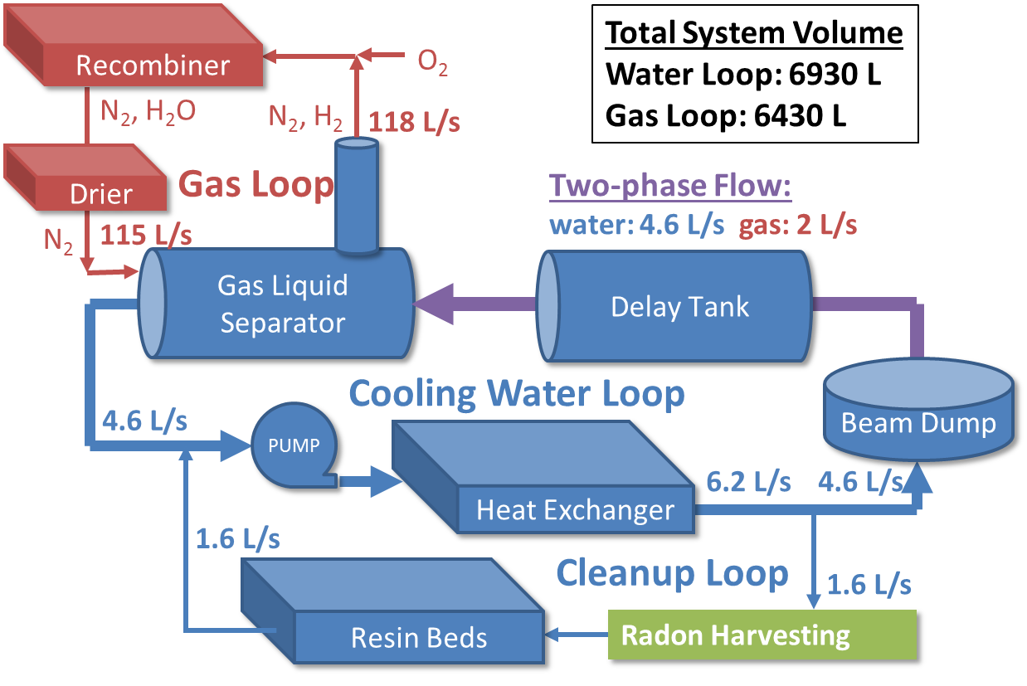
How to harvest?
Ate Visser & Nick Scielzo, LLNL
Harvesting

Slide 19
Harvesting technology
Membrane contactors
Hollow Fiber Supported Liquid Membranes (HFSLM)
Metal-Organic-Frameworks
Feed Phase
Hydrophobic Porous Membrane
Strip Phase
Ca²⁺
Ionophore+solvent
Driving forces:
Ions = acid concentration gradient
Gases = pressure gradient
Ionophore+solvent
H⁺
H⁺
HFSLM

Slide 20
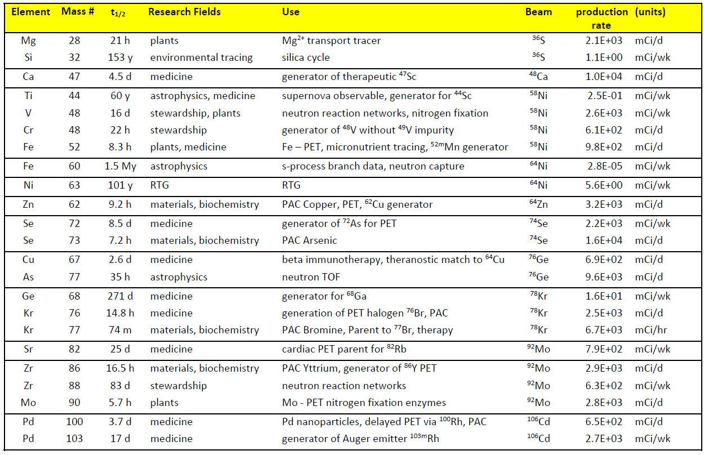
What will we aim for?

Slide 21
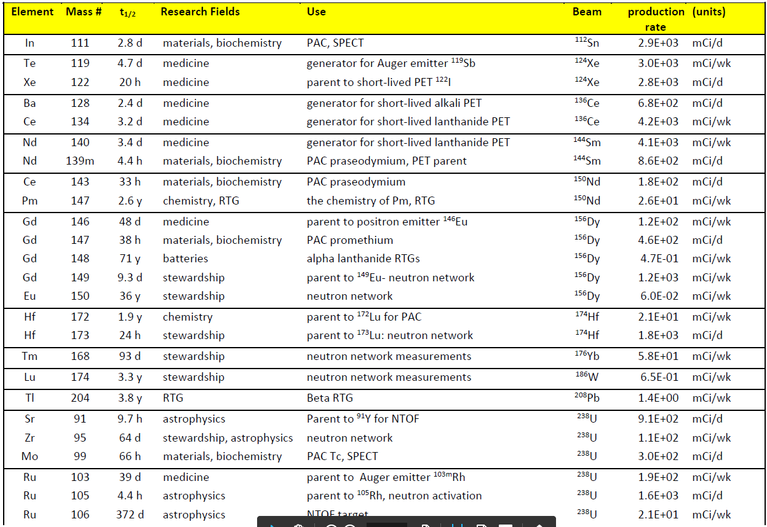
pt. II

Slide 22
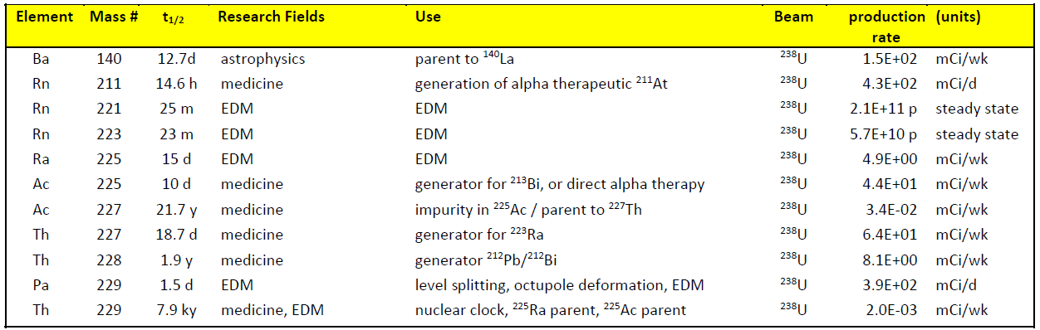
pt. III
58 desired nuclides which have reasonable chemical paths to radionuclidic purity.

Slide 23
Main areas of application
Medicine: Positron Emission Tomography and Alpha/Auger-internal radiotherapy
Materials science and Chemistry: Mossbauer spectroscopy and PAC
Astrophysics: neutron capture reactions at superthermal energies, half-life measurements, etc.
Stewardship: fast and thermal neutron reactions on ‘radiochemical tracers’
Radiothermal generators: small test-sources for development
Plant and Soil Sciences: micronutrient transport in the soil microbiome
Physics BSM: EDM search – deformed nuclei in atomic spectroscopy

Slide 24
Whitepaper
There are many interesting applications for isotopes harvested from FRIB, outlined in the “isotope harvesting at FRIB” whitepaper.
www.isotopeharvesting.blogspot.com
For now, here are a few examples:

Slide 25
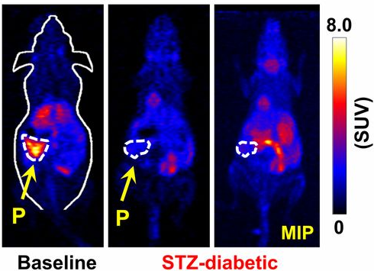
⁵²Fe/^{52m}Mn: a simple diabetes intervention tracer
Manganese ions accumulate in functional beta cells under glucose stimulation!
FRIB production rate: 36GBq/day
Single animal scan: 5 MBq
Radiomanganese PET Detects Changes in Functional β-cell Mass in Mouse Models of Diabetes, Hernandez et al. Diabetes 2017 May; db161285.
https://doi.org/10.2337/db16-1285

Slide 26

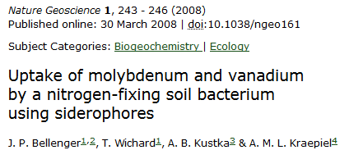
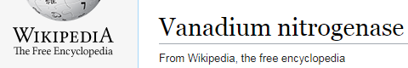

Plant Science
Plant micronutrient transport– ⁹⁰Mo, ⁴⁸V
How do roots access vanadium and molybdenum?
Can we use this information to cut down on fertilizer use?
Vanadium transport
N₂→NH₃
N₂→NH₃
N₂→NH₃
N₂→NH₃
Accessible vanadium
Deep vanadium

Slide 27
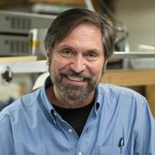
Everyday a new application is born, and “new” isotopes are required
Spin >1/2,
2-10 min isomer
low energy γ
pumpable

Slide 28
Conclusion
The research community has an insatiable appetite for radioisotopes
Your new physics experiment probably makes a lot of good ones
I’m looking forward to seeing what you blast out from the depths of knowledge!
To access our Harvesting Whitepaper: isotopeharvesting.blogspot.com

