Slide 1

SO(10) Yukawa unification :
gluinos at the LHC
Stuart Raby
PRISMA 2014
Gutenberg U.
July 23, 2014

Slide 2
My background
’76, Ph.D. Tel Aviv University – advisor - Larry Horwitz
’76, Postdoc - Cornell University w/ John Kogut
’78, Assistant professor - Stanford University
w/ Lenny Susskind
’81, LANL – Staff/ Group leader T-8
’89, Ohio State University
Worked on :
Extended Technicolor
Chiral gauge theories -
“Tumbling Gauge Theories”
“ Light Composite Fermions”

Slide 3
Worked on - continued:
“Supercolor”
Invisible axion in SUSY
SUSY GUTs
Proton decay- Dim. 5 ops.
SUSY Flavor Problem
Neutrino DM w/ magnetic moment ‘magnino’
Cosmological Polonyi problem
Heterotic String - Mini-Landscape
symmetry
Global F-theory model
Theories of Fermion Masses

Slide 4
Outline
Predictability in SUSY theories
SO(10) Yukawa unification
w/ Universal gaugino masses
Third family analysis - predictions
LHC bounds
Three family analysis - more predictions
Conclusions

Slide 5
Minimal SUSY spectrum

Slide 6
Predictability
SM - Quark & lepton masses
Eg.
Suggests - Family symmetries to
reduce no. arbitrary paras.
Eg. SU(2) x U(1) 3rd family & Higgs special
MSSM - R parity conservation
reduce no. arbitrary couplings

Slide 7
Predictability & SUSY
Too many arbitrary parameters !
FCNCs !!

Slide 8
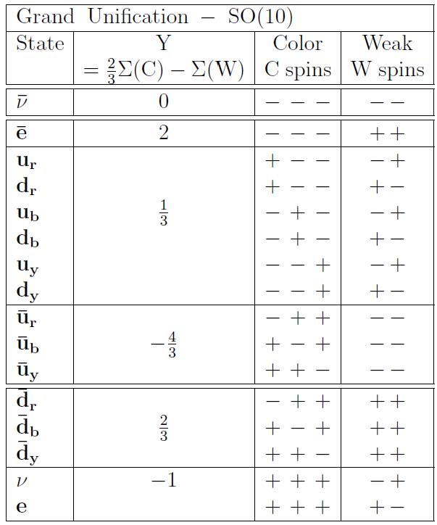
SO(10) Grand Unification
Georgi
Fritzsch & Minkowski
spinor repsn.
of SO( 10 )
tensor product
of 5 spin ½
w/even no. + signs
Georgi & Glashow

Slide 9
SUSY GUT + family symmetry

Slide 10
Yukawa Unification & Soft SUSY breaking
Blazek, Dermisek & Raby PRL 88, 111804 (2002)
PRD 65, 115004 (2002)
Baer & Ferrandis, PRL 87, 211803 (2001)
Auto, Baer, Balazs, Belyaev, Ferrandis & Tata
JHEP 0306:023 (2003)
Tobe & Wells NPB 663, 123 (2003)
Baer, Kraml, Sekmen & Summy
JHEP 0909 :005 (2009)
Badziak, Olechowski & Pokorski
JHEP 1108 :147 (2011)
Gogoladze, Shafi & Saleh Un JHEP 1208 :028 (2012)
Anandakrishnan, Raby & Wingerter arXiv:1212.0542
Anandakrishnan & Raby arXiv:1303.5125
Anandakrishnan, Bryant & Raby arXiv:1404.5628

Slide 11
Note, CANNOT predict top mass due to
large SUSY threshold corrections to
bottom and tau mass
Hall, Rattazzi & Sarid
Carena, Olechowski, Pokorski & Wagner
So instead use Yukawa unification to predict
soft SUSY breaking masses !!

Slide 12
Bottom mass corrections
Needed to fit data

Slide 13
Anandakrishnan, Raby & Wingerter
arXiv:1212.0542
PR D87 (2013) 055005
Anandakrishnan, Bryant & Raby
arXiv:1404.5628
Global χ² analysis

Slide 14
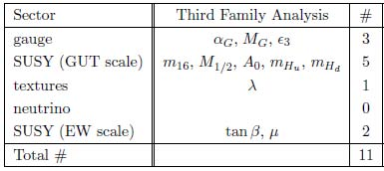
Free parameters -
w/ Universal gaugino masses

Slide 15
Radiative EWSB requires
Roughly ½ comes
From RG running from
Blazek, Dermisek & Raby
“Just so” = “NUHM2”
Gogoladze, Shafi & Un
universal Higgs mass - arXiv:1203.6082

Slide 16
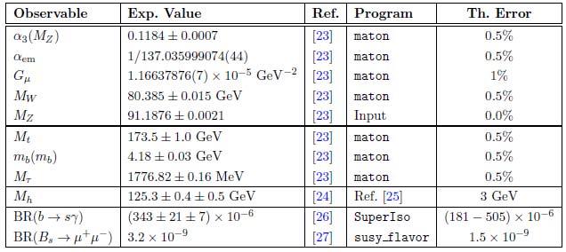
Low energy observables

Slide 17
Yukawa Unification
Universal Gaugino Masses
Fit t,b,tau requires

Slide 18
Inverted scalar mass hierarchy
Bagger, Feng, Polonsky & Zhang
PLB473, 264 (2000)
Third family scalars lighter than first two !
Suppresses flavor & CP violation

Slide 19
Heavy scalars

Slide 20
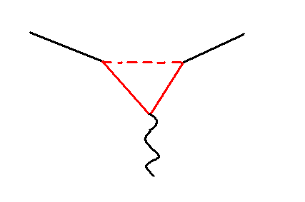
Need Heavy scalars !
b
s
γ

Slide 22
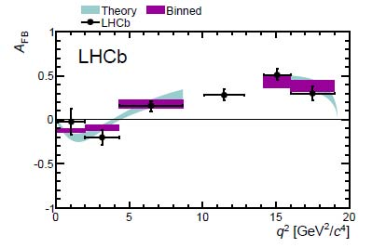
arXiv: 1304.6325

Slide 23
tension between b → s γ & b → s l⁺ l⁻
Albrecht, Altmannshofer, Buras, Guadagnoli, & Straub
JHEP 0710:055 (2007)

Slide 24
Light Higgs
SM-like

Slide 25
Light Higgs mass

Slide 26
Br( B_{s} -> μ⁺ μ⁻ ) :
Light Higgs SM-like
SM : 3 x 10⁻⁹ MSSM : ~ (tan β)⁶ /m_{A}⁴

Slide 27
Gluino mass 2 TeV

Slide 28
Gluino mass bound

Slide 29
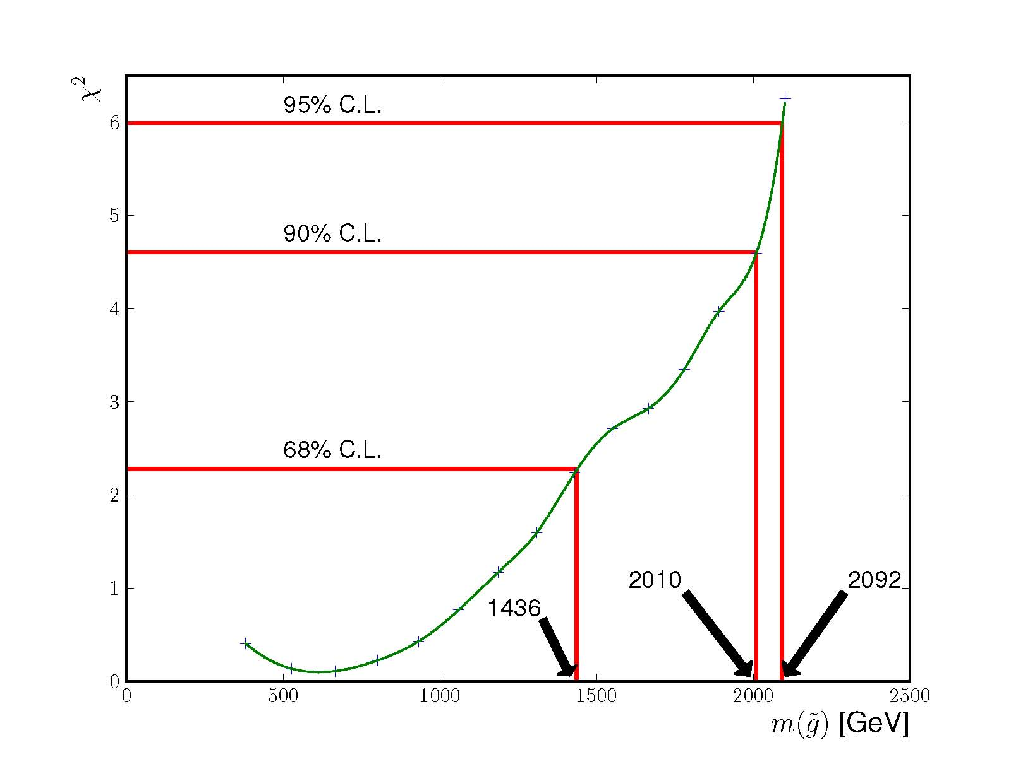
Gluino mass bound
m₁₆ = 20 TeV, M_{1/2} varied -> 2 d.o.f.

Slide 30
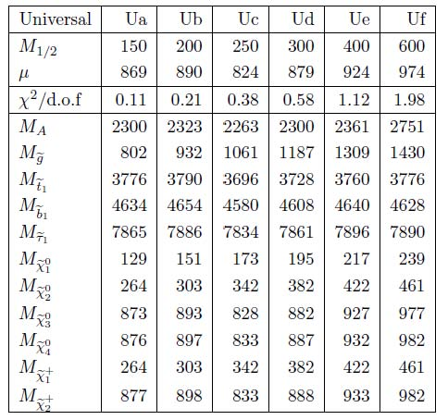
Anandakrishnan, Bryant & Raby arXiv: 1404.5628
m₁₆ =
20 TeV

Slide 31
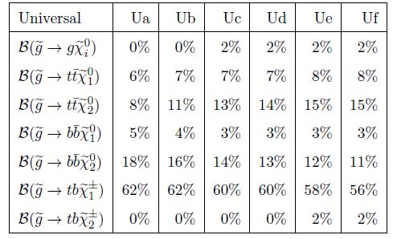

Slide 32
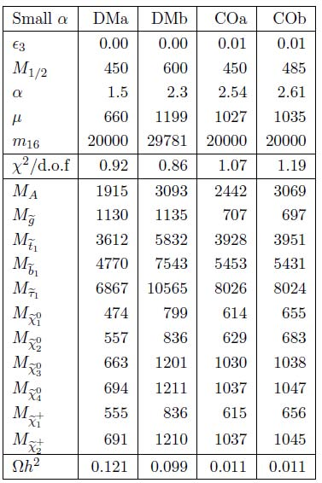
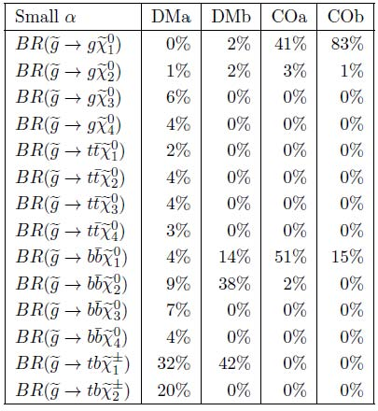

Slide 33
Dark Matter ?
LSP bino - over-closes the universe
Axion, axino DM ???
Or non-thermal DM !
Anandakrishnan & Sinha
arXiv:1310.7579
Non- universal gaugino masses - “mirage mediation”
Thermal DM !
Well tempered

Slide 34
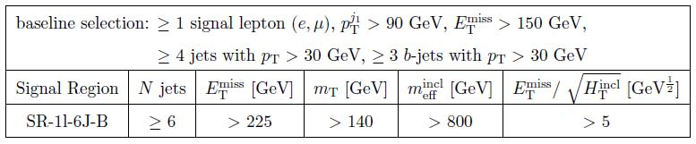
Most stringent signal region
ATLAS-CONF-2013-061
final states with large missing transverse momentum,
at least four, six, or seven jets, at least three jets
tagged as b-jets, and either zero or at least one lepton.

Slide 35
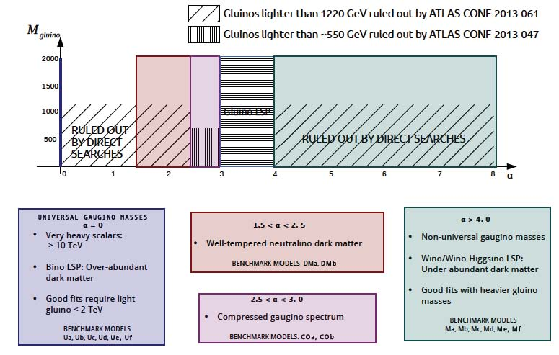
CMS & ATLAS data using CHECKMATE

Slide 36
Three family model
gives good fits
to low energy data

Slide 37
3 Family SO(10) + family symmetry
Dermisek & Raby PLB 622:327 (2005).
Dermisek, Harada & Raby PRD74, 035011 (2006)
Albrecht, Altmannshofer, Buras, Guadagnoli & Straub
JHEP 0710:055 (2007)
Anandakrishnan, Raby & Wingerter
arXiv:1212.0542

Slide 38
3 family SO₁₀ SUSY Model
D₃ x [U(1) x Z₂ x Z₃ ] Family Symmetry
Superpotential
Yukawa couplings
Global χ² analysis
Charged fermion masses & mixing
Neutrino masses & mixing

Slide 39
Superpotential for charged fermion
Yukawa couplings
Familon VEVs
assumed

Slide 40
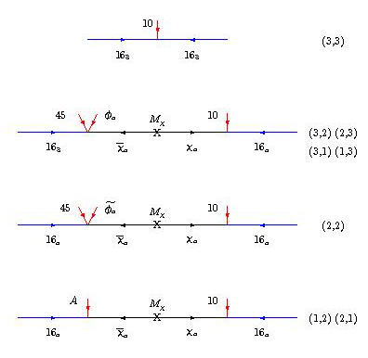
Effective
higher
dimension
operators

Slide 41
SO(10) x [ D₃ x U(1) family sym. ]
Yukawa Unification for 3rd Family
7 real para’s
+ 4 phases
+ 3 real Majorana
Neutrino masses
Dermisek & Raby
PLB 622:327 (2005).

Slide 42
SO(10) x [ D₃ x U(1) family sym. ]
Yukawa Unification for 3rd Family

Slide 43
Extend to neutrino sector
Assume 3 new real para’s

Slide 45
Using χ² analysis, fit
15 charged fermion & 5 neutrino
low energy observables with
11 arbitrary Yukawa & 3 Majorana mass parameters
4 & 2 d. o. f.
or 6 predictions

Slide 46
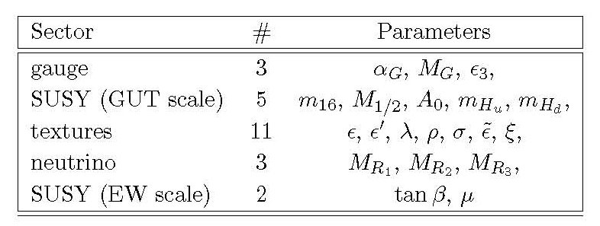
Global χ² analysis
24 parameters at GUT scale
compared to SM - 27 parameters
CMSSM - 32 parameters

Slide 47
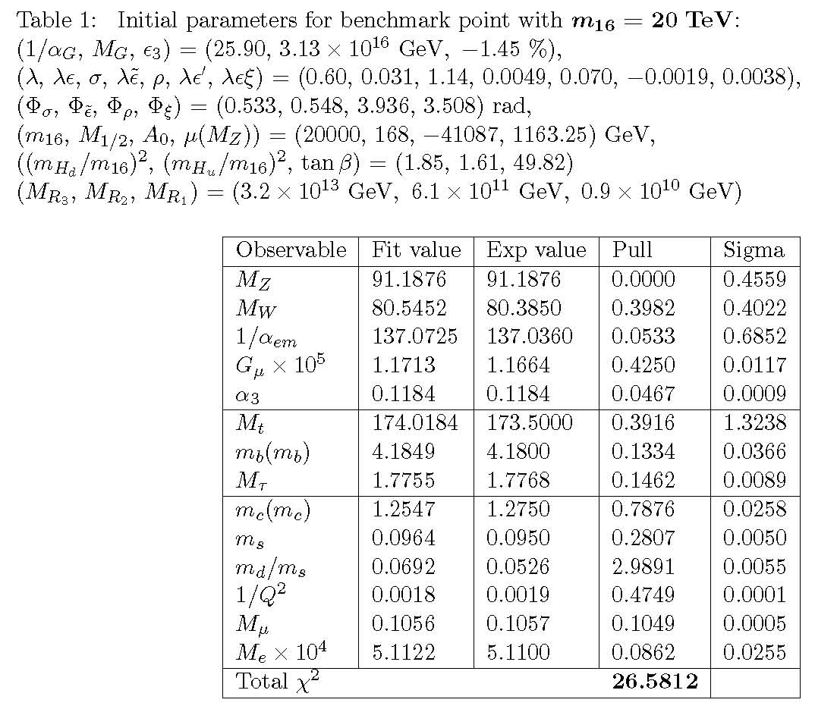
χ²/dof= 2

Slide 48
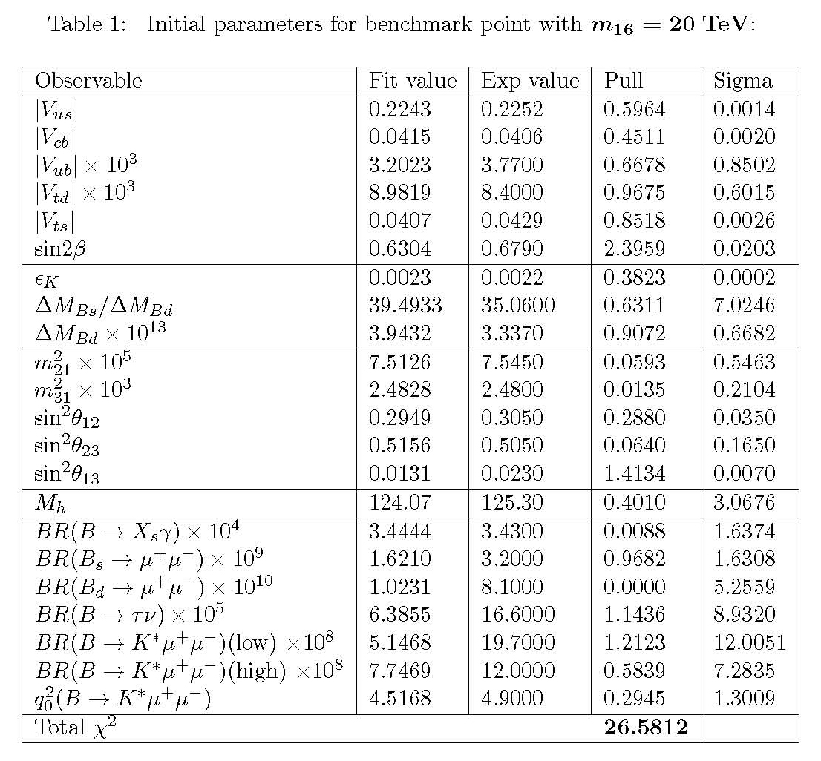

Slide 49
Gluino mass bound – 3 fam.

Slide 50
Gluino mass bound - 3rd fam. only

Slide 51
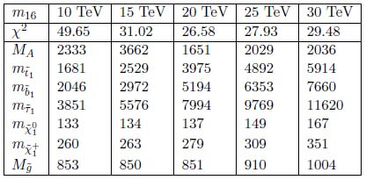

Slide 52
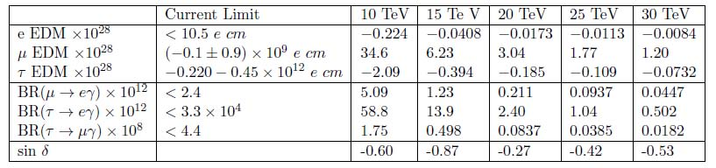

Slide 53
Conclusions
SO(10) Yukawa unification
Boundary conditions at M_{GUT}
~ Universal or “Mirage” gaugino masses
Light Higgs - SM-like
Three family model fits low energy data !!
SUSY at Run II of LHC ??
Optimistic !!

