Slide 1
Overview of the
BINP accelerator complex
Dmitry Shwartz
BINP, Novosibirsk
on behalf of IC, VEPP-4M, VEPP-2000 teams
June 29, 2017
PhiPsi’17

Slide 2
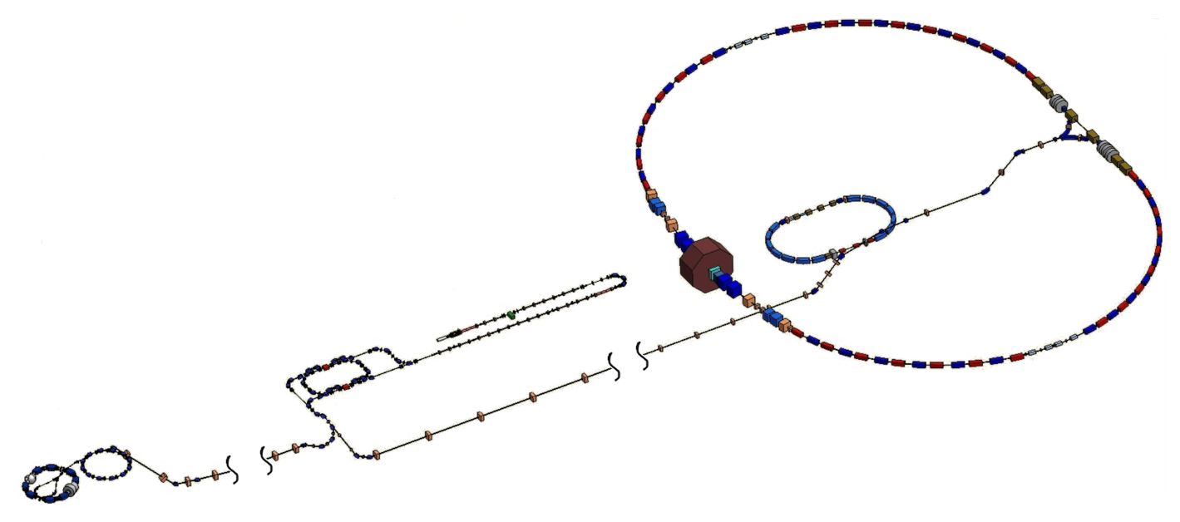
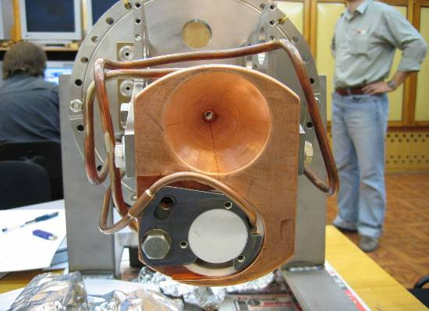
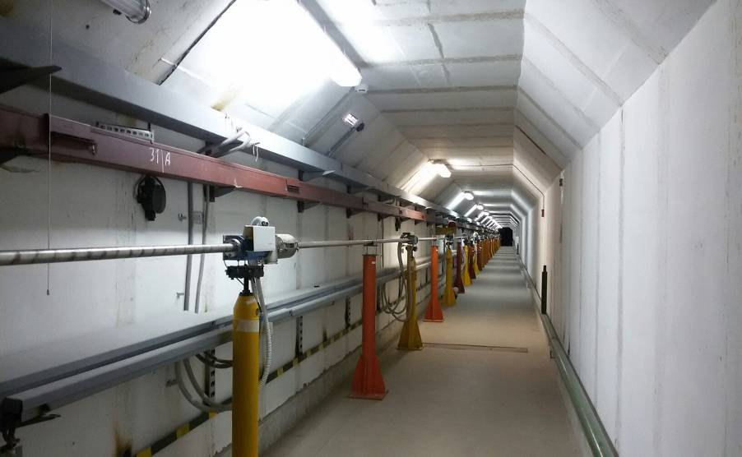
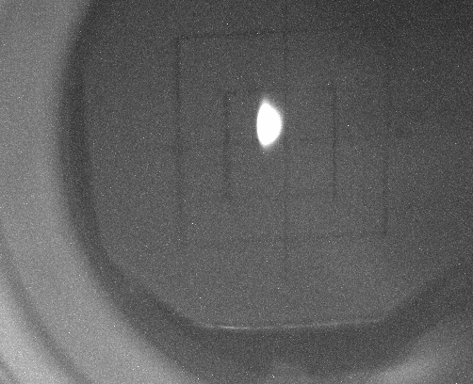
Accelerator complex layout
IC Parameters (2016)
Beam Energy: 395 MeV
Storage rate e⁻ @ 12.5 Hz: 4.0·10¹⁰/s (70 mA/s)
Storage rate e⁺ @ 12.5 Hz: 4.0·10⁹/s (7 mA/s)
VEPP-4M
VEPP-3
Conversion System
Linacs
Beamline to VEPP-2000
250 m
Damping
Ring
Beam @ VEPP-3
BEP
VEPP-2000
Injection Complex and beam transfer lines
Beamline to VEPP-4M
130 m

Slide 3
VEPP-4M
e⁺e– HEP at VEPP-4M with KEDR detector
SR at VEPP-3 (2 GeV)
SR at VEPP-4M (2÷4 GeV)
Nuclear physics at VEPP-3 with Deuteron facility
Test Beam Facility at VEPP-4M
Accelerator activity
Energy | 0.925 ÷ 4.75 (5.3)
Circumference | 366 |  |  |  | m
N of bunches | 2e⁺ × 2e– (16e–)
Harmonic number | 222
Betatron tunes, h/v | 8.54/7.57
Coupling | 0.05%
Bunch length | 5 |  |  |  | cm
Beam Energy | 1.5 | 1.9 | 4.7 | 5.2 | GeV
Emittance | 16 | 25 | 167 | 200 | nm·rad
Energy Spread | 2.5 | 3.0 | 7.8 | 8.5 | ·10⁻⁴
Bunch Current | 1.6 | 3.5 | 25 | 25 | mA
Luminosity | 0.9 | 3.3 | 44 | 25 | 10³⁰ cm⁻²·s⁻¹

Slide 4
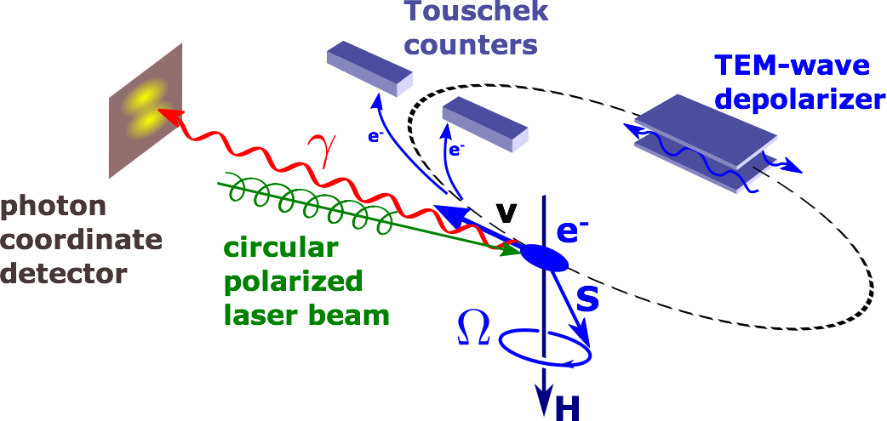
VEPP-4M Laser Polarimeter @ 4.1 GeV

Slide 5
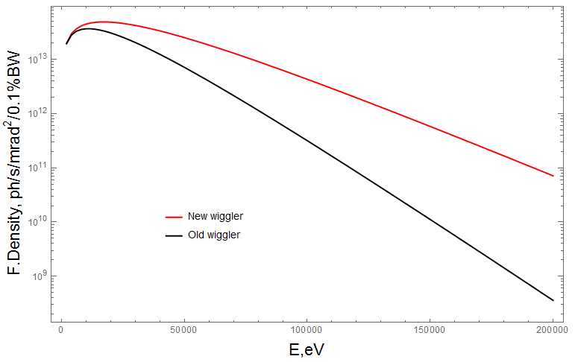
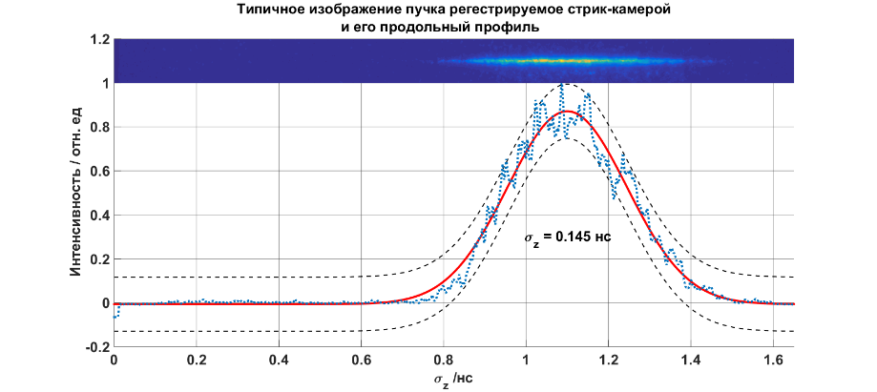
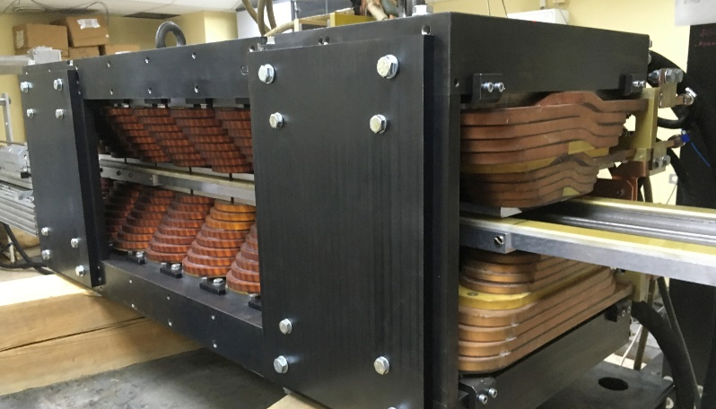
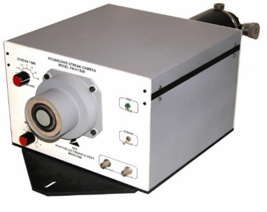
VEPP-4M Plans
Experiments at High Energy of VEPP-4M
R measurement from 5 to 7 GeV
Mass and lepton width of Y-mesons
γγ-physics
Upgrade
RF system upgrade
New power supplies for VEPP-3 & VEPP-4 (4.75 → 5.3 GeV)
Longitudinal Feedback for VEPP-3
New BPM system for VEPP-4 & VEPP-3
2T Hybrid Wiggler for SR program at VEPP-4M
Streak-camera (~ 1 ps)
EPICS for Control System

Slide 6
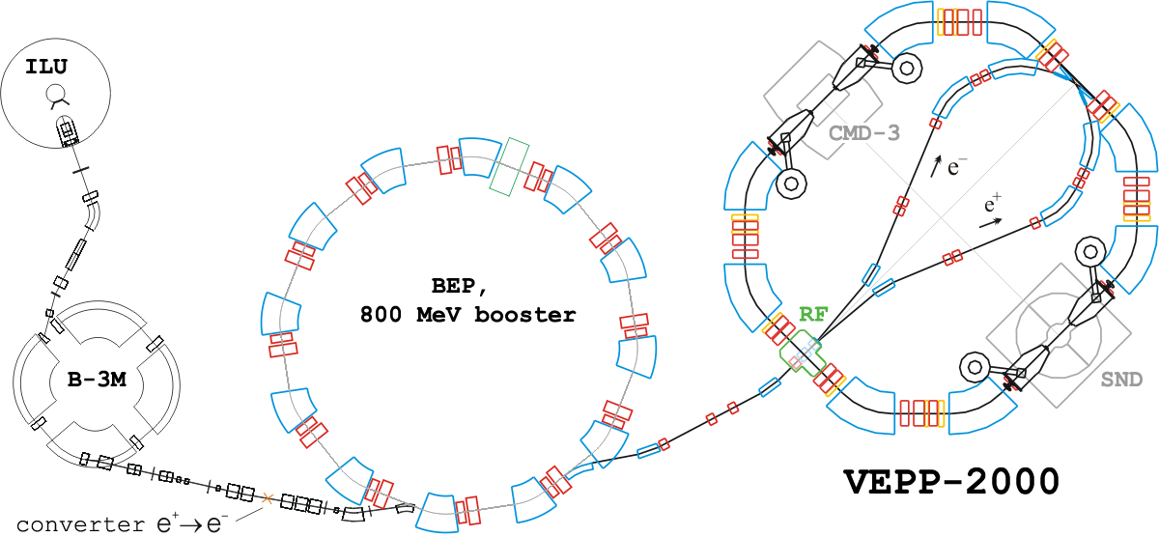
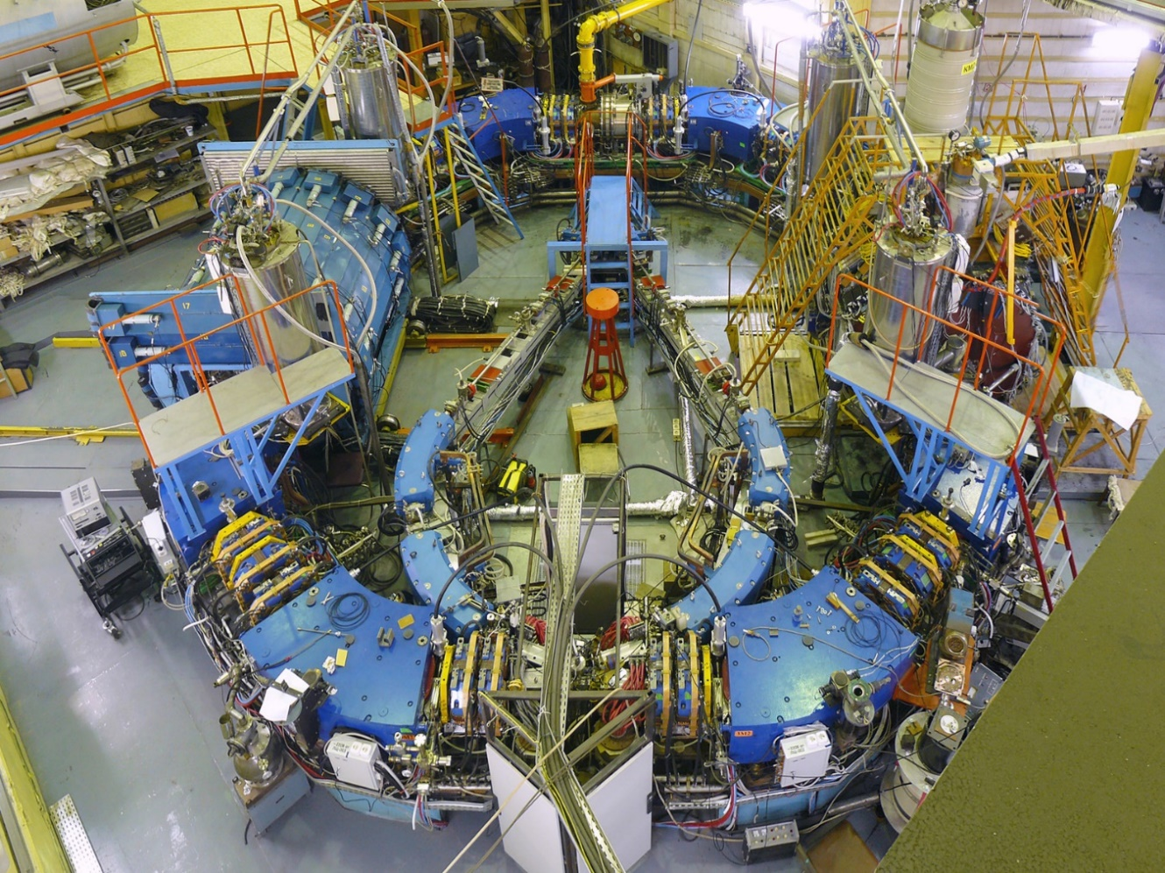
VEPP-2000
13 T final focusing
solenoids
max. production rate:
2×10⁷ e⁺/s
VEPP-2000 main design parameters @ 1 GeV
Circumference | 24.388 m | Energy range | 150 ÷ 1000 MeV
Number of bunches | 1 | Number of particles | 1×10¹¹
Betatron tunes | 4.1/2.1 | Beta-functions @ IP | 8.5 cm
Beam-beam parameter | 0.1 | Luminosity | 1×10³² cm⁻²s⁻¹

Slide 7
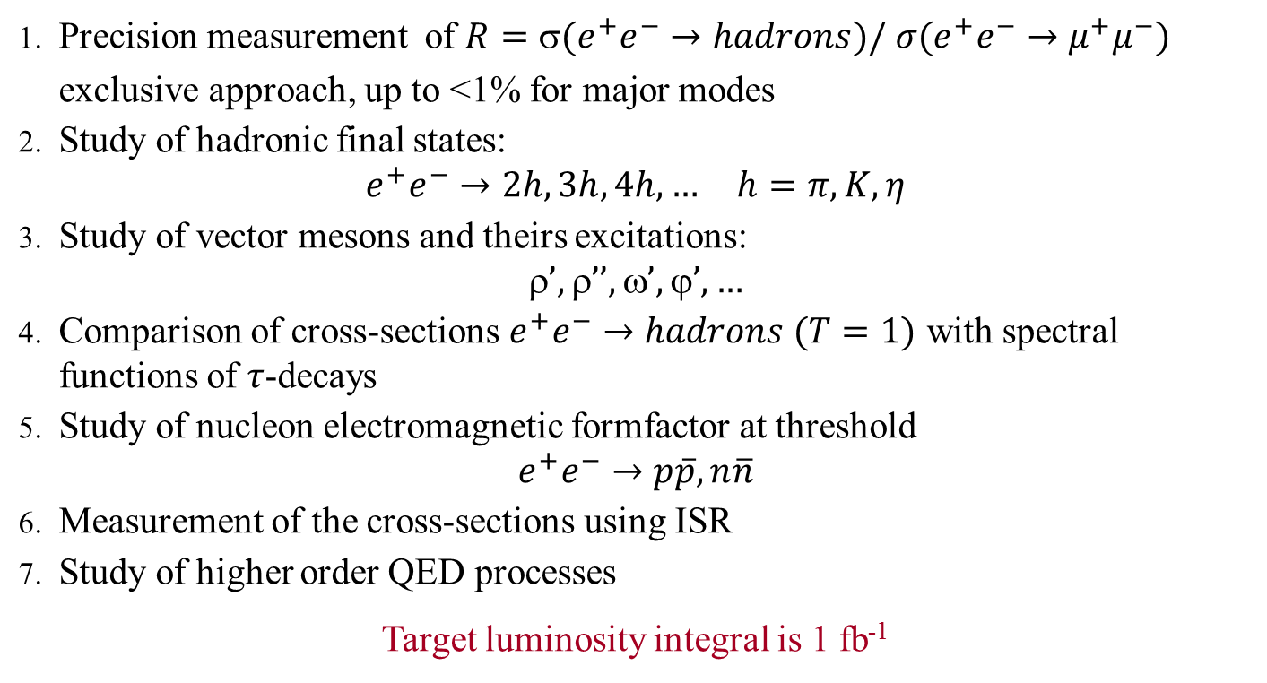
Experimental program
Precision measurement of $R=(e^{+}e^{−}→hadrons)/ σ(e^{+}e^{−}→μ^{+}μ^{−})$
    exclusive approach, up to <1% for major modes
Study of hadronic final states:
    $$e^{+}e^{−}→2h, 3h, 4h,… h=π,K,η$$
Study of vector mesons and theirs excitations:
  $$’, ’’, ’, ’,…$$
Comparison of cross-sections $e^{+}e^{−}→hadrons (T=1)$ with spectral functions of $τ$-decays
Study of nucleon electromagnetic formfactor at threshold
  $$e^{+}e^{−}→p\overline{p}, n\overline{n}$$
Measurement of the cross-sections using ISR
Study of higher order QED processes
Target luminosity integral is 1 fb⁻¹
Dedicated talks by I. Logashenko, T.Dimova, F.Ignatov, L.Kardapoltsev, A.Milstein

Slide 8
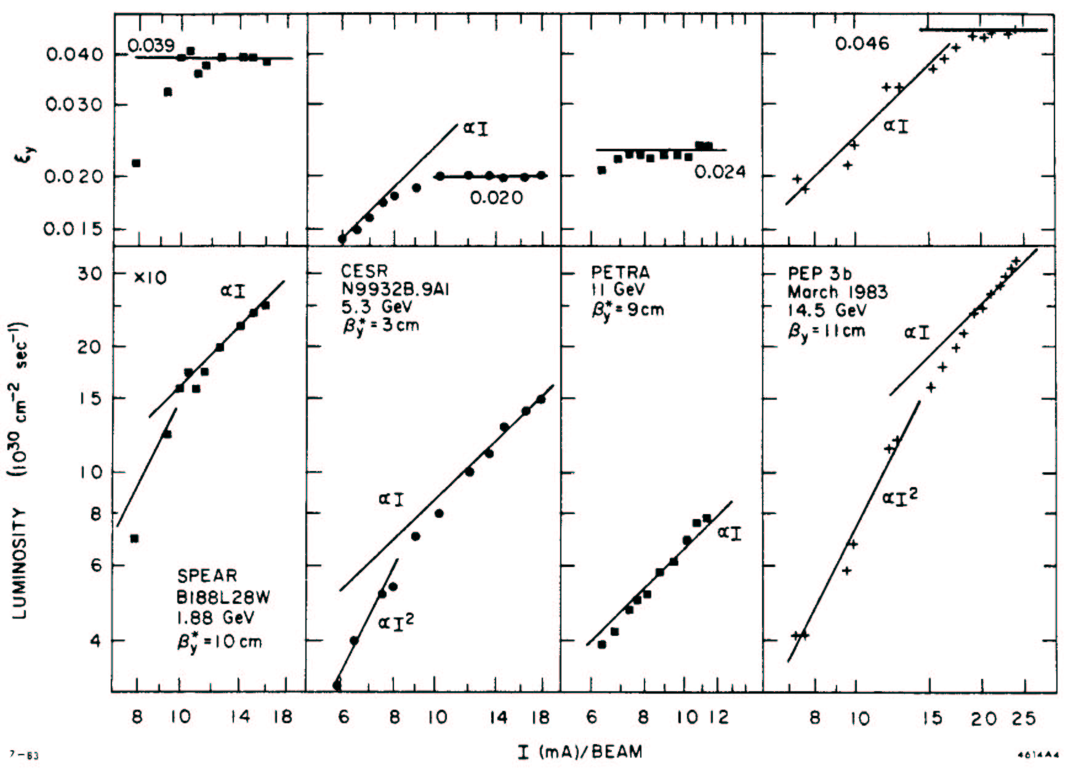
Beam-beam limit @ lepton colliders
Beam-beam parameter saturation,
emittance (and beam size) growth
Final limit:
emittance blowup,
lifetime reduction,
flip-flop effect
J.Seeman (1983)

Slide 9
Towards Integrability for Beam-Beam
To increase significantly beam-beam parameter threshold the motion stochasticity should be suppressed.
Half-integrability:
Working point vicinity to half-integer resonance.
Crab-waist approach for large Piwinsky angle
Round beams (+1 integral of motion >> 1D nonlinearity remains)
Even closer to full-integrable beam-beam?
Round beams + special longitudinal profile?
…?
Reduction of nonlinear motion dimensions number is very important: diffusion along stochastic layer through additional dimension is suppressed

Slide 10
The concept of Round Colliding Beams
Axial symmetry of counter beam force together with x-y symmetry of transfer matrix should provide additional integral of motion (angular momentum M_{z} = x′y - xy′). Particle dynamics remains nonlinear, but becomes 1D.
Lattice requirements:
Head-on collisions
Small and equal β-functions at IP:
Equal beam emittances:
Equal fractional parts of betatron tunes:
Round beam
M_{x} = M_{y}
F.M. Izrailev, G.M. Tumaikin, I.B. Vasserman. Preprint INP 79-74, Novosibirsk,(1979).
L.M. Barkov, et. al, Proc. HEACC’89, Tsukuba, Japan, p.1385.
S. Krishnagopal, R. Siemann, Proc. PAC’89, Chicago, p.836.
V.V. Danilov et al., EPAC’96, Barcelona, p.1149.
S. Henderson, et al., Proc. PAC’99, New York, p.410.

Slide 11
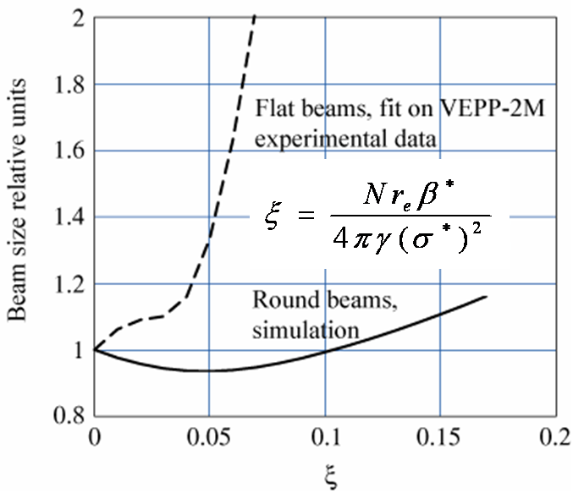
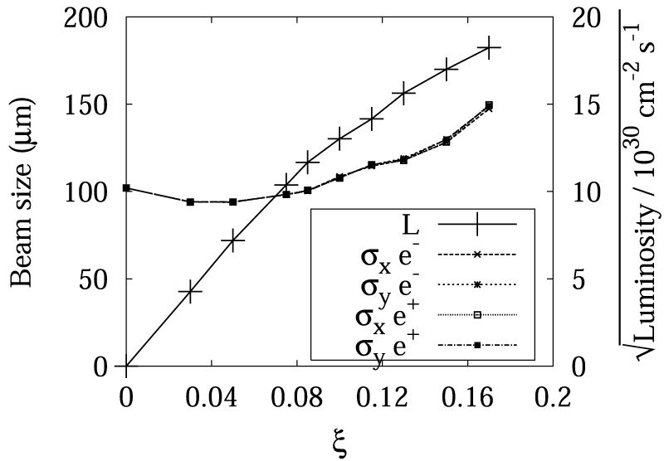
Historic beam-beam simulations
“Weak-Strong”
“Strong-Strong”
I.Nesterenko, D.Shatilov, E.Simonov, in Proc. of Mini-Workshop on “Round beams and related concepts in beam dynamics”, Fermilab, December 5-6, 1996.
Beam size and luminosity vs. the nominal beam-beam parameter (A. Valishev, E. Perevedentsev, K. Ohmi, PAC’2003 )

Slide 12
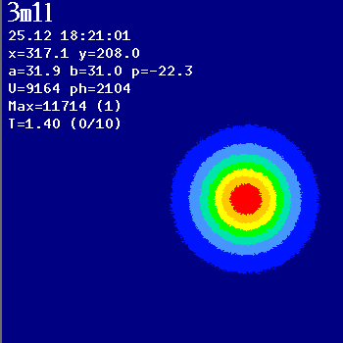
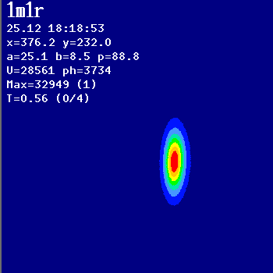
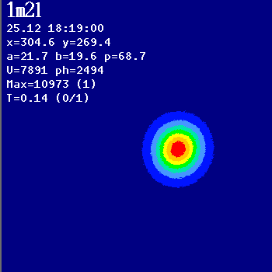
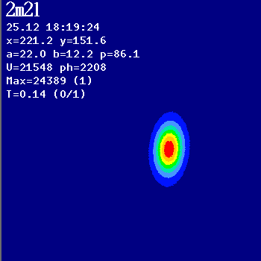
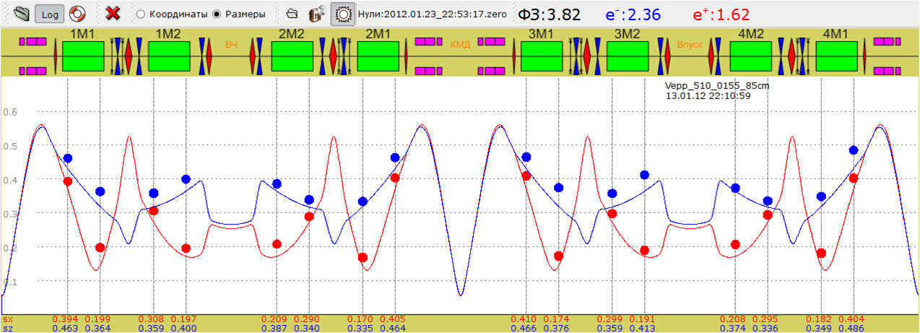
Beam size measurement via SR @ CCDs

Slide 13
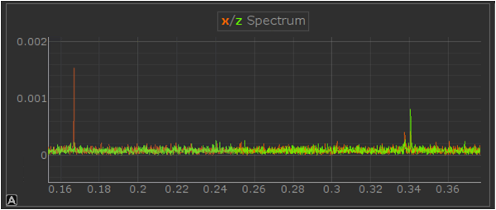
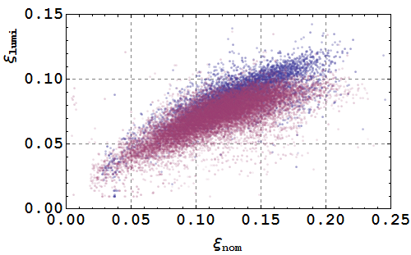
Beam-beam parameter
Beam-beam parameter extracted from luminosity monitor data
Coherent oscillations spectrum
σ
π
BB-threshold improvement with beam lengthening:
Е = 392.5 MeV
U_{rf} = 35 kV (purple)
U_{rf} = 17 kV (blue)
Δν = 0.175 → ξ = 0.125/IP

Slide 14
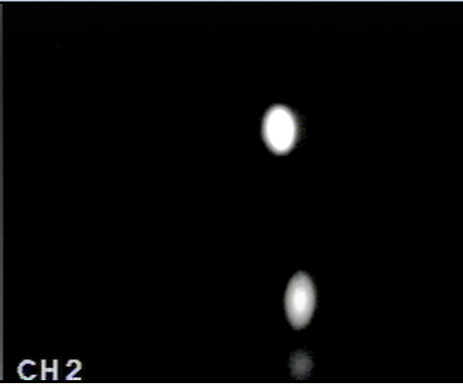
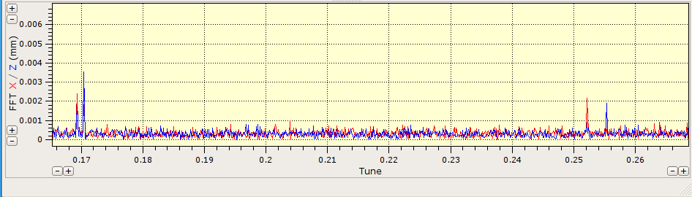
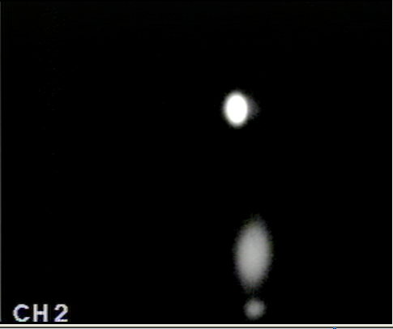
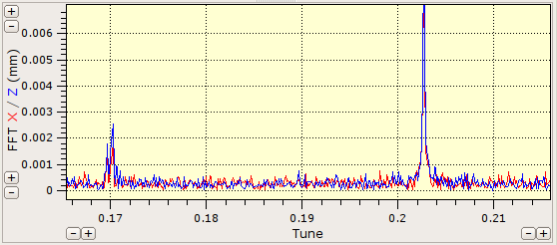
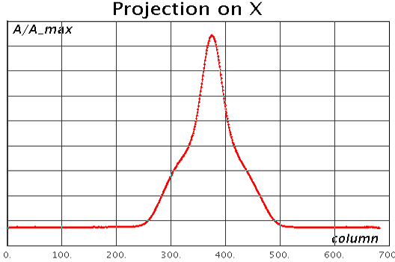
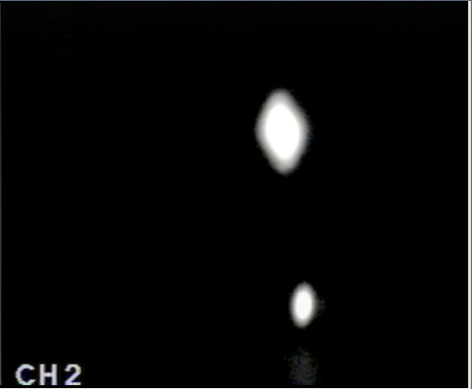
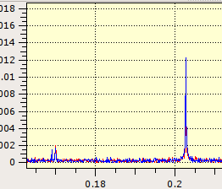
“Flip-flop” effect
TV
σ
π
e⁺
Pickup spectrum of the coherent oscillations
regular
e⁻
0.17
0.2
0.25
E = 240 MeV,
I_{beam} ~ 5×5 mA
blown-up e−
0.17
0.2
Coherent beam-beam π-mode interaction with machine nonlinear resonances?
blown-up e+
0.17
0.2

Slide 15
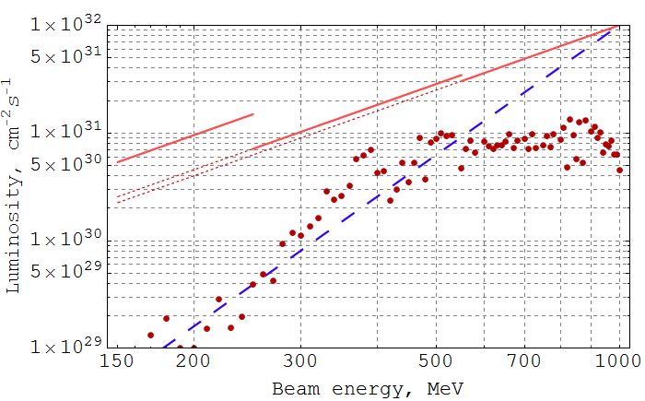
Luminosity vs. beam energy 2010-2013
Peak luminosity overestimate for “optimal” lattice variation
β* ∝ γ, L ∝ γ²
CMD-3 luminosity, averaged over 10% of best runs
Fixed lattice energy scaling law: L ∝ γ⁴
Historic VEPP-2M data
Energy ramping
e⁺ deficit
Beam-beam effects
DA, IBS lifetime

Slide 16
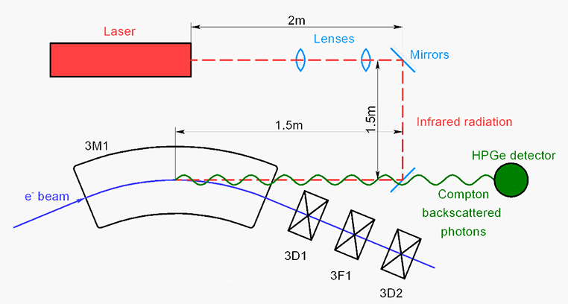
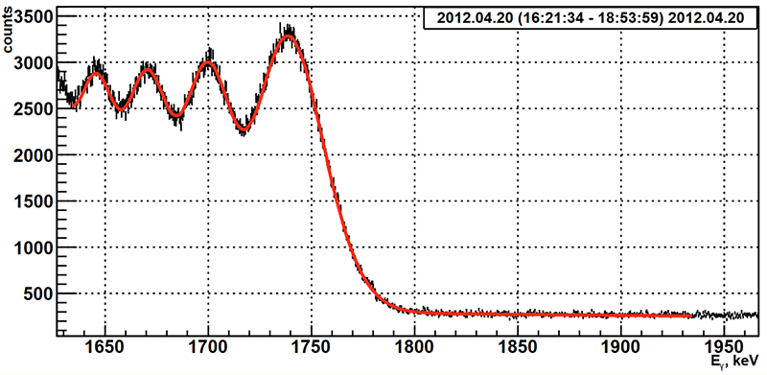
Beam energy measurements: CBS system
Backscattered photons spectrum edge:
E.V. Abakumova et al., PRL 110 2013 140402

Slide 17
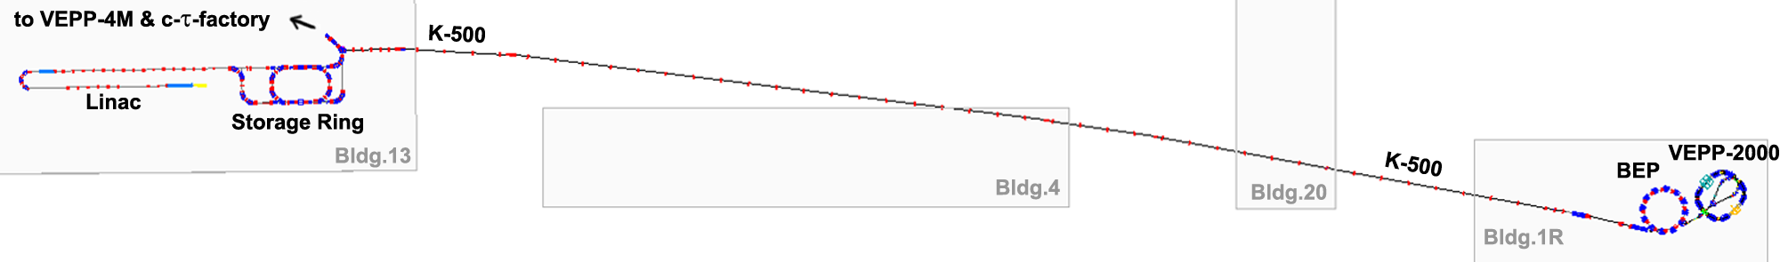
VEPP-2000 upgrade: 2013 >> 2016
VEPP-2000 complex
K-500 beam transfer channel
BINP Injection complex
e+, e− beams from new BINP Injection Complex (IC):
high intensity
higher energy (400 MeV);
high quality (!);
Booster BEP upgrade to 1 GeV.
Transfer channels BEP − VEPP to 1 GeV.
VEPP-2000 ring modifications.

Slide 18
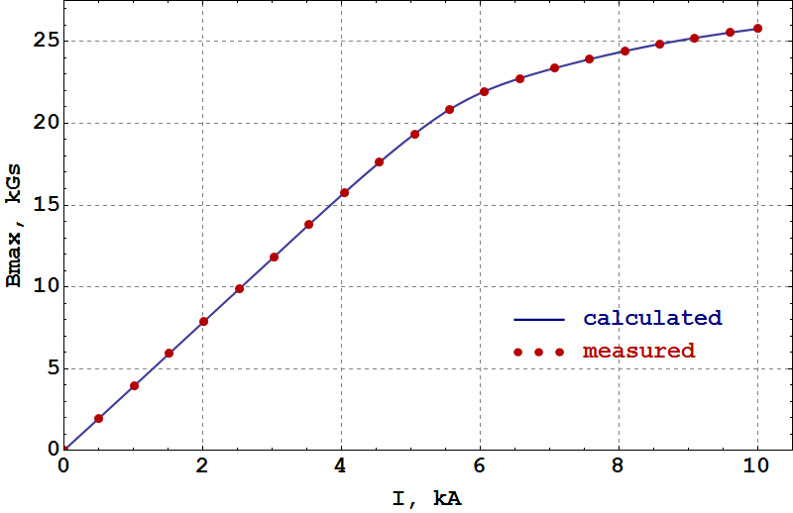
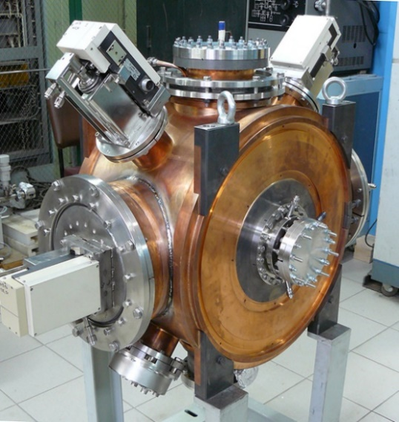
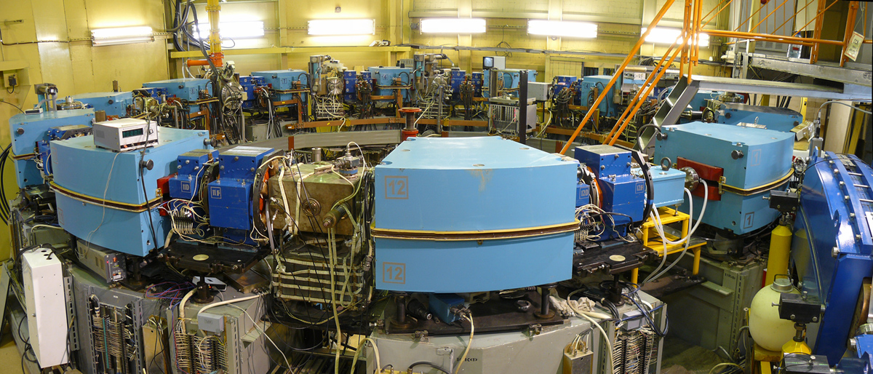
BEP reconstruction
New pulsed injection septum
New RF-system (110 kV, 174.382 MHz, q = 13)
Magnets yokes reprofiling (gap reduction, etc.). Fed in series all magnets has to follow single saturation curve. As well as chromatic sextupoles embedded into quads profile.
New correction coils
Vacuum chamber local deformation within reduced gaps
New pulse “bump” magnets (COD @ extraction)
New SR outlet
Dipoles excitation curve
@ 1 GeV:
H = 26 kGs,
I = 10.2 kA
P = 2.4 MW
RF cavity
Booster BEP

Slide 19
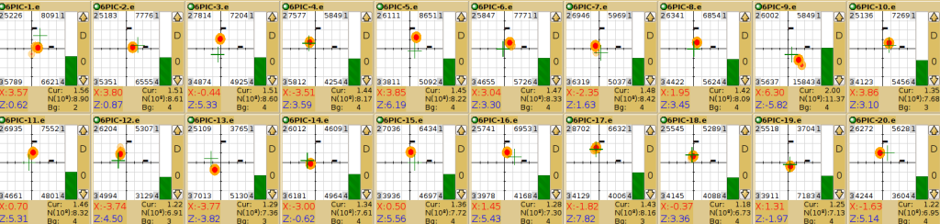
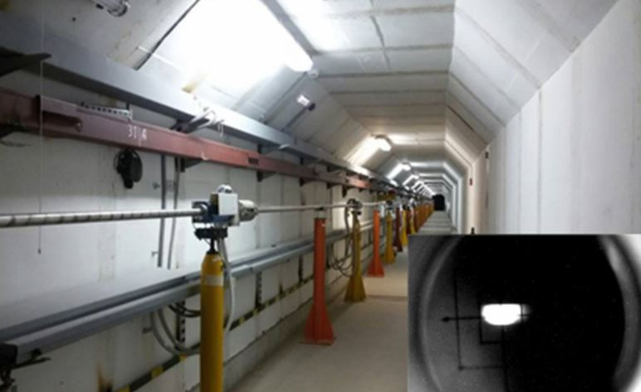
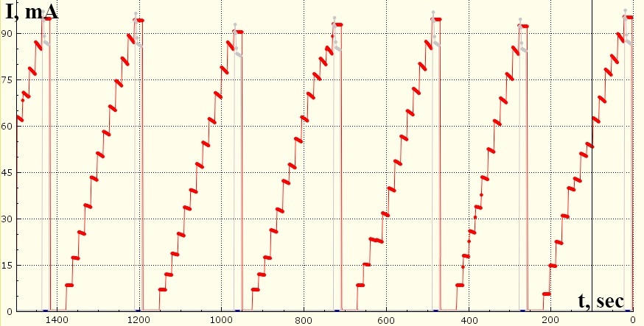
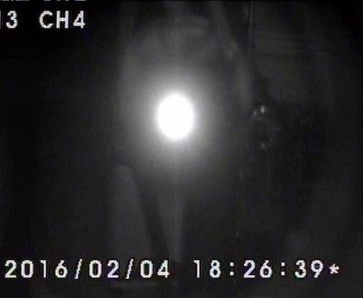
Beam commissioning (2016)
Image current BPMs @ K-500 transfer channel
K-500 tunnel and beam @ scintillator screen
Stacking rate of 2×10⁸ e⁺/sec @ 390 MeV is obtained (gain factor of 10 in comparison to old production system)
BEP operates stable up to E = 1 GeV
I, mA
First beam SR @ BEP
Positrons stacking @ BEP

Slide 20
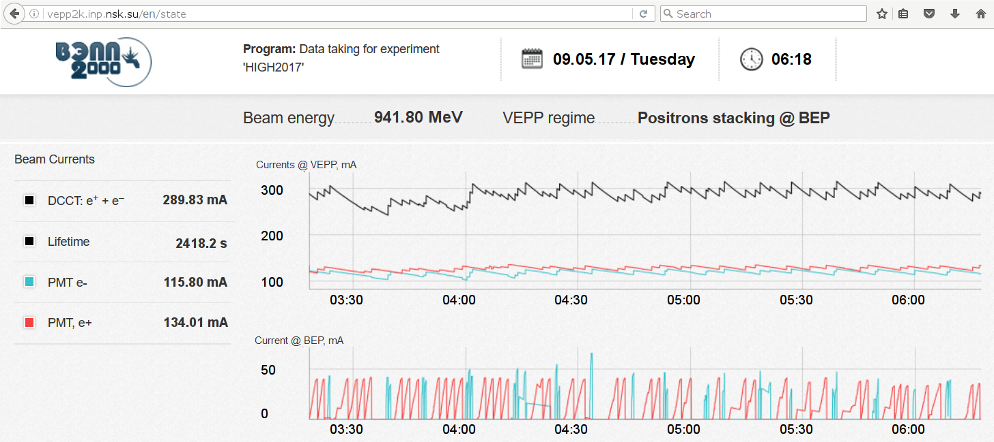
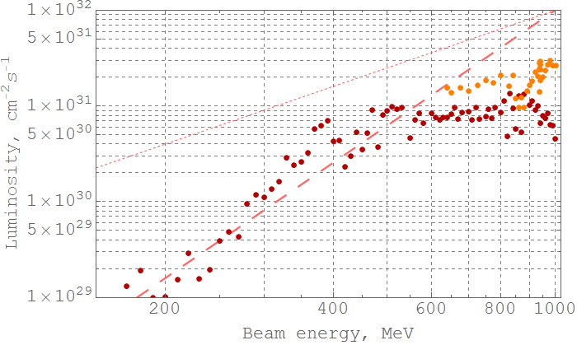
Luminosity with new injector (2017)
Run-2017 data
CMD-3 luminosity, averaged over 10% of best runs
Achieved peak luminosity 4×10³¹ cm⁻²s⁻¹
Best day integral 1.2 pb⁻¹

Slide 21
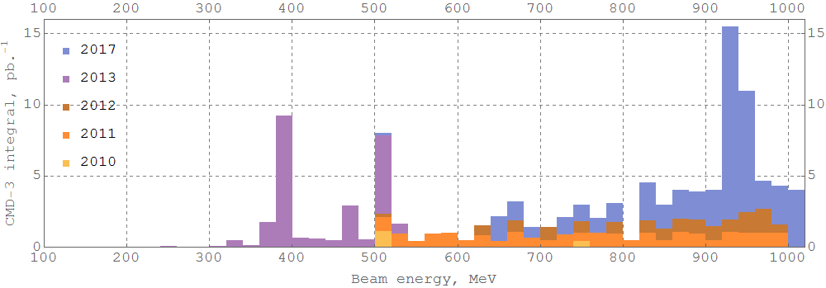
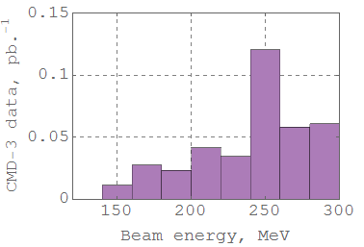
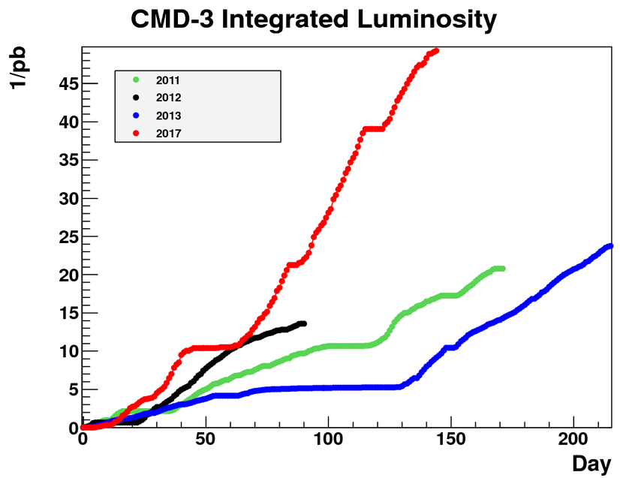
Collected data
ρ,ω
η̍
ϕ
NN
D^{*0}
Lowest energy ever obtained in e⁺e⁻ colliders

Slide 22
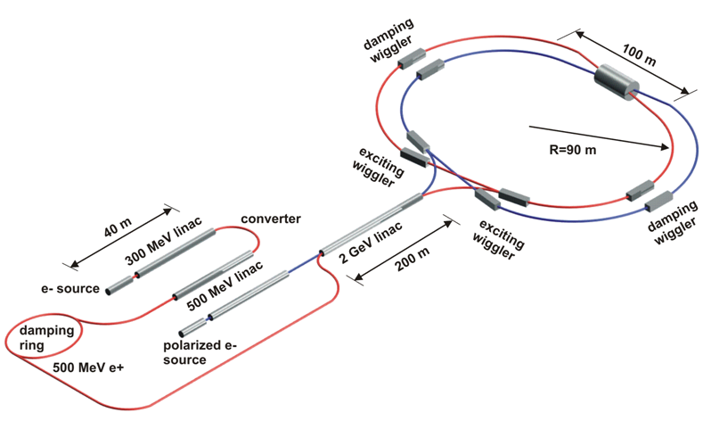
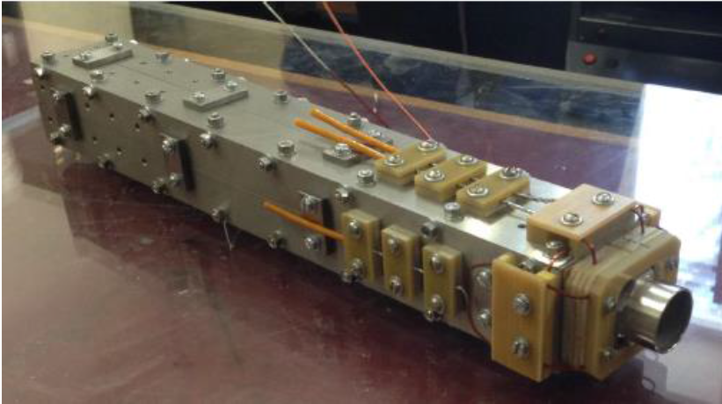
Super C-tau Factory project
Beam energy | 1.0 ÷ 2.5 GeV
Circumference | 780 m
Emittance (hor.) | 8 nm
Damping times | 30/30/15 ms
Bunch length | 16 ÷ 10 mm
Energy spread | 10.1 ÷ 7.38·10⁻⁴
RF frequency | 508 MHz
Harmonic number | 1300
Particles in bunch | 7·10¹⁰
N of bunches | 390
Total beam current | 1.7 A
Bb parameter | 0.15 ÷ 0.095
Luminosity | 0.63 ÷ 1.00·10³⁵
Max.gradient: 100 T/m
Max.current: 1100 A
Length: 40 cm
Aperture: 2 cm
NbTi 1.8 x 1.4 mm²
Saddle-type coils
New version of QD0 was developed at BINP recently and a single-aperture prototype was manufactured and tested.

Slide 23
Summary
New BINP injection complex started to serve both colliders.
VEPP-4M is under preparation for work at high energy with resonance depolarization system for precise energy control.
Round beams concept gives the luminosity enhancement @ VEPP-2000. The achieved beam-beam parameter value at middle energies amounts to ξ ~ 0.1–0.12 during regular operation.
VEPP-2000 resumed data taking after injection chain upgrade. During first run 52 pb⁻¹ per detector already collected.
Super c-tau factory project with luminosity of 1×10³⁵ cm⁻²s⁻¹ is proposed.
Thank you for your attention

Slide 24
Backup slides

Slide 25
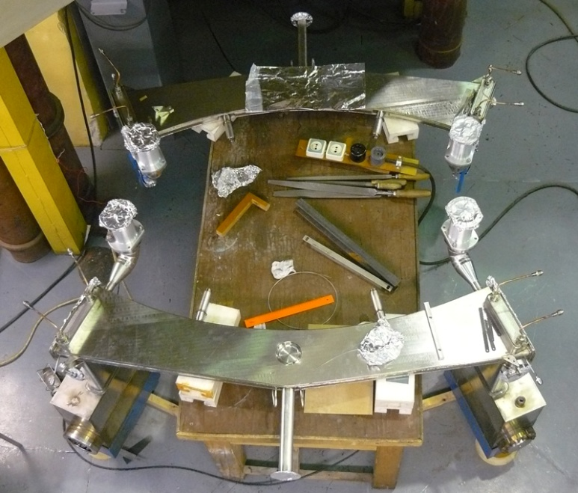
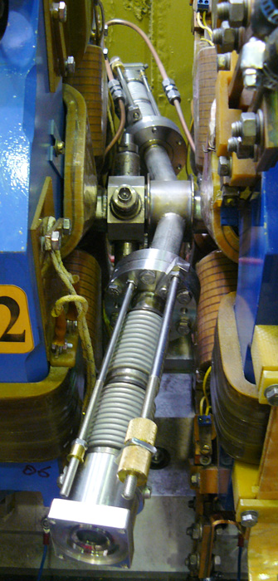
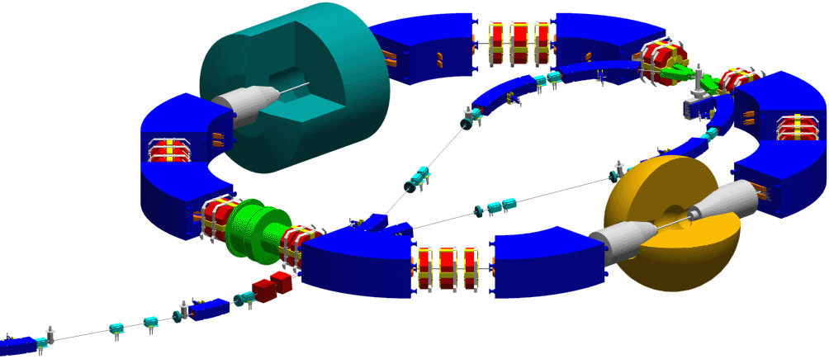

VEPP-2000 modifications
New vacuum chambers in two dipoles with additional kicker electrodes (injection @ 1 GeV)
Original kicker electrodes
Scraper 2
Scraper 1
Additional
kicker electrodes
New SR mirrors for beam diagnostics:

Slide 26


Bunch lengthening: microwave inst.
Bunch length measurement with phi-dissector as a function of single beam current for different RF voltage @ 478 MeV.
Energy spread dependence, restored from beam transverse profile measurements.
26

Slide 27



Beam sizes data analysis @ 392.5 MeV
U_{RF}= 35 kV
I = 15 mA corresponds to ξ ~ 0.1
And we should keep in mind that bunch lengthening is current-dependent…
U_{RF}= 17 kV

Slide 28
Round beams at e⁺e⁻ collider
Luminosity increase scenario:
Number of bunches (i.e. collision frequency)
Bunch-by-bunch luminosity
Round Beams:
Geometric factor:
Beam-beam limit enhancement:
IBS for low energy? Better life time!

Slide 29

Round Beams Options for VEPP-2000
Round beam due to coupling resonance?
The simplest practical solution!
Both simulations and experimental tests showed insufficient dynamic aperture for regular work in circular modes options.
Flat to Round or Mobius change needs polarity switch in solenoids and new orbit correction.

Slide 30


Dynamic sizes at the beam-size monitors
ξ_{nom} ~ 0.12

Slide 31



Integrable round beam?
(Danilov, Perevedentsev, 1997)
Proper profile of longitudinal distribution together with Δψ = nπ betatron phase advance between IPs makes the Hamiltonian time-independent, i.e. integral of motion.
Synchrotron motion destroys full integrability
a_{s} = 0.0
a_{s} = 1.0
β* = 5cm
σ_{s} = 5cm
ξ = 0.15
D.Shatilov, A.Valishev, NaPAC’13

Slide 32
LIFETRAC predictions
Very high ξ threshold values for ideal linear machine lattice, ξ_{th} ~ 0.25.
Chromatic sextupoles affect significantly on bb-effects decreasing threshold down to ξ_{th} ~ 0.15. (Break of the angular momentum conservation by nonlinear fields asymmetric to x-y motion)
Working point shift from coupling resonance under diagonal (ν_{x} > ν_{z}) preferable than vise versa. (Emittances parity breaking.)
Uncompensated solenoids acceptable in wide range (δν_{x,z} ~ 0.02) while coupling in arcs provided by skew-quadrupole fields should be avoided. (Angular momentum conservation break by skew-quads, breaking x-y symmetry of transport matrix.)
Inequality of x-y beta-functions in IP within 10 % tolerance does not affect on bb-effects.
Bb-effects do not cause emittance blow-up but reduce beam lifetime via non-Gaussian “tails” growth in transverse particles distribution.
Beam lifetime improves with working point approach to the integer resonance.
Qualitative agreement of all predictions with experimental experience.

Slide 33


Luminosity monitor
800 MeV
180 MeV

