Slide 1


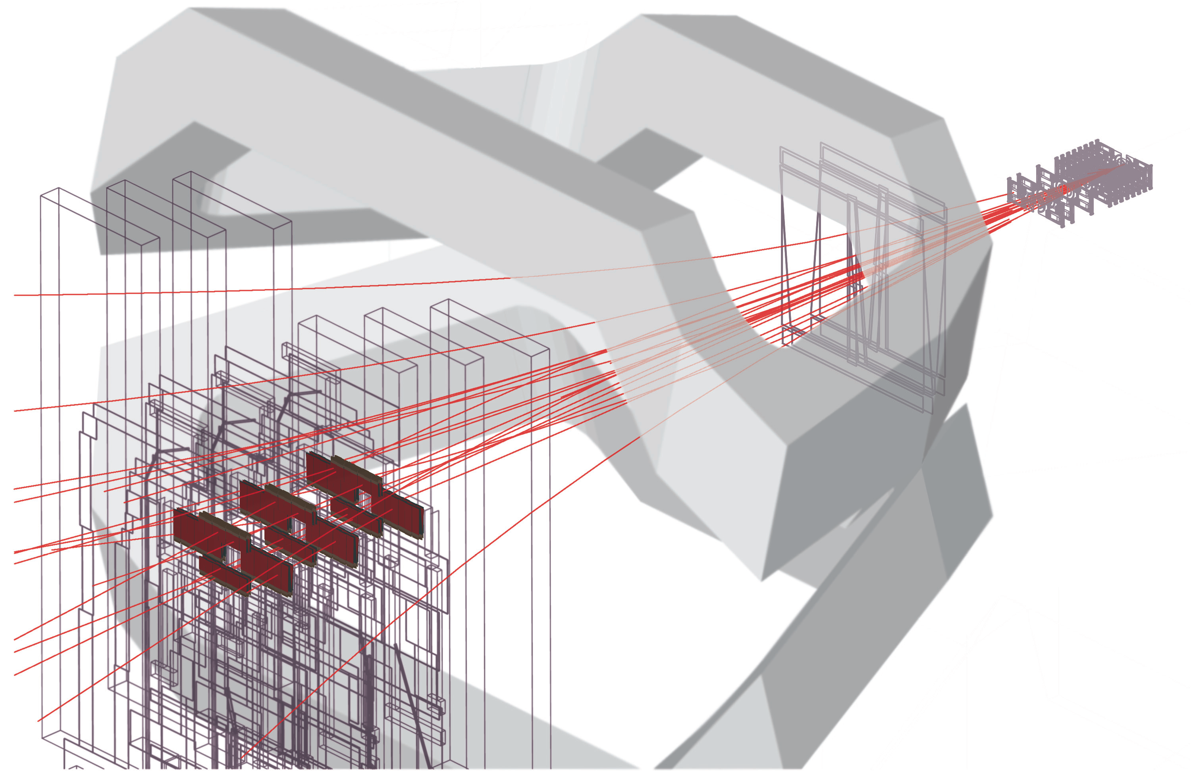

Recent results on hadronic spectroscopy at LHCb
M. Needham
University of Edinburgh
Mainz, 28th June 2017
On behalf of the LHCb collaboration

Slide 2
Outline
Introduction
Quarkonia production in b ➔ΦΦX decays
XYZ states: pentaquarks and tetraquarks
Observation of excited Ω_{c} baryons
Summary and outlook
New
Impossible to present everything
in 25 minutes hence focus on more
recent results + XYZ states

Slide 3
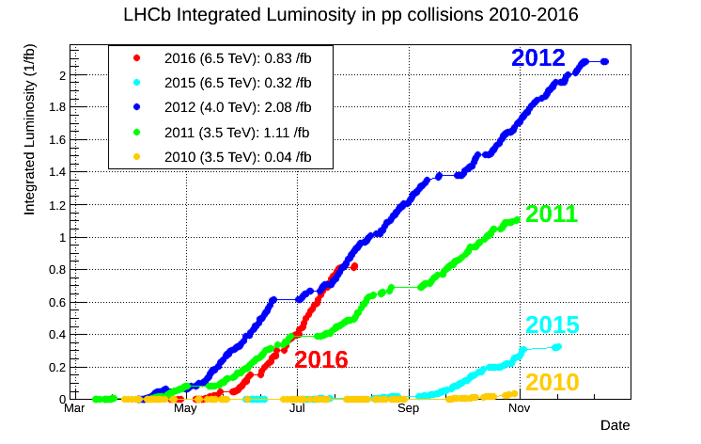
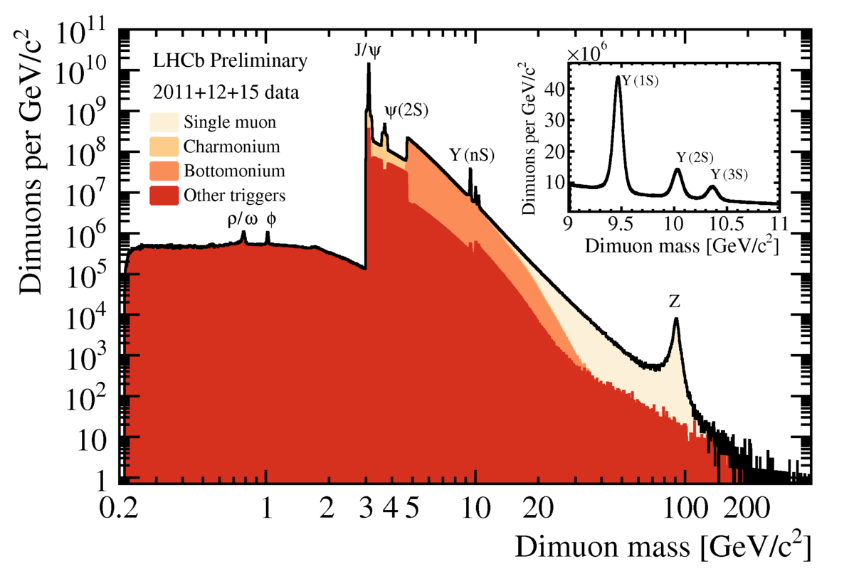
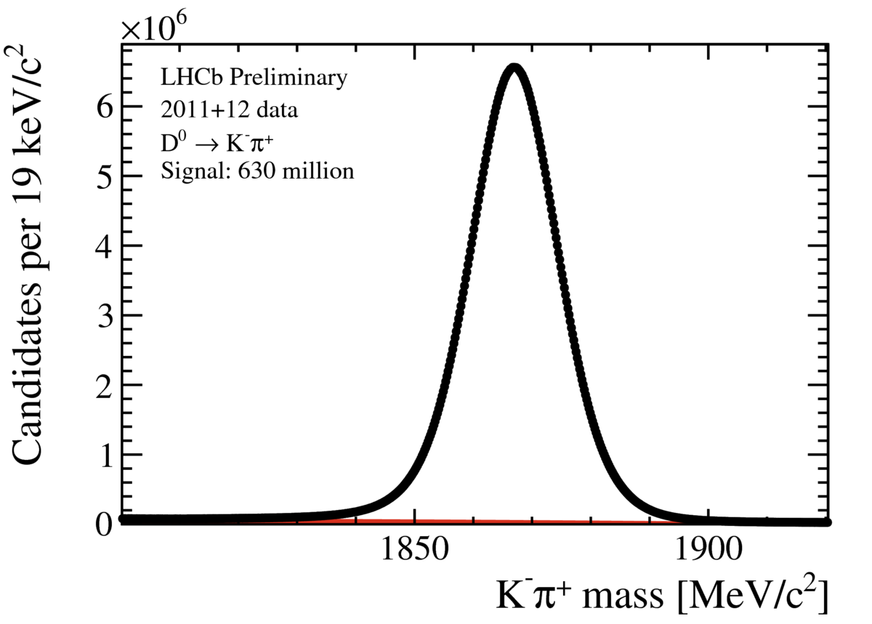
Introduction
LHCb-CONF-2016-005
World largest heavy flavour
dataset ! 3 fb⁻¹ Run 1, 2 fb⁻¹ Run2
Precision tracking
Excellent PID using RICH
Trigger for fully hadronic decays
630 million
candidates !

Slide 4
Charmonia production
in b ➔ϕϕX decays

Slide 5
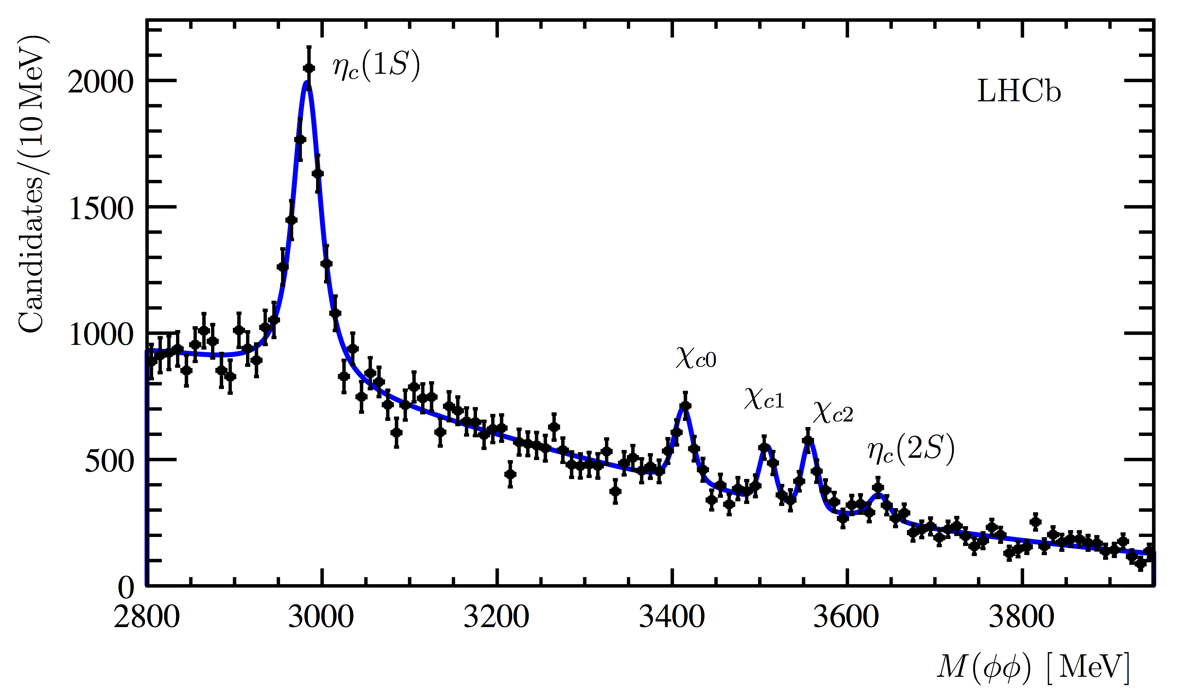
Quarkonia with b ➔ ϕϕX decays
Studies of inclusive quarkonia production in b-hadron decays allows
to probe QCD production models and to make spectroscopic measurements
Many charmonia states decay to ϕϕ final state
Run 1 dataset
Hadronic trigger
to select displaced
ϕϕ final state
No evidence for
X(3872), X(3915),
χ_{c2}(2P), limits set
New
arXiv:1706.07013

Slide 6
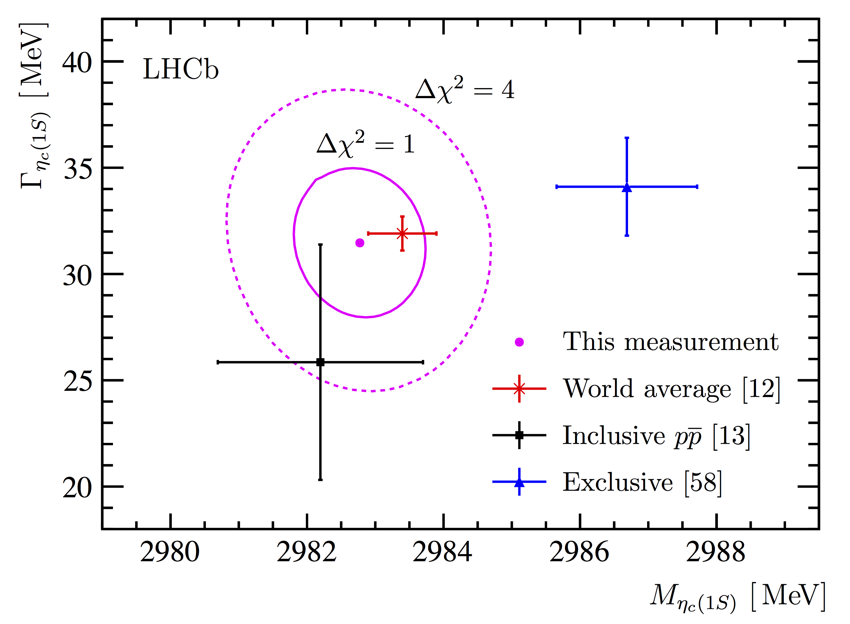
Quarkonia with b ➔ ϕϕX decays
Measured charmonium masses in agreement with world averages
Precision of η_{c}(1S) mass comparable to/in agreement with world average
EPJC 75 (2015) 311
Phys Lett B769 (2017) 305
[LHCb]
arXiv:1706.07013

Slide 7

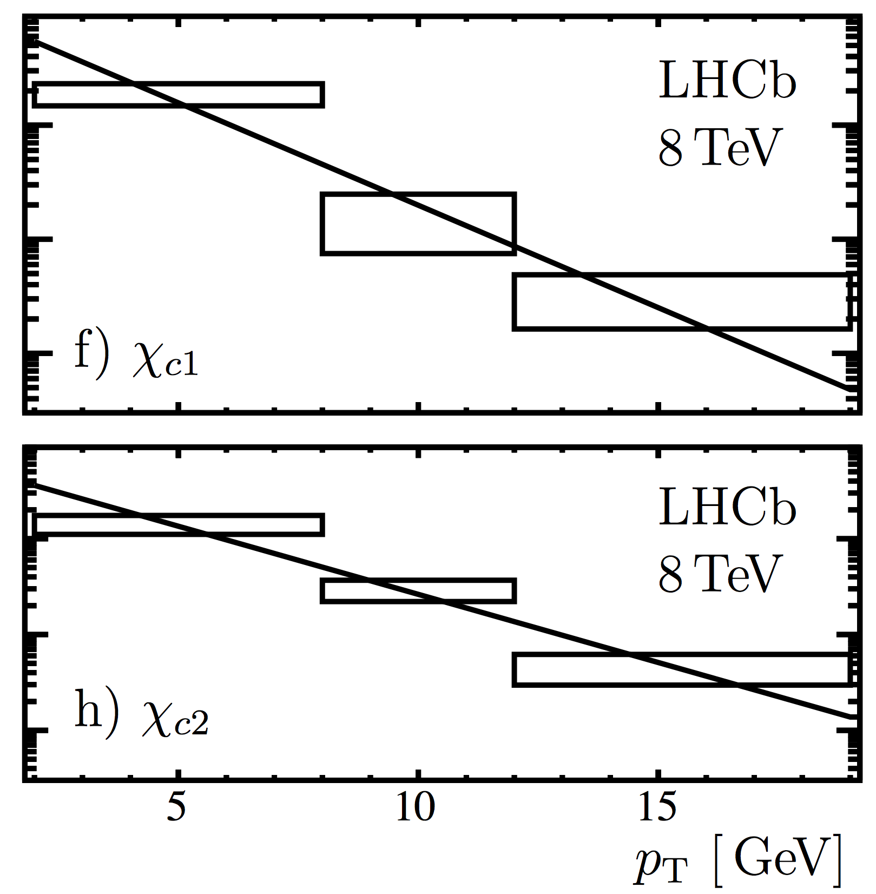
Quarkonia with b ➔ ϕϕX decays
Differential cross-section versus pt studied
Various branching ratios quoted, LHCb
measurement of b ➔ η_{c}X inclusive BF in
EPJC 75 (2015) 311 used for normalization
(Factorization: χ_{c0} and χ_{c2} suppressed. Spin
counting χ_{c0} suppressed to χ_{c2} arxiv 9808360)
arXiv:1706.07013

Slide 8
Exotic Spectroscopy

Slide 9

Exotic Spectroscopy
Why do quarks seem to come in twos or threes ?
A puzzle since earliest days of the quark model
Baryon Meson Tetraquark Pentaquark
Hot topic in recent years. Many candidates claimed

Slide 10
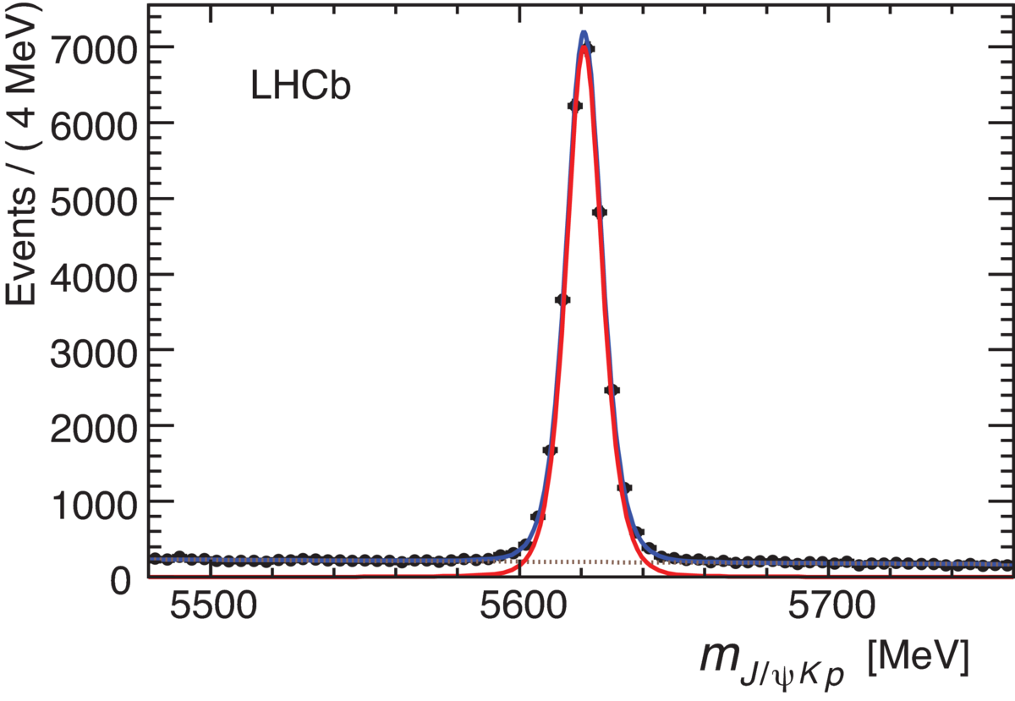
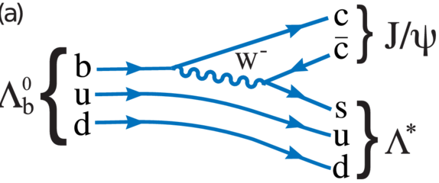
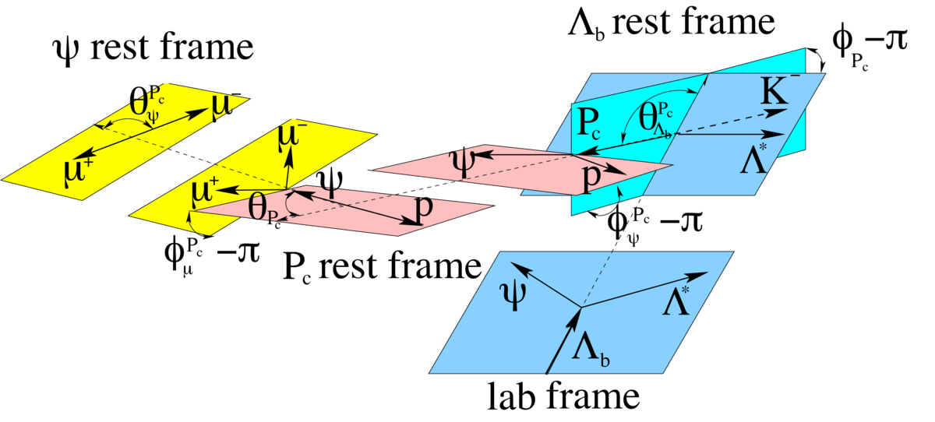
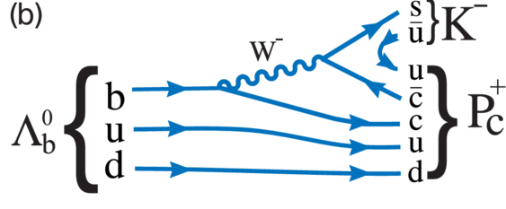
Pentaquarks
Summer 2015 LHCb observed two pentaquark candidates in Λ_{b} ➔ J/ψpK
Contributions from both Λ*
And pentaquark states possible
Disentangle with angular analysis
Phys. Rev. Lett 115 (072001) 2015

Slide 11
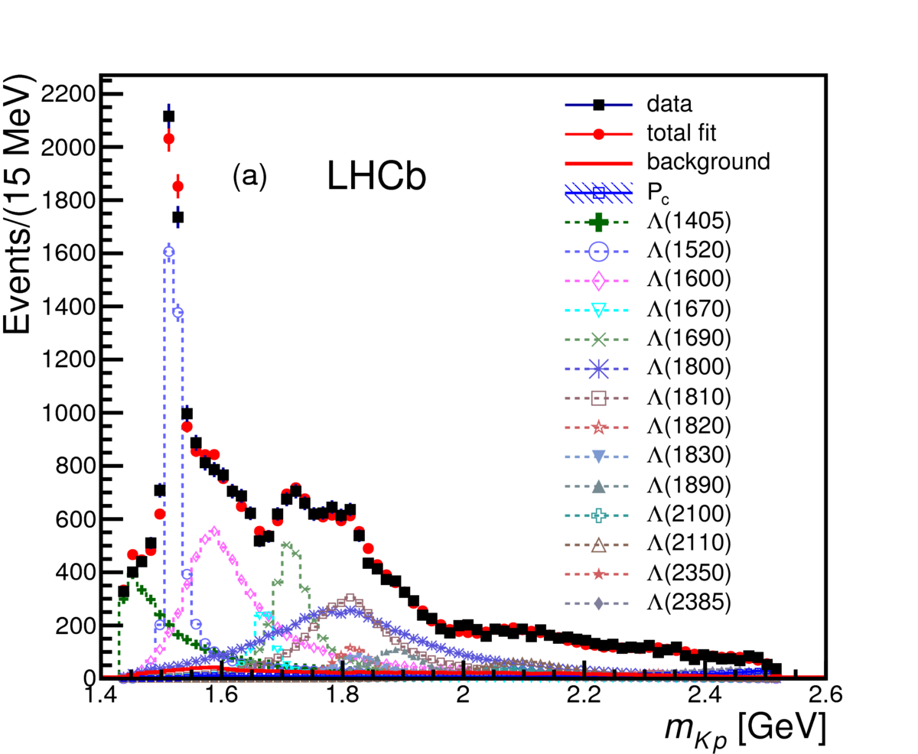
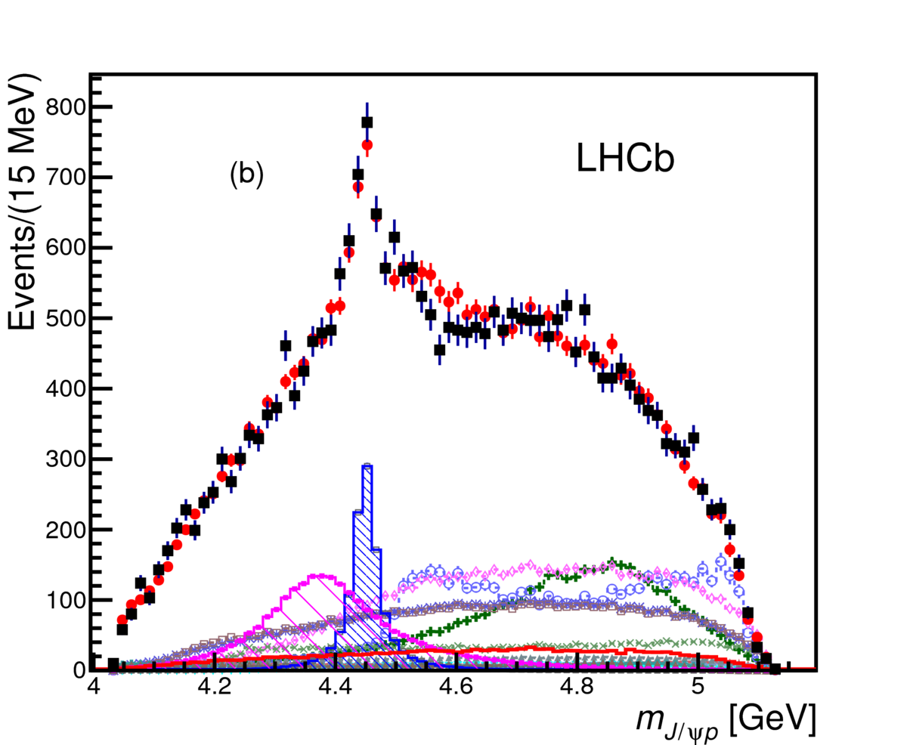
Pentaquarks
Phys. Rev. Lett 115 (072001) 2015
Width 200 MeV, spin 3/2 ?
Width 40 MeV, spin 5/2 ?
Confirmed with model independent approach PRL 117, 082003 (2016)
Important to confirm these observations in other channels + search for other pentaquarks

Slide 12
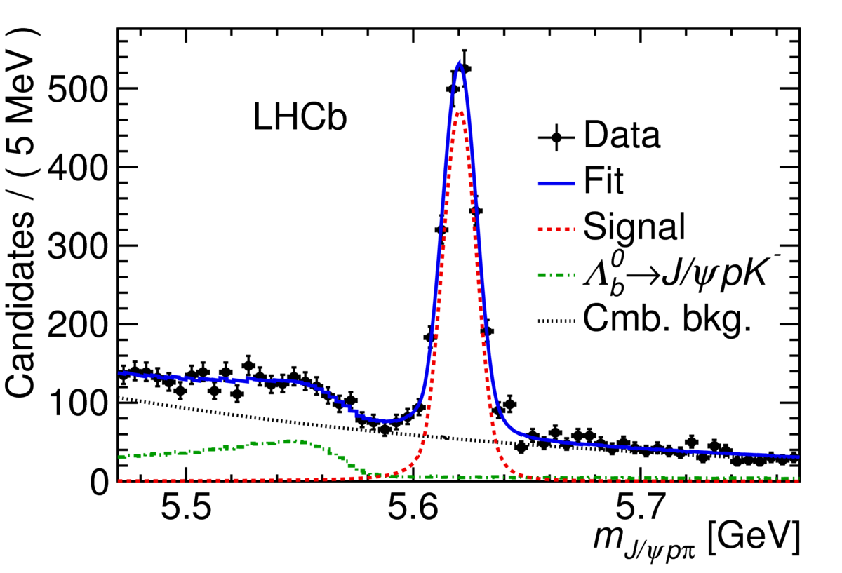
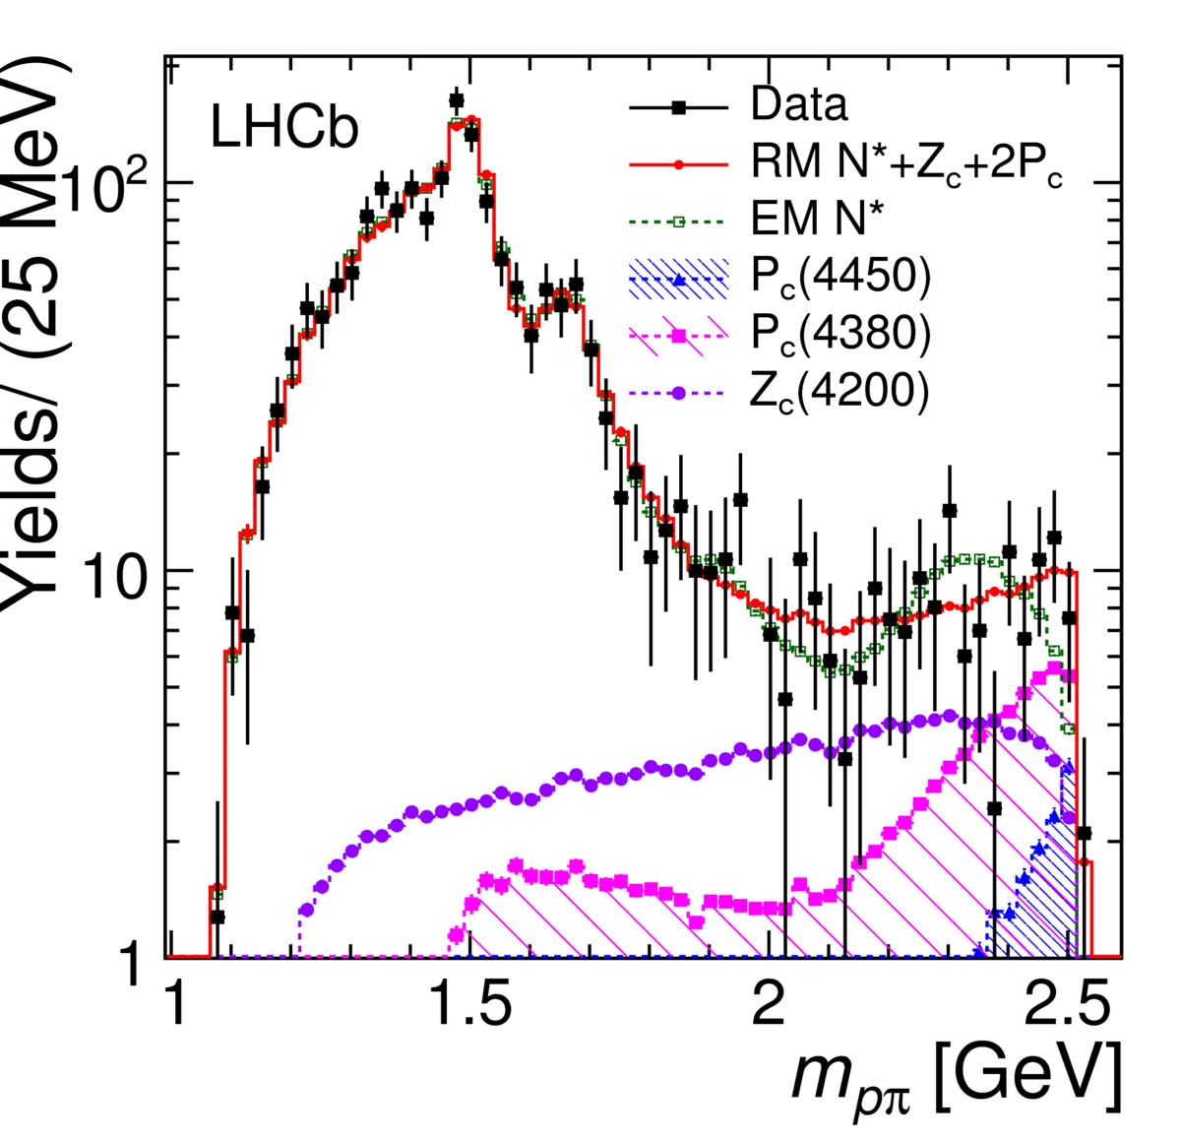
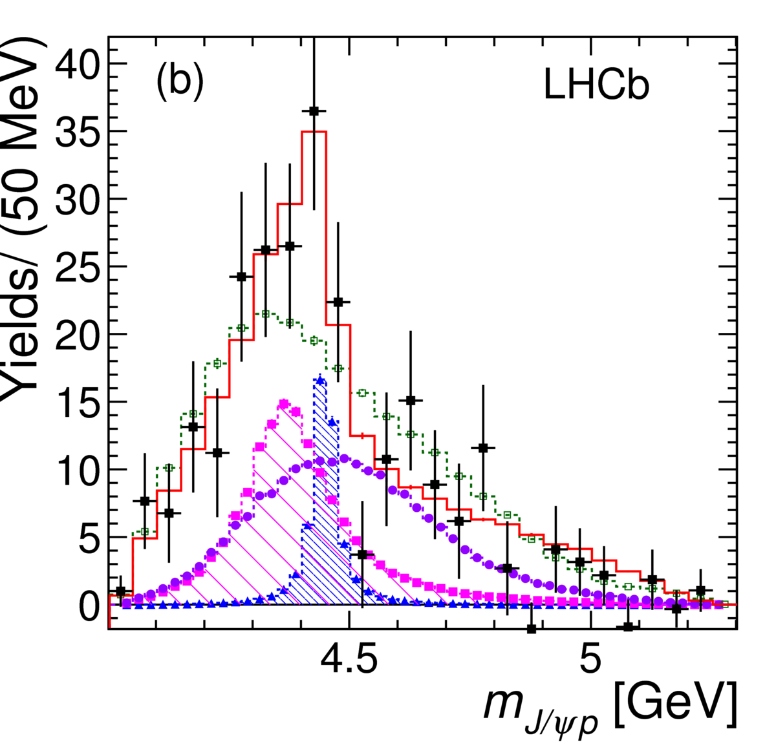
Study of Λ_{b}➔J/ψpπ
Cabibbo suppressed mode (less statistics)
Can be exotic Z contributions in J/ψ p
Fit with 2 pentaquarks + Z_{c}(4200) favoured
by 3σ compared to no exotic contributions
N*
PRL 117 082003

Slide 13
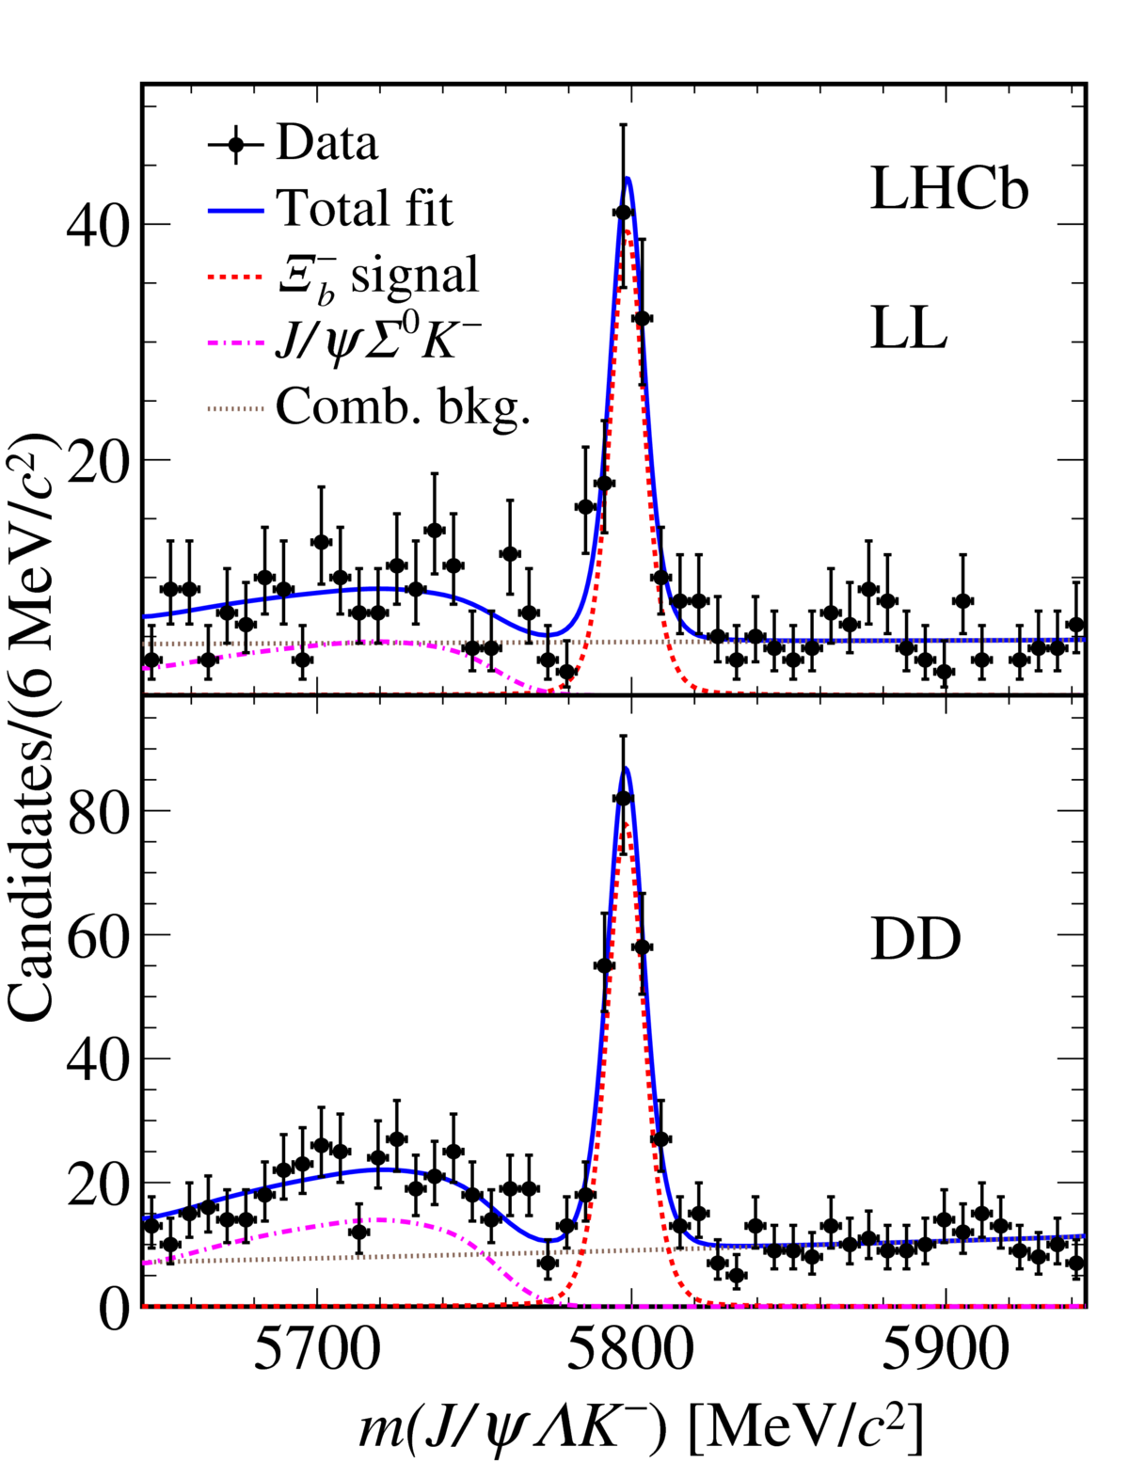
Observation of Ξ_{b}⁻ ➔J/ψΛK⁻
-
Suggested in arxiv: 1604.03769 to look for udscc pentaquark in this mode
Mode observed for first time
with Run 1 data
Around 300 Ξ_{b}⁻ candidates seen.
BF fraction and Ξ_{b}⁻ mass measured
In agreement with previous LHCb
Measurements [Slight tension with
CDF]
Including Run 2 data full amplitude
analysis can be performed
Λ decays
in vertex
detector
arxiv:1701.05274
Λ decays
after vertex
detector

Slide 14
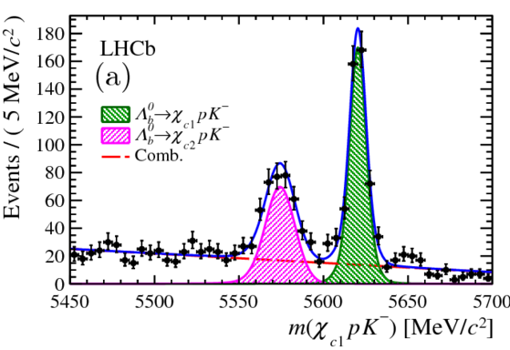
Observation of Λ_{b} ➔χ_{c1,2}pK
P_{c}(4450)⁺ very close to χ_{c1}p threshold: Triangle singularity ? (PRD92 071502 (2015)).
Motivates studies in this mode
Study with radiative χ_{cJ} decays
Mass constraint on χ_{c1} mass to
improve resolution
Forces χ_{c2} signal to lower mass
New
arxiv: 1704.07900
First study observation of this mode
Measure BF, Λ_{b} mass
Next step angular analysis adding
Run 2 data

Slide 15
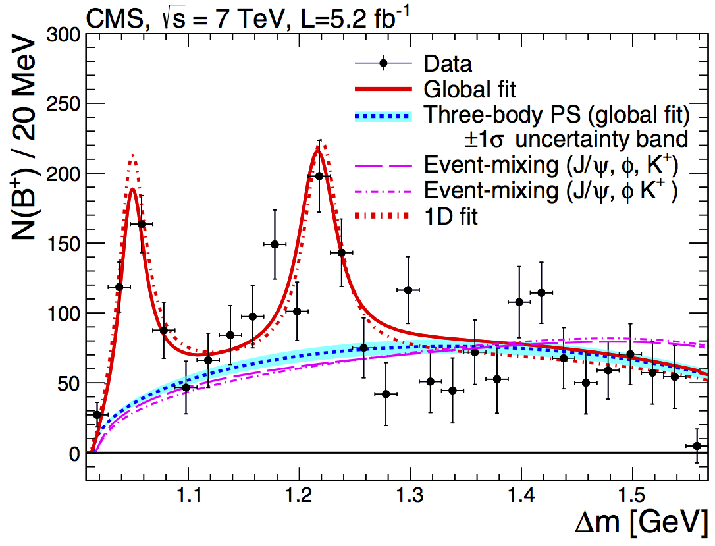
The puzzle of the X(4140)
CDF observed a narrow structure at threshold in B⁺ ➔ (J/ψϕ) K⁺
CMS also saw this and confirmed hint of structure at X(4300)
  CMS and CDF parameters not in best of agreement
Early LHCb analysis: no narrow structure (PRD 85 091103(R) 2012)
CDF/DOC/BOTTOM/PUBLIC/10244
Phys. Lett B 734 261-281
X(4140)
X(4300)
Exotic quarkonia candidates: Tetraquarks ? molecules ? cusps ?

Slide 16
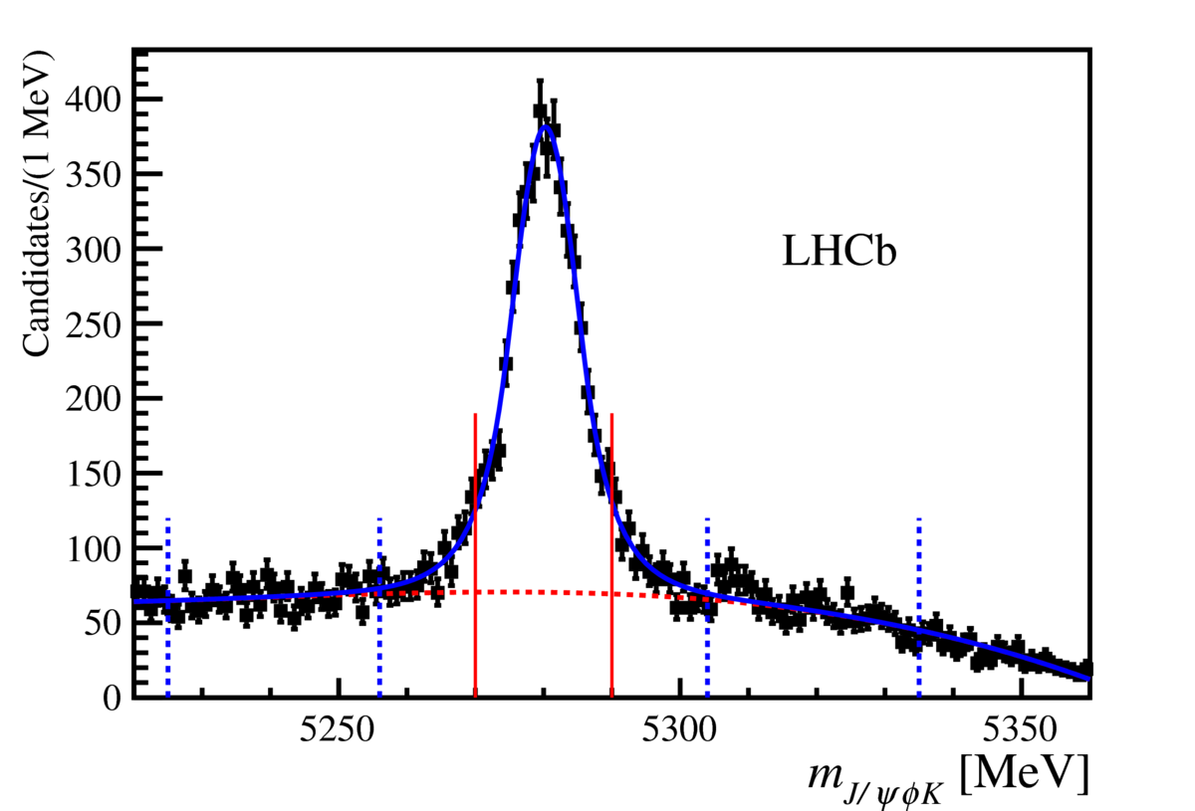
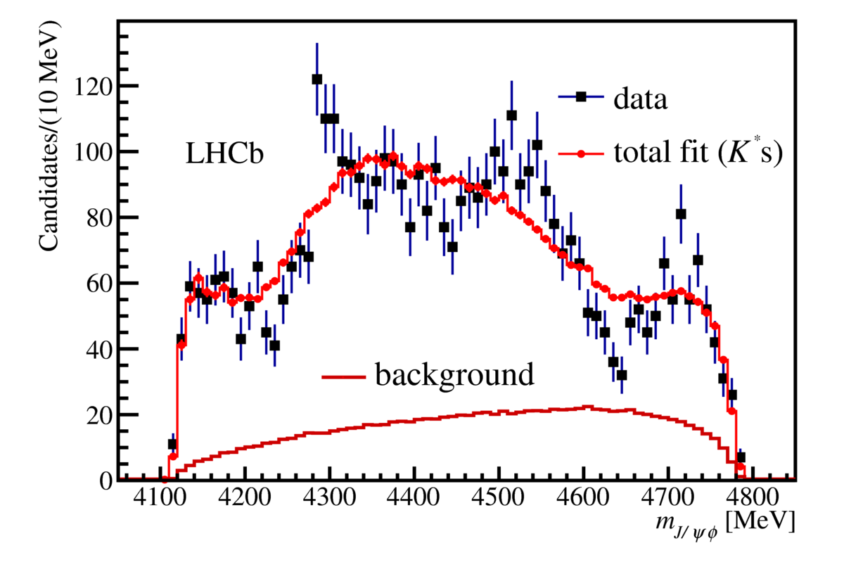
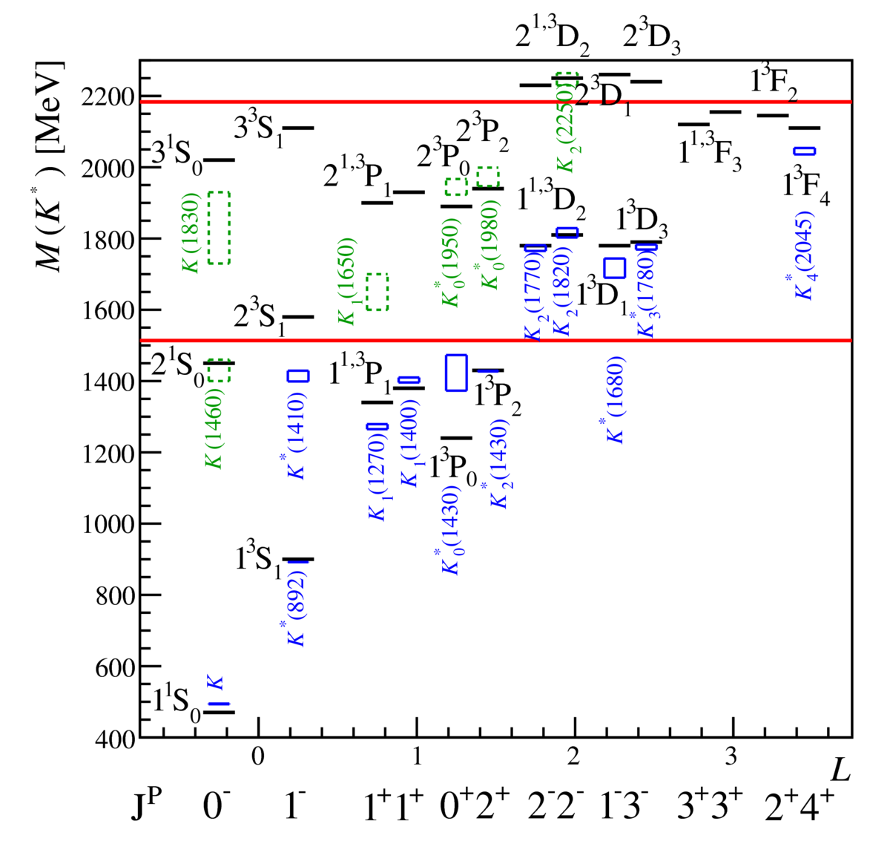
The puzzle of the X(4140)
4289 ± 151
candidates
First full amplitude analysis using
LHCb Run 1 dataset B⁺ ➔ (J/ψϕ) K⁺
Complication: have to deal with
decays of excited K* to ϕK⁺
Phys. Rev. D95 (2017) 012002
Phys Rev. Lett 118 (2017) 022003
Model with excited K* alone
cannot describe the data

Slide 17
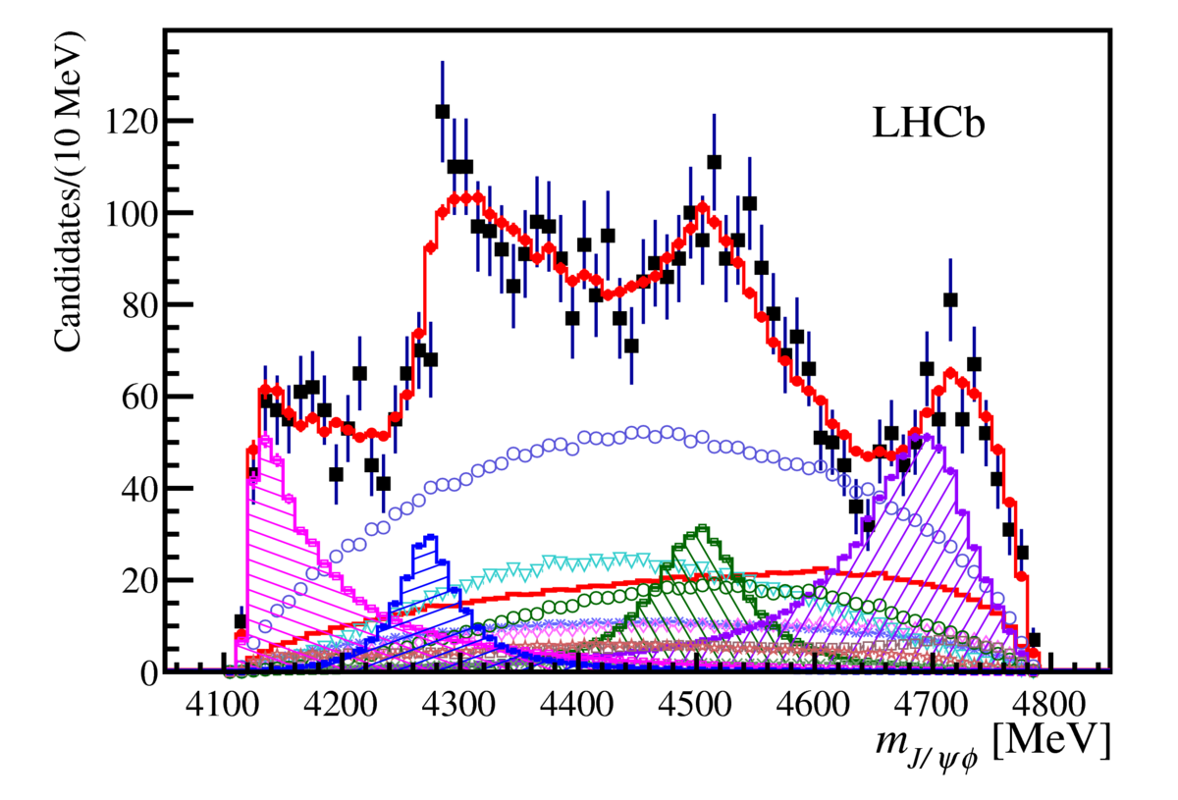
The puzzle of the X(4140)
Data well described by inclusion of four broad exotic resonances found
Phys. Rev. D95 (2017) 012002
Phys Rev. Lett 118 (2017) 022003
X(4274)
J^{PC} = 1⁺⁺
X(4500)
J^{PC} = 0⁺⁺
X(4140)
J^{PC} = 1⁺⁺
X(4700)
J^{PC} = 0⁺⁺
Reflections from K* states

Slide 18
The puzzle of the X(4140)
Measured width
of X(4140) bigger than
previous experiments
Analysis also provides
precise information on
excited K* states
Phys. Rev. D95 (2017) 012002
Phys Rev. Lett 118 (2017) 022003
What are the observed states ? Molecules, cusps, tetraquarks ?
X(4140) fits D_{s}D_{s}* cusp predicted by Swanson
(Int. J Mod Phys E25 1652010 16)
X(4274) quantum numbers rules out
cusp + molecule assignments
Resonance
Cusp

Slide 19
Charm baryons

Slide 20
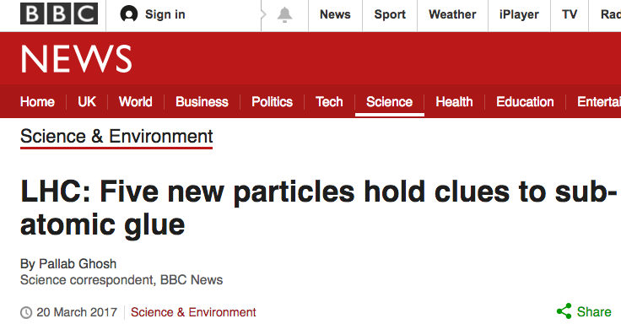
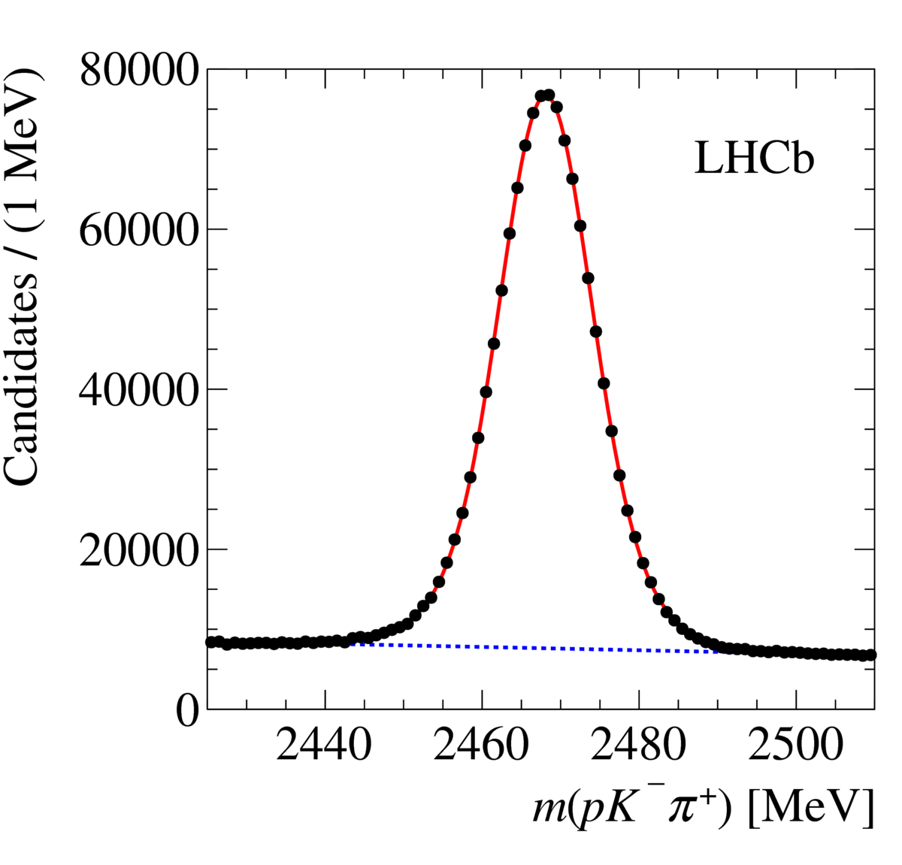
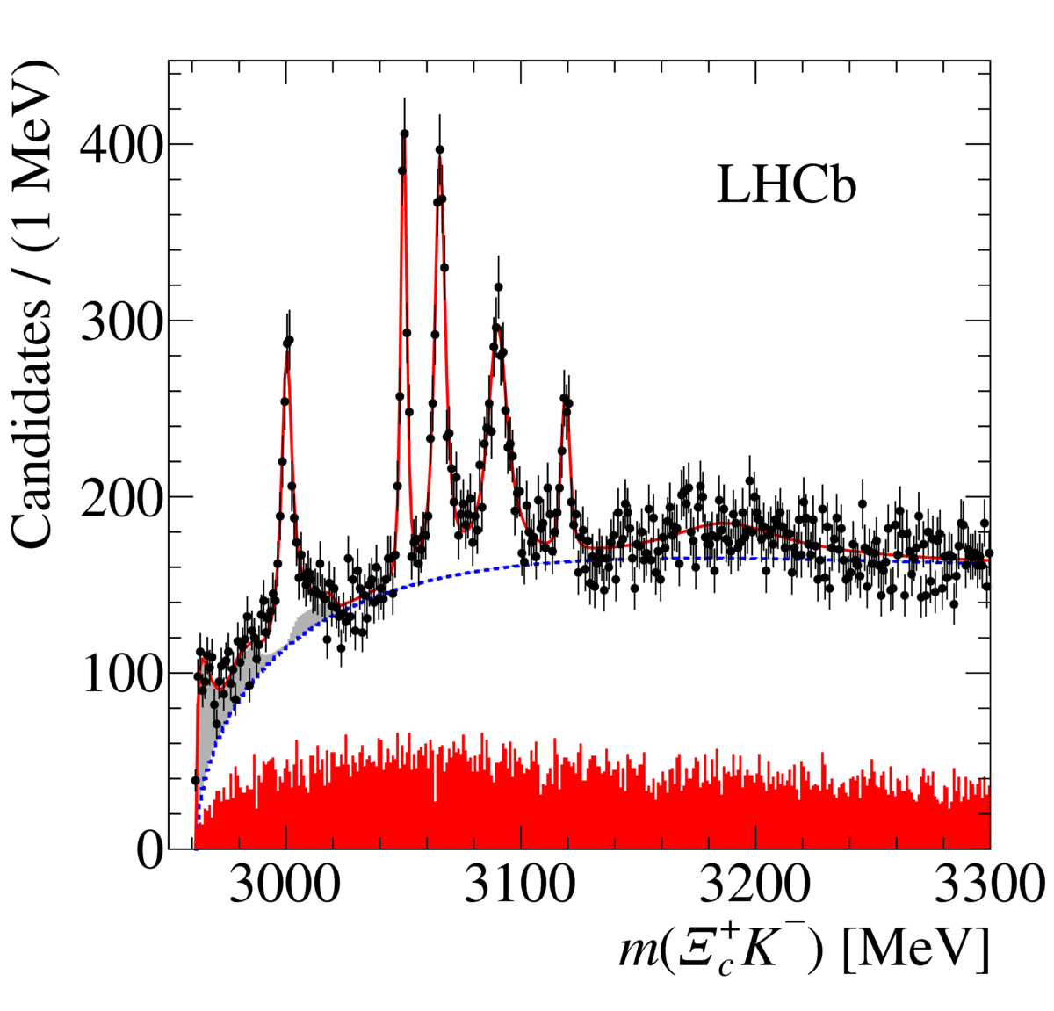
Excited Ω_{c} states
Add K⁻ to reconstructed Ξ_{c}⁺ candidates
3.3 fb⁻¹
P R L 118, 182001 (2017)
5 new narrow Ω_{c} states clearly observed
Very spectacular spectrum and
demonstration of power of LHC !

Slide 21
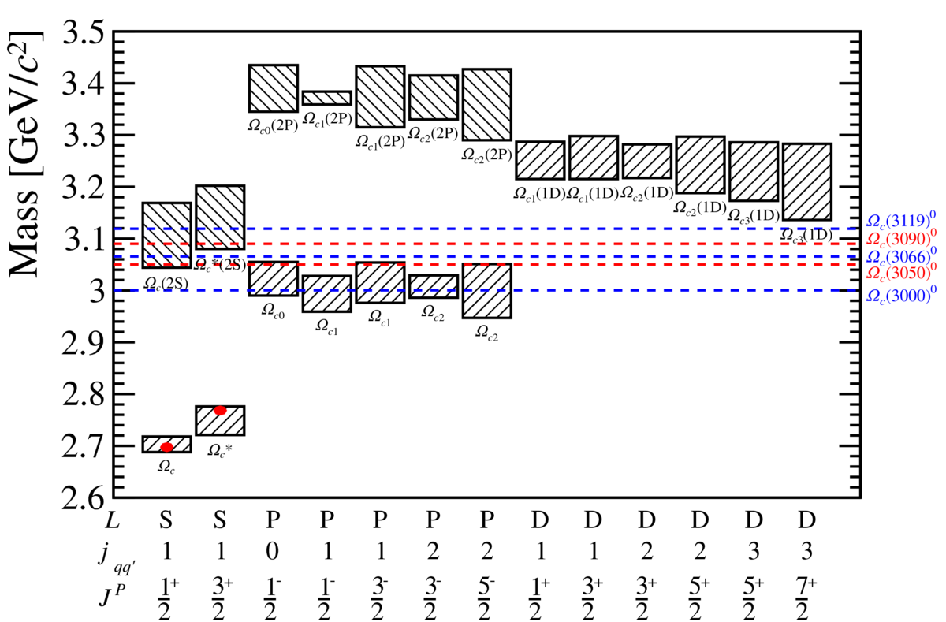
Excited Ω_{c} states
5 narrow states evidence
for sixth broader state at
high mass
PRL 118, 182001 (2017)
More measurements needed to
match observed states to theory
predictions
One puzzle is narrowness of states
Paper has 23 citations so far

Slide 22

Summary + Outlook
LHCb has made many important contributions to hadronic spectroscopy
Studies of quarkonia production and properties
Observation of Pentaquark/tetraquark candidates
Observation of new charm baryons
A lot more to come exploiting large Run 2 dataset !

Slide 23
Backup

Slide 24
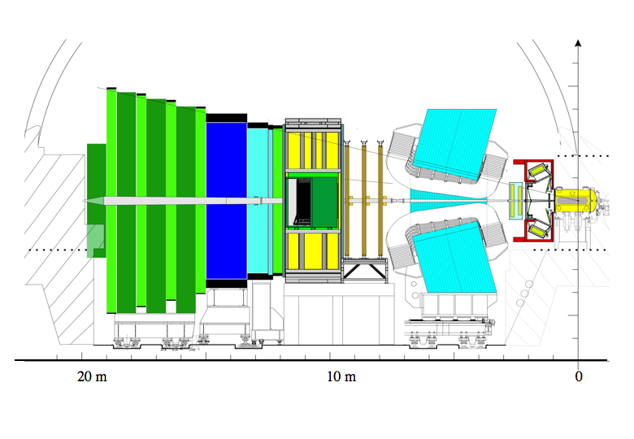
The LHCb Detector
Muon System
RICH Detectors
Vertex Locator
VELO
pp collision Point
~ 1 cm
B
Calorimeters
Tracking System
JINST 3 (2008) S08005

Slide 25
Quarkonia with b ➔ ϕϕX decays

Slide 26
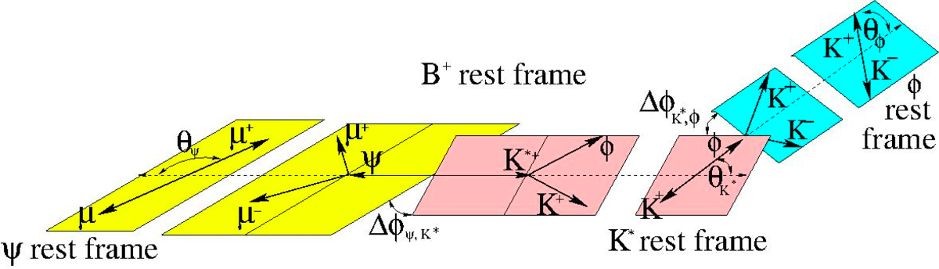
The puzzle of the X(4140)

Slide 27
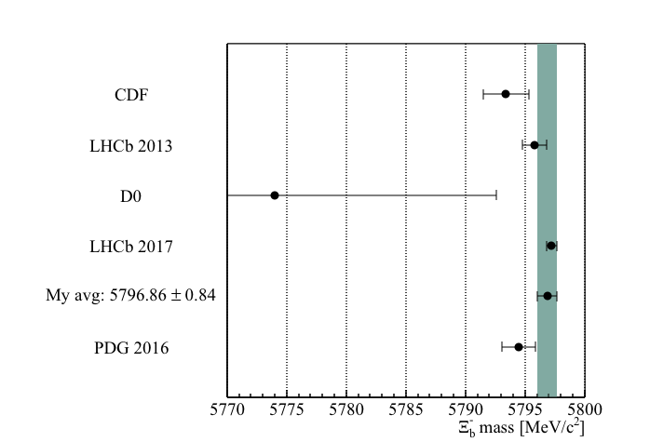
Mass measurements + Pentaquarks

Slide 28
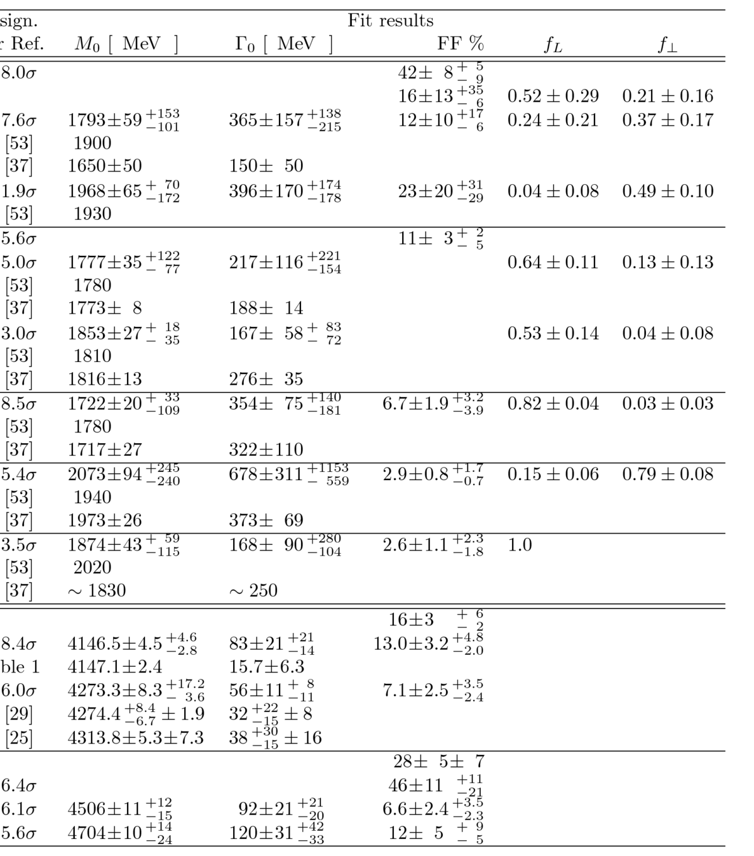
The puzzle of the X(4140)

