Slide 1
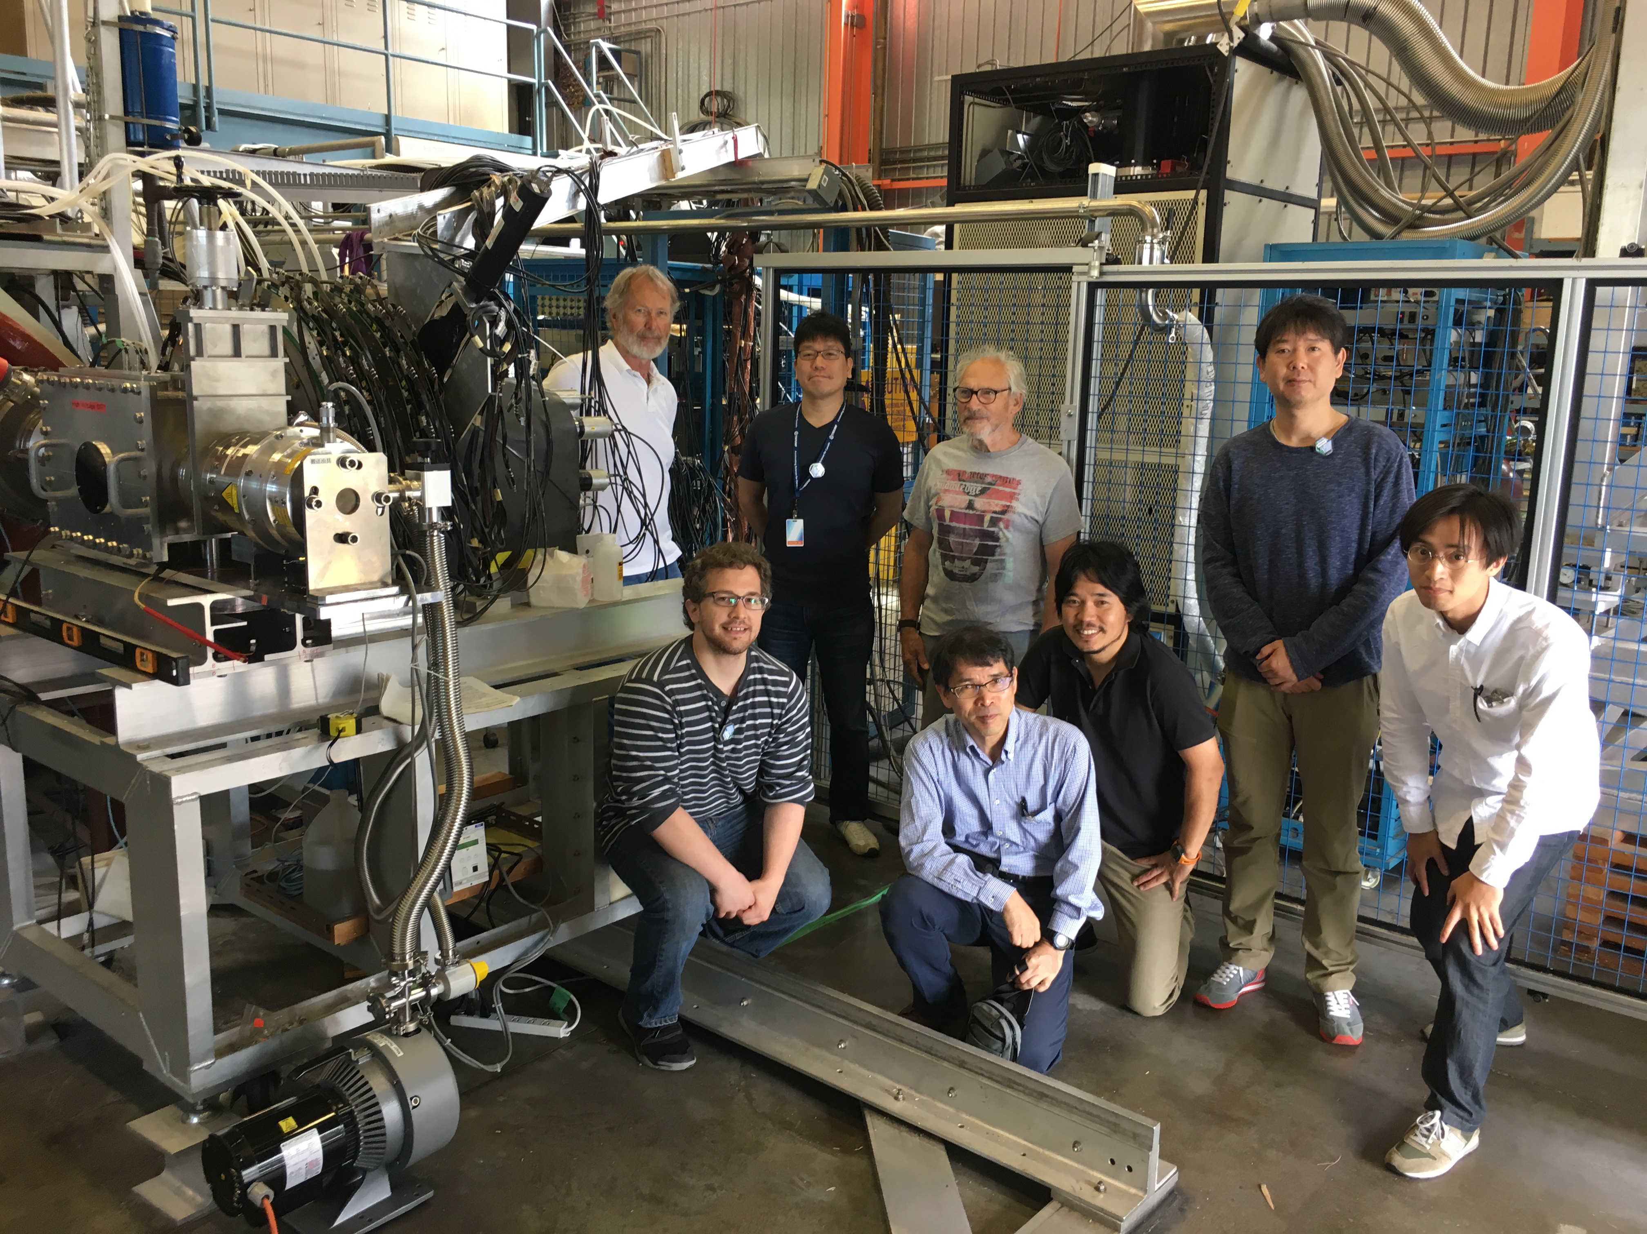
The muon g-2/EDM experiment at J-PARC
June 26, 2017
Tsutomu Mibe (IPNS/KEK)
for the J-PARC g-2/EDM collaboration
Photo of “muon cooling” experiment at TRIUMF M15
June 23-July 11, 2017

Slide 2
Experimental determination of a_{μ} = (g-2)/2
a_{μ} = (g-2)/2
ω_{a} : anomalous spin precession frequency
ω_{p} : proton’s Lamor precession frequency
Present : 0.54ppm (BNL)
→ 140ppb
(FNAL/J-PARC goal)
(→400ppb
(J-PARC phase-I))
Present uncertainty ~ 120ppb (direct) (LANL)
~ 30ppb (indirect from HFS, assuming SM)
→ 60ppb (direct, J-PARC MuSEUM goal)

Slide 3
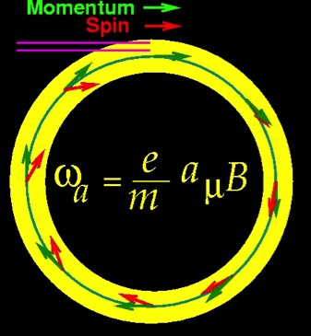
muon g-2 and EDM measurements
In uniform magnetic field, muon spin rotates ahead of momentum due to g-2 = 0
general form of spin precession vector:
BNL E821 approach
γ=30 (P=3 GeV/c)
J-PARC approach
E = 0 at any γ
FNAL E989
J-PARC E34

Slide 4
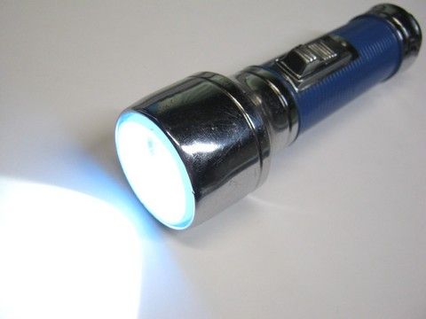
Muon beam
Conventional muon beam
proton
π⁺
μ⁺
emittance
~1000π mm・mrad
pion
production
Strong focusing
Muon loss
BG π contamination
decay

Slide 5
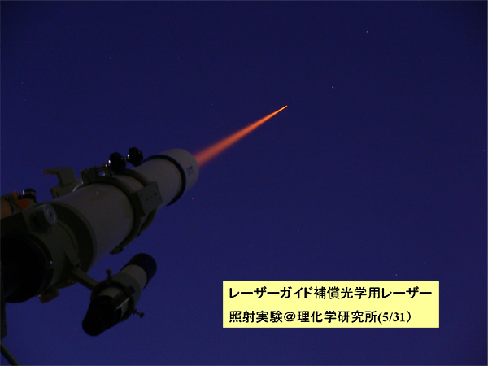
Muon beam
Conventional muon beam
proton
π⁺
μ⁺
emittance
~1000π mm・mrad
pion
production
Strong focusing
Muon loss
BG π contamination
decay
cooling
μ⁺
emittance
1π mm・mrad
Ultra-cold
muon beam
Free from any of these

Slide 6
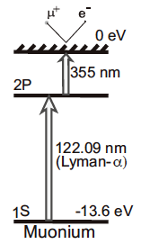
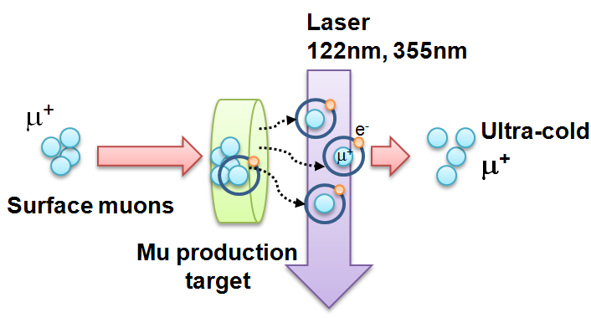
Ultra-cold Muon
Requirement for zero E-field:
Muons should be kept stored without E-focusing
→ Beam with ultra-small transverse dispersion,
i.e. Δp_{T}/p ~0
Laser resonant ionization of Mu (μ⁺e⁻)
re-acceleration
p =
28MeV/c
3 keV/c
300 MeV/c
Δp_{T}/p ~3 keV / 300 MeV =1E-5

Slide 7
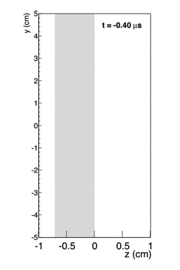
Ultra-cold Muon
Requirement for zero E-field:
Muons should be kept stored without E-focusing
→ Beam with ultra-small transverse dispersion,
i.e. Δp_{T}/p ~0
Laser resonant ionization of Mu (μ⁺e⁻)
re-acceleration
p =
28MeV/c
3 keV/c
300 MeV/c
G. Marshall
Δp_{T}/p ~3 keV / 300 MeV =1E-5

Slide 8
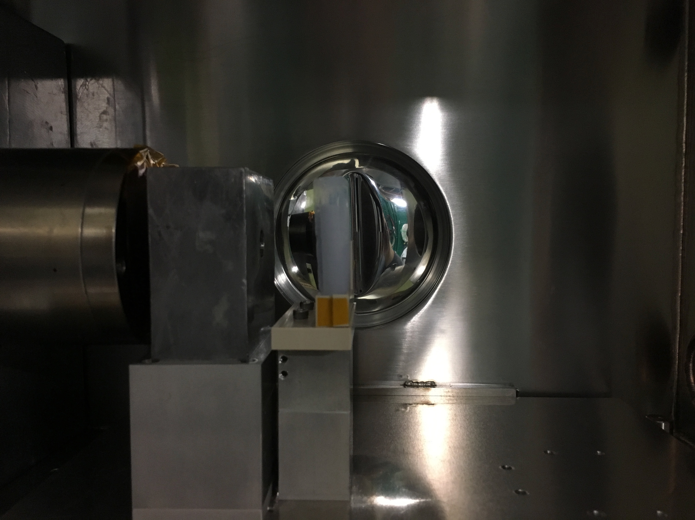
Muonium
at thermal energy
surface muon beam
Muonium
production
target
(Silica aerogel)

Slide 9
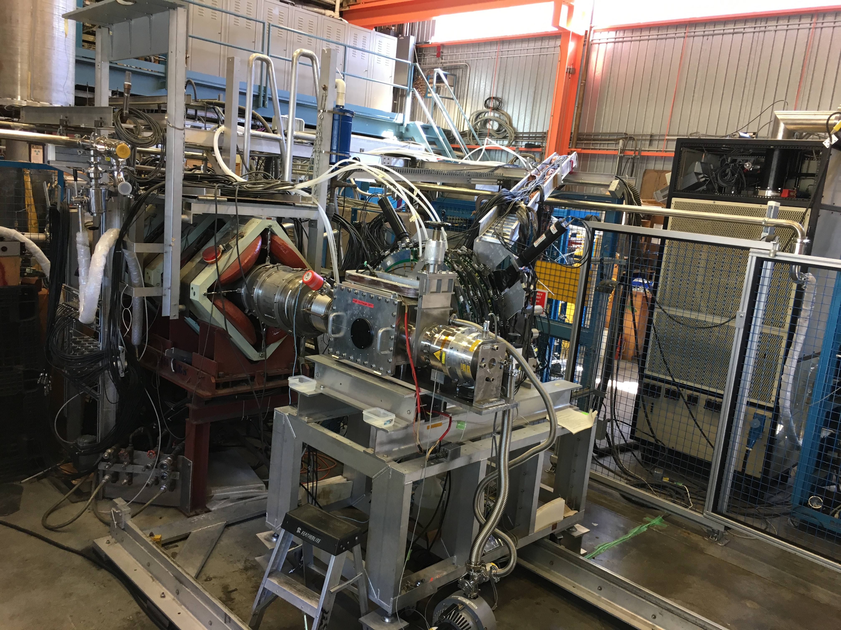
Optimization of muonium production target at TRIUMF (June 23 – July 11, 2017)
See also previous publications
Prog. Theor. Exp. Phys. 091C01 (2014)
Prog. Theor. Exp. Phys. 103C01 (2013)

Slide 10
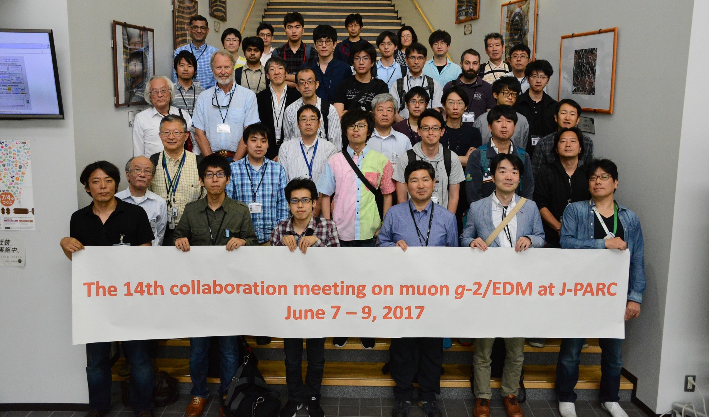
The J-PARC g-2/EDM collaboration
Collaborators
  Proposal (2009） ７２
  Conceptual Design Report (2011） ９２
  Technical Design Report (2015) １３７
  Technical Design Report (rev.) (2016) １４４
９ countries, 49 institutions
  Canda, Japan, Korea, UK, USA, France, Russia, Czech, China

Slide 11
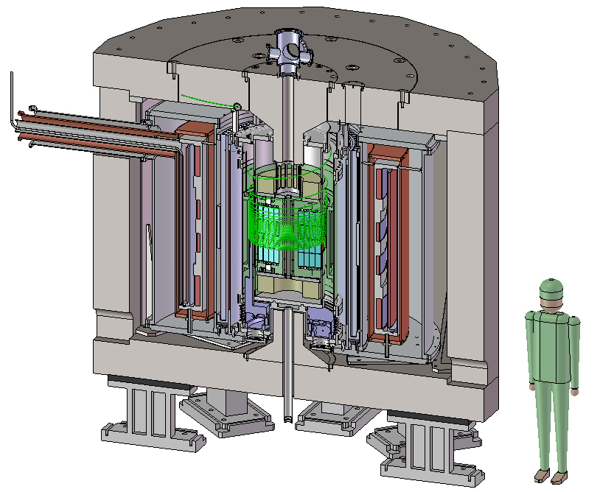
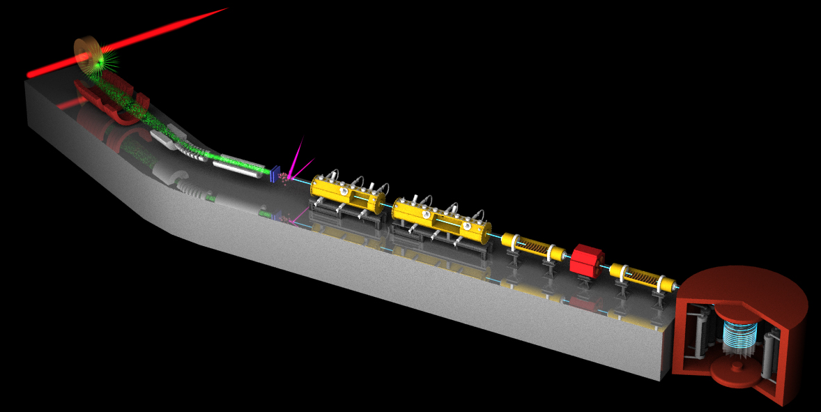
Muon g-2/EDM Experiment at
J-PARC with Ultra-Cold Muon Beam
Silicon
Tracker
3 GeV proton beam
( 333 uA)
Production target
(20 mm)
Surface muon beam
(28 MeV/c)
66 cm
Muonium Production
(300 K ~ 25 meV⇒2.3 keV/c)
Surface muon
Super Precision Storage Magnet
(3T, ~1ppm local precision)
Ultra Cold μ+ Source
Muon
storage
Resonant Laser Ionization of Muonium
Muon LINAC (300 MeV/c)

Slide 12
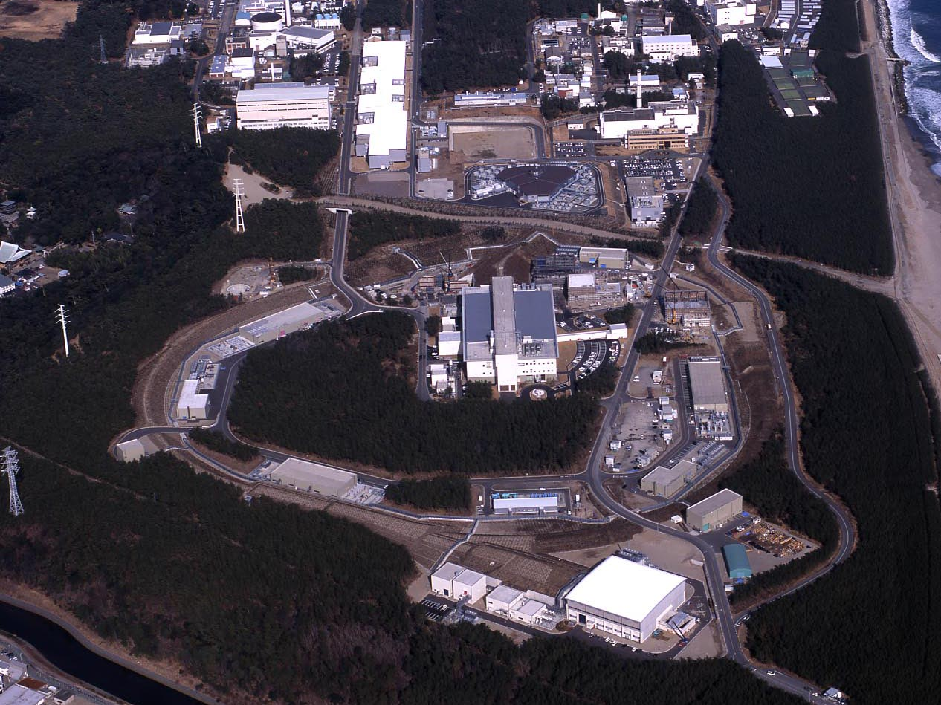
J-PARC Facility
(KEK/JAEA)
LINAC
3 GeV
Synchrotron
Neutrino Beam
To Kamioka
Material and Life Science
Facility
Main Ring
(30 GeV)
Hadron Hall
Bird’s eye photo in Feb. 2008

Slide 13
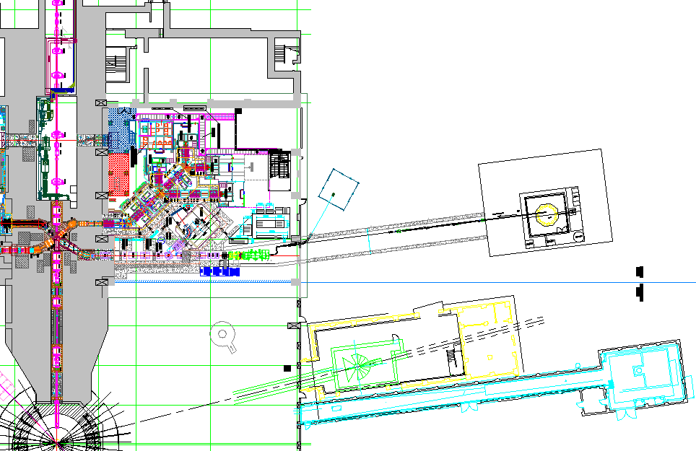
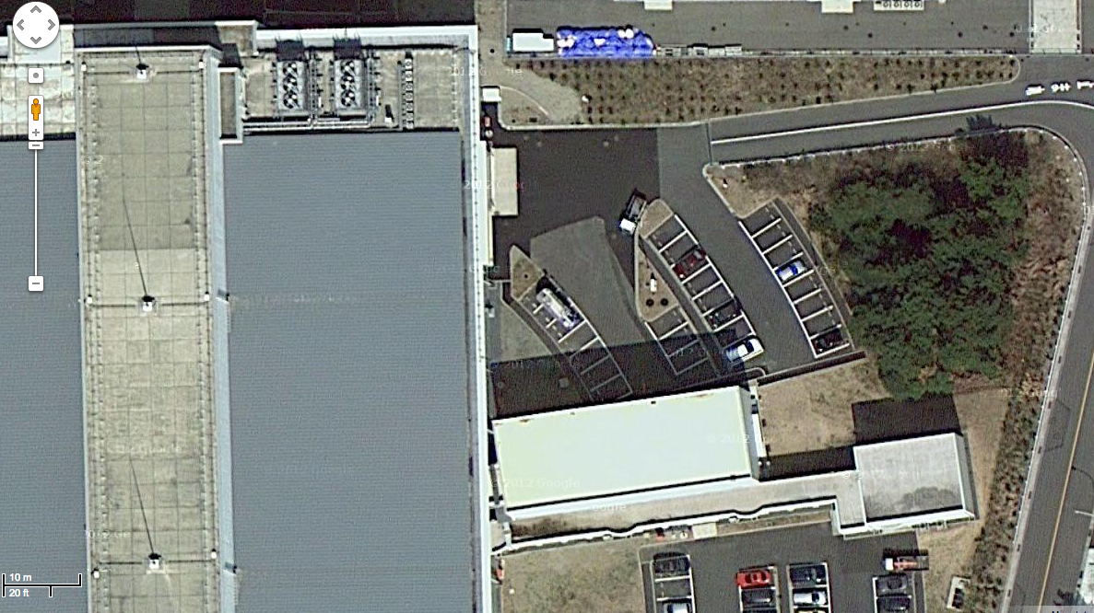
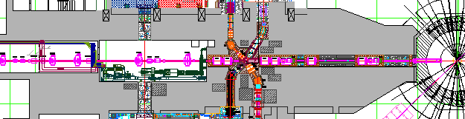
Proposed experimental site
Material and Life science Facility in J-PARC
Parking lot
g-2/EDM
storage magnet
H-Line
muon linac
muon
production
target
MuSEUM
DeeMe
sparation neutron
source

Slide 14
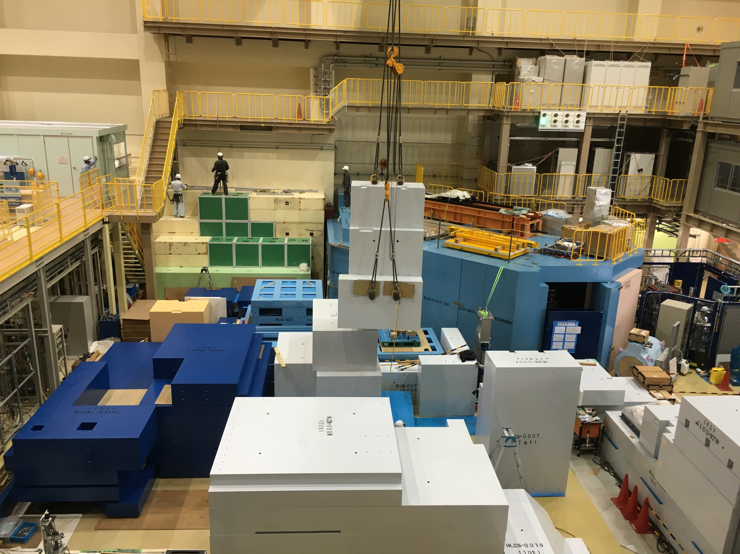

Slide 15
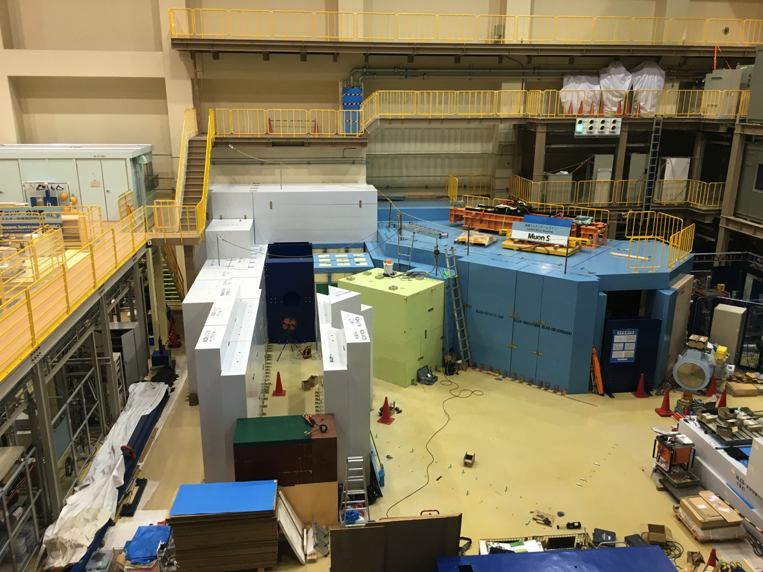
2016.8.17

Slide 16
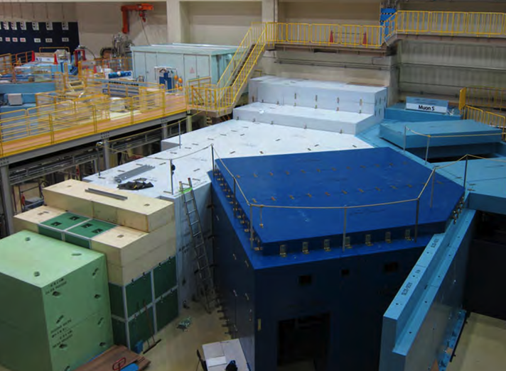
Completion of H-line shielding (fall, 2016) by MLF muon facility group
surface muon
branch
mu LINAC
MuSEUM (Mu-HFS, μ_{μ}/μ_{p})
DeeMe (mu-e conv.)

Slide 17
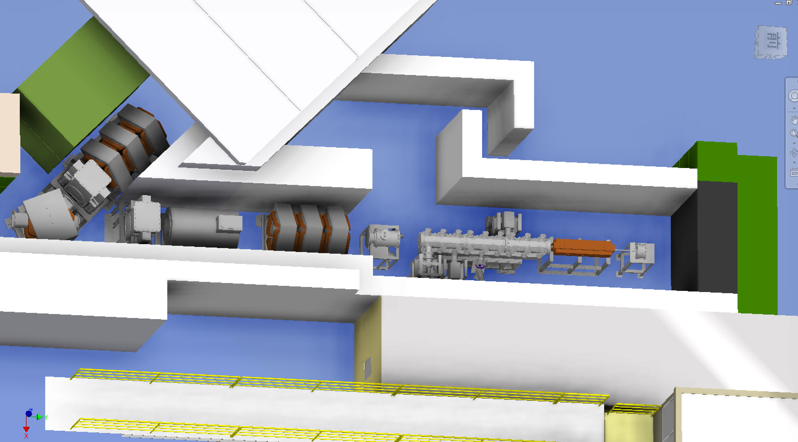
Beamline and muon accelerator at H-line
J-PARC MLF
Experimental Hall
H1 area
(MuSEUM/DeeMe)
Q-magnets
blocker
surface muon (4 MeV)
Mu
production
Initial
Accel.
RFQ
IH
Beam
diagnostics
detectors
Bend
magnet
Beam
Blocker
Solenoid
Q-magnets
accelerated muon (25meV→4.5 MeV)

Slide 18
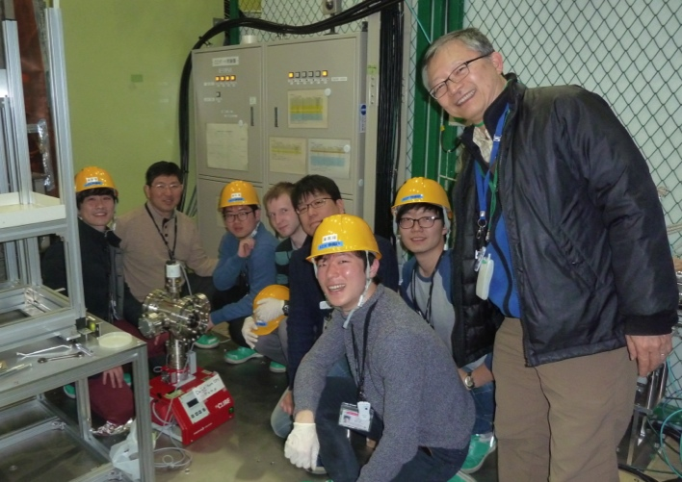
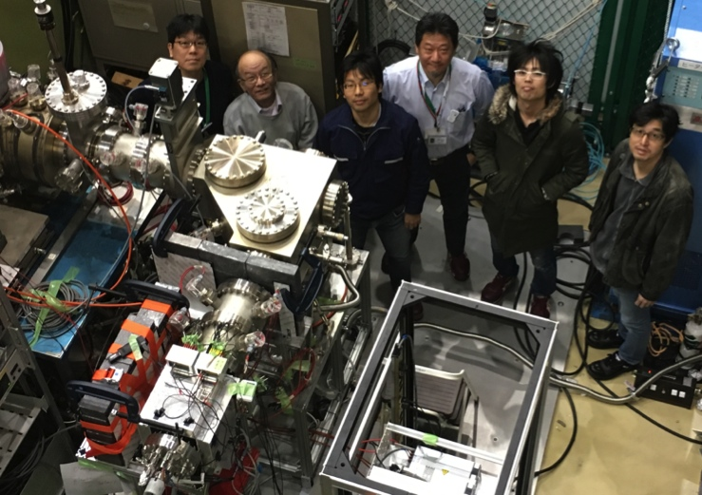
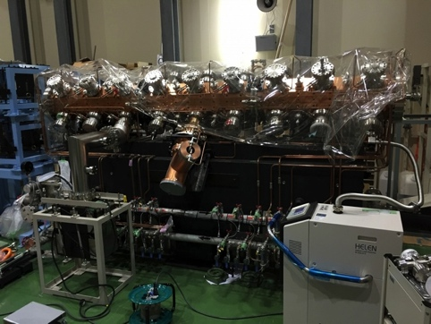
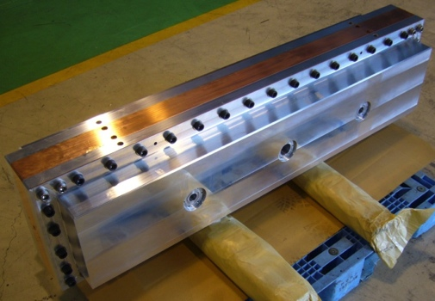
Beamline and muon accelerator at H-line
J-PARC MLF
Experimental Hall
H1 area
(MuSEUM/DeeMe)
Q-magnets
Data taken in 2016
Data taken in 2016
blocker
surface muon (4 MeV)
Mu
production
Initial
Accel.
RFQ
IH
Beam
diagnostics
detectors
Bend
magnet
Beam
Blocker
Solenoid
Q-magnets
accelerated muon (25meV→4.5 MeV)
Data taken in 2016
Reserved
Prototype

Slide 19
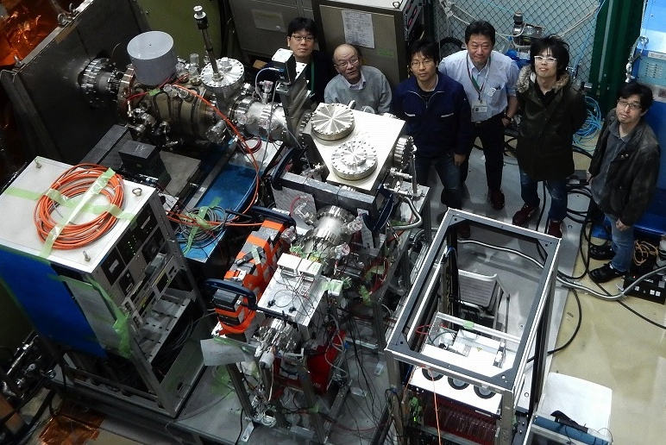
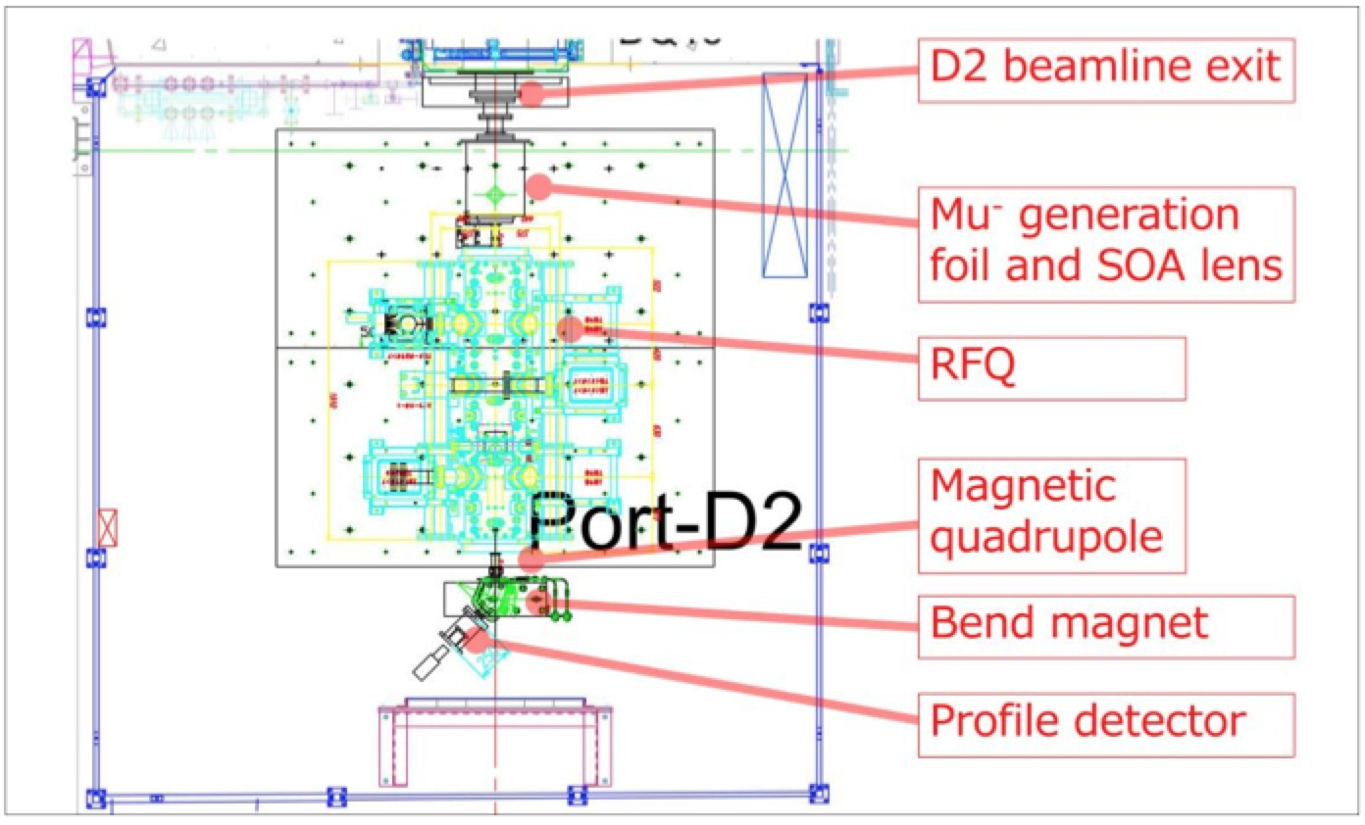
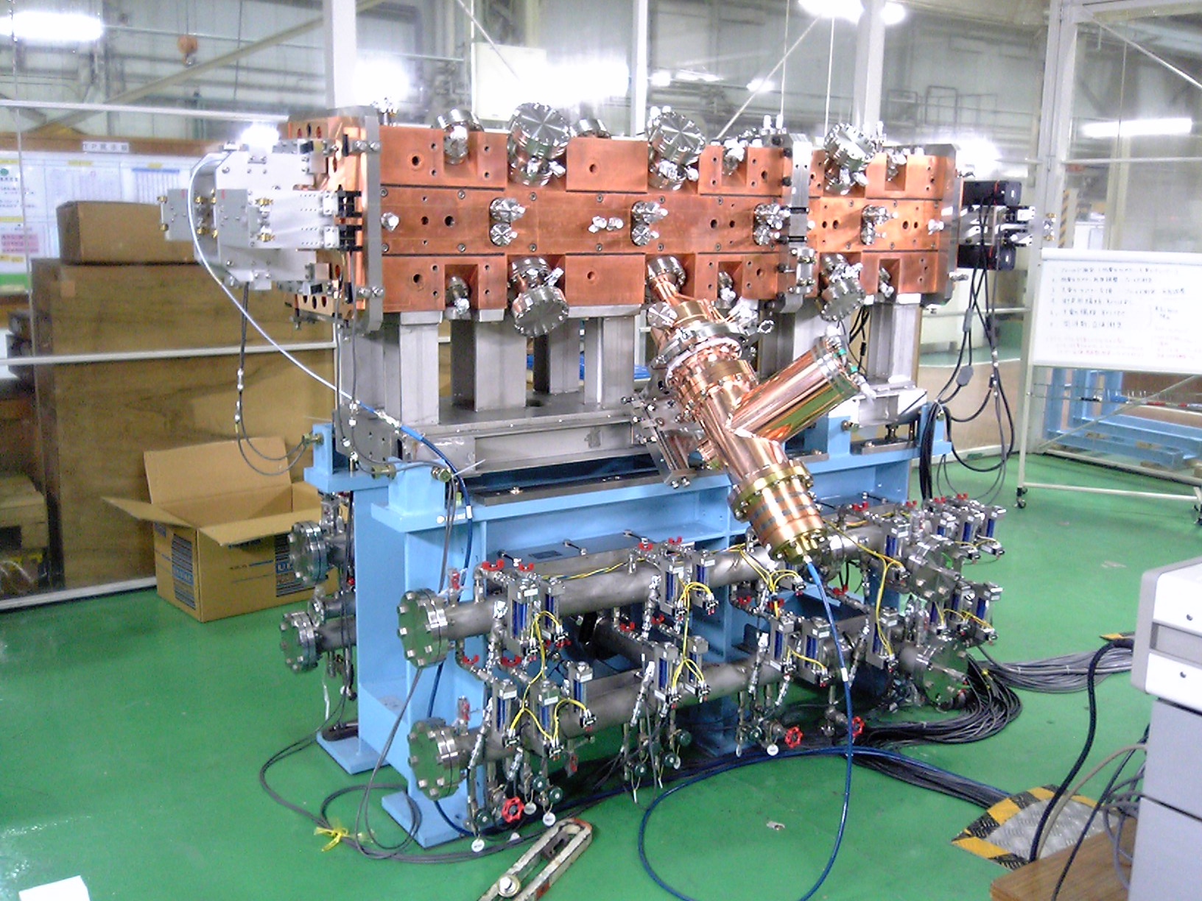
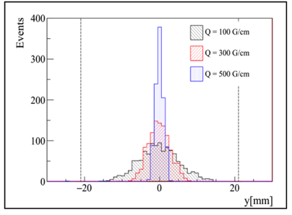
Muon acceleration test at D-line
Scheduled at D2 area in this November.
Tested in 2015B/2016AB
Prototype of J-PARC RFQ
(to be tested in 2017)
Tested in 2015B/2016AB
Simulated beam profile
after acceleration

Slide 20
Muon storage magnet and detector
Iron yoke
Cryogenics
Muon storage orbit
2900 mm
e+ tracking
detector
Super conducting coils
666 mm
20
20
20

Slide 21
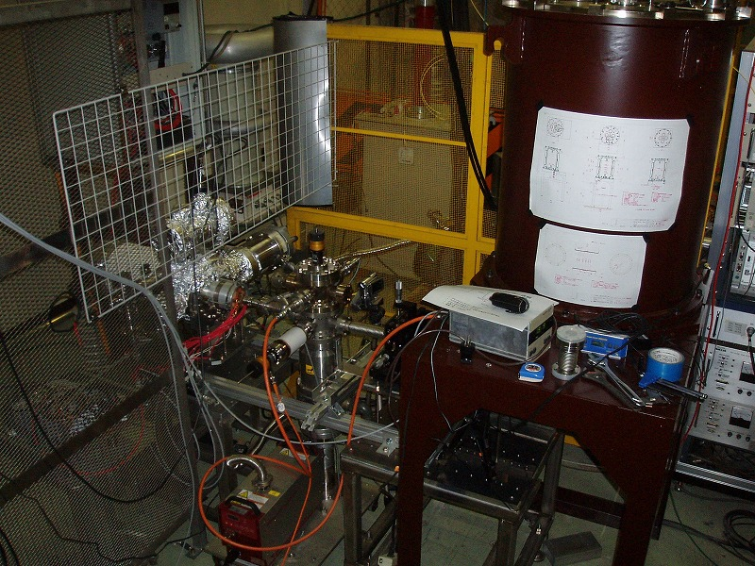
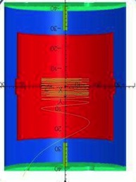
Demonstration of spiral injection with low-E electron beam in Tsukuba
Mini-solenoid
(102 G)
400mm
Electron gun
(112 keV/c)
Iinuma, Nakayama, Osawa, Rehman

Slide 22
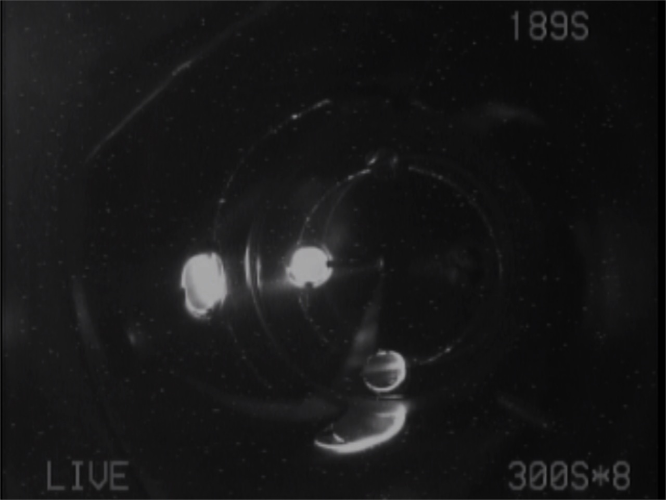

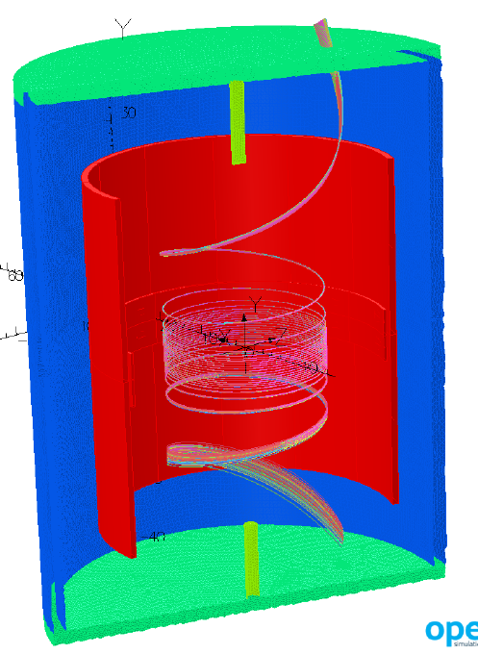
First observation of spiral track
(nominal B-field)
Slide by H. Iinuma
Beam
entrance

Slide 23
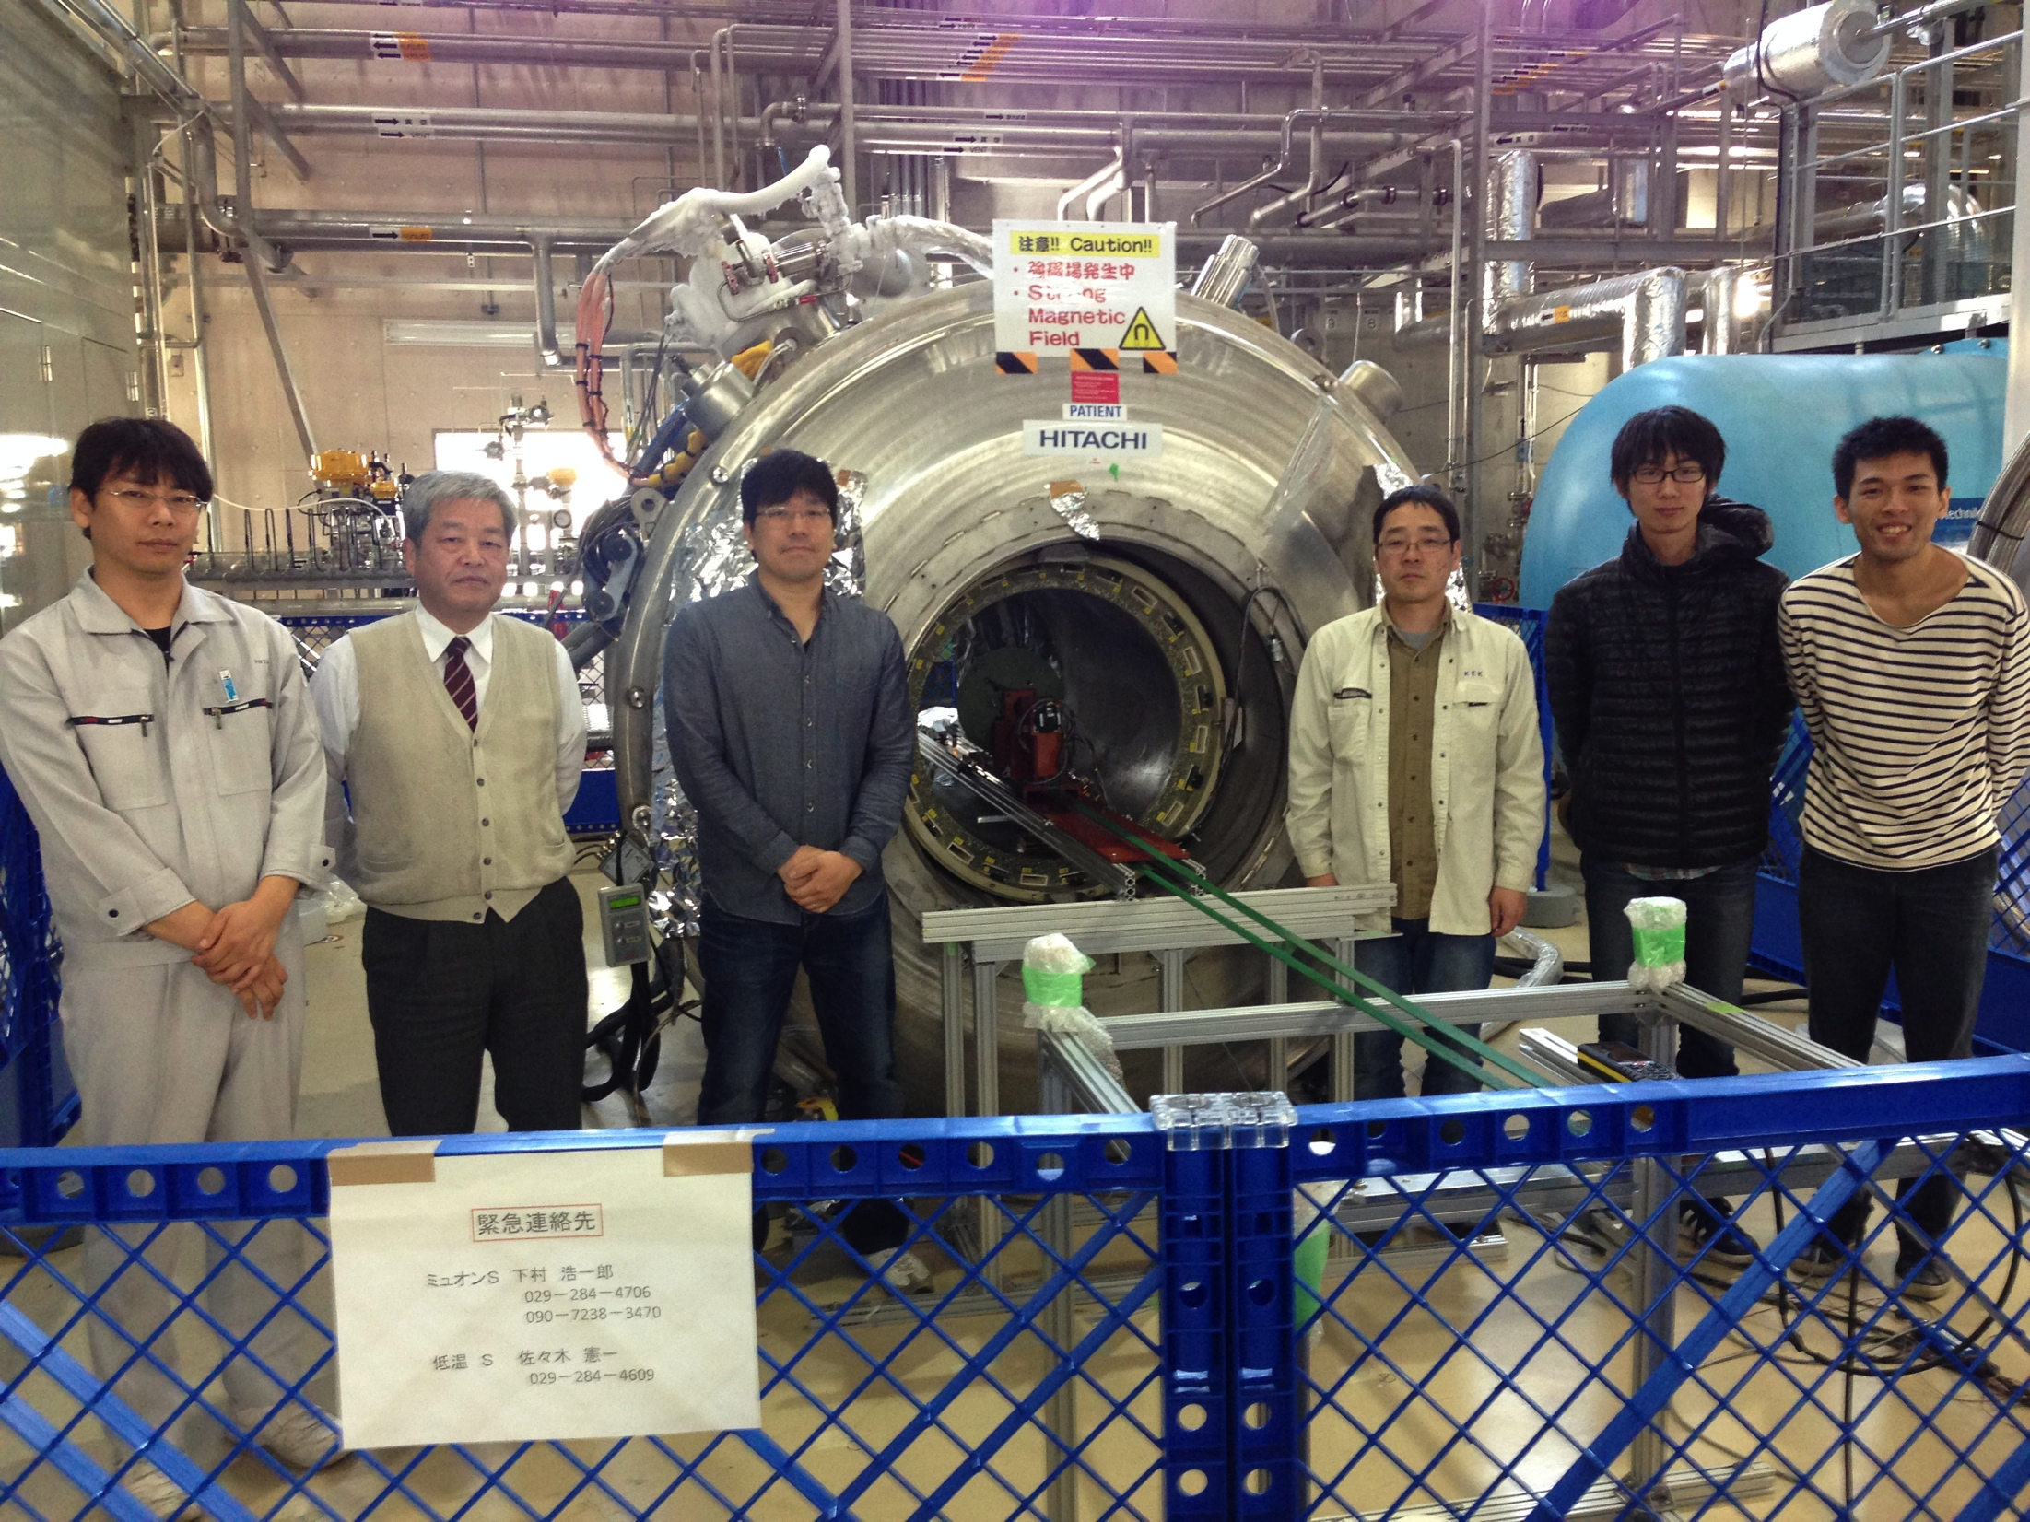
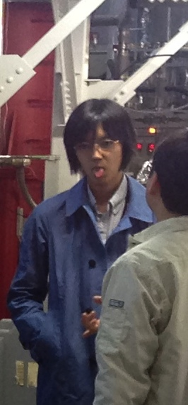
B-field shimming test with the MuSEUM magnet (1.7 T) at J-PARC

Slide 24
Field shimming by iron arrays
Plots by K. Sasaki
Before shimming
400 ppm
B(μT)
-600 ppm
azimuthal angle (rad)
axial position (mm)
0.4 ppm
After shimming
B(μT)
-0.5 ppm
r = 140 mm
azimuthal angle (rad)
axial position (mm)

Slide 25
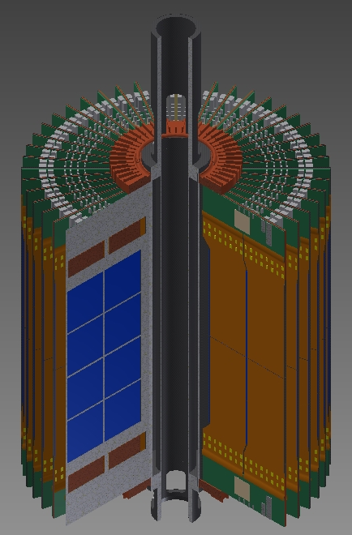
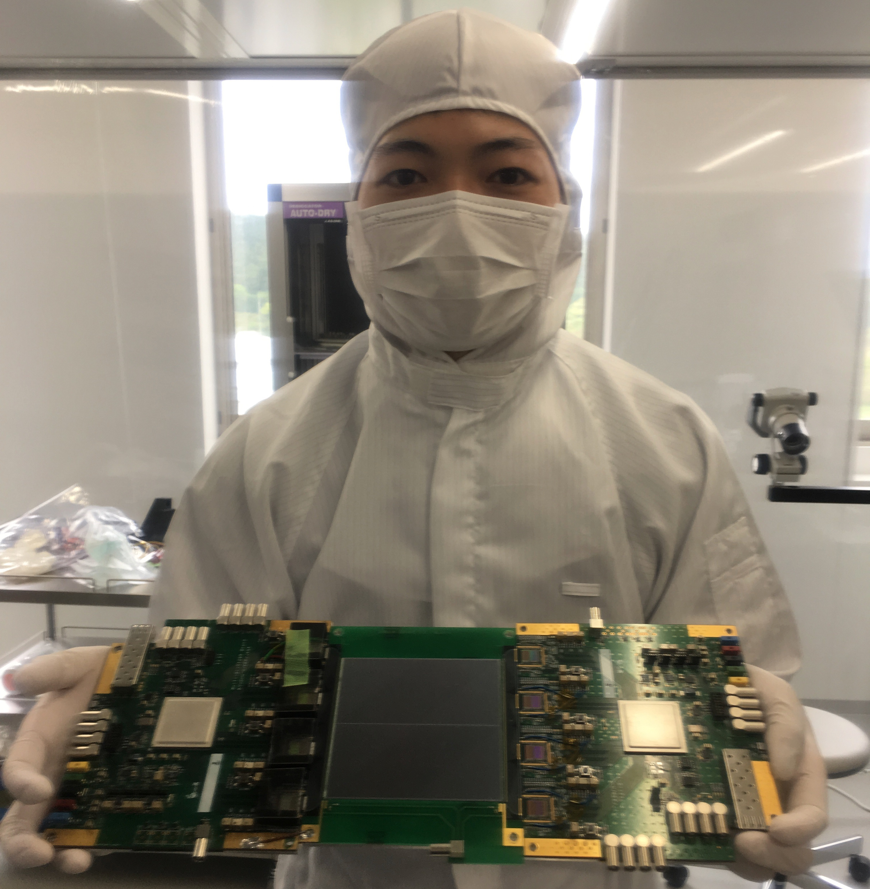
Positron tracking detector
Funded to build
~1/3 of detector vanes
silicon
strip
sensors

Slide 26
Experimental sequence
40ms (25 Hz)
Surface
muon beam
(28 MeV/c)
μ⁺
laser ionization
Mu
Thermal
muonium
(3keV/c)
~1μs
μ⁺
~1ns
Ultra-slow muon
(3keV/c)
μ⁺
~3ns
Acceleration + injection
(300 MeV/c)
40 μs
Storage and detection
(300 MeV/c)
μ⁺→e⁺

Slide 27
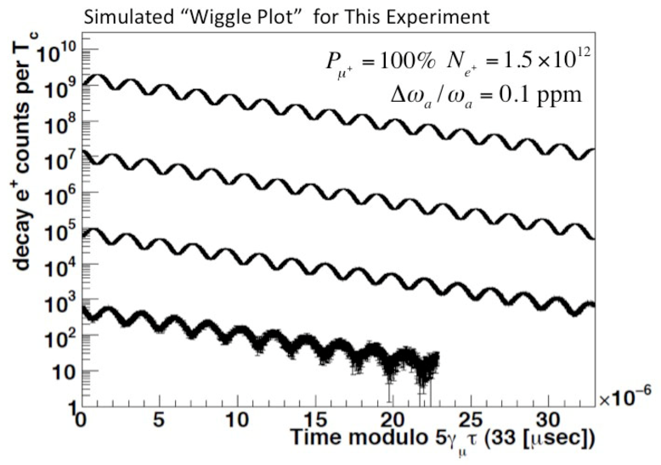
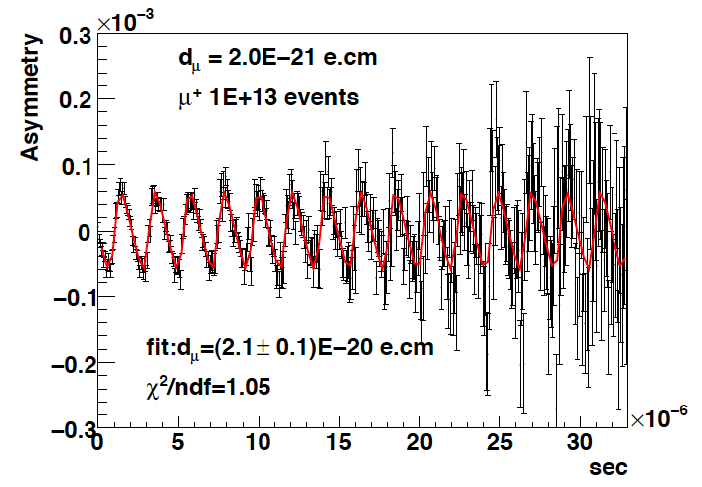
Expected time spectrum of e⁺ in μ→e⁺νν decay
p>200 MeV/c
d_{μ}=2E-20 e・cm
ω
number of e⁺
ω
Up-down asymmetry
∝EDM
e⁺ decay time (sec)
e⁺ decay time (sec)

Slide 28
TDR
TDR describes a technical design to achieve measurement of muon g-2 and EDM beyond BNL E821 precision.
  BNL E821 J-PARC E34
  g-2: 0.46 ppm → 0.37 ppm (→0.1ppm)
  EDM: 0.9 x 10⁻¹⁹ ecm → 1.3 x 10⁻²¹ ecm
prepared by 144 authors

Slide 29
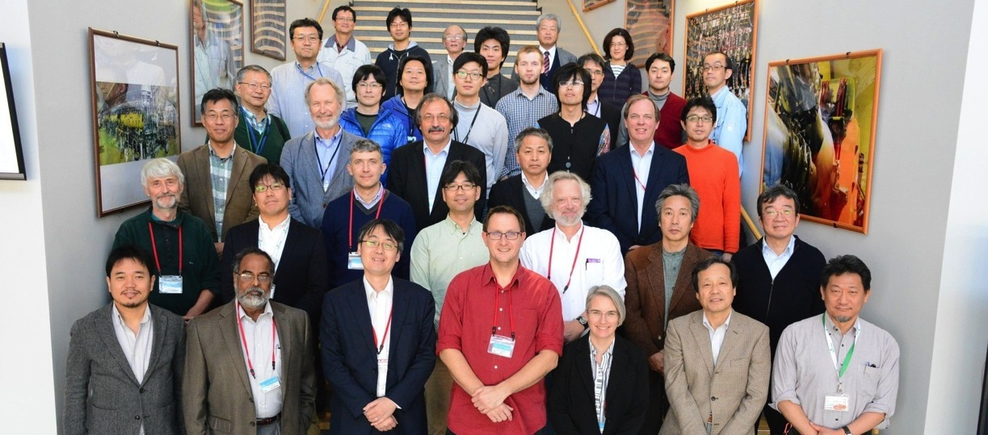
TDR focused review (Nov 15-16,2016)
#*
#* (co-spokesperson)
#
#*
#
# BNL-E821
* FNAL-E989
Gerry Bunce # (program manager)

Slide 30
Recommendations
Develop a “fast track” plan to achieve the Phase-1 result in a timely and cost-effective manner to capitalize on possible windows of opportunity, while keeping open an upgrade plan to realize the Phase-2 experiment. This includes value engineering of all systems.
This committee finds that Phase-1 of the E34 experiment is technically ready for Stage-2 approval. This is subject to resolution of the remaining technical issues identified herein and optimization of cost and schedule in order to realize a timely result.

Slide 31
Summary
New g-2/EDM experiment at J-PARC
  Ultra-cold muon beam
  Compact storage ring
R&D phase is ending.
  The TDR was reviewed by the focused review committee in Nov, 2016.
Construction phase is starting.
  Surface muon beamline under construction.
  ~3-3.5 years to start data taking when full funding is provided.

Slide 32
Comparison of experiments
 | BNL E821 | J-PARC E34
muon momentum | 3.09 GeV/c | 0.3 GeV/c
storage ring radius | 7 m | 0.33 m
storage field | 1.5 T | 3.0 T
focusing field (n-index) | 0.14 (electric) | 1.5 E-4 (magnetic)
average field uniformity | ≈1 ppm | << 1ppm
(local uniformity) | ≈50 ppm | ≈1ppm
Injection | inflector + kick | spiral + kick
Injection efficiency | 3-5% | 80%
muon spin reversal | -- | pulse-to-pulse
positron measurement | calorimeters | tracking
positron acceptance* | 65% | ≈100%
muon polarization | ≈100% | ≈50%
events to 0.46 ppm | 9 x 10⁹ | 5 x 10¹¹
* in the energy region of interest

Slide 33
Brief history
Date | Events
July, 2009 | LOI submitted to PAC8
January, 2010 | Proposal submitted to PAC9
January, 2012 | CDR submitted to PAC13, Milestones defined.
July, 2012 | Stage-1 status recommended by PAC15 Stage-1 status granted by the IPNS director
May, 2015 | TDR submitted to PAC
Oct, 2016 | Revised TDR submitted to PAC and FRC
Nov, 2016 | Focused review on technical design

Slide 34
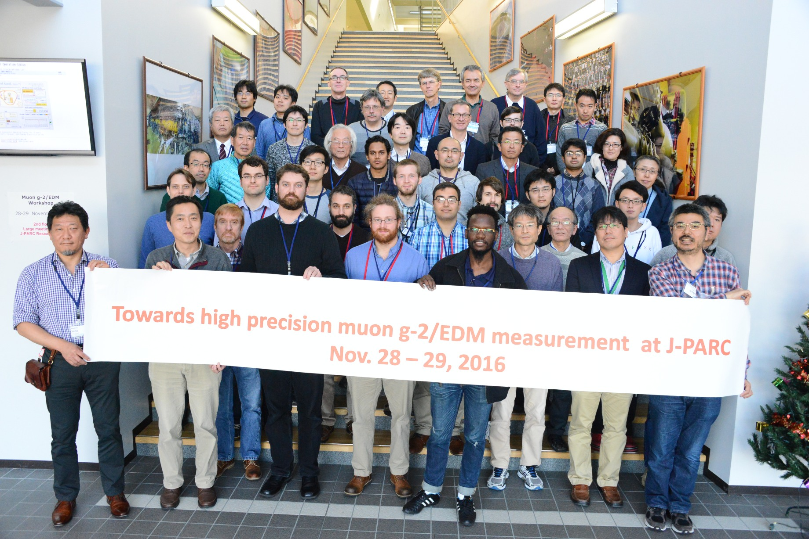
muon g-2/EDM theory workshop at J-PARC
54 participants from 12 countries
http://g-2.kek.jp/meetings/g-2ws_2016/

Slide 35
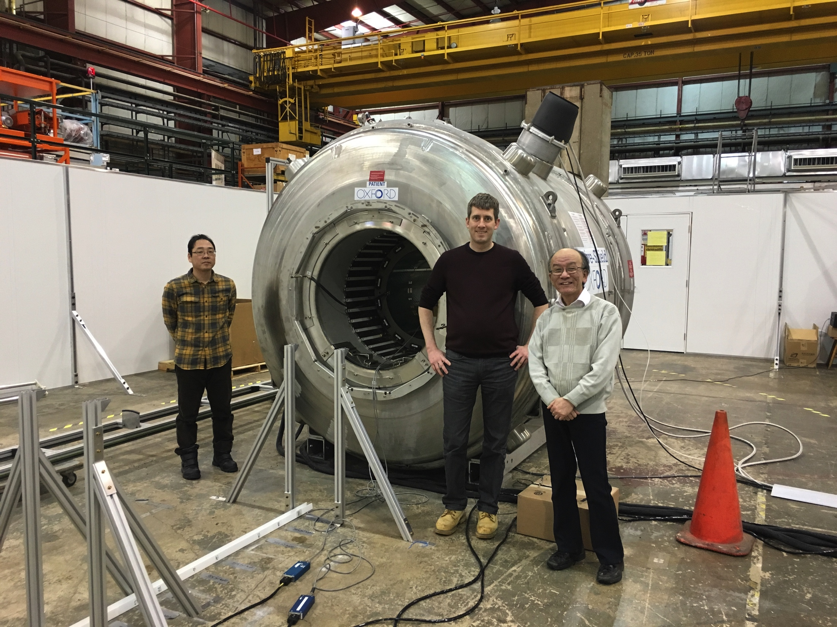
Cross calibration of NMR probes at ANL
Peter Winter
(ANL)
Ken’ich Sasaki
(KEK)
Koichiro Shimomura
(KEK)
The magnet is up and running at 1.45T.
Absolute calibration probes was tested with the same B-field.
Supported by the US-Japan corporative research program.
Photo by T. Mibe

Slide 36
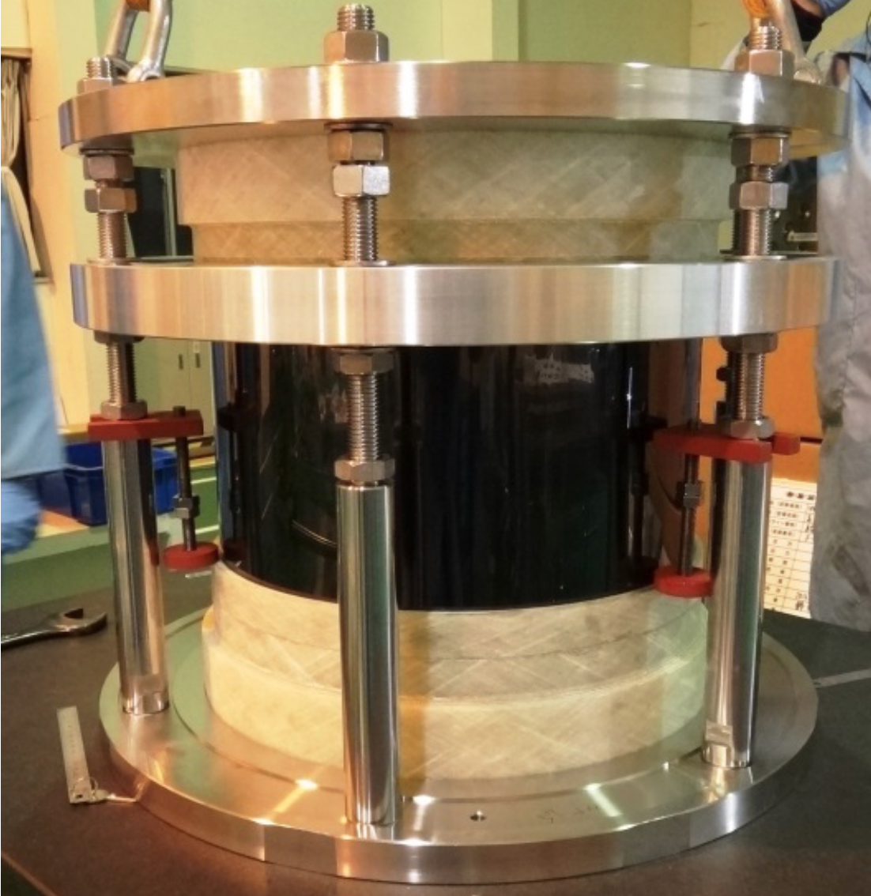
½ mechanical mockup of the muon storage vacuum chamber

Slide 37
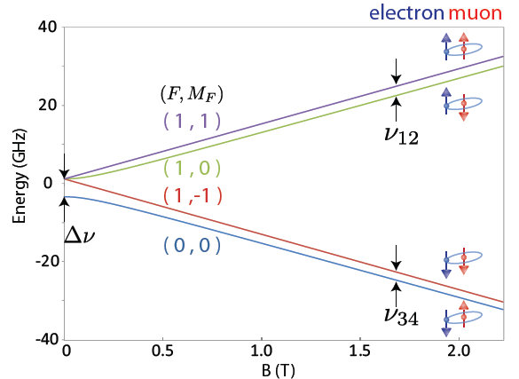
Mu Hyperfine Structure
Slide by K. Shimomura
Δν_{HFS}: Mu Hyperfine Structure
Zeeman Splitting
e⁻
μ⁺
4463 MHz
HF
e⁻
μ⁺
ZF
Pure leptonic system
(No composite particle)
ν₁₂+ν₃₄=Δν_{HFS}
ν₁₂−ν₃₄ ∝ μ_{μ}/μ_{p}

Slide 38


MuSEUM Collaboration
Slide by K. Shimomura
Y. Fukao, H. Iinuma, Y. Ikedo, R. Kadono , N. Kawamura, A. Koda,
K. M. Kojima, T. Mibe, Y. Miyake, K. Nagamine, S. Nishimura,
K. Nishiyama, T. Ogitsu, R. Okubo, N. Saito, K. Sasaki,
K. Shimomura, P. Strasser, M. Sugano, A. Toyoda, K. Ueno,
A. Yamamoto, M. Yoshida
Y. Higashi, T. Higuchi, S. Kanda, Y. Matsuda, Y. Matsudate,
T. Mizutani, S. Seo, M. Tajima, K. S. Tanaka (currently @ Tohoku Univ.),
T. Tanaka, H. A. Torii, Y. Ueno, D. Yagi
JAEA
T. U. Ito
K. Ishida, M. Iwasaki, O. Kamigaito
K. Kubo D. Kawall
M. Aoki, D. Tomono
E. Torikai

Slide 39
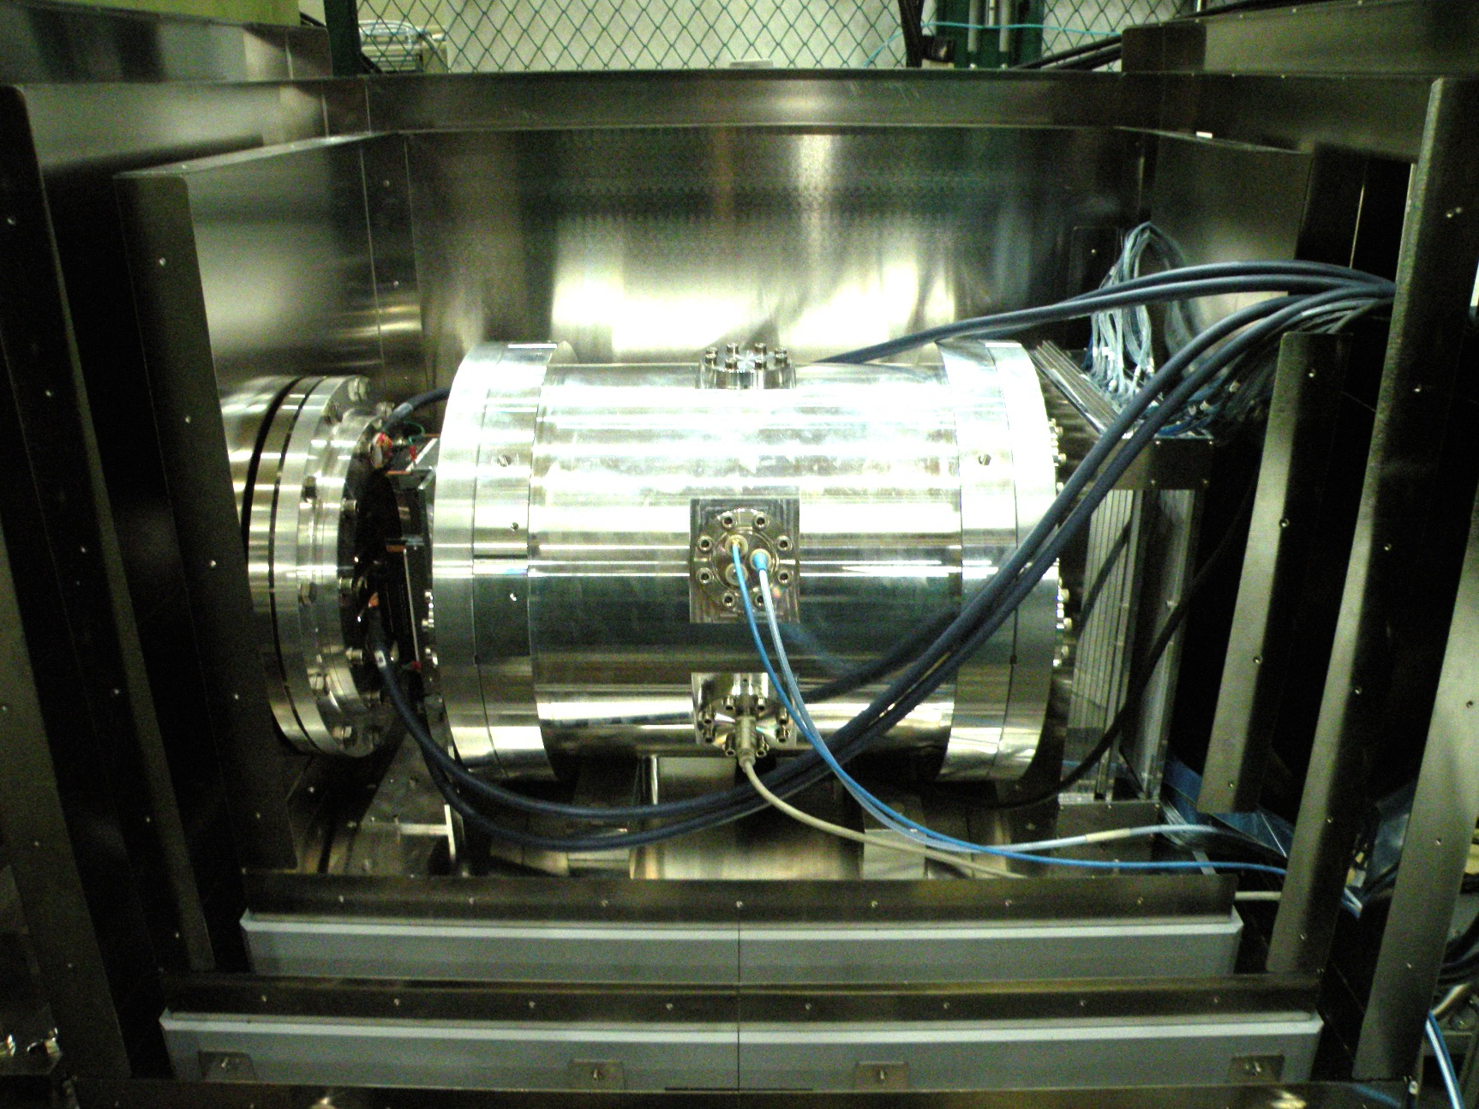
Resonance Measurement at B=0
Slide by K. Shimomura
Positron Counter
w/Al Absorber
Fiber Beam Profile Monitor
Muon Beam
Kr Gas Chamber
(RF Cavity inside)
200 mm
Three layers of magnetic shield

Slide 40
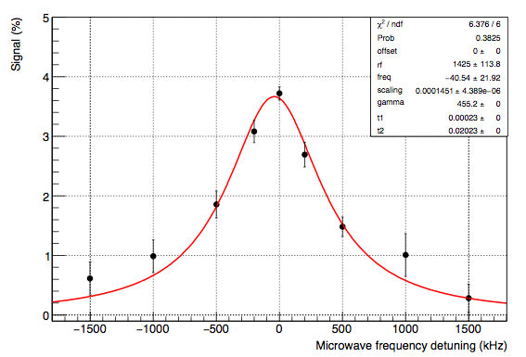
First data at B=0 (2016A)
Slide by K. Shimomura
Ph.D thesis
S. Kanda
(2016)
Spin flip signal (%)
Frequency detuning (kHz)
Muonium HFS resonance was observed
Fitted by Lorenzian and freq. center was 4463.1+-0.02 MHz
Expectation from precursor experiments is 4463.1 MHz

Slide 41
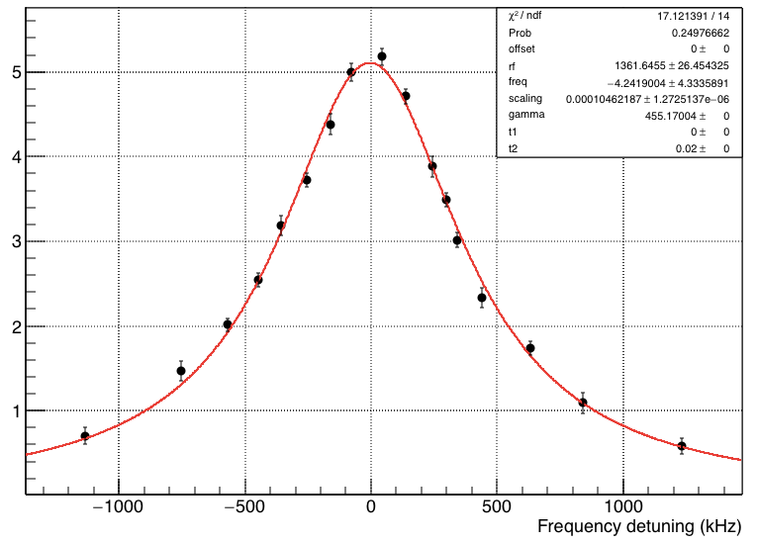
Resonance Lineshape at B=0 (2016B)
Slide by K. Shimomura
Spin flip signal (%)
Preliminary
Frequency detuning (kHz)
Statistical uncertainty ~ 4 kHz (x5 improvement)
More data to be collected in 2017
High-field data taking in preparation

