Slide 1
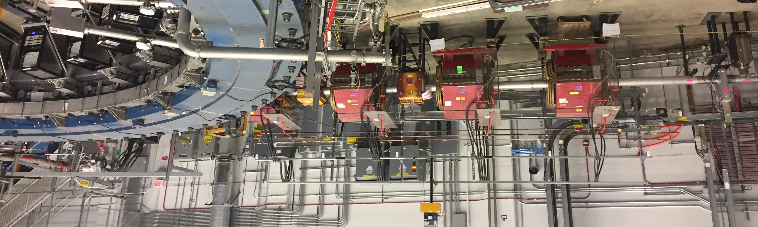
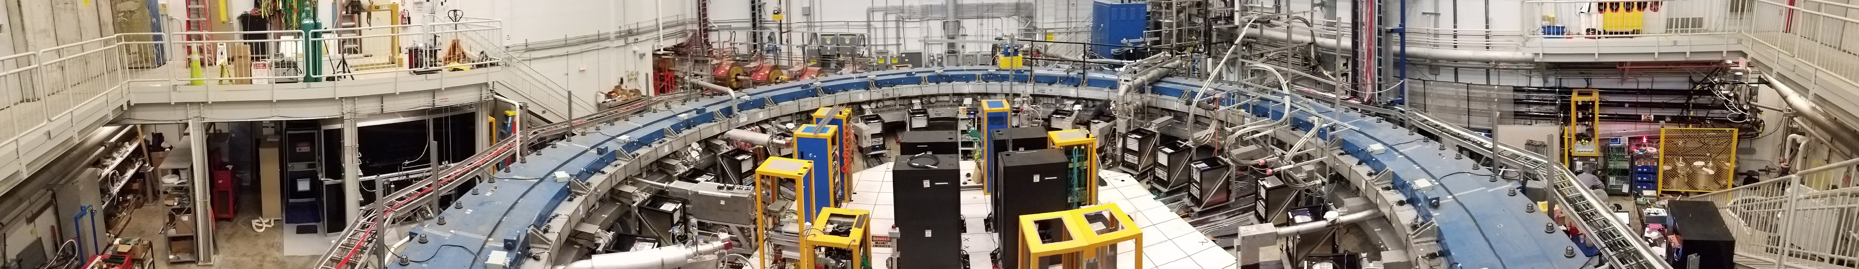
The Fermilab Muon (g - 2) Experiment:
Lee Roberts – Boston University
on behalf of the Muon g-2 collaboration

Slide 2
I.I. Rabi
Never measure anything but frequency

Slide 3








Muon g-2 Collaboration
US Universities
  Boston
  Cornell
  Illinois
  James Madison
  Kentucky
  Massachusetts
  Michigan
  Michigan State
  Mississippi
  Northern Illinois
  Regis
  Texas
  Virginia
  Washington
National Labs
  Argonne
  Brookhaven
  Fermilab
Italy
  INFN
    LNF Frascati,
    Naples
    Pisa
    Roma 2
    Trieste
    Lecce
  Udine
  Naples
  Trieste
  Rjeka
  Molise
  SNS Pisa
China:
  Shanghai
The Netherlands:
  Groningen
Germany:
  Dresden (thy)
England
  Cockroft Institute
  Lancaster
  Liverpool
  University College London
Korea
  KAIST
Russia:
  Dubna
  Novosibirsk

Slide 4
Motivation: Why?
Muon magnetic moment consists of a Dirac part and a Pauli part
The muon anomaly can be measured and calculated to sub ppm level precision, which leads to a confrontation between Nature and the Standard Model.
E989 Goals
Introduction to the experimental technique
  spin equations
  magic γ
E989 improvements
Schedule

Slide 5
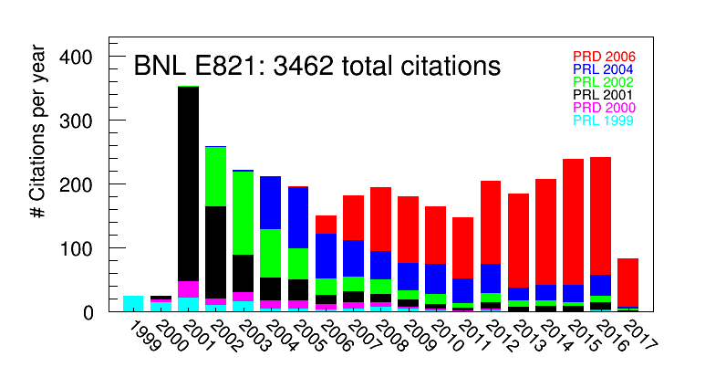
Tension with the Standard Model
With the SM values from above, present difference with the SM:
This difference with the SM is highly cited.
KNT also see > 3.6 σ
19 June 2017
We need more precise experiment and theory to determine whether this difference is a harbinger of New Physics, or a fluctuation.

Slide 6
Goal of Fermilab E989
A factor of 4 reduction in total error in a_{μ} over BNL (0.54 ppm)
  ± 0.54 ppm total error
Two things to notice:
  statistical error dominates
  systematic error is only 2.5 to 3 times larger than E989 goal
How to improve:
  get a hotter beam (Fermilab) (21 × statistics of BNL)
  improve everything in systematics, which have many contributing factors
Fermilab Goal: Equal statistical and systematic errors
  ± 70 ppb for ω_{a} and ω_{p}. total: ± 100 ppb
  ± 100 ppb for statistics
  Total error 140 ppb ( 0.14 ppm)

Slide 7
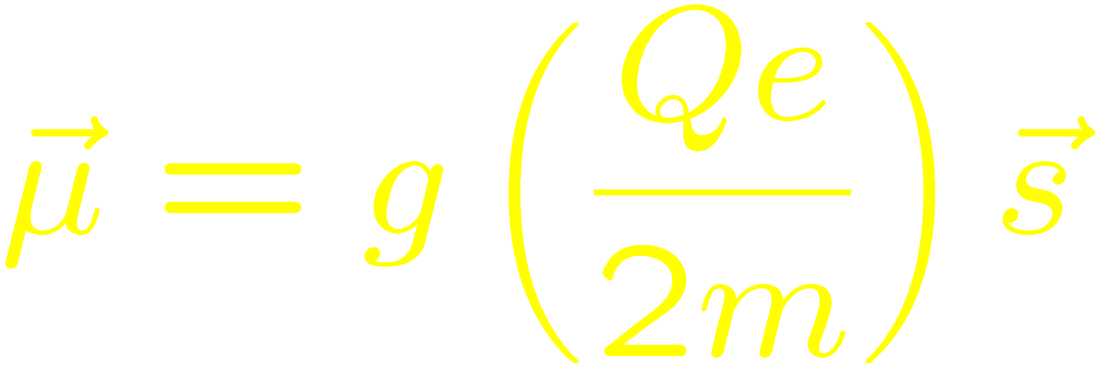
Measuring Lepton Magnetic Dipole Moments

Slide 8
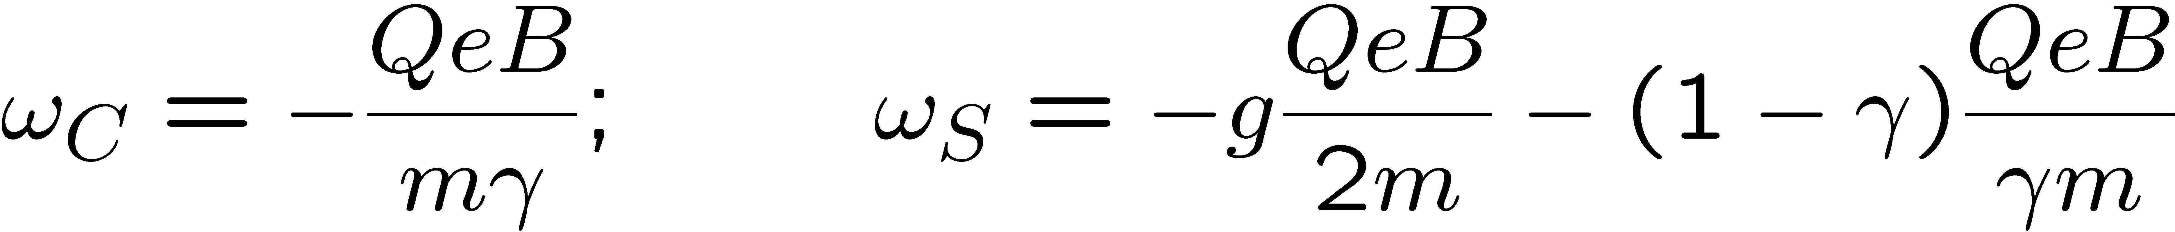
Spin Motion in a Magnetic Field
Particle: q = Qe moving in a magnetic field: momentum turns with cyclotron frequency ω_{C},
spin turns with ω_{S}
Spin turns relative to the momentum with ω_{a}

Slide 9
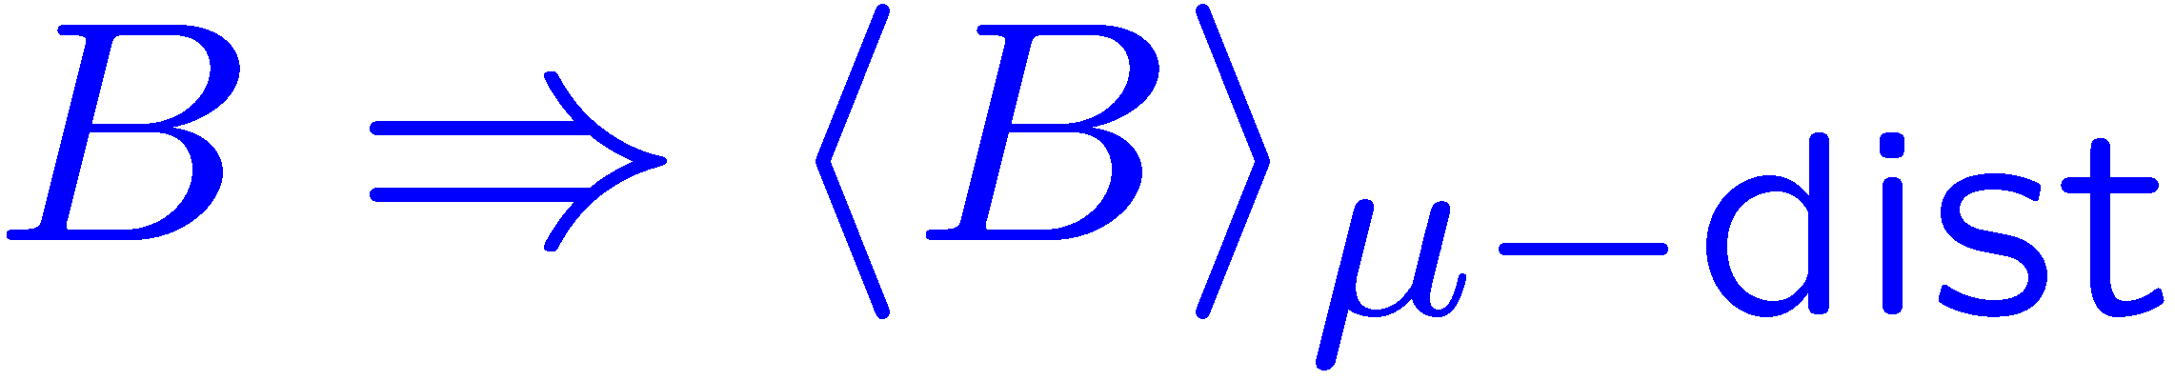
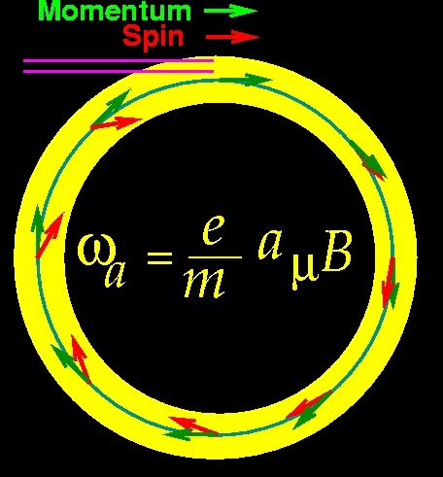
In a storage ring, we need vertical focusing
With an electric quadrupole field for vertical focusing and the magic γ
0
Measure two quantities
where B is expressed in terms of the Larmor frequency of a free proton

Slide 10
Experimental Technique
narrow time bunch of protons
x_{c} ≈ 77 mm
β ≈ 10 mrad
B·dl ≈ 0.1 Tm
Pions
Inflector
p=3.1GeV/c
Target
(1.45T)
Muon storage ring – weak focusing betatron
Muon polarization
Injection & kicking
Focus with electric quads
24 electron calorimeters
Injection orbit
Central orbit
Storage
ring
Kicker
Modules
R=711.2cm
d=9cm
R
R
β
Electric Quadrupoles
x_{c}
B. L. Roberts, Fermilab , 3 September 2008
- p. 10/68
Notes:
10

Slide 11
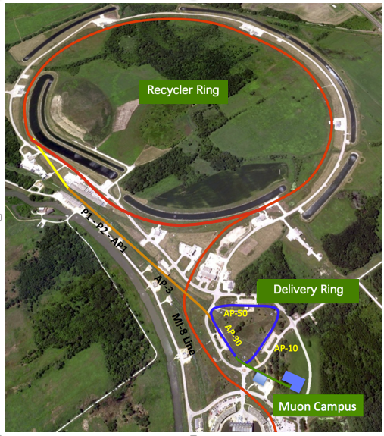
Beam: BNL
Fermilab
24 GeV/c proton beam
The pion decay channel is 80 m and the ring diameter is 14.1 m. Most m are thrown away to minimize pion content of the beam. π/μ ≃ 1:1, big source of background
8 GeV/c proton beam from Booster
The pion decay channel is ≃ 2 km, No pions left
Analyzed Events: E989
9 × 10⁹ goal: 2 × 10¹¹

Slide 12
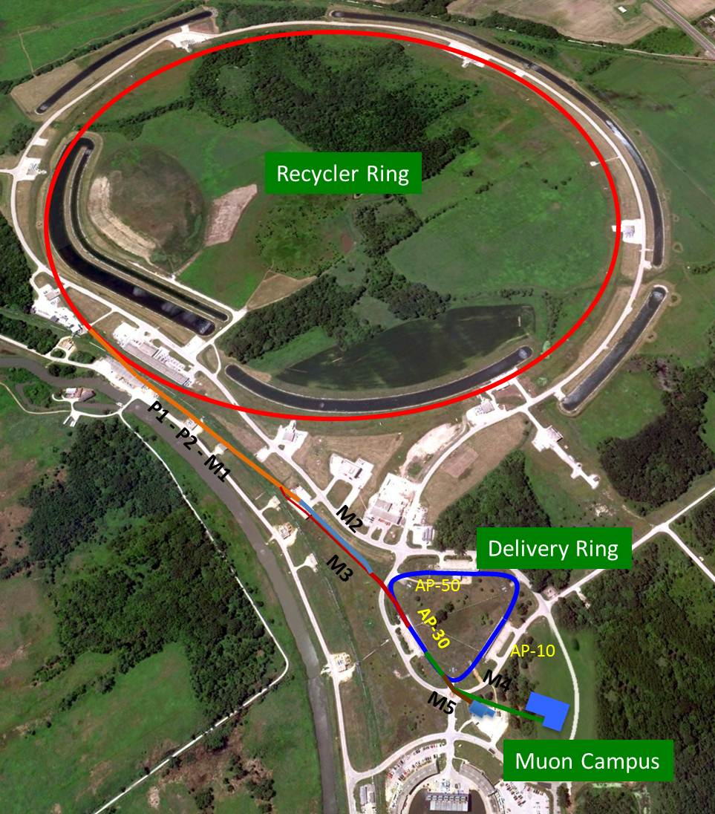
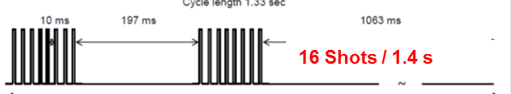
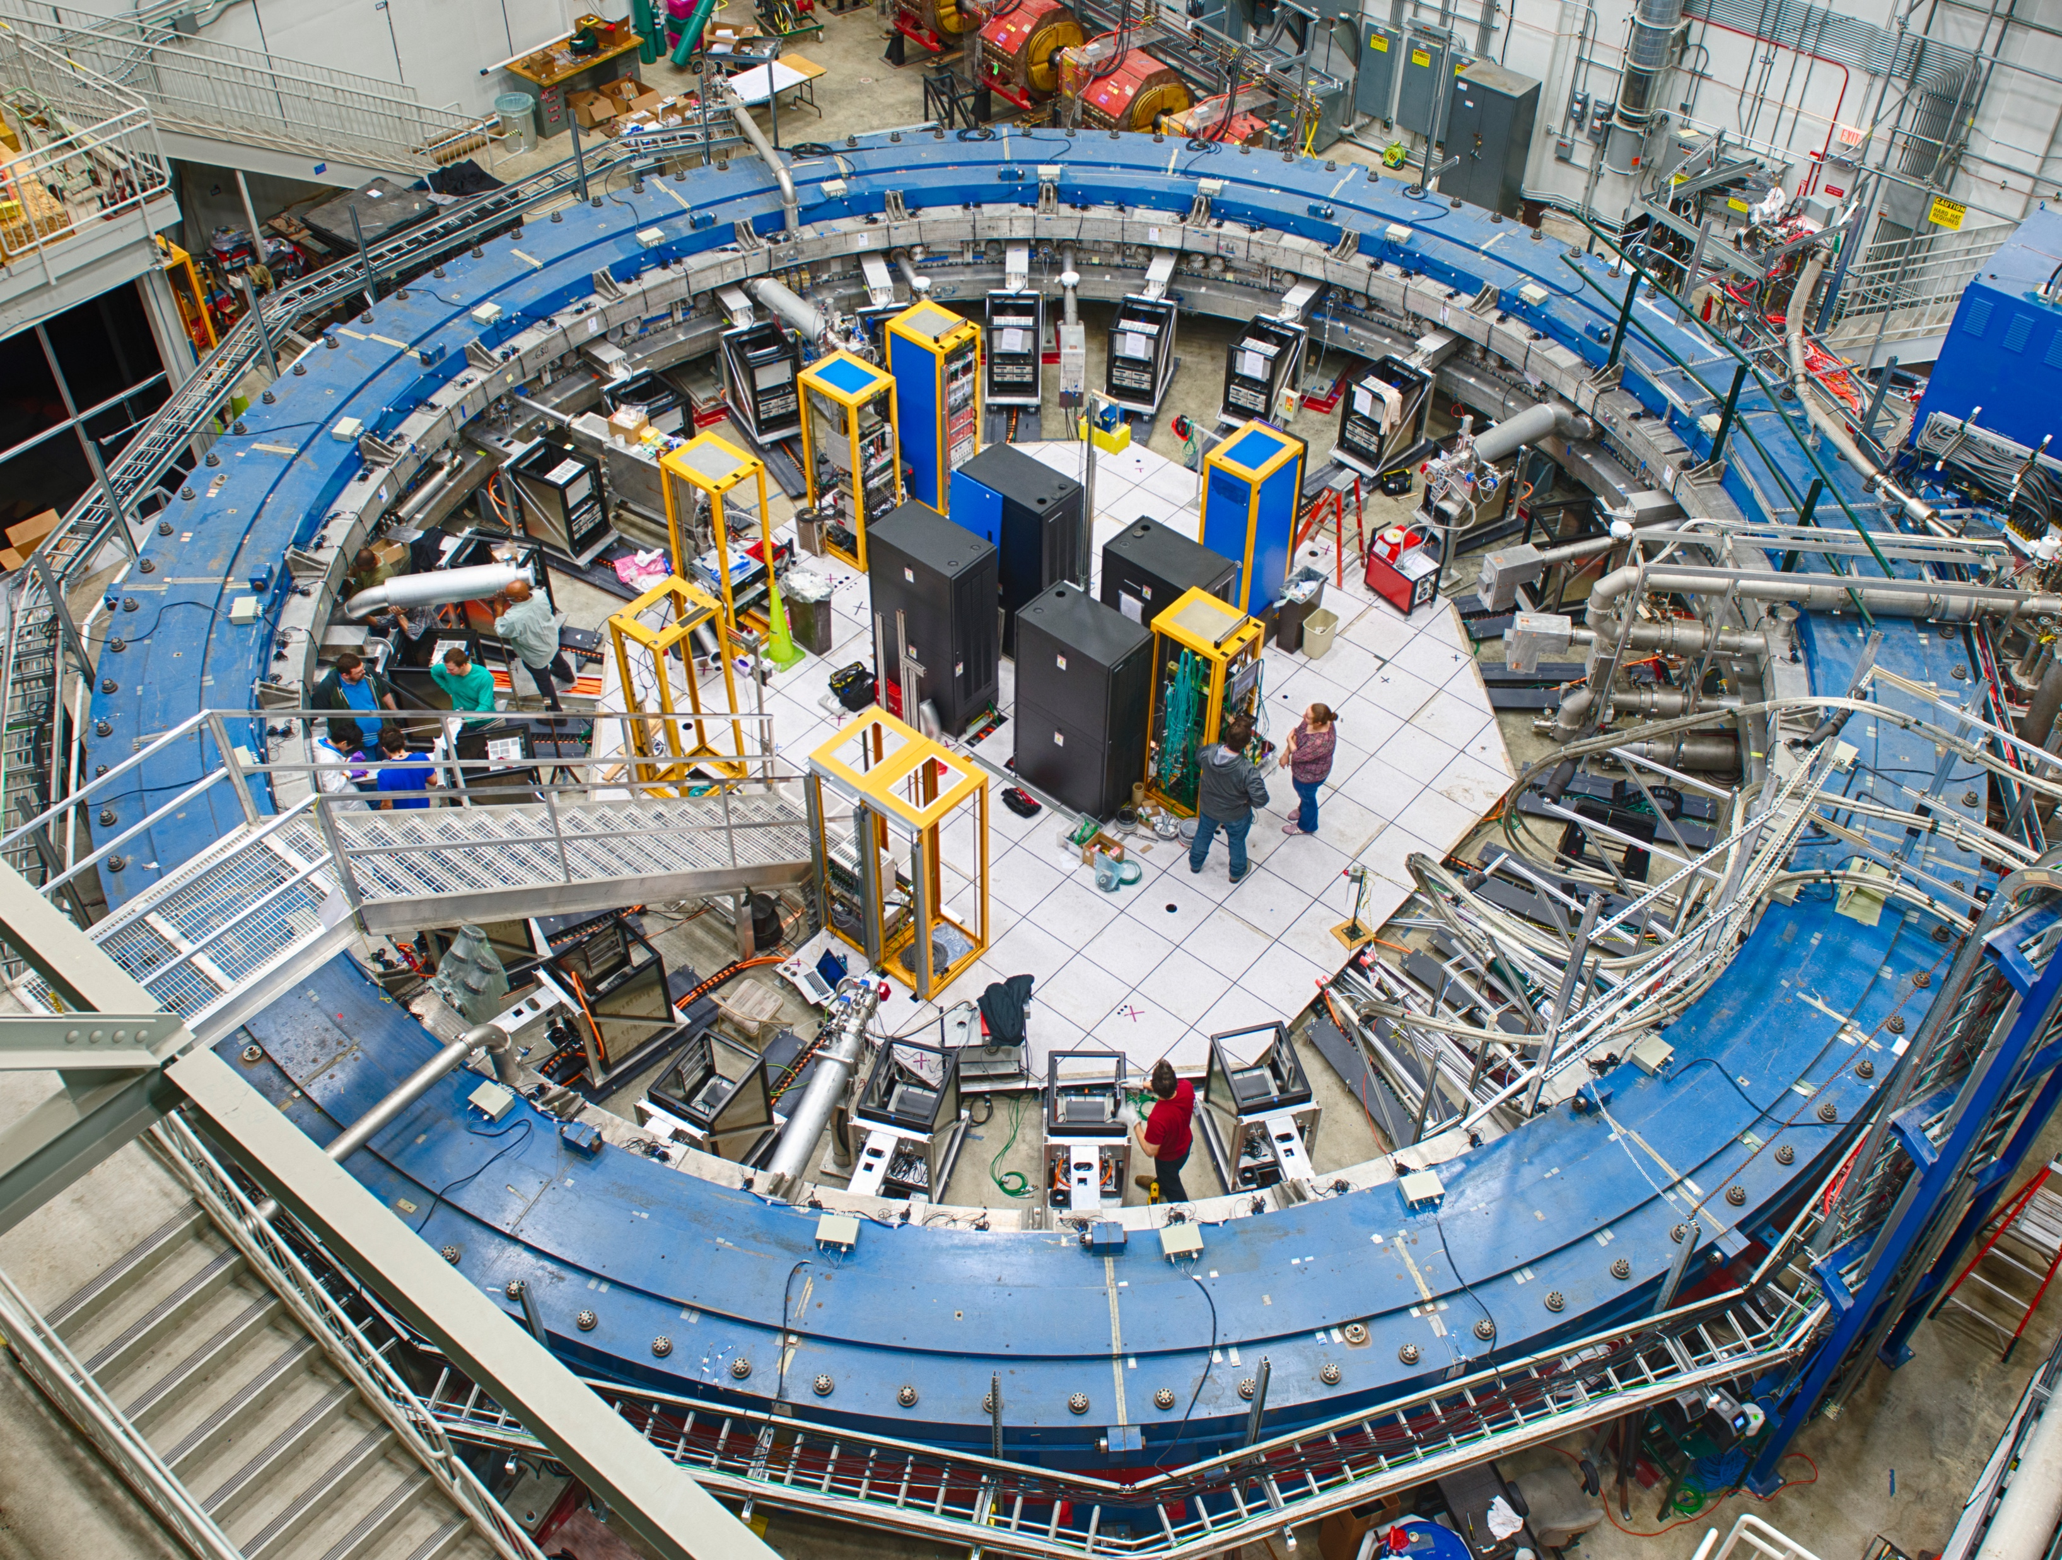
Muon g-2 Beam
8 GeV p batch into Recycler
Split into 4 bunches
Extract each bunch to strike target
Long FODO channel to collect π ◊ μν
p/π/μ beam enters DR; protons kicked out; π decay away
∼10,000 μ stored in ring per pulse
6/7/17

Slide 13
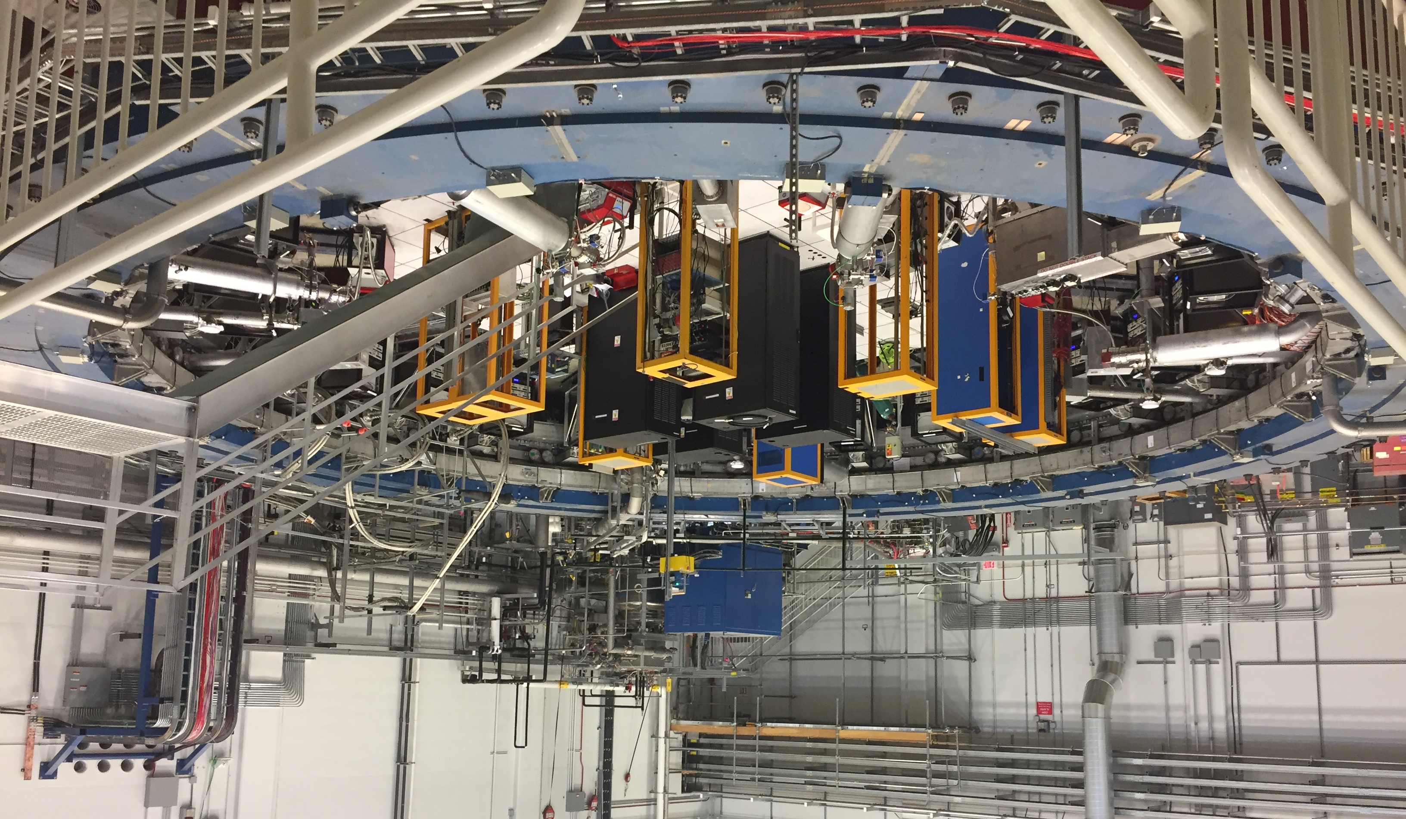
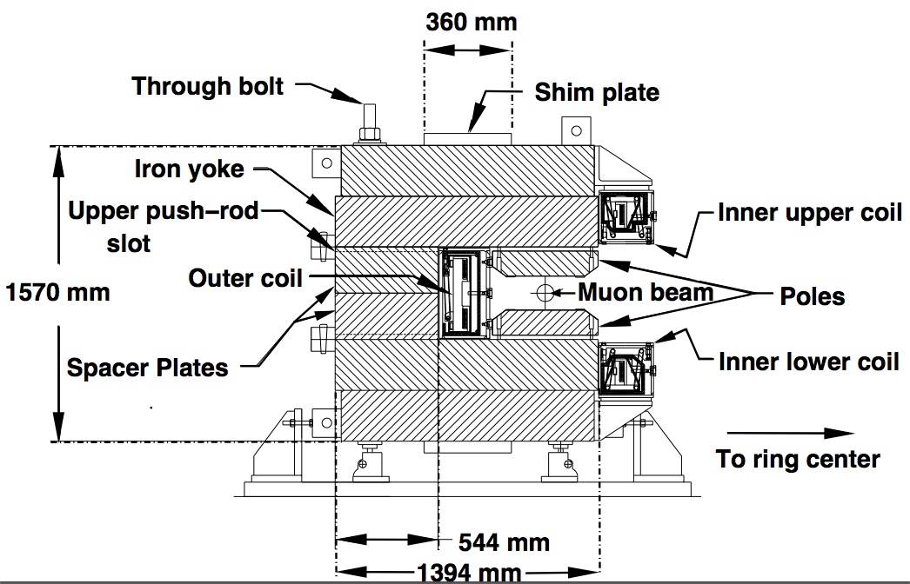
The Magnet (@Fermilab)
Muon lifetime γτ_{μ} = 64.4 μs
(g-2) period τ_{a} = 4.37 μs
Cyclotron period τ_{C} = 149 ns

Slide 14
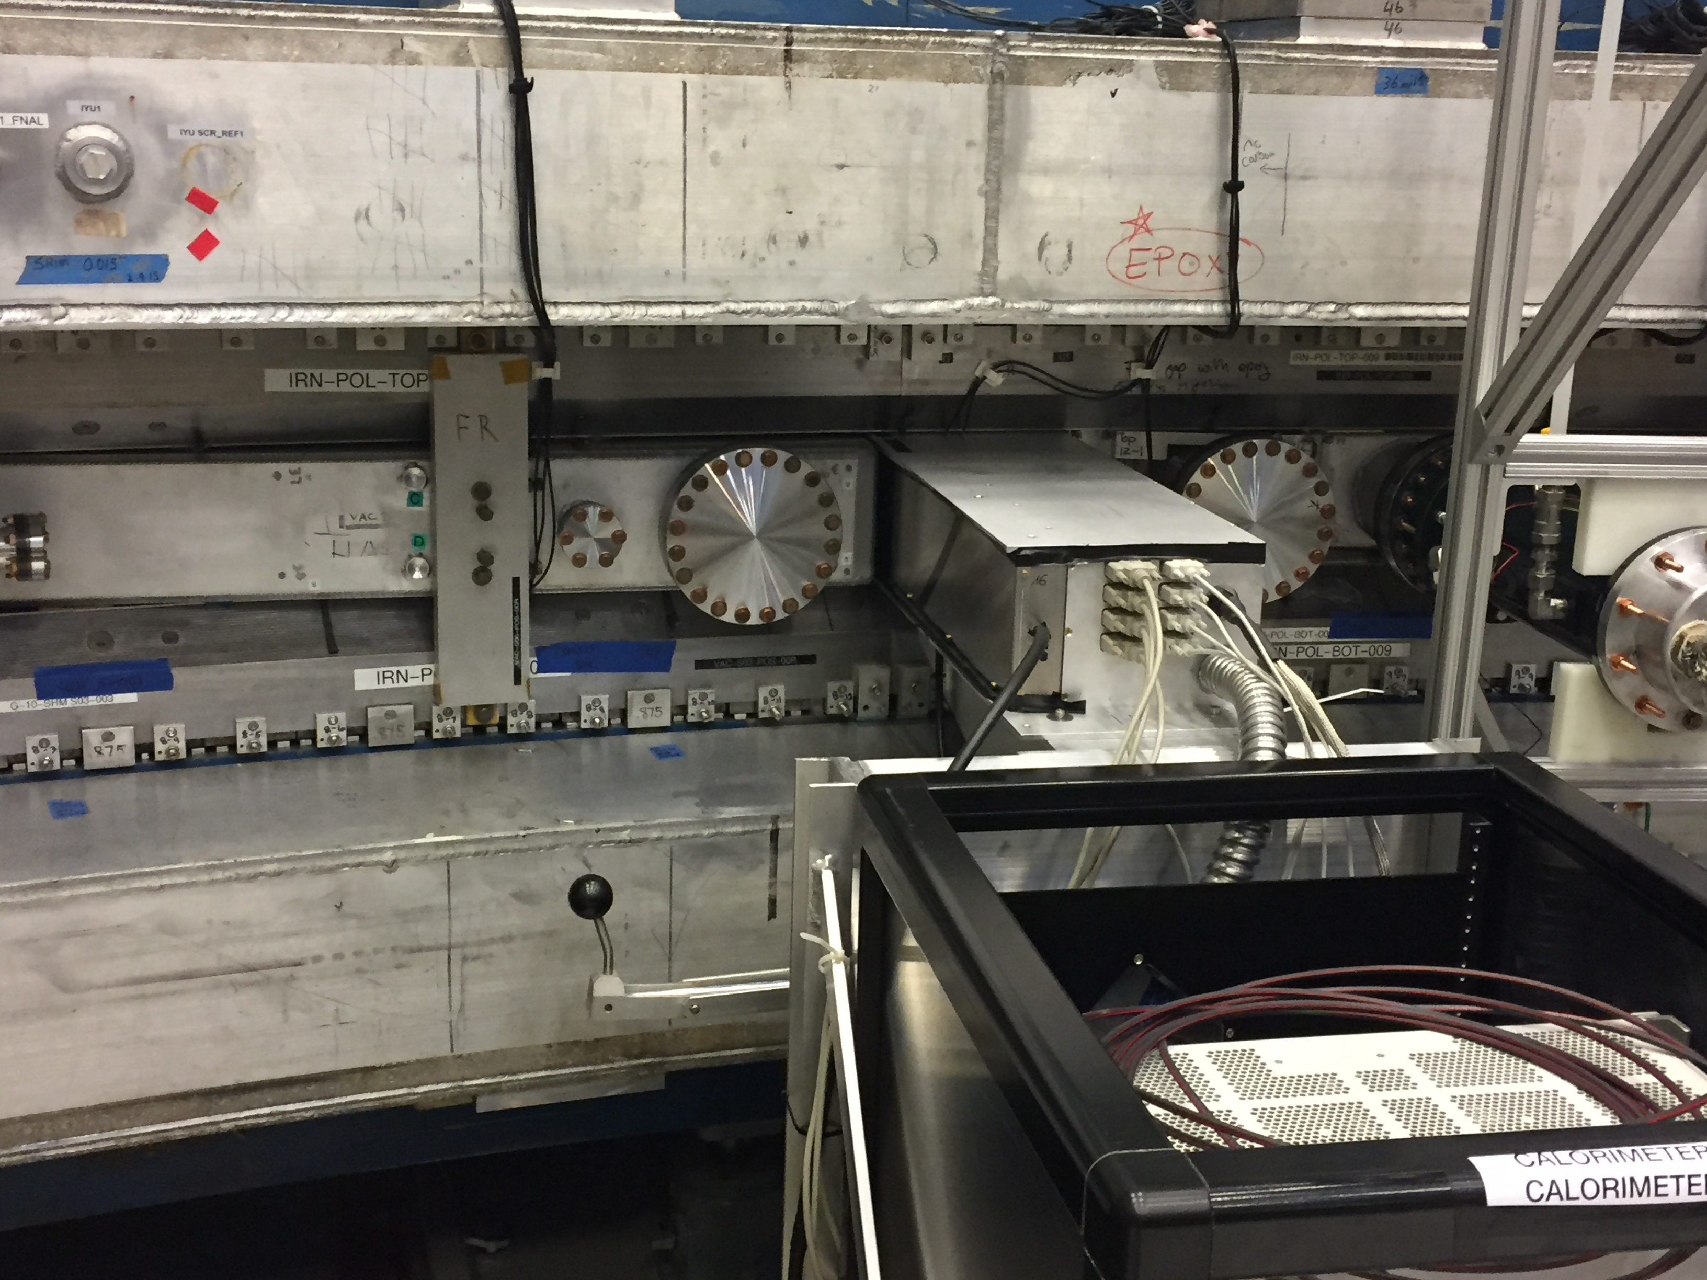
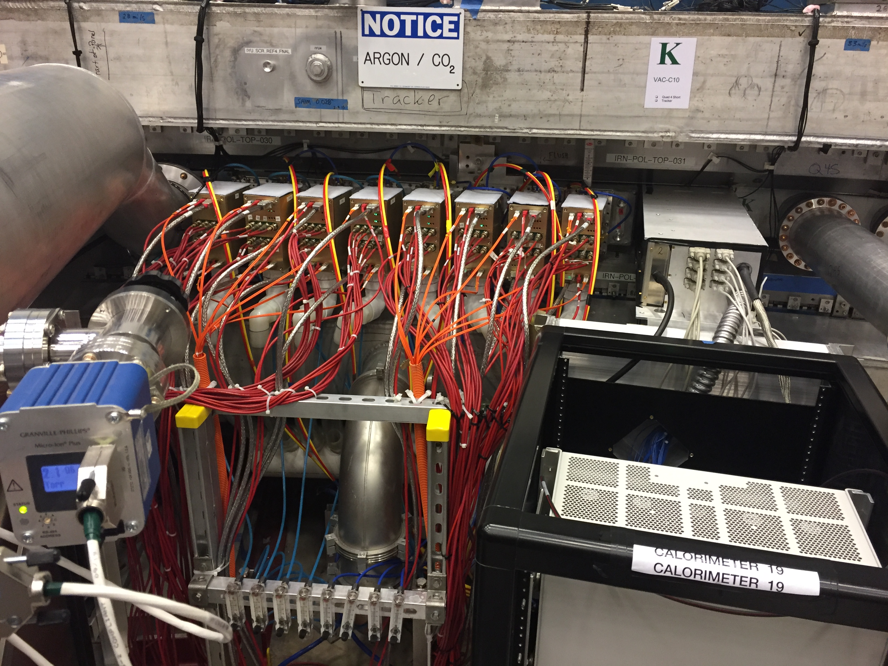
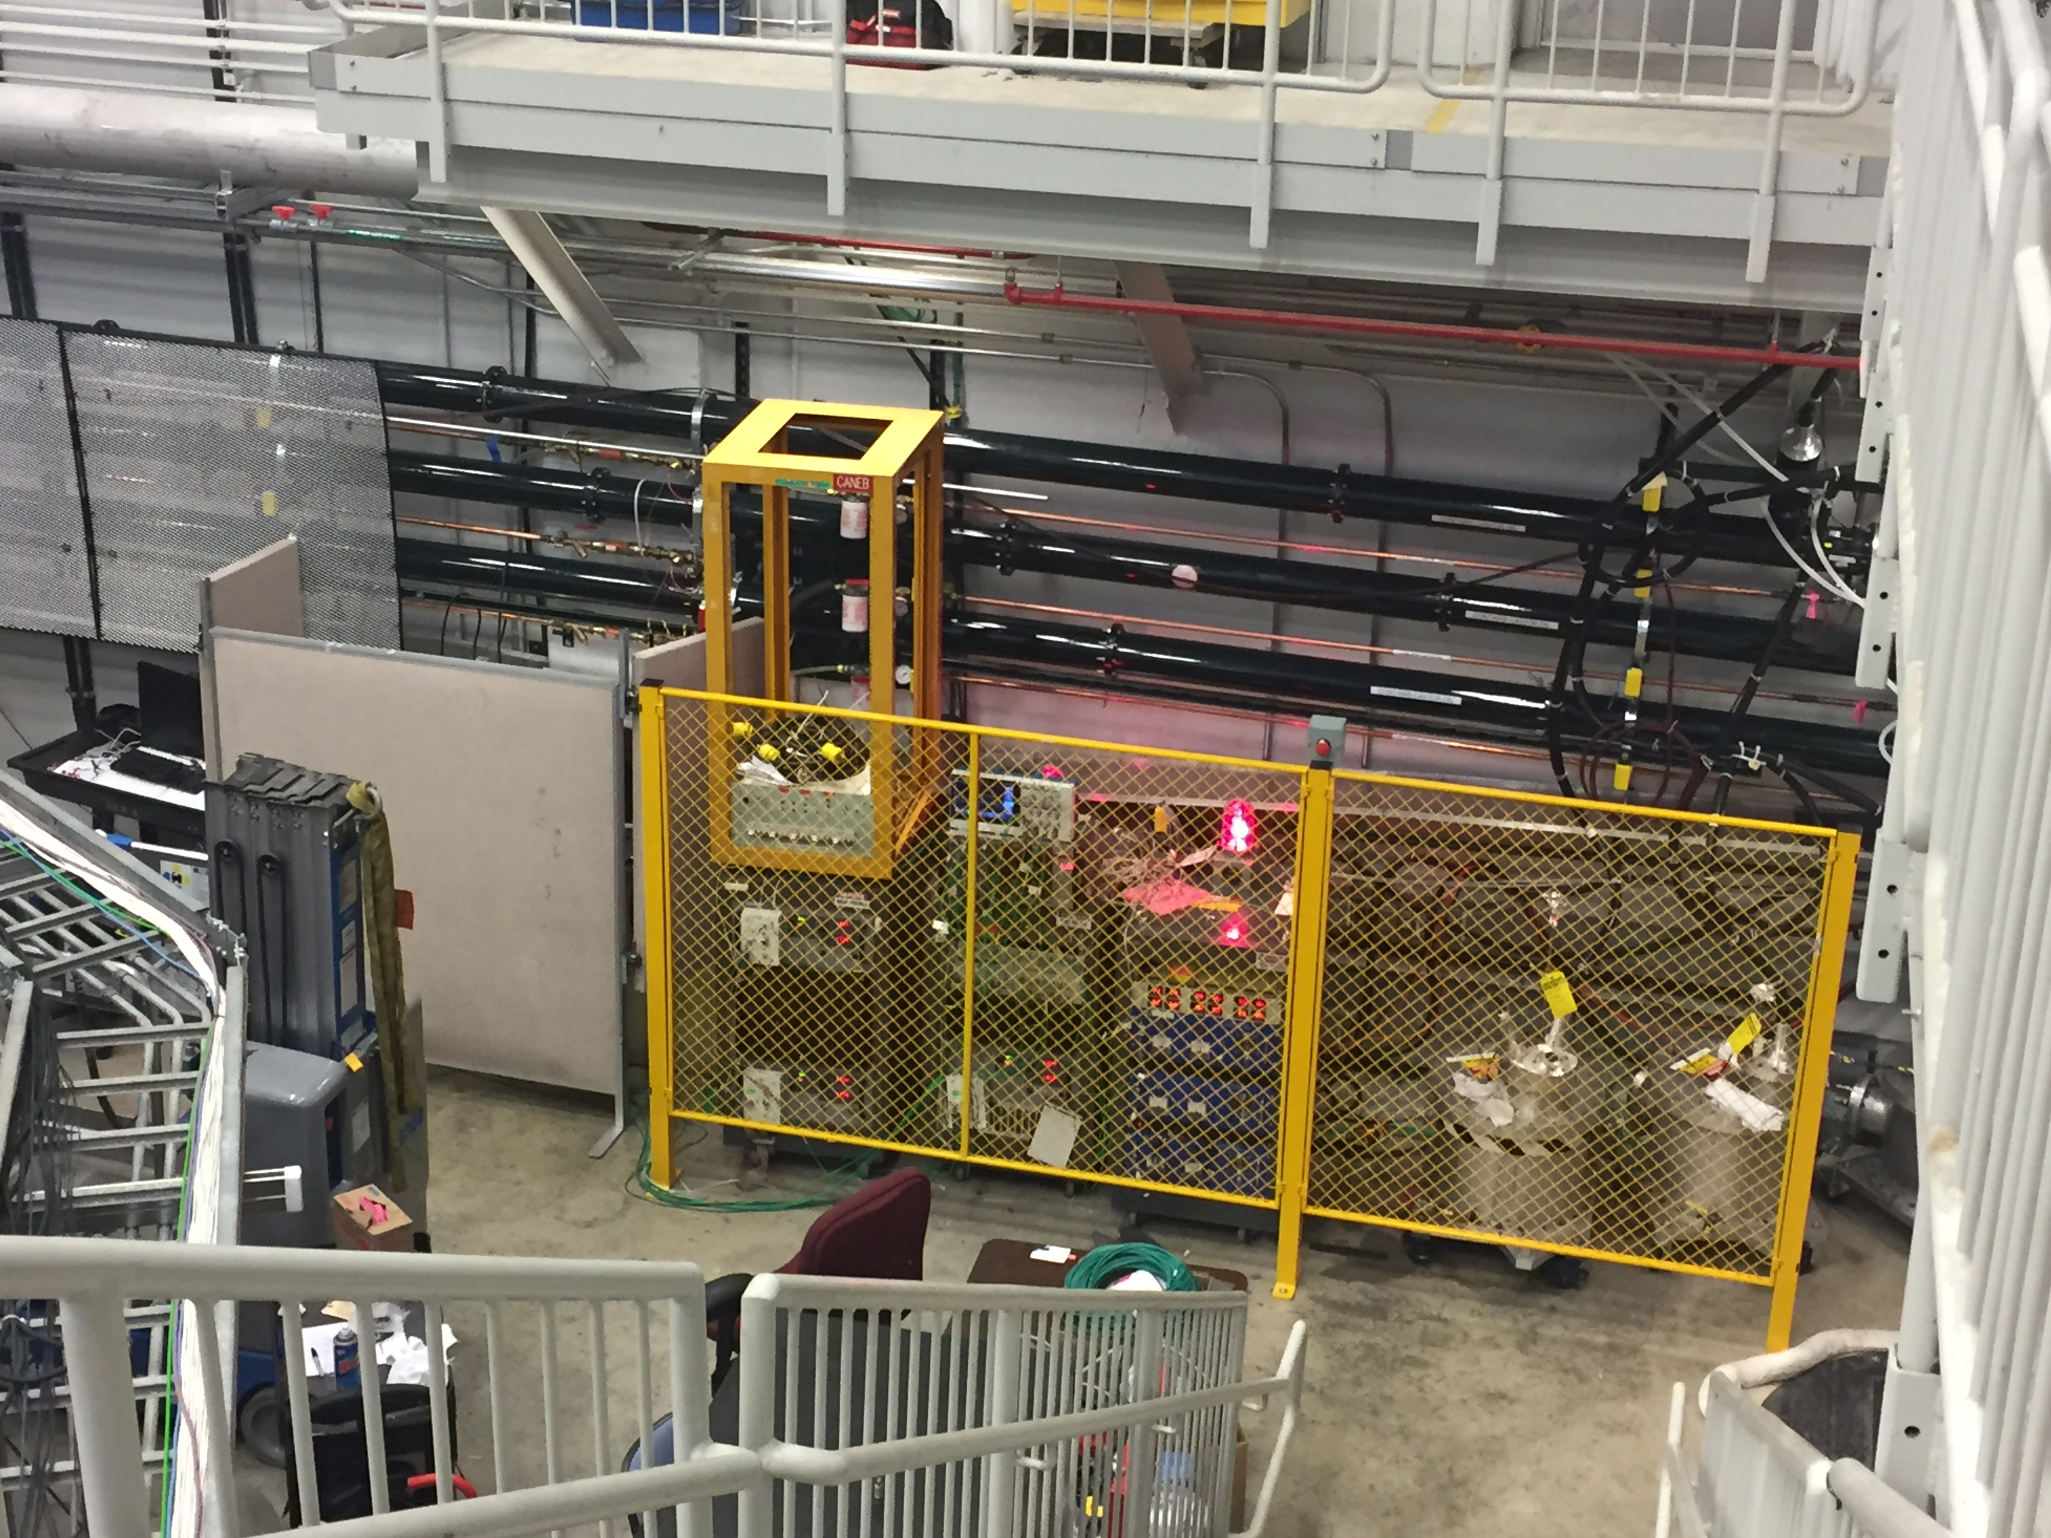
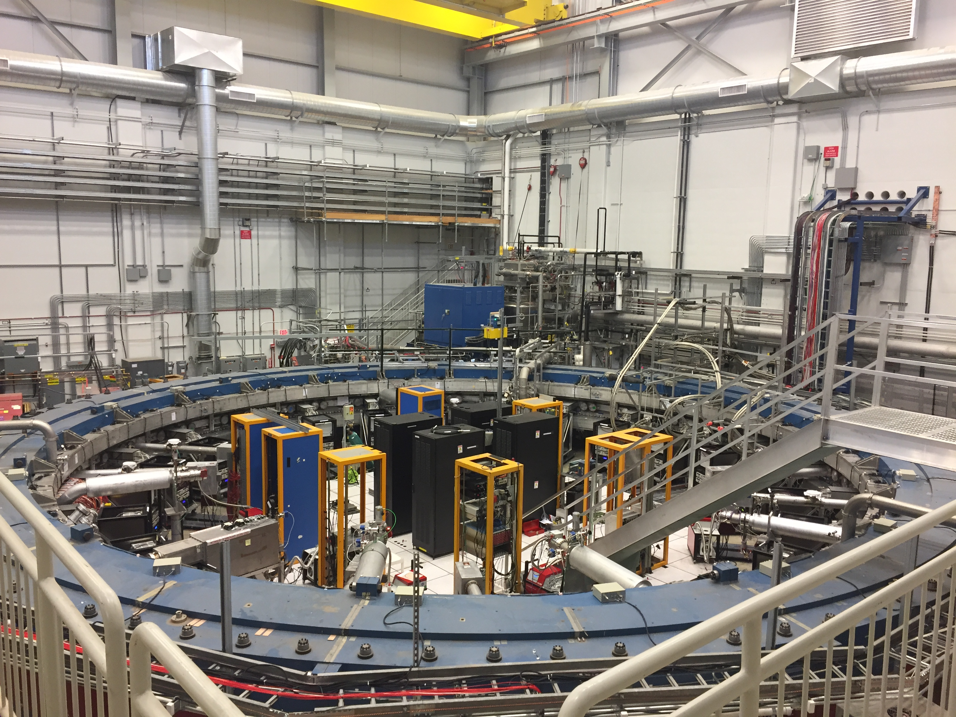
The storage ring: June 2017
Calorimeter
8 Trackers
Blumlein PFNs

Slide 15
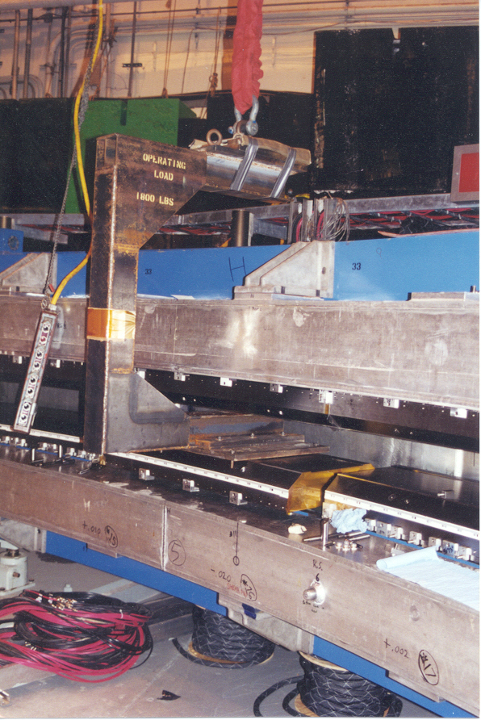
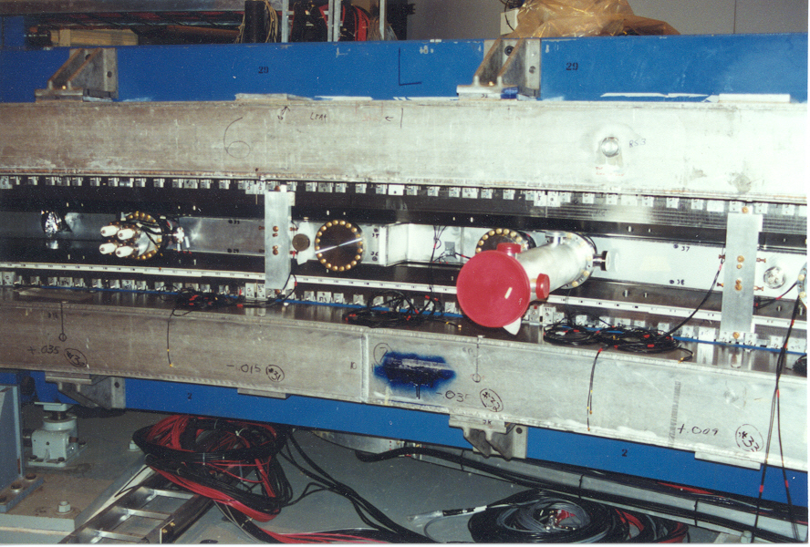
Pole piece installation (angle, match edges)
(From BNL installation)

Slide 16
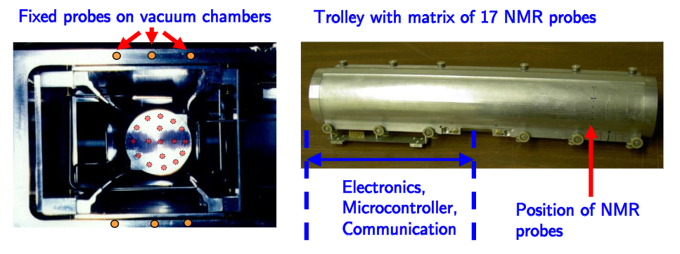
ω_{p} The Magnetic field:
We use pulsed NMR. A π/2 pulse is applied to a petroleum jelly sample, and the free-induction-decay is digitized and analyzed to determine the FID frequency
We monitor the field during data collection with 378 NMR probes outside of the vacuum chamber.
We map the field inside of the ring with dedicated “trolley runs”
Through a series of steps using a spherical water probe, we calibrate to the Larmor frequency of a free proton.

Slide 17
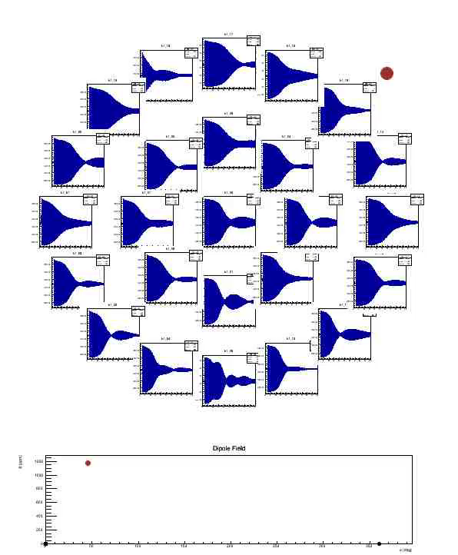
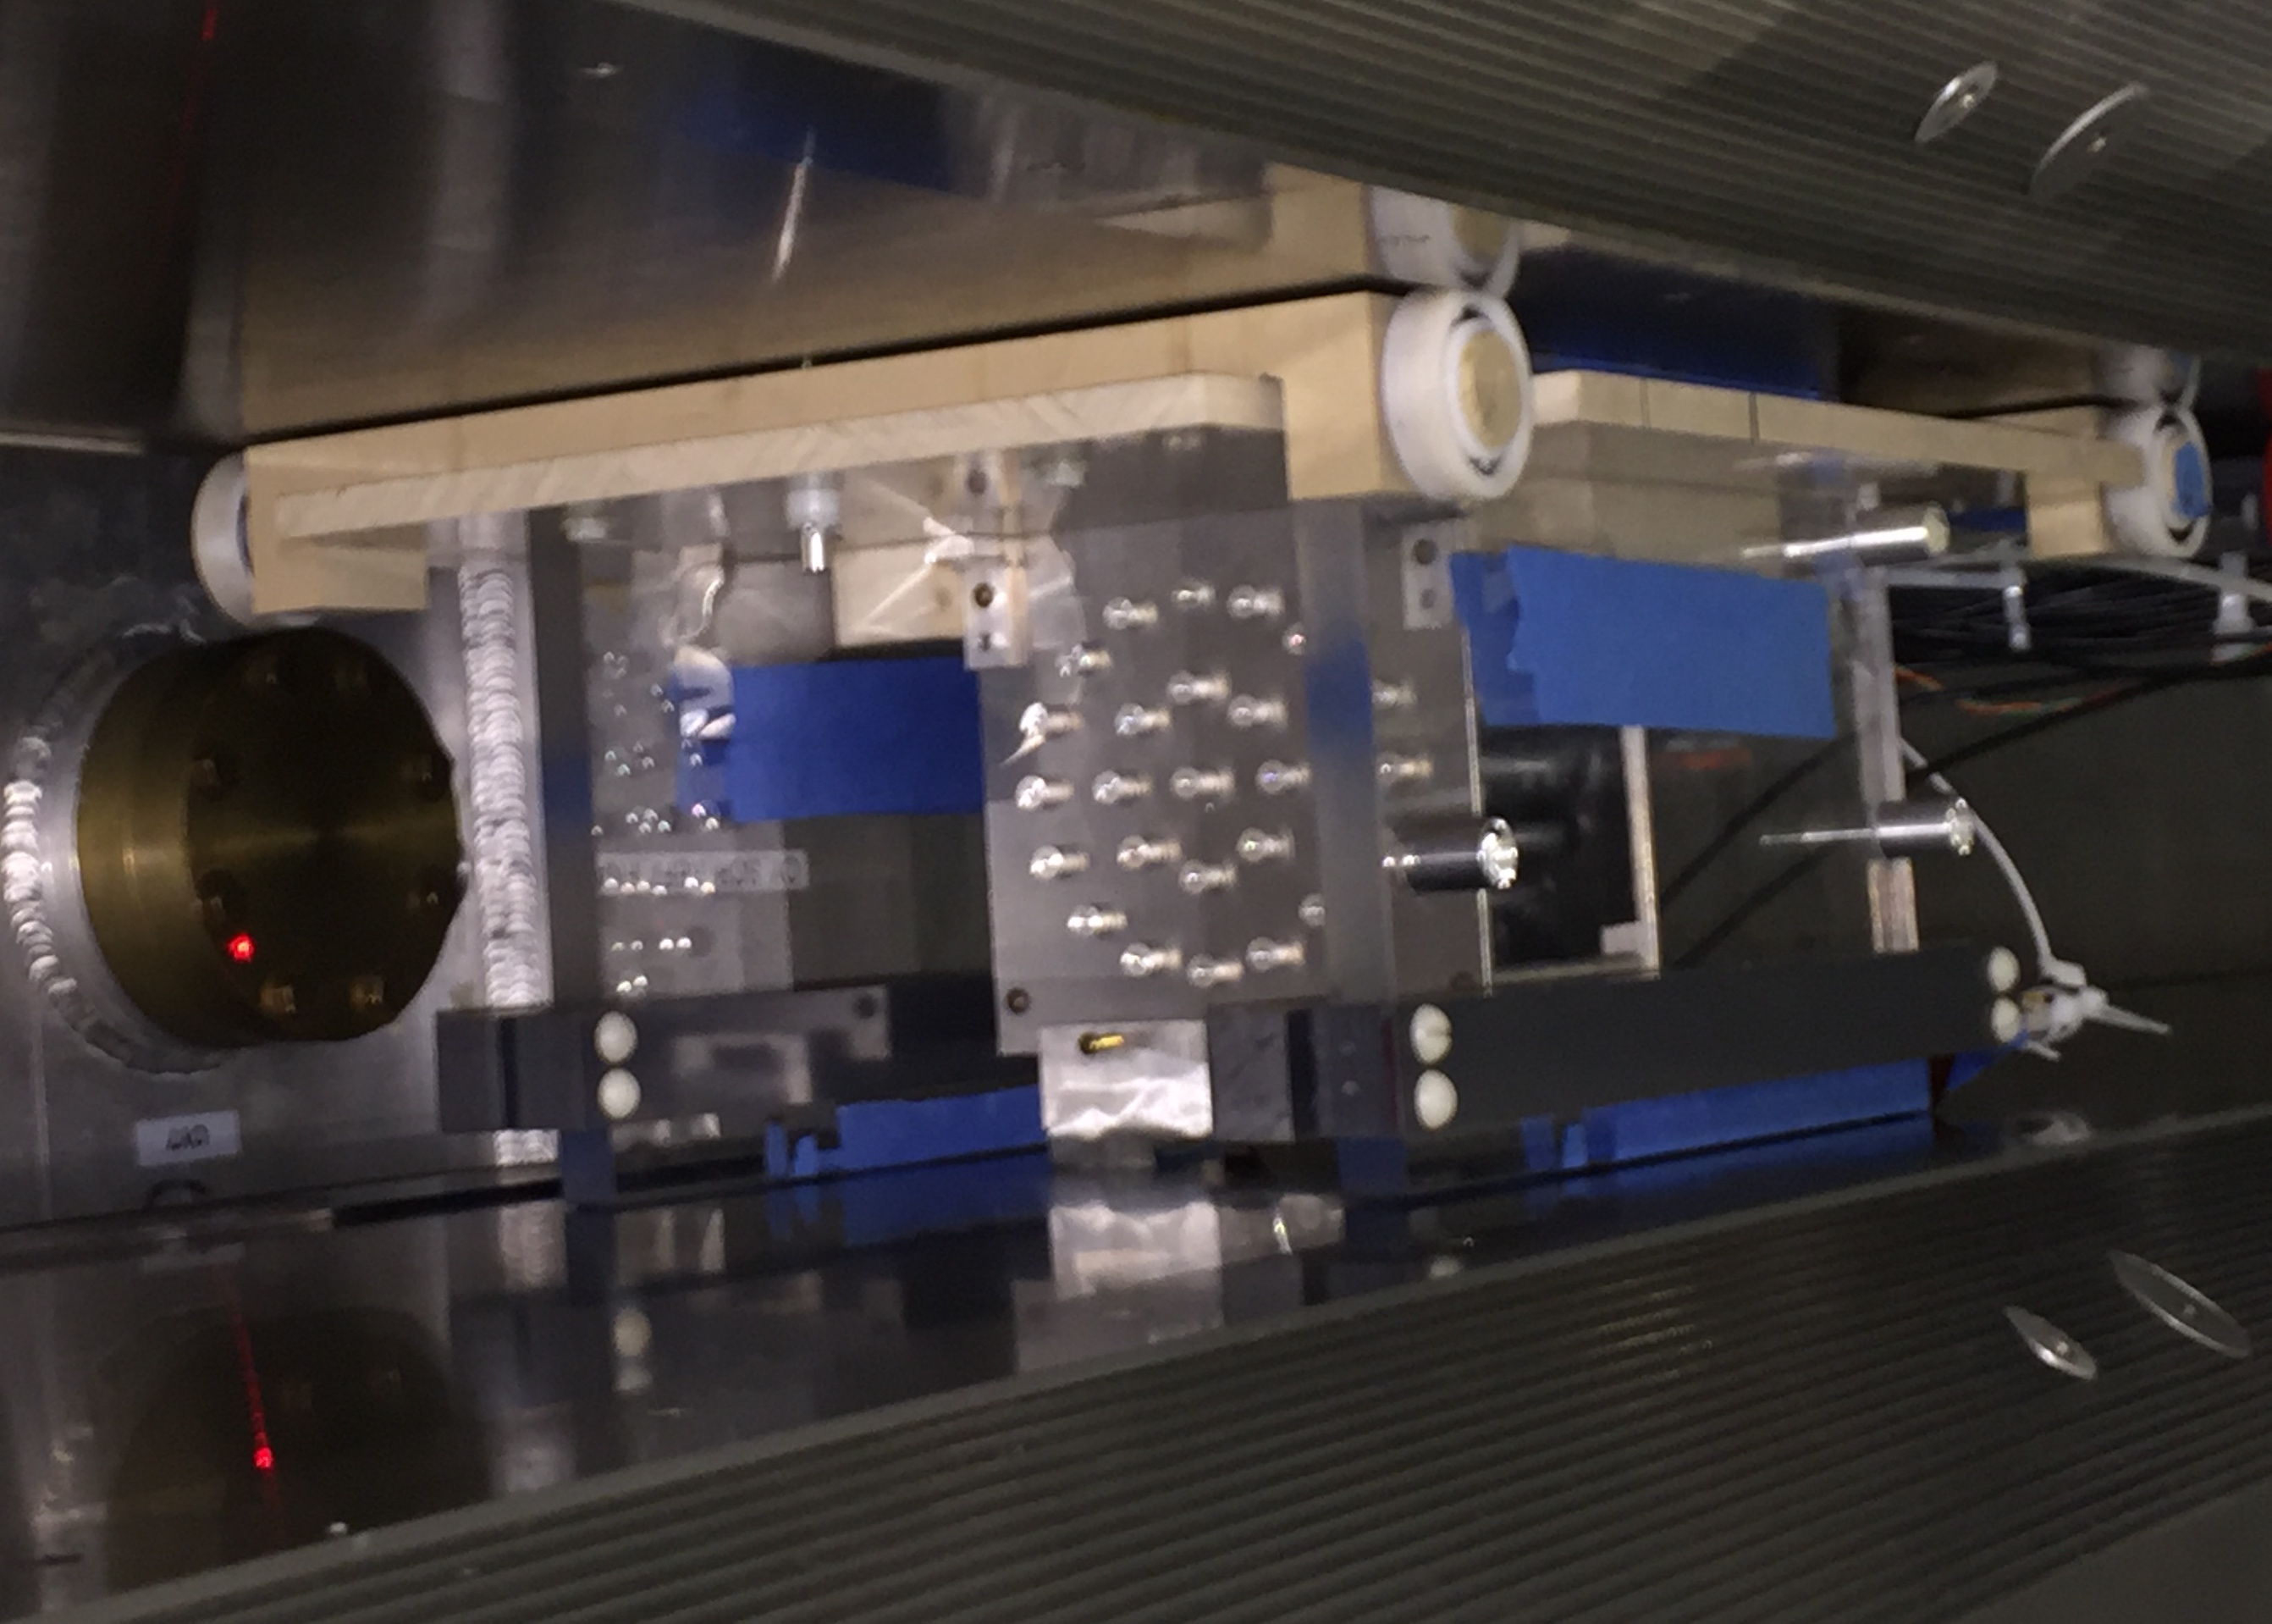
ω_{p} Initial course shiming of the magnet
Use a special trolley
Beating gradients

Slide 18
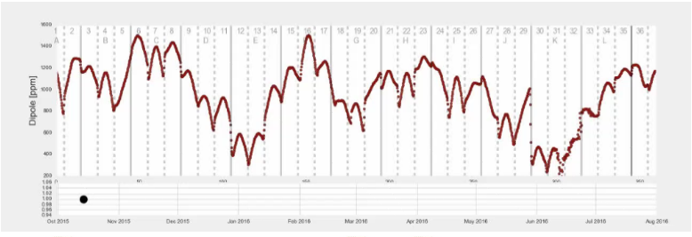
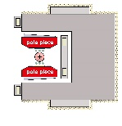
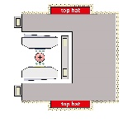
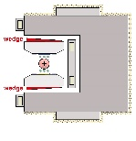
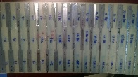
The precision field emerges
Initial dipole field map October 14, 2015 peak variation 1400 ppm
Evolution of the field map over the shimming period to date shows progress towards goal
Black dot on bottom plot follows timeline
Legend shows shimming phases from pole moves to surface iron foils
+

Slide 19
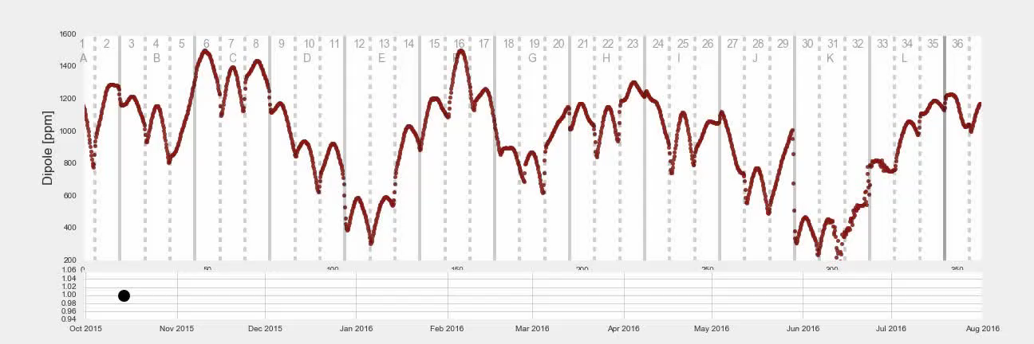
The precision field emerges
Initial dipole field map October 14, 2015 peak variation 1400 ppm
Evolution of the field map over the shimming period to date shows progress towards goal
Black dot on bottom plot follows timeline
Legend shows shimming phases from pole moves to surface iron foils
+

Slide 20
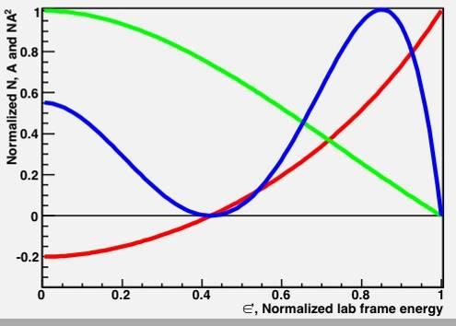
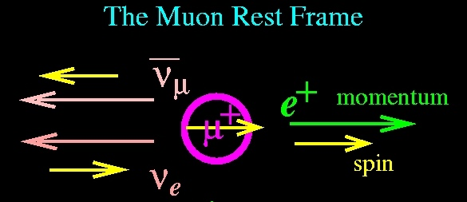
ω_{a}
Birth
after 2.2μs Death
Polarized muons born from pion decay
The highest energy positrons are correlated with the muon spin.
As the spin rotates forward and backward the number of e⁺ is modulated by ω_{a}
NA²
N
A
<A>=0.4

Slide 21
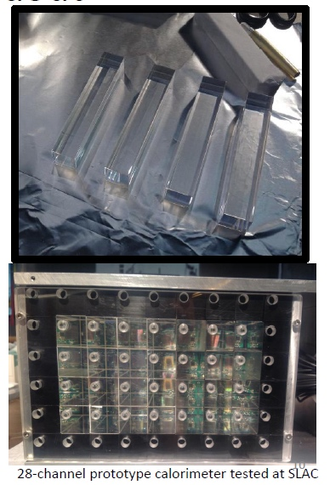
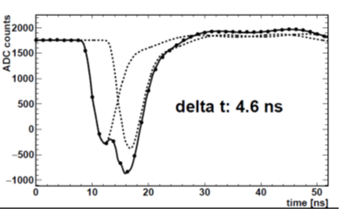
ω_{a} at Fermilab
24 new segmented PbF detectors 6 × 9 array
  measure E and t.
Custom 800 MHz waveform digitizers
Single pulse:
~5 ns fwhm
~25 ps timing
~20 – 6000 MeV range
Template fitting
Intrinsic 2-pulse resolution <5 ns
Fitting automatic

Slide 22
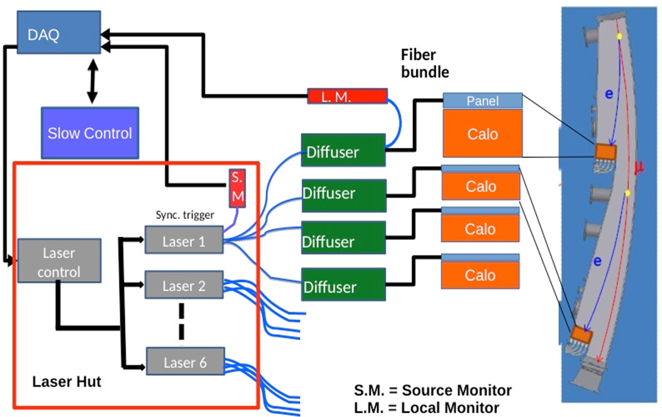
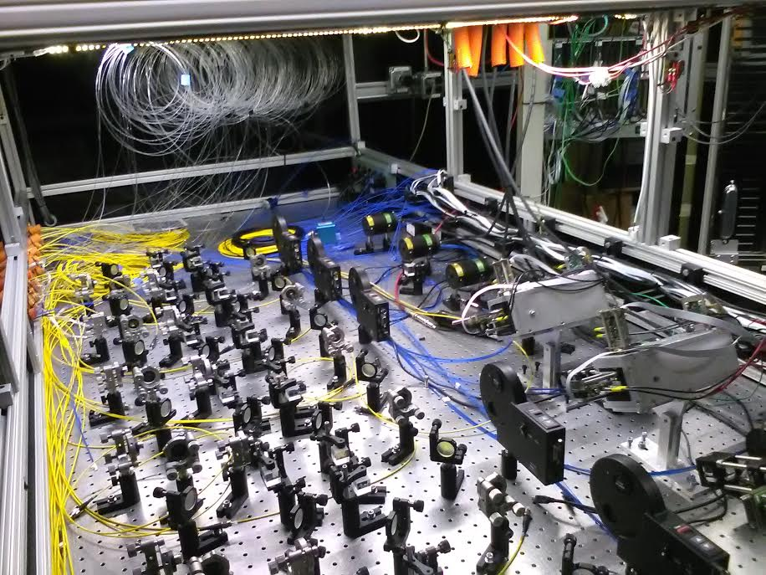
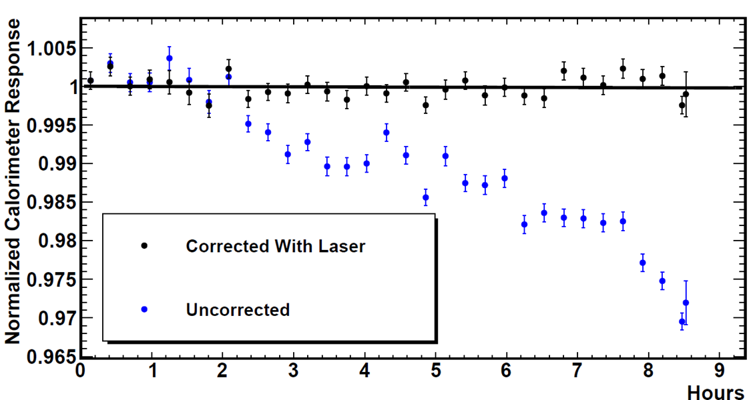
And for GAIN stability to ~few x 10⁻⁴
Our state-of-the-art Laser-based calibration system with demonstrated success
Inside the laser hut
10⁻⁴ / h demonstrated
Source, splitting, and filter wheel
- p. 22

Slide 23
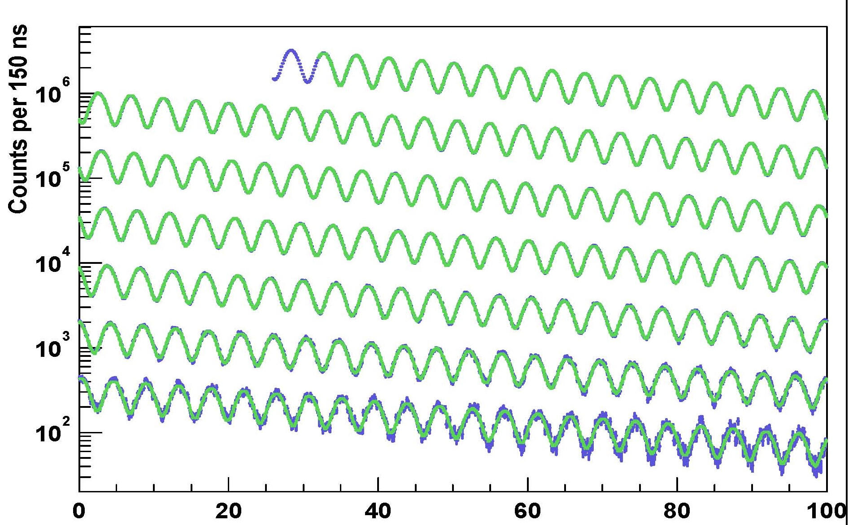
E821 arrival-time spectrum
γτ
0 – 100 μs
100 – 200 μs
200 – 300 μs
300 – 400 μs
400 – 500 μs
500 – 600 μs
600 – 700 μs
Time modulo 100 μs

Slide 24
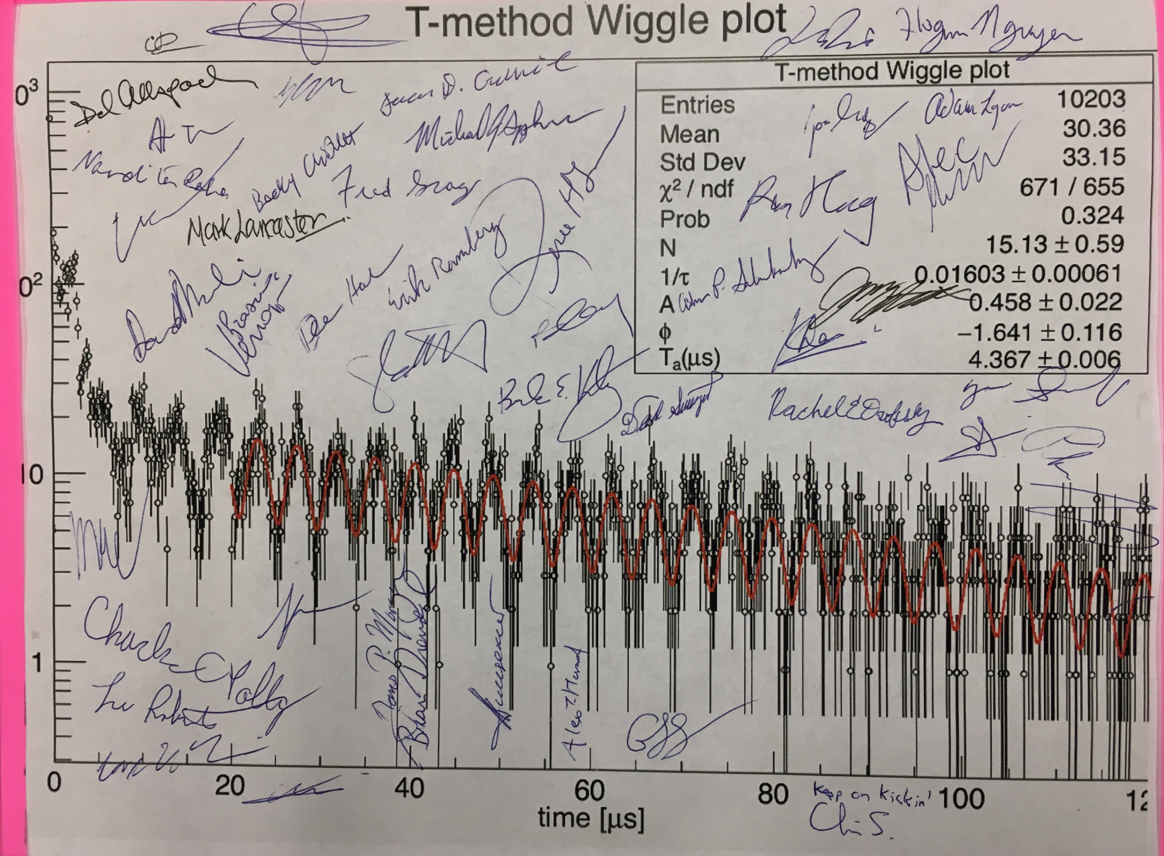
First observation of muon spin precession!
From an unseparated beam of p, π⁺ and μ⁺ (11 June 2017)

Slide 25
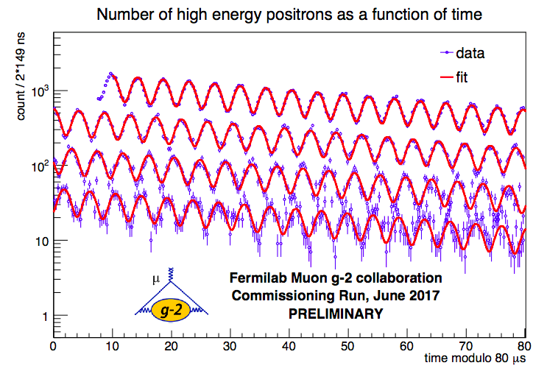
June 2017 ~ 700,000 positrons (~2 weeks)

Slide 26
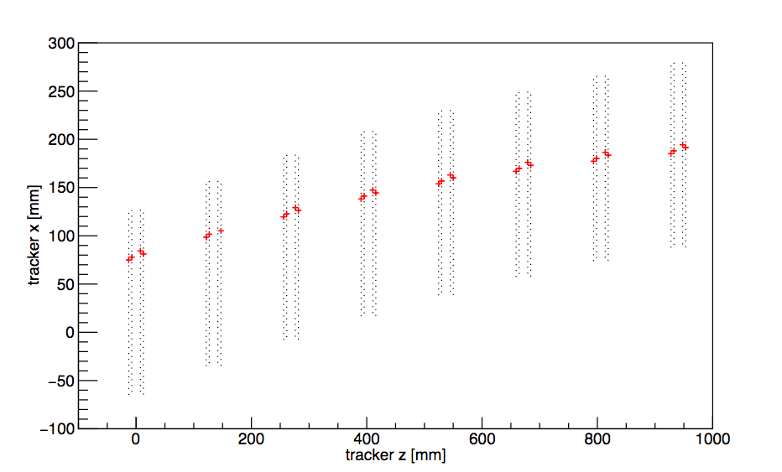
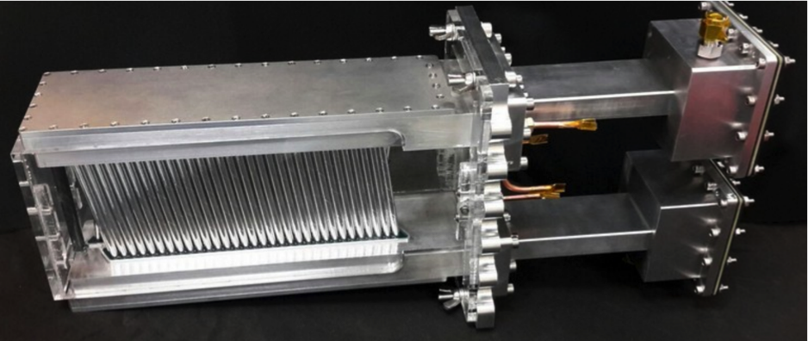
3 Tracking stations
calorimeter
One of the first tracks
Trackers are useful to:
  determine the muon distribution ρ (x,y)
  study pileup in the calorimeters
  determine the “electric field correction” from , since not all muons are at the magic γ .
  determine the “pitch” correction from , since the vertical betatron motion changes the measured frequency.

Slide 27
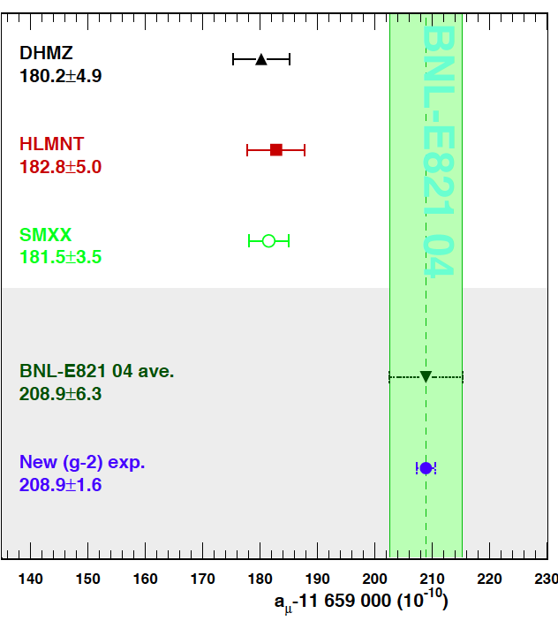
Where will we be when E989 is finished?
Snowmass White Paper:
Blum et al, arXiv:1311.2198v1 [hep-ph] 9 Nov 2013
Assume:
  SM improves
  Exp. reaches 1.6 × 10⁻¹⁰
Davier17
KNT17
2013
New data and dispersive evaluations
Error goals for HLO essentially reached.
Lattice is becoming competitive
New g - 2 theory initiative began as an international collaboration with a meeting at Fermilab in June! (Aida El-Khadra’s talk)

Slide 28
Fermilab Timescale
This Year:
  We are in first commissioning now until 7 July
  We will turn back on in November and finish comissioning
  US budget willing, we will then move to production running
Anticipated results: (≃ 1, 5, 25 × BNL data set)
  A BNL level data set should obtained relative quickly.
    We will stop data collection, and re-blind and keep running.
    BNL level result perhaps by late 2018, early 2019.
  The next data set should give us half the BNL error
  The final data set should give us one-fourth the BNL error.

Slide 29
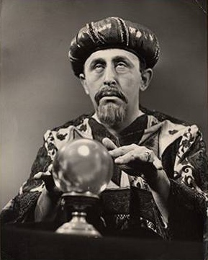
Will a_{μ} be inside or outside of the SM?
?

Slide 30
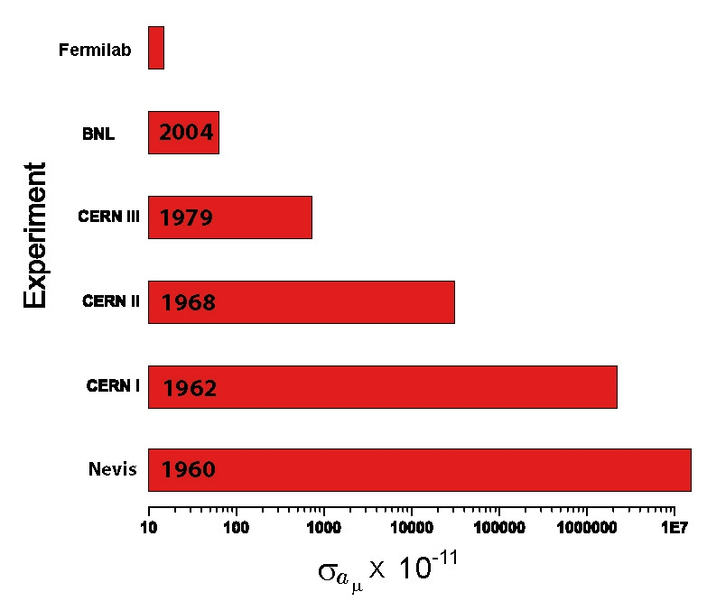
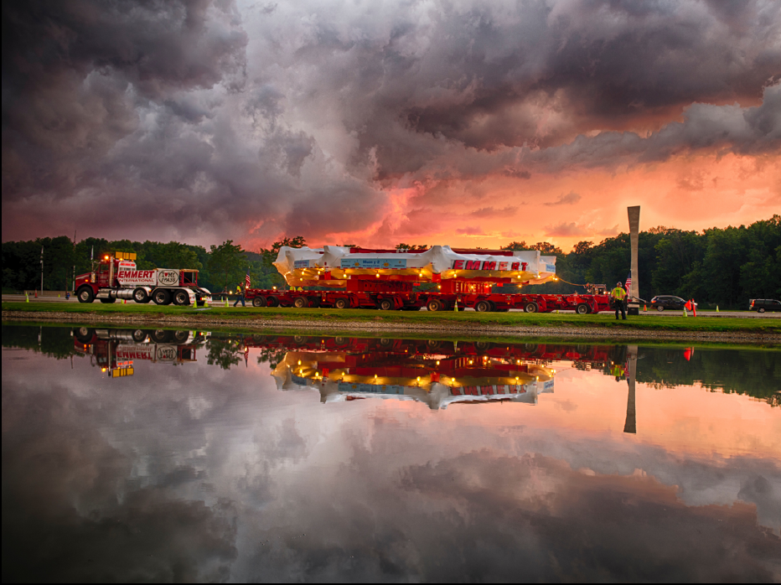
g = 2( … + C₃(α/π)³ + C₄(α/π)⁴+ Had + Weak + ? )
g = 2( … + C₃(α/π)³ + Had)
g = 2( … + C₃(α/π)³ + Had)
g = 2(1 + α/2π + C₃(α/π)³ )
g = 2(1 + α/2π)

Slide 31
Extra Slides

Slide 32
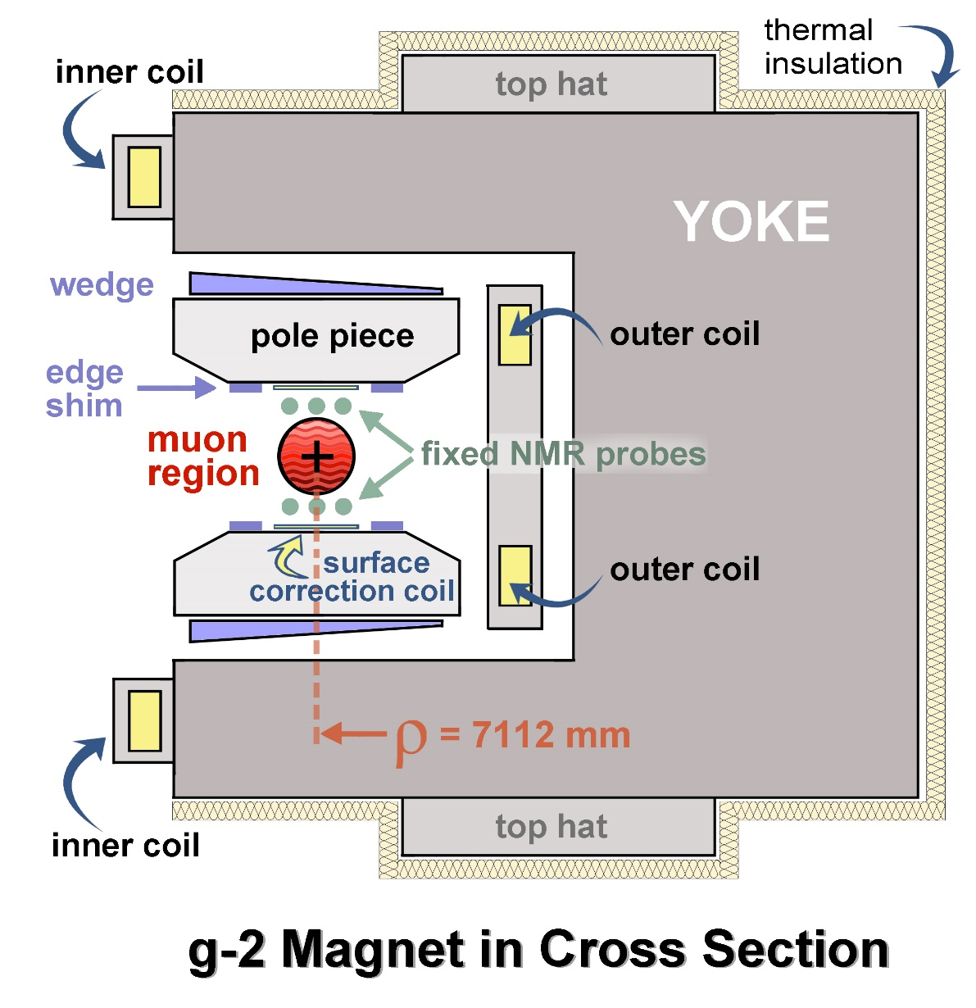
Anatomy of the Magnet
B Field 1.45T ~5200 Amps non-persistent current
12 Yokes: C shaped flux returns
72 Poles: shape field
Pole/yoke gaps improve field homogeneity
Wedges: angle - quadrupole (QP) asymmetry, change effective mu (10^{O})
Iron Top Hats: change effective mu (30^{O})
Edge Shims: QP, sextapole (SP) asymmetry (360^{O})
Surface iron foils: change effective mu locally (1^{O})
Surface coils: add average field moments (360^{O})

Slide 33
ω_{p} Absolute Calibration
Normalize to the Larmor frequency of the free proton
  Need to find an expression in terms of well measured quantities:
  now
  substituting for B :
  solving for a_{μ}
  now
  so:

Slide 34
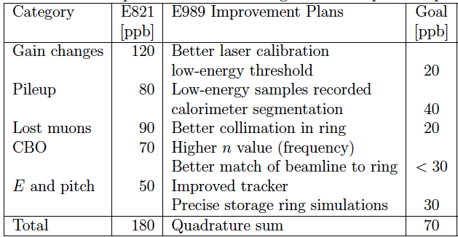
Systematic Errors on ω_{a} (ppb)

Slide 35
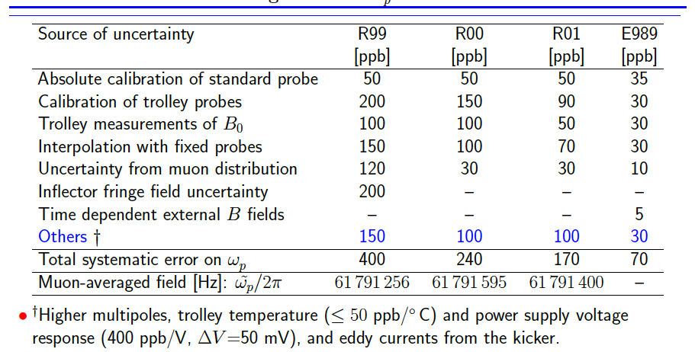
Errors from BNL and projected at Fermilab

Slide 36
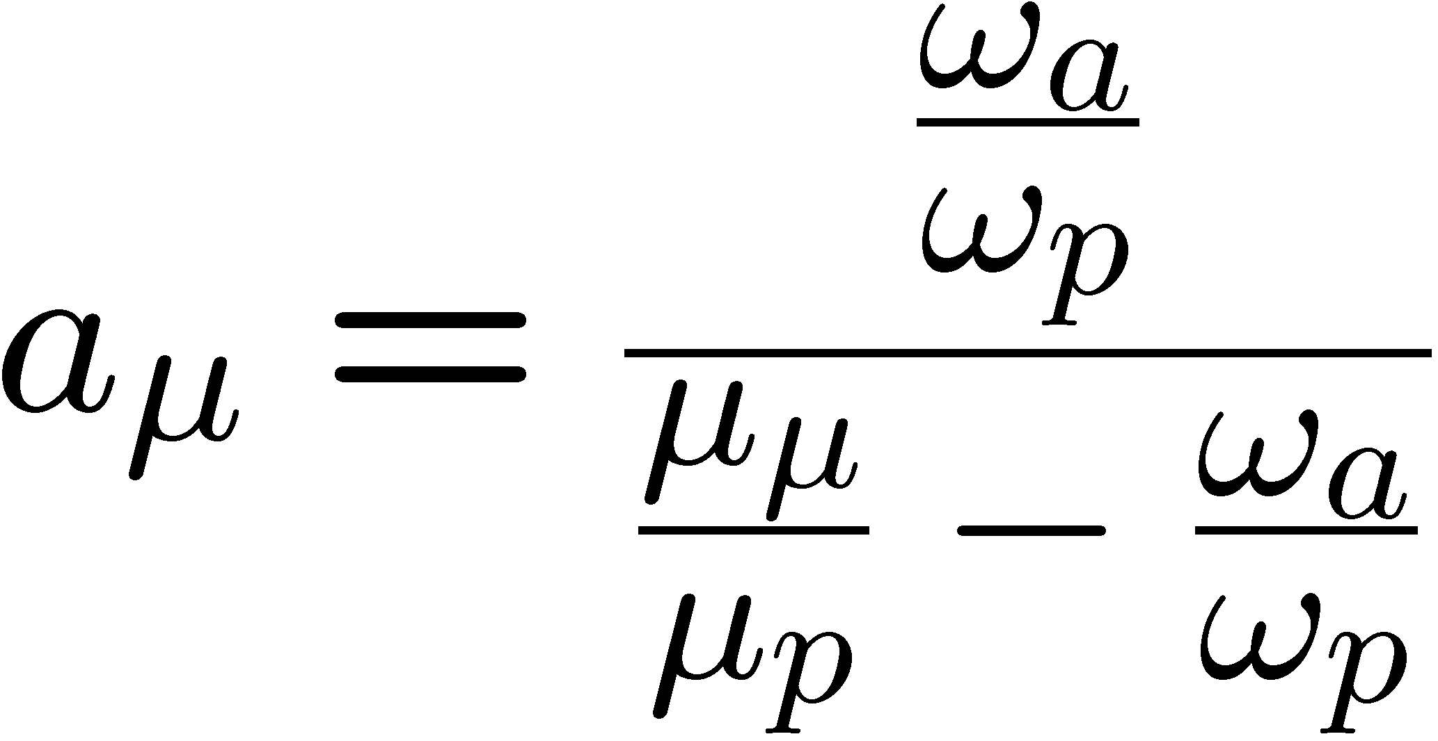
From ω_{a} and ω_{p} to a_{μ}
Old Formula:

Slide 37
Precision Experiments dominated by systematic uncertainties!
At BNL the systematic errors were:
At Fermilab projected systematic errors are:

Slide 38
In 2004 Fermilab hosted a proton driver workshop
We had a muon working group, where the usual cast of characters appeared. John Ellis was our theory leader
We quickly realized that the Fermilab complex could provide the perfect beam to a new g-2 experiment, but only if the Tevatron was not operational.
I think the physics conclusions that the muon group presented are certainly interesting and relevant now, and show why the Standard-Model value is so very important.

Slide 39
The Physics Case:
Scenario 1
  LHC finds SUSY
All three will have SUSY enhancements
  to understand the nature of the SUSY space we need to get all the information possible to understand the nature of this new theory
B. Lee Roberts for the μ working group: Proton Driver Workshop, FNAL - 9 October 2004

Slide 40
The Physics Case
Scenario 2
  LHC finds Standard Model Higgs at a reasonable mass, nothing else, (g-2) discrepancy could be the only indication beyond neutrino mass of New Physics
Then precision measurements come to the forefront, since they are sensitive to heavier virtual physics.
  μ-e conversion is especially sensitive to other new physics besides SUSY
B. Lee Roberts for the μ working group: Proton Driver Workshop, FNAL - 9 October 2004

