Slide 1



New results on the Be-8 anomaly
A.J. Krasznahorkay
Inst. for Nucl. Res., Hung. Acad. of Sci. (MTA-Atomki)

Slide 2
Phys. Rev. Lett. 117, 071803

Slide 3
Leitmotif of my present talk:
The atomic nucleus is a femto-laboratory including probably all of the interactions in Nature. A real discovery machine like LHC, but at low energy.
In an age of giant accelerators, of complex experiments, it is a pleasure to report on some simple experiments, made with simple equipment and having a simple interpretation

Slide 4
Dark Photon
Feynman graphs depicting interactions via a hypothetical Dark Photon γ’, kinetic mixing model.
Down: Interaction between the Standard Model sector and the Dark Sector via a Dark Photon. The loop denotes a pair of charged leptons, which couple both to the Standard Model photon as well as the Dark Photon.

Slide 5
Dark photons and the g-2 anomaly
Branching ratio
Lifetime

Slide 6
Experiments all over the world. Their Idea is: wherever there is a photon there is a dark photon...

Slide 7
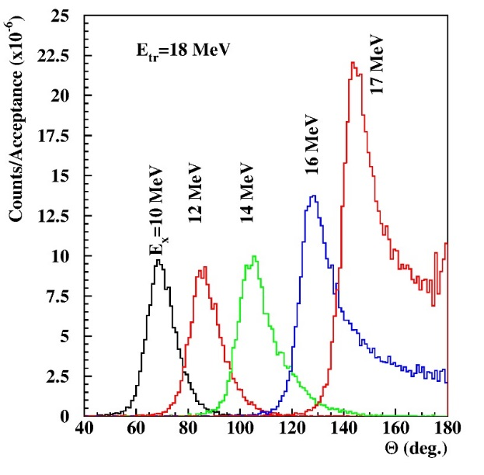
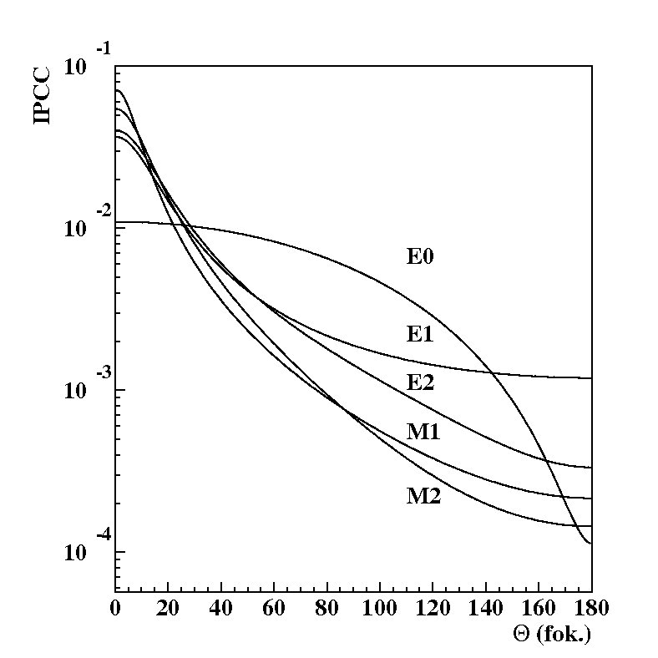
Study the ⁸Be M1 transitions
Excitation with the
⁷Li(p,γ)⁸Be reaction
18.2
1⁺
Ep= 1030 keV
Signature Background
17.6
1⁺
Ep= 441 keV
3.0
2⁺
0
0⁺
⁸Be

Slide 8
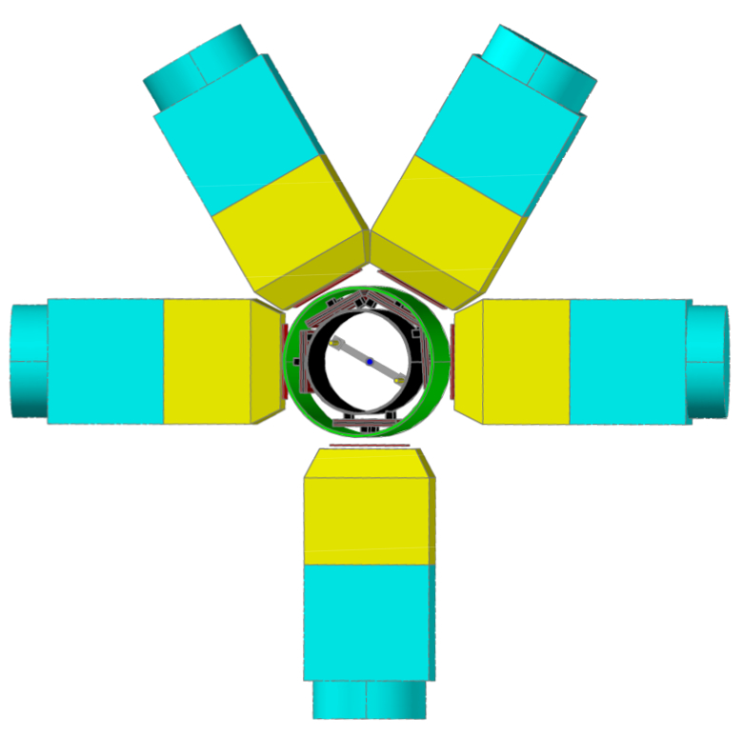
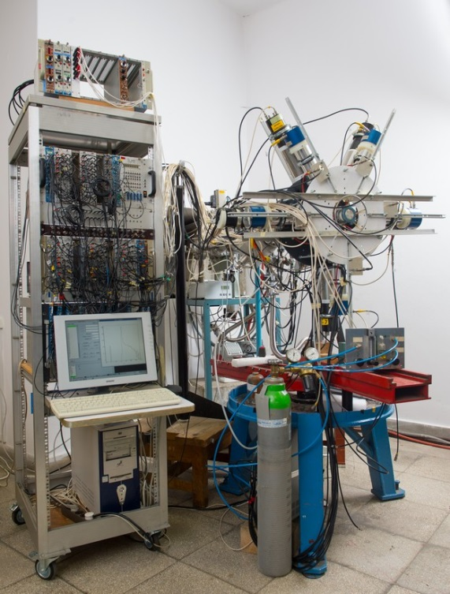
Geometrical arrangement of the scintillator telescopes (NIM, A808 (2016) 21)

Slide 9
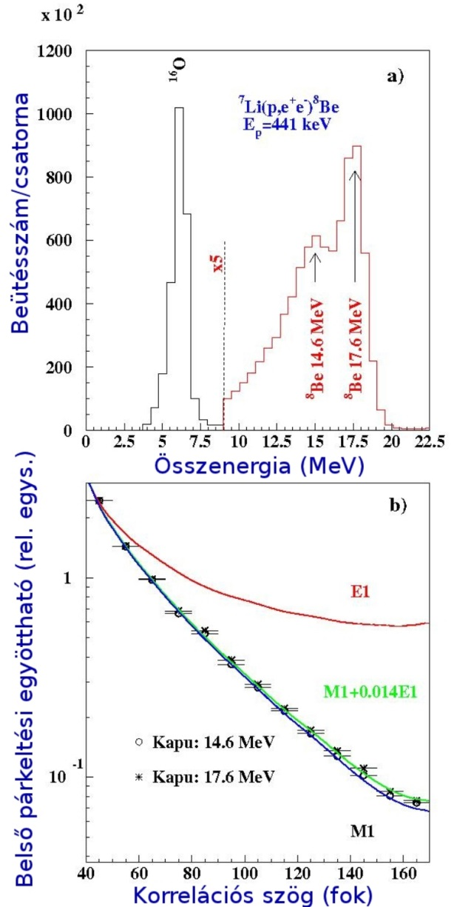
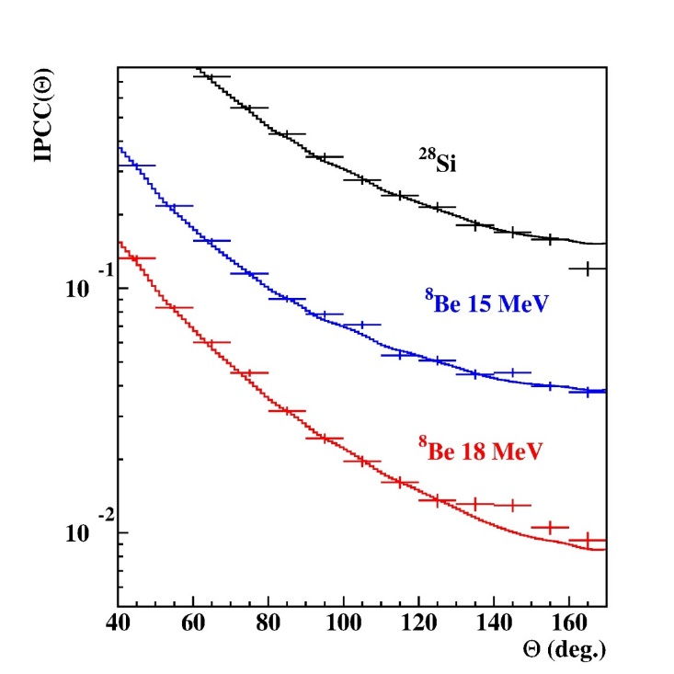
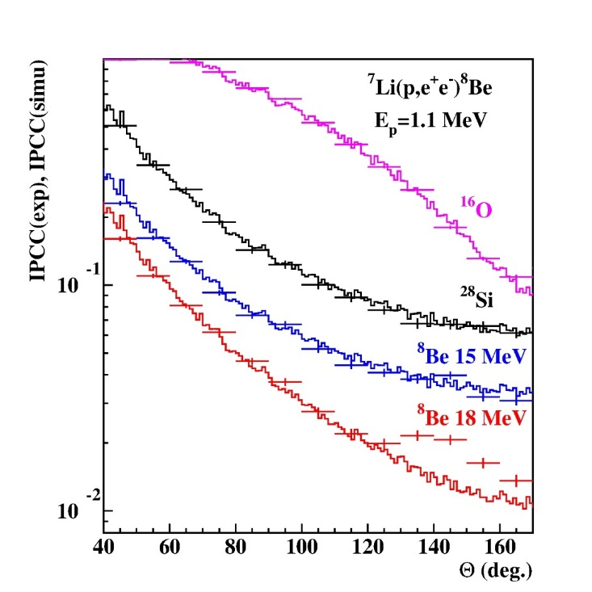
Results e⁺ - e⁻ sum energy spectra and angular correlations
Ep=1.04 MeV Ep=1.10 MeV
Deviation from IPC
Can it be some artificial effect caused by γ-rays?
Can it be some nuclear physics effect?
…

Slide 10
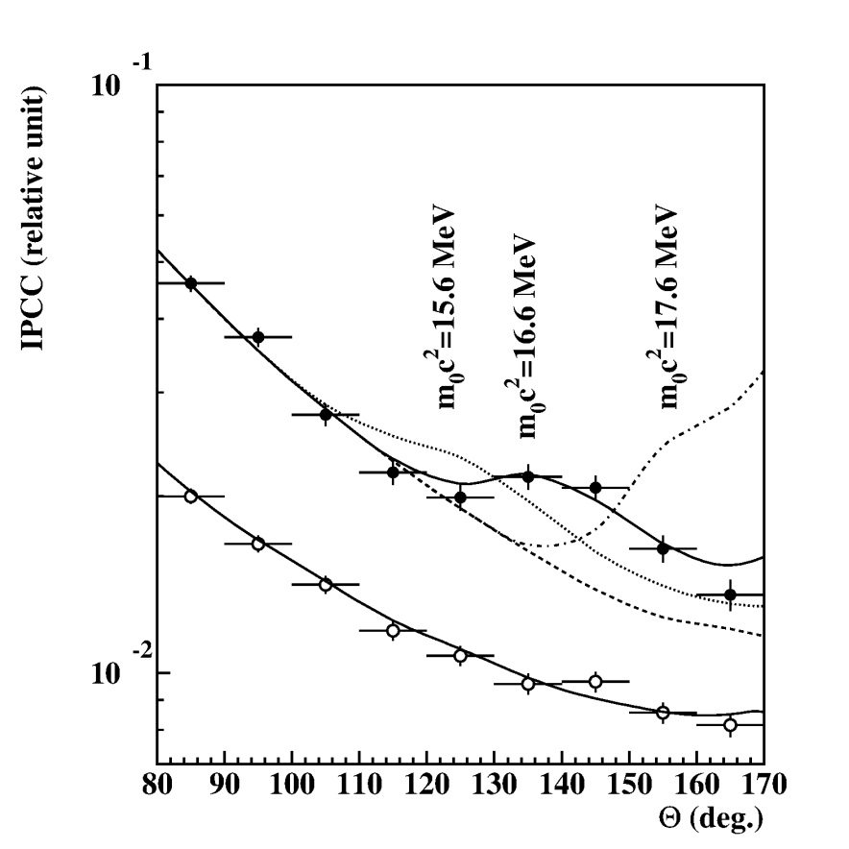
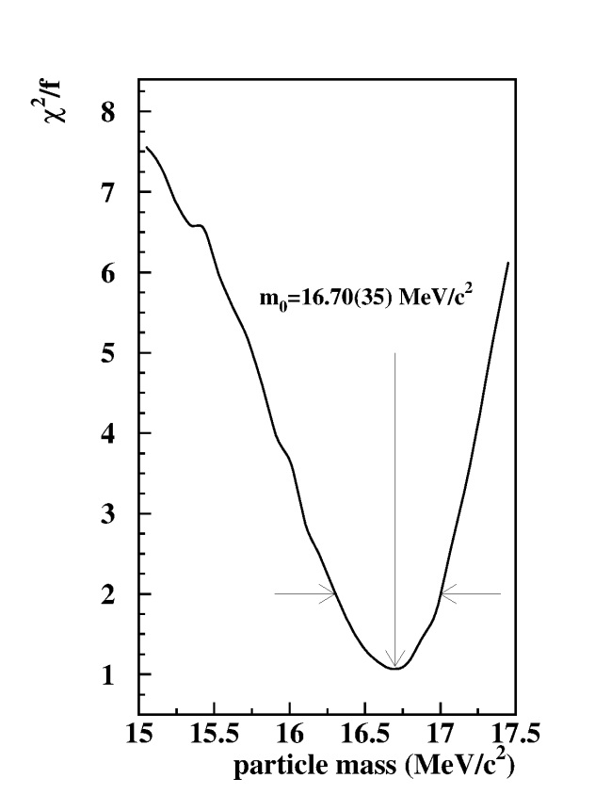
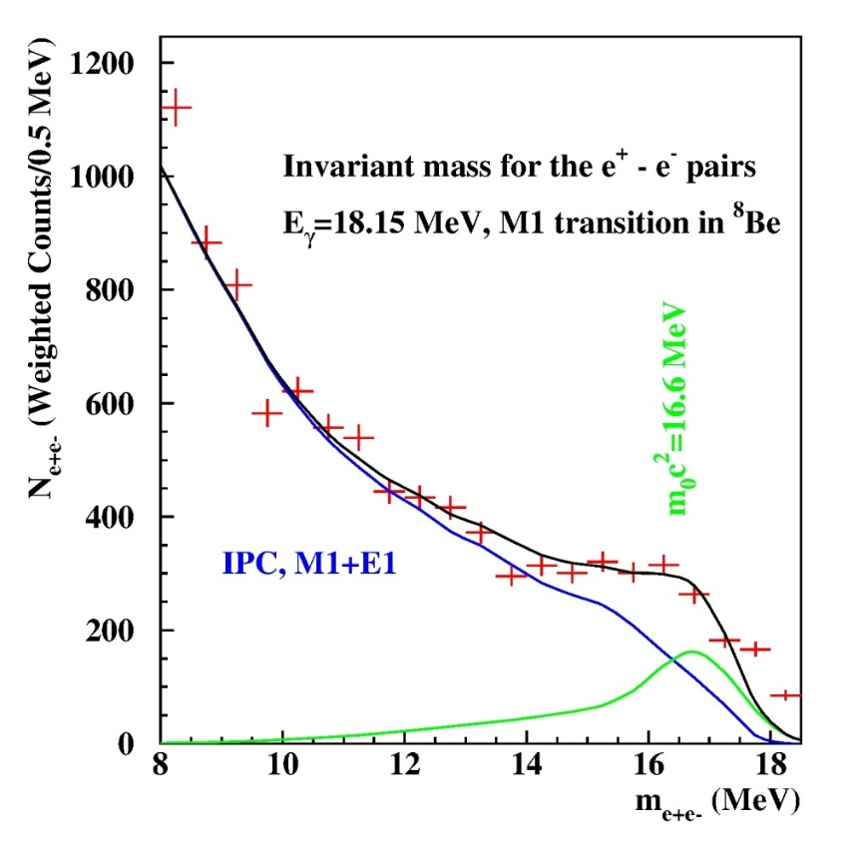
How can we understand the peak like deviation? Fitting the angular correlations
Experimental angular e⁺e⁻ pair correlations measured in the ⁷Li(p,e⁺e⁻) reaction at Ep=1.10 MeV with -0.5< y <0.5 (closed circles) and |y|>0.5 (open circles).
Determination of the mass of the new particle by the Χ²/f method
Invariant mass distribution plot for the electron-positron pairs

Slide 11
Introduction of the protophobic fifth force
(J. Feng et al.PRL 117, 071803, (2016))
Branching ratio:
Pion decay:

Slide 12
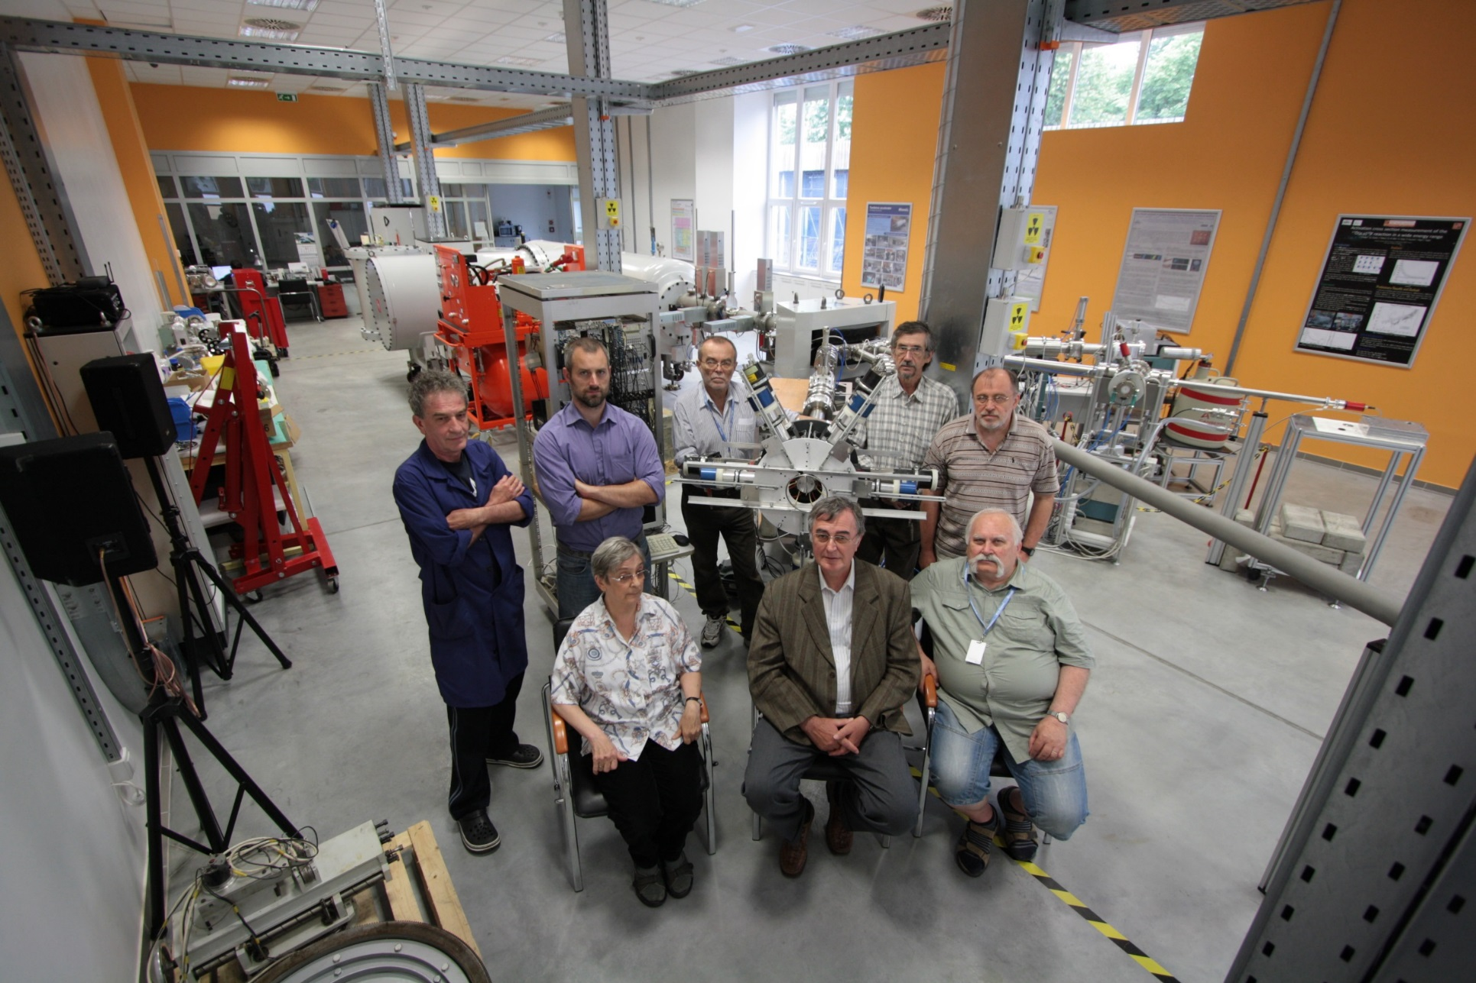
A 2.0 MV Medium-Current Plus Tandetron Accelerator System
Main specifications:
  TV ripple: 25 V_{RMS,} TV stability: 200 V (GVM), 30 V (SLITS)
  Beam current capability at 2 MV: 200 µA proton, 40 µA He

Slide 13
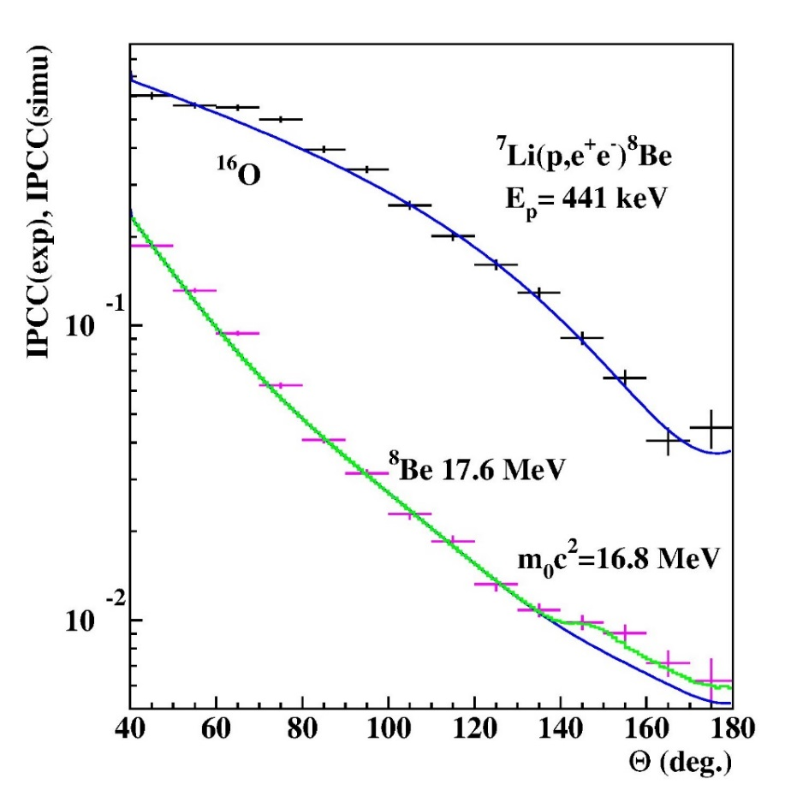
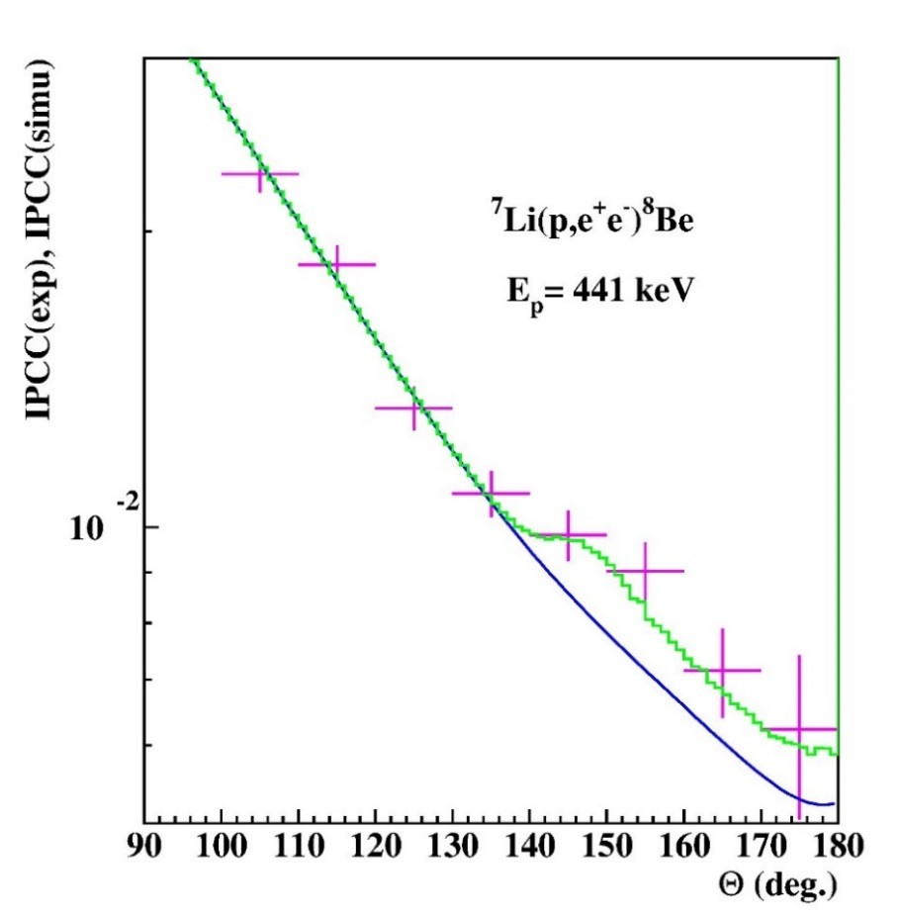
New results for the 17.6 MeV transition
→The prediction of Feng et al., is correct.

Slide 14
Fitting the data with the standard RooFit code

Slide 16
Thank you very much for your attention

