Slide 1

Signals for dynamical process from IMF-IMF correlation function
E.V. Pagano^{1,} for NEWCHIM COLLABORATION
¹INFN- Laboratori Nazionali del Sud

Slide 2
Bormio, Italy
27 Jan, 2017
E. V. Pagano
LNS-INFN
Space-Time characterization
of the emitting system
Correlation functions
Nuclear Dynamics
Theoretical Models
EOS of Nuclear Matter
Dynamical from Equilibrated
process distinction
Effective in medium n-n interactions σ
In this work we focused on IMF-IMF correlation function in order to characterize the IMF-IMF correlation function using a well studied process in CHIMERA such as the PLF fission in ¹²⁴Sn+⁶⁴Ni @ 35 MeV/A reaction and also in order to extract complementary information in order to elucidate some aspects of the mechanism that are not yet understood.
Some examples
Intermediate mass fragment emission in ³⁶Ar+¹⁹⁷Au collisions at E/A = 35 MeV. Y. D. Kim, et al. PRC45 (1992)
IMF-IMF correlations. O. Schapiro, A.R. DeAngelis, D.H.E. Gross Nuc.Phys. A568 (1994) 333-349
Distinction between multifragmentation mechanism from IMF-IMF correlation function. Subrata Pal Nuc.Phys A594 (1995) 157-174
Using CHIMERA detector
Isoscaling in central ¹²⁴Sn+⁶⁴Ni, ¹¹²Sn+⁵⁸Ni collisions at 35 AMeV E. Geraci et al. Nuc. Phys. A732 (2004) 173-201
Fragment-Fragment correlation function in the nuclear reaction ¹²⁴Sn+⁶⁴Ni at 35 AMeV with CHIMERA C. Maiolino et al. Proceedings of XLIII Int. Winter Meeting on Nuclear Physics, Bormio- Italy, March (2005)
Notes:
Correlation functions are commonly used in nuclear dynamics to obtain space-time information of the emitting systems. By theoretical models comparisons it is possible to study and to obtain information of EOS of nuclear matter, distinction between dynamical and equilibrated process, effective in medium n-n interactions. In the literature there are different works that study information coming from IMF-IMF correlation functions (mettere qualche referenza).

Slide 3
Bormio, Italy
27 Jan, 2017
E. V. Pagano
LNS-INFN
IMF = 3 ≤ Z ≤ 25
Y.D. Kim et al. Phys. Rev. C45 (1992) 387
The two IMFs coming from PLF velocity region (V_{PLF}≈ 8 cm/ns):
V_{par}≥ 5cm/ns and 25 ≤ Z_{H}+Z_{L} ≤ 50
Other analysis conditions:
60%≤P_{tot}≤110% of the P_{proj} & Z_{tot}≥40
Notes:
In the reference, the authors, shows for the classical approximation to the KOONIN-PRAT formula that with the assumptions that m=2Z, for all IMFs the propagator becomes a functions of the reduced velocity

Slide 4
Bormio, Italy
27 Jan, 2017
E. V. Pagano
LNS-INFN
¹²⁴Sn+⁶⁴Ni Reaction
25
3
5cm/ns

Slide 5
Bormio, Italy
27 Jan, 2017
E. V. Pagano
LNS-INFN
IMF = 3 ≤ Z ≤ 25
Y.D. Kim et al. Phys. Rev. C45 (1992) 387
The two IMFs coming from PLF velocity region:
V_{par}≥ 5cm/ns
Other analysis conditions:
60%≤P_{tot}≤150% of the P_{proj} & Z_{tot}≥40
Z_{azy} = Z_{H}/Z_{L}
I Region Asymmetry 1 ≤Z_{Asy}≤2 most symmetric
II Region Asymmetry 2 <Z_{asy}≤4 mid symmetric
III Region Asymmetry Z_{asy}>4 very asymmetric
Notes:
In the reference, the authors, shows for the classical approximation to the KOONIN-PRAT formula that with the assumptions that m=2Z, for all IMFs the propagator becomes a functions of the reduced velocity

Slide 6
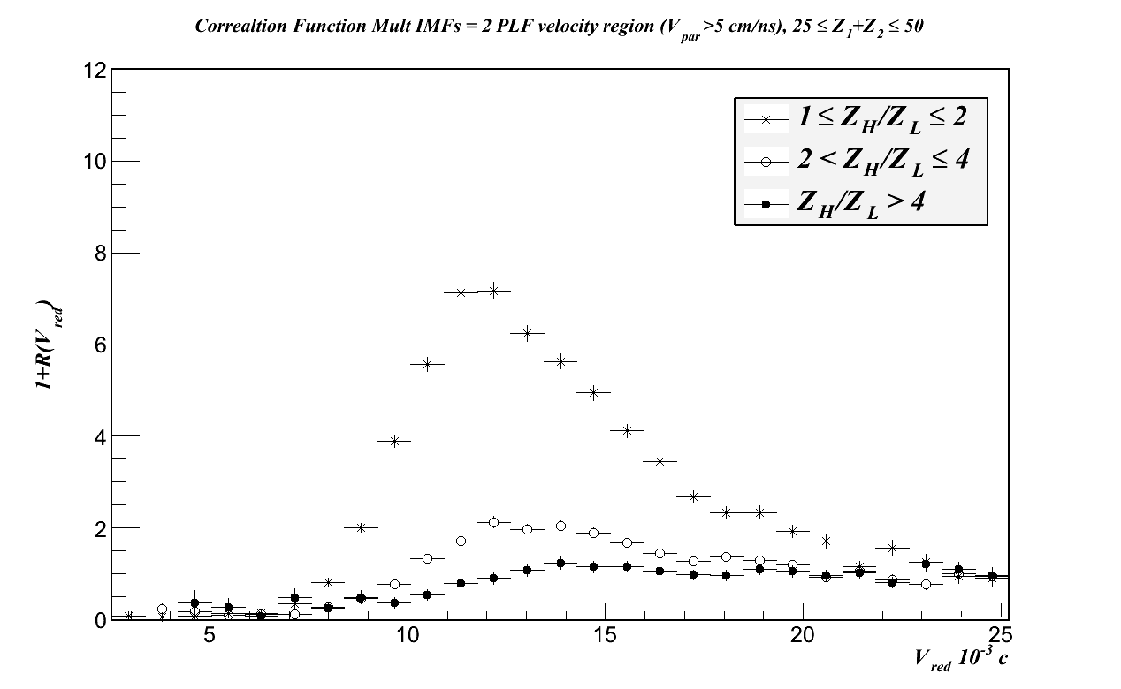
Bormio, Italy
27 Jan, 2017
E. V. Pagano
LNS-INFN

Slide 7
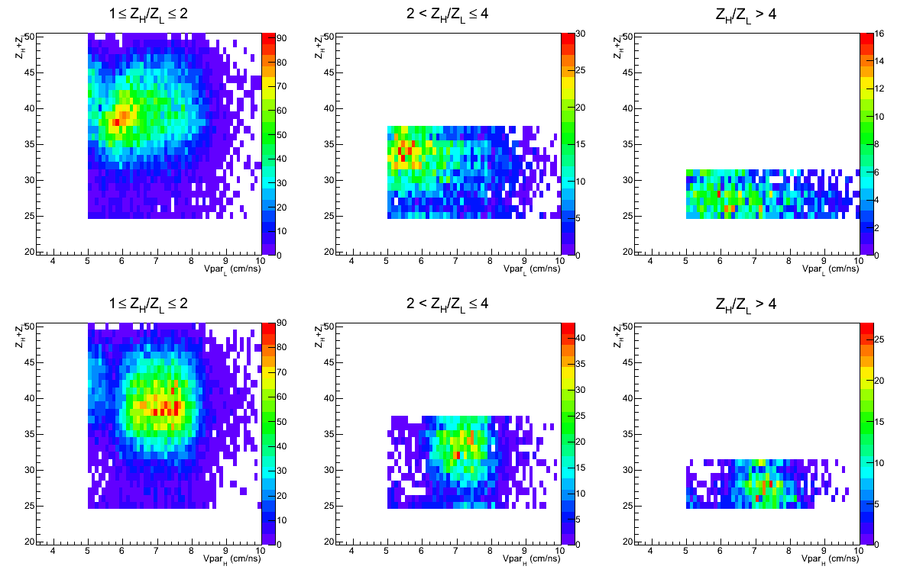
Bormio, Italy
27 Jan, 2017
E. V. Pagano
LNS-INFN

Slide 8
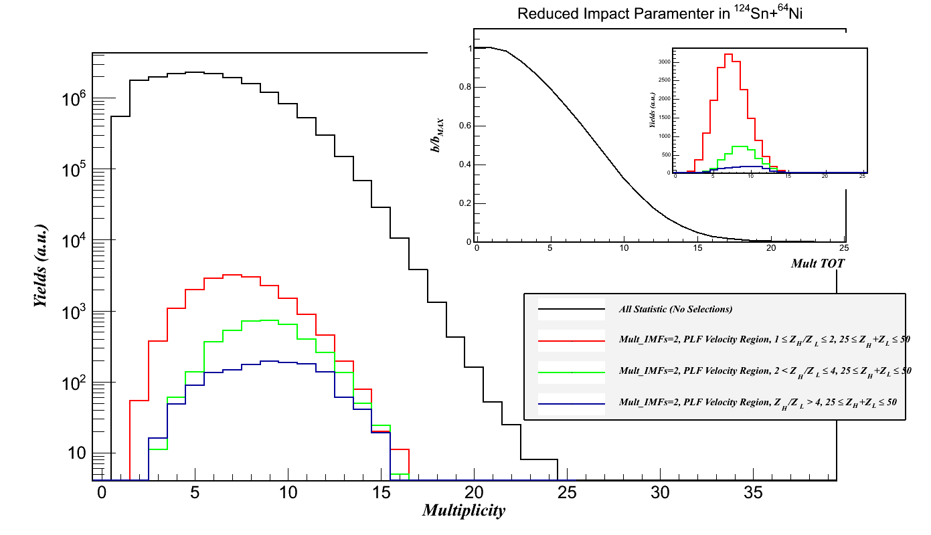
Bormio, Italy
27 Jan, 2017
E. V. Pagano
LNS-INFN
What about the dissipative window and the centrality?
According to the CAVATA method
The estimated impact parameter is:
3 fm < b < 8 fm
b_{max}= 10.8 fm
7
1≤Z_{H}/Z_{L}≤2
2<Z_{H}/Z_{L}≤4
Z_{H}/Z_{L}>4
10

Slide 9
Bormio, Italy
27 Jan, 2017
E. V. Pagano
LNS-INFN
Who is responsible for the changing shape of the correlation functions in the three regions of asymmetry?
Is it the Time scale of the process?
Is it the size of the emitting system?
Both?
25 ≤ Z_{H}+Z_{L} ≤ 50
25 ≤ Z_{H}+Z_{L} ≤ 35
35 ≤ Z_{H}+Z_{L} ≤ 50
Let try to fix the emitting system size

Slide 10
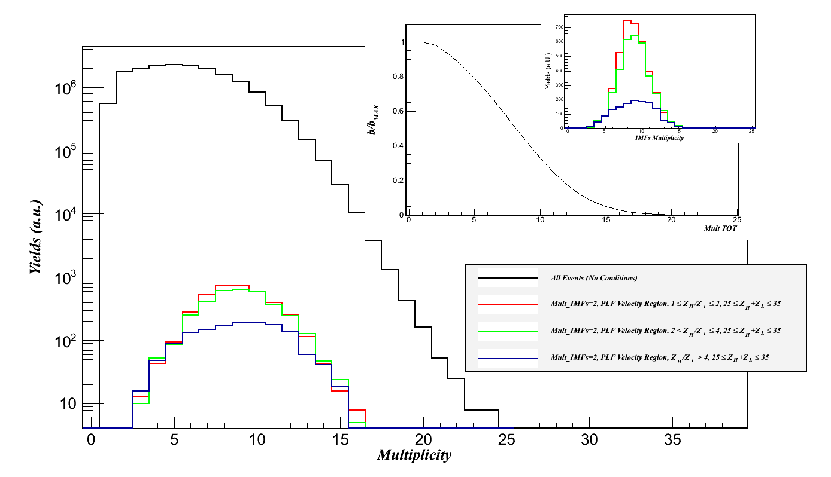
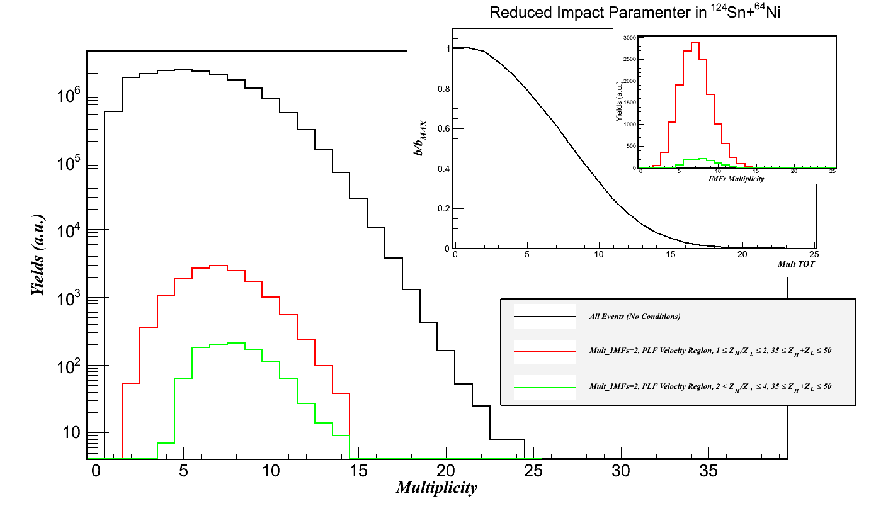
Bormio, Italy
27 Jan, 2017
E. V. Pagano
LNS-INFN
25≤Z_{H}+Z_{L}≤35
35≤Z_{H}+Z_{L}≤50
It is reasonable to say that in each of the two ranges we fix the same dissipative window

Slide 11
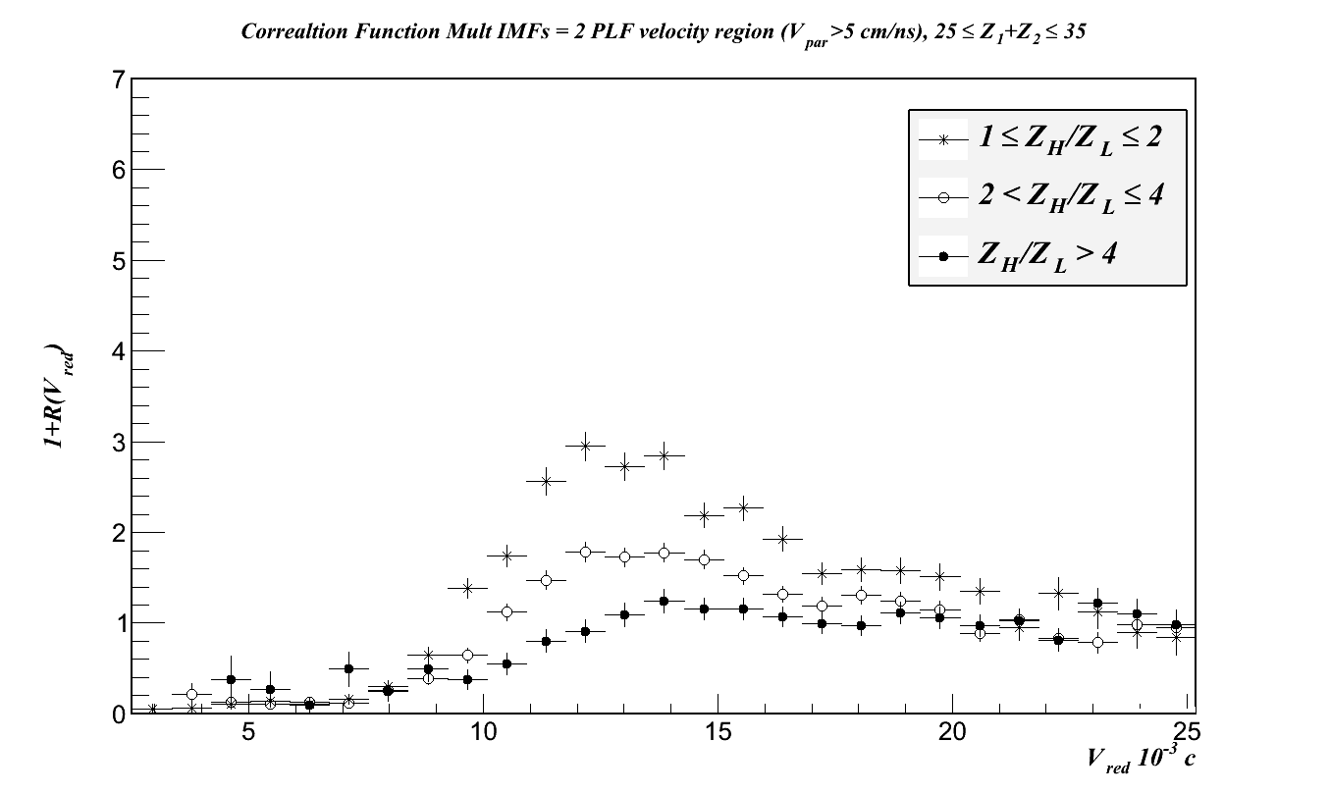
Bormio, Italy
27 Jan, 2017
E. V. Pagano
LNS-INFN

Slide 12
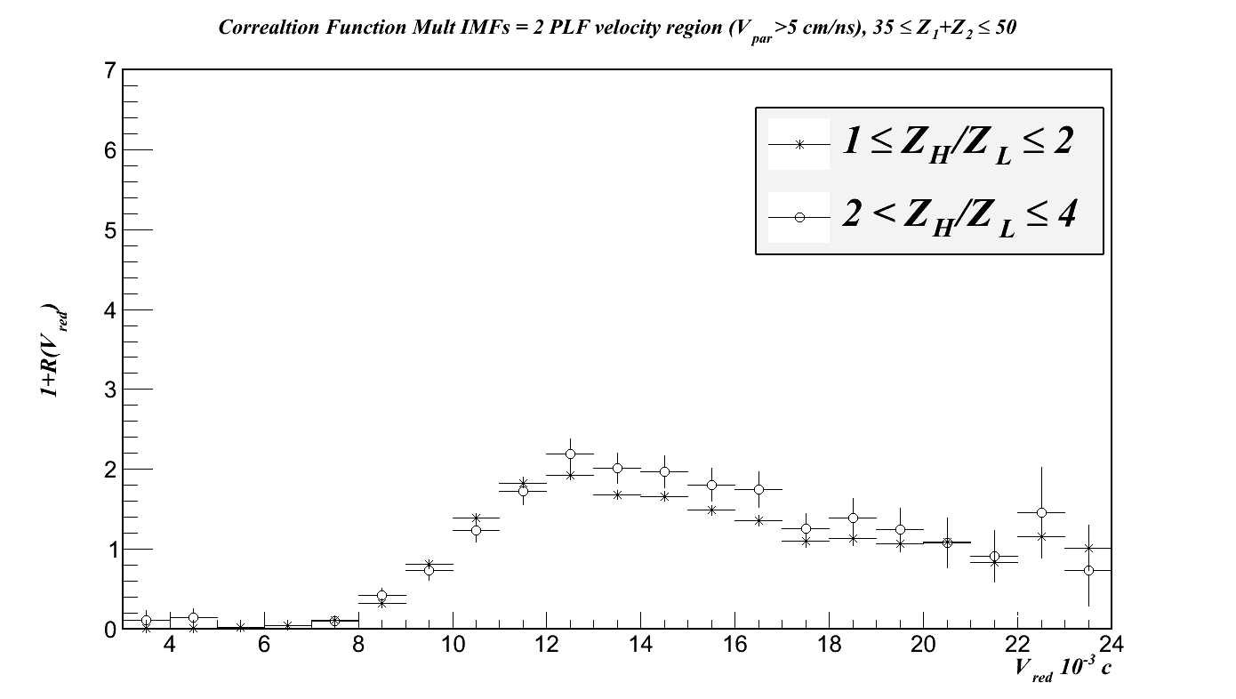
Bormio, Italy
27 Jan, 2017
E. V. Pagano
LNS-INFN

Slide 13
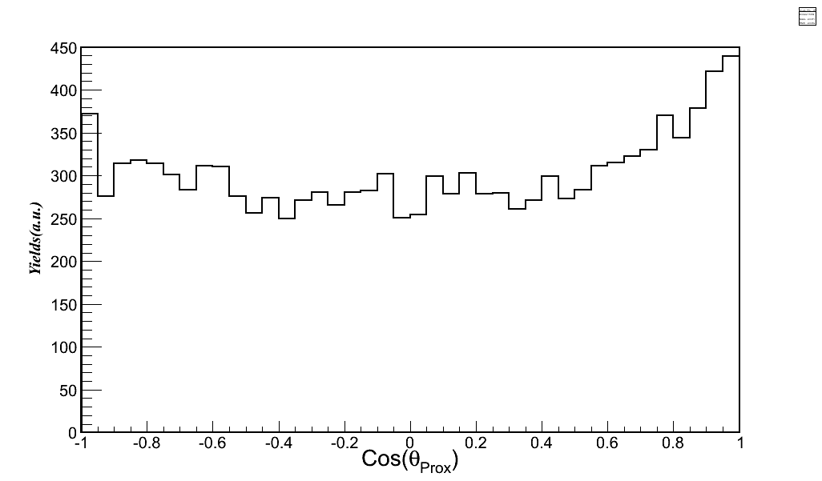
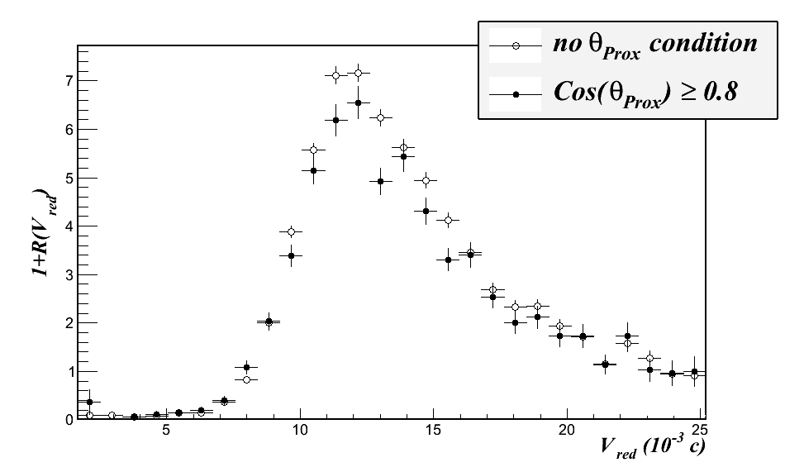
Bormio, Italy
27 Jan, 2017
E. V. Pagano
LNS-INFN
In order to try to disentangle dynamical against more equilibrated process we can use the Theta proximity variable:
25 ≤ Z_{H}+Z_{L}≤ 50
1 ≤ Z_{H}/Z_{L} ≤ 2
25 ≤ Z_{H}+Z_{L}≤ 50
1 ≤ Z_{H}/Z_{L} ≤ 2
PRELIMINARY
It is possible to associate dynamical emission processes for cos(θ_{prox})>0.8
E. De Filippo et al. Phys. Rev. C86 014610 (2012)
Fastest processes

Slide 14
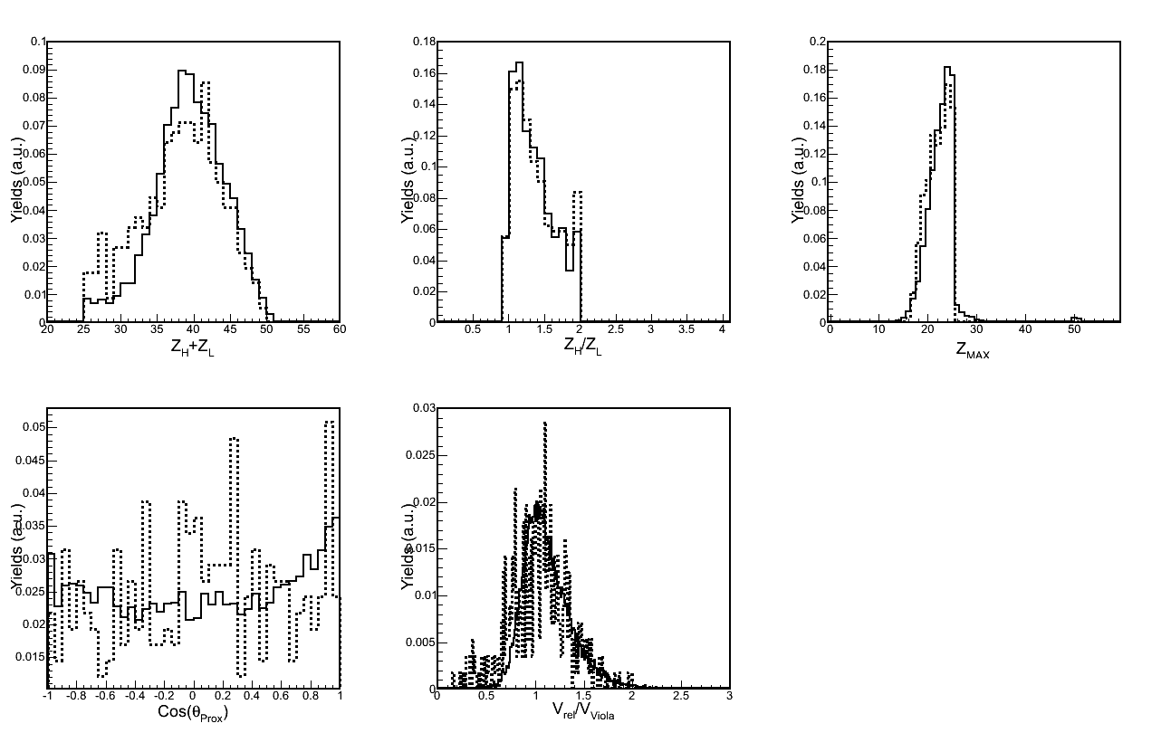
Bormio, Italy
27 Jan, 2017
E. V. Pagano
LNS-INFN
Comparisons with the models
The model that we are comparing is the COMD-II + GEMINI
M. Papa et al. PRC75 054616 (2007) and ref. therein
PRELIMINARY
NOT FILTRED WITH THE DETECTOR

Slide 15
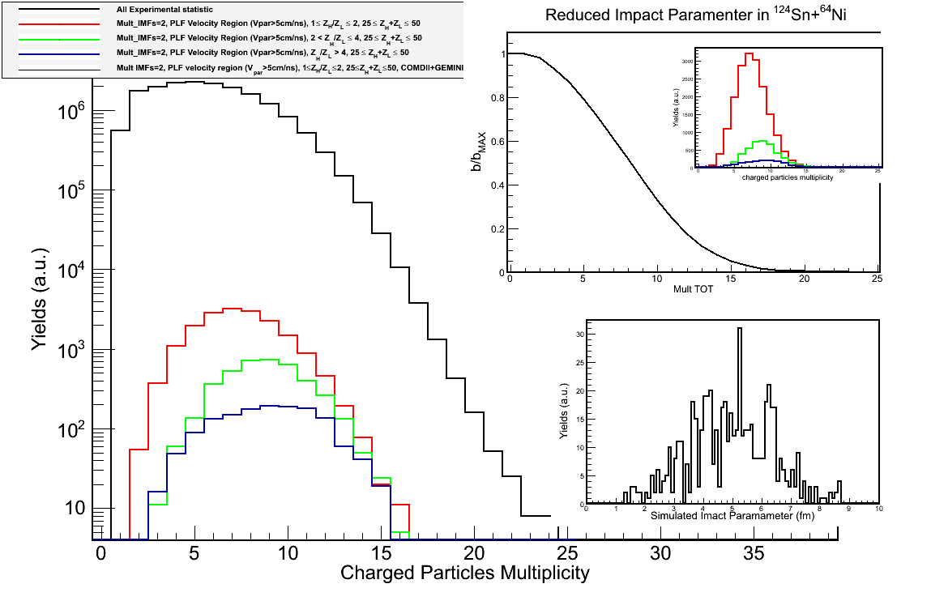
Bormio, Italy
27 Jan, 2017
E. V. Pagano
LNS-INFN
3 fm < b < 8 fm
b_{max}= 10.8 fm

Slide 16
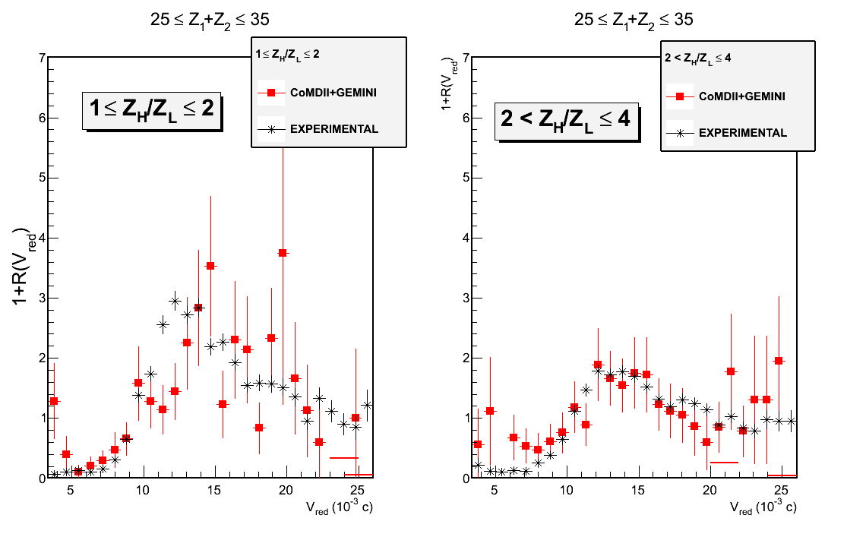
Bormio, Italy
27 Jan, 2017
E. V. Pagano
LNS-INFN

Slide 17
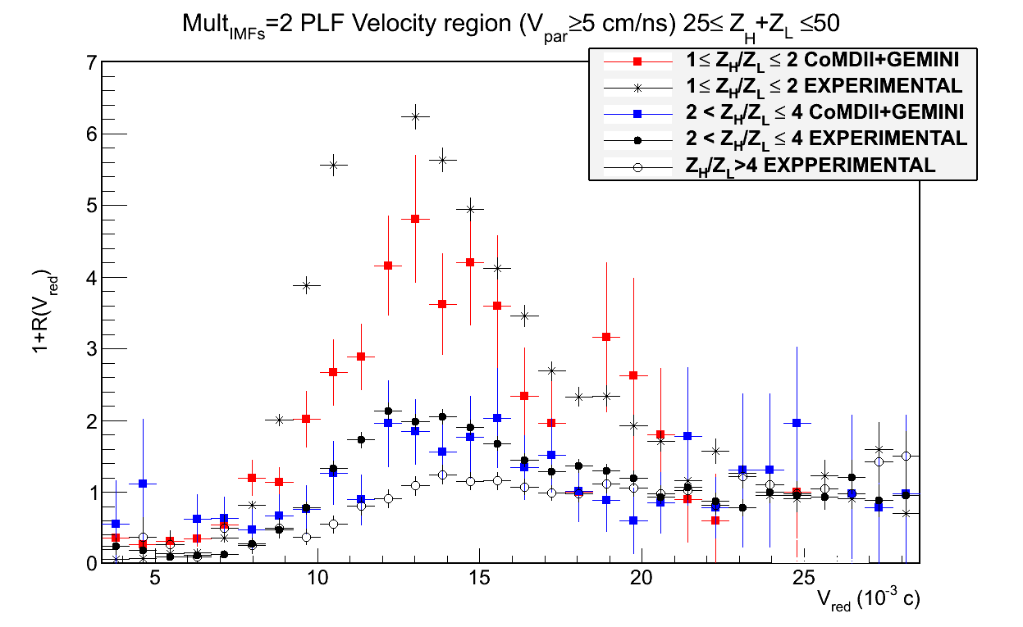
Bormio, Italy
27 Jan, 2017
E. V. Pagano
LNS-INFN
t_{CoMDII}≅650 fm/c
Asy in EOS Stiff
t>t_{CoMDI}
t≤t_{CoMDI}

Slide 18
Bormio, Italy
27 Jan, 2017
E. V. Pagano
LNS-INFN
Conclusions
This work is a preliminary study in order to “calibrate” the IMF-IMF correlation function. We have applied the intensity interferometry method to the already studied binary breakup/fission of the PLF in ¹²⁴Sn + ⁶⁴Ni @ 35 MeV/A. We are able to link the fullshape of the IMF-IMF correlation function with the timescale of the processes. By comparison with the COMDII theoretical model we pin down the timescale.
What next
Simulations effort
Increasing the statistics in the COMDII Model and study the result as a function of the time and filtering the data by the experimental setup.
Comparisons with other theoretical transport model like SMF and BLOB (M. Colonna, P. Napolitani et al.)
Experimental effort
After the well characterization of the method we will apply it in other physic cases, in other reactions, InKiIsSy experiment (isobaric system at the same energy but with different isospin) CHIMERA+FARCOS, and the new CHIFAR experiment just approved by the LNS PAC -2016- (same systems of REVERSE and InKiIsSy but at less energy of 20 AMeV)
Notes:
T

Slide 19
Bormio, Italy
27 Jan, 2017
E. V. Pagano
LNS-INFN
Thanks for the attention

Slide 20
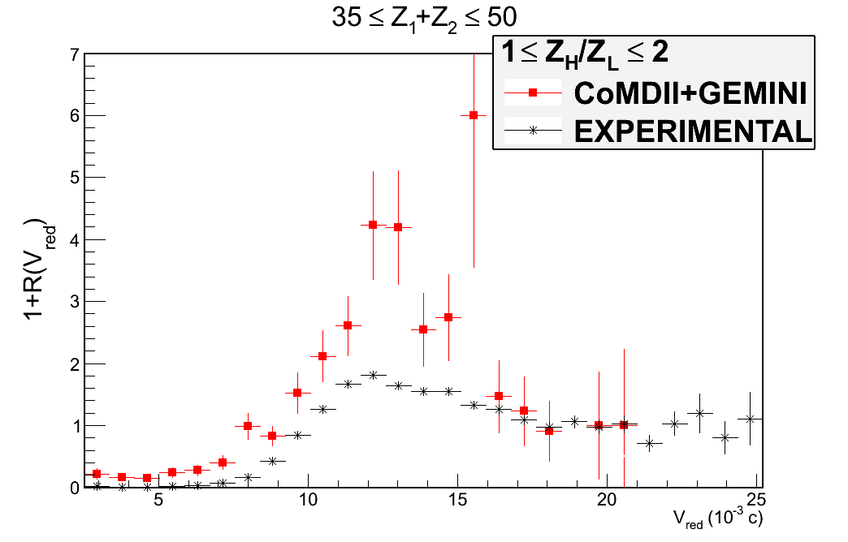
Bormio, Italy
27 Jan, 2017
E. V. Pagano
LNS-INFN

Slide 21
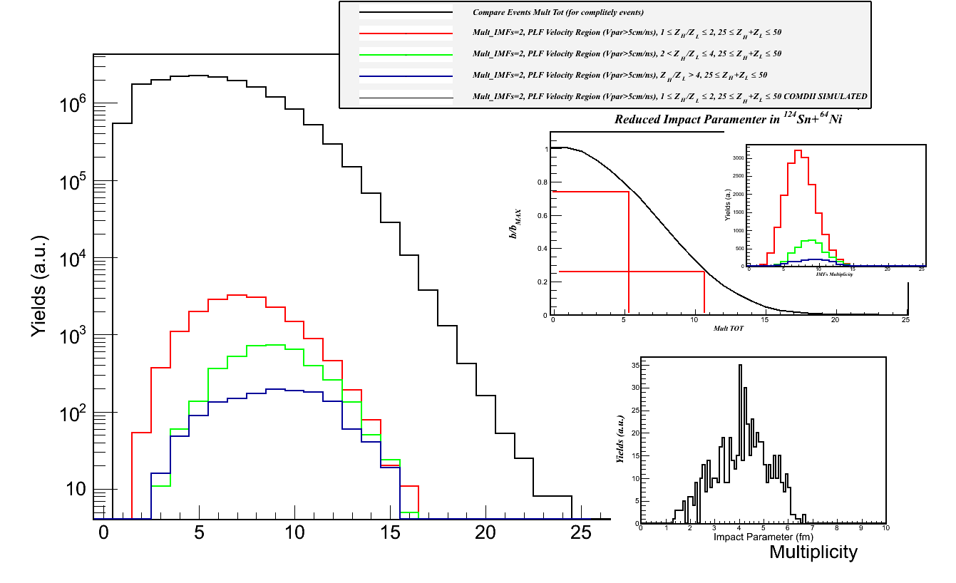
Bormio, Italy
27 Jan, 2017
E. V. Pagano
LNS-INFN
b_{max}= 10.8 fm
3 fm < b < 8 fm

Slide 22
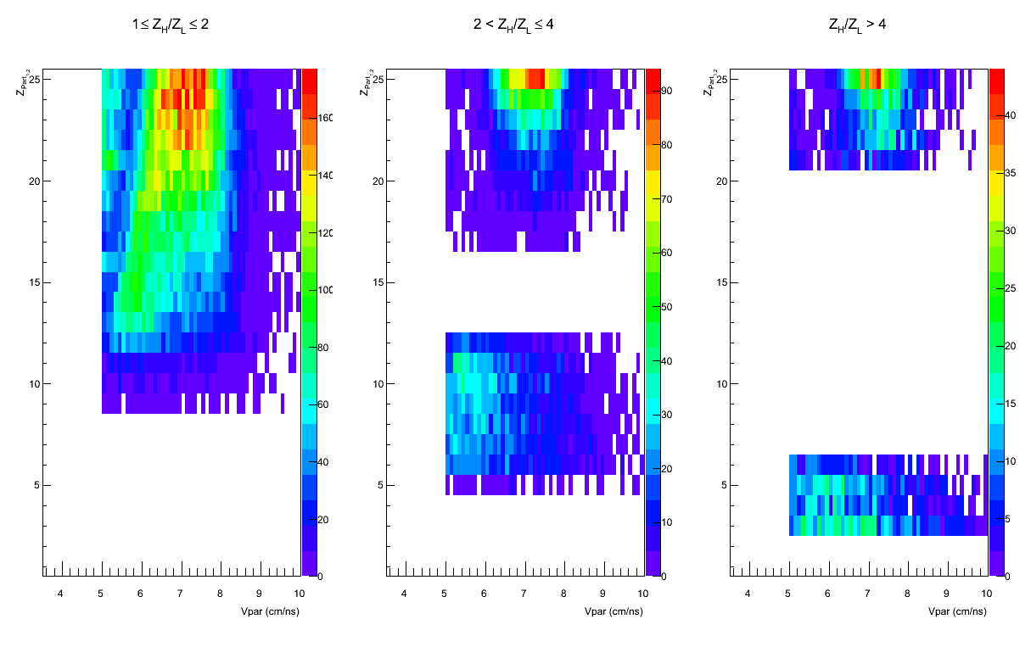
Bormio, Italy
27 Jan, 2017
E. V. Pagano
LNS-INFN
Which kind of IMFs are in the three regions of asymmetry?

Slide 23
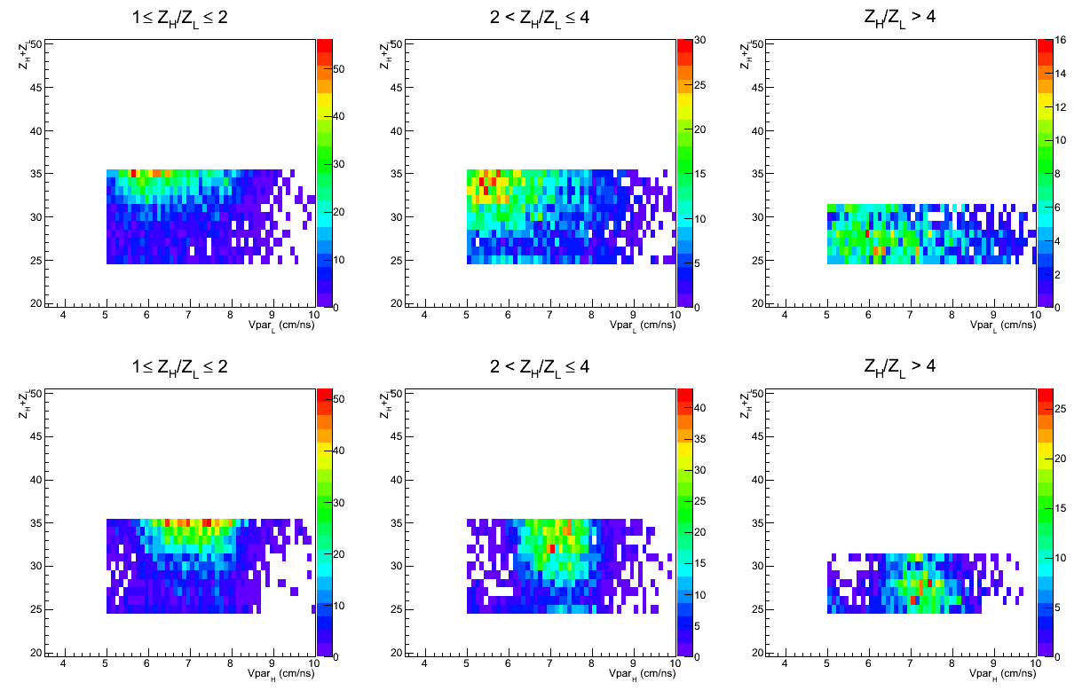
Bormio, Italy
27 Jan, 2017
E. V. Pagano
LNS-INFN
25 ≤ Z_{H}+Z_{L} ≤ 35

Slide 24
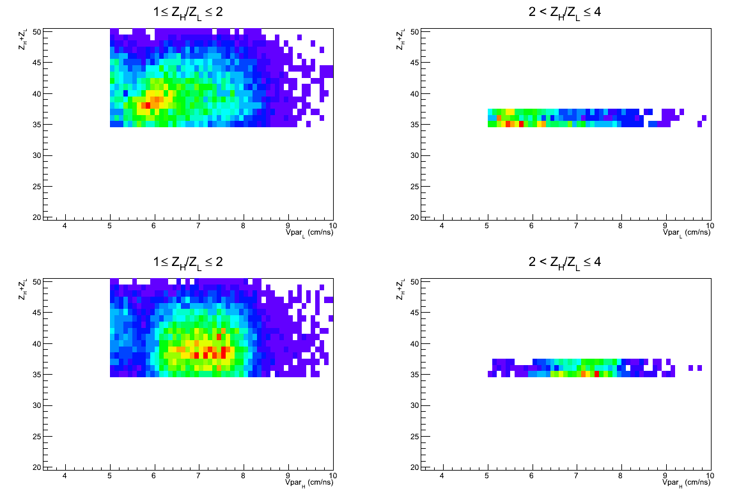
Bormio, Italy
27 Jan, 2017
E. V. Pagano
LNS-INFN
35 ≤ Z_{H}+Z_{L} ≤ 50

Slide 25
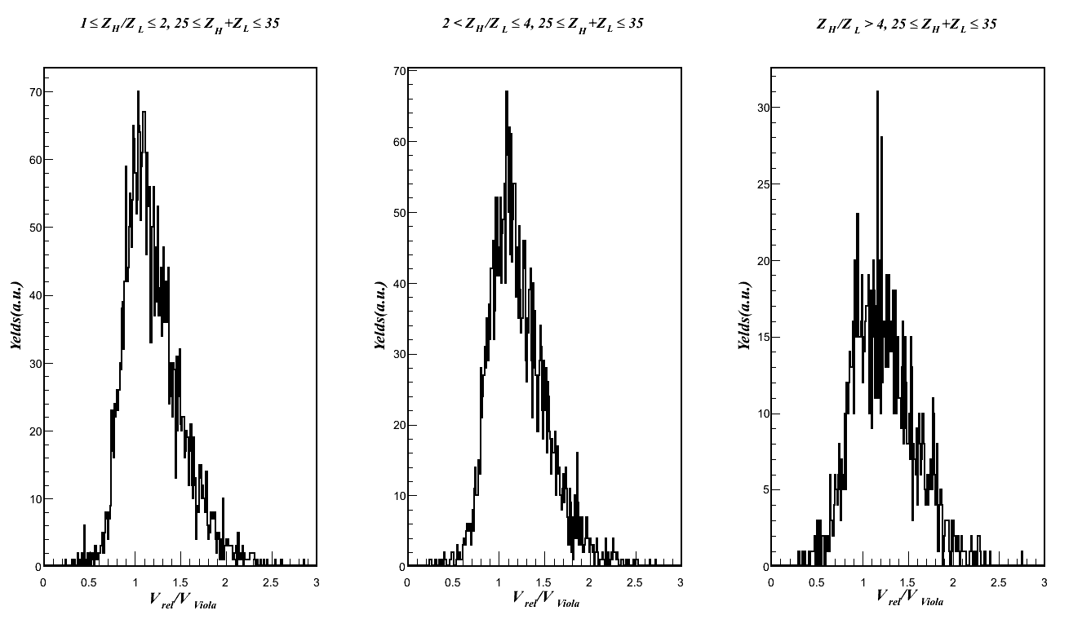
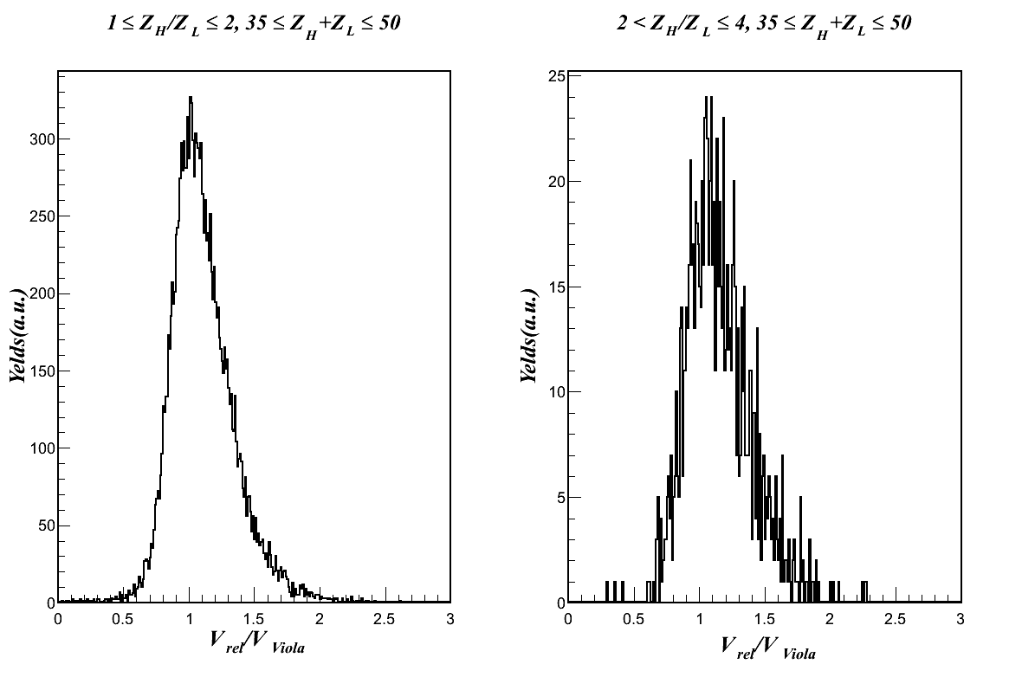
Bormio, Italy
27 Jan, 2017
E. V. Pagano
LNS-INFN
Can we call these processes PLF binary breakup/ fission?
V_{rel}/V_{Viola}
It is reasonable to think that we are looking a binary breakup/fission of the PLF

Slide 26
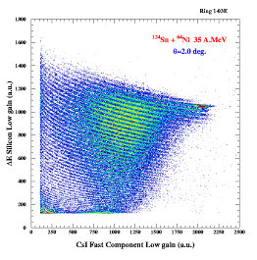
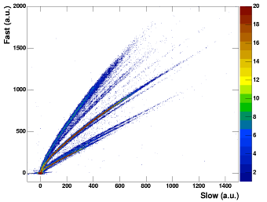
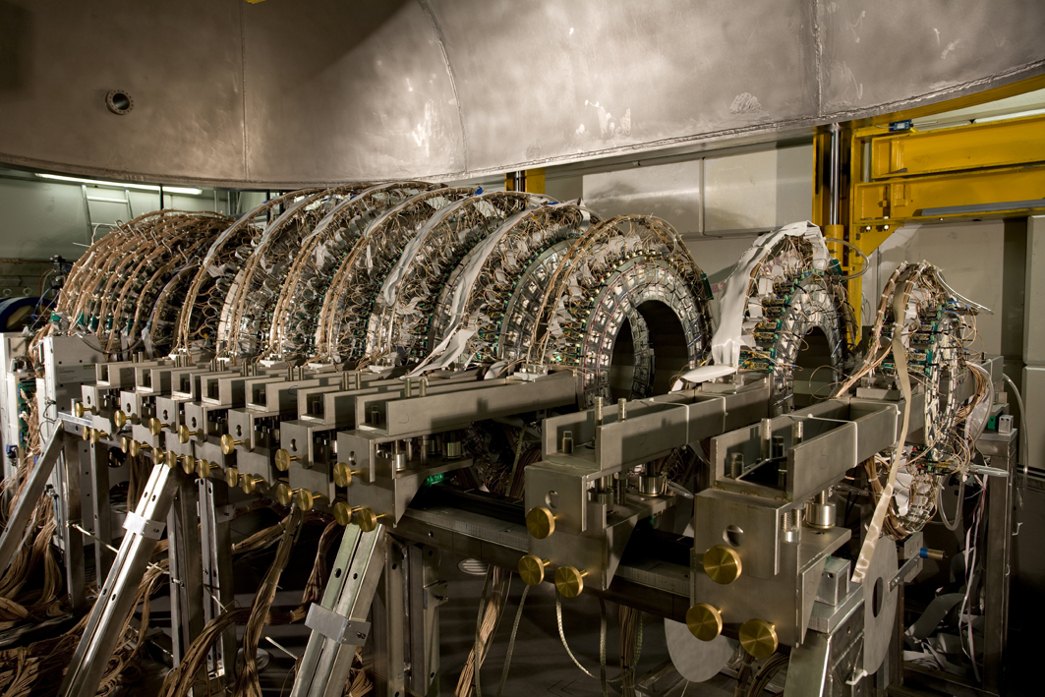
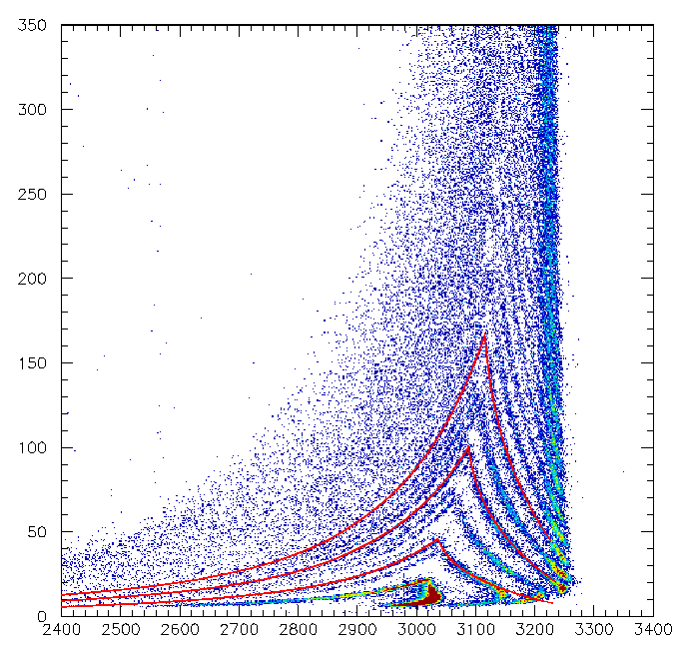
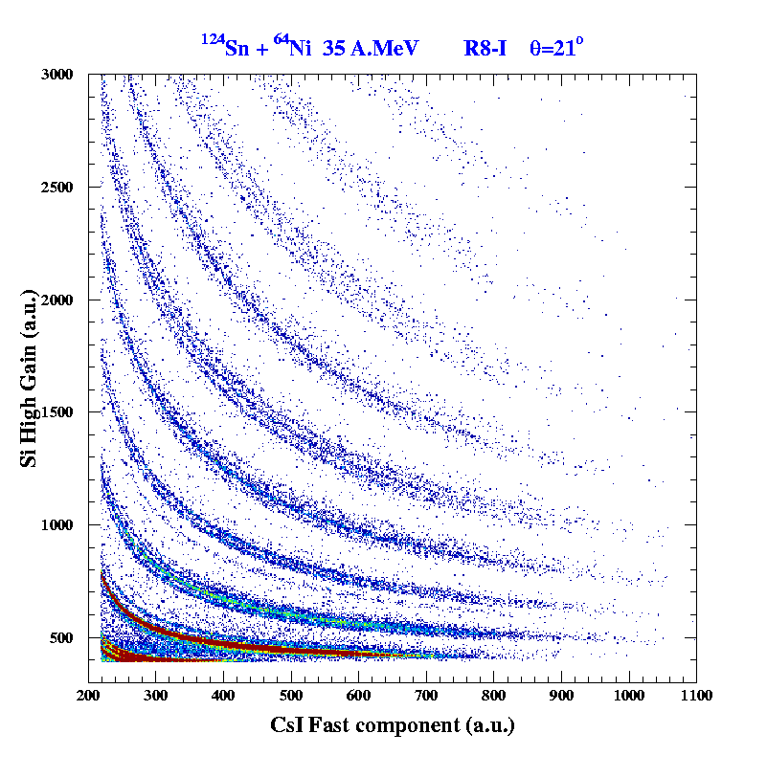
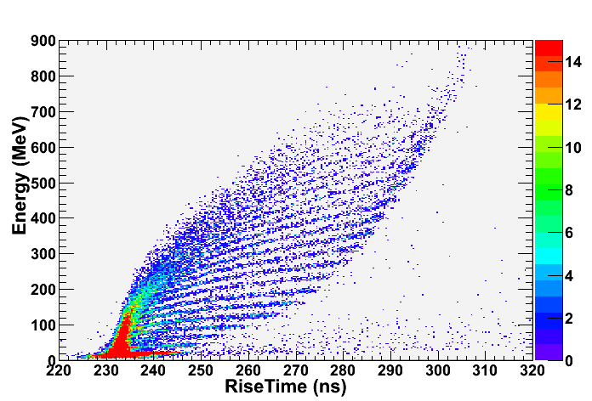
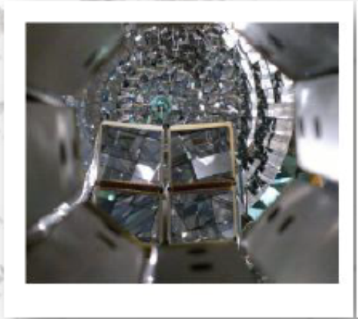
Bormio, Italy
27 Jan, 2017
E. V. Pagano
LNS-INFN
The CHIMERA detector : particle identification methods
ΔE-E Si-Csi
Charge for particles punching trough silicon
PSD – CsI
Isotopic identification up to Berillium
CsI(Tl)
Be
Li
1192
Si
HI
a
Z=50
α
³He
t
d
γ
p
ΔE-ToF
mass for particles stopped in silicon
ΔE-E
isotopic identification up to Z=9
Z=6
PSD – Si
charge for particles stopped in silicon
Z=16
FARCOS : an array of triple telescopes DSSSD-CsI
Z=10
Z=6

Slide 27
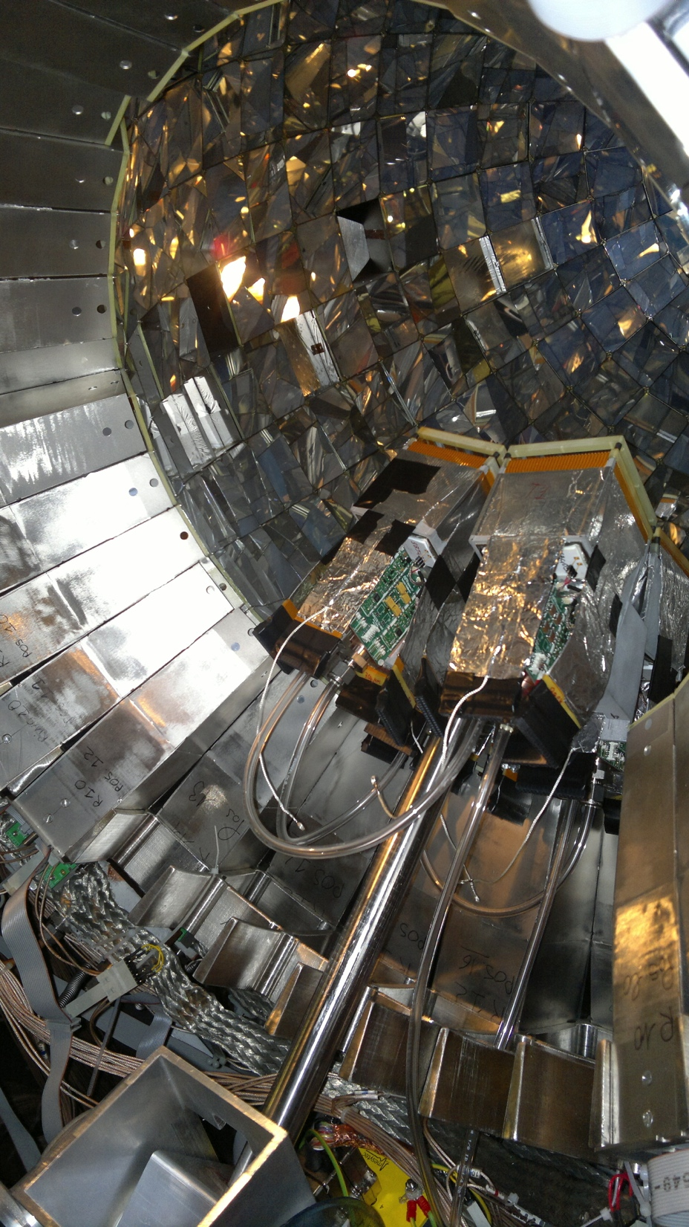
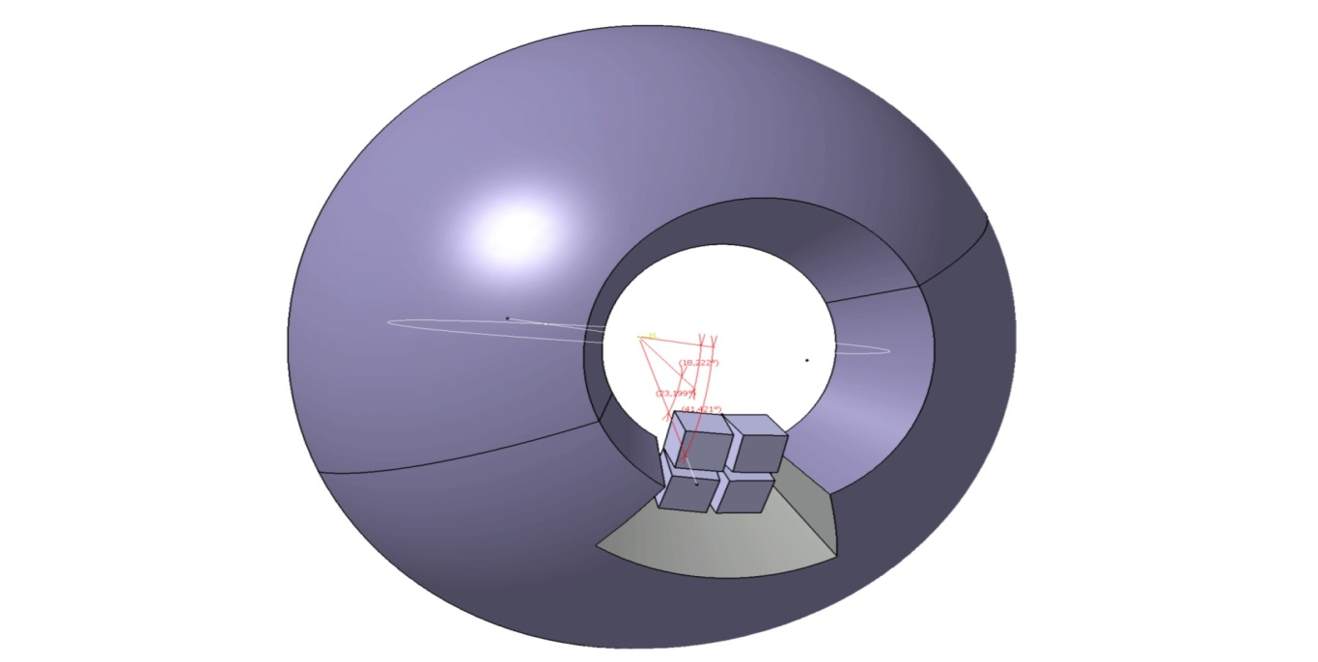
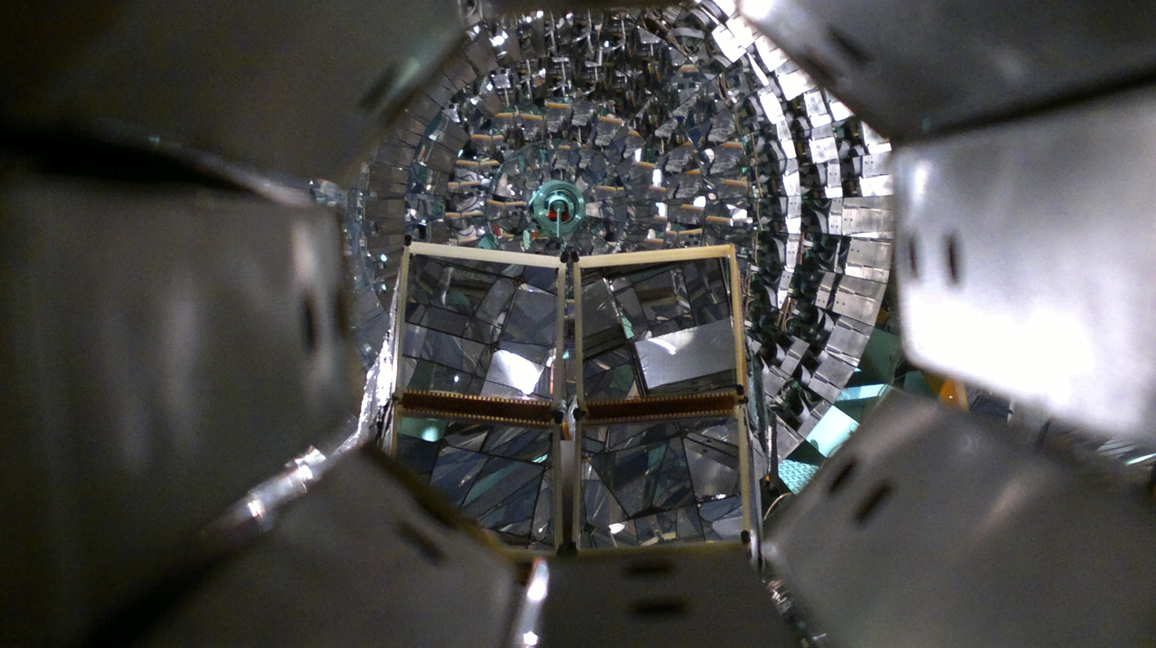
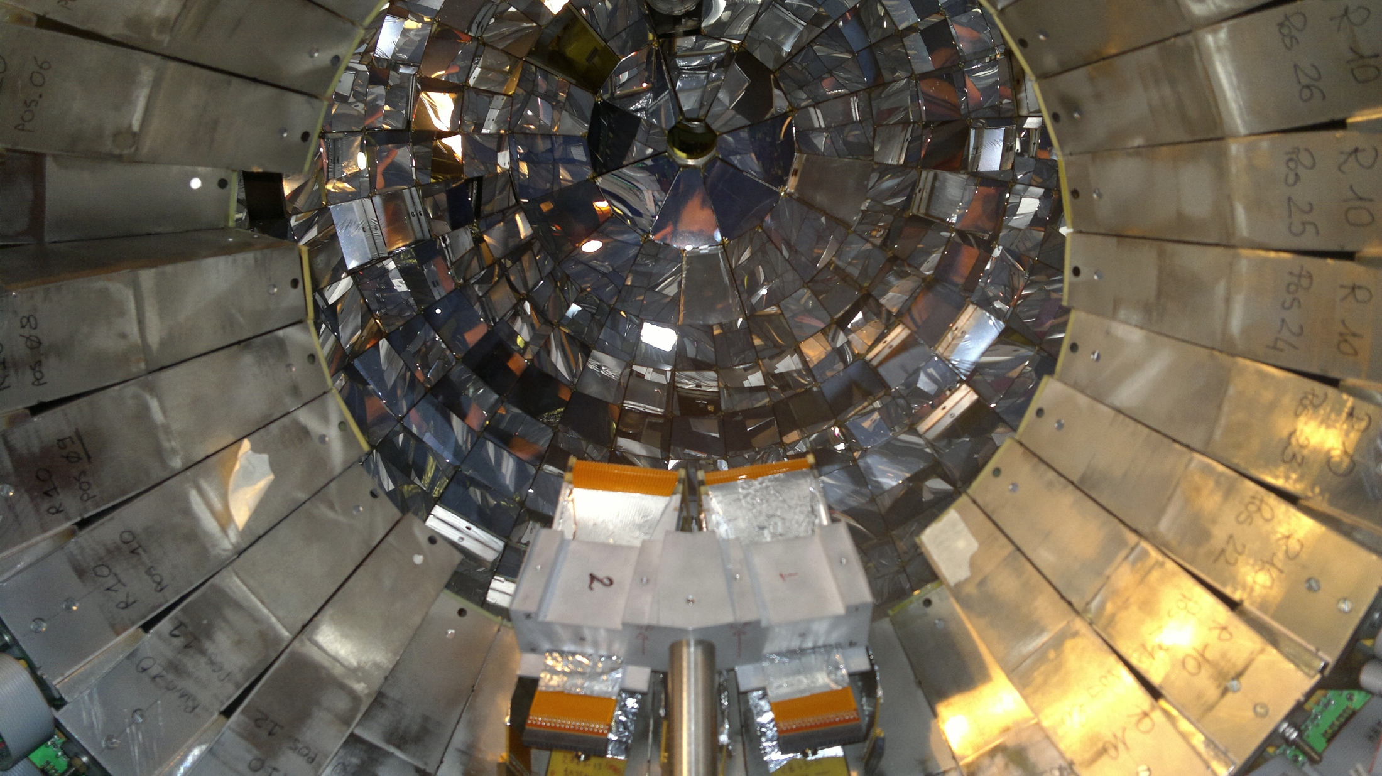
Bormio, Italy
27 Jan, 2017
E. V. Pagano
LNS-INFN
Test of FARCOS with beam @ LNS-INFN
Test with beam was made during the InKiIsSY experiment (INverse KInematic ISobaric SYstem)
The idea of this experiment is to use projectile/target combination having the same mass of the neutron rich ¹²⁴Sn+⁶⁴Ni system a N/Z similar to the neutron poor ¹¹²Sn+⁵⁸Ni one, that is ¹²⁴Xe+⁶⁴Zn, at the same bombarding energy of 35 MeV/u using the 4π detector CHIMERA and 4 modules of FARCOS prototype. For more details see L. Quattrocchi poster.
System | N/Z Projectile | N/Z target | N/Z Coumpound
¹²⁴Sn+⁶⁴Ni | 1.48 | 1.29 | 1.41P. Russotto et al., Phys. Rev. C 81, 064605 (2010).
¹¹²Sn+⁵⁸Ni | 1.30 | 1.13 | 1.24
¹²⁴Xe+⁶⁴Zn | 1.24 | 1.07 | 1.18
Xe+Zn @ 35 AMeV
4 telescopes at 25 cm from the target
θ_{lab} ∼ 16°−44° Δφ ∼ 60°

Slide 28
Bormio, Italy
27 Jan, 2017
E. V. Pagano
LNS-INFN
PROPOSAL
We propose:
to extend our investigation performed with CHIMERA at lower energies. We want to study the result obtained with REVERSE and InKiIsSy experiment as a function of energy and in particular at lower energy for the following reasons:
As predicted by Stochastic Mean Field (SMF)[1] calculations, the energy region between 10 and 25 A.MeV is extremely interesting due the predominance of one body dissipation which leads to formation of systems in various condition of shapes, angular momentum and excitation energies and to the strong competition between fusion and binary channels.
How the neck dynamics evolves at these energies with respect to the symmetry energy behavior is largely unknown.
The proposed study at 20 A.MeV is a good physics reference in the frame of stable beams in order to extend our studies at the low energies with SPES radioactive beams (<15 A.MeV) for which a specific LOI [2] has been presented by our group.
[1] C. Rizzo, M. Colonna, V. Baran, M. Di Toro, ., Phys. Rev. C90, 054618 (2014)
[2] NEWCHIM collaboration, SPES, Letter Of Intent – 2016
System | N/Z Projectile | N/Z target | N/Z compound | E/A (MeV)
¹²⁴Sn+⁶⁴Ni | 1.48 | 1.29 | 1.41 | 20
¹²⁴Xe+⁶⁴Zn | 1.30 | 1.13 | 1.24 | 20
¹¹²Sn+⁵⁸Ni | 1.24 | 1.07 | 1.18 | 20

