Slide 1
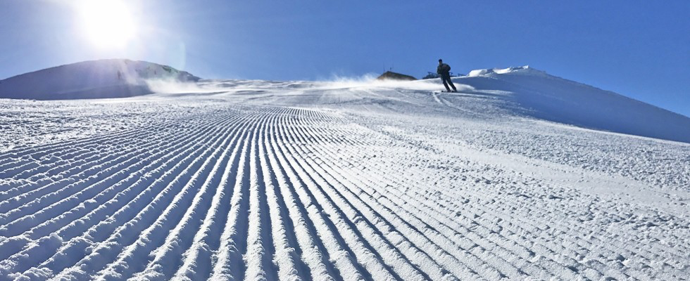


Skype meeting | 17 July 2014
Nuclear Astrophysics at the Low-Energy Frontiers:
Updates from the Laboratory
Marialuisa Aliotta
School of Physics and Astronomy
University of Edinburgh, UK and Scottish Universities Physics Alliance
55th International Winter Meeting on Nuclear Physics, 23-27 January 2017, Bormio – Italy

Slide 2
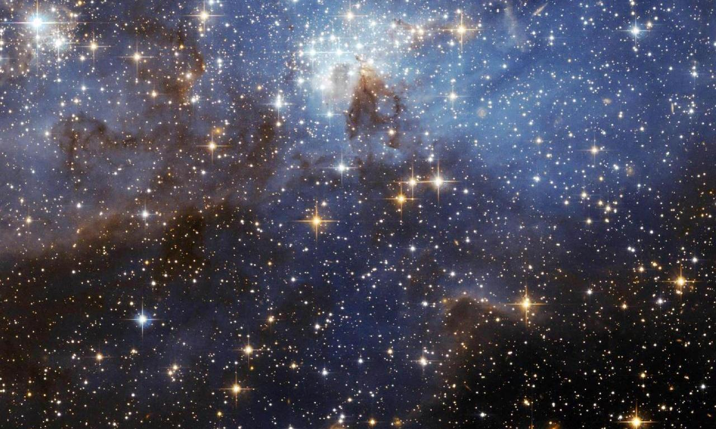
M. Aliotta
23-27 January 2017 – 55th International Winter Meeting on Nuclear Physics, Bormio

Slide 3
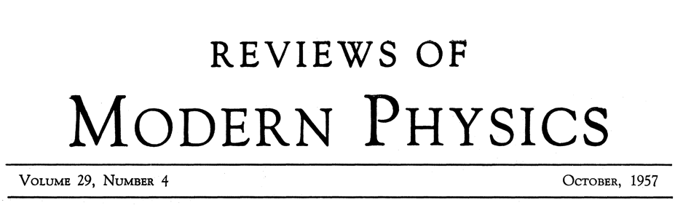
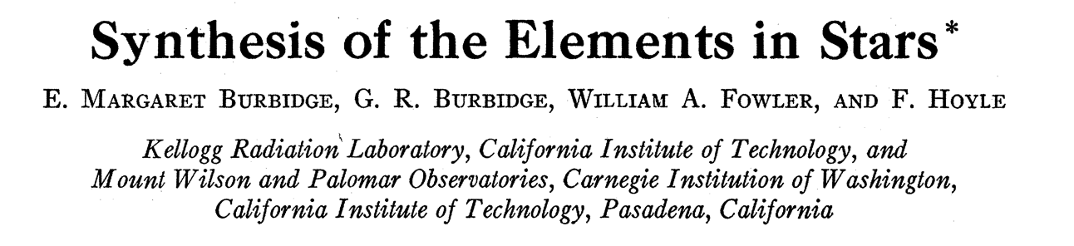

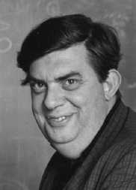
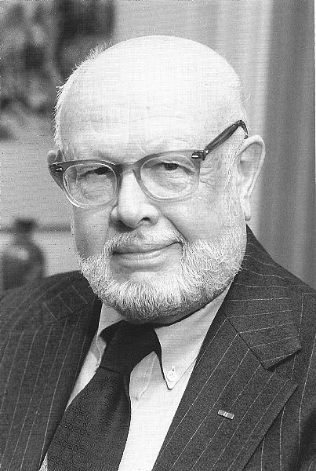
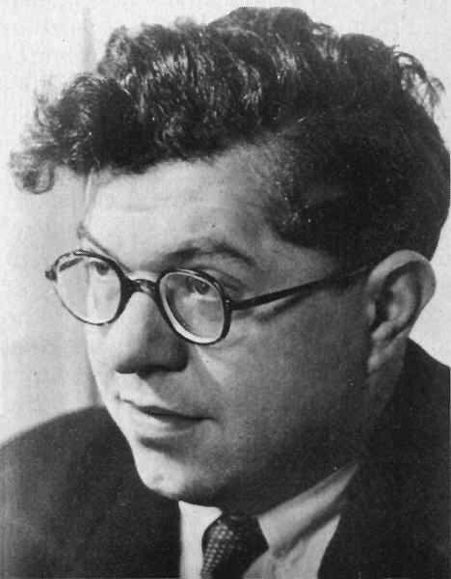
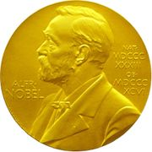
M. Aliotta
On the Origin of the Elements
Rev. Mod. Phys. 29 (1957) 547
(B²FH, 1957)
Burbidge
Burbidge
Fowler
Hoyle
1983
Nobel Prize
"for his theoretical and experimental studies of the nuclear reactions
of importance in the formation of the chemical elements in the universe"

Slide 4
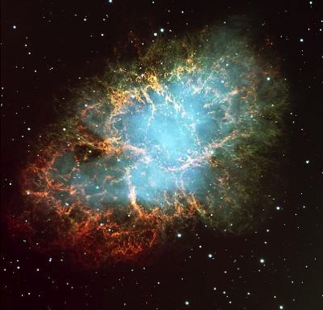
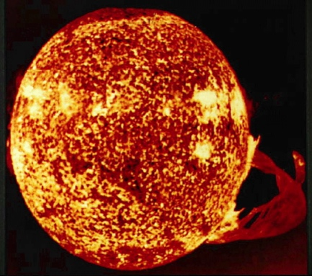
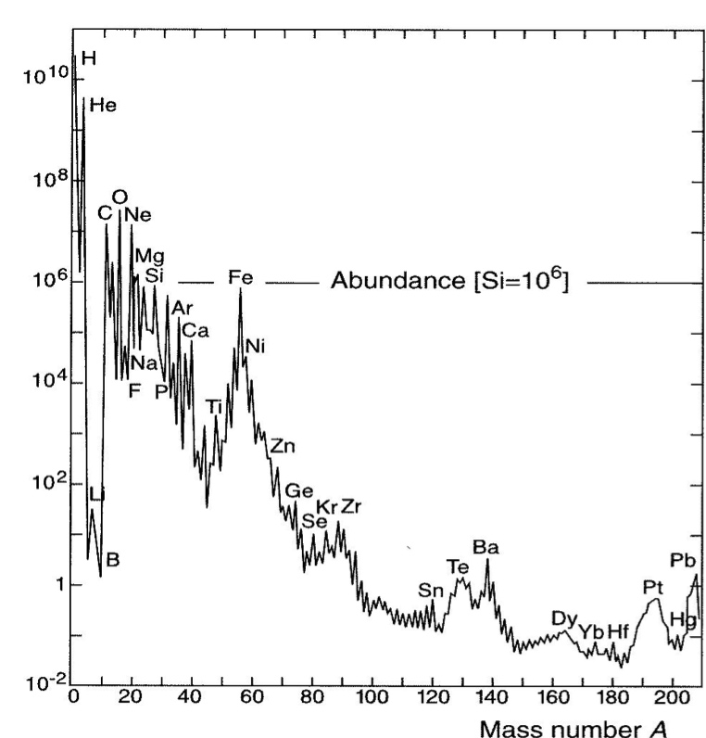
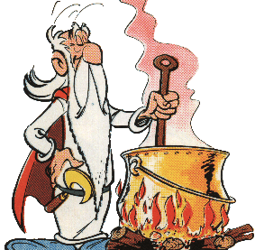
M. Aliotta
Overview
Interstellar
medium
BIRTH
gravitational
contraction
Stars
explosion
ejection
DEATH
abundance distribution
energy production
stability against collapse
synthesis of “metals”

Slide 5
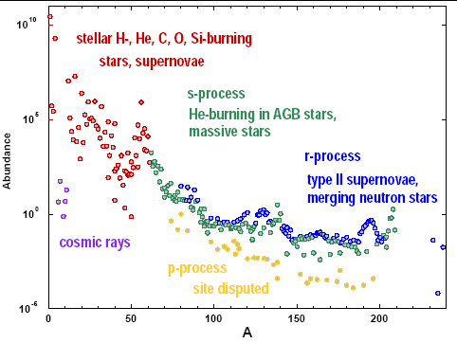
M. Aliotta
On the Origin of the Elements
Stellar nucleosynthesis
origin of elements and links to nuclear properties and processes

Slide 6

Direct evidence for nuclear reactions in stars?

Slide 7
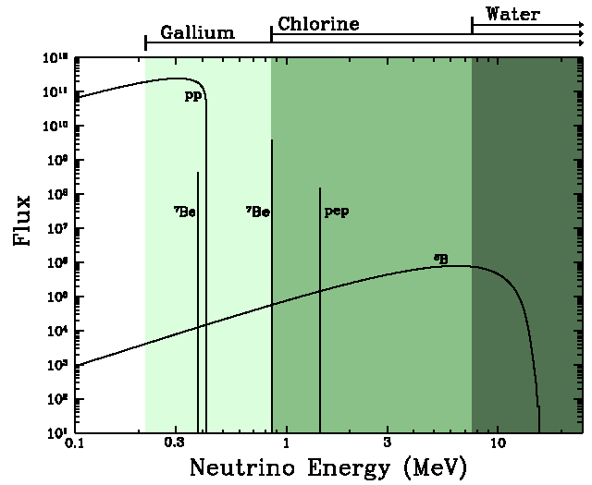
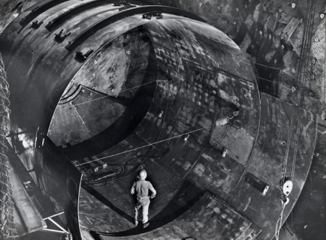
Direct evidence of nucleosynthesis in stars
Solar Neutrino Detection at Homestake in 1960s
http://sanfordlab.org/article/270
1965: Ray Davis inside partially constructed chlorine tank that was at the heart of his solar neutrino detector. The detector was installed in the cavern now occupied by the LUX dark matter detector. Credit: Anna Davis

Slide 8
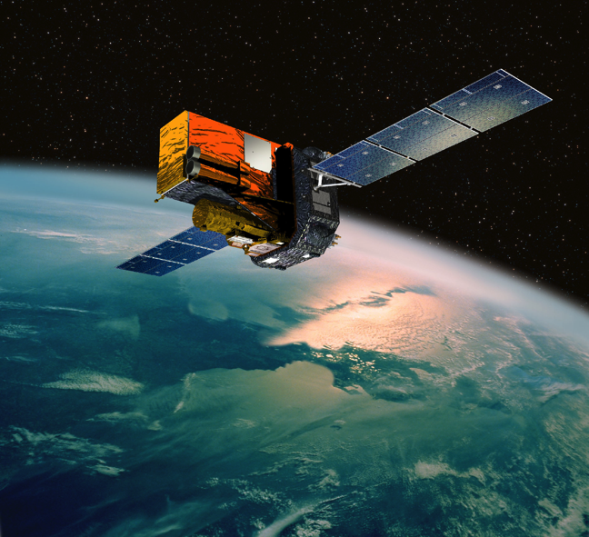
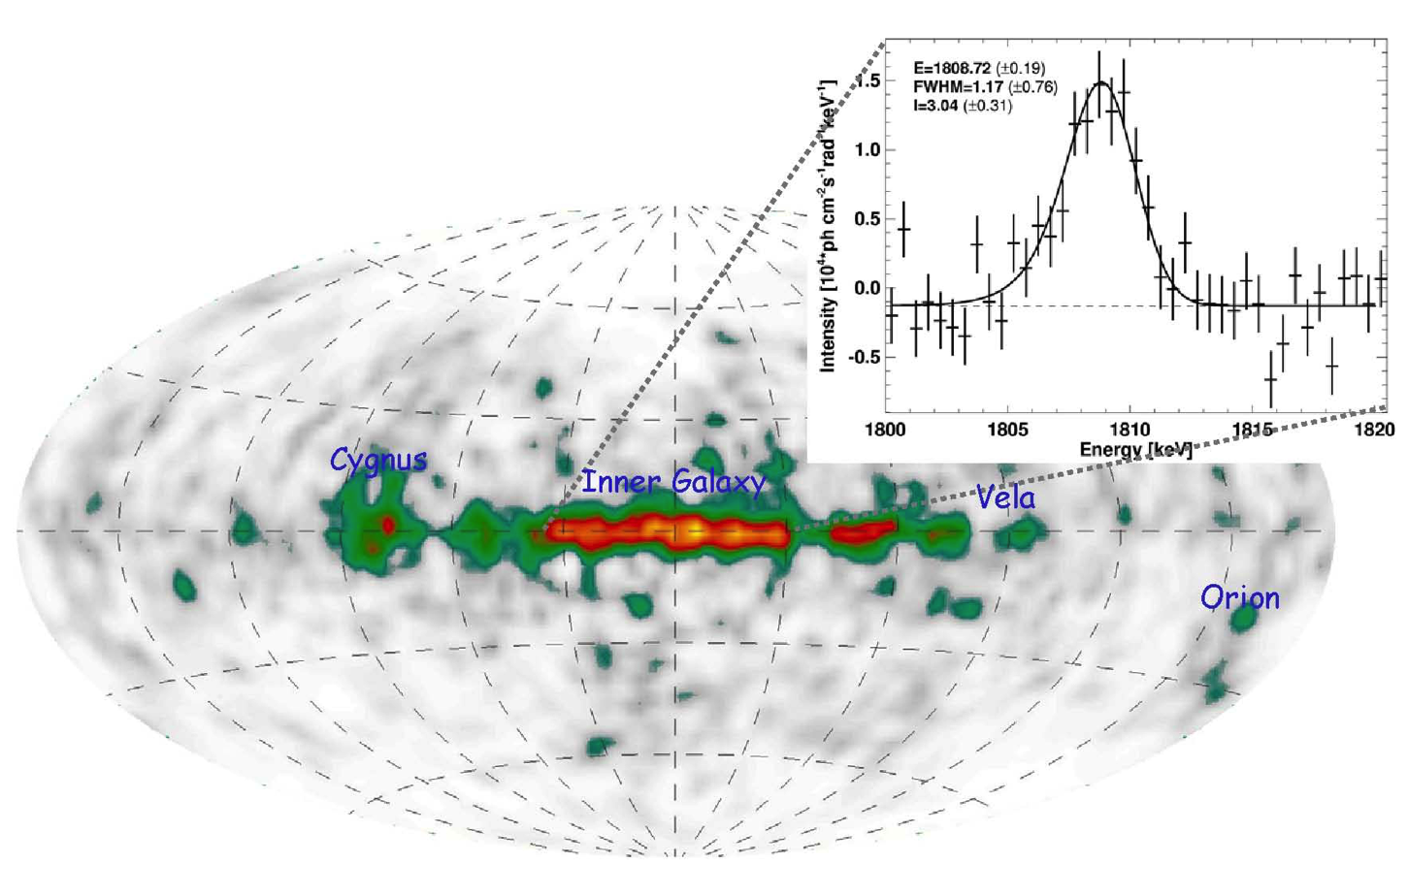
Direct evidence of nucleosynthesis in stars
discovery of ²⁶Al gamma-rays in 1982 by HEAO-C (Mahoney et al. 1982)
direct proof of ongoing nucleosynthesis in the Galaxy [t_{½} (²⁶Al) ~ 7.2x10⁵ y]
measurement of 1.808 MeV γ-ray line with COMPTEL and INTEGRAL
mainly localized
in spiral arms
regions of high star birth
credits: MPE 2001
From total amount of observed ²⁶Al
→ a rate of core collapse supernovae from massive stars of 2 per century
Diehl et al., Nature 439 (2006) 45

Slide 9
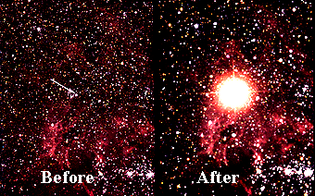
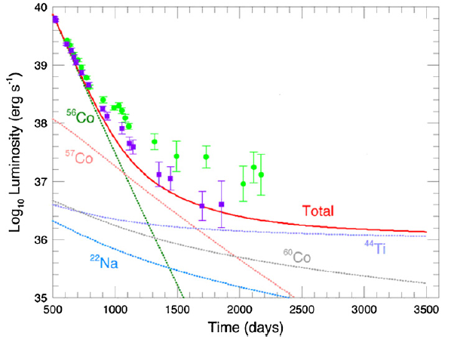
Direct evidence of nucleosynthesis in stars
Light curves of supernovae explosion powered by radioactive decay
SN1987A
http://www.astro.princeton.edu/~dns/teachersguide/SN1987A.gif
a ∼20 M⊙ star explosion
in the Large Magellanic Cloud
t_{½} (⁵⁶Co) = 77d
t_{½} (⁴⁴Ti) = 49 y
Dressler et al, J Phys G: Nucl Part Phys 39 (2012) 105201

Slide 10
M. Aliotta
nuclear reactions
&
nuclear properties
test predictions
against
observations
nucleosynthesis
calculations
sensitivity studies
stellar evolution models
23-27 January 2017 – 55th International Winter Meeting on Nuclear Physics, Bormio

Slide 11
Skype meeting | 17 July 2014
Explosive Nucleosynthesis
Novae
Supernovae Type Ia
X-ray Bursts

Slide 12
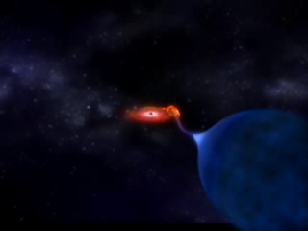
M. Aliotta
Explosive Scenarios: Novae, Supernovae type Ia, X-ray Bursts
23-27 January 2017 – 55th International Winter Meeting on Nuclear Physics, Bormio

Slide 13
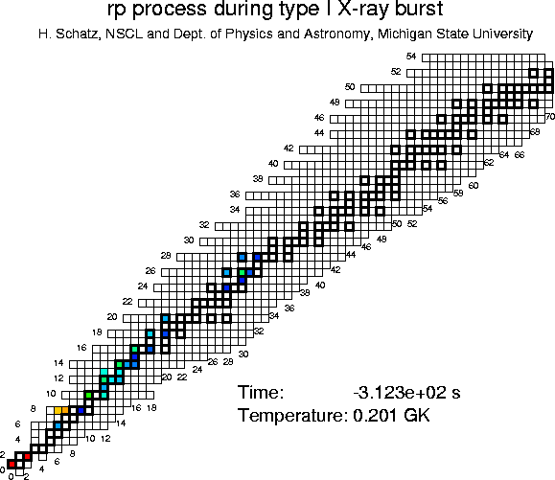
M. Aliotta
23-27 January 2017 – 55th International Winter Meeting on Nuclear Physics, Bormio

Slide 14
Skype meeting | 17 July 2014
Neutron sources for heavy elements production

Slide 15


M. Aliotta
Neutron Capture Processes: The s Process
(courtesy: Rene Reifarth)
s (slow) process
quiescent stages of stellar evolution
responsible for ~ 50% of “heavy” elements
Zr
Y
Sr
(n,γ)
Rb
Kr
(β⁻)
Br
proton number
(β⁺)
Se
As
Ge
neutrons
Ga
Zn
r-only
r-process
Cu
Ni
Co
Fe
neutron number
courtesy: R Reifarth

Slide 16
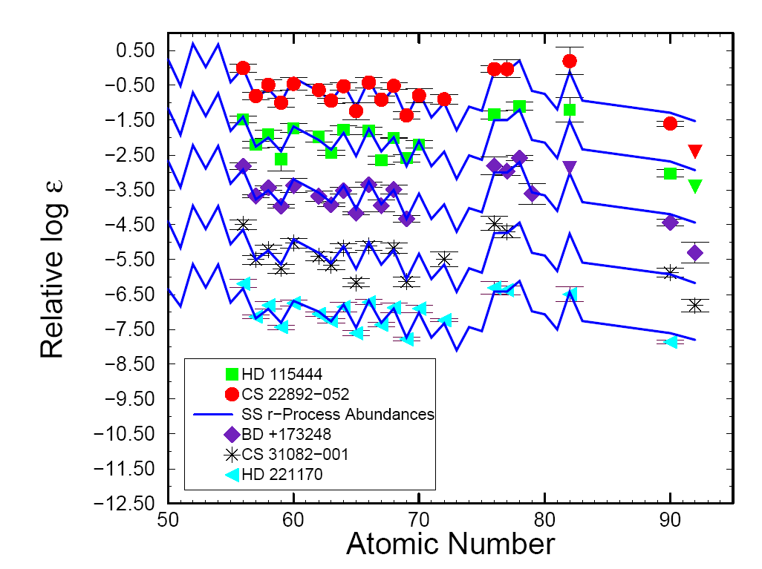
Nucleosynthesis Processes
Ultra Metal Poor stars provide info on early nucleosynthesis in Galaxy
New observations hint at robust r-process mechanism
(i.e. operating consistently over large periods of time in Galaxy’s history)
Kratz et al.: APJ 662 (2007) 39
log ɛ(A) ≡ log(N_{A}/N_{H}) + 12.0
With this definition: log ɛ(H) = 12

Slide 17
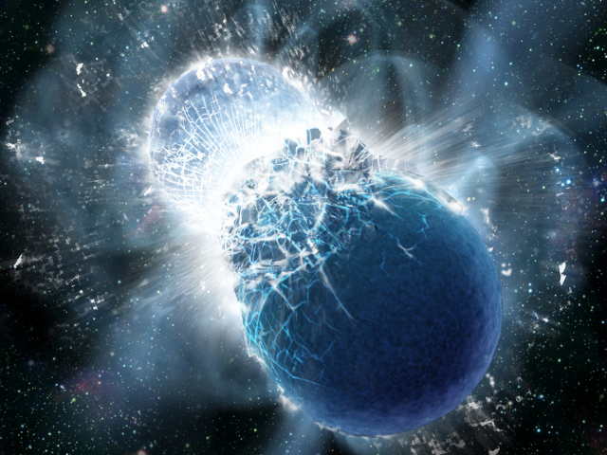

M. Aliotta
Nuclear reactions, stars, and the creation of the elements
Where does the r-process take place?
Crab Nebula SN 1054
Neutron Star Mergers?
Supernovae Explosions?
Pint of Science Festival, Edinburgh 23 May 2016
3 May 2016 - Physics Colloquium - Johannes Gutenberg-University Mainz

Slide 18
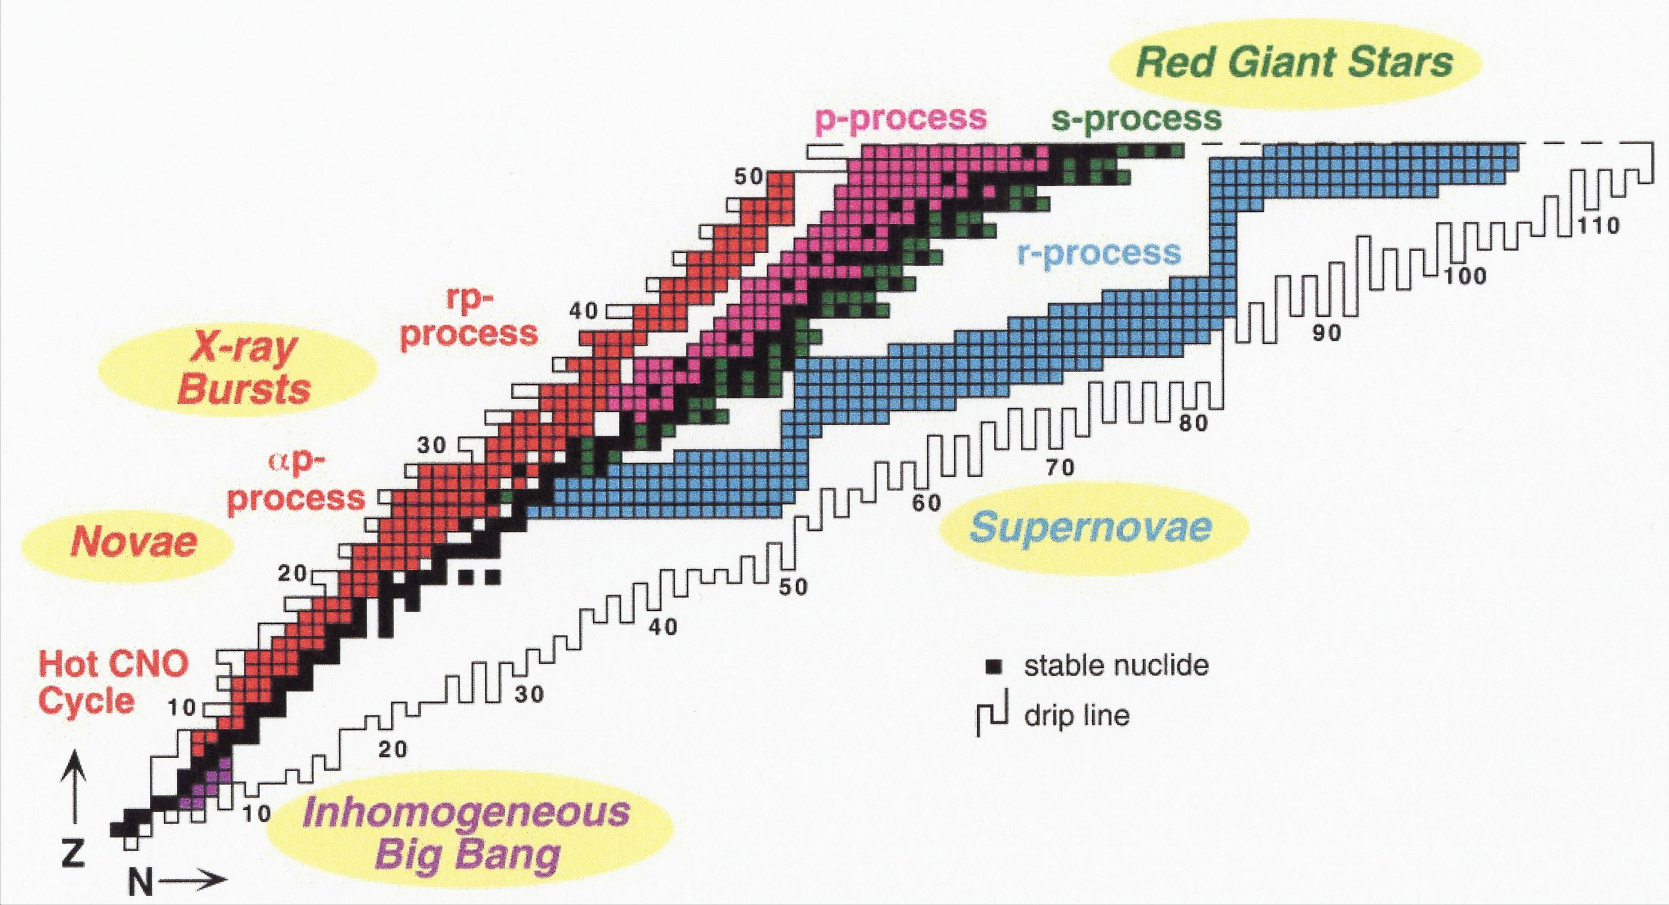
Experimental Nuclear Astrophysics
Mapping Astrophysical Processes to Nuclear Chart
M.S. Smith and K.E. Rehm,
Ann. Rev. Nucl. Part. Sci, 51 (2001) 91-130

Slide 19
Experimental Nuclear Astrophysics
RIBs facilities in the World
ISOL (Isotope Separation On Line)
CYCLONE (Louvain-la-Neuve) REX-ISOLDE (CERN, Switzerland)
SPIRAL (Ganil, Caen) HRIBF (ORNL)
ISAC (TRIUMF, Vancouver)
  Future project: EURISOL in Europe
Projectile fragmentation
GANIL (Caen) NSCL (MSU)
GSI (Darmstadt) RIKEN (Saitama)
FlerovLaboratory (Dubna) IMP (Lanzhou)
  Two major projects: FAIR @ GSI, RIBF @ RIKEN, FRIB @ MSU
In-Flight
ATLAS (Argonne) CIAE (Beijing)
CRIB (RIKEN) Texas AMU, Notre Dame
Sever limitations on beam species and beam intensities

Slide 20
Open Questions
Bib Bang Nucleosynthesis and the Li problem
CNO neutrinos and solar metallicity in the core
Fate of massive stars
Nucleosynthesis in AGB stars and Galactic chemical evolution
Neutron sources for the s-process
…

Slide 21

M. Aliotta
Experimental Challenges
23-27 January 2017 – 55th International Winter Meeting on Nuclear Physics, Bormio

Slide 22


M Aliotta
Experimental Nuclear Astrophysics
Thermonuclear Reactions in Stars at Sub-Coulomb Energies
low cross sections → low yields → poor signal-to-noise ratio
Yield = N_{projectiles} x N_{target} x cross section x detection efficiency
10¹⁴ pps
x
10¹⁹ cm⁻²
x
10⁻¹⁵ b
x
100% for charged particles
~1% for gamma rays
Y = 0.3-30 counts/year

Slide 23
M. Aliotta
Experimental Nuclear Astrophysics
maximising the yield requires:
improving “signal” (e.g. high beam currents, high target density, high efficiency)
reducing “noise” (i.e. background)
combination of both

Slide 24
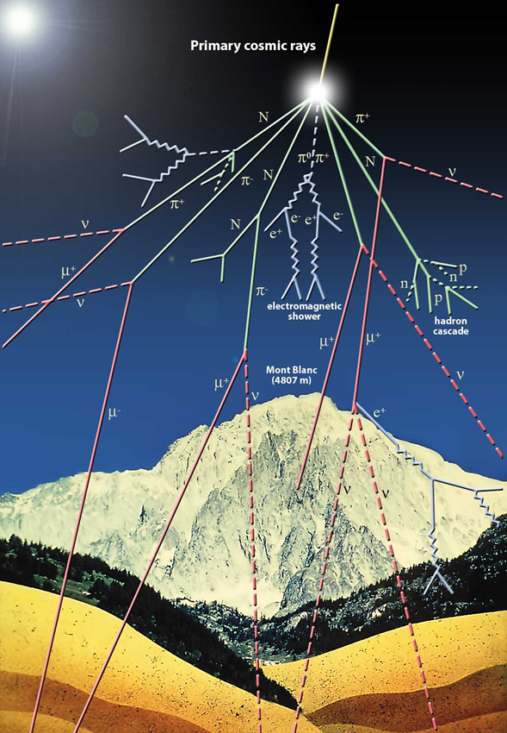
Experimental Nuclear Astrophysics
Main Sources of Background:
natural radioactivity (mainly from U and Th chains and from Rn)
cosmic rays (muons, ^{1,3}H, ⁷Be, ¹⁴C, …)
neutrons from (a,n) reactions and fission
typical γ-ray spectrum at surface lab
ambient
neutron induced
cosmic rays
ideal location: underground + low concentration of U and Th

Slide 25
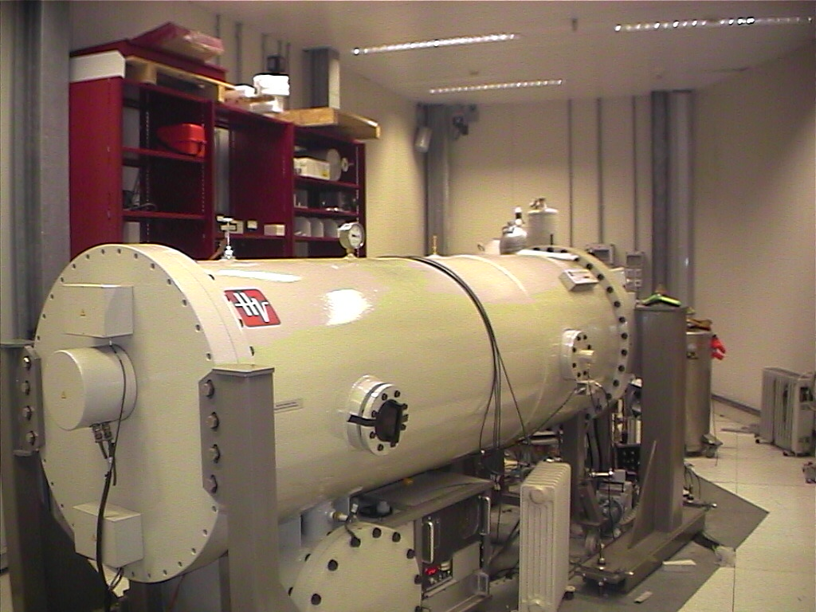
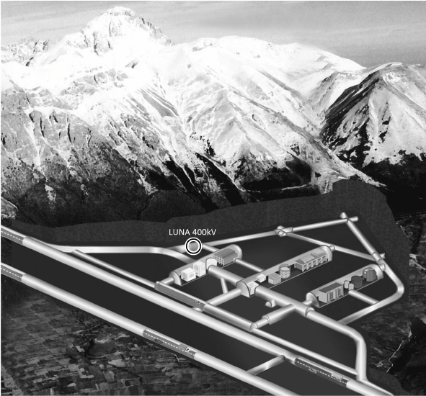
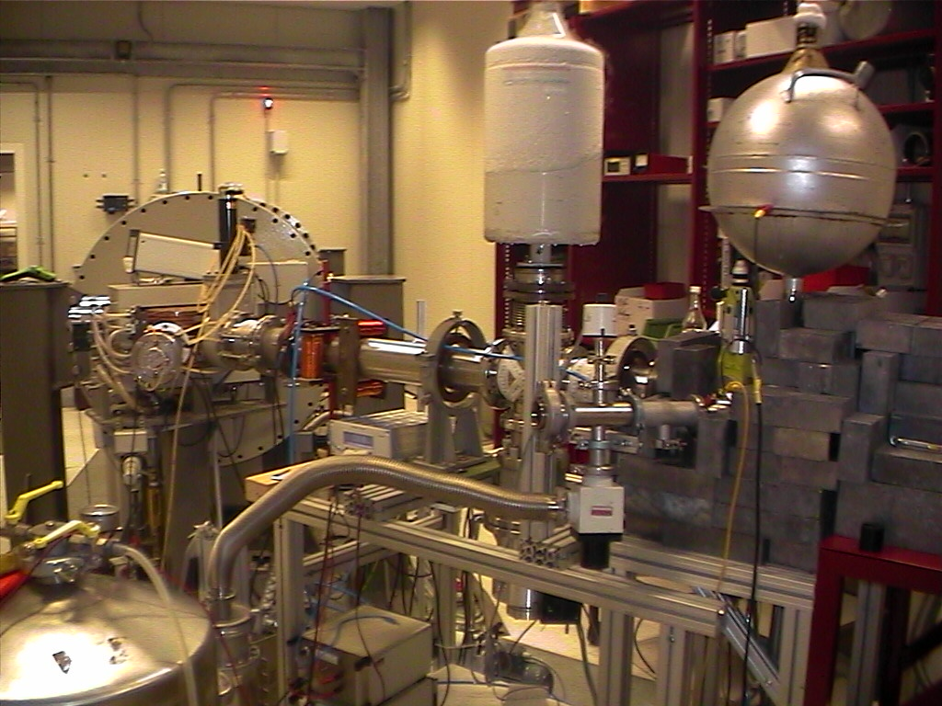
M. Aliotta
Nuclear reactions, stars, and the creation of the elements
Laboratory for Underground Nuclear Astrophysics (LUNA)
only underground accelerator in the world
but new ones coming up in the US and China
Pint of Science Festival, Edinburgh 23 May 2016
3 May 2016 - Physics Colloquium - Johannes Gutenberg-University Mainz

Slide 26
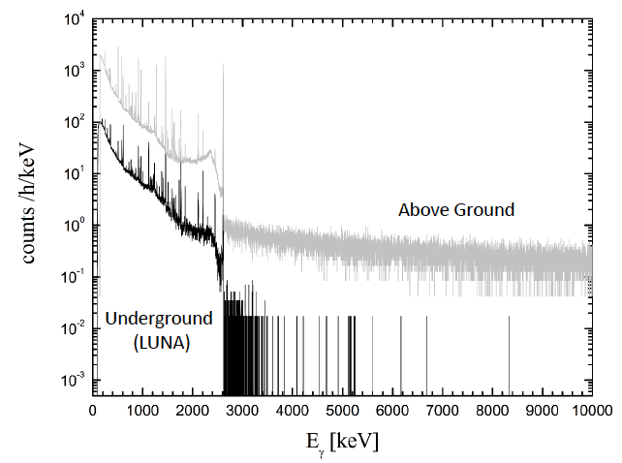
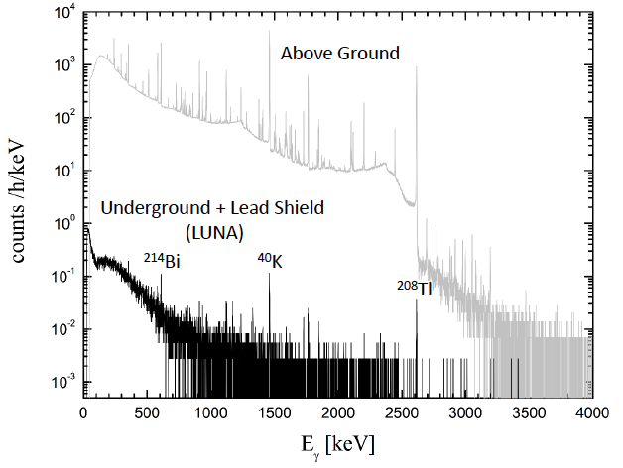
M Aliotta
Gamma-ray background: underground vs overground comparison
Costantini et al, Rep Prog Phys 72 (2009) 086301

Slide 27
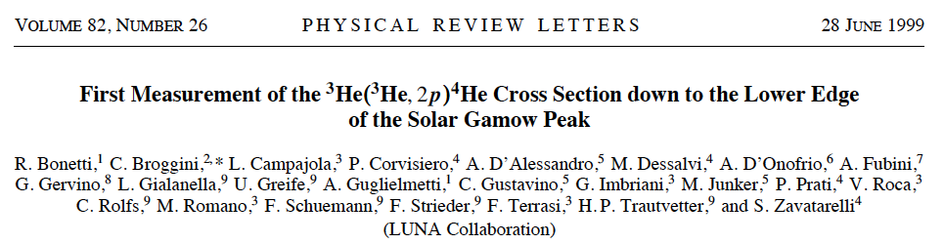
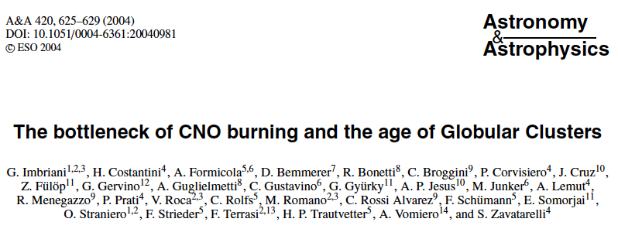
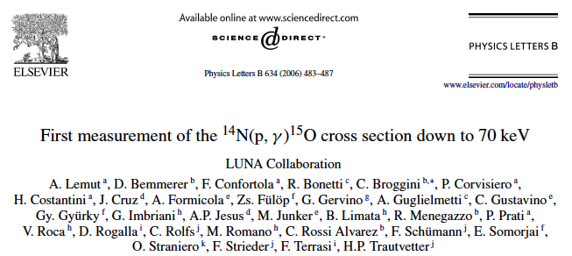
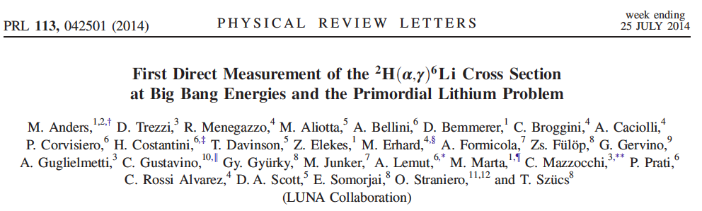
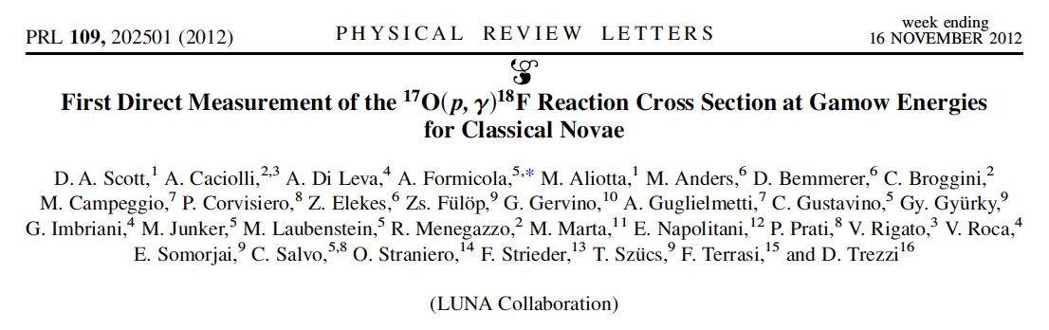
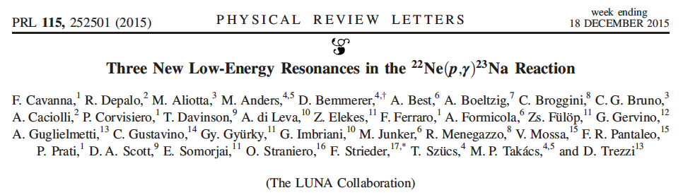
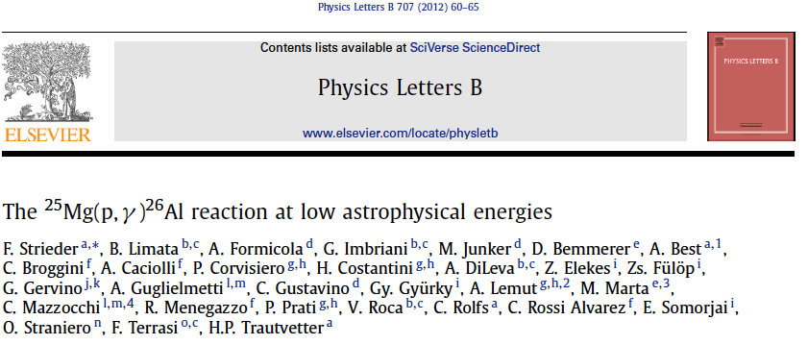
M. Aliotta
Nuclear reactions, stars, and the creation of the elements
excluded a “nuclear solution” to the missing neutrino problem
improved constraints on the synthesis of ²⁶Al
excluded a “nuclear solution” to the lithium problem
increased age of universe by 1 billion years
firmer constraints on amount of ¹⁸F produced in novae explosions
slowest reaction in CNO cycle in the Sun
discovery of new states in ²³Na; implications on pre-solar grains
Pint of Science Festival, Edinburgh 23 May 2016
3 May 2016 - Physics Colloquium - Johannes Gutenberg-University Mainz
Notes:
7Li BBN predictions 2-4x higher than observed; 6Li BBN predictions 3 o.o.m. lower than observed

Slide 28

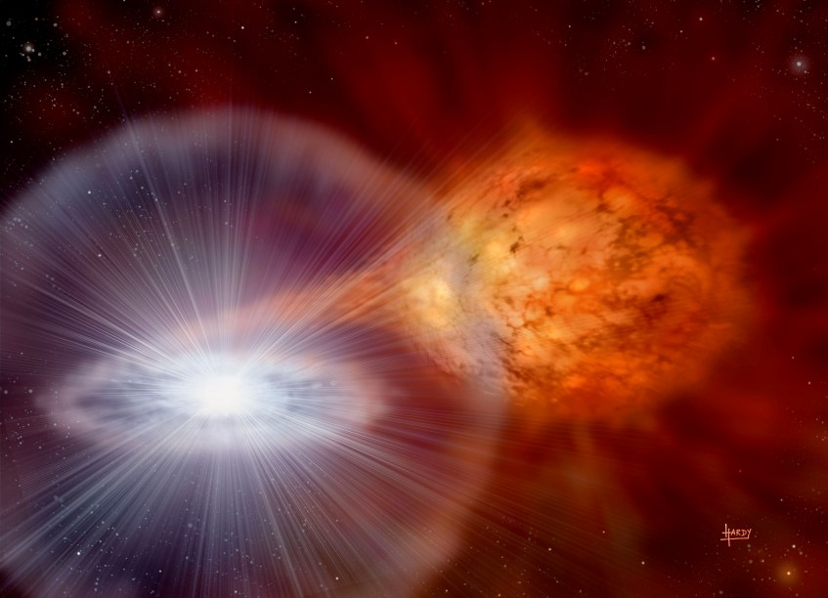
Skype meeting | 17 July 2014
The ¹⁷O(p,γ)¹⁸F Reaction in Classical Novae
Notes:
CO and One novae: 511 keV + continuum radiation emitted before maximum in visual luminosity nova explosion, thus difficult to see
t1/2 158 min
no observations so far from sensitive telescopes

Slide 29
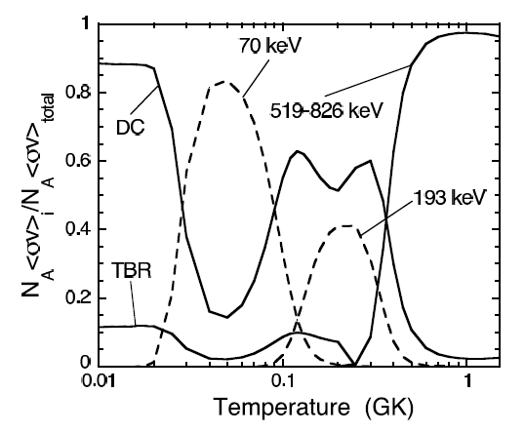
M Aliotta
¹⁷O(p,γ)¹⁸F reaction in novae
reaction proceeds through:
resonant contributions (E_{p} = 70, and 193 keV )
non-resonant contributions
  direct capture
  tails of broad high-energy resonances
Novae

Slide 30
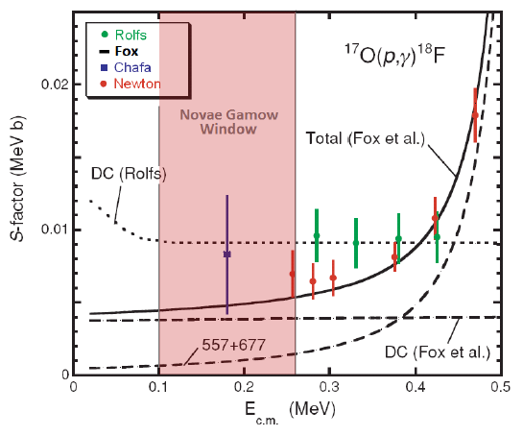

M Aliotta
¹⁷O(p,γ)¹⁸F reaction in novae
Astrophysical S factor for ¹⁷O(p,γ)¹⁸F reaction and its extrapolations
(before LUNA measurement)
Main issues:
discrepancy between different data sets
uncertain extrapolation of S factor
only one data point within Gamow window
factor of 2 discrepancy between resonance strength values
Fox, PRC 71 (2005) 055801
Chafa, PRC 75 (2007) 033810
Scott, PhD Thesis, UoE (2014)

Slide 31
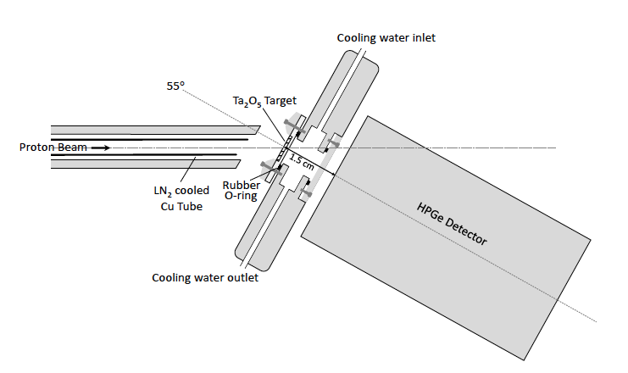
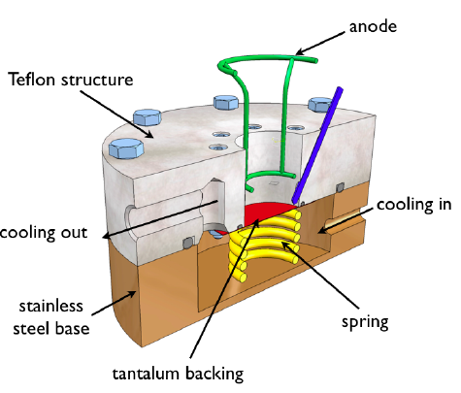
M Aliotta
¹⁷O(p,γ)¹⁸F reaction in novae
Experimental setup
high-intensity proton beam
onto Ta₂O₅ targets
HPGe detector in close geometry
for prompt γ-ray measurement
Scott, PhD Thesis, UoE (2014)
targets prepared by anodization
of Ta backing in ¹⁷O-enriched water
Caciolli et al. EPJA 48 (2012) 144

Slide 32
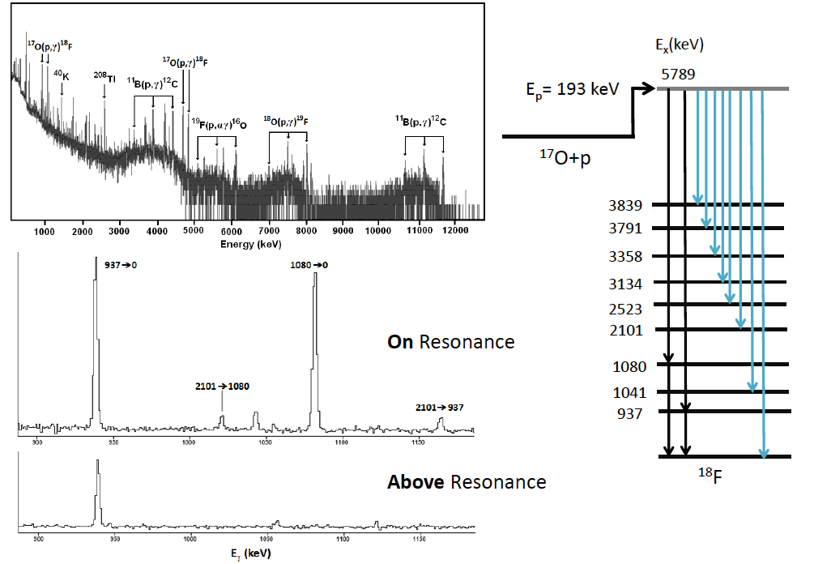
M Aliotta
¹⁷O(p,γ)¹⁸F reaction in novae
many more transitions observed compared to previous studies

Slide 33
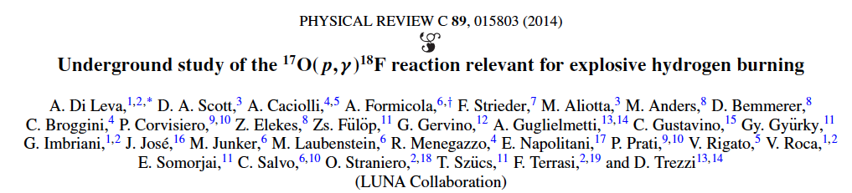
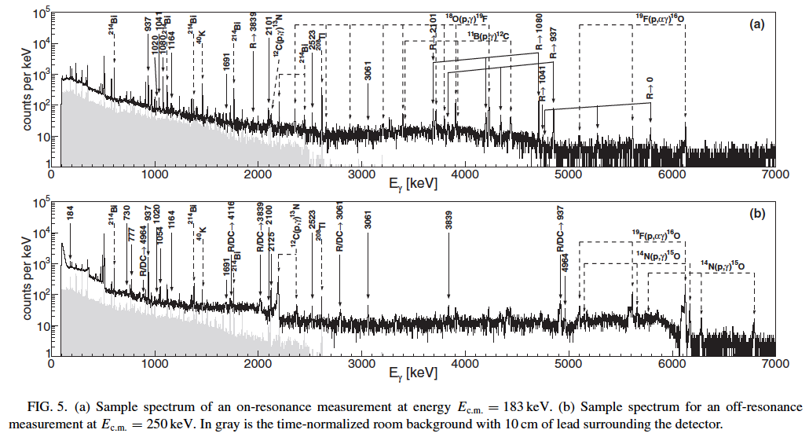
M Aliotta
¹⁷O(p,γ)¹⁸F reaction in novae

Slide 34
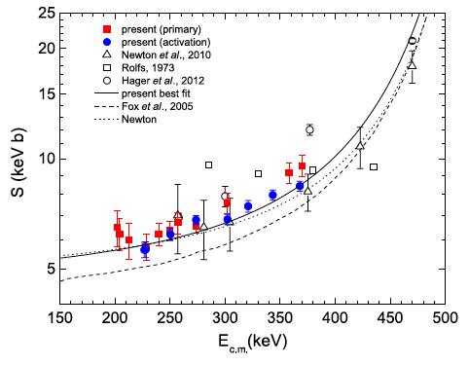
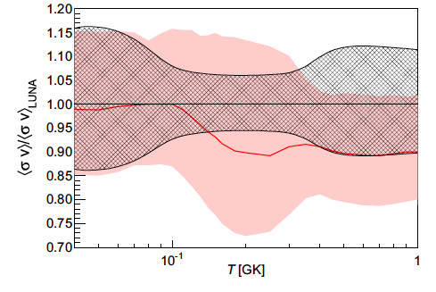
M Aliotta
¹⁷O(p,γ)¹⁸F reaction in novae
[see also: Di Leva et al. PRC 89 (2014) 015803]
first measurement within Gamow window
reaction rate: factor of 4 reduction

Slide 35
Skype meeting | 17 July 2014
¹⁷O(p,α)¹⁴N reaction
hydrogen burning in:
red giants
asymptotic giant branch stars
massive stars
classical novae
affects for ¹⁷O/¹⁶O ratio and ¹⁸F abundance
provides constraints on oxide grains formation in AGB stars

Slide 36
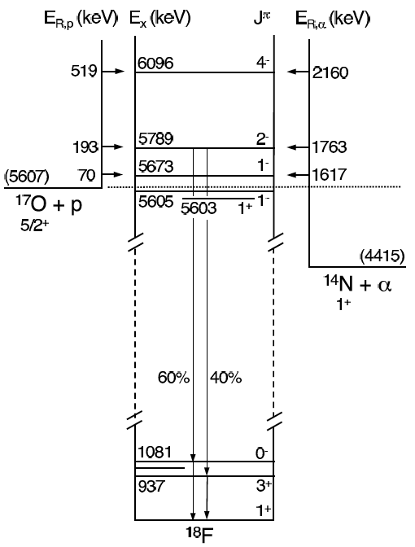
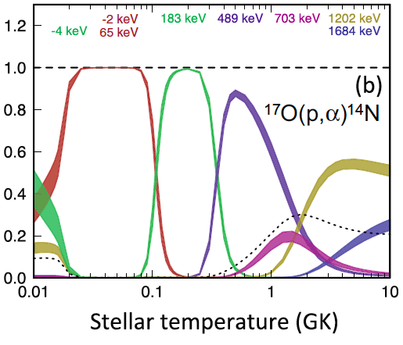
M Aliotta
Astrophysical Motivation
Buckner et al, PRC 91 (2015) 015812
resonance strength of 193keV state well known
resonance strength of 70keV state largely uncertain
Q-value (p,α) reaction = 1.2 MeV
alpha particles energy at backward angles ~ 1MeV

Slide 37
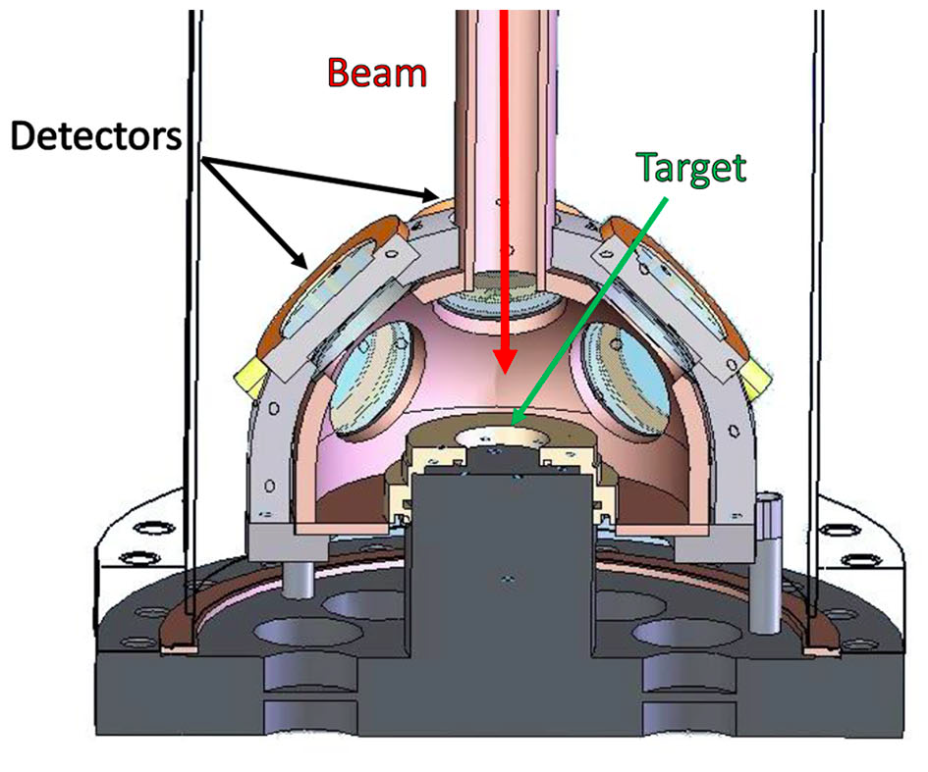


M Aliotta
Scattering Chamber for the ^{17,18}O(p,α)^{14,15}N reactions at LUNA
Purpose-built scattering chamber to host array of 8 silicon detectors
Bruno et al EJPA 51 (2015) 94
protective aluminized Mylar foils (2.4 μm) before each detector
expected alpha particle energy E ~ 200 keV (from 70 keV resonance)

Slide 38

M Aliotta
Scattering Chamber for the ^{17,18}O(p,α)^{14,15}N reactions at LUNA
Outer
chamber
Bottom of the
Scattering chamber
Target
Holder
Water cooling
tubes

Slide 39
M Aliotta
Commissioning Phase:
detector calibration with standard alpha source
concurrent measurement of thickness of Al-Mylar protective foils
resonance strength measurements of 183keV state in ¹⁷O(p,α)¹⁵N
resonance strength measurement of 144keV state in ¹⁸O(p,α)¹⁴N
efficiency measurements (to validate simulations)
background suppression factor (above ground vs underground) with and without lead shielding around chamber

Slide 40



M Aliotta
factor of 15 reduction
in background
intrinsic alpha-particle activity

Slide 41


M Aliotta
¹⁷O(p,α)¹⁴N results
use stronger 193keV resonance
to identify ROI for expected alpha particles from 70keV state
net counts = on-resonance run –
background run (= off-resonance run)
ωγ = 10.0 ± 1.4 (stat) ± 0.7 (sys) neV
most accurate result to date

Slide 42



M Aliotta
¹⁷O(p,α)¹⁴N Results
15x background reduction in ROI
+ improved experimental conditions
reaction rate ~ 2-2.5x higher than previously assumed

Slide 43

M. Aliotta
¹⁷O yield from 2-10 M_{sun} stars is 15-40% smaller than previously thought
23-27 January 2017 – 55th International Winter Meeting on Nuclear Physics, Bormio

Slide 44

M. Aliotta
  ¹⁷O/¹⁶O composition and origin of pre-solar grains revisited
Under Embargo
23-27 January 2017 – 55th International Winter Meeting on Nuclear Physics, Bormio

Slide 45


M. Aliotta
High-precision measurements of chemical composition of
pre-solar grains in meteorites
fragment of Allende Meteorite
(named after nearest post office)
8 February 1969 – Mexico
isotopic anomalies point to origin other than solar
evidence for processes that occurred in other stars before Solar System formed
Carbon-Aluminum inclusions
the largest carbonaceous chondrite ever found on Earth
best known and most studied meteorite in history
spheroidal chondrules
http://www.marmet-meteorites.com/id46.html
23-27 January 2017 – 55th International Winter Meeting on Nuclear Physics, Bormio

Slide 46

M. Aliotta
Pre-solar grains in meteorites
Pre-solar grains in meteorites
Carbon-rich (diamond, graphite, silicon carbide)
Oxygen-rich (silicates, Al-rich oxides, …)
  Group I (about 75%): show excess in ¹⁷O compared to solar values;
  origin well-understood: red giants (1-3 M)
  Group II (about 10%): excess in ¹⁷O, but depleted in ¹⁸O (up to 2 o.o.m. less than in solar system); ²⁶Al ~ factor of 10 higher than
  in Group I
  origin highly debated!
23-27 January 2017 – 55th International Winter Meeting on Nuclear Physics, Bormio

Slide 47

M. Aliotta
On the origin of Group II grains
Massive (4-8 M) AGB stars expected to produce large amounts of dust, BUT…
M Lugaro et al., Nature Astronomy 1 (2017) 0027
massive AGB stars
Hot Bottom Burning
higher temperatures (60-100 MK)
mixing due to convection
low-mass AGB stars
Cool Bottom Processing
lower temperatures (40-55 MK)
mixing due to ad-hoc “extra mixing”
23-27 January 2017 – 55th International Winter Meeting on Nuclear Physics, Bormio

Slide 48

M. Aliotta
On the origin of Group II grains
with previous ¹⁷O(p,α)¹⁴N reaction rate (Iliadis, 2010):
massive AGB stars excluded as possible sites of origin
low-mass AGB stars can be a possible site, but extra mixing process unclear
with new reaction rate (LUNA , 2016):
massive AGB stars become likely site of origin (as expected)
no need to invoke “extra mixing”
M Lugaro et al., Nature Astronomy 1 (2017) 0027
23-27 January 2017 – 55th International Winter Meeting on Nuclear Physics, Bormio

Slide 49



M. Aliotta
On the origin of Group II grains
M Lugaro et al., Nature Astronomy 1 (2017) 0027
23-27 January 2017 – 55th International Winter Meeting on Nuclear Physics, Bormio

Slide 50

M Aliotta
LUNA MV
Future Underground Facilities for Nuclear Astrophysics
LUNA MV: upgrade to 3.5 MV accelerator by 2018
First 5 years of scientific activity devoted to:
¹⁴N(p,γ)¹⁵O
CNO neutrinos and solar abundance problem
¹³C(α,n)¹⁶O and ²²Ne(α,n)²⁵Mg
  neutron sources for s-process
¹²C+¹²C fusion reactions
massive stars’ evolution
MV
400kV

Slide 51
Skype meeting | 17 July 2014
Fate of Massive Stars
Which stars explode as supernovae?

Slide 52

M. Aliotta
Carbon burning and the evolution of massive stars
Carbon Burning
Determines final evolution of massive stars (8-10 solar masses): CO WD or ccSN
Dictates ignition conditions for thermonuclear explosions
¹²C + ¹²C → ²⁴Mg*
→ ²⁰Ne + α + 4.62 MeV
→ ²³Na + p + 2.24 MeV

Slide 53

The ¹²C+¹²C Reaction
M. Aliotta
Nucleosynthesis Processes
importance: evolution of massive stars
Gamow region: 1 – 3 MeV
min. measured E: 2.1 MeV (by γ-ray spectroscopy)
Crab Nebula SN 1054
extrapolations differ by
3 orders of magnitude
Strieder, J. Phys. G35 (2008) 14009
main experimental challenges:
complex and not well understood ‘resonance-like’ structures
beam induced background at low energies (mostly on H and D contaminants)

Slide 54

M. Aliotta
¹²C + ¹²C fusion reactions
¹²C+¹²C Working Group
Caserta – Naples – Edinburgh Collaboration
L. Morales-Gallegos, M. Aliotta, CG Bruno, R. Buompane, M. De Cesare, T. Davinson, J. G. Duarte, A. Di Leva, A. D'Onofrio, L. Gasques, L. Gialanella, G. Imbriani, D. Rapagnani, M. Romoli,
D. Schuermann
Centre for Isotopic Research on the Cultural and Environmental heritage (CIRCE)
purpose-built ΔE-E detectors
  CF₄ ionization chamber (35 mbar)
  silicon strip detector (32 cm²)
(thin & thick) high-purity graphite or HOPG target (water cooled)
thermo-camera (for target monitoring)
scattering chamber enclosed in N₂ atmosphere (aquarium)

Slide 55



M. Aliotta
¹²C + ¹²C fusion reactions
sample ΔE-E matrix
proton spectrum
E_{cm} = 4.3 MeV
proton spectrum
E_{cm} = 3.15 MeV
courtesy: L Morales-Gallegos

Slide 56

M. Aliotta
Sample proton spectrum with identified peaks from ¹²C(¹²C,p)²³Na
and protons from ¹²C(d,p)¹³C on deuterium contaminants
¹²C(d,p)¹³C
courtesy: L Morales-Gallegos
23-27 January 2017 – 55th International Winter Meeting on Nuclear Physics, Bormio

Slide 57

M. Aliotta
Deuterium Content vs Target Temperature
clear reduction for both HOPG and NG targets
target purity further improved by presence of aquarium
PRELIMINARY
courtesy: L Morales-Gallegos
23-27 January 2017 – 55th International Winter Meeting on Nuclear Physics, Bormio

Slide 58
M. Aliotta
Summary
impressive progress in Nuclear Astrophysics achieved over last 60-70 years
major advances in astronomical observations from space-borne satellites
major advances in computational power (complex stellar structure and evolution models)
major advances in nuclear experiment capabilities (RIB facilities and underground dedicated accelerator)
many open questions remain…
bright future for new generations to come
23-27 January 2017 – 55th International Winter Meeting on Nuclear Physics, Bormio

Slide 59

M. Aliotta
With thanks to all colleagues at LUNA and CIRCE
23-27 January 2017 – 55th International Winter Meeting on Nuclear Physics, Bormio

Slide 60
Skype meeting | 17 July 2014
¹⁸O(p,α)¹⁵N reaction
hydrogen burning in:
asymptotic giant branch stars
¹⁵N abundance in SiC grains
¹⁹F abundance in AGB

Slide 61


M Aliotta
The ¹⁸O(p,α)¹⁵N reaction: Current status
most resonances well known
but energy and strength of
95keV resonance still debated
Q-value = 3.9 MeV
Lorenz-Wirzba NPA 313 (1979) 346

Slide 62
M Aliotta
Experimental Data
151 keV resonance
PRELIMINARY
lowest energy
to date
217 keV resonance
334 keV resonance
95 keV resonance
courtesy: CG Bruno

Slide 63

M Aliotta
R-matrix analysis
FINAL RESULTS TO BE PUBLISHED SOON
courtesy: CG Bruno

Slide 64


Neutron Source
M. Aliotta
Nucleosynthesis Processes
¹³C(α,n)¹⁶O
importance: s-process in AGB stars
Gamow region: 130 - 250 keV
min. measured E: 270 keV
M. Heil et al. PRC 78 (2008) 025803
mainly hampered by cosmic background
→ excellent case for underground study

Slide 65

M. Aliotta
RUN 366 (HOPG 70mbar)
target temperature [ºC]
23-27 January 2017 – 55th International Winter Meeting on Nuclear Physics, Bormio

Slide 66
M. Aliotta
Explosive Scenarios: Novae, Supernovae type Ia, X-ray Bursts
Type I X-ray Bursts
Light curves
bursts from 4U/MXB 1636-53
Szatjano et al. ApJ 299 (1985) 487-495
light curve features resulting from interplay between accretion rates and
complex patter of nuclear reactions
23-27 January 2017 – 55th International Winter Meeting on Nuclear Physics, Bormio

Slide 67






M. Aliotta
Nuclear reactions, stars, and the creation of the elements
Our cosmic inheritance
Nuclear Physics
Astrophysics
Chemistry
Central image credit:
Mackintosh, Al-Khalili, Jonson, Pena: Nucleus - A trip into the Heart of Matter, 2nd edition - Dundee University Press, 2011
Pint of Science Festival, Edinburgh 23 May 2016
3 May 2016 - Physics Colloquium - Johannes Gutenberg-University Mainz

