Slide 1
Radiative capture and photodisintegration reactions for the synthesis of the p nuclei
Philipp Scholz
for the group of Prof. Dr. Andreas Zilges
Institute for Nuclear Physics, University of Cologne
Workshop on New Vistas in Low-Energy Precision Physics (LEPP)
April 4th-7th, 2016
Supported by the ULDETIS project within the UoC Excellence Initiative institutional strategy and by DFG (ZI 510/8-1, INST 216/544-1).
* Partly supported by the Bonn-Cologne Graduate School of Physics and Astronomy.

Slide 2
Outline
Introduction
Nucleosynthesis of heavy elements and the p nuclei
the γ-process reaction network
Experimental measurements of cross-sections
photo-induced reaction measurements
charged-particle induced reaction studies
Experimental results
testing the E1-strength in ⁹⁰Zr via ⁸⁹Y(p,γ)
total and partial cross sections for ⁹²Mo(p,γ)

Slide 3
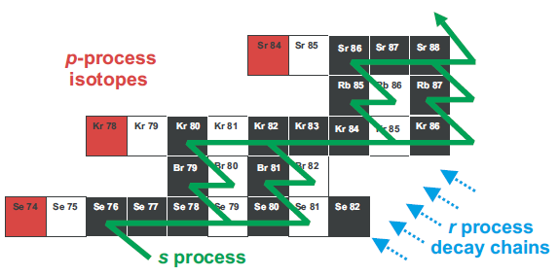
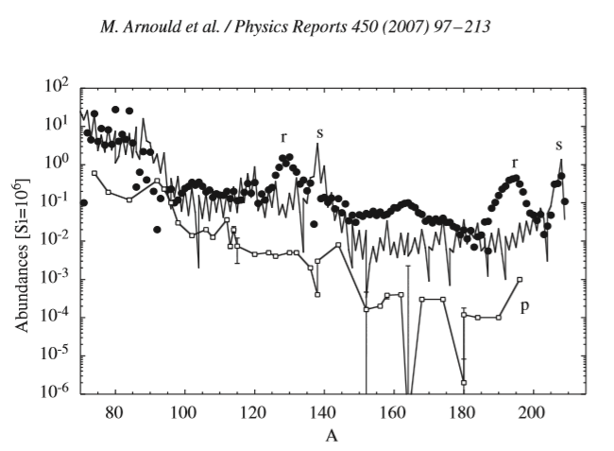
The synthesis of the p nuclei
T. Rauscher et al., Rep. Prog. Phys. 76 (2013) 066201
p nuclei
30-35 neutron deficient isotopes
cannot be produced by neutron-capture reactions
relatively low isotopic abundances in comparison to s- and r-isotopes
originally thought to be produced via proton-capture
temperatures would lead to immediate photodisintegration
M. Arnould et al., Phys. Rep. 450 (2007) 97

Slide 4
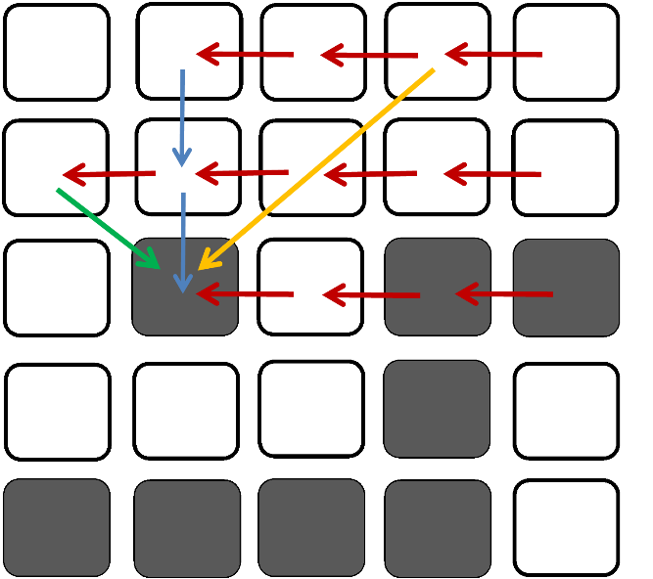
The synthesis of the p nuclei
γ process reaction-network
huge photodisintegration reaction-network
at temperatures between 1.5 GK and 3 GK in ccSN or type Ia SN
starting from stable seed nuclei formed in the s- or r-process
γ-process path proceeds first via (γ,n) reactions
branching for A < 130 mainly via (γ,p)
above A > 130 (γ,α) get more important

Slide 5
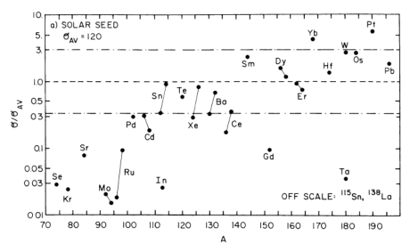
The synthesis of the p nuclei
reaction-network calculations
γ-process network calculations cannot reproduce solar system abundance
other contributions from rp-, α- or other processes?
problems with photoinduced reaction cross sections?
S.E. Woosley and W. M. Howard, ApJSS 36 (1978) 285

Slide 6
Experimental measurements of cross sections
Photodisintegration
measuring cross sections via direct detection of ejectiles or via photoactivation
using either monochromatic γ-ray beams or Bremsstrahlung
separation energy S_{n} or S_{p}
n or p
γ
γ
β
^{A}X
^{A‘}Y

Slide 7
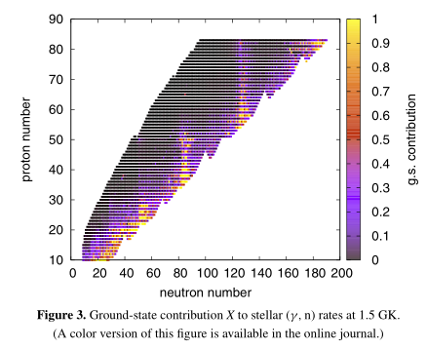
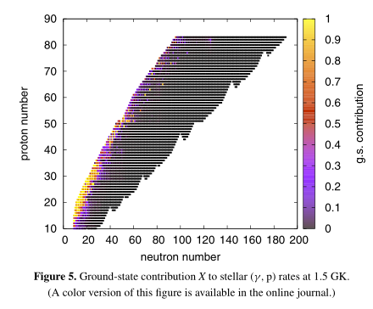
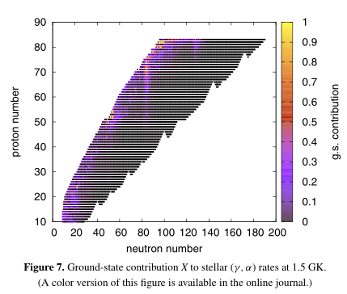
Experimental measurements of cross sections
Ground-state contributions
measured cross sections cannot directly used for astrophysics
for γ-induced reaction the ground-state contribution is almost zero
larger contribution from excited states in the stellar plasma (T₉ > 1.5)
reaction rates are obtained from the inverse reactions via reciprocity theorem
(γ,n)
(γ,p)
(γ,α)
T. Rauscher, ApJSS 201 (2012) 26

Slide 8
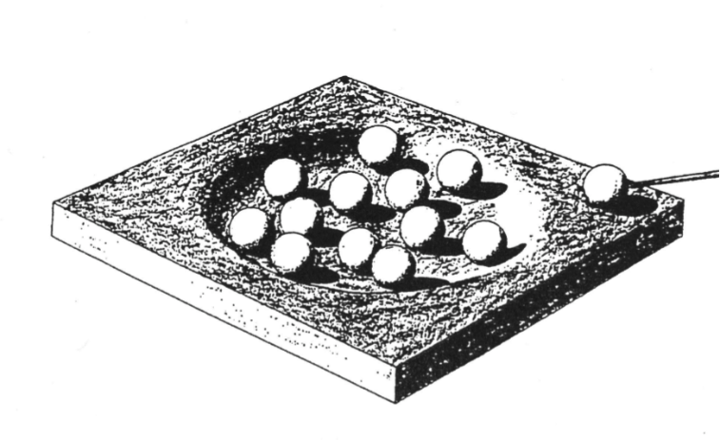
Experimental measurements of cross sections
Statistical model
cross sections in the Gamow window are small ( < µb)
most of the reactions are not accessible in the laboratory
reaction rates are calculated mostly in the scope of the statistical model
cross-section measurements to improve nuclear physics input-parameters:
γ-strength function (also via (γ,γ’))
particle + nucleus optical model potentials

Slide 9
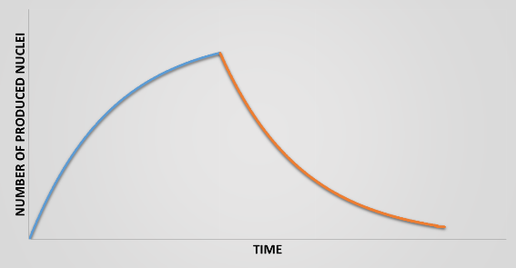
Charged-particle induced reaction cross sections
Activation technique
widely used technique for measureing cross-sections
temporal and spatial separation of irradiation and spectroscopy
no access to reactions involving stable reaction products
feasible half-lives neccessary

Slide 10
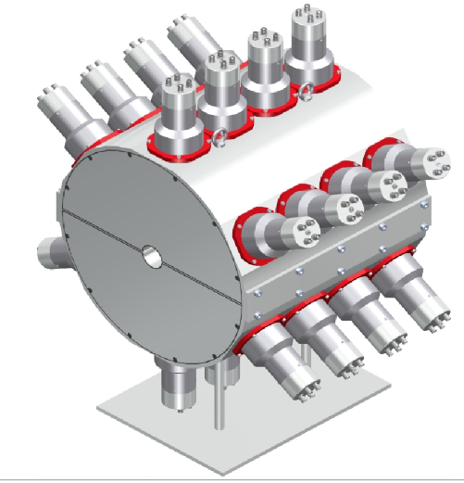
Charged-particle induced reaction cross sections
Activation technique
widely used technique for measureing cross-sections
temporal and spatial separation of irradiation and spectroscopy
no access to reactions involving stable reaction products
feasible half-lives neccessary
4π summing crystal method
complete deexcitation is summed up in one peak
access to stable reaction products
need for very different Q-values for competing reactions
no access to partial cross-sections

Slide 11
Charged-particle induced reaction cross sections
Activation technique
widely used technique for measureing cross-sections
temporal and spatial separation of irradiation and spectroscopy
no access to reactions involving stable reaction products
feasible half-lives neccessary
4π summing crystal method
complete deexcitation is summed up in one peak
access to stable reaction products
need for very different Q-values for competing reactions
no access to partial cross-sections
In-beam method with HPGe detectors

Slide 12
In-beam technique with HPGe detectors
de-excitation of the entry state
determination of partial cross sections
very sensitive on the γ-ray strength function
E_{p}
+ Q

Slide 13
In-beam technique with HPGe detectors
de-excitation of the entry state
determination of partial cross sections
very sensitive on the γ-ray strength function
transitions to the ground state
determination of the total cross section
E_{p}
+ Q

Slide 14
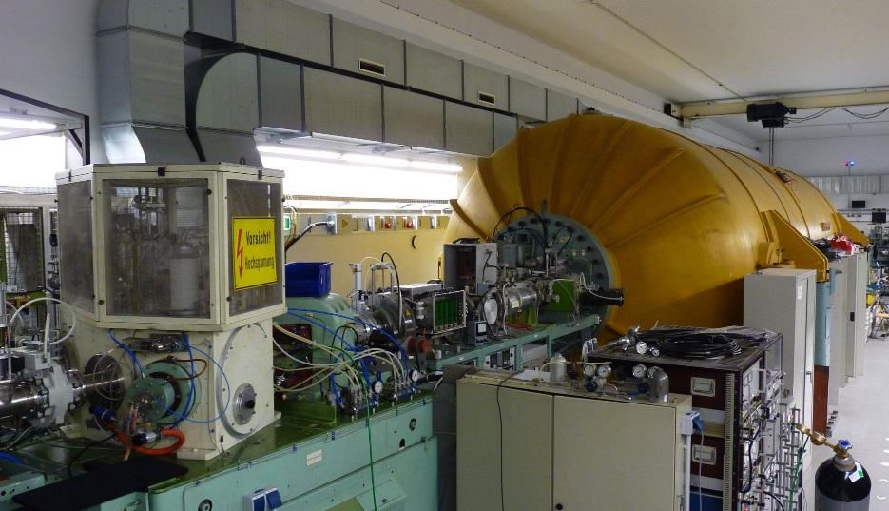
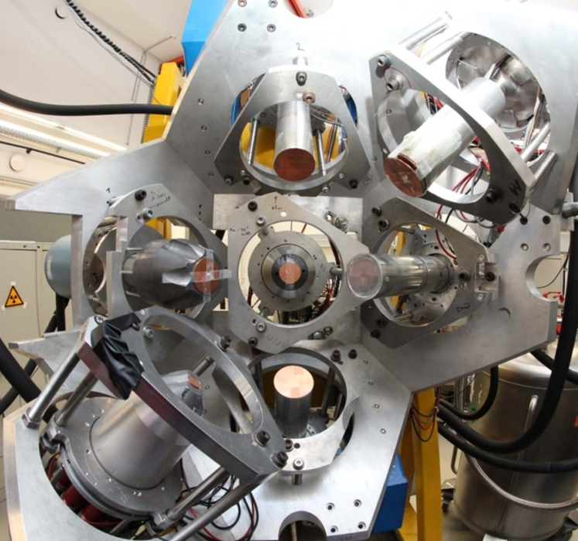
In-beam technique with HPGe detectors
10 MV FN-Tandem ion accelerator
HORUS γ-ray spectrometer
14 HPGe detectors
High resolution ≈ 2 keV @ 1332 keV
High total efficiency ≈ 2% @ 1332 keV
5 different angles with respect to beam axis
determination of angular distributions
BGO shields
L. Netterdon et al., NIM A 754 (2014) 94-100

Slide 15
In-beam technique with HPGe detectors
Target chamber
cooling trap
tantalum coating
independent current readouts
δ-electron suppression
built-in detector for Rutherford Backscattering Spectrometry (RBS)
L. Netterdon et al., NIM A 754 (2014) 94-100

Slide 16
In-beam measurement of the ⁸⁹Y(p,γ)
reaction in a region which is normally underproduced in reaction network calculations
total cross section was measured twice before
γ-ray strength function in ⁹⁰Zr was measured before
natural yttrium target (583µg/cm²)
beam currents between 1nA and 60nA
five different proton energies between 3.65 MeV and 4.70 MeV, i.e. γ-ray energies between 7.71 MeV and 12.98 MeV (Q-Value: 8353.4 keV)
⁹³Tc
⁹²Mo
⁹⁴Mo
⁹¹Nb
⁹²Nb
⁹³Nb
⁹⁰Zr
⁹¹Zr
⁹²Zr
⁸⁹Y
⁸⁶Sr
⁸⁷Sr
⁸⁸Sr

Slide 17
In-beam measurement of the ⁸⁹Y(p,γ)

Slide 18
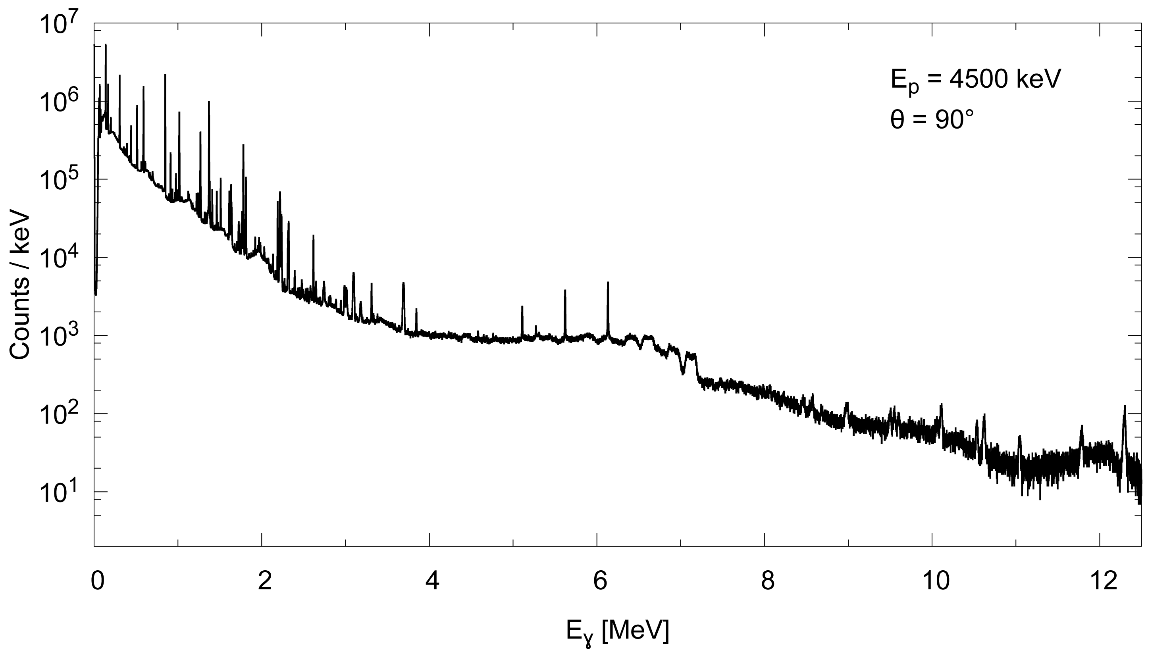
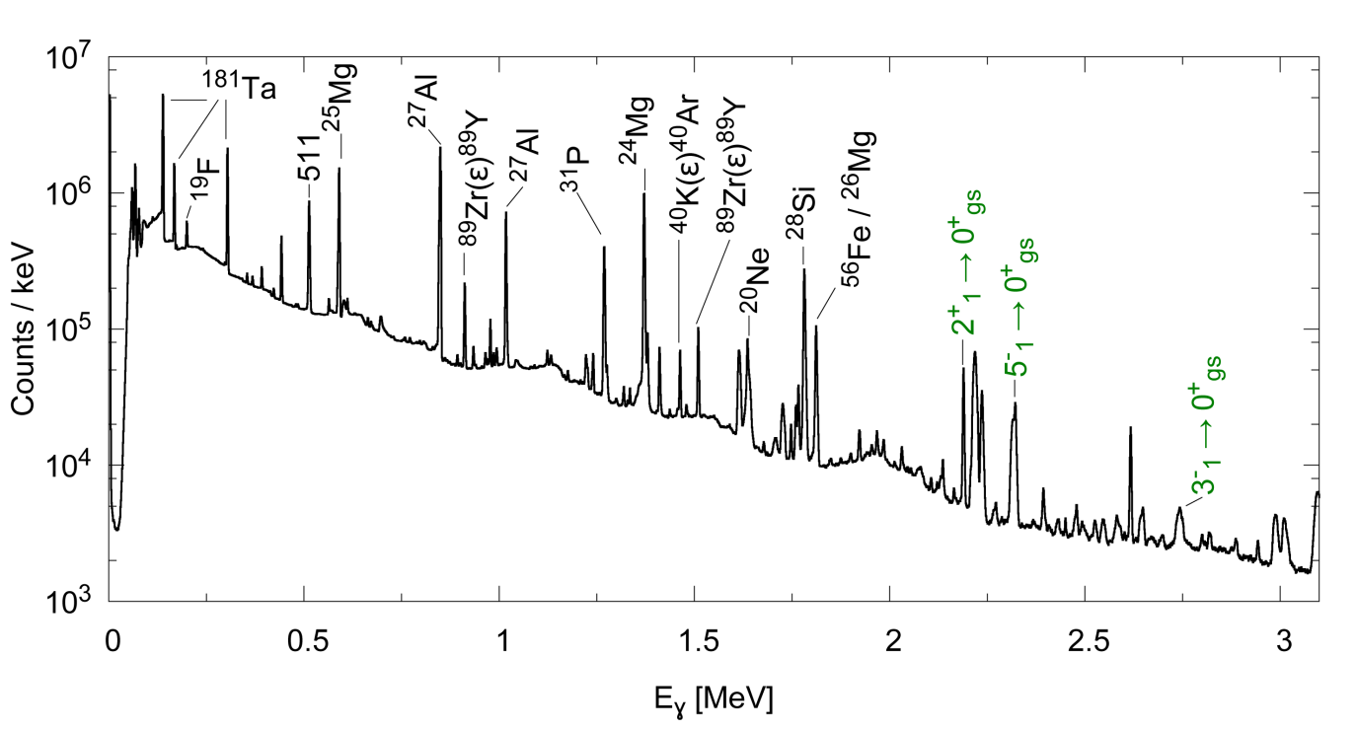
In-beam measurement of the ⁸⁹Y(p,γ)

Slide 19
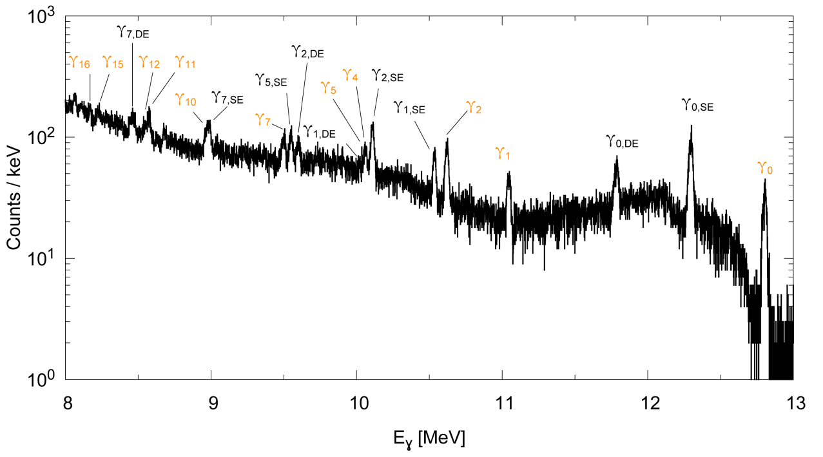
In-beam measurement of the ⁸⁹Y(p,γ)
γ₀
γ₁
γ₂
γ₃
γ₄
γ₅
L. Netterdon et al., PLB 744 (2015) 358

Slide 20
In-beam measurement of the ⁸⁹Y(p,γ)
⁸⁹Y(p,γ) partial cross sections: huge deviations

Slide 21
In-beam measurement of the ⁸⁹Y(p,γ)
using γ-strength function from (γ,γ’) measurement:
R. Schwengner et al., PRC 78 (2008) 064314

Slide 22
In-beam measurement of the ⁸⁹Y(p,γ)
adjusting γ-strength to measured data
L. Netterdon et al., PLB 744 (2015) 358
R. Schwengner et al., PRC 78 (2008) 064314

Slide 23
In-beam measurement of the ⁸⁹Y(p,γ)
Impact on ⁹⁰Zr(γ,p)⁸⁹Y
15 % larger reaction rate than based on E1-strength from (γ,γ‘)
twice as large as BRUSLIB reaction rate (QRPA strength)
three times smaller than NONSMOKER rates (Lorentzian-type E1-strength)
R. Schwengner et al., PRC 78 (2008) 064314
L. Netterdon et al., PLB 744 (2015) 358

Slide 24
In-beam measurement of the ⁹²Mo(p,γ)
⁹³Tc
⁹²Mo is the most abundant p nuclei and its origin is highly debated
total cross-section were measured before with different techniques at energies below 3.5 MeV
isotopically enriched ⁹²Mo target (94 %)
beam currents between 50 nA and 350 nA
proton energies between 3.7 MeV and 5.4 MeV
extending measurement towards higher energies
sensitive to higher energy γ-ray transitions
⁹²Mo
⁹⁴Mo
⁹¹Nb
⁹²Nb
⁹³Nb
⁹⁰Zr
⁹¹Zr
⁹²Zr
⁸⁹Y
⁸⁶Sr
⁸⁷Sr
⁸⁸Sr

Slide 25
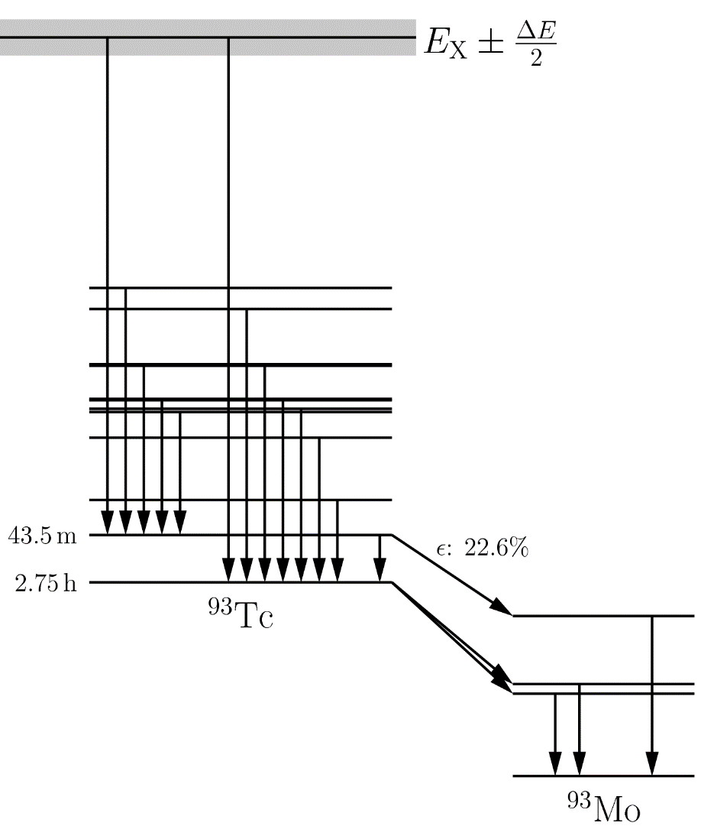
In-beam measurement of the ⁹²Mo(p,γ)
Problem: metastable state @ 391 keV
Significant half-life
Electron capture branching to ⁹³Mo
Solution:
Determine σ_{gs}
Determine σ_{m}

Slide 26
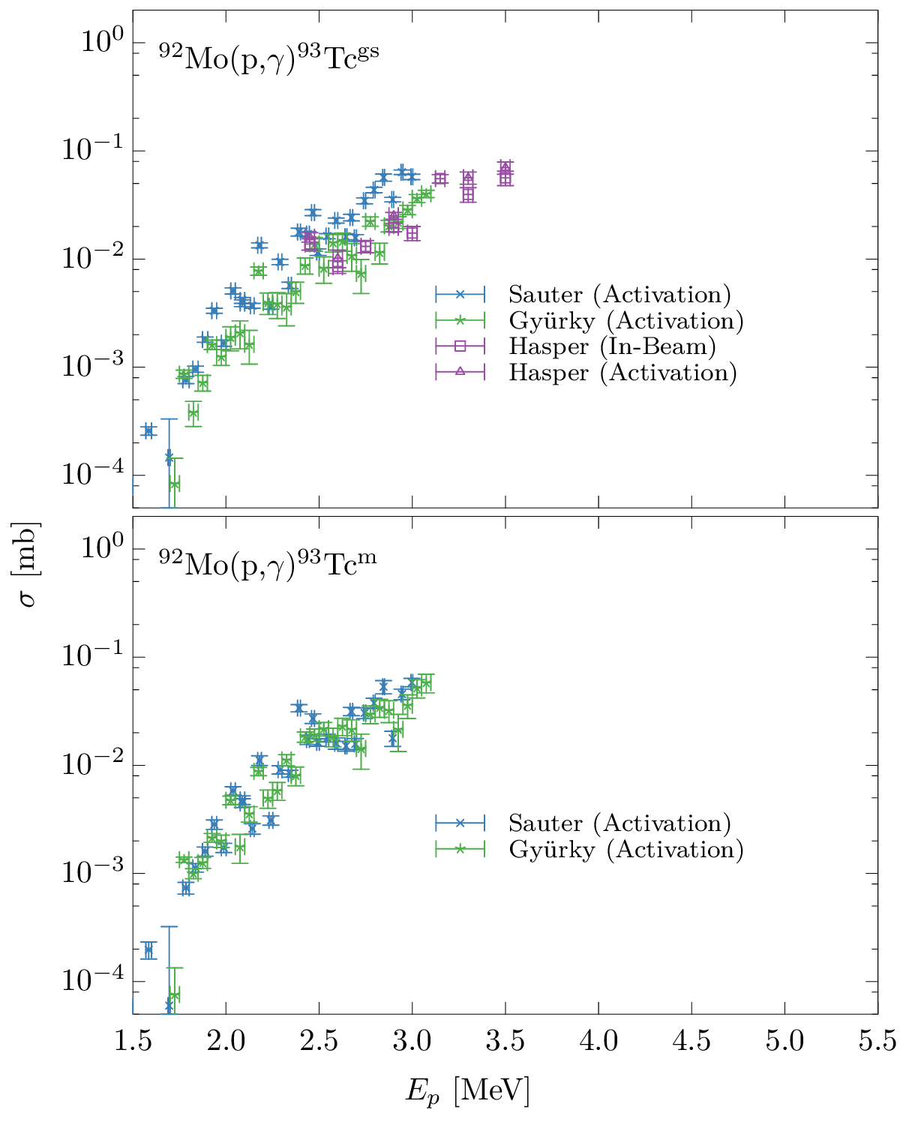
In-beam measurement of the ⁹²Mo(p,γ)
Total cross sections
Previously measured cross sections show fluctuating behavior
TALYS calculations
Unsatisfactory reproduction with default settings
modified γ-strengths
M1 shell model
Gogny-HFB + QRPA
Skyrme-HFB + QRPA
T. Sauter and F. Käppeler, PRC 55, 3127 (1997)
Gy. Gyürky et al., NPA 922, 112–125 (2014)
J. Mayer et al., PRC, accepted

Slide 27
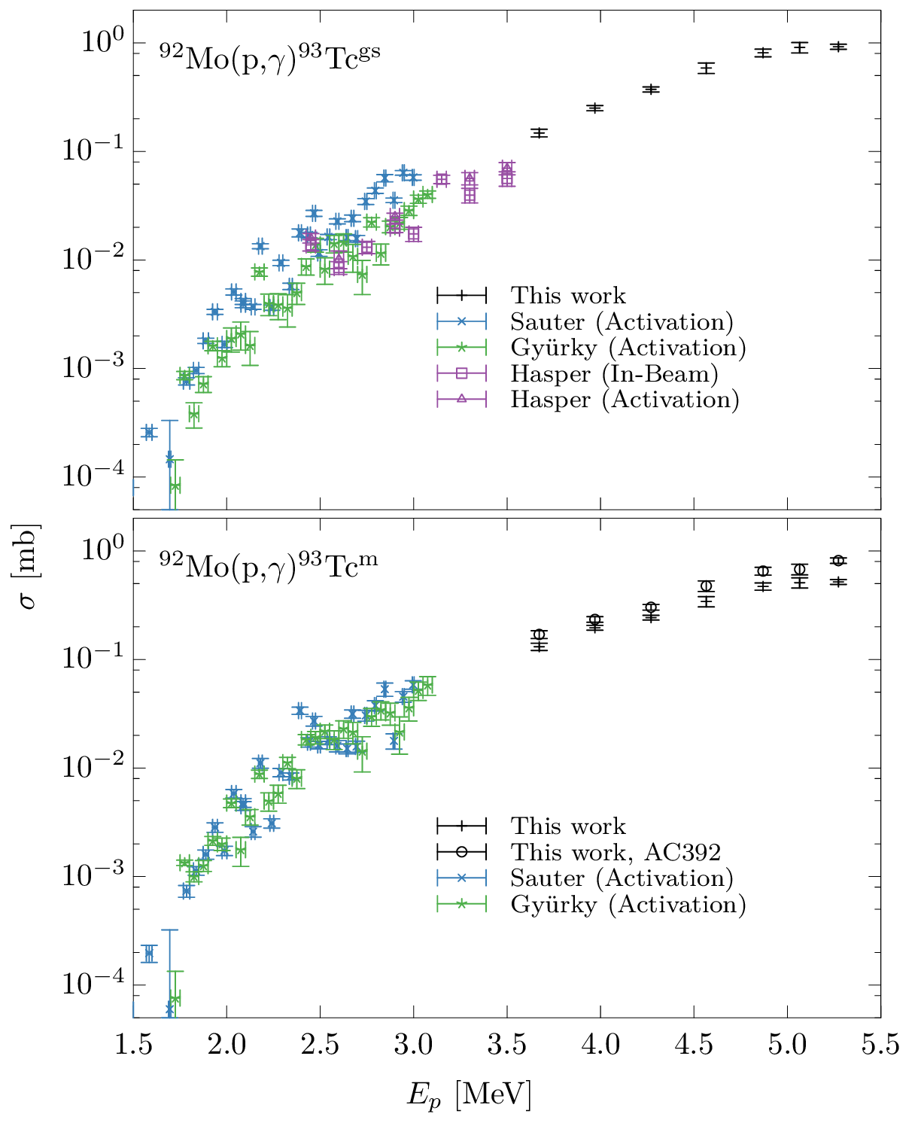
In-beam measurement of the ⁹²Mo(p,γ)
Total cross sections
Previously measured cross sections show fluctuating behavior
TALYS calculations
Unsatisfactory reproduction with default settings
modified γ-strengths
M1 shell model
Gogny-HFB + QRPA
Skyrme-HFB + QRPA
T. Sauter and F. Käppeler, PRC 55, 3127 (1997)
Gy. Gyürky et al., NPA 922, 112–125 (2014)
J. Mayer et al., PRC, accepted

Slide 28
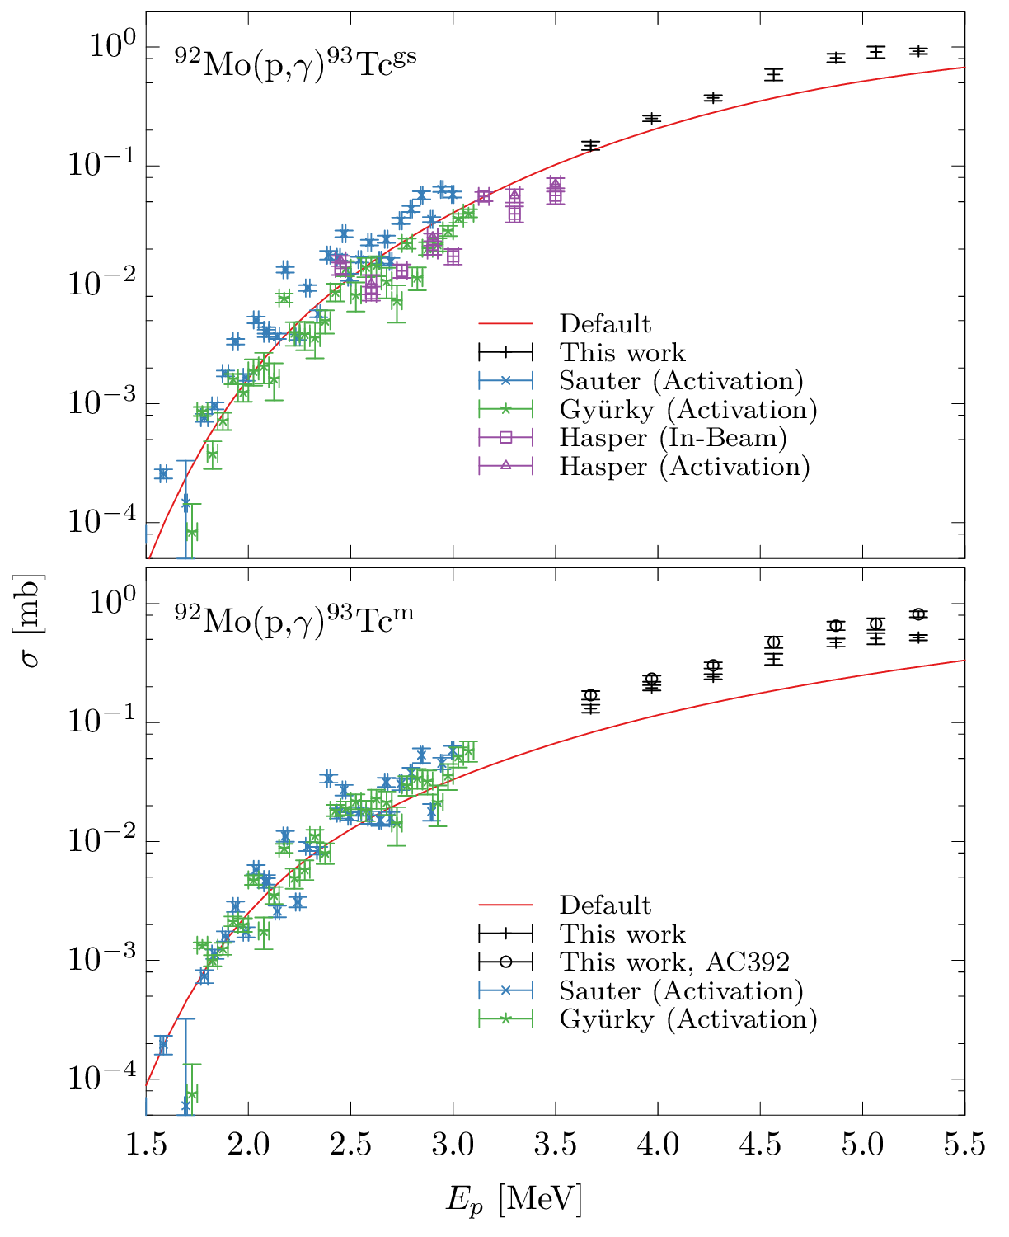
In-beam measurement of the ⁹²Mo(p,γ)
Total cross sections
Previously measured cross sections show fluctuating behavior
TALYS calculations
Unsatisfactory reproduction with default settings
modified γ-strengths
M1 shell model
Gogny-HFB + QRPA
Skyrme-HFB + QRPA
T. Sauter and F. Käppeler, PRC 55, 3127 (1997)
Gy. Gyürky et al., NPA 922, 112–125 (2014)
J. Mayer et al., PRC, accepted

Slide 29
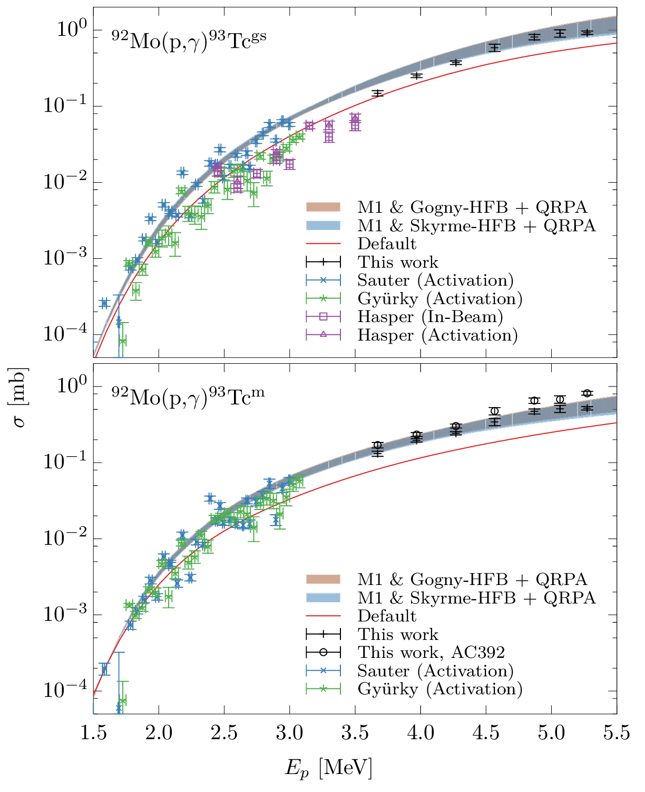
In-beam measurement of the ⁹²Mo(p,γ)
Total cross sections
Previously measured cross sections show fluctuating behavior
TALYS calculations
Unsatisfactory reproduction with default settings
modified γ-strengths
M1 shell model
Gogny-HFB + QRPA
Skyrme-HFB + QRPA
T. Sauter and F. Käppeler, PRC 55, 3127 (1997)
Gy. Gyürky et al., NPA 922, 112–125 (2014)
J. Mayer et al., PRC, accepted

Slide 30
In-beam measurement of the ⁹²Mo(p,γ)
Partial cross sections
J. Mayer et al., PRC, accepted

Slide 31
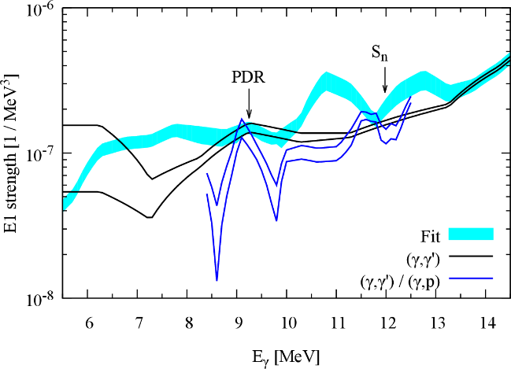
Summary
the origin of the p nuclei is still unclear due to astrophysical and nuclear physics uncertainties
direct measurements of (γ,x) reaction rates can in most cases not directly applied to reaction network calculations
reaction rates are usually calculated within the statistical model and via reciprocity theorem from the inverse reactions
charged-particle induced reaction studies can be used for the improvement of models for statistical properties of nuclei
γ-ray strength functions
particle+nucleus optical model potentials

Slide 33
Overview of nucleosynthesis processes
HELIUM BURNING
Producing ¹²C via triple-a
¹²C(a,g), ¹⁶O(a,g), ²⁰Ne(a,g)²⁴Mg, ¹⁴N(a,g)¹⁸F, ¹⁵N(a,g)¹⁹F, ¹⁸O(a,g)²²Ne, ²²Ne(a,g)²⁶Mg
T₉ = 0.1-0.4
protons
neutrons

Slide 34
Overview of nucleosynthesis processes
ADVANCED BURNING STAGES
¹²C+¹²C in core carbon burning and ¹⁶O+¹⁶O producing n,p,a
Secondary reactions with n,p,a
Photodisintegration starts to play a role at T₉ > 1 producing more light particle
protons
neutrons

Slide 35
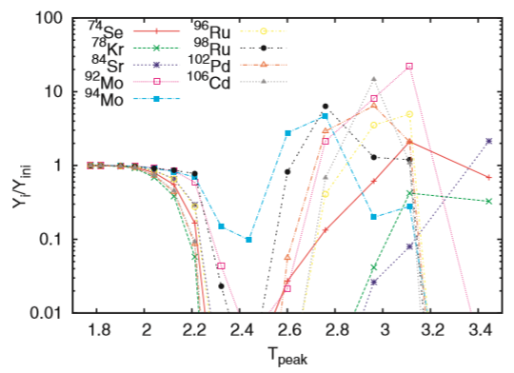
Uncertainties for γ process nucleosynthesis
Astrophysical uncertainties
seed abundances from s- or r-process or chemical evolution
temperature and density profiles
contribution from, for instance, α-process in neutrino-driven wind scenarios or rp process in Type Ia X-ray bursts?
S.E. Woosley and W. M. Howard, ApJSS 36 (1978) 285
T. Rauscher et al., Rep. Prog. Phys. 76 (2013) 066201

Slide 36
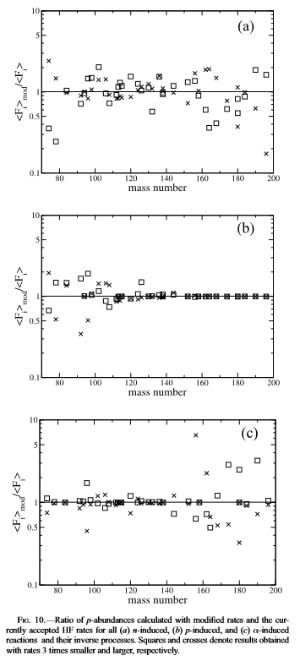
Uncertainties for γ process nucleosynthesis
(γ,n)
Nuclear physics uncertainties
sensitivity study of the γ process in ccSN
all p isotope abundances are sensitive to (γ,n) reaction rates
only the lighter p nuclei are sensitive to (γ,p)
(γ,a) especially important for the production factors of the heavier p isotopes
(γ,p)
(γ,α)
W. Rapp et al., ApJ 653 (2006) 474

Slide 37
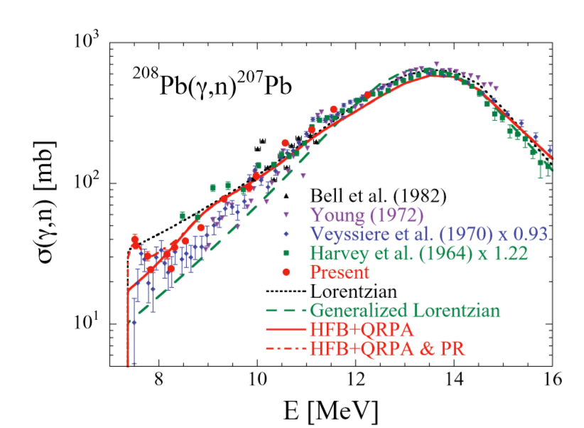
Experimental measurements of cross sections
Monochromatic γ-ray beams
Example: HIγS @ Duke, TERAS @ Tsukuba
using Laser Compton-Backscattering to produce (quasi-) monochromatic γ-rays
measuring (γ,n) cross sections point-by-point until the neutron treshold
T. Kondo et al., Phys. Rev. C 86 (2012) 014316

Slide 38
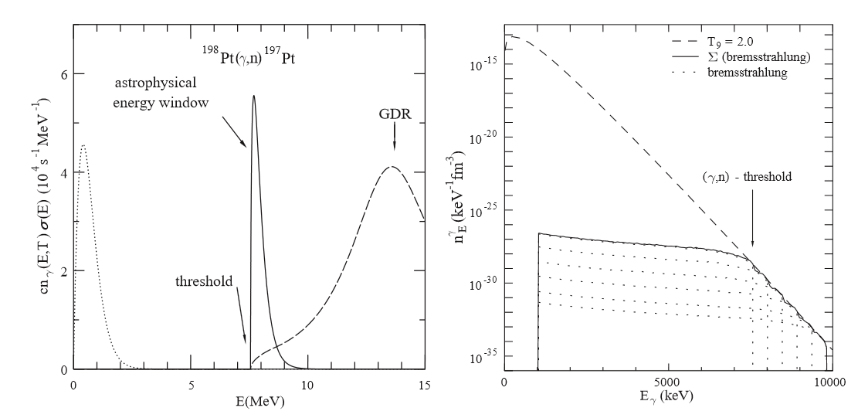
Experimental measurements of cross sections
Bremstrahlung
simulating a planck distribution with many Bremsstrahlung spectra using different endpoint energies
direct measurement of (γ,n) reaction rate at a specific temperature
P. Mohr et al., PLB 488 (2000) 127

Slide 39
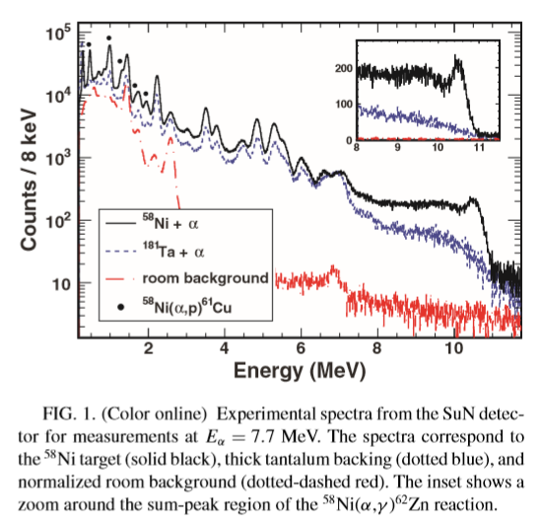
Experimental measurements of cross sections
4π-summing crystal
SuN – NaI 4π summing detector [NSCL]
S. Quinn et al., Phys. Rev. C 89 (2014) 054611

Slide 40
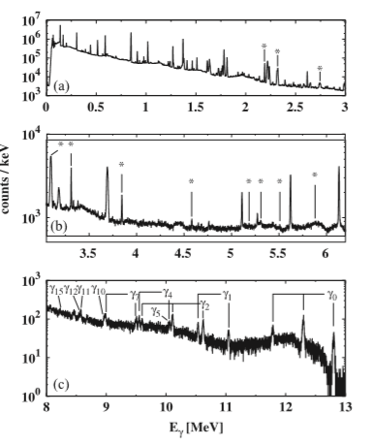
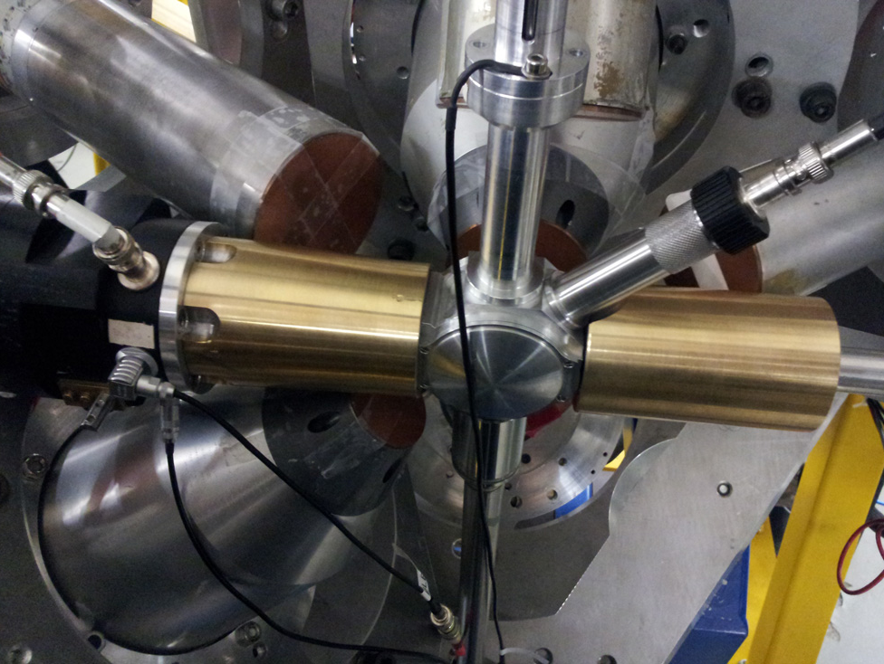
Experimental measurements of cross sections
In-beam method with HPGe detectors
⁸⁹Y(p,γ)
Nuclear astrophysics @ HORUS
L. Netterdon et al., NIM A 754 (2014) 94

Slide 41
In-beam technique with HPGe detectors
Target chamber
cooling trap
tantalum coating
independent current readouts
δ-electron suppression
built-in detector for Rutherford Backscattering Spectrometry (RBS)
L. Netterdon et al., NIM A 754 (2014) 94-100

Slide 42
In-beam technique with HPGe detectors
Target chamber
current readout
Beam
cooling trap

