Slide 1
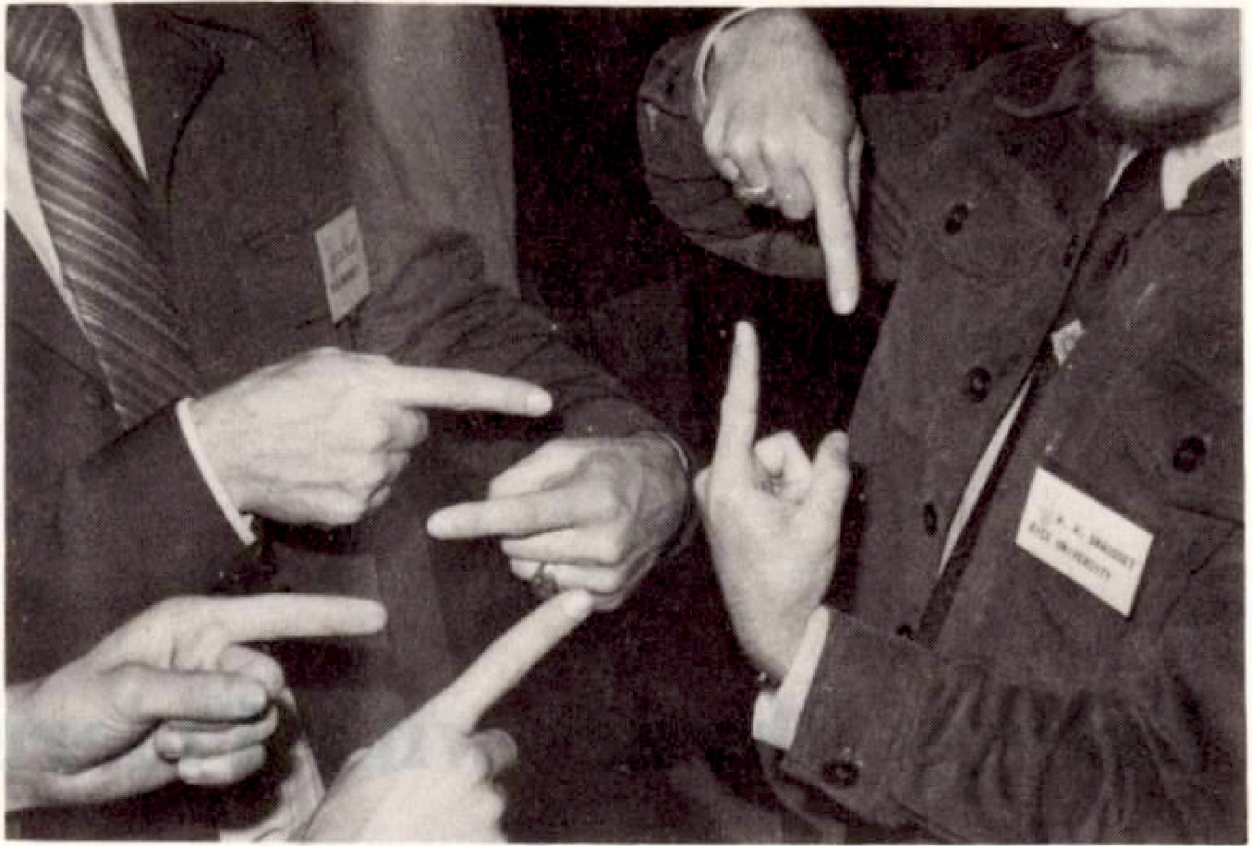





Polarized electron scattering at very low momentum transfers: nuclear structure and beyond
Joachim Enders, Technische Universität Darmstadt
New Vistas in Low-Energy Precision Physics (LEPP)
Mainz
April 4-7, 2016
SFB 634

Slide 2
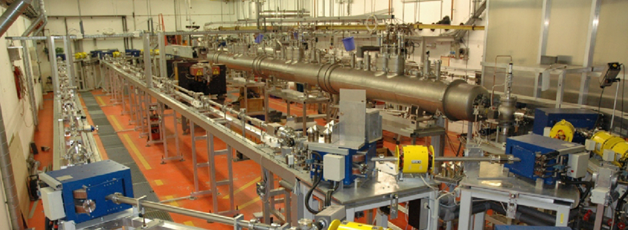
S-DALINAC
Operational parameters
  100 keV polarized beam, 250 keV beam from thermionic gun, < 300 μA
  3 – 10 (14) MeV behind superconducting injector linac, < 60 (150) μA
  15 – 80 (120) MeV after main accelerator, < 15 μA (typical 1 μA)
A. Richter, Proc. EPAC 1996, p. 110

Slide 3
Ideas
MeV Mott Scattering Analyzing Strength
Fifth Structure Function of Electron Scattering
Bremsstrahlung Polarization Correlations
Electron Pair Polarization Correlations

Slide 4
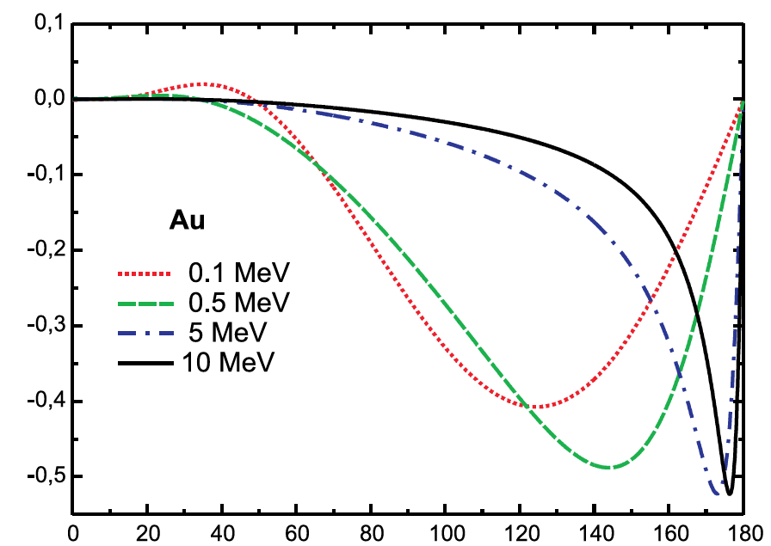
Analyzing Strength of Elastic Electron Scattering: The Sherman Function
Elastic electron scattering
  polarization dependency
  transverse spin orientation
At energies E > 10 MeV
  minimum close to 180°
  S ≈ 0 else
At energies E > 15 MeV
  cross section mod. by form factor: charge & magnetization distribution
  Sherman function: nuclear charge & magnetization distribution
Sherman Function
Scattering Angle (deg)

Slide 5
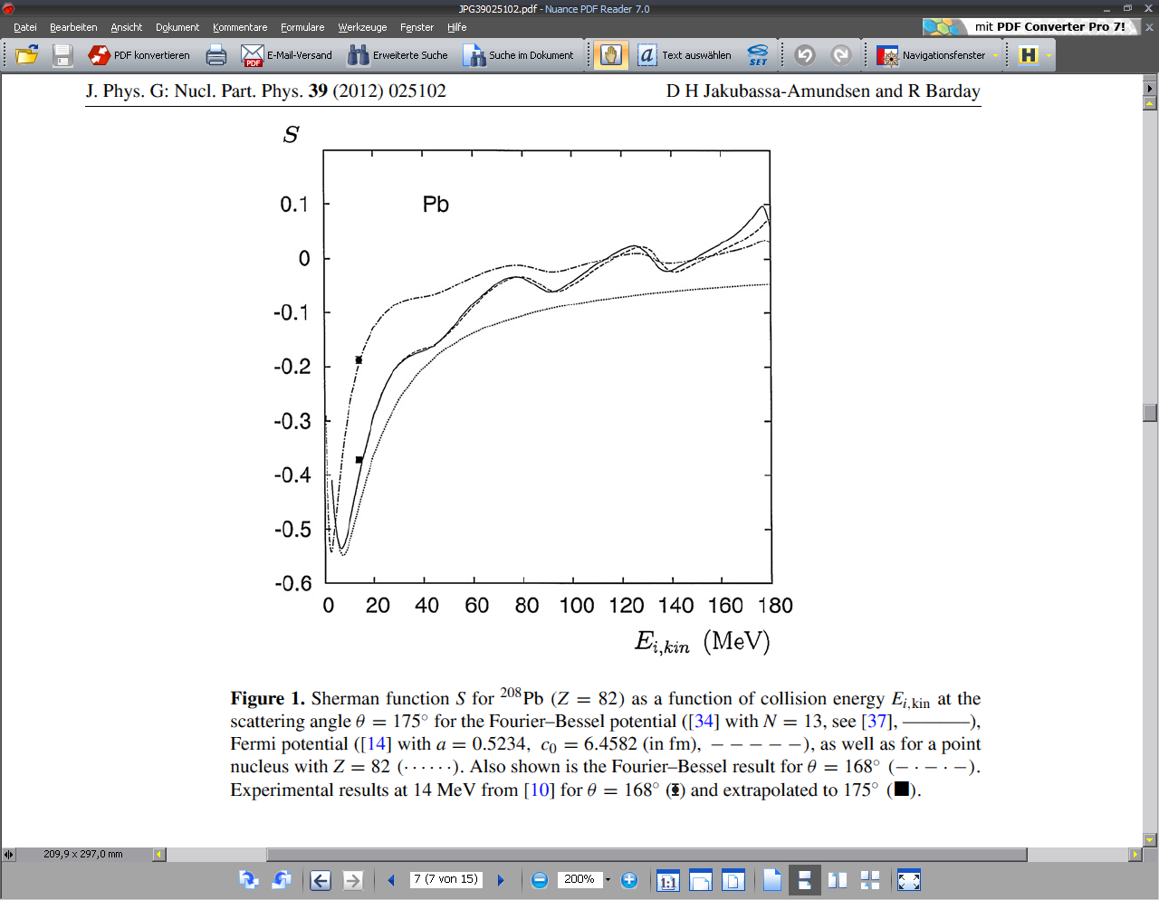
Data vs. Predictions
D. H. Jakubassa-Amundsen, R. Barday,
J. Phys. G 39, 025102 (2012)
→ (Basically) no data!
J. Sromicki et al., PRL 82, 57 (1999)
MAMI, 14 MeV

Slide 6
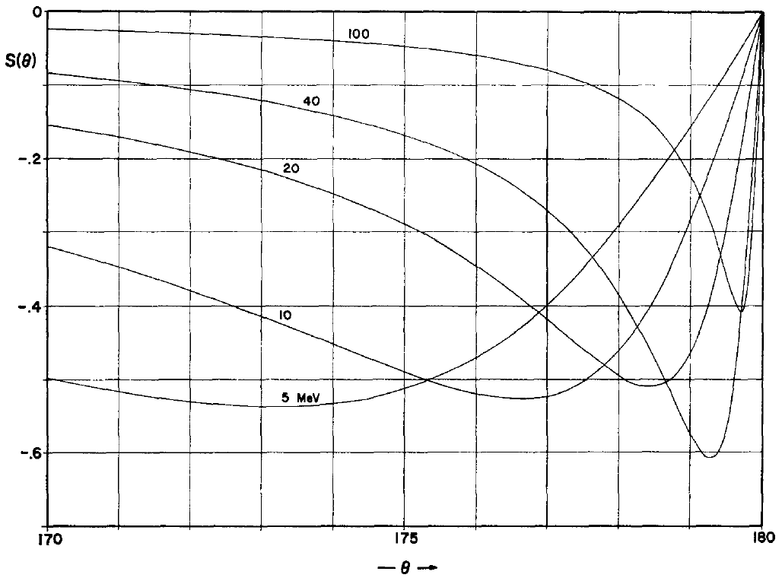
Predictions
²⁰⁸Pb(e,e’)
P. Uginčius, H. Überall, G.H. Rawitscher,
NPA 158, 418 (1970)

Slide 7
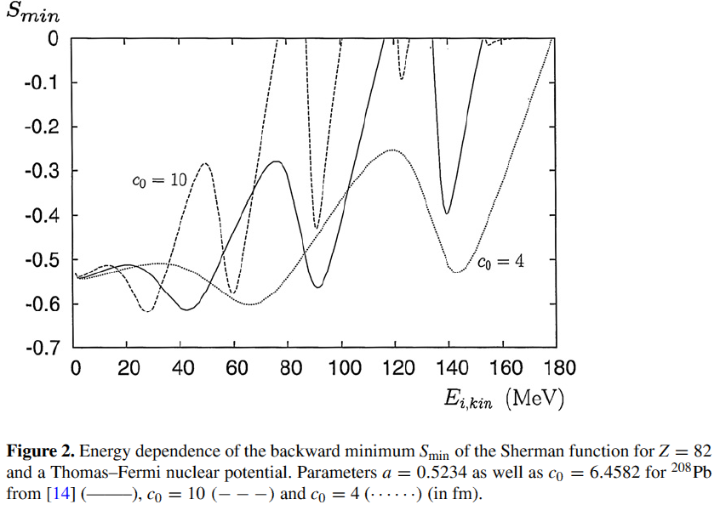
Predictions
Access to details
of charge distribution at low q?
But: Need to measure
  very close to 180°
  at energies between 25 and 100 MeV
D. H. Jakubassa-Amundsen and R. Barday,
J. Phys. G 39, 025102 (2012)

Slide 8
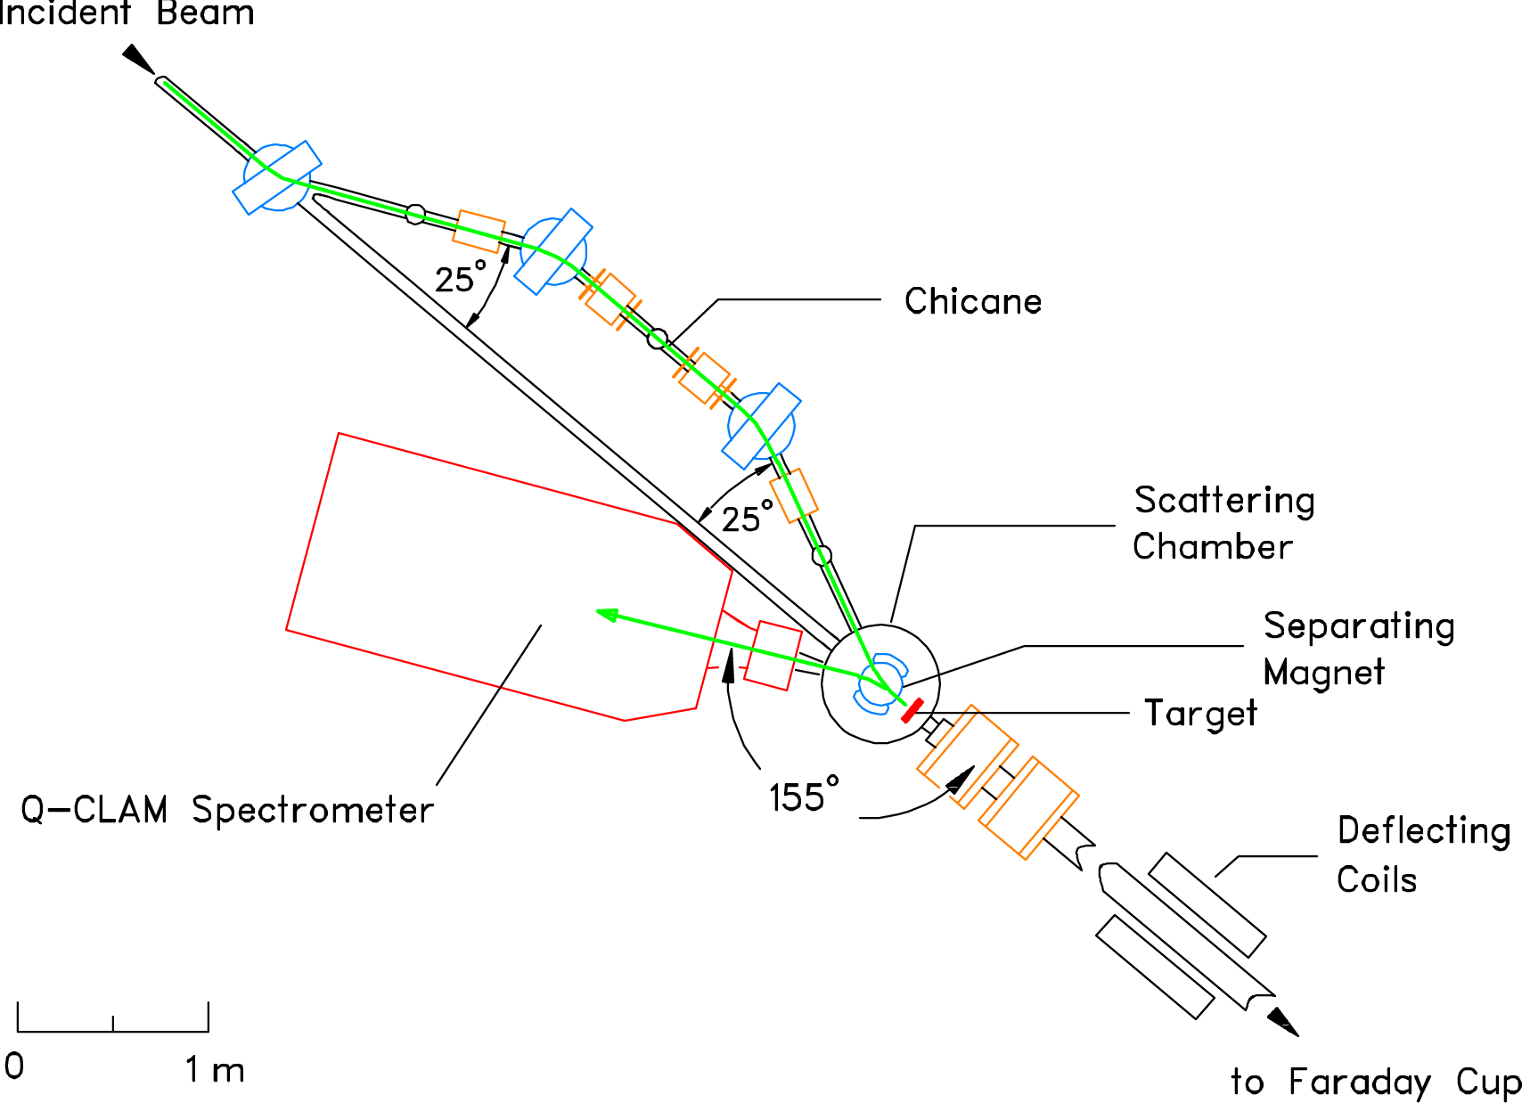
Electron Scattering at 180°
180° scattering facility
at the S-DALINAC
  transverse polarization
  angle resolution
  in dispersive
  direction crucial:
  Δθ<0,5°
Possible first experiment(s)
  40 MeV and 70 MeV, ²⁰⁸Pb

Slide 9
Ideas
MeV Mott Scattering Analyzing Strength
Fifth Structure Function of Electron Scattering
Bremsstrahlung Polarization Correlations
Electron Pair Polarization Correlations

Slide 10
Polarized Structure Functions (e,e’x)
x
A
e’
Fifth structure function
in electron scattering
depends on beam helicity
No data at momentum transfers
below 1.5 fm⁻¹
γ
A*
A
e

Slide 11
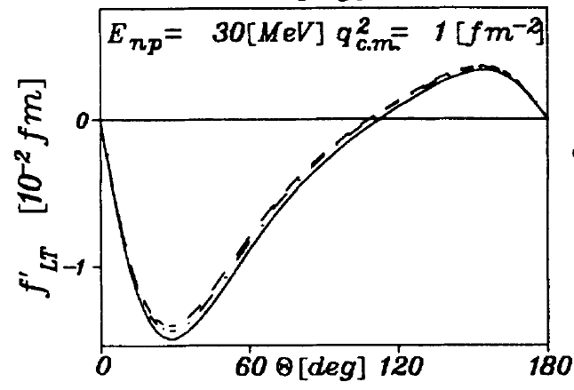
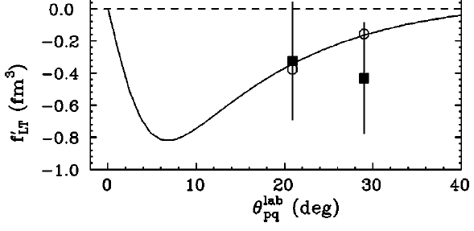
Polarized Structure Functions of ²H, ³He
S. M. Dolfini et al.,
PRC 60, 064622 (1999)
H. Arenhövel, W. Leidemann,
E. L. Tomusiak, PRC 46, 455 (1992)
²H: Comparison
with Bates data
and with predictions

Slide 12
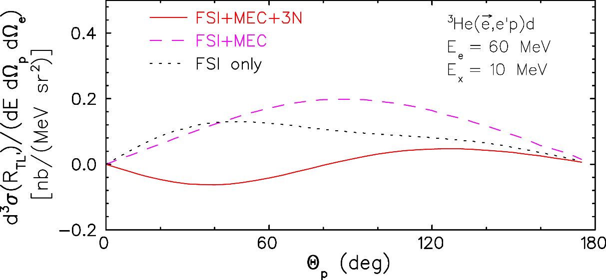
Polarized Structure Functions of ²H, ³He
estimated sensitivity
J. Golak, private communication
²H: Comparison
with Bates data
and with predictions
³He: Sensitivity
to 3N force predicted

Slide 13
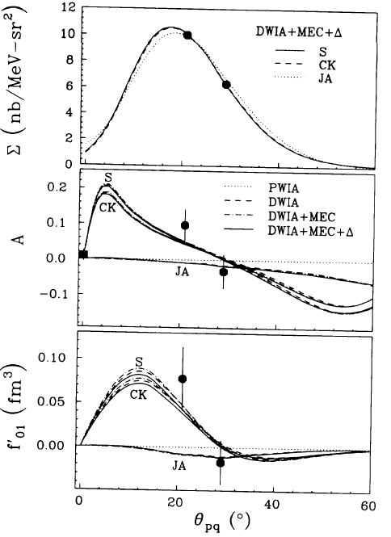
Polarized Structure Functions of ²H, ³He
²H: Comparison
with Bates data
and with predictions
³He: Sensitivity
to 3N force predicted
¹²C: from (CH₂)_{n} target → Bates
Challenge to theory:
Most important information
concerning LT’?
J. Mandeville et al., PRL 72, 3325 (1994)

Slide 14
Ideas
MeV Mott Scattering Analyzing Strength
Fifth Structure Function of Electron Scattering
Bremsstrahlung Polarization Correlations
Electron Pair Polarization Correlations

Slide 15
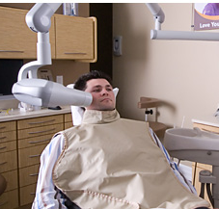
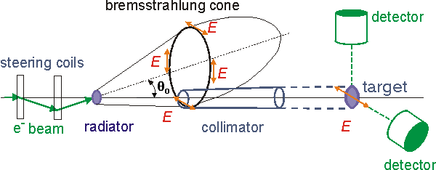
Bremsstrahlung
Many applications
in technology, medicine, …
Cross section and angular distribution
well understood (Bethe-Heitler)
Off-axis bremsstrahlung
yields polarized X-rays
wcdental.ca
hzdr.de

Slide 16
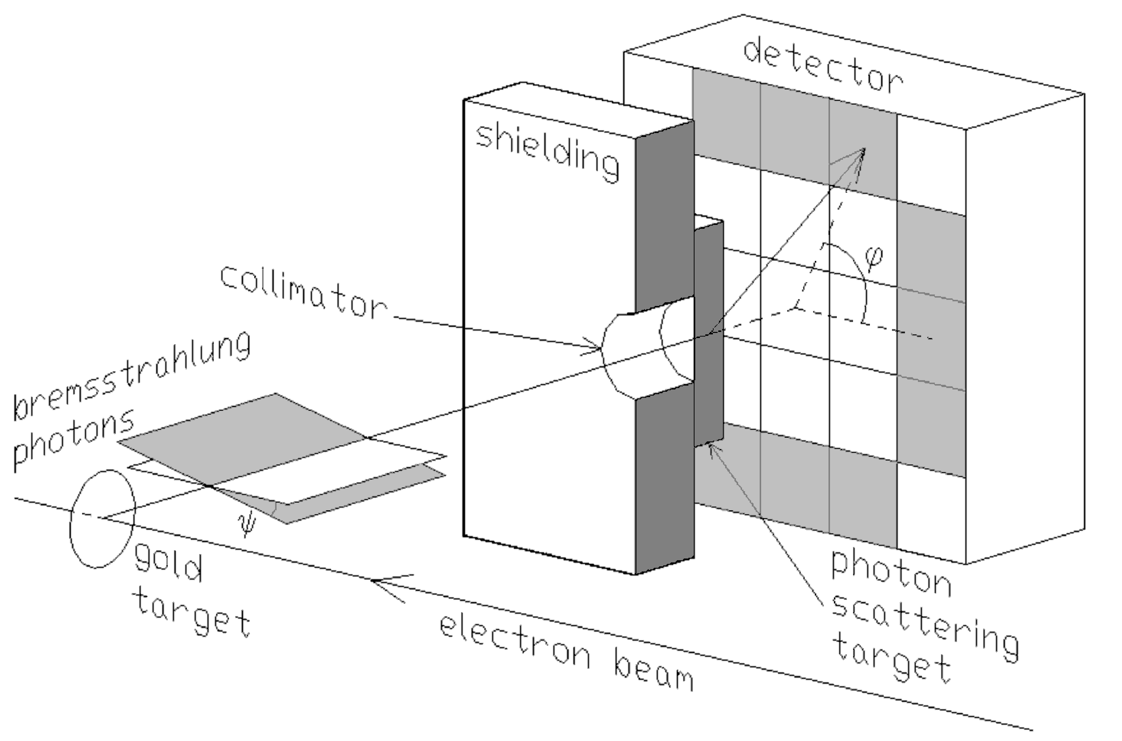
Linear Polarization of Bremsstrahlung from Longitudinally Polarized Electrons
Linear polarization: segmented (planar pixel) HPGe detector, 5x5 pixels
Polarized electrons: rotation of
bremsstrahlung linear polarization
detector
E_{e}=100 keV
shield
collimator
bremsstrahlung
Au target
passive
scatterer
electron beam
S. Tashenov et al., PRL 107, 173201 (2011)

Slide 17
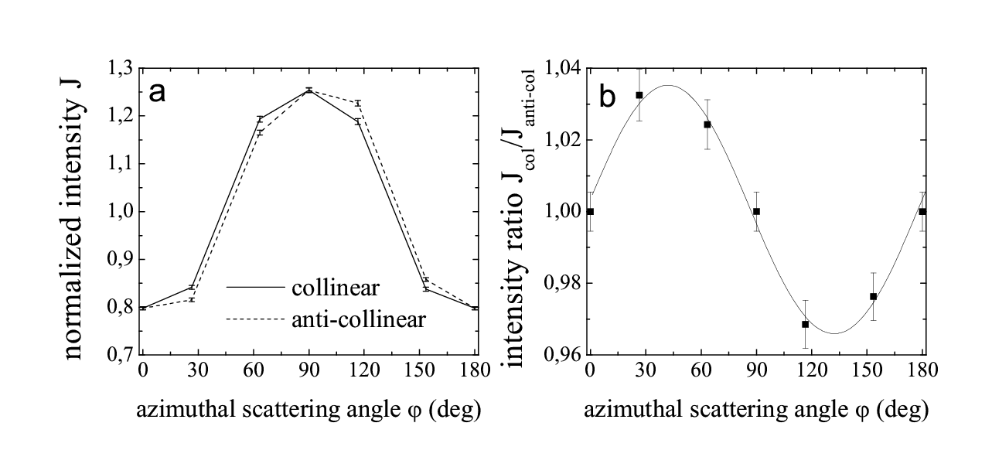
Linear Polarization of Bremsstrahlung from Longitudinally Polarized Electrons
Linear polarization: segmented (planar pixel) HPGe detector, 5x5 pixels
Polarized electrons: rotation of
bremsstrahlung linear polarization
E_{e}=100 keV
S. Tashenov et al., PRL 107, 173201 (2011)

Slide 18
Linear Polarization of Bremsstrahlung from Transversely Polarized Electrons
Transverse electon polarization
(in scattering plane)
32 x 32 planar pixel Si(Li): active scatterer
  degree of linear polarization
  rotation of polarization axis
R. Märtin et al., PRL 108, 264801 (2012)

Slide 19
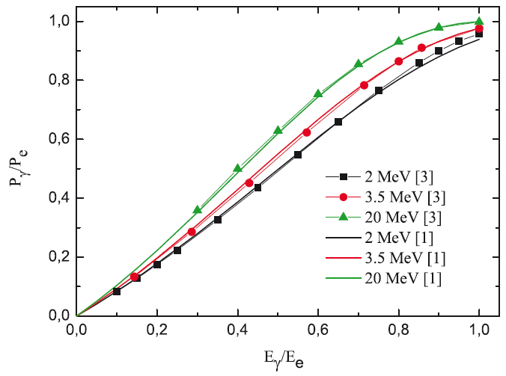
Circular Polarization of Bremsstrahlung from Polarized Electrons
Energy-dependent bremsstrahlung
circular polarization
of longitudinally polarized electrons
Compton transmission polarimeter
Commissioning experiment
at MAMI (3.5 MeV, 2010)
Polarization transfer function C₃₂
Towards a complete
characterization of the
Stokes parameters
of bremsstrahlung
R. Barday et al.,
J.Phys: Conf. Ser.
298, 012022
(2011)
P. Bangert, Bachelor Thesis (2010)

Slide 20
Ideas
MeV Mott Scattering Analyzing Strength
Fifth Structure Function of Electron Scattering
Bremsstrahlung Polarization Correlations
Electron Pair Polarization Correlations

Slide 21

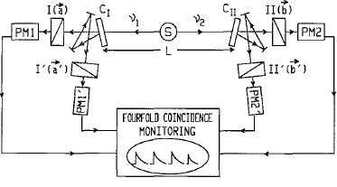
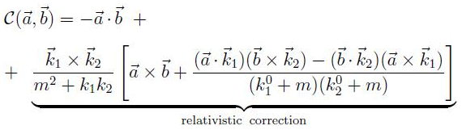
Spin Correlations of Entangled Particles
Aspect et al.,
PRL 49, 4804 (1982)
EPR experiment: photon pairs
Correlation function
Proposal by
Ciborowski, Bodek, Kozela, Rembielinski et al.,
Theoretical correlation function
  Depend on spin operator used
  Entangled pair:
  Møller scattering:
  Interplay between singlet and triplet states

Slide 22
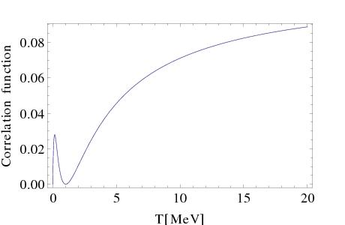
Quantum Entanglement of Ultrarelativistic Electrons in Singlet and Triplet States (QUEST)
Predicted correlation function
  Large
  Energy dependent
J. Rembielinski et al.

Slide 23
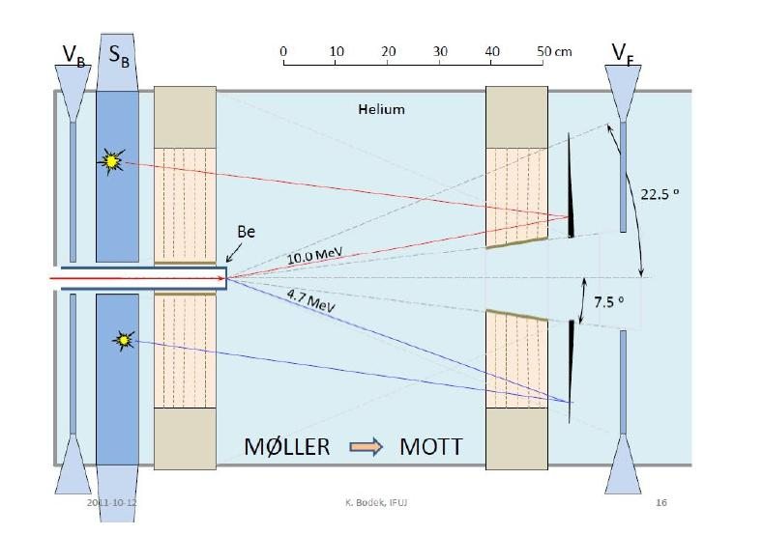
Quantum Entanglement of Ultrarelativistic Electrons in Singlet and Triplet States (QUEST)
Møller scattering → entangled pair
Mott scattering → spin analysis
Test experiment 2013
  Existing equipment
  partially functional
  ~ 15 MeV
  σ, S/N overestimated
„Cracow approach“
  Detector acceptance
„Warsaw approach“
  Increase σ, lower E

Slide 24
Summary
MeV Mott Scattering Analyzing Strength
Fifth Structure Function of Electron Scattering
Bremsstrahlung Polarization Correlations
Electron Pair Polarization Correlations

Slide 25

Thank You For Your Attention!
LEPP Workshop
Mainz 2016
SFB 634

Slide 26
Thanks To…
S-DALINAC Polarized Injector
M. Espig, Y. Fritzsche, A. Kaiser, Neeraj K., C. Schwebler, M. Wagner – TU Darmstadt
Analyzing Strength of Mott Scattering
D. H. Jakubaßa-Amundsen – LMU München, R. Barday – Helmholtzzentrum Berlin
Fifth Structure Function
P. von Neumann-Cosel, T. Kröll, N. Pietralla – TU Darmstadt
J. Golak – JU Crakow, H. Arenhövel – U Mainz
Bremsstrahlung Experiments
S. Tashenov, A. Surzhykov – U Heidelberg,
D. H. Jakubaßa-Amundsen – LMU München
S. Märtin, T. Stöhlker, G. Weber – HI Jena & GSI Darmstadt
K. Aulenbacher – U Mainz
QUEST Collaboration
J. Ciborowski, M. Wlodarczyk, M. Dragowski – U Warsaw
K. Bodek, D. Kepka, D. Rozpedzik – JU Crakow, A. Kozela – IPN-PAS
J. Rembielinski, P. Caban – U Lodz

Slide 27
S-DALINAC
2
1
3
4
5
1
Status
1
Polarized Source
2
10 MeV Bremsstrahlung
3
Photon Tagger
4
(e,e‘x) Experiments & 180°Scattering
5
(e,e‘) with High Resolution
Notes:
7. April 2016
|
| 27

Slide 28
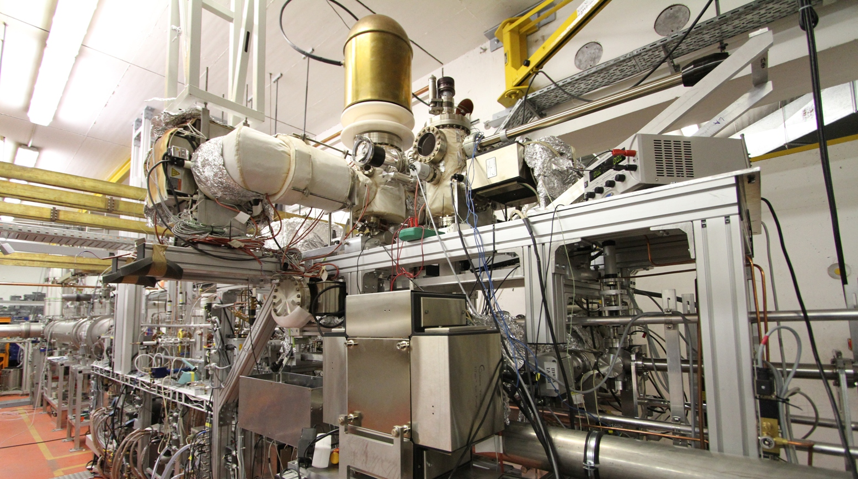
Source of Polarized Electrons
Bulk and Superlattice GaAs
Titanium-Sapphire Laser:
  380 fs pulse length
  75 MHz repetition rate
  40 m fibre/stabilized transfer
Diode laser: DC or 3 GHz
Load-lock system
Total height ~ 1.8 m
Vacuum < 10⁻¹¹ mbar
Performance
  Vacuum lifetime ~ 1000 h
  Charge lifetime ~ 10 C @ 7 μA
  90-115 keV, I < 50 μA
  86% polarization
  0.15 mm mrad emittance
Y. Poltoratska et al.,
J. Phys.: Conf. Series 298, 012002 (2011)
Implementation complete:
ready for first experiments

Slide 29
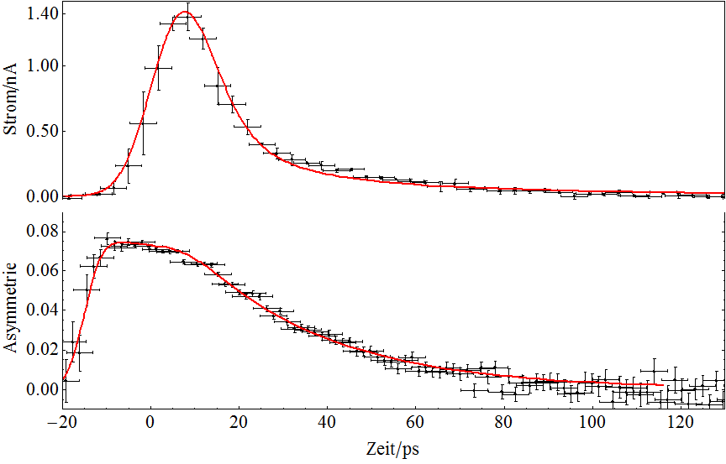
Ultra-fast Studies of NEA Photocathodes
Bulk-GaAs Photocathode
Beam Current (nA)
τ = 4,2 ps
1/A = 100 ps
1/A2 = 61,1 ps
B = 1E-10 cm³/s
D = 200 cm²/s
Asymmetry
Time (ps)
M. Wagner, Dissertation in preparation

Slide 30
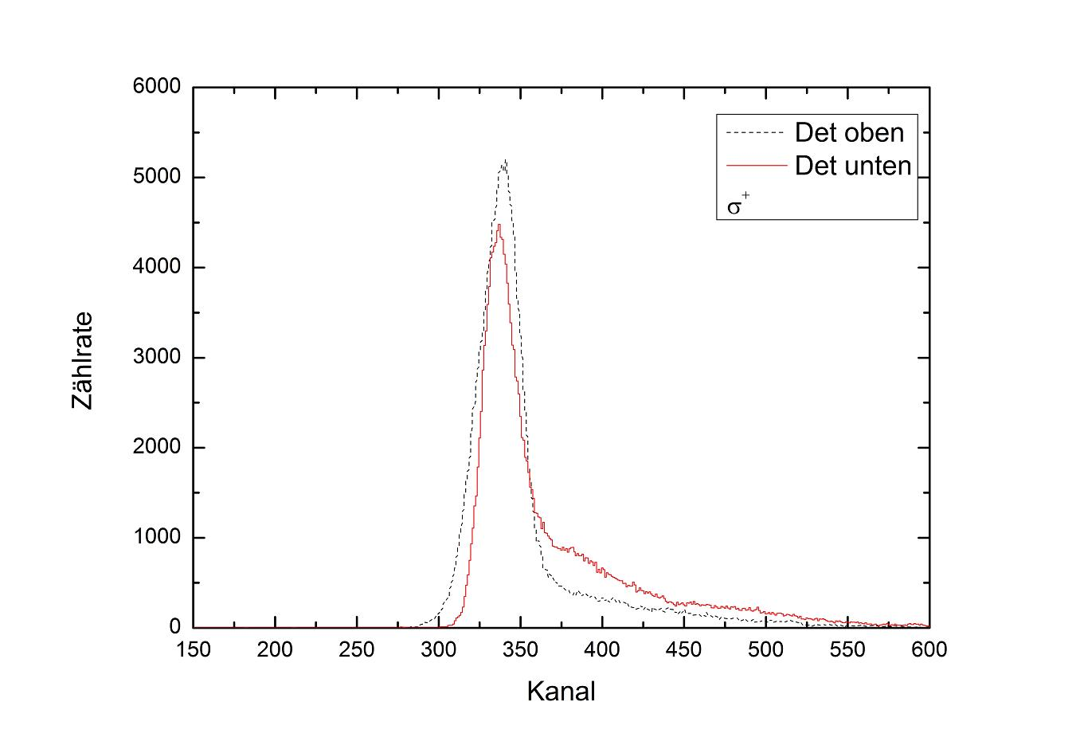
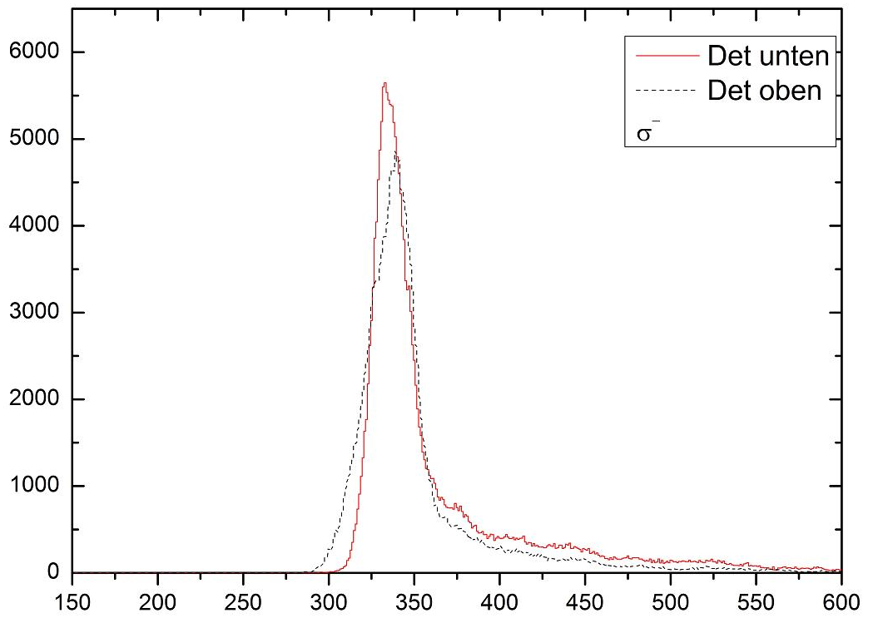
Polarized Electron Beam at 6.2 MeV
top
bottom
Ag(e,e)
Bulk GaAs
Counts/Channel
Channel

Slide 31
Polarized Electron Beam at 6.2 MeV
bottom
top
Ag(e,e)
Bulk GaAs
Counts/Channel
→ Polarization
P ≈ 28%
Channel

Slide 32
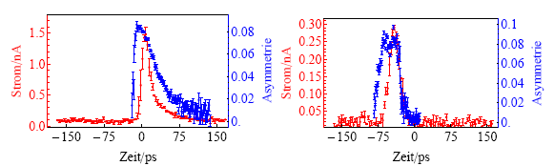
Bulk vs. Strained Superlattice
Bulk GaAs
Superlattice GaAs
Electron Beam Current (nA)
Mott Scattering Asymmetry
Mott Scattering Asymmetry
Electron Beam Current (nA)
Time (ps)
Time (ps)
M. Wagner, Dissertation in preparation

Slide 33
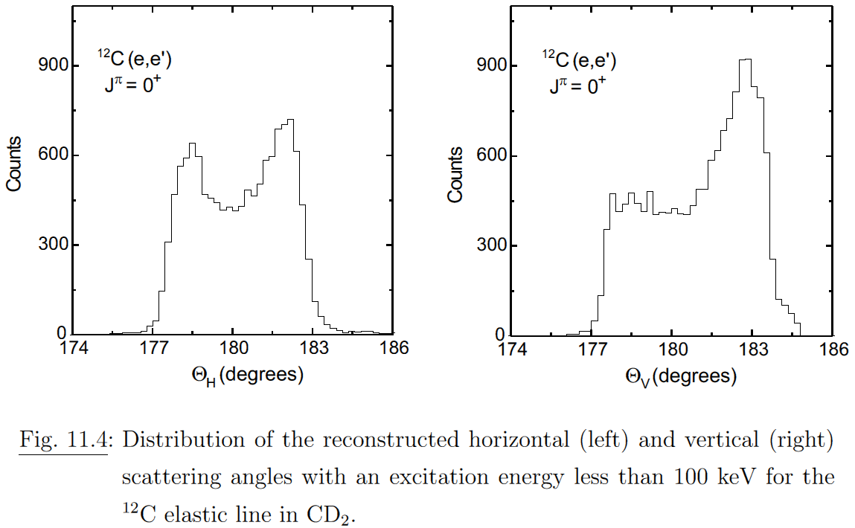
Polarized Elastic Scattering Around 180°
N. Ryezayeva, Dissertation, TU Darmstadt (2006)
C. Lüttge et al., NIMA 366, 325 (1995)

Slide 34
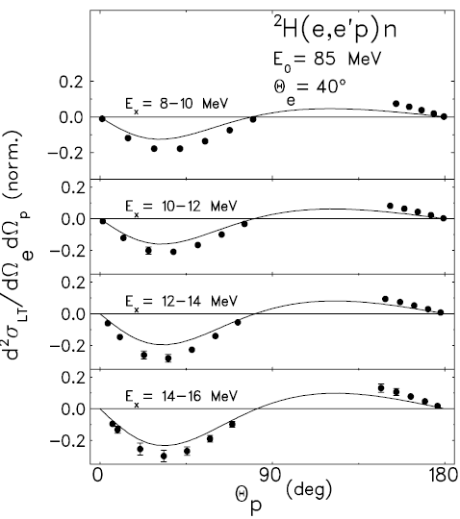
Polarized Structure Functions of ²H, ³He
P. von Neumann-Cosel et al.
PRL 88, 202304 (2002)
²H: Comparison
with Bates data
and with predictions
²H: Comparison
with earlier
S-DALINAC data

Slide 35
Linear Polarization of Bremsstrahlung from Transversely Polarized Electrons
Transverse electron polarization
(in scattering plane)
32 x 32 planar pixel Si(Li): active scatterer
  degree of linear polarization
carbon
detector
shield
collimator
bremsstrahlung
Au target
passive
scatterer
electron beam
R. Märtin et al., PRL 108, 264801 (2012)

Slide 36
Linear Polarization of Bremsstrahlung from Transversely Polarized Electrons
Transverse electon polarization
(in scattering plane)
32 x 32 planar pixel Si(Li): active scatterer
  degree of linear polarization
  rotation of polarization axis
Target-thickness effects
R. Märtin et al., PRL 108, 264801 (2012)

Slide 37
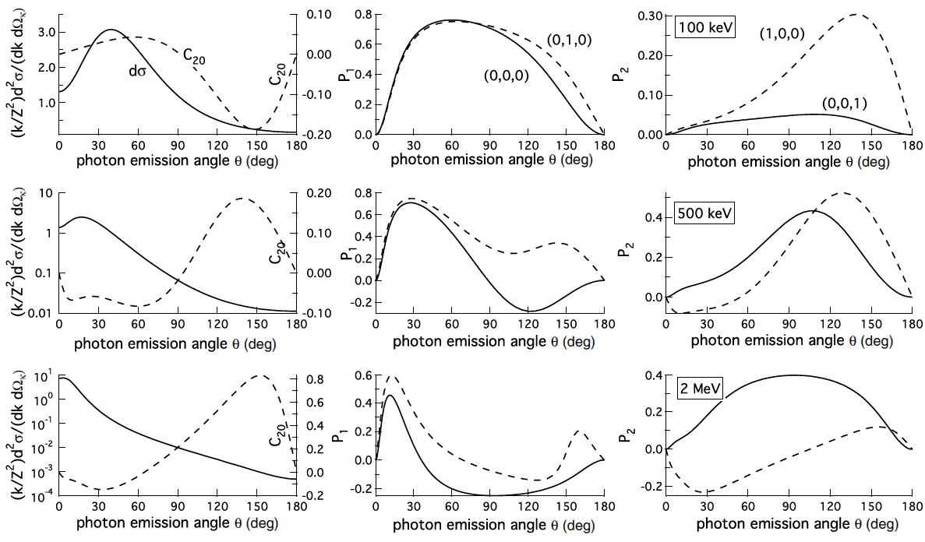
Predicted Cross Sections and
Stokes Parameters for Linear Polarizations
S. Tashenov et al., PRA 87, 022707 (2013)

Slide 38
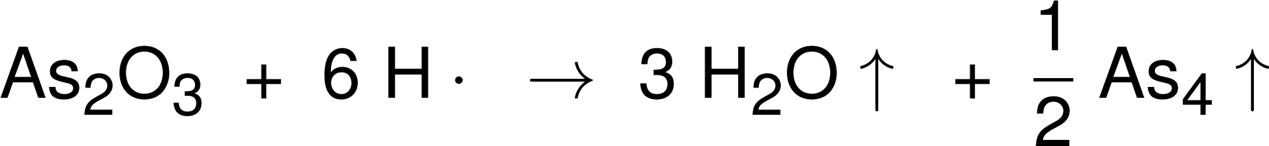
Future Teststand / Atomic Hydrogen Cleaning
Quantum efficiency decrease
  deterioration of CsO NEA layer
  C, AsO_{x}, Ga₂O₃ reduce quantum efficiency
Atomic hydrogen cleaning

Slide 39
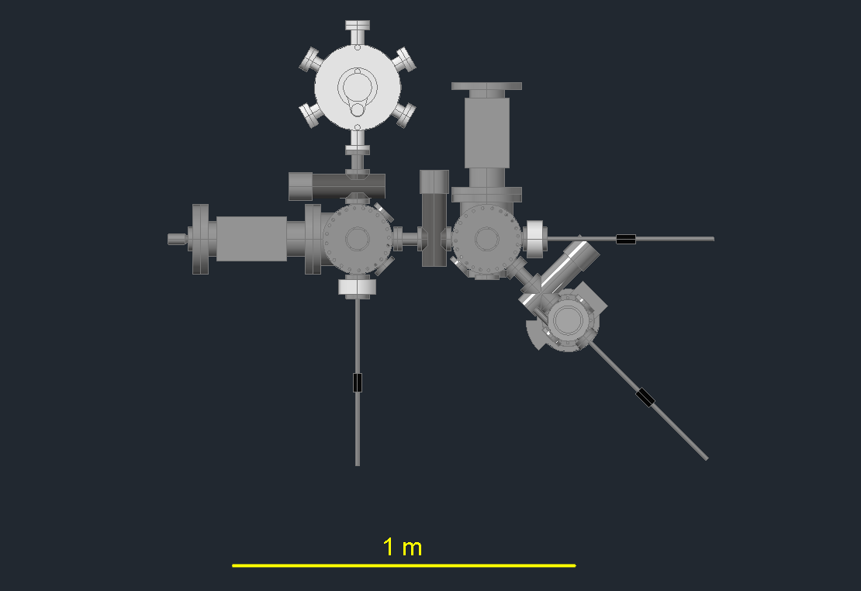
Cleaning & Preparation Test System
60 kV (100 kV) test beam
for future experiments
Cathode Test Chamber
Atomic Hydrogen Cleaning Chamber
Load-Lock Chamber and Transport Vessel
Cathode Activation Chamber
M. Espig et al.,
Proc. IPAC 2012, p. 2642

Slide 40
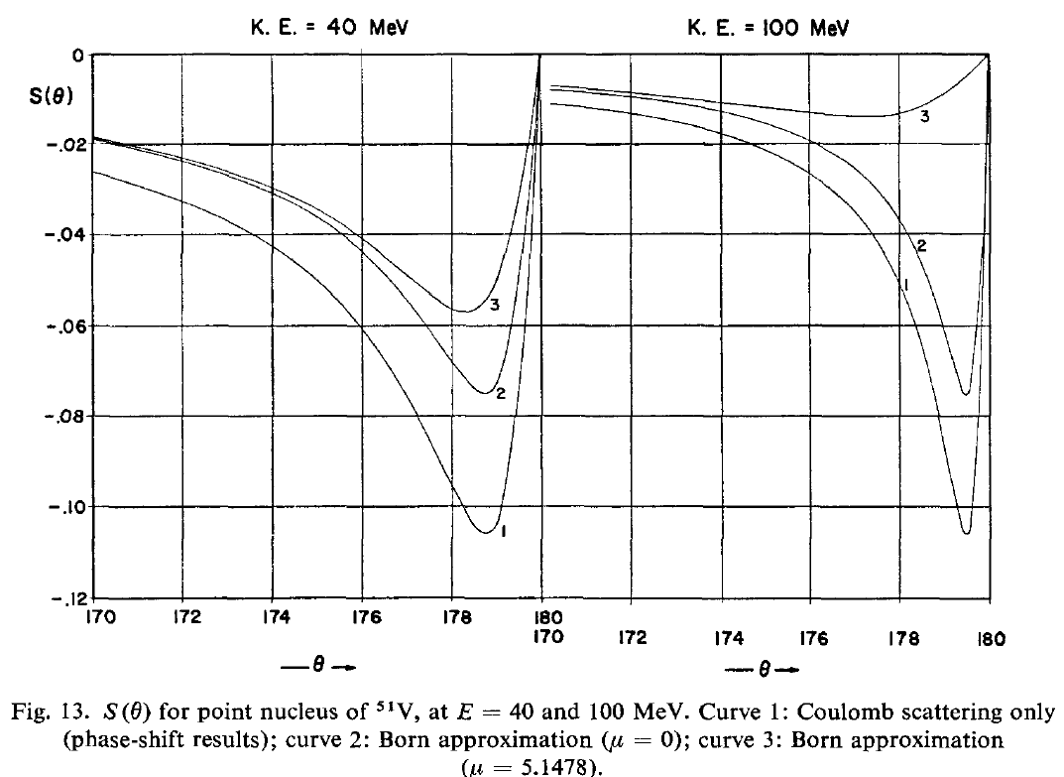
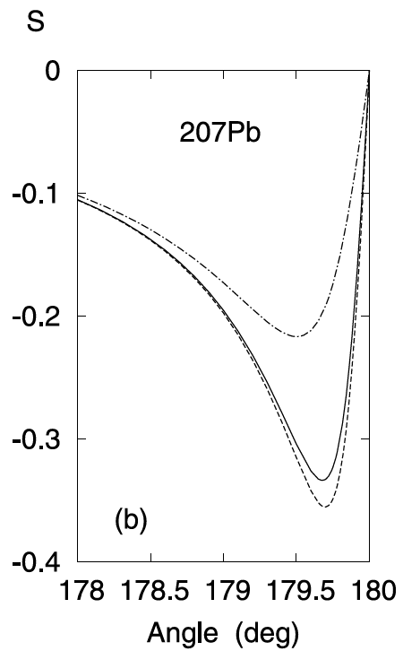
Magnetic Scattering?
100 MeV
P. Uginčius, H. Überall, G.H. Rawitscher,
NPA 158, 418 (1970)
D. H. Jakubassa-Amundsen, NPA 896, 59 (2012)

