Slide 1


NUCLEAR REACTIONS OF ASTROPHYSICAL INTEREST AT LUNA
D. Trezzi (for the LUNA collaboration)
Università degli Studi di Milano | INFN – New Vistas in Low-Energy Precision Physics (LEPP)

Slide 2
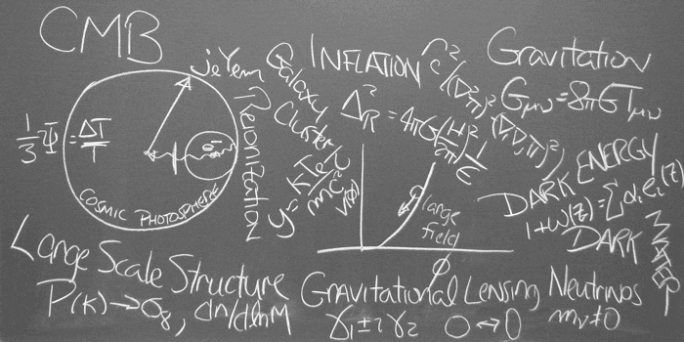
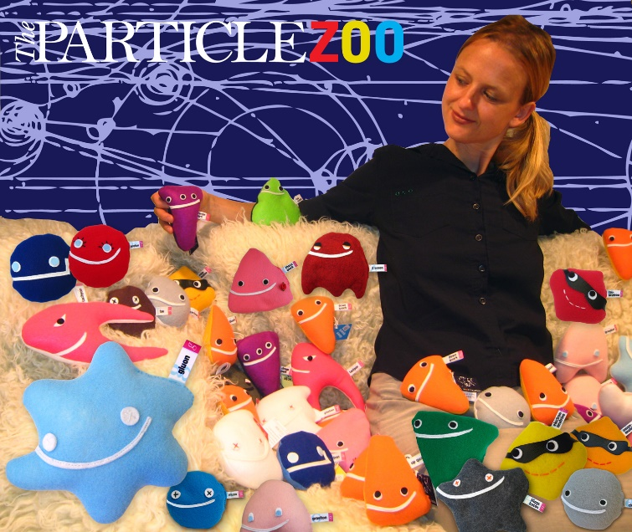
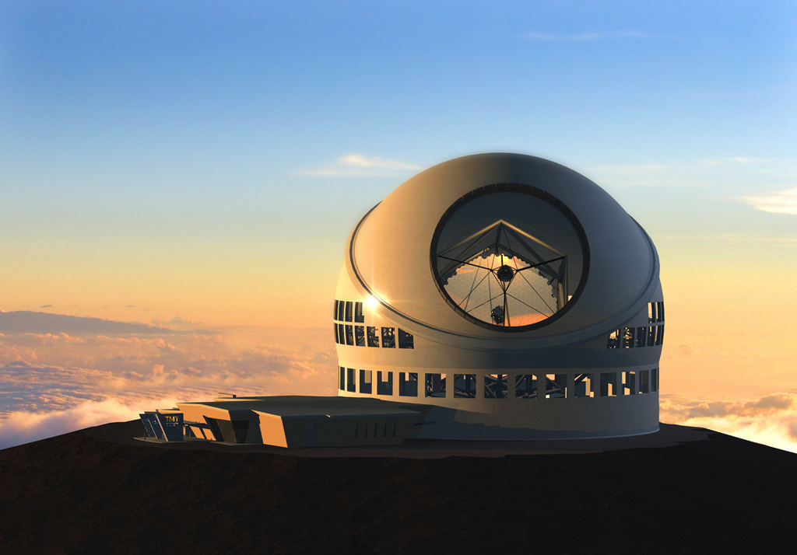
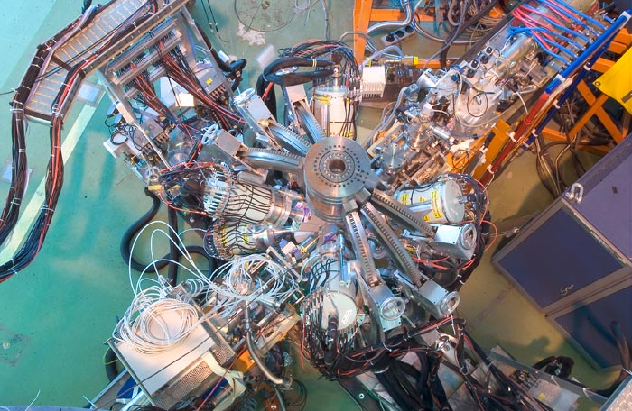
NUCLEAR REACTIONS OF ASTROPHYSICAL INTEREST AT LUNA | D. Trezzi
PARTICLE PHYSICS
ASTROPHYSICS & PLASMA PHYSICS
NUCLEAR PHYSICS
ASTRONOMY & COSMOLOGY
Università degli Studi di Milano | INFN – New Vistas in Low-Energy Precision Physics (LEPP)

Slide 3
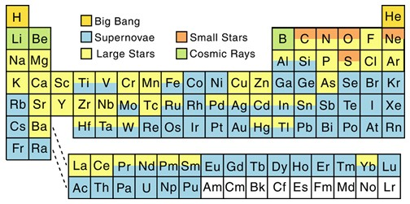
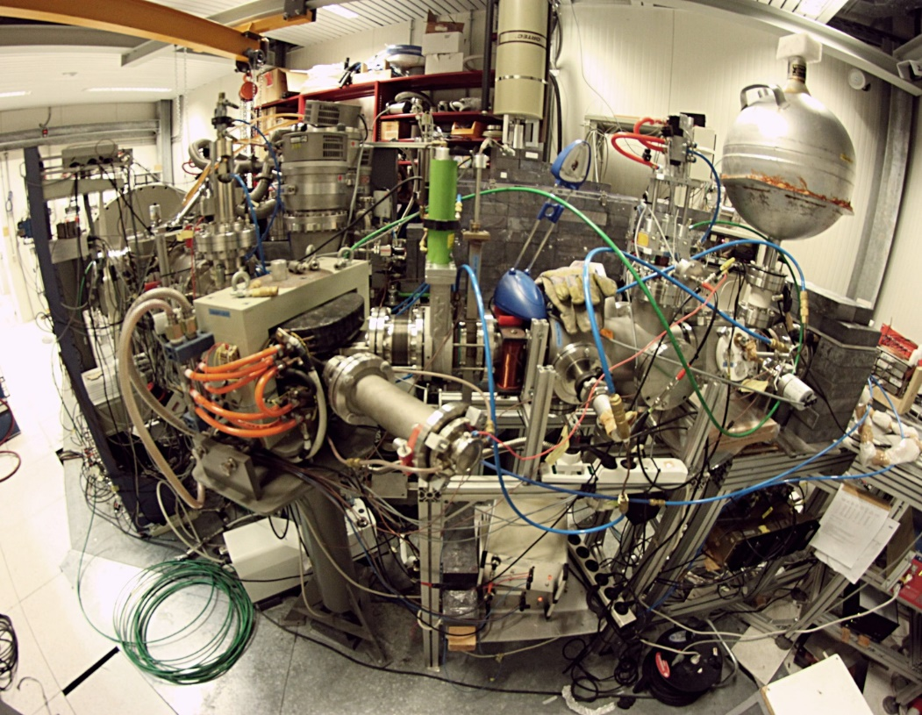
NUCLEAR REACTIONS OF ASTROPHYSICAL INTEREST AT LUNA | D. Trezzi
NUCLEAR ASTROPHYSICS: the origin of the elements
Elements that make up everything that we see around us were made by nuclear reactions and decays in stars.
These processes also produce the energy that makes stars shine.
The abundances of the elements and isotopes provide important information about the astrophysical environments where they were created.
This field of research is called Nuclear Astrophysics.
LUNA: Laboratory for Underground Nuclear Astrophysics
Università degli Studi di Milano | INFN – New Vistas in Low-Energy Precision Physics (LEPP)

Slide 4
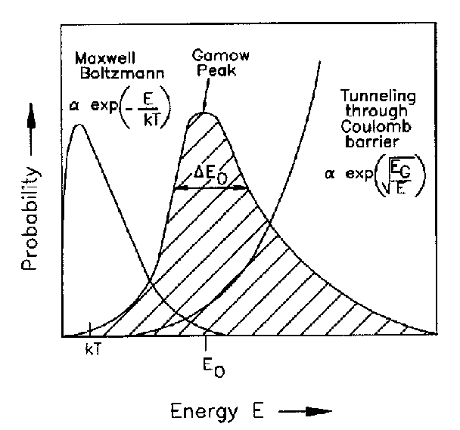

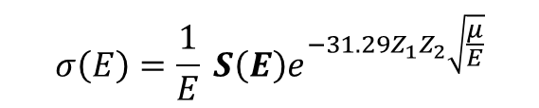
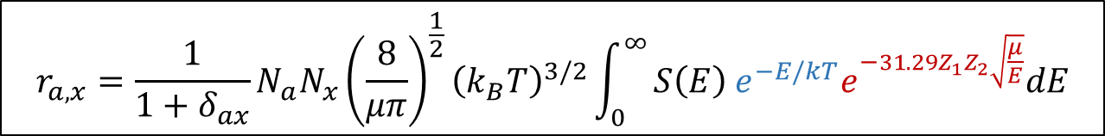
NUCLEAR REACTIONS OF ASTROPHYSICAL INTEREST AT LUNA | D. Trezzi
THERMONUCLEAR FUSION Gamow Peak and Astrophysical S-factor
[charge particles]
$$r_{a,x}=\frac{1}{1+δ_{ax}}N_{a}N_{x}{\left(\frac{8}{μπ}\right)}^{\frac{1}{2}}{\left(k_{B}T\right)}^{3/2}\int_{0}^{∞}{S\left(E\right) e^{−E/kT}e^{−31.29Z_{1}Z_{2}\sqrt{\frac{μ}{E}}}dE}$$
where the Astrophysical S-factor S(E) is related to the cross section through:
$$σ\left(E\right)=\frac{1}{E} S\left(E\right)e^{−31.29Z_{1}Z_{2}\sqrt{\frac{μ}{E}}}$$
Università degli Studi di Milano | INFN – New Vistas in Low-Energy Precision Physics (LEPP)

Slide 5
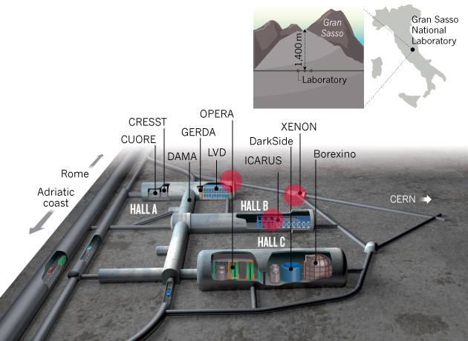
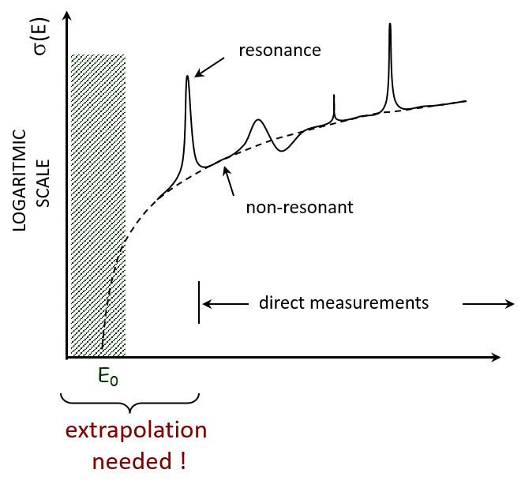
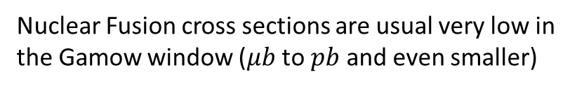
NUCLEAR REACTIONS OF ASTROPHYSICAL INTEREST AT LUNA | D. Trezzi
GOING DEEP UNDERGROUND
LUNA and the Laboratori Nazionali del Gran Sasso
Nuclear Fusion cross sections are usual very low in the Gamow window ($μb$ to $pb$ and even smaller)
The reaction particles are hidden by natural (cosmic ray) background
Deep Underground Laboratories are necessary: Gran Sasso, Felsenkeller and Canfranc in Europe
Università degli Studi di Milano | INFN – New Vistas in Low-Energy Precision Physics (LEPP)

Slide 6




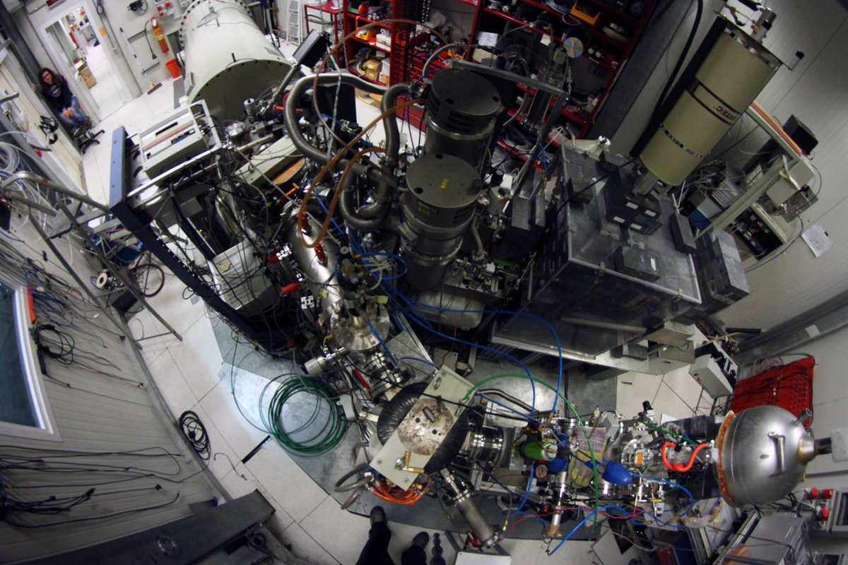
NUCLEAR REACTIONS OF ASTROPHYSICAL INTEREST AT LUNA | D. Trezzi
THE LUNA EXPERIMENT
LUNA 50 kV (1992-2001) – Solar Phase
LUNA 400 kV (2000-2018) – CNO, Mg-Al and Ne-Na cycles, BBN
LUNA-MV (since 2018) – Helium burning
LUNA ACCELERATOR
High current
Long term stability
High energy accuracy
TARGETS
Windowless gas target
Solid target
DETECTORS
137% HPGe
BGO
Silicon
NaI
Università degli Studi di Milano | INFN – New Vistas in Low-Energy Precision Physics (LEPP)

Slide 7
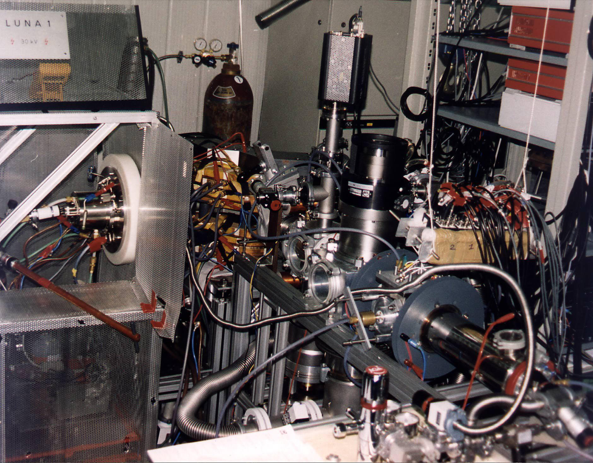

NUCLEAR REACTIONS OF ASTROPHYSICAL INTEREST AT LUNA | D. Trezzi
LUNA 50 kV
Energy range: 10-50 kV
Current: 1 mA
Beam spread: 20 eV
years and years ago…
TAKE NOTE!
Silver Moon workshop at LNGS
Università degli Studi di Milano | INFN – New Vistas in Low-Energy Precision Physics (LEPP)

Slide 8
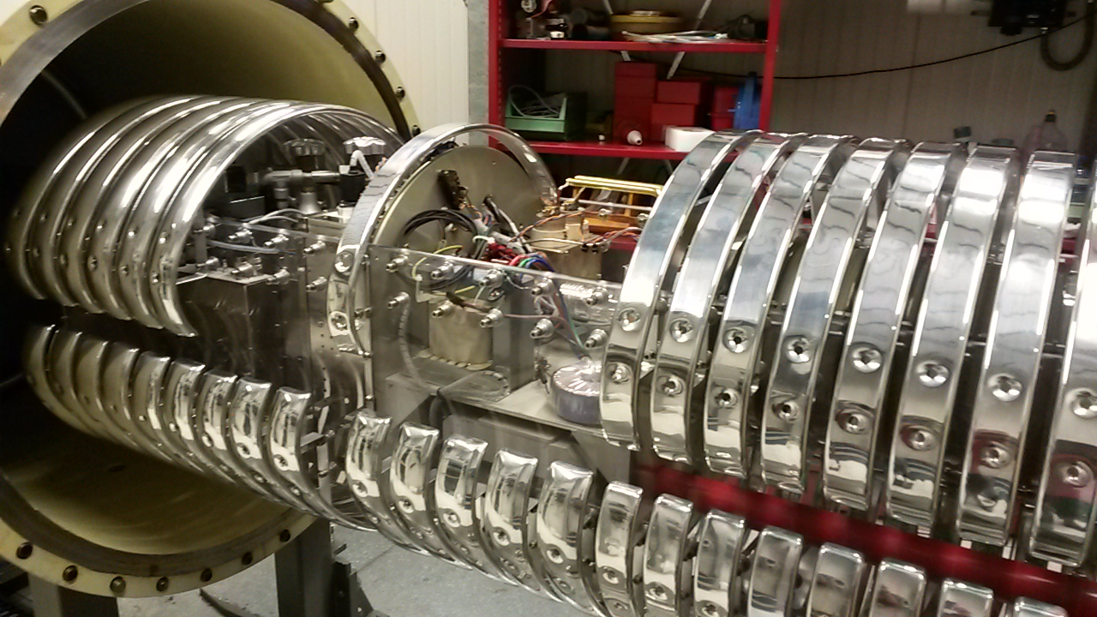
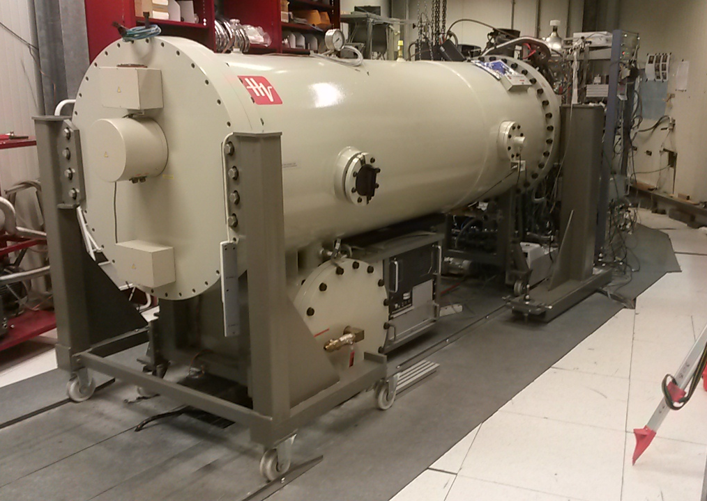
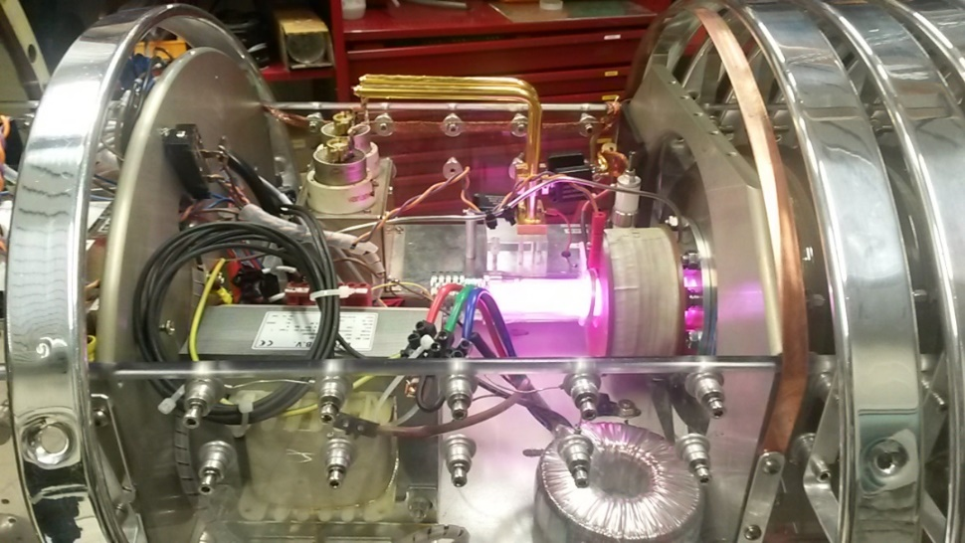
NUCLEAR REACTIONS OF ASTROPHYSICAL INTEREST AT LUNA | D. Trezzi
LUNA 400 kV
Energy range: 50-400 kV
Current: 1 mA
Beam spread: < 100 eV
Stability: 5 eV/h
Università degli Studi di Milano | INFN – New Vistas in Low-Energy Precision Physics (LEPP)

Slide 9
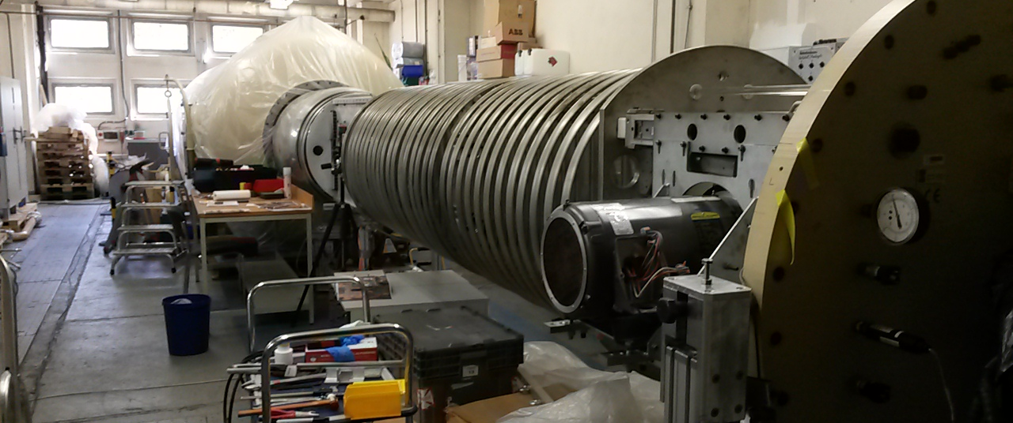
NUCLEAR REACTIONS OF ASTROPHYSICAL INTEREST AT LUNA | D. Trezzi
This machine will provide not only proton and helium (3/4) but also ¹²C⁺ and ¹²C⁺⁺
↓ credits: HZDR, Dresden
LUNA MV
Energy range: 200-3500 kV
Current: < 1 mA
Beam spread: 350 eV
Stability: < 35 eV/h
Università degli Studi di Milano | INFN – New Vistas in Low-Energy Precision Physics (LEPP)

Slide 10
NUCLEAR REACTIONS OF ASTROPHYSICAL INTEREST AT LUNA | D. Trezzi
THE LUNA EXPERIMENT
LUNA 50 kV (1992-2001) – Solar Phase
LUNA 400 kV (2000-2018) – CNO, Mg-Al and Ne-Na cycles, BBN
LUNA-MV (since 2018) – Helium burning
LUNA ACCELERATOR
High current
Long term stability
High energy accuracy
TARGETS
Windowless gas target
Solid target
DETECTORS
137% HPGe
BGO
Silicon
NaI
Università degli Studi di Milano | INFN – New Vistas in Low-Energy Precision Physics (LEPP)

Slide 11
NUCLEAR REACTIONS OF ASTROPHYSICAL INTEREST AT LUNA | D. Trezzi
THE LUNA EXPERIMENT
LUNA 50 kV (1992-2001) – Solar Phase
LUNA 400 kV (2000-2018) – CNO, Mg-Al and Ne-Na cycles, BBN
LUNA-MV (since 2018) – Helium burning
LUNA ACCELERATOR
High current
Long term stability
High energy accuracy
TARGETS
Windowless gas target
Solid target
DETECTORS
137% HPGe
BGO
Silicon
NaI
Università degli Studi di Milano | INFN – New Vistas in Low-Energy Precision Physics (LEPP)

Slide 12
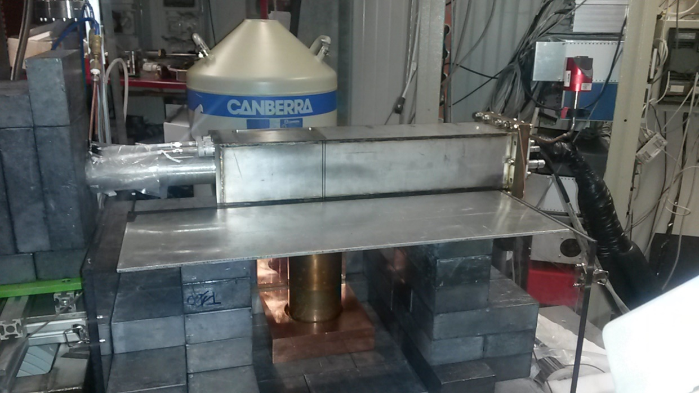
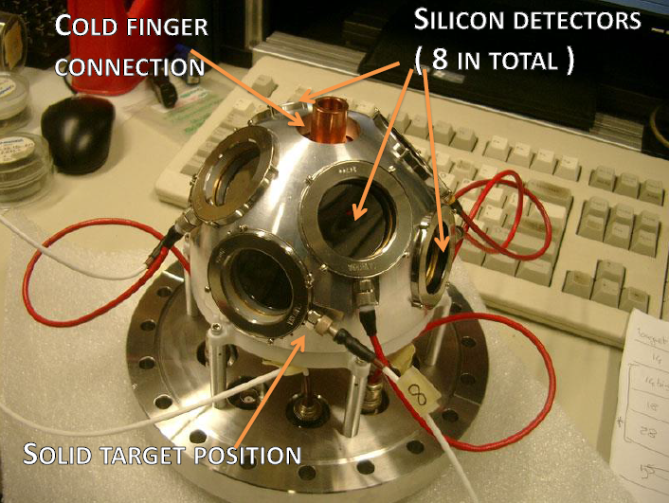
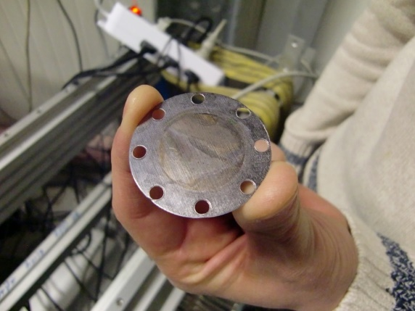
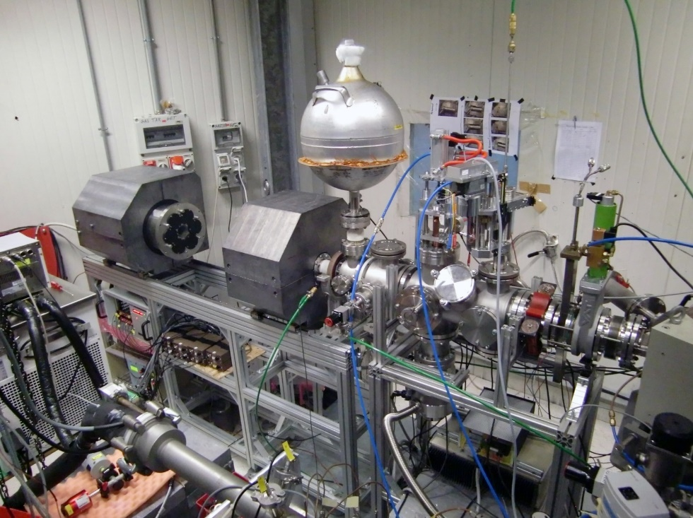
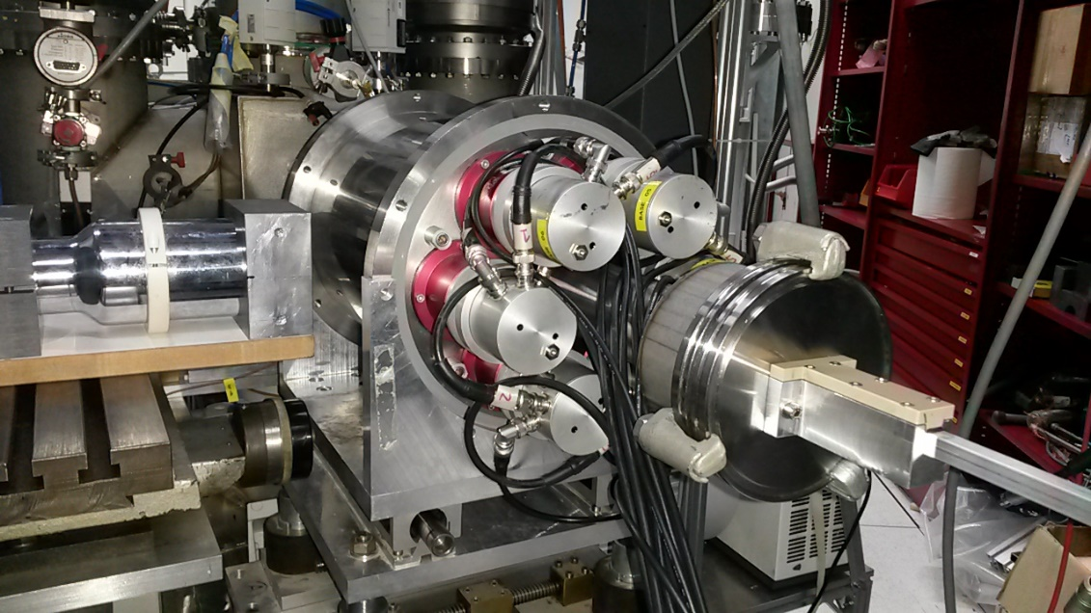
NUCLEAR REACTIONS OF ASTROPHYSICAL INTEREST AT LUNA | D. Trezzi
Università degli Studi di Milano | INFN – New Vistas in Low-Energy Precision Physics (LEPP)

Slide 13
NUCLEAR REACTIONS OF ASTROPHYSICAL INTEREST AT LUNA | D. Trezzi
25y of NUCLEAR ASTROPHYSICS AT LUNA
ELECTRON SCREENING AND STOPPING POWER
²H(³He,p)⁴He and ³He(²H,p)⁴He
SOLAR FUSION REACTION
³He(³He,2p)⁴He ²H(p,γ)³He and ³He(α,γ)⁷Be
CNO, Ne-Na AND Mg-Al CYCLES
¹⁴N(p,γ)¹⁵O ¹⁵N(p,γ)¹⁶O ²²Ne(p,γ)²³Na ²²Ne(α, γ)²⁶Mg ²³Na(p,γ)²⁴Mg and ²⁵Mg(p,γ)²⁶Al
EXPLOSIVE HYDROGEN BURNING IN NOVAE AND AGB STARS
¹⁷O(p,γ)¹⁸F ¹⁷O(p,α)¹⁴N ¹⁸O(p,γ)¹⁹F and ¹⁸O(p,α)¹⁵N
BIG BANG NUCLEOSYNTHESIS
²H(α,γ)⁶Li ²H(p,γ)³He and ⁶Li(p,γ)⁷Be
NEUTRON CAPTURE NUCLEOSYNTHESIS
¹³C(α,n)¹⁶O
at LUNA-MV: ¹²C(α,γ)¹⁶O, ¹³C(α,n)¹⁶O ²²Ne(α,n)²⁵Mg, ¹²C+¹²C and much more…
Università degli Studi di Milano | INFN – New Vistas in Low-Energy Precision Physics (LEPP)

Slide 14
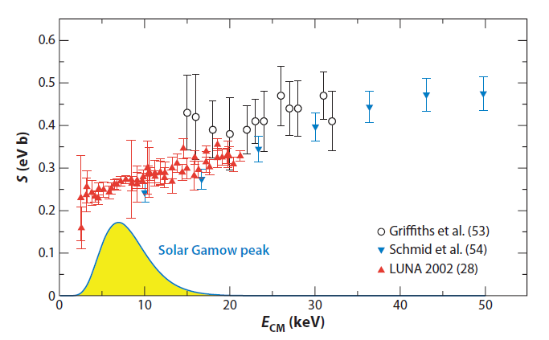
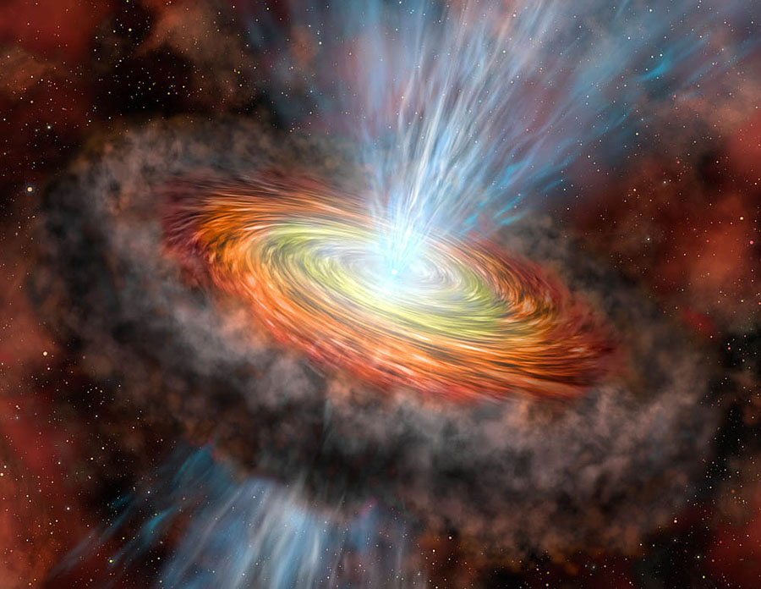
NUCLEAR REACTIONS OF ASTROPHYSICAL INTEREST AT LUNA | D. Trezzi
THE ²H(p,γ)³He REACTION
SOLAR FUSION | BIG BANG NUCLEOSYNTESIS
the ²H(p,γ)³He reaction controls the equilibrium abundance of solar deuterium,
The ²H(p,γ)³He reaction controls the life of protostars before they enter into the main-sequence phase.
LUNA demonstrate, for the first time, that it is possible to direct study solar fusion in the Gamow window from underground laboratories.
Università degli Studi di Milano | INFN – New Vistas in Low-Energy Precision Physics (LEPP)

Slide 15
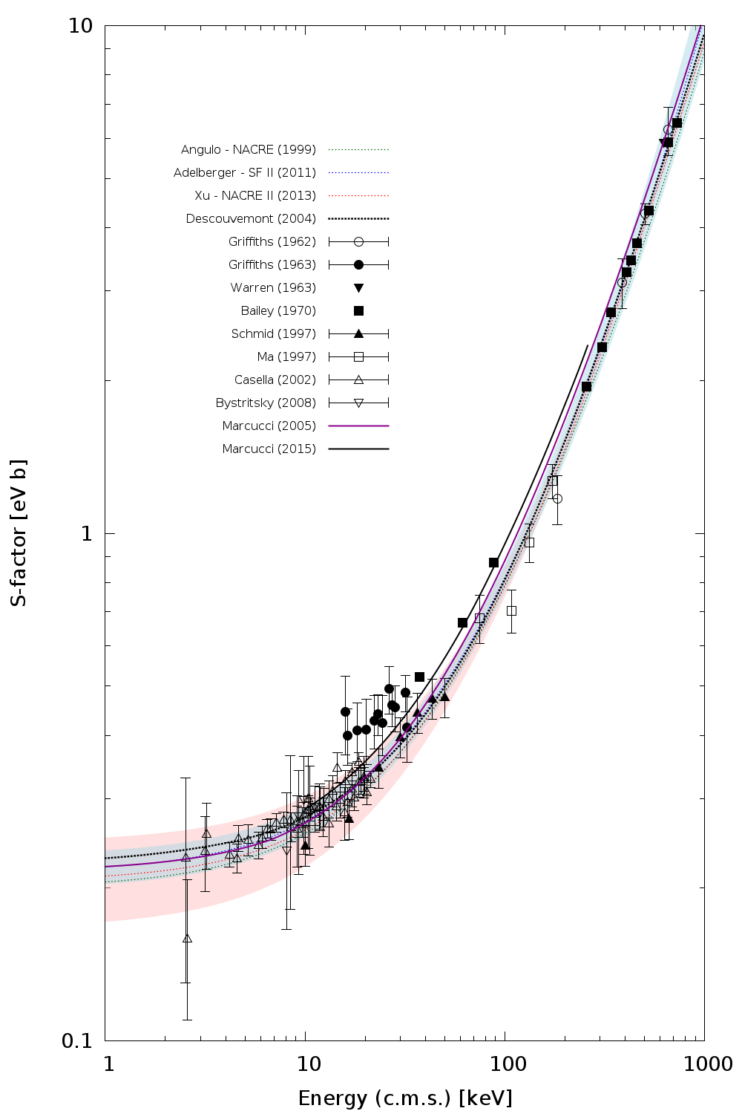
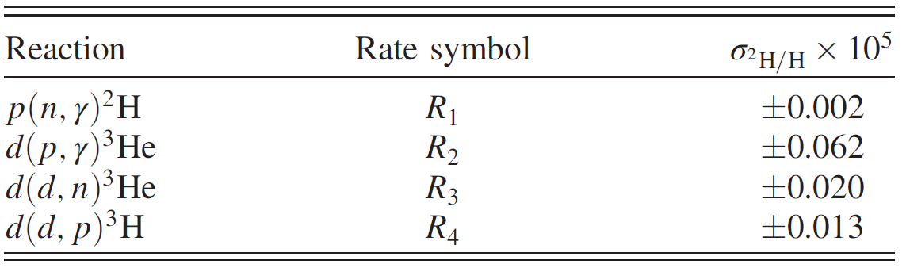
NUCLEAR REACTIONS OF ASTROPHYSICAL INTEREST AT LUNA | D. Trezzi
THE ²H(p,γ)³He REACTION
SOLAR FUSION | BIG BANG NUCLEOSYNTESIS
L. E. Marcucci et al. paper
Phys. Rev. Lett. 116, 102501
Primordial deuterium abundance is quite in agreement with the calculated value:
HIGH PRECISION COSMOLOGICAL DATA (Planck)
LOW PRECISION (about 9%) NUCLEAR DIRECT DATA IN THE BBN ENERGY RANGE
RAW data
(Feb 2016)
High precision data is desirable (< 5%)
Università degli Studi di Milano | INFN – New Vistas in Low-Energy Precision Physics (LEPP)

Slide 16
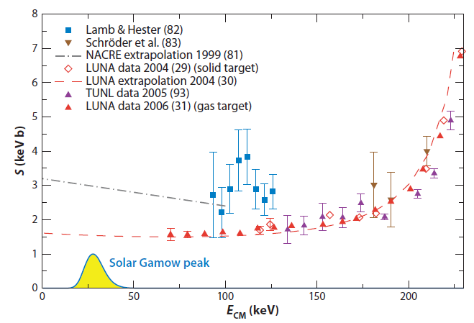
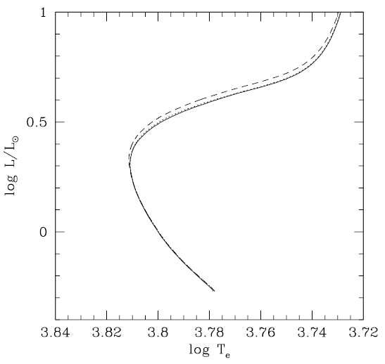
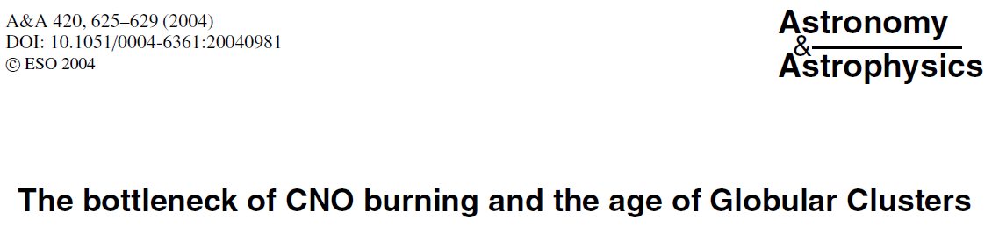
NUCLEAR REACTIONS OF ASTROPHYSICAL INTEREST AT LUNA | D. Trezzi
THE ¹⁴N(p,γ)¹⁵O REACTION
CNO & GLOBULAR CLUSTER
The ¹⁴N(p,γ)¹⁵O is the slowest reaction of the CNO cycle; it controls the cycle’s energy production rate.
The turnoff luminosity point of a globular cluster is used to determine the age of the cluster → lower limit of the Universe age (TOL-A relation)
Solar flux of CNO neutrinos reduced by a factor 2!
«when a given turnoff luminosity is considered, the revised isochrones imply systematically older ages, namely between 0.7 and 1 Gyr.»
Università degli Studi di Milano | INFN – New Vistas in Low-Energy Precision Physics (LEPP)

Slide 17
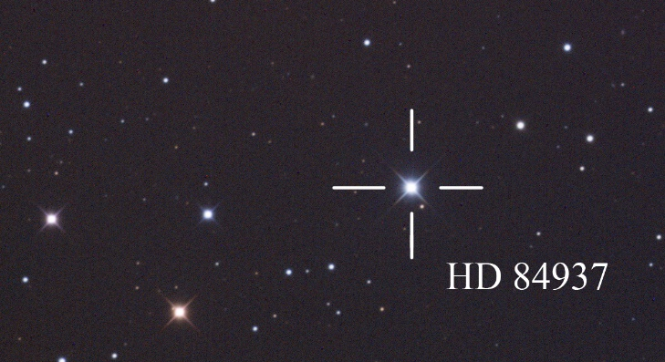
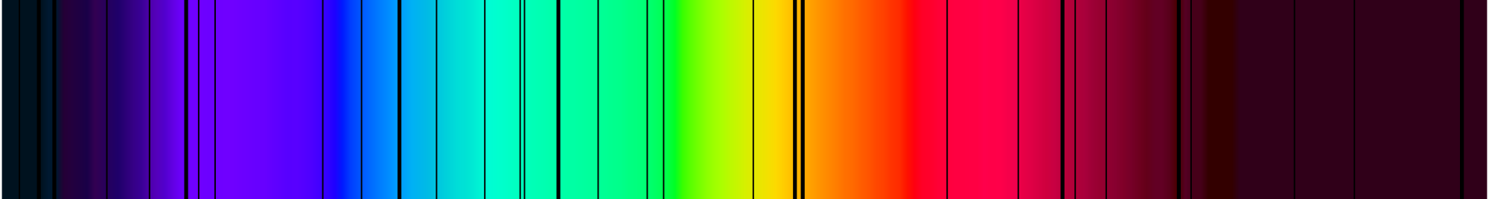
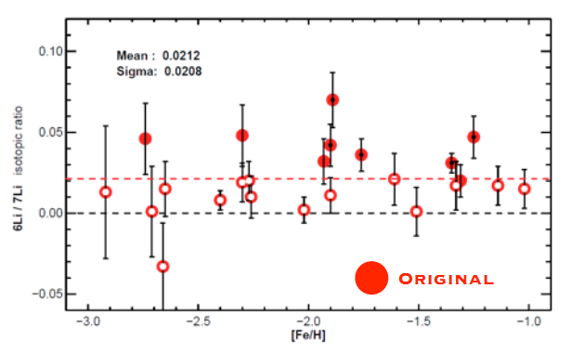
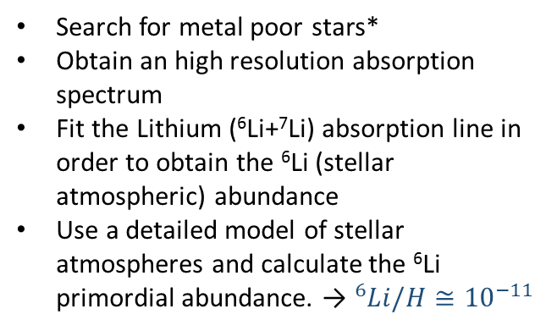
NUCLEAR REACTIONS OF ASTROPHYSICAL INTEREST AT LUNA | D. Trezzi
THE ²H(α,γ)⁶Li REACTION
BIG BANG NUCLEOSYNTHESIS
Search for metal poor stars*
Obtain an high resolution absorption spectrum
Fit the Lithium (⁶Li+⁷Li) absorption line in order to obtain the ⁶Li (stellar atmospheric) abundance
Use a detailed model of stellar atmospheres and calculate the ⁶Li primordial abundance. → ${}_{ }^{6}{Li}/H≅{10}^{−11}$
Università degli Studi di Milano | INFN – New Vistas in Low-Energy Precision Physics (LEPP)

Slide 18
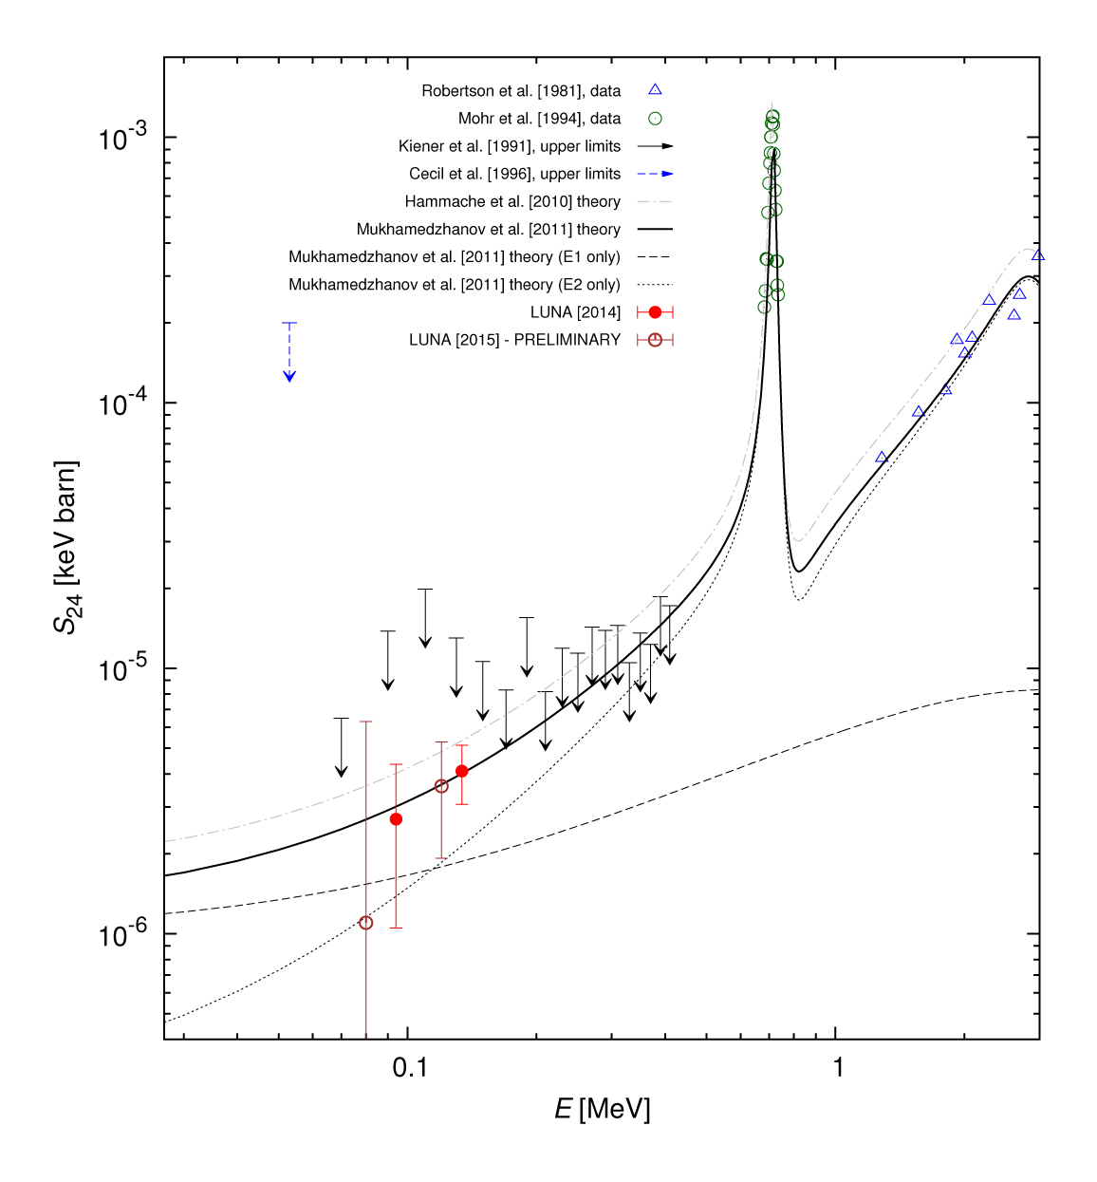
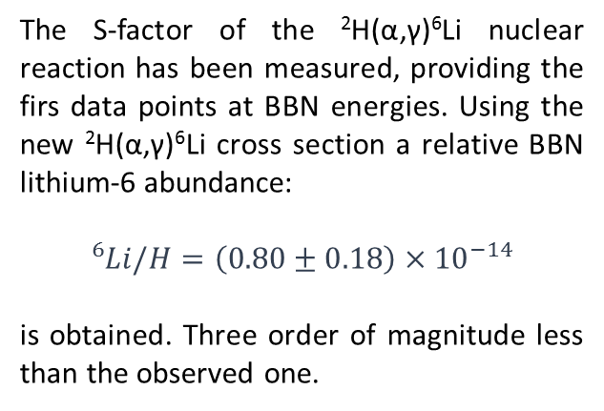
NUCLEAR REACTIONS OF ASTROPHYSICAL INTEREST AT LUNA | D. Trezzi
THE ²H(α,γ)⁶Li REACTION
BIG BANG NUCLEOSYNTHESIS
The S-factor of the ²H(α,γ)⁶Li nuclear reaction has been measured, providing the firs data points at BBN energies. Using the new ²H(α,γ)⁶Li cross section a relative BBN lithium-6 abundance:
${}_{ }^{6}{Li/H=\left(0.80±0.18\right)×{10}^{−14}}$
is obtained. Three order of magnitude less than the observed one.
M. Anders et al., PRL 113 (2014) 042501
Università degli Studi di Milano | INFN – New Vistas in Low-Energy Precision Physics (LEPP)

Slide 19
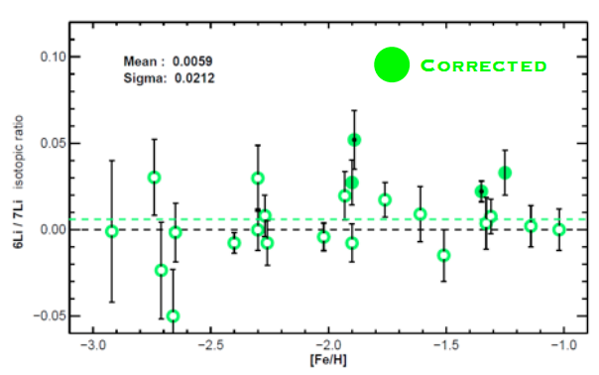
NUCLEAR REACTIONS OF ASTROPHYSICAL INTEREST AT LUNA | D. Trezzi
THE ²H(α,γ)⁶Li REACTION
BIG BANG NUCLEOSYNTHESIS
The S-factor of the ²H(α,γ)⁶Li nuclear reaction has been measured, providing the firs data points at BBN energies. Using the new ²H(α,γ)⁶Li cross section a relative BBN lithium-6 abundance:
${}_{ }^{6}{Li/H=\left(0.80±0.18\right)×{10}^{−14}}$
is obtained. Three order of magnitude less than the observed one.
M. Anders et al., PRL 113 (2014) 042501
Università degli Studi di Milano | INFN – New Vistas in Low-Energy Precision Physics (LEPP)

Slide 20
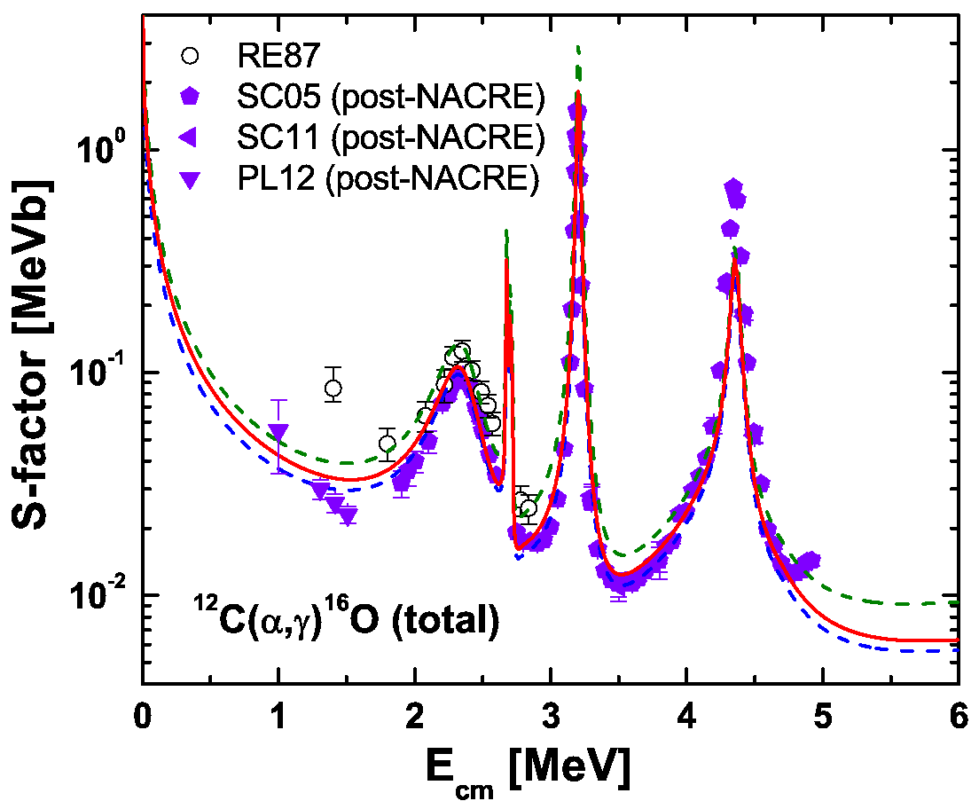
NUCLEAR REACTIONS OF ASTROPHYSICAL INTEREST AT LUNA | D. Trezzi
THE ¹²C(α,γ)¹⁶O REACTION
THE HOLY GRAAL OF NUCLEAR ASTROPHYSICS
Gamow peak helium burning 300 keV – 10⁻⁸ nb
The ¹²C(α,γ)¹⁶O reaction:
plays a fundamental role in the evolution of any star during the helium-burning phase.
Determines the Carbon to Oxygen ratio abundance.
Influences the nucleosynthesis of elements up to the iron peak for massive stars.
Influences the cooling timescale of white dwarfs.
Influences the proprieties of thermonuclear as well as core collapse supernovae.
… waiting for LUNA-MV
William A. Fowler, Nobel lecture 1983
Università degli Studi di Milano | INFN – New Vistas in Low-Energy Precision Physics (LEPP)

Slide 21


NUCLEAR REACTIONS OF ASTROPHYSICAL INTEREST AT LUNA | D. Trezzi
CONCLUSIONS: limits and future prospective
Nuclear Astrophysics is forever: reactions never measured, unknown in given energy ranges, high precision required…
LUNA-MV + LUNA 400 kV “usual” can not reach energies lower than 50 keV.
In some reactions, electron screening correction must be applied.
LUNA-MV can not produce too much neutrons (LNGS requirement).
NEW OPPORTUNITIES
for everybody
http://luna.lngs.infn.it/
Università degli Studi di Milano | INFN – New Vistas in Low-Energy Precision Physics (LEPP)

Slide 22

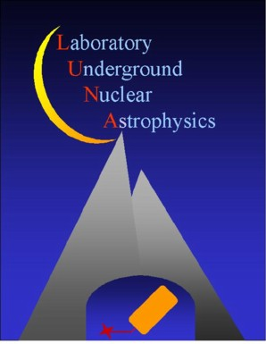


NUCLEAR REACTIONS OF ASTROPHYSICAL INTEREST AT LUNA | D. Trezzi
THE LUNA COLLABORATION
A. Boeltzig, A. Formicola, M. Junker, I. Kochanek, C. Savarese | Laboratori Nazionali del Gran Sasso/GSSI, Italy
D. Bemmerer, M. Takacs, T. Szucs | HZDR, Germany
C. Broggini, A. Caciolli, R. Depalo, R. Menegazzo | Università di Padova and INFN Padova, Italy
C. Gustavino | INFN Roma1, Italy
Z. Elekes, Zs. Fülöp, Gy. Gyurky, E. Samorjai | INR MTA-ATOMKI Debrecen, Hungary
O. Straniero | Collurania Astronomical Observatory Teramo, Italy
F. Cavanna, P. Corvisiero, F. Ferraro, P. Prati, S. Zavatarelli | Università di Genova and INFN Genova, Italy
A. Guglielmetti, D. Trezzi | Università di Milano and INFN Milano, Italy
A. Best, G. Imbriani, A. Di Leva | Università di Napoli “Federico II” and INFN Napoli, Italy
G. Gervino | Università di Torino and INFN Torino, Italy
M. Aliotta, C. Bruno, T. Davinson | University of Edinburgh
E. Fiore, V. Mossa, F. Pantaleo, V. Paticchio, R. Perrino, L. Schiavulli, A. Valentini | Università di Bari and INFN Bari, Italy
Università degli Studi di Milano | INFN – New Vistas in Low-Energy Precision Physics (LEPP)

Slide 23


NUCLEAR REACTIONS OF ASTROPHYSICAL INTEREST AT LUNA | D. Trezzi
Università degli Studi di Milano | INFN – New Vistas in Low-Energy Precision Physics (LEPP)

