Slide 1
THE MESA Accelerator
Kurt Aulenbacher,
LEPP workshop,
Mainz, April 04, 2016

Slide 2
Outline
Impact of CFP: new MESA lattice & timeline
MESA assembly strategy

Slide 3
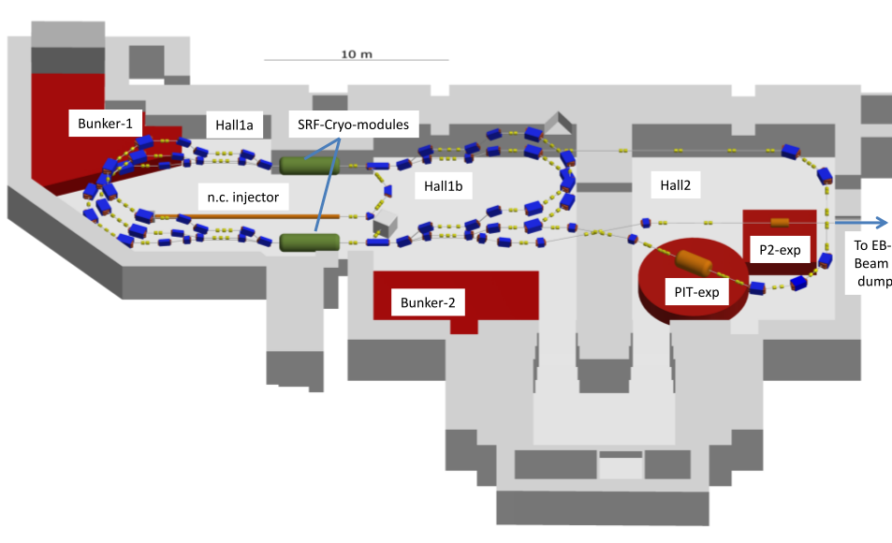
New challenges for the MESA facility….
Initial „Plan A“: Use existing building for
0.15mA 155 MeV polarized external beam (P2)
and 1mA, 105MeV (later: 10mA) unpolarized beam for
„pseudo internal“ windowless target experiment
“Plan A”
(summer 2014)

Slide 4
New challenges for the MESA facility
Today: Accelerator parameters unchanged
BUT: increased number of proposed experiments,
with also increased space requirements
& additional boundary conditions
→ space extension (and change of accelerator lattice)
almost unavoidable: „Plan B“

Slide 5
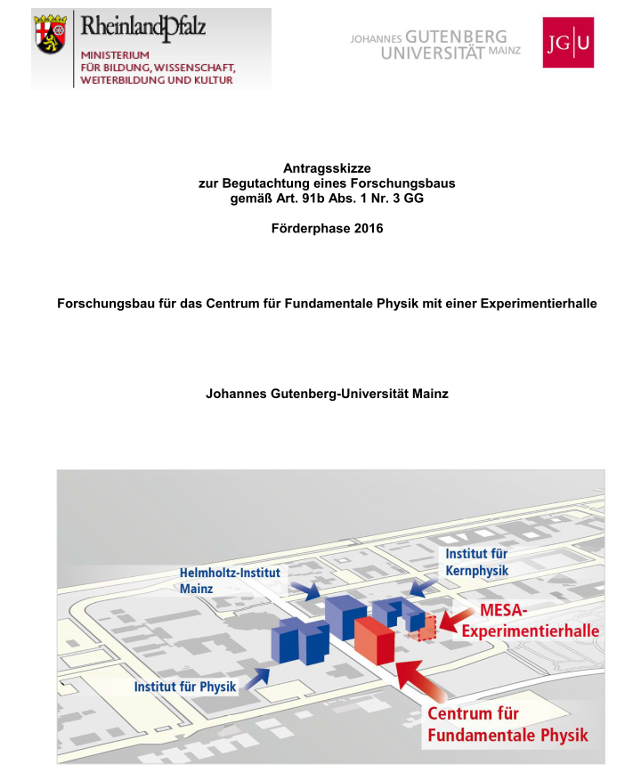
The new research buildings (Forschungsbau):
“Centrum für Fundamentale Physik”, CFP
Plans and budget for underground
building had been
worked out April-November 2014.
final CFP application submitted
in 12/2014
CFP-office/laboratory building,
probably adjacent to HIM building
CFP-Underground building extends
MESA-facility („MESA Experimentierhalle-1“)
Funding recommended by
german science council („Wissenschaftsrat“)
in March 2015
Official funding granted by
federal government end of June 2015

Slide 6
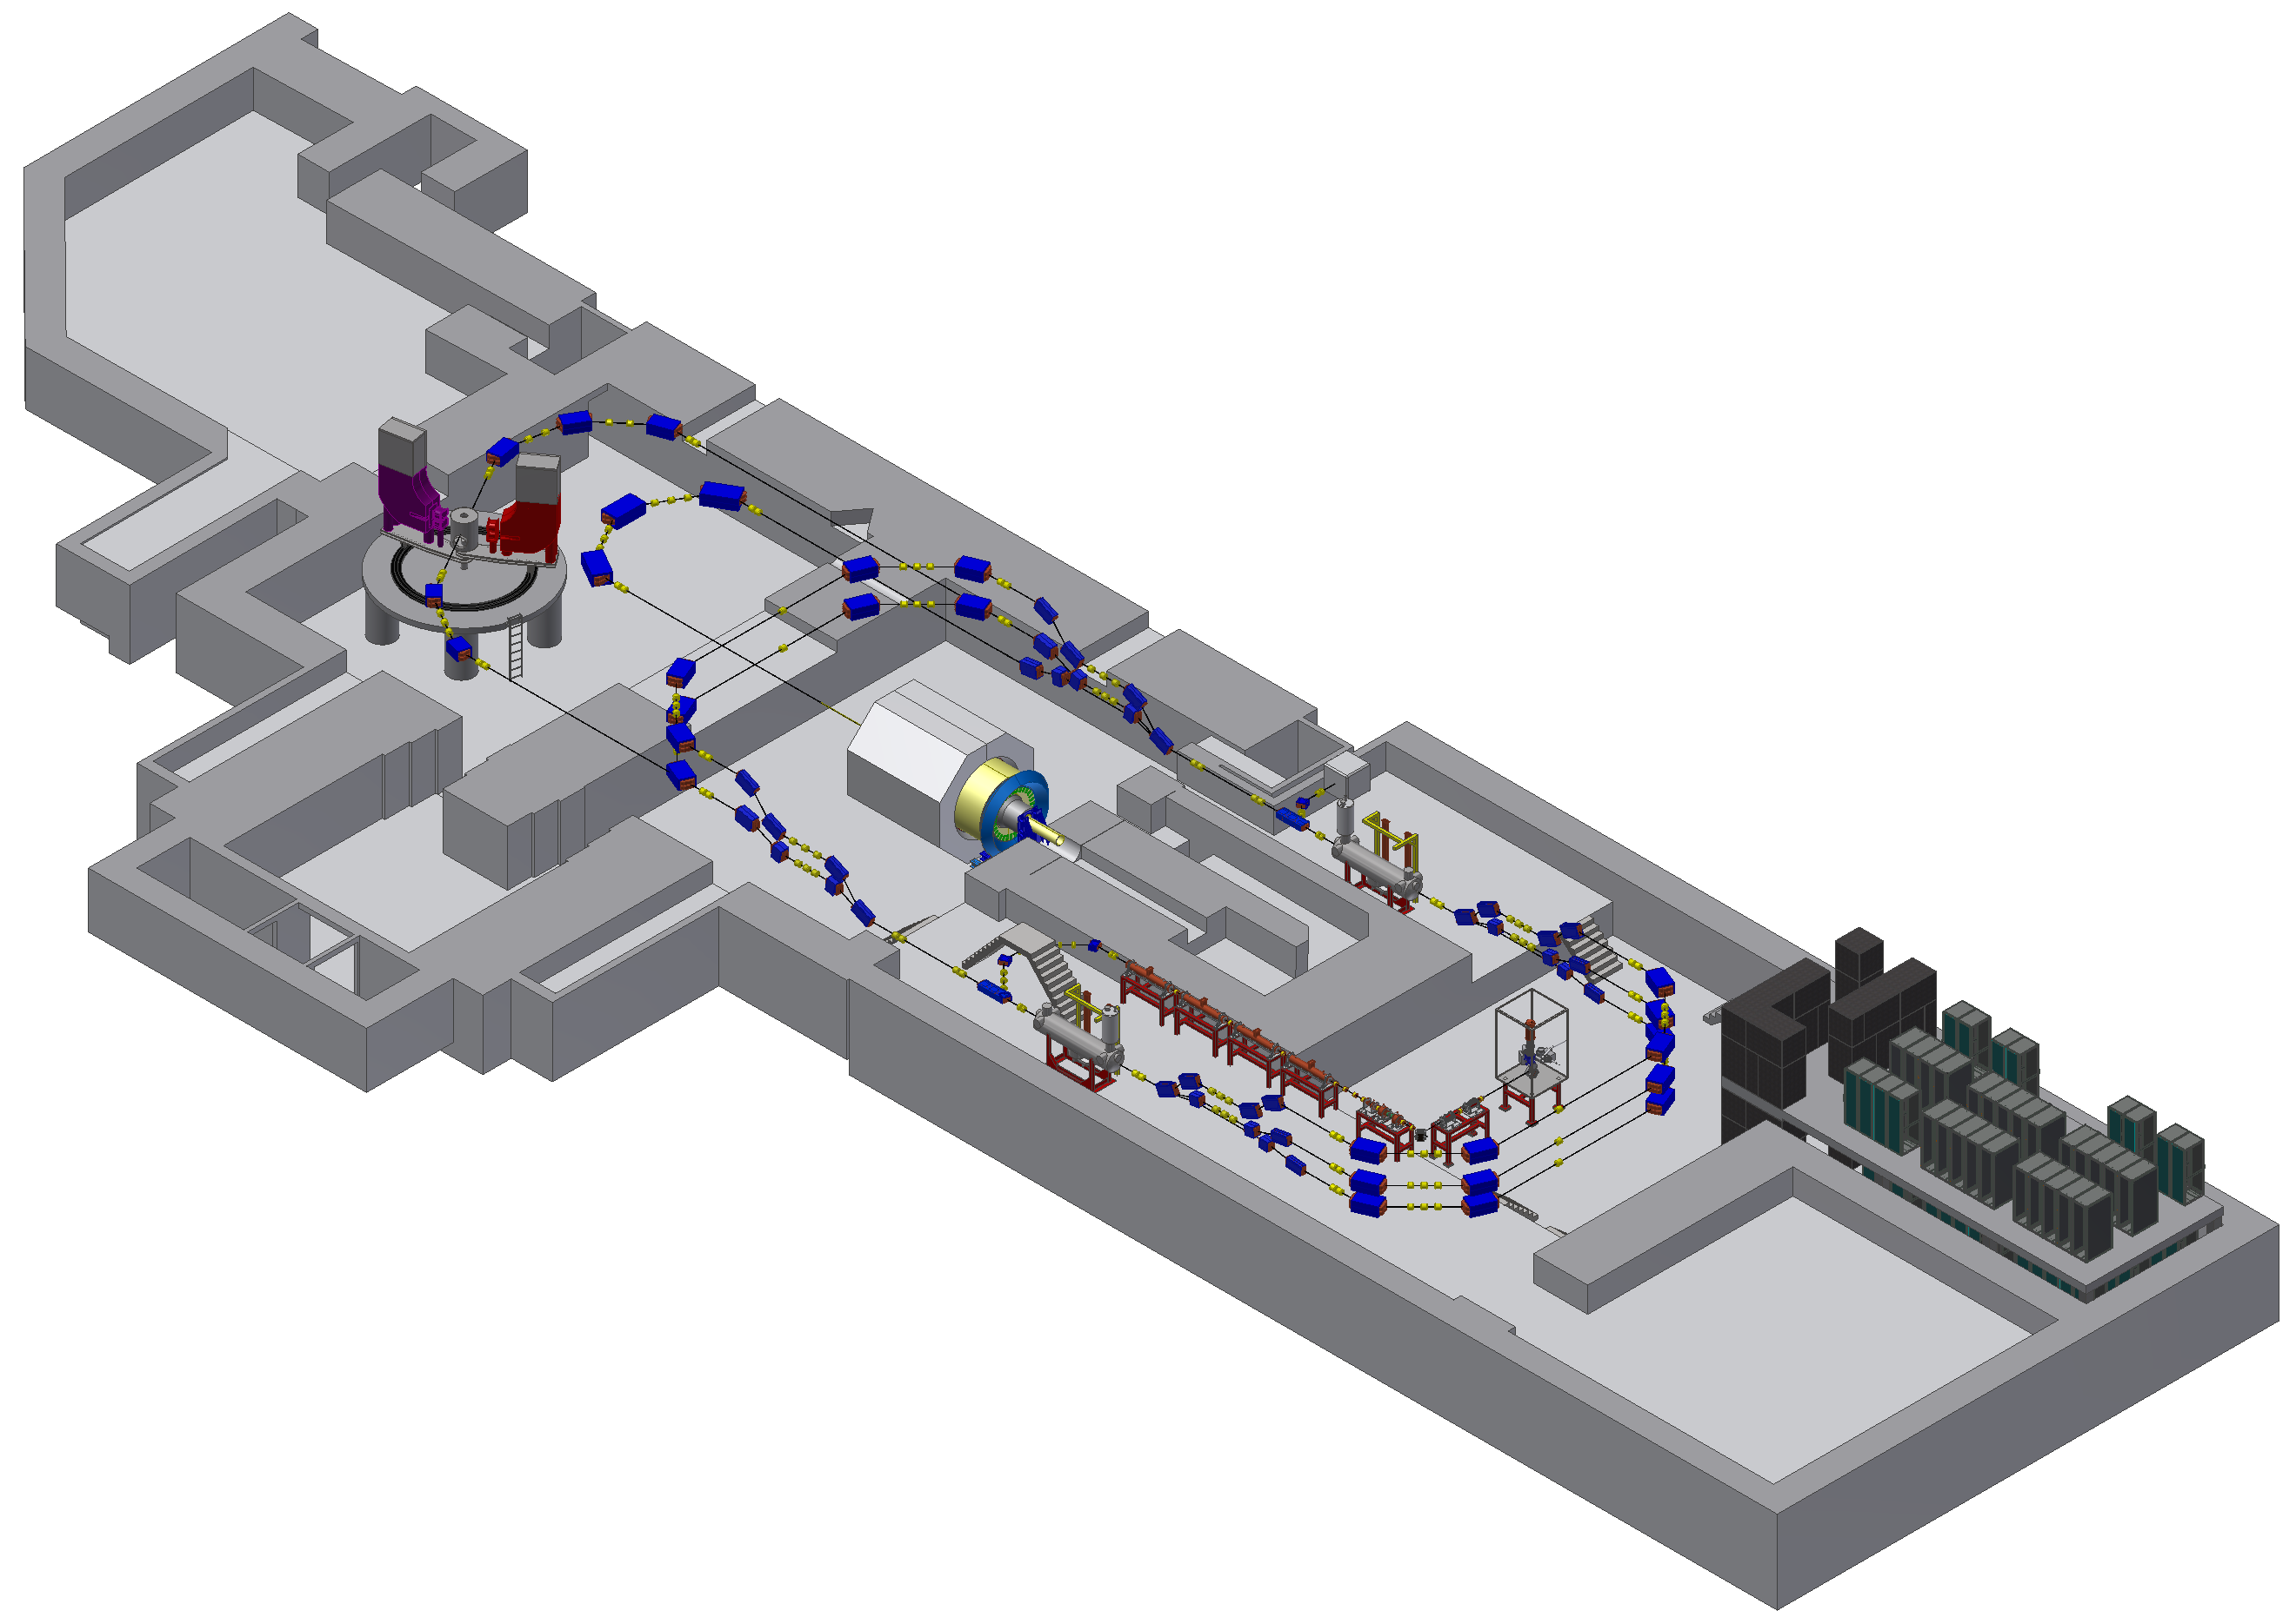
PLAN “B” (April-Oktober)
The CFP-based MESA lattice aka
“Plan B” – science& site advantages
4
#
=hall number
3
2
OLD
MAGIX
NEW (u-CFP)
P2
1
Beam dump building used
BDX ideal
More space for MESA!
Hall-4 available for future experiments…
BDX
D. Simon

Slide 7
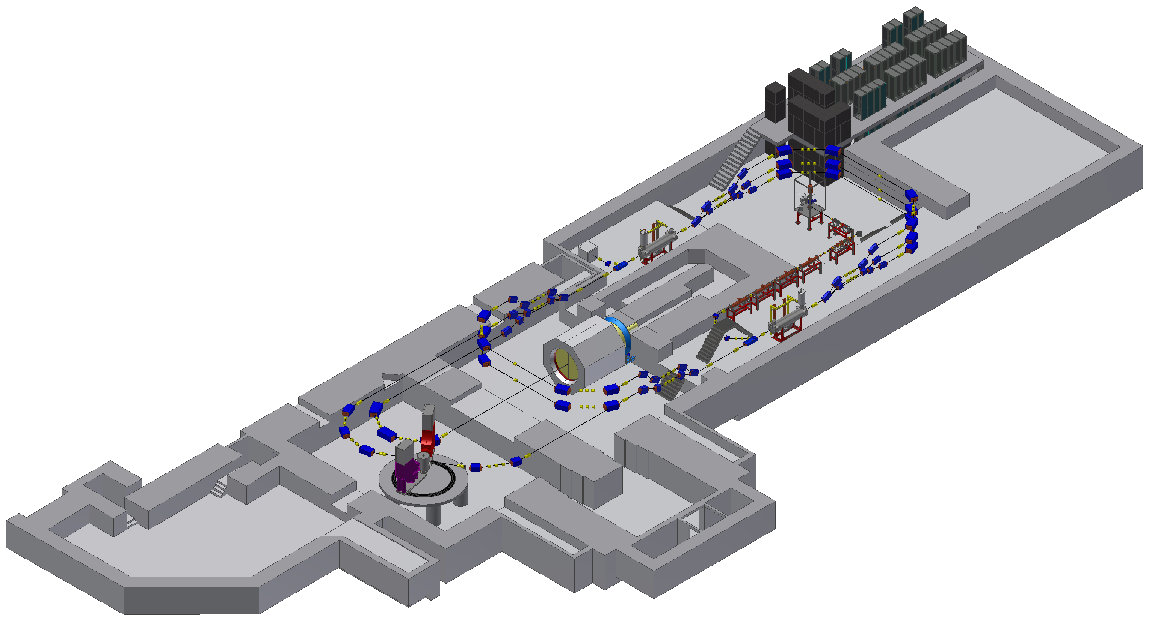
PLAN “B” – interference & transport issues
1
P2 does not interfere significantly with MESA-operation!
2
Beam dump shielding is strong enough
3
Cryomodules can be transported in/out of hall
4
P2 arc and MAGIX arc close, but they
are at different elevations
5
3,8 m diameter solenoid coil can be put in
place
3
2
1
5
4
D. Simon

Slide 8
A few words concerning hall
4
Hall 4 fire protection situation will be resolved when CFP ready
No new breakthroughs in wall between halls 3 & 4 advisable...
...but can be used with external beams from MESA AND MAMI
4
3

Slide 9
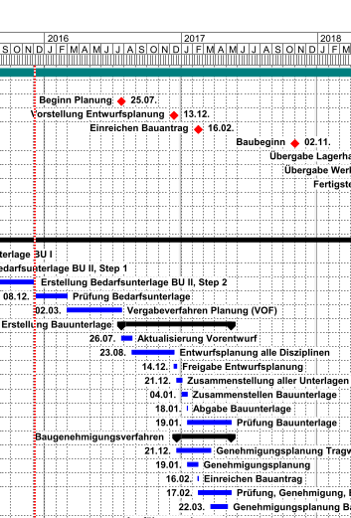
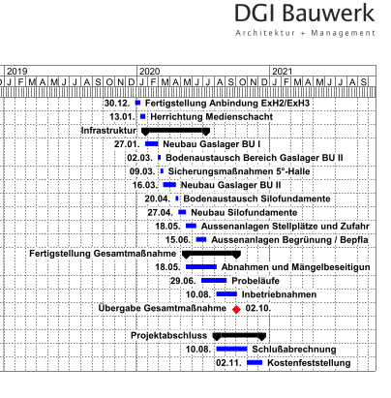
Civil Construction: ….a very complex enterprise
Building „ready“

Slide 10
Quantum of solace…
Extended time scale enables:
More thorough design of „conventional“ components: lattice, magnets, vacuum system, control system, diagnostics amm)
→ This will not lead to project delay!
Project more stable wrt to lead time escalation
Testing of components under realistic Conditions
( even with I_{beam} >1mA !) is POSSIBLE!
Cryomodules can be tested at HIM experimental site (albeit without beam)!
→„MESA Assembly Strategy“

Slide 11
PLAN “B” – accelerator components
5 MeV
Dump
MEEK-2
MARC
2,4
Two- floor
InstrumentationBunker
155 MeV
Dump
MELBA
MARC 1,3,5
MAMBO
MARC
0
MEEK-1
MELBA: MEsa Low –energy Beam Apparatus
MAMBO: MilliAMpere Booster
MEEK: Mesa Elbe-Enhanced-Kryomodule
MARC: MESA (recirculation) ARC

Slide 12
MESA assembly Strategy STEP-1: MELBA
Components to be operated with beam:
STEP-1: Assembly of MELBA (MEsa Low Energy Beam Apparatus) in 2016
MAGIX
P2
Hall-3 is presently being made available
for intermediate set-up!

Slide 13
MESA assembly Strategy: Step-2: Operation of MAMBO
„Milliampere Booster“ (MAMBO)→ av. 2017
first two sections operational 2017, other two tested
MAGIX
P2

Slide 14
MESA assembly Strategy Step -3: Cryomodules
MEEK-Kryomodules will be tested at HIM in 2017
MAGIX
P2

Slide 15
MESA assembly Strategy: Operation of MAMBO with I_{beam} >1mA in Hall-3
fixed β
(ΜΑΜΒΟ−2)
graded β
(ΜΑΜΒΟ−1)
chopper/
buncher
α-magnet 2
MARC-0
Spin
rotation
6d beam characterization
+ dump
Injection
chicane
Source &
α-magnet 1
Exp.-Halle MESA 3
15m

Slide 16
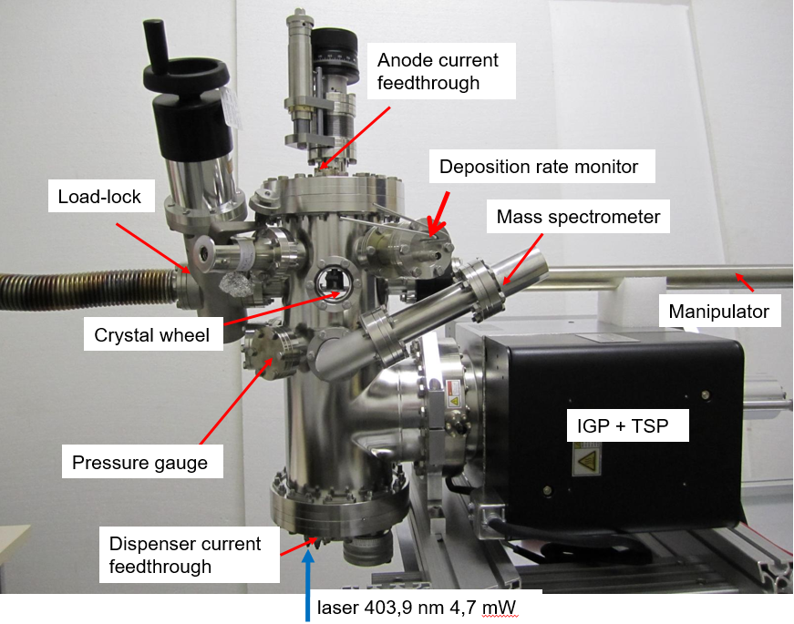
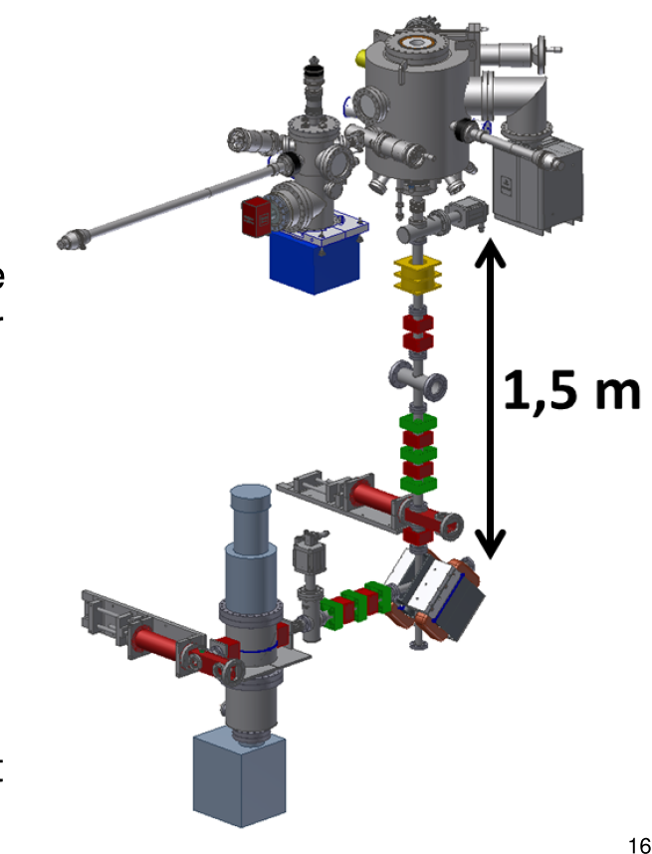
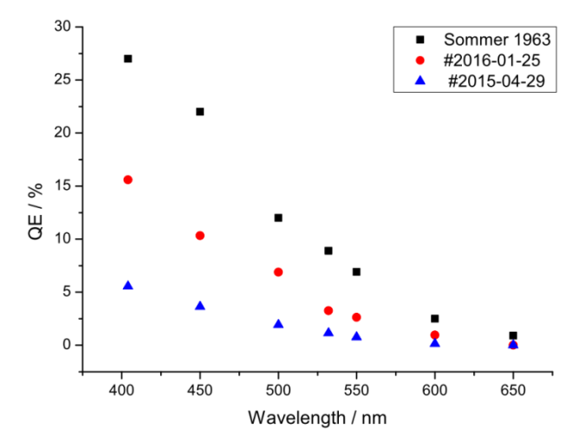
Assembly of MELBA (MEsa Low Energy Beam Apparatus) in summer 2016
(all parts shown in picture are in house)
Load lock system
Electron Source
„STEAM“
transport
S. Friederich
Solenoid
Quadrupoles
Scanners
Differential
pumping
V. Bechthold
Robust Photocathodes with QE=15% (45mA/Watt)at 400 nm: available! → 1mA can be generated with laser from a blue ray disc player I

Slide 17
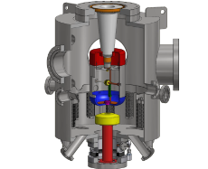
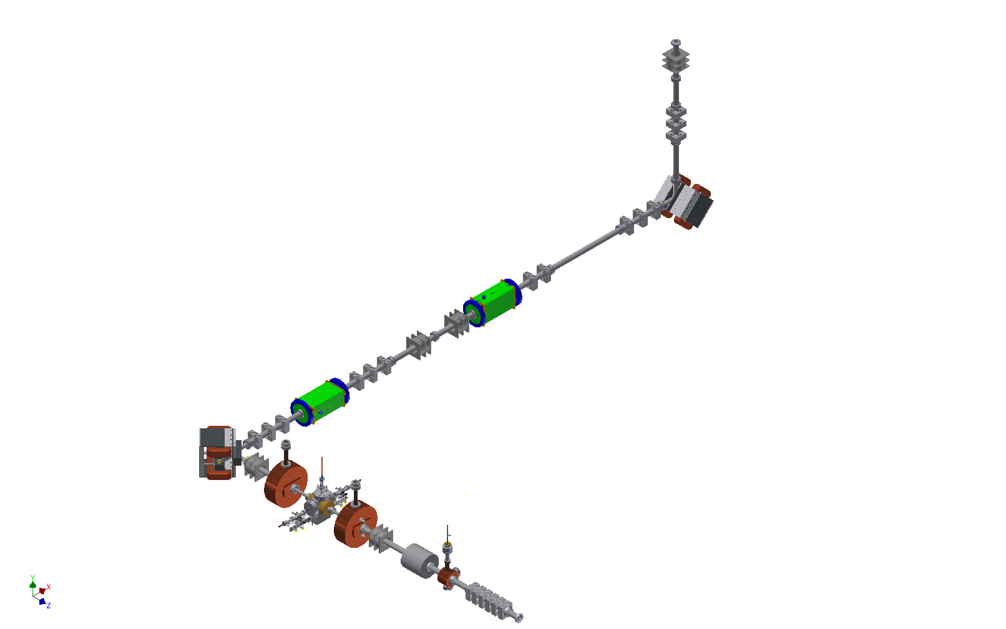
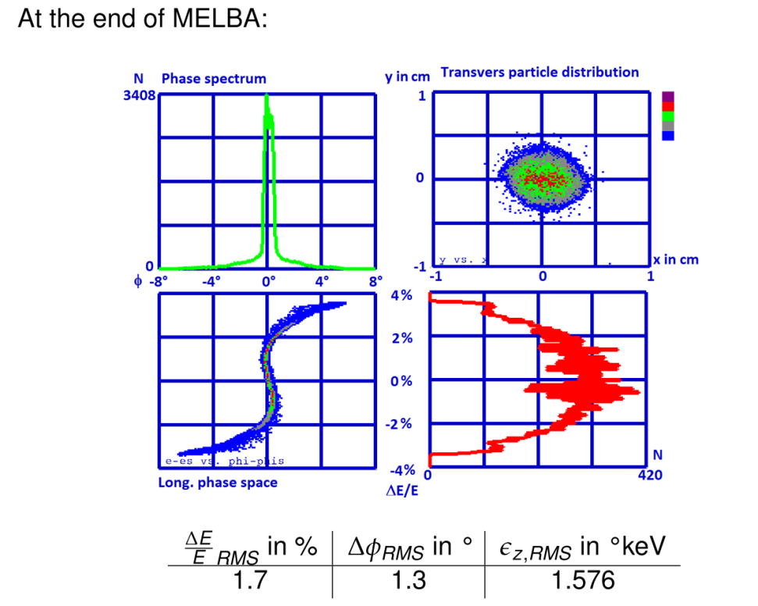
STEP-1: Assembly of MELBA (MEsa Low Energy Beam Apparatus) until early 2017
„Start to end“ Simulation predicts for 100keV beam:
-Compatibility with spin rotation
Sufficient beam quality
for injection into MAMBO
with 1pC bunches (=1,3mA)
Source
Polarisation
Vacuum
Matching
C. Matrejcek

Slide 18
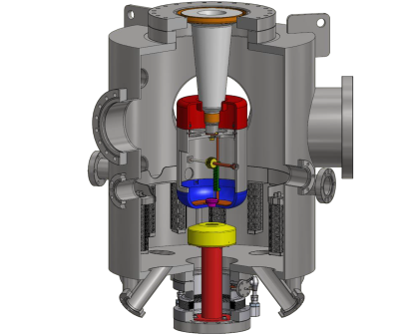
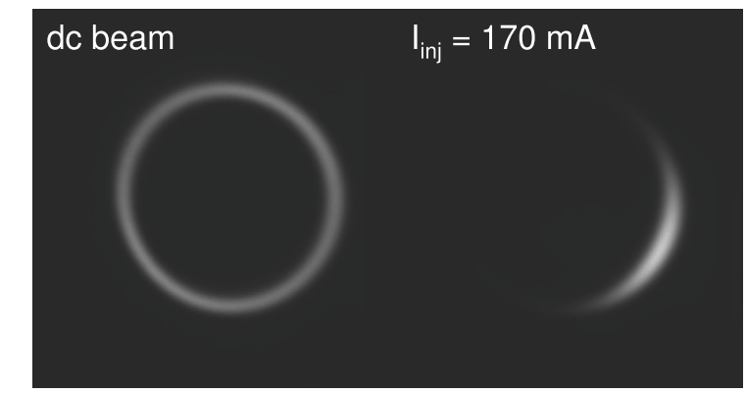
STEP-1: Assembly of MELBA (MEsa Low Energy Beam Apparatus) in 2016
Blue ray disc laser and longitudinal diagnostics
already tested….
Source
I. Alexander
Polarisation
Vacuum
Longitudinal diagnostics at
Bunch charges corresponding to
> 1mA average current
Matching

Slide 19
Conclusion
CFP building enables good conditions for initial experiments &
…… enables new ones &
…. Potential for completely new projects
.. but considerable extension of timeline by ~ 3 years
. Assembly strategy foreseen for accelerator components during
time of civil contsrruction,
test withs high intensity beam of preaccelreator planned
Cryomodule tests in new HIM building

Slide 20
Thank you for your attention!

Slide 21
fixed β
(ΜΑΜΒΟ−2)
graded β
(ΜΑΜΒΟ−1)
chopper/
buncher
α-magnet 2
MARC-0
Spin
rotation
6d beam characterization
+ dump
Injection
chicane
Source &
α-magnet 1
Exp.-Halle MESA 3
15m

Slide 22
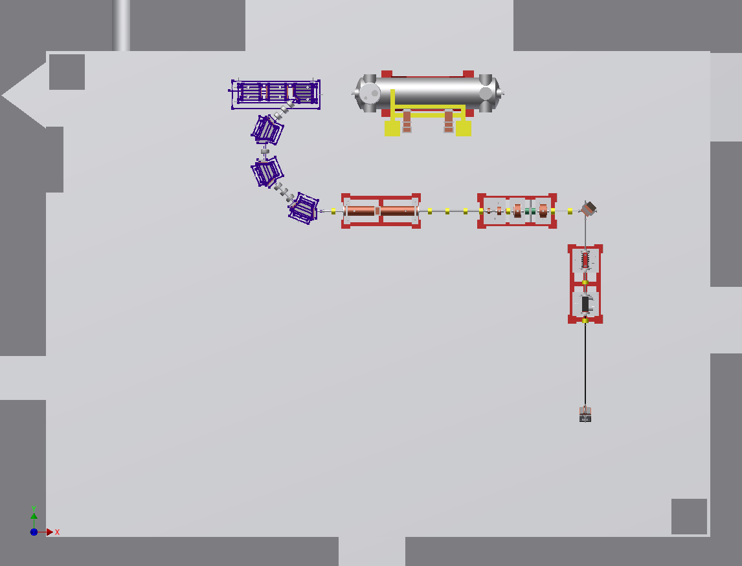
injection chicane
MEEK
injection arc
graded β
chopper/buncher
α-magnet 2
spin-rotation
Task 3: add MEEK ????
Not favorized, too small time window
Kryomodules will be tested after delivery
(without beam) at HIM site
α-magnet 1

Slide 23
MESA assembly Strategy Step -3
HIM building ready for occupancy in 4/2016!
Large area clean room for cavity assembly
Großgeräteantrag (high pressure water rinsing, ultrasonic bath,…) of 1,6M€ submitted to DFG.
Helium transfer line from L280 to HIM is installed
Bunkered test stand will be installed, starting from 5/2016
2K pump (SAC) (4g/s) tendering starts this month!
→ Expect to be ready for testing in HIM in 5/17!
Possibility to visit HIM either in the
Lunchbreak oder this evening!
MAGIX
P2

Slide 24
Strategy & timeline 2015-2020:
Use ExHall-3 until ~6/2018 : demonstration of high current
injector operation (Full MELBA +two modules of MAMBO+
MARC-0)
Test all other Rf/SRF components with full field
Upgrade of L280 in 16/17 (cash-flow!)
Use 16/17 for preparing tendering of MARC-Magnets
and 8g/s SAC, (delivery 2019?)
other conventional components (vacuum, support structure)
also in 18/19
Cryogenic line installation only after building ready!
Virtually all components should be delivered and tested before
CFP-building is ready!

Slide 25
Long range initiatives

Slide 26
MESA-Scientific staff, Post-Docs & PhD students
How to maintain?
Staff: K.Aulenbacher (project leader, MELBA,), F. Hug (MEEK, beam dynamics), R. Heine (MAMBO), M. Dehn (control, diagnostics), J. Diefenbach (radiation protection, feedbacks)
Post-Docs: L. Hein (Beam dynamics)
F. Schlander (SRF, left 1/2016 to ESS)→ n.n.
PhD students:
I Alexander MELBA High power Beam diagnostics
V. Bechthold Photocathodes
S. Friederich Electron source, high brightness operation
S. Heidrich: MESA Magnets, MARC-0
P. Heil: High bunch charge, MAMBO beam dynamics
R. Herbertz Beam stabilization, feedbacks
B. LeDroit (6/2016) Halo suppression
C. Matejcek MELBA beam dynamics and characterization
D. Simon – cryogenic operation of MEEK
T. Stengler MEEK-HOM damping
Ch. Stoll (6/2016): ERL related beam dynamics
5 MeV
Dump
MARC
2,4
MEEK-2
155 MeV
Dump
MELBA
Two- floor
InstrumentationBunker
MAMBO
MARC 1,3,5
MARC
0
MEEK-1

Slide 27
Excellence cluster “PRISMA-2”?
January 2016: „Imboden-Komitee“ presents its conclusions
on results and possible continuation of excellence initiative to
greman research minstery BMBF
…Concludes that „Clusters“ are succesful concept and suggests
BMBF to create possibilites for new proposals
…Proposes that existing clusters should be extended until 2019.
The latter recommendation, if accepted by government,
probably allows to continue personell funding (invest?)
→In additon, brainstorming for „PRISMA-2“ has started.

Slide 28
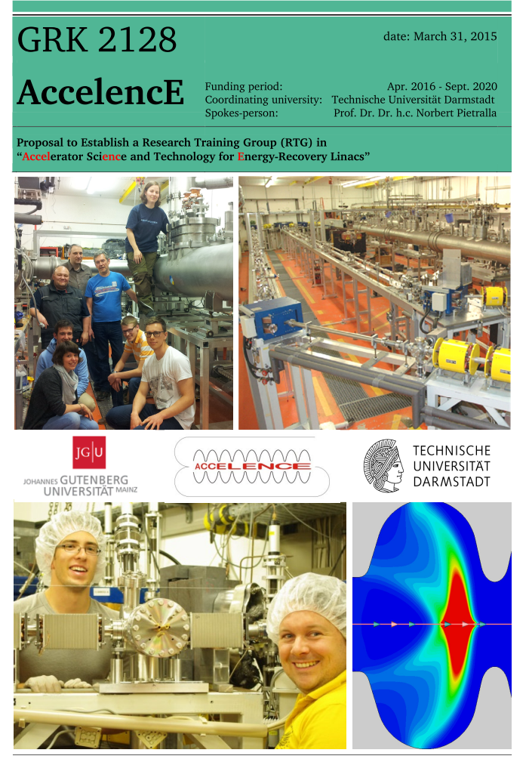
GRK-2128 “Accelence”
Common application by TUD and JGU for graduate
school.
Accelerator science and technology for enrgy
recovery linacs
Application succesful in 10/2015
First funding period (4,5 years) starts in 4/2016,
4PhD positions for JGU.

Slide 29
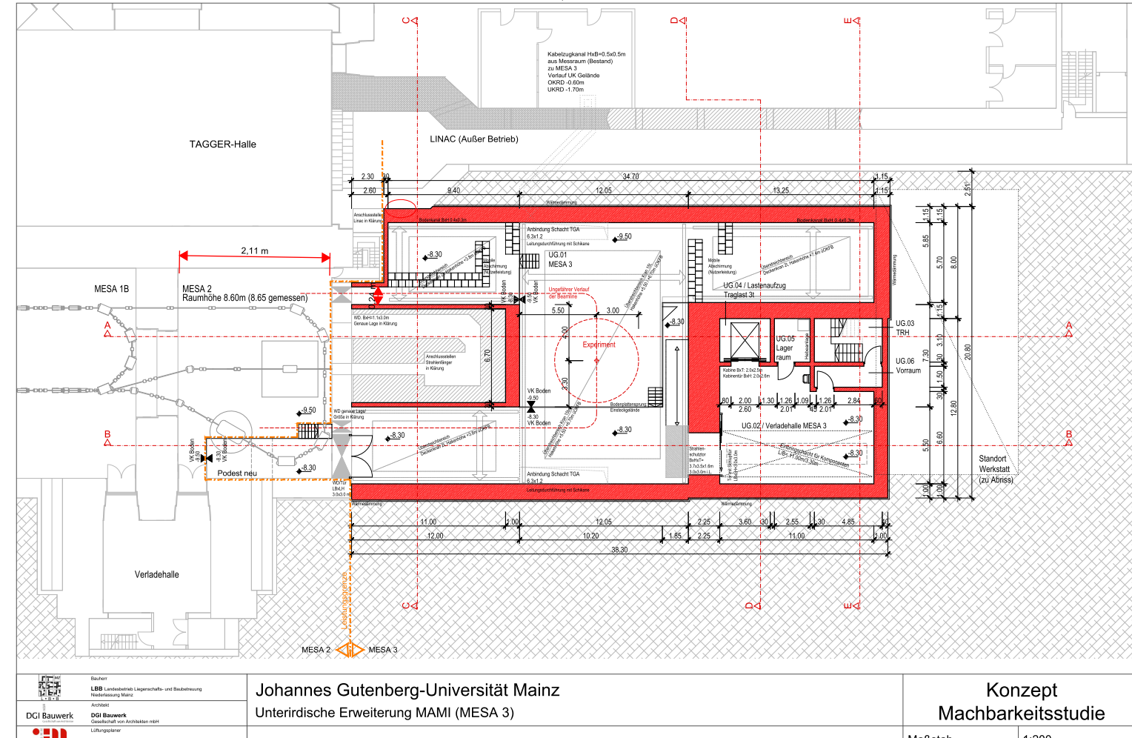
“Centrum für Fundamentale Physik”, CFP
New underground building at KPH -some details
Arc arrangement idea by R. Heine

Slide 30
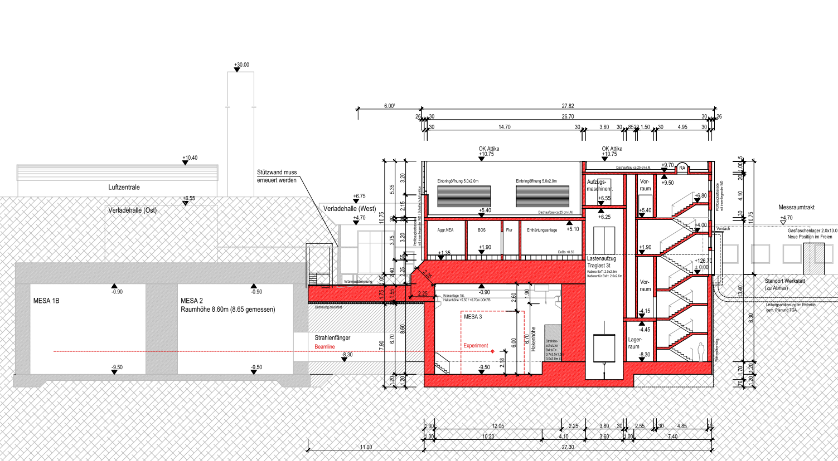
“Centrum für Fundamentale Physik”, CFP
New underground building-some details
Radiation protection: see talk by
Jürgen Diefenbach
Note: Experiment and Accelerator power and cooling will be installed in the
Technical rooms of new building ! → excellent infrastructure conditions !
(if compared to initial suggestion…)

Slide 31
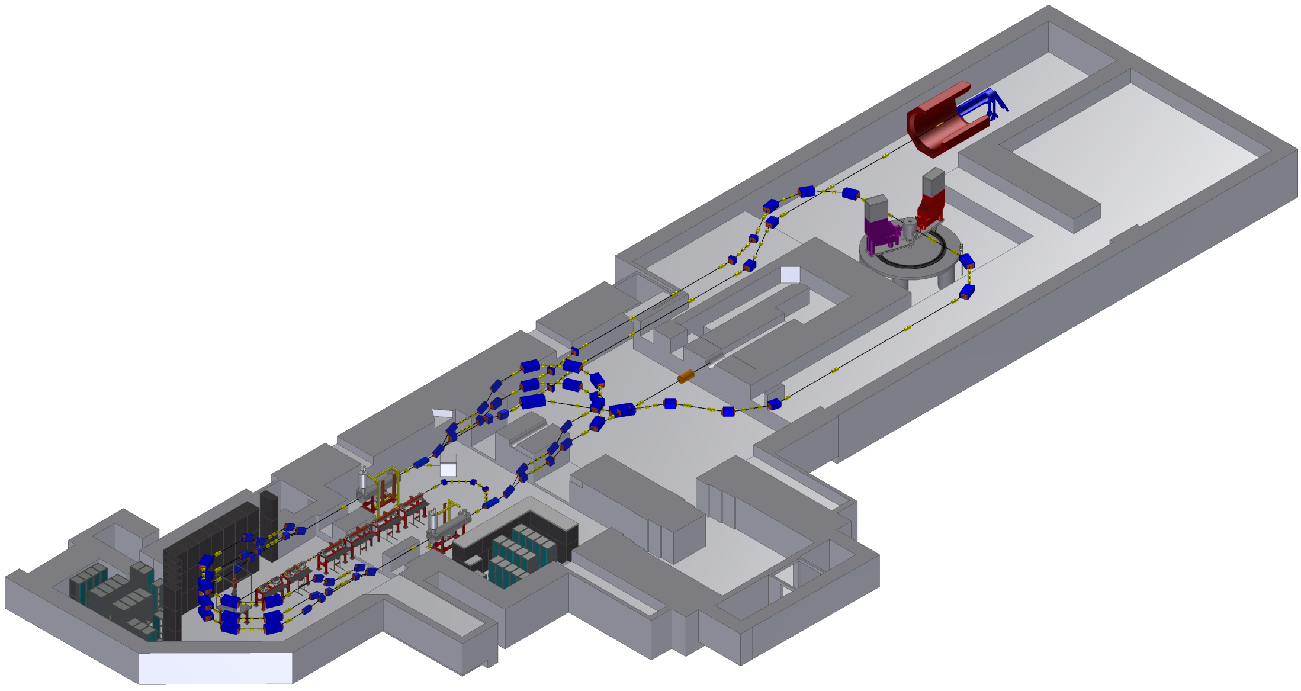
PLAN “A” (April 2015)
New Building
Hall-1
P2
Old Building
2
MAGIX
3
4
Beam dump
building
Inconveniences of „Plan A“,
space has shrinked in Hall-1 due
to extension of MESA lattice!
Large ADDITIONAL costs for
civil engineering in old building,
in particular ventilation, ground-work
(earth shield!) and five large breakthroughs
MESA Instrumentation

Slide 32
PLAN “B”
MESA Instrumentation
New Building
Hall-1
BDX
BDX
Old Building
2
3
P2
4
Beam dump
building
MAGIX
Future exp.

Slide 33
Step-3 (see talks by Florian Hug)
HIM building ready in spring 2016
Bunkered test stand, 4g/s closed cycle, corresponding 16 mbar SAC
Delivery of Cryomodules due in 2017 (first due date: 3/2017)
Acceptance test of modules under realistic conditions
The team:
Dr. Felix Schlander (Kryomodul project managment)
Jun. Prof. Dr. Florian Hug (LLRF, control, Kryomodul project managment)
N.N. LLRF Post-Doc (succesor Felix Schlander)
Dipl Phys. Daniel Simon - Cryogenics
M. Sc. Timo Stengler (Cryomodule characterization, in particular HOM thermal management)
Ba Sc. Philipp Weber (R.f. charecterization)

Slide 34
PLAN “B” – fire protection/cost reduction
Hall-4 now formally belongs to old part of building
Halls 1-3 get „up to date“ fire protection
Hall-4 fire protection will be enforced together
with the rest of KPH buildings
1
2
3
4
No breakthroughs, only circular holes → building stability issues solved
Existing ventilating machine sufficient for Hall 2/3!
→No significant groundwork over old halls, since no shafts for new ventilation required!
Fire protection authority accepts concept for halls 1-3 in September 2015,
Architects finalized concept until 12/2015, Science ministery is favorably impressed, begins
Adminstrative procedures

Slide 35
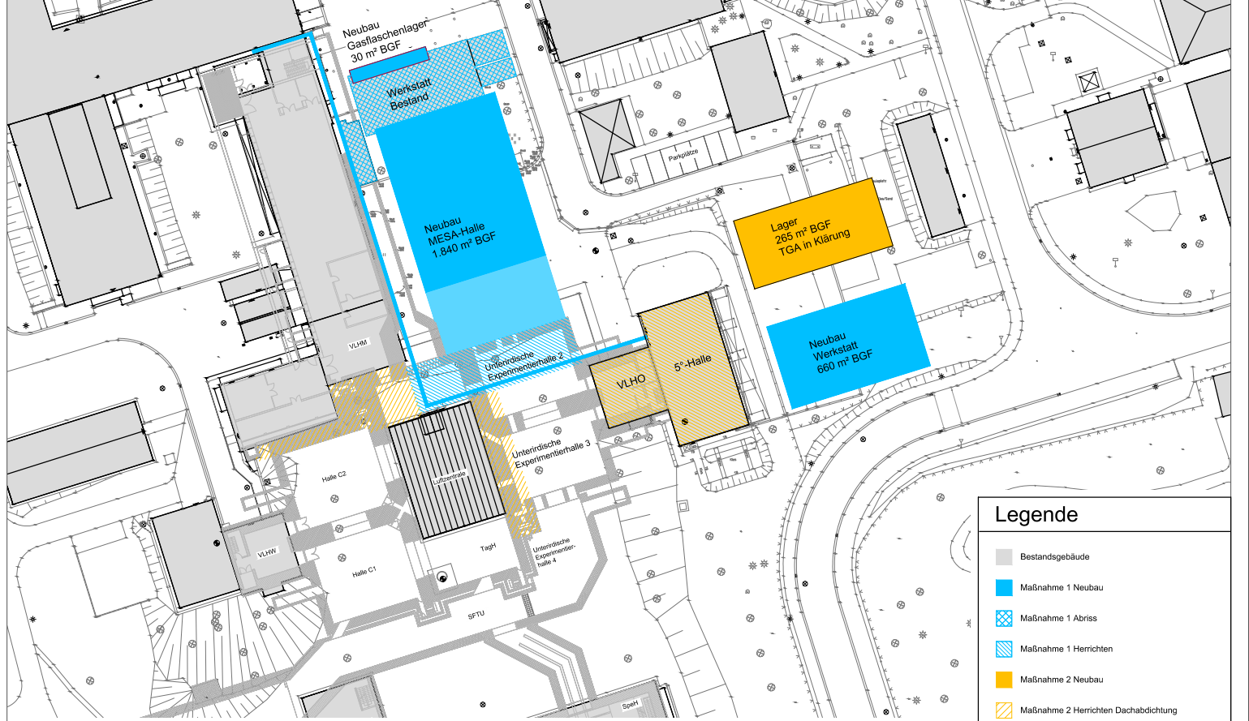
PLAN “B” – Kryogenics & R.f.
See talk by D. Simon
Five degree Hall becomes „Cryogenic center“

Slide 36
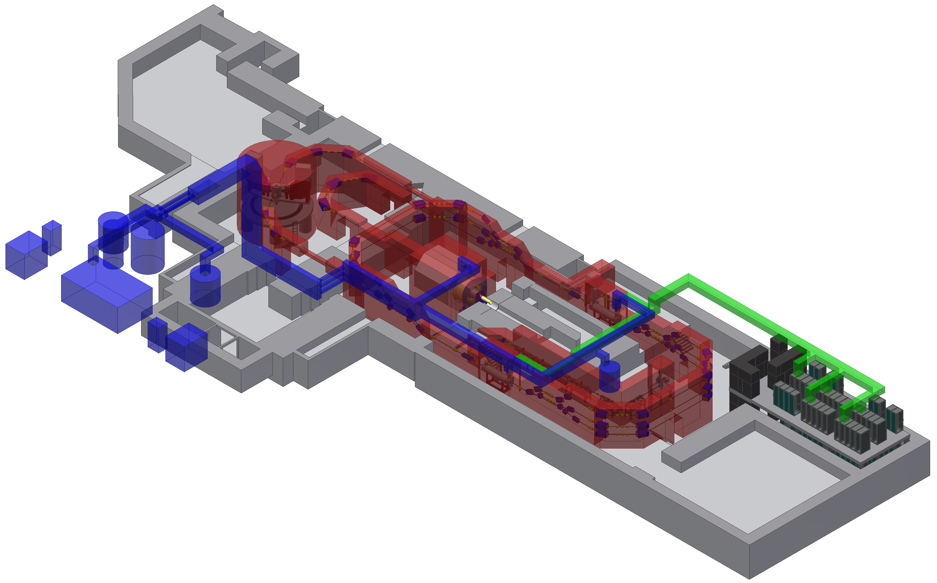
PLAN “B” – Kryogenics & R.f.
See talk by D. Simon
Valve Box (RI):
-Lq. Helium input
-Connection to Cryomodules
1
4
5
3
2
5
Five degree Hall:
1 L280 liquifier (8g/s)
1 L280 refrigerator (P2)
8g/s SAC
5000 l lq. He Dewar
2*250 kW Kompressor
1
2
3
Transfer lines:
- 4.5 K Lq. Helium to valve box
- 16mbar gas from box
~15 K gas to/from P2 refrigerator
4
5

