Slide 1

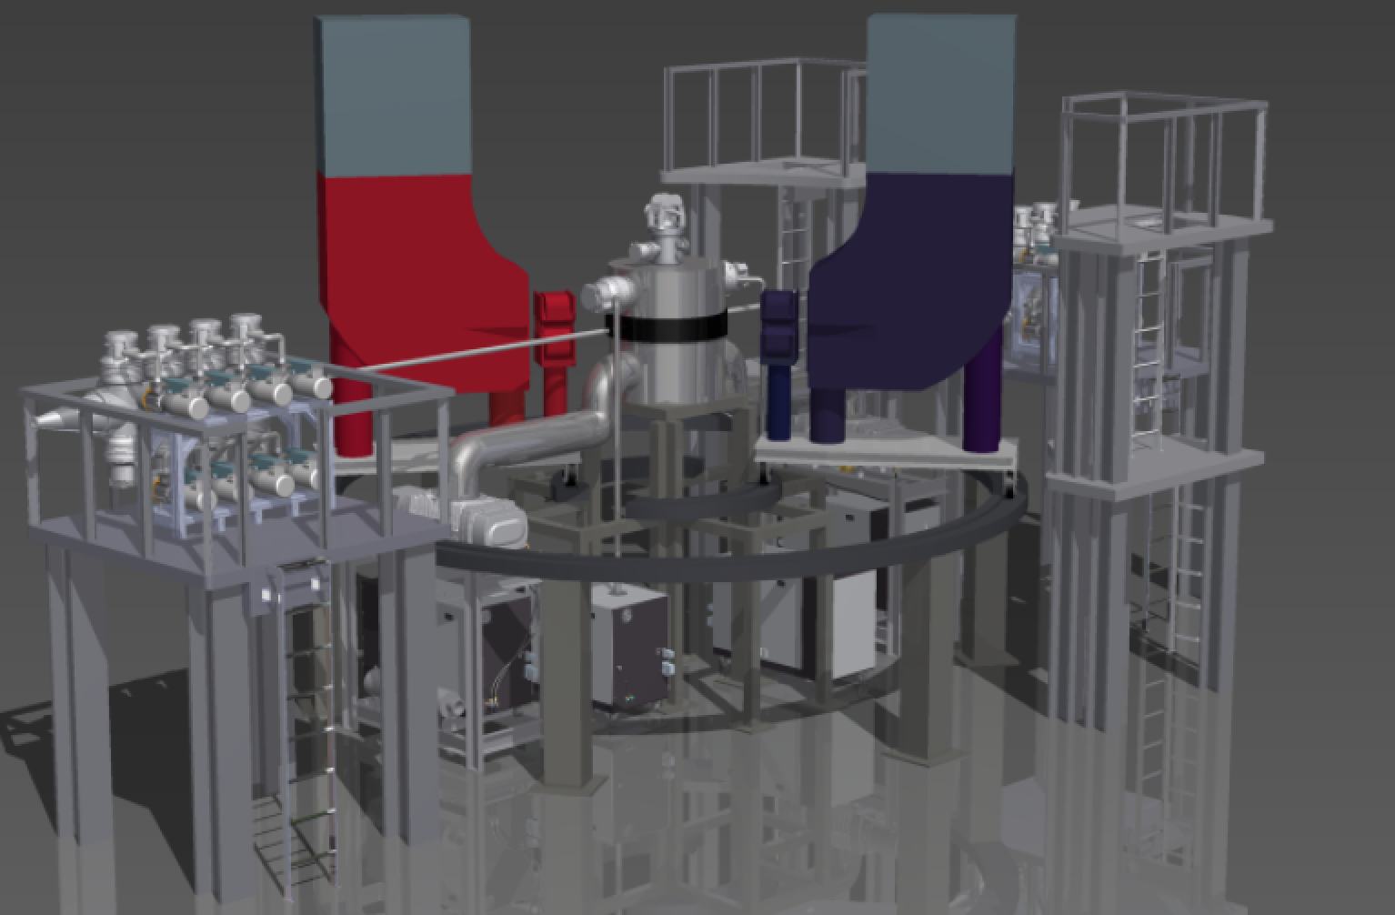

Precision Hadron and Particle Physis at MAGIX/MESA
Achim Denig
LEPP16 Workshop
Mainz, April 4, 2016
Notes:
A warm welcome to this workshop also from my side.
After Marc‘s introduction and Kurt‘s overview of the MESA accelerator project,
I would now like to come to a first overview of the experiment we are foreseeing for the internal
Target setup at MESA, the so-called MAGIX expt.

Slide 2
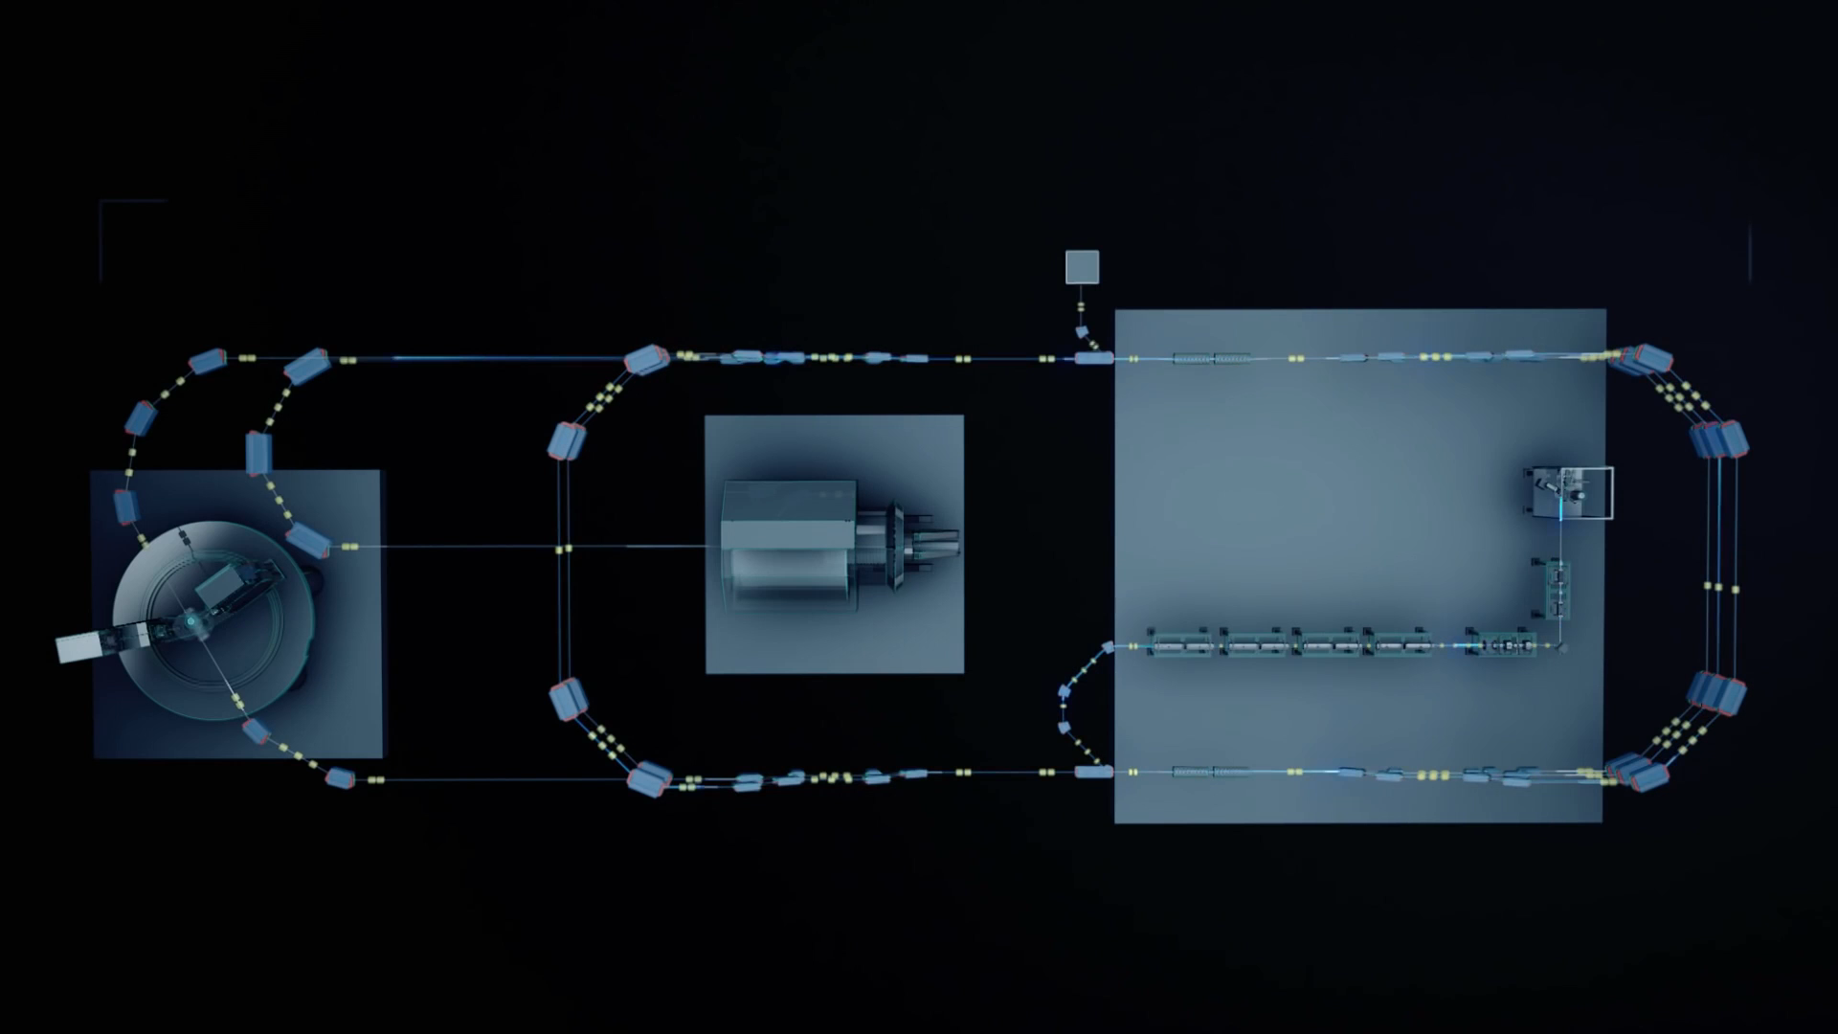
The MESA Project
K. Aulenbacher
ERL mode: E_{max} = 105 MeV, I_{max} > 1 mA
Mainz Energy-Recovering Superconducting Accelerator
Notes:
I would like to remind you that 2 experiments are planned for the initial stage of MESA,
The P2 experiment is shown here in this animation, which will use an external beam. Nik Berger will later on today give an overview of P2.
As I mentioned, we are going to concentrate on the experiment at the internal target setup, which is shown here

Slide 3
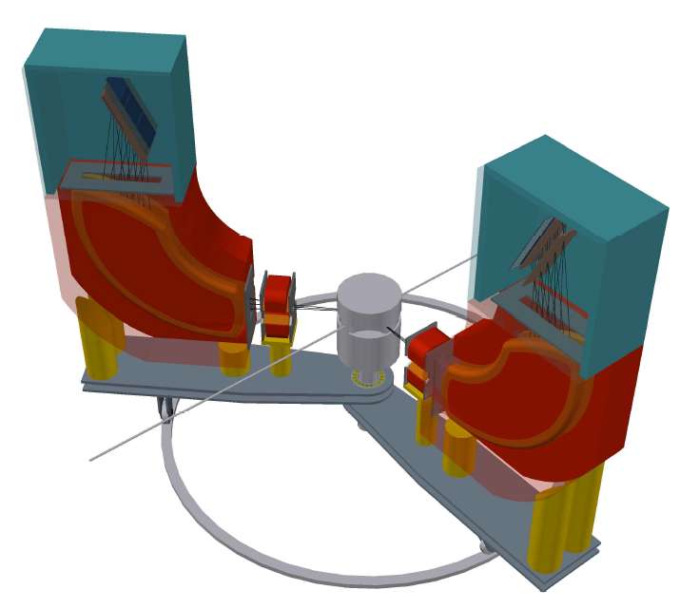
The MAinz Gas Internal Gas EXperiment
Operation of a high-intensity ERL beam
in conjunction with light internal target
a novel technique in nuclear and particle physics
for physics at the low-energy frontier of the Standard Model
windowless
internal gas
target
High resolution spectrometers MAGIX:
double arm
compact design
momentum resolution: Δp/p < 10⁻⁴
acceptance: ±50 mrad
GEM-based focal plane detectors
Gas Jet or polarized T-shaped target
1mA
ERL beam
S. Caiazza

Slide 4
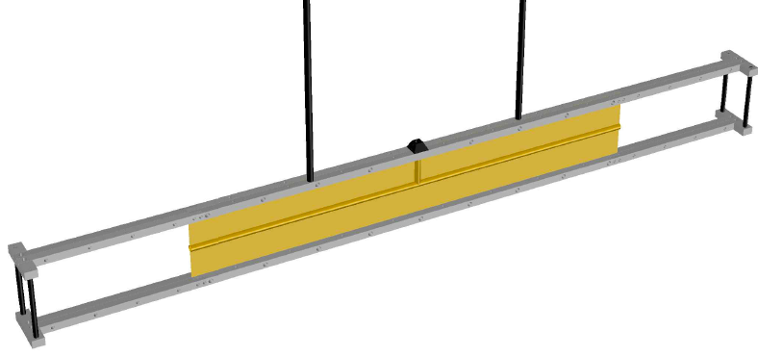
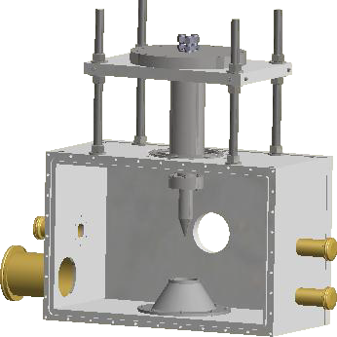
Internal Gas Targets for MAGIX
Thin T-shaped foil
Gas Jet Target
Length (~ 30 cm)
First prototype with mylar foil
Can use polarized gases
Estimated luminosity with polarized beam O(10 ³² cm⁻² s⁻¹)
Supersonic gas jet
Higher gas density
O(mm) target length
Estimated luminosity
O(10 ³⁵ cm⁻² s⁻¹)
Khoukaz, Grieser
St. Aulenbacher

Slide 5
The MAGIX Spectrometers
Simple Design: Quadrupole + Dipole
200 MeV maximum momentum
90 MeV momentum acceptance @ 200 MeV
Finite-element simulations (J. Müller)
10⁻⁴ relative momentum resolution
Assuming 50 μm resolution in the focal plane

Slide 6
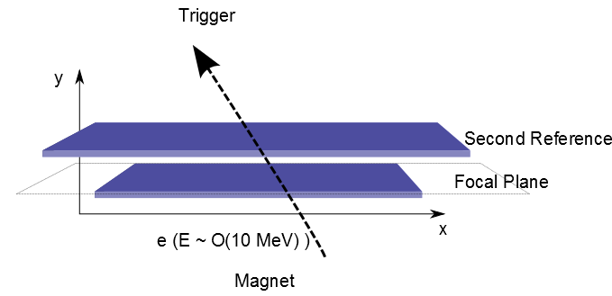
The Focal Plane Detectors
2 Sensitive layers
  - The first centered on the focal plane
  - The second with a sizable lever arm
  to measure the angle
GEM Detectors
  - 2D Strip readout
  - 0.7% radiation length
  - High rate capabilities
  - Small TPC detector ???
  - Aim for 50 µm resolution
P. Gülker, B. Ketzer

Slide 7

Physics Programme
7

Slide 8
MAGIX Physics Progam
Precision Experiments in the fields of:
- Electromagnetic Form Factors of the
Nucleons
- Nucleon Polarizabilities
- Few Body Physics
- Nuclear Reactions with astrophysical
Relevance
- Searches for Particles of the Dark Sector
- ….
Precision Experiments in the fields of:
- Electromagnetic Form Factors of the
Nucleons
- Nucleon Polarizabilities
- Few Body Physics
- Nuclear Reactions with astrophysical
Relevance
- Searches for Particles of the Dark Sector
- ….
Notes:
Let me briefly discuss the physics program of MAGIX
We have identified the following applications, which are spanning a relatively wide range from nuclear physics to particle physics searches BSM.
In this talk I will not dwell on the Few Body and Nuclear Physics aspects as they need to be further worked out and as
We would like to discuss these aspects at this workshop

Slide 9

9
Proton Radius
Puzzle
Tuesday morning

Slide 10
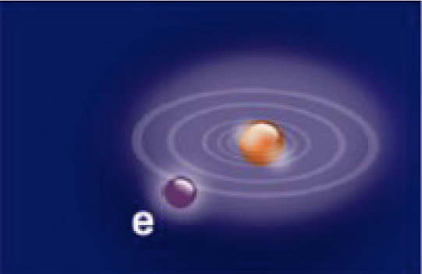
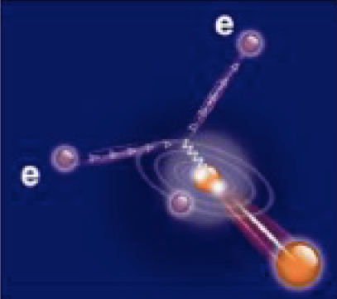


Proton Radius Puzzle
Atomic Spectroscopy
(HFS, Lamb-Shift in electronic / muonic systems)
Pohl et al.
[Nature 2010]
Antognini et al.
[Science 2013]
Lamb Shift
μH :
p
R_{E} = 0.8409 ± 0.0004 fm
e/µ
7σ Difference
R_{E} = 0.8770 ± 0.0045 fm
ep-Data &
Electronic Spectroscopy:
p
Codata
Bernauer et al.
[A1] (PRC 2014)
Electron Scattering on the proton
(EM form factors, low Q²)

Slide 11
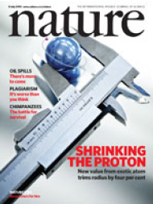
Proton Radius Puzzle - What is going on?
A worldwide effort in atomic physics,
hadron/particle physics and theory
New physics explanation ?
Unknown QED / hadronic correction
in µH data ?
Electron scattering expts. not at sufficiently
low Q²?
Different coupling of electron-proton vs. muon-proton
→ light or heavy new particles (Dark Photon)?

Slide 12
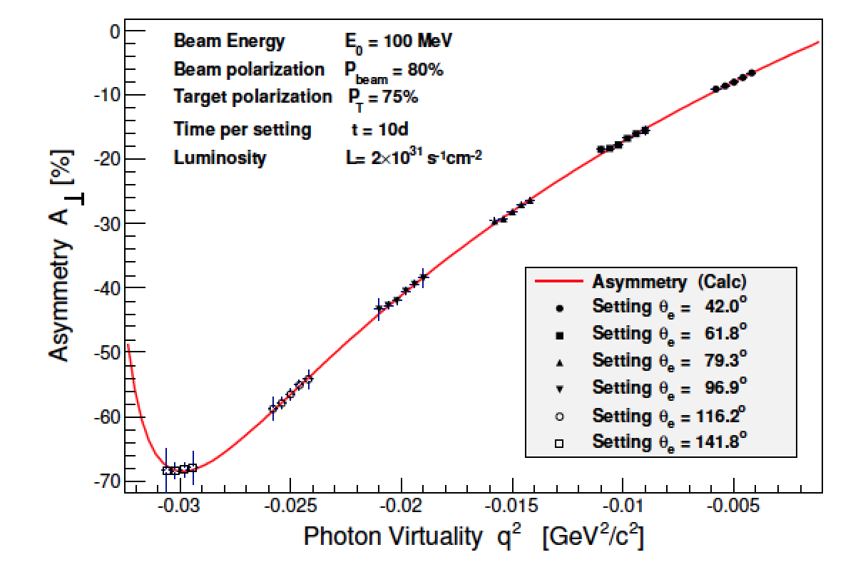
EM Form Factors @ MESA
Simulation:
Polarized target, 3 x 10¹⁵ / cm² (very conservative)
80% polarisation
1mA beam current, 105 MeV
Electric/Magnetic Form Factor Ratio from
Beam-Target Polarization
MESA projected errors

Slide 13
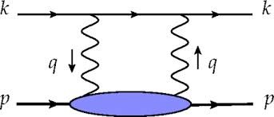
QED and Hadronic Corrections in µH
Corrections in muonic hydrogen Lamb Shift
QED
ΔE = 320 µeV
largest hadronic correction / uncertainty:
ΔE_{2γ} = (33 ±2) µeV
Hadronic
2-Photon exchange
→ Forward Compton scattering
→ Uncertainty dominated by the
magnetic polarizability β
Carlson, Vanderhaeghen 2011
Birse, Mc Govern 2012
Notes:
Now, coming back to the proton radius puzzle
People have investigated in detail also the corrections which have to be taken into account to extract the proton radius from muoni hydr.
Apart from well-understood QED correct. (shown here in blue), there remains one hadronic correct. Which is associated with the 2ph exch. Diagram
To set this into perspect.

Slide 14
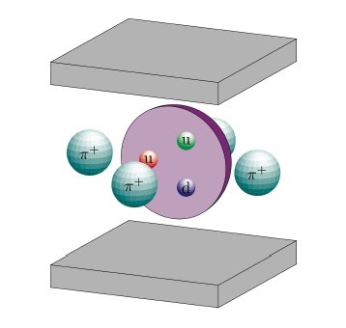
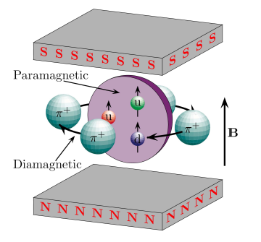
14
Nucleon
Polarizabilities
Wednesday morning

Slide 15
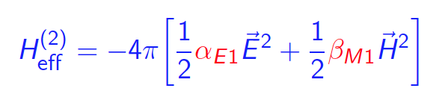
Proton Polarizabilities
Reaction of nucleon under influence of an EM field
<--> Compton scattering
provides fundamental information of the nucleon;
very sensitive test of theories (H/BχPT, Disp. Rel.).
Electric Polarizability: α_{E1}
Magnetic Polarizability: β_{M1}
Spin (Vector) Polarizabilities: γ_{E1E1}, γ_{M1M1}, γ_{M1E2}, γ_{E1M2}
Attempts at MAMI to reduce magnetic
polarizability β by a factor of 2
using spin observables (difficult)

Slide 16
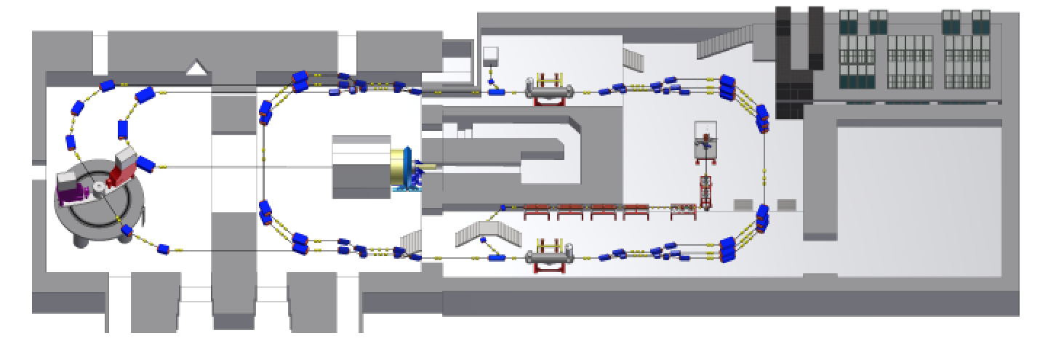
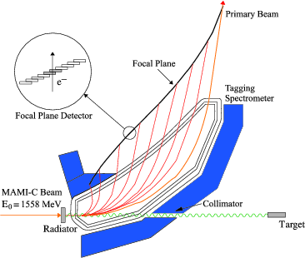
Proton Polarizabilities @ MESA
Use dipole close to MAGIX
as tagging spectrometer
for scattered electron
→ quasi-real photon
E_{γ} = E_{MESA} – E‘
Low-energetic proton measured in one of the
spectrometers
D. Hornidge

Slide 17
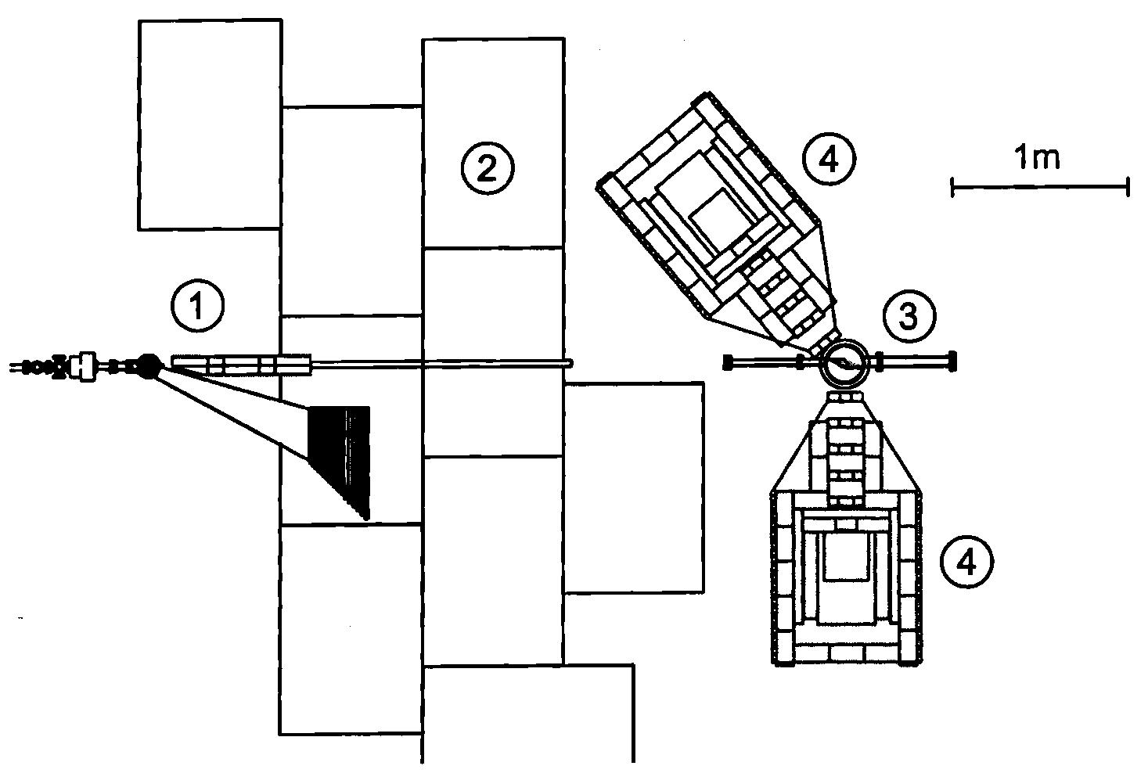
Proton Polarizabilities @ MESA
Measurement of photon in final state
via dedicated detectors
1 – bremsstrahlung facility,
2 – concrete shielding,
3 – high pressure ionization chamber (active target),
4 – γ-detectors (NaI) at θ_{γ}=130 and θ_{γ} =90 deg.
E. Maev
Highly-pressurized active target (TPC) developed by group from St. Petersburg (proton detection)

Slide 18
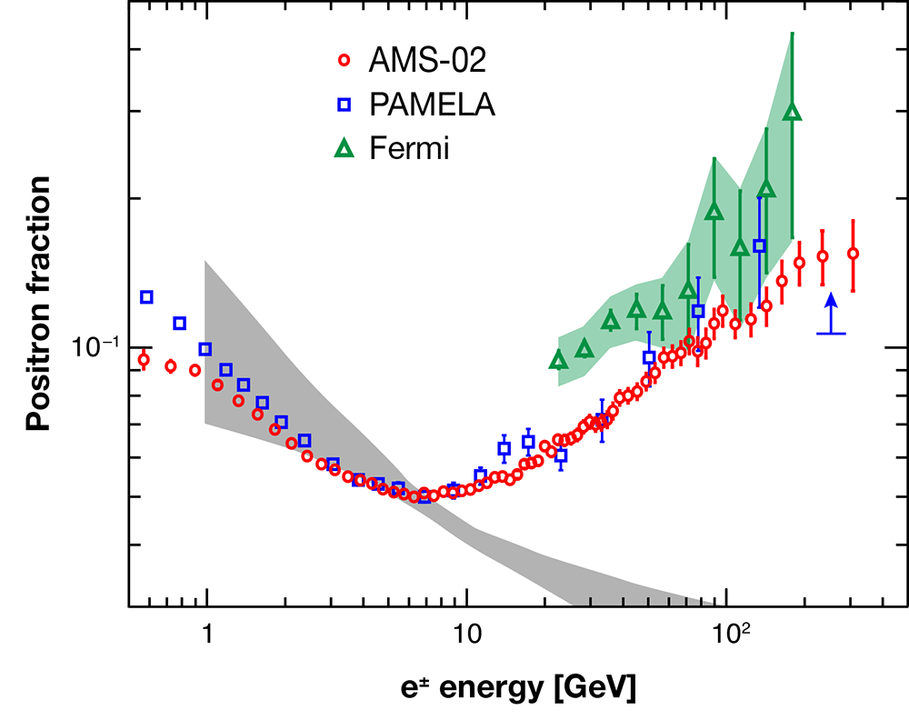
18
Search for the
Dark Photon
Tuesday afternoon
Thursday afternoon

Slide 19
Dark Photon
New massive force carrier of extra U(1)_{d} gauge group; predicted in almost all string compactifications
Dark photon
LHC
10⁻⁶
10⁻²
10⁶
10⁹
10¹¹
10¹³
Mass [eV]
Axion
α ′=ε ² · α_{em}
W’, Z’
Search for the O(GeV/c²) mass scale in a world-wide effort
Could explain large number of astrophysical anomalies
Could explain presently seen deviation of 3.6σ between (g-2)_{μ}
Standard Model prediction and direct (g-2)_{μ} measurement
Arkani-Hamed et al. (2009)
Andreas, Ringwald (2010); Andreas, Niebuhr, Ringwald (2012)
Pospelov(2008)

Slide 20
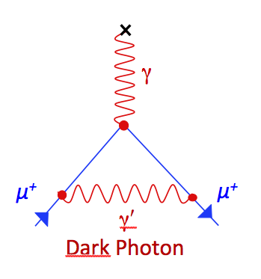
Dark Photon Status in 2010
Year 2010
Coupling
allowed parameter range
for (g-2)_{µ} explanation
terra incognita
white region
motivated by
dark matter !
Mass

Slide 21

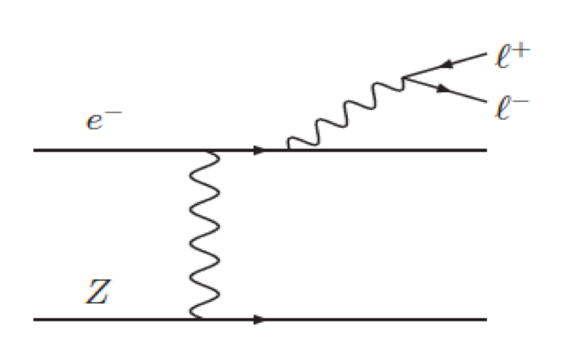
Results from A1/MAMI
Year 2014
γ ′
e⁻
e⁺
Merkel et al. [A1]
PRL ’11, PRL ‘14
→ at time of publication most stringent
limit ruling out major part of the parameter range motivated by (g-2)_{µ}

Slide 22
Results from A1/MAMI
Year 2015
Merkel et al. [A1]
PRL ‘11
PRL ‘14
γ_{ISR}
e⁺
µ⁺
µ⁻
e⁻
→ at time of publication most stringent
limit ruling out major part of the parameter range motivated by (g-2)_{µ}

Slide 23
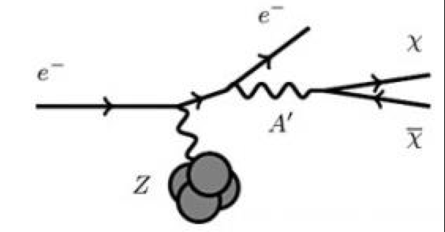
Dark Sector Searches at MESA
H. Merkel
MAGIX / MESA
Model 1: Dark Photon coupling to SM particles
→ parameter range motivated by Dark Photon relation to Dark Matter
Model 2: Dark Photon coupling to Dark Matter
→ could still explain (g-2)_{µ} discrepancy
→ exploit excellent momentum resolution
of MAGIX (proton recoil!)
Model 2: Dark Photon coupling to Dark Matter
→ could still explain (g-2)_{µ} discrepancy
→ exploit excellent momentum resolution
of MAGIX (proton recoil!)
Option 3: Direct Search for Dark Matter → Beam Dump Experiment (BDX)

Slide 24
Aim of this Workshop
Let us discuss the physics of MAGIX/MESA in a broad context
and identify future key experiments

Slide 25
BACKUP

Slide 26
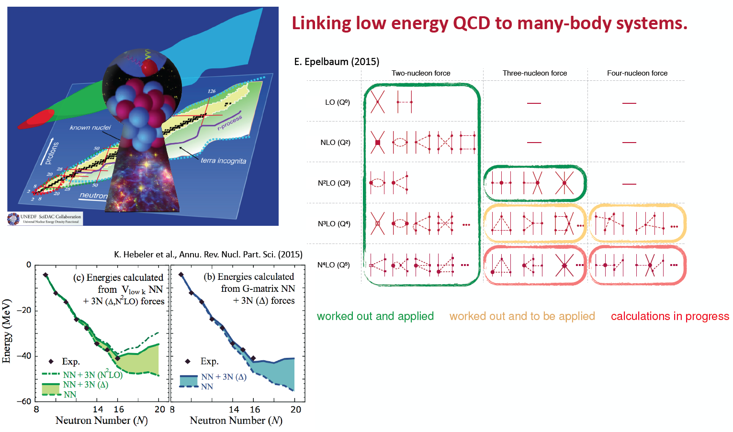
Few-body physics at MAGIX
Thursday morning

Slide 27

Direct Dark Matter
Search (BDX)
27

Slide 28
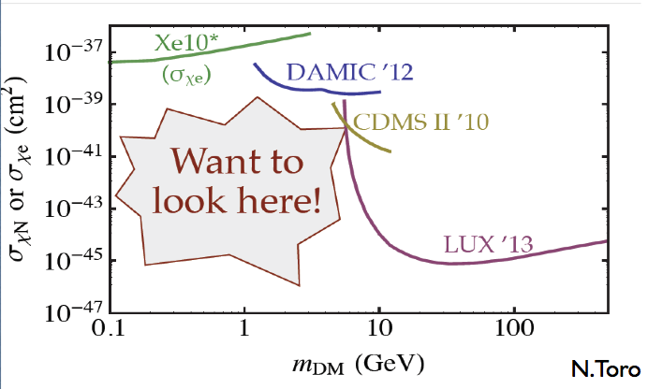
Beam Dump Experiment (BDX) @ MESA
Dark Matter Exclusion Plots

Slide 29
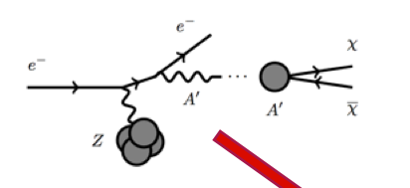
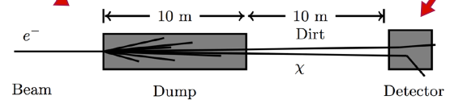
Beam Dump Experiment (BDX) @ MESA
Electron Scattering on Beam Dump → Collimated pair of Dark Matter particles !
BDX
MESA
This existing beam dump is going to
be the P2 beam dump
10,000 hours @ 150 µA
10²³ electrons on target
Timing Structure !

Slide 30
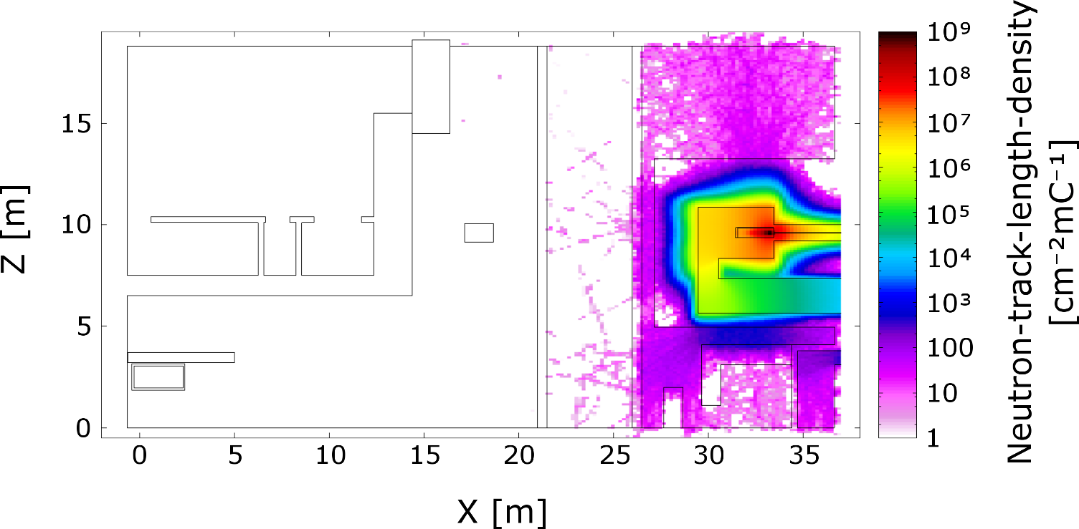
Beam Dump Experiment (BDX) @ MESA
Background situation
FLUKA simulation of neutron
background promising
MESA running below pion
production threshold → no neutrinos!

Slide 31
Beam Dump Experiment (BDX) @ MESA
Testing competititve parameter range
→ Terra incognita dark matter

Slide 32
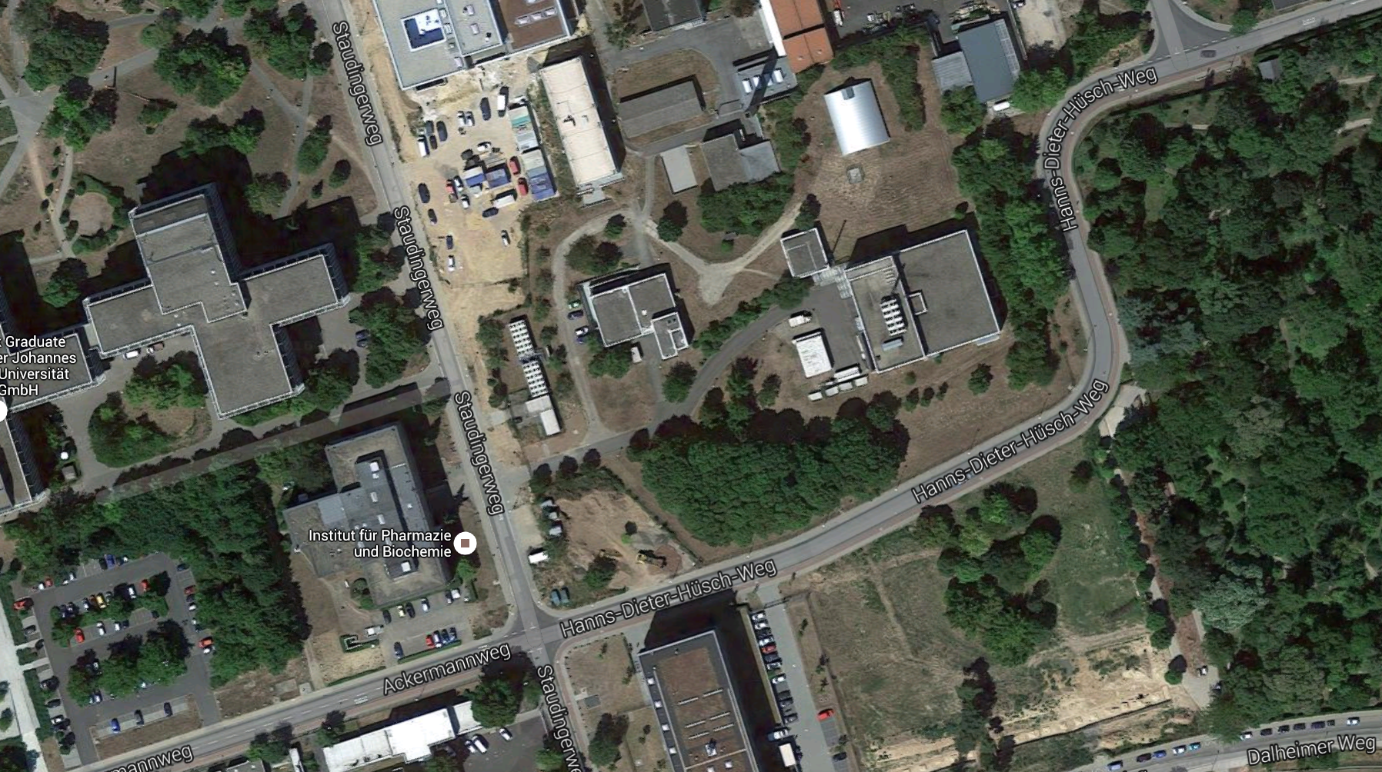
BDX @ MAMI
HIM
KPH
MAMI
Beam
1.6 GeV
IPh
A1
Beam Dump
Similar rate of EOT as in MESA case
Higher beam energy → wider coverage
of kinematic range
No existing hall after beam dump
→ Biology building under construction?!

Slide 33
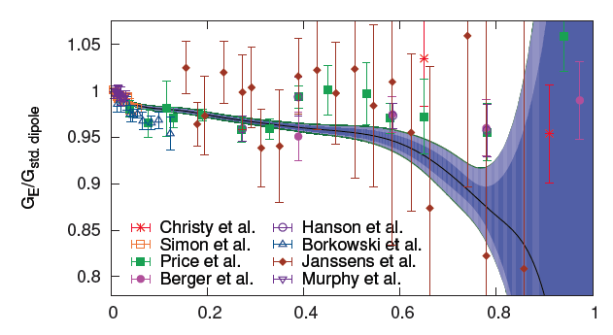



Electromagnetic Form Factors in ep Scattering
Elastic form factors in ep scattering:
Super-Rosenbluth measurement
G_{E}/G_{Dipole}
G_{E}: spatial
electric charge distribution
G_{M}: distribution of
magnetic moments
Q²/GeV²
average of all fit models
with uncertainties
Proton charge radius:
Bernauer et al.: <r_{E}> = 0,879(8) fm
Bernauer et al. PRL '10 ; PRC '14

Slide 34
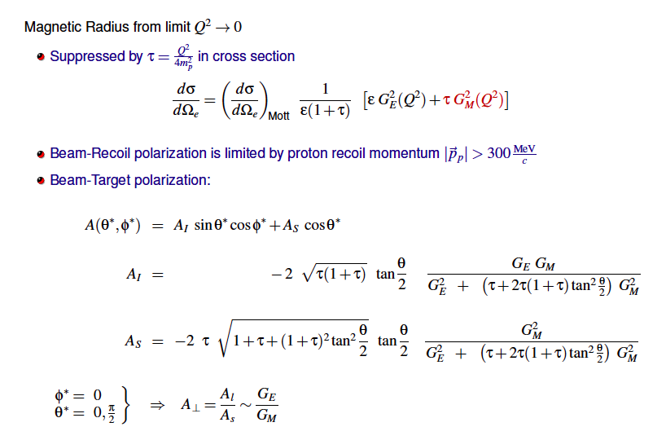
MAGIX @ MESA
Electric/Magnetic Form Factor Ratio

Slide 35




Proton Radius Puzzle: A Worldwide Effort
Atomic physics with
electronic probes
MUSE
µp scattering
vs.
ep scattering
New measurements
of µD, µHe
- Magnetic radius
- ed scattering
- ISR analysis
- Future: MESA
New electron
scattering data
(E8-007, PRad)

Slide 36
ISR Measurement of EM Form Factors
Detailed understanding of target walls required

Slide 37
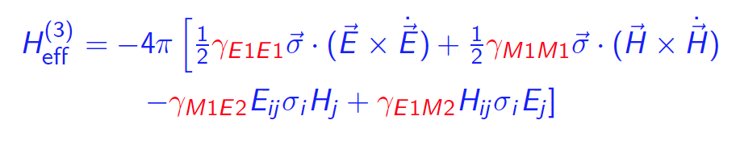

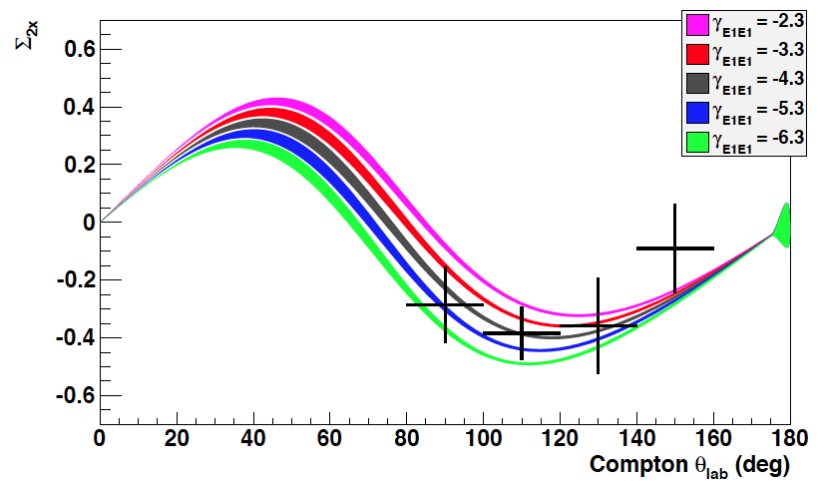
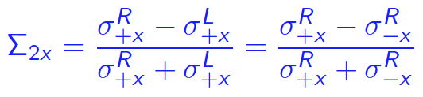
Proton Polarizabilities
Reaction of nucleon under influence of an EM field <--> Compton scattering
provides fundamental information of the nucleon
very sensitive test of theories (H/BχPT, Disp. Rel.)
Electric Polarizability: α_{E1}
Magnetic Polarizability: β_{M1}
Reaction of nucleon under influence of an EM field <--> Compton scattering
provides fundamental information of the nucleon,
very sensitive test of theories (H/BχPT, Disp. Rel.).
Electric Polarizability: α_{E1}
Magnetic Polarizability: β_{M1}
Spin (Vector) Polarizabilities: γ_{E1E1}, γ_{M1M1}, γ_{M1E2}, γ_{E1M2}
6
6
For the first time measured at MAMI
via double polarization variables Σ_{2x}
Martel et al. [A2] PRL '15

Slide 38
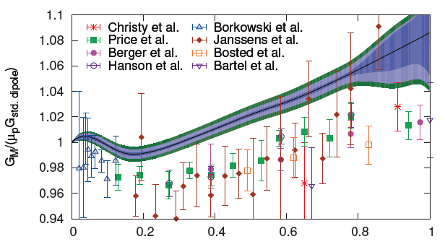
EM Form Factors of the Proton
Full Q² range
G_{E}
G_{M}
average of all fit models
with uncertainties
Proton radius:
PRL10 (A1): <r_{E}> = 0,879(8) fm
1307:6227 (incl. world data set e- scatt.)
  <r_{E}> = 0,879(8) fm

Slide 39
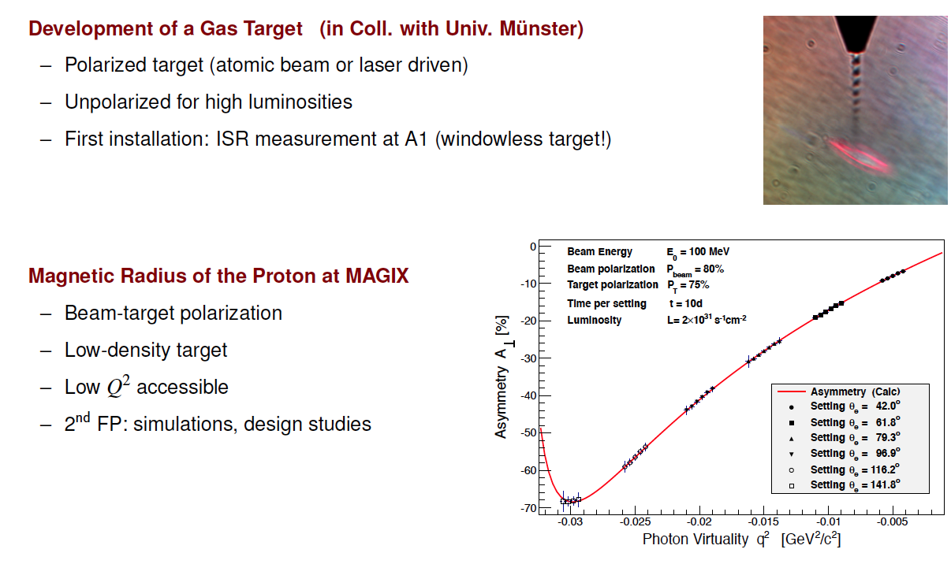

Slide 40
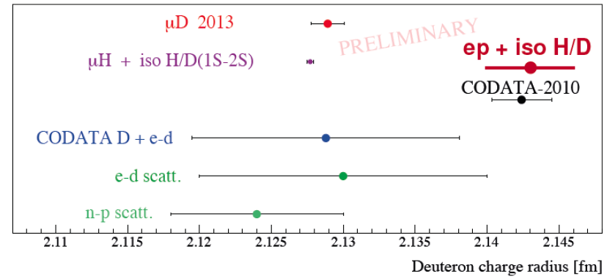
Myonische (leichte) Kerne
Neue Daten vom PSI für leichte Kerne: Myonisches D, ³He, ⁴He gemessen!
Vorläufiges Ergebnis für µD
Codata + iso H/D(1S-2S)
H/D (1S-2S) Isotopen-Shift r_{d}²-r_{p}² = 3.82007(65)
Konsequenzen: - Puzzle besteht auch in myonischem Deuterium
- Falls Neue-Physik-Erklärung: keine Kopplung an Neutron
- Isotopen-Shift in elektronischen und myonischen Systemen gleich
Problem: - Fehler in µD vollkommen dominiert durch hadronische Korrekturen

Slide 41
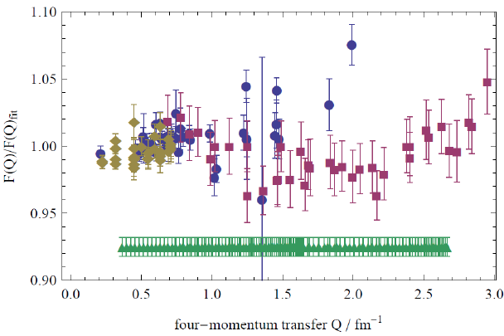
Proton Radius Puzzle – Entwicklungen
Exp. Aktivitäten in Mainz (SFB-1044):
ed Streuung, Strahlzeit (2014)
→ neue Bestimmung von r_{d} !
Elektro-Desintegration in ed-Streuung
→ erlaubt Reduktion der hadronischen
Korrekturen in PSI-Messungen
ISR- Methode in ep-Streuung (2013/14)
→ Zugang zu Q²-Werten bis 10⁻⁴ GeV²
Neue ep-Messung bei MAMI-C (2015)
A2: Polarisierbarkeiten
MAMI '14
Exp. Aktivitäten außerhalb Mainz:
E08-007 @ JLAB ep, wird analysiert
PRad @ JLAB ep, in Vorbereitung
MUSE@PSI: μp Streuung, in Vorbereitung
Atomphysik: Elektron. atomare Spektrosk.

Slide 42
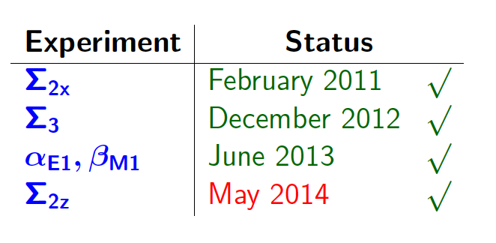
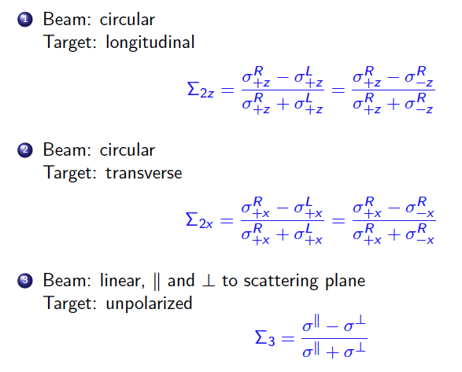
Polarisierbarkeiten

Slide 43
Dark Photon Search @ A1
Features 2010 pilot run (4 days)
Beam energy 855 MeV
Target: 0.05 mm Tantalum
Beam current ~100µA → Luminosity ~10³⁹ cm⁻²s⁻¹
Kinematic configuration: - complete energy transfer to γ’ boson
- symmetric e⁻ and e⁺ momenta
Cerenkov detector for electron/positron identification
Time difference
between spectro-
meters A, B
δM_{ee}~ 0.5 MeV
QED bkg.
Hypothetical Dark Photon signal:
bump in one
single bin
ΔT_{AB}< 1 ns

Slide 44
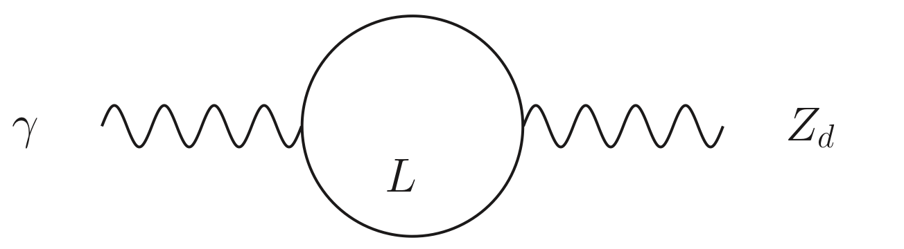
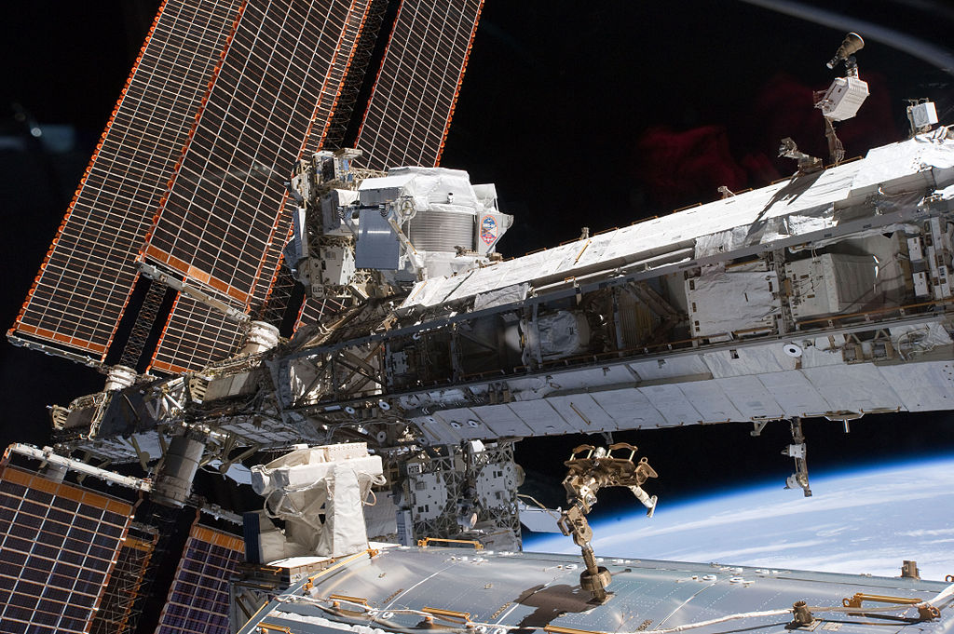
Kinetic Mixing and Dark Matter
Holdom [1986]
A way to relate the dark sector to the SM (coupling ~ ε²)
DM
γ
e⁺
γ′
Dark
Sector
U(1)_{d}
Standard
Model
Sector
U(1)
Heavy Charged Leptons L
(carry U(1)_{d} charge)
e⁻
Dark Photon
(aka A′, U, Z_{d}, ...)
DM
Excess of positrons in cosmic ray spectrum due to Dark Matter annihilation?
AMS02@ISS

Slide 45
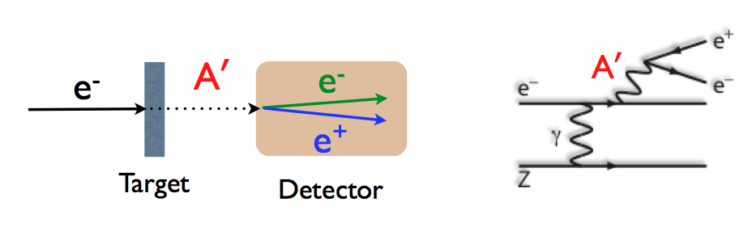
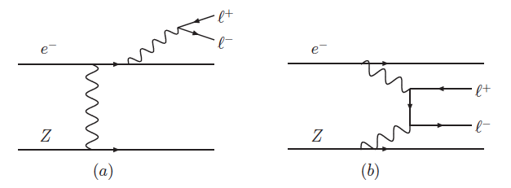
Results from A1
Low-Energy Electron Accelerators with high Intensity ideally suited for Dark Photon search
Bjorken et al. (2009)
Signal processes
QED background processes
γ
γ
γ ′
e⁻
irreducible
e⁺
different kinematics

Slide 46
The MESA Project
K. Aulenbacher
Mainz Energy-Recovering Superconducting Accelerator
E_{max} = 155 MeV
I_{max} > 1 mA (ERL)
commissioning 2020
Mode 1:
Extracted Beam
P2 Experiment
Mode 2: ERL
Internal Target
MAGIX Experiment

