Slide 1


New Vistas in Low-Energy Precision Physics
LEPP16: Introduction
Marc Vanderhaeghen
LEPP16 Workshop
Kupferberg, Mainz, April 4-7, 2016

Slide 2
Frontiers of the Standard Model
Fra Mauro(1459)

Slide 3
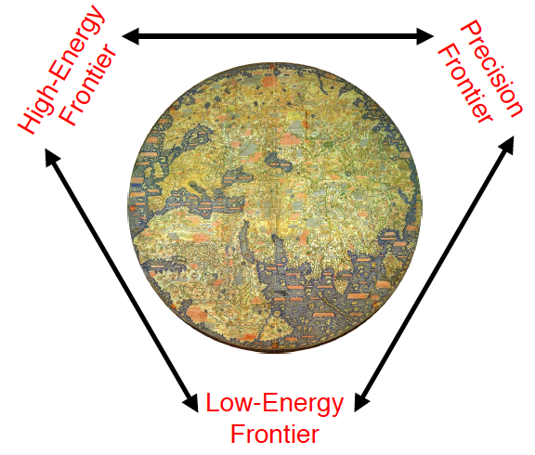

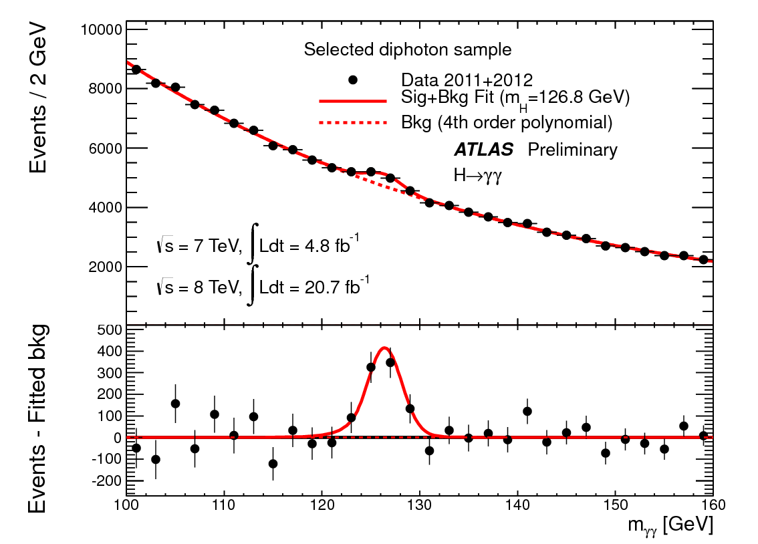

Frontiers of the Standard Model
New Physics
LHC
Higgs discovery
Production of new
physics particles
Later: ILC
Englert, Higgs
Nobel prize 2013
Higgs discovery

Slide 4
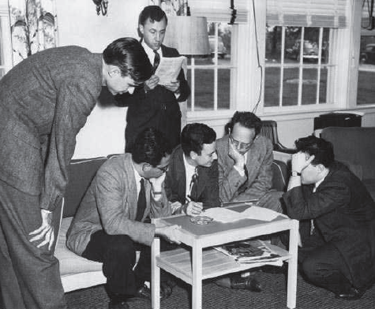
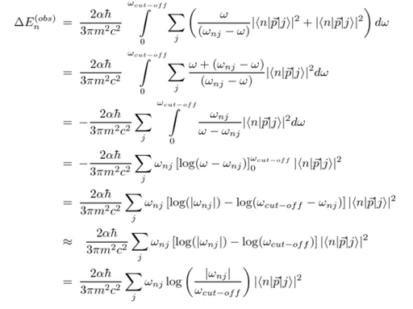
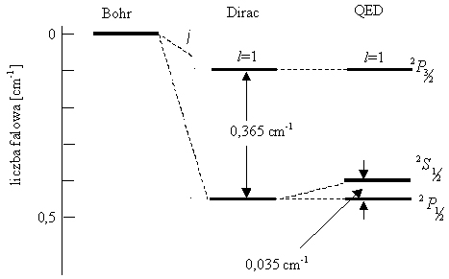
Frontiers of the Standard Model
New Physics
Testing SM at low
energies, quantum loop corrections
sin²θ_{W}
(g-2)μ
EDM
Flavor physics
Atomic physics
H. Bethe(1947)

Slide 5
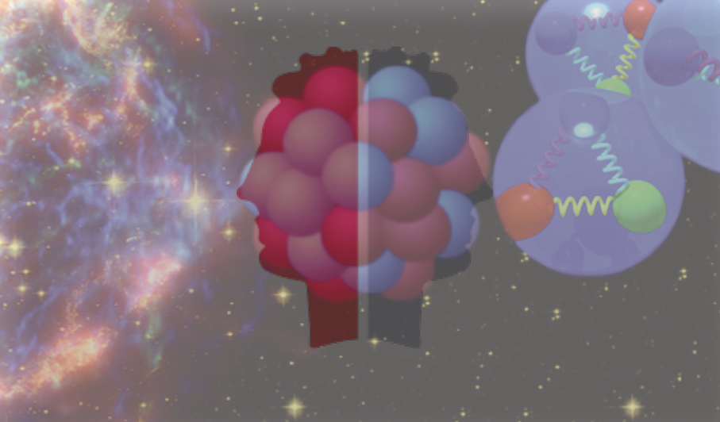
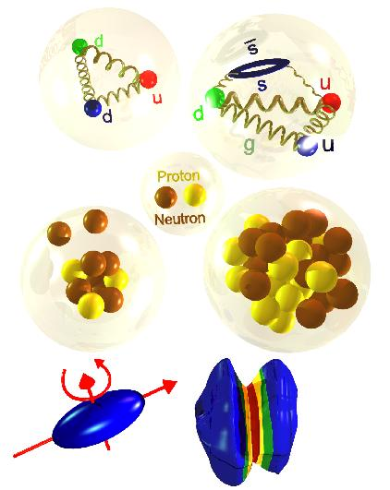
Frontiers of the Standard Model
New Physics
from quarks to stars:
looking outward
vs looking inward
Hans Bethe:
Nobel prize 1967
Terra incognita
Hadron physics: Strong interactions, Complex systems
How do quarks/gluons merge into hadrons (mass, spin,…) ?
How does hadron structure emerge from basic constituents?

Slide 6
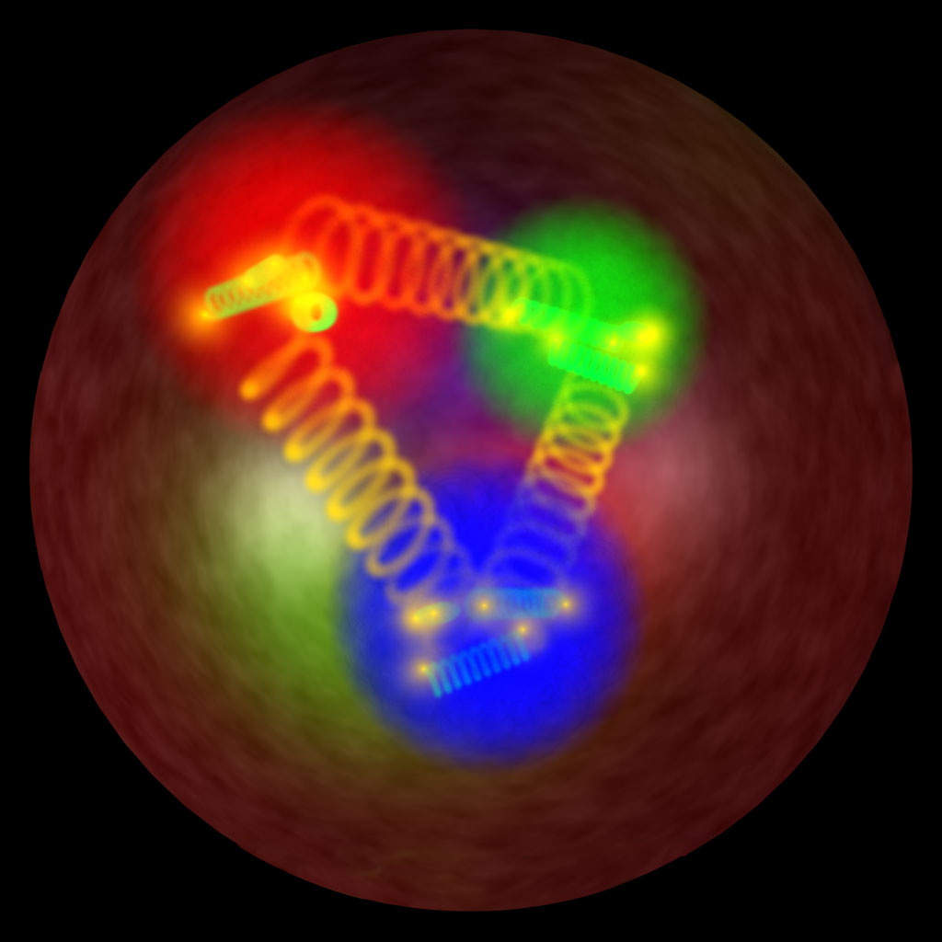

Low-Energy Precision Physics
Central concept of CRC 1044
Hadron physics (= The Low-Energy Frontier of the Standard Model)
plays a central and connecting role in interpretation of
measurements at the precision frontier of the Standard Model
sin²θ_{W}
(g-2)_{μ}
R_{E}
Proton charge radius
polarizabilities
Few-body
nuclei
Neutron skin,
nuclear EOS
dark photons,
dark matter
Strong interactions
Hadron structure
Hadron spectroscopy
Particle physics
Atomic physics
Astro(particle) physics

Slide 7
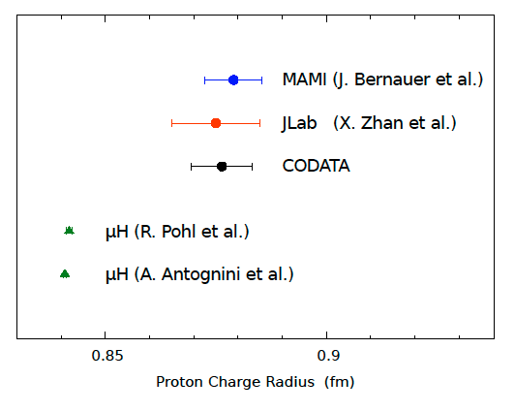
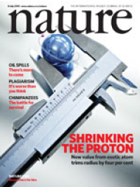
Proton radius puzzle
New avenues
Lepton scattering experiments:
global analysis, new experiments,
e / μ universality, …
Theory: hadronic corrections to atomic spectroscopy and electron scattering
Hadron physics input: polarizability program on nucleons / few-body systems
μH data:
R_{E} = 0.8409 ± 0.0004 fm
Pohl et al.(2010)
Antognini et al.(2013)
7 σ difference
ep-data:
R_{E} = 0.8775 ± 0.0051 fm
CODATA(2012)

Slide 8
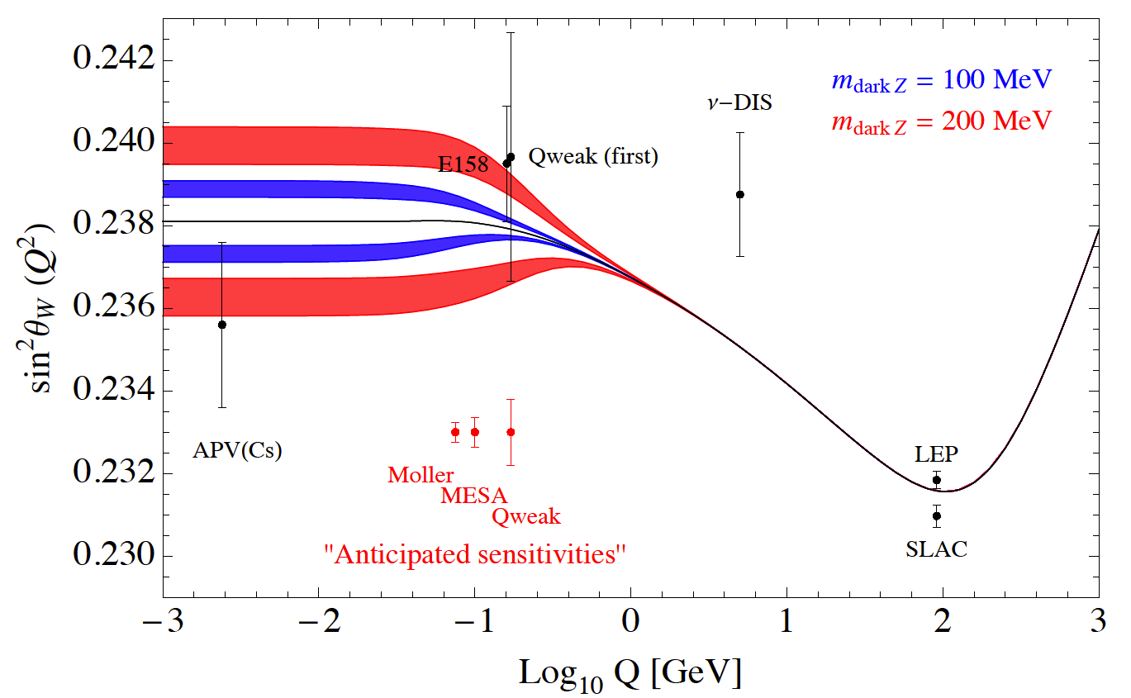
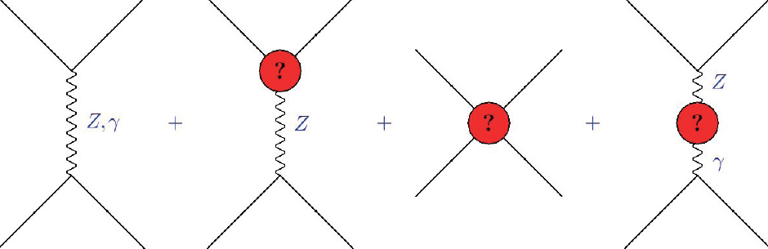
Precision parity violation program
SM: universal quantum corrections leads to
a scale dependent, „running“ sin²θW(Q)
Marciano
Sensitivity to new beyond SM physics:
extra Z
mixing with dark Z
contact interactions
new fermions
Proton parity program:
exceeding scale accessible in direct LHC searches, complementarity with precision searches @ LHC
contact int:
Λ_{new} ≈ 17 TeV (E158@SLAC)
P2@MESA: 0.13% measurement of sin²θW
Λ_{new} ≈ 49 TeV
Nuclear parity program:
use parity violation tool in a complementary way to extract the neutron skin of nuclei
-> relevance to nuclear astrophysics

Slide 9
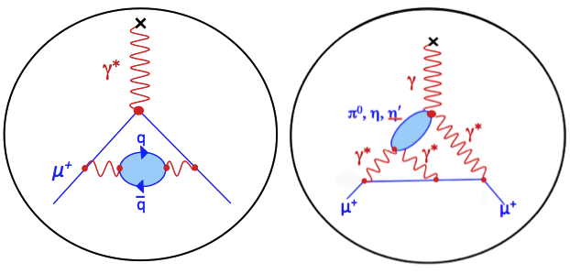
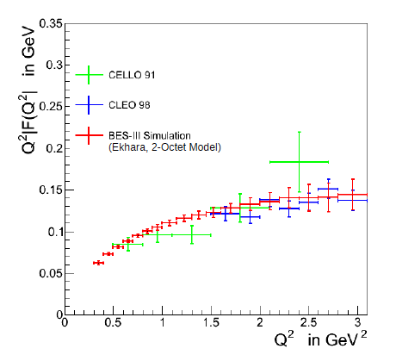
Muon magnetic moment: (g-2)_{µ}
a_{μ}^{exp} – a_{μ}SM = (28.7 ± 8.0) · 10⁻¹⁰ (3.6 σ) 
New FNAL (g-2)_{μ} expt. (2016):
δ a_{μ}^{exp} = 1.6 x 10⁻¹⁰
P5 panel (2014): flagship expt.
hadronic vacuum polarization
hadronic light-by-light scattering
e⁺ e⁻ -> π⁺ π⁻ : most relevant channel for (g-2)_{μ}
0.9% total systematic uncertainty achieved
Dominant region covered by BESIII
Interplay exp – theory (dispersion, lattice)

Slide 10
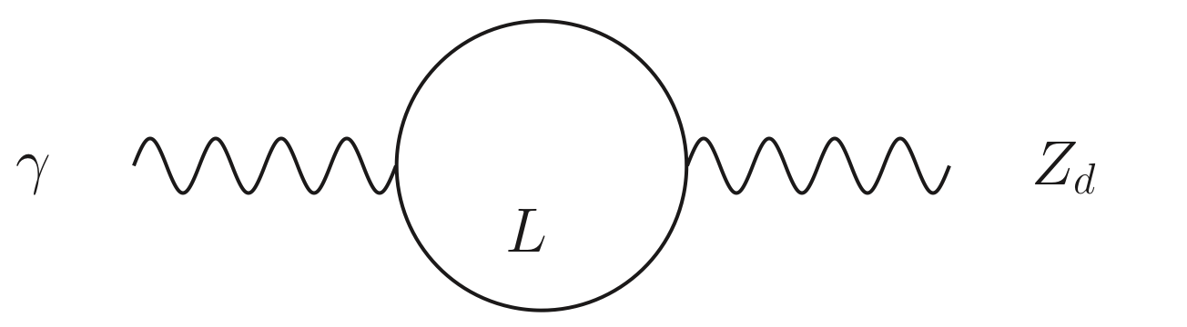
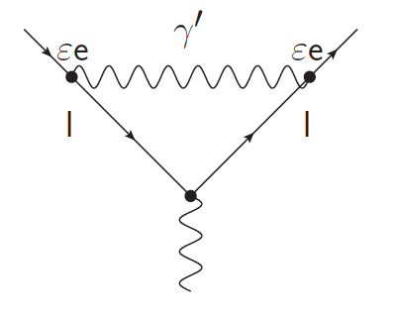
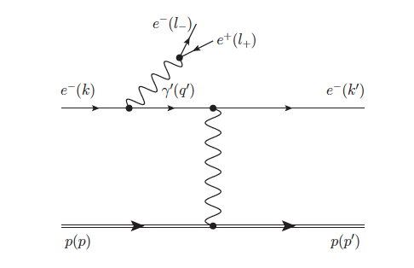
Dark photon / dark matter searches
light dark sector: could explain astrophysical anomalies:
e⁺ excess in cosmic ray flux
possible explanation for (g-2)_{μ}
Holdom (1986),...
e⁺
DM
Dark
Sector
U(1)_{d}
γ′
γ
Standard
Model
Sector
U(1)
Heavy Charged Leptons L
(carry U(1)_{d} charge)
e⁻
DM
Dark Photon
(aka A′, U, Z_{d}, ...)
red band: (g-2)_{μ}
Bjorken et al.(2009)
Dark Photon as explanation for
(g-2)_{µ} (almost) ruled out !
… at least in most straight-forward model
Low-mass/low-coupling range will be covered by JLab, MESA,… expts.
Year 2015

Slide 11
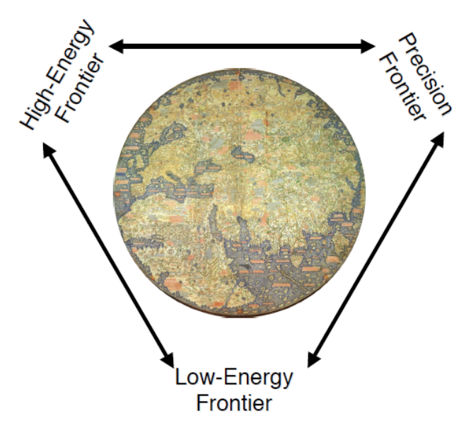
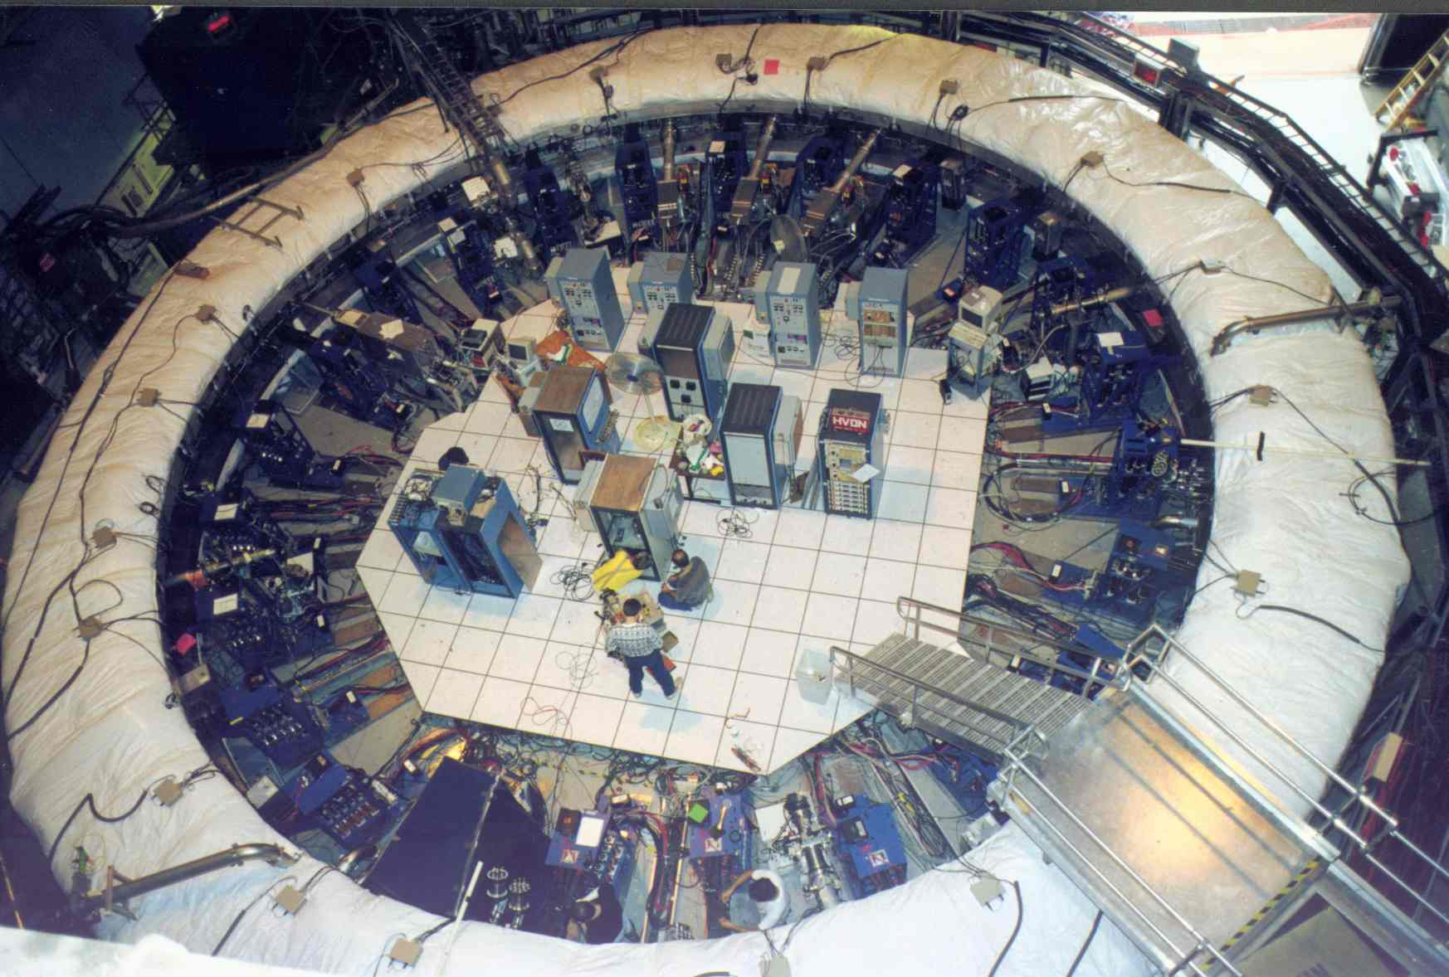

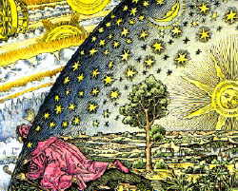
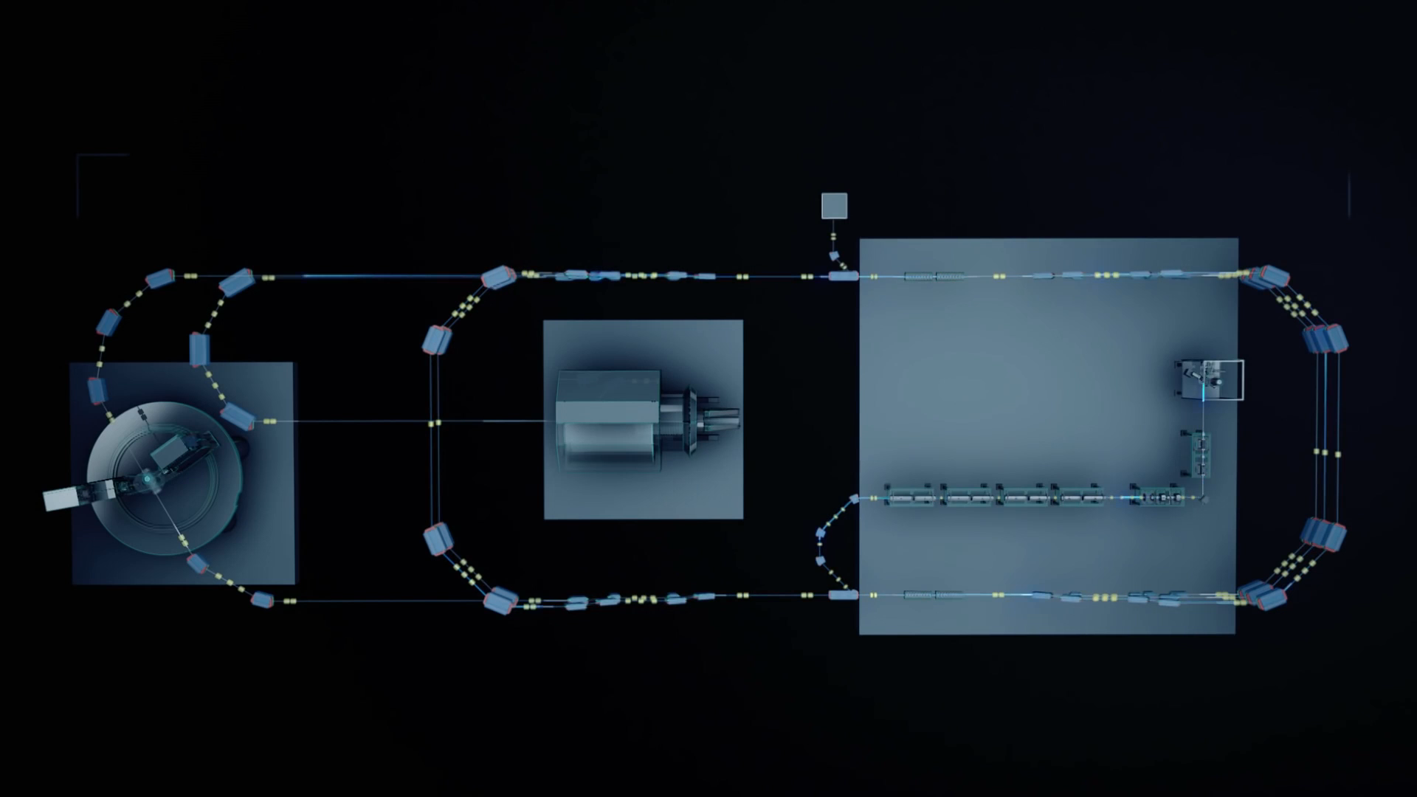
Outlook
Precision Low Energy expts.
New tools: MESA, ...
Identify key expts.
Impact new physics:
determine required
precision
Complementarity: precision hadron structure
Goal: “Physics Book”

Slide 12
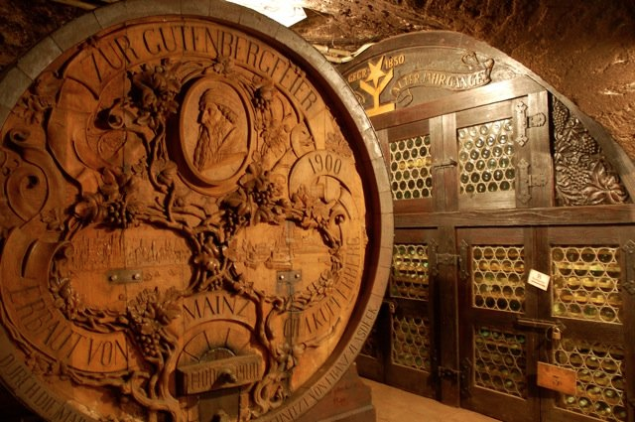
Have a productive time in Mainz !

