Slide 1



The PRISMA Cluster of Excellence
Hartmut Wittig
Institute for Nuclear Physics and Helmholtz Institute Mainz
New Vistas in Low-Energy Precision Physics
4 April 2016

Slide 2
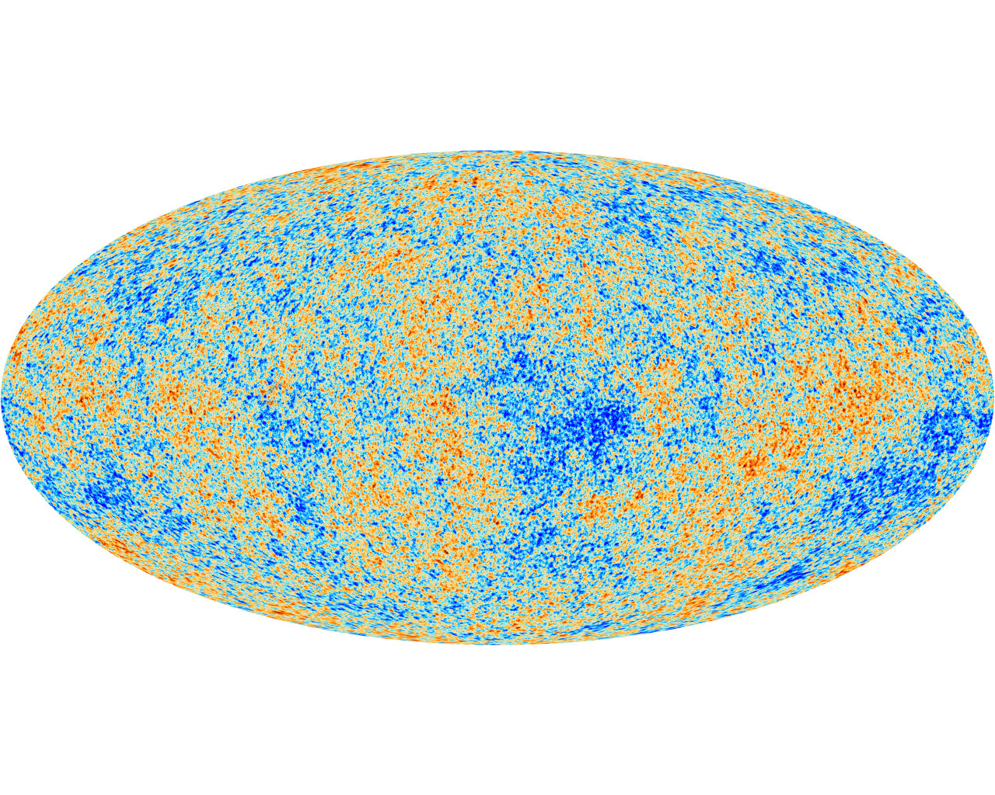
Research Theme
Higgs discovery completes the Standard Model
Discrepancies in precision observables may signal “New Physics”
Astrophysical evidence for the existence of dark matter
Experimental findings on neutrino masses and mixings
Comprehensive research programme in particle, hadron and astroparticle physics

Slide 3
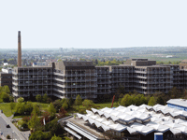
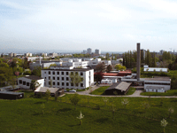
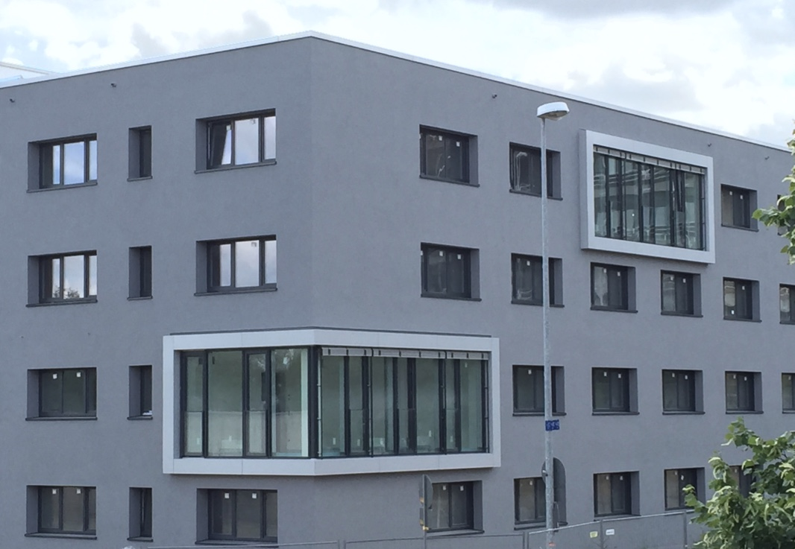
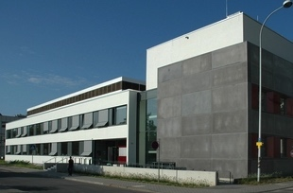
★
Cluster of Excellence PRISMA
Participating institutes:
Research Areas:
A: Fundamental Interactions
B: Origin of Mass and Physics
beyond the Standard Model
C: Structure of Matter
D: Theoretical Concepts and
mathematical Foundations
Physics, Mathematics
Nuclear Physics
Helmholtz Institute Mainz
Nuclear Chemistry
Structural Initiatives:
Electron Accelerator MESA
TRIGA Reactor and User Facility
Mainz Institute for Theoretical Physics
Detector Laboratory
★
Precision Physics, Fundamental Interactions and Structure of Matter
3
3

Slide 4
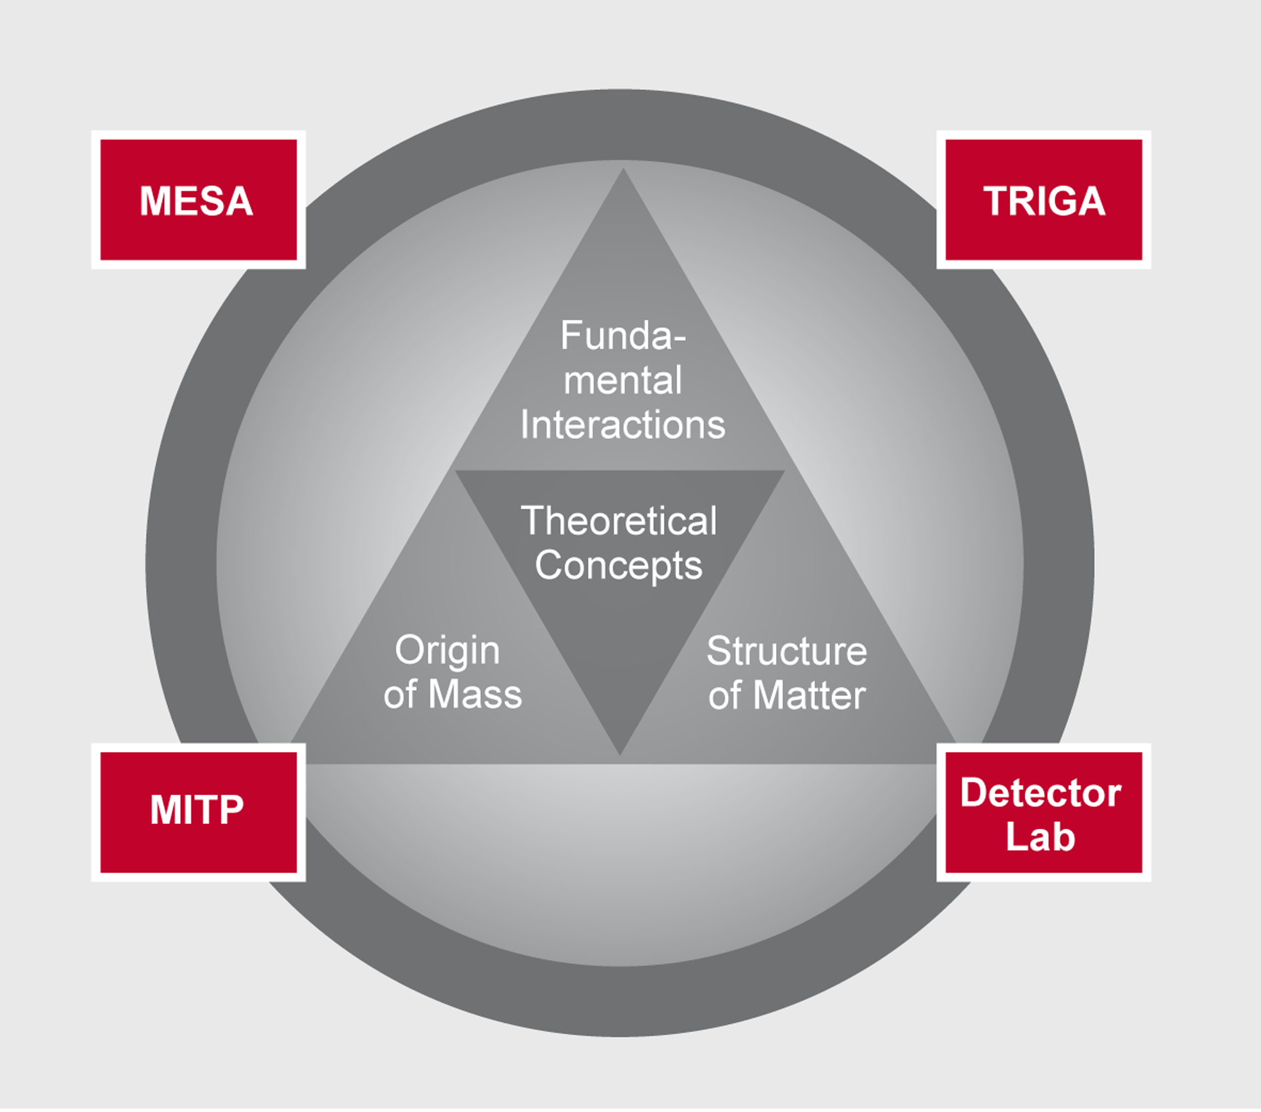
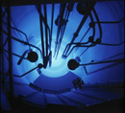

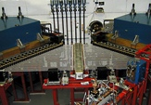
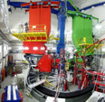



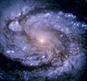
UCNs at
TRIGA
Atom & Ion-
Traps
MESA, MAMI
BES-III, NA62
PANDA
ATLAS
XENON
IceCube
Energy
10⁻²³ eV
1 MeV
1 GeV
1 TeV
10¹¹ TeV
Symmetry tests
New forces
Hadron physics
Dark Sector
New particle searches
Flavour sector, Dark Matter
Astroparticle
physics

Slide 5
PRISMA Facts and Figures
Budget
Nov 2012 – Oct 2017 28.11 Mio. €
Structural Initiatives: 35 %
New appointments:
W2 Lattice Gauge Theory Harvey Meyer
W2 Collider Physics Joachim Kopp
W2 Flavour Physics Michael Wurm
W2 Astroparticle Physics Sebastian Böser
W3 Precision Hadron and Particle Physics Nik Berger
W3 Mathematical Physics Johannes Henn
W2 Atomic Physics Randolf Pohl
03/04/16
5
5

Slide 6
Center of Fundamental Physics (CFP)
Extension of the PRISMA research programme based on currently established indications of “new physics”
Astrophysical evidence for dark matter
Experimental findings on neutrino masses and oscillations
Physics of the weakly interacting universe
Neutrino physics, astroparticle physics
Exploration of the dark sector
Precision physics at low energies
Experiments at the MESA accelerator and TRIGA
research reactor
Low-energy precision physics
MESA and TRIGA research facilities
Exploration of the dark sector
Detector development
Neutrino and astroparticle physics

Slide 7
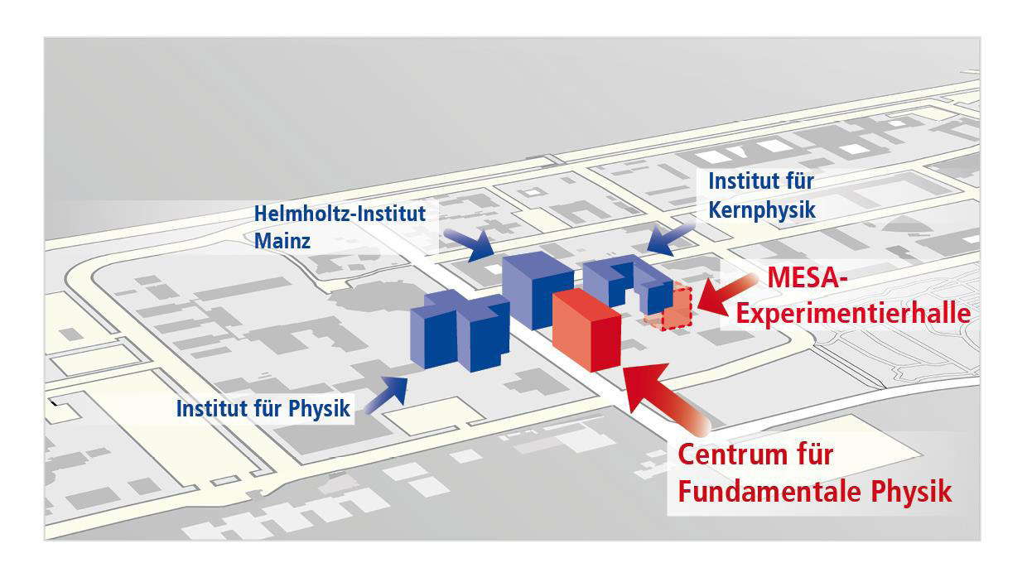
CFP Research Building
Center for Fundamental Physics with underground experimental hall:
Funding proposal approved in 2015

Slide 8
CFP Research Building
Underground experi-mental hall, 260 m²
Costings:
Office and laboratory building, 3352 m²
  47% office space (coordination, new research groups)
  Meeting rooms and laboratories for Detector Lab
  Laboratories for new research groups
  Lecture hall for MITP
Underground hall | € 17m
Equipment | € 10m
Construction CFP | € 34m
Total: | € 61m
Construction phase:
2018 – 2020

Slide 9

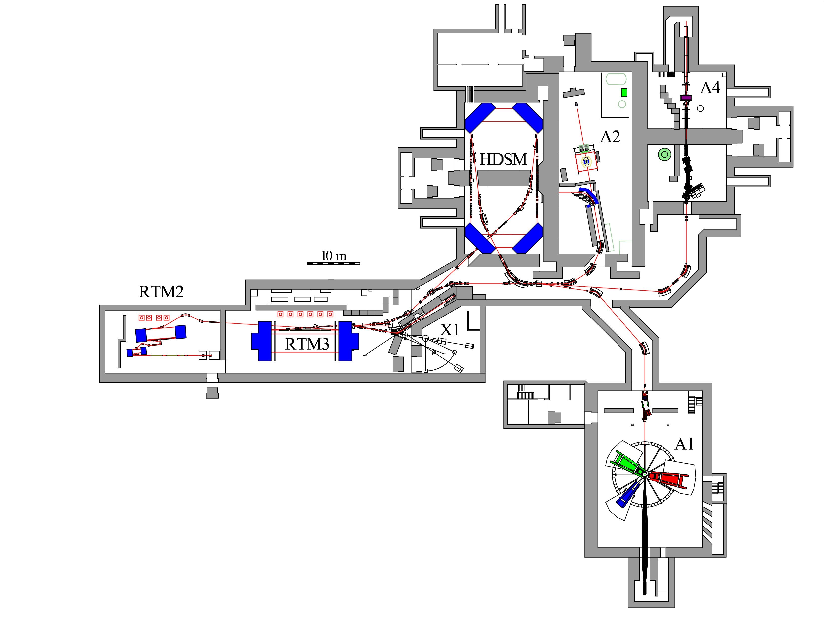

Low-energy precision physics at Mainz
Mainz Microtron
MAMI
MESA
Accelerator
Instrumentation
Accelerator

Slide 10
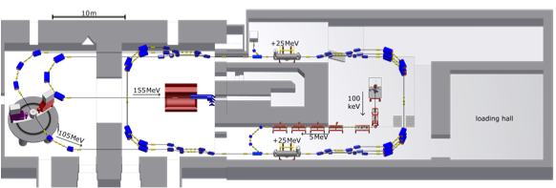




Low-energy precision physics at Mainz
MESA — “Mainz Energy-Recovering Superconducting Accelerator
Instrumentation
Accelerator
MAGIX
P2
Superconducting cavities
“Energy Recovery” vs. “Extracted Beam” modes
Beam energy: 105 MeV / 155 MeV
Current: 1–2 mA

Slide 11
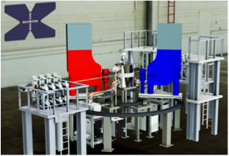
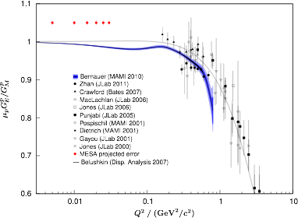


MAGIX — high precision spectrometer
Double arm spectrometer
Momentum resolution: Δp/p < 10^{—4}
Internal gas target developed jointly with WWU Münster (A. Khoukaz)
Instrumentation
Accelerator
Proton radius puzzle:
measure proton form factors in ep-scattering at very small Q²

Slide 12
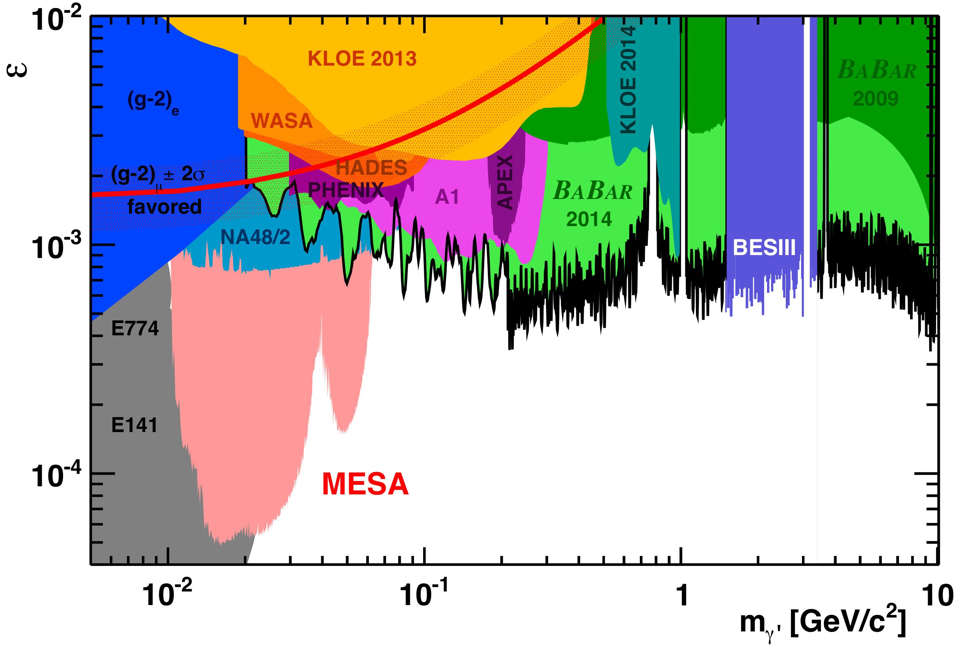
MAGIX — high precision spectrometer
Double arm spectrometer
Momentum resolution: Δp/p < 10^{—4}
Internal gas target developed jointly with WWU Münster (A. Khoukaz)
Instrumentation
Accelerator
Proton radius puzzle
Dark photon searches
Proton polarisabilities

Slide 13



P2 — Parity violation at low energies
Electroweak mixing angle at low energies — weak charge of the proton
Instrumentation
Accelerator
Left-right asymmetry in polarised ep-scattering
Tree level:
Magnetic spectrometer
Liquid hydrogen target
Expected precision:

Slide 14
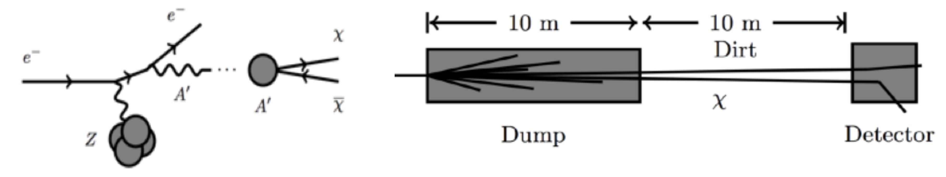
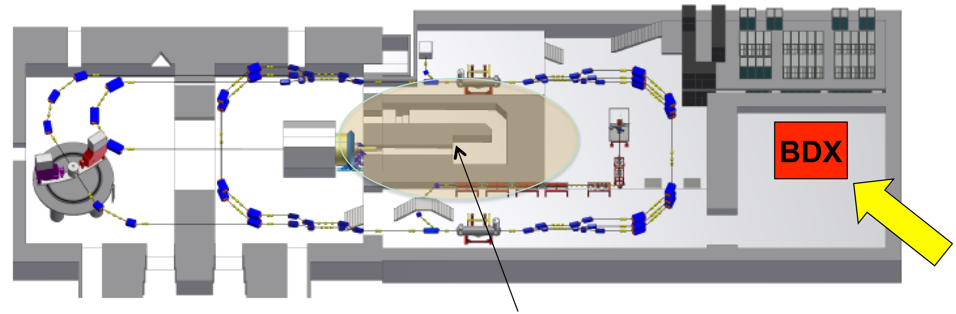
New research opportunities: BDX@MESA
Electron scattering on beam dump generates collimated beam of dark matter particles
Instrumentation
Accelerator
P2 beam dump

Slide 15
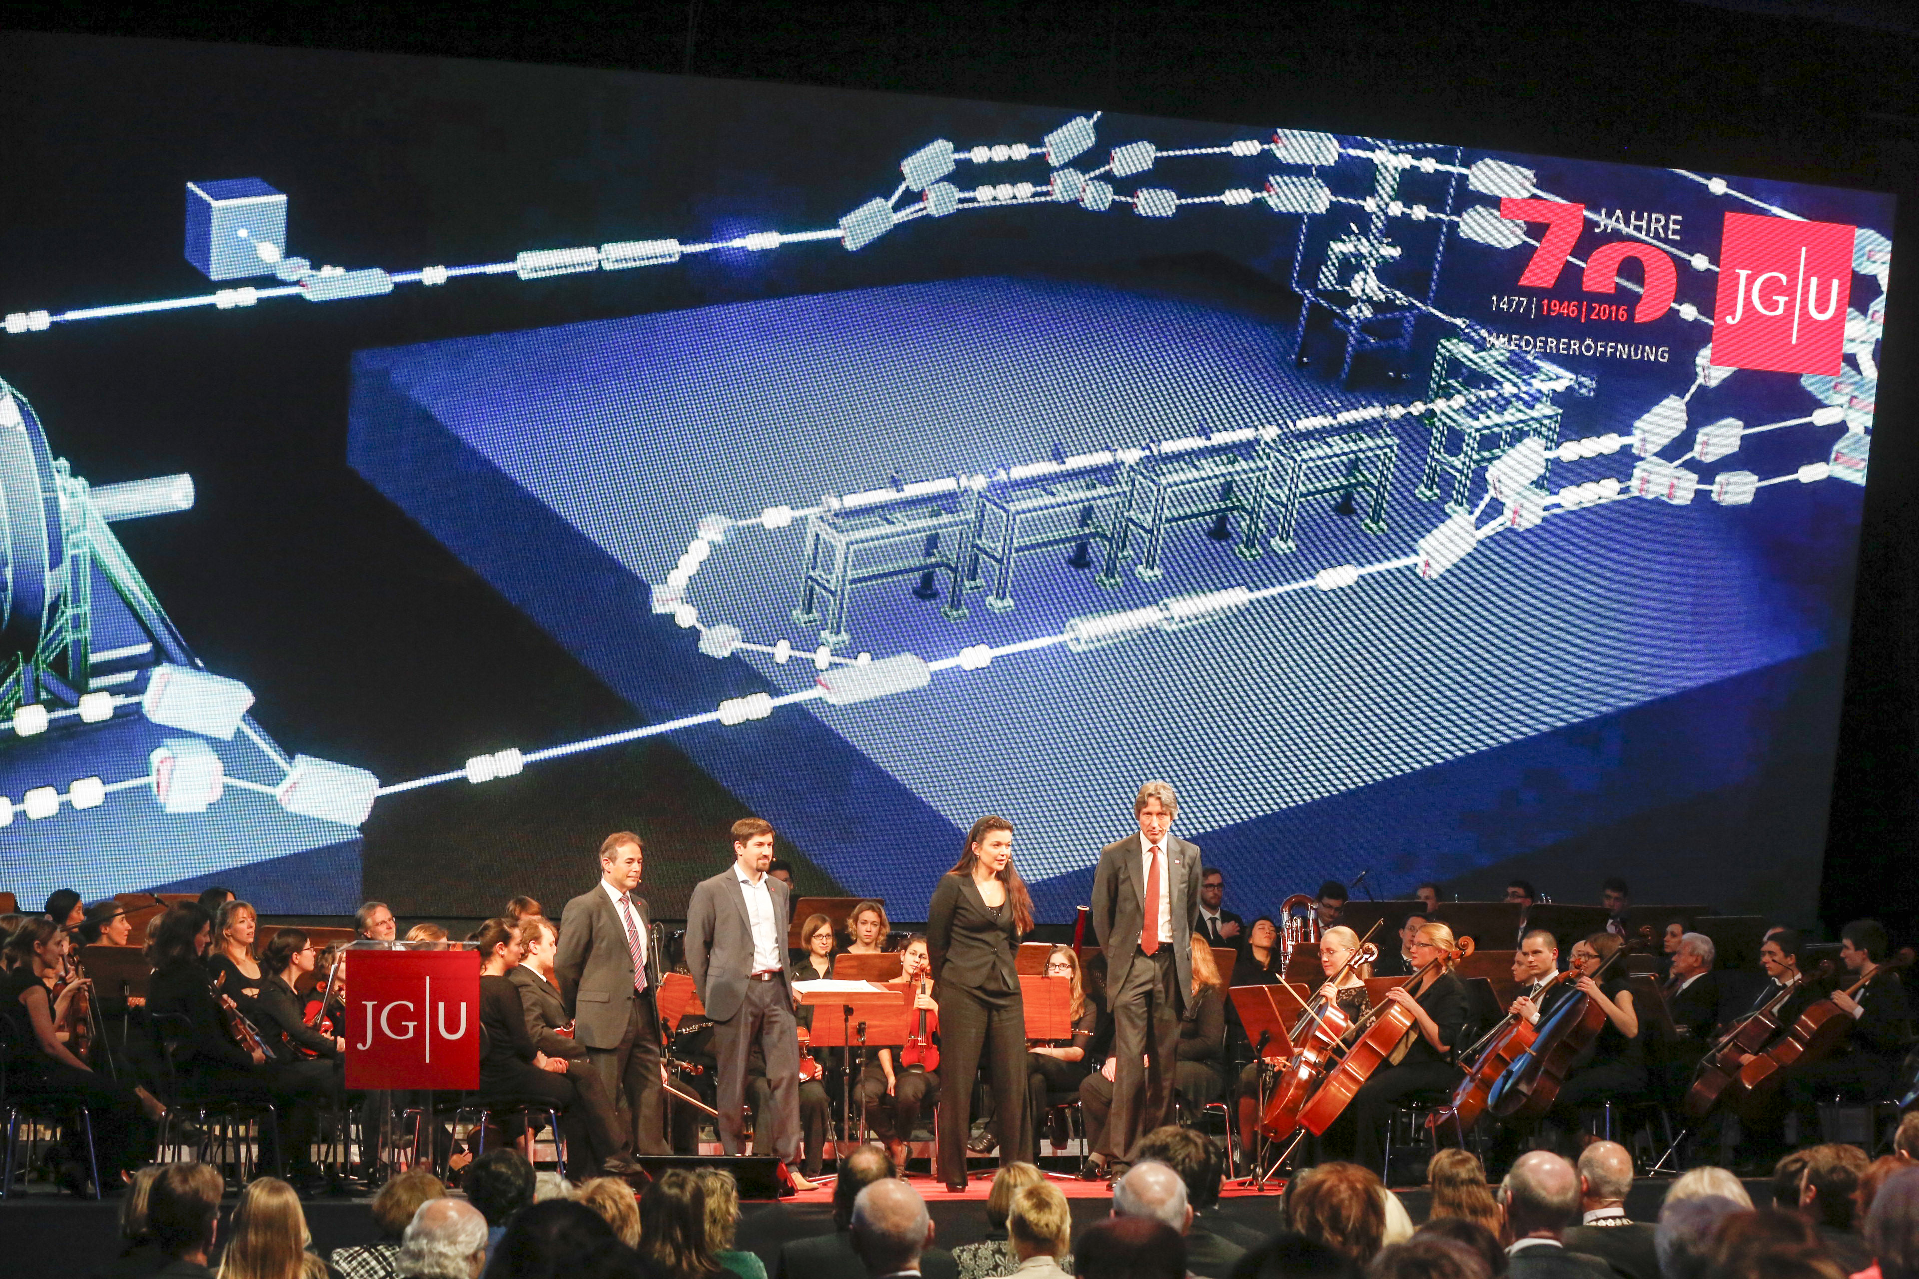
https://www.youtube.com/watch?v=qUQjABa-YQo
Instrumentation
Accelerator

Slide 16
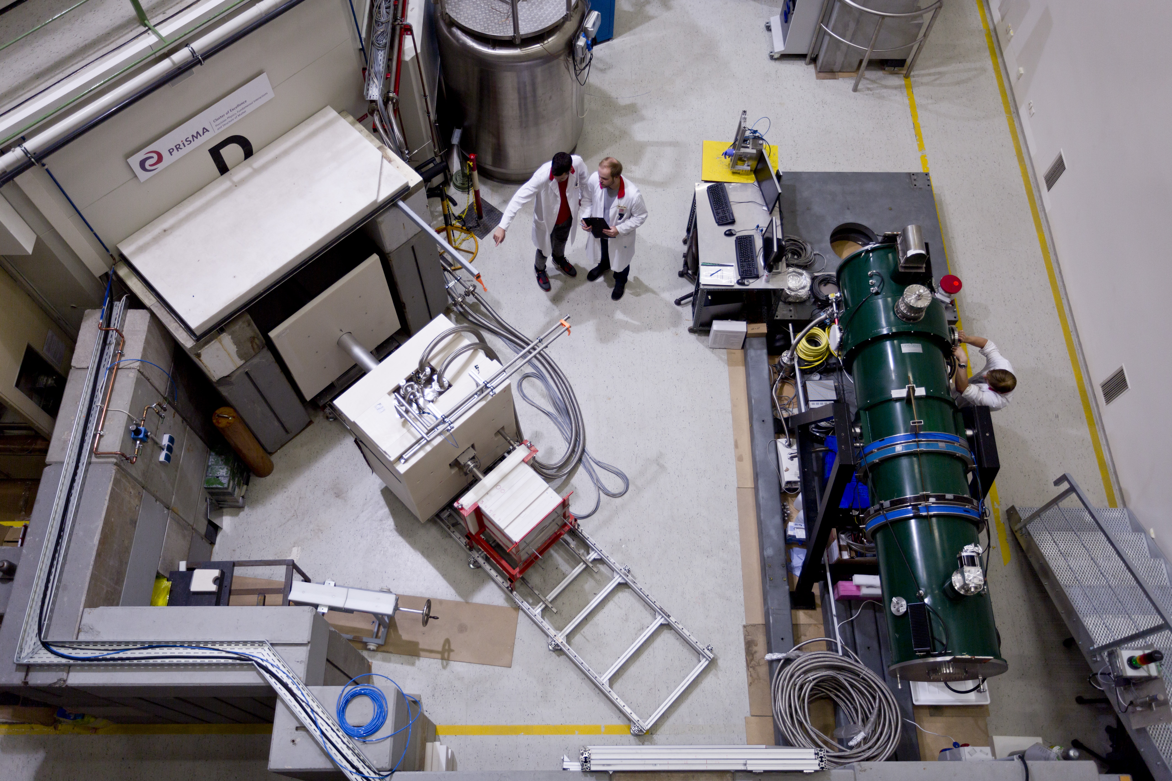
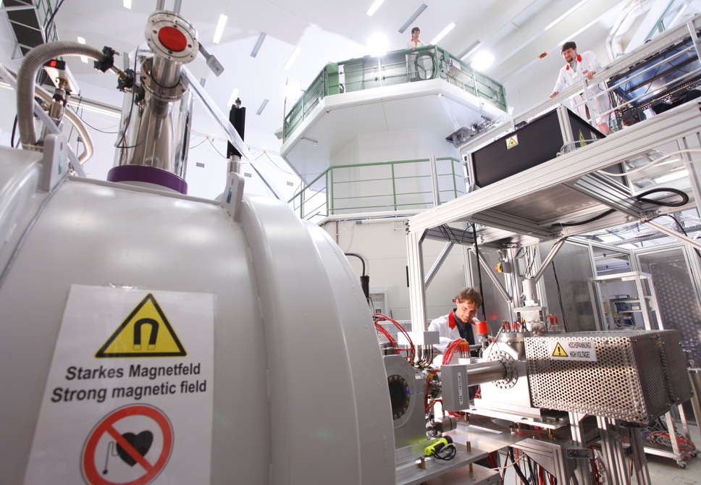
TRIGA User Facility
Precision physics with ultracold neutrons (UCNs)
Precision nuclear spectroscopy at TRIGA-SPEC
Instrumentation
Accelerator
Neutron lifetime
Angular correlations
Search for electric dipole moment of the neutron
Highly precise mass measurements of radioactive isotopes
Laser spectroscopy of short lived radioactive isotopes

Slide 17
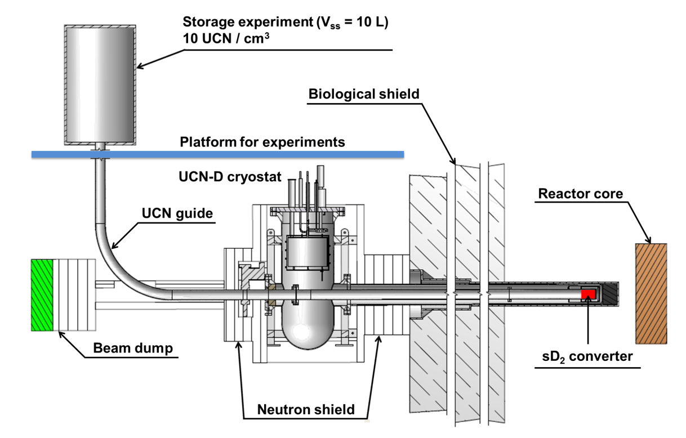
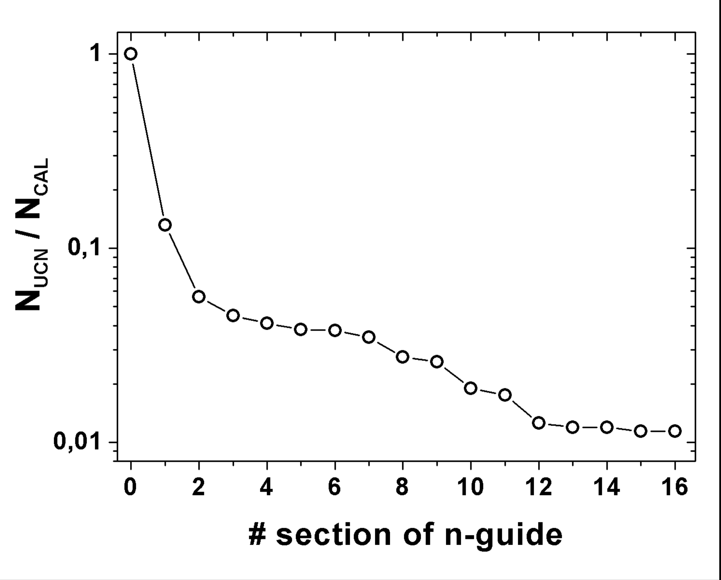
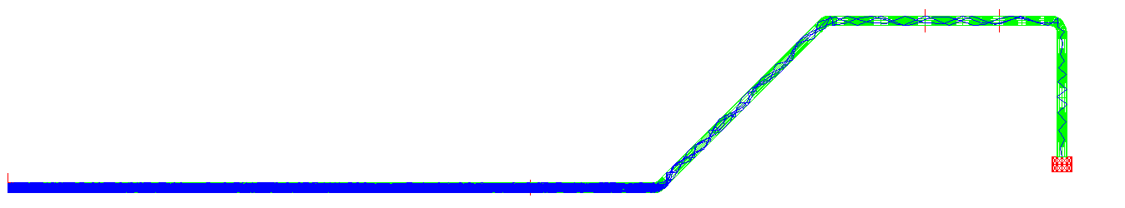
UCN source at TRIGA Mainz
Target:
50 UCN/cc in 10 – 20 litre
storage
volume
sD₂ converter 86.8%
separation foil
20 %
1st 45° bend
27%
guide section
28%
horizontal guide section (57.4%)
detector
17
17

Slide 18
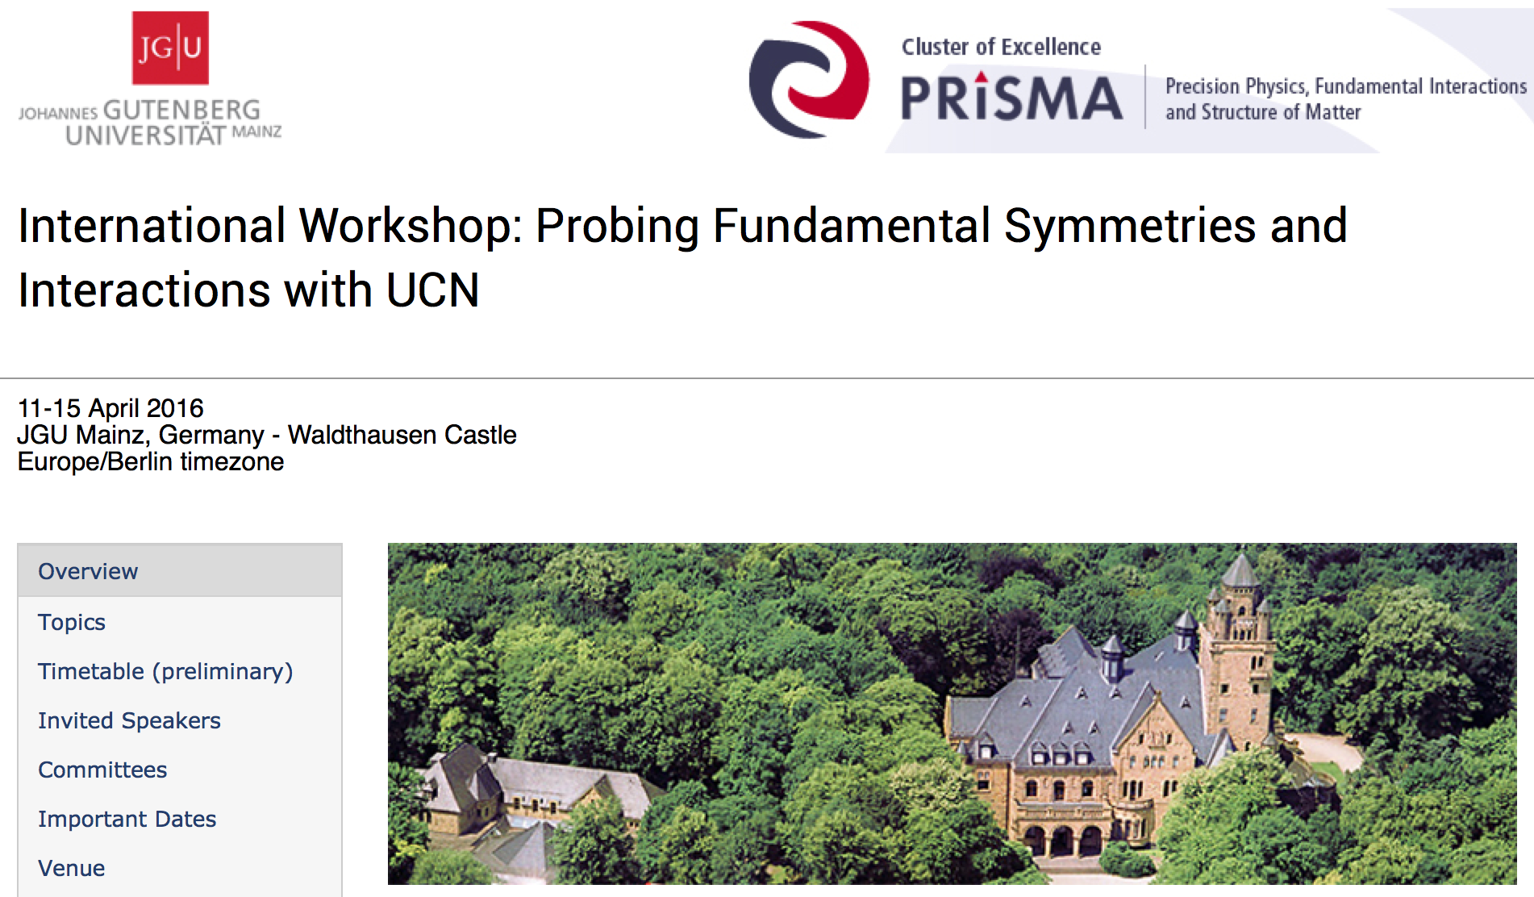
Instrumentation
Accelerator

Slide 19
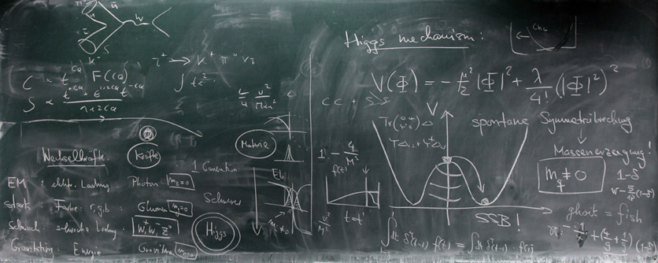
Mainz Institute for Theoretical Physics

Slide 20
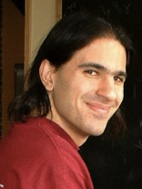
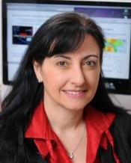
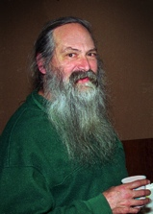
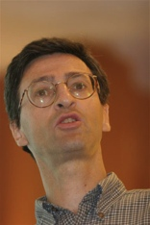
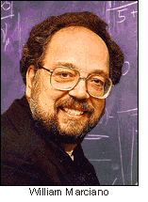
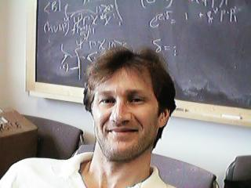
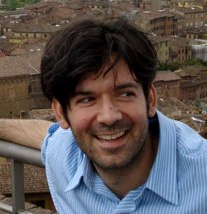
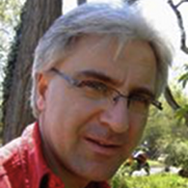
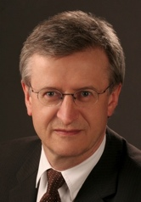
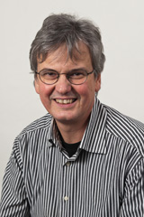

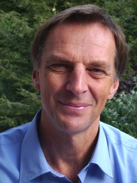
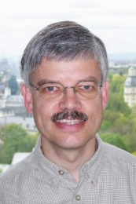
MITP Advisory Board
Nima Arkani Hamed (IAS Princeton)
Marcela Carena (Fermilab & Univ. Chicago)
Michael Creutz (Brookhaven Nat. Lab.)
Gian Giudice (CERN)
William Marciano (Brookhaven Nat. Lab.)
Martin Savage (Univ. Washington & INT Seattle)
Neal Weiner (New York Univ.)
Stefan Dittmaier (Univ. Freiburg)
Manfred Lindner (MPI-K Heidelberg) – Chair
Jan Louis (Univ. Hamburg)
Dirk Kreimer (Humboldt Univ. Berlin)
Christof Wetterich (Univ. Heidelberg) – Deputy Chair
Dieter Zeppenfeld (KIT Karlsruhe)

Slide 21
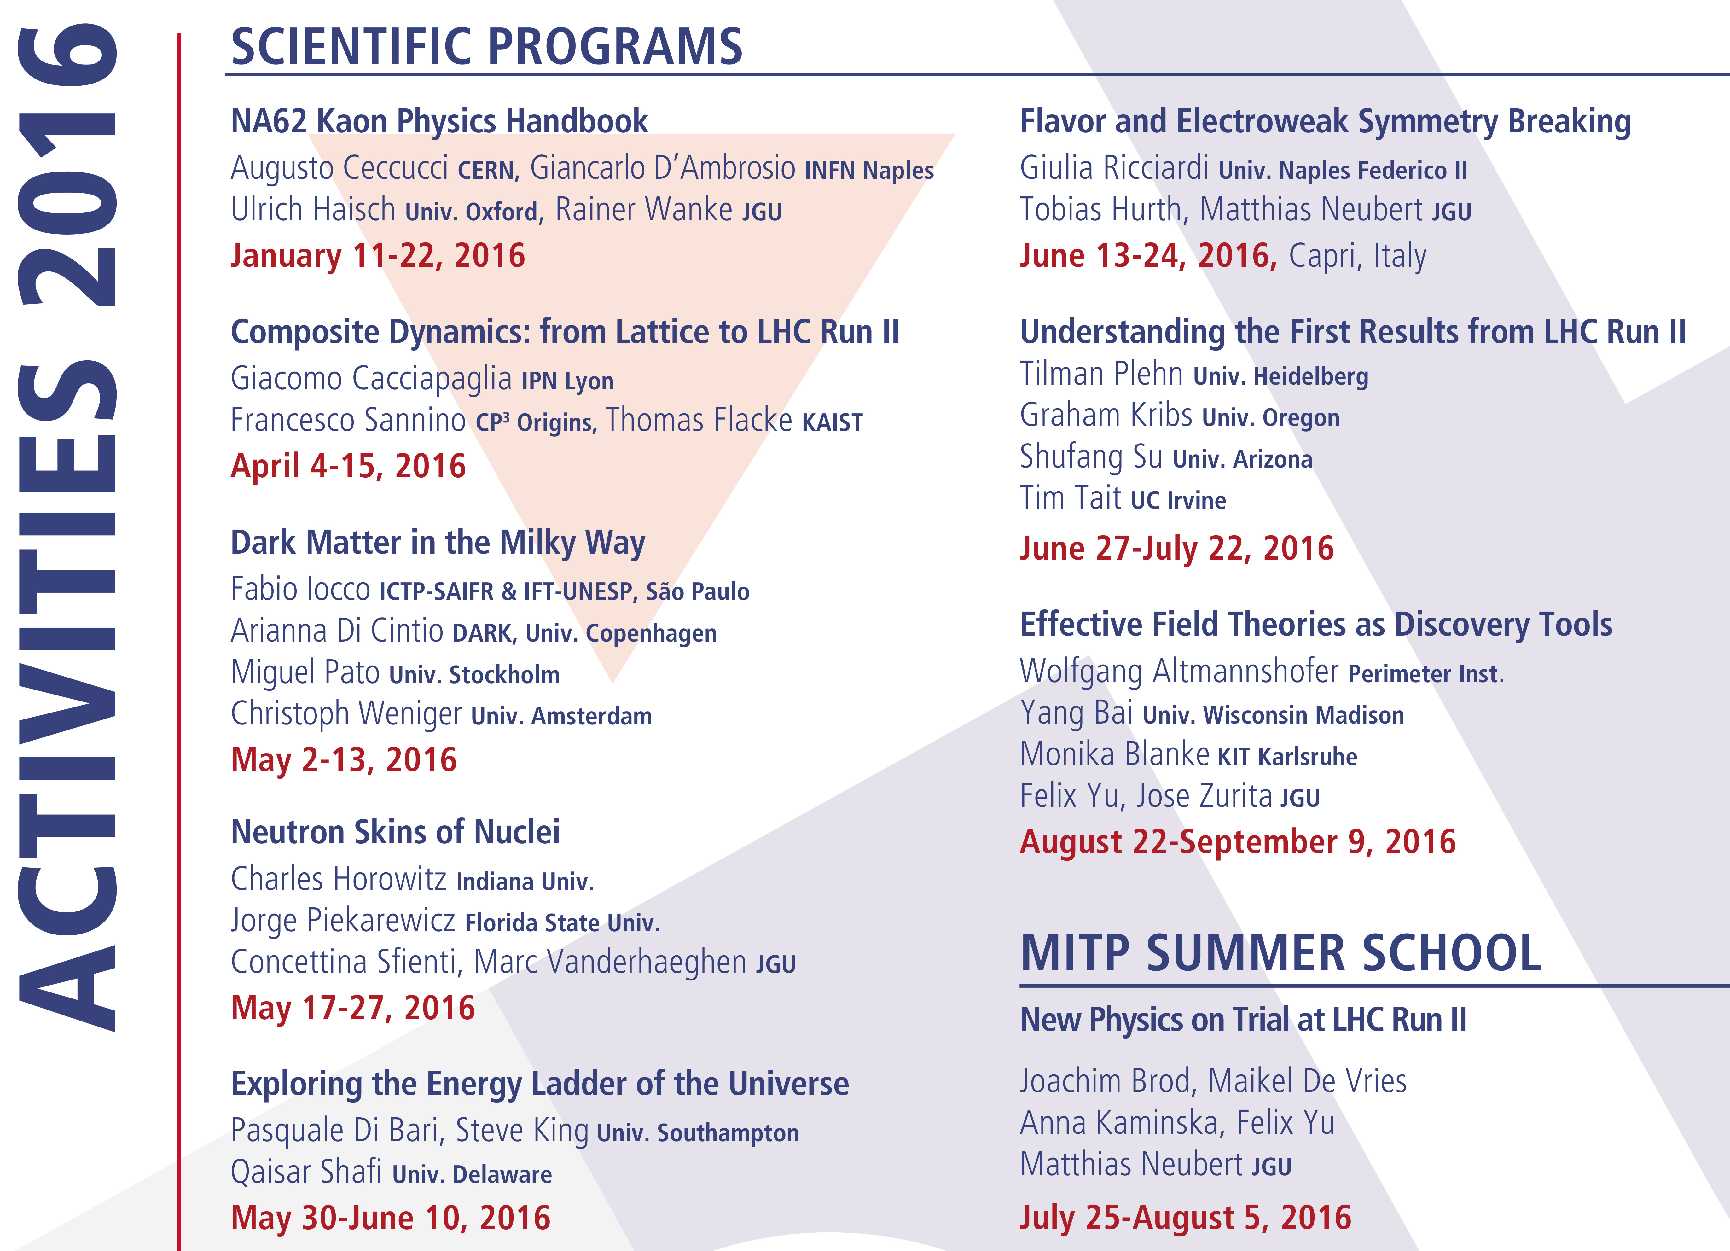

Slide 22
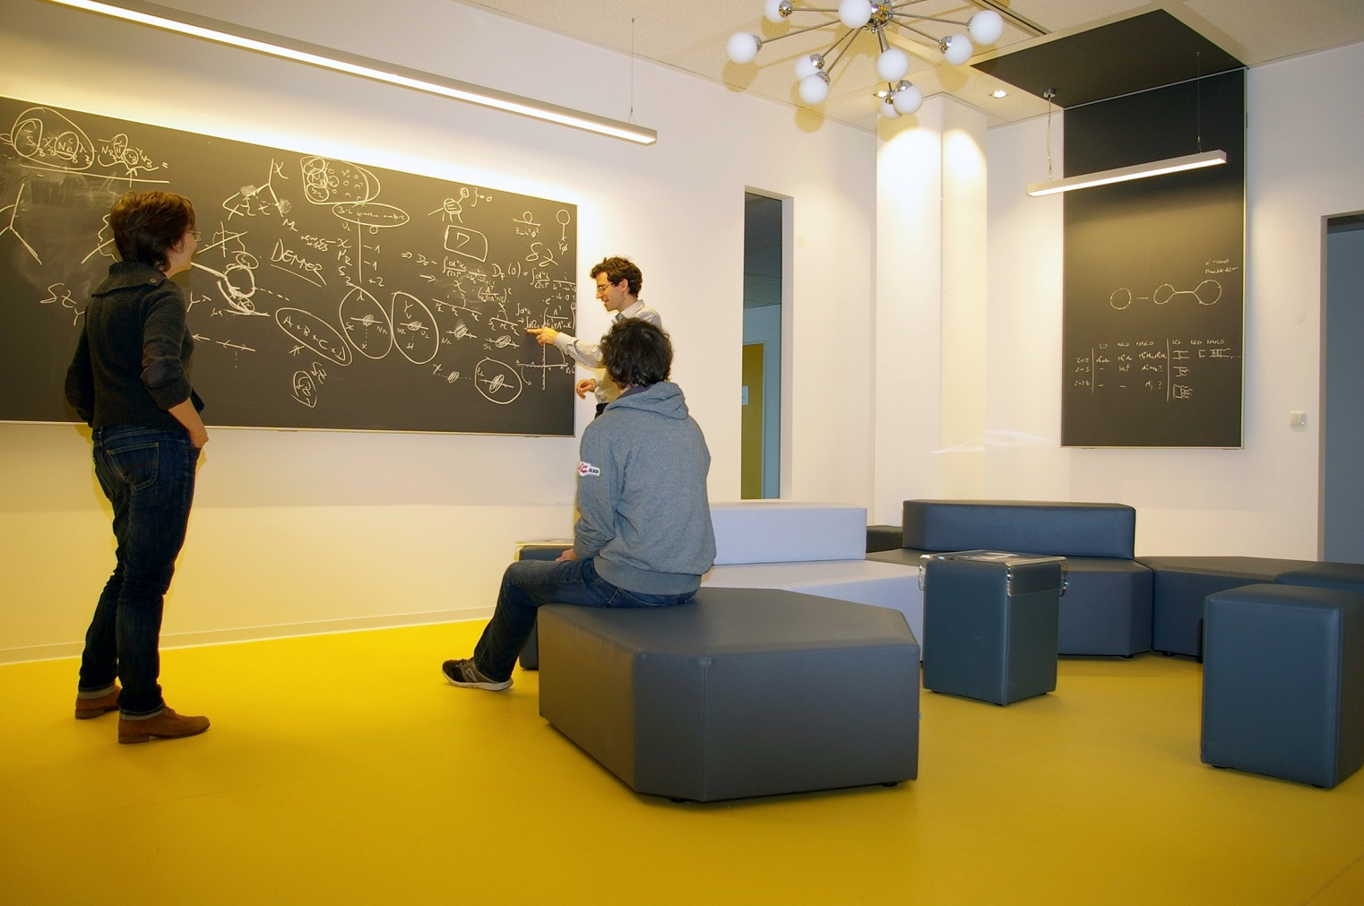
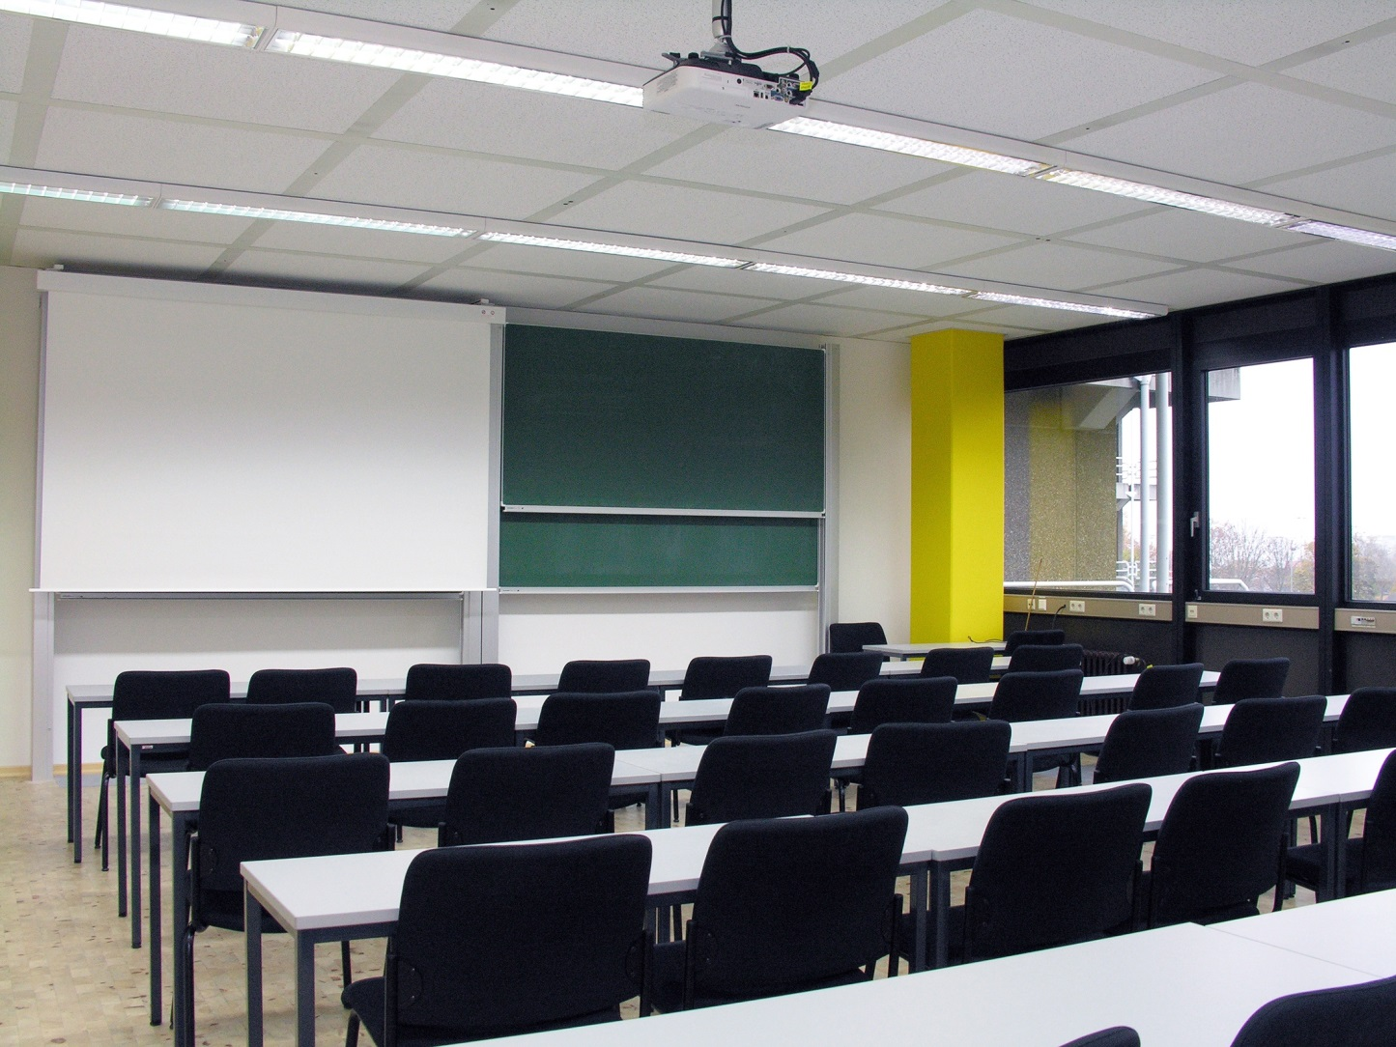
MITP Facilities

Slide 23


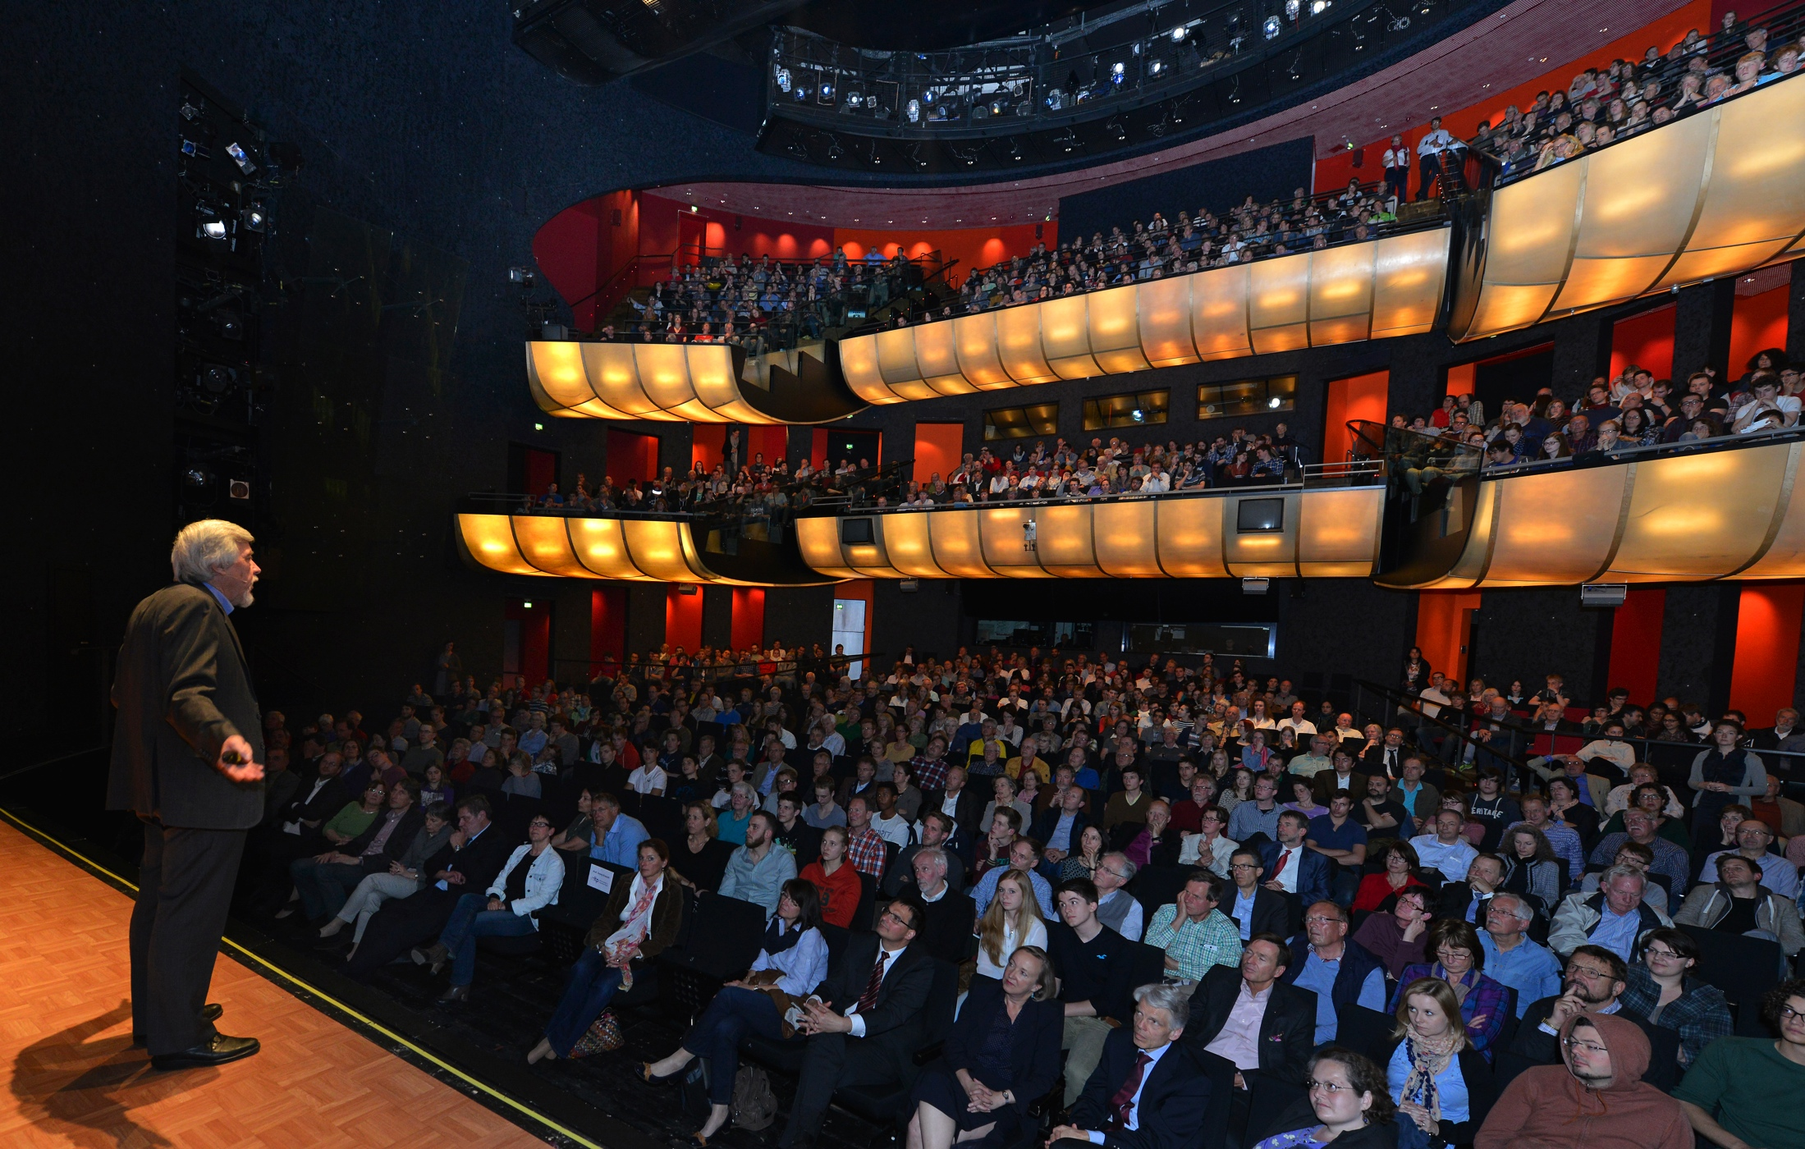

Slide 24
Future of the Excellence Initiative
Political consensus on continuation of Excellence Initiative
January 2016: Evaluation and recommendations by international panel of experts (“Imboden Committee“):
Clusters of Excellence have emerged as most successful line of funding
Recommend extending currently funded projects by two years
Recommend more flexibility regarding scientific profile
Cooperation between different universities encouraged
Political framework is being worked out – announcement, call for proposals expected in June 2016
Shape the research programme for PRISMA-II

Slide 25
Thank you!

