Slide 1

Bachelor- und Masterarbeit
The Gas Electron Multiplier - Recent Developments and Applications
Bernhard Ketzer
Helmholtz-Institut für Strahlen- und Kernphysik
Universität Bonn

Slide 2
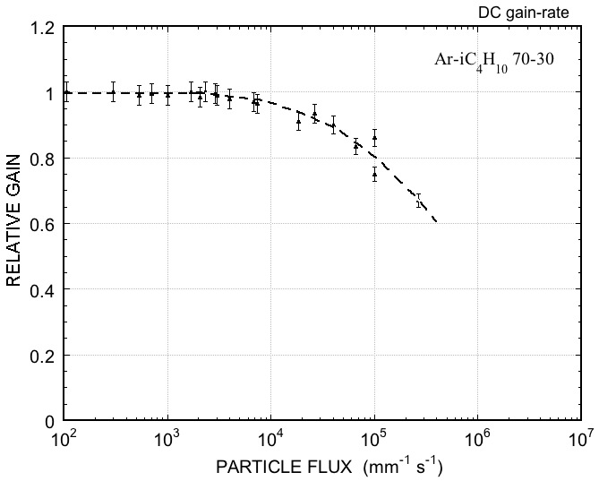
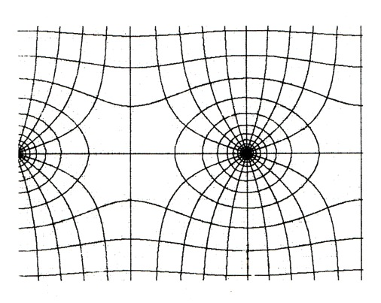
Limitations of Wire-based Detectors
Localization accuracy: typ. 100-500 μm
Volume / 2-track resolution: typ. 10×10×10 mm³ (signal induction on pads)
Rate capability: limited by build-up of positive space-charge around anode
e⁻
~ 100 ns
I⁺
~ 100 µs
[A. Breskin et al., NIM 124, 189 (1974)]

Slide 3
Limitations of Wire-based Detectors
Localization accuracy: typ. 100-500 μm
Volume / 2-track resolution: typ. 10×10×10 mm³ (signal induction on pads)
Rate capability: limited by build-up of positive space-charge around anode
Ion backflow: IB = I_{cathode} / I_{anode} ~ 30% for TPC with MWPC
e⁻
~ 100 ns
I⁺
~ 100 µs

Slide 4
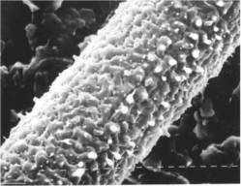
Limitations of Wire-based Detectors
Localization accuracy: typ. 100-500 μm
Volume / 2-track resolution: typ. 10×10×10 mm³ (signal induction on pads)
Rate capability: limited by build-up of positive space-charge around anode
Ion backflow: IB = I_{cathode} / I_{anode} ~ 30% for TPC with MWPC
Aging and discharge damage: polymerization of organic compounds
Reduction of cell size
by a factor of 10
Photolithography
Etching
Coating
Wafer post-processing
[O. Ullaland, LBL-21170, 107 (1986)]

Slide 5
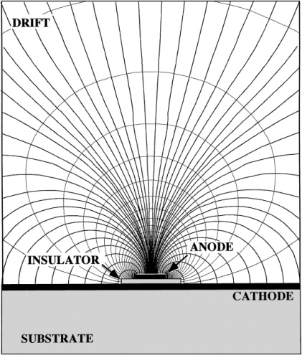
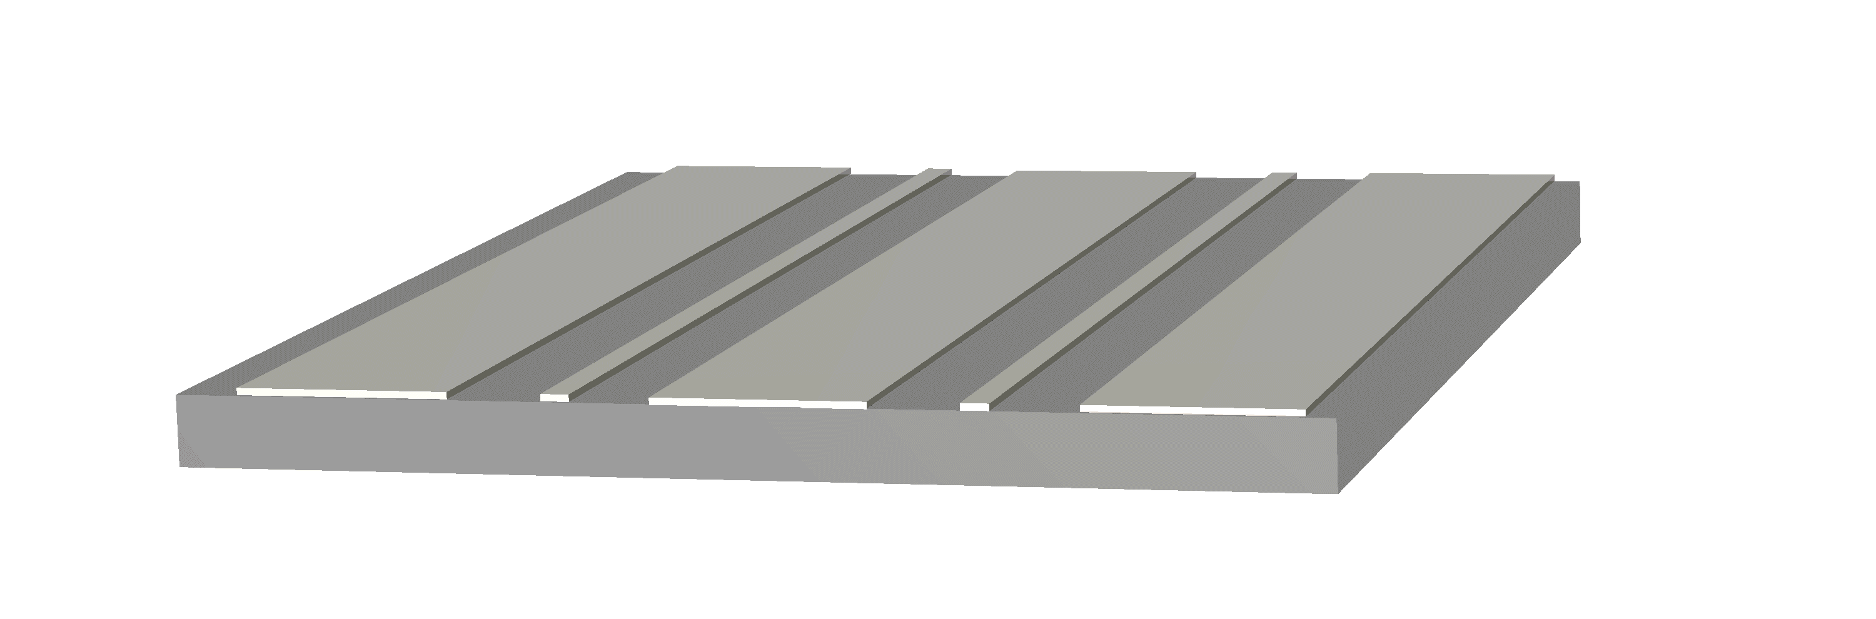
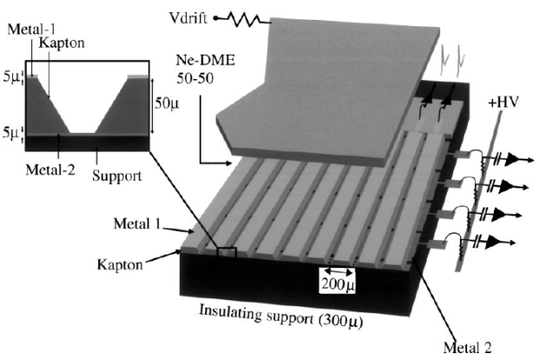
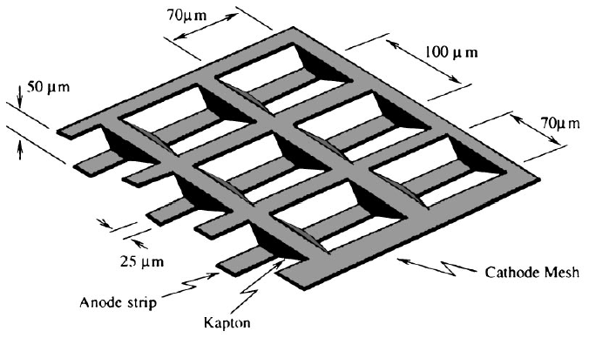
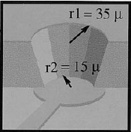
The MPGD Zoo
Microstrip Gas Chamber
[A. Oed, NIM A263, 351 (1988)]
Microgap Chamber (MGC)
[F. Angelini et al., NIM A335, 69 (1993)]
Microdot Chamber
[S.F. Biagi et al., NIM A361, 72 (1995)]
10 μm
80 μm
Compteur à Trous (CAT)
[F. Bartol et al., J. Phys. III 6, 337 (1996)]
Micro Groove Counter
[Bellazzini et al., NIM A424, 444 (1999)]
Micro Wire Detector
[B. Adeva et al., NIM A435, 402 (1999)]
WELL Detector (μCAT)
[R. Bellazzini et al., NIM A423, 125 (1999)]
50 μm
and many more...

Slide 6
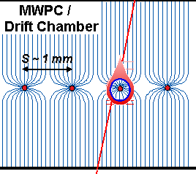
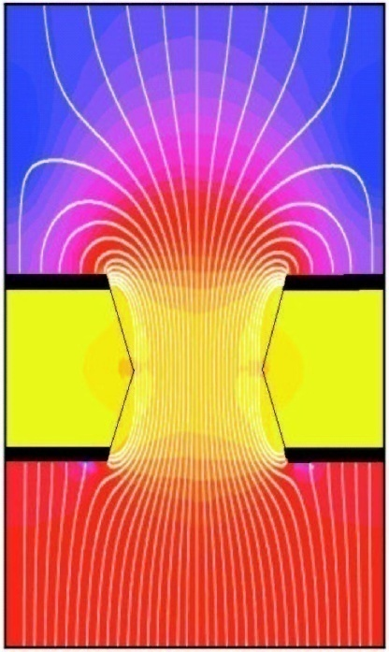
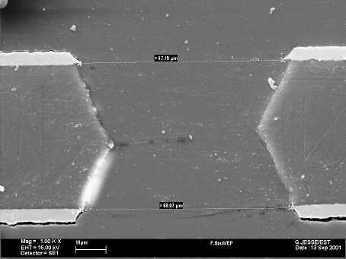
GEM
70 μm
GEM: Gas Electron Multiplier
[F. Sauli, NIM A386, 531 (1997)]
Thin polyimide foil, typ. 50 μm
Cu-clad on both sides, typ. 5 μm
Photolithography: ~ 10⁴ holes/cm²
Granularity 10×higher than MWPC
ΔU=300-500 V
   high E-field: ~50 kV/cm
   avalanche multiplication

Slide 7
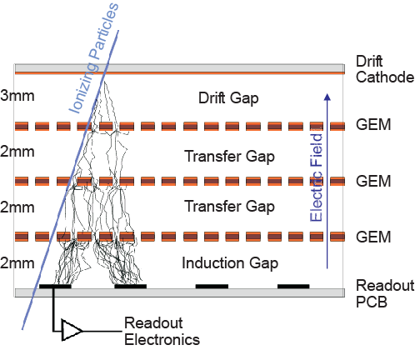
GEM
Triple GEM amplification
higher gain at lower GEM voltages
[S. Bachmann, B. Ketzer et al., NIM A479, 294 (2001)]
discharge prevention
[B. Ketzer et al., IEEE Trans. Nucl. Sci. 48, 1065 (2001)]
no aging up to 7 mC/mm²
[C. Altunbas, B. Ketzer et al., NIM A515, 249 (2003)]
GEM: Gas Electron Multiplier
[F. Sauli, NIM A386, 531 (1997)]
Thin polyimide foil, typ. 50 μm
Cu-clad on both sides, typ. 5 μm
Photolithography: ~ 10⁴ holes/cm²
Granularity 10×higher than MWPC

Slide 8
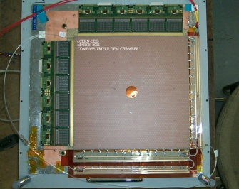
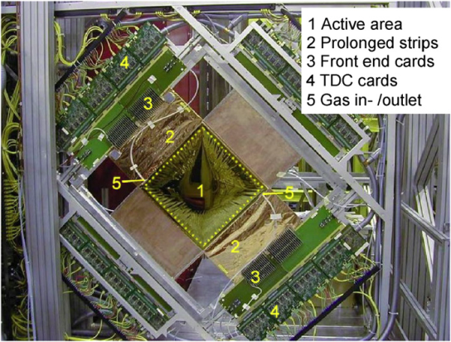
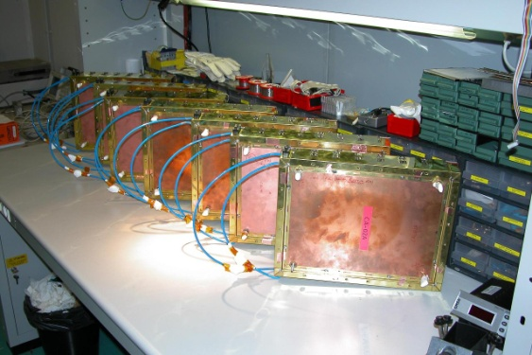
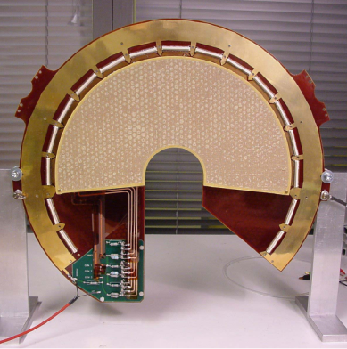
MPGD in Running Experiments
Exp. | # | Type | Readout | # of ch. | Size (cm²) | Gas | s_{space} (mm) | s_{time} (ns) | e (%)
COMPASS | 22 | GEM | 2-D strips | 1536 | 31×31 | Ar/CO₂ (70/30) | 70 | 12 | >97
 | 12 | MM | 1-D strips | 1024 | 40×40 | Ne/C₂H₆/CF₄ (80/10/10) | 90 | 9 | >97
LHCb | 24 | GEM | pads | 192 | 10×24 | Ar/CO₂/CF₄ (45/15/40) |  | 4.5 | >97
TOTEM | 40 | GEM | pads + strips | 1536 + 256 | 30 × 20 | Ar/CO₂ (70/30) | ~70 (q) |  | >92
also CAST, NA48, PHENIX …
30 cm

Slide 9
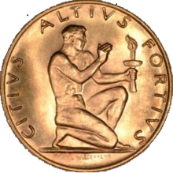
New Challenges
Larger active areas
  Bulk Micromegas
  Single-mask GEMs
Higher rates
Pixel readout
Ion backflow suppression
Aging, discharge protection
  Materials
  Multi-stage amplification
  Segmentation
  Resistive coating
Higher resolutions
  μPixel
  InGrid
Special shapes
  cylindrical
  spherical

Slide 10
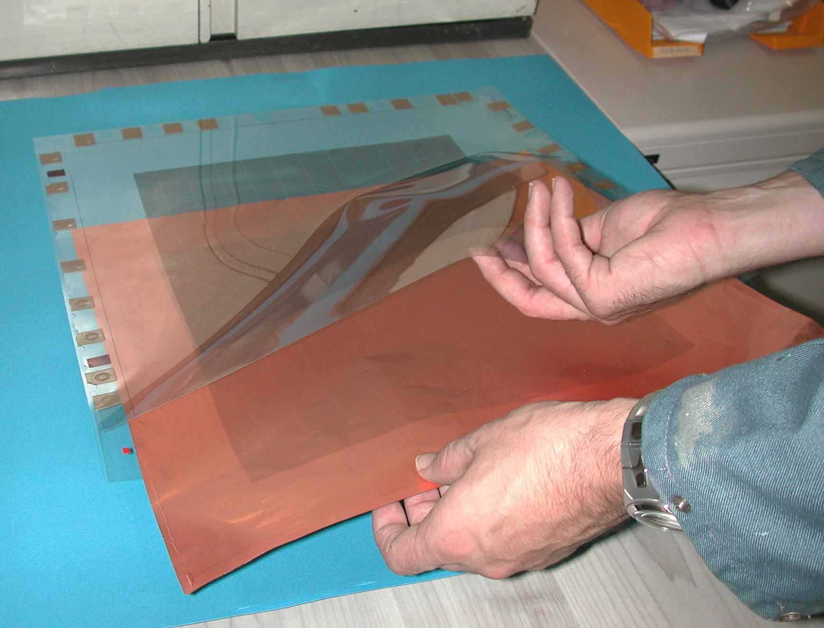
GEM Manufacturing
Limitations of double-mask technique
1. Image transfer using two film
masks (photoplotted polyester)
 Difficult above 400×400 mm²
due to
  Film accuracy
  Temperature and humidity variations
  Alignment of masks
2. Raw material:
  rolls of 100 m × 0.457 m
  new: 0.6 m width
Notes:
Raw material: APICAL + vacuum deposited Cu (no glue)
Cu etching: FeCl3 + HCl
Kapton etching: Ethylenediamine (C2H8N2) + KOH + Ethanol

Slide 11
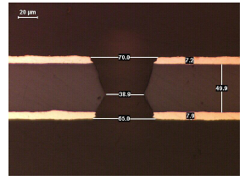
Single-Mask Process
Photoresist deposition on base material
Photoresist hole patterning (single mask)
15um resist
15um resist
Top copper etching
Resist stripping
Polyimide anisotropic etching
Bottom resist protection deposition
Bottom copper etching
Top copper protected by galvanic connection
Resist stripping
Soft polyimide etching
[M. Villa et al., arXiv 1007.1131v1]
Notes:
Top cover protection:
3 V DC to to top electrode
GND on basin walls
-> DC current from wall to top electrode, making it inert to the etching bath.

Slide 12
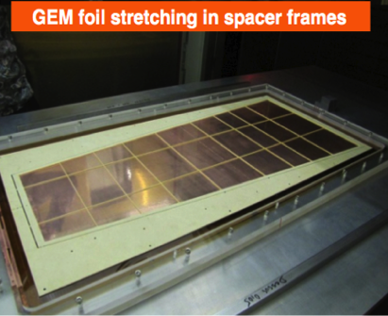
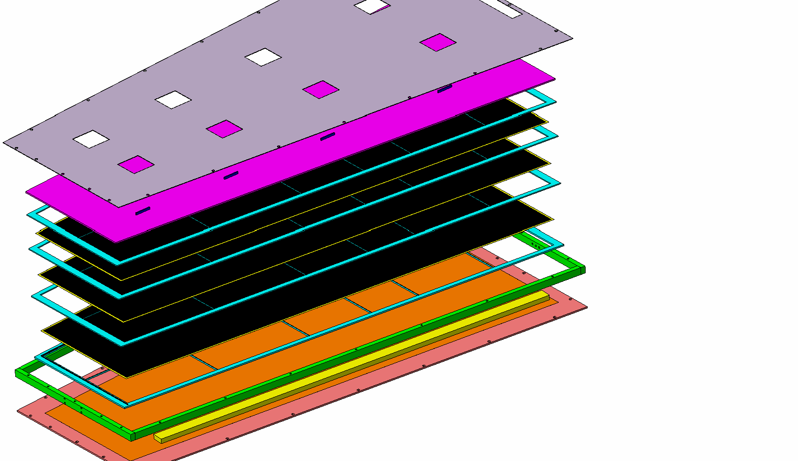
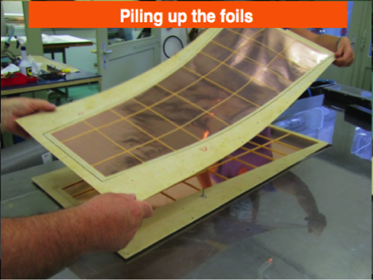
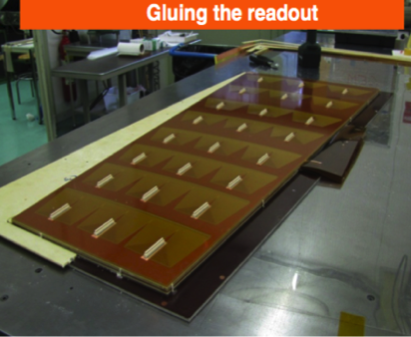
CMS Muon Chambers
CMS Muon Detector Upgrade: REi/1
990 x (220-455) mm²
Radial Readout Strips
0.6 to 1.2 mm pitch
[M. Tytgat, MPGD 2013]

Slide 13
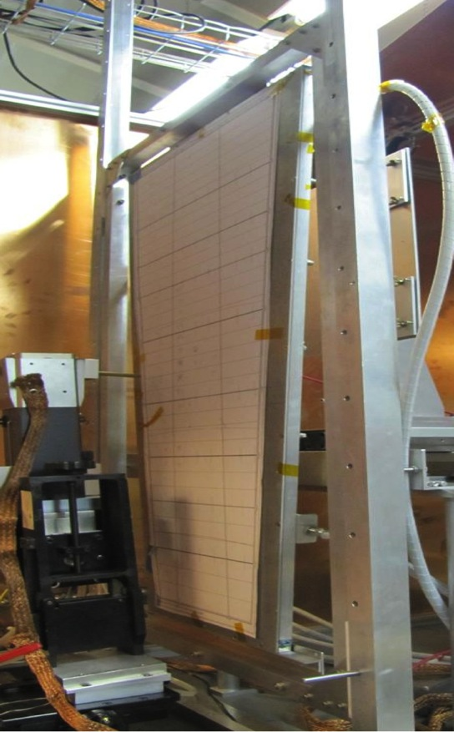
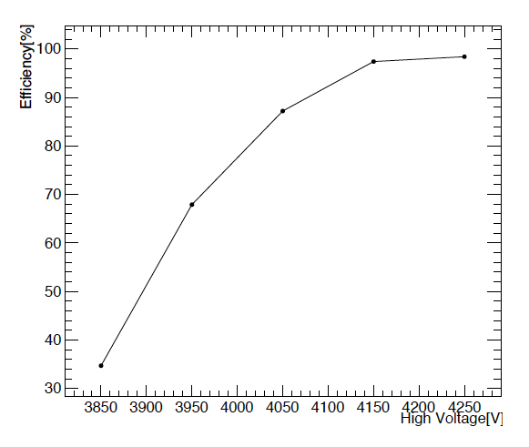
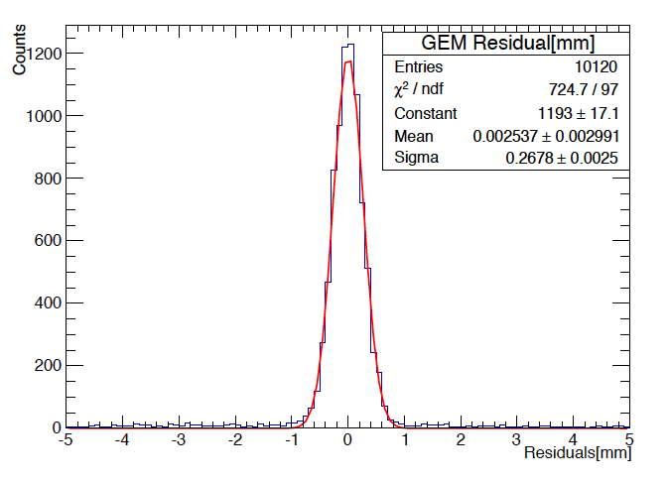
CMS Muon Chambers
EFFICIENCY
TRIPLE GEM
990 mm
POSITION ACCURACY
~ 260 µm
D. Abbaneo et al, JINST 9(2014)C01053

Slide 14
New Challenges
Larger active areas
  Bulk Micromegas
  Single-mask GEMs
Higher rates
Pixel readout
Ion backflow suppression
Aging, discharge protection
  Materials
  Multi-stage amplification
  Segmentation
  Resistive coating
Higher resolutions
  μPixel
  InGrid
Special shapes
  cylindrical
  spherical

Slide 15
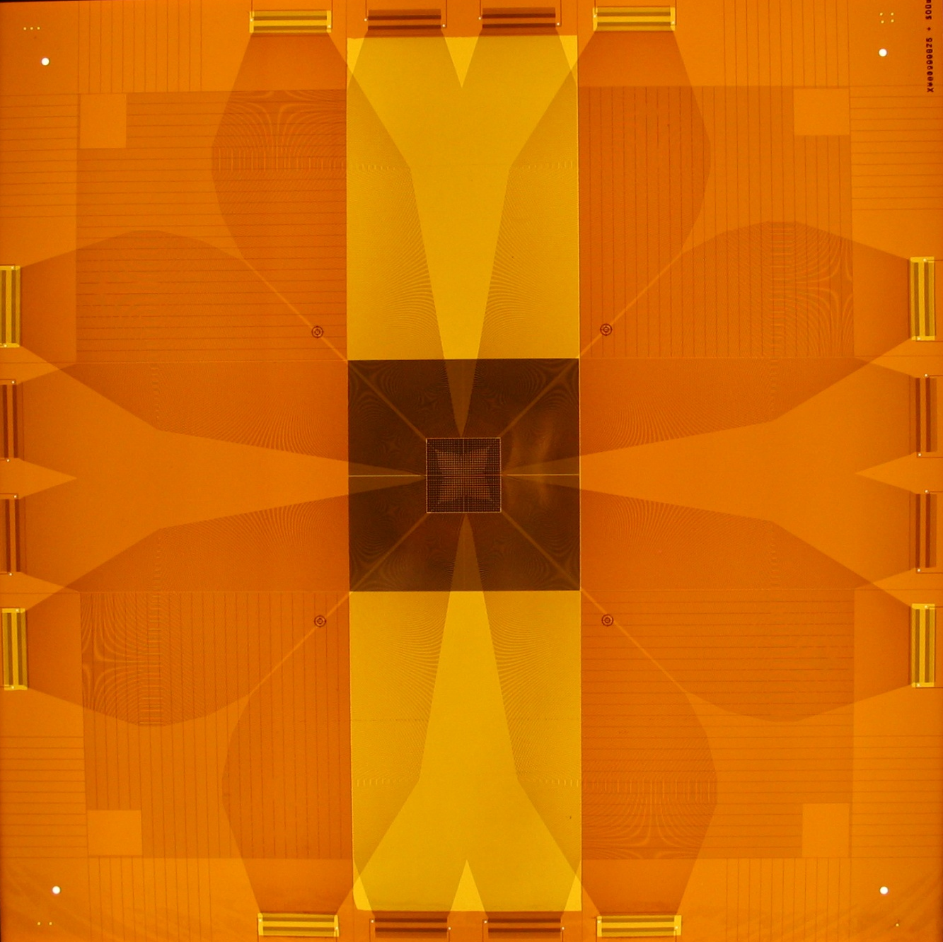
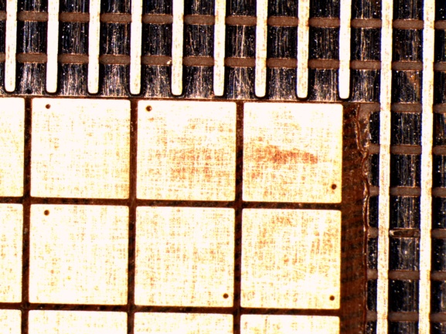
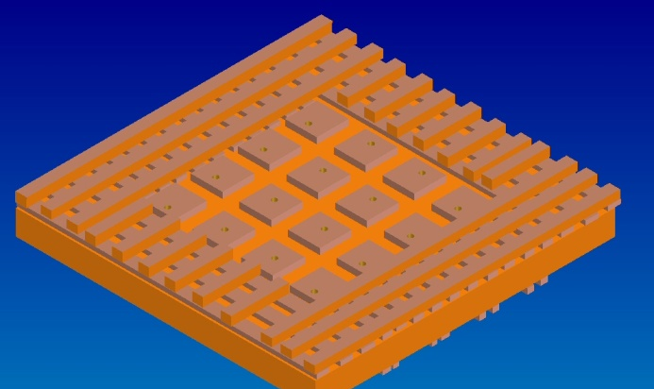
COMPASS PixelGEM
Pixel + strip readout
Center: 32×32 pixels, 1 mm²
Periphery: 2×512 strips (2D)
Readout electronics moved
away from the beam
450 mm

Slide 16
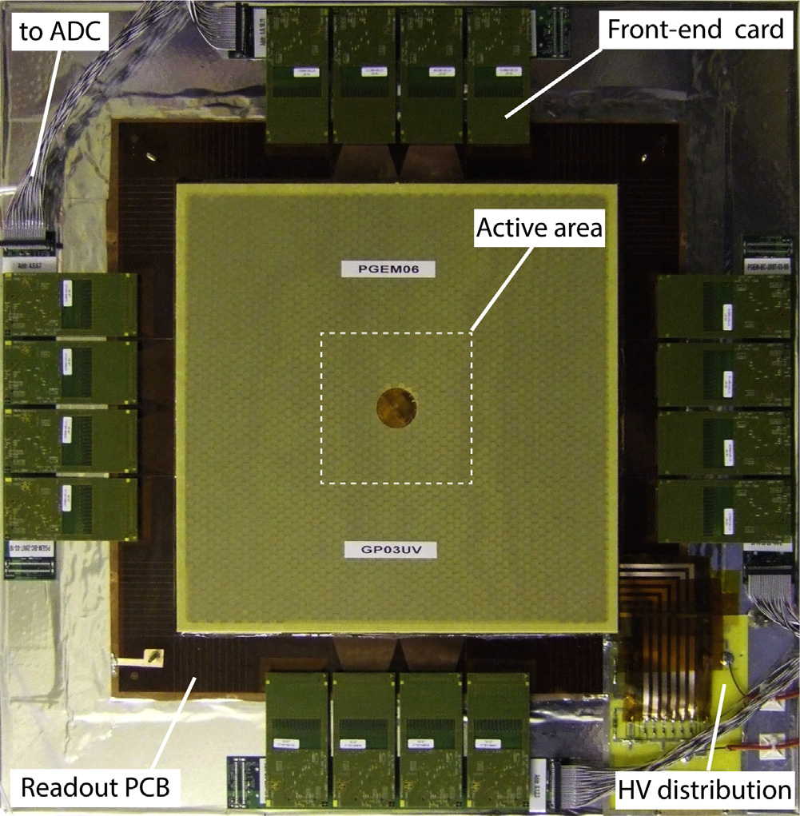

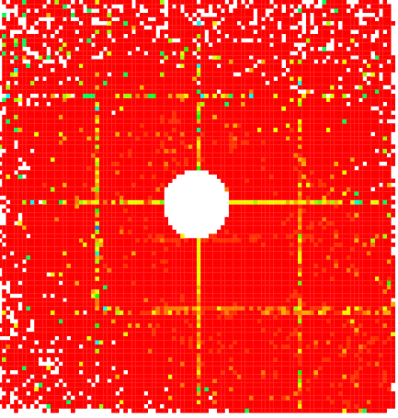
COMPASS GEM Detectors
Large-area GEM
PixelGEM
31 cm
2-D Strip readout: 22 detectors
Thickness: 0.4% X₀
Resolution: σ_{x}=70μm, σ_{t}=12ns
Pixel + Strip readout: 5 detectors
Thickness: 0.26% X₀
Resolution: σ_{x}=125μm, σ_{t}=11ns
High rates: ~10⁵ mm⁻²s⁻¹
[B. Ketzer et al., NIM A535, 314 (2004)
B. Ketzer et al., IEEE NSS 2007, N12-5 (2007)]

Slide 17
New Challenges
Larger active areas
  Bulk Micromegas
  Single-mask GEMs
Higher rates
Pixel readout
Ion backflow suppression
Aging, discharge protection
  Materials
  Multi-stage amplification
  Segmentation
  Resistive coating
Higher resolutions
  μPixel
  InGrid
Special shapes
  cylindrical
  spherical

Slide 18
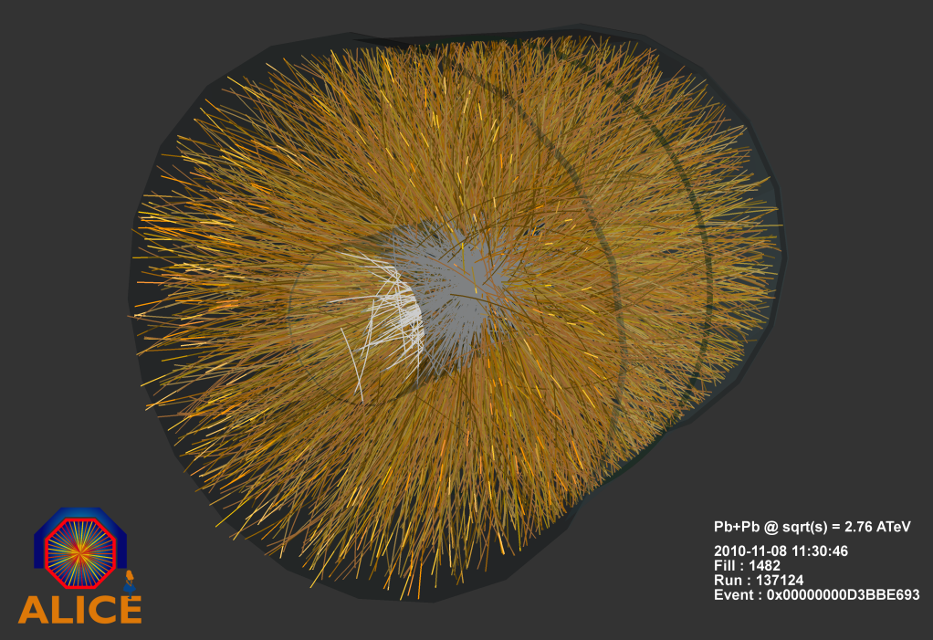
Time Projection Chamber
An (almost) ideal tracking detector:
Large acceptance
Large active volume
Low material budget
3D picture of event
   simple pattern recognition
Extremely high particle densities
 heavy ion experiments
Good momentum resolution
Particle identification
Limitations:
No redundancy
Calibration very demanding
Drift distortions due to ion backflow
Gating  low trigger rates
Examples:
STAR (420 cm × 400 cm)
ALICE (500 cm × 500 cm)
Notes:
In the last 3 years, ALICE has delivered a wealth of new data on heavy ion collisions at unprecedented energies to study the properties of the QGP

Slide 19
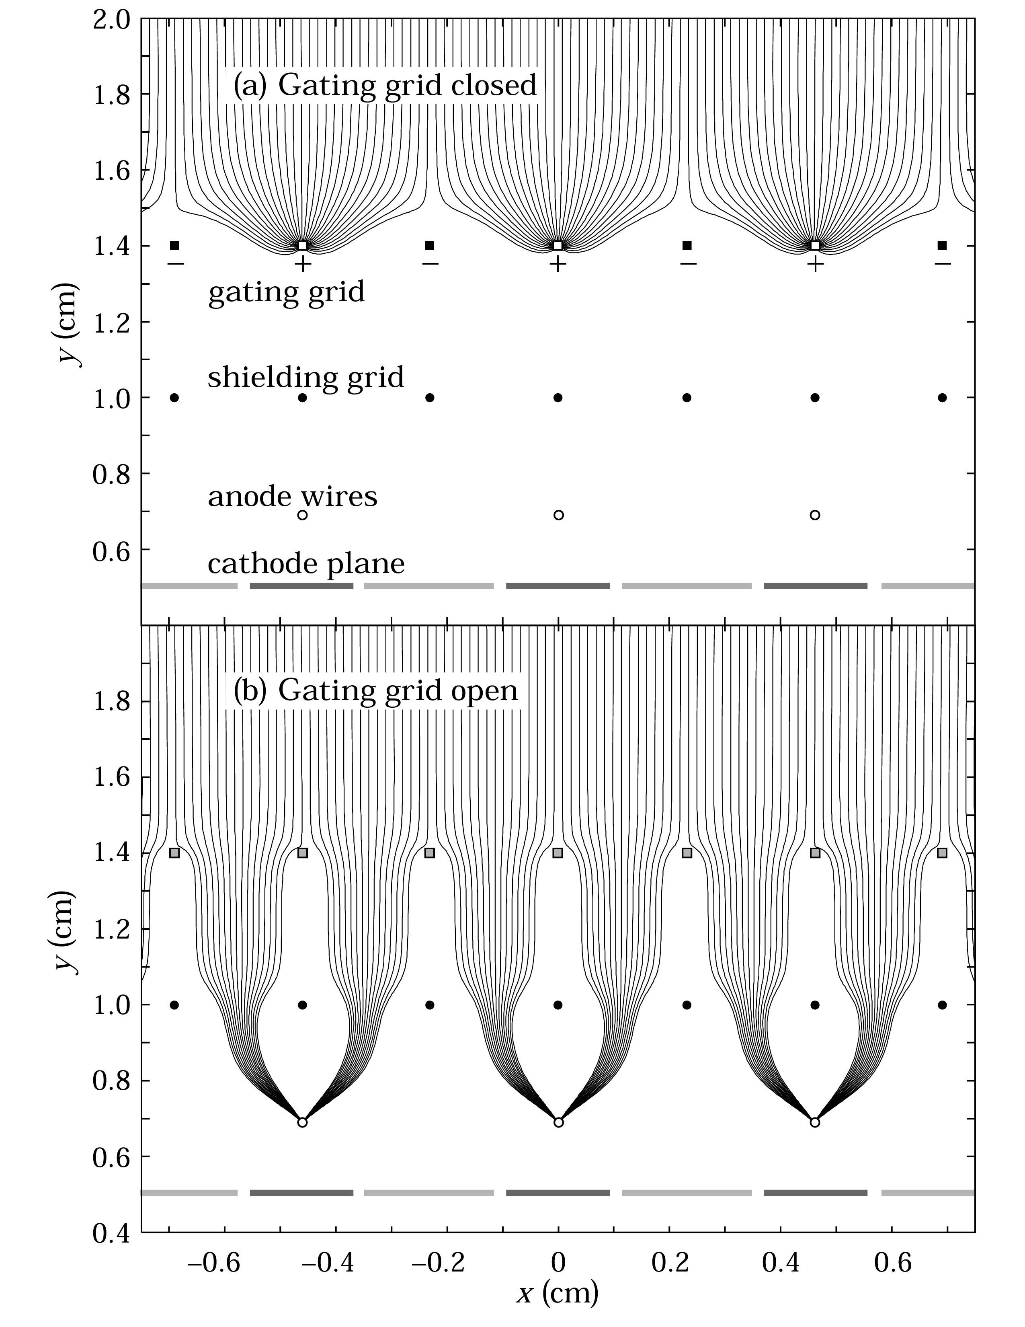
Time Projection Chamber
Limitations:
No redundancy
Calibration very demanding
Drift distortions due to ion backflow
Gating  low trigger rates
Examples:
STAR (420 cm × 400 cm)
ALICE (500 cm × 500 cm)

Slide 20
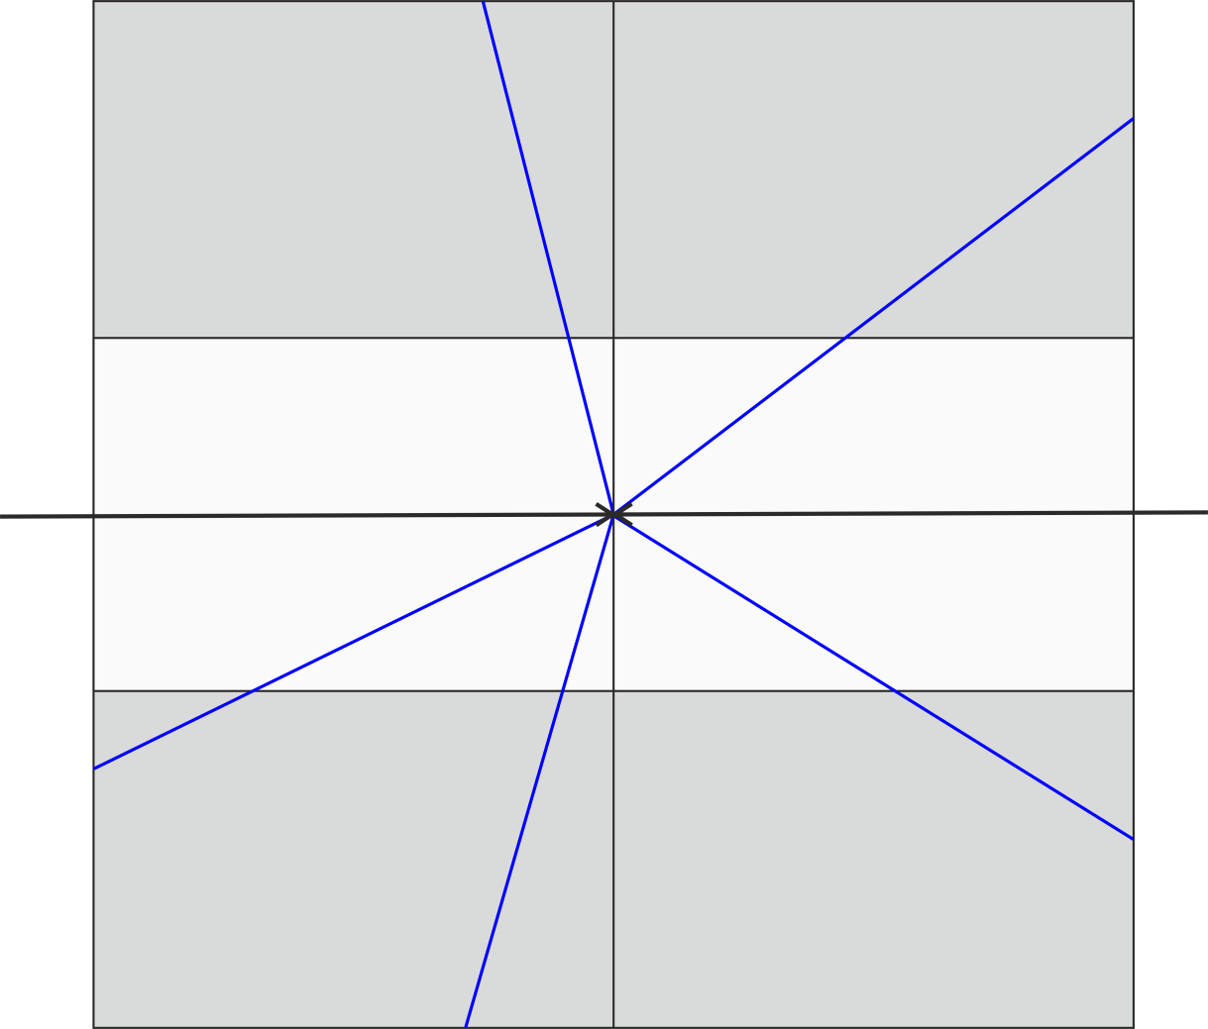
Operation at High Rates
High rates: drift time > 1 / (event rate)  overlapping events

Slide 21
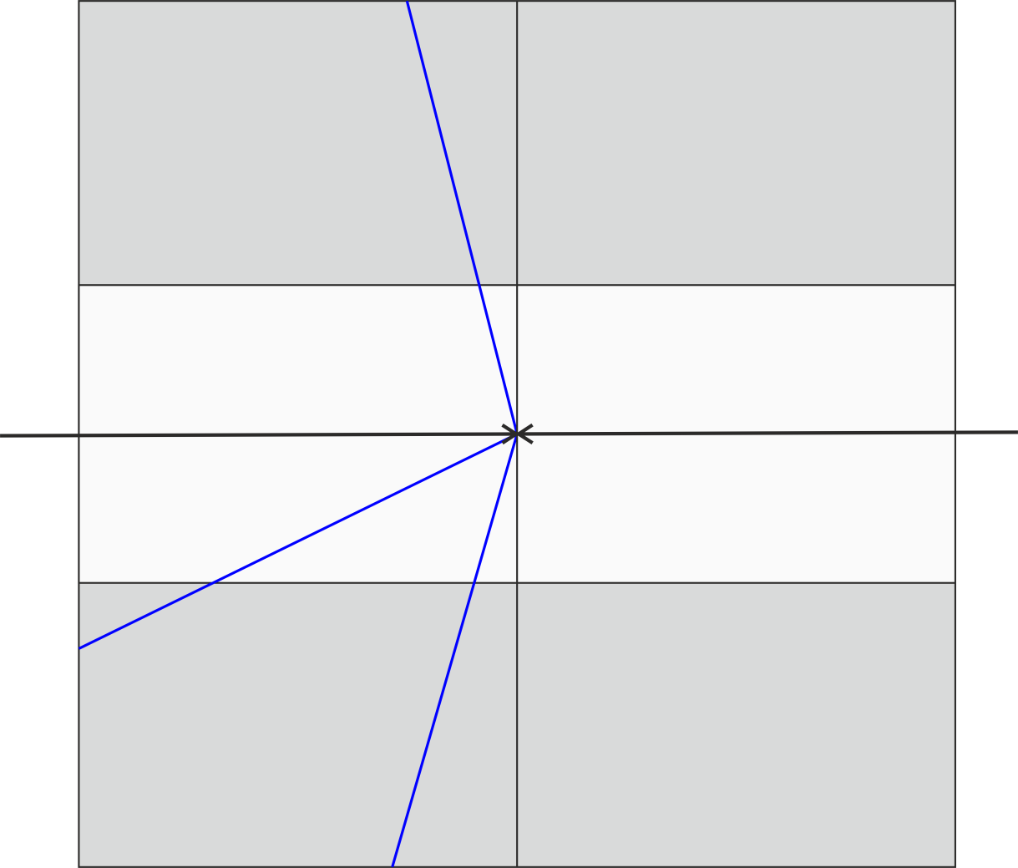
Operation at High Rates
High rates: drift time > 1 / (event rate)  overlapping events

Slide 22

Operation at High Rates
High rates: drift time > 1 / (event rate)  overlapping events

Slide 23
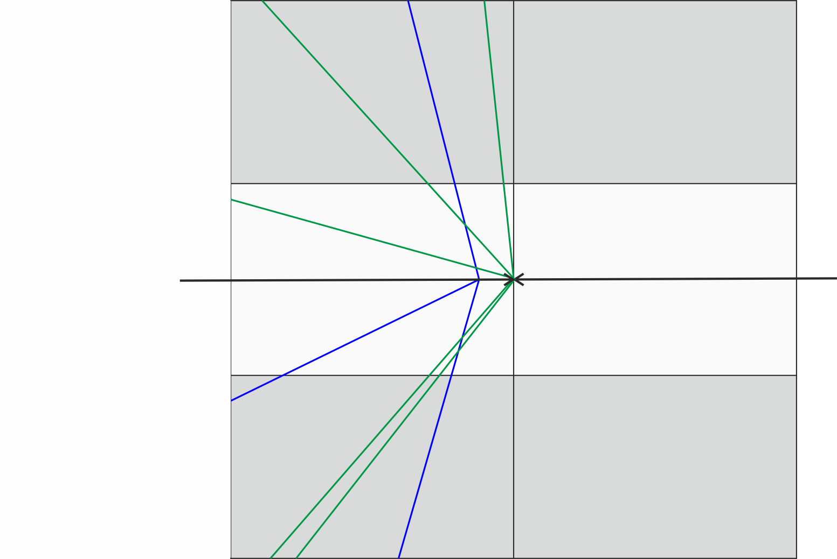
Operation at High Rates
High rates: drift time > 1 / (event rate)  overlapping events

Slide 24
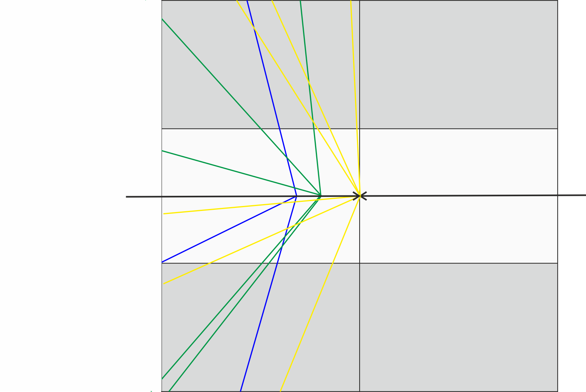
Operation at High Rates
High rates: drift time > 1 / (event rate)  overlapping events

Slide 25
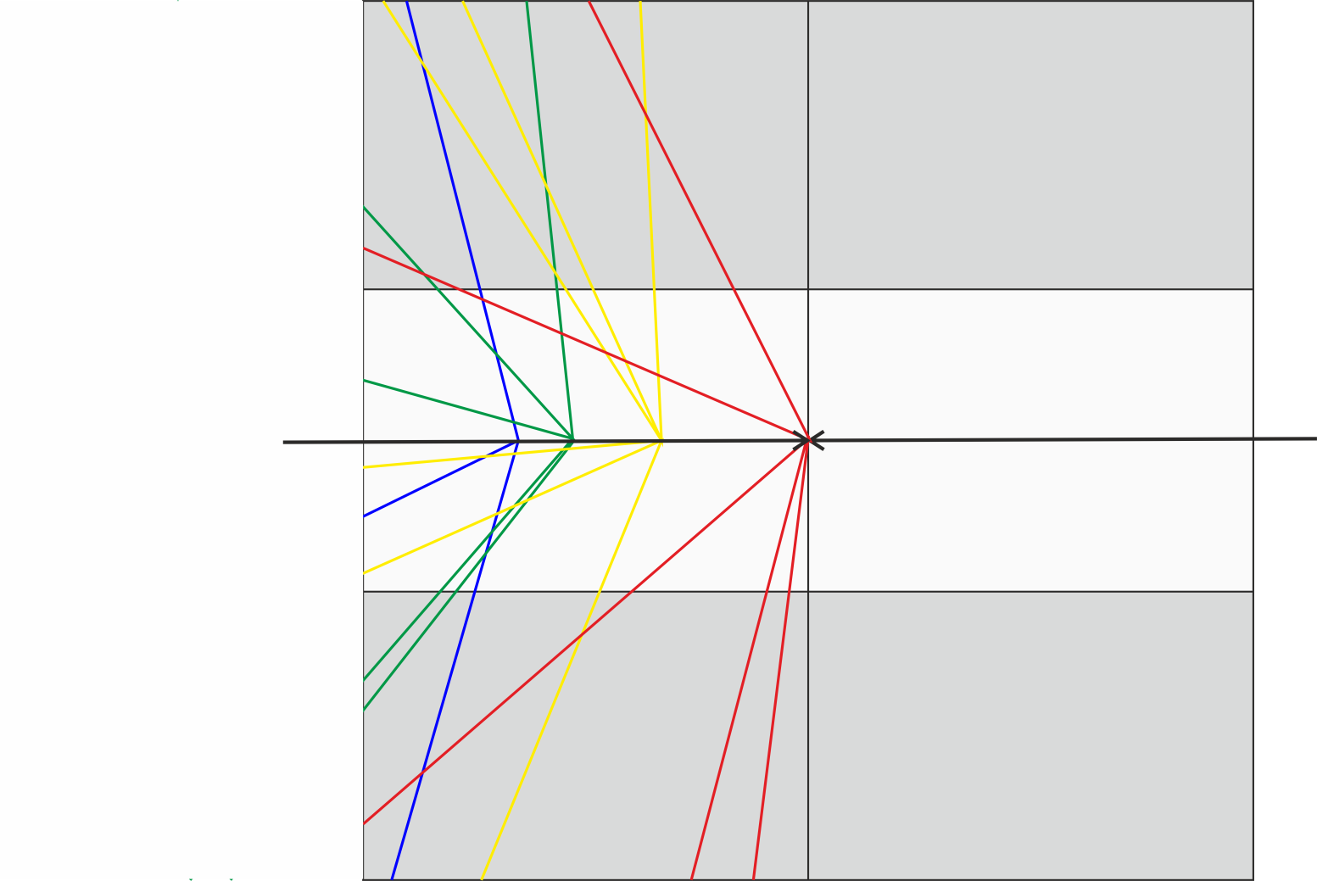
Operation at High Rates
High rates: drift time > 1 / (event rate)  overlapping events

Slide 26
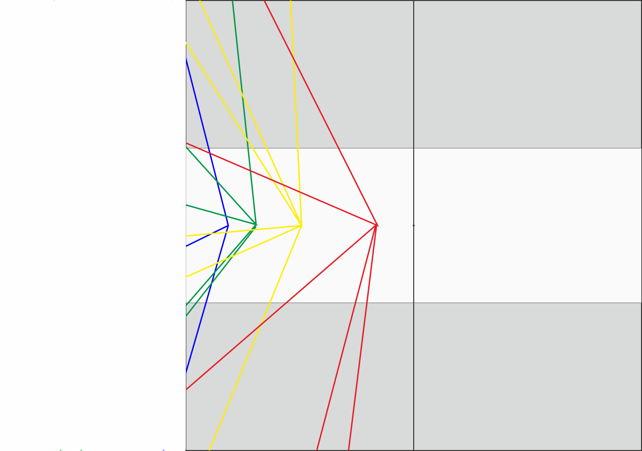
Operation at High Rates
High rates: drift time > 1 / (event rate)  overlapping events

Slide 27
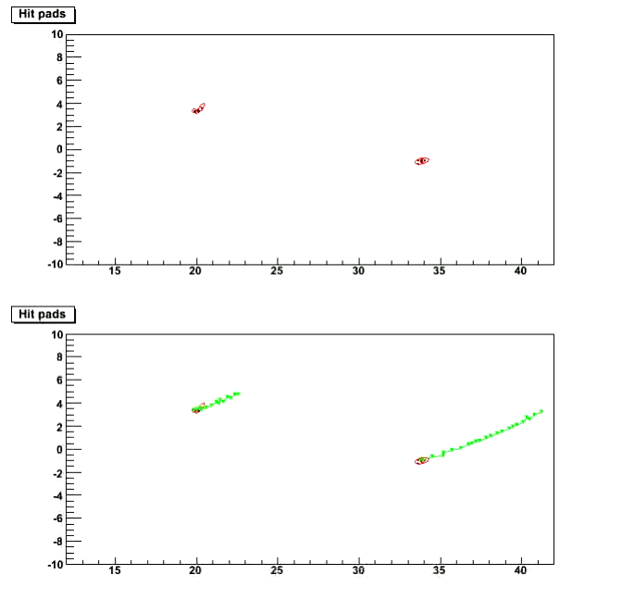
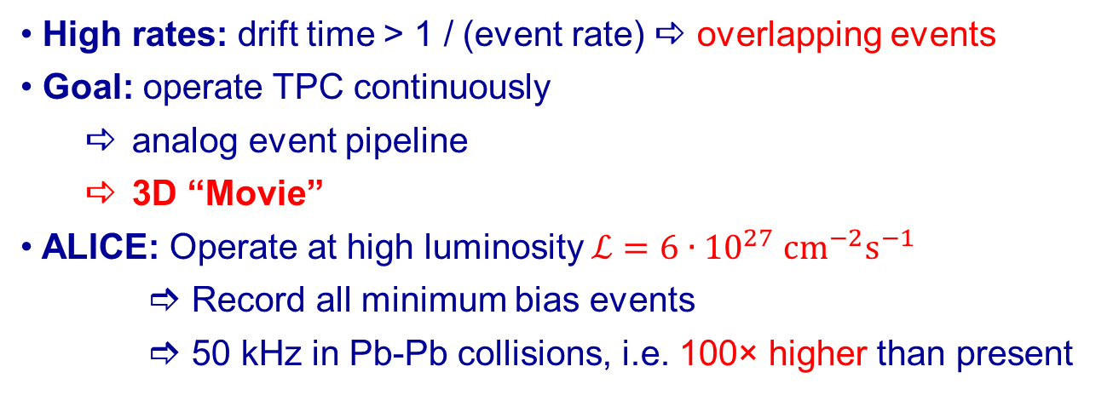
Operation at High Rates
High rates: drift time > 1 / (event rate)  overlapping events
Goal: operate TPC continuously
  analog event pipeline
  3D “Movie”
ALICE: Operate at high luminosity $ℒ=6∙{10}^{27} {cm}^{−2}s^{−1}$
       Record all minimum bias events
       50 kHz in Pb-Pb collisions, i.e. 100× higher than present

Slide 28
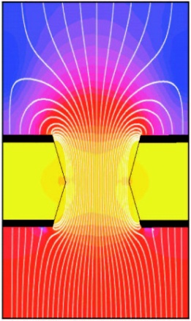
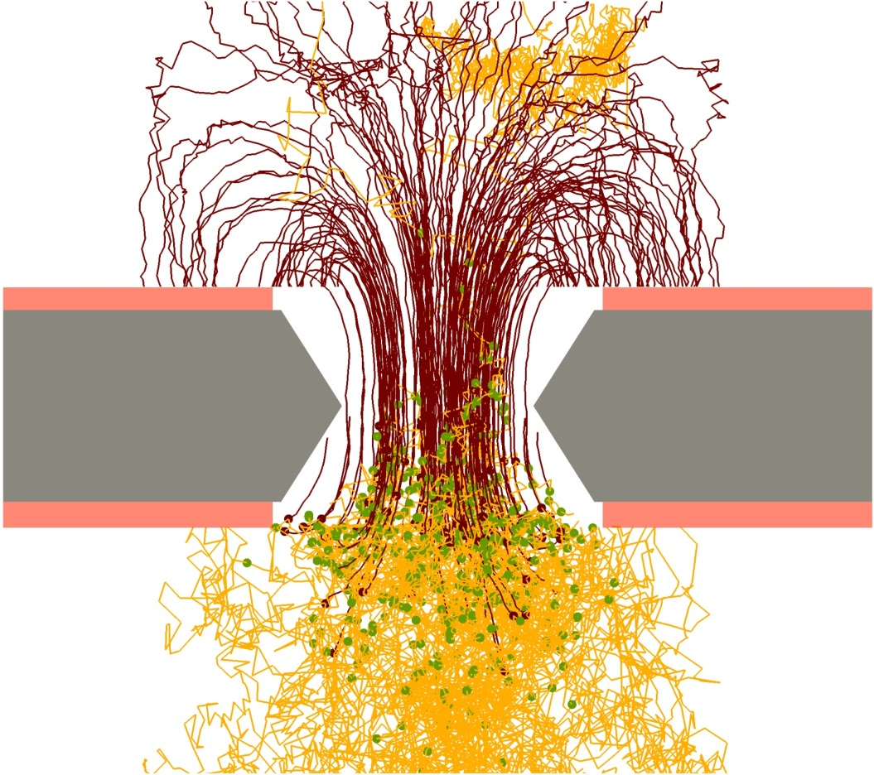

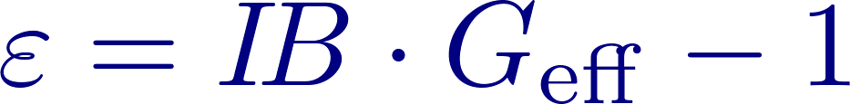


Ion Backflow Suppression in GEM
$$E_{drift}=250 V/cm$$
$$E_{trans}=3.75 kV/cm$$
Low ion density in drift region requires
  low primary ionization
  low gain
  low ion backflow

Slide 29
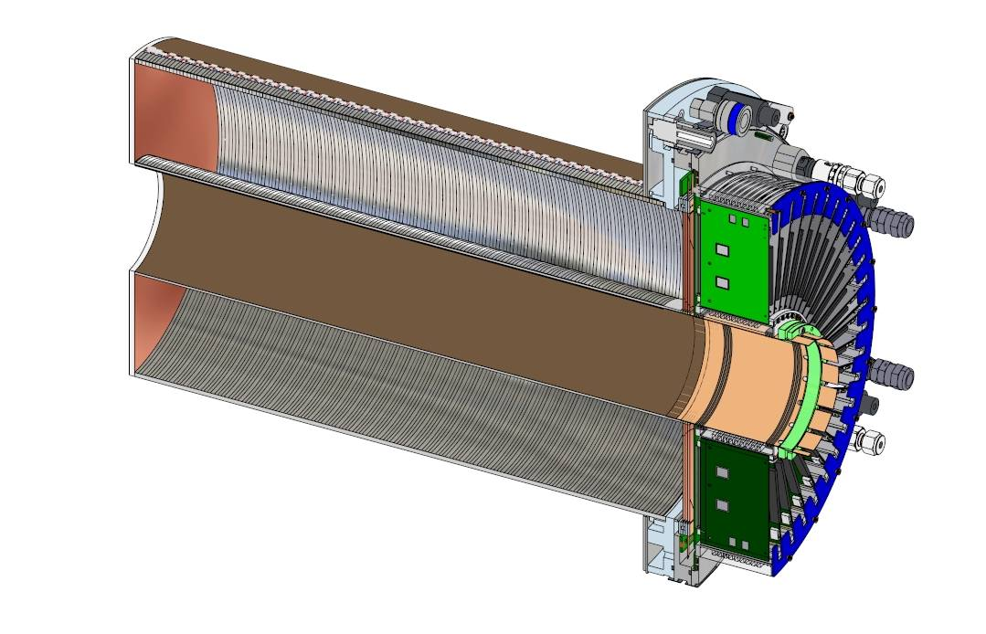




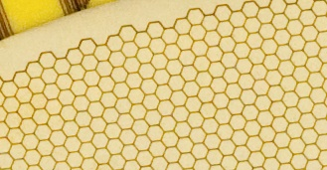
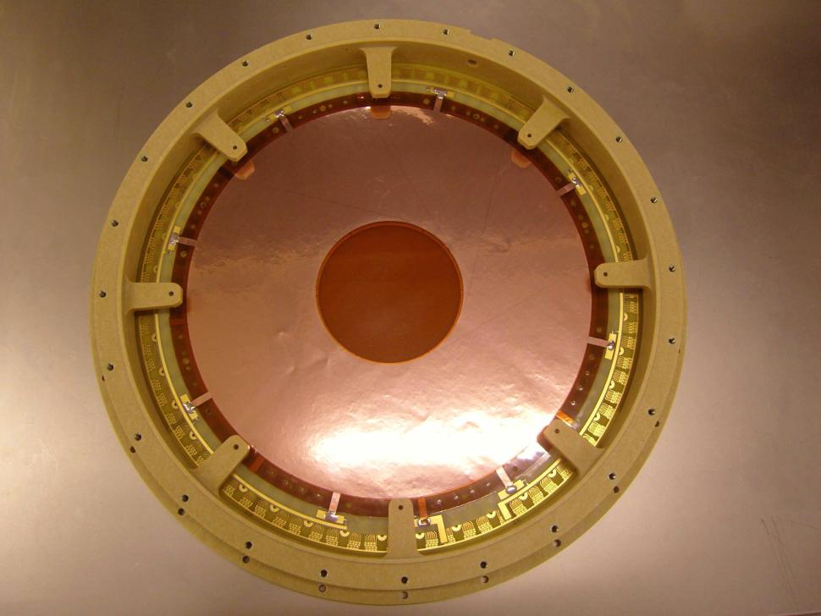
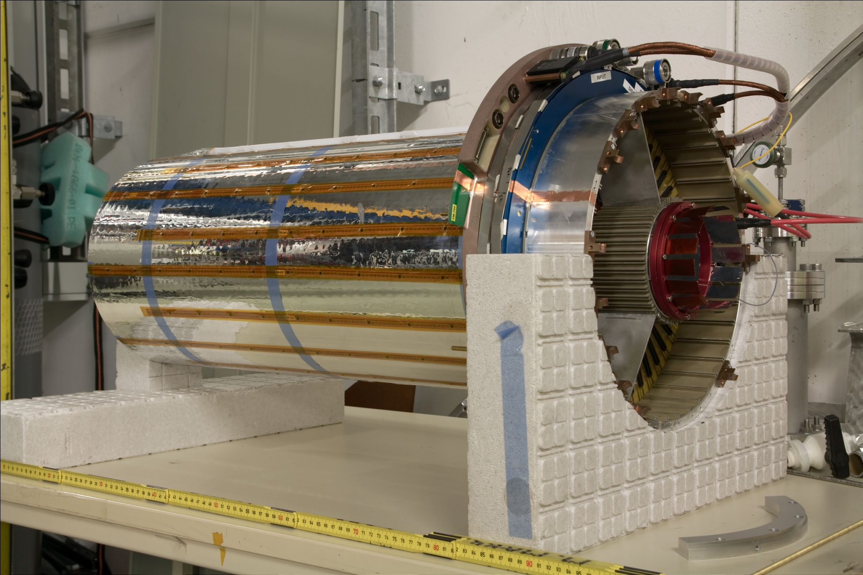
FOPI GEM-TPC
Light-weight field cage
Drift length 725 mm
Ø 105-300 mm
Triple GEM amplification
10254 ch., AFTER ASIC
Gas: Ar (Ne)/CO₂ (90/10)
[B. Ketzer et al., NIM A 732, 237 (2013),
M. Ball et al., arXiv1207.0013, 2012]
Notes:
Very thin FC walls: 4mm Kapton/Rohacell sandwich

Slide 30
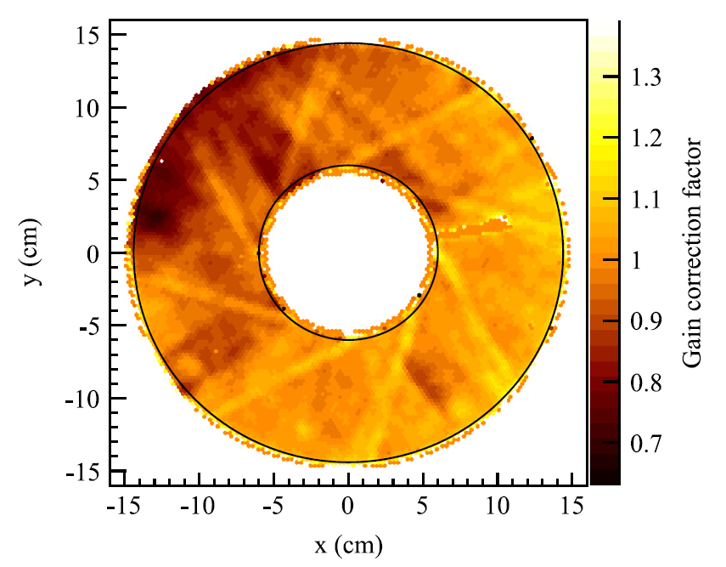
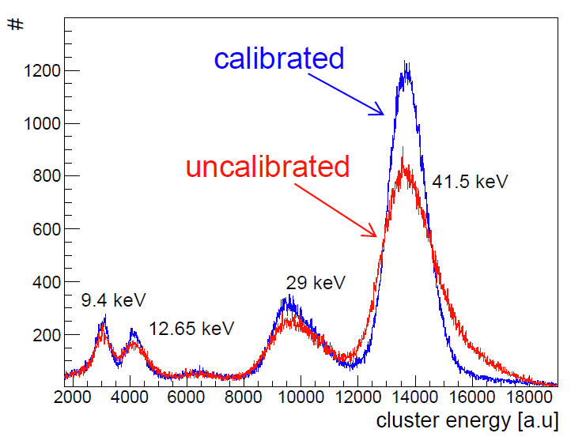


dE/dx Resolution
Gain equalisation using ^{83m}Kr:
  Main peak 5.1%
PID using dE/dx:
  Resolution ~ 18%
  in agreement with expectation
  no density correction yet
First dE/dx measurement
with GEM-TPC
[F.V. Böhmer et al., NIM A 737, 214 (2014)]

Slide 31



ALICE: The Space Charge Challenge
Ion blocking in GEMs not as efficient as with gating grid
ALICE Goal: IB = 1%, ε = 20 at G = 2000
$t_{d,ion}=160 \text{ms}$ ions from 8000 events in drift volume!
Distortions up to 19 cm in $r$ and 7 cm in $rφ$ (near drift cathode for small radii)
Well below 10 cm for the largest part of drift volume
Similar to STAR TPC at RHIC
to be corrected to the level of intrinsic resolution!

Slide 32





Ion Backflow – Rate Dependence
Ar/CO₂ (70/30)
Poisson equation:
For homogenous space charge density and parallel plate boundary conditions:
z
d
Expected after LS2: 5000 fC/cm²
drift

Slide 33






Charge Transfer in Single GEM
Need to understand charge transfer  simulations + measurements
similarly for back-drifting ions…

Slide 34



Ion Backflow
But: very little diffusion for ions
   beware of hole alignment: critical for IB!
Deliberate misalignment of holes difficult
Rotate foils by 90° to avoid long-range variations: Moiré pattern

Slide 35


Charging-Up of GEM Foils
Observed experimentally: initial increase of gain under irradiation
Generally ignored in simulations!
Attempt to study the effect in simulations:
  Calculate electric field
  Simulate gas avalanches
  Record charges ending up on insulator
  Add corresponding charge to electric field calculation
Result:
  Charge on insulator reduces losses
  Saturation reached after 3·106 eprim/hole
  Gain increases by ~30%

Slide 36



Ion Backflow – ALICE Solution
Triple-GEM setup not sufficient
New chambers: 4-GEM setup with standard (S) and large pitch (LP)
Field configuration optimized to provide
    IB < 1%
    σ_{E}/E < 12% (for ⁵⁵Fe X-rays)
    Discharge stability
Large pitch
Standard pitch
140 μm
280 μm

Slide 37





Ion Backflow – ALICE Solution
Triple-GEM setup not sufficient
New chambers: 4-GEM setup with standard (S) and large pitch (LP)
Field configuration optimized to provide
    IB < 1%
    σ_{E}/E < 12% (for ⁵⁵Fe X-rays)
    Discharge stability
Ion blocking:
GEM1: asymmetric field
GEM2/GEM3: geometric blocking
GEM4: asymmetric field

Slide 38



Charge Transfer in 4-GEM System
Simulation of charge transfer for 4-GEM system:
GEM1 (S)
$ε_{coll}=$ collection efficiency
$ε_{extr}=$ extraction efficiency
$M=G_{abs}=$ absolute gain
$G_{eff}=ε_{coll}×G_{abs}×ε_{extr}=$ effective gain
$n_{e−ion}=$ number of produced e-ion pairs
$n_{ion,back}=$ number of ions drifting back into
drift volume
GEM2 (LP)
GEM3 (LP)
GEM4 (S)

Slide 39

IB vs Energy Resolution
IB and energy resolution are anticorrelated when U_{GEM1} is varied
Goals have been reached, even with some margin for fine-tuning
Much larger phase space scanned  no significant improvement expected

Slide 40

ALICE TPC Upgrade

Slide 41



ALICE TPC Upgrade
87cm
114cm
47cm
50cm
Notes:
Detector to be operated in a completely new environment
single-mask technology
4-GEM stack
S-LP-LP-S

Slide 42



ALICE TPC Upgrade

Slide 43



Front-end Electronics
SAMPA ASIC:
Polarity opposite wrt MWPC
Continuous readout  simultaneous sampling and data transfer
Data throughput: $50 \text{kHz} ×100 \text{MB}\text{=5 }\text{TB}\text{/}\text{s}$ (of FEE, not written to disk)
Triggered mode for calibration
Digital filter for common mode correction in DSP

Slide 44
New Challenges
Larger active areas
  Bulk Micromegas
  Single-mask GEMs
Higher rates
Pixel readout
Ion backflow suppression
Aging, discharge protection
  Materials
  Multi-stage amplification
  Segmentation
  Resistive coating
Higher resolutions
  μPixel
  InGrid
Special shapes
  cylindrical
  spherical

Slide 45



KLOE-2 at DAΦNE
DAFNE: e⁺e⁻Φ, √s~m_{Φ}=1.02 GeV
Luminosity upgrade: 5 – 10 fb⁻¹/yr
DC wall
New inner tracker:
Reconstruction of K_{S} and η,η’ decays
σ_{rφ}~200 μm, σ_{z}~500 μm
Extremely light-weight: < 2% X₀
5 kHz/cm² rate capability
[KLOE-2 Inner Tracker TDR , arXiv:1002.2572]

Slide 46





C-GEM for KLOE-2
5 cylindrical triple GEM detectors:
no spacers
Ø=260 - 460 mm, L=700 mm
stretched at end caps
XV stereo strip readout (40°)
Pitch 650 μm
DC wall

Slide 47


C-GEM for KLOE-2
KLOE-2 Inner Tracker: Three layers of Triple-GEM detectors
SPATIAL RESOLUTION
(X: Bending Plane):
A. Balla et al, Nucl. Instr. and Meth. A732(2013)221

Slide 48





Spherical GEM
Elliminates parallax error
X-ray diffraction
Neutrons, photon
Thermoplastic heat forming
[S. Duarte Pinto et al., IEEE NSS Conference Record N11-1, 2009]

Slide 49
Conclusions
MPGD (GEM, MM) have matured to reliable detectors
Overcome drawbacks of wire-based detectors:
  rate capability, resolution, ion backflow,
  radiation hard
Big progress in last 5 years:
  large active areas: CMS, ATLAS, ALICE, Kloe-2 (cylindrical)
  microscopic understanding improved: charging-up, charge transfer
  discharge stability: multi-GEM, resistive coating
TPC with GEM allows for continuous readout  3D movie
What I did not cover:
new materials and geometries: THGEM, Glass, Ceramic, Graphene, …
mPixel readout, InGrid
photon detection
dual-phase TPC, electroluminescence, TPC-RICH, active-target TPC

Slide 50






Conclusions
MPGD: reliable detectors
Good resolution: t, x, E
High rate capability
Radiation hard
Ion backflow reduction
Photon feedback reduction
Inexpensive
Large active areas

Slide 51




Outlook
Future Experiments:
STAR
ATLAS, CMS (muon)
ALICE, COMPASS (RICH)
TOTEM (T1)
PANDA, CBM
ILC (TPC, DHCAL)
JLAB
- Inner Tracker & Vertex: gas
TPC: gas
Outer Tracker: gas
Calorimeters in outer region
RD51 (CERN):
~73 institutes worldwide
430 authors
Work packages
Test beam facility
http://rd51-public.web.cern.ch

Slide 52
Spare Slides

Slide 53




Electric Fields

Slide 54


GEM Manufacturing
50 μm Kapton
5 μm Cu both sides
Photoresist coating,
masking and
exposure to UV light
Metal chemical etching
Kapton chemical etching
Second masking
Metal etching,
cleaning, passivation
Notes:
Raw material: APICAL + vacuum deposited Cu (no glue)
Cu etching: FeCl3 + HCl
Kapton etching: Ethylendiamine (C2H8N2) + KOH

Slide 55


GEM Manufacturing
50 μm Kapton
5 μm Cu both sides
Standard GEM:70 µm Ø at 140 µm pitch
Photoresist coating,
masking and
exposure to UV light
Metal chemical etching
Kapton chemical etching
5 µm
70 µm
Second masking
55 µm
Metal etching,
cleaning, passivation
Notes:
Raw material: APICAL + vacuum deposited Cu (no glue)
Cu etching: FeCl3 + HCl
Kapton etching: Ethylendiamine (C2H8N2) + KOH

Slide 56



PixelGEM Readout Plane
Pixel plane: 2 layers (50μm)
Strip plane: 2 layers (50μm)

Slide 57

Readout Plane
x strips
y strips
pixels

Slide 58
COMPASS PixelGEM
High intensity muon beam: up to 1.2·10⁵ /mm²/s
σ_{x}=135μm
σ_{t}=7.3ns
[B. Ketzer et al., IEEE NSS Conference Record N12-5, 2007]
[A. Austregesilo et al., Nucl.Phys.Proc.Suppl.197:113-116,2009]

Slide 59


CMS Muon Chambers
Present Muon System:
  Drift Tubes
  Cathode Strip Chambers
  RPC
  no coverage for |η|>1.6
  (REi/1)
S-LHC: Requirements for REi/1 locations:
  L~10³⁴⁻³⁵ cm⁻² s⁻¹
  Flux: several 10 kHz/cm²
  Total integrated charge: several 10 C/cm²
  Triggering capability
Proposal:
triple GEM
990 × (220 - 455) mm²
[D. Abbaneo et al., RD51-Note-2010-005-1]

Slide 60


Performance of Single-Mask GEMs
Gain compatible with double-mask GEMs
Charging-up time seems to be slightly shorter
[M. Villa et al., arXiv 1007.1131v1]

Slide 61



The ALICE Detector
Main tracking device: TPC
${σ_{p}}/{p<7\%}$ at 10 GeV
-0.9 < η < 0.9
$σ_{dE/dx}=5\%$ (159 clusters)
Readout rate: 500 Hz (Pb-Pb)
Volume: ~ 90m³
Gas: Ne/CO₂(/N₂) (90/10/5)
Drift voltage: 100kV, 94μs drift time
72 MWPCs with 557768 readout pads

Slide 62

Discharge Studies

Slide 63




Quality Assurance
QA protocol has been developed:
HV „cleaning“ of foils to remove residual dust (production, transport)
Electrical characterization: leakage current, discharges (in dry gas!))
Precision optical scanning: defects, distribution of hole diameters
Gain mapping

Slide 64

Influence of Humidity
Mean and variance of Ileak (excluding ramping) for every sector
Strong dependence on humidity, often non-reproducible
Slightly lower currents after additional HV cleaning
Number of discharges increasing with humidity

Slide 65








Baseline Shift at High Rates
Strong capacitive coupling between anode pads due to GEM foil above
Consequence: common mode signal due to charges arriving on full pad plane
ALICE: $N=5500, C_{p}≈0.1 \text{pF}$
Conventional filter: moving average
  unstable: may fail
New non-linear filter: slope-based
  reliably follows baseline
Implemented on DSP of SAMPA chip

Slide 66


Reconstruction Strategy
Two-stage reconstruction scheme:
Cluster finding, cluster-to-track association: 5 TB/s  50 GB/s
  Scaled average space charge distortion map, $u_{d}$, gain eq.  $𝒪(1 \text{mm})$
Tracking, ITS-TRD track matching
  High-resolution space charge correction  $𝒪(200 \text{μ}\text{m})$ in $rφ$

Slide 67

Reconstruction Strategy
Notes:
Figure 7.17 shows the ITS-TPC matching effiency (left) as well as the transverse momentum resolution
(right) obtained from a full MC, implementing the remaining residual space charge distortions after
applying the calibration procedure described in Sec. 8.4.
The matching efficiency is above 95% for all momenta. For standalone TPC tracks (red), the pT resolution is slightly worse than the one obtained without distortions (see also Fig. 7.6), while for TPC tracks constrained to the interaction vertex (blue) and tracks matched to the ITS (black) the performance is practically the same as for the ideal case without space-charge distortions

Slide 68




Neutron Detection with GEM
CASCADE
Coating of GEMs with 1-3 μm ¹⁰B
¹⁰B+ng⁷Li+α
Stack of 8 coated GEM foils
efficiency 23% at 2.5Å
Rate capability > 2.7 MHz/cm²
Time resolution < 1μs
Spatial resolution 4mm
[http://www.physi.uni-heidelberg.de/physi/cascade/]

Slide 69



Cobra
[A. Lyashenko et al., NIM A 598 (2009) 116–120]
reached
problem of IB completely eliminated!
to be studied: e- transparency, size

Slide 70
New Challenges
Larger active areas
  Bulk Micromegas
  Single-mask GEMs
Higher rates
Pixel readout
Ion backflow suppression
Aging, discharge protection
  Materials
  Multi-stage amplification
  Segmentation
  Resistive coating
Higher resolutions
  μPixel
  GridPix
Special shapes
  cylindrical
  spherical

Slide 71



MPGD readout by Pixel ASIC
Ultimate resolution:
Only diffusion-limited
Granularity = primary ionization
cluster spread: pixel size < 100μm
CMOS ASIC: 2100 pixels, 80μm
[R. Bellazzini et al., NIM A535, 477 (2004)]
`Naked’ CMOS pixel chip:
charge collecting pad
preamplifier, shaper
discriminator / sample&hold
data readout (MUX)
MediPix2 / TimePix: 65k pixels, 55μm
[X. Llopart et al., TNS 49, 2279 (2002)]
Resolve individual clusters!
pattern recognition & track
fitting in dense environment
dE/dx resolution for TPC

Slide 72


The Electronic Bubble Chamber
Setup:
Triple GEM
He/CO₂ or Ar/CO₂
TimePix
TOT + Time info
14 mm
[A. Bamberger, NIMA 573, 361 (2007)]

Slide 73


InGrid
Integrated Micromegas and Pixel Sensor
(Si wafer post-processing & MEMS)
Deposit anode
Deposit SU-8
photoresist
UV exposure
Deposit metal
Insulating
pillars
Pattern metal
Develop resist
[J. Timmermans, VCI 2007]
Notes:
MEMS: Micro electro-mechanical systems
holes aligned to readout pads
support pillars in between

Slide 74
Discharge Protection
Deposit of resistive layer on pixels
Double amplification
 local reduction of E field
20 μm a-Si, ρ=2 10⁸ Ω cm
7 μm Si₃N₄, ρ=10⁸-10¹⁵ Ω cm
SiNProt
Notes:
Discharges:
evaporation of surface structure of chip due to hot plasma
too large input charge damaging the pixel circuitry

Slide 75

InGrid TPC for ILD

Slide 76



GridPix
Drift gap ~ 10-20 mm
Recording of arrival time  3D track image
Small drift distance  minimize diffusion
Small capacitive load: < 10 fF
No leakage currents
 low noise: < 100 e-

Slide 77


Gossip
Gas on Slimmed Silicon Pixels
Reduced drift gap: 1 – 1.2 mm
 collection of e⁻ within 25 ns
No radiation damage of detection
medium (gas is exchanged)
Small amount of material
Probability for δ-e⁻ small
Low sensitivity to neutrons and X-rays
Proposal for Gaseous Pixel Detectors
for the ATLAS Inner tracker at the sLHC
[H. van der Graaf, F. Hartjes, A.-P. Colijn, ATL-P-MN-0016]

Slide 78

Photon Detection with THGEM

Slide 79

Graphene on GEM

Slide 80


TPC-RICH for sPHENIC, EIC
[C. Woody et al.]

Slide 81

Dual-phase TPC

