Slide 1
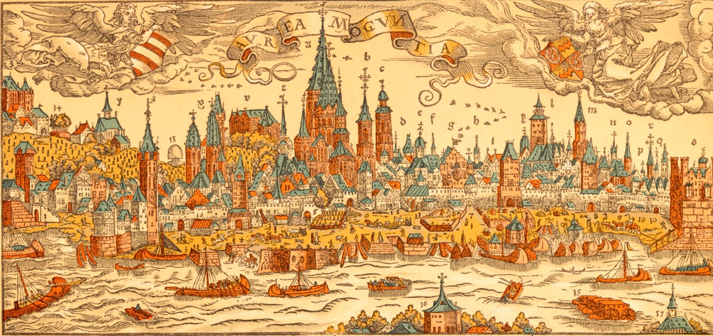

New Vistas in Low-Energy Precision Physics
LEPP16: Summary
Kees de Jager
LEPP16 Workshop
Kupferberg, Mainz, April 4-7, 2016

Slide 2
Introduction
Impossible to summarize 50 talks in 30 minutes
Very limited selection with strong personal bias
Stolen (and mangled) many slides from presentations
Apologize in advance for offending speakers by ignoring them, disagreeing or whatever
Having said that, thoroughly enjoyed myself listening to fascinating presentations

Slide 3
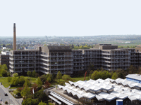
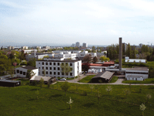
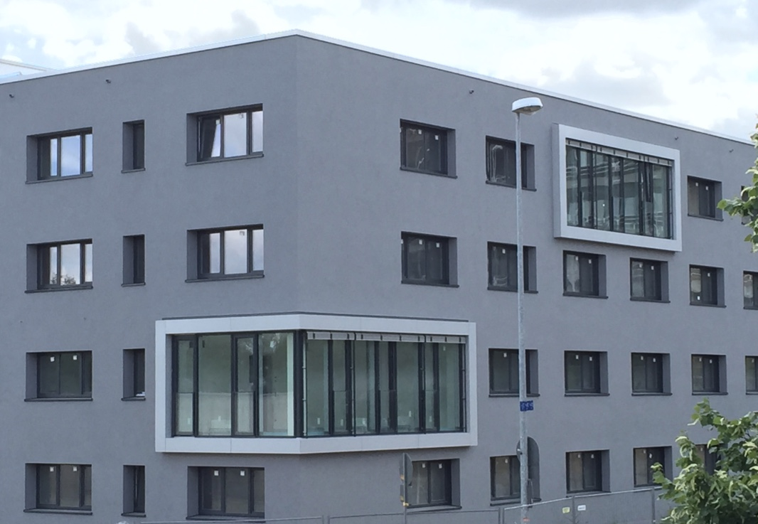
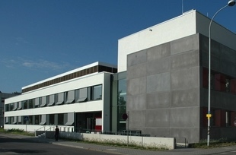
Cluster of Excellence PRISMA
Participating institutes:
Research Areas:
A: Fundamental Interactions
B: Origin of Mass and Physics
beyond the Standard Model
C: Structure of Matter
D: Theoretical Concepts and
mathematical Foundations
Physics, Mathematics
Nuclear Physics
Helmholtz Institute Mainz
Nuclear Chemistry
Structural Initiatives:
Electron Accelerator MESA
TRIGA Reactor and User Facility
Mainz Institute for Theoretical Physics
Detector Laboratory
★
Precision Physics, Fundamental Interactions and Structure of Matter

Slide 4
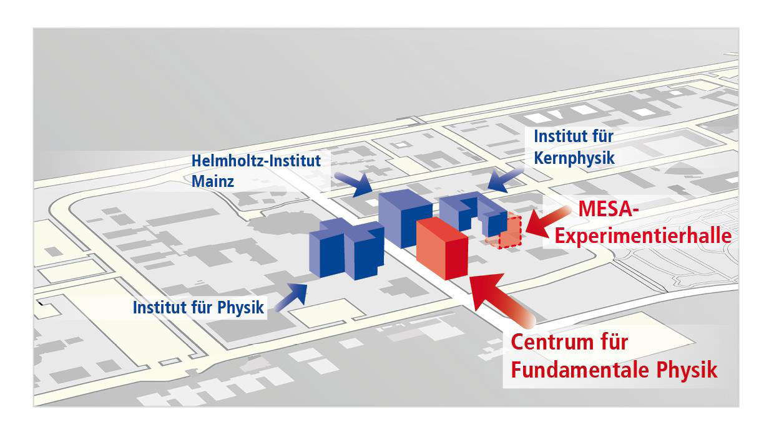
Centre for Fundamental Physics (CFP) Research Building
Construction phase:
2018 – 2020
Underground experimental hall 260 m²
Costings:
Office and laboratory building, 3352 m²
  47% office space (coordination, new research groups)
  Meeting rooms and laboratories for Detector Lab
  Laboratories for new research groups
  Lecture hall for MITP
Underground hall | € 17m
Equipment | € 10m
Construction CFP | € 34m
Total: | € 61m

Slide 5
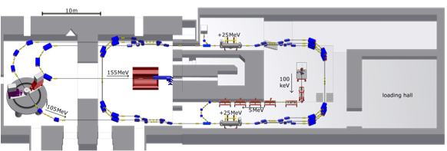


Low-energy precision physics at Mainz
Kurt Aulenbacher
MESA — “Mainz Energy-Recovering Superconducting Accelerator
Beam energy: 105 MeV / 155 MeV
Current: 1–2 mA
P2
Superconducting cavities
Completion of construction delayed until middle of 2020
Allows optimization of research program and of design and delivery contracts

Slide 6
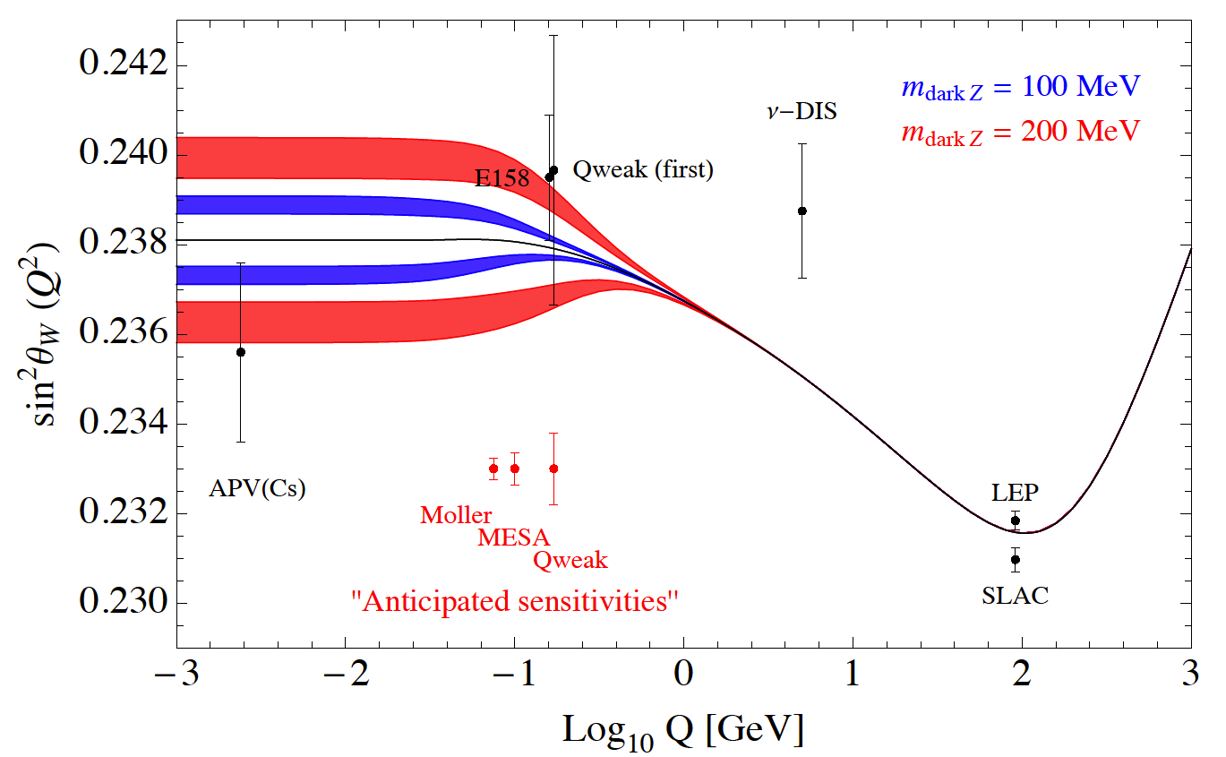
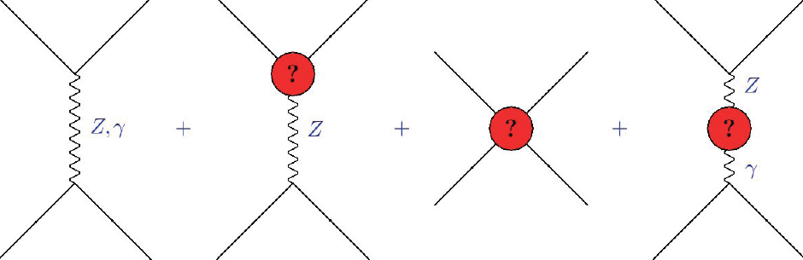
Precision parity violation program P2
SM: universal quantum corrections leads to
a scale dependent, „running“ sin²θW(Q)
Marciano
Sensitivity to new beyond SM physics:
extra Z
mixing with dark Z
contact interactions
new fermions
P2@MESA: 0.13% measurement of sin²θW
Λ_{new} ≈ 49 TeV
contact int:
Λ_{new} ≈ 17 TeV (E158@SLAC)
exceeding scale accessible in direct LHC searches, complementary with precision searches @ LHC
Nik Berger

Slide 7
P2 Detector
INTEGRATING
CERENKOV
DETECTOR
SOLENOIDAL MAGNET
SHIELDING
H TARGET
Design progressing
Full MC under
development
Detector prototypes
being tested with beam

Slide 8
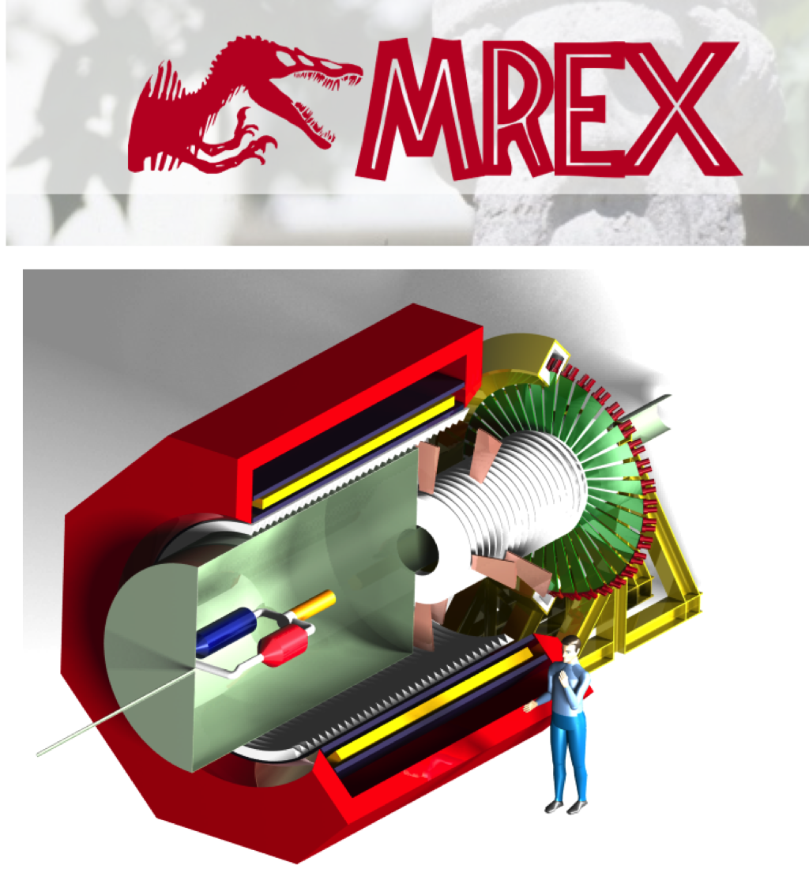
Neutron Skin Studies
Concettina Sfienti
use parity violation to extract the neutron skin of nuclei
No truly model-independent method,
except for maybe PV (weak charge of proton ~ 0, neutron = 1)
Choices to be made:
Nucleus (Pb, Ca isotope series)
Run at several Q²
What is neutron skin?
Difference in radius?
Radius of what? matter?
Full azimuthal coverage 4 x stat
1440 hrs -> δR_{n}/R_{n} = 0.5%

Slide 9
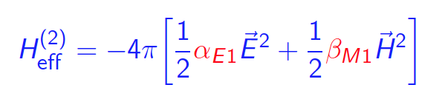
Proton Polarizabilities
Reaction of nucleon under influence of an EM field
<--> Compton scattering
provides fundamental information on the nucleon;
very sensitive test of theories (H/BχPT, Disp. Rel.).
Electric Polarizability: α_{E1}
Magnetic Polarizability: β_{M1}
Spin (Vector) Polarizabilities: γ_{E1E1}, γ_{M1M1}, γ_{M1E2}, γ_{E1M2}
Ongoing program at MAMI to reduce the error on the magnetic polarizability β
by a factor of 2 using spin observables

Slide 10
Nucleon Polarizabilities
Judith McGovern
Detailed review of analysis of Compton scattering to extract electric and magnetic
polarizabilities of proton and neutron using Chiral Perturbation Theory and
Dispersion Relations

Slide 11
Nucleon Spin Polarizabilities
David Hornridge and Rory Miskimen
presented the new MAMI data on several nucleon spin polarizabilities
Good progress on development of active polarized target
Goal is to determine all four spin polarizabilities
Σ₃
Σ_{2x}

Slide 12
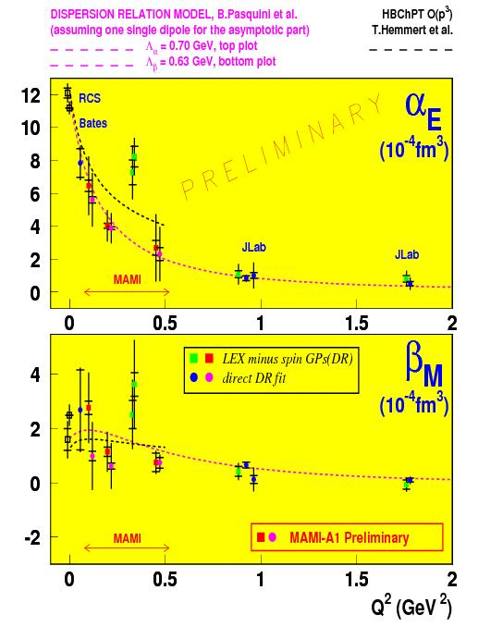
Virtual Compton Scattering
Helene Fonvieille
Electric and magnetic GPs with the new MAMI data
Q²=0.1 and 0.45 GeV² are still first-pass (preliminary)
Another measurement of α_{E}(Q²) soon to come out at Q²=0.2 GeV²:
« vcsDelta » experiment at Mainz
(N. Sparveris et al.)
data taken in 2013
W= Δ(1232) region
PhD Thesis of A.Blomberg (Temple U.)
Asymmetry between (cross section at θ =180º and at θ = 0º) + use the DR model (extracts also the CMR of N -> Δ transition).
Is this physical or not ?

Slide 13


Low-energy precision physics at Mainz
MESA — “Mainz Energy-Recovering Superconducting Accelerator
MAGIX
Beam energy: 105 MeV
Current: 1–2 mA

Slide 14
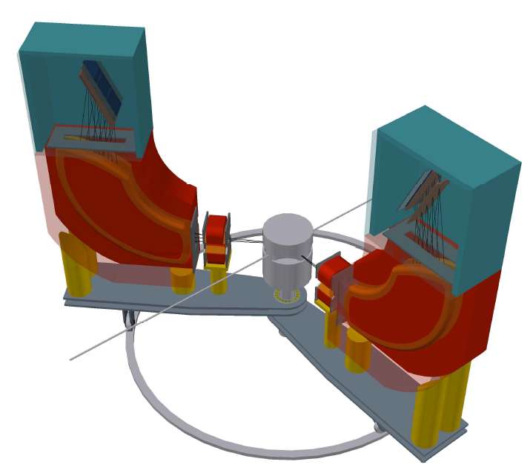
The MAinz Gas Internal Gas EXperiment
Operation of a high-intensity ERL beam
in conjunction with a light internal target
a novel technique in nuclear and particle physics
for physics at the low-energy frontier of the Standard Model
windowless
internal gas
target
High-resolution spectrometers MAGIX:
double arm
compact design
momentum resolution: Δp/p < 10⁻⁴
acceptance: ±50 mrad
GEM-based focal plane detectors
Gas Jet or polarized T-shaped target
1 mA
ERL beam
Sabato Stefano Caiazza

Slide 15
Gas Targets for MAGIX
Alfons Khoukaz
Production of Gas-Jet Beams
Expansion of gas through Laval nozzles into vacuum
Production of supersonic jets
High target thickness directly behind nozzle E.g. 10¹⁹ atoms/cm³
  Formation of typical node structure
But:
  Target thickness decreases rapidly with distance from nozzle
  Gas beam strongly expands in lateral direction
  High pumping speeds required
Production of Cluster-Jet Beams
Expansion of croygenic gas/liquid through a fine (e.g. Ø 30 µm) Laval nozzle
Condensation of gas or spraying of the liquid
  formation of nano- to micro-meter sized particles
  quasi-homogeneous beam

Slide 16
Gas Targets for MAGIX
Silke Grieser
Design can be used as gas or cluster jet
Target can be ready in the summer of 2016

Slide 17
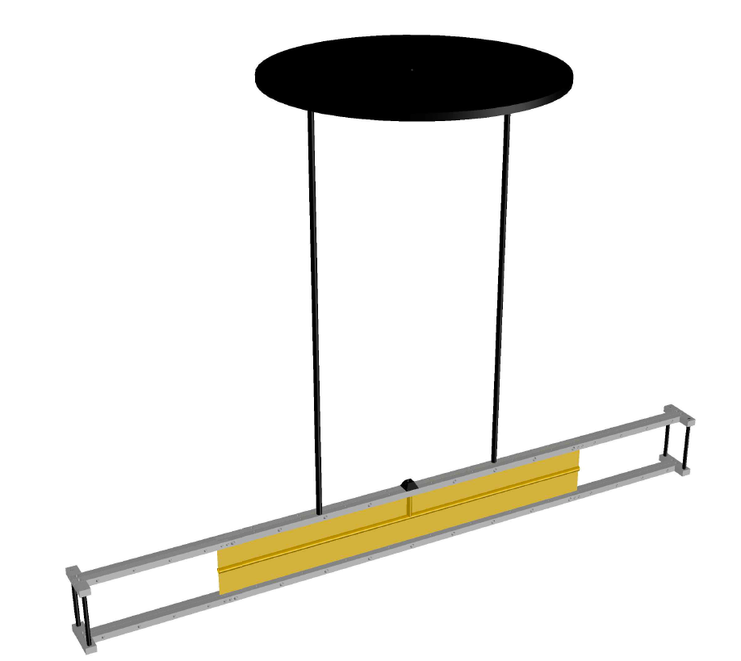
Target Layout
Beam
Thin-foil tube
Moderate gas density $O\left({{10}^{22}}/{m^{3}}\right)$
Moderate gas density 𝑂(〖10〗^22∕𝑚^3 )
Length (~ 30 cm)
Jet Target
Supersonic gas jet
O(mm) target length
Higher gas density $O\left({{10}^{26}}/{m^{3}}\right)$
Higher gas density 𝑂(〖10〗^26∕𝑚^3 )
Estimated luminosity with polarized beam $O({10}^{32} cm^{−2}s^{−1})$
Estimated luminosity with polarized beam 𝑂(〖10〗^32 𝑐𝑚^(−2) 𝑠^(−1))
Estimated luminosity $O({10}^{35}cm^{−2}s^{−1})$
Estimated luminosity 𝑂(〖10〗^35 𝑐𝑚^(−2) 𝑠^(−1))
To be used with polarized gases
Notes:
The target system is a multi stage evacuation system which will bring the vacuum quality to that typical of the beam pipe of (what is the density in the pipe).
The inner target will be placed in a first expansion chamber connected to a set of powerful root pumps. The first chamber is then connected to 3 more pumping stages.
In the inner part, the target will be made of a thin mylar foil with the inner part shaped as a pipe of (which diameter)
3D rendering from Comsol?
Photo of the target mockup and 3d rendering of the target system
Scheme of the pumping system with the number density in the pipe between the stages

Slide 18
Focal Plane detectors
Gas detectors
Low material budget
Low cost for large area coverage
Micro Pattern Gas Detectors
Resolution of the order of 50 μm achieved by several detector groups
Gas Electron Multiplier
Modern gas amplification systems
Thin kapton foil coated with copper and pierced by microscopic holes
Gas amplification in the holes
2 Layer Hodoscope
Short drift TPC
Simple detector to build
Uniform and high position resolution
Moderate material thickness
Only 2 reconstructed points
More delicate to optimize
Worse single point resolution
Minimal material thickness
Multiple samples and full track reconstruction possible

Slide 19
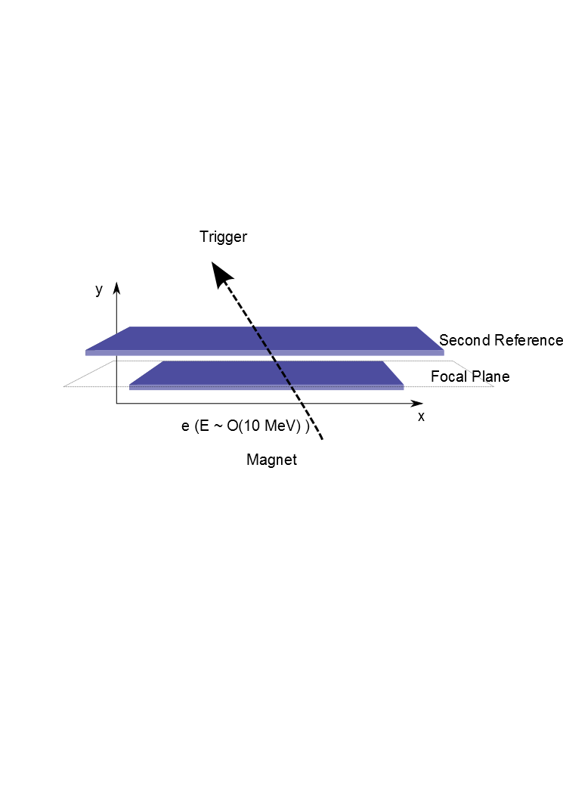
Hodoscope Tracker
Sabato Stefano Caiazza
Two Sensitive layers
Reliable design
Optimization
The first centered on the focal plane
The second with a sizeable lever arm to measure the angle
2 or 3 GEM
2D Strip read-out
Small drift
Thin coated GEMs
Foil-based readout plane
~ 0.7% radiation length
Material reduction to improve angular measurement

Slide 20
MAGIX Physics Progam
Precision Experiments in the fields of:
Electromagnetic Form Factors of both Nucleons
Nucleon Polarizabilities
Few-Body Physics
Nuclear Reactions with Astrophysical Relevance
Searches for Particles of the Dark Sector
- ….
Notes:
Let me briefly discuss the physics program of MAGIX
We have identified the following applications, which are spanning a relatively wide range from nuclear physics to particle physics searches BSM.
In this talk I will not dwell on the Few Body and Nuclear Physics aspects as they need to be further worked out and as
We would like to discuss these aspects at this workshop

Slide 21
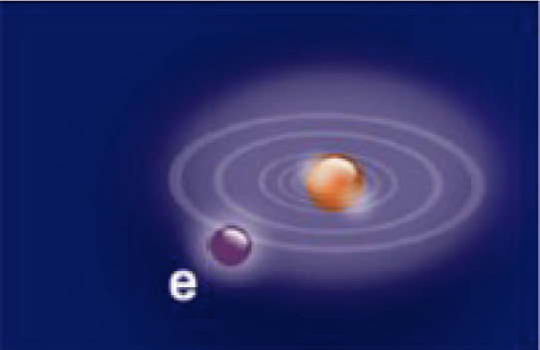
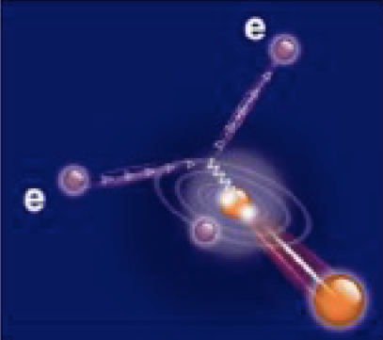


Proton Radius Puzzle
Atomic Spectroscopy
(HFS, Lamb-Shift in electronic / muonic systems)
Pohl et al.
[Nature 2010]
Antognini et al.
[Science 2013]
Lamb Shift
μH :
p
R_{E} = 0.8409 ± 0.0004 fm
e/µ
7σ difference
R_{E} = 0.8770 ± 0.0045 fm
ep-Data &
Electronic Spectroscopy:
p
CODATA
Bernauer et al.
[A1] (PRC 2014)
Electron Scattering on the proton
(EM form factors, low Q²)

Slide 22
“Solving” the proton radius puzzle
Everybody has confidence in the muonic Lamb shift results
This implies that the results of both electron scattering and
of the atomic Lamb shift have to be moved
Jan Bernauer showed that
  Normalization error hardly affects the extracted radius
  Neglecting higher-order terms in a “Taylor-expansion” can shift radius by 0.04 fm
  “kink” at very low Q² will probably not affect radius
Bottom line:
In stead of investing efforts in testing different fits and/or fit regions of existing data, recheck:
radiative corrections, detector efficiencies, target foil backgrounds and possibly the effect of the magnetic form factor
Most importantly, need new data
Hall A, PRad, ISR with gasjet, MAGIX, …

Slide 23
Magnetic Form Factor
Up-Down structure
not seen in older fits
Gives rise to small r_{m}
Sensitive to radiative corrections
Force the form factor to gradually rise to 1 and
investigate the effect on the charge radius
Take accurate data

Slide 24
Electronic Lamb shift
Possible systematic errors in atomic spectroscopy (Carl Carlson)
Near-term outlook

Slide 25
BSM resolution?
Carl Carson presented the possibility of the break-down of lepton universality
A new particle coupling to muons and protons, but hardly to electrons
A light (~1 MeV) scalar particle might work
Would also be compatible with muonic Lamb shift on He
Such a particle would be observable in the TREK experiment at JPARC
So hold your breath until then!

Slide 26
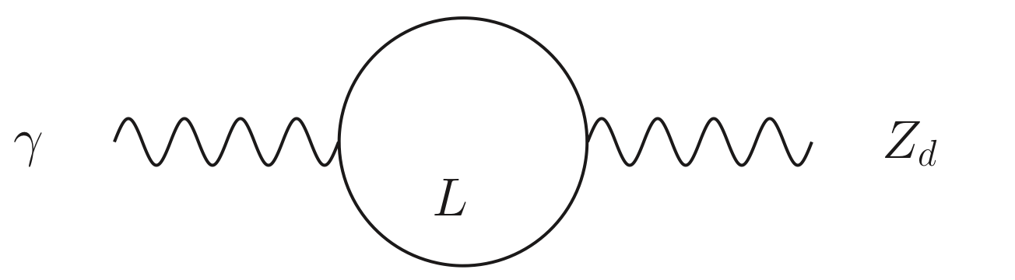
Dark photon / dark matter searches
light dark sector: could explain astrophysical anomalies:
e⁺ excess in cosmic ray flux
Holdom (1986),...
e⁺
DM
Dark
Sector
U(1)_{d}
γ’
γ
Standard
Model
Sector
U(1)
Heavy Charged Leptons L
(carry U(1)_{d} charge)
e⁻
DM
Dark Photon
(aka A‘, U, Z_{d}, ...)
Excellent overview by Maxim Pospelov
HPS has taken first data, looking good (Maurik Holtrop)
DarkLight funded, taken first test data (Ross Corliss)
BDX LOI supported by JLab PAC, preparing proposal for PAC44
Needs 1 M$+ from JLab + 1 M$+ for detector (Marco Battaglieri)
(could also run at MESA for much less $)

Slide 27
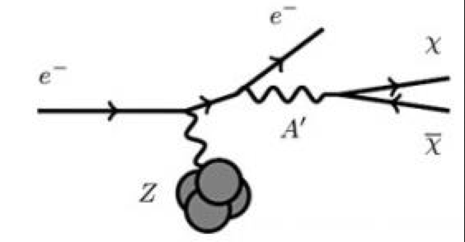
Dark Sector Searches at MESA
Harald Merkel
MAGIX / MESA
Model 1: Dark Photon coupling to SM particles
→ parameter range motivated by Dark Photon relation to Dark Matter
Model 2: Dark Photon coupling to Dark Matter
→ could still explain (g-2)_{µ} discrepancy
→ exploit excellent momentum resolution
of MAGIX (proton recoil!)
Model 2: Dark Photon coupling to Dark Matter
→ could still explain (g-2)_{µ} discrepancy
→ exploit excellent momentum resolution
of MAGIX (proton recoil!)
Option 3: Direct Search for Dark Matter → Beam Dump Experiment (BDX)

Slide 28
Conclusions
Very active program with MAMI-C (SFB1044)
  Nucleon FF (proton radius puzzle)
  Few-body systems
  Nucleon polarizabilities
PV experiments with MESA (P2, neutron skin)
Impressive technological developments for MAGIX spectrometer
  Spectrometer design
  Gas Target
  Detectors
Need impetus for development of experimental program with MAGIX
Look forward to follow-up workshops focused on MAGIX
Many thanks to
Achim Denig and Marc Vanderhaeghen
and their supporting staff
for a highly enjoyable workshop

Slide 29
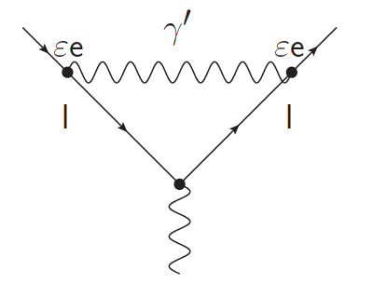
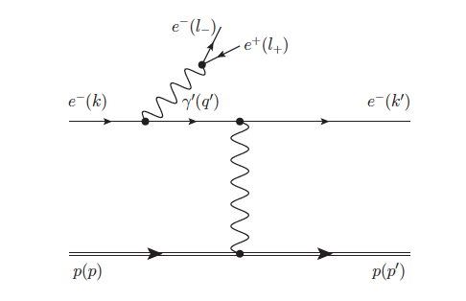
Dark photon / dark matter searches
light dark sector: could explain astrophysical anomalies:
e⁺ excess in cosmic ray flux
possible explanation for (g-2)_{μ}
Holdom (1986),...
e⁺
DM
Dark
Sector
U(1)_{d}
γ’
γ
Standard
Model
Sector
U(1)
Heavy Charged Leptons L
(carry U(1)_{d} charge)
e⁻
DM
Dark Photon
(aka A‘, U, Z_{d}, ...)
red band: (g-2)_{μ}
Bjorken et al.(2009)
Dark Photon as explanation for
(g-2)_{µ} (almost) ruled out !
… at least in most straight-forward model
Low-mass/low-coupling range will be covered by JLab, MESA,… expts.
Year 2015

Slide 30
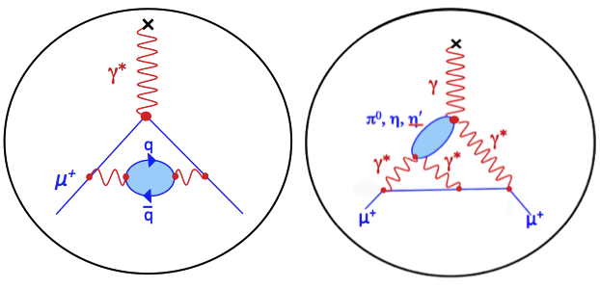
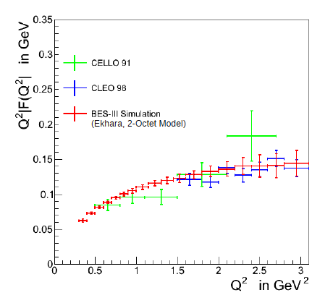
Muon magnetic moment: (g-2)_{µ}
a_{μ}^{exp} – a_{μ}SM = (28.7 ± 8.0) · 10⁻¹⁰ (3.6 σ)
New FNAL (g-2)_{μ} expt. (2016):
δ a_{μ}^{exp} = 1.6 x 10⁻¹⁰
P5 panel (2014): flagship expt.
hadronic vacuum polarization
hadronic light-by-light scattering
e⁺ e⁻ -> π⁺ π⁻ : most relevant channel for (g-2)_{μ}
0.9% total systematic uncertainty achieved
Dominant region covered by BESIII
Interplay exp – theory (dispersion, lattice)

