Slide 1
Gases, Clusters and Pellets:
Jet Targets for Accelerator Experiments
New Vistas in Low-Energy Precision Physics (LEPP)
Kupferbergterrasse Mainz, April 4-7, 2016

Slide 2
Typical Requirements on Internal Targets
Target material: H₂, D₂, N₂, Ne, Ar,..., Xe
  Hydrogen as proton target for elementary reactions on the nucleon
  Deuterium as deuteron or effective neutron target
  Heavier gases (N₂, Ne, Ar, ..., Xe) for interactions with large nuclei (high A, Z)
Pure target material without unwanted elements
  Windowsless, no target holder, ...
Pointlike interaction zone
Homogeneous spatial target density
Target thickness constant in time
  No time structures
  DAQ system ↔ dead time

Slide 3
Typical Requirements on Internal Targets
Continously adjustable target thickness
  Optimum event rates for individual experimental situation
  Compensation of beam consumption → constant event rate
Target should be compatible with a close to 4π detector
The best target type depends on
  the experimental setup (detector, accelerator, DAQ, ...)
  the experimental program
  the required event rate (luminosity, cross section, ...)
Highly suited and well established:
Cluster targets, gas jet targets, pellet targets

Slide 4
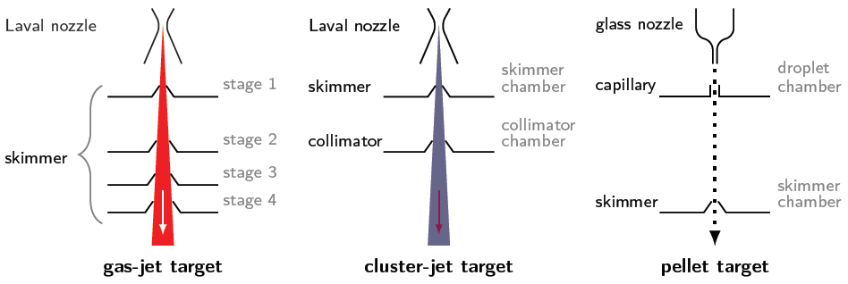
Production of Gas, Cluster and Pellet Beams

Slide 5
Production of Gas, Cluster and Pellet Beams
dN/dm
10⁰
10²
10⁴
10⁶
10⁸
10¹⁰
10¹²
10¹⁴
10¹⁶
Mass distribution

Slide 6
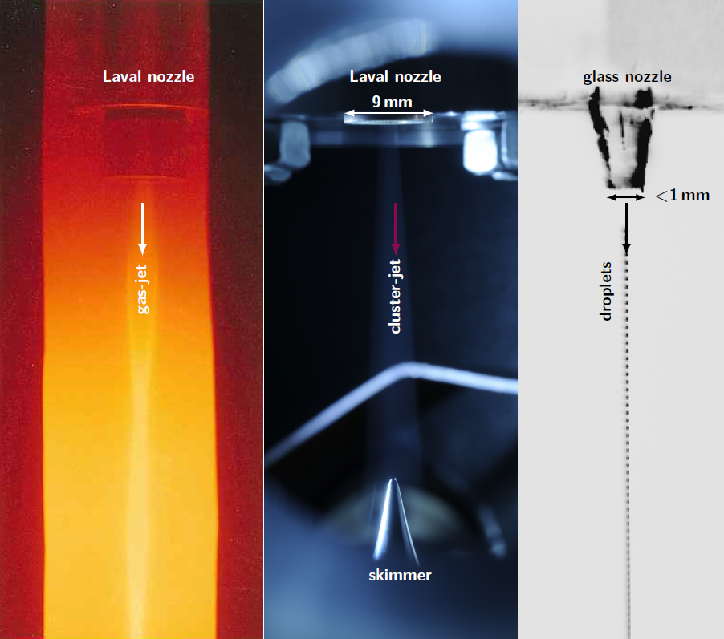

Slide 7
Gas Jet Beams

Slide 8
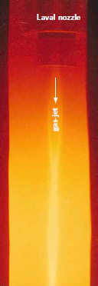
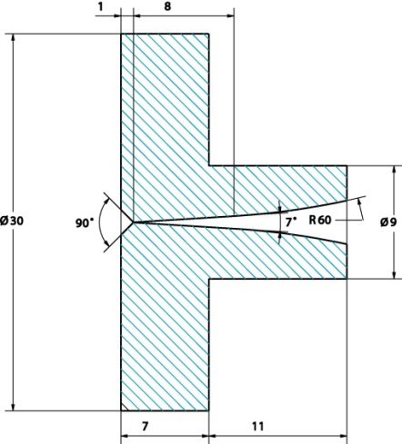
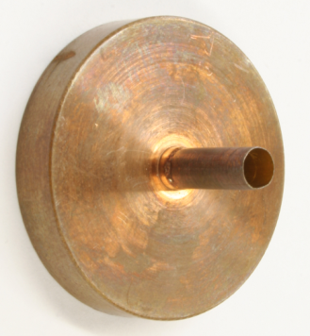
Production of Gas-Jet Beams
Expansion of gas through Laval nozzles into vacuum
Production of supersonic jets
High target thickness directly behind nozzle
  E.g. 10¹⁹ atoms/cm³
  Formation of typical node structure
But:
  Target thickness decreases rapidly with distance from nozzle
  Gas beam strongly expands in lateral direction
  High pumping speeds required

Slide 9
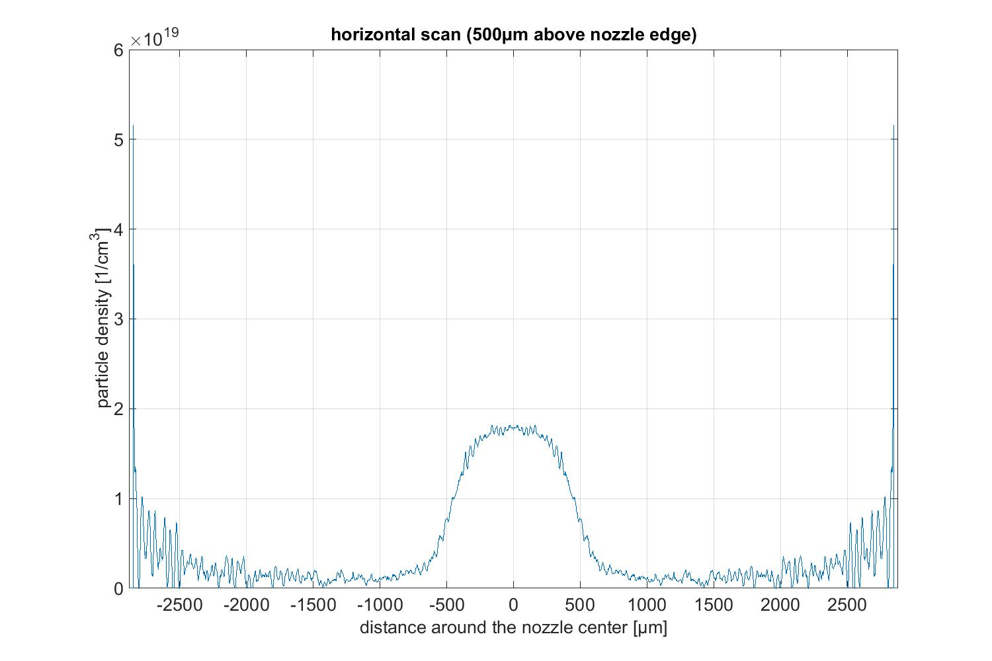
Gas Jet Beams
Argon (293 K, 17 bar)
Nozzle: d_{min} = 0.5 mm
d_{out} = 1.0 mm
d_{max}
d_{min}

Slide 10
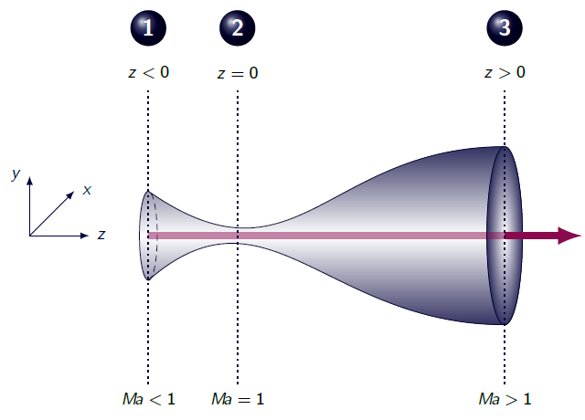
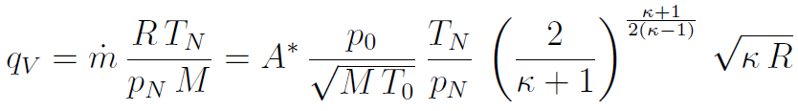
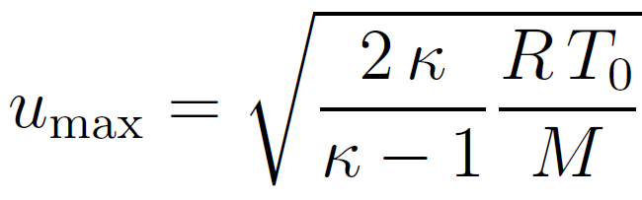
Gas Target Thickness Variation
Gas input pressure p₀ variation
  target thickness changes within e.g. one order of magnitude
  thickness variation typically within seconds possible
Gas starting temperature T₀ variation
  thickness changes within several orders of magnitude
  slow process (typically within minutes)

Slide 11
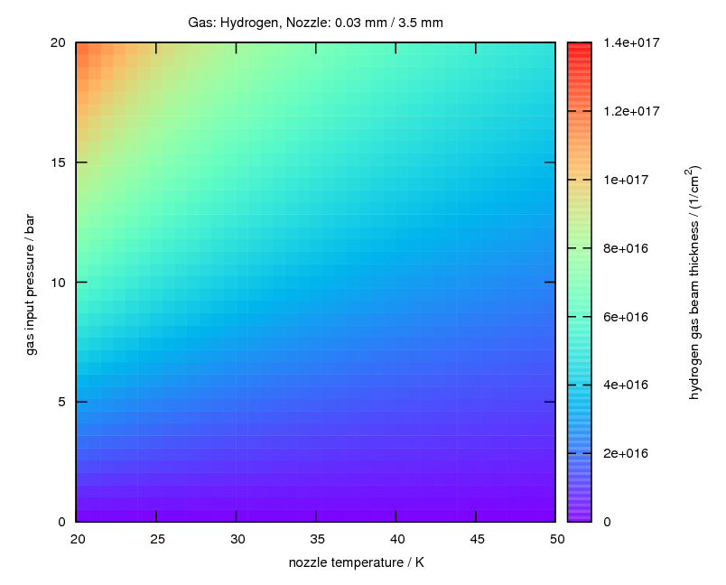

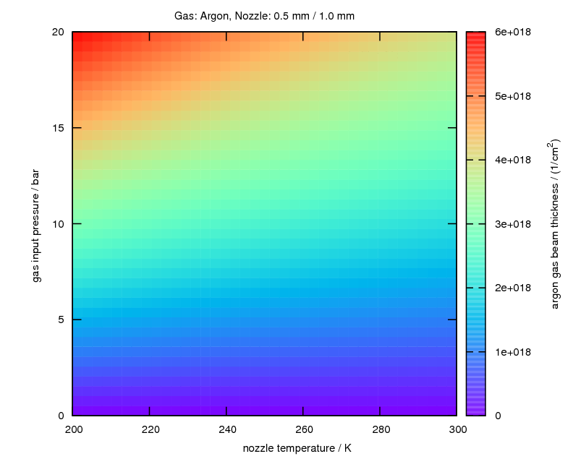
Gas Target Thickness Variation
Numerical calculations:
Target thickness direcetly above nozzle exit
O(10¹⁷) atoms/cm²
O(10¹⁹) atoms/cm²
O(10¹⁹) atoms/cm²
Hydrogen
Nozzle: d_{min} = 0.03 mm,
d_{max} = 3.5 mm
Hydrogen
Nozzle: d_{min} = 0.3 mm,
d_{max} = 3.5 mm
Argon
Nozzle: d_{min} = 0.5 mm,
d_{max} = 1.0 mm

Slide 12
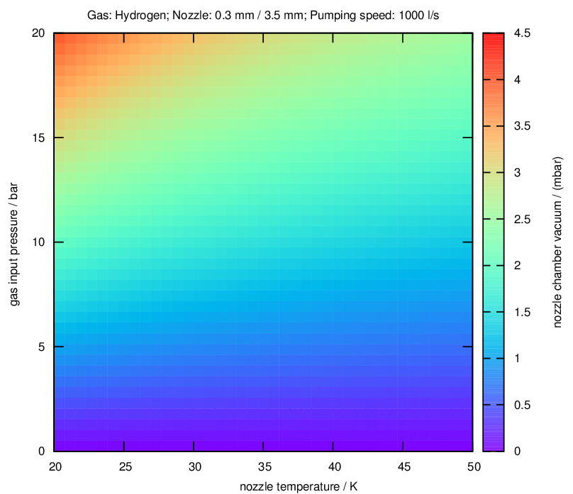
Gas Flow and Vacuum Conditions
Target thicknesses and vacuum conditions, assuming a pumping speed of 1000 l/s in the nozzle chamber

Slide 13
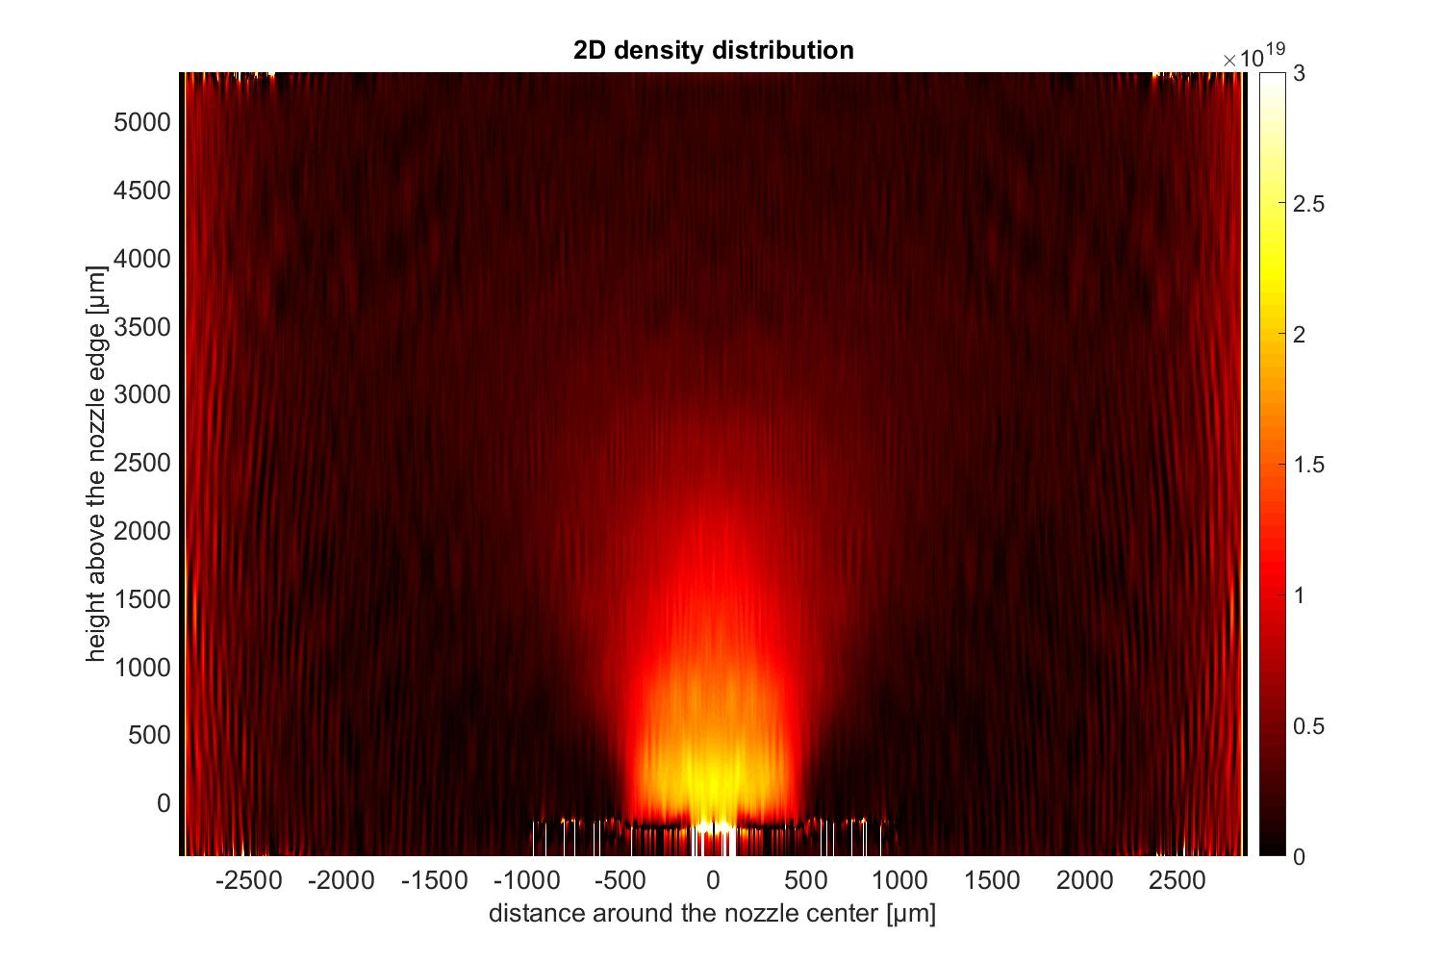
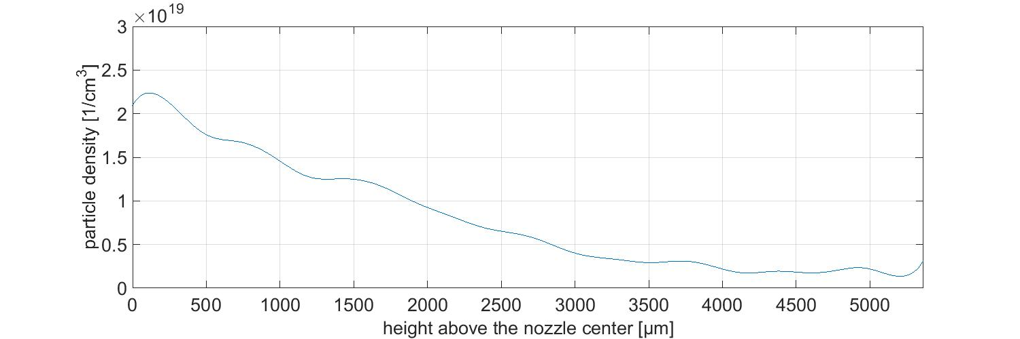
Gas Jet Beams
Argon (293 K, 17 bar)
Nozzle: d_{min} = 0.5 mm
d_{out} = 1.0 mm
4 mm!

Slide 14
Cluster Jet Beams

Slide 15
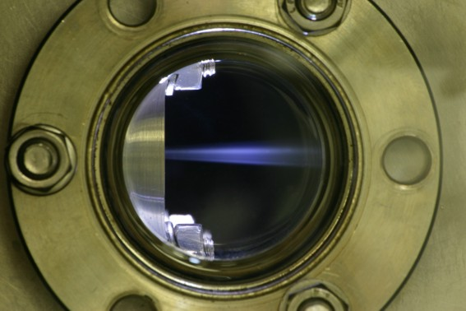
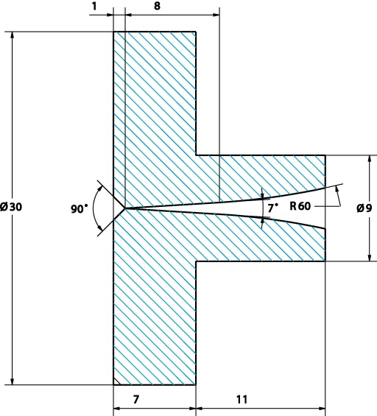

Production of Cluster-Jet Beams
Expansion of croygenic gas/liquid through fine (e.g. Ø 30 µm) Laval nozzles
Condensation of gas or spraying of the liquid
  formation of nano- to micro-meter sized particles
  quasi-homogeneous beam

Slide 16
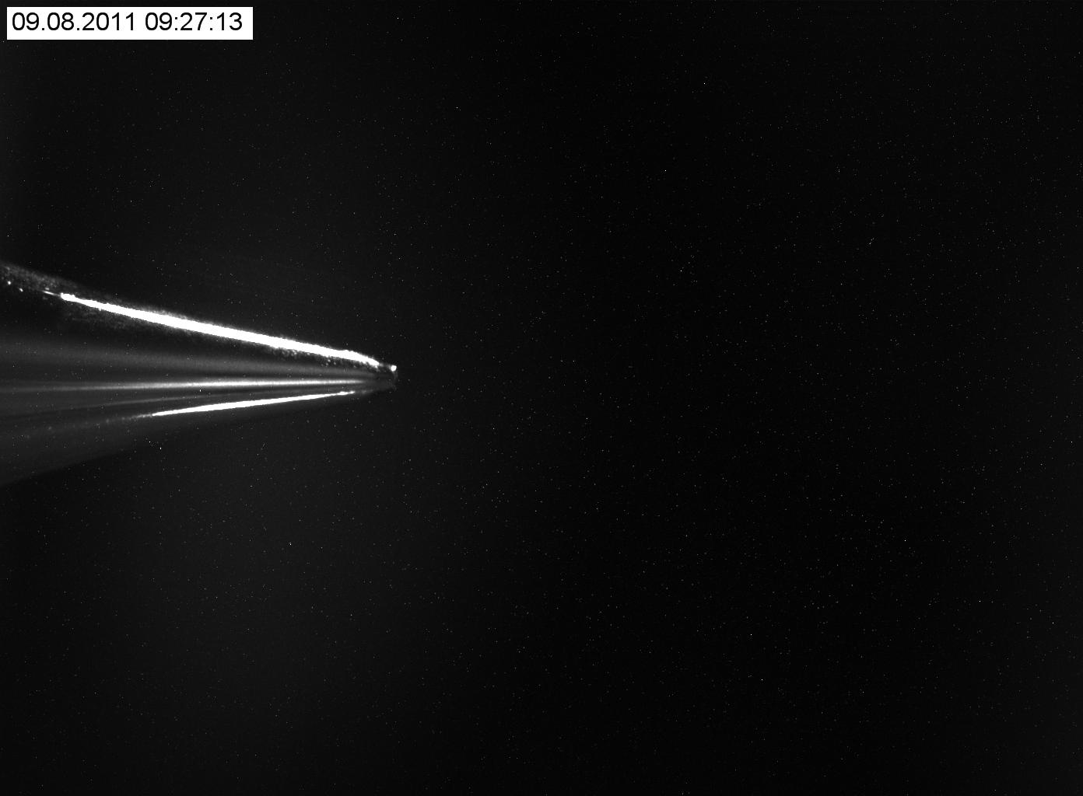
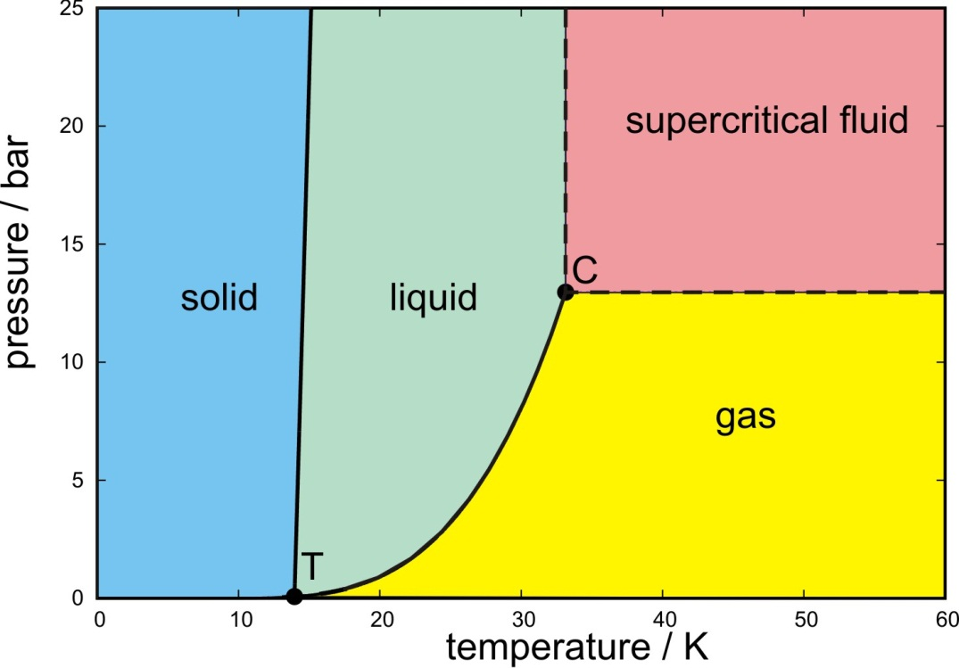
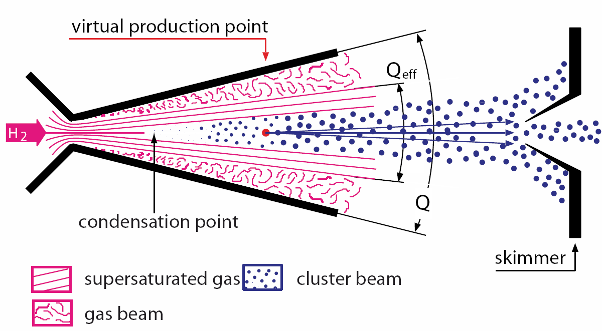
Production of Cluster-Jet Beams
skimmer
Target beam thickness strongly depends on
  nozzle properties (inner diameter e.g. 30 µm, shape, ...)
  gas/liquid input pressure p₀
  gas/liquid input temperature T₀
p₀/T₀

Slide 17
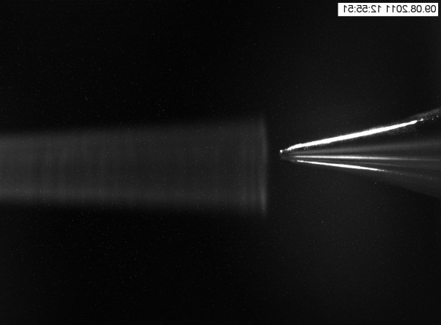
Production of Cluster-Jet Beams
skimmer
skimmer
Target beam thickness strongly depends on
  nozzle properties (inner diameter e.g. 30 µm, shape, ...)
  gas/liquid input pressure p₀
  gas/liquid input temperature T₀
p₀/T₀

Slide 18
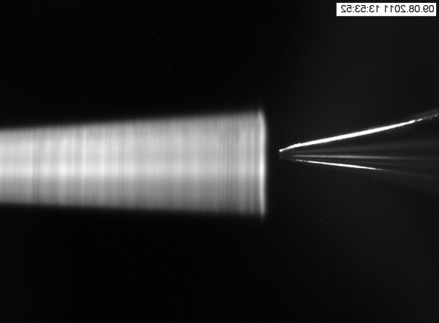
Production of Cluster-Jet Beams
skimmer
skimmer
Target beam thickness strongly depends on
  nozzle properties (inner diameter e.g. 30 µm, shape, ...)
  gas/liquid input pressure p₀
  gas/liquid input temperature T₀
p₀/T₀

Slide 19
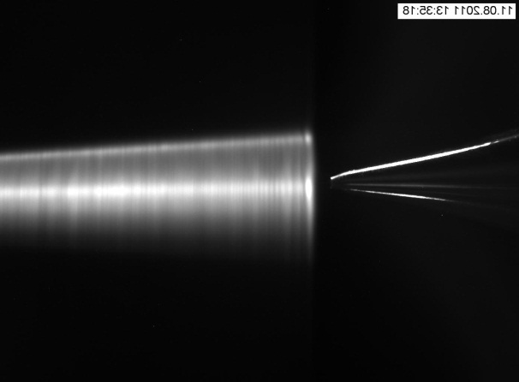
Production of Cluster-Jet Beams
skimmer
skimmer
Target beam thickness strongly depends on
  nozzle properties (inner diameter e.g. 30 µm, shape, ...)
  gas/liquid input pressure p₀
  gas/liquid input temperature T₀
p₀/T₀

Slide 20
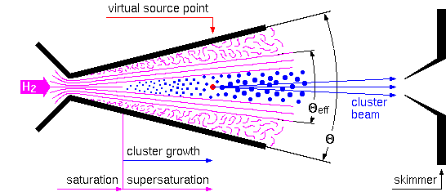
Production of Cluster-Jet Beams
Preparation of a cluster-jet beam by a set of two skimmers behind the nozzle
Constant opening angle of the cluster-jet after the second skimmer
cluster beam
second skimmer

Slide 21
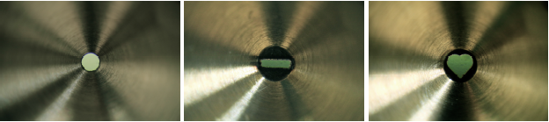
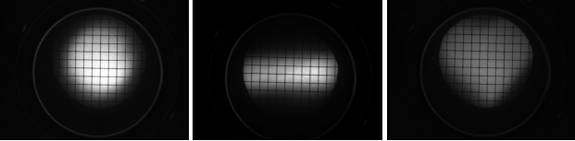
Cluster Beam Preparation by Skimmers
Skimmers (O(0.5 mm))
Cluster beam MCP images (after 5 m flight path)

Slide 22
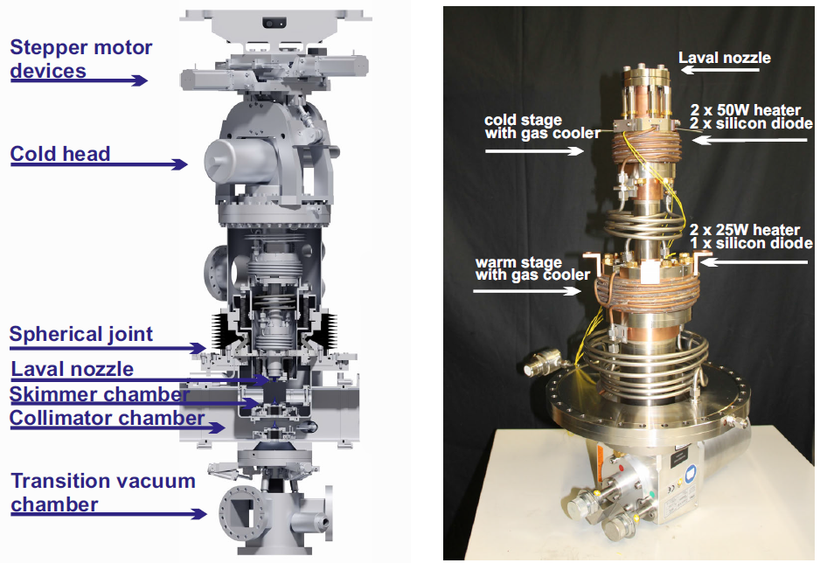
The PANDA Cluster-Source

Slide 23
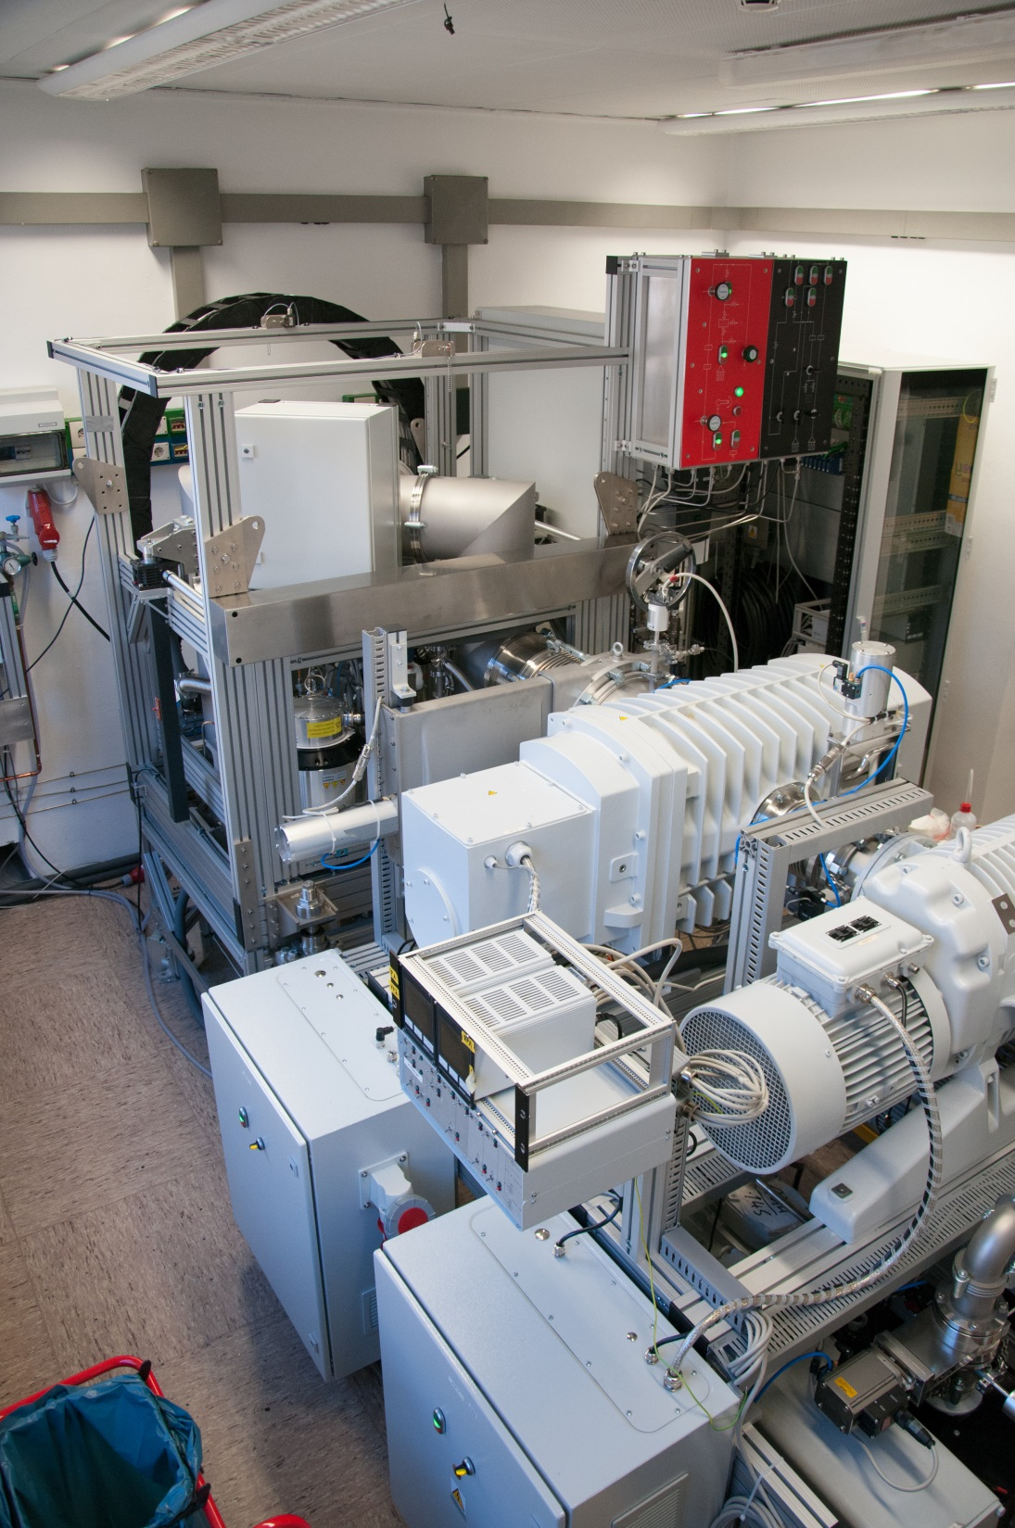
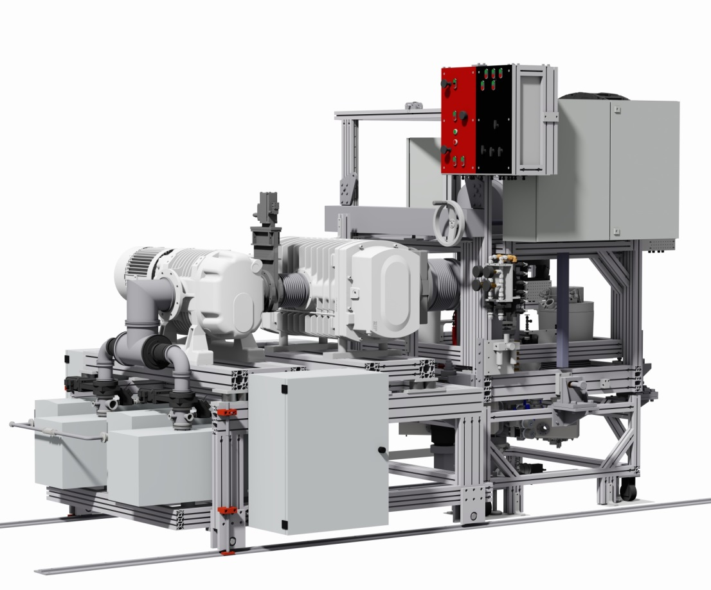
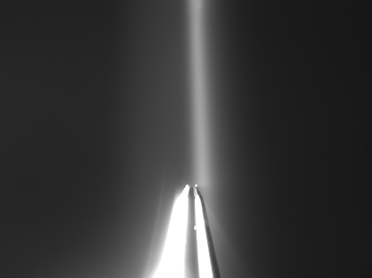
PANDA Cluster Target
PANDA cluster target + pumping system now fully in operation
cluster beam
Skimmer tip

Slide 24
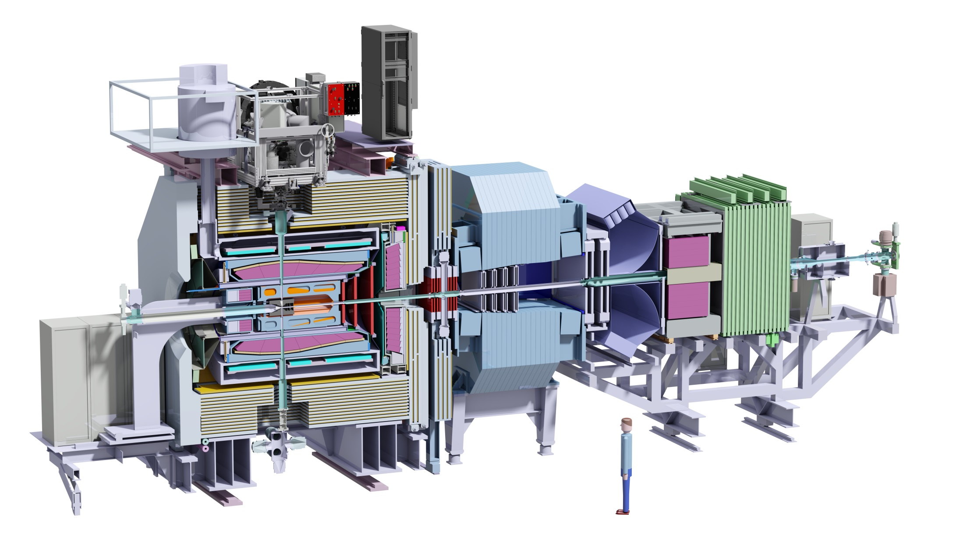
Planned PANDA Setup with Cluster Target

Slide 25
Cluster Beam Profiles at the PANDA Vertex Point
Well defined target beam at a distance of d = 2 m behind the nozzle (corresponds to PANDA interaction point)
Target thickness of 2x10¹⁵ H-atoms/cm³ achieved (2.1 m!)
T₀=19 K
p₀=18.5 bar
x-direction
y-direction

Slide 26
Target Thickness Variation
Gas/liquid input pressure p₀ variation
  target thickness changes within one order of magnitude
  thickness variation typically within seconds possible
Gas/liquid starting temperature T₀ variation
  thickness changes within several orders of magnitude
  slow process (typically within minutes)
T₀=20-50 K
p₀=5-19 bar

Slide 27
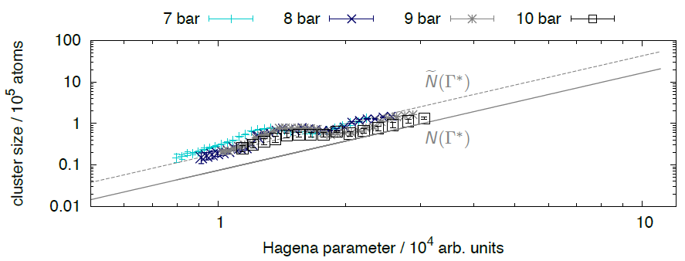

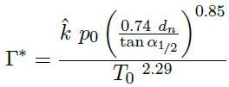
Recent Results on Cluster Beams
Cluster masses as function of stagnation conditions (p₀, T₀) and nozzle diameter (d_{n}) can be described well by Hagena law: Important for PANDA (event rate, DAQ, dead time, ...)
Esperanza Köhler, PhD thesis 2015
WWU Münster, Germany

Slide 28
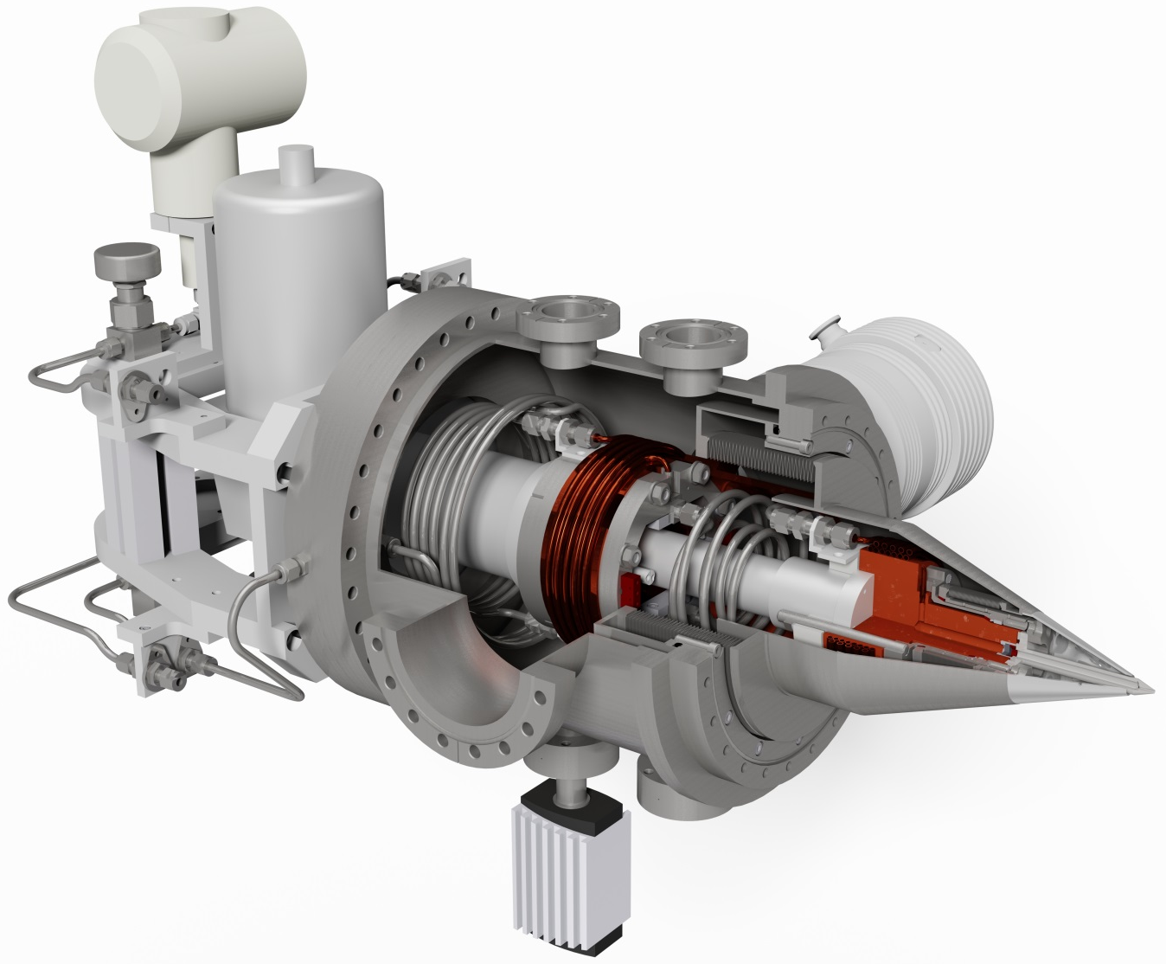
The Gas/Cluster-Jet Target for MAGIX
For details see talk from
Silke Grieser (Wed.)
nozzle
Jet direction

Slide 29
Pellet Beams

Slide 30
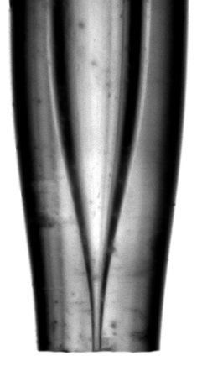
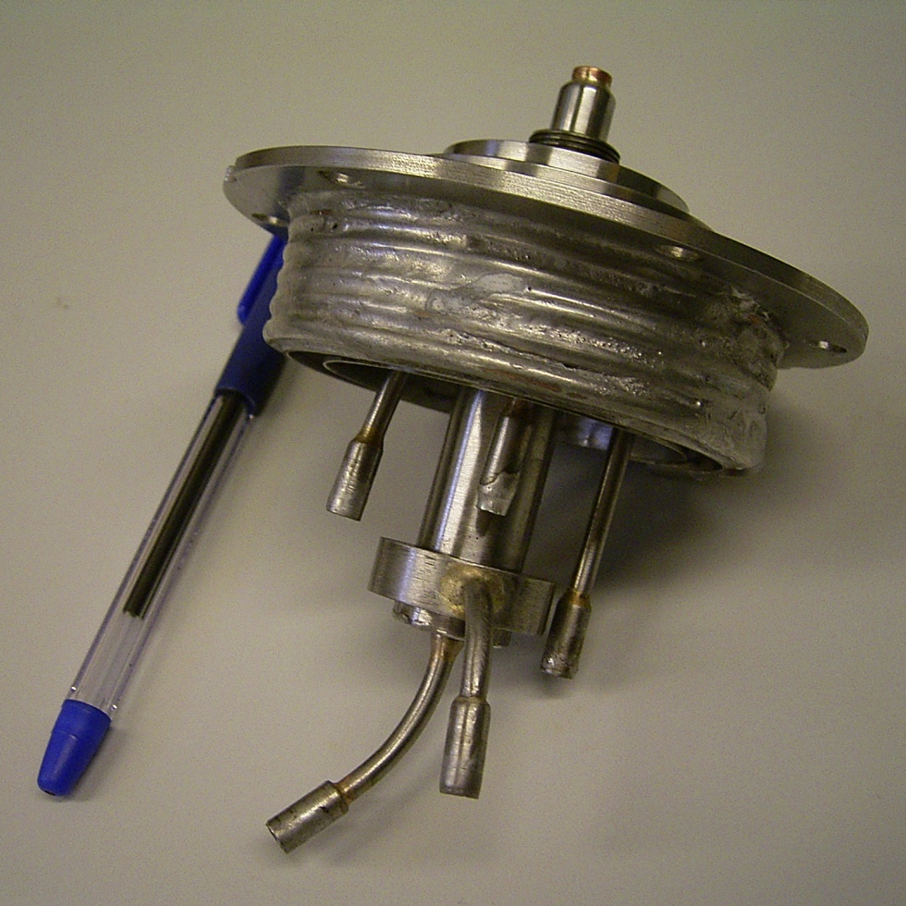
Production of Pellet beams
Injection of a jet of a cryogenic liquid through a thin nozzle into a gas close to triple-point conditions
Excitation of the nozzle by a piezoelectric transducer
→ periodic monosized droplets
Droplet size depends on nozzle diameter and piezo frequency
glass nozzle, Ø 10-20 µm
gas input
pumping out
He
H2
He

Slide 31
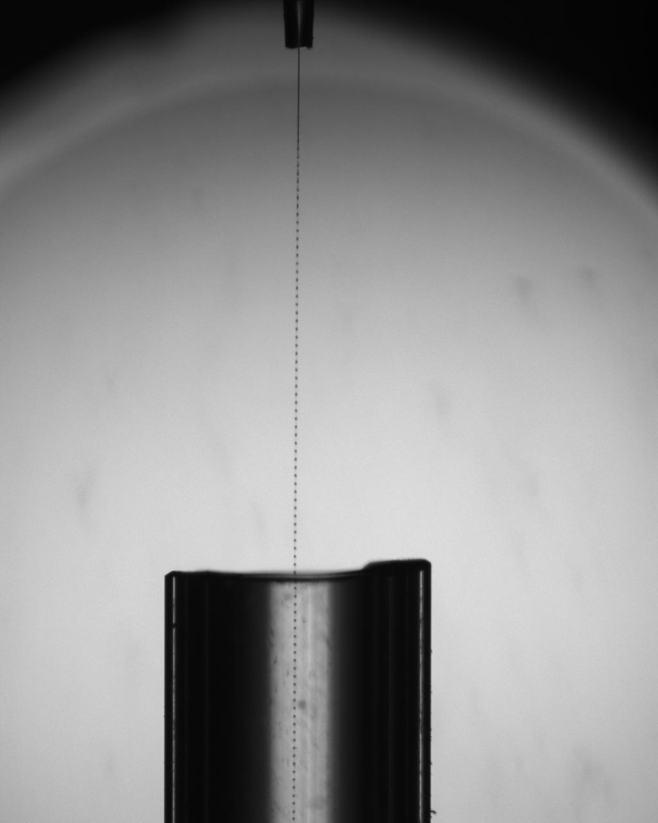
Production of Pellet beams
glass nozzle
Droplets pass through a thin tube into vacuum („vacuum injection“)
→ cooling due to surface evaporation
→ frozen pellets
Pellets pass the scattering chamber
hydrogen droplets
Ø ~ 10 µm
f = 181 kHz

Slide 32
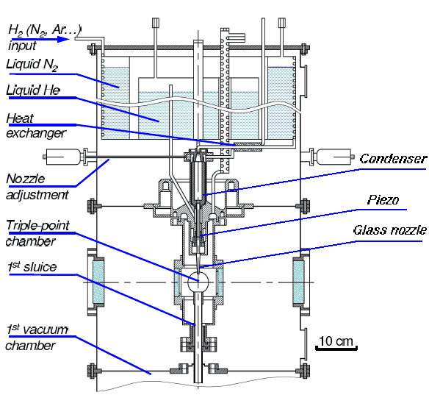
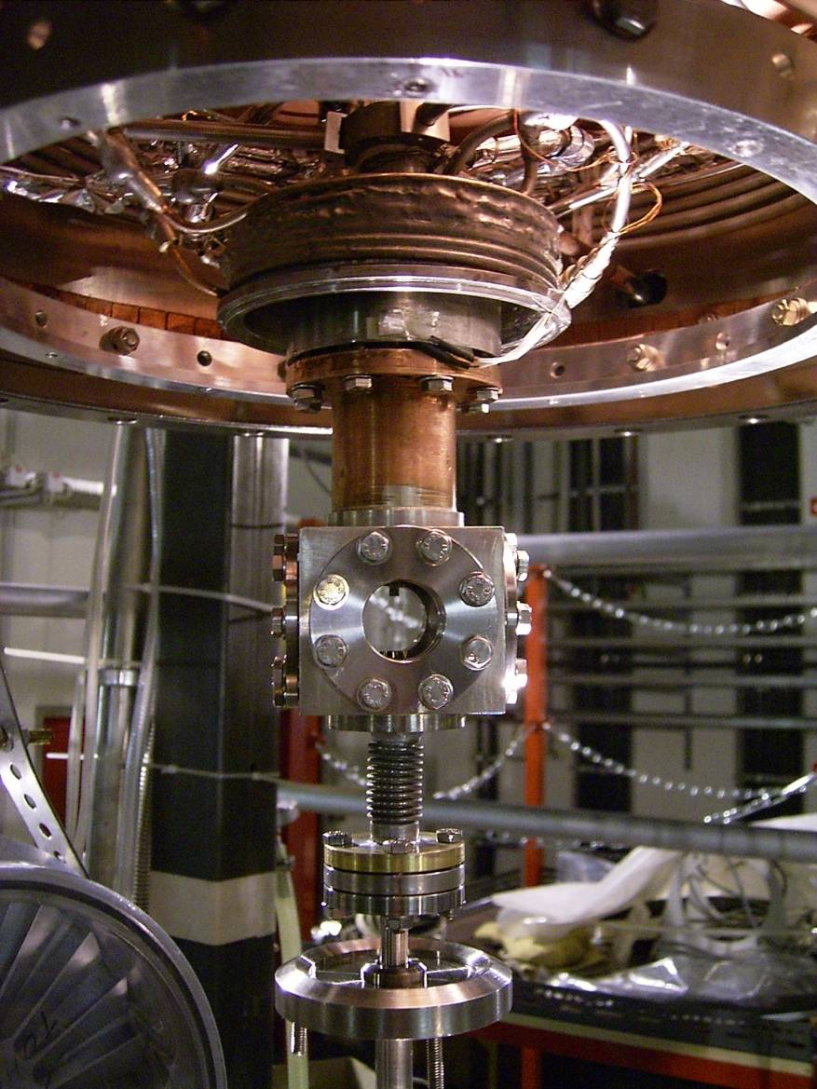
Prototype for PANDA: The Jülich/Moscow Target
condenser
1 cm
generator
triple point
chamber
glass sluice

Slide 33
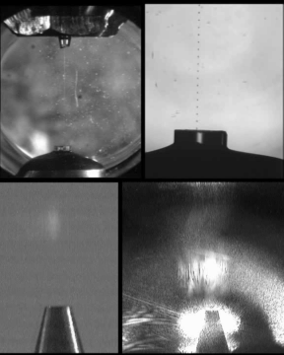
A Pellet Target in Operation: WASA-at-COSY
glass nozzle
droplets
droplets
vacuum injection
vacuum injection
pellets
pellets
skimmer
skimmer

Slide 34

A Pellet Target in Operation: WASA-at-COSY
glass nozzle
droplets
droplets
vacuum injection
vacuum injection
pellets
pellets
skimmer
skimmer

Slide 35
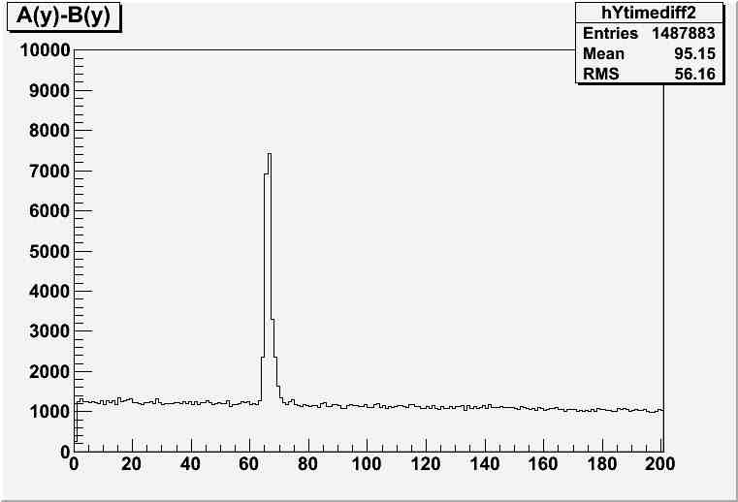
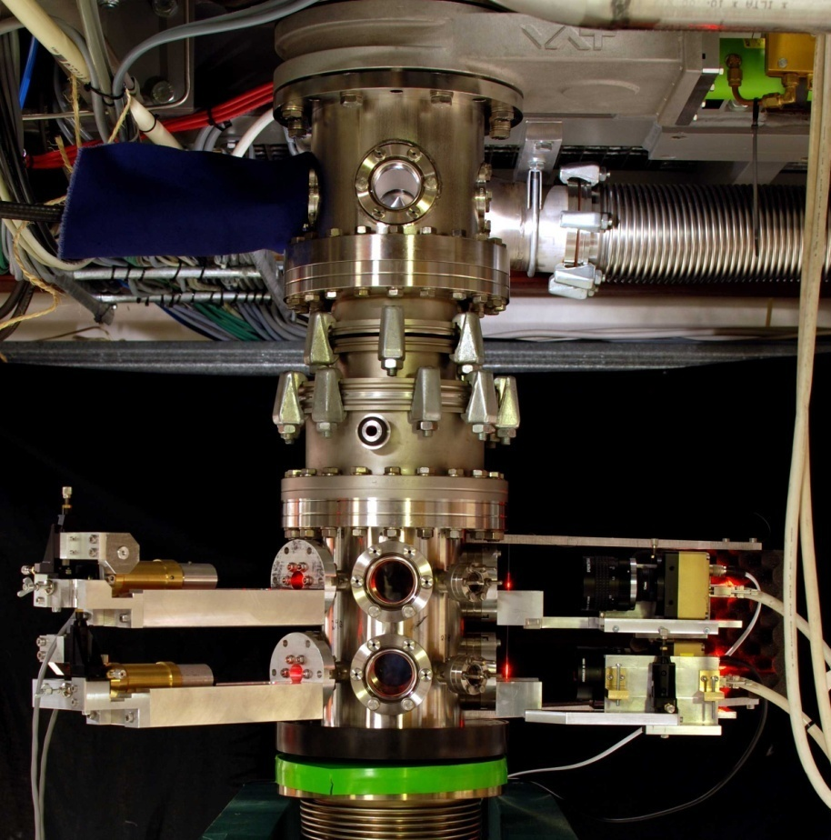
Pellet Tracking System
time difference
Determination of the velocity and 3D-vertex information of individual pellets by a multi-camera tracking system
Aimed resolution: < 1mm
Upper tracking device with two
levels close to the pellet
generator (8 linescan cameras)
Lower tracking device with two
levels at the beam dump
(8 linescan cameras)
A
B

Slide 36
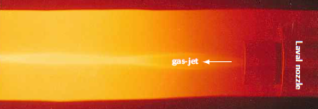
Summary
Gas jet beams:
  All types of gases can be used
  High target beam thickness (e.g. O(10¹⁹) atoms/cm³) directly behind the nozzle
  Interaction point very close to the nozzle
  High gas load at the interaction point
  Rapid expansion of the beam in all directions
  Target beam without time structure
  Simple target thickness variation
  Compact target beam generator possible

Slide 37
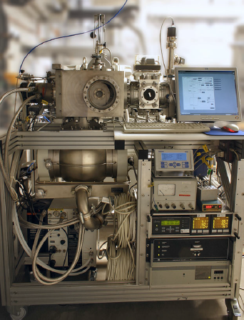
Summary
Cluster jet beams:
  All types of gases can be used
  High target thickness (e.g. O(10¹⁹) at./cm³) close to nozzle
  High target beam thickness (O(10¹⁵) at./cm³) also at large distances from the nozzle, i.e. 2 m
  Target generator can work as gas and/or cluster source
  Interaction point very close to nozzle or at larger distances
  Easy target beam shaping and lower gas load at the interaction point by use of specially shaped collimators
  Well defined beam shape even at large distances
  Target beam with (nearly) no time structure
  Simple target thickness variation
  Compact target beam generator possible

Slide 38
Summary
Pellet beams:
  All types of gases can be used
  Pellets with uniform size/diameter
  Individual pellets (Ø 20 µm) have a mean thickness of O(10¹⁹) atoms/cm²
  Effective target beam thickness of e.g. O(10¹⁵) atoms/cm² at large distances from the nozzle, i.e. 2 m
  Target beam shaping and lower gas load at the interaction point by use of collimators
  Well defined beam shape even at large distances
  Target beam with time structure
  Target thickness variation possible (time structure)
  More complex and larger target generator size

Slide 39
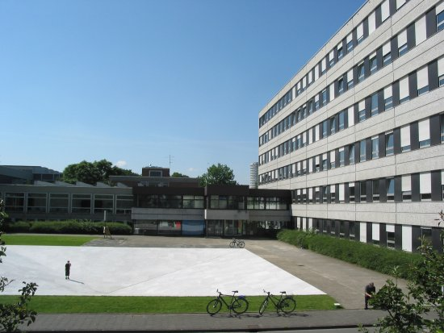
Thank you very much....

Slide 41
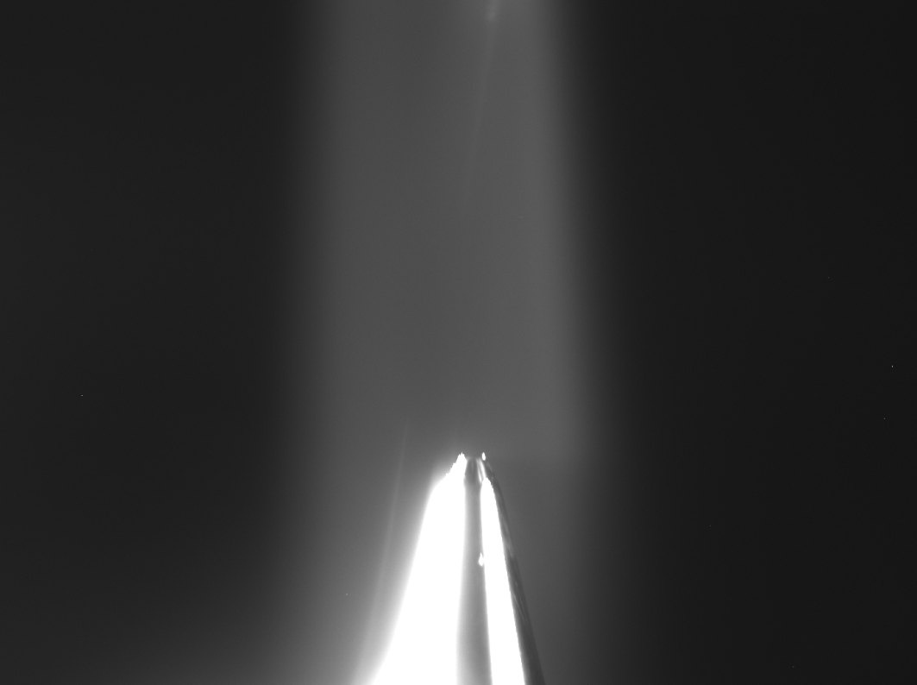

First Cluster Beams (03.12.2015!)
T = 22 K, p = 16 bar
T = 22 K, p = 17 bar
Cluster beam
Skimmer tip
skimmer

Slide 42
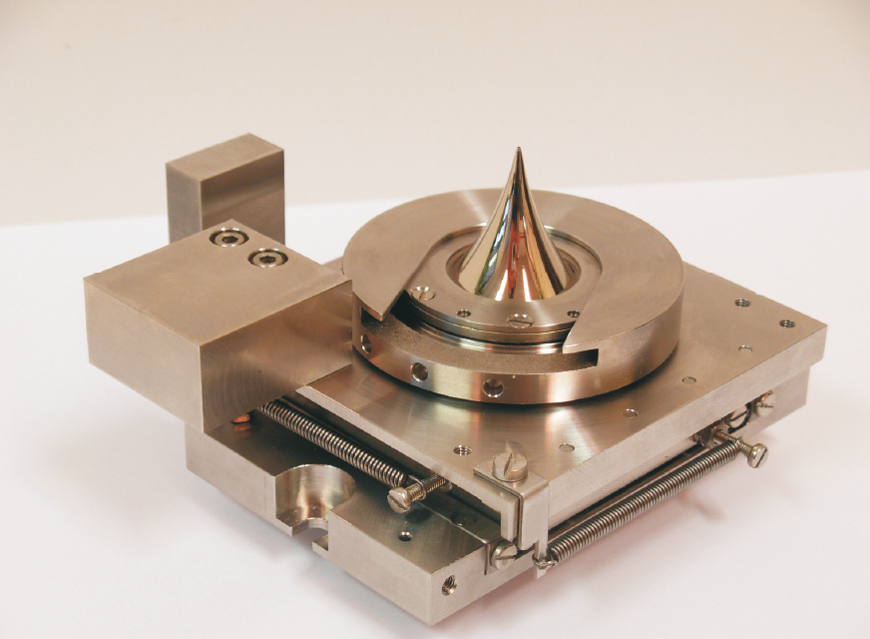
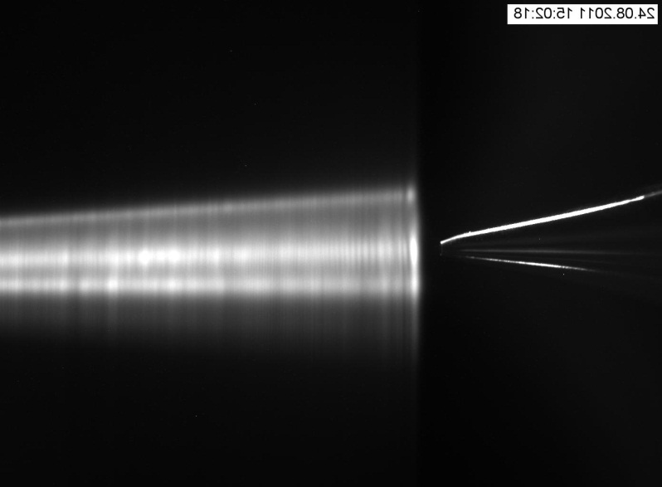
Mechanical Adjustments
Both skimmers can be moved during operation
  Alignment of the target beam in the scattering chamber
The complete nozzle setup can be tilted relative to the (fixed) skimmer
  Selection of the high-density cluster core
skimmer
skimmer
skimmer
nozzle (not visible)

Slide 43
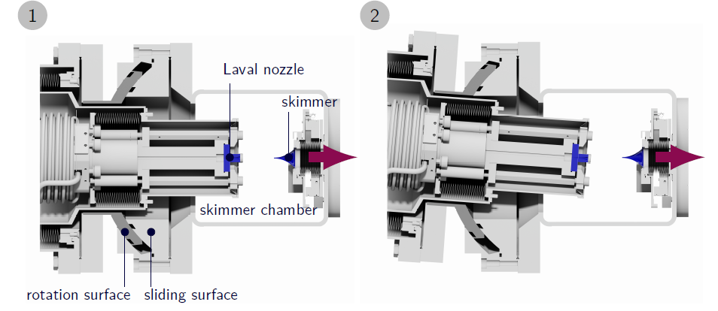
Mechanical Adjustments

Slide 44
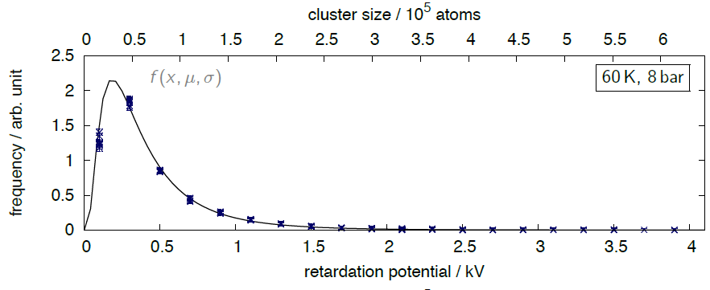

Recent Results on Cluster Beams
Studies on cluster mass distributions (here: hydrogen in gaseous phase before entering the nozzle)
Cluster beam mass distribution can be described well by log-normal distribution
Esperanza Köhler, PhD thesis 2015

Slide 45
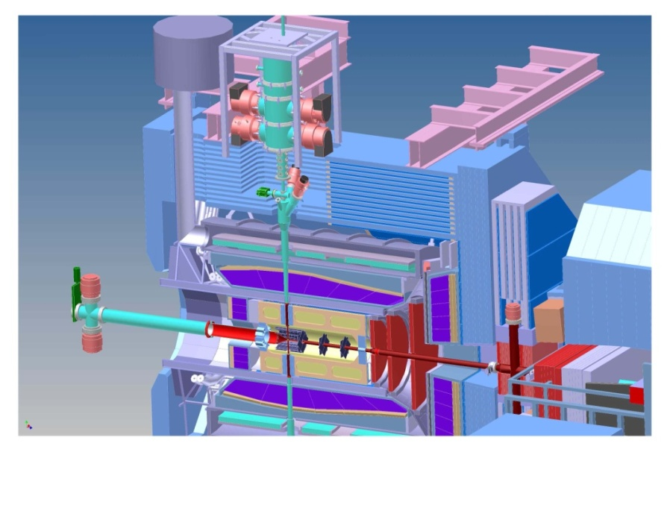

From the Prototype to PANDA
Optimization and design studies on the pellet generator in progress (ITEP)
Design of the pellet tracking is fixed and will be build up and optimized
(Univ. Uppsala)

Slide 46
Expected Target Parameters at PANDA
 | Cluster Target | Pellet Target
 |  | PTR mode (tracking) | PHL mode (high luminosity)
Effective target thickness | > 1x10¹⁵ at./cm² | ≤ 2x10¹⁵ at./cm² | ≥ 4x10¹⁵ at./cm²
Cluster/Pellet size | nm - µm | Ø ≥ 20 µm | Ø ≤ 15 µm
Cluster/Pellet frequency | Continuous beam | ≈ 15 k plt/s | ≥ 150 k plt/s
Target stream diameter | 4 mm x 12 mm | Ø ≈ 3 mm | Ø ≤ 3 mm
Average dist.between cluster/pellets | ≤ 10 µm | ≥ 4 mm | << 4 mm
p beam size | Ø ≤ 1 mm | Ø_{vertical} ≥ 3.5 mm | Ø_{vertical} ≤ 3.5 mm
Average no. of cluster/pellets in p beam | ≥ 10⁷ | ≈ 1 | ≈ 10

