Slide 1
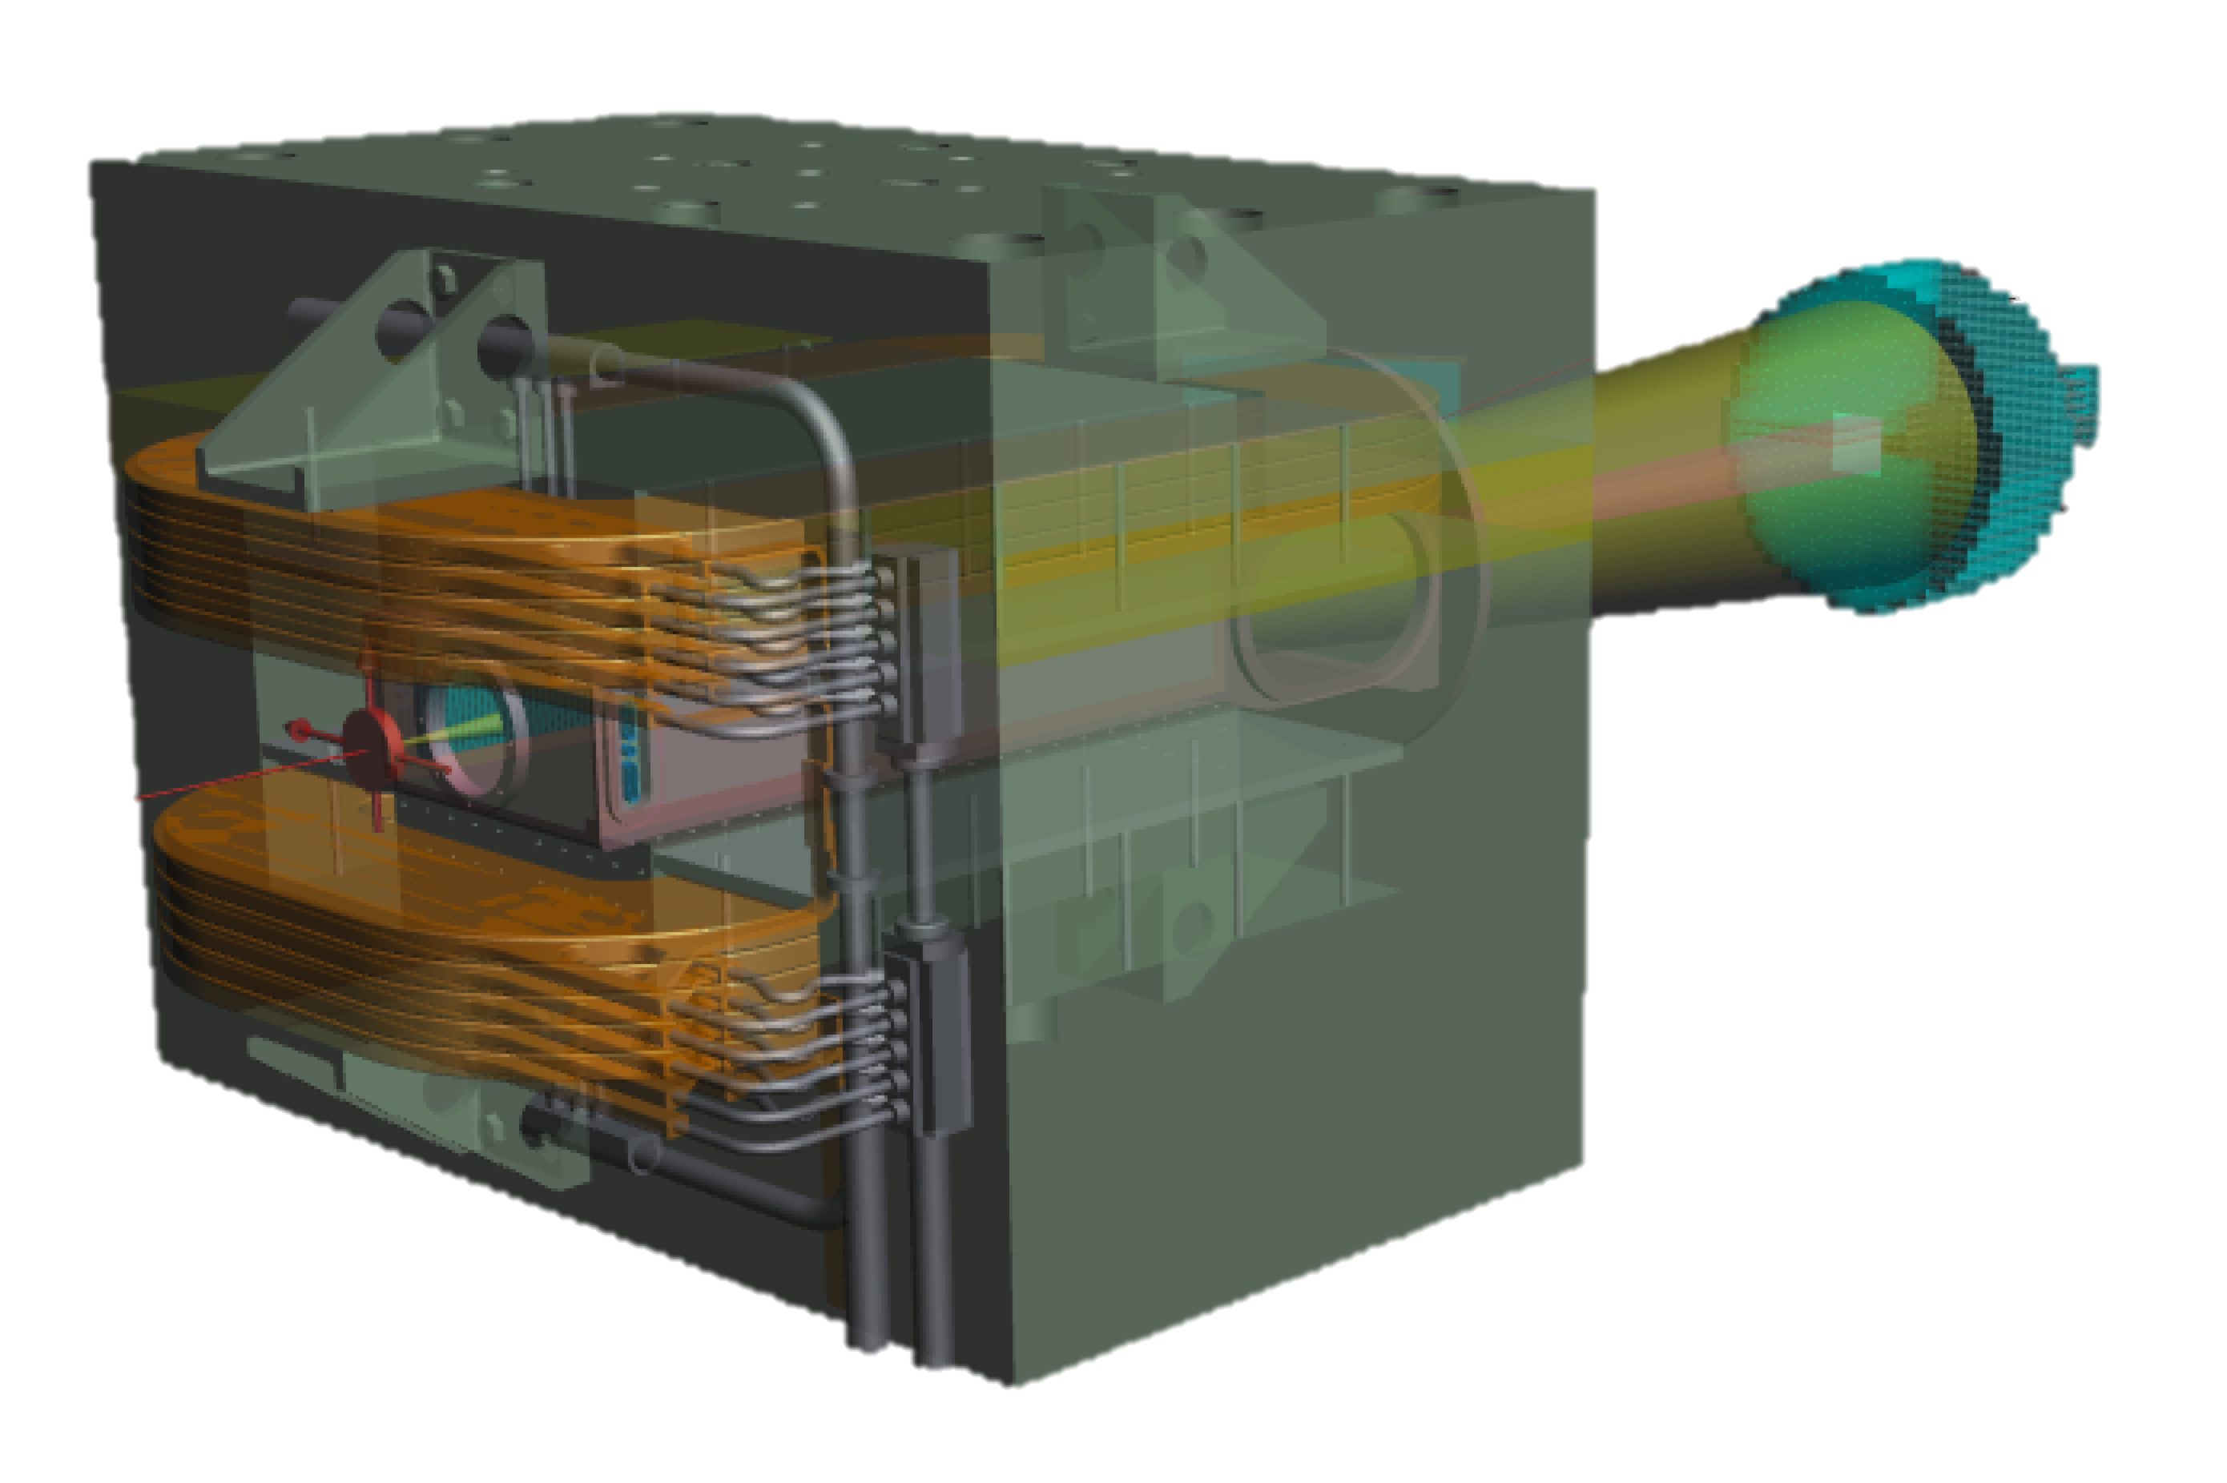
Dark photon searches in positron annihilations with the PADME experiment
Paolo Valente – INFN Roma
New Vistas in Low-Energy Precision Physics (LEPP)
4-7 April 2016 Kupferbergterrasse Mainz

Slide 2
Why a dark photon?

Slide 3
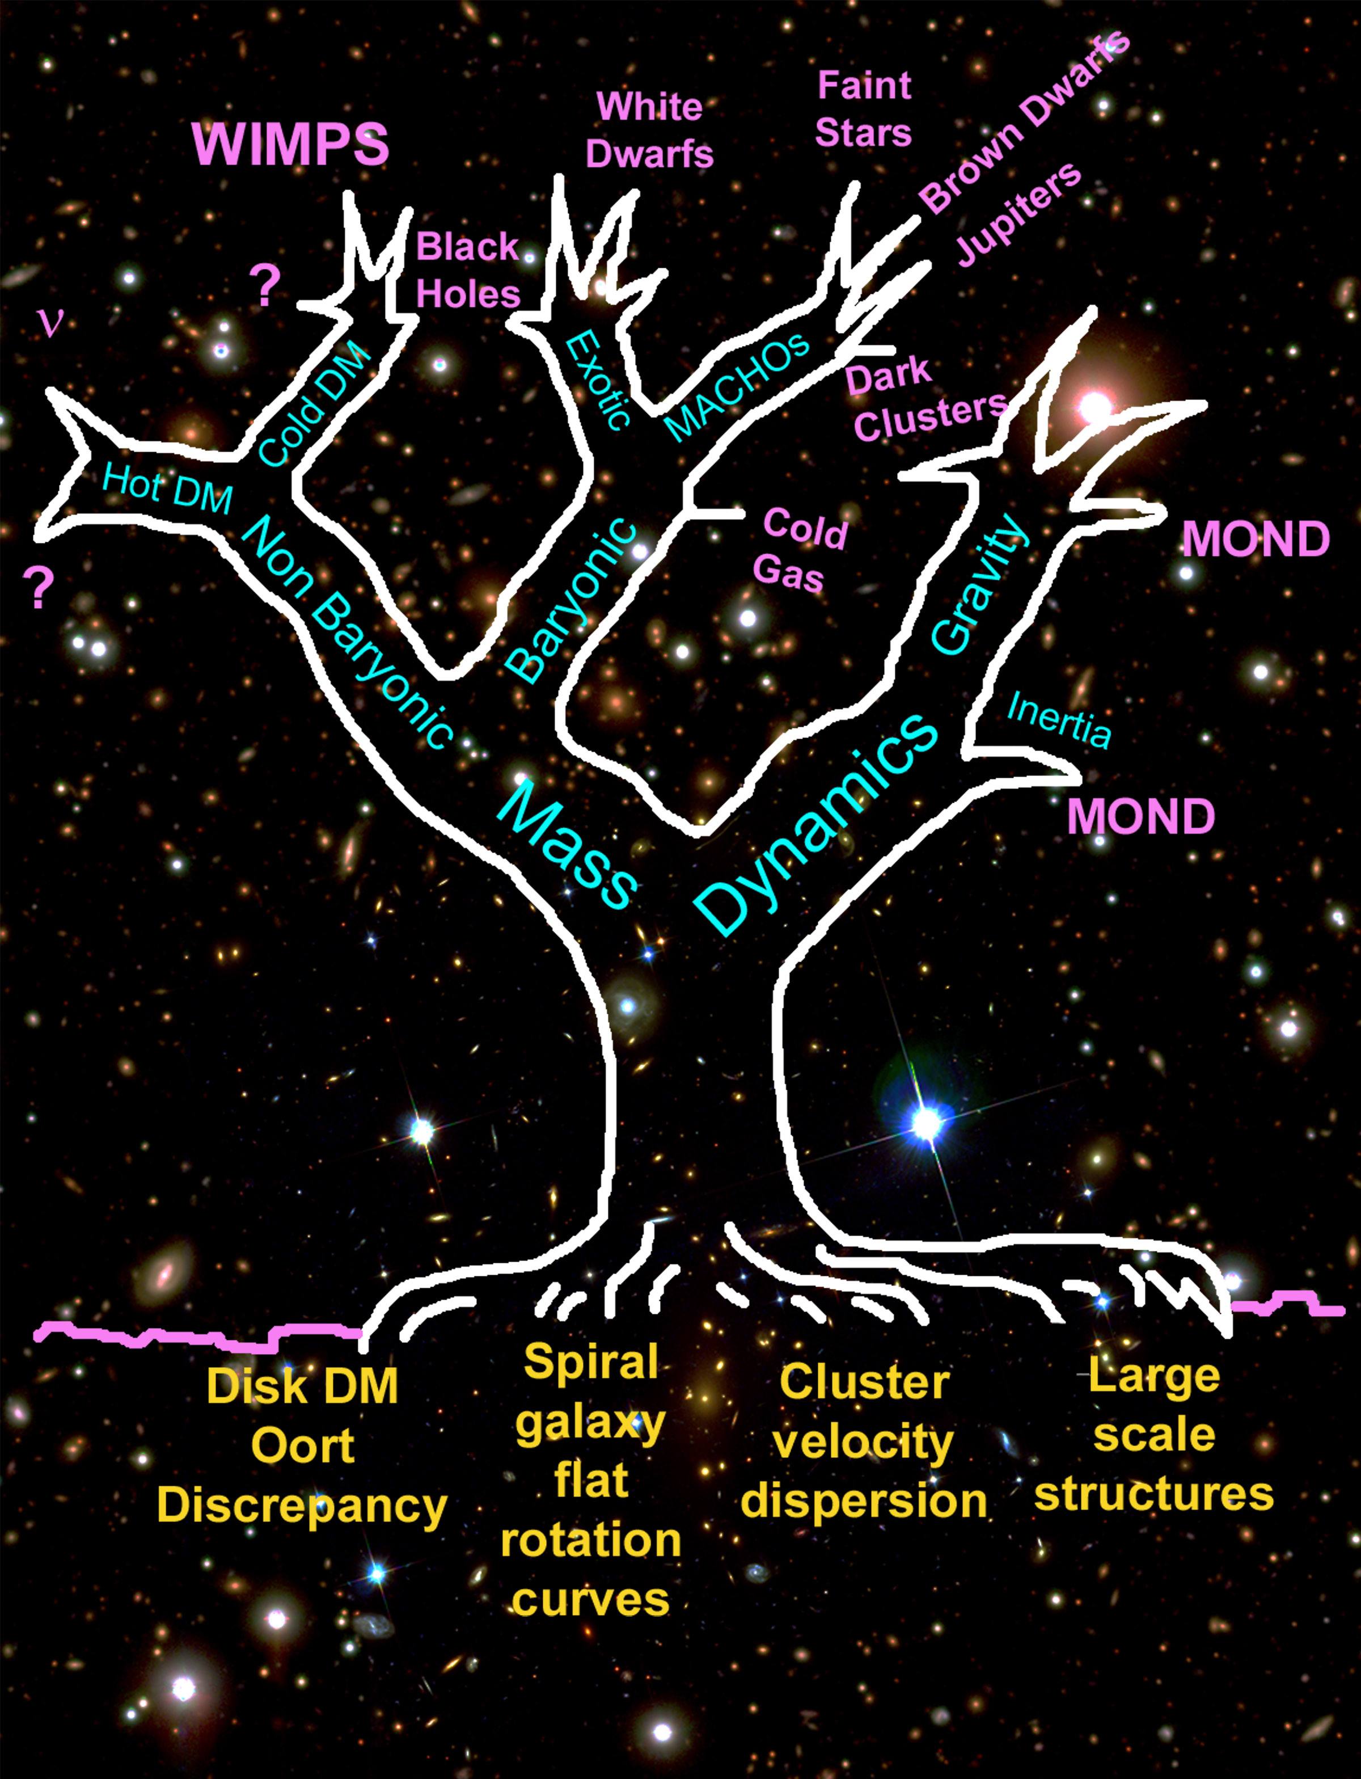
The dark matter problem
Astrophysics
Particle physics
Modify gravity
Original drawing by Stacy McGaugh (1995)
Several hypothesized solutions
Particle physics is not the only possible solution
However…
Roots are strong empirical observations

Slide 4




Portals to secluded sector
“portal”
Dark Sector
?
Standard Model
SU(3) × SU(2) × U(1)
vector
dark photon
Higgs
dark scalar
neutrino
sterile neutrino
axion
ALPs

Slide 5
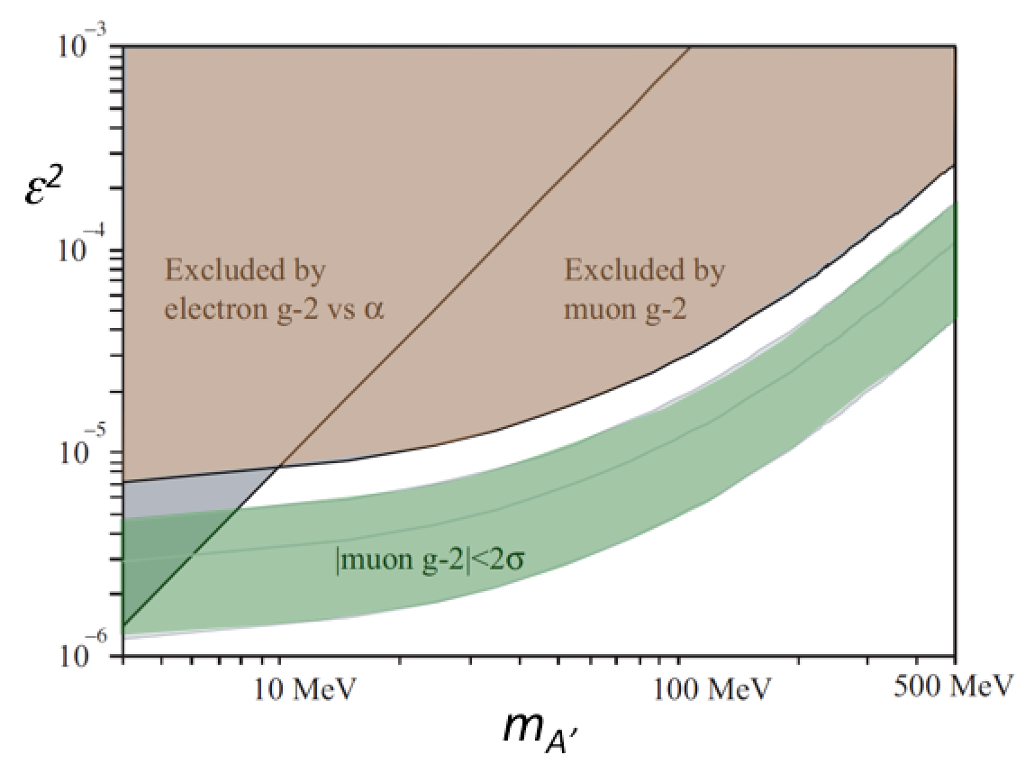
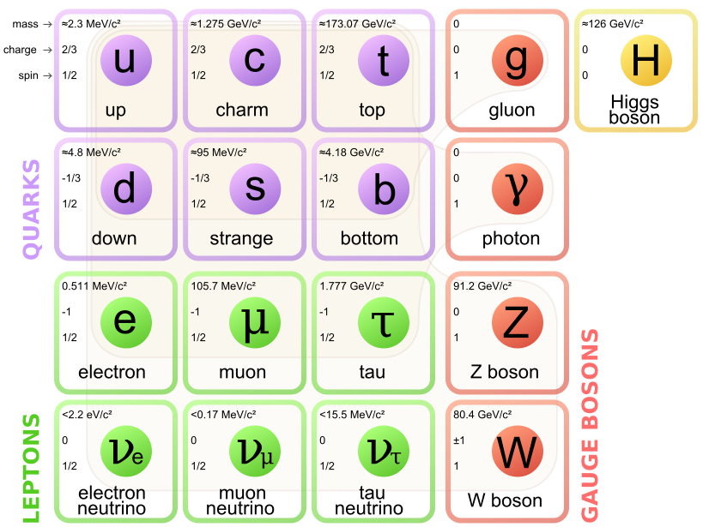
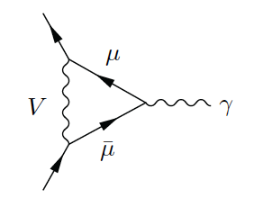
Dark photon
Dark Sector
The simplest hidden sector model just introduces one extra U(1) gauge symmetry and a corresponding gauge boson: the “dark photon" or U boson or heavy photon (γ’ or A’)
An extra U(1) symmetry implied in many Standard Model extensions, some classes of string theory, etc.
Appealing explanation of the muon g-2 discrepancy
Z’?
Dark fermions
χ
?
ψ
?
A’
?
h’?
Standard Model
A’

Slide 6
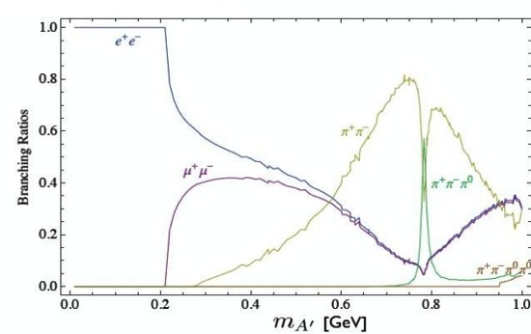
Dark photon visible decays
Assume that no additional lighter states exist in the dark sector with m_{χ}<m_{A’}/2
Dark photon couples to SM particles through kinetic mixing only (with universal coupling εq)
For m_{A’}<2 m_{μ} only decays to e⁺e⁻
A portal to the hidden sector:

Slide 7
Dark photon invisible decays
If χ state with U(1) charge q_{U} and coupling constant g_{U} exists in the dark sector with m_{χ}<m_{A’}/2, the coupling to the A’ will be: q_{U}g_{U}
A’→χχ will be dominant wrt to visible decays for α_{D}>α, i.e. |q_{U}g_{U}|>εe
_
χ
SM
A’
_
A’
χ
SM

Slide 8
Dark photon production
Bremsstrahlung
Annihilation
Meson decay
γ
A’
e⁻
γ
e⁻
π⁰,η
e⁻
γ
A’
A’
e⁺
A’ can be produced in e± collision on target by:
  Bremsstrahlung: e N → e N A’
  Annihilation: e⁺ e⁻→ γ A’
  Meson decays

Slide 9
Experimental status

Slide 10
Dark photon experiments/electrons
We have to add experiments using meson decays: η,π⁰ → γ A’ with dark photon “visibile” decay;
Or A’ coming from dark Higgs decays
e⁻Z → e⁻Z A’
A’ → e⁺e⁻
Thin target, visible decays
(APEX, HPS, A1)
e⁻Z → e⁻Z A’
A’ → e⁺e⁻
e⁻Z → e⁻Z A’
A’ → χχ
Dump, visible decays
Dump, invisible decays, recoil
(E-137, E-141, E-774, Orsay, …)
(BDX)

Slide 11

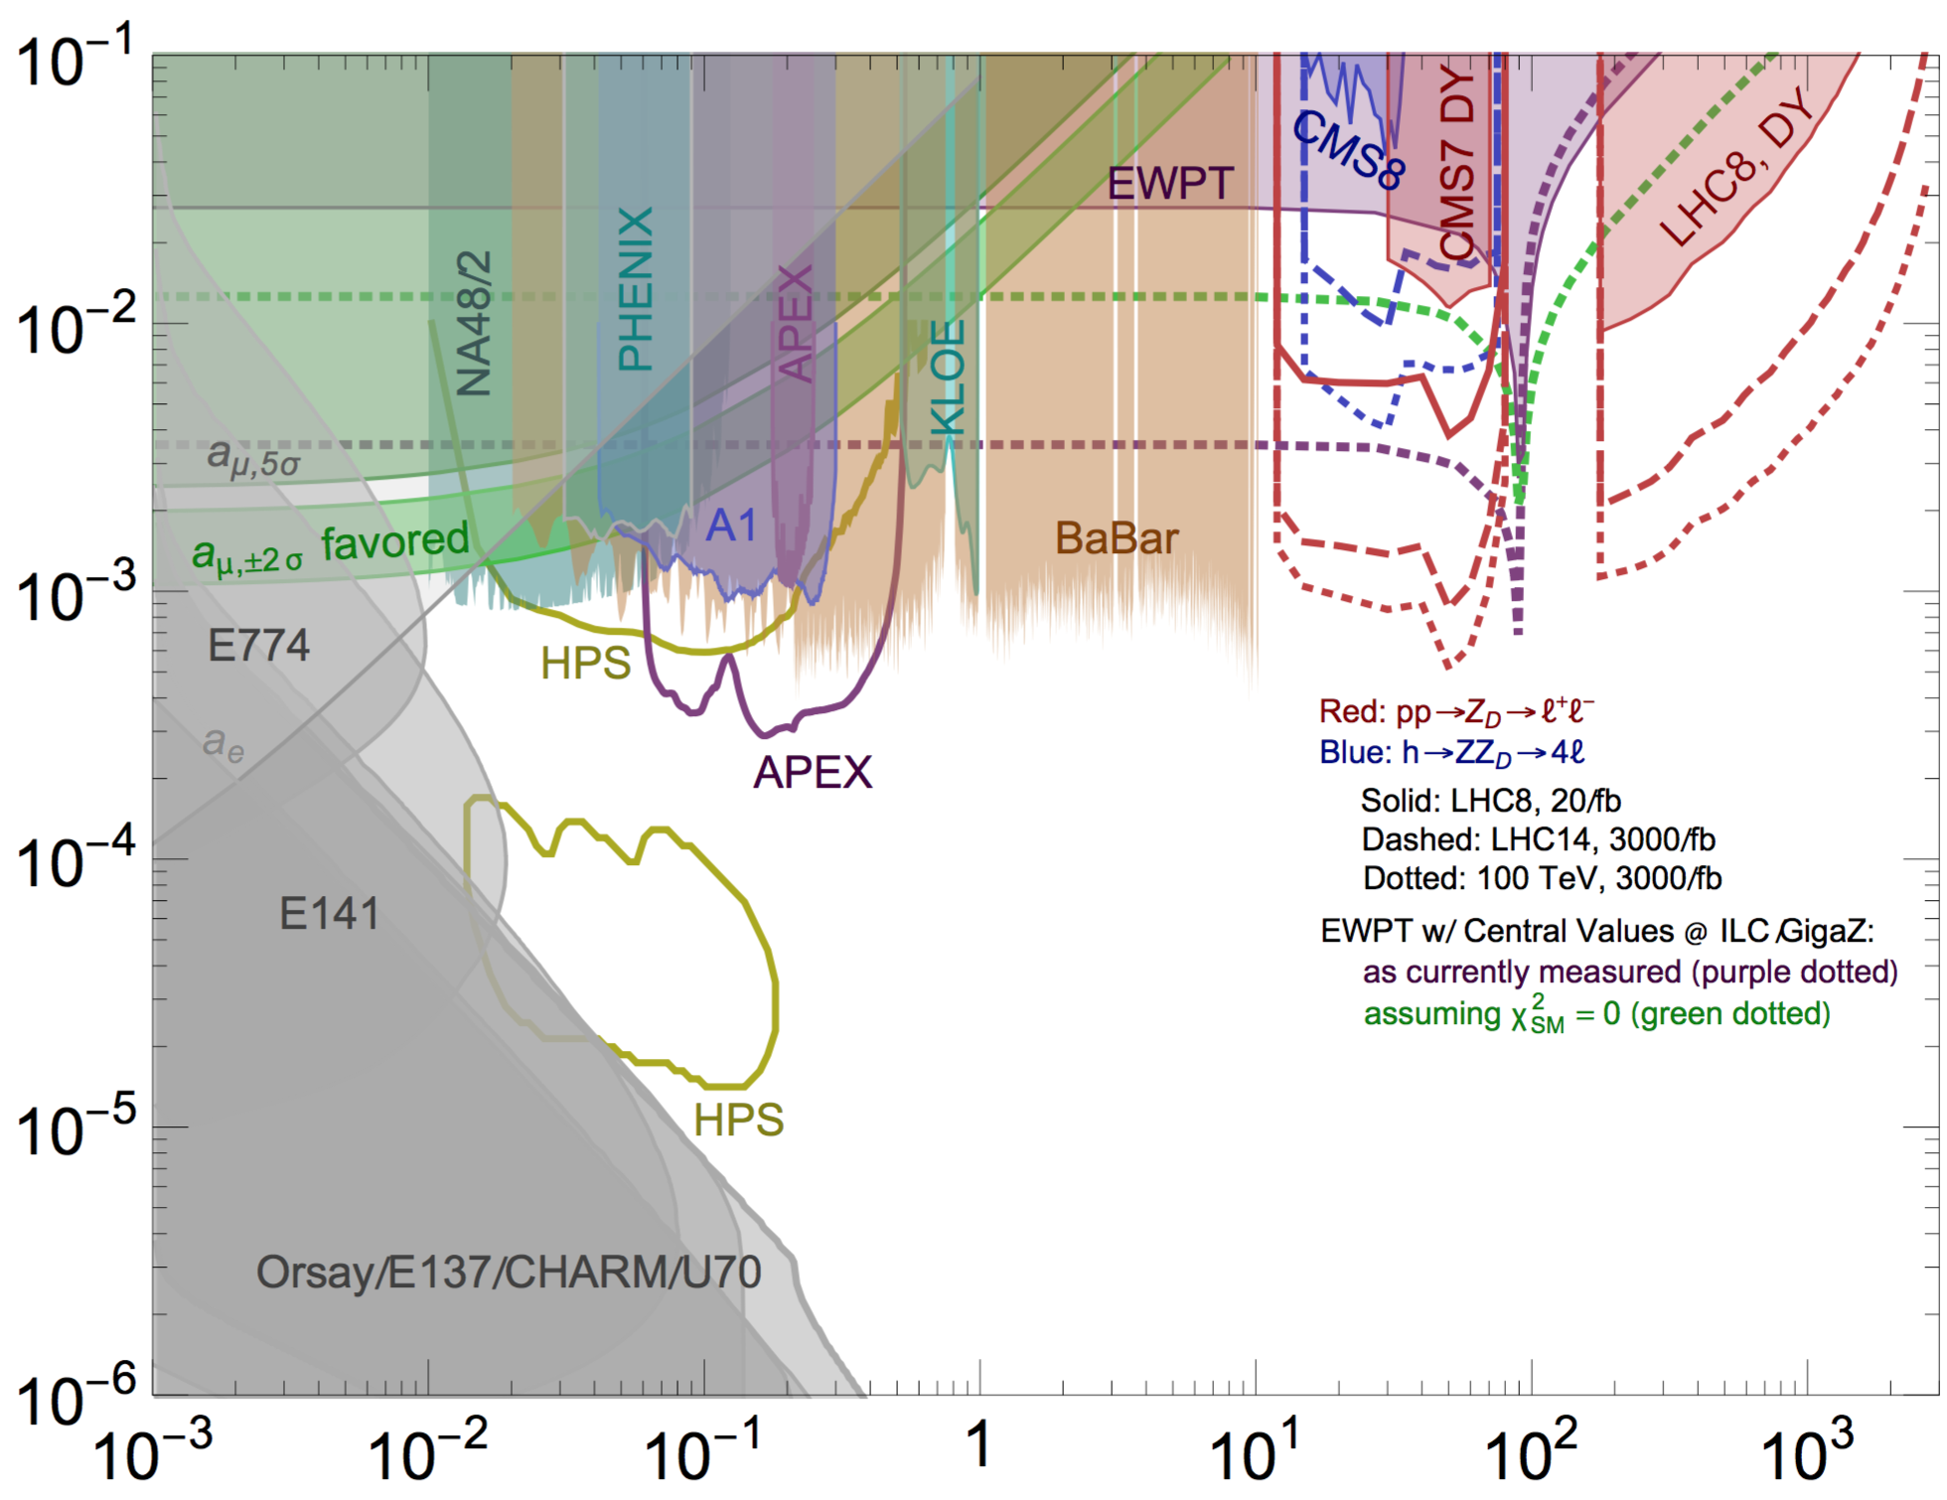
Decay to visible states (e⁺e⁻)
Indirect limits from a_{μ} and a_{e}
Bremsstrahlung on thick target (dump experiments)
  Requires the dark photon to decay beyond the dump
Bremsstrahlung on thin target
  Look for e⁺e⁻ excess over Standard Model background (bump hunt, displaced vertices)
  Requires M_{A’} > 2m_{e}
Meson decays (collider experiment)
  Requires coupling to quarks
Thin target or meson decays, A’ → visible
ε
Thin target
Practically, all the (g-2)_{μ} favored band already excluded
Still large interest for excluding the uncovered parameter space
m_{A’} (GeV/c²)
Re-analysis of electron beam-dump experiments

Slide 12
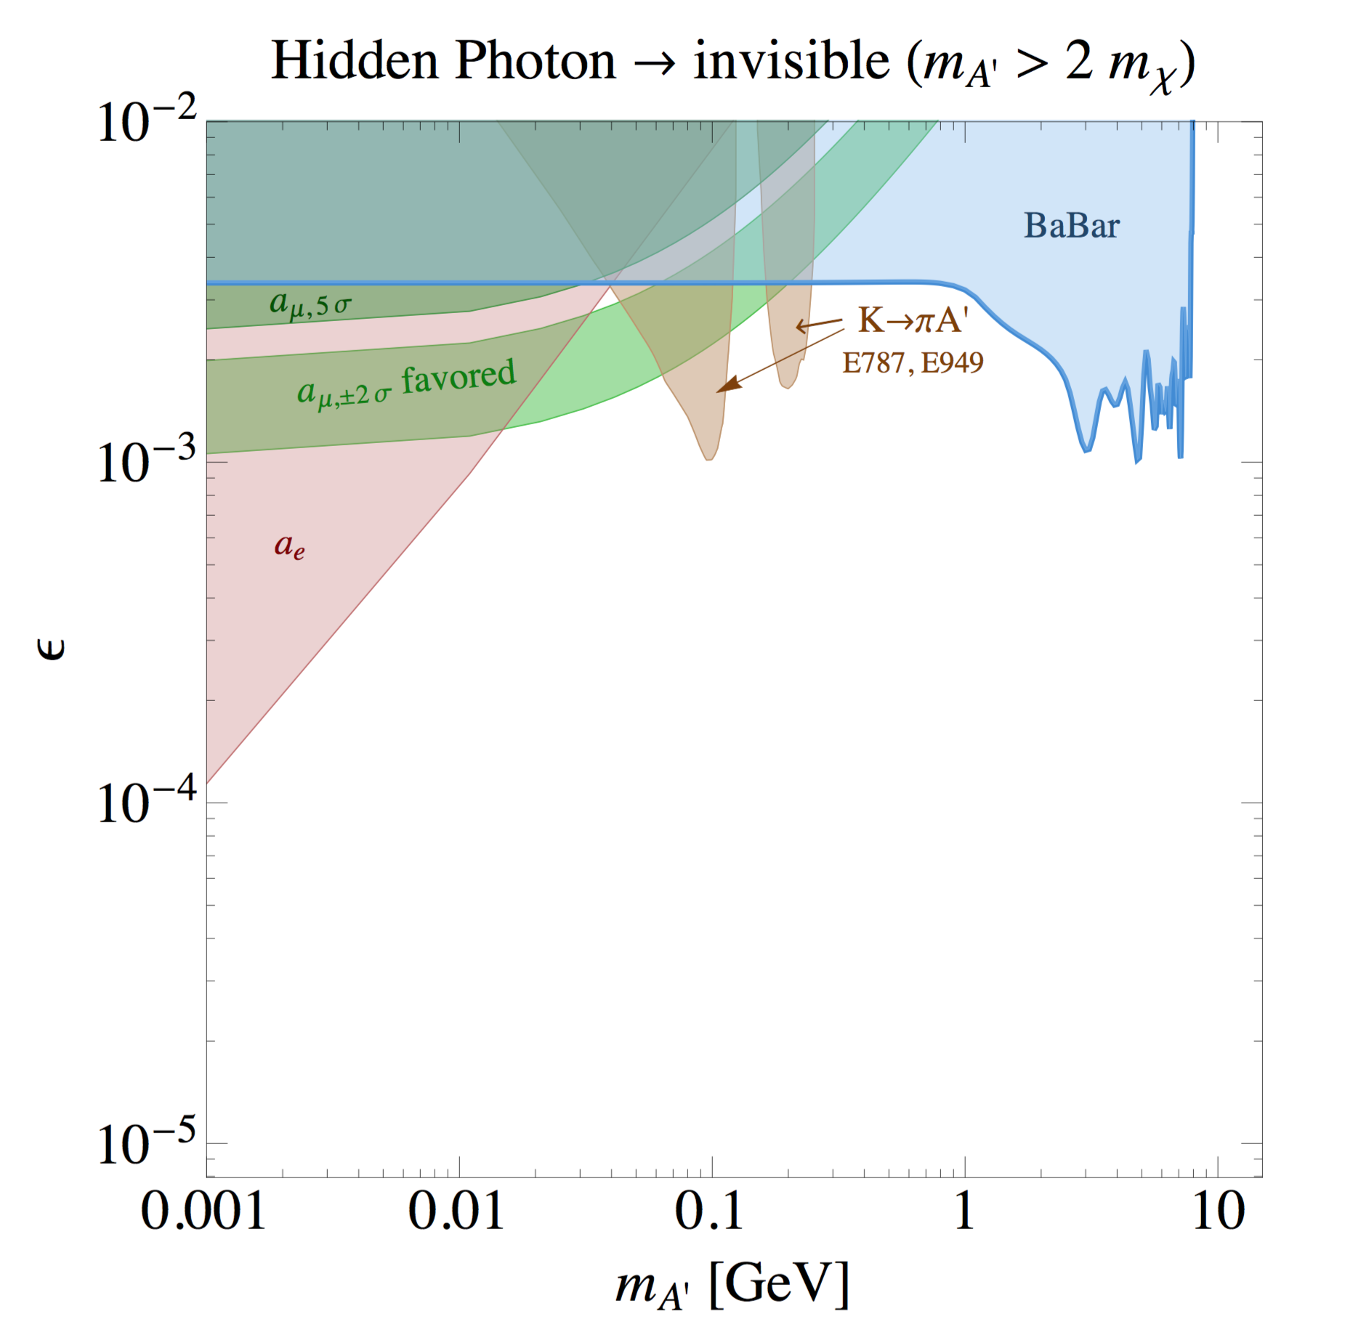
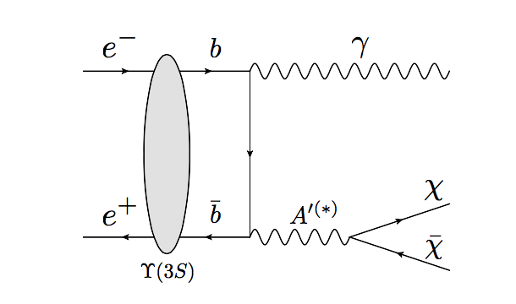
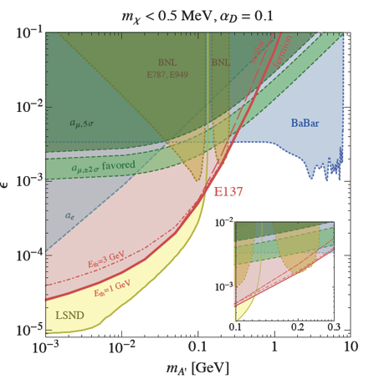

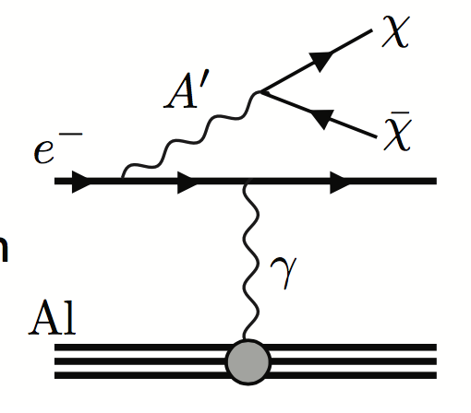
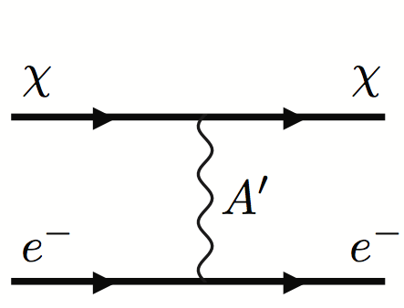
Decay to invisible states
Babar ’08 ArXiv 0808.0017
Search for Invisible Decays of a Light Scalar in Radiative Transitions Υ_{3S}γA’
Direct searches for A’ invisible decays only depend on ε² and m_{A’}
No assumptions on coupling to quarks (Both Υ_{3S} and K± results rely on that)
  χ scattering searches depend on 4 parameters: ε², M_{A’} and M_{χ} and α_{D}
α_{D}
α_{D}
ε
ε

Slide 13
The PADME approach

Slide 14
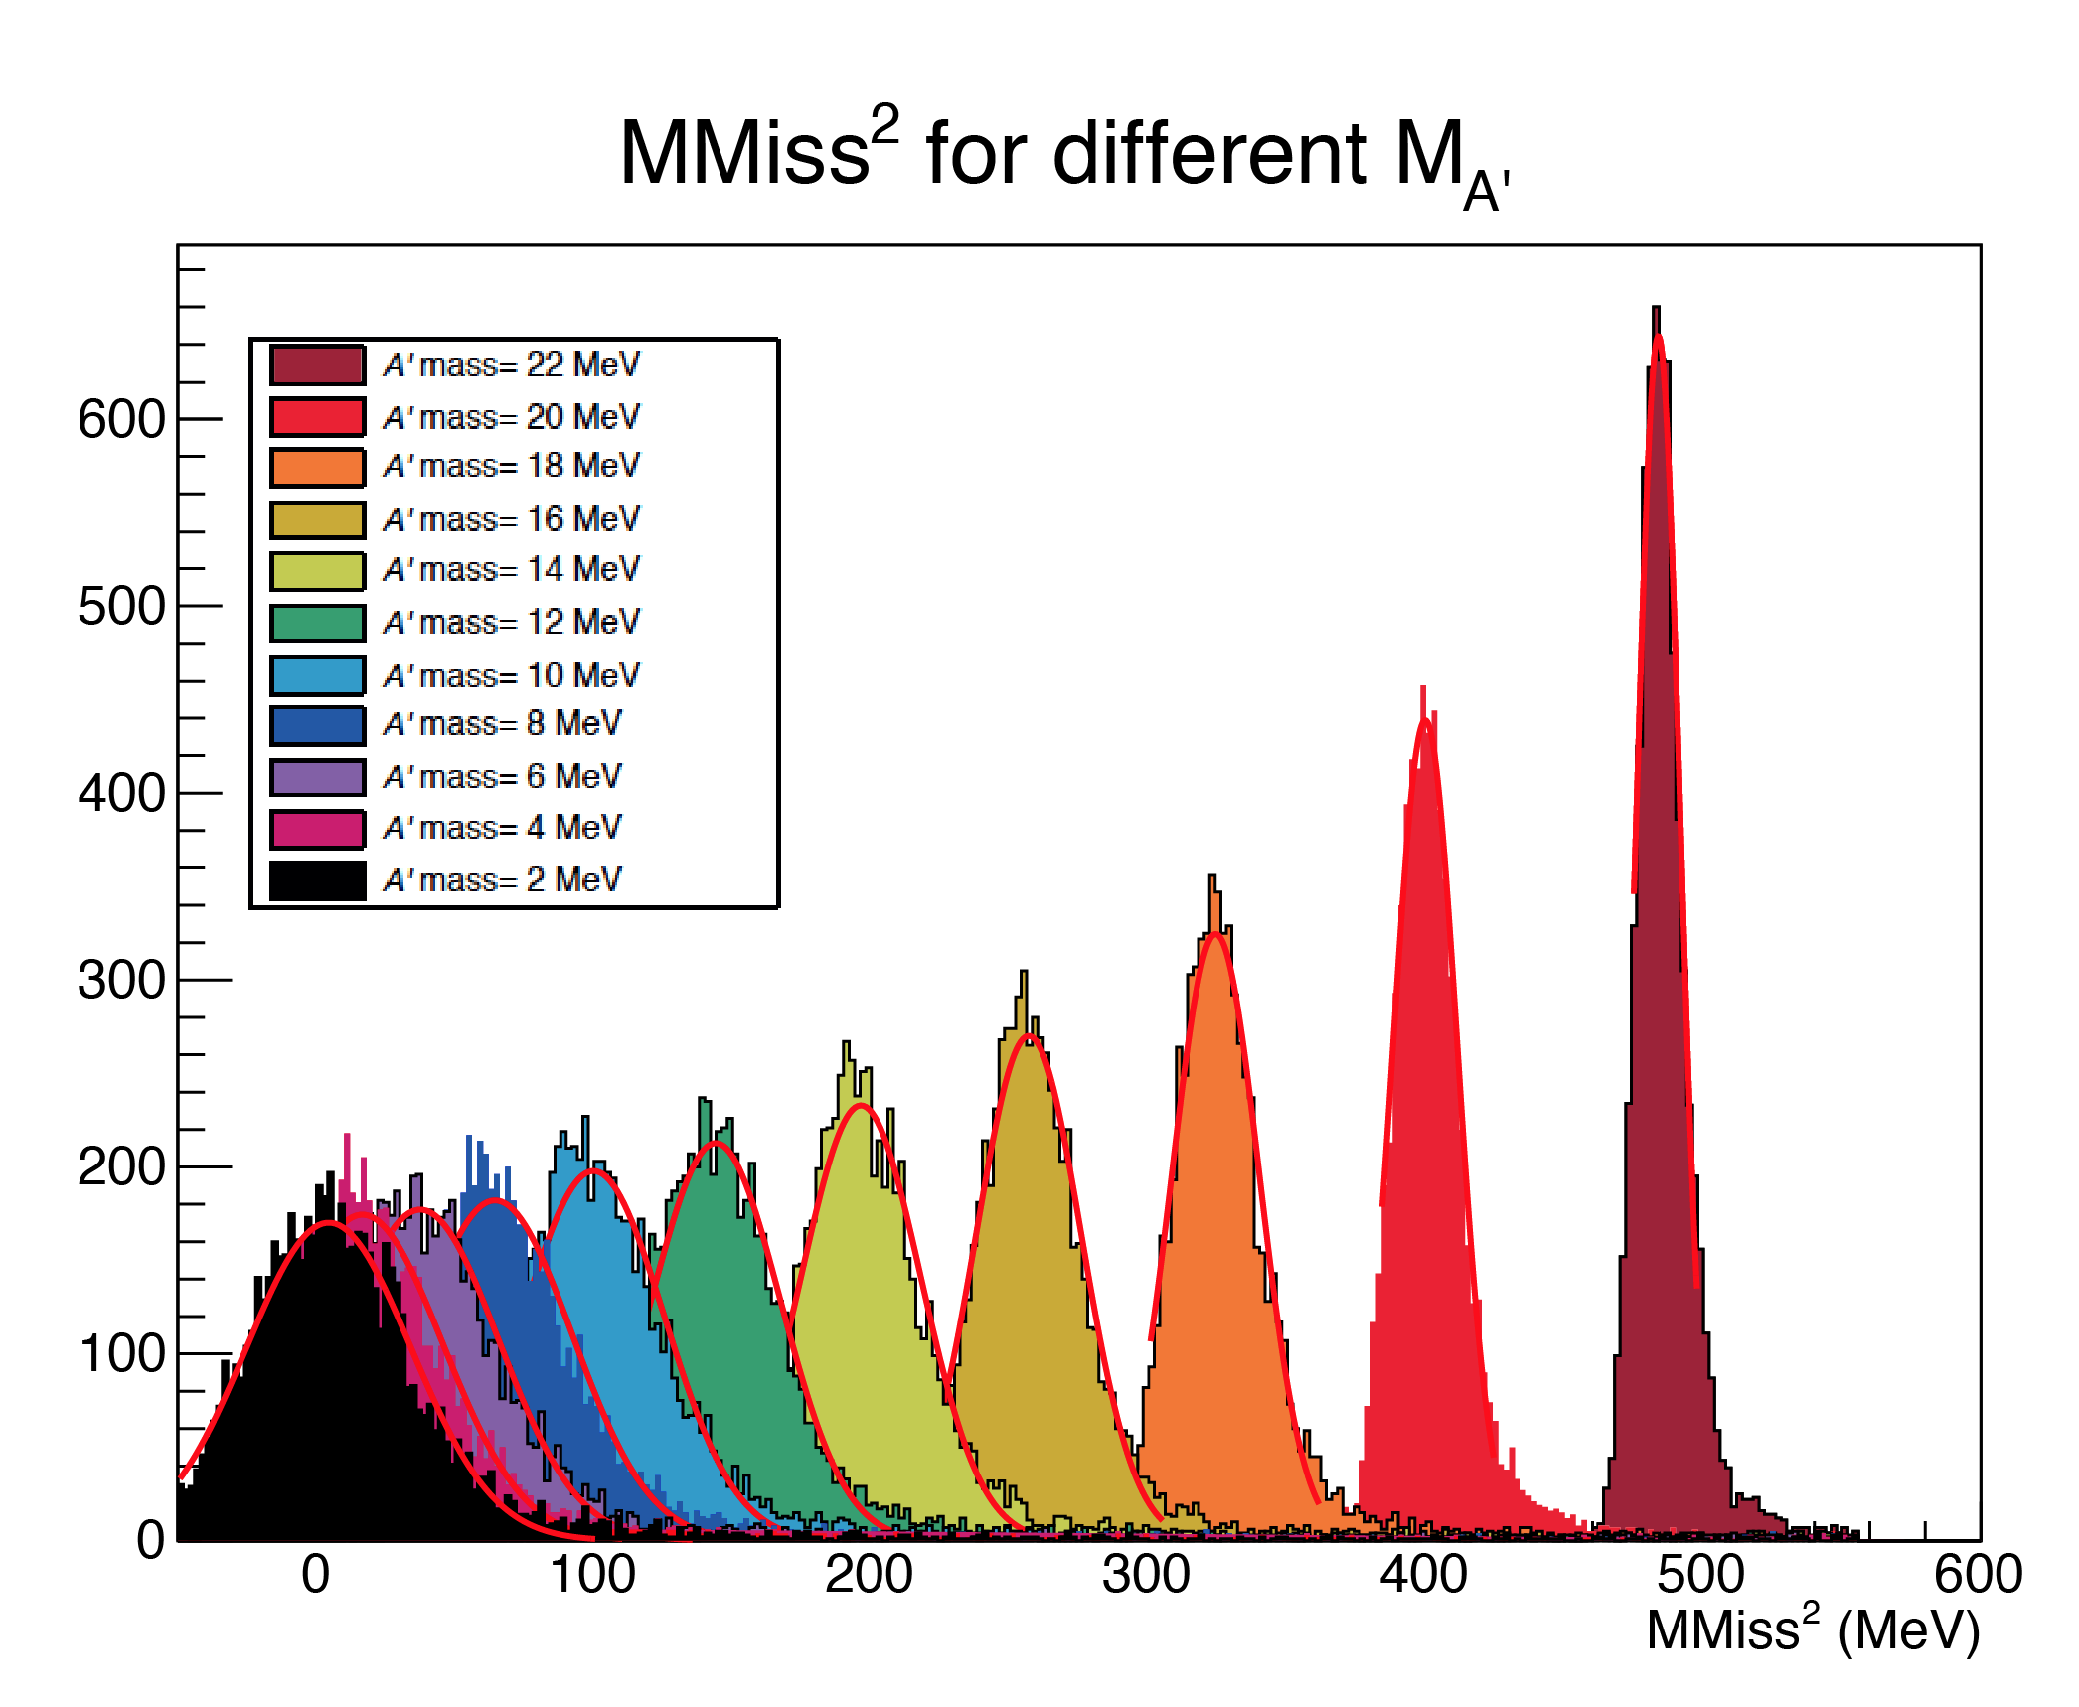
The PADME approach
one photon + nothing
e⁺e⁻ → γ (E_{miss})
Annihilation, invisible decays
Know e⁺ beam momentum and position
  Tunable intensity (in order to optimize annihilation vs. pile-up)
Measure the recoil photon position and energy
Calculate M²_{miss} = (P _{e+} + P _{e+} − P _{γ})²
  Only minimal assumption: A’ couples to leptons
  PADME will limit the coupling of any new light particle produced in e⁺e⁻ annihilations: scalars (h’), vectors (A’) or pseudoscalars (ALPs)

Slide 15
Signal and background
Dark photon event
calorimeter
We need to fight the backgrounds:
one photon + something else, typically one or more photons going undetected:
magnet
Bremsstrahlung event
γγ(γ) event
positron veto detector
calorimeter
calorimeter
magnet
magnet

Slide 16
PADME-visible
Of course, also visible decays can be searched for
Present PADME detector has been optimized for the invisible search
However, we foresee scintillator detectors both on the “electron” and “positron” side of the analyzing magnet to allow detection of decays to l⁺l⁻ pairs
e⁺e⁻ → γ A’
A’→ e⁺e⁻
Annihilation, visible decays
calorimeter
magnet

Slide 17
First of all, we need the positron beam…

Slide 18
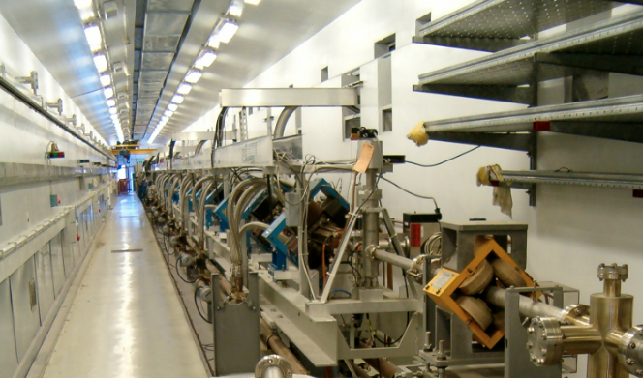
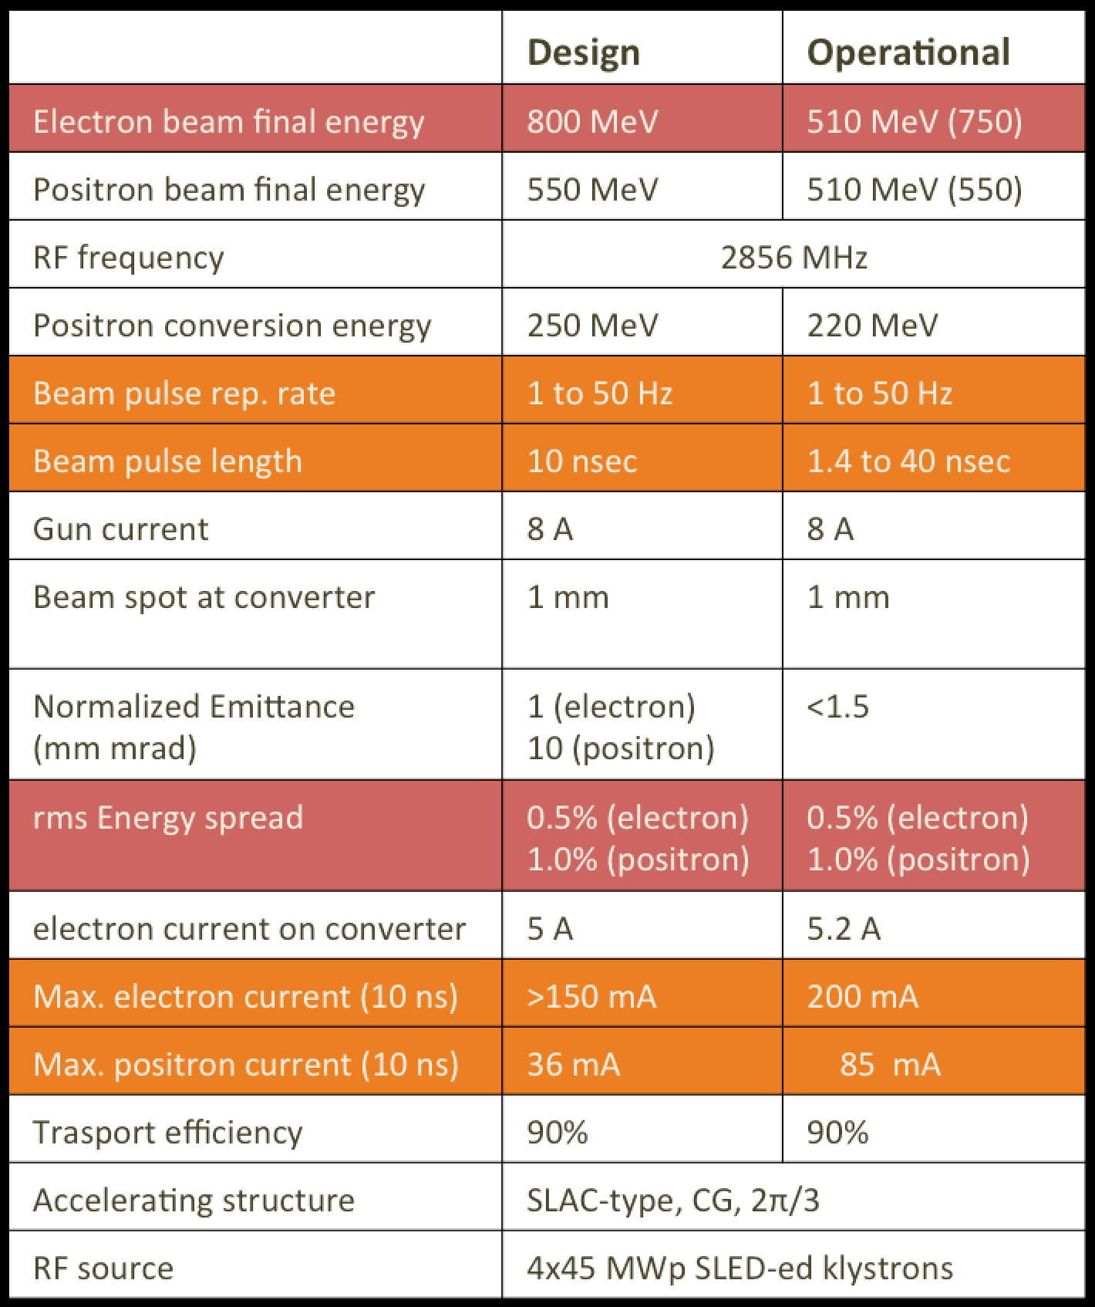
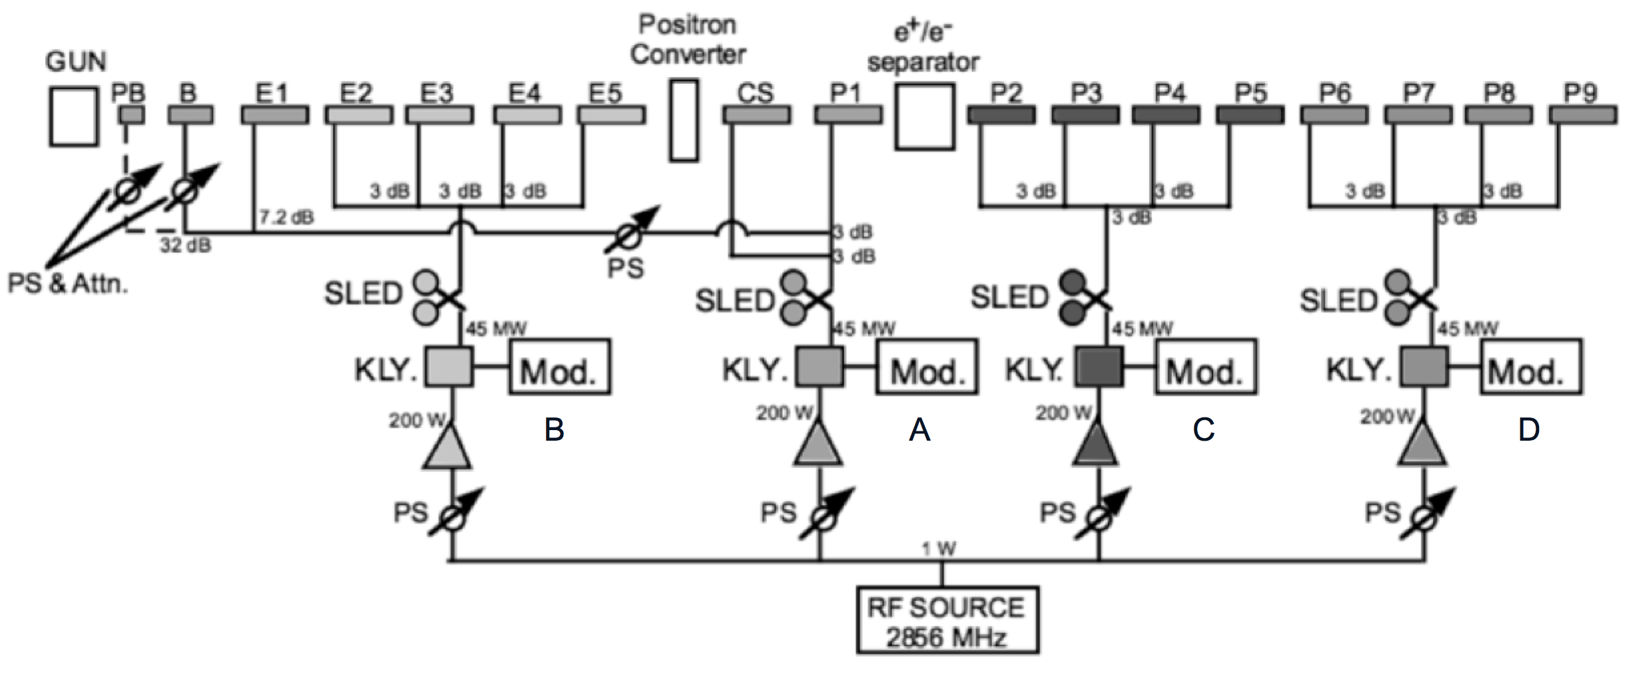
The Frascati LINAC
TW, CG, 2/3π, S-band SLAC-type accelerating sections
LINAC parameters
50 Hz repetition rate

Slide 19
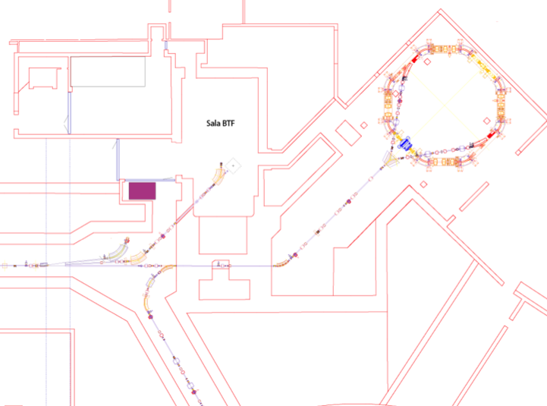
The beam test facility
Damping
Ring
BTF
transfer line
LINAC
10 m
transfer line
to DAΦNE main rings

Slide 20
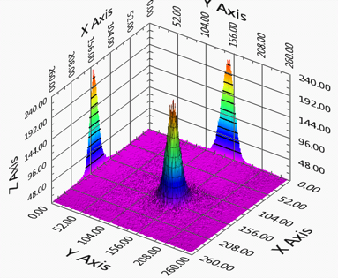
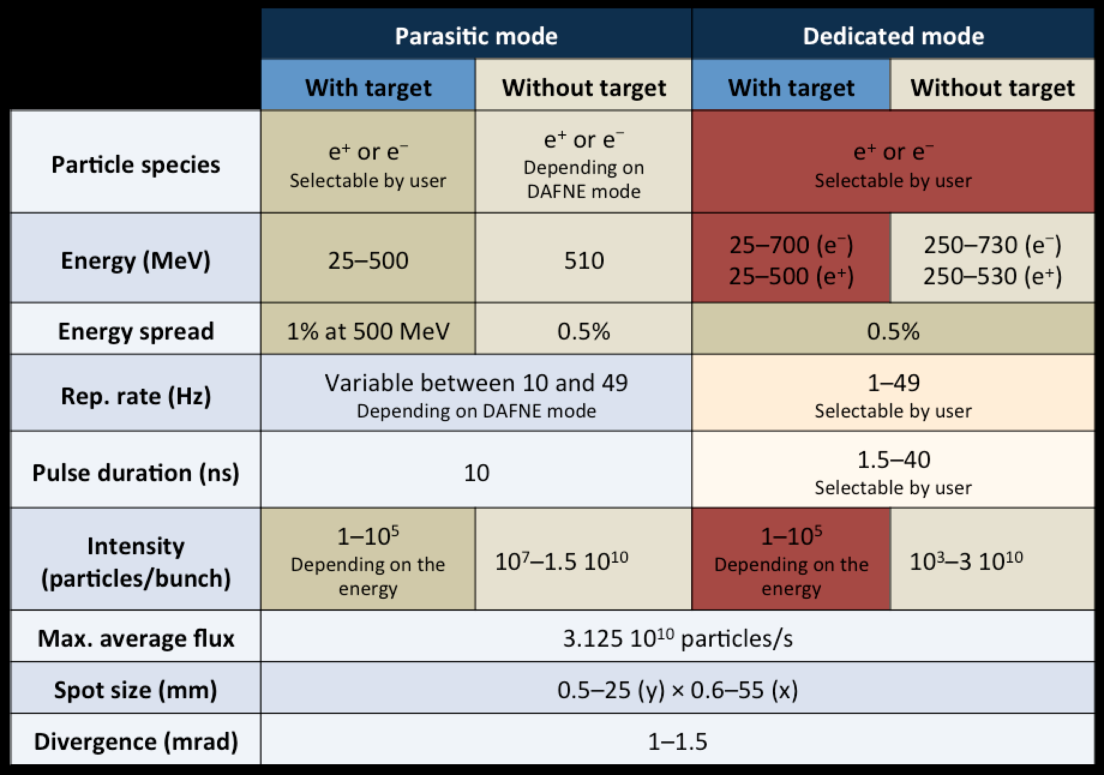
BTF summary
  Energy spread Δp/p ~1%
  Beam spot: <1 mm RMS
  Divergence: 1 – 1.5 mrad
  Beam position: 0.25 mm RMS
  Pulse duration: 1.5 – 40 ns
    10 ns during collider operations
  Two intensity ranges (with and without attenuation target)
    PADME will be limited by the pile-up anyhow
Beam spot size
Effect of multiple scattering and Bremsstrahlung on the Beryllium exit window and in air has to be considered
Both size and divergence depend on the optics
Beam parameters

Slide 21
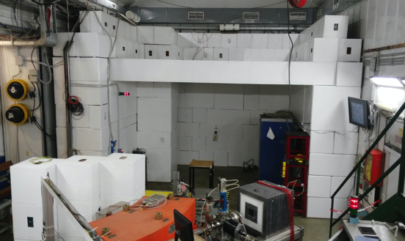
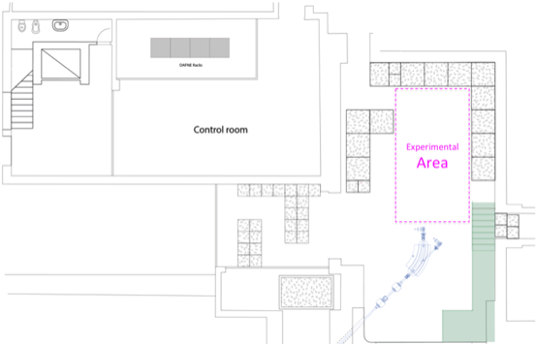
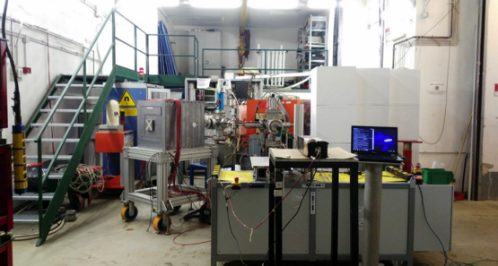
BTF experimental hall
BTF
control room
Approximately <5.5 m total length
(<3 m lateral width)

Slide 22
Then, we need a low Z target…

Slide 23

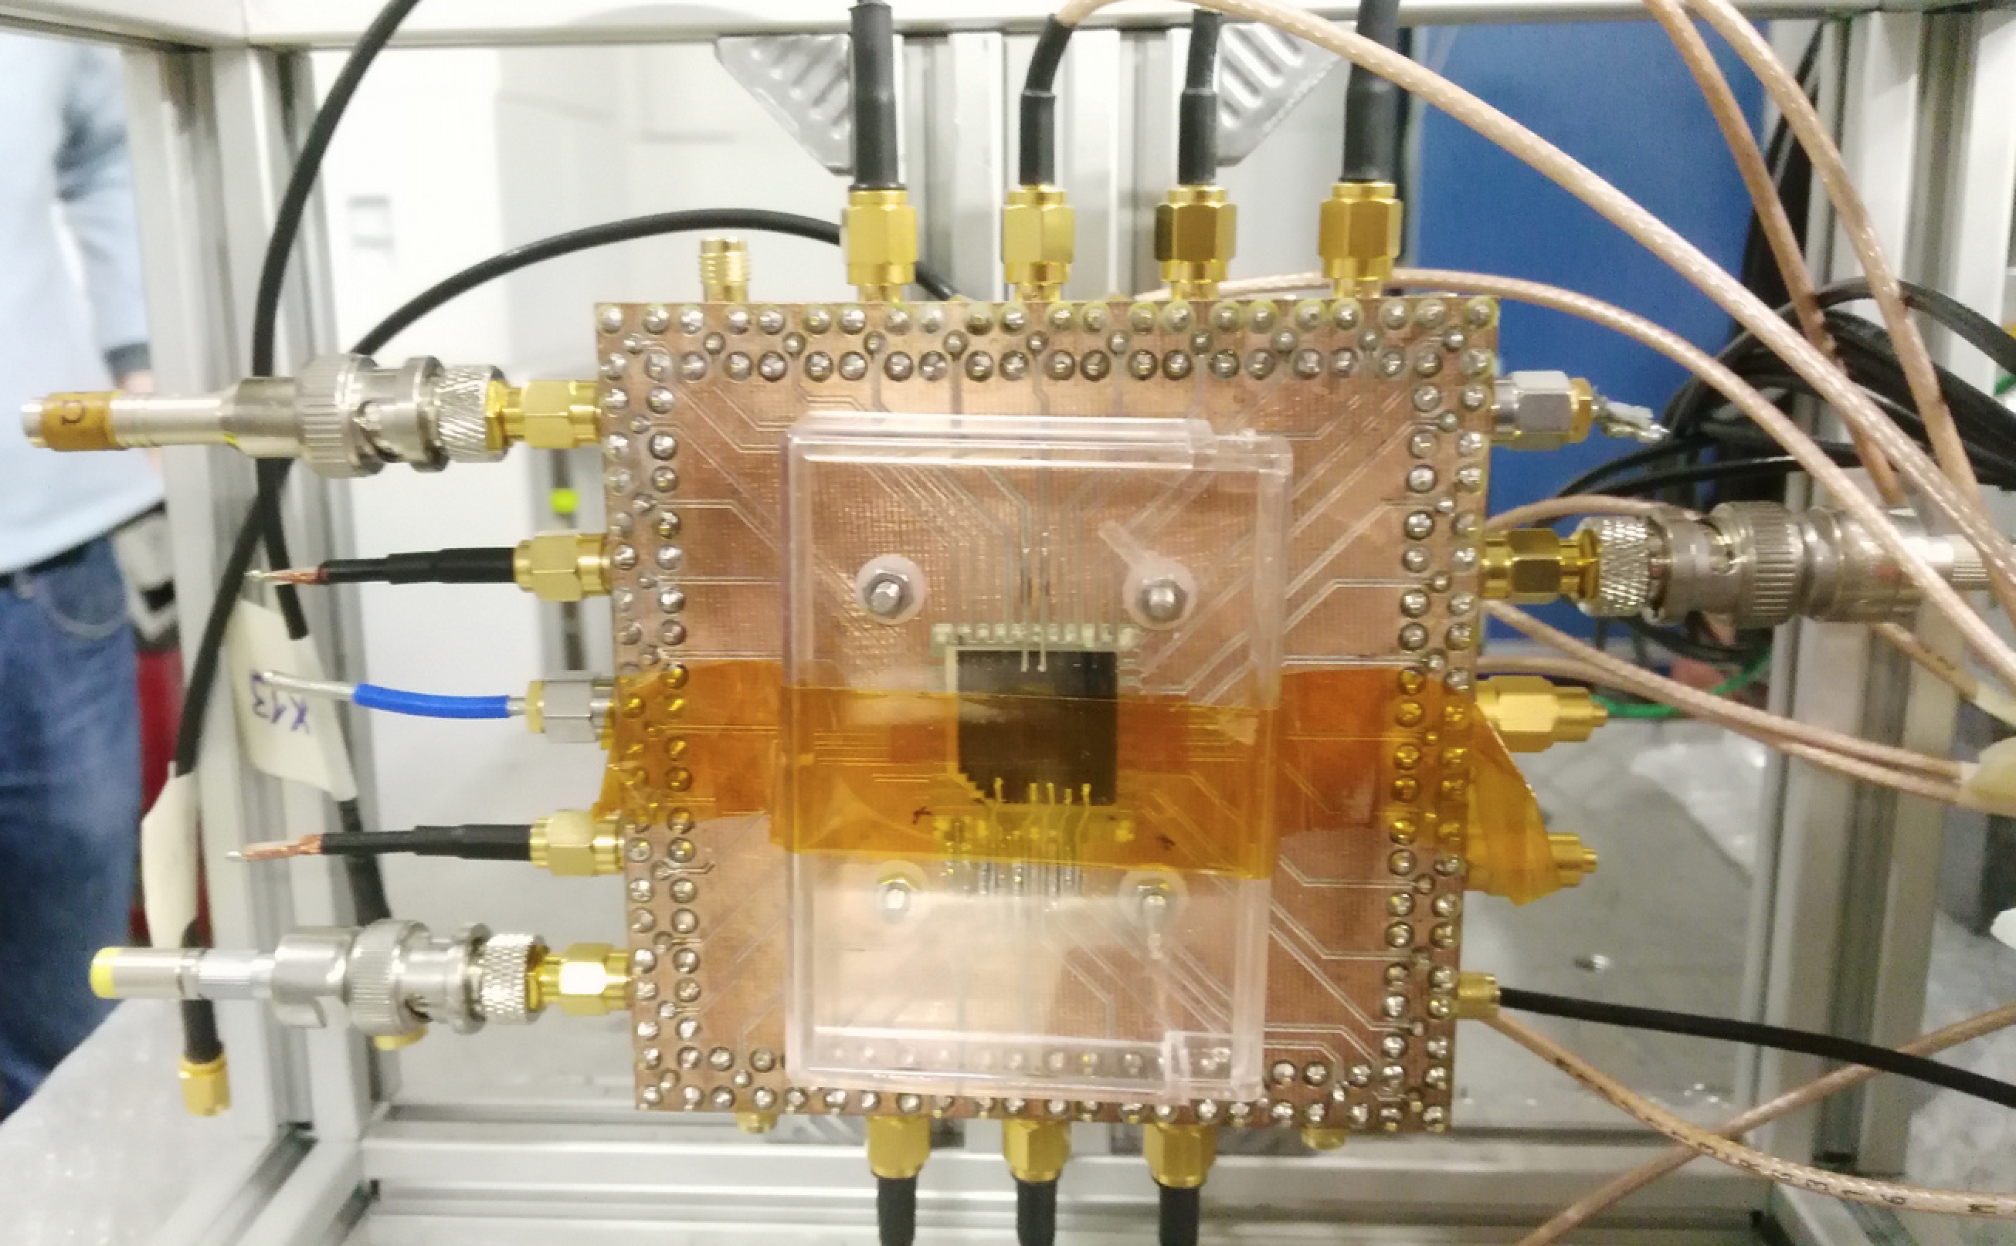
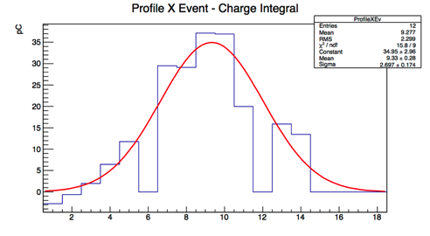
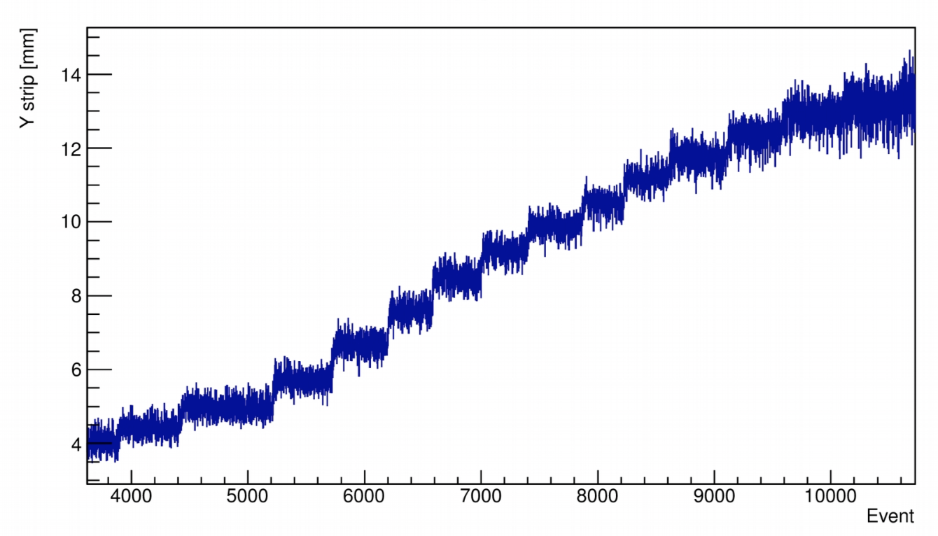
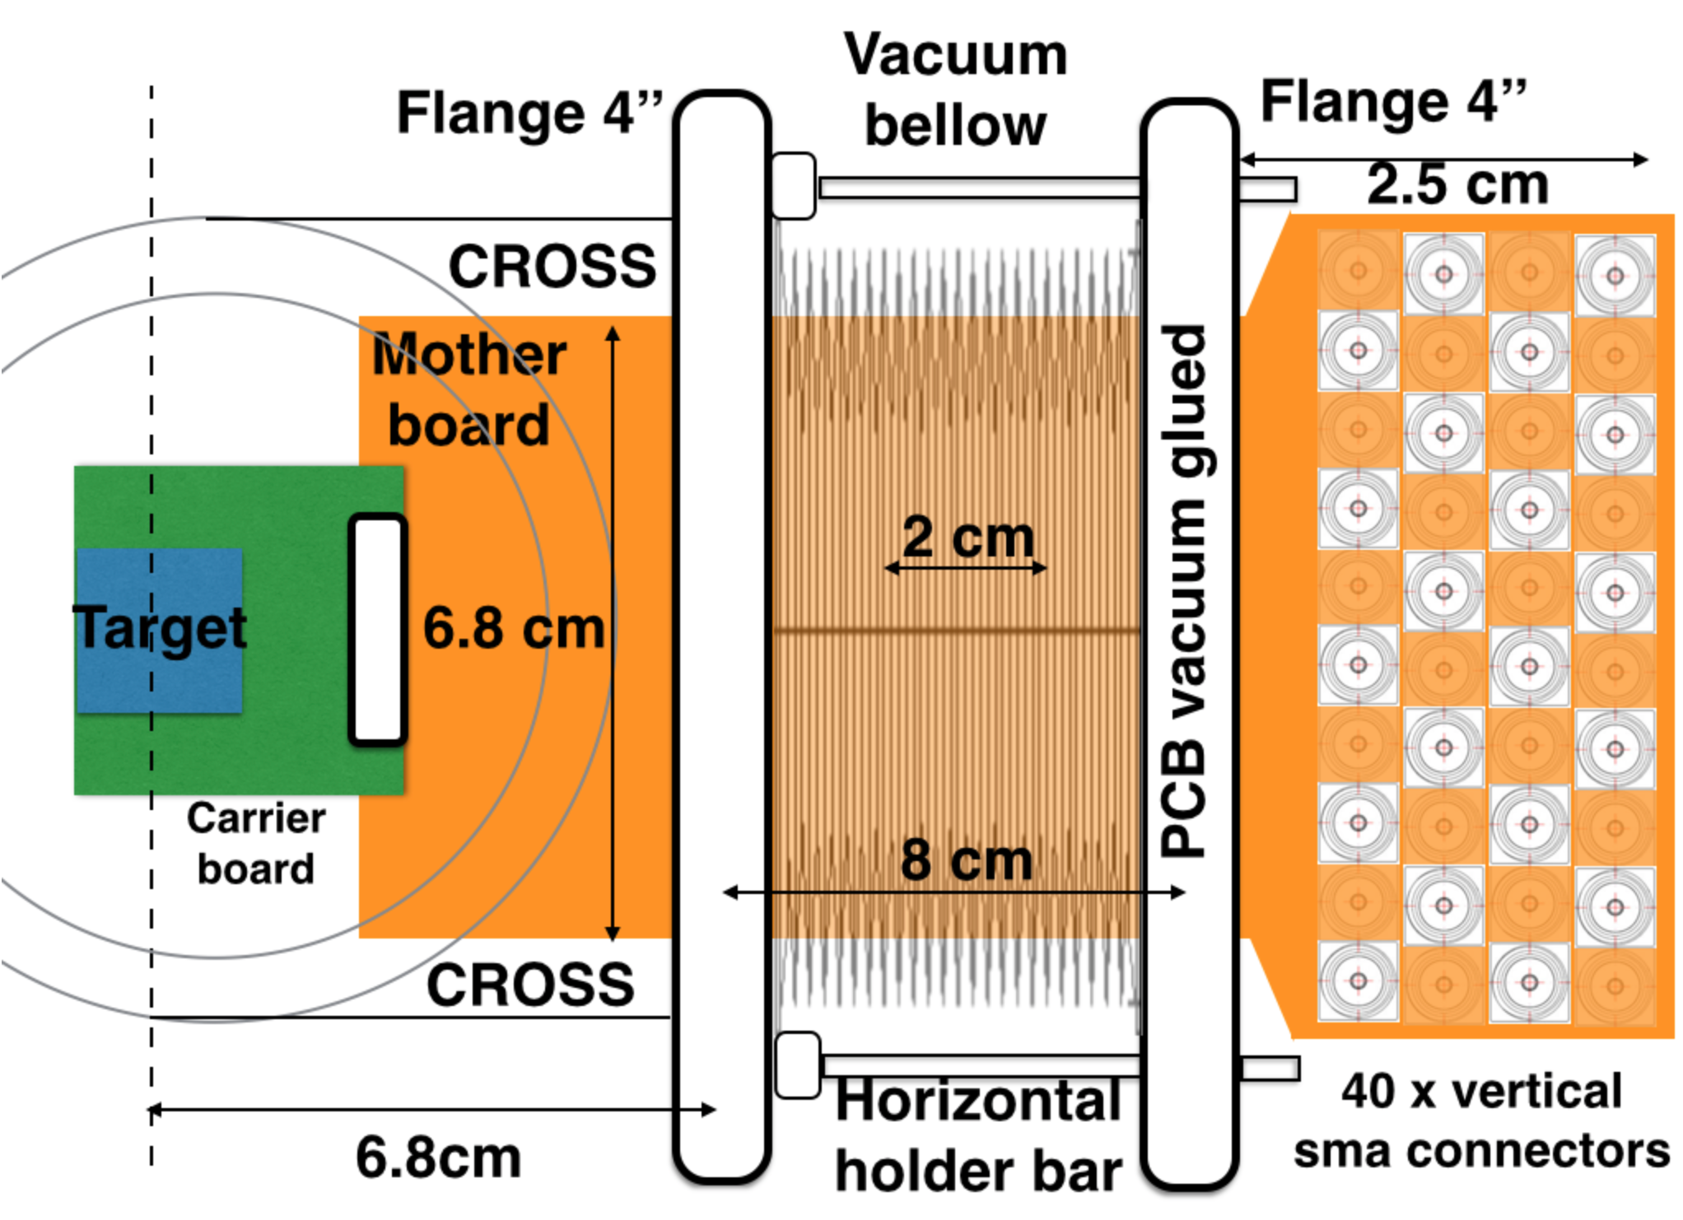
Thin diamond target with graphite strips
Monitor beam intensity and spot position/size
20×20×0.050 mm³ sensor
1 mm pitch x-y graphitic strips produced by UV laser
Very fragile to handle
Vacuum and movement system under development
Beam position scan
First beam-test: few not connected strips
  Home made PCB, wire bonding with Silver conductive glue

Slide 24
We need to sweep away the beam…

Slide 25
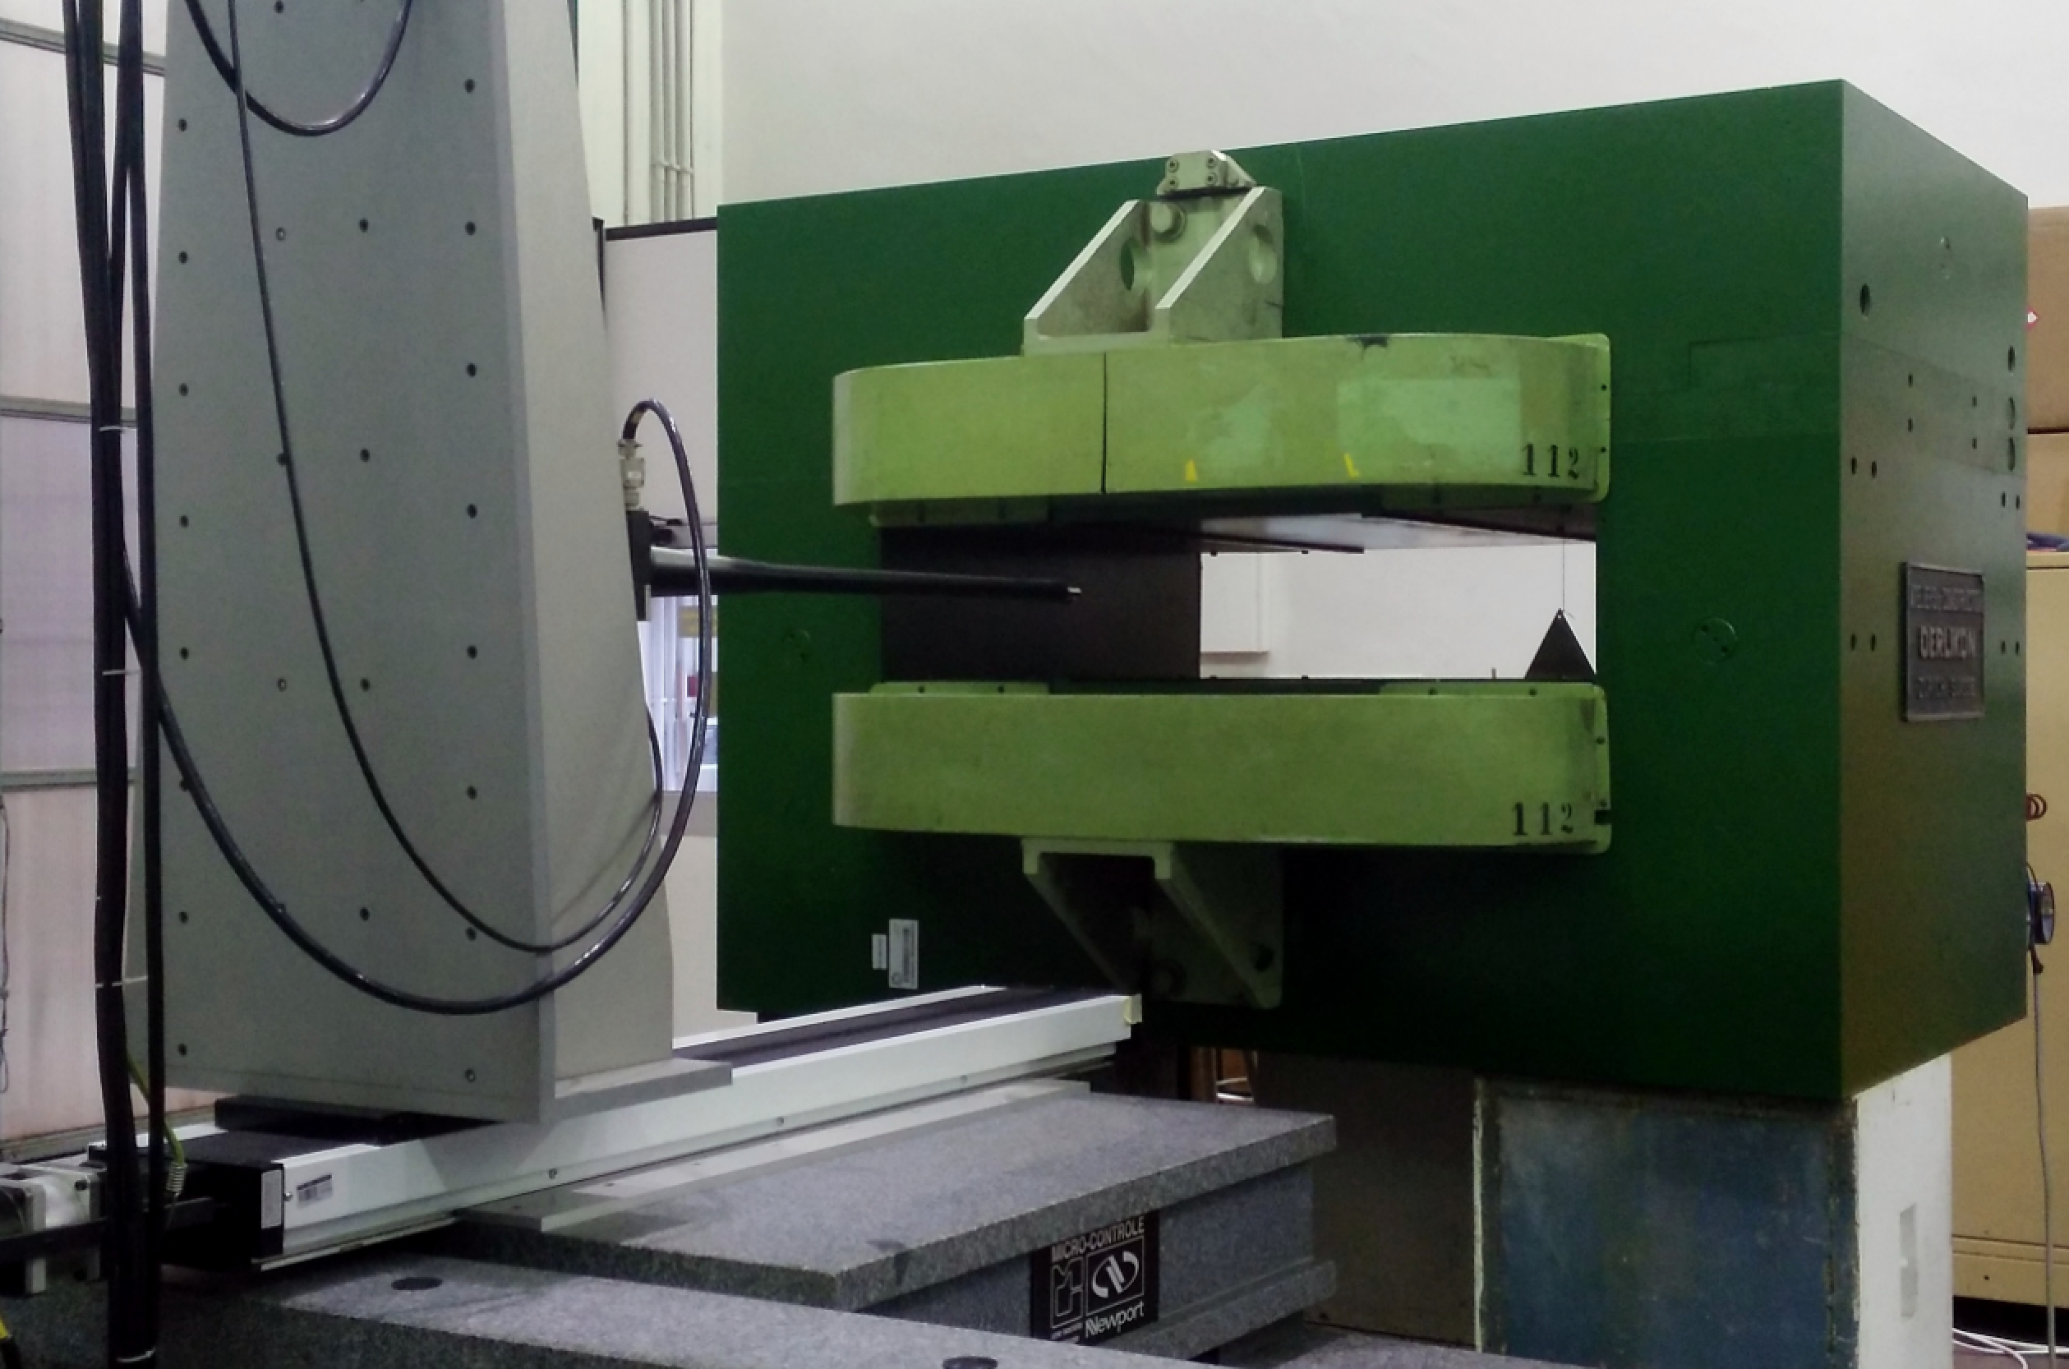
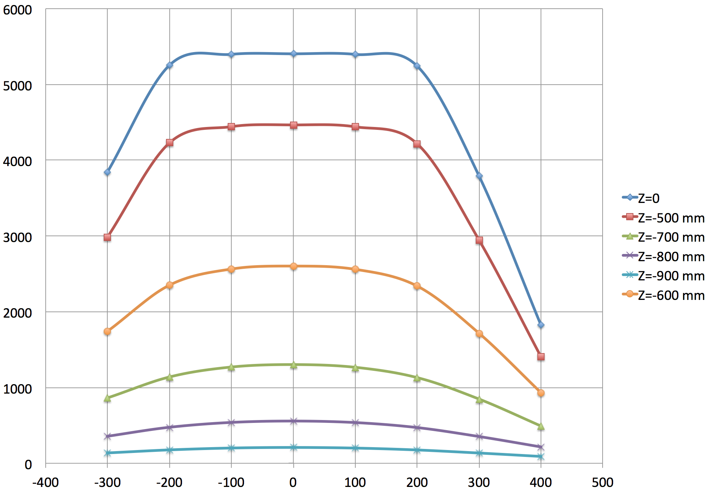
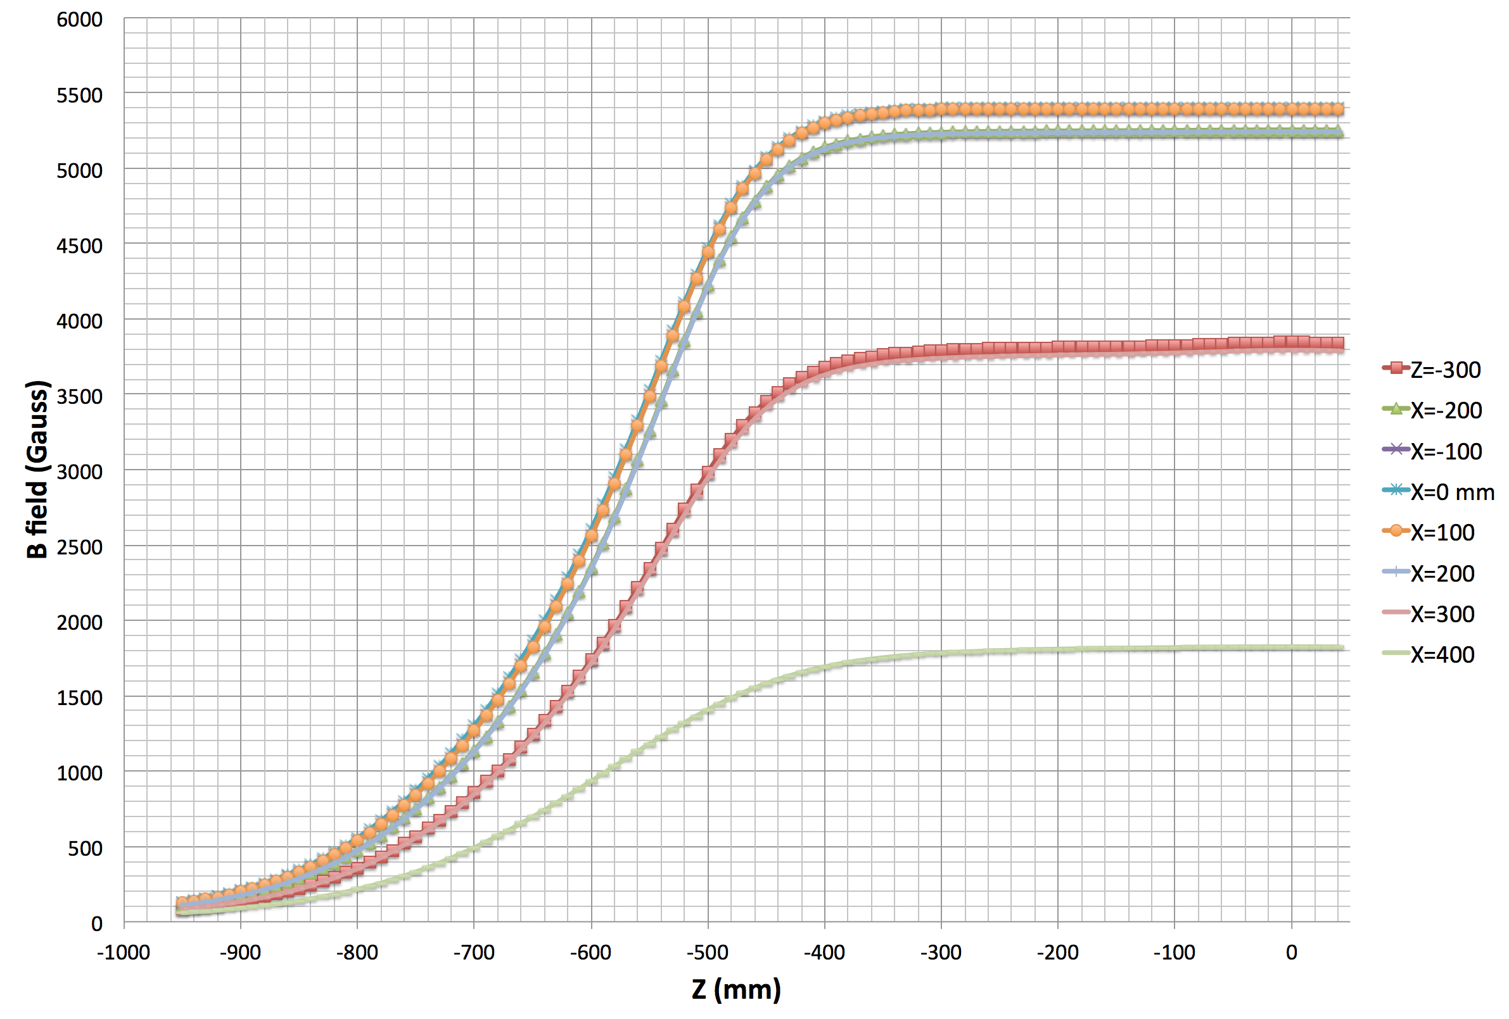

Magnet for PADME
MBP-S series, on loan from CERN
  Many thanks to TE-MSC-MNC, R. Lopez, D. Tommasini
  Shipped to Frascati in Dec. 2015
Poles: 100 cm length, 52 cm width
Variable gap 11 to 20 cm, further extended by us to 23 cm gap
Detailed field mapping under way:
  Good B field quality
  Fringe field not negligible, even outside the coils, relevant for the precise beam steering onto the active target
coils
pole

Slide 26
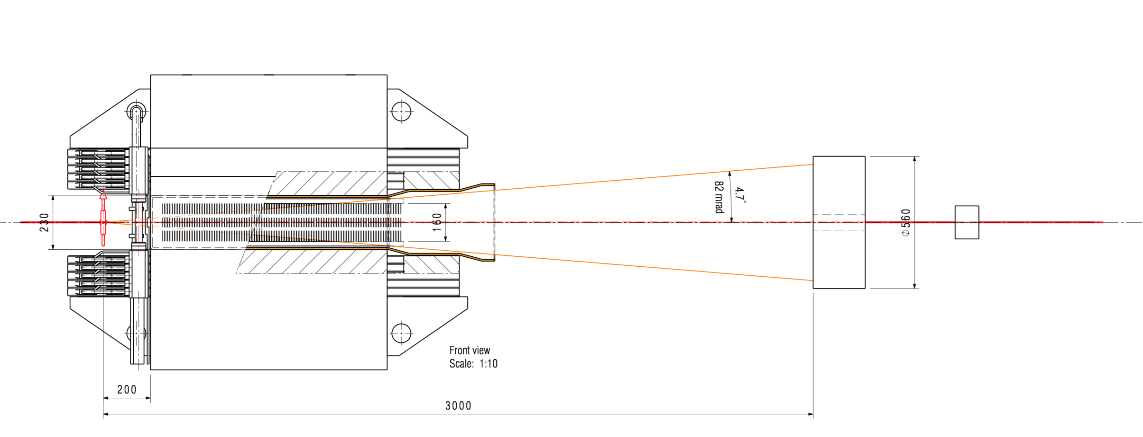
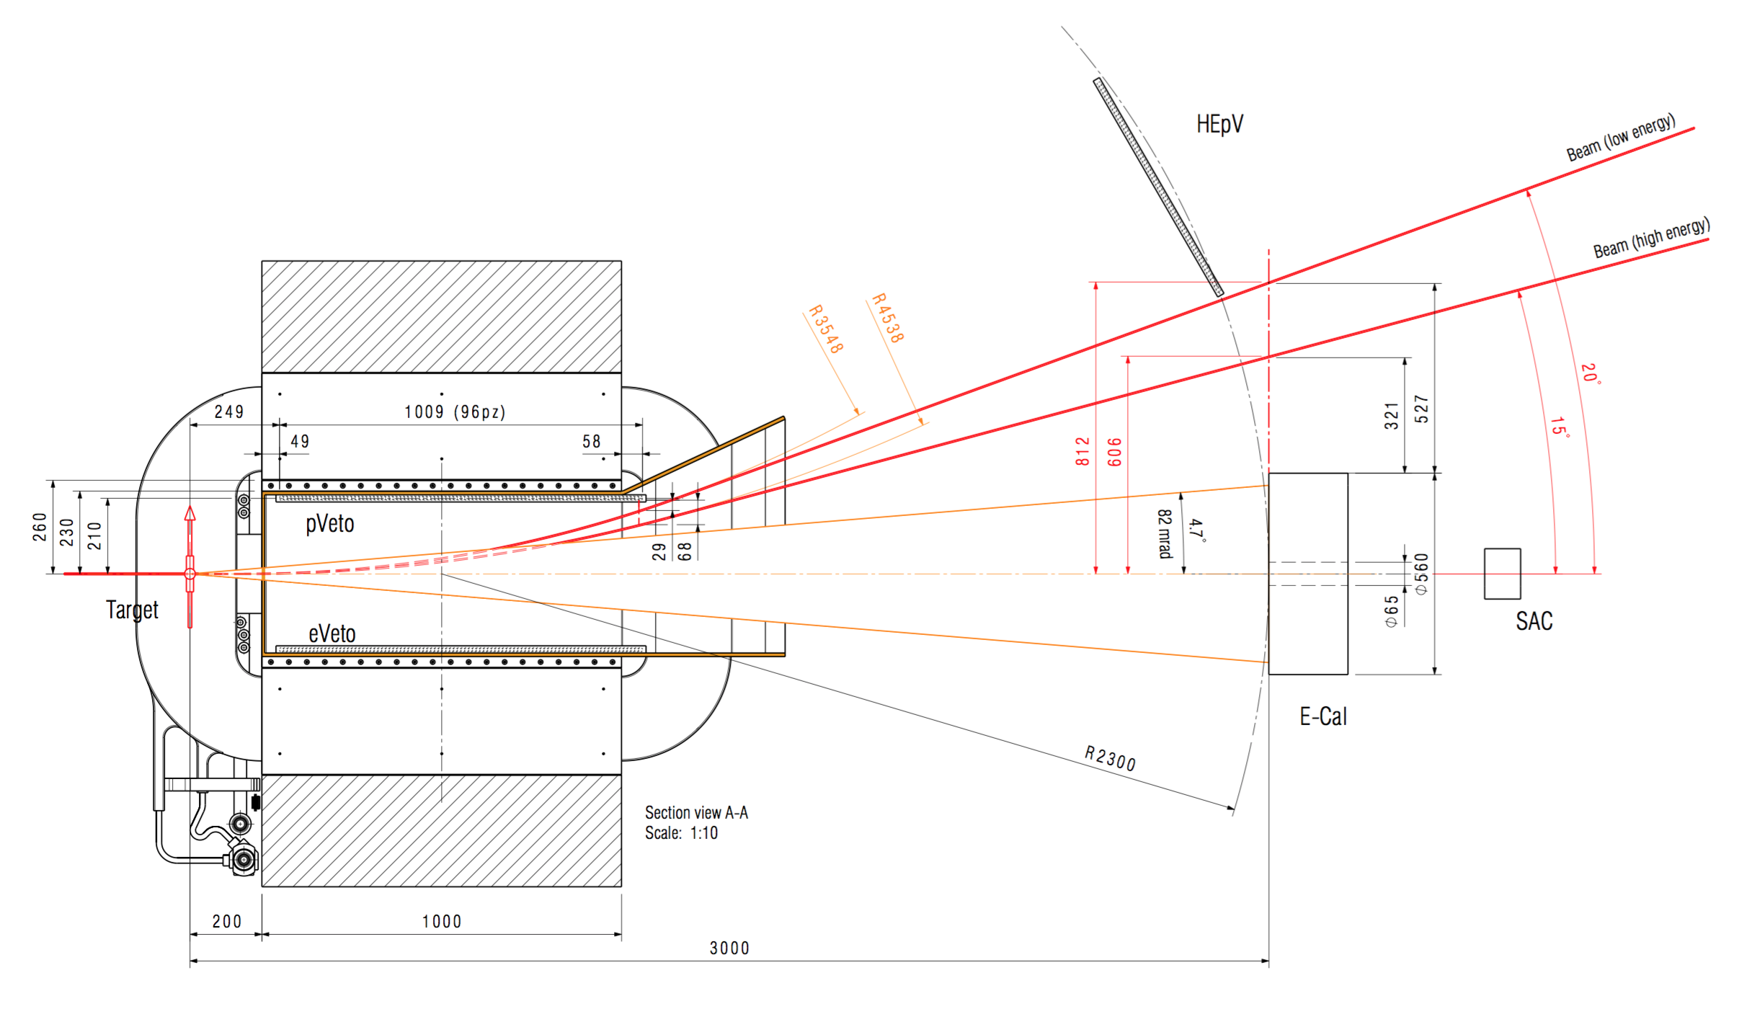
Acceptance vs. magnet
Side view
Magnet gap (– vacuum pipe depth)
Fixes the maximum (vertical) acceptance
together with the target position
Calorimeter
Top view
Given the gap, the minimum magnetic field is given by beam momentum and needed sweeping angle, depending on the calorimeter angular acceptance (in the bending, horizontal, plane)
Calorimeter

Slide 27
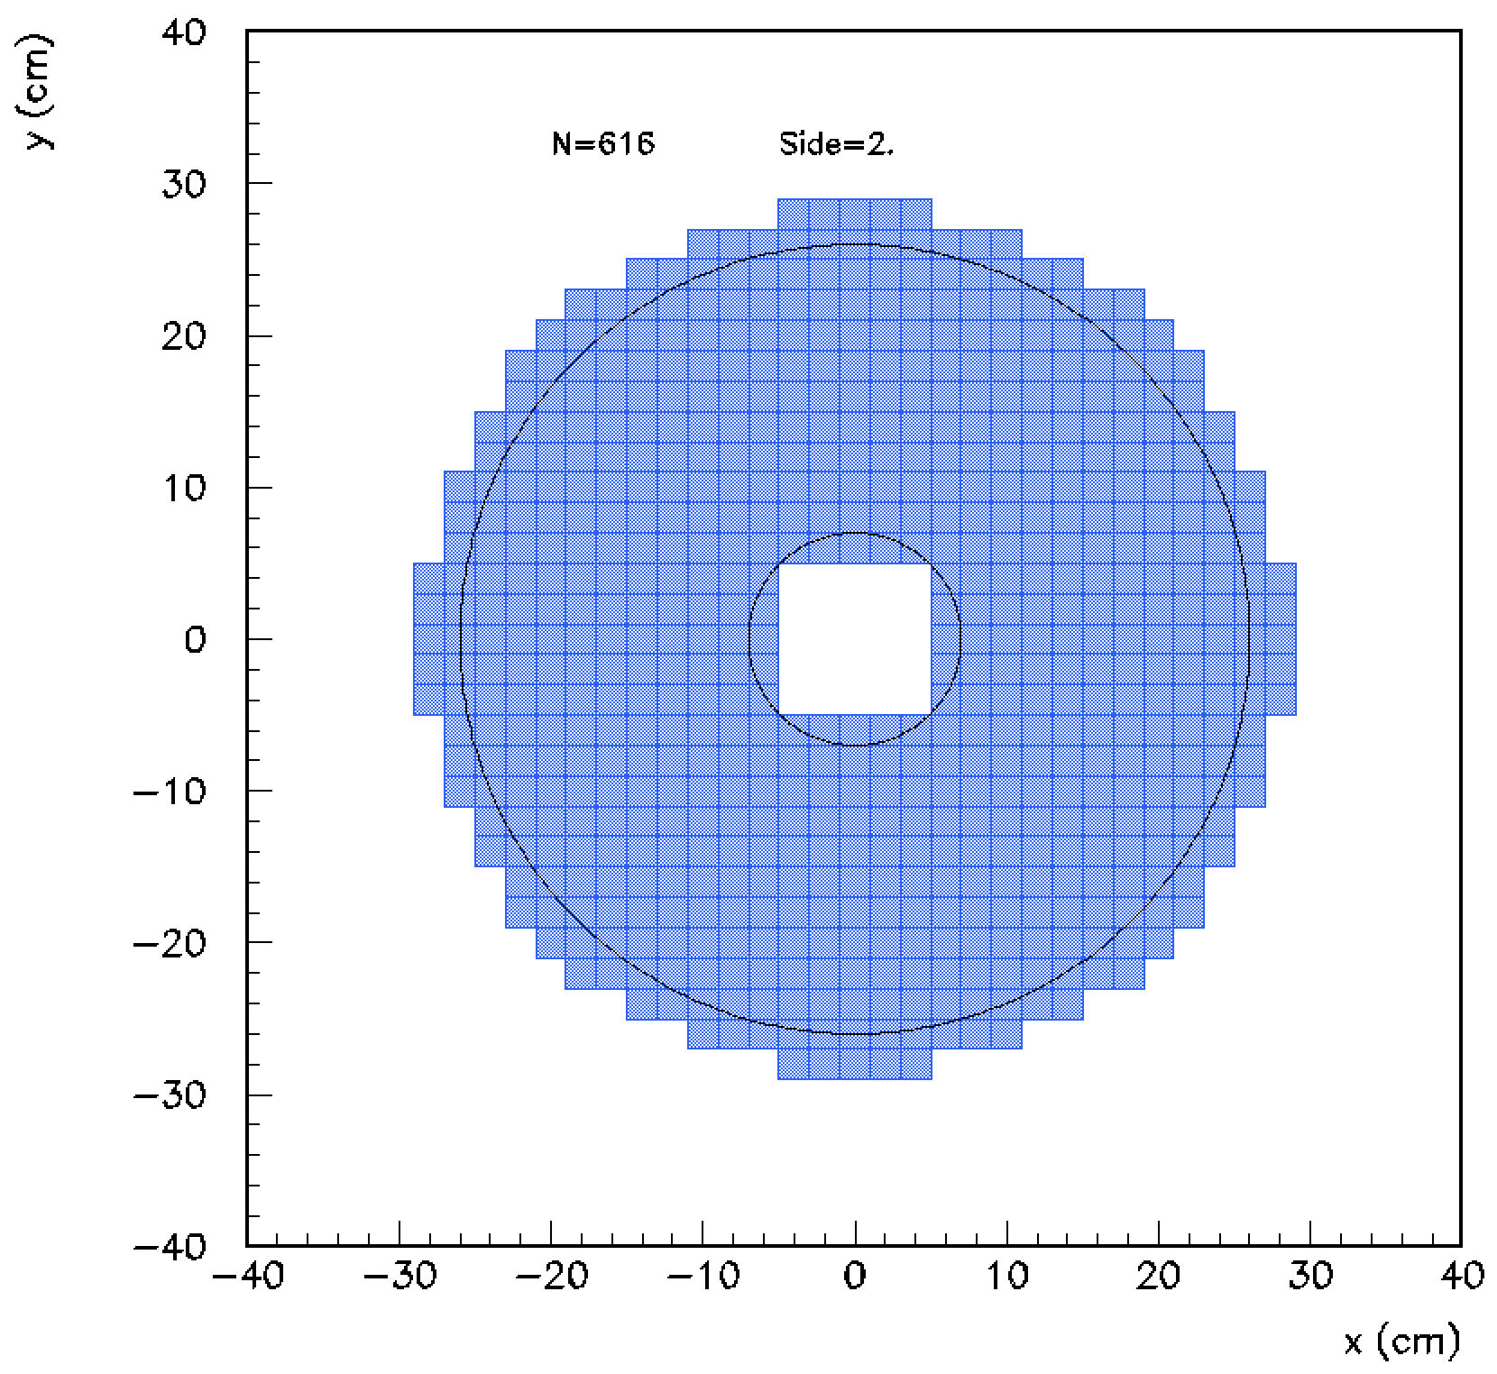
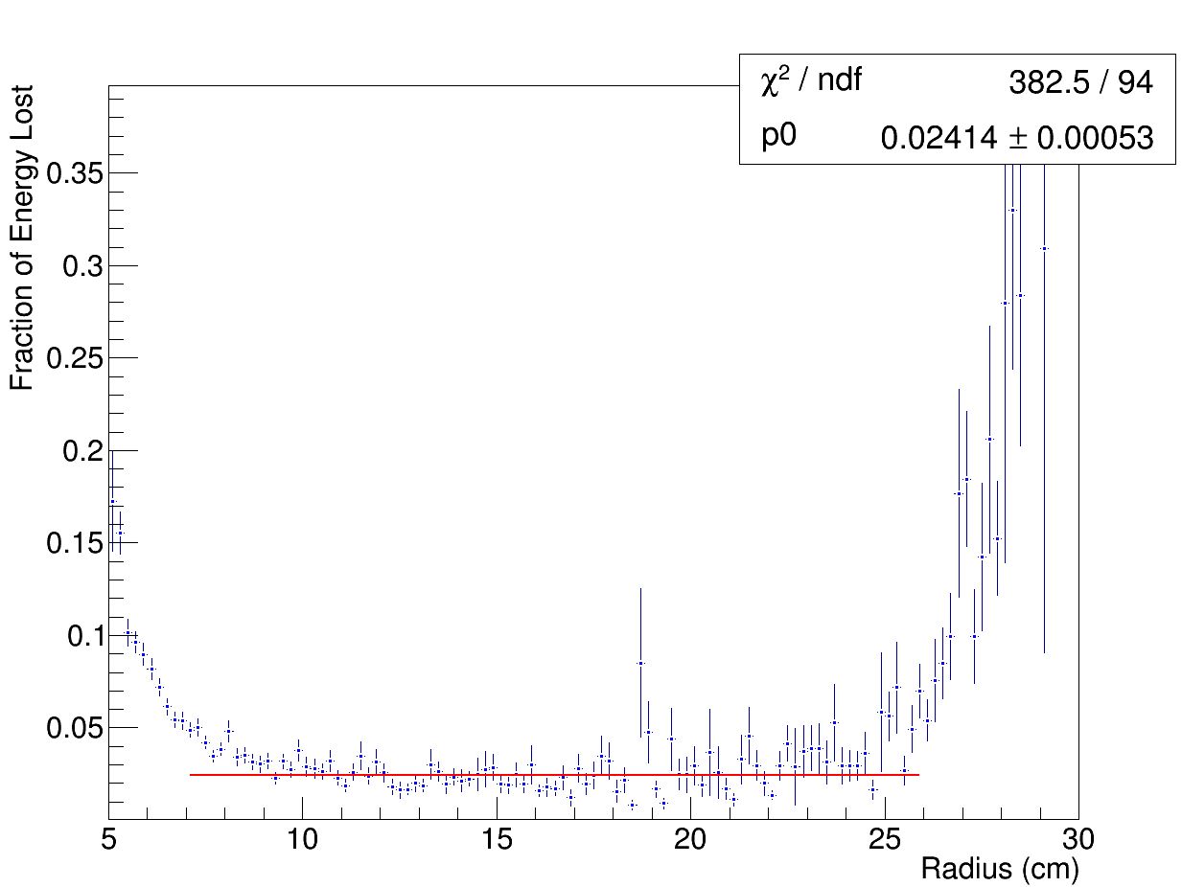

Calorimeter: signal acceptance
N=616 crystals, 2×2 cm² size
Fraction of energy loss, leaving at least 1.5 cells for lateral containment
Central hole to keep under control pile-up, mainly due to Bremsstrahlung events

Slide 28
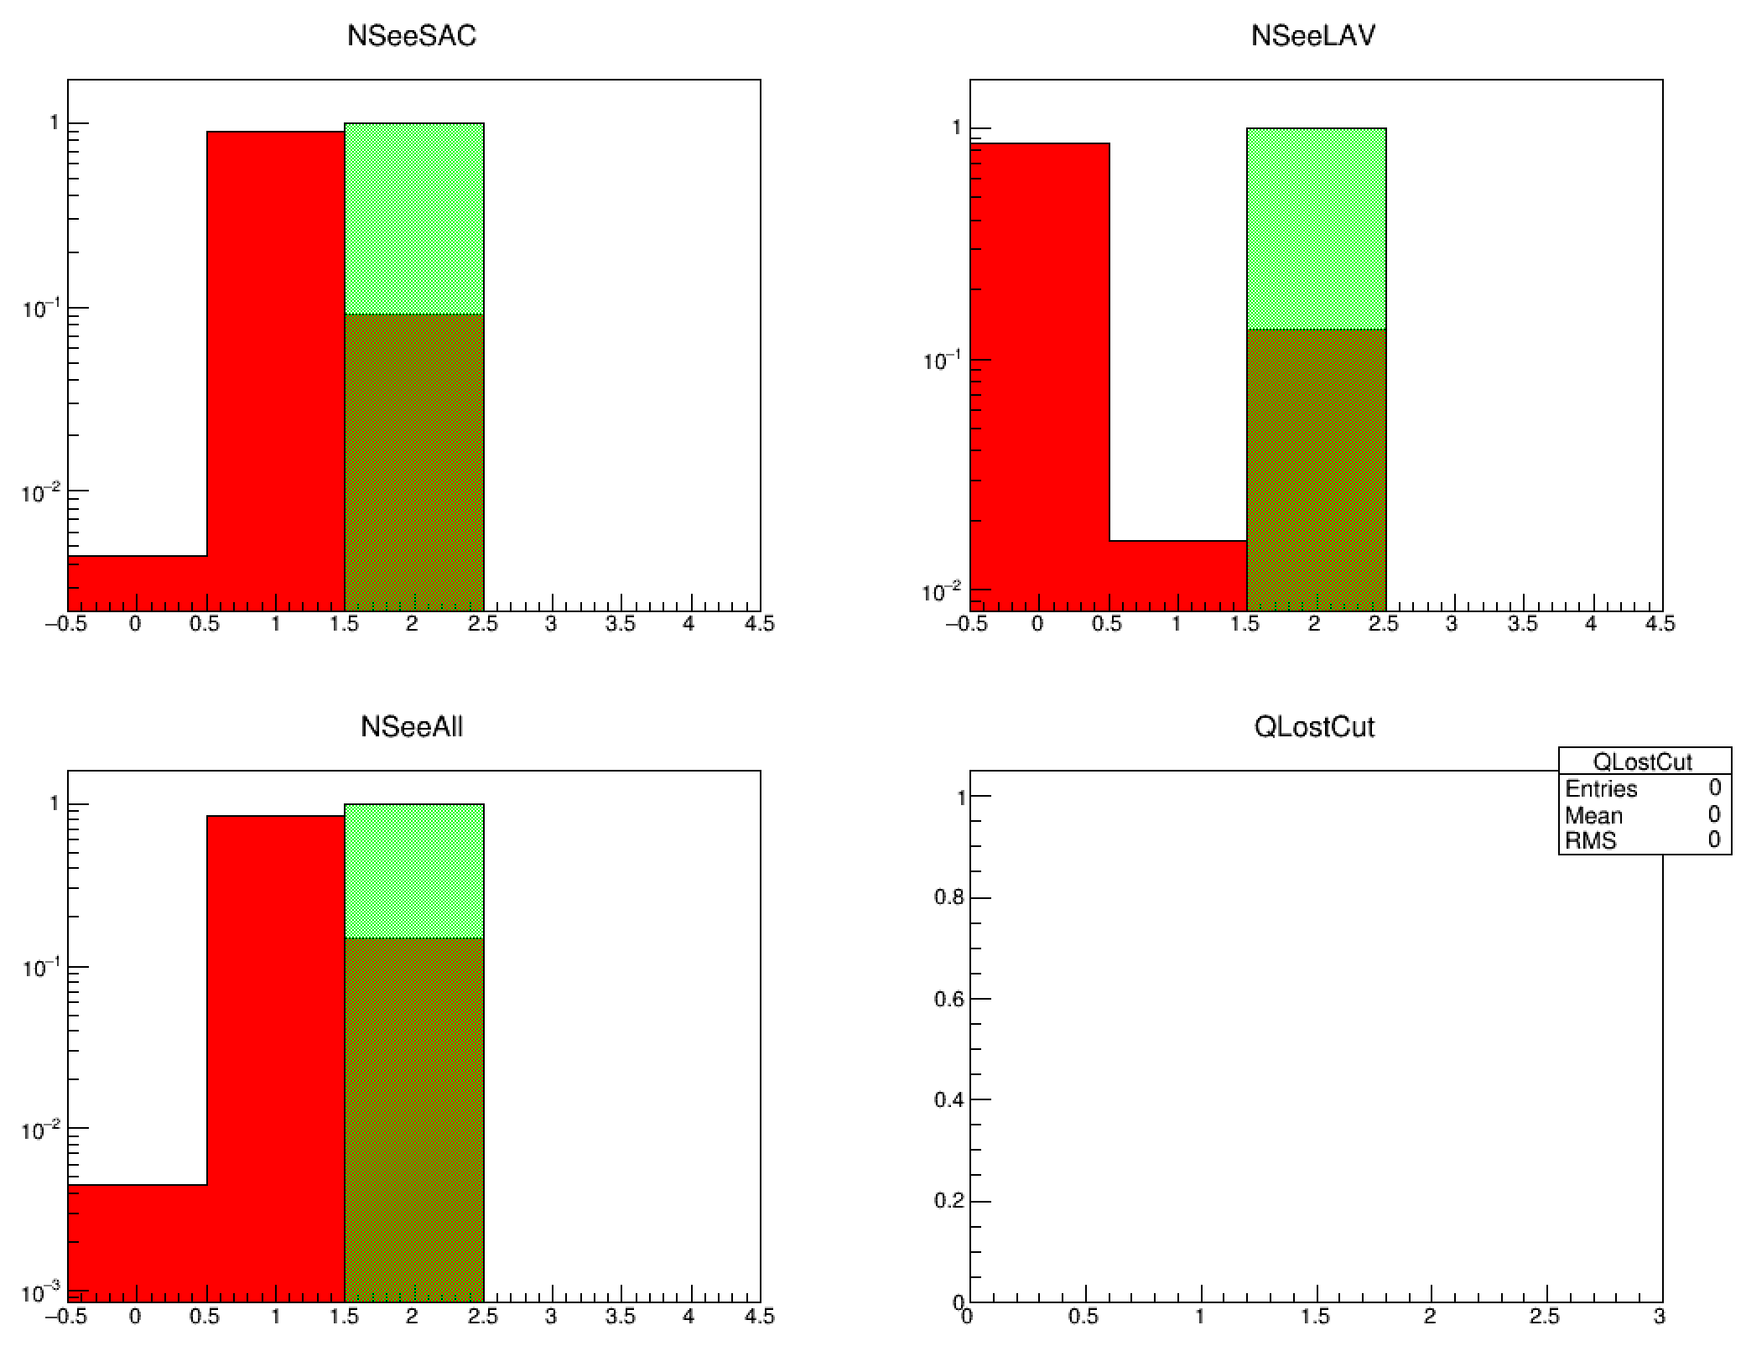
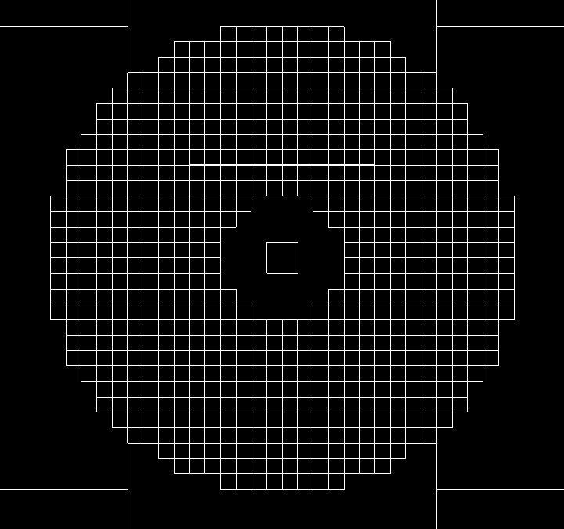
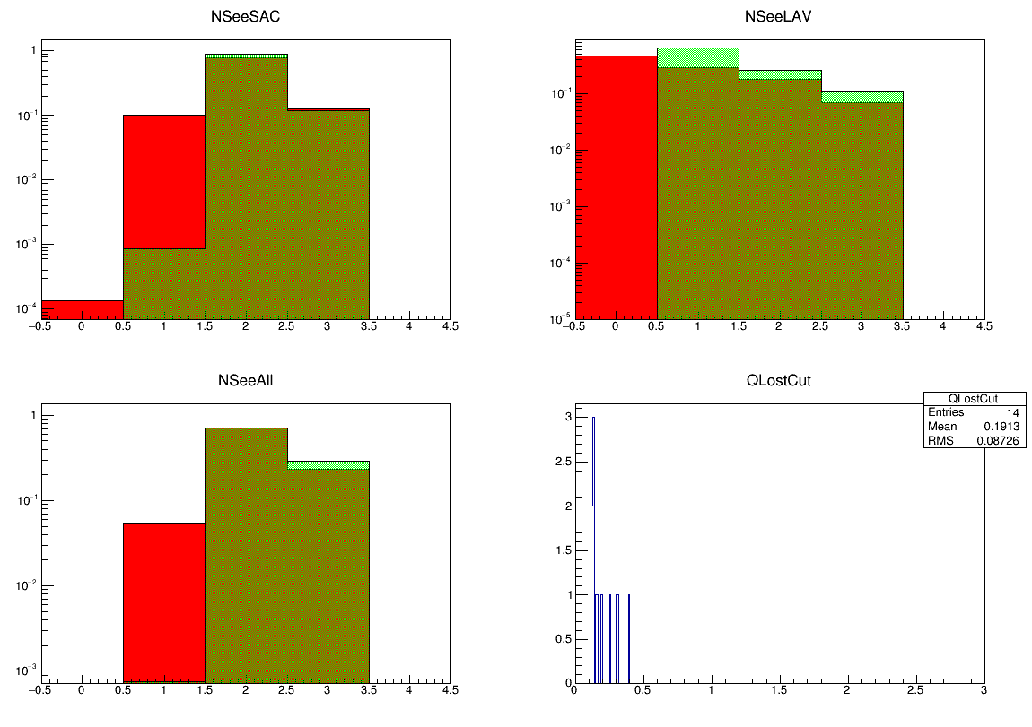
Calorimeter 2γ and 3γ backgrounds
Lost
θ>100 mrad
1+2
2+3
3
2
2
Region 1
<20 mrad
Region 3
θ>75 mrad
1+2+3
Lost
1
No 2γ events
Recoil γ definition:
10 MeV < E < 400 MeV
30 mrad < θ < 65 mrad
Per-mil 3γ background

Slide 29

Measuring the recoil photon
Our main detector is of course a calorimeter, with two basic requirements:
1. Measure E_{γ} and θ_{γ}
  Good energy resolution: 1-2%/√E[GeV])
    High Photo-statistics
    Containment
  Good angular resolution: ≈1 mrad
2. Fight pile-up
  Sub-ns timing resolution
γ
The material choice fixes light yield & time resolution, Moliére radius & X₀
The Moliére radius determines granularity
The granularity + required angular resolution, set the distance from the target
Given the distance, the lateral size fixes the angular coverage (i.e. acceptance)
But…
…we have to take into account two important constraints:
The overall size of the experiment is the hall length (<5 m)
Another important bound is the cost, which is driven by the material, size and granularity (i.e. the number of channels)
e⁺
Target
So we have to keep it compact!

Slide 30
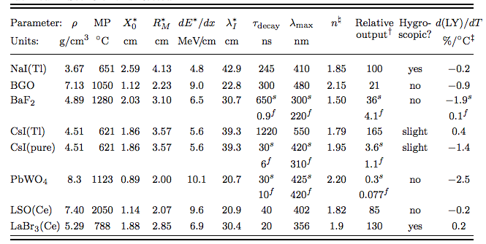
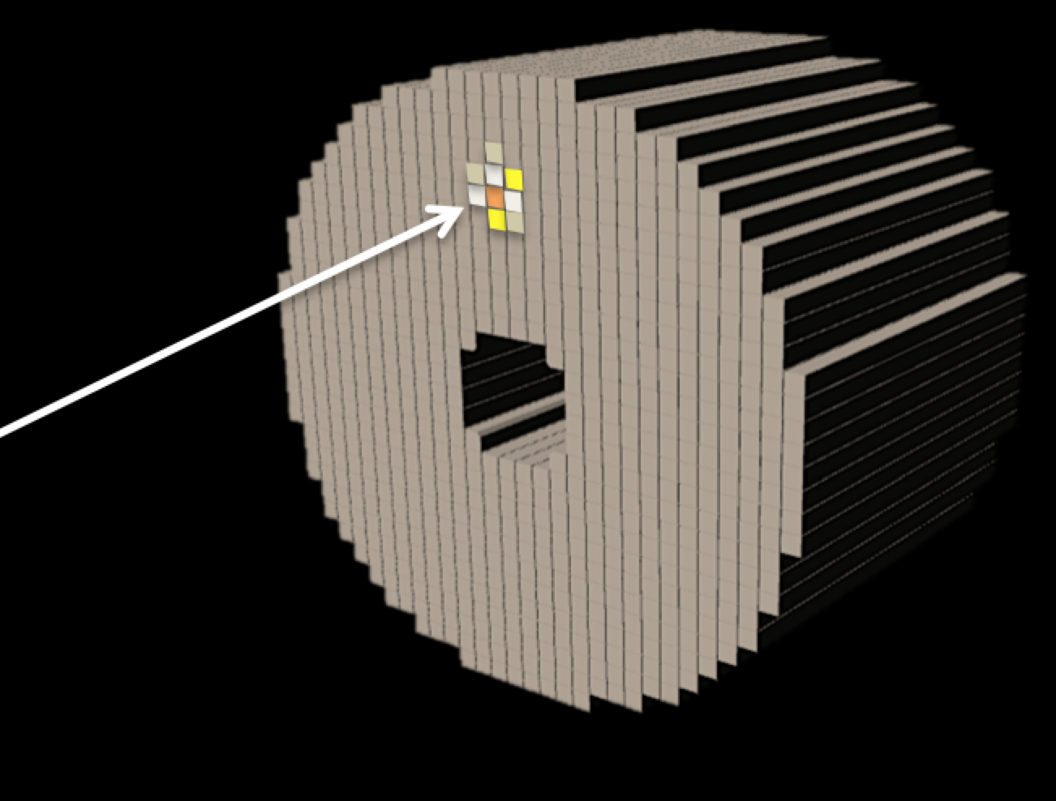
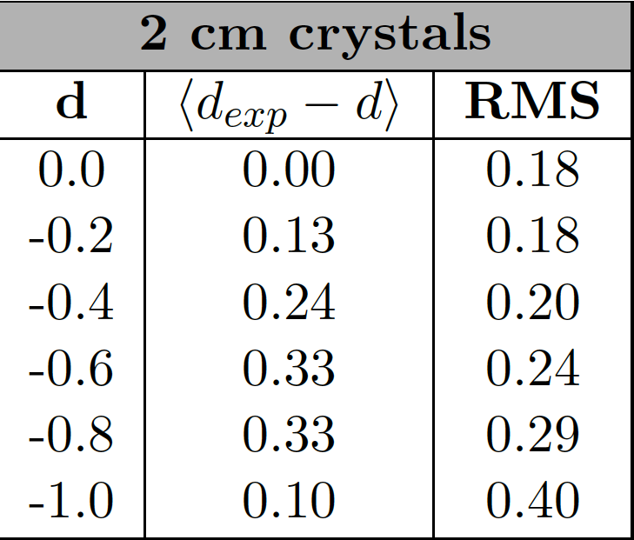
Crystal choice
Small Moliére radius and high light yield: BGO and LYSO
BGO: high LY, high ρ, small X₀ and small R_{M}, long τ_{decay}
  σ(E)/E in 1-2%/√E range
LYSO(Ce): high LY, high ρ, small X₀ and small R_{M}, short τ_{decay}
  σ(E)/E =1.1%/√E ⨁ 0.4%/E ⨁1.2%
Granularity ≈R_{M} → 2 cm
σ_{point}=6 mm → 1 mrad at 6 m distance (too much!)
But we have clusters:
Center of gravity should have a better resolution
Most of the energy will be in a single crystal, pulling the cog towards the center of the most energetic one)
LYSO would be faster and with higher light yield
but…
E=500 MeV
Results with a Geant4 “photon gun”,
σ_{cluster} up to 3.3 mm + systematic shift

Slide 31
We’ve got BGO crystals…

Slide 32
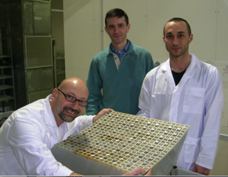
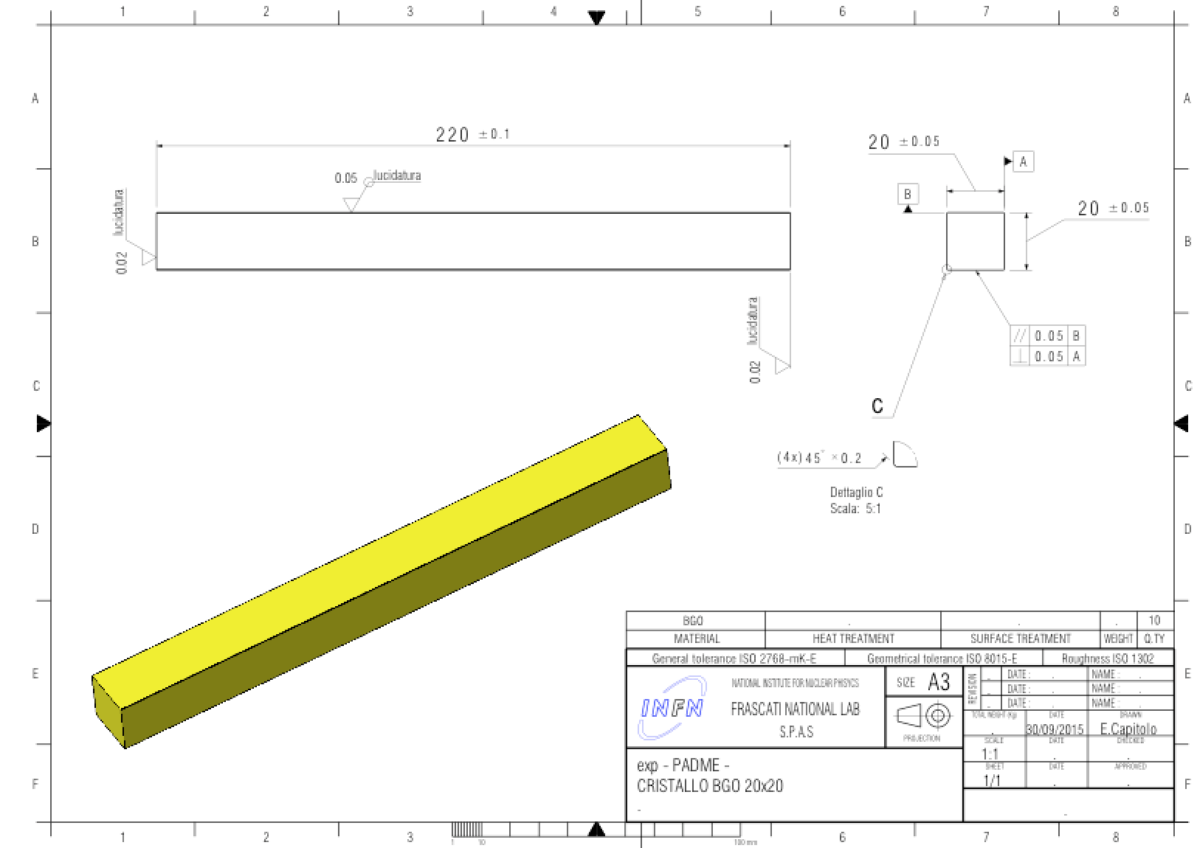
L3 BGO crystals
140 BGO crystals from former L3 electromagnetic calorimeter
Asked 500 more to the L3 collaboration
Cut from trapezoidal prism shape to square section 20×20 mm², 220 mm long

Slide 33
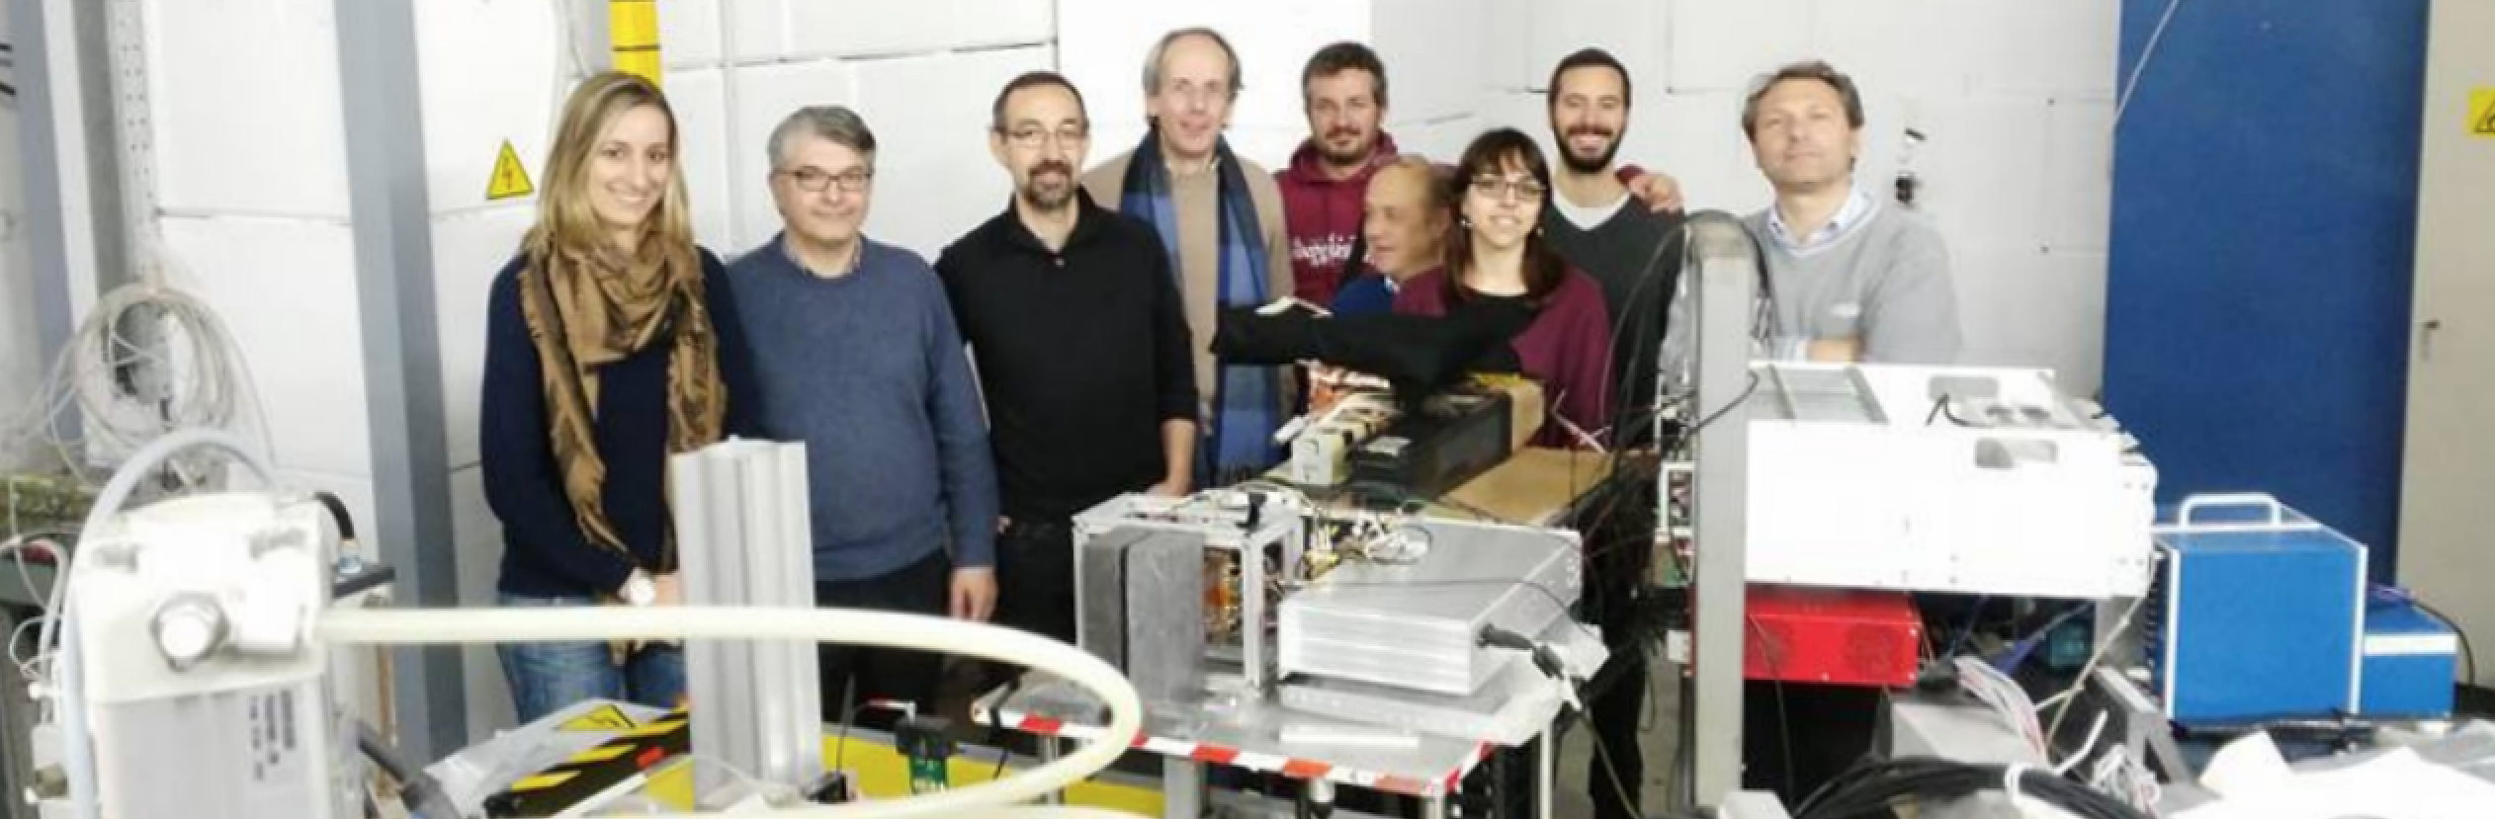
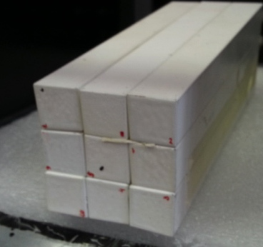
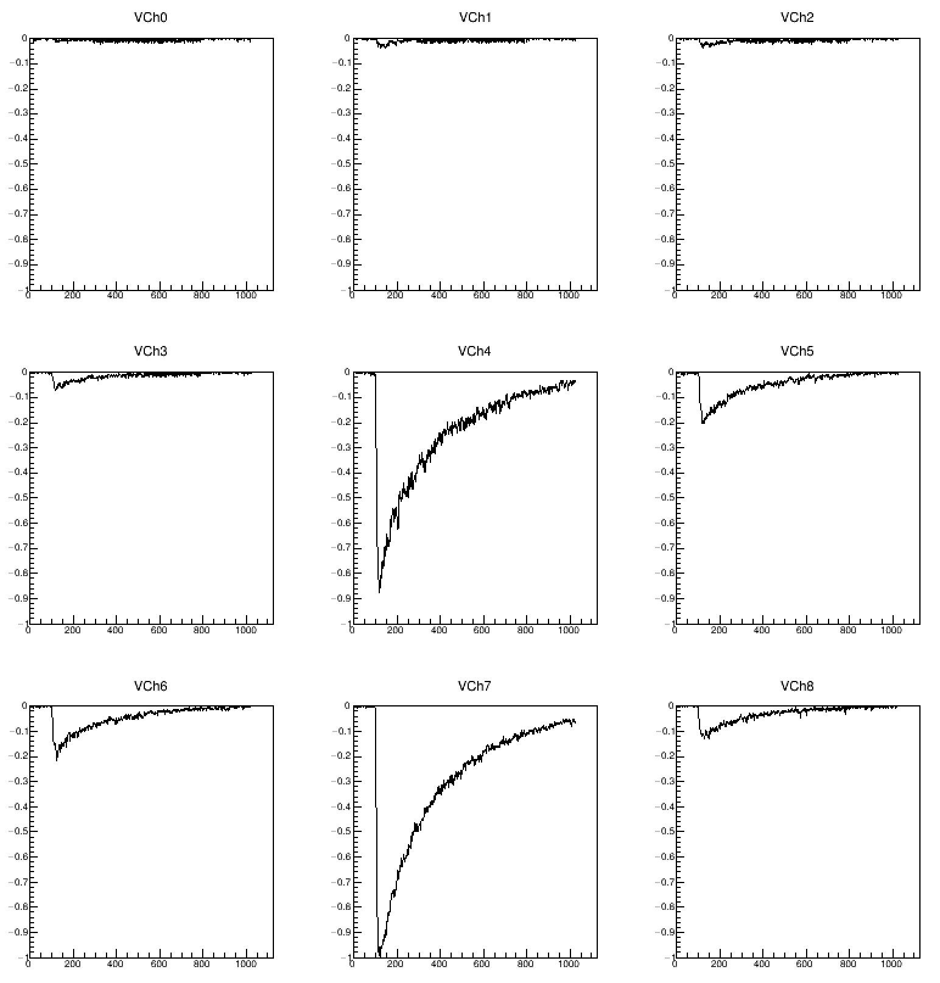
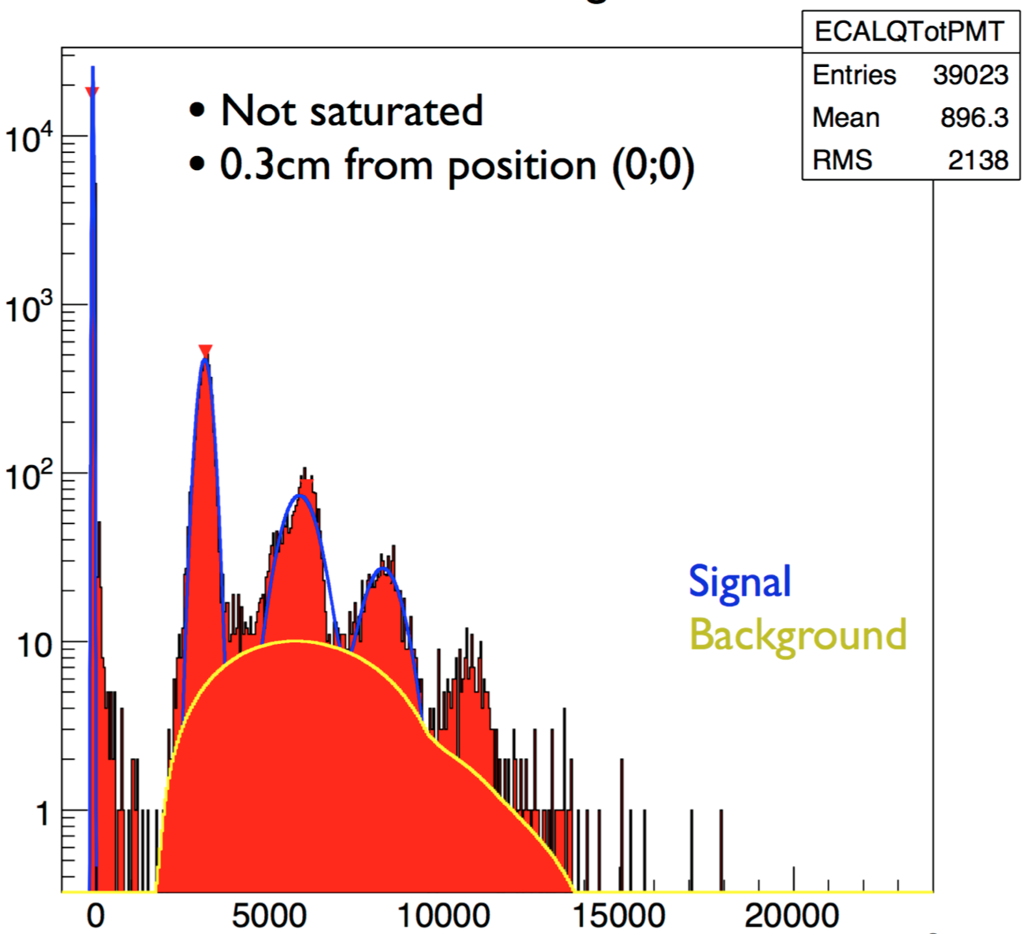
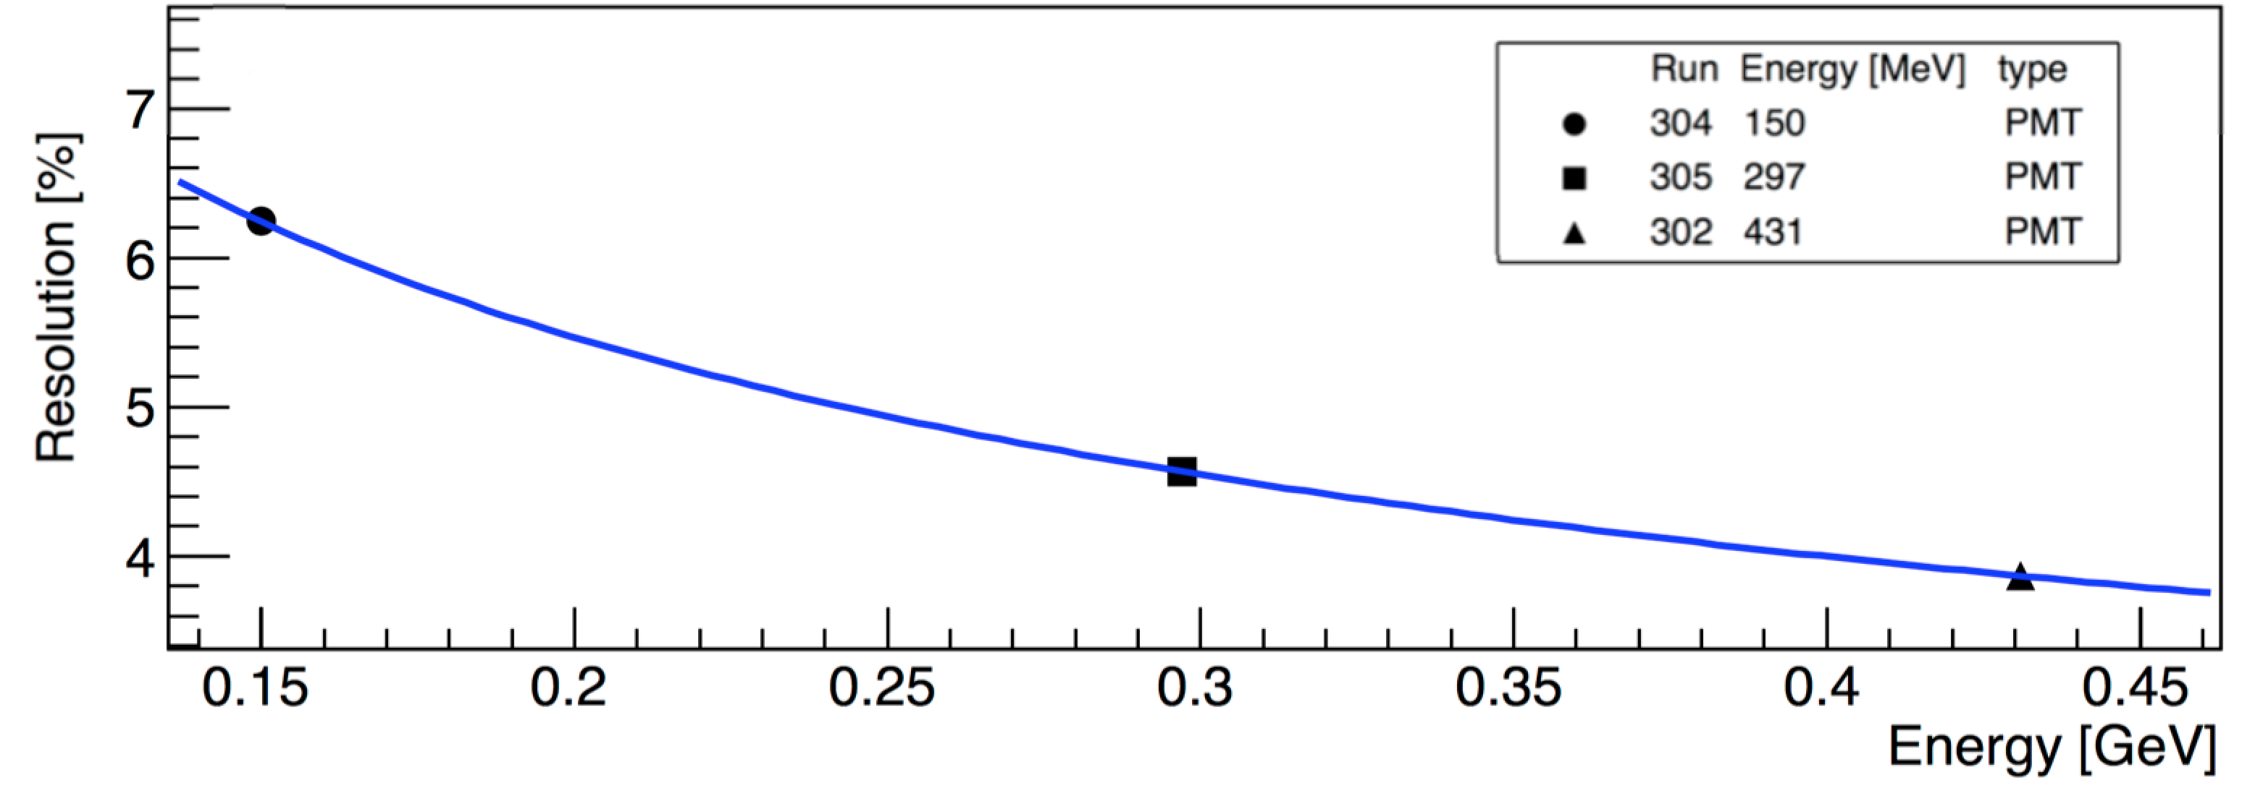
Beam-test
First tests of diamond target and crystal calorimeter
DAQ based on 1 GS/s digitizer (DRS-4)
3×3 BGO matrix
2.3%/√E already achieved without inter-calibration

Slide 34
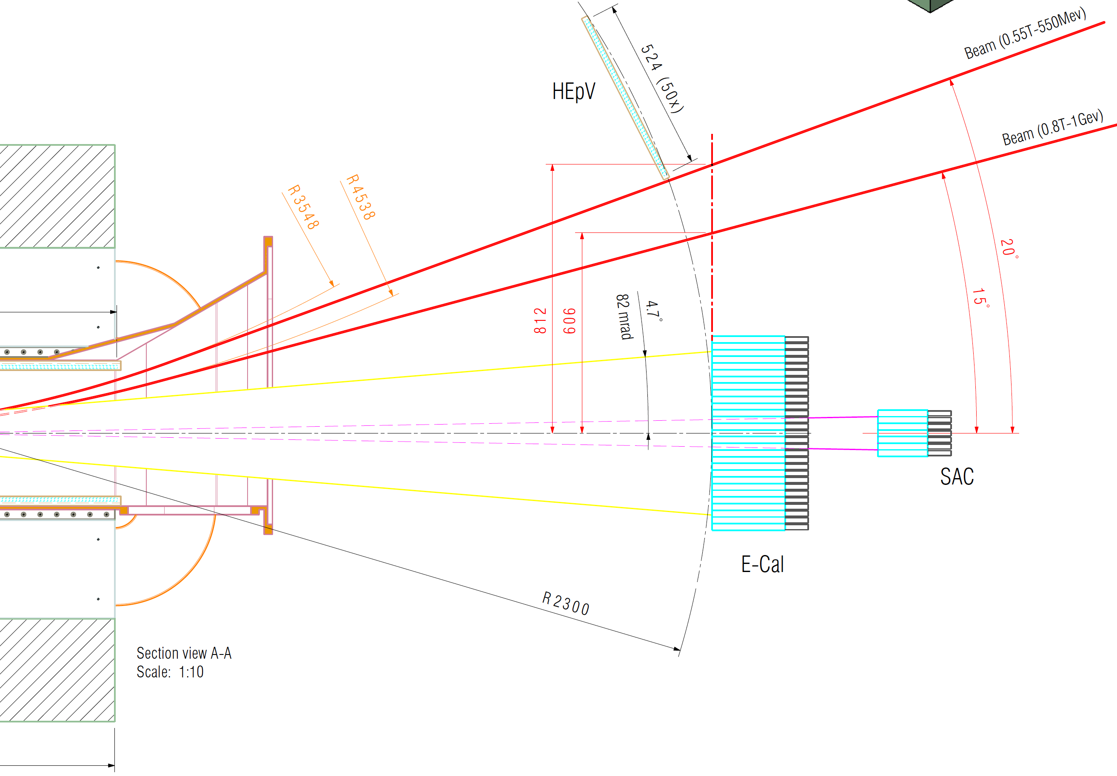

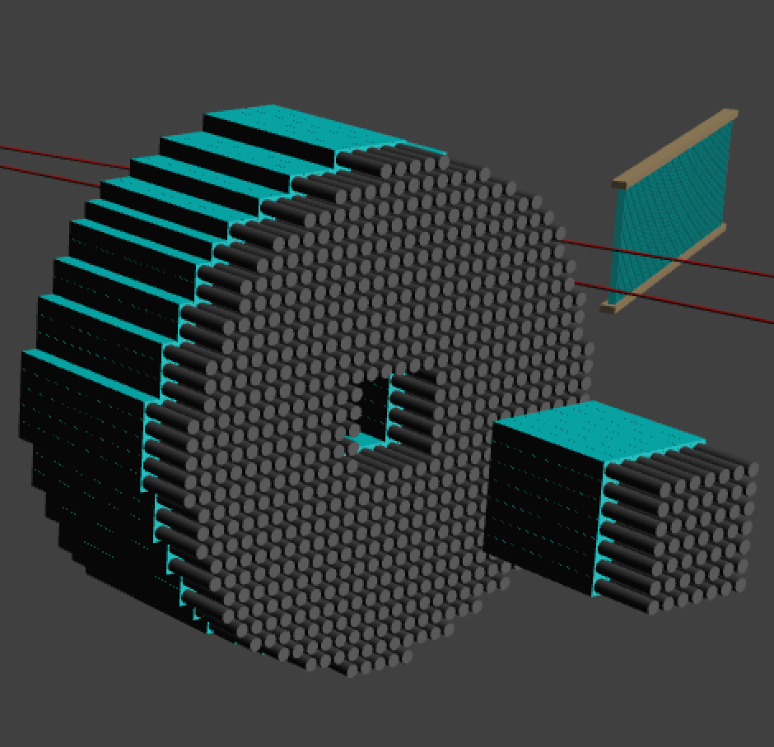
Small angle calorimeter
BGO calorimeter cannot tolerate the Bremsstrahlung rate in the very central crystals
  Inner hole 5×5 crystals
Small angle calorimeter designed to tolerate a rate of the order of 10 clusters (40 ns pulses)
The only fast enough inorganic crystal is BaF₂ with a fast PMT readout
A possible alternative: Cherenkov detector

Slide 35
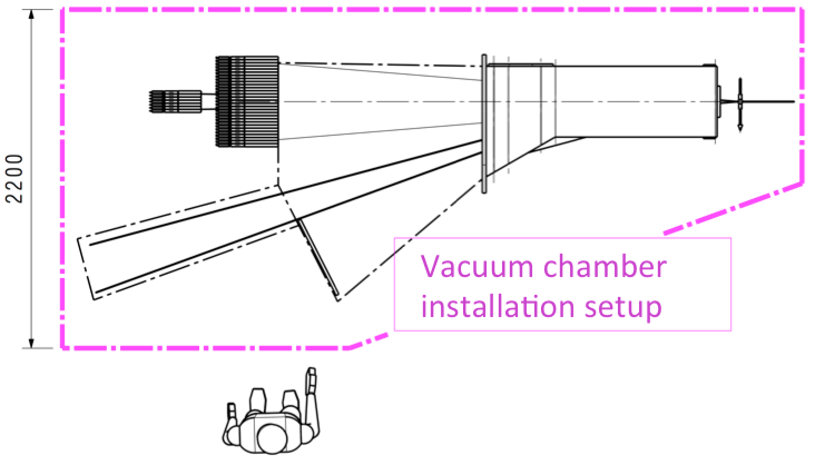
Vacuum vessel
Al 2219 T851 or AL6082 T6
2 mm side walls
4 mm ribs
Vacuum mandatory for three purposes:
Not to spoil beam quality before hitting the target
To minimize photon interactions before reaching the calorimeter
To minimize positron interactions before hitting the veto detector (in particular showers!)
Different possibilities under study to minimize the material thickness, i.e. increase acceptance (given the magnet gap) for the vessel, with the following requirements:
Hold the vacuum
Host the scintillating bars for positron veto detectors
Interface to target box (upstream) and straight section before calorimeter (downstream)

Slide 36
Putting all together…

Slide 37
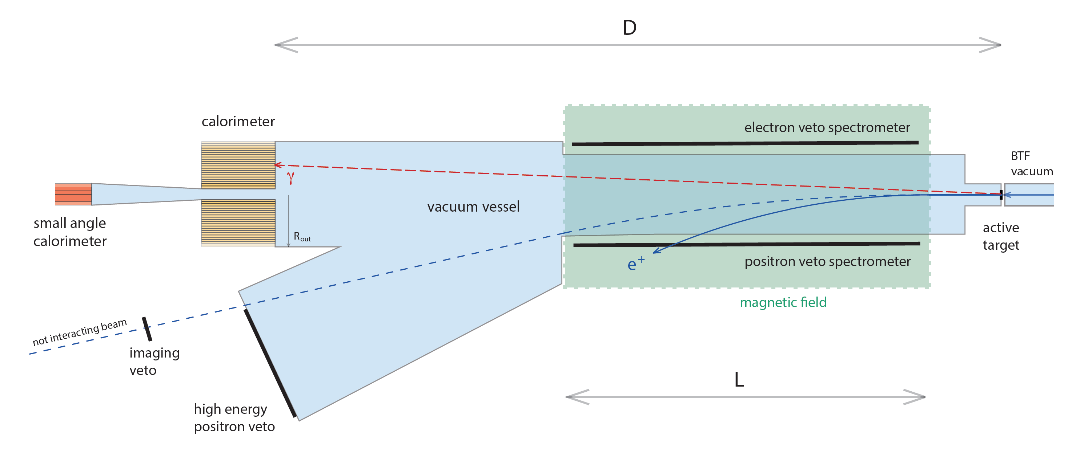
  10³-10⁴ e⁺ on target per bunch, at 50 bunches/s (10¹³-10¹⁴ e⁺/year), limited by pile-up, mainly due to Bremsstrahlung events
Positron annihilations on target: thin and active (e.g. 50-100μm diamond with strips)
  Optimize by looking at annihilation vs. Bremsstrahlung cross section
Magnetic spectrometer ~ 1m length × 0.5 T for sweeping away 550 MeV beam
  Conventional magnet with large gap for gaining acceptance
  Possibility to increase field for energy upgrade to ~ 1 GeV
  Positron veto (from Bremsstrahlung events)
Cylindrical crystal calorimeter
  Optimize radius vs. distance by looking at background rejection vs. acceptance
  In order to have an acceptable rate, central hole
Compute missing mass from the momenta of the incoming positron and of the recoil photon
Small angle detector for Bremsstrahlung veto
Vacuum pipe

Slide 38




High Energy
positron veto
Small Angle
BaF₂ or SF57
Calorimeter
BGO crystals
Positron veto
Target

Slide 39
PADME sensitivity

Slide 40

Monte Carlo simulation
Positron veto
High energy
Positron beam
Positron veto
Low energy
Target
Small angle
veto
Calorimeter
Complete GEANT4 simulation
3 γ production via CalcHEP

Slide 41


Signal vs. background
Signal acceptance
Simple cuts:
1 cluster in fiducial region (angle and momentum)
no hit in positron veto in ±2ns
<50 MeV in small angle
2-σ missing mass cut
e⁺N→e⁺Nγ
e⁺e⁻→ γγ(γ)
Pile up

Slide 42




Residual background
Bremsstrahlung
A high-resolution imaging veto could help rejecting E≈E_{beam} events
e⁺
nominal trajectory
3 photons decay
e⁺
γ
γγ events can be cleanly selected for measuring the beam flux, in addition to the diamond

Slide 43

PADME sensitivity
Based on 2.5x10¹⁰ fully GEANT4 simulated 550MeV e+ on target events
  Number of BG events is extrapolated to 1x10¹³ electrons on target
10¹³ EOT
PADME 10¹³ EOT
2 years of data taking at 60% efficiency
Bunch length of 40 ns
5000 e⁺/bunch × 2⋅10⁷s × 49 Hz
E_{e+}=550 MeV: M_{A’} < 23.7 MeV/c²
E_{e+}=1 GeV: M_{A’} < 32 MeV/c²

Slide 44





ALPs at PADME
Primakoff
PADME can search for invisible decaying or long living ALPs by searching for
1γ + M²_{miss} final states
In the visible final state a → γγ all production mechanisms can be explored extending the mass range in the region of ~100MeV
The observables at PADME will be: eγγ or γγγ
Limits on ALPs coupling to photons
Bremsstrahlung
PADME region
Annihilation
ALP decay to photons
+
arXiv:1512.03069

Slide 45


Dark Higgs at PADME
Dark Higgs production at PADME
Limits on Dark Higgs
Depending on dark Higgs and dark photon masses:
2M_{A’}< M_{h’}
Dominant A’h’ → A’A’A’ → 6 leptons
2M_{A’}> M_{h’}
Dominant A’h’ → A’ Invisible → 2 leptons
In PADME just count the number of events with:
6 leptons in time
With zero total charge
And sum of the momenta < E_{beam}
No data below m_{A’} = 250 MeV

Slide 46
Conclusions
PADME detector construction fully funded for 1,35 M€
Aim at a first physics run in 2018, immediately after the KLOE-2 run
Construction schedule tight but still respected
  Mainly dominated by BGO calorimeter construction
  Well advanced R&D activities on diamond thin target
  Towards a final design for positron veto, small angle calorimeter and high-energy positron (imaging) veto
Even though the sensitivity we have estimated is for the current beam parameters and energy, there is room for improvement:
Beam:
  New gun pulser installation due next summer
  Simulation of optimized positron production target started
  LINAC consolidation and energy upgrade proposed
  BTF beam doubling
Detector:
  PADME is being designed in order to be capable of searching also visible decays of the dark photon
  And also to replace the target with a thicker one in order to perform a “classical” dump experiment

Slide 47

Looking forward to new jedi
collaborators
http://www.lnf.infn.it/acceleratori/padme

Slide 48

Decay to invisible states, scattering searches
m_{χ} dependence

Slide 49

Visible and invisible decays exclusion
Fix ε to the preferred value from a_{μ} (±2σ), limits are represented in the plane α_{D} versus m_{A’}
Still different curves due to the mass dependence of the dark sector particles m_{χ}
Adapted from arXiv:1406.2698v1
N.B. ε is fixed to the minimum value of the a_{μ} band
PADME

Slide 50

DAΦNE complex in Frascati
DAΦNE, replacing ADONE (operational until 1993), has been running as e⁺e⁻ collider at 1,02 GeV since 1999, for KLOE, DEAR, FINUDA, Siddharta, and now KLOE/2 …
Synchrotron light source operational with 3 lines (X, UV, IR)
High current electron/positron linac + damping ring + test facility
Power supplies
modulators
linac
Synchrotron light
DAFNE
KLOE hall
Pumps
BTF
Cryogenics
Power supplies
Damping
ring

Slide 51


BTF beam-line upgrade

Slide 52





BTF users
Luckily enough, BTF is already extensively used by many experimental groups in HEP and astro-particles…

Slide 53



Linac energy upgrade
Linac layout downstream the positron converter:
≈15 m
Additional sections
Proposal of exploiting drift space at the end of accelerating structures put forward
Adding four more SLAC-type accelerating sections (3 m length)
    Fed by a 5th RF station: 45 MWp klystron + SLED: 17.5 MV/m × 12 m = +210 MeV
  Or/And
  Increasing the accelerating gradient splitting the RF power of one station /2 instead that /4 sections
    Assuming 27 MV/m: +110 MeV (4 accelerating sections)
    1 to 3 more RF stations for the last 4 to 12 sections

Slide 54




Increasing linac beam pulse length
Diluting the same number of positrons in a longer pulse is a plus from the point of view of pile-up
Main limitation coming from the SLac Energy Doubling system (SLED) used to reach higher energy in our linac
Uncompressed RF field 4.5 μs long, but with a 1/9 lower accelerating field
Going off the flat top impacts the energy spread
F.-J. Decker et al.
SLAC-PUB-7214 (1996)
New pulser capable of up to 1 μs pulses will be installed during next shutdown (summer 2016)
500 ns pulses with 0.5% energy spread achieved at SLAC

Slide 55




Positron veto
  Time resolution better than 500ps
  Momentum resolution of few % based on impact position
  Efficiency better than 99.5% for MIPs
  Low energy part inside the magnet gap
  High energy part close to not interacting beam
High energy
100 cm
Low energy

Slide 56


Positron veto
Low momentum losses are reduced for E_{γ}<400 MeV
Interesting positron energy starting at ~150 MeV
Which granularity?
1 cm scintillator bars, readout by SiPM
Few % momentum resolution in a large part of the spectrum

Slide 57


PADME TDAQ
Readout based on digitizers CAEN V1742
~1000 channels
~33 FADC boards
Trigger and clock distribution to the 33 boards
Online FADC zero suppression (L0)
FADC boards synchronization to few 100ps needed

Slide 58
Decay to invisible signal selection
Only one cluster in calorimeter
  Rejects e+e⁻→γγ, e+e⁻→γγ(γ) final states
30 mrad < θ_{Cl} < 65 mrad
  Improve shower containment σ(E)/E
Positron veto: no tracks in the spectrometer in ±2 ns
  Reject BG from Bremsstrahlung identifying primary positrons
Photon veto: no g with E_{γ}>50 MeV in time in ±1ns in the additional small angle veto (SAV), covering the hole acceptance
Cluster energy within: E_{min}(M_{A’}) < E_{Cl} < E_{max}(M_{A’}) MeV
  Removes low energy bremsstrahlung photons and piled up clusters
Missing mass in the region: M_{miss2} ± σ(M_{miss2})

Slide 59
PADME-dump
10²⁰ EOT, 1.2 GeV; 20 cm aperture at 50 cm from 8 cm W dump
Zero background hypothesis, in depth production to be refined, not yet a sensitivity plot
e⁻
NA48/2
Now
DUMP
BaBar
e⁻
DUMP
PADME e⁺e⁻
PADME μ⁺μ⁻
Real case
e⁻
E137
DUMP

Slide 60



BDX @ LNF
From A. Celentano
Acceptance limit at ≈100 MeV coming from beam energy
α_{D}=0.1 m_{χ}=10 MeV
Beam energy 1.2 GeV (e⁻)
CsI detector 60×60×225 cm³ built with crystals from dismounted BaBar calorimeter?

Slide 61



LINAC beam dump
4 m
New segment
A new thin vacuum chamber
A straight vacuum pipe to the inside of the existing dump cavity
Additional shielding for copying with neutron production
Use DR pumps hall for shielding and experiment
Additional shielding
DR pumps hall

Slide 62

PADME layout in BTF hall

