Slide 1


It’s a kind of Magix
The development of the Magix experiment
Stefano Caiazza
LEPP 2016 – Mainz - Apr. 06 2016
Notes:
Good afternoon everyone.
My name is Stefano Caiazza and my goal here is to introduce you to the new project we are developing a bit downstream the Rhein, in Mainz. This project is called Magix and I hope by the end of this talk you will be able to see the Magix of what we will try to do
My goal here today is to introduce you to a couple of new projects we are developing in Mainz, namely the MESA accelerator and one of the experiment that are going to be built on top of that, which is Magix.
I will start from the current tools we have at our disposal in Mainz and that is MAMI.
In the hall formerly occupied by A4 we decided to build our knew little, precious jewel, that is MESA
MESA is a recirculating accelerator which can work in two mode, recirculated beam and extracted beam and will have two experiments, P2 and Magix.
P2 will be a dedicated experiment for the measurement of the electroweak mixing angle through the measurement of the parity violating asymmetry in the electron scattering.
Magix will be a versatile system, inspired to the A1 setup. It is constituted of a twin arm spectrometer on an open gas internal target.
In fact the gas target is one of the most peculiar features of the experiment. Because of the high current we cannot use any containment for the target gas. Moreover we cannot introduce too much material because we run on a recirculating beam. Ergo we developed this system with the open target and pump cascade to remove the gas before it goes in the beam pipe
On the detector side we need to achieve a momentum resolution of the order of 10-4 and resolution on the elevation angle of 0.05 deg. To achieve this type of momentum resolution and keep the spectrometers compact we need a detector with a resolution of the order of 50 um and this can be only achieved with a gas detector with modern MPGD technology.
We are currently evaluating two options.
A safe hodoscope mode optimized for the extremely high rate expected and a short drift TPC.
The first one is a proven technology which has the disadvantage of introduce a large quantity of material.
The second can reduce the material at a minimum but we have to evaluate the occupancy
What type of signature we can expect in our experimental conditions?
With the energy and the setup we are designing we expect to be able to work on this type of measurements…

Slide 2
MESA LAyout
Multi-orbit recirculator with energy recovery
Extracted beam @ 155 MeV
Experiment on the recirculating beam (MAGIX) @105 MeV
Thin gas target on the beam path with a dedicated detector
External loop after two recirculation
After a final recirculation, then dumped
Dedicated experiment (P2)
Energy recovery
External loop of half-wave length
Electron energy transferred back to the cavity
Financed by the PRISMA Cluster of Excellence
Notes:
What we can do in the available space is a multi orbital recirculator.
This little toy works as follow:
We pre-accelerate the electrons to relativistic energies with a normal conductive linac up to 5 MeV.
After the initial acceleration the electron bunches are enter two recirculation loops. Because particles of different momenta will be sharing the same RF bucket in the straights, we need a different arc for each momenta. This arcs are stacked vertically and the number of levels is mainly determined by the available space in the experimental hall. But this configuration also allows for a 100% duty factor for the accelerator

Slide 3
MESA
Gas
Internal target eXperiment
Notes:
This experiment is called Magix which stands for…
As I mentioned one of the characterizing features of Magix is its internal gas target which allows to perform fix target experiments on a recirculating beam.
The gas density, thus the available luminosity, is limited by the necessity to recapture the beam after its passage through the target so that it can be decelerated.
With this constrains we calculated that we can achieve a luminosity of 10^35
The gas target

Slide 4
Low energy electron scattering
Electron scattering on fixed target below the pion threshold
Low momentum electron coincidence
High acceptance
For high precision measurements
On the scale of the bunch frequency (ns timestamping)
To improve the statistics on rare event searches
Good momentum resolution
Good angular resolution
For background rejection and vertex reconstruction
Low momentum
E-Nucleon scattering
Pair production
Elastic or inelastic
Form factor measurements
With SM or dark U(1) photons
Proton radius
e⁺ e⁻ coincidence
Notes:
I would like to start discussing this experiment analyzing what type of processes we can expect with an electron scattering experiment below the pion production threshold.
There are actually only two available typologies. On one hand we have a simple scattering process where one aims to detect scattered electron and possibly the recoil proton and measure the differential cross section at different angles
On the other hand we have a trident pair production with a final state of an electron-positron pair and the scattered electron and nucleus. The relevant objects are usually the pair of which we want to measure the invariant mass, as in the case of the dark photon.
So what we actually need to develop is a detector for low momentum coincidence on the scale of the bunch frequency, which will be of the order of the GHz
To be able to collect enough statistics for rare event searches we need a system with as high as possible acceptance. At the same time we need very good momentum resolution to perform high precision measurements but we have to remember that we are dealing with 100 MeV electrons, which is relatively low.
At the energy we consider, which are below the pion production threshold there are two relevant
As I was mentioning it is to be optimized to achieve the highest luminosity to study rare event and/or collect extremely high statistics.
So, as I mentioned, MESA is being designed to achieve several scientific goals.
Some of them requires extremely high statistics to be competitive, like the search for the dark photons. In this case we also require extremely good resolution to be able to separate the signals from the background.
Other type of measurements will also require the possibility to polarize the beam and the target
This means that our system must be able to measure the coincidence of up to two electrons with high momentum accuracy, high acceptance, time-stamping and vertex reconstruction

Slide 5
Research Projects
Dark photon and dark matter
Form factors and proton radius
Astrophysical cross-sections
Good momentum resolution, off-plane angle measurement
Proton recoil
Scattering angle resolution and flexible gas target choice
Scattering angle resolution, forward angles with possibly polarized targets
Photon detector, tagger and low-energy proton recoil
Test of chiral effective theories
Polarizabilities
Good momentum resolution @ low momenta with polarized beam and target

Slide 6
The experiment

Slide 7
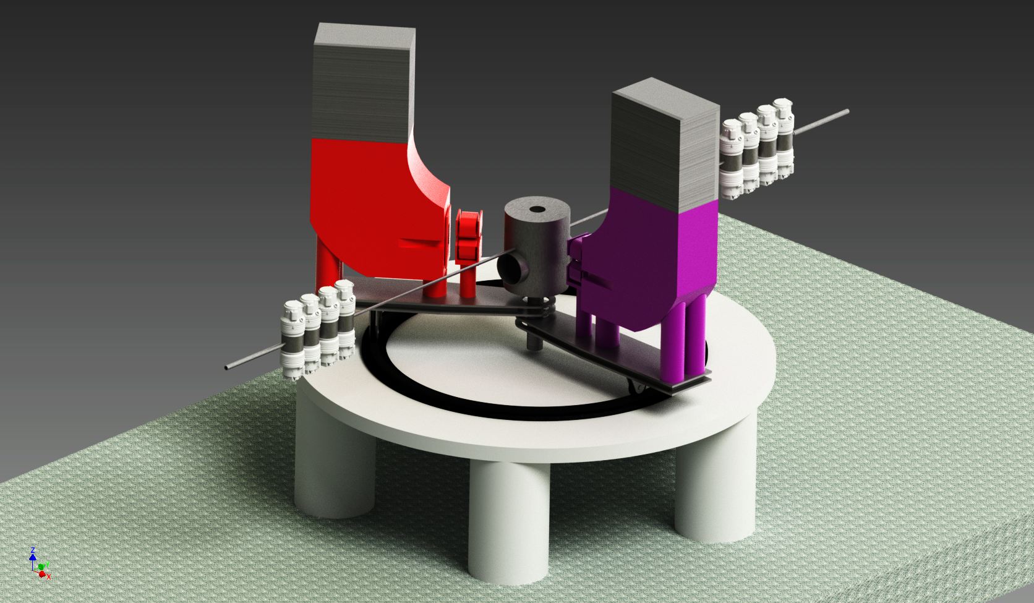
Magix Components
Internal Gas Target
Twin ARm DIpole Spectrometer
Focal Plane Detectors
Notes:
One of the main feature of our experiment is still the internal gas target which is coupled to a couple of compact, high resolution spectrometers called TARDIS.
Put the inventor rendering with the system within the experimental hall and there I will highlight the two systems

Slide 8
Internal Gas Target
Notes:
One of the most relevant topic here is probable our design of the gas target

Slide 9
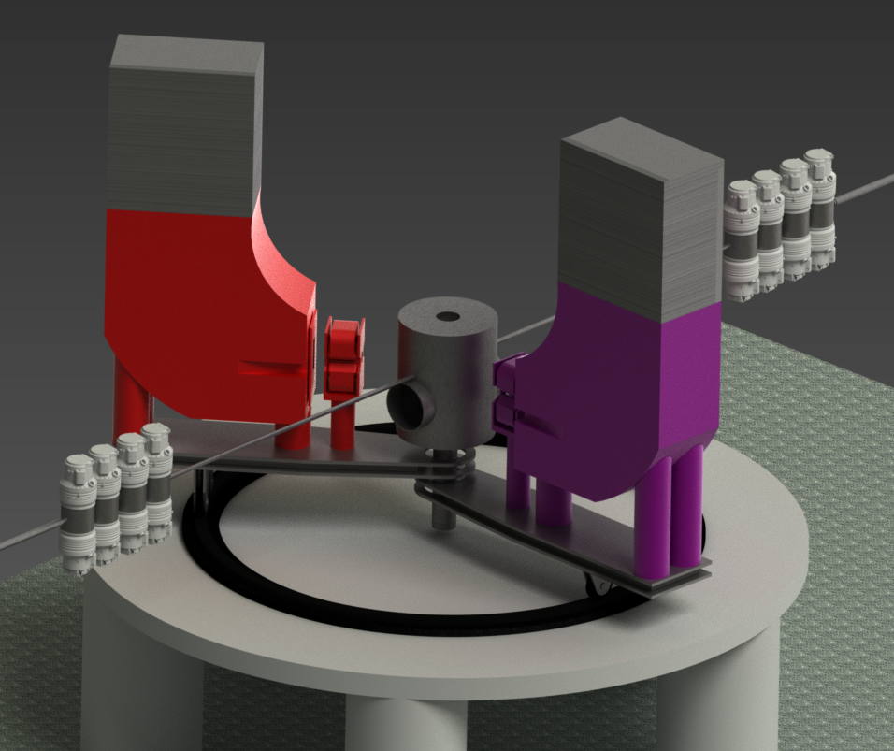
Design requirements
Recirculating beam
Windowless target
$$L≅I_{b}∗ ρ_{t}∗l_{t}$$
𝐿≅𝐼_𝑏∗ 𝜌_𝑡∗𝑙_𝑡
Thin target required to recapture the beam
Max energy loss O(10⁻³)
Minimize background interaction
Gas Density O(10²⁵)
Containing the gas flow without a container
Fixed Target luminosity
Notes:
The first component of the system is our internal target.
What we need is to have a limited volume with as high gas density as possible to achieve the highest luminosity.
In a fix target like this the luminosity can be calculated multiplying the beam current with the target density and the target length.
On the other hand we need to preserve the beam to allow the machine to recapture it and decelerate it which limits the maximum target density
Another important constraint is that we cannot use a physical container for the gas and this is for two reasons: first of all any material in front of the beam will create background, reduce the beam quality and practically lowers the density of the active part of the target. Additionally here we have a 1 MW beam and even a fractional absorption in a window will simply melt the window.
The third important constraint is that we cannot leak our gas in the rest of the beam pipe.

Slide 10
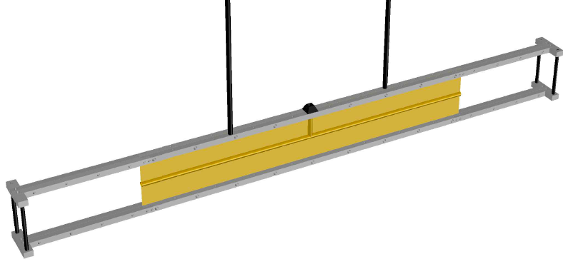
Target Layout
Beam
Foil-thin tube
Moderate gas density $O\left({{10}^{22}}/{m^{3}}\right)$
Moderate gas density 𝑂(〖10〗^22∕𝑚^3 )
Length (~ 30 cm)
Jet Target
Supersonic gas jet
O(mm) target length
Higher gas density $O\left({{10}^{26}}/{m^{3}}\right)$
Higher gas density 𝑂(〖10〗^26∕𝑚^3 )
Estimated luminosity with polarized beam $O({10}^{32} cm^{−2}s^{−1})$
Estimated luminosity with polarized beam 𝑂(〖10〗^32 𝑐𝑚^(−2) 𝑠^(−1))
Estimated luminosity $O({10}^{35}cm^{−2}s^{−1})$
Estimated luminosity 𝑂(〖10〗^35 𝑐𝑚^(−2) 𝑠^(−1))
To be used with polarized gases
Notes:
The target system is a multi stage evacuation system which will bring the vacuum quality to that typical of the beam pipe of (what is the density in the pipe).
The inner target will be placed in a first expansion chamber connected to a set of powerful root pumps. The first chamber is then connected to 3 more pumping stages.
In the inner part, the target will be made of a thin mylar foil with the inner part shaped as a pipe of (which diameter)
3D rendering from Comsol?
Photo of the target mockup and 3d rendering of the target system
Scheme of the pumping system with the number density in the pipe between the stages

Slide 11
Twin ARm DIpole Spectrometer
Notes:
Coupled to the gas target we have our detector system
Coupled to the gas target without any window, we have the detector system which will be made of a pair of compact high resolution magnetic spectrometers that we called TARDIS (and obviously they will be painted blue)

Slide 12
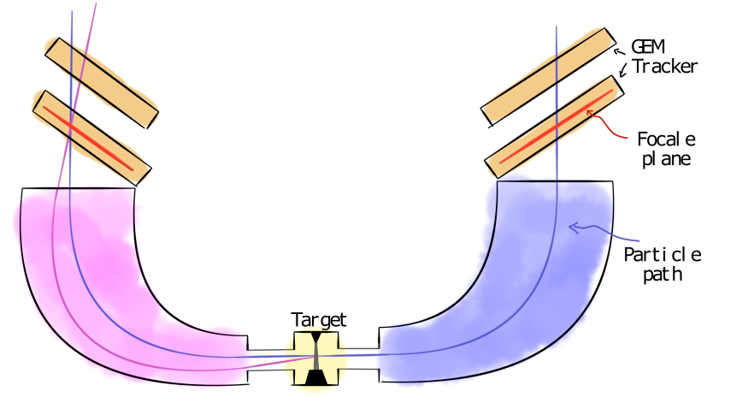
The spectrometer concept
Particles of different momenta at different positions
Mapping of momenta to position
Parallel-to-point focusing
Mapping of angles to position
Momentum focusing
Angular focusing
Notes:
The basic concept of a spectrometer is to focus particle of different momenta at different positions on a focal plane.

Slide 13
Magnet Optics
Acceptance
200 MeV maximum momentum
90 MeV momentum acceptance @ 200 MeV
Momentum resolution
10⁻⁴ relative momentum resolution
Assuming 50 μm resolution at the focal plane
Angular range
$$∆θ ≅5 ∗{10}^{−2}°$$
∆𝜃 ≅5 ∗〖10〗^(−2)°
± 3.25° θ and ± 3.75° φ
22 cm vertex acceptance at 90°
$$∆φ ≅0.2 °$$
∆𝜑 ≅0.2 °
Notes:
They are also comparatively simple, being made of only a quadrupole and a dipole. The system has been designed for a maximum momentum of 200 MeV and has a 90 MeV acceptance
We performed a FEM simulation which showed that we can achieve a 10-4 momentum resolution assuming a detector with 50 um resolution at the focal plane

Slide 14
Focal
Plane
Detectors
Notes:
Coupled to the gas target we have our detector system
Coupled to the gas target without any window, we have the detector system which will be made of a pair of compact high resolution magnetic spectrometers that we called TARDIS (and obviously they will be painted blue)

Slide 15

Detector challenges
High resolution on low momentum electrons
1 < p < 100 MeV
Large sensitive surface
$$\frac{∆p}{p}≈{10}^{−4}$$
∆𝑝/𝑝≈〖10〗^(−4)
$$∆θ≅5∗{10}^{−2} °$$
∆𝜃≅5∗〖10〗^(−2) °
Material reduction
No window before the magnet
Thin detector design
$120∗30 cm^{2}$ focal plane surface
120∗30 𝑐𝑚^2 focal plane surface
$50 μm$ point resolution in the focal plane
50 𝜇𝑚 point resolution in the focal plane
At least 2 points to reconstruct the full kinematics
High rate capability
With a CW operation rates up to $O(1 MHz)$
With a CW operation rates up to 𝑂(1 𝑀𝐻𝑧)
Count rates of $O(10 KHz)$
Count rates of 𝑂(10 𝐾𝐻𝑧)

Slide 16
Focal Plane detectors
Gas detectors
Low material budget
Low cost for large area coverage
Micro Pattern Gas Detectors
Resolutions of the order of 50 μm achieved by several detectors
Gas Electron Multiplier
Modern gas amplification systems
Thin kapton foil coated with copper and pierced by microscopic holes
Gas amplification in the holes
2 Layer Hodoscope
Short drift TPC
Simple detector to built
Uniform and high position resolution
Moderate material thickness
Only 2 reconstructed points
More delicate to optimize
Worse single point resolution
Minimal material thickness
Multiple samples and full track reconstruction possible

Slide 17
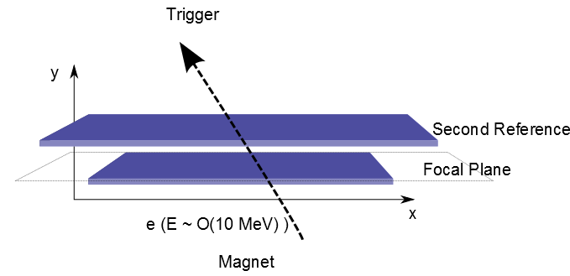
Hodoscope Tracker
2 Sensitive layers
Reliable design
Optimization
The first centered on the focal plane
The second with a sizable lever arm to measure the angle
2 or 3 GEM
2D Strip readout
Small drift
Thin coated GEMs
Foil based readout plane
~ 0.7% radiation length
Material reduction to improve angular measurement

Slide 18
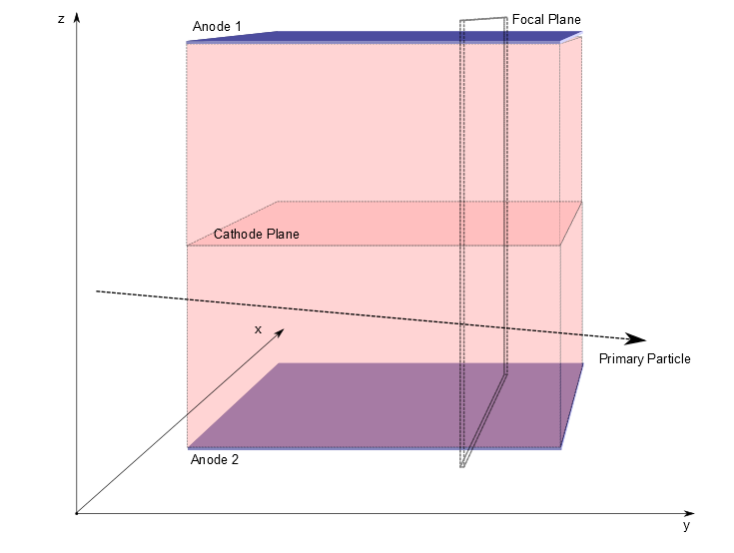
Short-drift TPC
Performances
Can we optimize it for the high rates we will have?
Features
Double sided TPC with middle cathode plane
15 cm max drift length
10 pad rows with 2 mm pads on GEM amplification
Stretched foil entry window with printed field cage
Magnetic field
Extension of the dipole to enclose the TPC
What momentum resolution can be reached?
Which angular resolution can be reached?

Slide 19
Detector testing
Detector Characterization
Further developments
Detector gain
Position resolution
Gain uniformity
Rate Capability
Increasing the detector size
Testing a foil readout system
Building a SD TPC prototype

Slide 20
Conclusions

Slide 21
More I didn’t Say
Trigger
Fast scintillator fibers
Photon tagger
Software &Simulation
Plugin based extendible framework
Slow Control
Simulation
DAQ
Analysis
Additional detectors
Recoil detector
ns timestamping, mm resolution

Slide 22
Magix
Versatile experiment for precision physics
Conceptual design
Nuclear and particle physics projects under study
Technical design
Prototyping and testing
Double spectrometer on a windowless target
Magnet simulation
Target development
Detector development
Target prototype will be used in an existing experiment
Detector prototype tested with cosmics and test-beams

Slide 23
Thanks for your attention

Slide 24
BACKUP

Slide 25
Software and Simulation

Slide 26
Software framework
Core software
Custom package extensible through plugin components
Analysis
Common versatile configuration system for all plugins.
Simulation
Fast simulation plugin with special generators (rad. corrections and specific models)
Generators linked to full simulation (GEANT or custom)
Directly connected with the simulation tools
Interfaced with your favorite histogramming tool

Slide 27
Detector trigger

Slide 28
Slow Control

Slide 29
Tube target
Thin polymer foil
Cryogenic injector
20 μm mylar prototype
Reduces the recombination of polarized gas
Acceptable multiple scattering @ 10 MeV
Notes:
The target system is a multi stage evacuation system which will bring the vacuum quality to that typical of the beam pipe of (what is the density in the pipe).
The inner target will be placed in a first expansion chamber connected to a set of powerful root pumps. The first chamber is then connected to 3 more pumping stages.
In the inner part, the target will be made of a thin mylar foil with the inner part shaped as a pipe of (which diameter)
3D rendering from Comsol?
Photo of the target mockup and 3d rendering of the target system
Scheme of the pumping system with the number density in the pipe between the stages

Slide 30
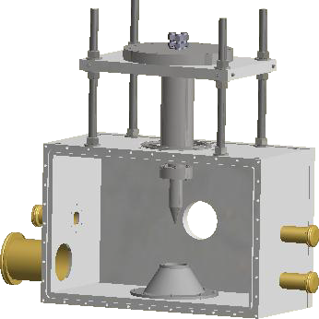
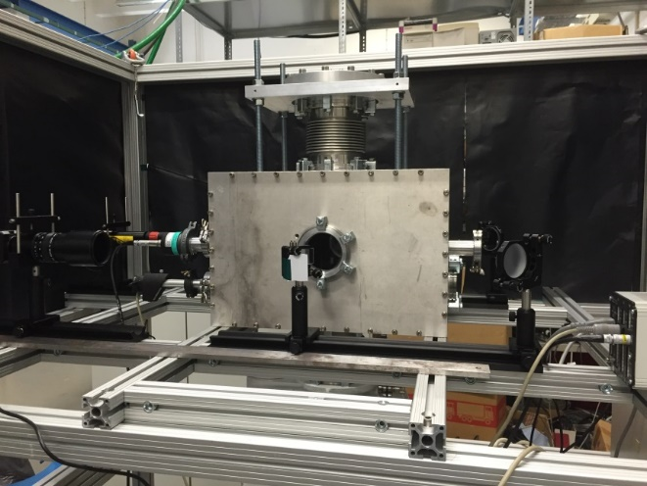
Jet Target
High pressure supersonic jet
Special gas nozzle to create a supersonic jet
Injection development (Nozzle and cold head)
Gas catcher to evacuate the chamber
Prototype development
No polarized gases due to high recombination rate
Multiple gas type usable
Collaborative effort with Münster University
Hydrogen, Oxygen, Helium already foreseen
Chamber evacuation system
Monitoring and slow control
Beam
Notes:
The target system is a multi stage evacuation system which will bring the vacuum quality to that typical of the beam pipe of (what is the density in the pipe).
The inner target will be placed in a first expansion chamber connected to a set of powerful root pumps. The first chamber is then connected to 3 more pumping stages.
In the inner part, the target will be made of a thin mylar foil with the inner part shaped as a pipe of (which diameter)
3D rendering from Comsol?
Photo of the target mockup and 3d rendering of the target system
Scheme of the pumping system with the number density in the pipe between the stages

Slide 31
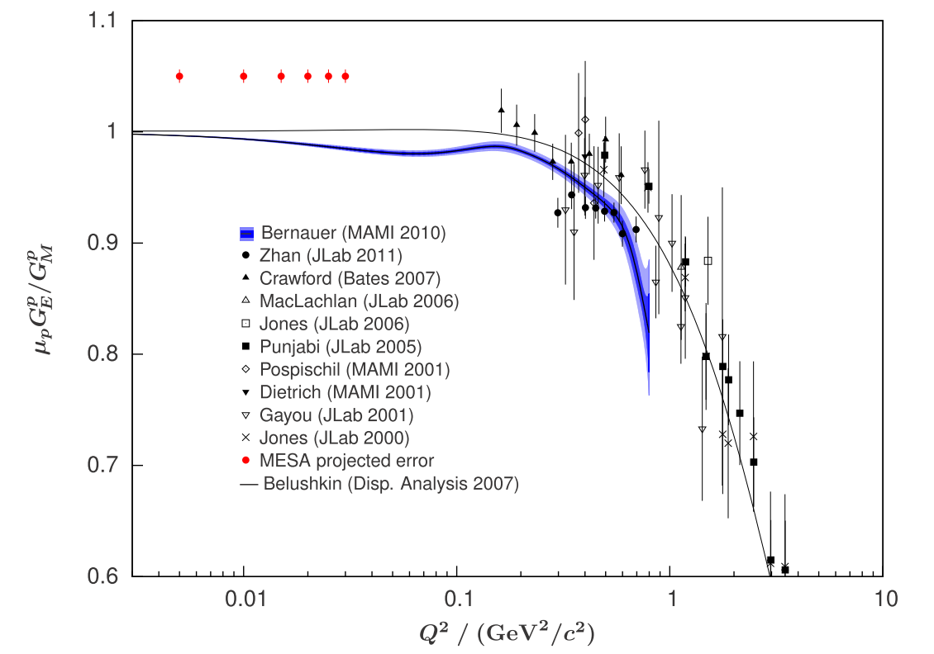
Low Q² nuclear form factors
Electric form factors
Magnetic form factors
Low energy (5-100 MeV)
Small forward angle (14°)
Polarized gas target
Polarized electron beam
Reduced extrapolation error and assumptions at Q² = 0
Extension at lower Q² of measurements already done at MAMI
Allows precise measurements of the magnetic radius of the proton
Notes:
Our setup

Slide 32
Current SETUP: MAMI @ KPH
MAMI - Multi-stage microtron
1.5 GeV @ 0.1 mA
http://www.kph.uni-mainz.de
Mainz Institut für Kernphysik
Running cutting edge experiments for nuclear and hadron physics since 1957
Long list of scientific accomplishments
Some limitations
Statistics on rare searches
Multiple-scattering @ low energy
Minimum $Q^{2}$
Minimum 𝑄^2
Notes:
Let me start from the foundation of our work, that is MAMI.
As it happens in Mainz we have a long and out-standing expertize in running cutting edge experiments for nuclear and hadron physics. The current workhorse of our university is MAMI, a multi-stage microton capable of delivering an electron beam of 0.1 mA at energies up to 1.5 GeV. This device performed admirably and if you connect to our institute website you will find a list of the many accomplishment and publications of the experiments running with the beams provided by that machine.
And if you look carefully you will find out that for many of those experiments the limitations didn’t come from the available beam energy but rather from the statistics like in the case of searches for rare events like an hypotethical dark photon or that sometimes it is the minimum energy that limits the accuracy as when one tries to measure form factors at extremely low Q2 as for the extraction of the proton radius
Nonetheless I will start from the workhorse of our establishment, which is MAMI
Probably most of you know much better than me all the accomplishment of MAMI. Here you can see the layout of the current system with the main experimental hall. Because any further extension of the MAMI accelerator chain would be excessively expensive we decided to develop our tools in another direction.

Slide 33
MESA Laboratory
Using existing space
Relevant time and money savings
Hard space constraints
Cannot hinder the ordinary operation of MAMI
The work is started
Insulating shield finished
Removal of obsolete services started
The funding for additional space and equipment secured
Notes:
This new project is called MESA and will be hosted in the space formerly used by the A4 experiment that was concluded. The possibility to use an existing build reduces the costs in a relevant matter but forces the accelerator to the adapt to existing space. Moreover, because MAMI will remain operation as the workhorse of our institute for the foreseeable future, our new project should not hinder the operation of MAMI
MAMI will continue to be used in the foreseeable future so any additional installation should not disturb the routine operation of MAMI.

Slide 34
Electron scattering searches
Measurement
Electron-nucleus scattering
Parameter space coverage
Low dark photon mass
Requirements
Relatively high coupling
Bump search on the SM spectrum
High momentum resolution
High luminosity
Measurement of the e⁺e⁻ invariant mass
High efficiency at low electron momenta
Cover the area more promising to reconcile g-2
Minimize multiple scattering
Notes:
Let me focus one more moment on this last technique which is more relevant for what follows.
This type of technique can cover the phase space which would allow the dark photon to explain the g-2 discrepancy.
For this experiments one scatters an electron beam on a fixed target and measure the invariant mass of the e+e- produced in the typical trident process.
In case of a dark photon the invariant mass will present a sharp peak superimposed to the typical SM spectrum.
For such a measurement we need high luminosity, high momentum resolution and high detection efficiency of low momentum electrons

Slide 35
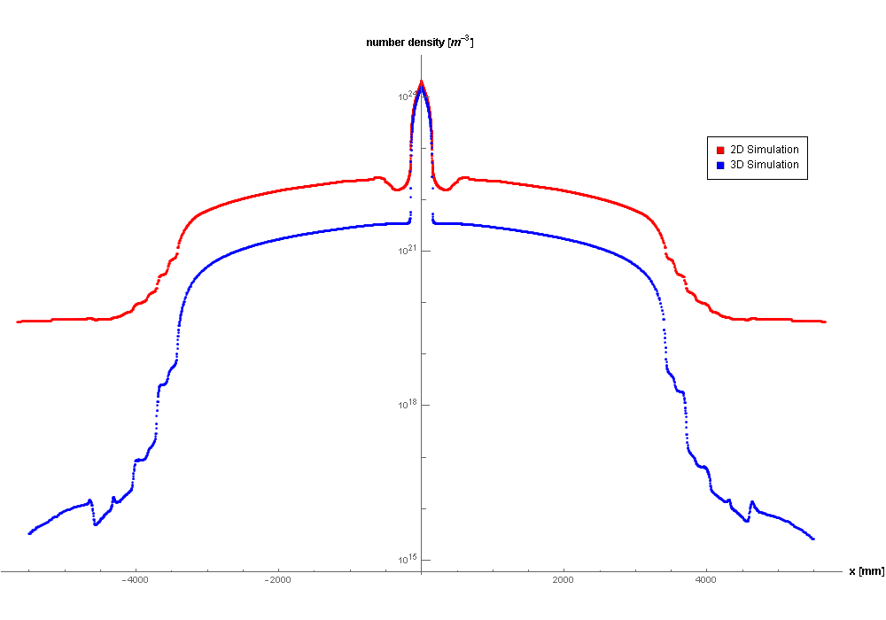
Target development
Polarized gas injection
Prototype testing
Fluid-dynamic simulation
Allows to design the pump system
Estimated luminosity $O({10}^{35})$
Estimated luminosity 𝑂(〖10〗^35)
Target-machine integration
Necessary for nuclear physics experiments
Interactions with the beam-halo
Target cooling
Beam monitoring
Simulation validation
On-beam test
Preliminary
Notes:
Gas simulation, allows a luminosity of about 10^35

Slide 36
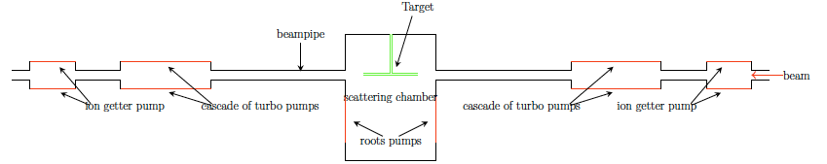
Differential pumping System
Cascade of turbo pumps
Remove injected gas outside of target
Do not pollute the beam pipe
Scattering chamber
High-volume root pumps to extract most of the gas
Mi, 15:45 HK 42.6
Entwickling eines pseudo internen Gastargets (PIT) für MAGIX •Stephan Aulenbacher
Notes:
The target system is a multi stage evacuation system which will bring the vacuum quality to that typical of the beam pipe of (what is the density in the pipe).
The inner target will be placed in a first expansion chamber connected to a set of powerful root pumps. The first chamber is then connected to 3 more pumping stages.
In the inner part, the target will be made of a thin mylar foil with the inner part shaped as a pipe of (which diameter)
3D rendering from Comsol?
Photo of the target mockup and 3d rendering of the target system
Scheme of the pumping system with the number density in the pipe between the stages

Slide 37
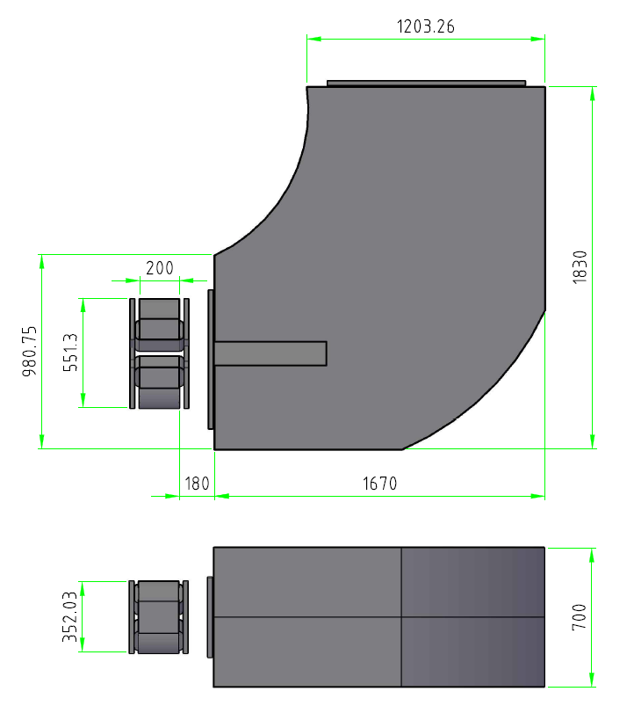
Spectrometer Geometry
Size
2.85 m in the radial direction
Magnet section about 2 m high
Spectrometer rotation
14° minimum rotation angle
Detector section about 1 m high above the magnets
Focal plane
130 * 30 cm²
Symmetric in both directions
Notes:
We say compact because, compared to the MAMI spectrometers, ours will only be about 3 meters in size which makes them comparatively small.
I need the rendering of the spectrometer with the detailed size

Slide 38
P2 Experiment
Measurement of the Weinberg angle
Polarized beam (85% @ 0.15 mA)
Dedicate experiment
Measured with high precision only at the Z-pole
High statistic and exquisite accuracy required
10000 hours scheduled at 10³⁹ luminosity
Fixed target
Several measurement planned at low energy
Measurement technique
Measure the parity violating asymmetry in electron-nucleon scattering

Slide 39
Hodoscope Tracker
2 Sensitive layer
Reliable design
Optimization
The first centered on the focal plane
The second with a sizable lever arm to measure the angle
2 or 3 GEM
2D Strip readout
Small drift
Thin coated GEMs
Foil based readout plane
~ 0.7% radiation length
Material reduction to improve angular measurement

Slide 40
Short-drift TPC
Minimal material budget
Only a thin entry window
No constraints on the readout system
A traditional triple-GEM readout can be used
Full track reconstruction
Multiple samples along the track
PID possible
Rate capability
Can we optimize it for the high rates we will have?

Slide 41
Search for Invisible Decays
Hidden assumptions
What if they are wrong?
DP only decays to electrons
DP is the dominant contribute to the g-2 discrepancy
No bump
Missing energy reconstruction if we detect the recoil nucleon
Scenario under study
Compatible with our detector concept
Maybe with a complementary beam dump experiment
Χ
Χ
Notes:
The previous projections and limits always assume the dark photon having a branch ratio of 1 with electrons and the g-2 welcome band also assumes that the dark photon is the only additional particle that can interact with the muons in those radiative corrections. This means that closing the welcome band is not anyway an exclusion of the dark photon, just a constraint on its effect on the SM radiative corrections. A new thing we are starting to explore is the possibility to work out constraints on the potential decay of the dark photon in additional invisible particle, i.e. Dark Matter.
Considering the momentum resolution of our spectrometers, this could be done if we can detect the recoil nucleon

Slide 42
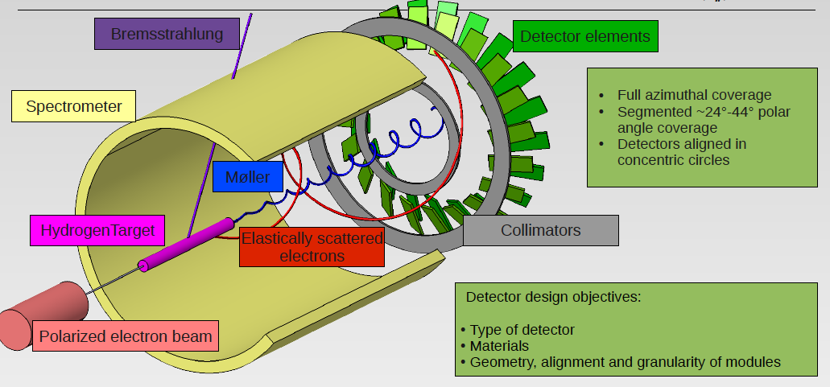
P2 Detector concept

Slide 43
Beam Dump
EXPERIMENT

Slide 44
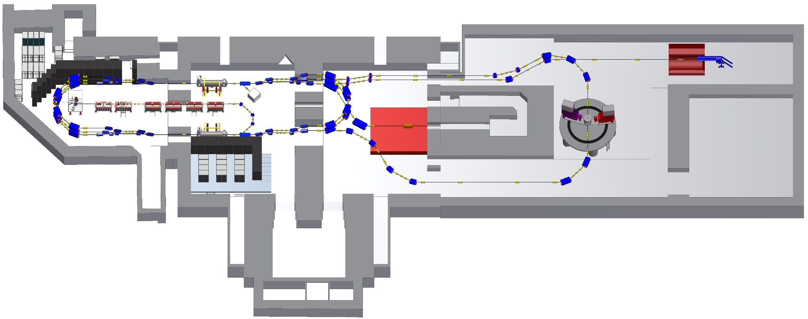
Hall Extension
BDX
P2 Beam dump
10000 hours @ 0.15mA
10²³EOT
Beam Dump eXperiment
Potential dark matter beam for free
Simple detector in low background

Slide 45
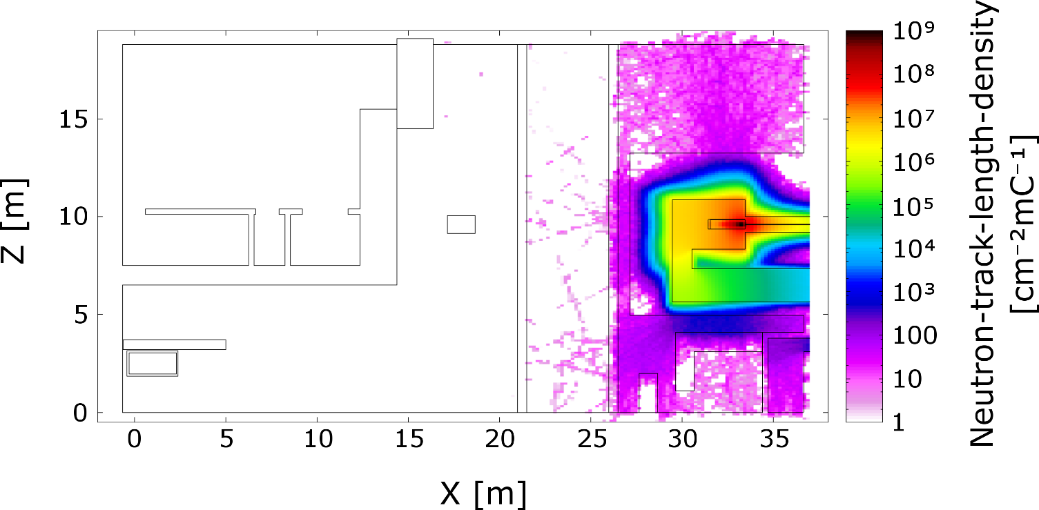
BDX Outlook
Background evaluation
Sensitivity estimation
FLUKA simulation of neutron background is promising
Competitive at low mass
Below pion threshold (no ν)
Plot courtesy of M. Battaglieri

