Slide 2
Outline
Principle of measurement
  The physics
  aSPECT
Beam time 2013 – towards it and beyond
  Overview
  Systematics
  Ideogram of a values
    First hand corrections of systematics
Outlook

Slide 3
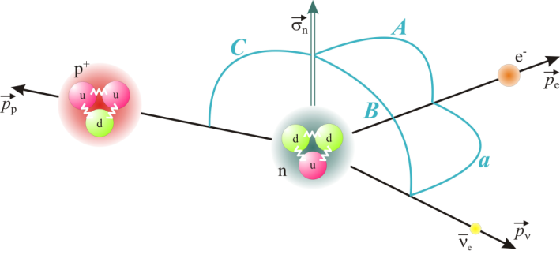
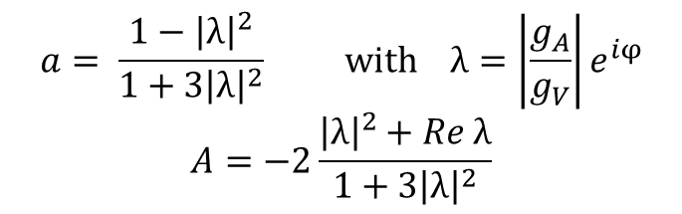

Principle of measurement
Beamtime 2013
Outlook
The physics
aSPECT
Motivation
$$n→p+e+\overline{ν}e+782,3 keV$$
β-decay of the neutron
$$dW\left(\vec{p_{e} },\vec{p_{ν}}\right)∝b\frac{m_{e}}{E_{e}}+a\frac{\vec{p_{e}}\vec{p_{ν}}}{E_{e}E_{ν}}+\frac{\vec{p_{n}}}{p_{n}}\left\{A\frac{\vec{p_{e}}}{E_{e}}+B\frac{\vec{p_{ν}}}{E_{ν}}+…\right\}+…$$
Correlation coefficients, e.g.
Lifetime
$$a= \frac{1−{\left|λ\right|}^{2}}{1+3{\left|λ\right|}^{2}} with λ=\left|\frac{g_{A}}{g_{V}}\right|e^{iφ}$$
$$A=−2\frac{{\left|λ\right|}^{2}+Re λ}{1+3{\left|λ\right|}^{2}}$$
$${τ_{n}}^{−1}∝{\left(V_{ud}\right)}^{2}\left(1+3{\left|λ\right|}^{2}\right)$$
Notes:
Unique system, no corrections for daughter particle, system is overdetermined

Slide 4
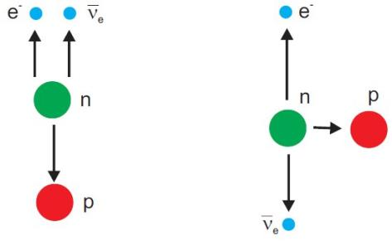
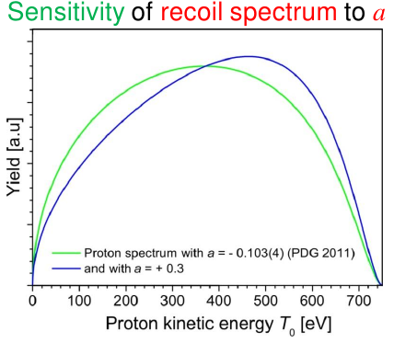
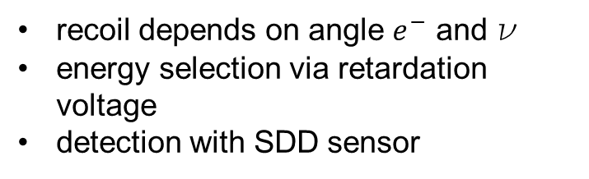
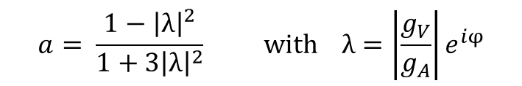
Principle of measurement
Beamtime 2013
Outlook
The physics
aSPECT
Proton spectrum
β-υ angular correlation coeff. a
$$a= \frac{1−{\left|λ\right|}^{2}}{1+3{\left|λ\right|}^{2}} with λ=\left|\frac{g_{V}}{g_{A}}\right|e^{iφ}$$
Proton
recoil depends on angle $e^{−}$ and ν
energy selection via retardation voltage
detection with SDD sensor
Notes:
beta decay of free neutrons, various parameters, we take a; a is linked to lambda; depending on angle between e and nu => shift in spektrum

Slide 5
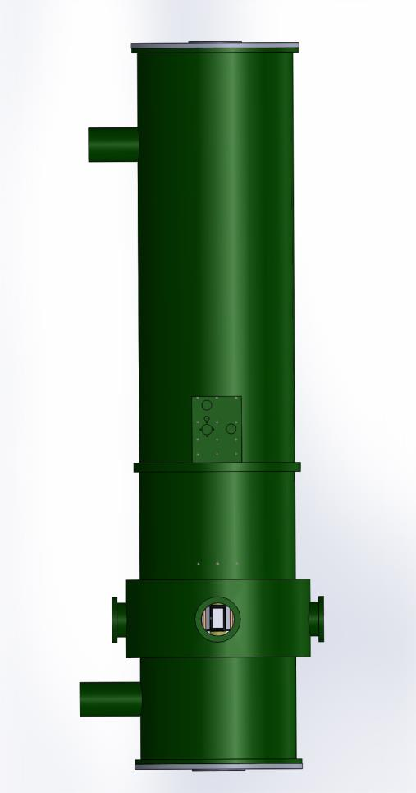
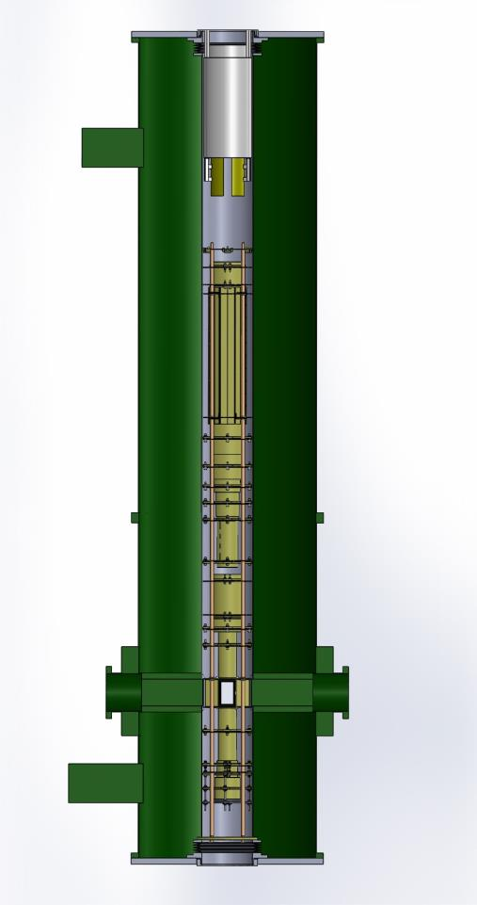
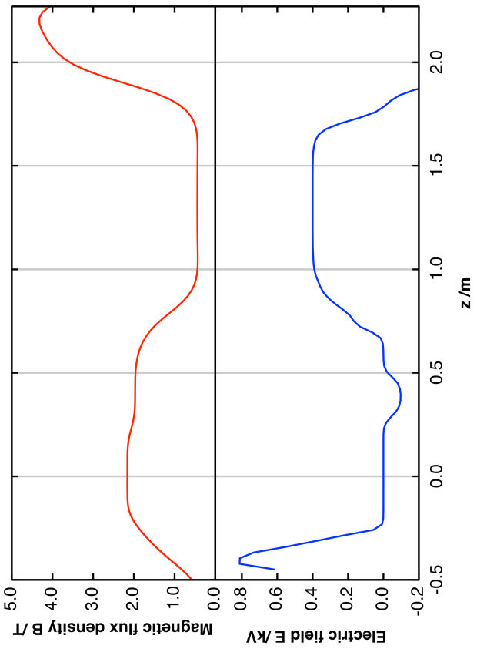


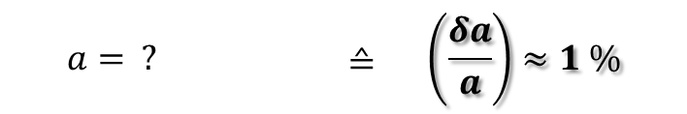
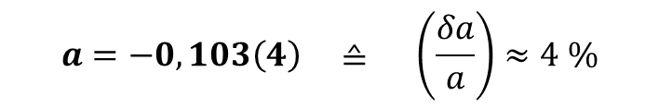
Principle of measurement
Beamtime 2013
Outlook
The physics
aSPECT
aSPECT - principle
z
$$\vec{B}$$
$$\vec{E}$$
Current value of a (PDG 2014)
$$a=−0,103\left(4\right) ≙ \left(\frac{δa}{a}\right)≈4 \%$$
For more details on aSPECT
Our goal
O. Zimmer et al., NIM A 440 (2000) 440
F. Glück et al., EPJ A 23 (2005) 135
S. Baeßler et al., EPJ A 38 (2008) 17
M. Simson et al., NIM A 611 (2009) 203
G. Konrad et al., Nucl. Phys. A 827 (2009) 529c
$$a= ? ≙ \left(\frac{δa}{a}\right)≈1 \%$$
aSPECT
MAC-E type spectrometer
Measures integral spectrum of protons
r
Proton momentum

Slide 6
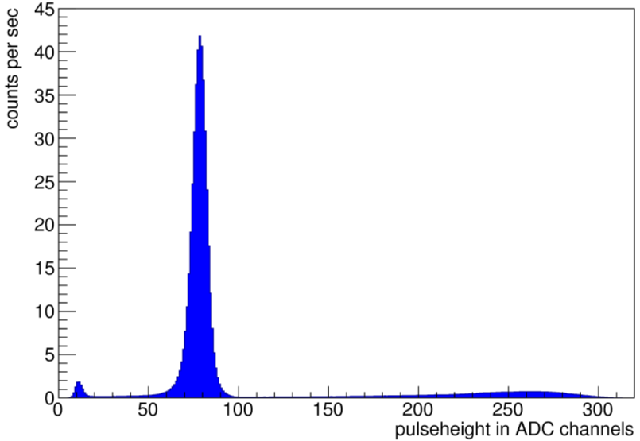
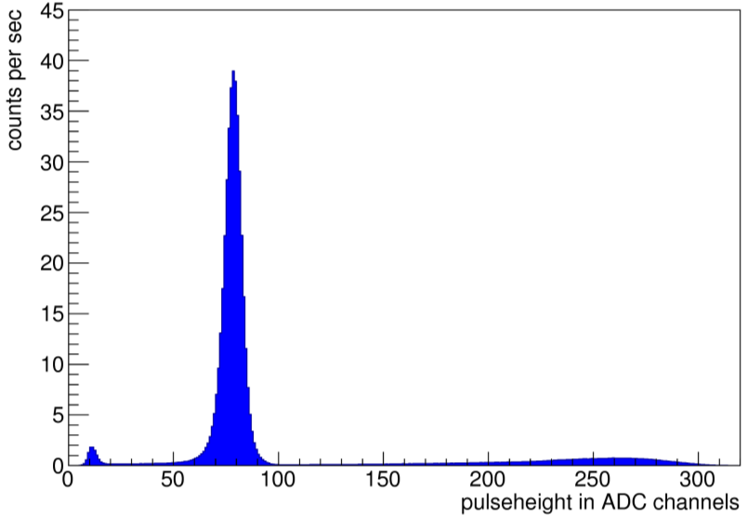
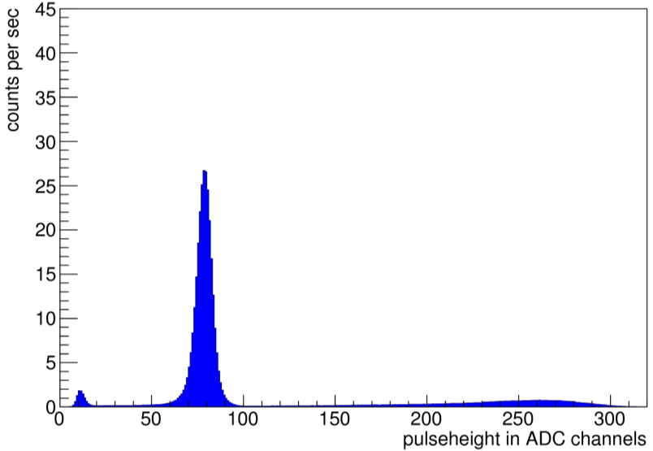
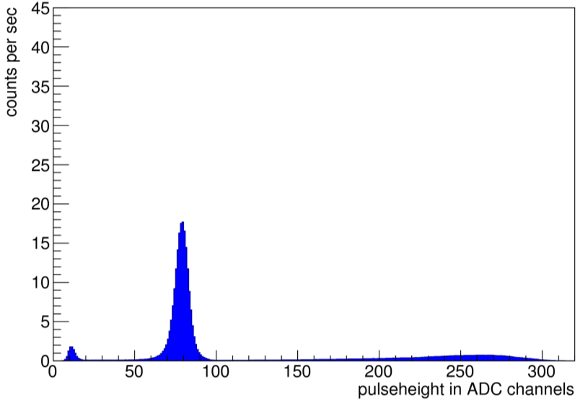
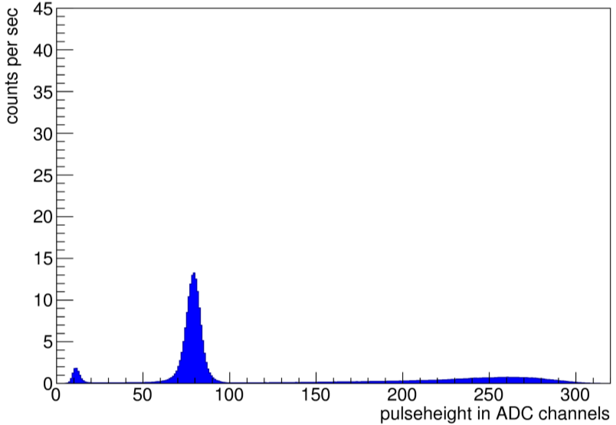
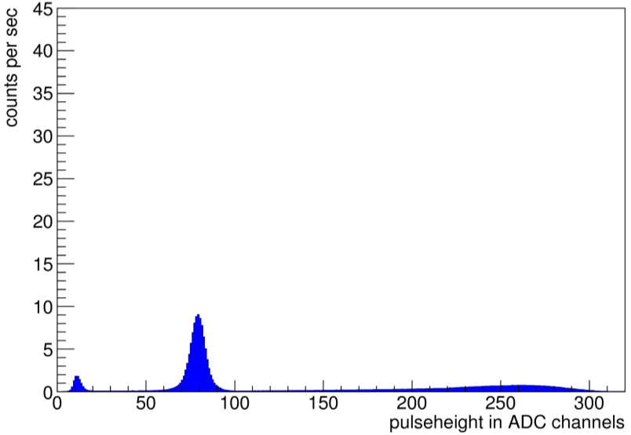
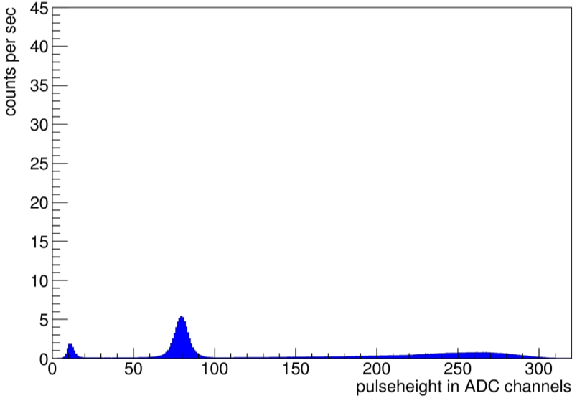
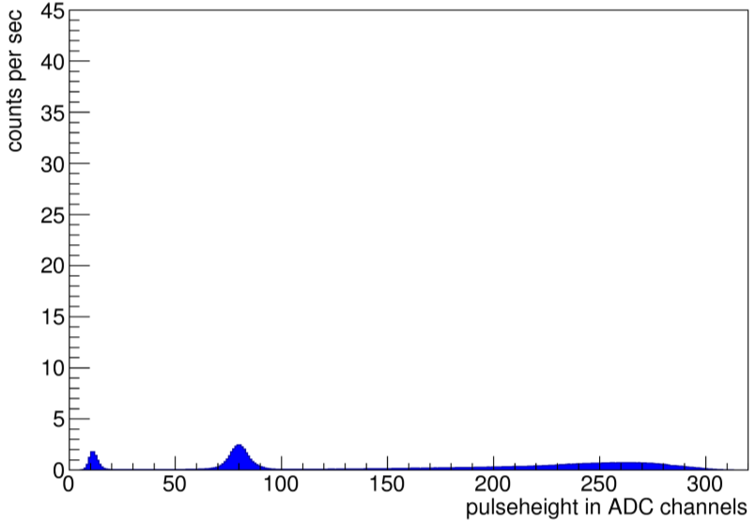
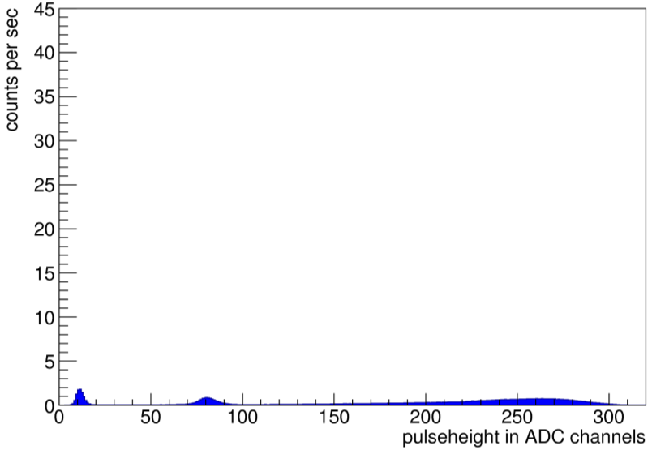
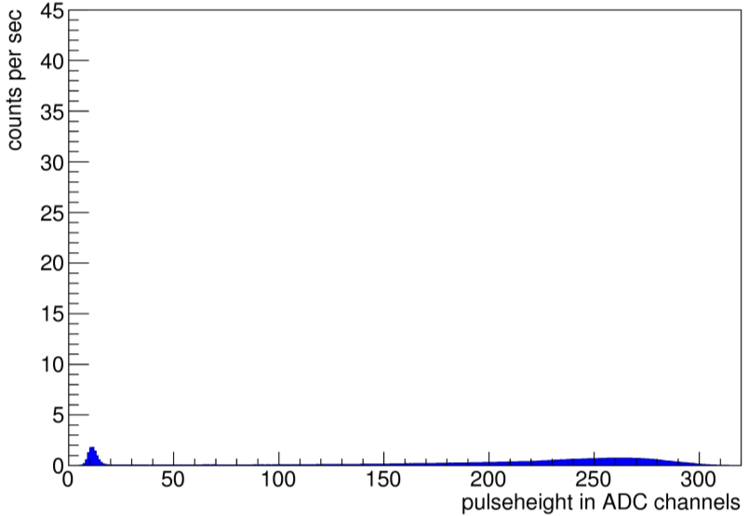
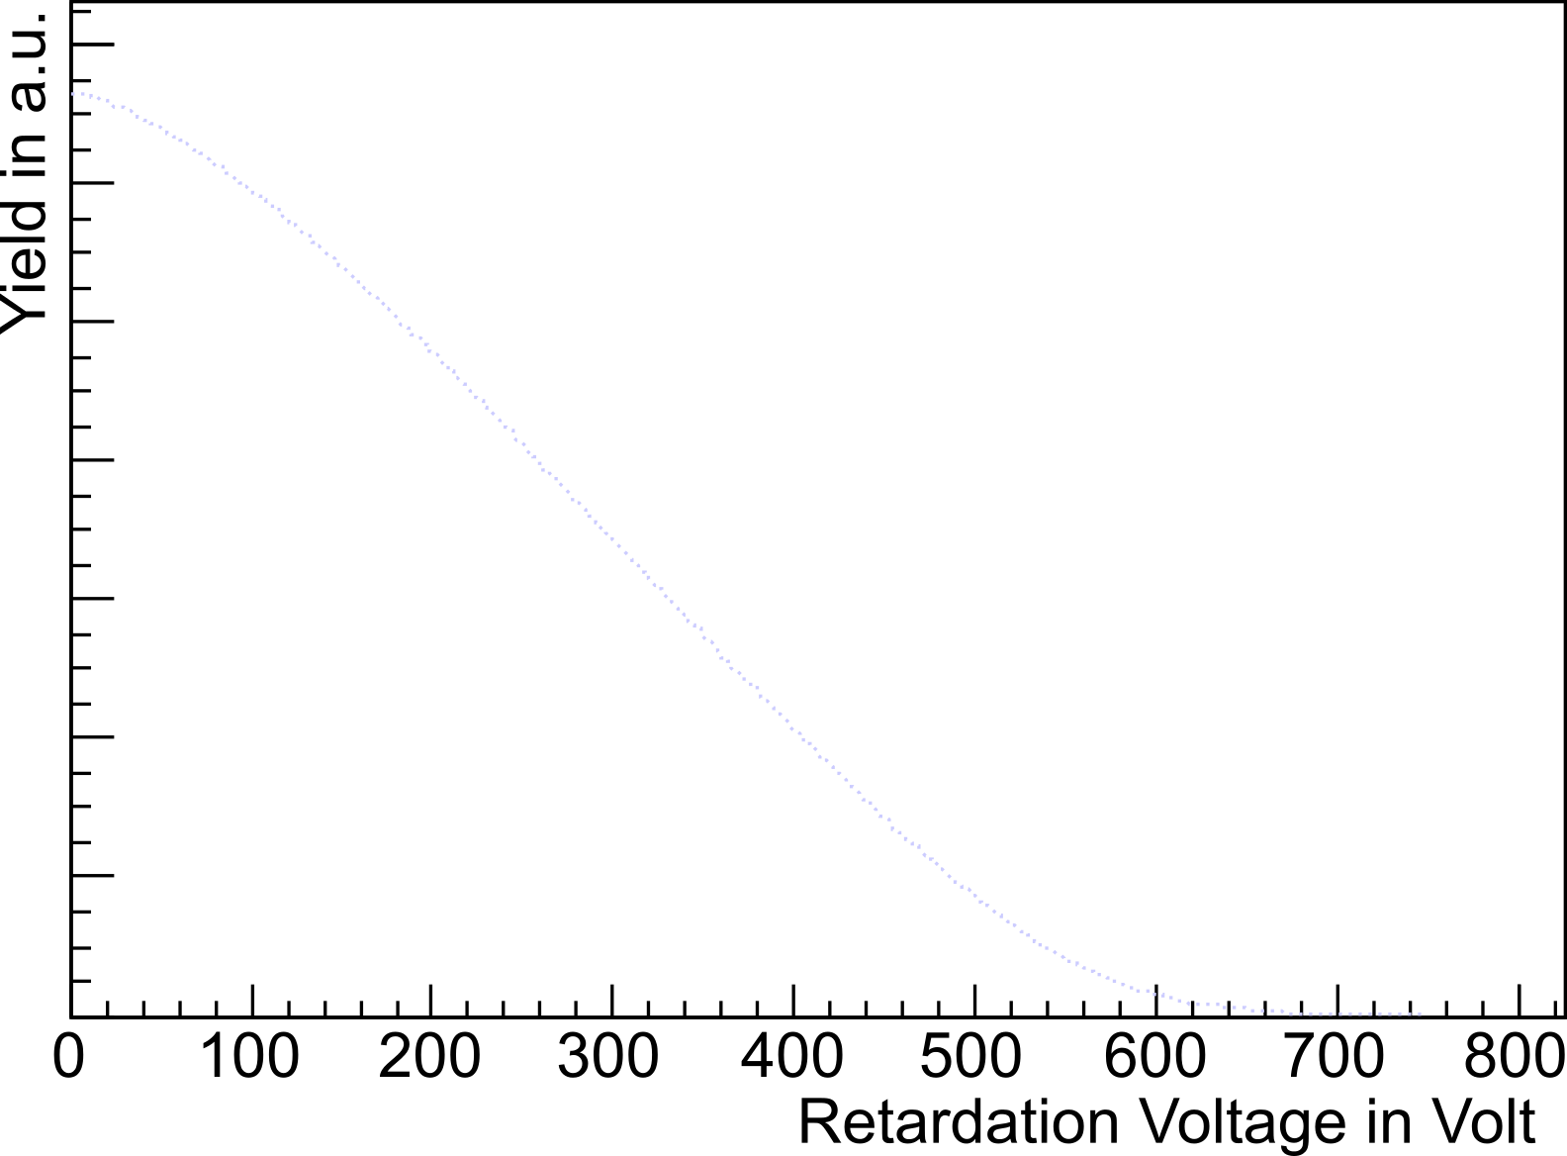
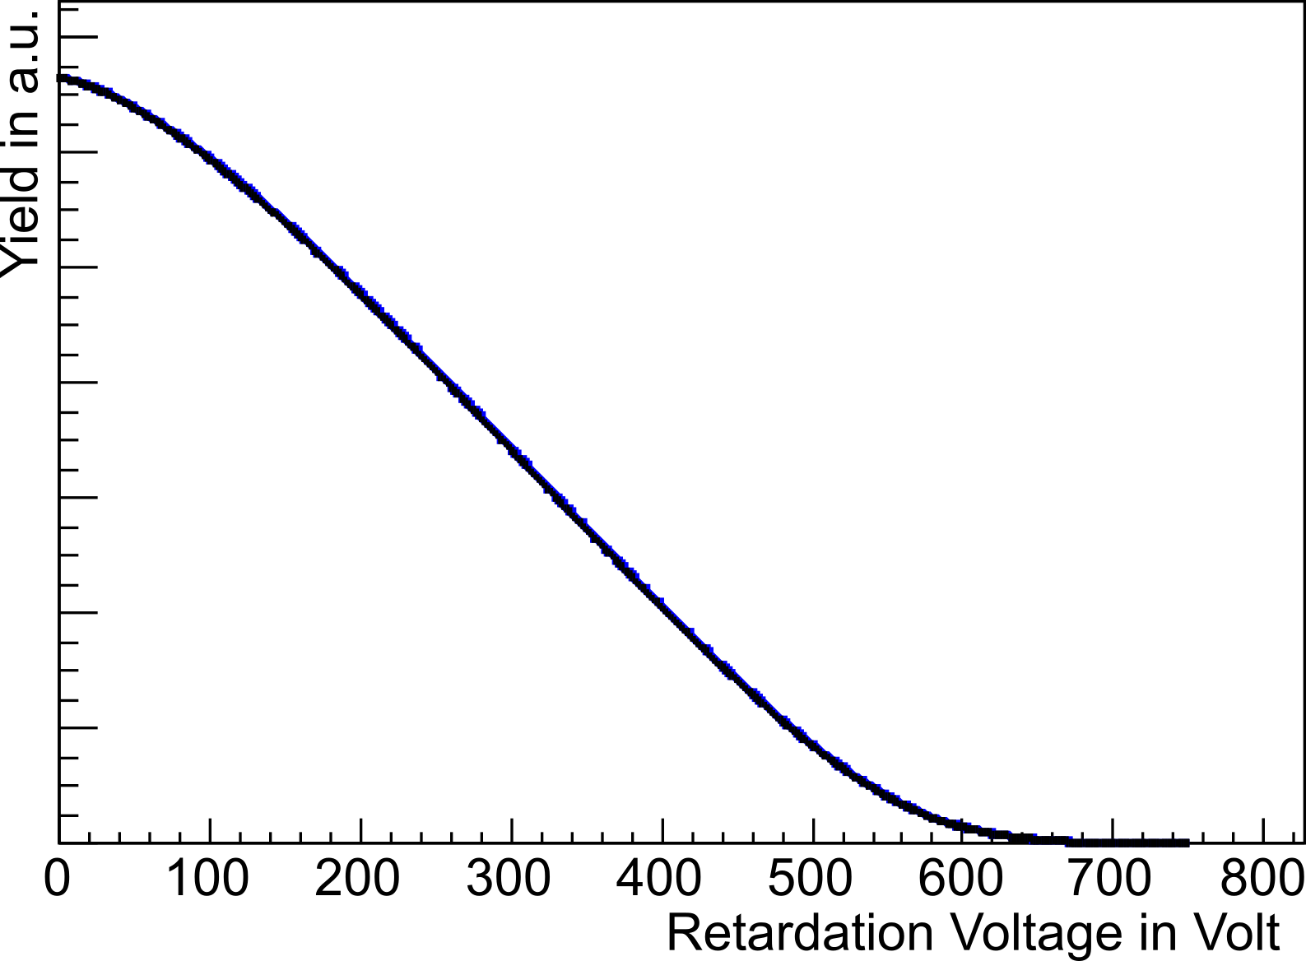
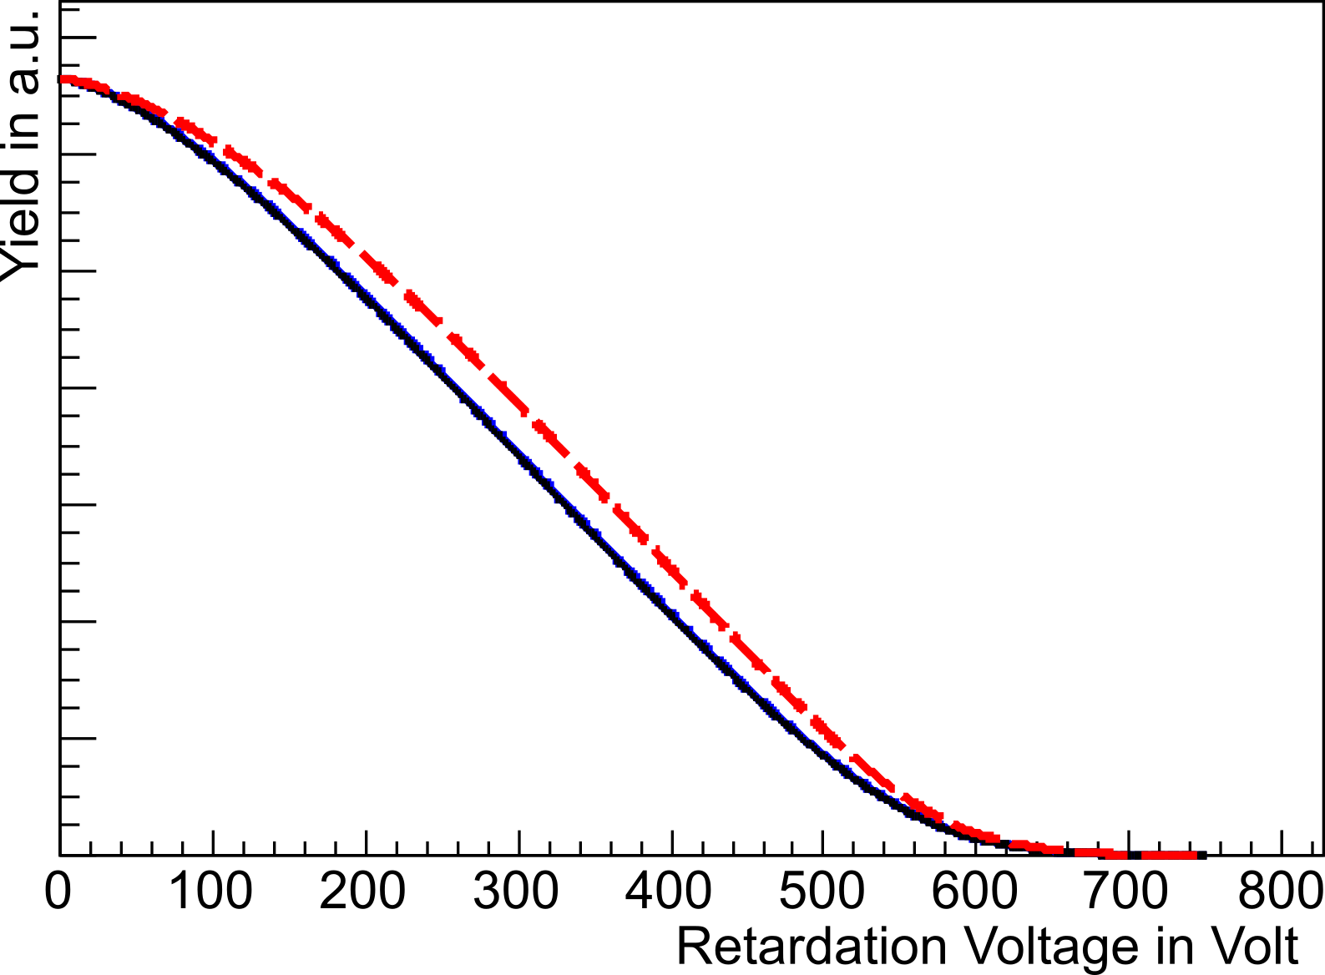
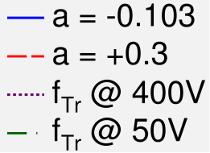
Principle of measurement
Beamtime 2013
Outlook
The physics
aSPECT
aSPECT – determine a
Pulseheight Spectrum
Proton Spectrum
proton
region
electron region
noise

Slide 7
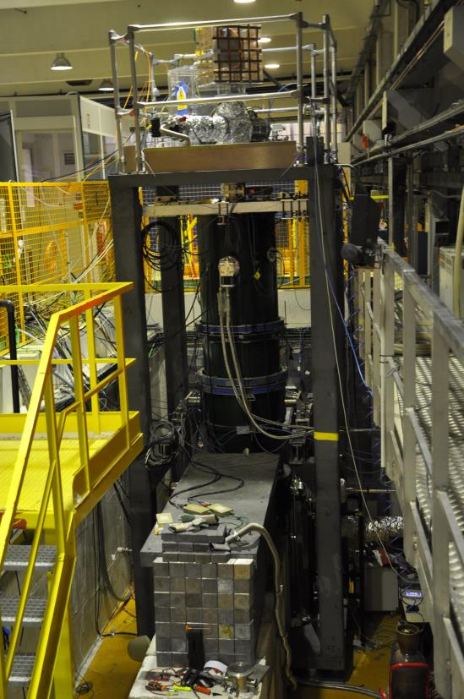
Principle of measurement
Beamtime 2013
Outlook
Overview
Systematics
Ideogram of a values
Beamtime 2013
100 days of beamtime @ ILL
40 days of pure data taking (including sys. tests)
  Initial tuning
  Investigations of the systematics
  Statistic runs for a
Various support measurements: magnetic field, beam profile, ...
~ 1,3 % statistical error per day and detector pad
Systematic investigations with full statistic
2 different DAQs
2 different beam profiles
Various background conditions
No severe systematics observed so far!
Notes:
Two improved DAQs, no run-away discharges, very good statistics=> systematics are main problem

Slide 8
Principle of measurement
Beamtime 2013
Outlook
Overview
Systematics
Ideogram of a values
Beamtime 2013
Leading systematic uncertainties
DAQ efficiency
Transmission-Function
Background
Cuts on proton region
Edge effect
Fields inside the DV electrode
For more details, see
R. Muñoz-Horta, PhD thesis, Mainz 2011
M. Simson, PhD thesis, TUM 2010
M. Borg, PhD thesis, Mainz 2011
G. Konrad, PhD thesis, Mainz 2011
F. Ayala Guardia, PhD thesis, Mainz 2011
R. Maisonobe, PhD thesis, ILL 2014
Notes:
due to time reasons only selected systematics

Slide 9
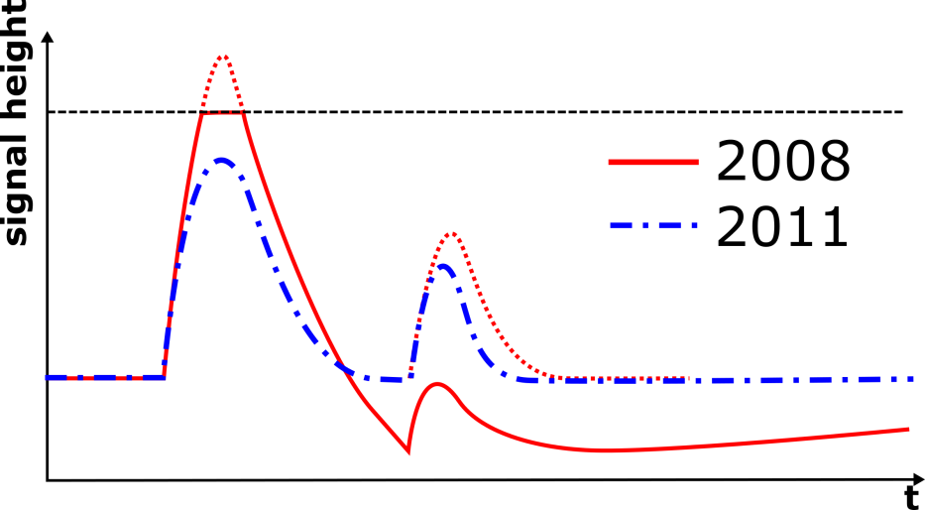
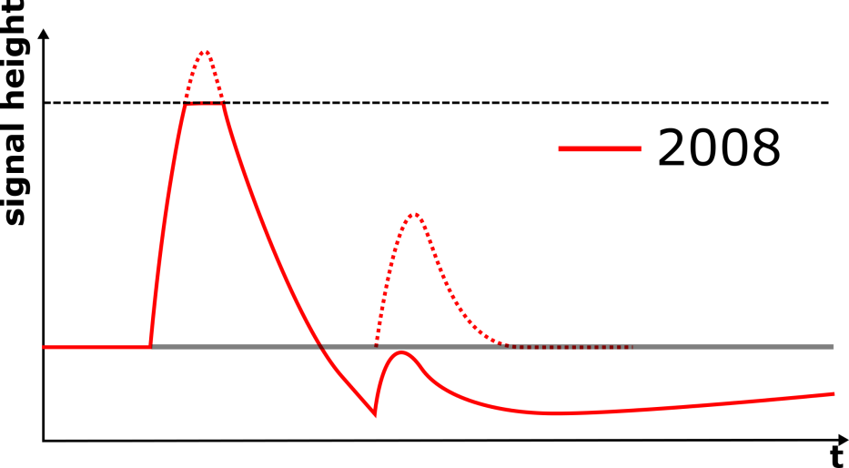
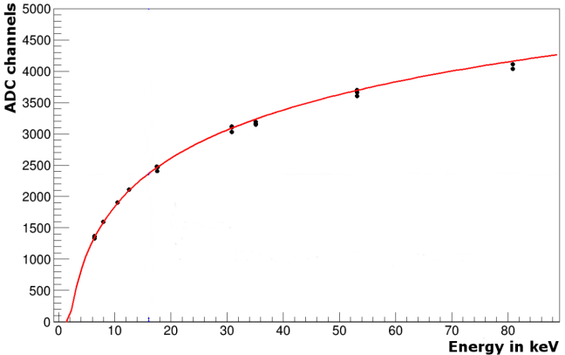
Principle of measurement
Beamtime 2013
Outlook
Overview
Systematics: DAQ efficiency
Ideogram of a values
DAQ efficiency
The problem:
The solution:
A saturation of the DAQ electronics caused a loss of energy (and events!) after high energy pulses:
TOF dependent
=> retardation voltage dependent
reduced amplification of pre-amplifier
a shaper with logarithmic amplification

Slide 10
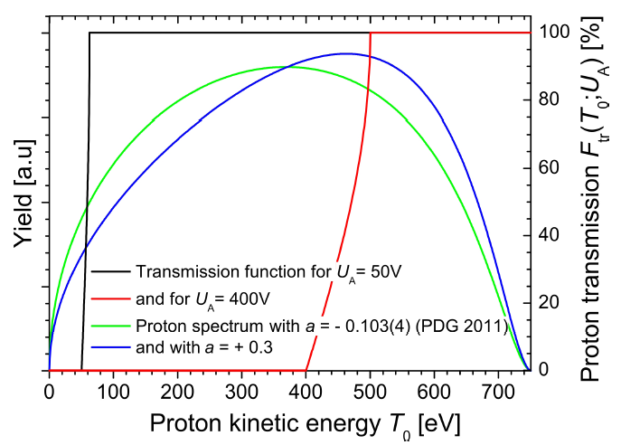



Principle of measurement
Beamtime 2013
Outlook
Overview
Systematics: Transmisson Func
Ideogram of a values
Transmission-Function
Transmission-Function
$$f_{Tr}= f_{Tr}\left(\frac{B_{AP}}{B_{DV}},ϕ_{AP}−ϕ_{DV}\right)$$
Magnetic field ratio r_{B}
Measured with NMR:
$$\frac{B_{AP}}{B_{DV}}= r_{B}=0.202887$$
$$\frac{Δr_{B}}{r_{B}}≈5∙{10}^{−5} ≙ \frac{δa}{a}=0.05 \%$$
Potential difference U_{A}
$$ϕ_{AP}−ϕ_{DV}=U_{A}$$
Conservative estimation:
$$\frac{ΔU_{A}}{U_{A}}≈50 mV ≙ \frac{δa}{a}≈0.5 \%$$
PRELIMINARY
PRELIMINARY

Slide 11
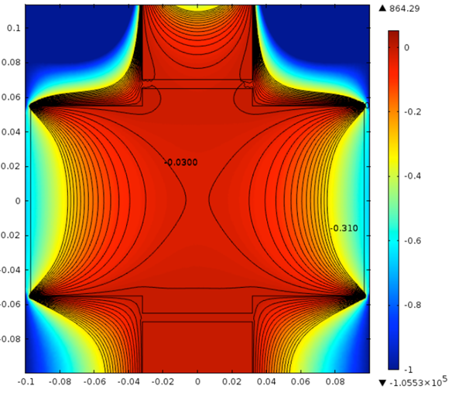
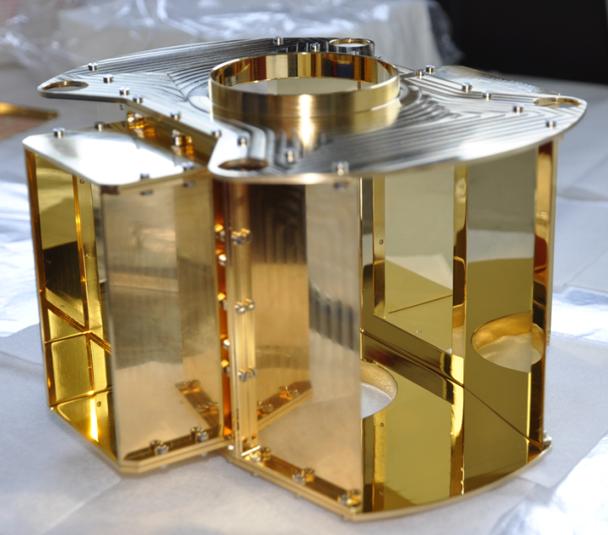
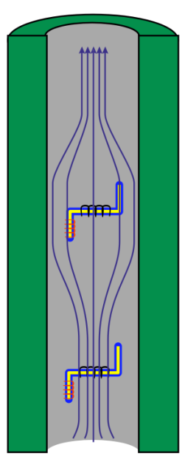
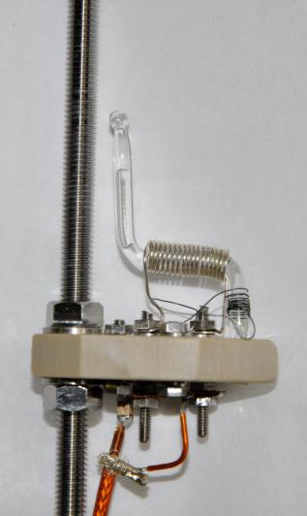
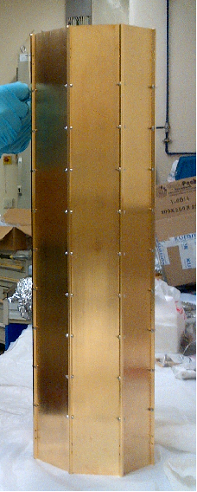
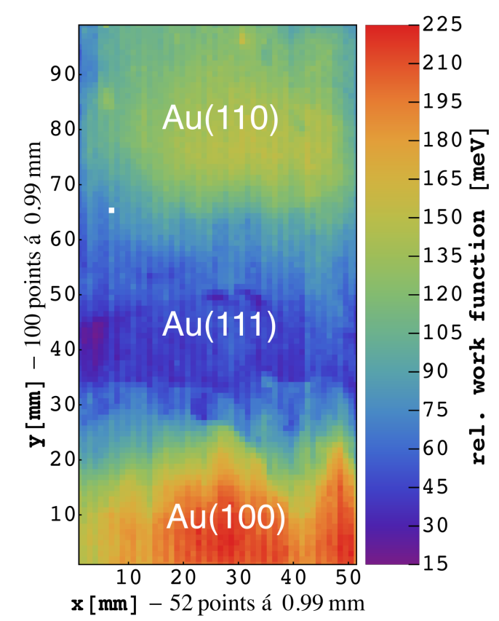

Principle of measurement
Beamtime 2013
Outlook
Overview
Systematics: Transmisson Func
Ideogram of a values
Transmission-Function
Decay Volume
Larmor frequency
Analysing Plane
$$ω0=γB0$$

Slide 12
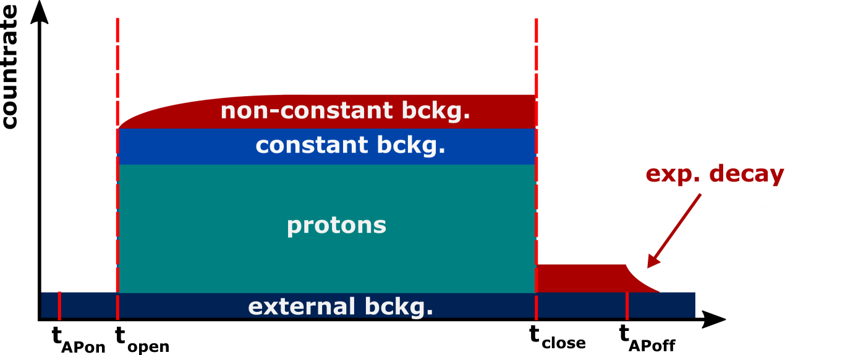
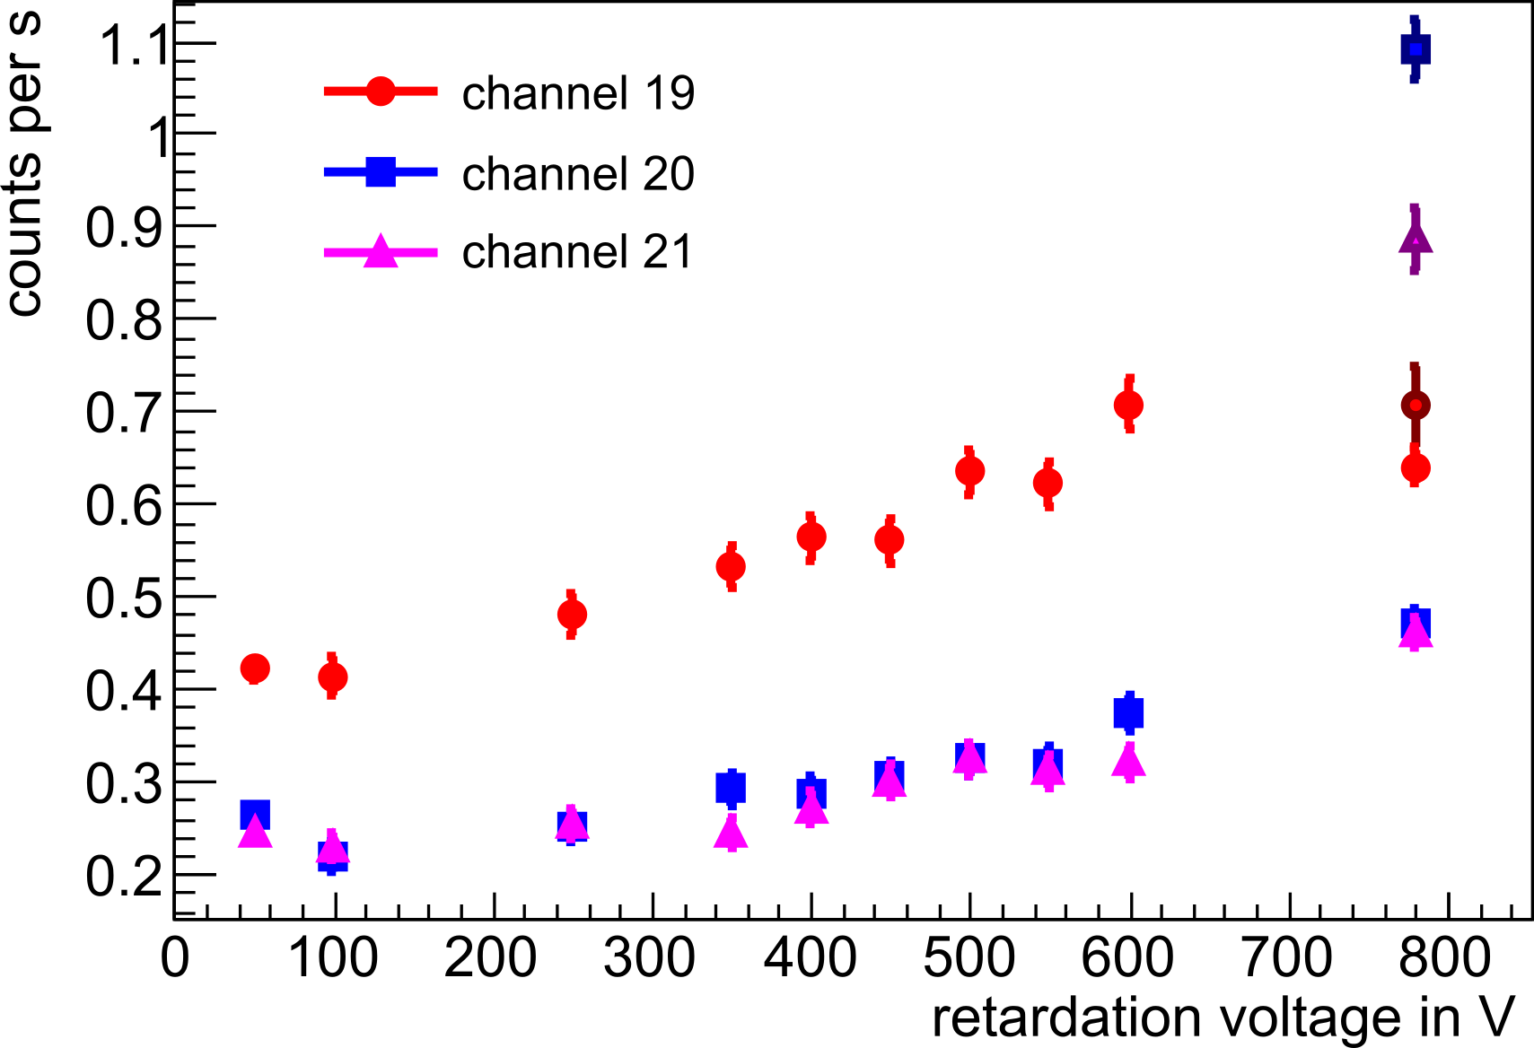
Principle of measurement
Beamtime 2013
Outlook
Overview
Systematics: Background
Ideogram of a values
Background investigation
Sources of background:
External (cosmic, γ‘s from neutron hall, ...)
Intrinsic from spectrometer (ionised residual gas, ...)
Beam related (low E electrons, γ‘s)

Slide 13
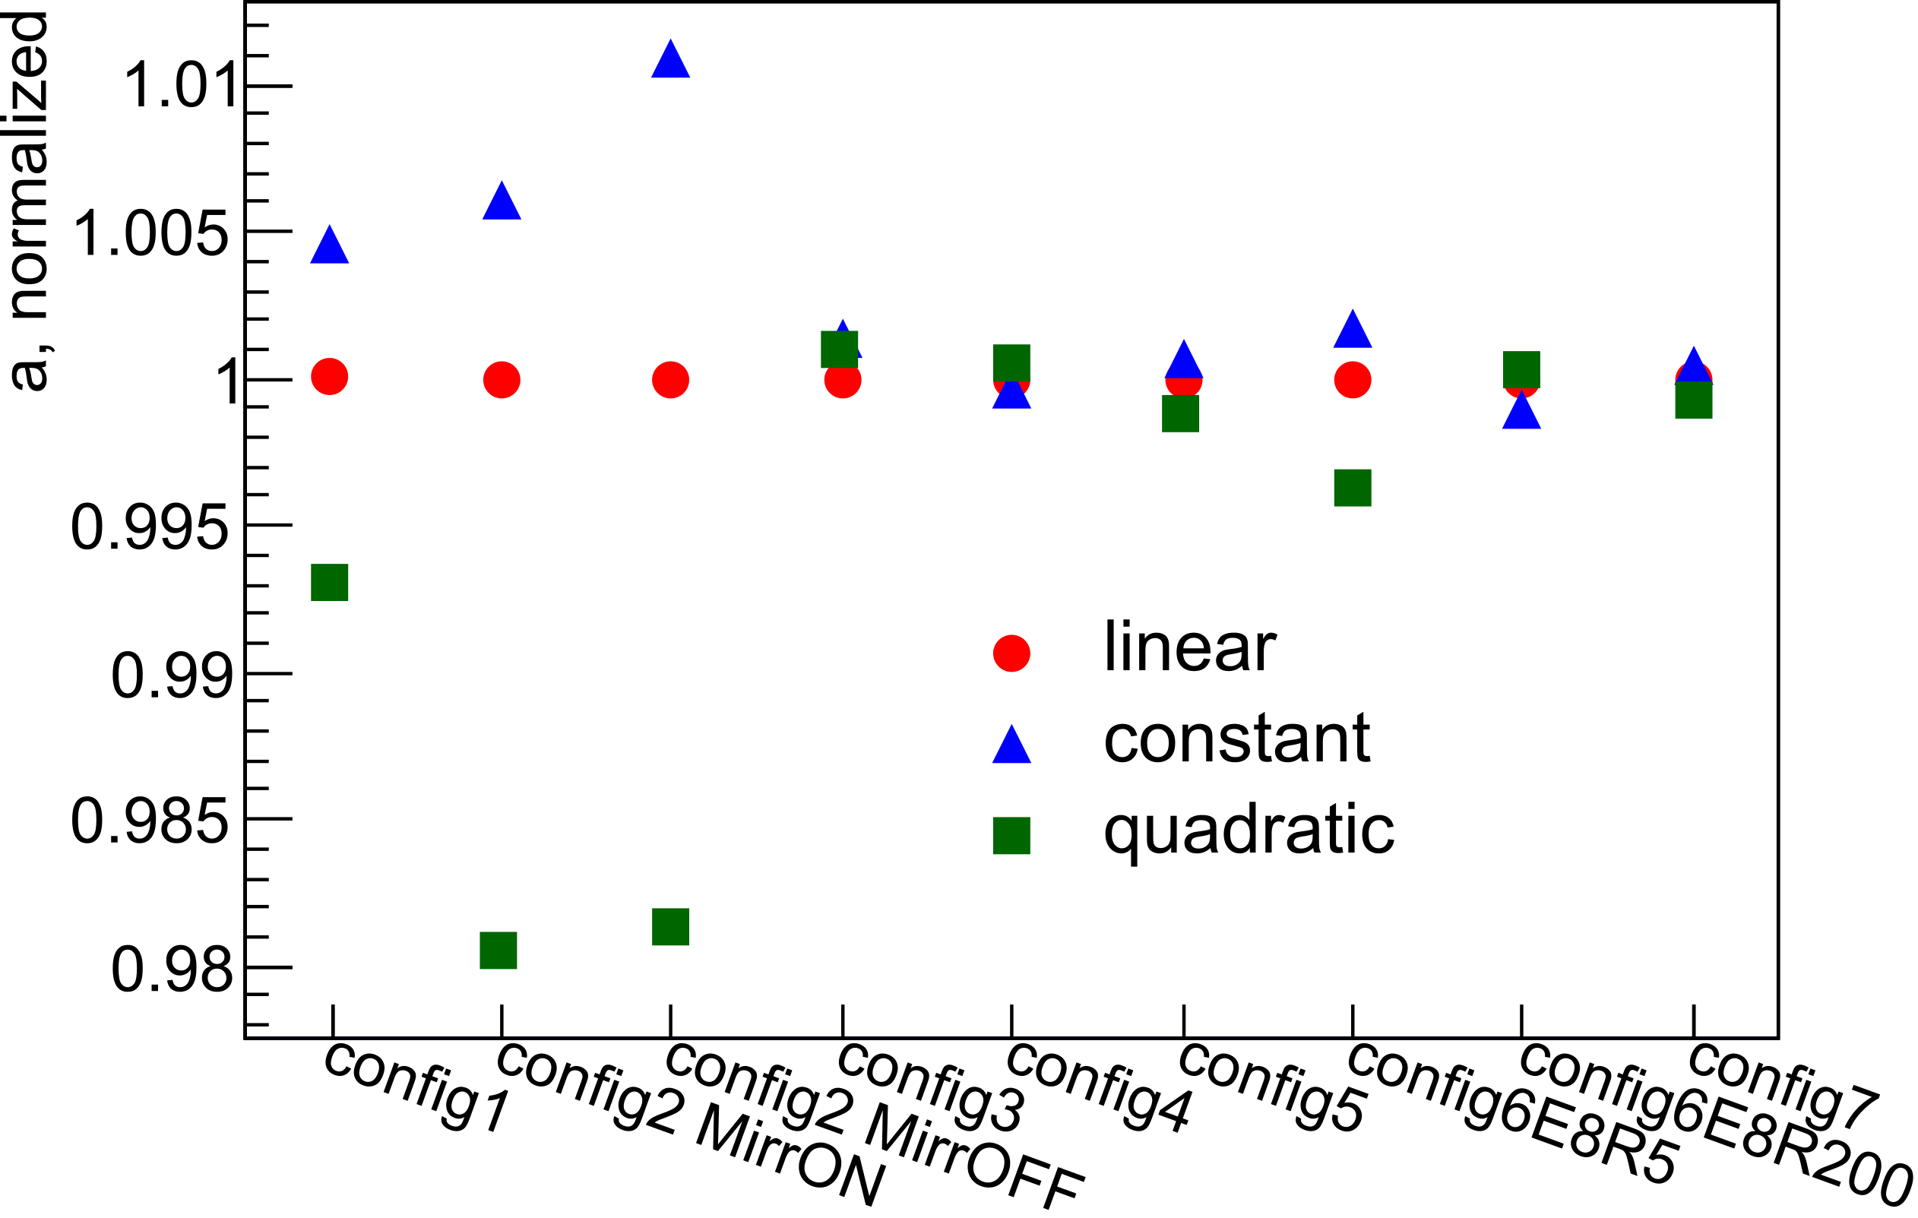
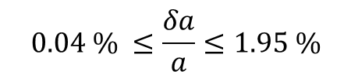
Principle of measurement
Beamtime 2013
Outlook
Overview
Systematics: Background
Ideogram of a values
Background investigation
Background model
$$0.04 \% ≤\frac{δa}{a}≤1.95 \%$$
PRELIMINARY

Slide 14
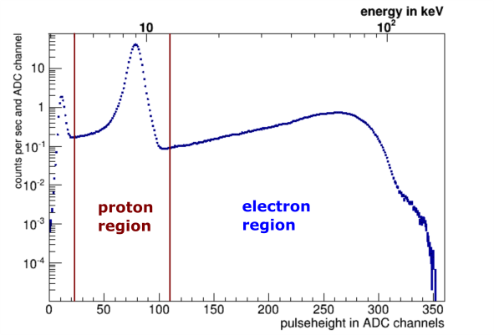
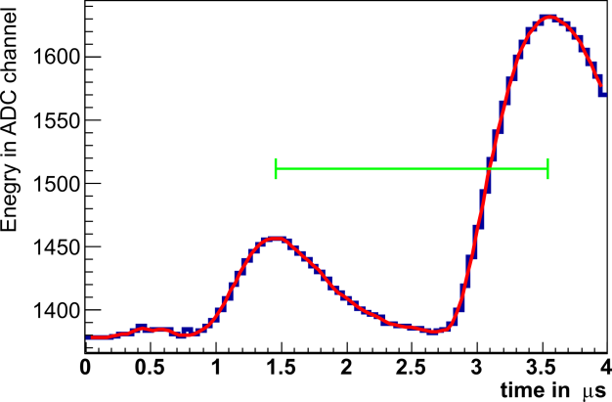
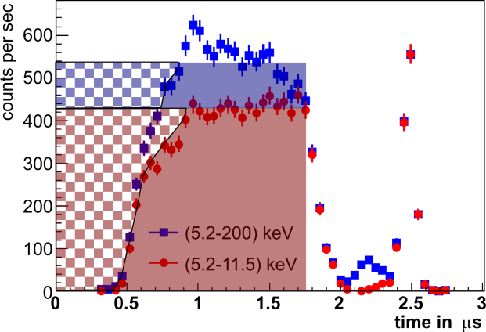
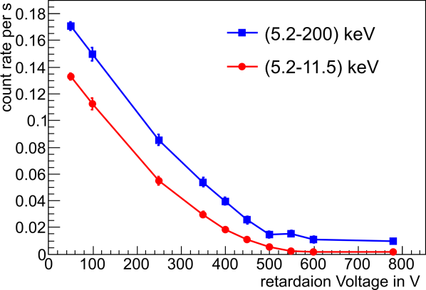

Principle of measurement
Beamtime 2013
Outlook
Overview
Systematics: Pile-Up
Ideogram of a values
Cuts on proton region
ΔT
upper Cut on proton region
PRELIMINARY
$$0.2 \% ≤\frac{δa}{a}≤0.68 \%$$
lower Cut on proton region
t.b.d. by SRIM simulation
ΔT

Slide 15
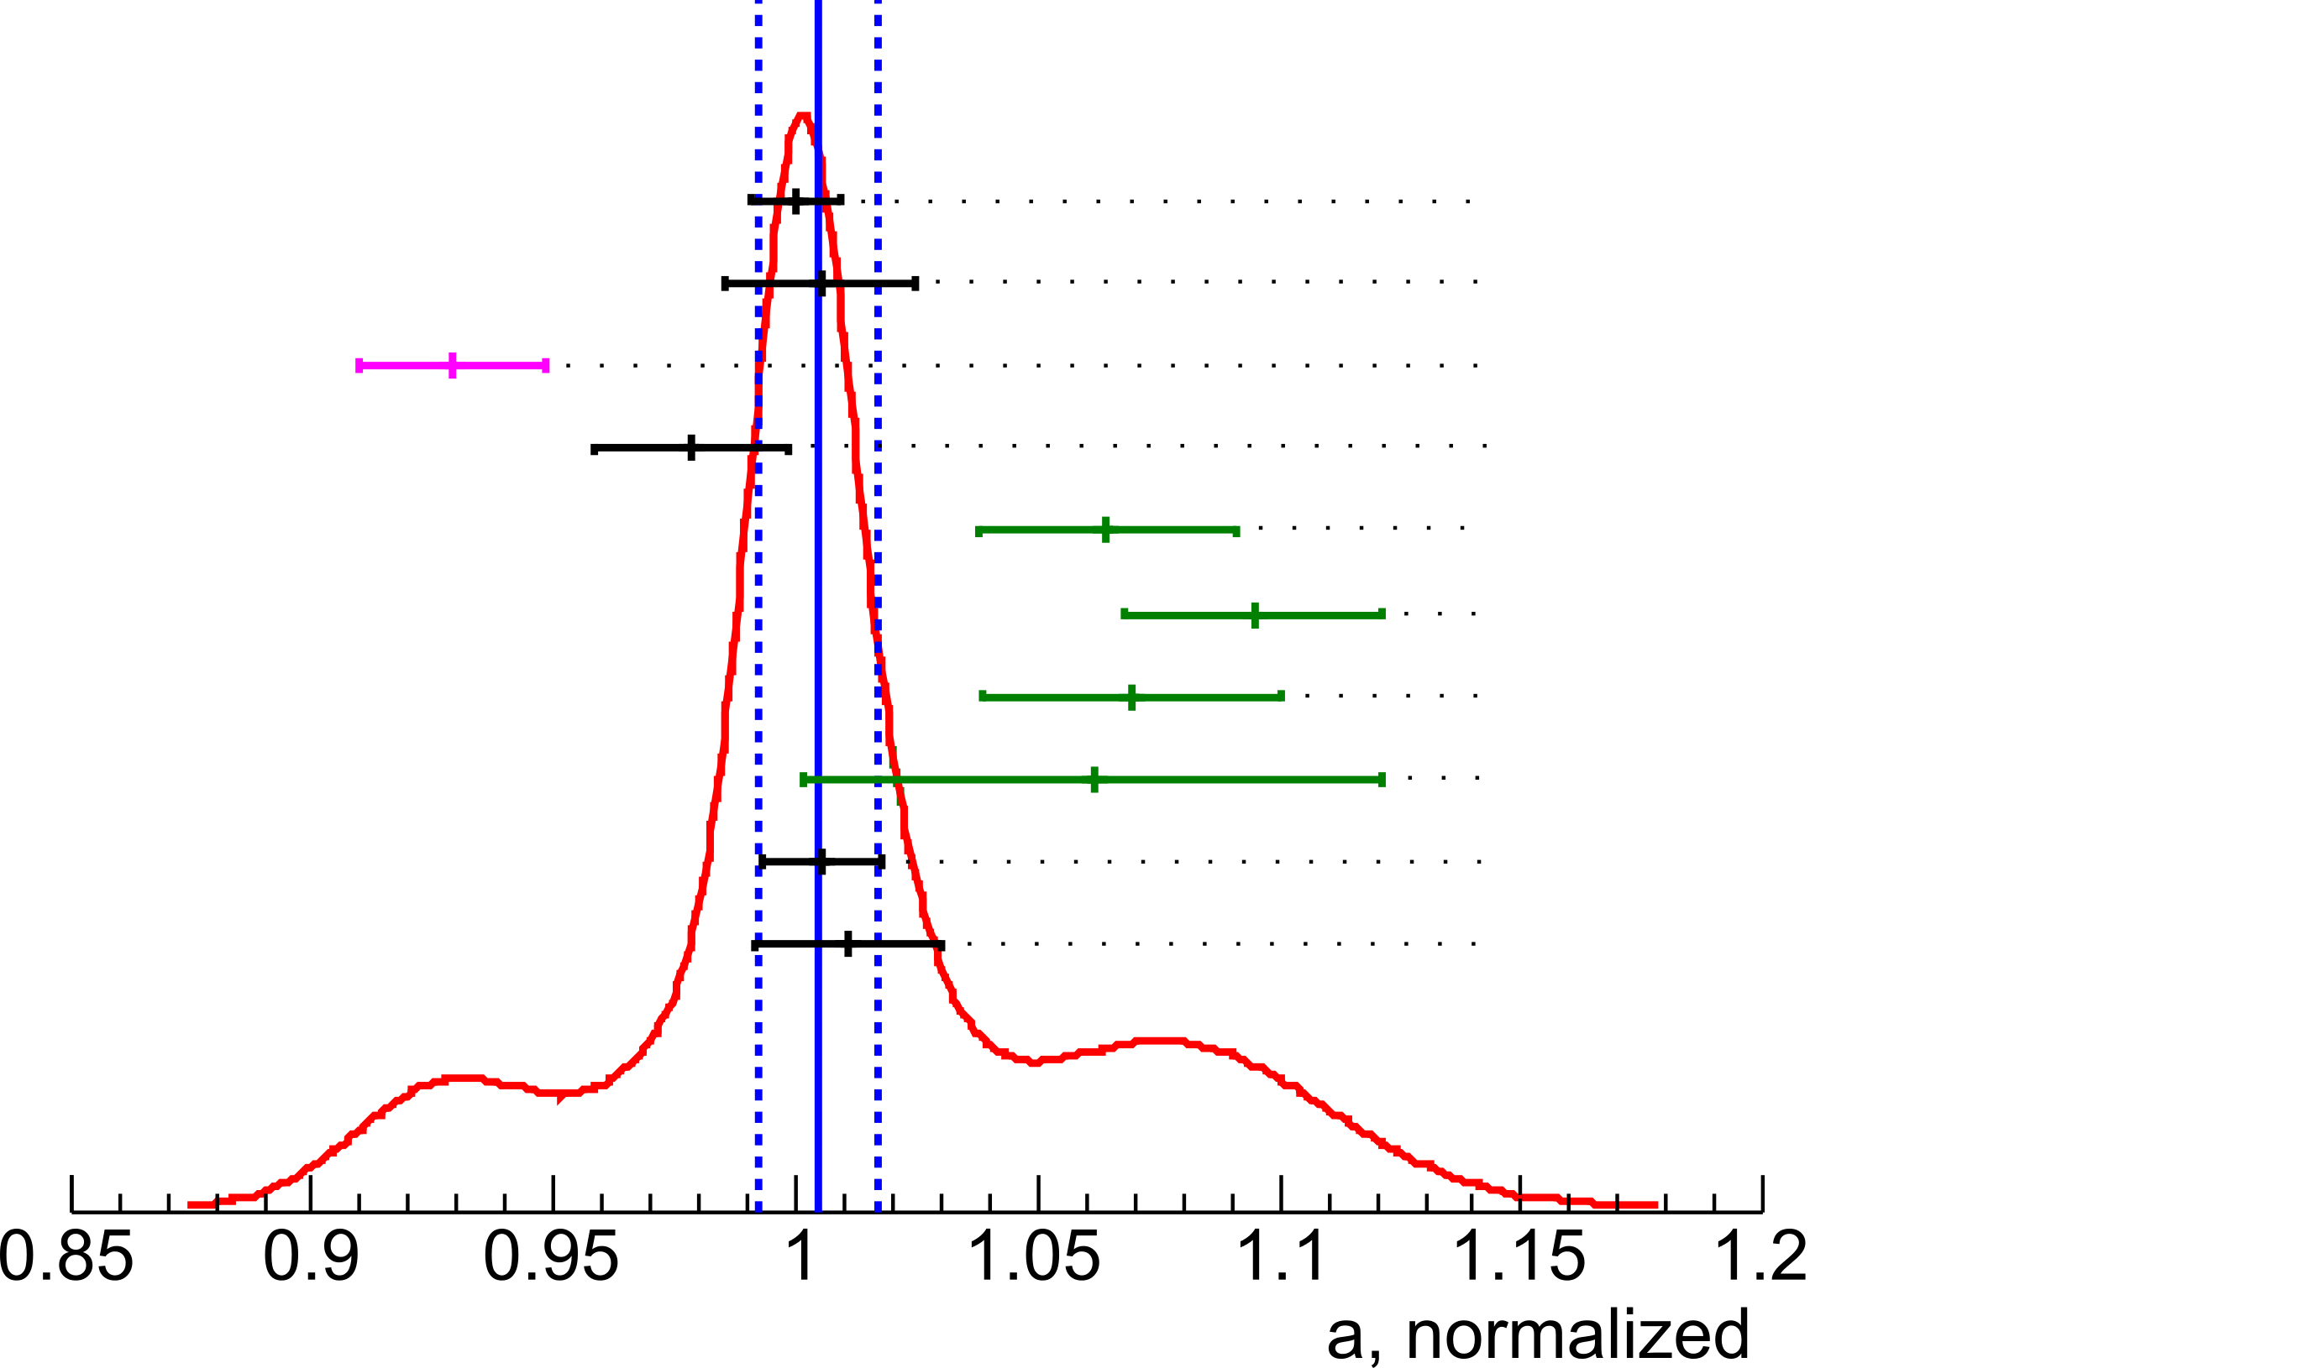
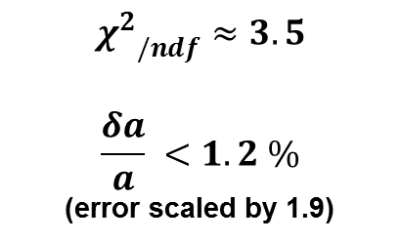
Principle of measurement
Beamtime 2013
Outlook
Overview
Systematics
Ideogram of a values
Ideogram of a values
a - uncorrected
$${χ^{2}}_{/ndf}≈3.5$$
$$\frac{δa}{a} <1.2 \%$$
(error scaled by 1.9)
„standard“
PRELIMINARY
ON
mirror
OFF
diff. edge effect, bckg
enhanced edge effect
PRELIMINARY
proton trapping in DV
„new“ DAQ
Notes:
!! error bars shown are CORRELATED ones !! uncorrelated ones are drawn in y direction
Already included: Pulseheight correction, energy calibration, linear background model.
Not included: edge effect, U_A correction, final error propagation

Slide 16
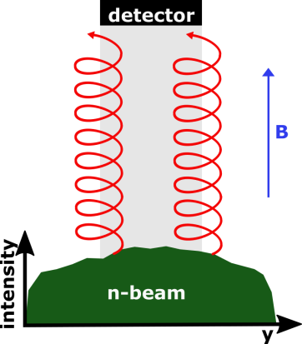
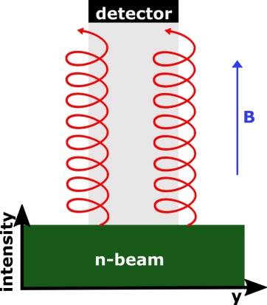





Principle of measurement
Beamtime 2013
Outlook
Overview
Systematics
Ideogram: First corrections
Edge Effect and detector position
What it is?
p dependent detection of the decay protons onto the detector. Shifts a in the order of a few %!
How to solve it.
enhance the effect experimentally,
determine it with particle tracking simulations.
8 cm
copper
foil
5 cm
Notes:
edge effect p_r dependent procetion of the source onto detector. Our source=neutron beam; if flat everything would be fine, but its not => measure beam profile in DV with activated copper foil, add. determine with activated copper wire area in beam profile, which is projected onto detector and also detector orientation

Slide 17

Principle of measurement
Beamtime 2013
Outlook
Overview
Systematics
Ideogram of a values
Ideogram of a values
„standard“
ON
mirror
OFF
diff. edge effect, bckg
enhanced edge effect - corrected
PRELIMINARY
proton trapping in DV
„new“ DAQ
Notes:
!! error bars shown are CORRELATED ones !! uncorrelated ones are drawn in y direction
Already included: Pulseheight correction, energy calibration, linear background model.
Not included: edge effect, U_A correction, final error propagation

Slide 18


Principle of measurement
Beamtime 2013
Outlook
Overview
Systematics
Ideogram: First corrections
B- and E-fields in the DV
Proton reflection due to field gradients
magnetic mirror due to B-field
retardation potential due to E-field
change of phase-space leaving the DV
DV
electrode

Slide 19



Principle of measurement
Beamtime 2013
Outlook
Overview
Systematics
Ideogram: First corrections
Ideogram of a values – with first corrections
„standard“
ON
a – first corrections
mirror
OFF - corrected
$${χ^{2}}_{/ndf}≈0.36$$
$$\frac{δa}{a} ≈1 \%$$
diff. edge effect, bckg
PRELIMINARY
enhanced edge effect - corrected
PRELIMINARY
proton trapping in DV
„new“ DAQ
a - PDG 2014
$$\frac{δa}{a}≈4 \%$$
Notes:
!! error bars shown are CORRELATED ones !! uncorrelated ones are drawn in y direction
Already included: Pulseheight correction, energy calibration, linear background model.
Not included: edge effect, U_A correction, final error propagation

Slide 20
Principle of measurement
Beamtime 2013
Outlook
Outlook
In 2016:
  Finalize investigation of systematic effects:
    DAQ effects
    magnetic field ratio r_{B}
    background
    upper cut on proton region (pile-up)
    retardation voltage U_{A}
    edge effect
    fields in DV
    lower cut on proton region
    minor effects
  Combine everything for final a value and uncertainty

Slide 21







The aTEAM

Slide 22
The aTEAM
Backup slides

Slide 23


Edge Effect – FIRST correction

Slide 24


Principle of measurement
Beamtime 2013
Outlook
Overview
Systematics: Saturation 2008
Distribution of a values
Saturation 2008
Solution 2011:
Reduce amplification of Preamplifier
New designed shaper with log. amplification for large signals
Second DAQ system with FlashADC and software shaping
counts
Proton spectrum
(shaper)
proton region
noise
electron region
energy in a.u.
new shaper card with log. amplification

Slide 25







Principle of measurement
Beamtime 2013
Outlook
Overview
Systematics: Saturation 2008
Distribution of a values
Dependency of lower/upper cut
${Δa}/a$ < 0,8%
2008
${Δa}/a$ < 0,8%
noise
protons

Slide 26



Principle of measurement
Beamtime 2013
Outlook
Overview
Systematics: Saturation 2008
Distribution of a values
Offline tests of DAQ electronics
Pulse generator:
variable e⁻ pulse
variable p⁺ pulse
variable time difference

Slide 27




Principle of measurement
Beamtime 2013
Outlook
Overview
Systematics: Saturation 2008
Distribution of a values
Offline tests of DAQ electronics
Energy calibration:
¹³³Ba source
Cu holder
stainles steel holder

Slide 28
Principle of measurement
Beamtime 2013
Outlook
Overview
Systematics: Background
Distribution of a values
Background 2011
Problem in 2011:
Strong discharges in the time scale of a measurement cycle!
Strong, chaotic background
Could not be solved during beam time

Slide 29

Principle of measurement
Beamtime 2013
Outlook
Overview
Systematics: Background
Distribution of a values
Background 2012/3
Improvements for 2012/3
Improved cleaning
Installed add. turbo pumps
Improved vacuum
New internal collimation
Replaced corroded parts
Smoothed edges of electrode system
Recoated electrode system
New dipole-electrode above AP as ExB
no more discharges!

Slide 30


Principle of measurement
Beamtime 2013
Outlook
Overview
Systematics: Background
Distribution of a values
Background 2013
PRELIMINARY
Background investigations:
Still ongoing, but looks promising.
PRELIMINARY

Slide 31



Principle of measurement
Beamtime 2013
Outlook
Overview
Systematics: Background
Ideogram of a values
Background investigation
Background model
AP dependence
PRELIMINARY
PRELIMINARY
$$0.04 \% ≤\frac{δa}{a}≤1.95 \%$$
$$0.02 \% ≤\frac{δa}{a}≤0.2 \%$$

Slide 32

Principle of measurement
Beamtime 2013
Outlook
Overview
Systematics: Pulseshape
Distribution of a values
Pulseshape analysis
Differences in the shape?
different shapes of pulses are visible
no better discrimination than cut on pulseheight
shape is mainly determineg by shaper

Slide 33



Principle of measurement
Beamtime 2013
Outlook
Overview
Systematics: Edge Effect
Distribution of a values
Edge Effect and detector position
copper
wire
Edge effect
Detector position from measurement
Beam profile from measurement
Simulation to correct (few %) for edge effect

Slide 34





Principle of measurement
Beamtime 2013
Outlook
Overview
Systematics: Pulseheight corr.
Distribution of a values
Pulseheight correction
Due to pile-up events can be asigned the wrong pulseheight
Solved by a spline fit to the pulse. Allows to determine:

Slide 35


Principle of measurement
Beamtime 2013
Outlook
Overview
Systematics: Transmission-Func.
Distribution of a values
Magnetic field measurement
Magnetic field ratio r_{B}
$$\frac{Δr_{B}}{r_{B}}≈1∙{10}^{−4} ≙ \frac{δa}{a}=0.1 \%$$
Two methods to measure
Hall probe
  Wide field range 0-3 T
  Not precise enough >10⁻³
Nuclear Magnetic Resonance
  Narrow field range few mT
  Extreme precise 10⁻⁷
Notes:
10^-7 are the bad end for NMR, experts get it easily some orders of magnitude better

Slide 36


Principle of measurement
Beamtime 2013
Outlook
Overview
Systematics: Transmission-Func.
Distribution of a values
Nuclear Magnetic Resonance
NMR measurements
Measurement of B at DV/AP in beam place after beam time
Test of different influences, like detector, shutter, ramping of magnet
$\frac{Δr_{B}}{r_{B}}<0.5∙{10}^{−5}$ ☺
PRELIMINARY
Larmor frequency
$$ω0=γB0$$

Slide 37


Principle of measurement
Beamtime 2013
Outlook
Overview
Systematics: Transmission-Func.
Distribution of a values
Potential difference U_{A}
Potential difference U_{A}
$$ϕ_{AP}−ϕ_{DV}=U_{A}$$
$$\frac{ΔU_{A}}{U_{A}}=7 mV ≙ \frac{δa}{a}=0.1 \%$$
Solution(?)
Precision power supply
Precision DMM to measure voltage between DV and AP
So what is the problem?

Slide 38

Principle of measurement
Beamtime 2013
Outlook
Overview
Systematics: Transmission-Func.
Distribution of a values
Work function
Potential applied to electrode…
…is modified by the work function!
E.g. gold
$$\left\langle 100\right\rangle 5,47 eV$$
$$\left\langle 110\right\rangle 5,37 eV$$
$$\left\langle 111\right\rangle 5,31 eV$$
Various 5-5,5 eV
WF measurement of DV at air
RMS (average)
of all electrodes: 19 mV
between electrodes: 35 mV
PRELIMINARY
Notes:
Surface contact potential, modified by water or similar

Slide 39
Principle of measurement
Beamtime 2013
Outlook
Overview
Systematics: Transmission-Func.
Distribution of a values
Field leakage
WF difference between materials
Stainless steel and gold have difference in WF in the order of 1 V
=> Field leakage into DV up to 30 mV
PRELIMINARY
Notes:
Field leakage from bore tube, internal collimation (made conductive to avoid charge up)

Slide 40



Work function measurements
www.kptechnology.com

Slide 41


Kelvin Probe

Slide 42

Decay Volume

Slide 43

Analysing Plane

Slide 44



Principle of measurement
Beamtime 2013
Outlook
Overview
Systematics
Ideogram: First corrections
B- and E-fields in the DV
Proton reflection due to field gradients
fields modify phase space of protons leaving the DV
calculate kin. energy of protons along z for reflections
$$T_{kin}\left(z\right)=T_{0}−e\left(U\left(z\right)−U_{0}\right)\frac{B(z)}{B_{0}}T_{0}\sin^{2}θ_{0}$$
Decay Volume
reflected by B-field towards AP
reflected by E-field towards mirror

Slide 45

Offline tests of DAQ electronics

