Slide 1
A new
ultracold neutron source
at TRIGA Mainz
Hollering Alexander
15.4.2016

Slide 2
Outline
TRIGA Mainz
Setup of the source at TRIGA Mainz
First measurements
3.1) Time of flight
3.2) Storage experiment
4) Conclusion and Outlook

Slide 3
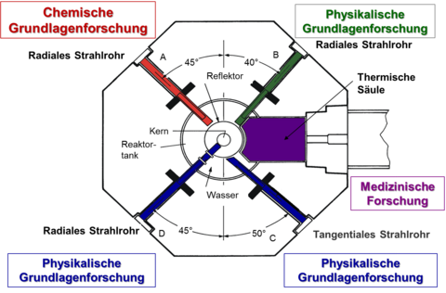
1) TRIGA Mainz
Operation modes:
Steady state (0-100 kW)
Max. neutron flux:
$4 ⋅{10}^{12} ncm^{−2}s^{−1}$
Pulse mode 250 MW,
30 ms (FWHM)
Max. neutron flux:
$1⋅{10}^{16} ncm^{−2}s^{−1}$
Both measured at central
irradiation pipes
http://www.kernchemie.uni-mainz.de/719.php

Slide 4
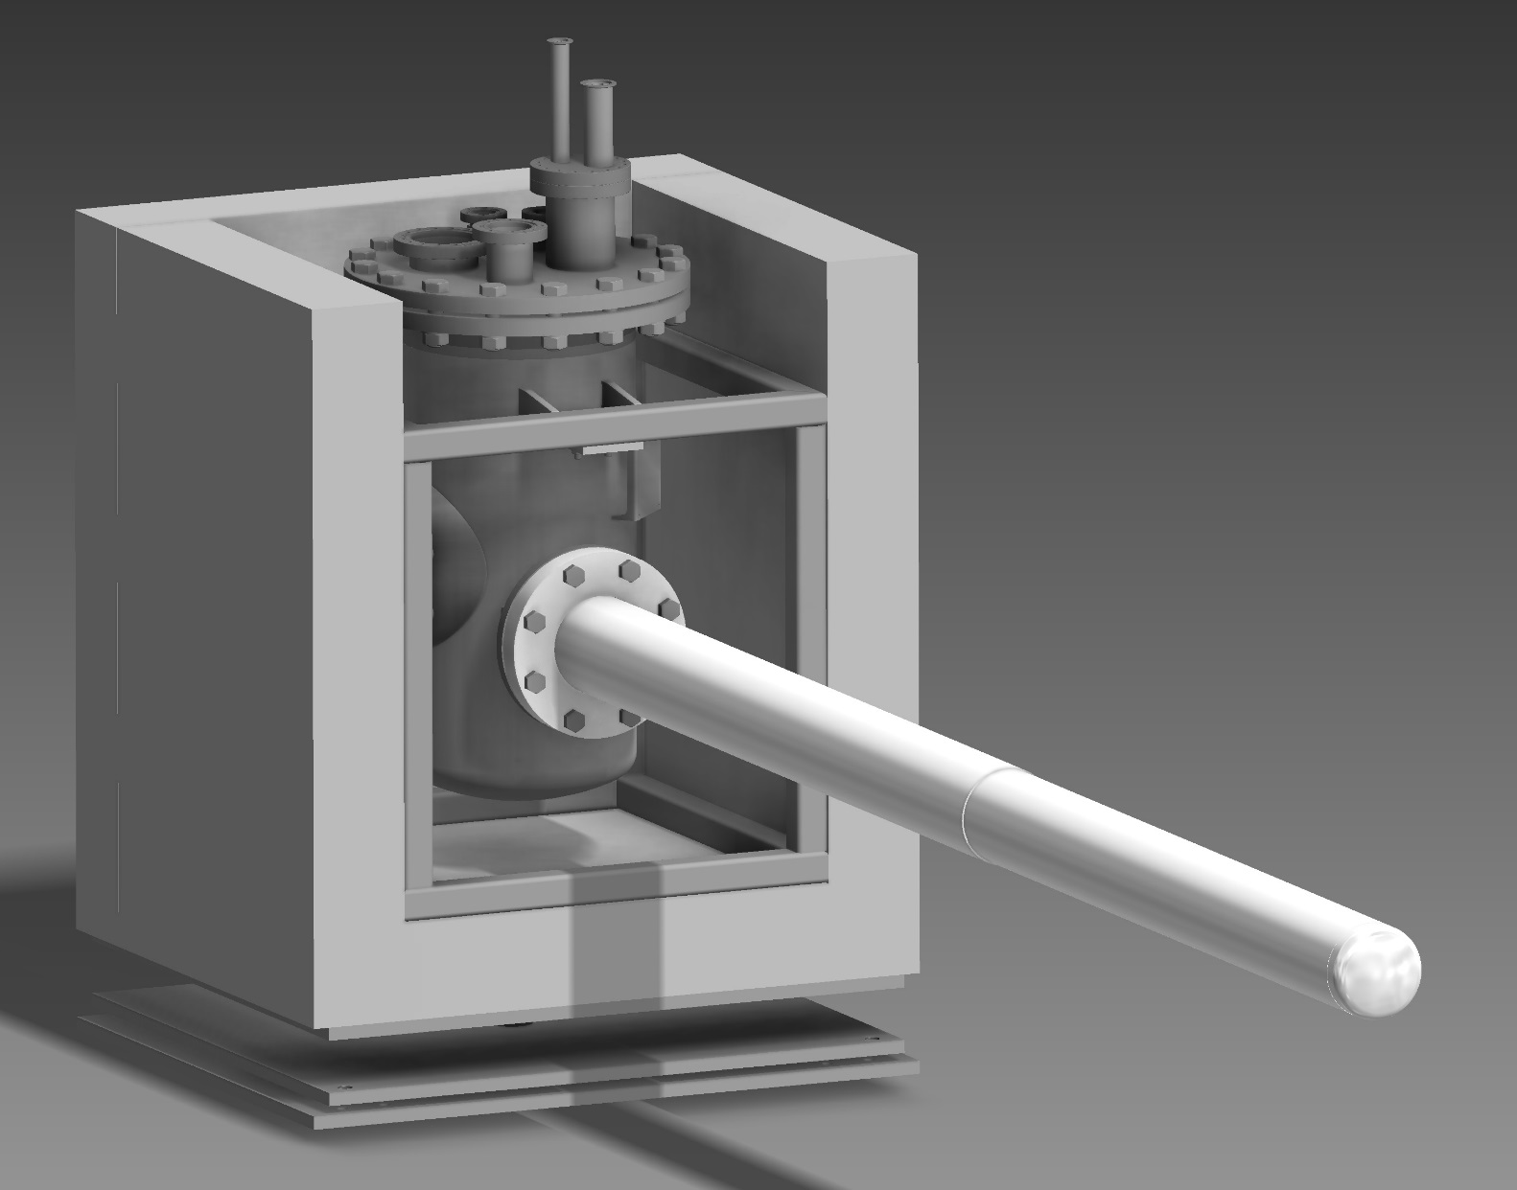
2) Setup
Ca. 1200 mm

Slide 5
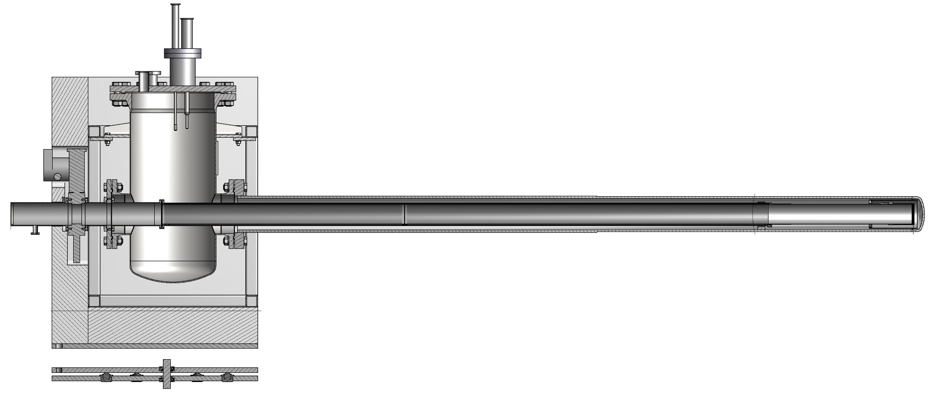
2) Setup
Inner surface coated with NiMo
Thermal bridge, wall thickness 0.6 mm
80 mm
Ca. 1200 mm
Solid $D_{2}$ crystal
9 mol ortho-$D_{2}$
2500 mm
500 mm
3700 mm

Slide 6
2) Setup
He-
Liquifier
14 l/h
Ca. 1200 mm
Storage tank
2500 mm
500 mm

Slide 7
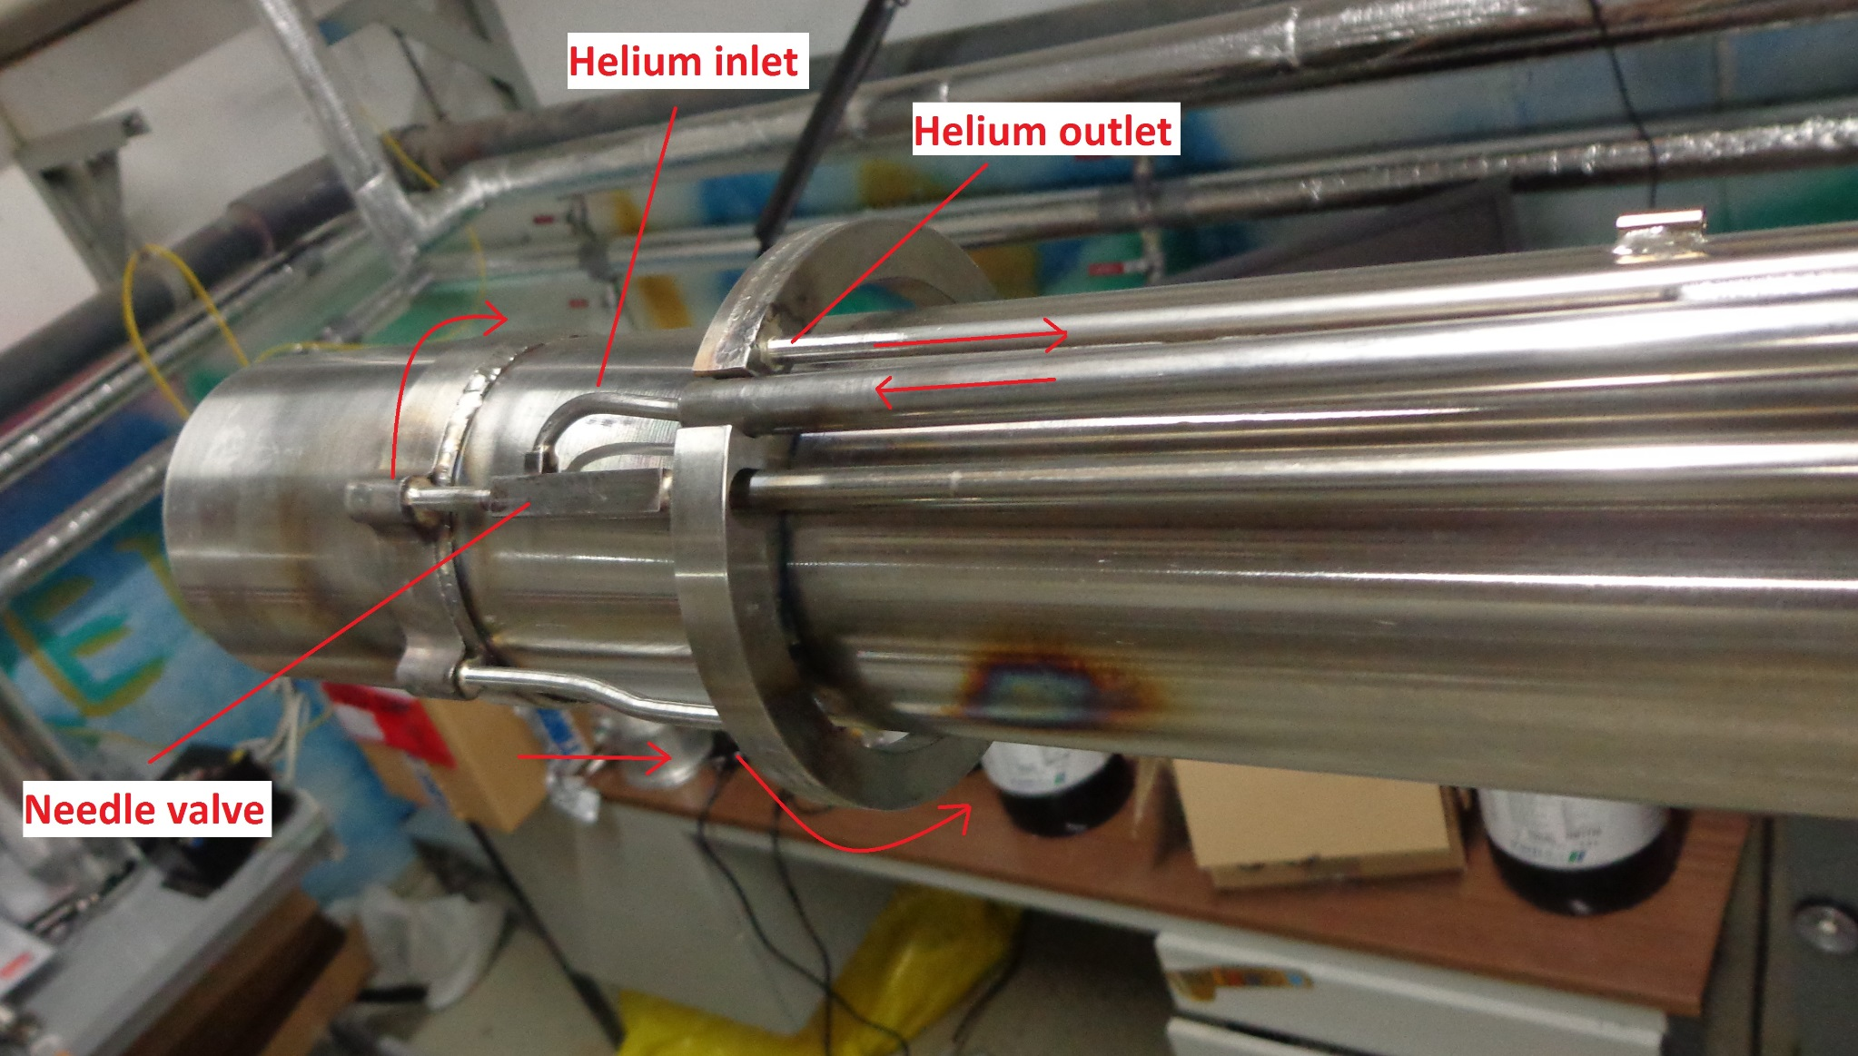
2) Setup

Slide 8
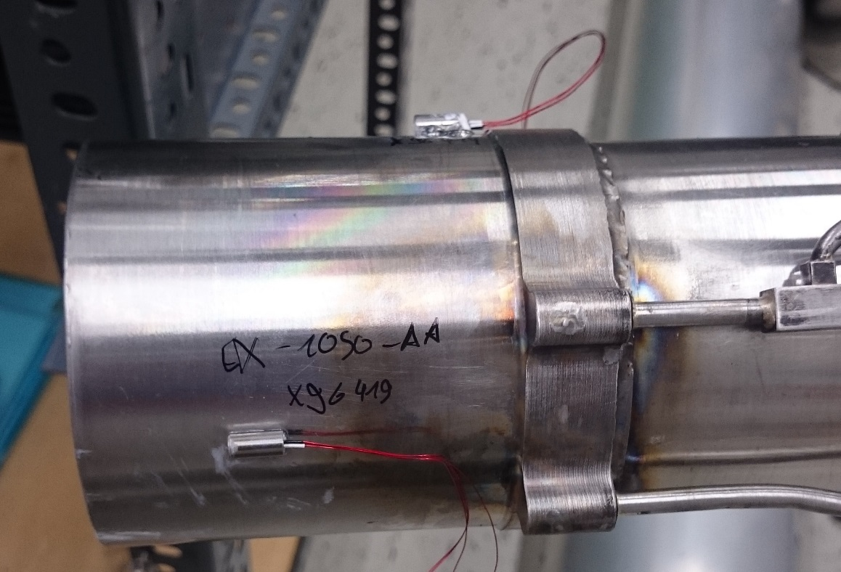
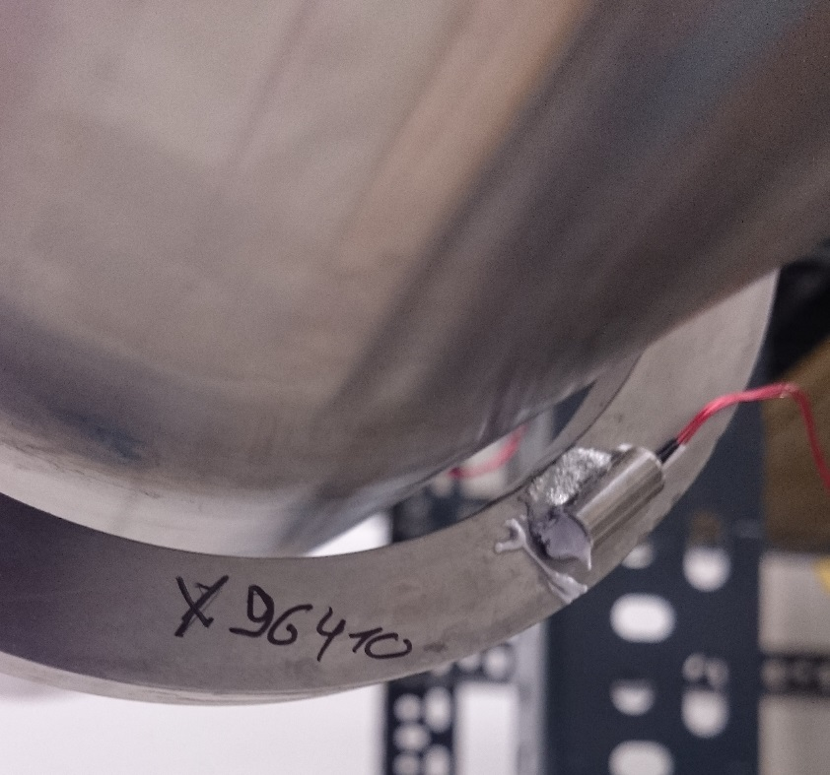
2) Setup
Cernox temperature sensors

Slide 9
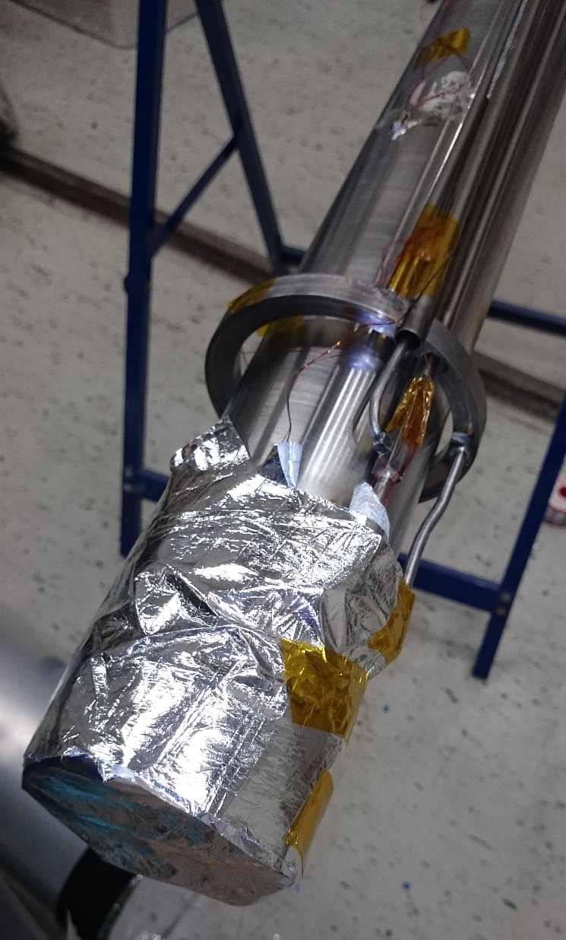
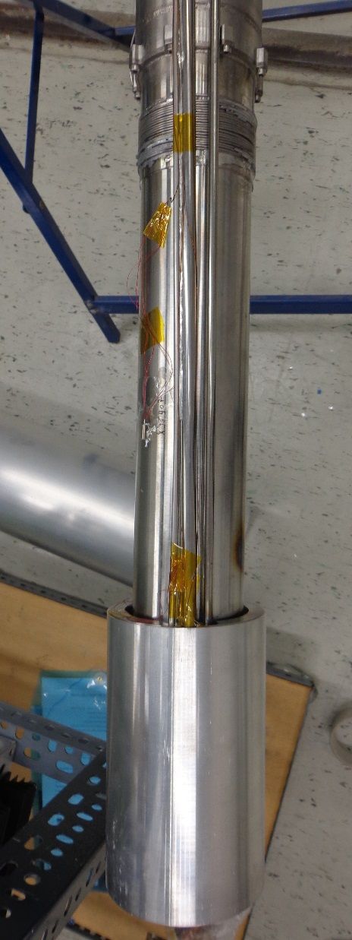
2) Setup
Heating coil
Thermal bridge
Thermal shield

Slide 10
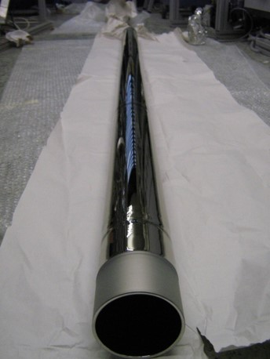
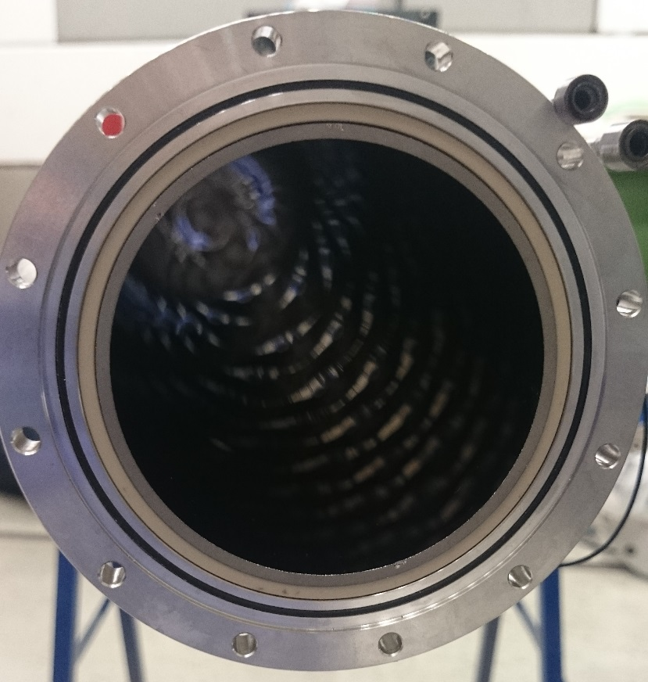
2) Setup
PEEK
Neutron
guide
Supermirror neutron guides coated with NiMo-Ti (m=1.5)
Spacer between guide and stainless steel
Polyether ether ketone (PEEK)

Slide 11
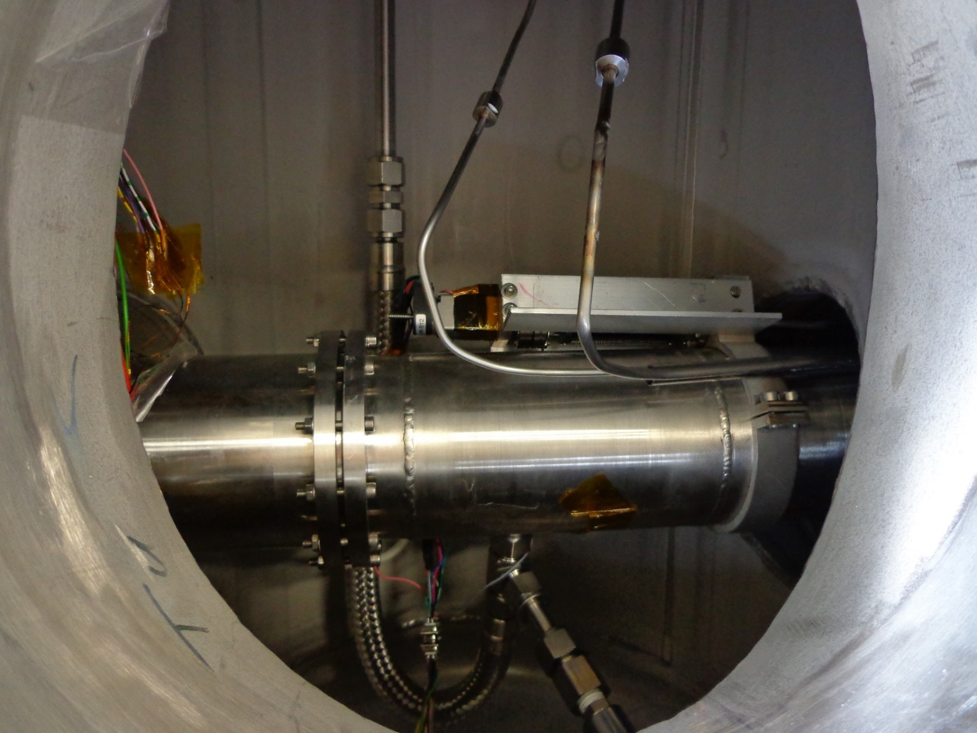
2) Setup
Helium
lines
Aluminium window
Deuterium line
Pressure sensor

Slide 12
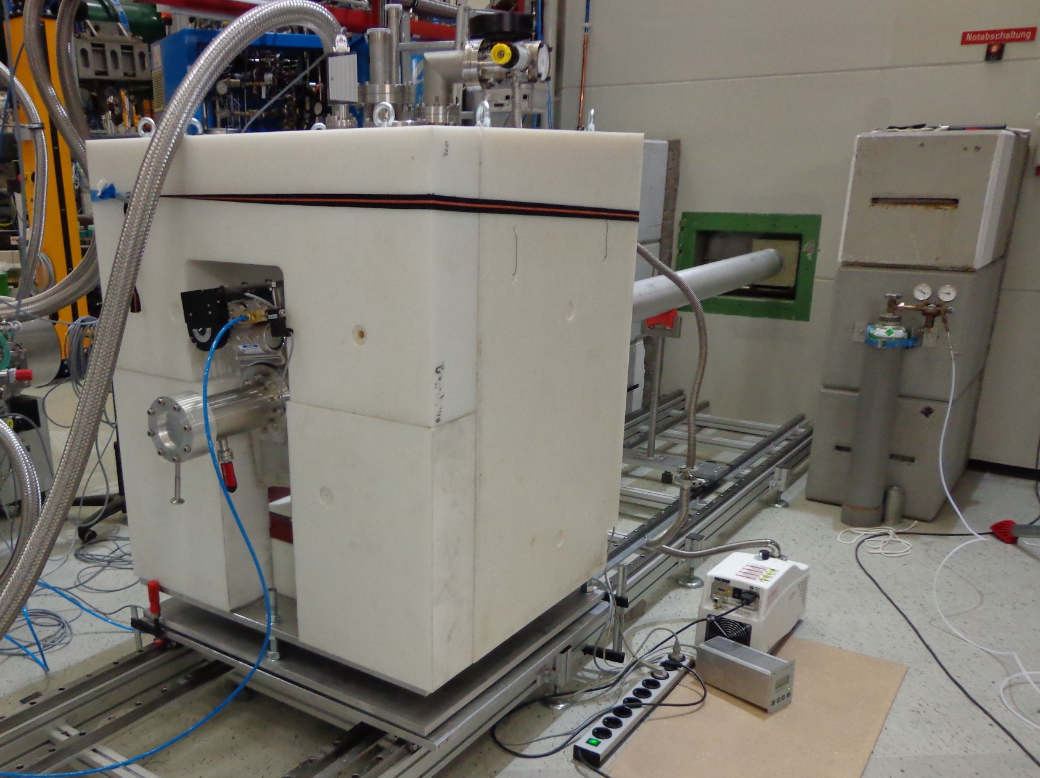
2) Setup

Slide 13
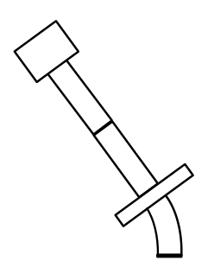
3) First measurements
3.1) Time of flight
3.1.1) Behind 45° bend (100 kW)
2 m flight path
Cascade-U
detector
Chopper
45° bend
Source

Slide 14
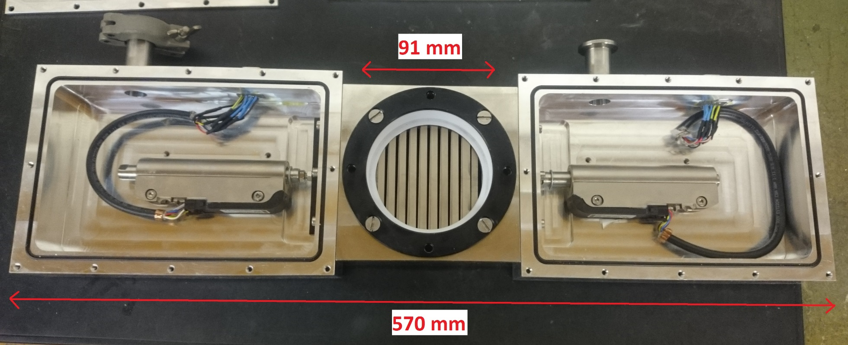
3.2) Time of flight
Chopper
Settings for Measurement:
12 ms opening
4/3 Hz
Titanium grating with gadolinium absorber

Slide 15
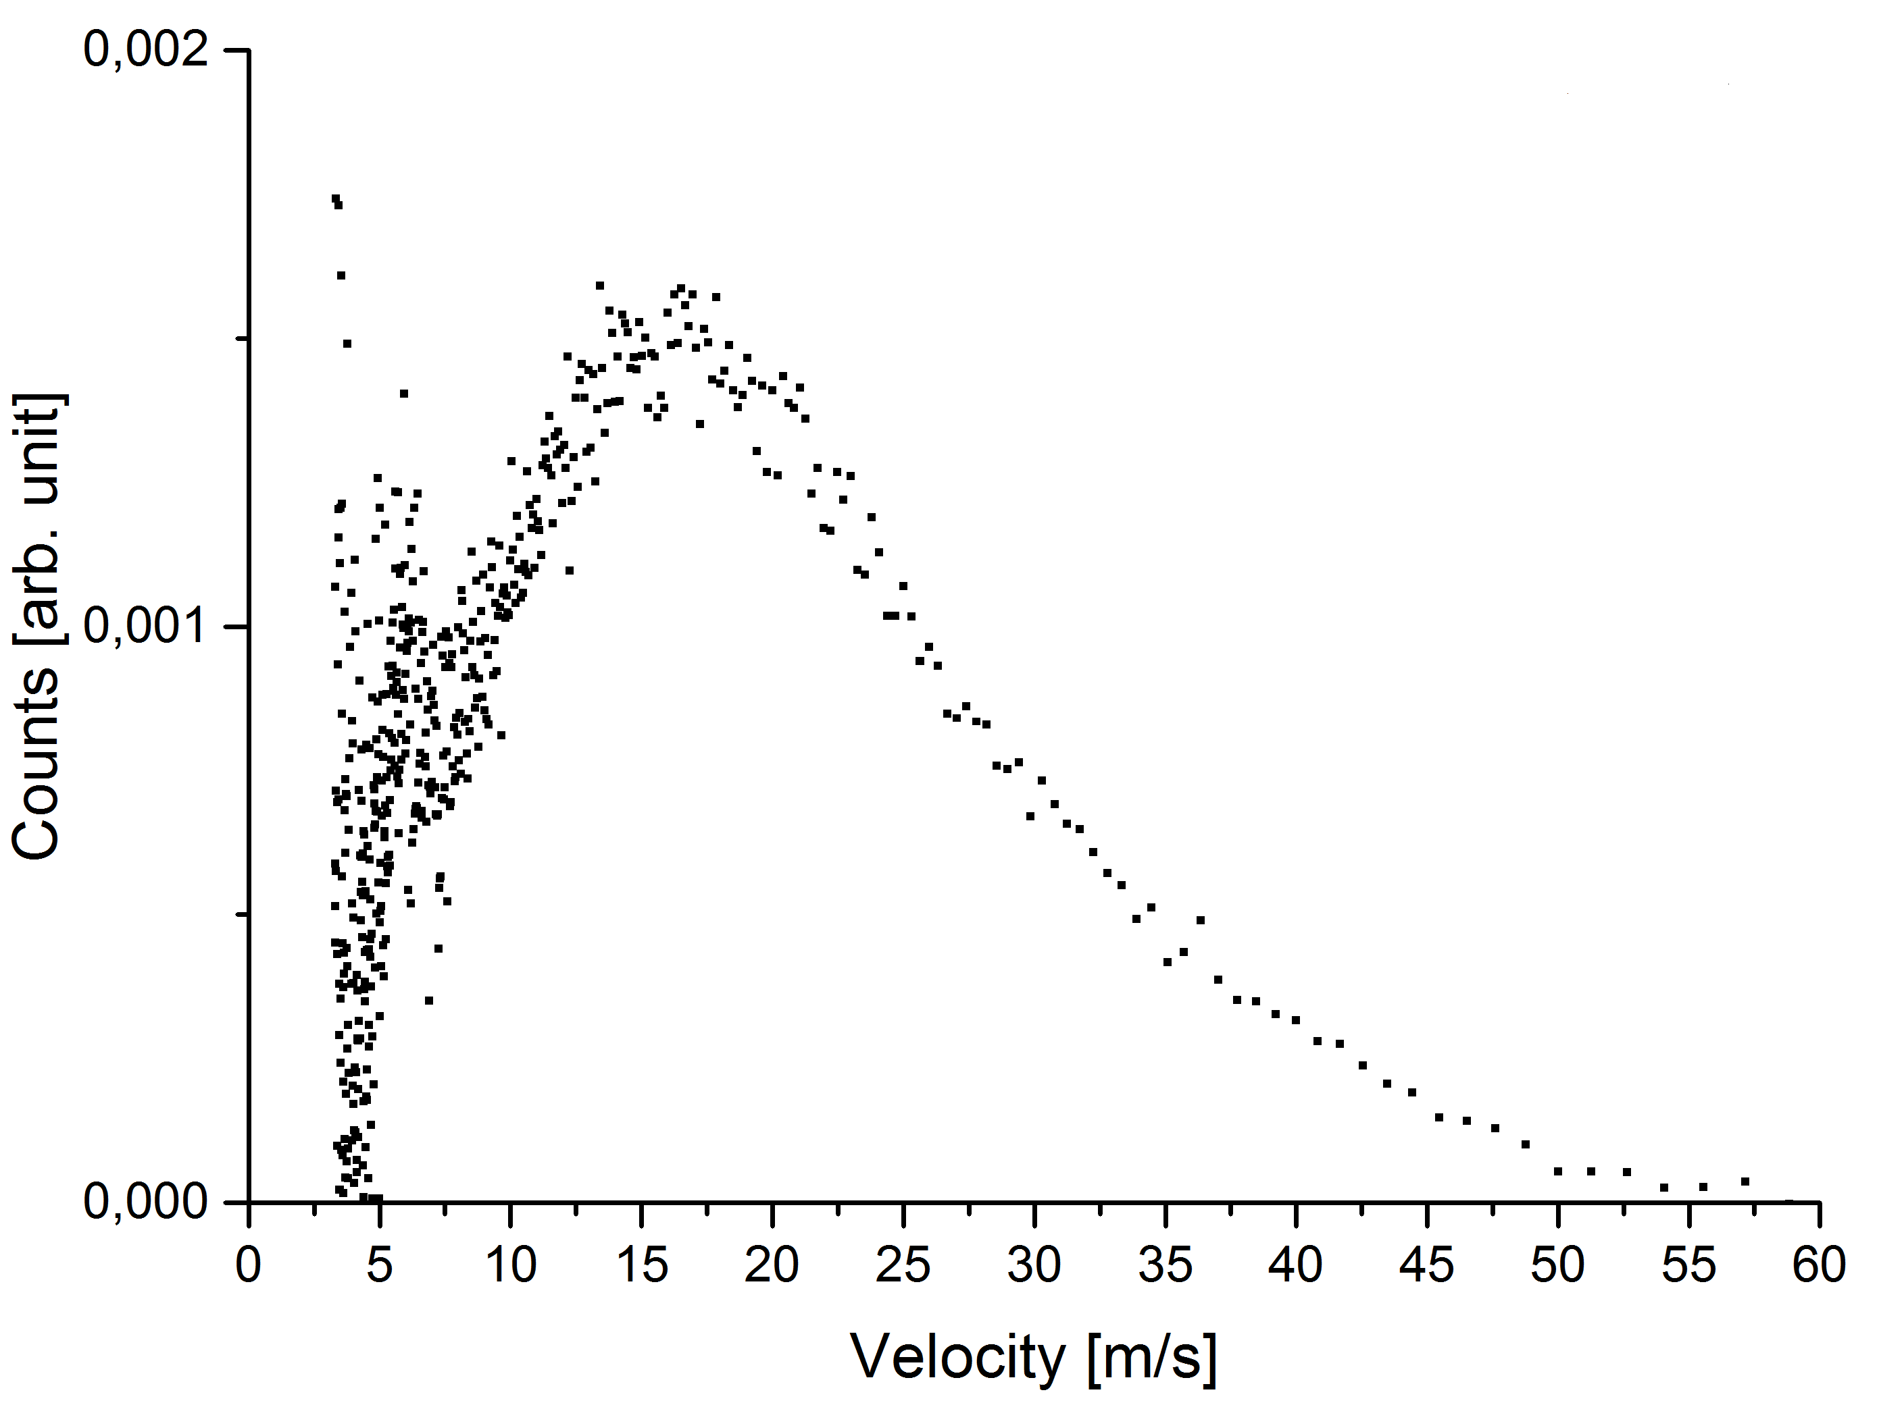
3.1.1) Behind 45° bend

Slide 16
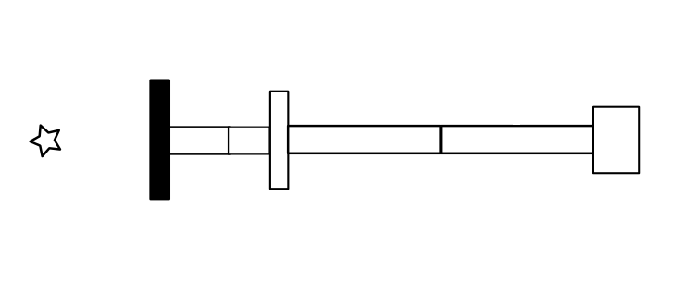
3.1) Time of flight
3.1.2) In direct beam (50 kW)
VAT shutter
2 m flight path
Source
Detector
Chopper

Slide 17
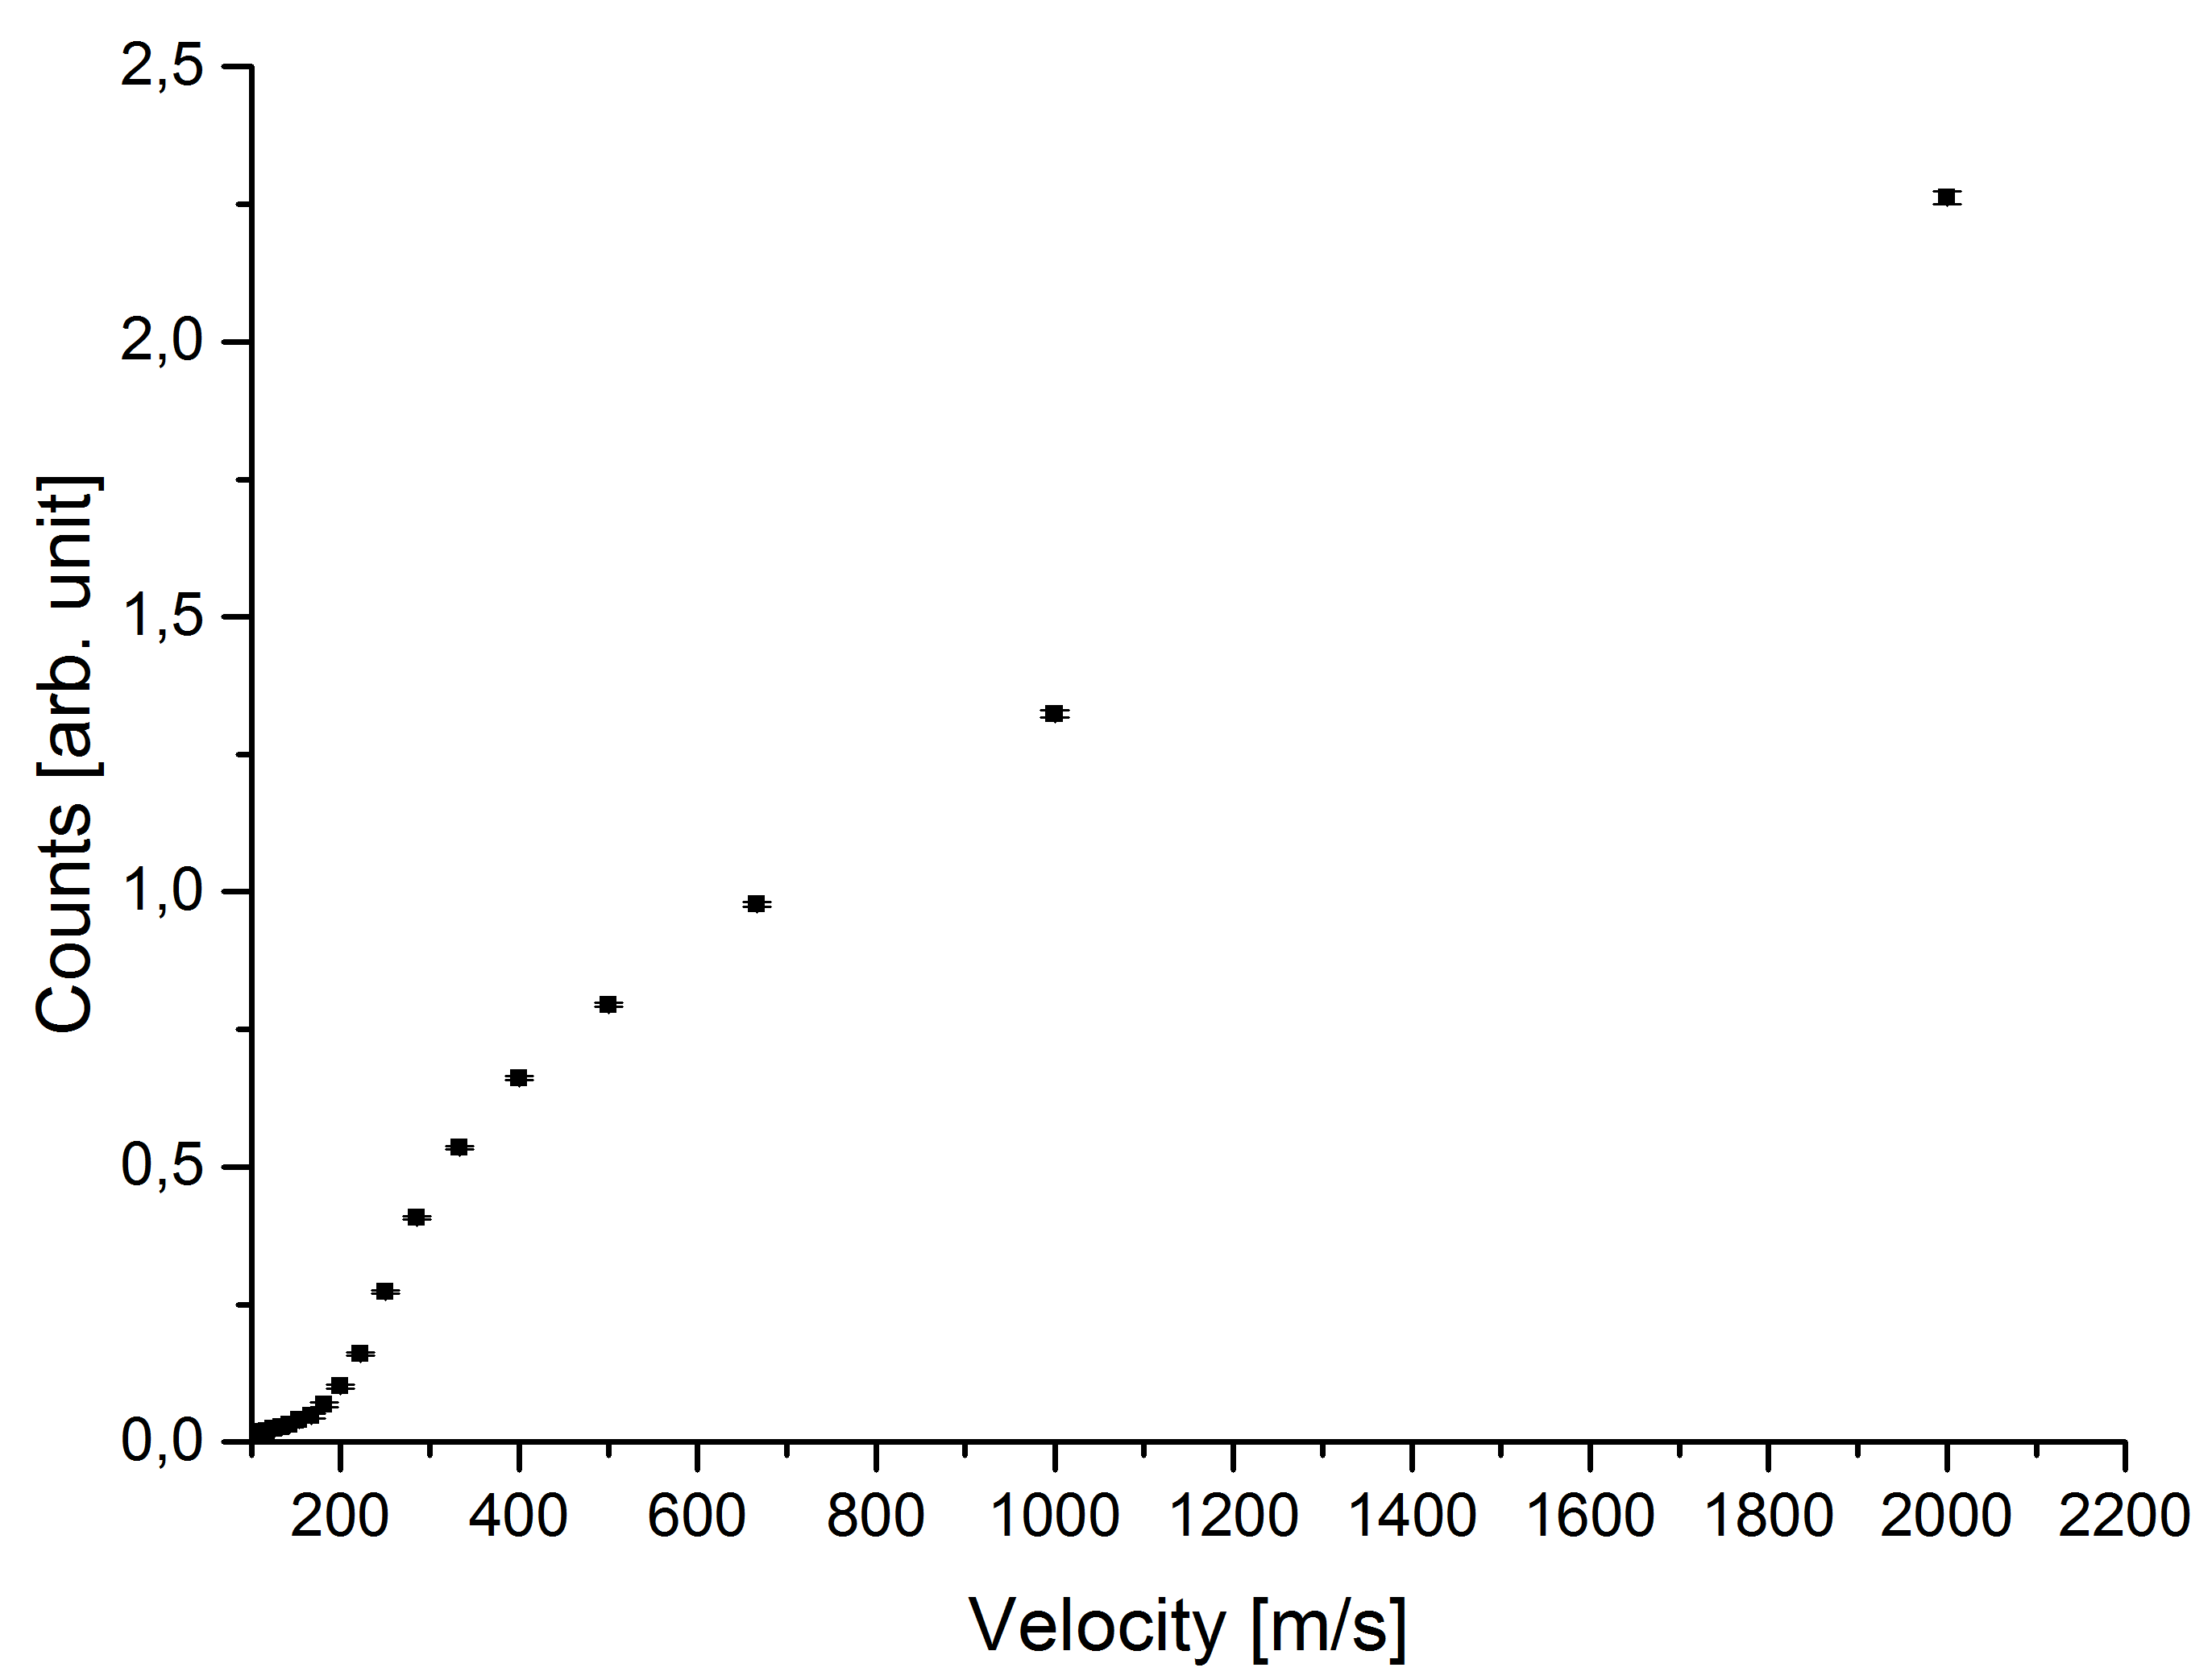
3.1.2) In direct beam

Slide 18
3) First measurements
3.2) Calculation of neutron fluxes (from TOF)
Correction due to Chopper opening
Correction of detector efficiency
Dividing by surface of open Chopper
3.2.1) Behind 45°-bend (100 kW)
Approximately $5⋅{10}^{2}\frac{n}{s⋅cm^{2}}$ UCN - VCN
3.2.2) In direct beam (approx. to 100 kW)
Approximately $4⋅{10}^{6}\frac{n}{s⋅cm^{2}}$ VCN - CN

Slide 19
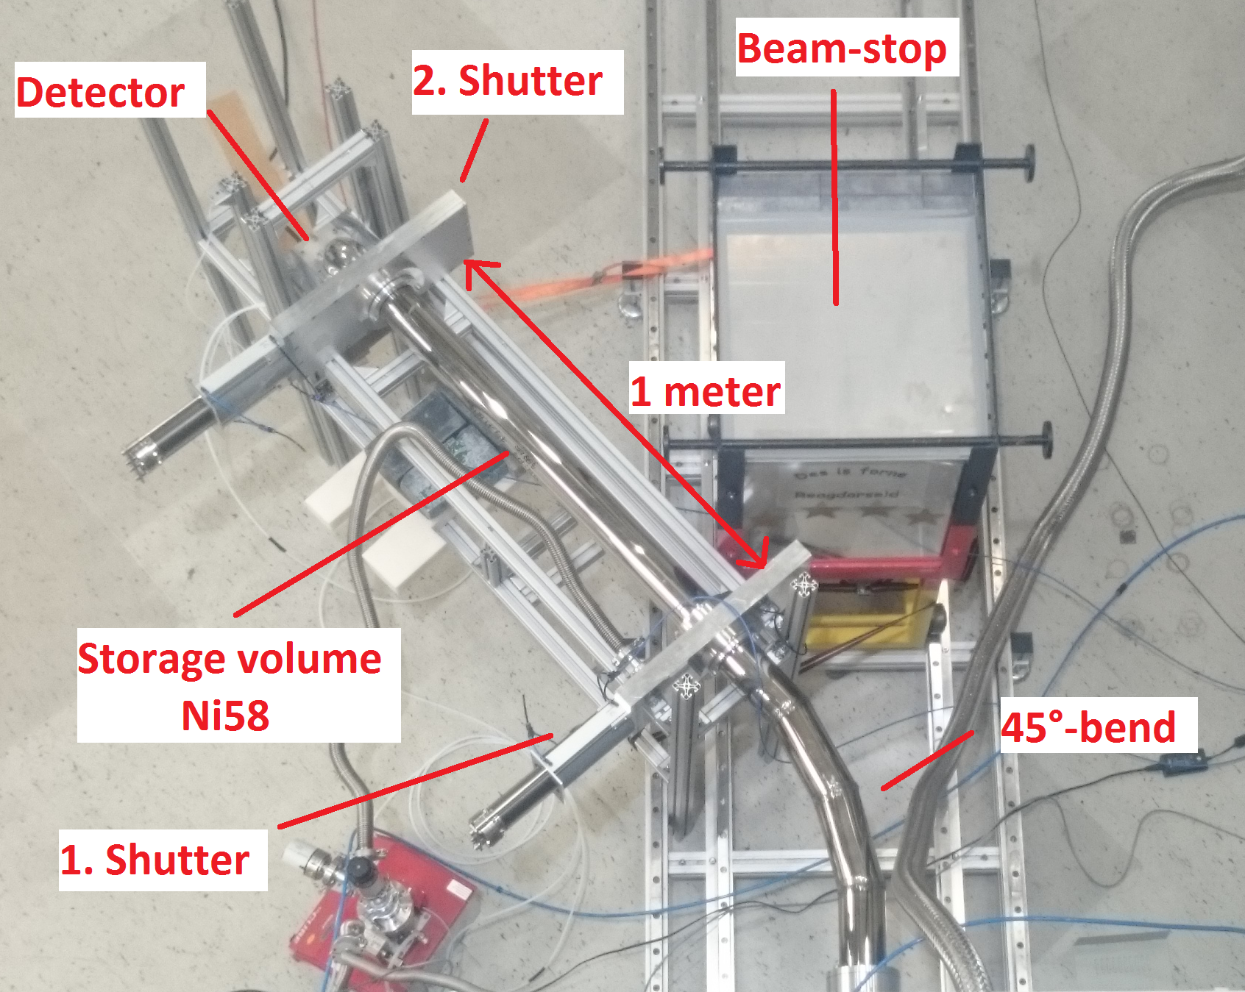
3) First measurements
3.3) Storage measurement
View from top

Slide 20
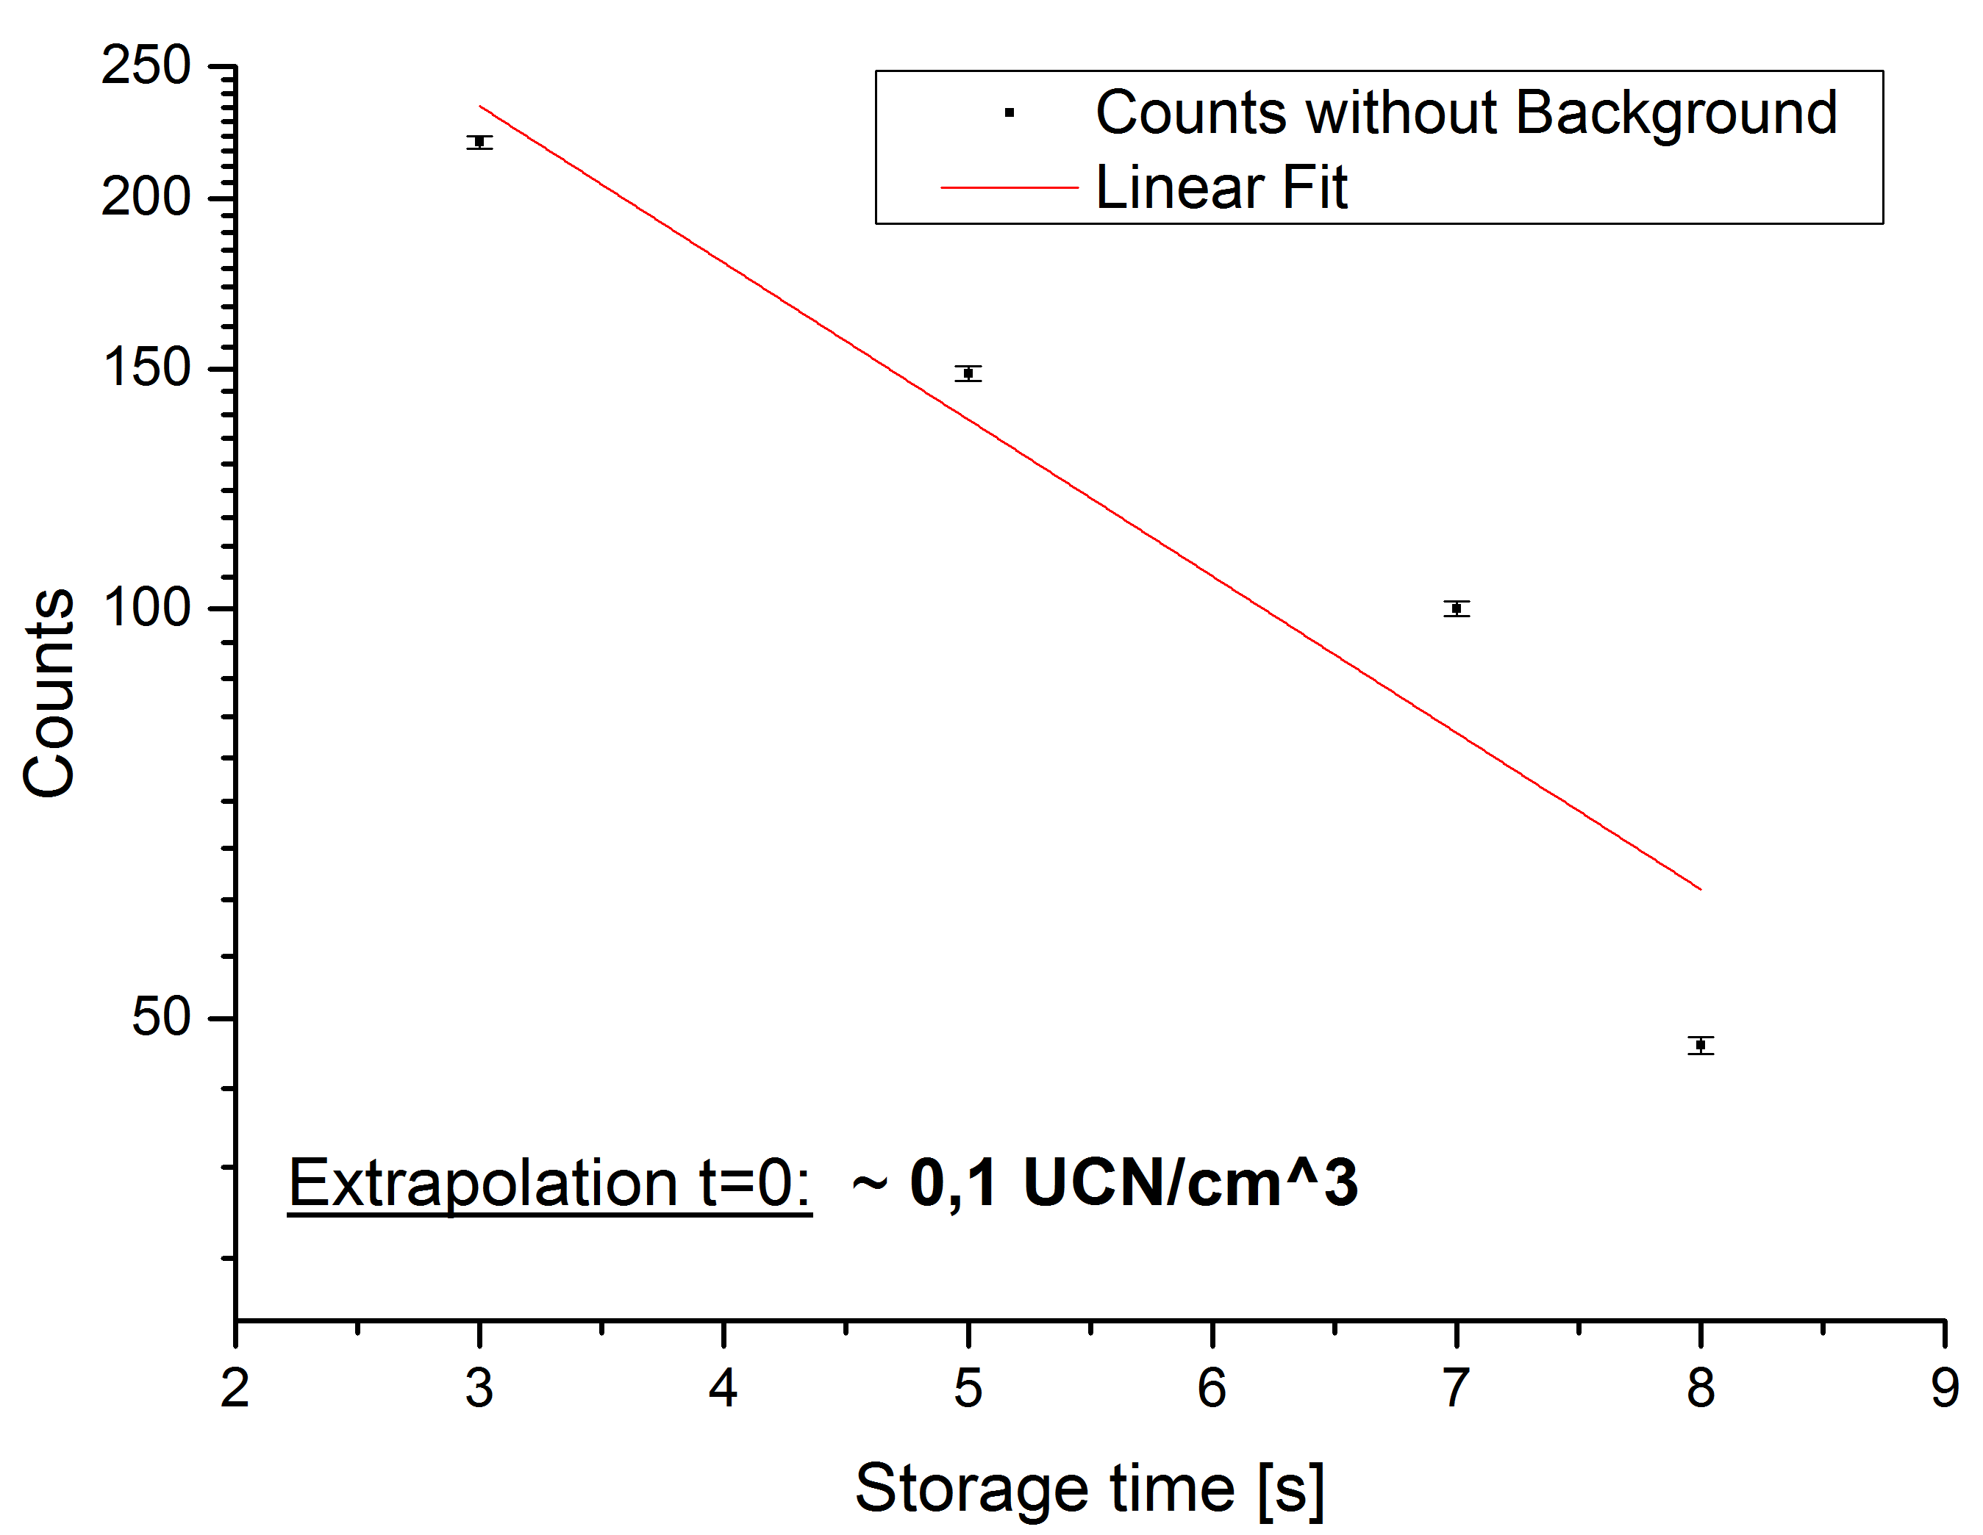
3.3) Storage
3.3.1) Steady state power (100 KW)

Slide 21
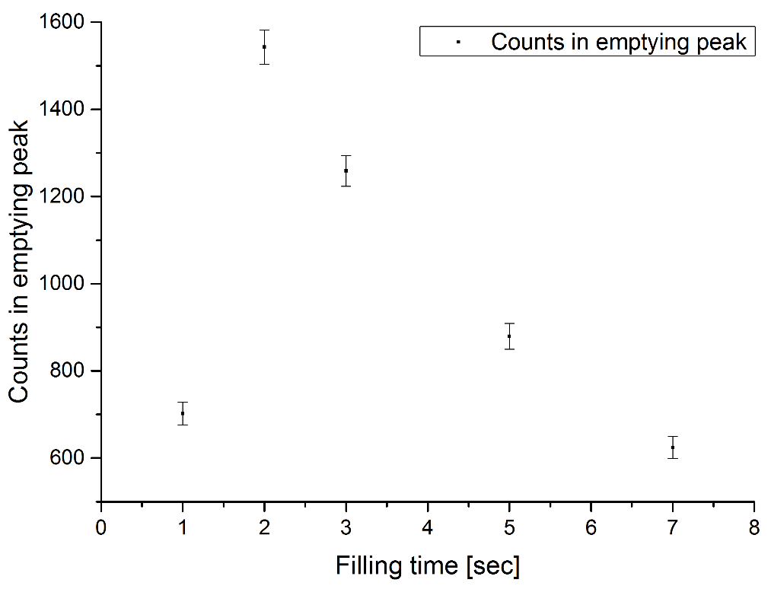
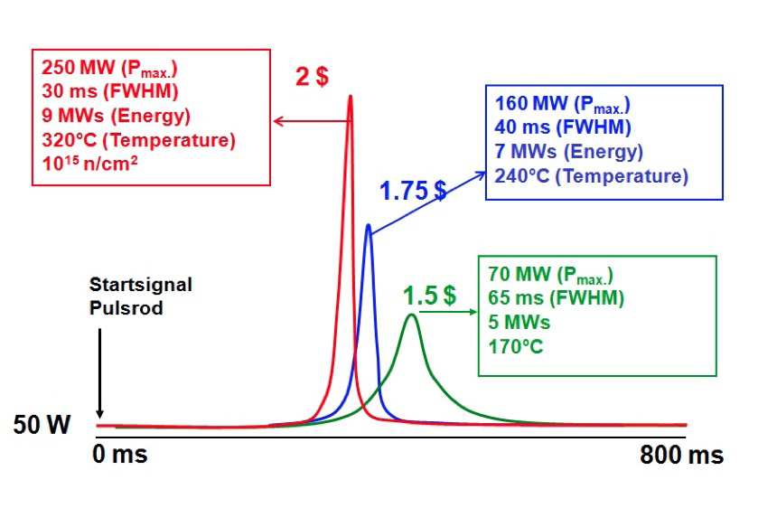
3.3) Storage
3.3.2) Pulse mode filling curve (1.25 $)
Dependency of puls strenght and lenght
Filling curve for 1.25$ puls

Slide 22
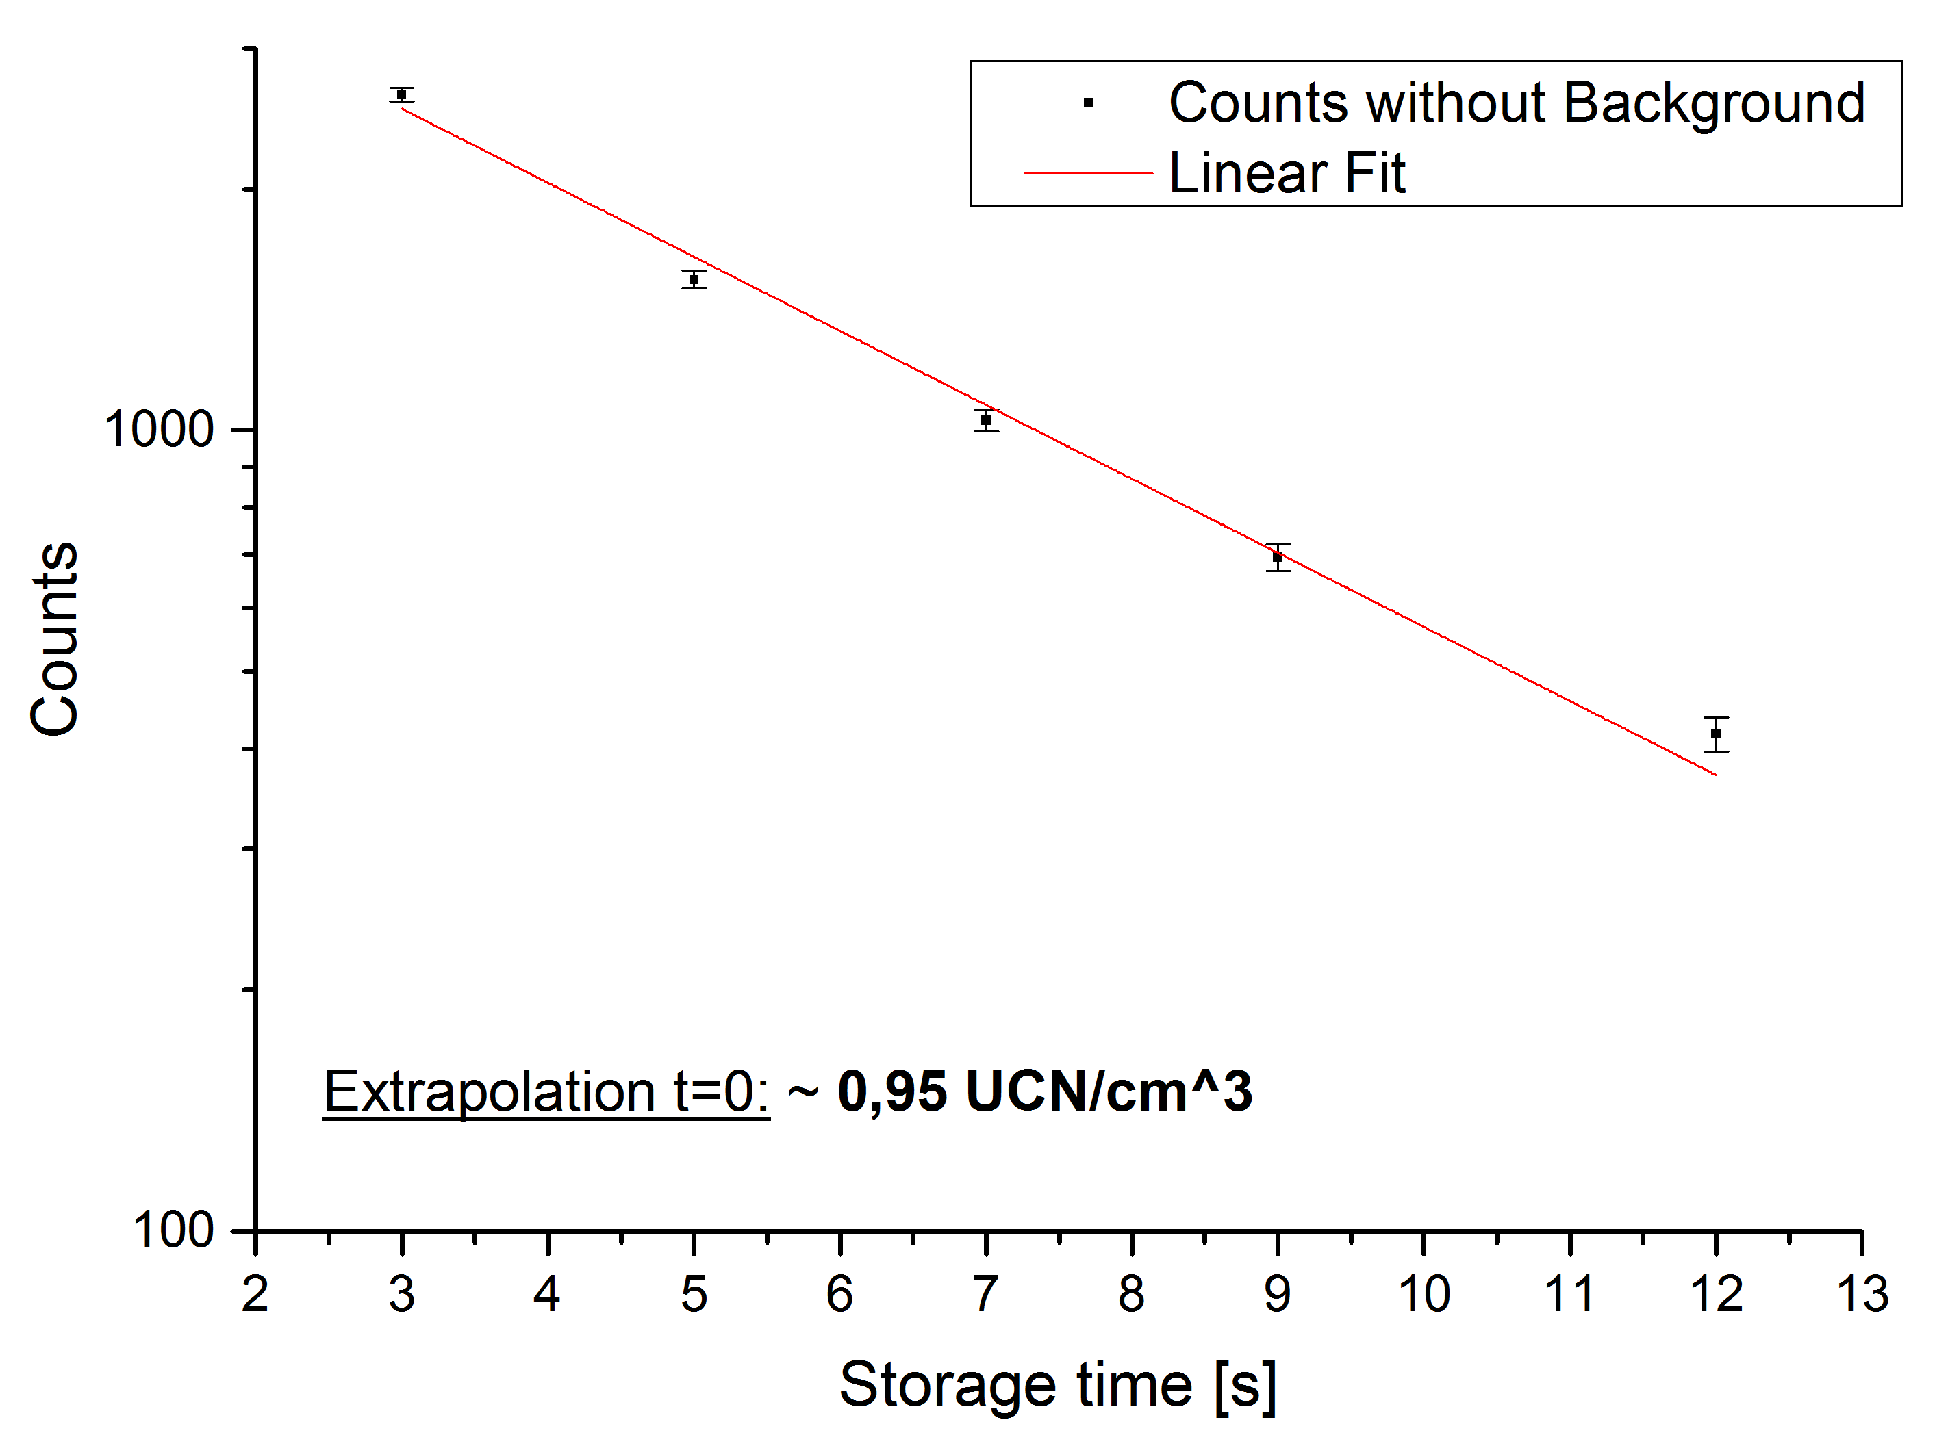
3.1) Storage
3.3.2) Pulse mode (1,25 $)

Slide 23
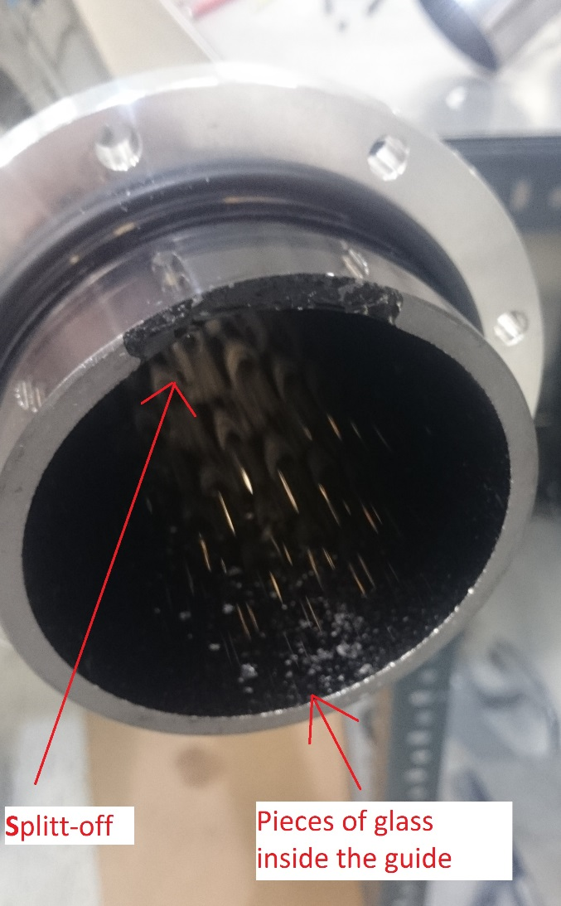
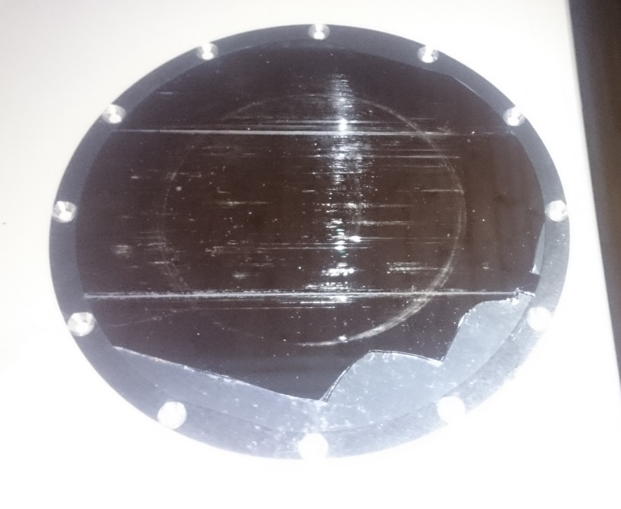
3.1) Storage
3.3.3) Explanation
Some parts broke during experiment
Measurements need to be repeated!

Slide 24
4) Conclusion and Outlook
Accurate working cooling system
Consumption of UCN source is approx. 8 l/h
Production of helium liquifier (14 l/h)
1.5 hours for cooldown (~12 l)
Production of UCN is proved
Repetition of storage experiment required
(in steady state and pulse mode)
Improvement of radiation shielding round beam exit required
Characterisation of the source by Bernhard Lauss (PSI)

Slide 25
Tobias Reich
Norbert Trautmann
Christopher Geppert
Klaus Eberhardt
Yury Sobolev
Operators of TRIGA Mainz
…
Stephan Paul
Andreas Frei
Thorsten Lauer
Thorsten Zechlau
Yuri Schroffenegger
Workshop and technicians
…
Financed by SPP 1491

Slide 26
Thank you for your attention!

Slide 27
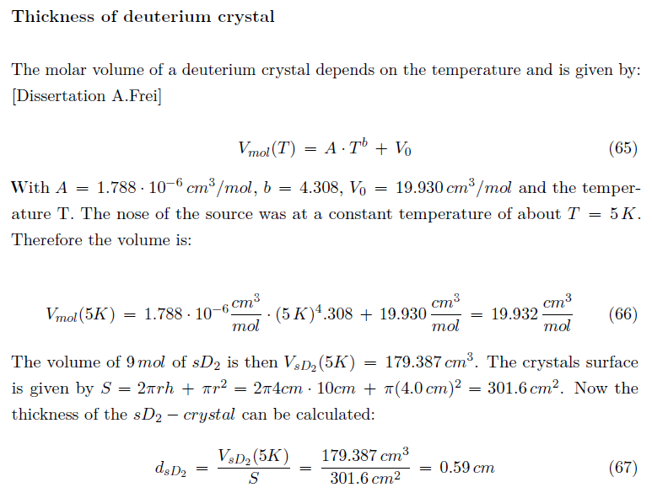
Appendix

Slide 28
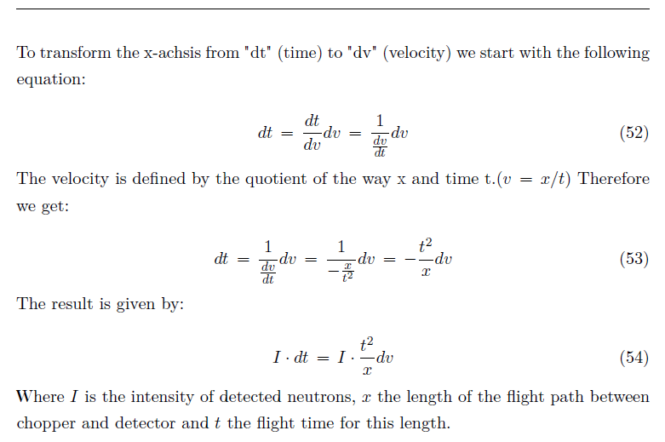
Appendix
Transformation to velocity spectrum

Slide 29
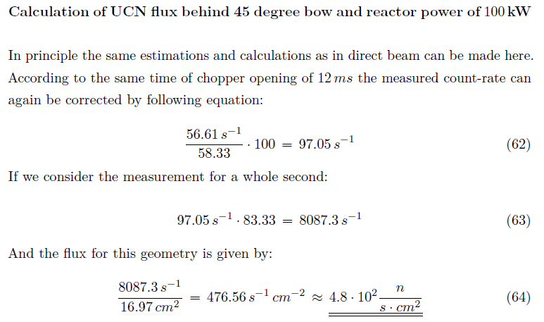
Appendix

Slide 30
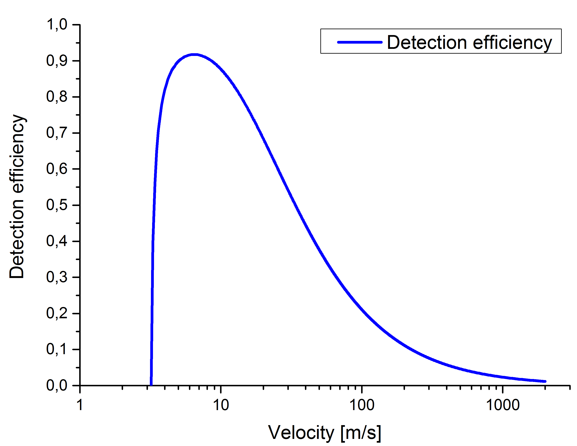
Appendix

Slide 31
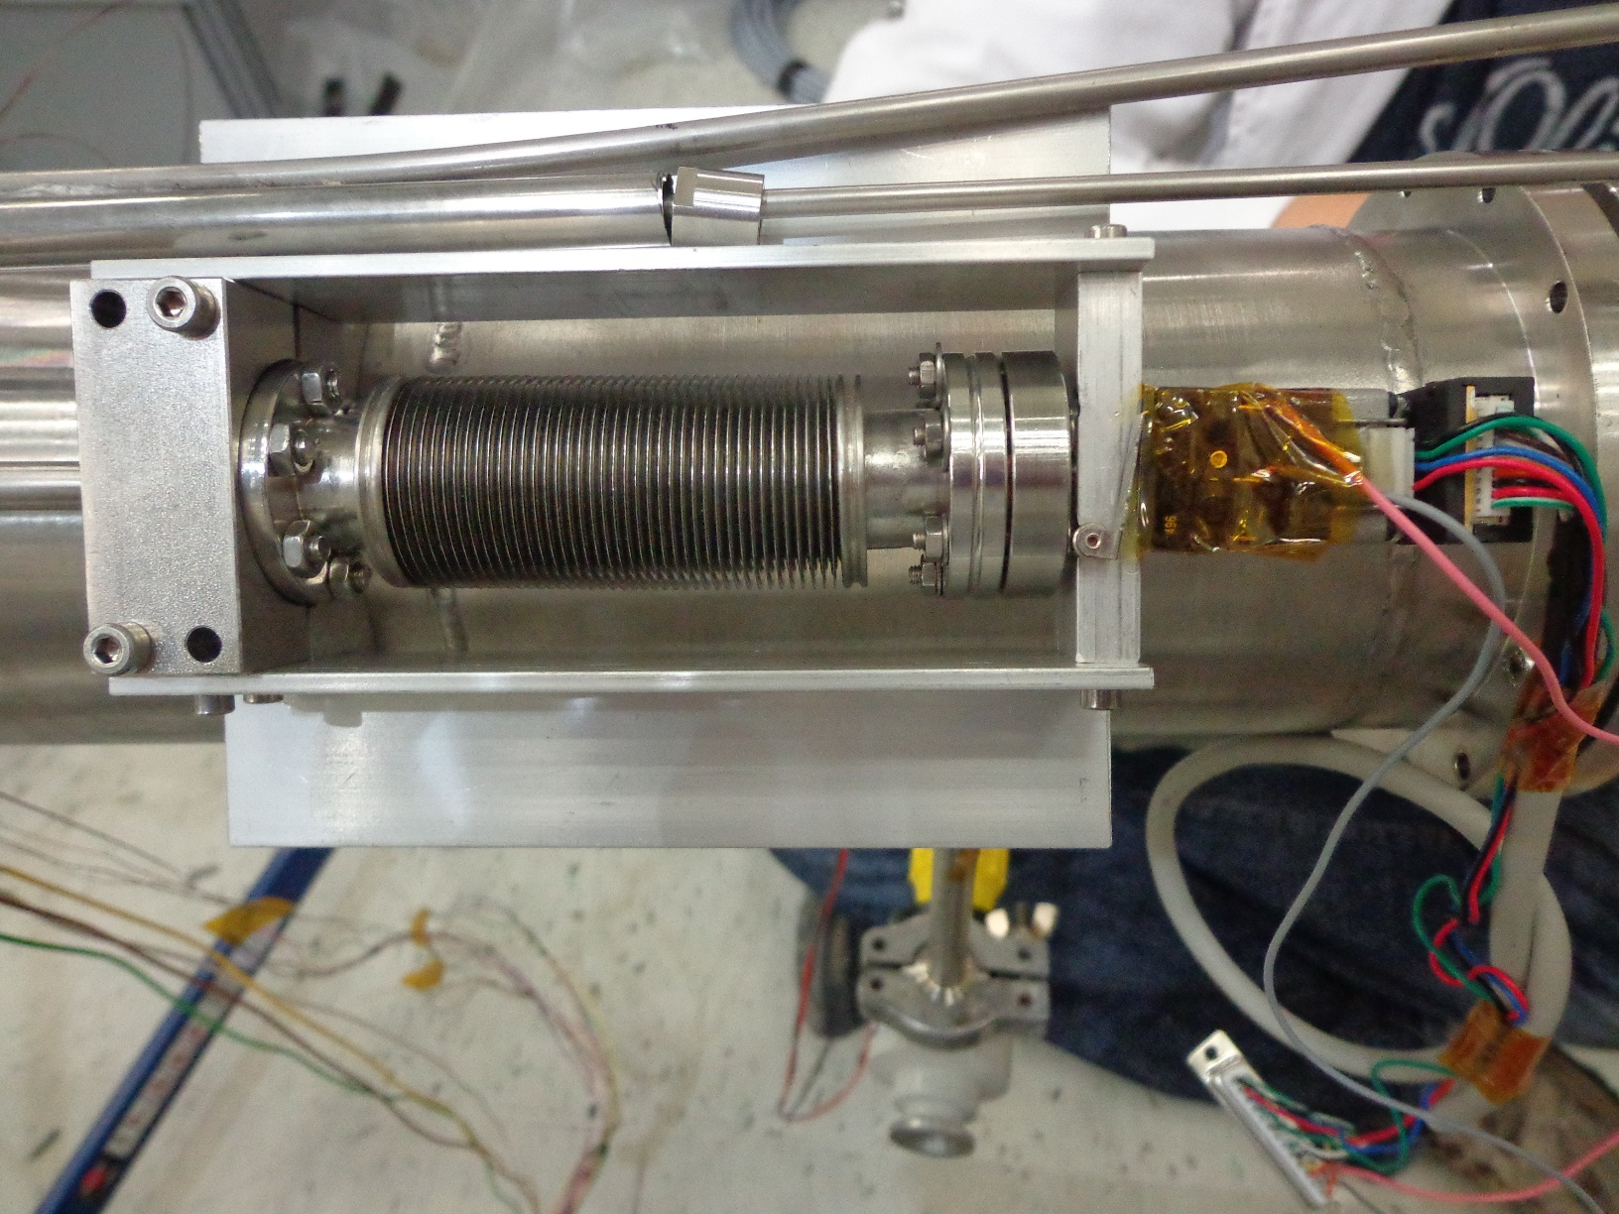
Appendix

Slide 32
2) Setup
First cooling down

Slide 33
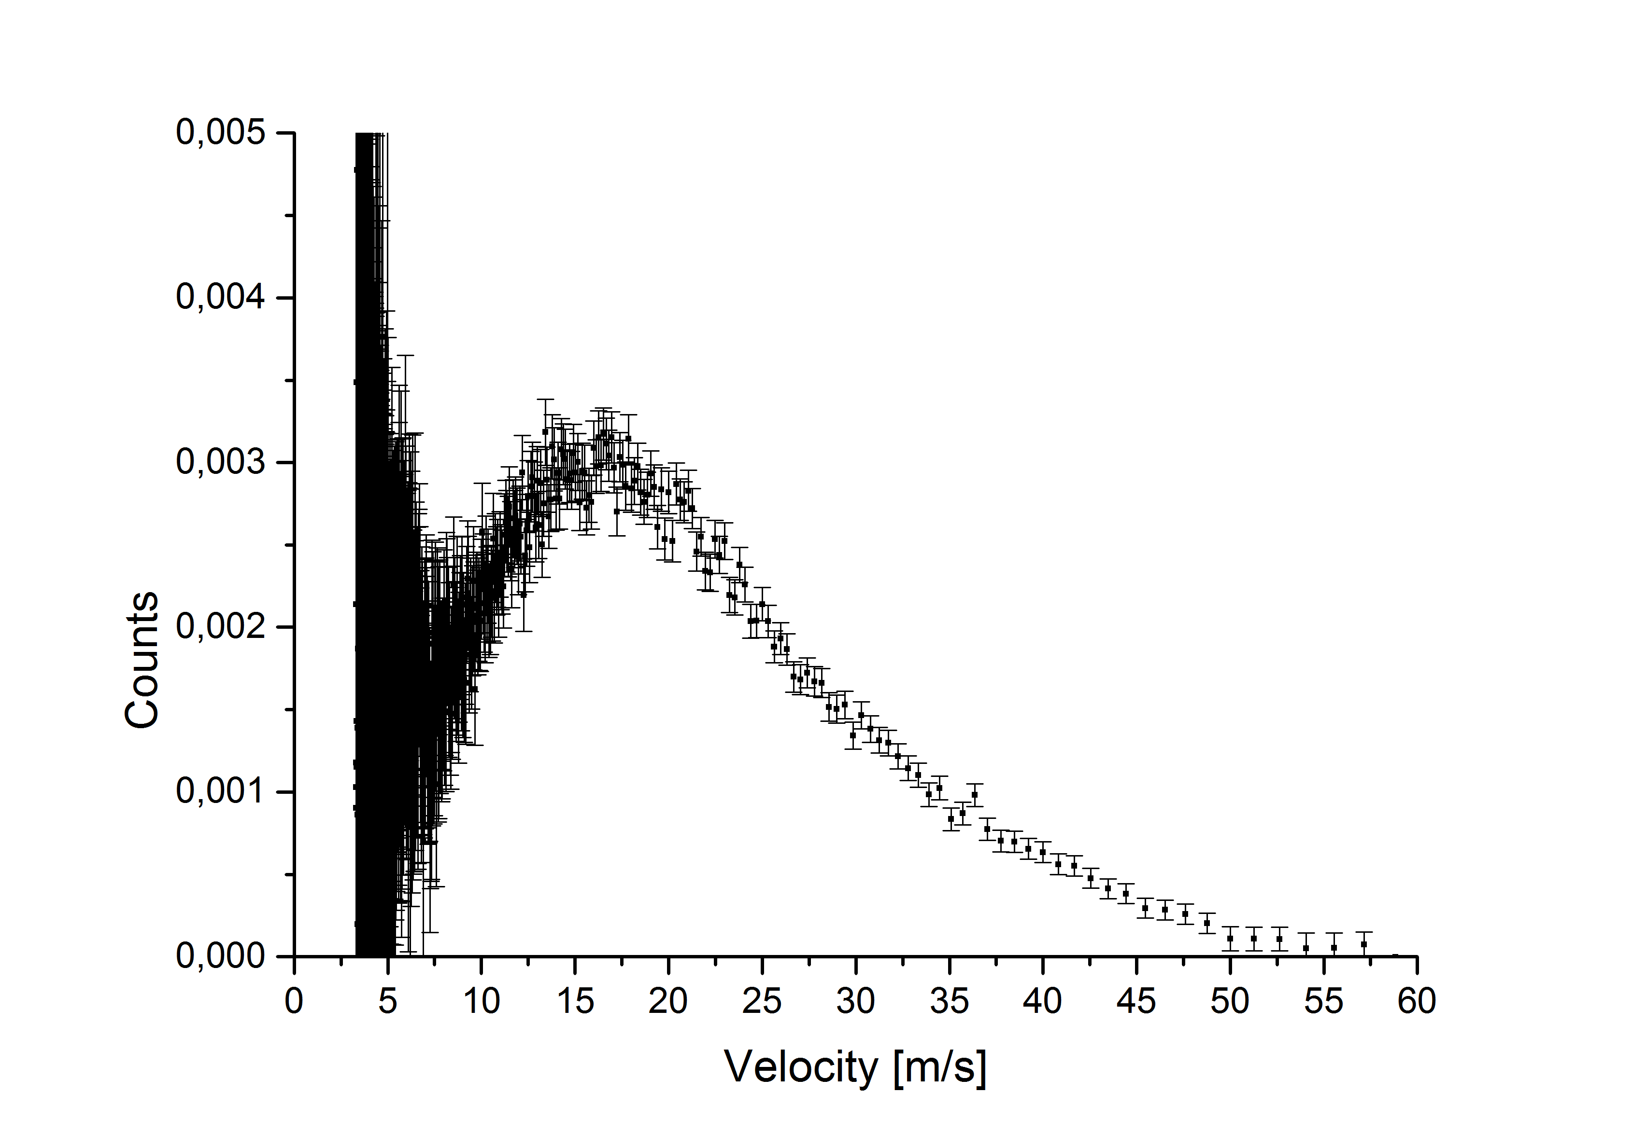
Appendix

