Slide 1
Irradiation Effects on Solid Deuterium
Stephan Wlokka

Slide 2
Agenda
Ortho-/Para-Deuterium
Ortho-/Para Conversion
Natural conversion
Radiation-assisted conversion
Experimental Setup
Results
Conclusion

Slide 3
Ortho-/Para-Deuterium
Deuteron ➔ Boson➔ Symmetric Wave Function
Vibration Always symmetric
Spin S=0 ➔ S S=1 ➔ AS S=2 ➔ S
Rotation J=0, 2, 4, … ➔ S J=1, 3, 5,… ➔ AS

Slide 4
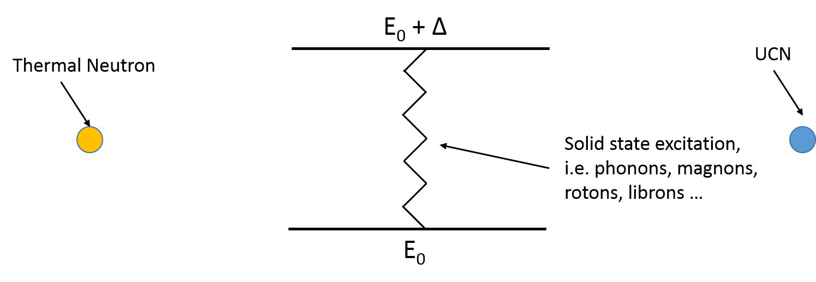
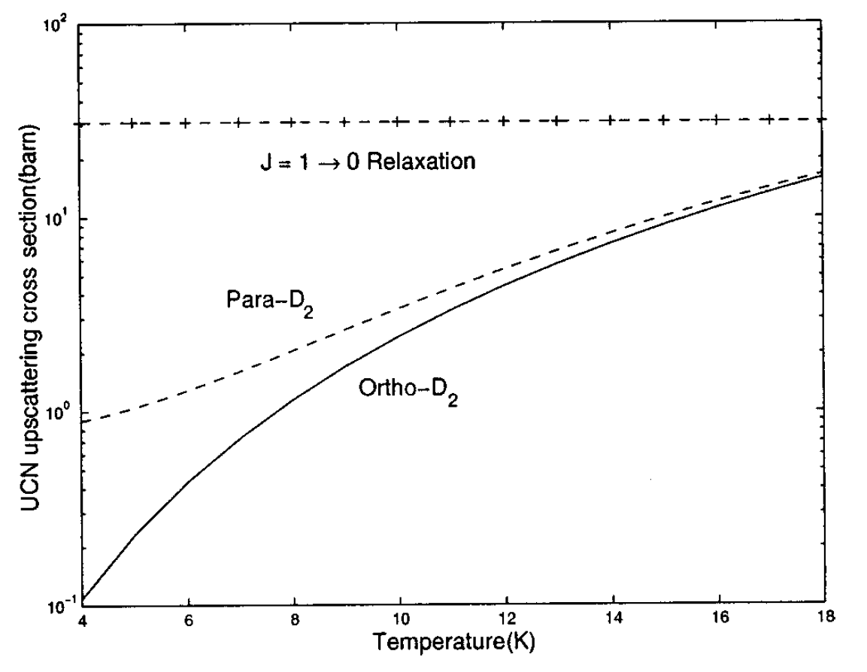
Ortho-/Para-Deuterium
4
70 meV
3
42 meV
2
21 meV
1
7 meV
0
0 meV
Even J
Odd J
Liu et. al, Phys. Rev. B 62, R3582 (2000)

Slide 5
Ortho-/Para Conversion

Slide 6
Ortho-/Para Conversion
At low temperatures only J=0 and J=1 levels are occupied
The conversion is mediated through dipole-dipole or quadrupole-quadrupole forces
The conversion time is on the order of 10⁻⁴ h⁻¹
➔ Conversion into equilibrium takes up to 6 months
Process can be increased using materials with a strong magnetic moment
Possible catalysts:
Chromium-Oxide
Ferrous hydroxide
Conversion times of 10⁻¹ h⁻¹ are possible

Slide 7
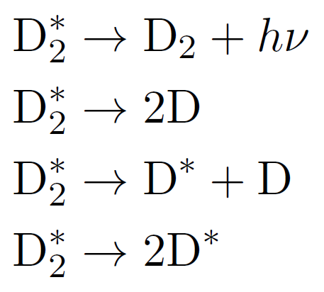
Radiation-assisted conversion
Irradiation of deuterium leads to the dissociation of D₂ molecules
Atomic deuterium is para-magnetic ➔ spin-flip is possible
Ionization
Excitation

Slide 8
Radiation-assisted conversion
D₂⁺ is only stable in high-vacuum
Recombination

Slide 9
Radiation-assisted conversion
Deuterium dissociation rate
Conversion rate
to ortho
Conversion rate
to para
Recombination rate

Slide 10
Radiation-assisted conversion

Slide 11
Experimental Setup
D₂-Cell and Cryogenics
Raman Spectrometer
Tandem Accelerator Beamline

Slide 12
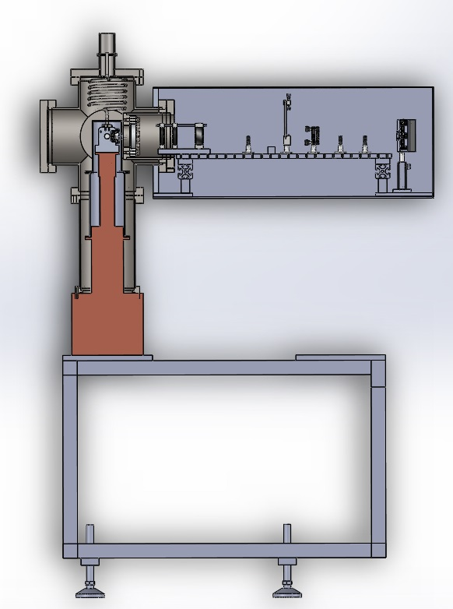
D₂ Cell
D₂ Gas
Protons
532 nm Laser

Slide 13
Cryogenics
12 mm

Slide 14
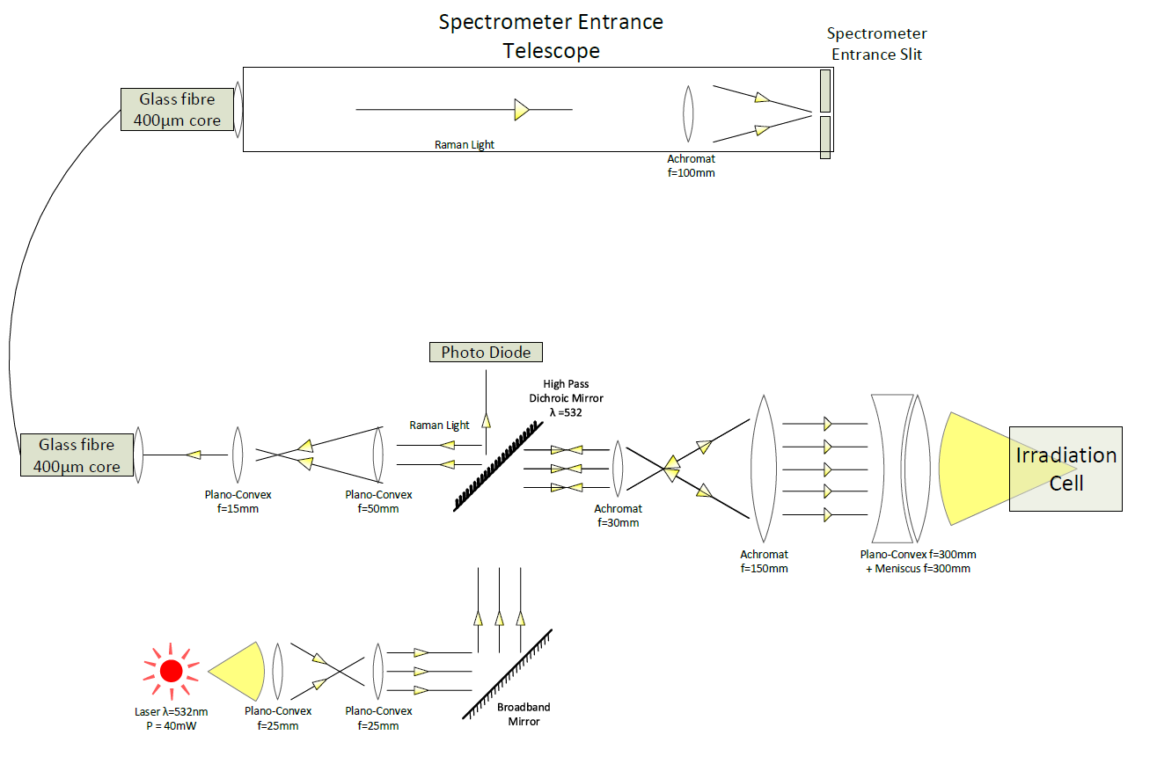
Raman Optics
High pass
Dichroic Mirror
λ_{50/50}=535 nm
Laser
Source
λ=532 nm

Slide 15
Raman Spectrometer
J=0→2
600s exposure
J=1→3

Slide 16
Beamtime
Deuterium Temperature: 7.5 – 8.0 K
Irradiation particles: protons
Irradiation current: 2.0 – 3.5 nA
Proton energy: 20.5 MeV (11 MeV after entrance window)
Protons were stopped after they passed through half of the cell
Beam days: 10
~12 h of irradiation per day
During the nights the crystal was either heated up to 16K or 19K and refrozen

Slide 17
Ortho content during beam time

Slide 18
Day by day comparison

Slide 19
Results
β=(1.1±0.5)·10⁻²⁴ cm³s⁻¹
k=(5±4)·10⁻⁸ cm³s⁻¹
k_{FRM II}=3.65·10⁻⁷ cm³s⁻¹
χ²/dof = 7.8/18

Slide 20
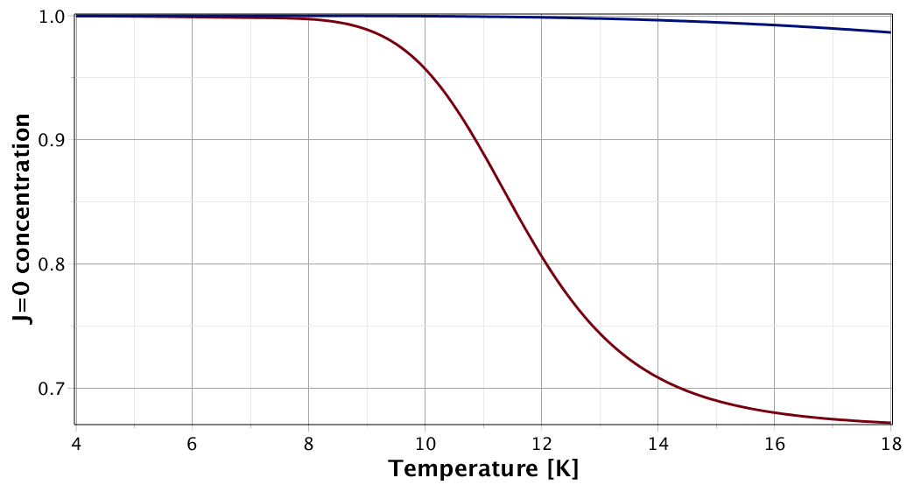
Comparison to literature
Conversion time: $τ={\left(β\left[D\right]\right)}^{−1}≈30 h$
Scaling up irradiation to FRM II values: $τ≈11 \text{h}$
Measurement of Collins et al @ 8K: $τ≈3 \text{h}$
Collins et al., Phys. Rev. B 44 (13), 6598 (1991)
Values scaled up to tritium irradiation: $τ≈4 \text{h}$
For FRM II irradiation values

Slide 21
Ortho content and line width

Slide 22
Measuring high ortho contents (0.98+)
$$\left(v,J\right)=\left(0,1\right)→\left(1,1\right)$$
$$\left(v,J\right)=\left(0,0\right)→\left(1,0\right)$$

Slide 23
Conclusion
An experiment to determine the effect of irradiation on the ortho-/para ratio in solid deuterium has been conducted
The deuterium was irradiated with 20.5 MeV protons and a beam current of 2.0-3.5 nA
The ortho content of the deuterium was increased
No plateau or end point of the irradiation effect was observed
The irradiation and conversion parameters could be determined
$β=\left(1.1±0.5\right)∙{10}^{−24}{\text{cm}}^{3}{\text{s}}^{−1}$
$k=\left(5±4\right)∙{10}^{−8}{\text{cm}}^{3}{\text{s}}^{−1}$
Strong correlation between peak width and ortho fraction observed
New beam time (7 days) scheduled for May 2nd

Slide 24
One more thing

