Slide 1
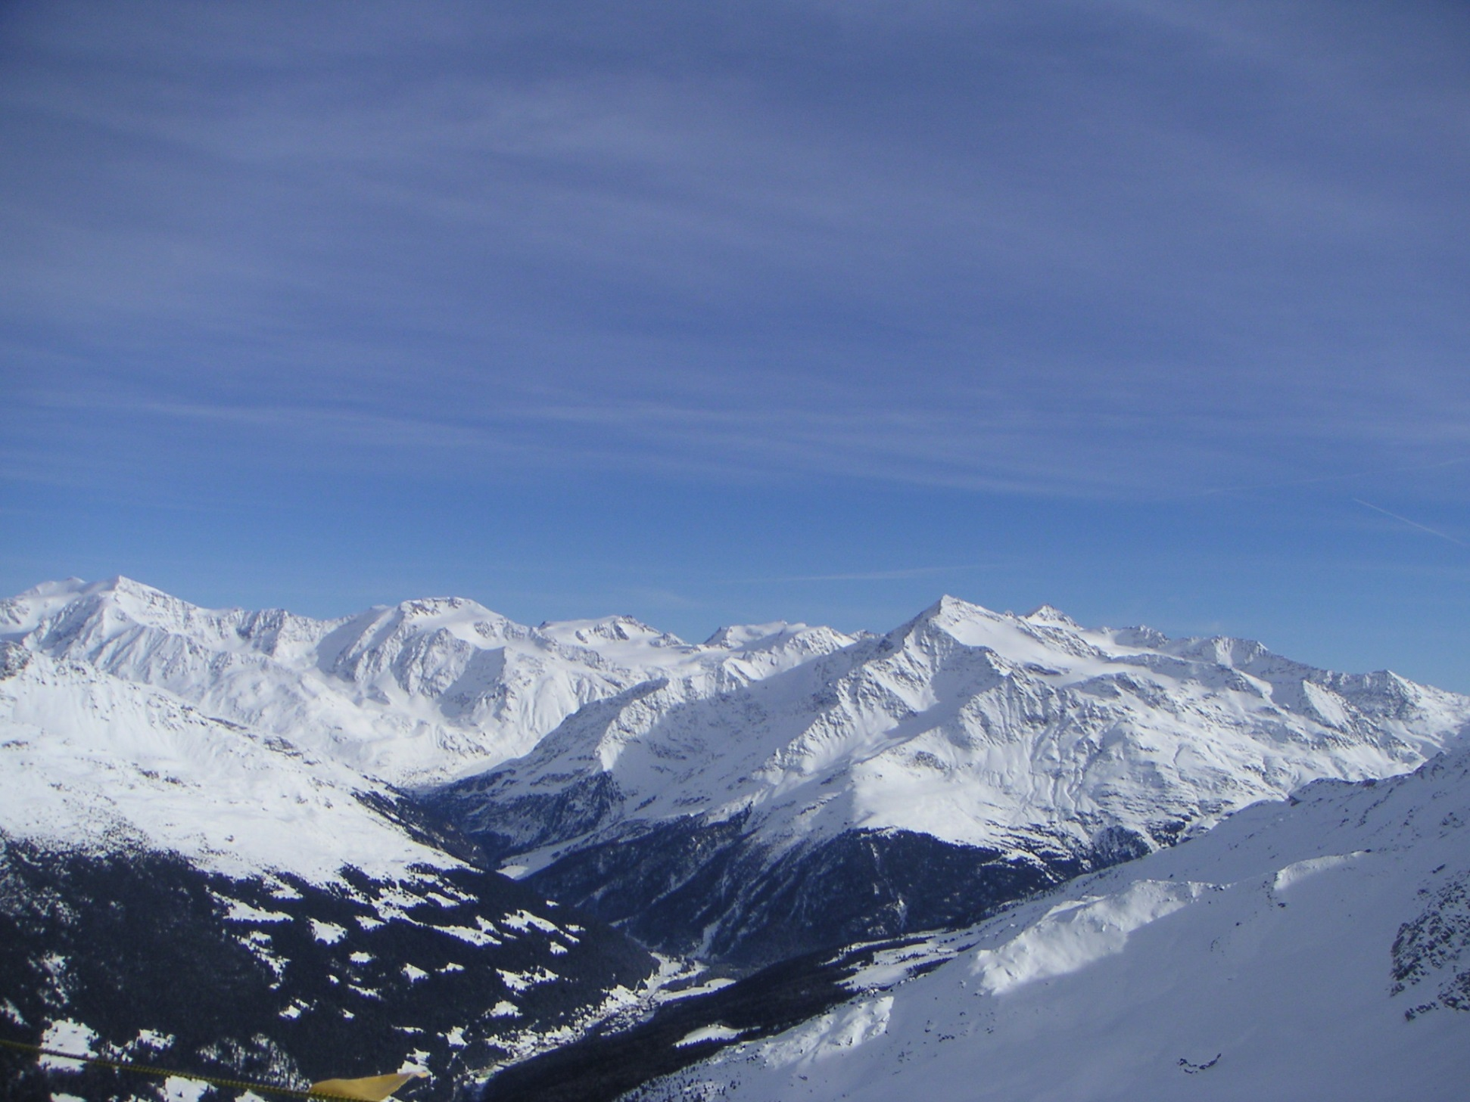
Symmetry energy and density
W. Trautmann
GSI Helmholtzzentrum, Darmstadt
M. Cevedale
P. San Matteo
view at Bormio 3000

Slide 2
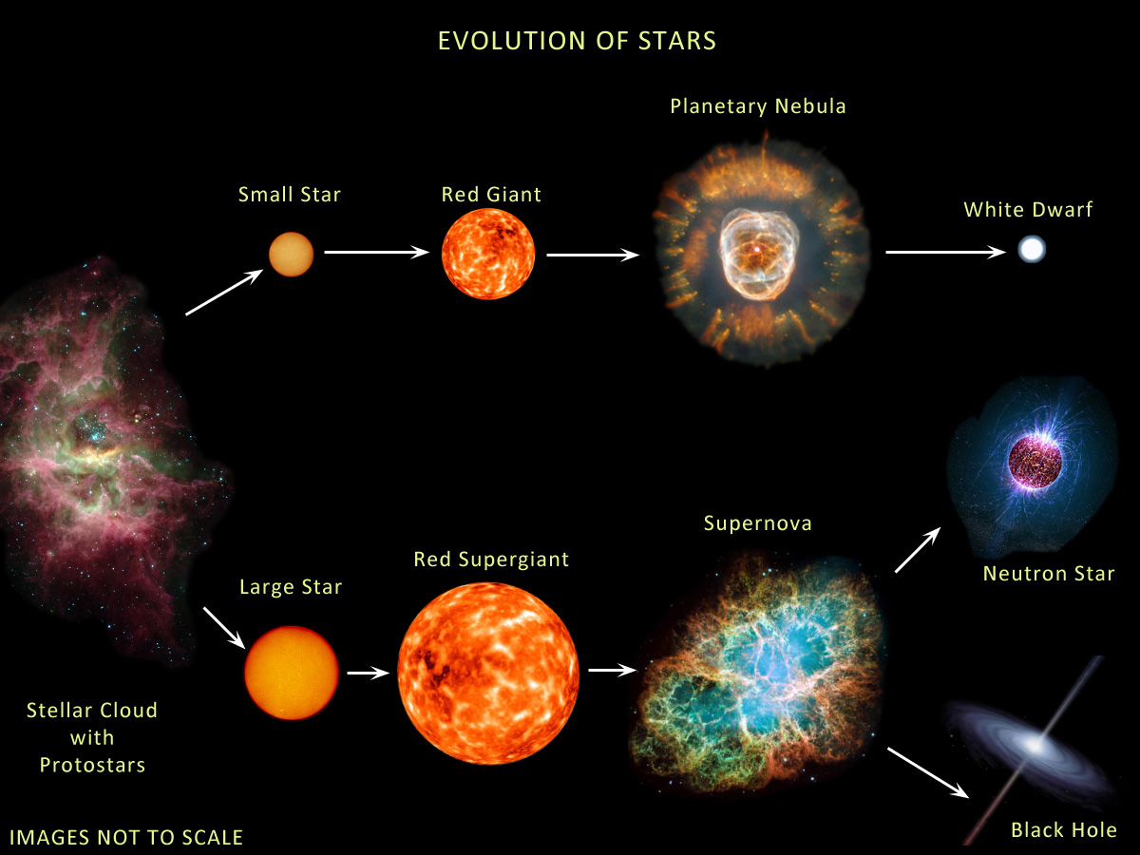
----- ~ 8 solar masses -----
source: Anna Watts, QM2014

Slide 3
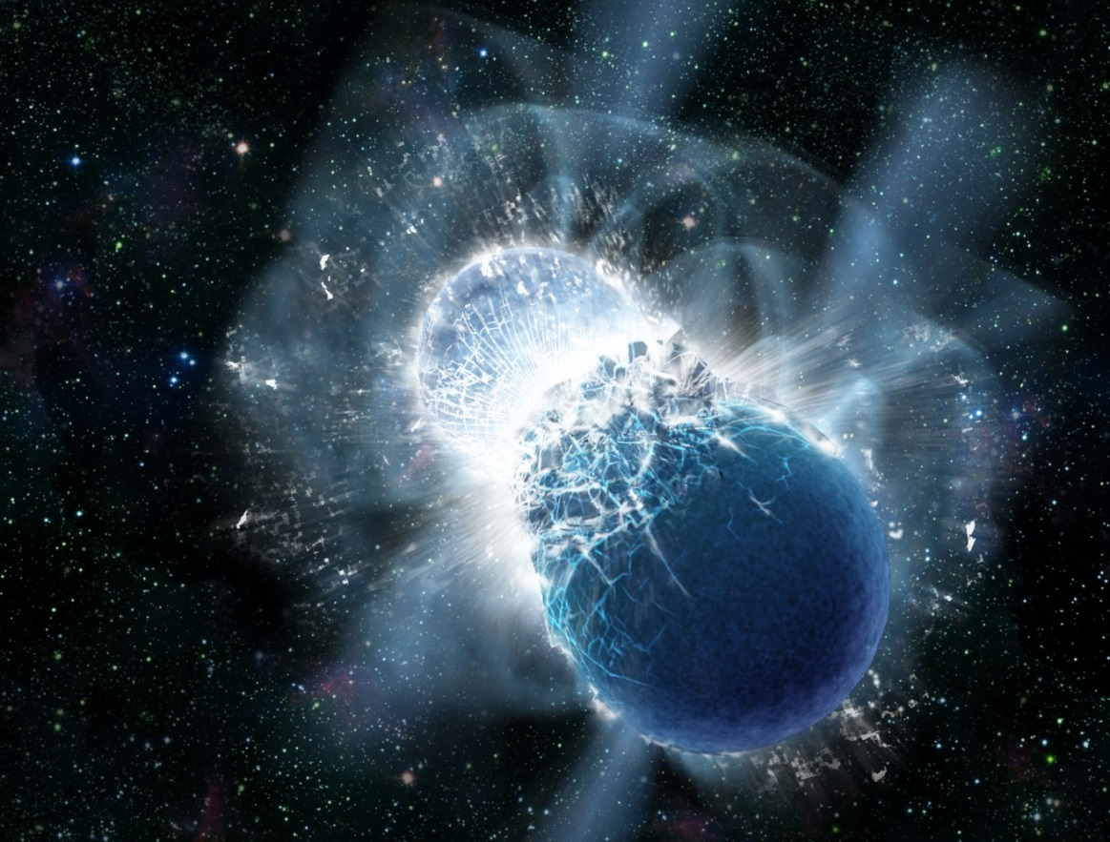
neutron star merger (artists conception)
Quelle: SciTechDaily 23.10.2013
source: Anna Watts, QM2014

Slide 4
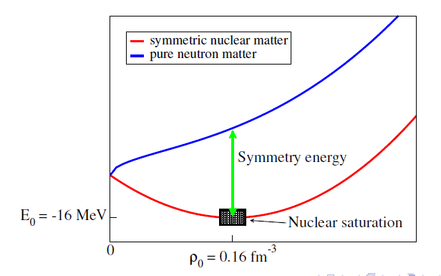
Nuclear Equation of State (EoS)
remember talk of S. Gandolfi
0

Slide 5
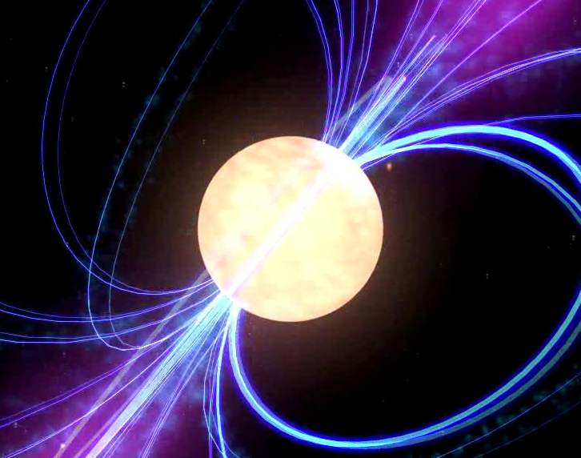
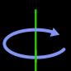
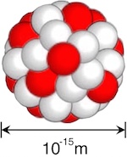
Nuclear Physics and Astrophysics: E_{sym} (ρ)
20 km
10 fm
10⁻¹⁴ m
0.00000000000001 m 20000 m
55 orders of magnitude in mass

Slide 6
the world average: L = 58.8865 MeV
Li and Han, PLB 727 (2013)
(L=3p₀/ρ₀)
from n-skins
neutron skins
masses
collective excitations
isospin diffusion
crust oscillations
r-mode instabilities
mass-radius analysis

Slide 7
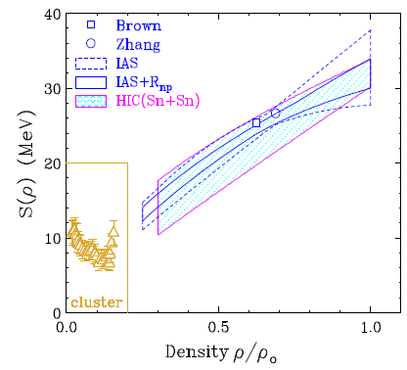
"A way forward in the study of the symmetry energy ..."
Horowitz et al., JPhG 41 (2014)
following NUSYM13
maximum sensitivity
of structure data near 2/3 ρ₀
Zhang and Chen (PLB 726 (2013)) use
Skyrme-Hartree-Fock to analyze
isotope binding energy difference and
neutron skin thickness of Sn isotopes;
B.A. Brown (PRL 111 (2013)) uses Skyrme,
properties of doubly-magic nuclei (binding
energies, rms charge radii, and single-particle
energies) and Δr_{np}=0.16 – 0.24 fm for ²⁰⁸Pb.

Slide 8
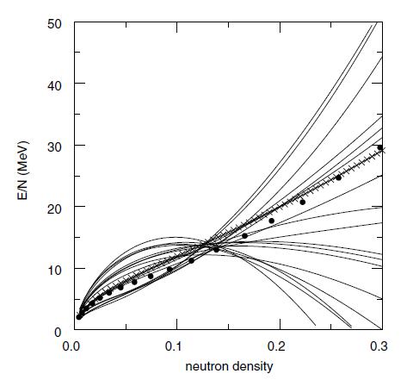
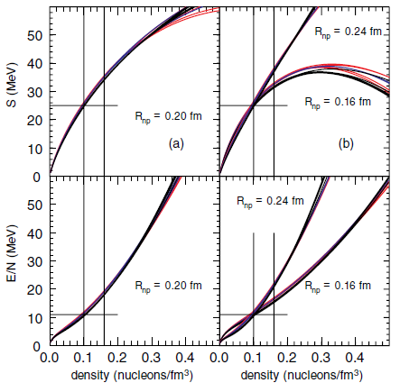
Brown, PRL 85 (2000)
Brown, PRL 111 (2013)
13 Skyrme sets fitted to ground-state properties of doubly magic nuclei
E_{sym} determined at 0.1 fm⁻³
neutron skin determines slope at 0.1 fm⁻³
Notes:
13 Skyrme interactions, CSkP set + SkM* and SLy4

Slide 9
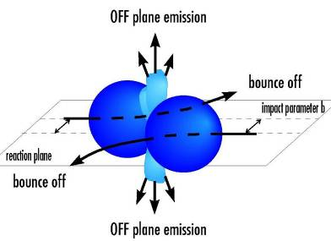
pressure gauge for neutron-star matter
neutron-over-charged particle
elliptic-flow ratio
in neutron-rich systems
analysis with transport
UrQMD (Li & Bleicher)
Tübingen QMD (Cozma)
differential squeeze-out
Notes:
31.10.2015

Slide 10
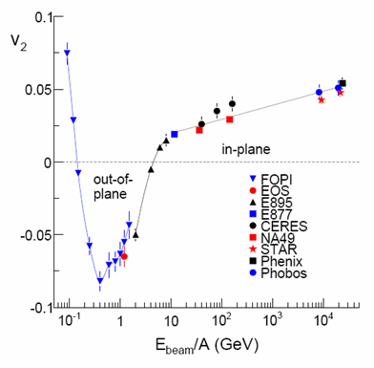
pressure gauge for neutron-star matter
neutron-over-charged particle
elliptic-flow ratio
in neutron-rich systems
analysis with transport
UrQMD (Li & Bleicher)
Tübingen QMD (Cozma)
studied reactions:
¹⁹⁷Au + ¹⁹⁷Au @ 400 A MeV
⁹⁶Ru + ⁹⁶Ru @ 400 A MeV
⁹⁶Zr + ⁹⁶Zr @ 400 A MeV
Notes:
31.10.2015

Slide 11
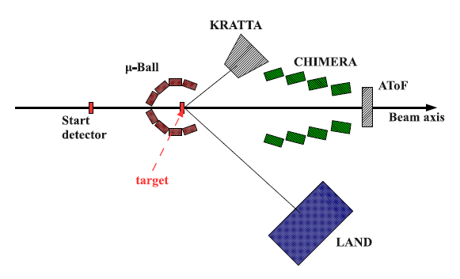
Asy-Eos experiment S394 in May 2011
CHIMERA, ALADIN Tof-wall,
μ-ball, for impact parameter
orientation and modulus
studied reactions:
¹⁹⁷Au + ¹⁹⁷Au @ 400 A MeV
⁹⁶Ru + ⁹⁶Ru @ 400 A MeV
⁹⁶Zr + ⁹⁶Zr @ 400 A MeV
Constraining the Symmetry Energy at Supra-Saturation Densities
with Measurements of Neutron and Proton Elliptic Flows
Co-Spokespersons: R.C. Lemmon and P. Russotto

Slide 12
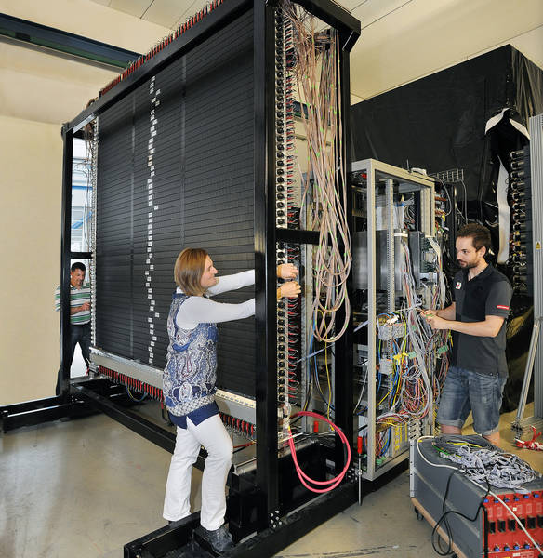
NeuLAND
all plastic
improved calorimetry
4 planes in RIKEN
5 planes at GSI
more planes to come

Slide 13
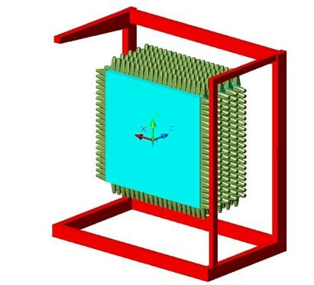
NeuLAND
all plastic
improved calorimetry
4 planes in RIKEN
5 planes at GSI
more planes to come
existing
LAND:
2 x 2 m²
1 m deep
18 t

Slide 14
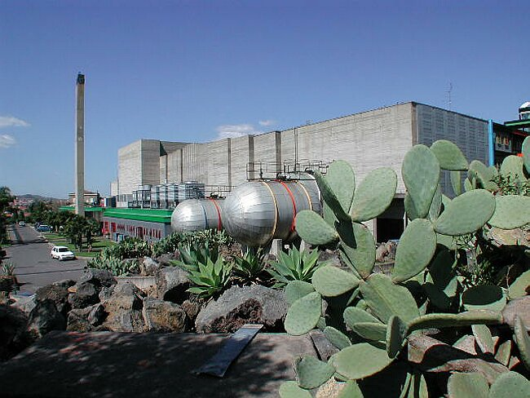
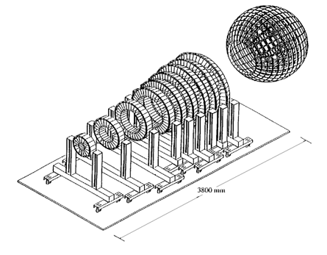
Laboratori Nazionali del Sud
4 double rings
of CHIMERA,
LNS Catania
Catania, Sicilia
3,8 m
Notes:
31.10.2015

Slide 15
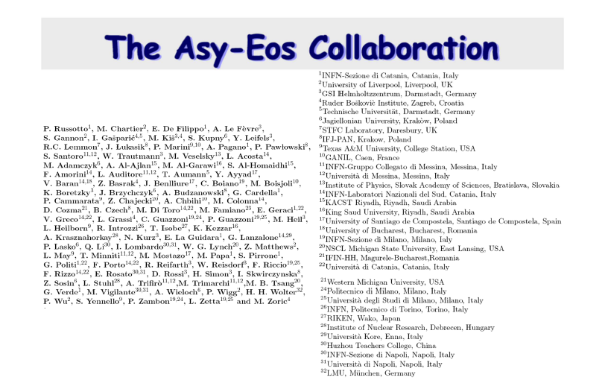
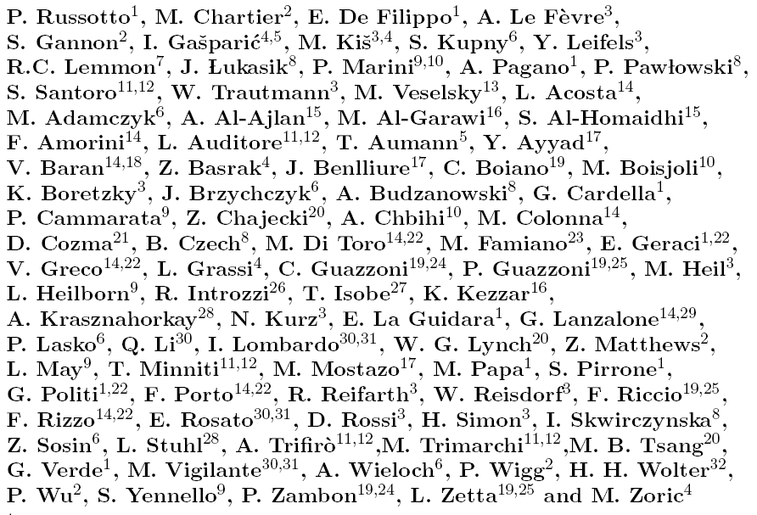














spokespersons: P. Russotto (Catania)
R. Lemmon (Daresbury)
Notes:
15

Slide 16
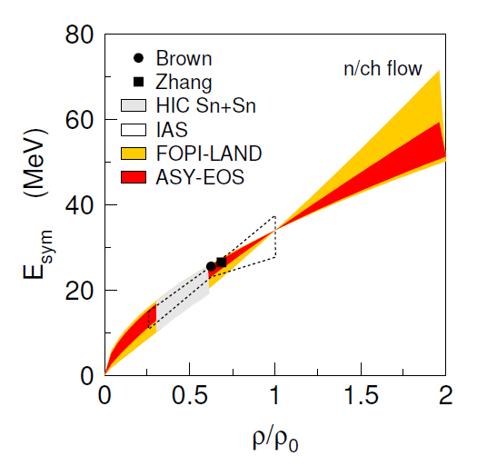
L=72±13 MeV
new data
data: Leifels et al. PRL 71 (1993)
differential flow: Russotto et al. PLB 697 (2011)
see Bormio 2014
Notes:
31.10.2015

Slide 17
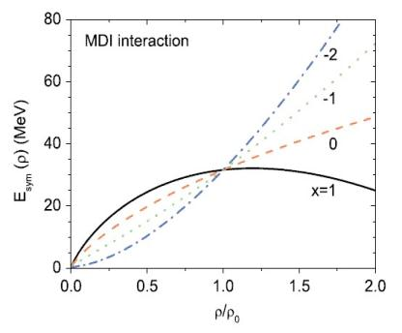
sensitivity to density
of elliptic-flow ratio for Au+Au @ 400 AMeV
Dan Cozma et al.
Tübingen QMD and force developed by
Das, Das Gupta, Gale, and Bao-An Li,
Phys. Rev. C 67 (2003) 034611

Slide 18
sensitivity to density
of elliptic-flow ratio for Au+Au @ 400 AMeV
Dan Cozma et al.
calculate DEFR (ρ)
Difference of Elliptic-Flow Ratio
ρ
Tübingen QMD and force developed by
Das, Das Gupta, Gale, and Bao-An Li,
Phys. Rev. C 67 (2003) 034611

Slide 19
sensitivity to density
Difference of Elliptic-Flow Ratio
of elliptic-flow ratio for Au+Au @ 400 AMeV
Dan Cozma et al.
ρ
Tübingen QMD and force developed by
Das, Das Gupta, Gale, and Bao-An Li,
Phys. Rev. C 67 (2003) 034611

Slide 20
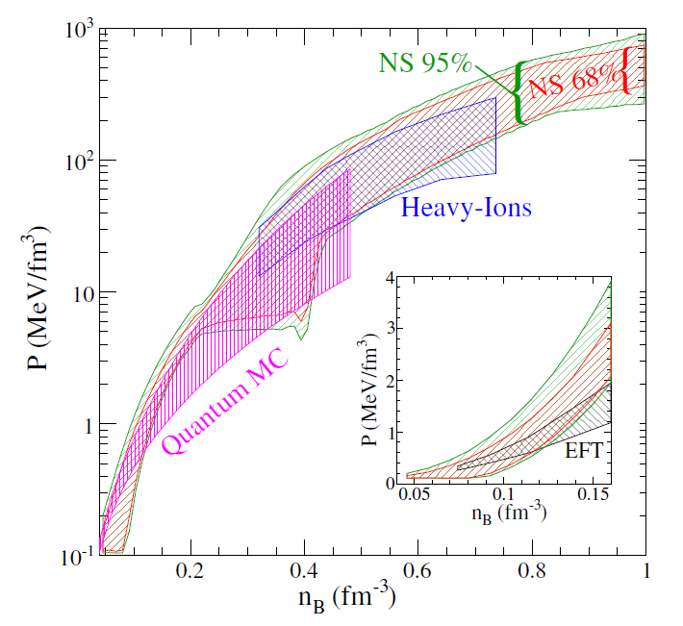
asymmetry pressure
p₀ = 3.8 ± 0.7 MeV/fm³
ρ₀
Steiner, Lattimer, and Brown, ApJ 765, L5 (2013)

Slide 21
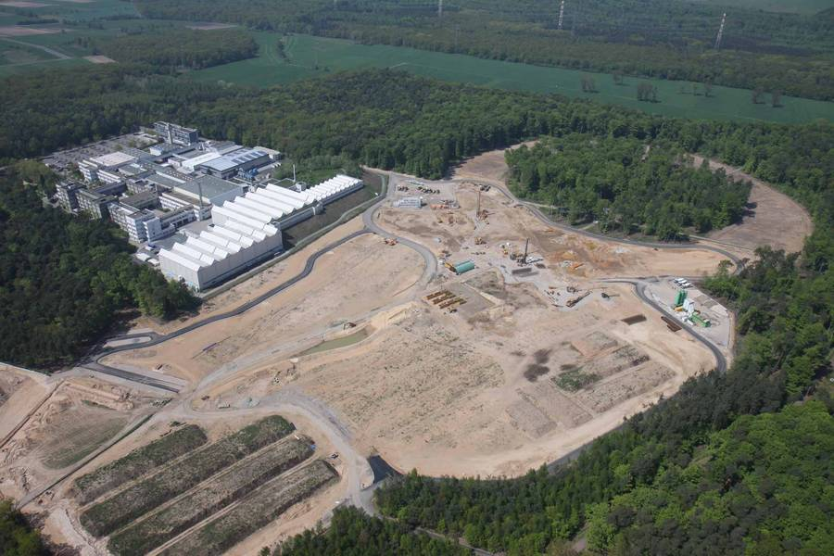

FAIR civil construction

Slide 22
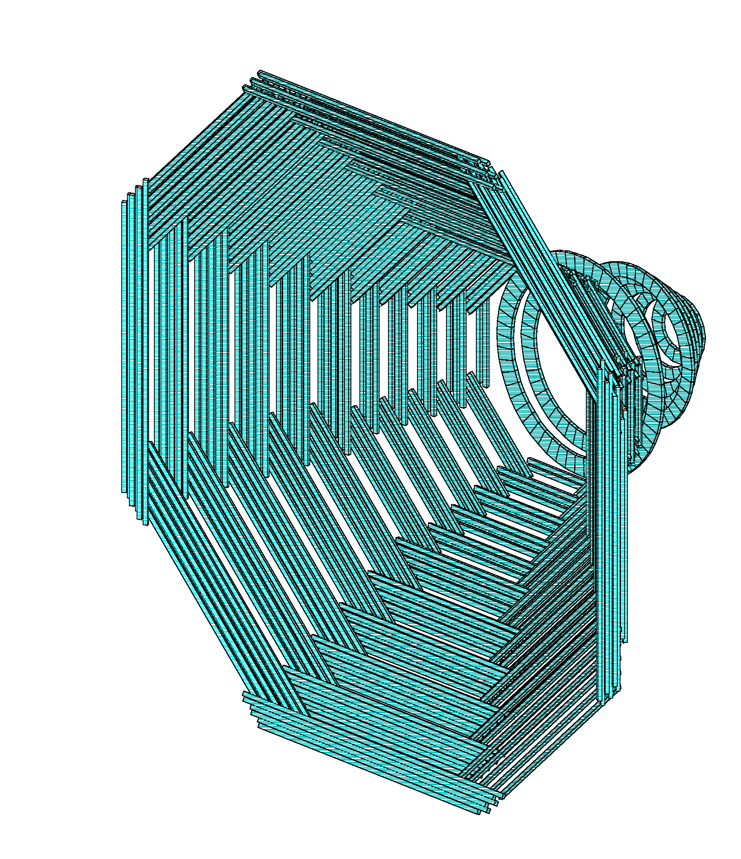
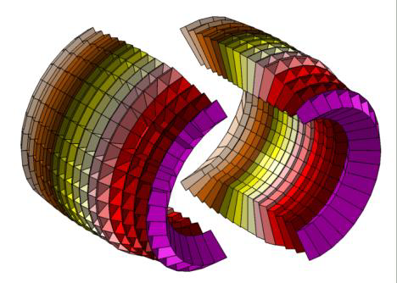
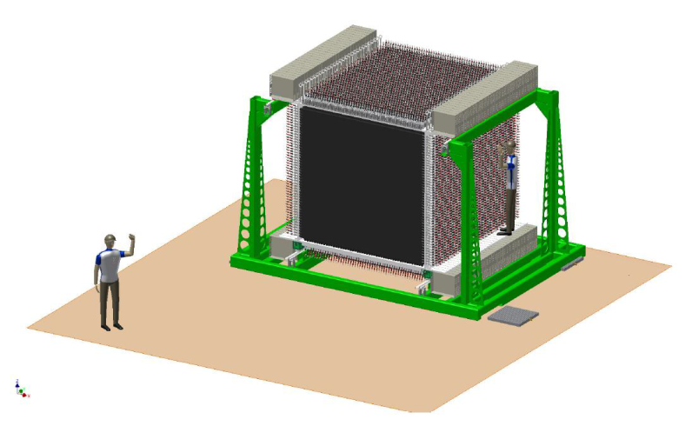
PLAWA
FAIR instrumentation
Califa
NeuLAND

Slide 23
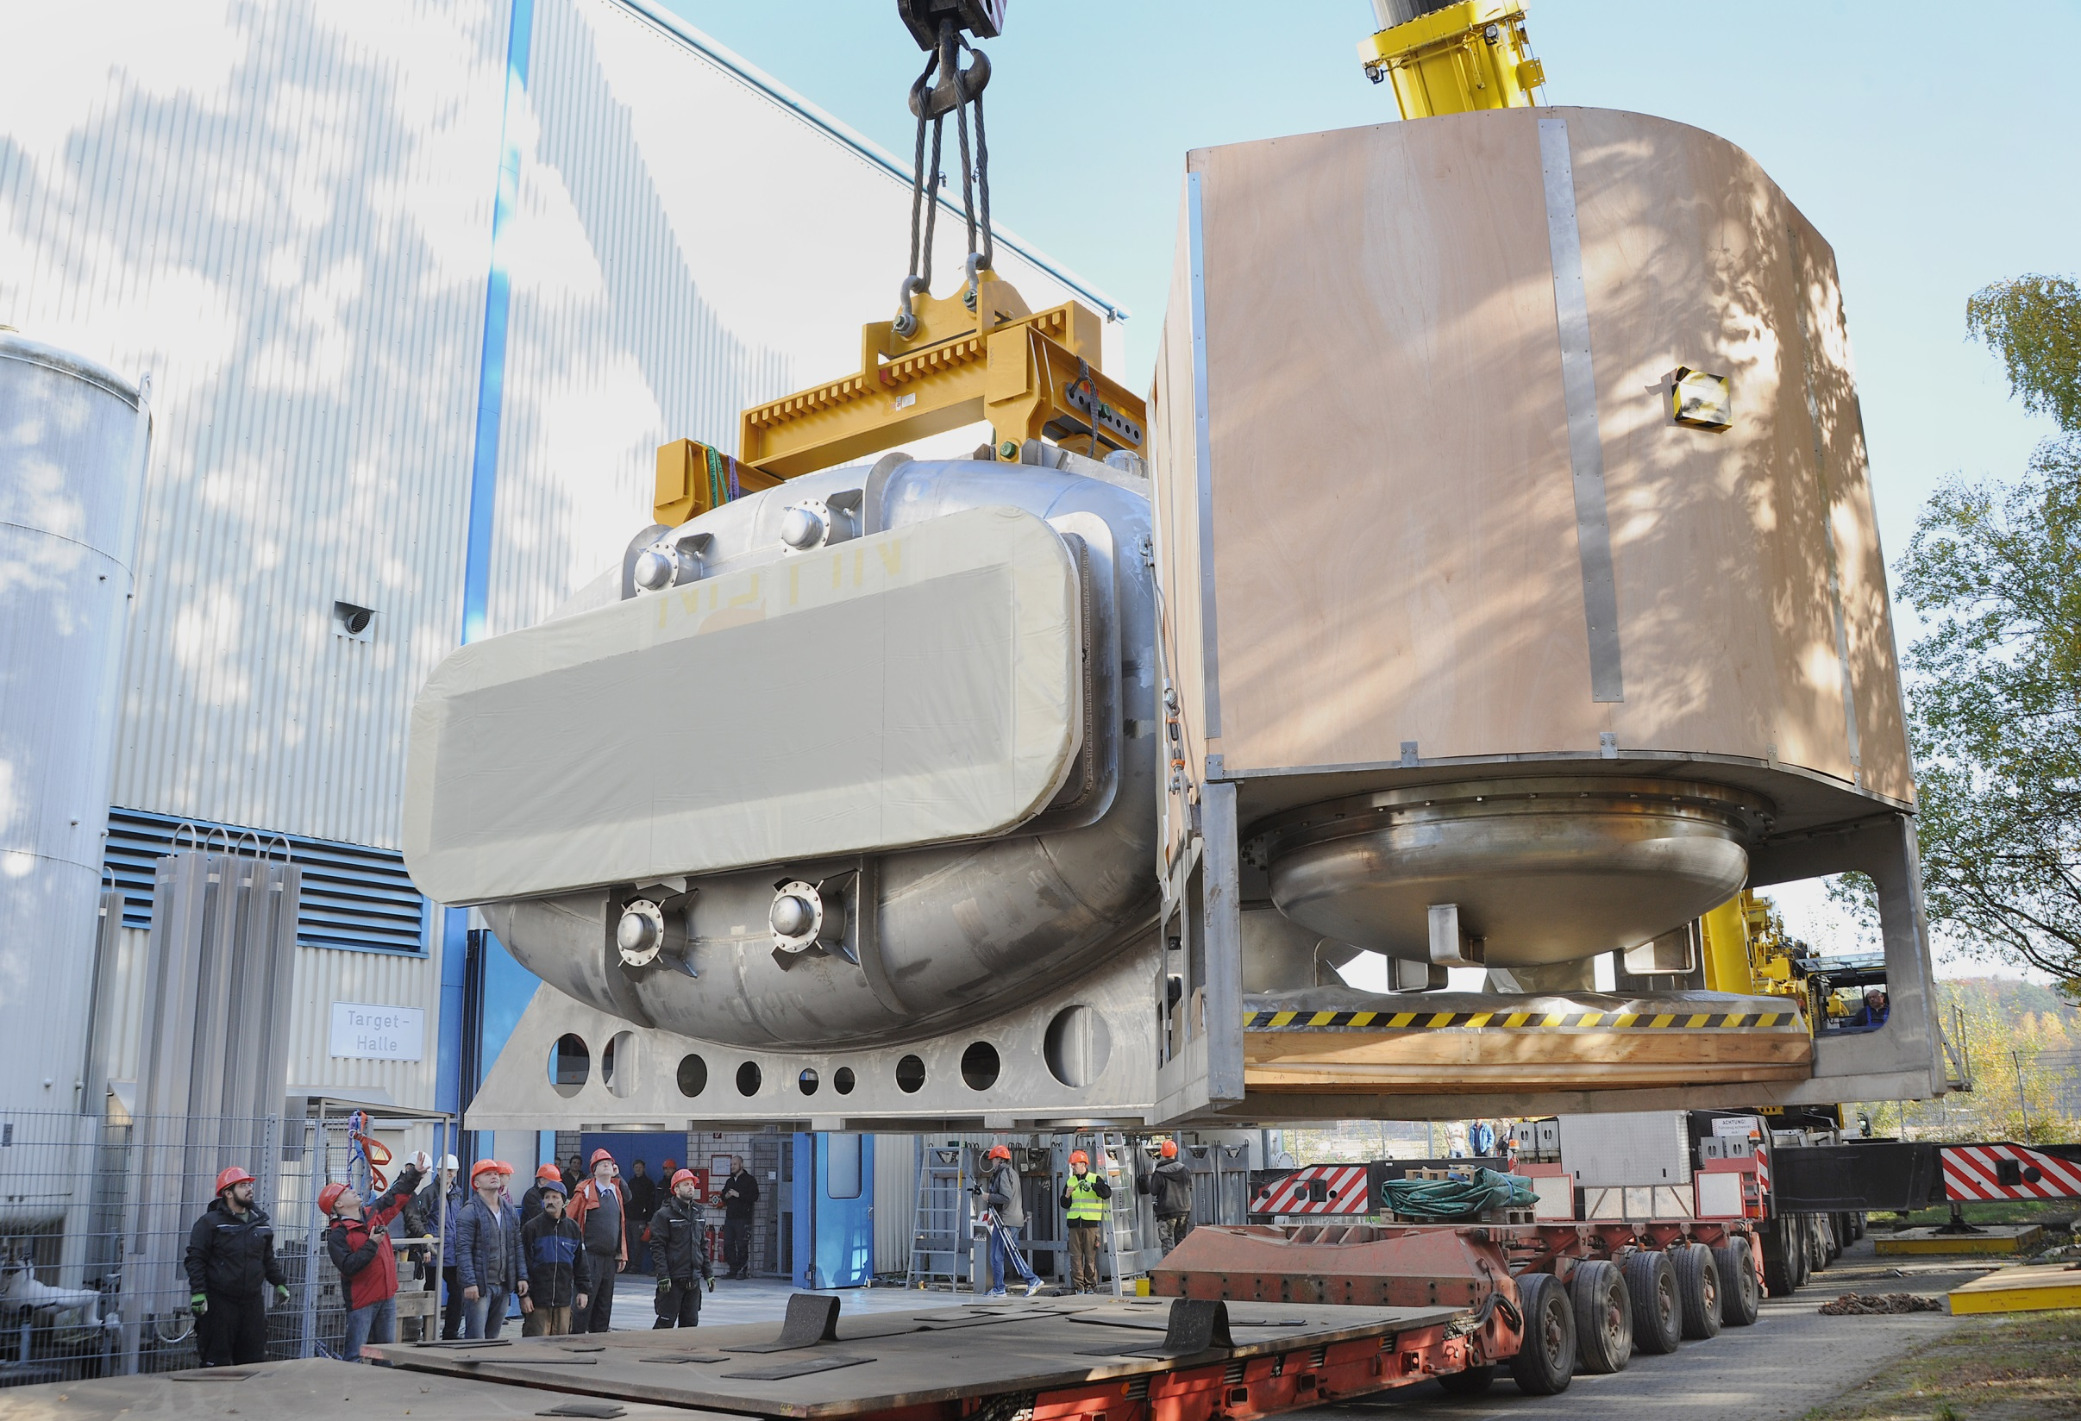
GLAD
GSI Large
Acceptance Dipole
superconducting
iron free
bending power 5 Tm

Slide 24
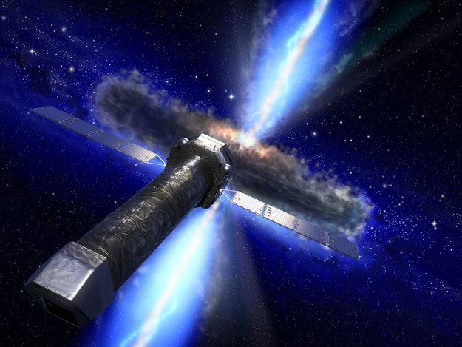
Athena+ X-ray Observatory
ESA 2028 (proposed)
quiescent
Low-Mass
X-ray Binaries
http://www.the-athena-x-ray-observatory.eu/
Notes:
31.10.2015

Slide 25
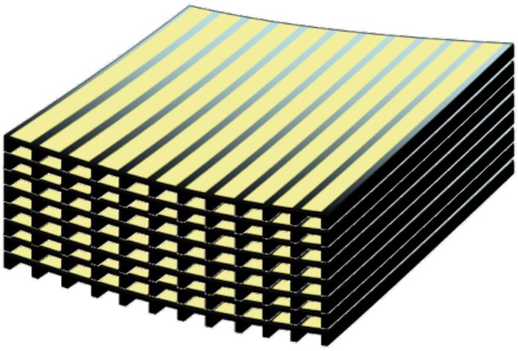
Athena+ X-ray Observatory
ESA 2028 (proposed)
coated silicon wafers
millions of pores
in hundreds of modules
2 m² active area
http://www.the-athena-x-ray-observatory.eu/
Notes:
31.10.2015

Slide 26

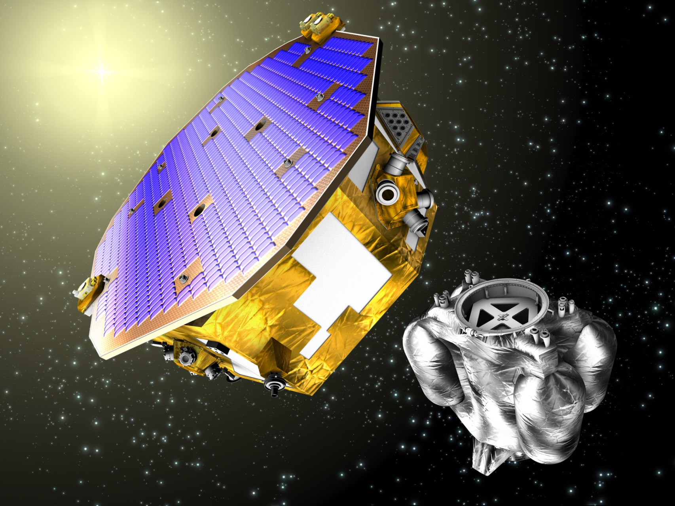
launched 03. 12. 2015
Lagrange point reached
22.01.2016
picotechnology
Notes:
31.10.2015

Slide 27
launched 03. 12. 2015
Lagrange point reached
22.01.2016
picotechnology
lisa in 2034
neutron-star seismology with gravitational waves
72nd Winter Meeting ...
Notes:
31.10.2015

Slide 28
backups

Slide 29
the symmetry energy from astrophysics
radii for neutron stars with 1.4 solar mass
radius
Bob Rutledge (Mc Gill, Montreal) 8.2 – 10.4 km
method: qLMXB‘s (Bormio 2015)
Jim Lattimer (Stony Brook, USA) 11.2 – 12.8 km
method: PRE-bursts and qLMXBs
(Eur. Phys. J. A 2014)
quiescent Low-Mass X-ray Binaries: radiate while
accreting mass from a neighboring star
Photospheric-Radius-Expansion bursts: X-ray bursts energetic
enough to reach the so-called Eddington limit at which
radiation pressure is sufficiently large to overcome gravity,
leading to expansion of the star’s photosphere.
Notes:
L=72 entspricht R=11.5 nach Roca-Maza 2011 und Betty Tsang 2008. Neuere Werte dafür

Slide 30
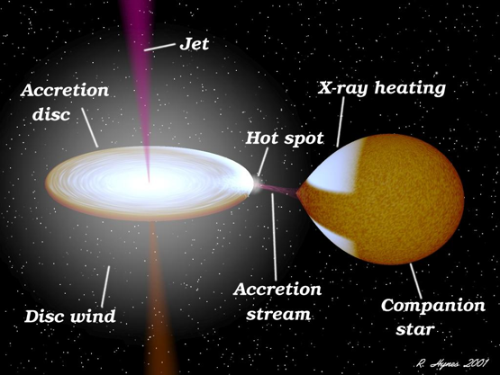

Slide 31
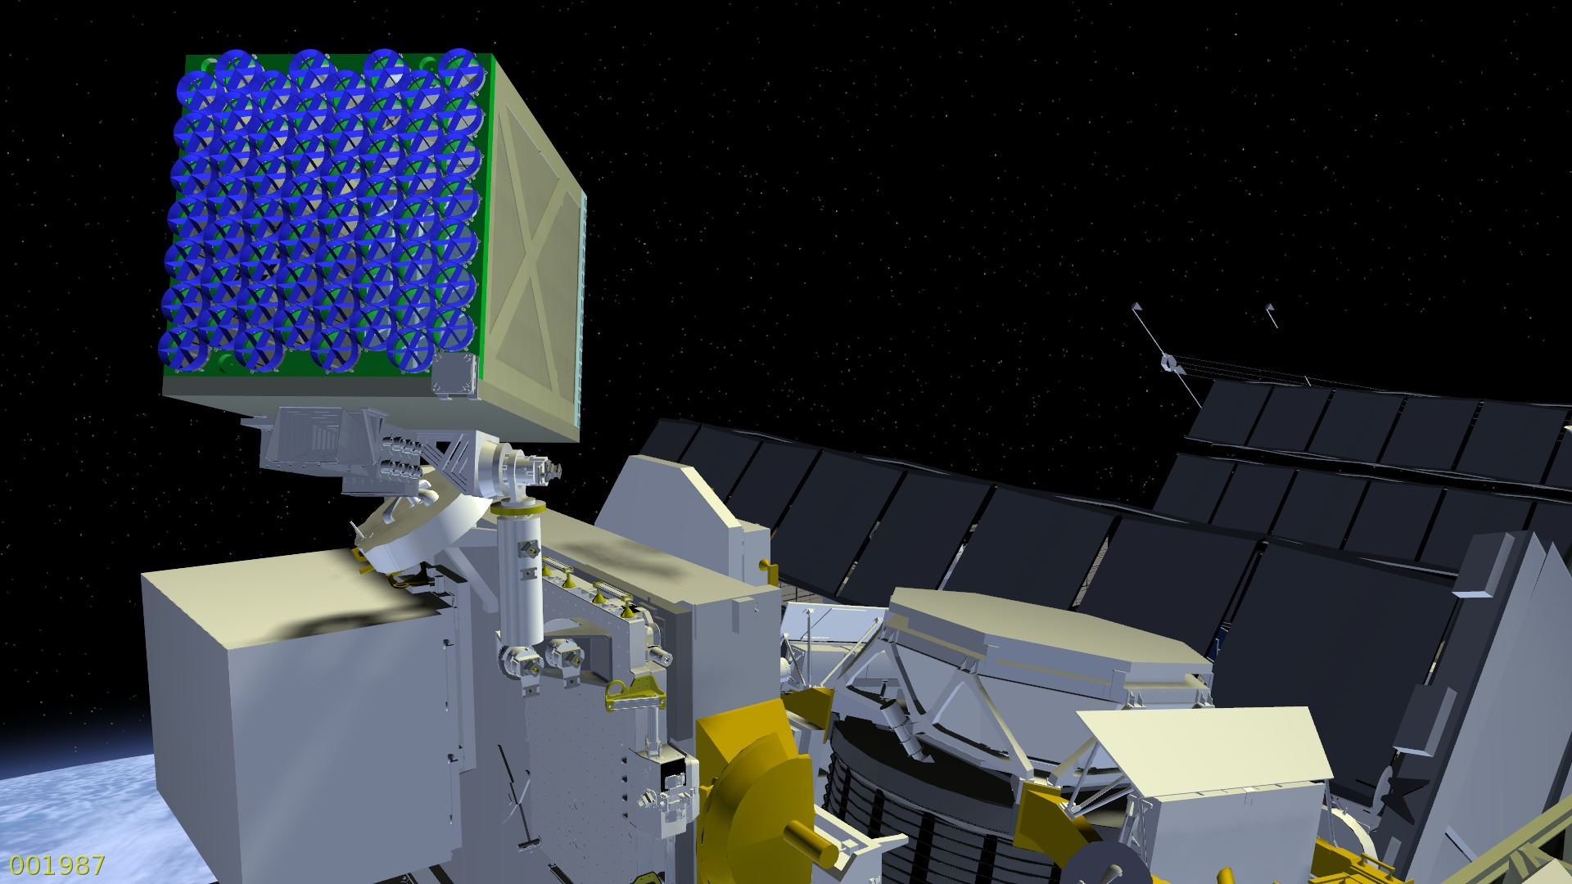
NICER on the ISS
2017
Neutron-star Interior Composition Explorer
56 X-ray telescopes
Method:
rotation-resolved spectroscopy
with 100 nanosecond timing resolution
Quelle:NASA
Notes:
rotation-resolved spectroscopy with 100 nanosecond timing

Slide 32
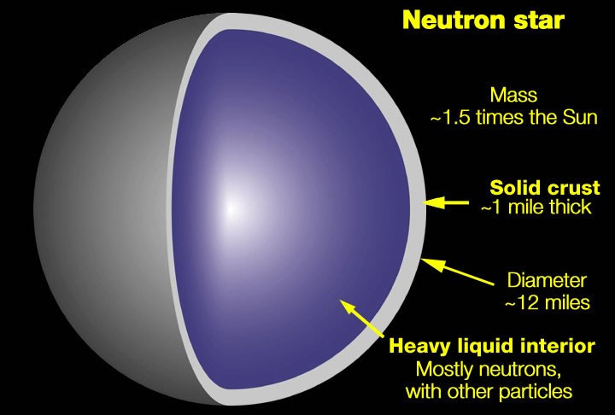
one number: L= 72 MeV corresponds to
pressure 6,1 10³² Pa at density 2,7 10¹⁴ g/cm³
6100 000 000 000 000 000 000 000 000 bar
?
http://astro.hopkinsschools.org/course_documents/stars/smallest/neutron_stars.htm
Notes:
31.10.2015

Slide 33
more systematic parameter test with Tübingen QMD*)
M.D. Cozma et al., PRC 88, 044912 (2013)
elliptic flow ratio and difference
Au + Au @ 400 A MeV
conclusion:
super-soft not compatible
with FOPI-LAND data
steps towards
model invariance:
tested in UrQMD:
FP1 vs. FP2,
i.e. momentum dep. of NNECS
tested in T-QMD:
soft vs. hard 190<K<280 MeV
density dependence of NNECS
asymmetry dependence of NNECS
wave packet 2.5<L<7.0 fm²
optical potential
momentum dep. of isovector potential
superstiff
supersoft
*) V.S. Uma Maheswari, C. Fuchs, Amand Faessler, L. Sehn, D.S. Kosov, Z. Wang, NPA 628 (1998)
Notes:
33
effective mass scaling model for the in-medium NN cross-sections and explicit momentum dependence of the symmetry energy part. Requires experimental data for the elliptic flow of both charged and neutral particles of high quality, of an accuracy of 1% or better.

