Slide 1
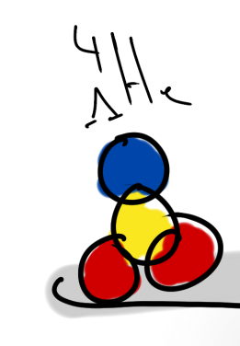
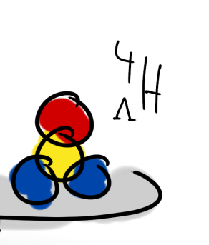
Experimental Tests of Charge Symmetry Breaking in Hypernuclei
Patrick Achenbach
U Mainz
Jan. 2o16

Slide 2
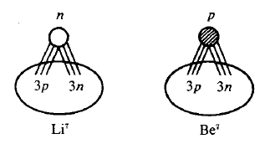
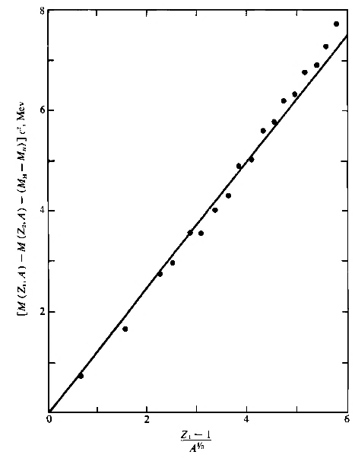
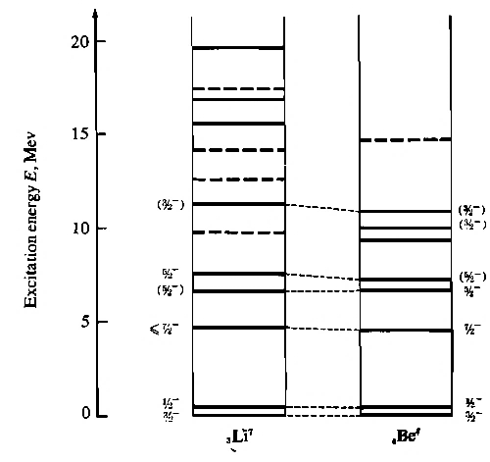
Some historical observations
ΔM
- no magnetic interaction
- no neutron halo/skins
- no radius difference
- no shell effects
- …
ΔM
3 E_{p-n} + 3 E_{n-n} ~ 3 E_{p-p} + 3 E_{p-n}
⁷Li ↔ ⁷Be
³He ↔ ³H
(Z-1)/A^{1/3}
[Gleit et al. Nuclear Data Sheets 5 (1963)]
[Lauritsen & Ajzenberg-Selove, NP 78 (1966)]

Slide 3
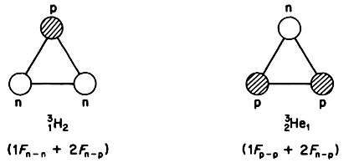
Charge symmetry in ordinary nuclei
Charge independence: strong force independent of isospin (E_{pp} = E_{nn} = E_{pn})
Charge symmetry: strong force independent of I₃ flip (E_{pp} = E_{nn})
Charge-symmetry breaking in nuclear two-body force…
… is studied in mirror nuclei after correcting for Coulomb effects
… is very small
… is much smaller than part which violates charge-independence

Slide 4
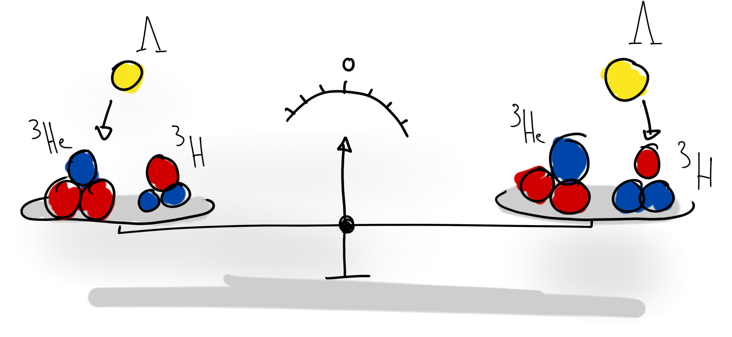
Effect of charge symmetry in hypernuclei
Opportunity to study strong force symmetries with Λ as neutral probe
Λ hyperon has no isospin and no charge →
Λ binding in mirror hypernuclei directly tests charge symmetry
E_{Λp} = E_{Λn} → B_{Λ} (_{Λ}^{A}Z) = B_{Λ}(_{Λ}^{A}Z+1)

Slide 5
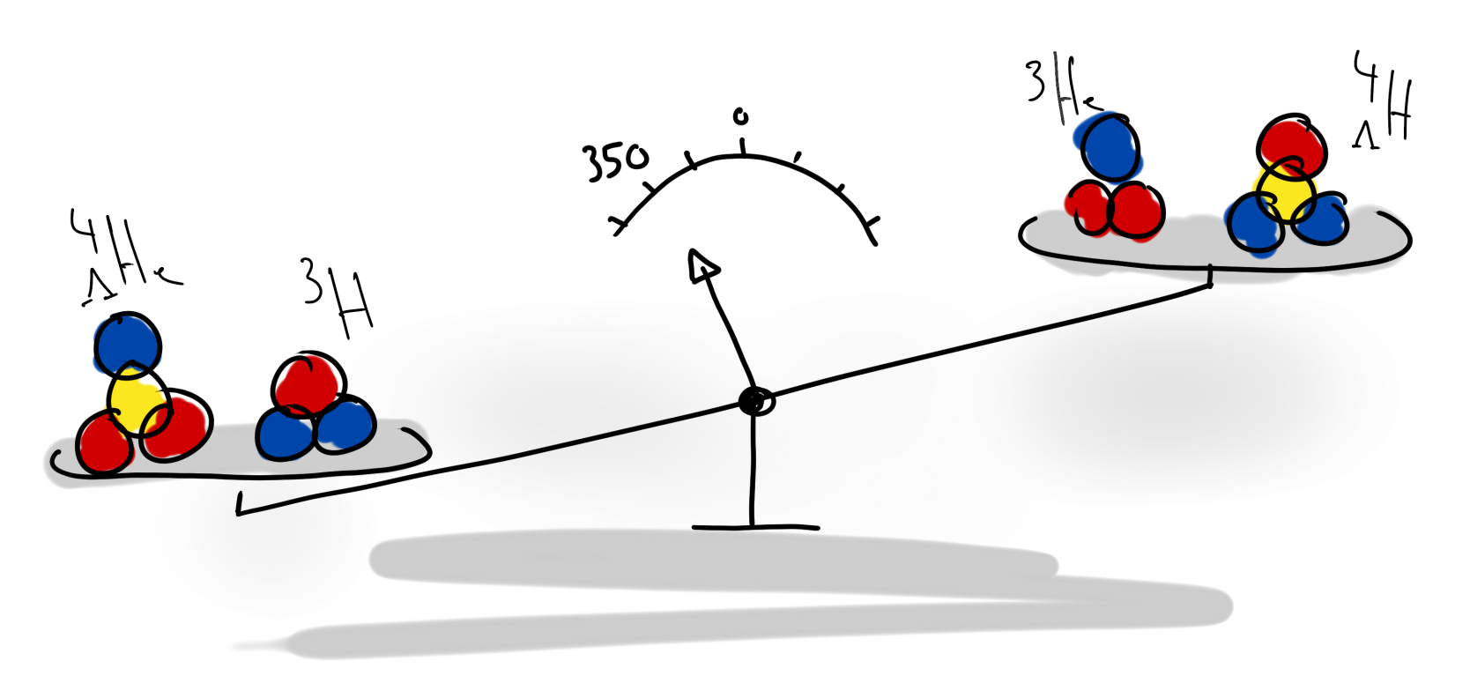
Large charge symmetry breaking in A = 4
⁴_{Λ}H - ⁴_{Λ}He ground state mass difference exceptionally large > 300 keV
charge symmetry breaking effect resists consistent reproduction by theory
⁴_{Λ}H - ⁴_{Λ}He coulomb corrections due to ΛN-ΣN coupling < 50 keV
[M. Juric et al. NP B52 (1973)]
[A. R. Bodmer and Q. N. Usmani, PRC 31, 1400 (1985)]

Slide 6
How to solve the puzzle?
1.
check experimental data consistency, accuracy and systematic errors
study other aspects / components of charge symmetry breaking
perform measurements with independent experimental technique
combine information from steps 1. – 3.
2.
3.
4.

Slide 7
1. check experimental data consistency, accuracy and systematic errors

Slide 8
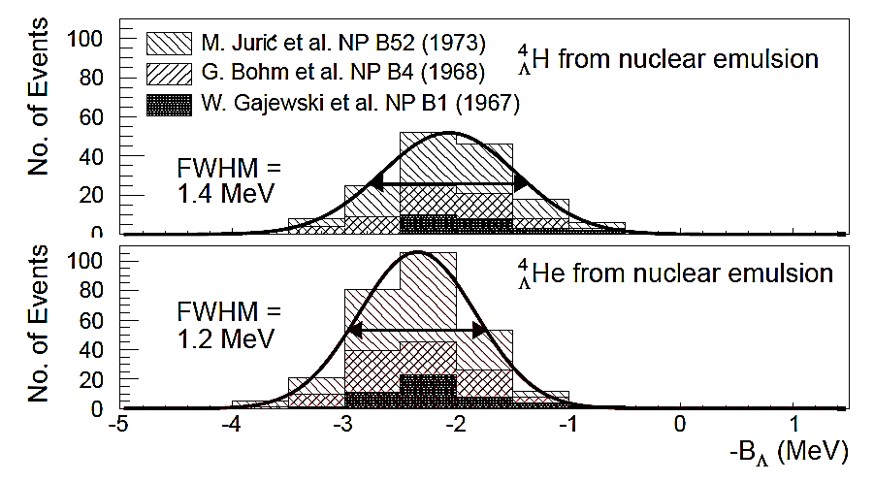
Emulsion results on _{Λ}⁴H and _{Λ}⁴He
ΔB_{Λ} = 0.35±0.06
δB = ±0.04 MeV
δB = ±0.03 MeV
only three-body decay modes used for hyperhydrogen
155 events for hyperhydrogen, 279 events for hyperhelium

Slide 9
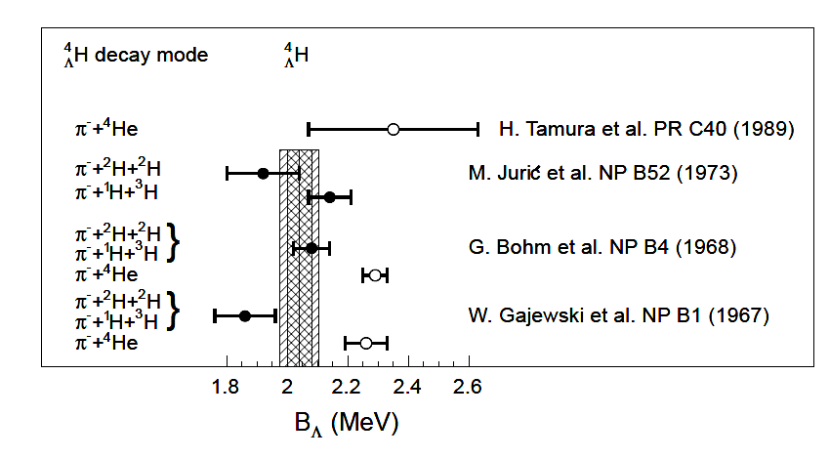
World data on _{Λ}⁴H
⁴H
decay
→ π⁻+¹H+³H: B = 2.14 ±0.07 MeV
Λ
0.22 MeV difference
decay
⁴H
→ π⁻+²H+²H: B = 1.92 ±0.12 MeV
Λ
Total: B = 2.08 ±0.06 MeV
[M. Juric et al. NP B52 (1973)]

Slide 10
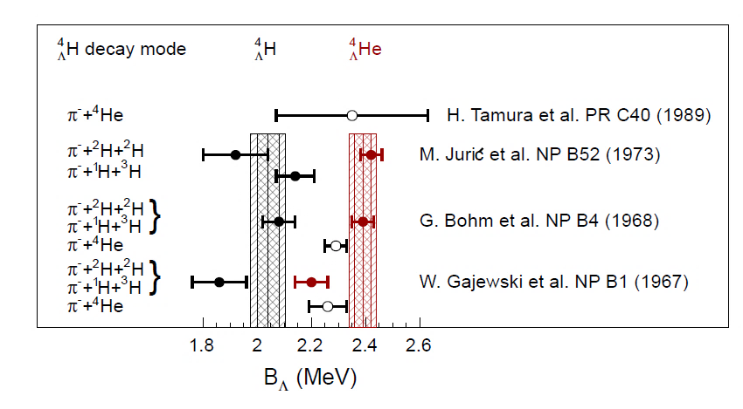
World data on A = 4 system
Λ
⁴He
decay
→ π⁻+¹H+³He: B = 2.42 ±0.05 MeV
Λ
0.02 MeV difference
decay
→ π⁻+2¹H+²H: B = 2.44 ±0.09 MeV
⁴He
Λ
Total: B = 2.42 ±0.04 MeV
[M. Juric et al. NP B52 (1973)]

Slide 11
2. study other aspects / components of charge symmetry breaking

Slide 12
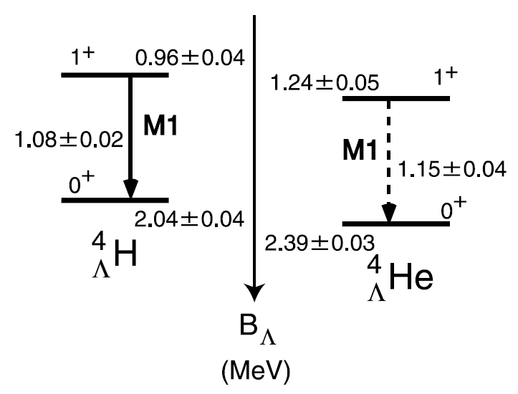
The A = 4 level schemes (before 2015)
ΔB_{Λ} (ex. st.) = 0.28±0.06
ΔB_{Λ} (gr. st.) = 0.35±0.06
[H. Tamura, NPA 914 (2013) 99]
charge symmetry breaking only if emulsion data is correct
spin-independent charge symmetry breaking

Slide 13
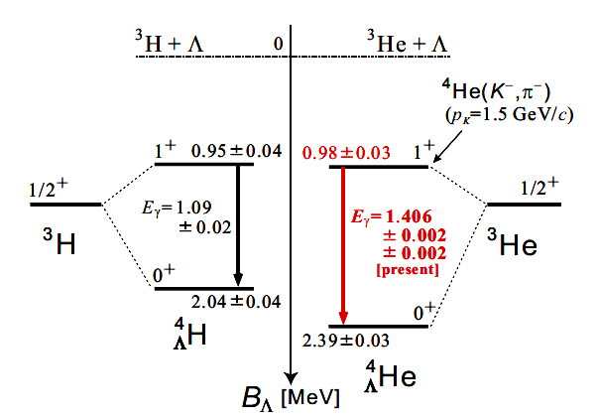
The A = 4 level schemes
ΔB_{Λ} (ex. st.) = 0.03±0.05
ΔB_{Λ} (gr. st.) = 0.35±0.06
[T. O. Yamamoto, PRL 115 (2015) 222501]
observation of charge symmetry breaking in γ-ray spectroscopy
spin-dependent charge symmetry breaking

Slide 14
3. perform measurements with independent experimental technique

Slide 15
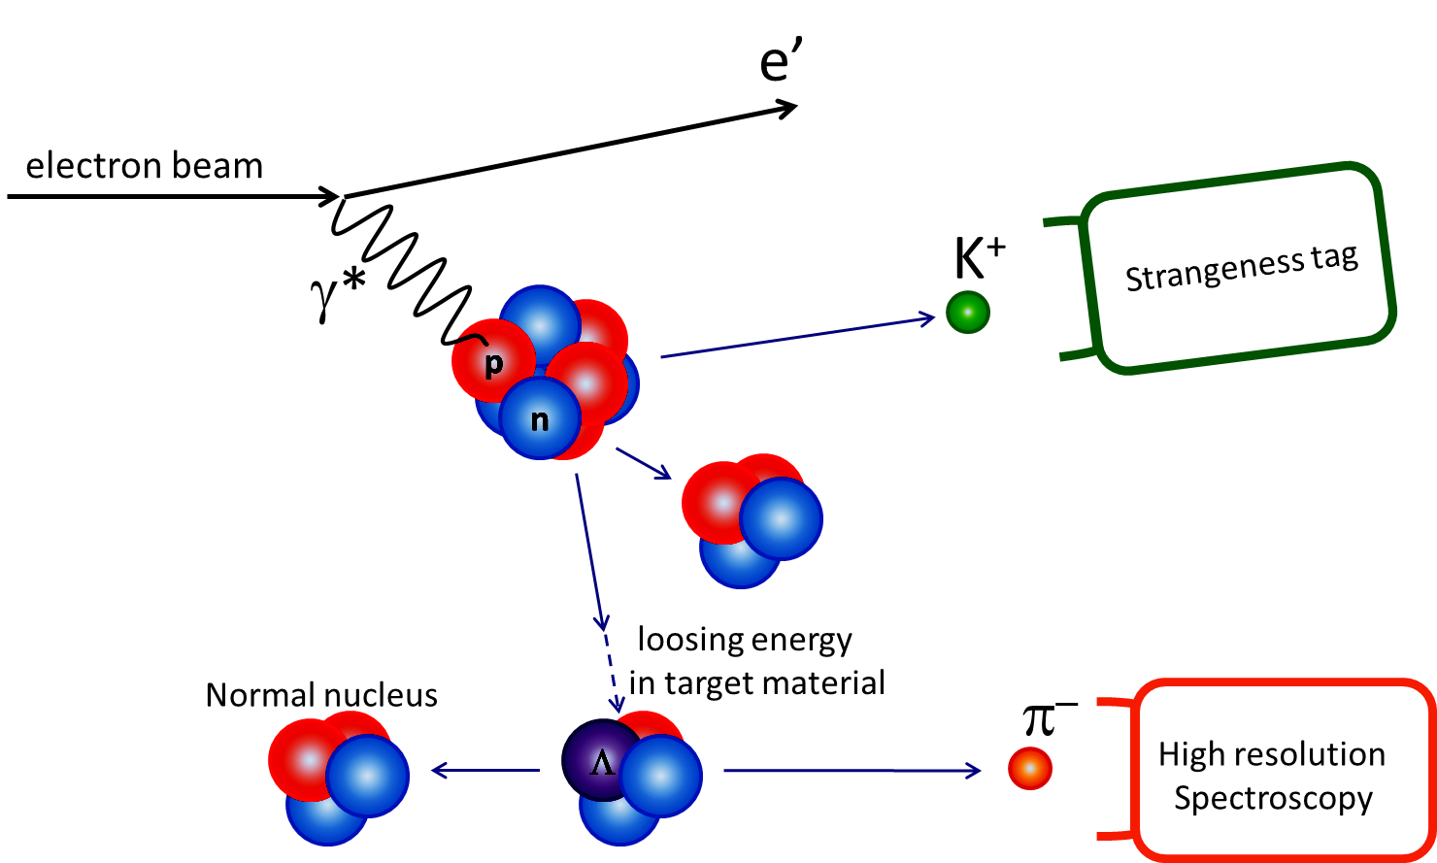
Hyperfragment decay-pion spectroscopy with electron beams
energy and momentum transfer to target nucleus
different possible fragmentation processes
stopping
detection
of pions
two-body decay at rest ⇒ mono-energetic pions

Slide 16
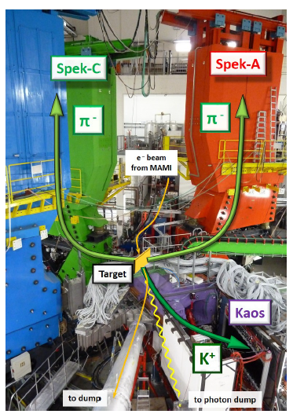
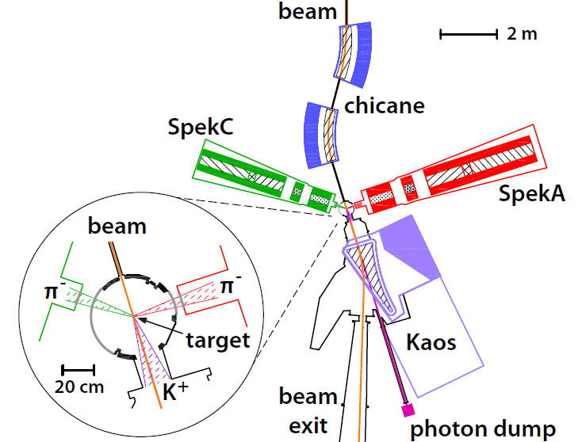
Experimental setup at MAMI

Slide 17
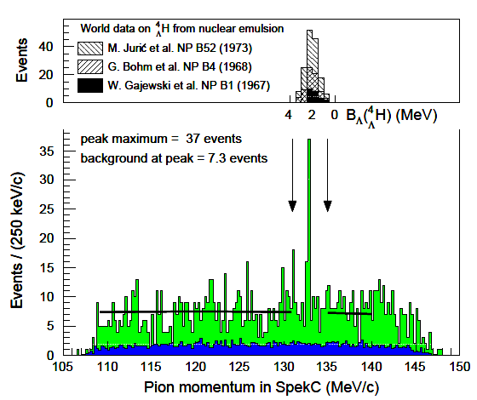
Decay-pion spectrum
Emulsion data on binding energy scale
mono-energetic pions
decays of quasi-free produced hyperon
accidental background reactions

Slide 18
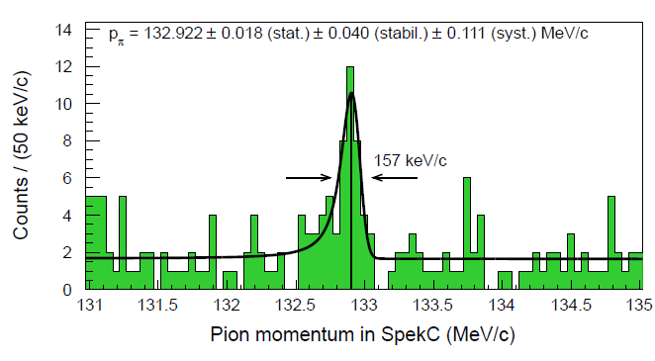
Fit to decay-pion momentum
fit composed of Gaussian resolution function convoluted with a Landau distribution representing energy loss on top of background function
observed signal shape and width consistent with simulation

Slide 19
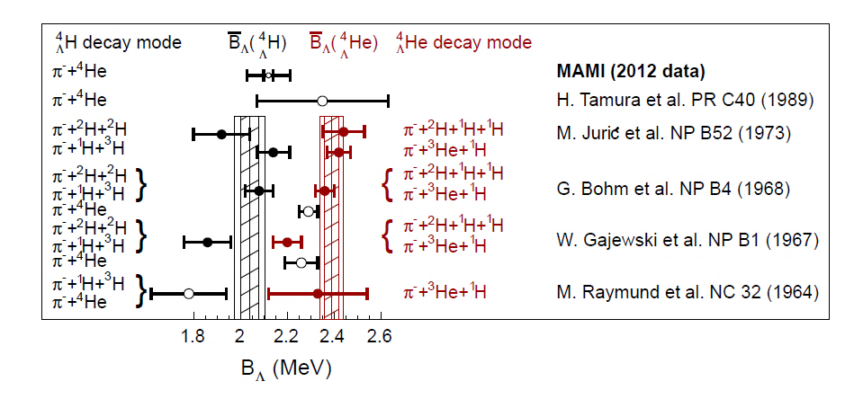
World data on A = 4 system
MAMI 2012 experiment Λ binding energy of _{Λ}⁴H:
B_{Λ} ~ 2.12 ± 0.01 (stat.) ± 0.09 (syst.) MeV
A. Esser et al. (A1 Collaboration), PRL 114, 232501 (2015)

Slide 20
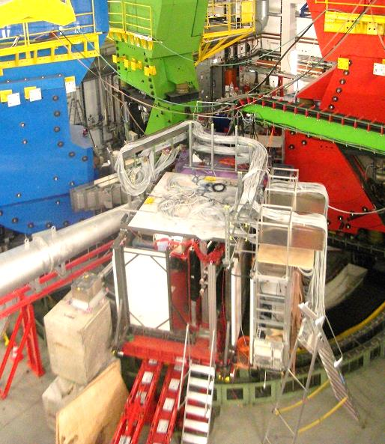
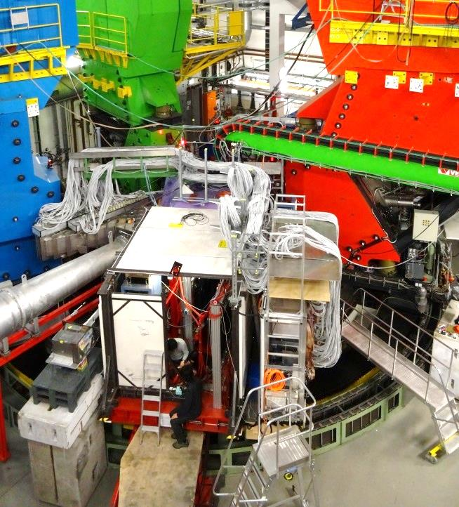
Continuation of experiment in 2o14
2o12
2o14
improved background
&
systematics
better pion rejection by improved aerogel
suppression of background by improved shielding
suppression of background by trigger upgrade in SpekA & C
suppression of background by beam-line upgrade
dedicated collimator for decay region
better control of magnet field variations
full overlap of SpekA and SpekC momentum acceptances

Slide 21
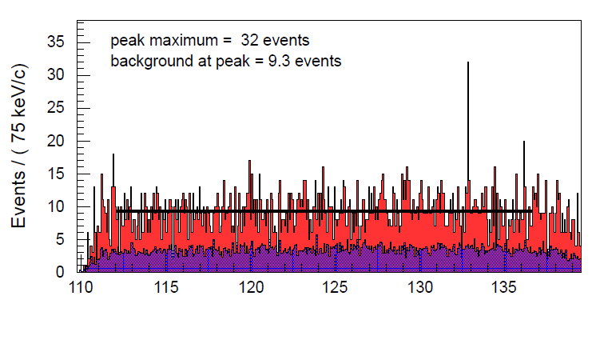
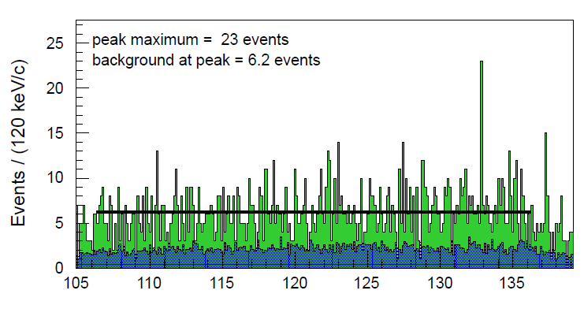
Simultaneous observation in two spectrometers
⁴_{Λ}H
^{SpekA}
preliminary
SpekA → B_{Λ}(⁴_{Λ}H) = 2.16 MeV
⁴_{Λ}H
^{SpekC}
preliminary
SpekC → B_{Λ}(⁴_{Λ}H) = 2.17 MeV

Slide 22
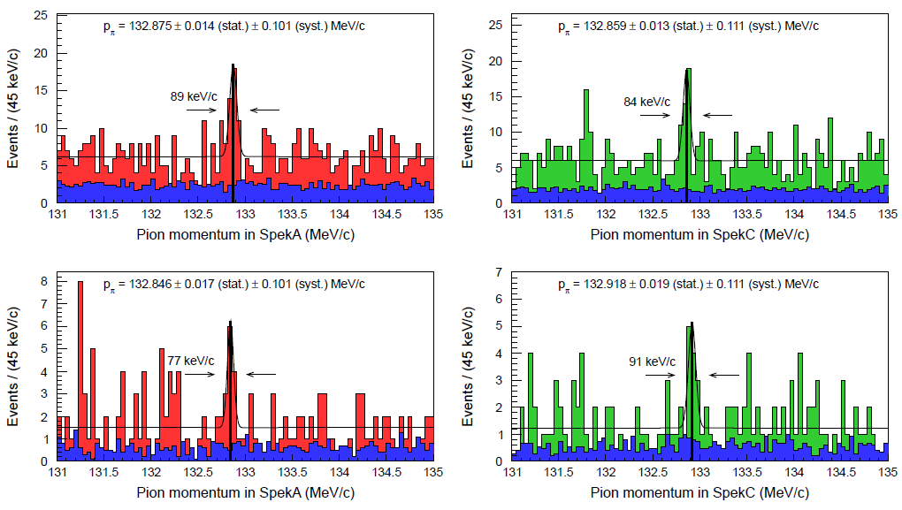
Systematic studies of the decay-pion line
consistent result for B_{Λ}(⁴_{Λ}H) from MAMI 2012 and MAMI 2014 (prelim.)
independent measurement in two spectr., two targets, two beam-times

Slide 23
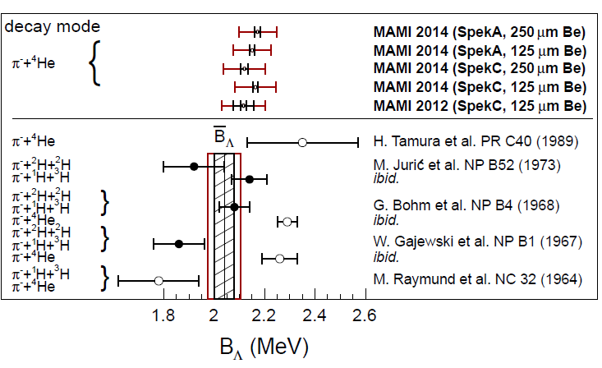
World data on ⁴_{Λ}H mass
outer error bars correlated from calibration
MAMI
emulsion
B_{Λ}(⁴_{Λ}H) (stat.) (syst.)
emulsion: 2.04 ± 0.04 ± 0.05 MeV (other syst. errors?)
MAMI 2012: 2.12 ± 0.01 ± 0.08 ± 0.03 MeV (Esser, PRL 114 (2015))
MAMI 2012: 2.12 ± 0.01 ± 0.08 ± 0.03 MeV (recalibration, JPS Conf.)
MAMI 2014: 2.16 ± 0.01 ± 0.08 MeV (preliminary, to be subm.)

Slide 24
4. combine information from steps 1. – 3.

Slide 25
Current knowledge on CSB in the A = 4 system
ΔB_{Λ} (0+ gr. st.) = 350 ± 50 keV (emulsion data)
ΔB_{Λ} (0+ gr. st.) = 233 ± 90 keV (MAMI + emulsion data)
ΔB_{Λ} (1+ ex. st.) = 280 ± 50 keV (emulsion + old γ-ray data)
ΔB_{Λ} (1+ ex. st.) = 34 ± 54 keV (emulsion + new γ-ray data)
ΔB_{Λ} (1+ ex. st.) = −83 ± 90 keV (MAMI + emulsion + new γ-ray data)
for the first time a positive CSB for the ground state and a negative CSB for the excited state can be extracted from (MAMI) data
cf. latest chiral effective models with central force ΛN-ΣN coupling based on charge symmetric Bonn-Jülich YN potential
D. Gazda et al.: Ab-initio calculations of charge symmetry breaking in the A=4 hypernuclei. arXiv:1512.01049

Slide 26
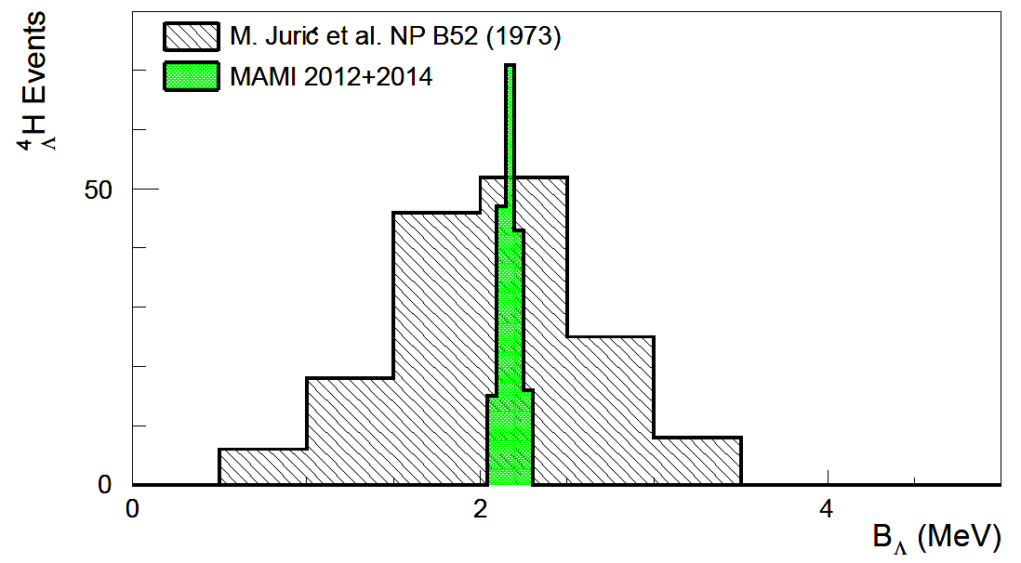
New precision era in hypernuclear physics
High-resolution pion spectroscopy has replaced emulsion technique
High-purity germanium spectroscopy has replaced NaJ detectors
MAMI
emulsion
Charge symmetry breaking (CSB) has been revisited
CSB appears to be considerably stronger in hyper- than in ordinary nuclei
CSB in A = 4 system is strongly spin-dependent …
...and possible changing sign between ground and excited states

Slide 27
The A = 4 CSB puzzle
Calculation | Interaction | B_{Λ}(⁴_{Λ}H_{gs}) | B_{Λ}(⁴_{Λ}He_{gs}) | ΔB_{Λ} (⁴_{Λ}He-⁴_{Λ}H)
A. Nogga, H. Kamada and W. Gloeckle, PRL 88, 172501 (2002) | SC97e | 1.47 | 1.54 | 0.07
 | SC89 | 2.14 | 1.80 | 0.34
H. Nemura. Y. Akaishi and Y. Suzuki, PRL 89, 142504 (2002) | SC97d | 1.67 | 1.62 | -0.05
 | SC97e | 2.06 | 2.02 | -0.04
 | SC97f | 2.16 | 2.11 | -0.05
 | SC89 | 2.55 | 2.47 | -0.08
E. Hiyama, M. Kamimura, T. Motoba, T. Yamada and Y. Yama PRC 65, 011301 (R) (2001) | AV8 | 2.33 | 2.28 | -0.05
world data average |  | 2.04±0.04 | 2.39±0.03 | 0.35±0.06
calculations have been made since decades but fail to explain large ΔB_{Λ}
coupled channel calculation using interaction SC89 fails to bind excited state

Slide 28
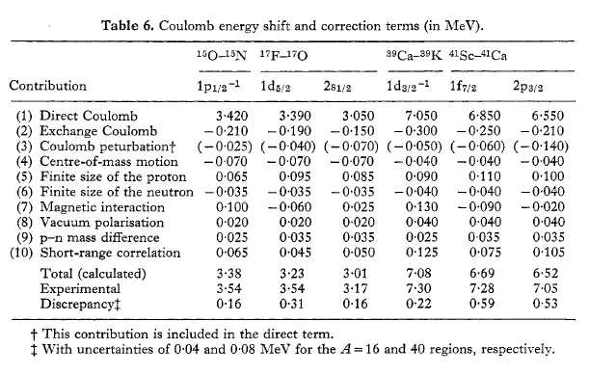
Coulomb shift in mirror nuclei

Slide 29
Possible origins of CSB ΛN interaction
π
π
Σ
N Λ N
ΛΣ mass difference ~ 80 MeV < NΔ mass difference ~ 300 MeV
M(Σ⁺) < Μ(Σ⁰) < Μ(Σ⁻), ΔΜ(Σ⁻−Σ⁺)∼8MeV
[Nogga, Kamada, Glockle, PRL 88 (2002) 172501.]
Phenomenological potential :
A.R.Bodmer & Q.N.Usmani, PRC 31(1985)1400.

Slide 30
⁷_{Λ}He spectrum from Jlab E05-115

