Slide 1
Recent ALICE results
A selections of recent results with discussion
Marco van Leeuwen
Nikhef, Utrecht University
for the ALICE collaboration

Slide 2
Time evolution in a heavy ion collision
Quark Gluon Plasma/Liquid
Strong evidence for (near) thermal equilibrium
Pre-equilibrium
Freeze-out (post-equilibrium)
Expectation: main difference between heavy ion collisions and pp, p+Pb volume + density ⇒ rescattering during evolution ⇒ approach to thermal equilibrium

Slide 3
Heavy ion collisions
Heavy-ion collisions produce ‘quasi-thermal’ QCD matter
Dominated by soft partons p ~ T ~ 100-300 MeV
‘Bulk observables’
Study hadrons produced by the QGP
Typically p_{T} < 1-2 GeV
Physical model/picture: hydrodynamical flow, thermodynamics
‘Hard probes’
Hard-scatterings produce ‘quasi-free’ partons
⇒ Probe medium through energy loss
p_{T} > 5 GeV
Physical model/picture: hard scattering+parton energy loss
Two basic approaches to learn about the QGP
Bulk observables
Hard probes

Slide 4
Intro: collision systems
Canonical thinking
‘Recent’ developments
pp
Observation:
Flow-like long range correlations
Hard scattering +
‘Underlying event’
p
p
Suggested mechanisms:
Multi-parton interactions
Color reconnection
p+Pb
Pb
Observation:
Flow-like long range correlations
p
pp-like plus Cold Nuclear Matter effects
Multi-parton interactions
Color reconnection
Color Glass Condensate
Pb+Pb
Pb
Bulk dynamics described by hydrodynamics
+ Hard Probes
Pb
Physical picture holds
But some features also seen in high-multiplicity p+Pb and pp?

Slide 5
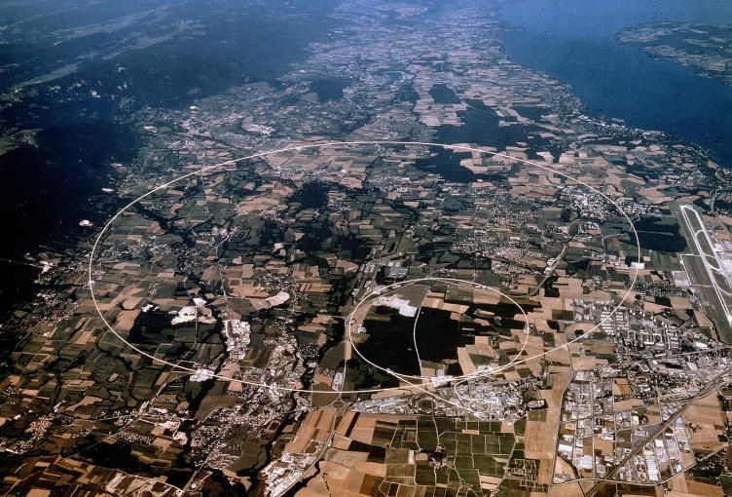
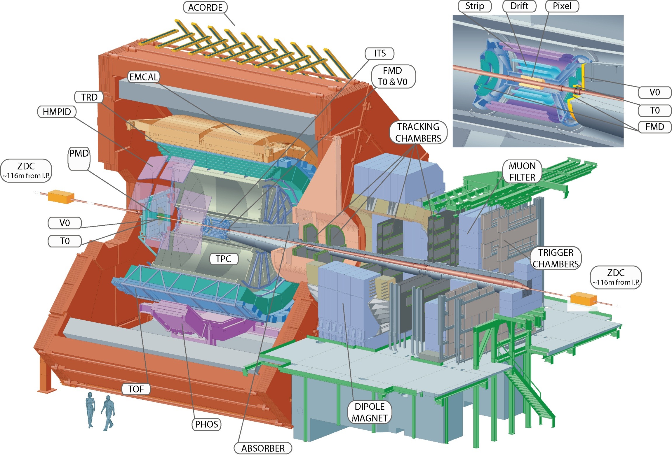
Intro: LHC and ALICE
LHC, Geneva
ALICE: general purpose detector
2010-2013: Run 1
pp @ 7, 8 TeV
p+Pb @ 5.02 TeV
Pb+Pb @ 2.76 TeV
Focus on
Tracking in high-multiplicity events
Particle identification
Forward muon detector for quarkonia
Run 2 started 2015
pp @ 13 TeV
Pb+Pb @ 5.02 TeV
p+Pb @ 8 TeV in 2016 or 2018

Slide 6
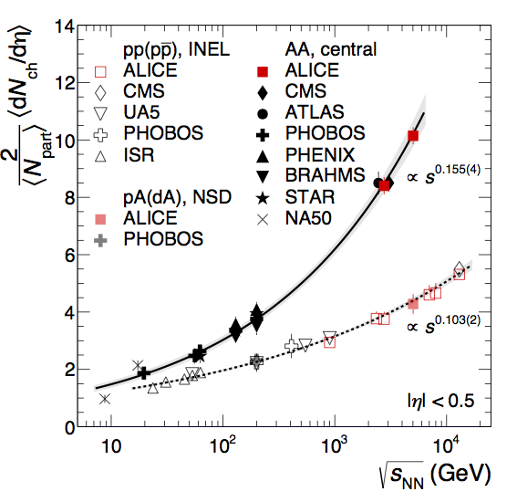
Multiplicity dNch/dη in pp, Pb+Pb
PLB 753, 319
First results from Run-2: multiplicity at new energies
Trend continues to rise faster for AA than pp: conversion of energy to particles in AA is more efficient (larger ‘stopping’)

Slide 7
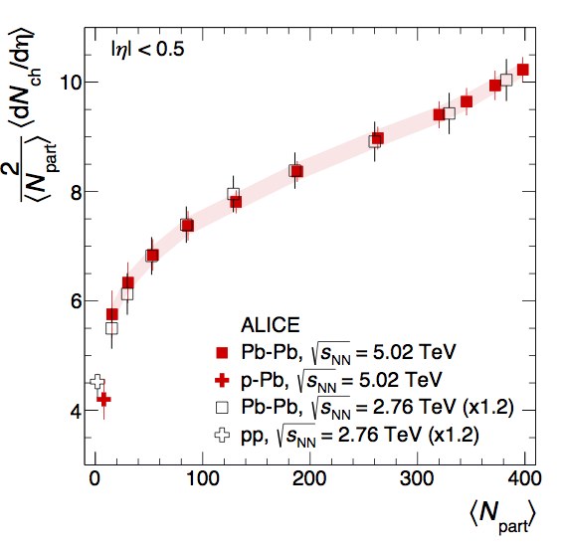
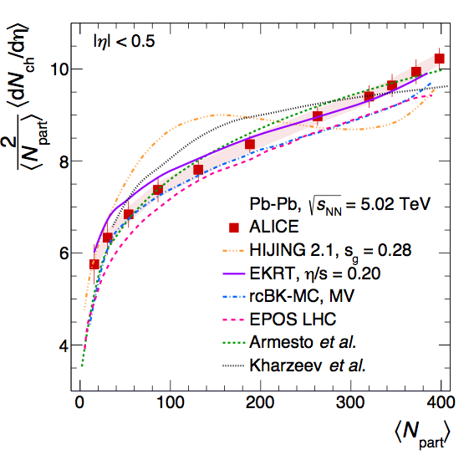
Multiplicity vs centrality PbPb
arXiv:1509.07299
Centrality dependence
very similar at 5.02 and 2.76 TeV
(overall factor 1.2)
Model comparisons:
Soft physics models agree
Hijing: some deviations
Driven by geometry
No change in contribution hard vs soft processes

Slide 8
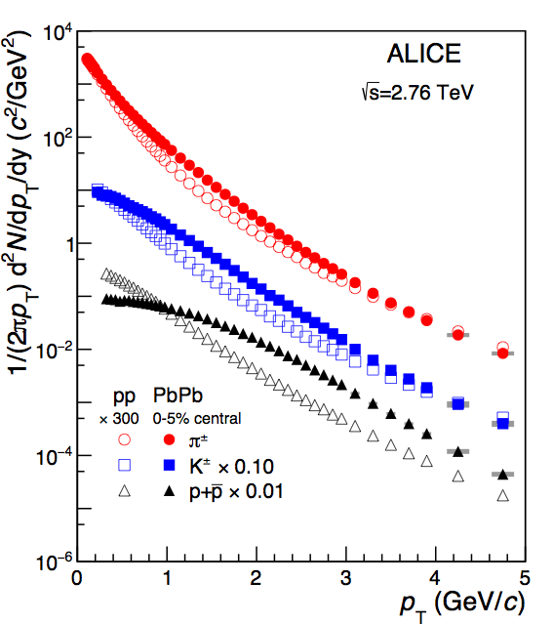
Radial and elliptic flow
ALICE, PLB 736, 196
Spectra change from pp to Pb+Pb:
Increase in mean pT
Larger effect for larger mass
First indication of collective behaviour Pressure leads to radial flow
Same Lorentz boost (β) gives larger momentum for heavier particles
(m_{p} > m_{K} > m_{π})

Slide 9
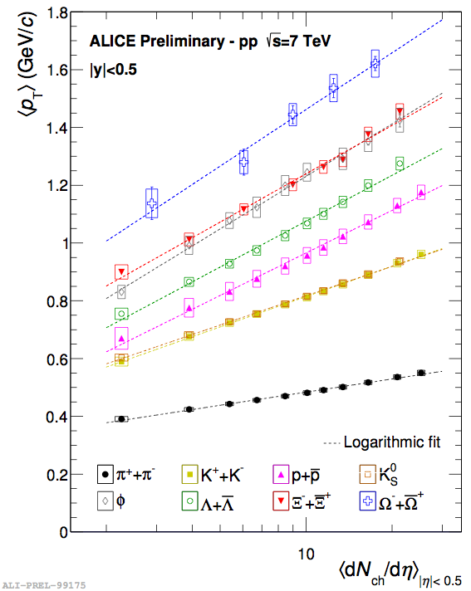
Mean pT overview pp
QM15 talk, L Bianchi
Mean pT in pp collisions also increases with multiplicity and particle mass
Multiple (initial state) interactions
or proto-flow?
Or are they the same?
Logarithmic fit ‘to guide the eye’:

Slide 10
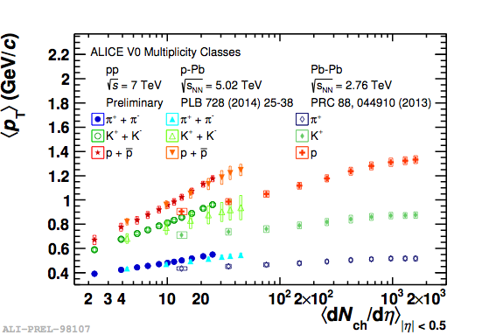
Mean pT overview pp, p+Pb, Pb+Pb
QM15 talk, A Ortiz
Increasing mean pT trend continues in p+Pb
Raises question: is there flow, collective behaviour in pp, p+Pb?
And how is it generated?

Slide 11
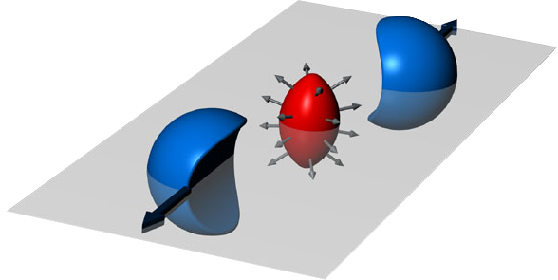
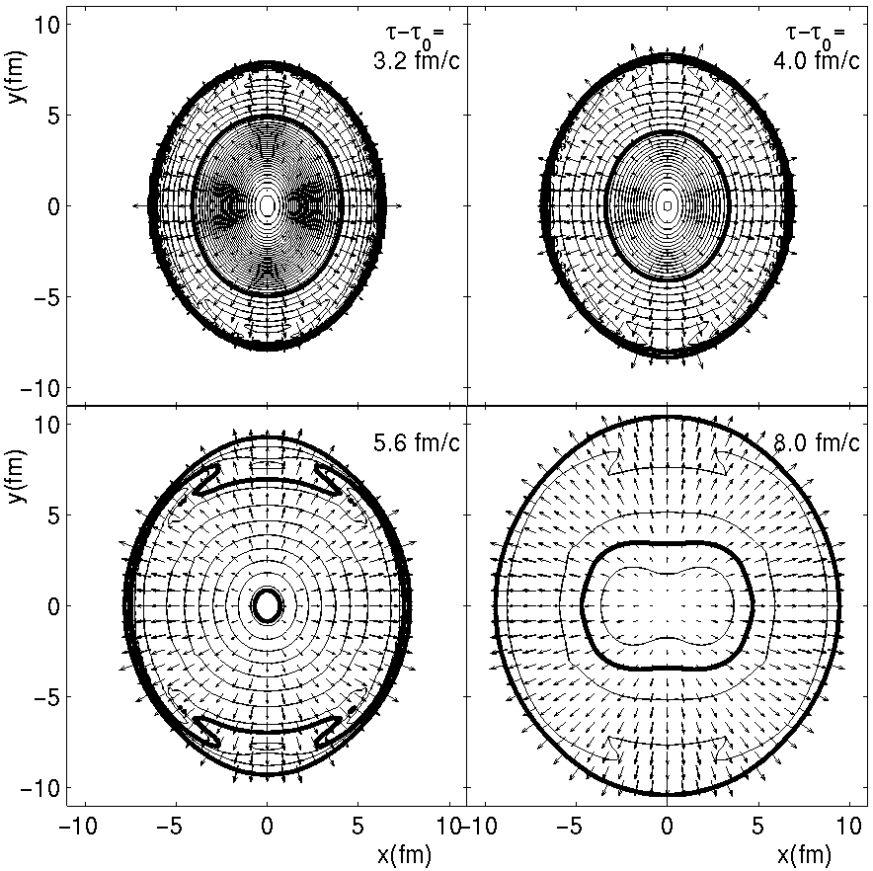
Elliptic flow
Hydrodynamical calculation
Reaction plane
Elliptic flow:
Yield modulation in-out reaction plane
ϕ
reaction
plane
Anisotropy reduces during evolution v₂ more sensitive to early times
b

Slide 12
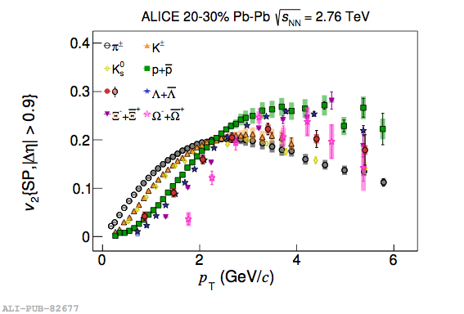
Elliptic flow
JHEP106, 190
Mass-dependence of v₂ measures flow velocity
Measurements include 8 particle species
Tests hydrodynamical description, freeze-out models

Slide 13
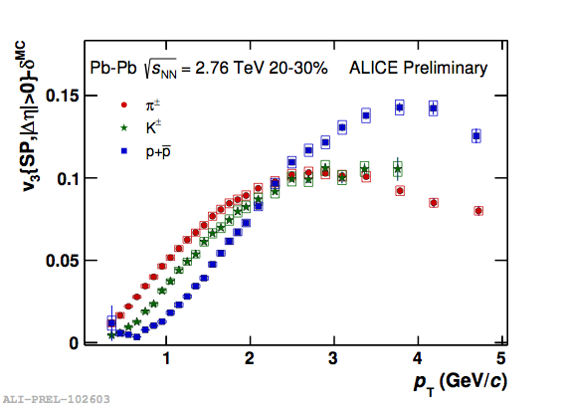
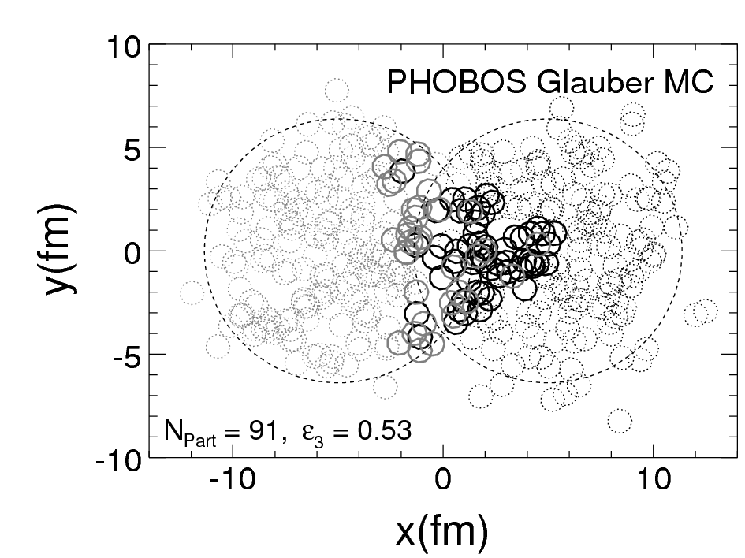
Higher harmonics
N. Mohammadi, QM2015
Alver and Roland, PRC81, 054905
Odd harmonics driven by initial state fluctuations
3rd harmonic ‘triangularity’ v₃ is large
(in central events)
Use multiple harmonics to constrain medium properties (viscosity) and initial state
Mass ordering also seen for v₃
indicates collective flow

Slide 14
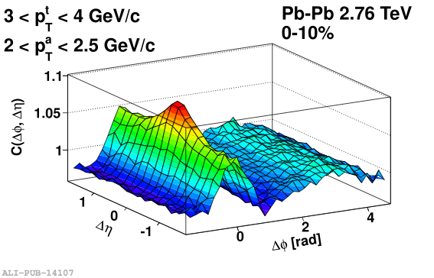
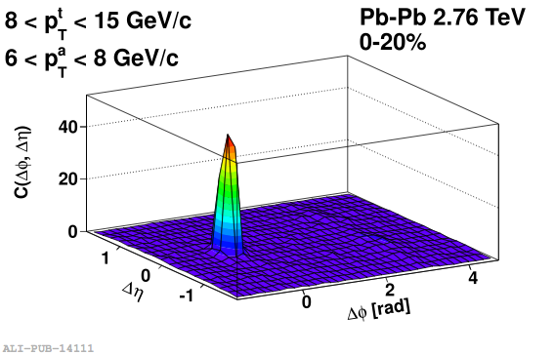
2-particle correlations
trigger
Near side
associated
PLB 708, 249
Intermediate pT
High pT
Pb+Pb
Near-side peak: jets (+decays): larger at high pT
Flow v2, v3: long range correlation (early times+ long expansion)
Near side long range correlation: flow (v2, v3)
Most prominent at lower pT
Away-side: recoil jet also gives a long-range correlation (η1 ≠ η2)

Slide 15
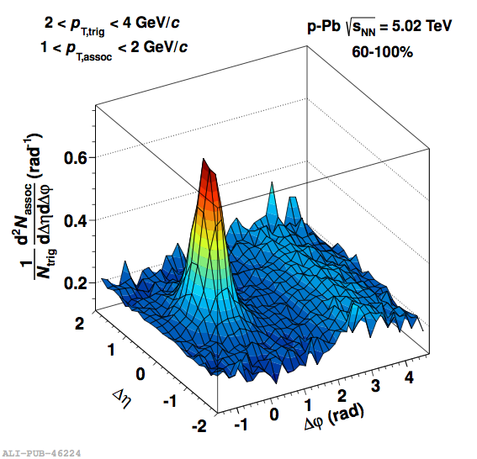
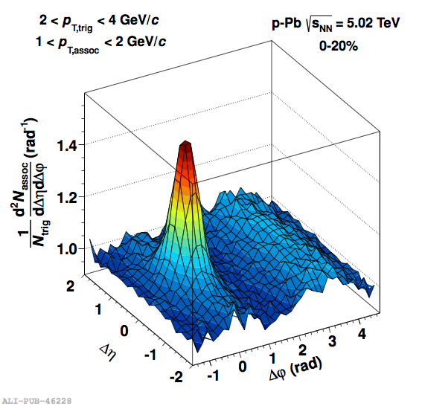
2-particle correlations in p+Pb
Pb+Pb
ALICE, PLB 719, 29
Peripheral p+Pb
Central p+Pb
Near-side long range correlation in central p+Pb
Must be early-time; looks like elliptic flow

Slide 16
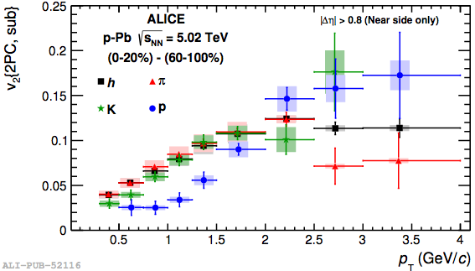
v2 from di-hadron correlations in p+Pb
PLB 726,164
Similar ‘mass ordering’ observed for v2 from two-particle correlations in p+Pb
Is this also pressure-driven?

Slide 17
Higher pT: probes of the QGP
‘Hard probes’
Hard-scatterings produce ‘quasi-free’ partons
⇒ Probe medium through energy loss
p_{T} > 5 GeV

Slide 18
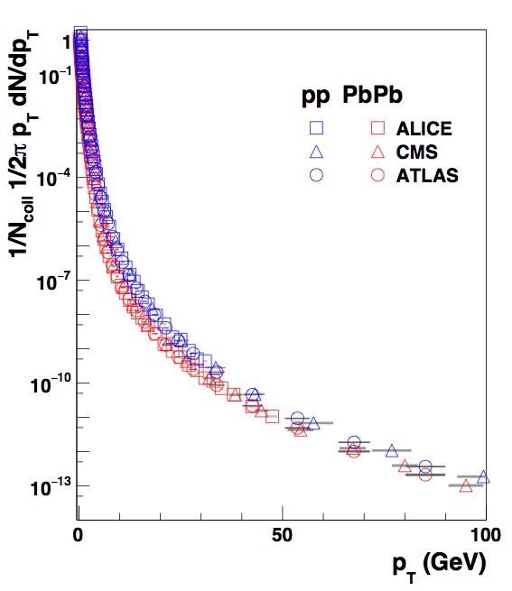
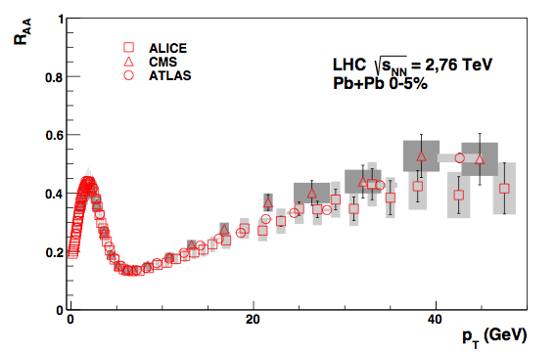
Nuclear modification: Pb+Pb
ALICE, PLB720, 52
CMS, EPJC, 72, 1945
ATLAS, arXiv:1504.04337
Charged particle pT spectra
Nuclear modification factor
Low pT: soft production,
Npart scaling
Energy loss
Ncoll: number of binary nucleon-nucleon collisions
R_{AA} < 1
Pb+Pb: clear suppression (RAA < 1): parton energy loss

Slide 19
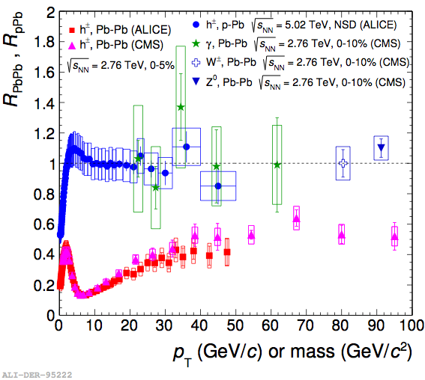
RAA overview
ALICE: PLB 720, 52; EPJ. C74, 3054
CMS: http://arxiv.org/abs/1410.4825 (Z0) EPJ. C72, 1945; PLB 710, 256; PLB 715, 66
RAA < 1 for hadrons:
Parton energy loss
Hadrons: energy loss
R_{AA} < 1
γ: no interactions
R_{AA} = 1
RAA ≈ 1 for 𝛾, Z, W:
No energy loss for electromagnetic and weak probes
p+Pb: RpPb ≈ 1 at high pT
No/very small ‘cold nuclear matter’ effects on high-pT probes

Slide 20
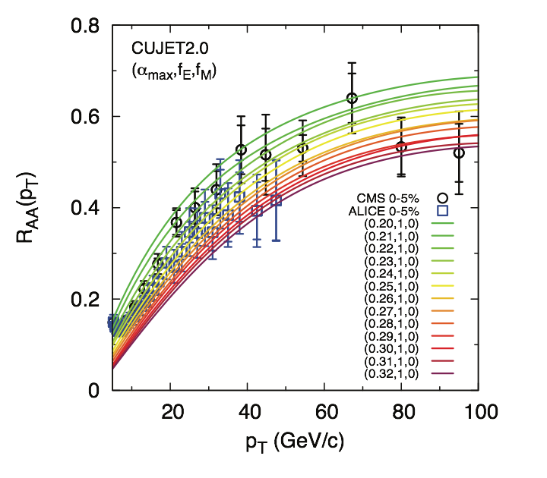
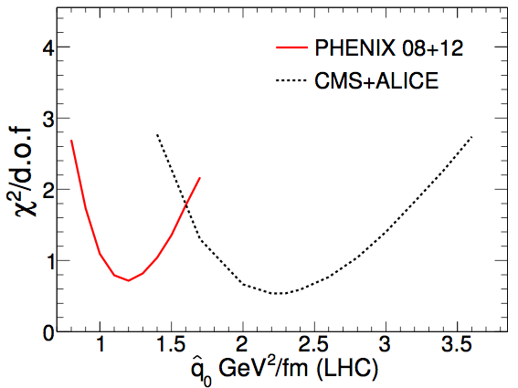
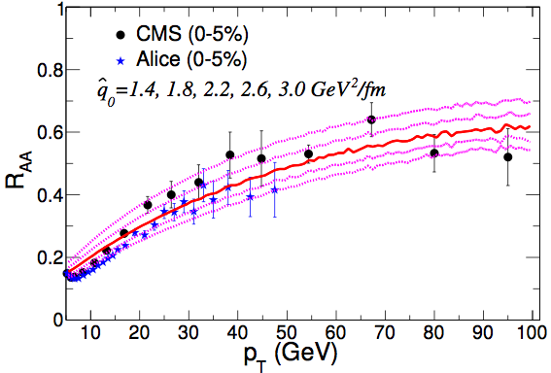
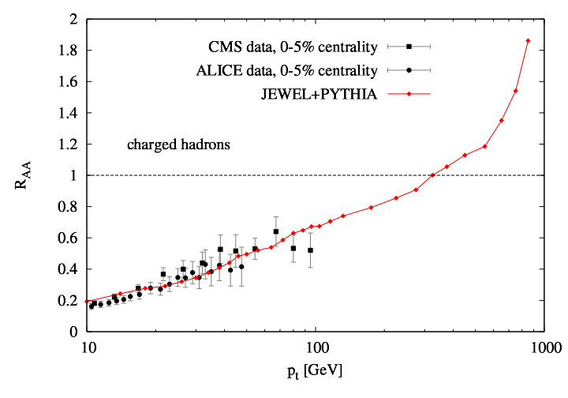
RAA vs models
‘Analytical models’
Burke et al, JET Collaboration, arXiv:1312.5003
HT-BW
Several formalisms/approximations for parton energy loss exist
Allows to determine medium properties, transport coefficient
Monte Carlo event generators
JEWEL:
MC event generator with parton energy loss
Based on analytical formalism
1 parameter: medium density tuned to data
Zapp, JHEP 1303, 80

Slide 21
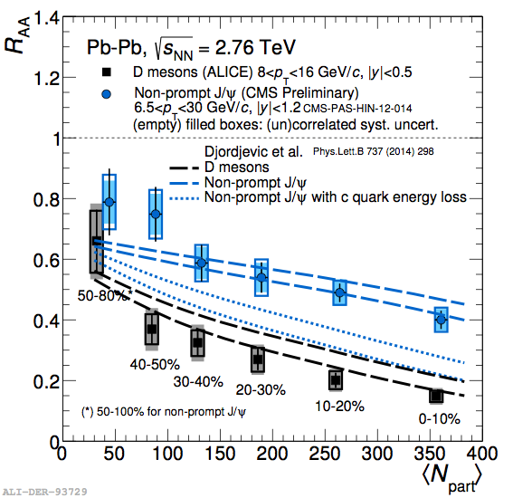
Heavy flavour RAA; mass dependence
ALICE, JHEP11, 205
Compare
charm: D-mesons
beauty: non-prompt J/Ψ
Larger suppression for charm than for beauty
Agrees with expected
‘dead-cone effect’
energy loss reduced when v < c
Indicates radiative energy loss: induced gluon bremmsstrahlung

Slide 22
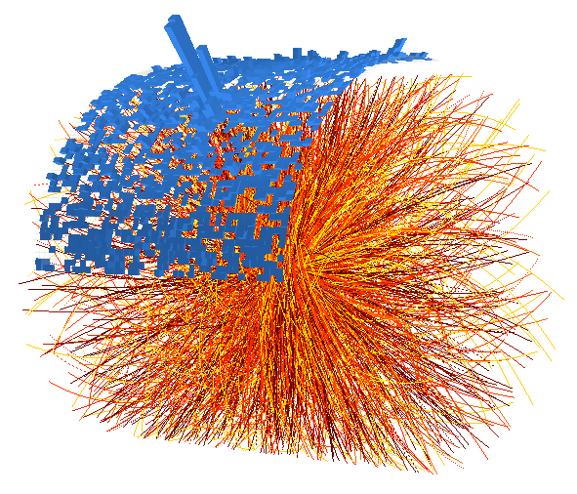
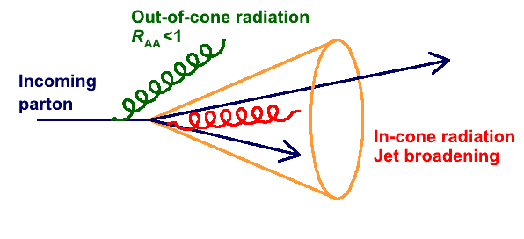
Jets: reconstructing the partons
Goal: measure energy loss distributions
Longitudinal (fragmentation function)
Transverse (jet profiles
ϕ
Qualitatively two scenarios:
In-cone radiation: R_{AA} = 1, change of fragmentation
Out-of-cone radiation: R_{AA} < 1
η

Slide 23
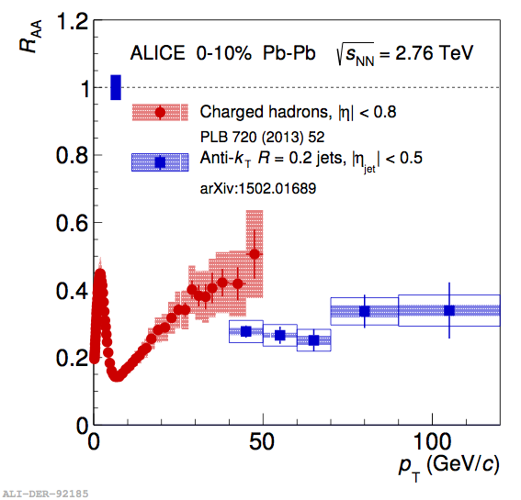
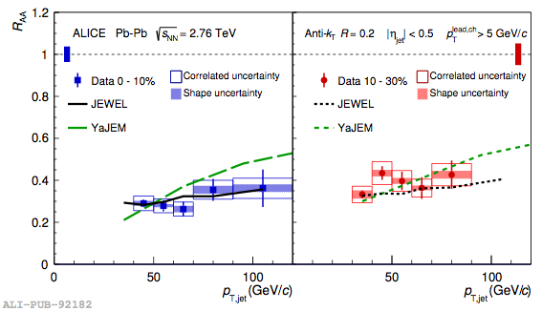
Jet RAA
ALICE, PLB 746, 1
Jet suppression (R = 0.2) similar to charged particle suppression
Suppression/out-of-cone radiation
reasonably well described by energy-loss Monte Carlo models
Large effect of out-of-cone radiation (R=0.2)

Slide 24
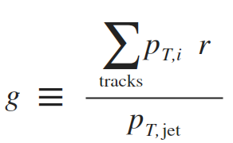
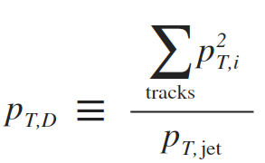
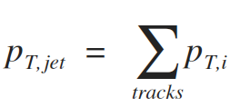
Jet shapes
Measure particle distribution inside jets on a jet-by-jet basis
Radial moment (girth)
pT-dispersion
pT-weighted jet width
(Normalised) spread of pT
Anti-correlated with multiplicity
Large range of jet shape variables can be explored
So far, focused on two: 1 transverse, 1 longitudinal

Slide 25
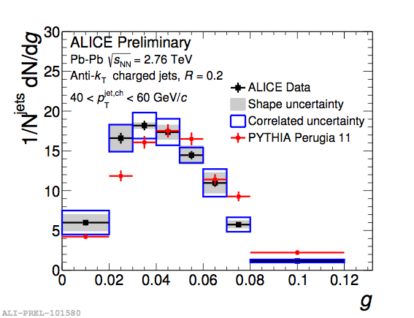
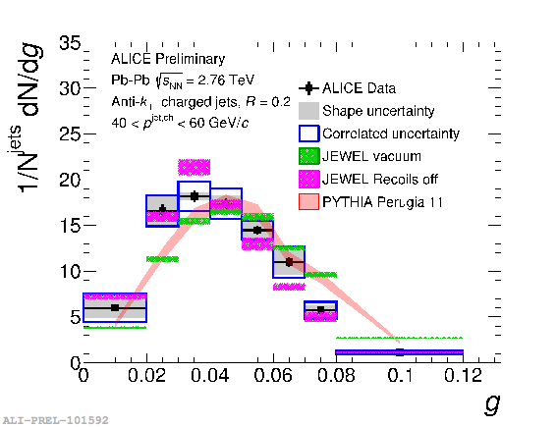
Jet shapes: radial moment
QM talk, Cunqueiro
Radial moment smaller in Pb+Pb
than pp (PYTHIA)
JEWEL model shows similar trend
Jets in medium narrower than in vacuum

Slide 26
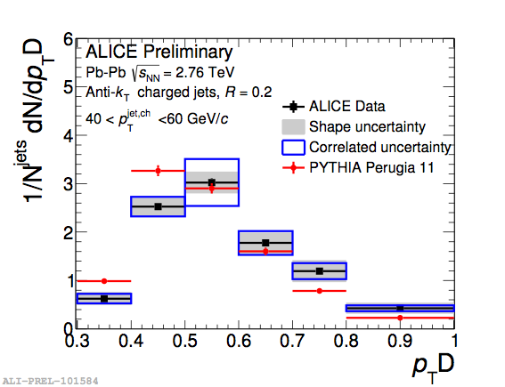
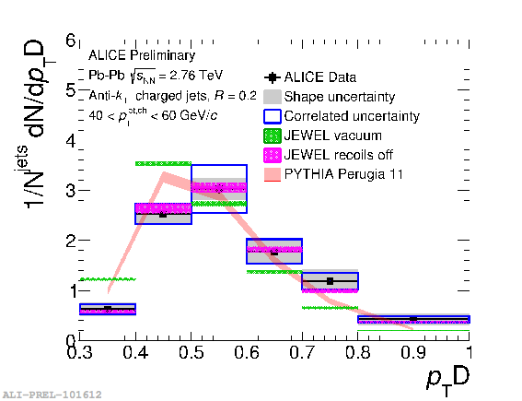
Jet shapes: pT,D
QM talk, Cunqueiro
pT,D slightly larger in Pb+Pb
than pp (PYTHIA)
JEWEL model shows similar trend
Larger pT,D: smaller multiplicity and/or harder fragment distribution

Slide 27
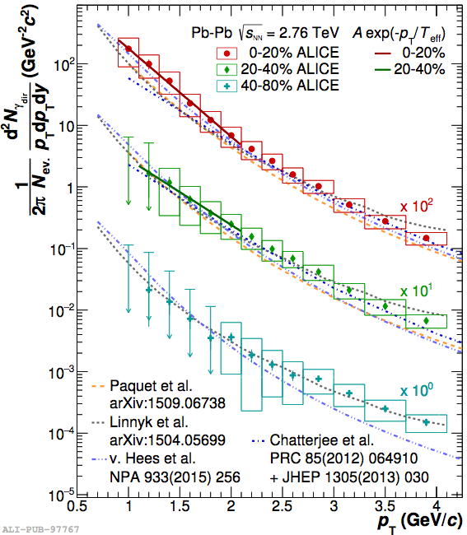
Direct photons
arXiv:1509.07324
Main expected sources:
High pT: hard scattering; quark-gluon Compton process
Low pT: thermal radiation
Excess at low pT in central collisions
indicates thermal photon production

Slide 28
Summary
Soft particle production
Flow: sensitive to initial state geometry and medium properties
Exploring pp, p+Pb as a function of multiplicity
Flow-like effects observed
Thermalisation in small systems? What is the mechanism?
High pT: Hard probes
Large nuclear modification: parton energy loss
Exploring jets, jet shapes to map out radiation, validate understanding of dynamics
Many topics not covered due to time:
J/Ψ production (quark coalescence), femtoscopy: map source size and final state interactions, correlation measurements (final state interactions), heavy nuclei production, etc…..

Slide 29
Thank you for your attention
See also the other ALICE contributions:
Neutral mesons in pp and PbPb — L Leardini
Open heavy flavour — D Moreira de Godoy
Electron identification for low mass di-leptons (Poster) — A Dashi
b-tagging performance (Poster) —L Kramarik

Slide 30
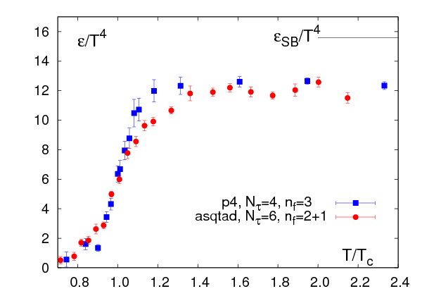
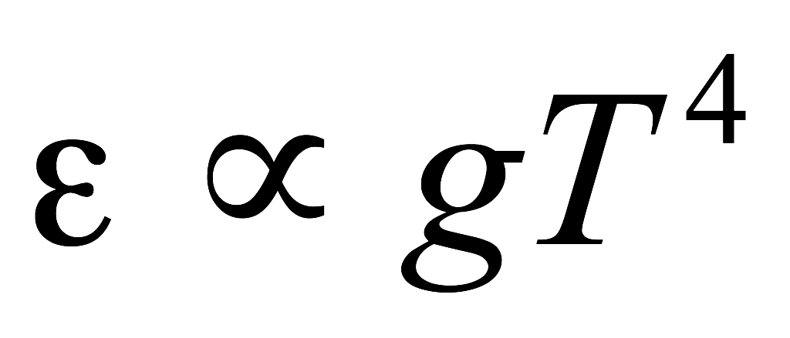
Introduction: Heavy Ion Physics
Phase diagram
Energy density vs temperature (lattice)
Quark Gluon Plasma
(Quasi-)free quarks and gluons
Temperature
Critical
Point
Early universe
Bernard et al, hep-lat/0610017
Confined hadronic matter
Elementary collisions
(accelerator physics)
High-density phases?
Neutron stars
Nuclear matter
T_{c} ~ 170 -190 MeV
ε_{c} ~ 1 GeV/fm³
Study the properties of many-body QCD systems
Properties of equilibrium matter: equation of state, transport coefficient
Dynamics: hadronisation, interactions of partons with the medium

Slide 31
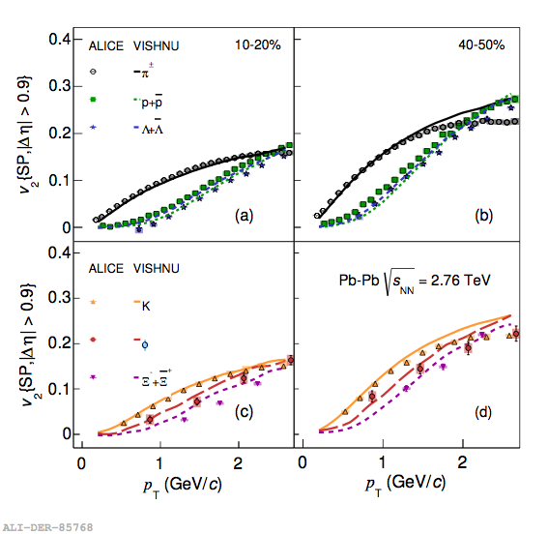
Elliptic flow vs hydrodynamical model
ALICE, JHEP106, 190
VISHNU: Song and Heinz, PLB 658, 279
Good agreement between hydrodynamical calculation and measurements

Slide 32
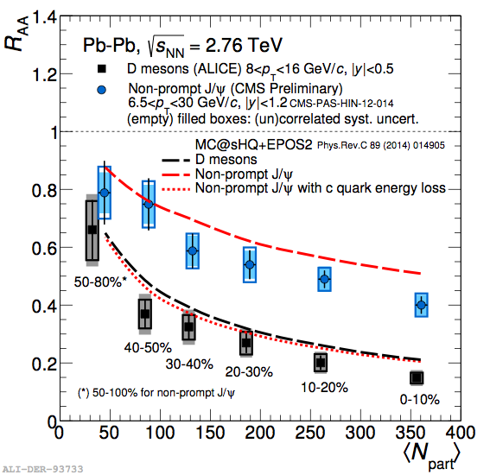
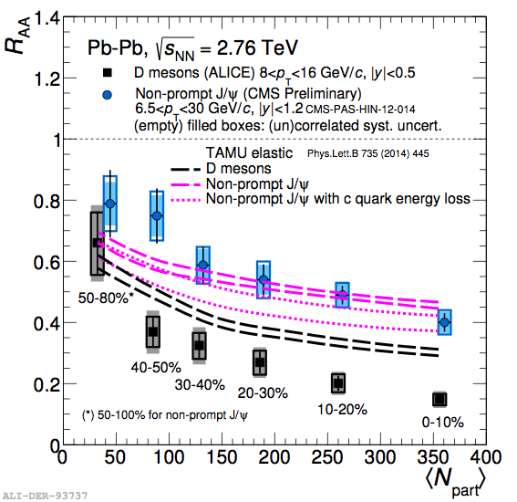
Heavy flavour RAA: other models
Heavy quark transport MC
TAMU: elastic scattering
Difference beauty vs charm consistent with radiative energy loss
Difference beauty vs charm smaller in elastic model than in data

Slide 33
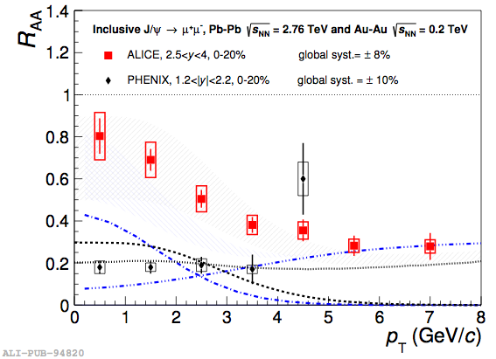
J/Ψ production in Pb+Pb
PHENIX, arXiv:1103.6269
ALICE, arXiv:1506.08804
Transport models: arXiv:1102.2194, arXiv:1401.5845
Less suppression at low pT
cc recombination
Large suppression at high pT
energy loss + quarkonia melting

Slide 34
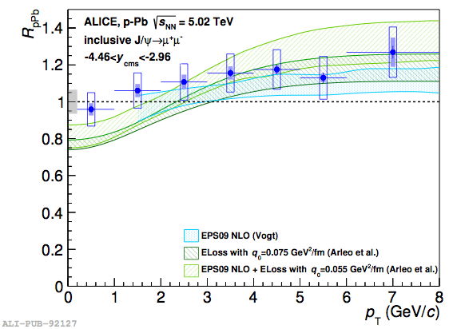
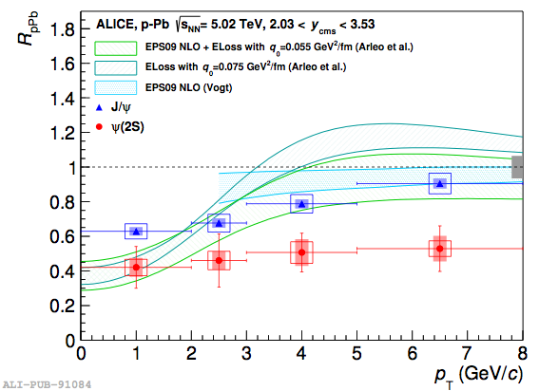
J/Ψ production in p+Pb
ALICE, arXiv:1308.6726
Backward rapidity -4.46 < y < -2.96
Forward rapidity 2.03 < y < 3.53
RpPb close to 1; small enhancement?
Significant suppression
Compatible with several mechanisms
Ψ’ suppression unexpectedly large

Slide 35
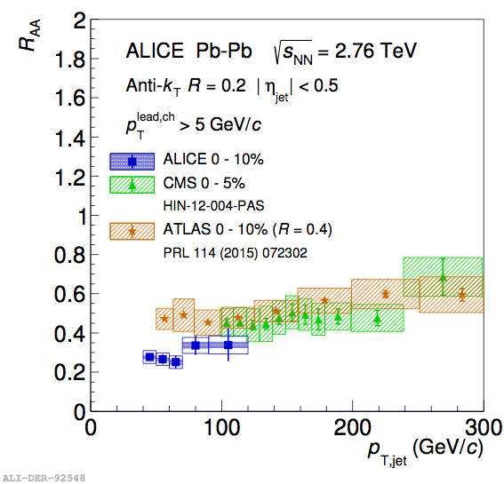
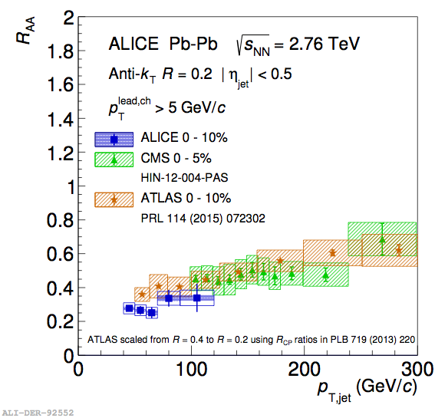
Jet RAA comparison
Good agreement between the experiments

Slide 36
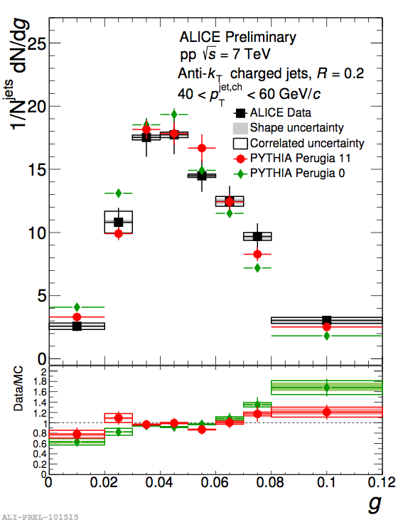
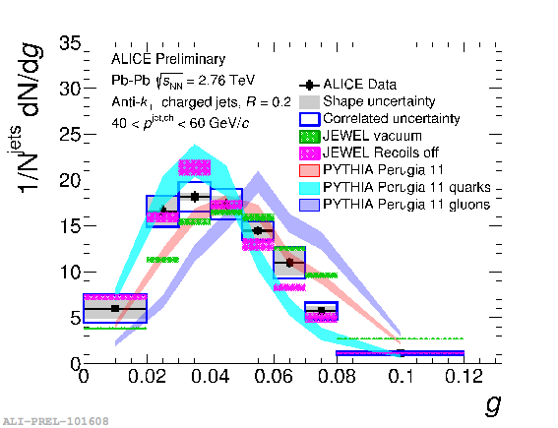
Radial moment pp + quark/gluon jets

Slide 37
pT,D in pp + quark/gluon jets

Slide 38
Medium-induced radiation
radiated
gluon
propagating
parton
Key parameter: Transport coefficient
Mean transverse kick per unit path length
Depends on density ρ through mean free path λ

Slide 39
Comparing several models
RHIC:
(T=370 MeV)
LHC:
Burke et al, JET Collaboration, arXiv:1312.5003
(T=470 MeV)
Expect factor 2.2 from multiplicity + nuclear size
values from different models agree
larger at RHIC than LHC

Slide 40
Relation transport coefficient and viscosity
Elliptic flow
Transport coefficient from RAA
H. Song et al, PRC83, 054912
(Scaled) viscosity slightly larger at LHC
Scaled transport coefficient slightly smaller at LHC
Increase of η/s and decrease of q/T³ with collision energy
are probably due to a common origin, e.g. running 𝛼S
Results agree reasonably well with expectation:

