Slide 1

Precision mass measurements of
neutron-rich cadmium for r-process studies
Dinko Atanasov
Max-Planck Institute for Nuclear Physics
54th International Winter Meeting on Nuclear Physics,
25-29 January 2016, Bormio, Italy

Slide 2
Outline
Nuclear astrophysics – a place to begin…
Production of exotic elements – ISOL type facility
The mass spectrometer ISOLTRAP
Results on ¹²⁹⁻¹³¹Cd
Summary and Outlook

Slide 3
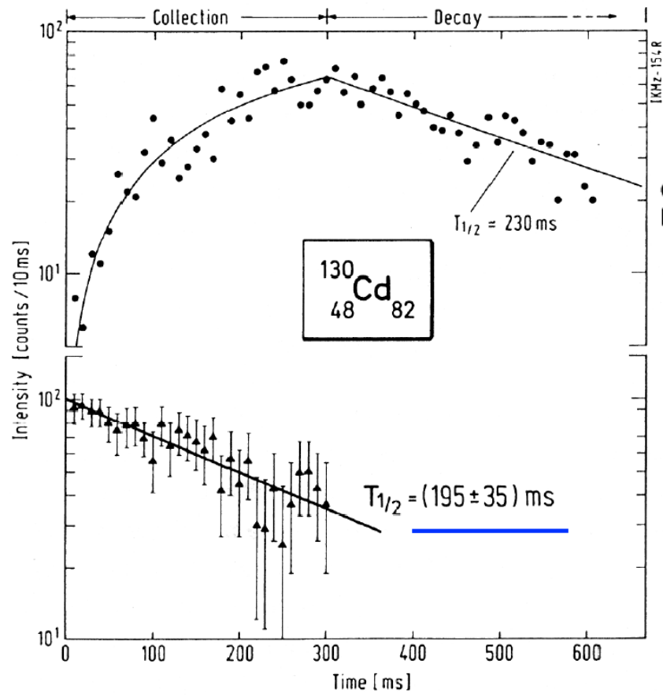
Previous investigations in this region
● 1986 - ISOLDE – Half-Life
measurements
K. –L. Kratz et al., ZPhys (1986)

Slide 4
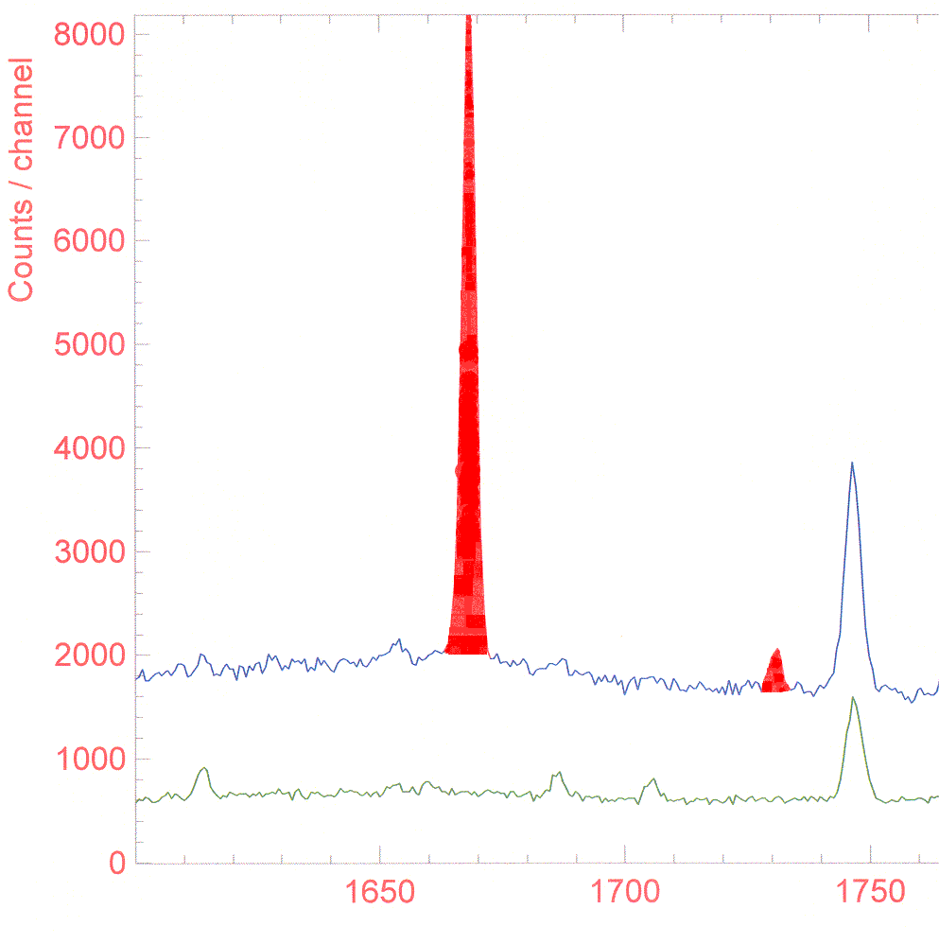
Previous investigations in this region
● 1986 - ISOLDE – Half-Life
measurements
● 2003 - ISOLDE – Beta and
Gamma Spectroscopy
Laser ON
Laser OFF
1669 keV
1735 keV
K. –L. Kratz et al., ZPhys (1986)
I. Dillmann et al., PRL (2003)

Slide 5
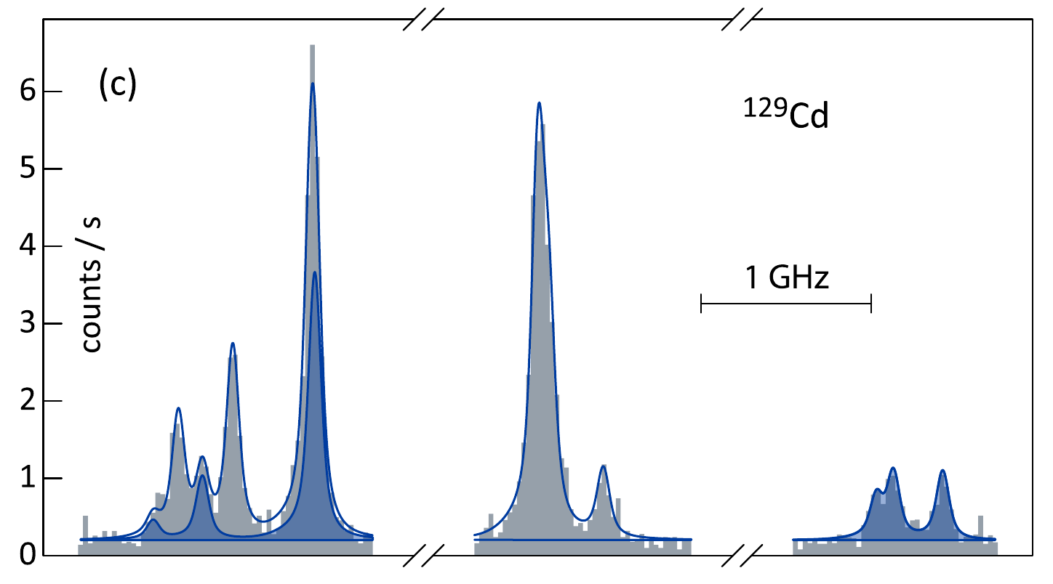
Previous investigations in this region
● 1986 - ISOLDE – Half-Life
measurements
● 2003 - ISOLDE – Beta and
Gamma Spectroscopy
Laser ON
● 2013 - ISOLDE – HFS from
Laser spectroscopy
Laser OFF
1669 keV
1735 keV
K. –L. Kratz et al., ZPhys (1986)
I. Dillmann et al., PRL (2003)
D. Yordanov et al., PRL (2013)

Slide 6
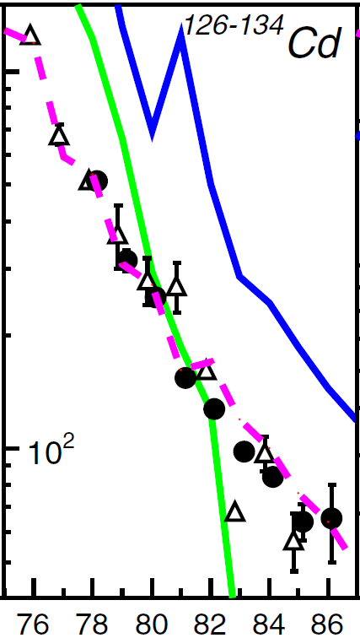
Previous investigations in this region
● 1986 - ISOLDE – Half-Life
measurements
● 2003 - ISOLDE – Beta and
Gamma Spectroscopy
Laser ON
● 2013 - ISOLDE – HFS from
Laser spectroscopy
Laser OFF
● 2015 - RIKEN – Half-Life
measurements
1669 keV
1735 keV
K. –L. Kratz et al., ZPhys (1986)
I. Dillmann et al., PRL (2003)
D. Yordanov et al., PRL (2013)
G. Lorusso et al., PRL (2015)

Slide 7
Elemental abundance in the Solar system
s-, r-, p-, rp-process
Interior of stars

Slide 8
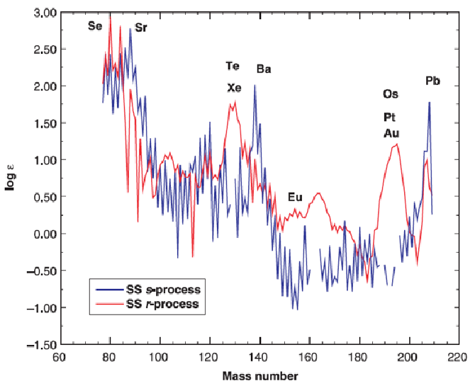
Solar system r-process residuals
s-, r-, p-, rp-process
Nuclear fusion
N =50
N =82
N =126
N =50
N =82
N =126
Sneden and Cowan 2003

Slide 9
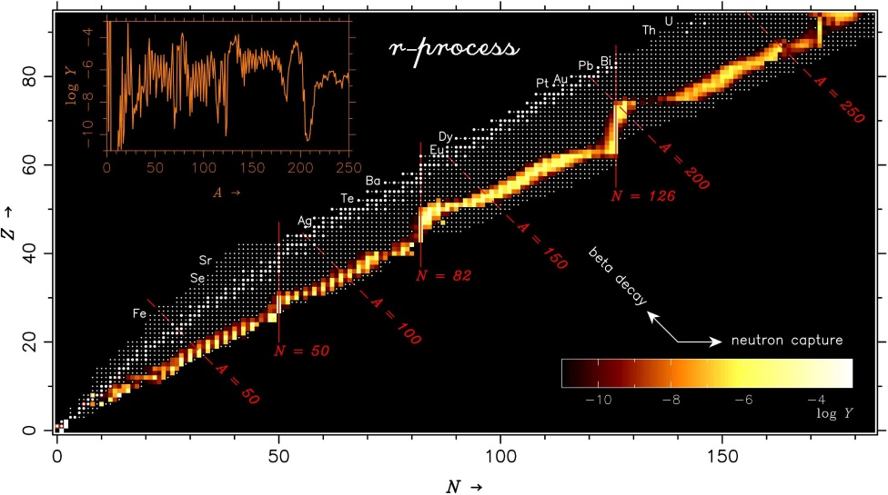
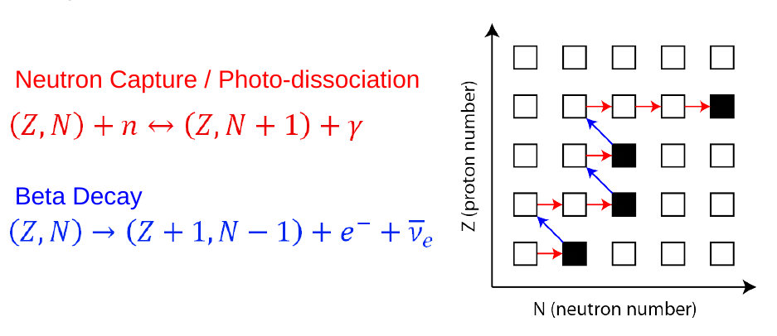
The r-process
S.Wanajo et al ApJ, 606, 1057-1069, 2004, M. Mumpower CETUP 2015

Slide 10
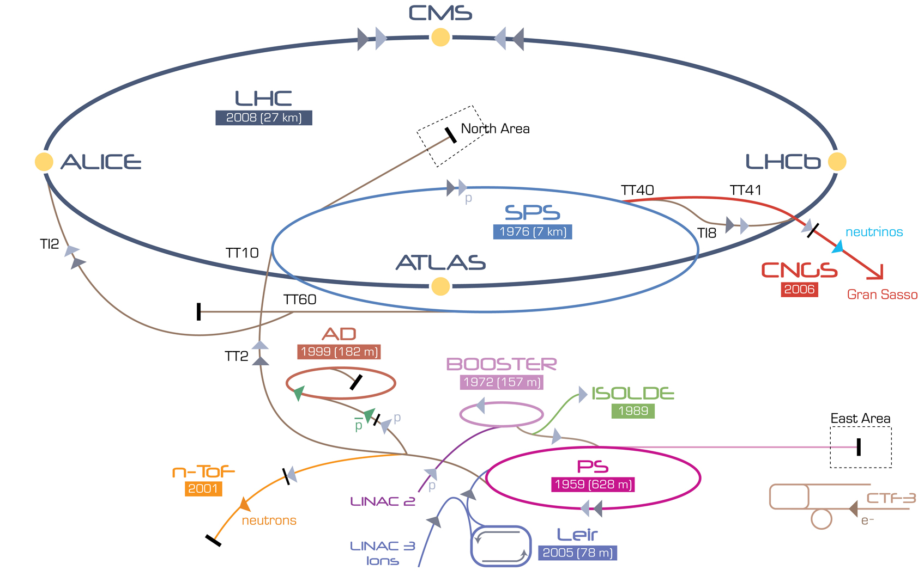
Experimental facility

Slide 11
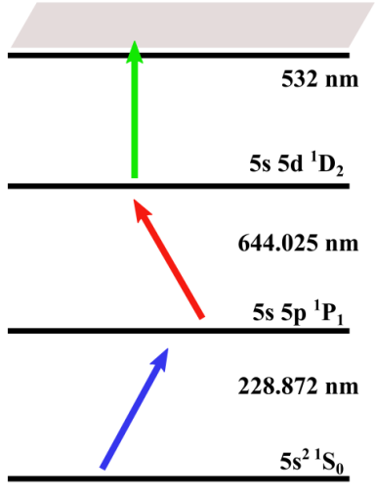
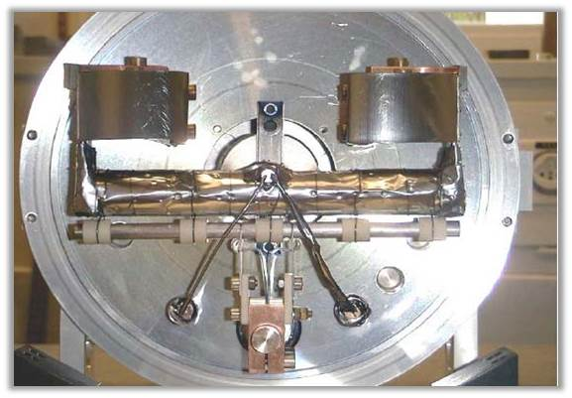
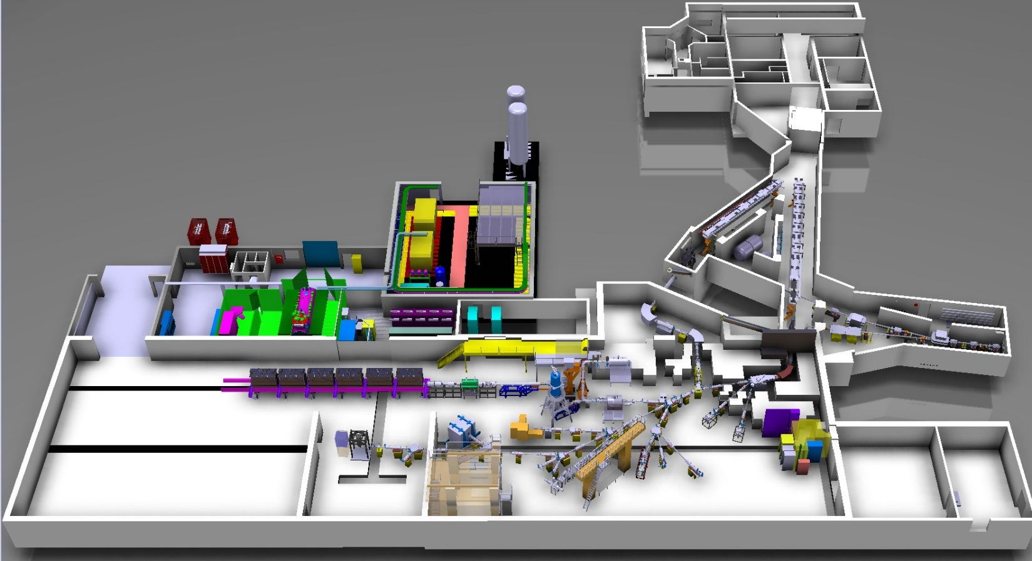
Online radioactive isotope production
Cd ionization
Target – UCx, neutron
converter and quartz line
proton beam
E = 1.4 GeV
ISOLTRAP

Slide 12
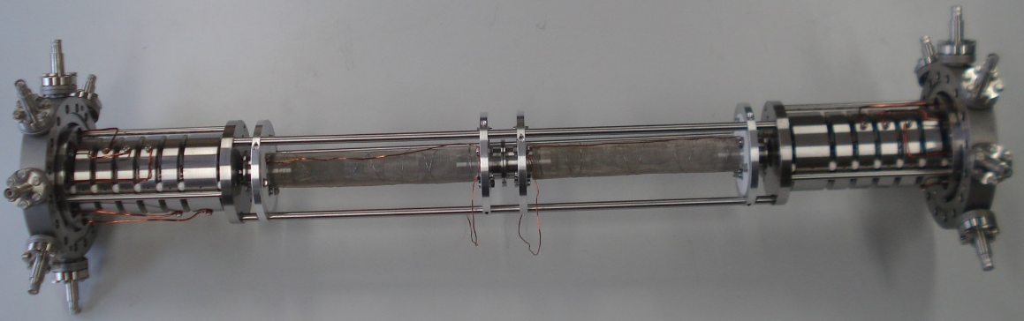
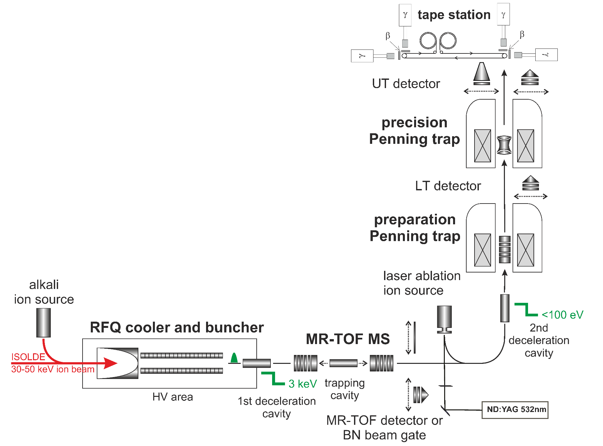
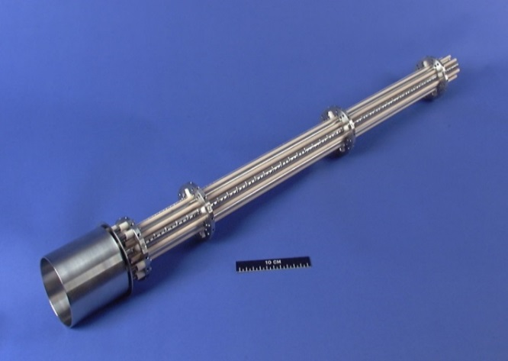
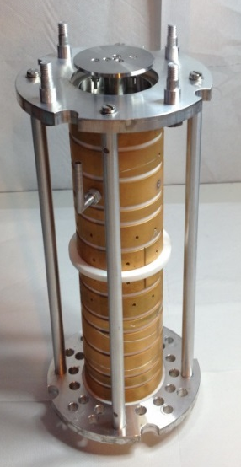
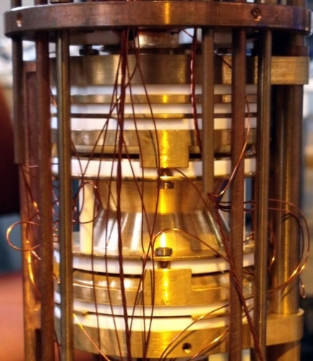
ISOLTRAP setup
2010
1994
1987
2000
M. Mukherjee et al., Eur. Phys. J. A 35, 1 (2008); S. Kreim et al., Nucl. Instrum. Methods B 317, 492 (2013).

Slide 13

ISOLTRAP setup
Measurement of cyclotron frequency:
100 ms – 1 s trapping for σ_{m}/m = 10⁻⁶-10⁻⁸
Beam purification:
1 s trapping for m/Δm =10⁵-10⁶
Beam purification:
200-300 ms trapping for m/Δm =10⁴-10⁵
Beam purification:
30 ms trapping for m/Δm = 10⁵
F. Herfurth et al., NIM A 469, 254 (2001); R. N. Wolf et al., Int. J. Mass Spectrom 313, 8 (2012); G. Savard et al., Phys. Lett. A 158, 247 (1991);

Slide 14
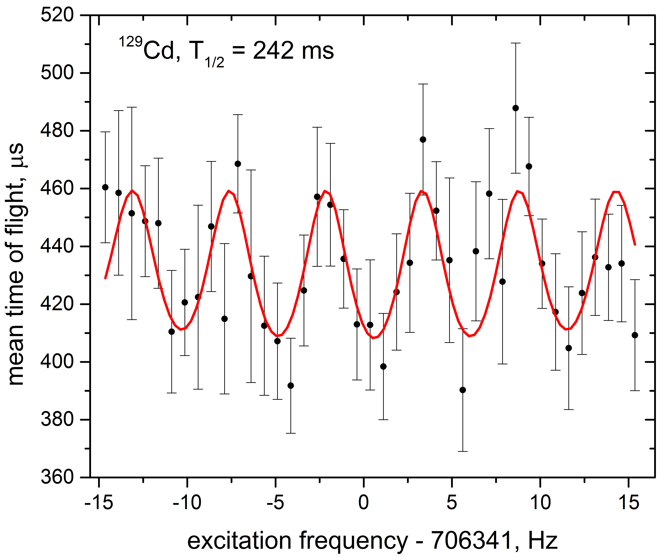
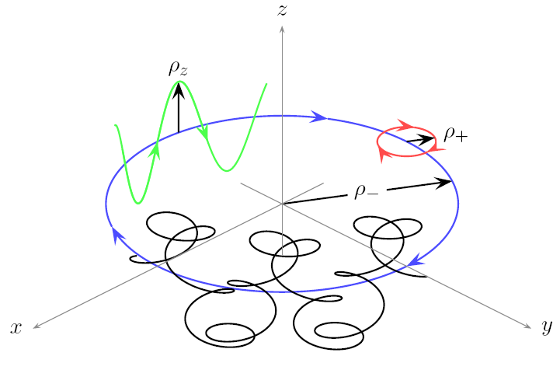
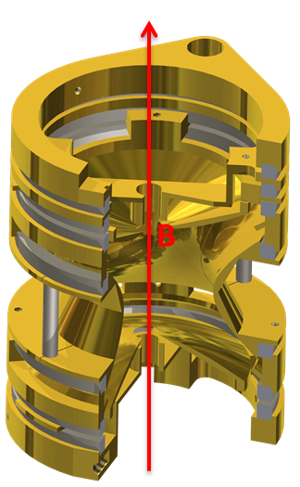
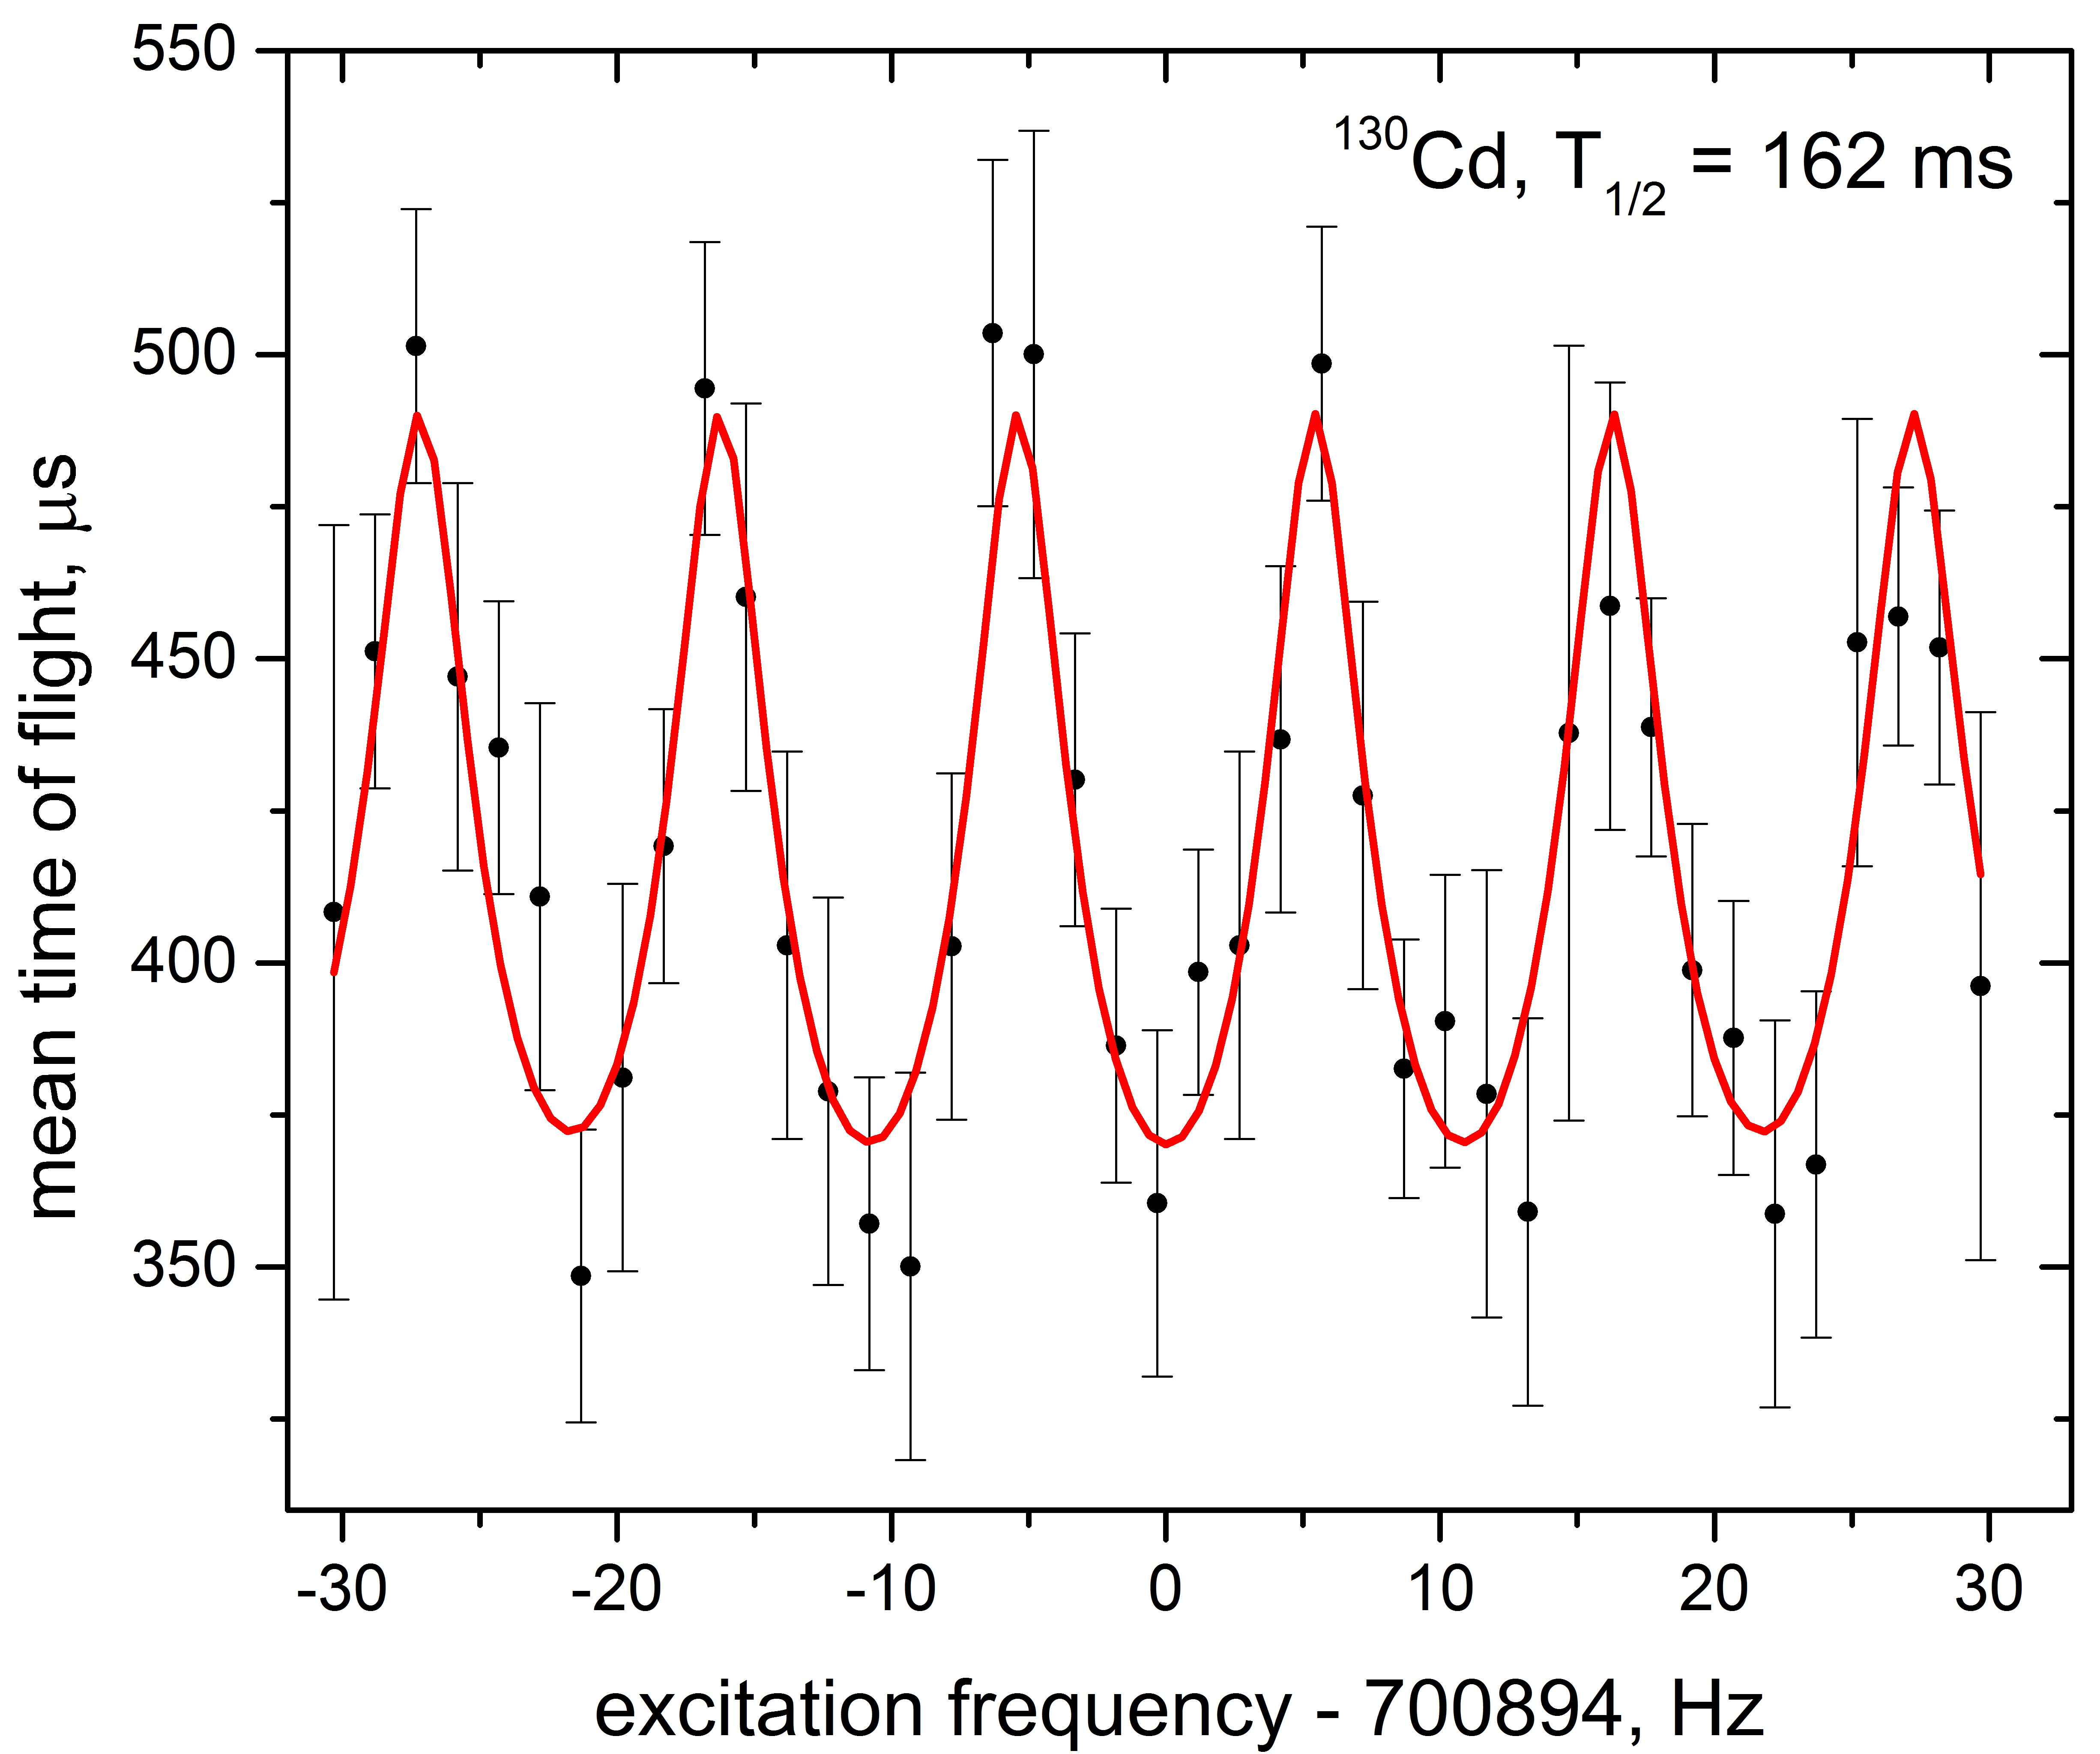

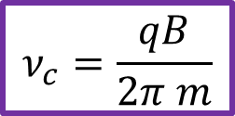
Mass measurements at ISOLTRAP
>1500 events
Penning trap measurements
Axial motion
Cyclotron
motion
$$ν_{c}=\frac{qB}{2π m}$$
Magnetron
motion
rf excitation
$$ν_{c}=v_{+}+v_{−}$$
t_{ex}(¹²⁹Cd) = 20-160-20 ms
t_{ex}(¹³⁰Cd) = 10-80-10 ms
>550 events
M. König et al., Int. J. Mass Spectrom. 142, 95 (1995); S. George et al., Phys. Rev. Lett. 98, 162501 (2007);

Slide 15

Mass measurements at ISOLTRAP
MR-TOF MS
¹³⁰Cs
¹³⁰In
¹³⁰Cd
≈ 88 ions/s from ISOLDE
Total of 1366 ions collected for ≈6.6h
Laser blocked
ions of interest ¹³¹Cd ≈ 0.2 ions / 160 ms
contamination ¹³¹Cs ≈ 0.6 ions / 160 ms
$$t=a.\sqrt{m/q}+b$$
R. N. Wolf et al., IJMS 313, 8 (2012); F.Wienholtz et al., Nature 489, 346 (2013)

Slide 16
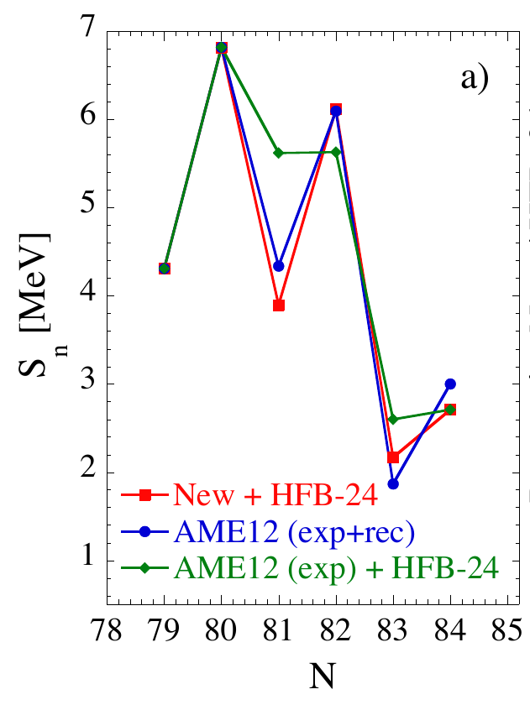
Results
S_{n}(N, Z) = B(N, Z) – B(N-1, Z)
Δ_{n} = S_{n}(N, Z-1) – S_{n}(N, Z)
A | Ratio r or C_{ToF} | ME (keV)
129 | 0.970 105 338(136) | −63 148(74)
130 | 0.977 645 186(180) | −61 118(22)
131 | 0.482 304 4(539) | −55 215(100)
D. Atanasov et al., PRL 115, 232501 (2015);

Slide 17
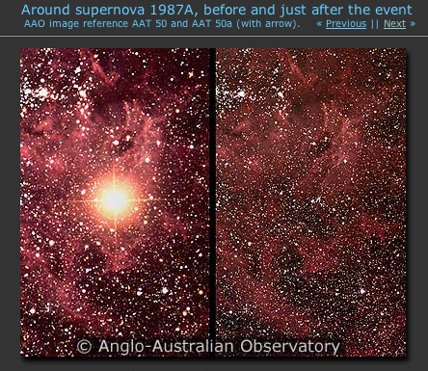
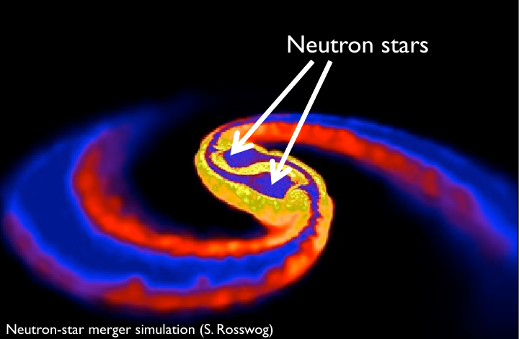
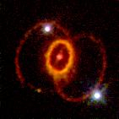
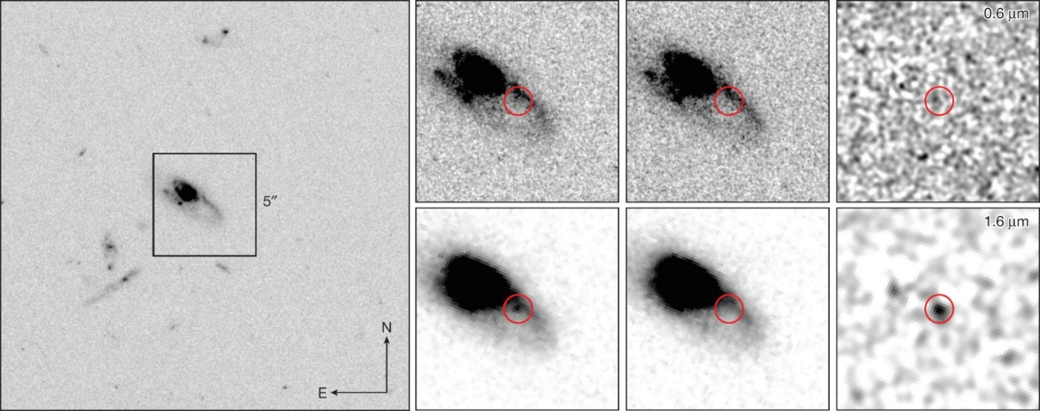
Where to find r-process
Core-collapse supernova
Neutron stars mergers
SN1987A
T. Tsujimoto A&A 565 L5 2014 , NR Tanvir et al. Nature , 1-3 (2013)

Slide 18
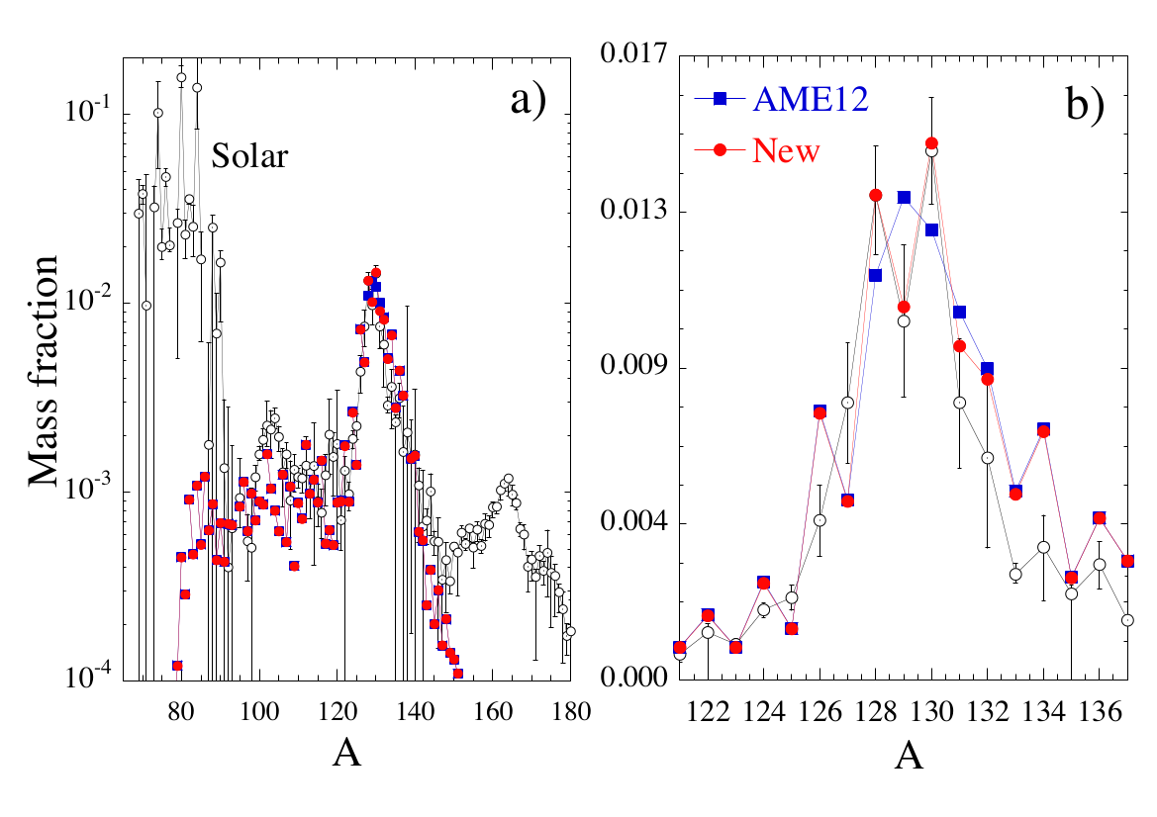
Collapse scenarios - Supernovae
SN1987A
Calculations performed by S.Goriely

Slide 19
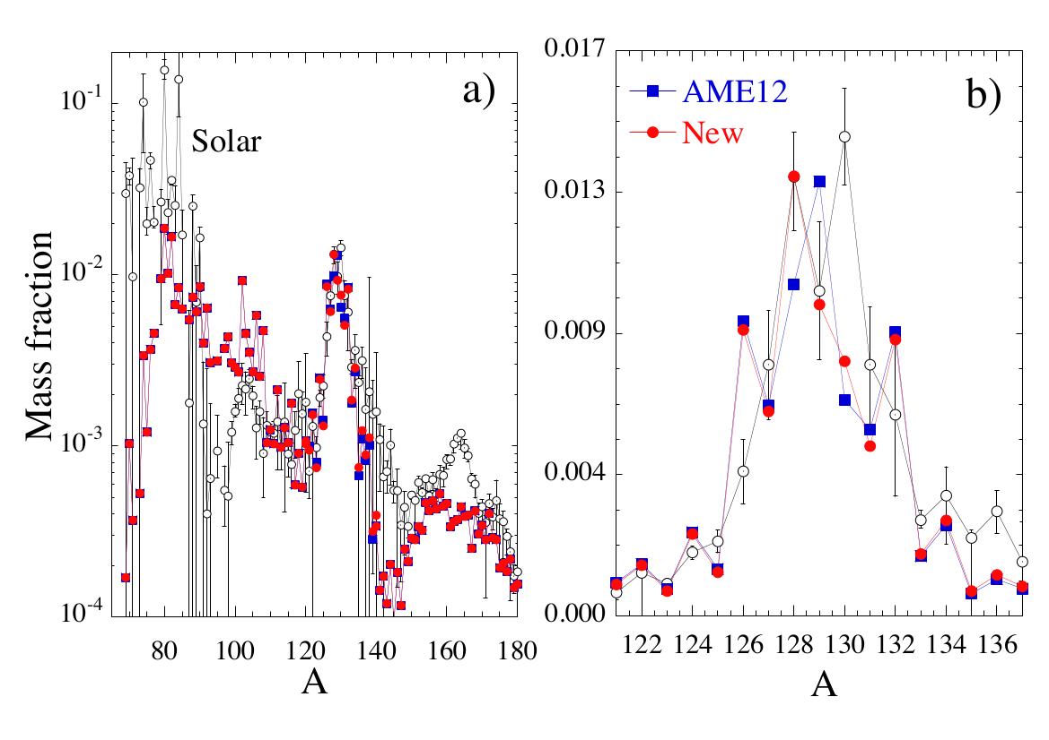

Collapse scenarios – Neutron Star Mergers
Calculations performed by S.Goriely

Slide 20
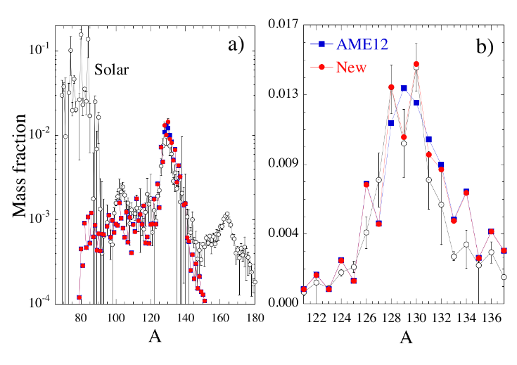
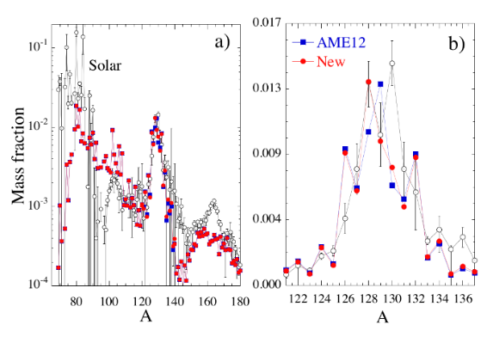
Summary and Outlook
Mass measurement of exotic ¹²⁹⁻¹³¹Cd
Aim to bring further reliability in r-process
calculations
Future beam time availability for
measurements in this region

Slide 21





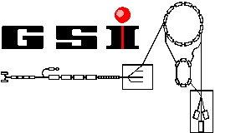
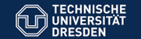




http://isoltrap.web.cern.ch
Thank you and big thanks to my colleagues
Experiment - P. Ascher, K. Blaum, R. B. Cakirli, T. Cocolios, S. George, F. Herfurth,M. Kowalska, S. Kreim, Yu. A. Litvinov, D. Lunney, V. Manea, D. Neidherr, M. Rosenbusch,
L. Schweikhard, A. Welker, F. Wienholtz, R. Wolf, K. Zuber,
Theoretical calculations - S. Goriely, H. –T. Janka, O. Just
Grants No.: 5P12HGCI1, 05P12HGFNE, 05P15HGCIA, and 05P09ODCIA) ; HCJRG-108 ; ST/L005743/1, ST/L005816/1
Contract No. 262010; HA216/EMMI;

Slide 22
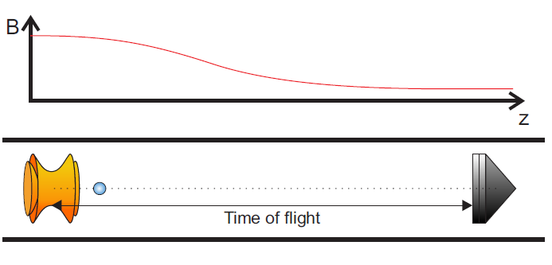
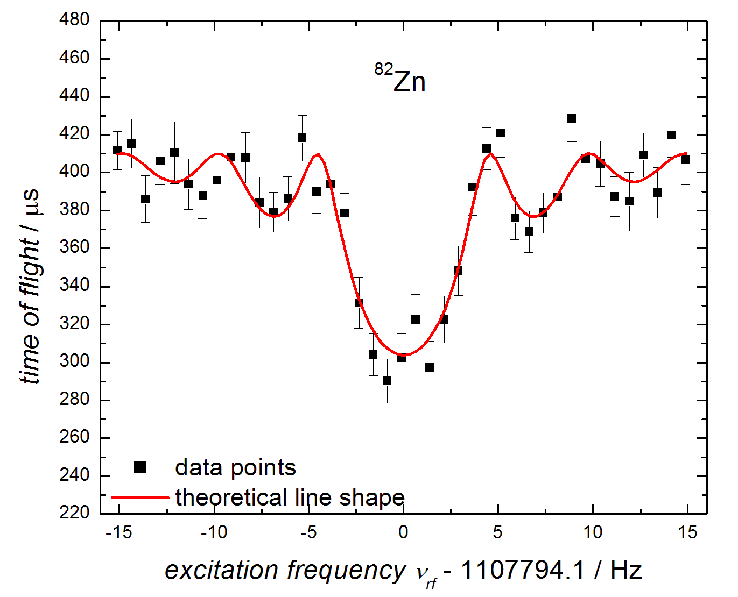
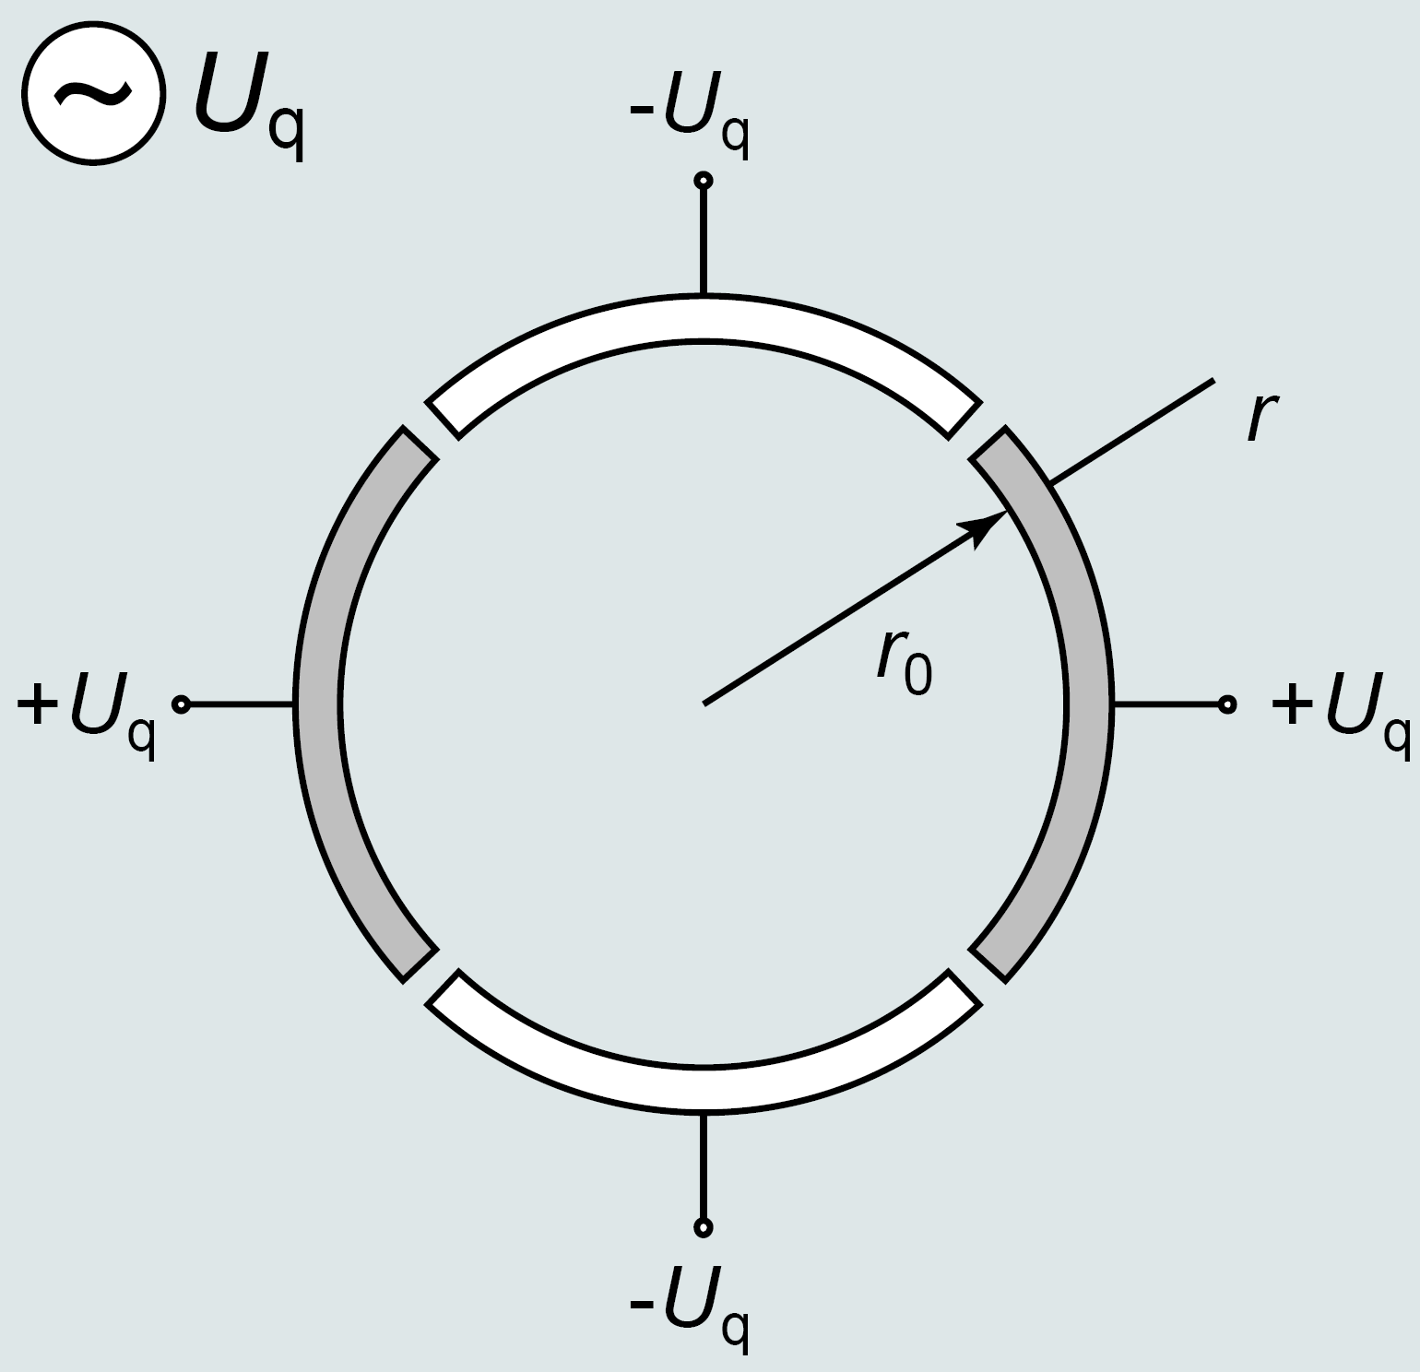
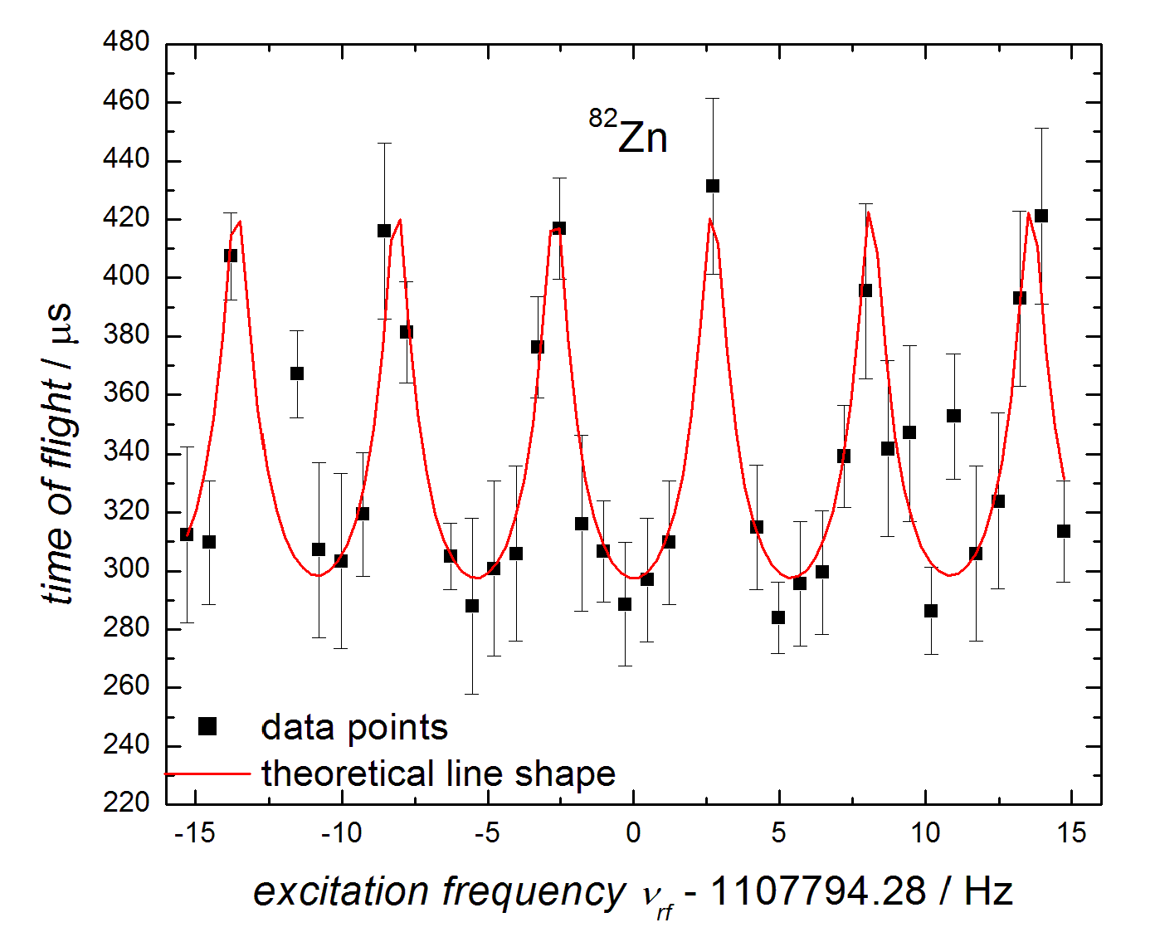
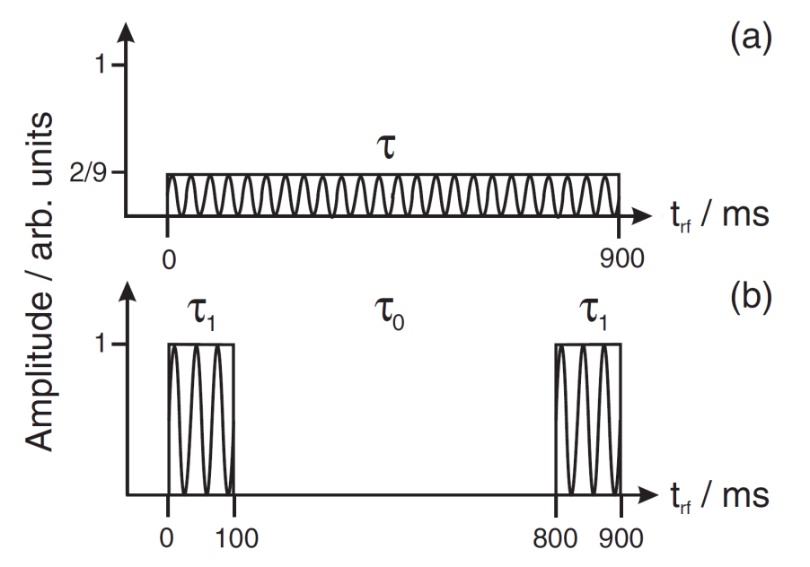
ToF-ICR and Ramsey excitation

Slide 23
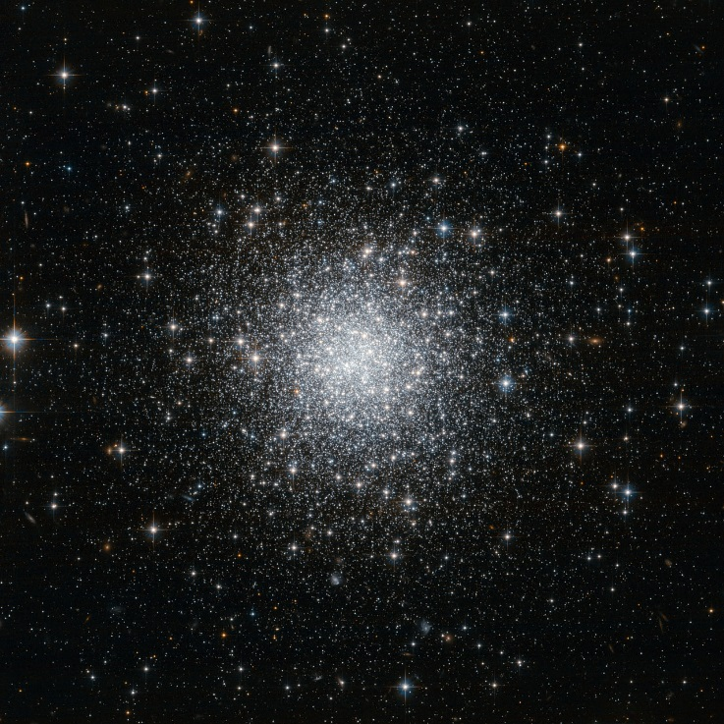
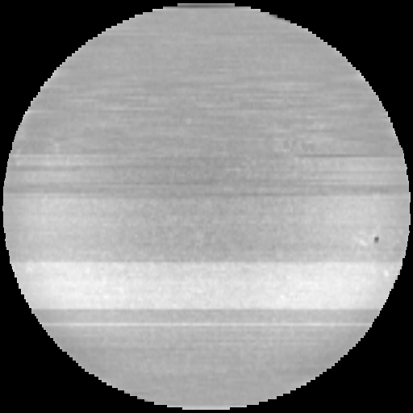
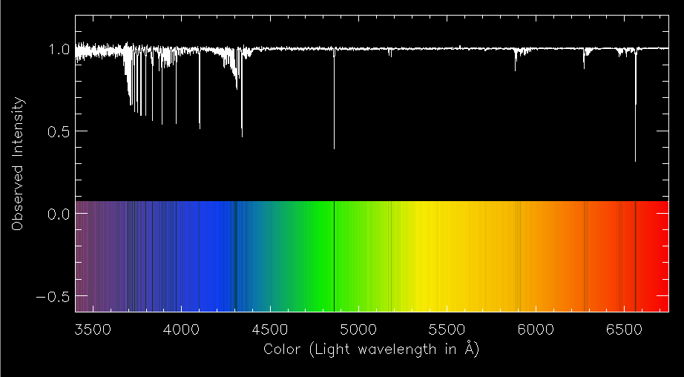

Where to look for ?
Population I –
Sun-like type
Population II – Globular clusters
Credits: Mt. Wilson Observatory
Credits: ESA/Hubble & NASA
Metallicity
$\left[Fe/H\right]={\log_{10}\left(\frac{N_{Fe}}{N_{H}}\right)}_{star}$- ${\log_{10}\left(\frac{N_{Fe}}{N_{H}}\right)}_{⊙}$
Credits: Brian Koberlein

Slide 24
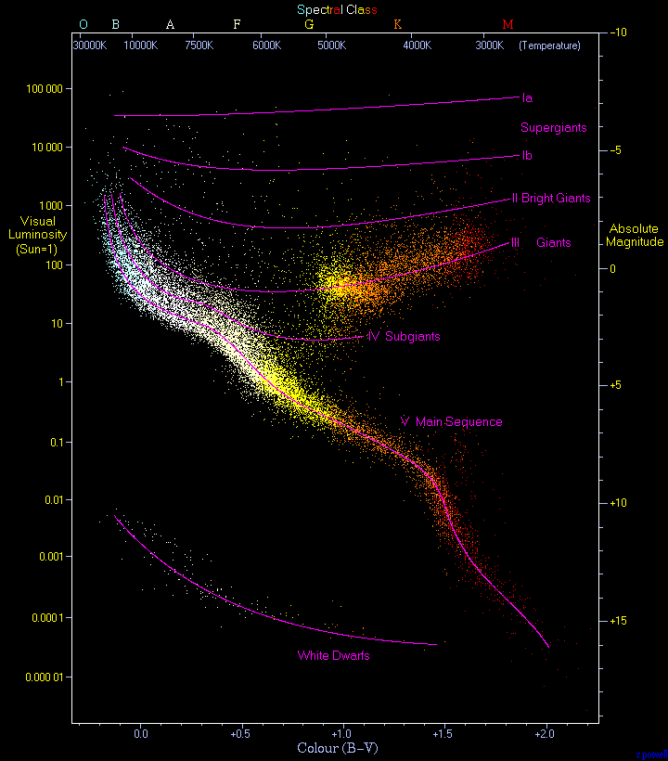
Evolutionary stages of stars
Position on Diagram | Nuclear reactions
Main Sequence | p-p, He burning, CNO-cycle
Giants | He burning, CNO-cycle, O, Mg, Si – burning
Hertzsprung-Russell diagram
Explosions:
Explanation by
s-, r-, p- processes
Stellar remnants:
White dwarf – core of C-O
Neutron star – core of neutrons
Black hole - ?
Richard Powell - http://www.atlasoftheuniverse.com/hr.html

Slide 25
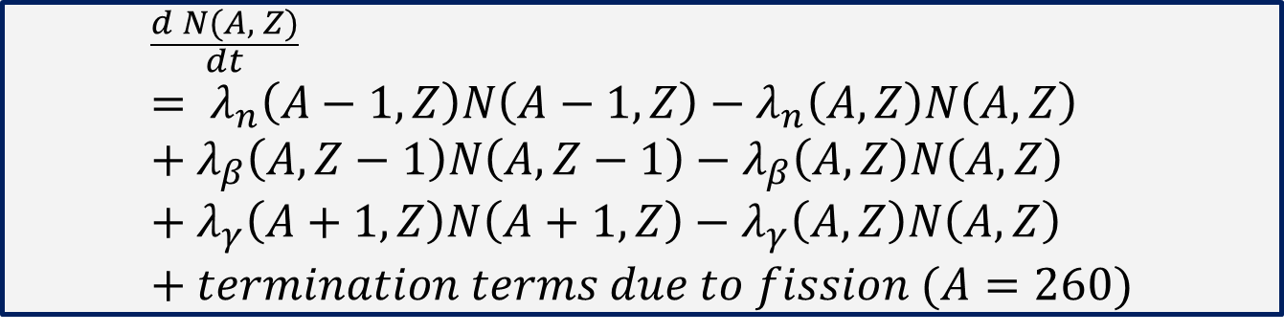
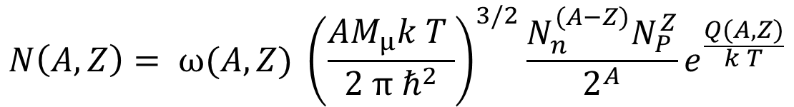
Canonical model
The nuclide abundance equation in explosive burning
$$\frac{d N(A, Z)}{dt}= λ_{n}\left(A−1,Z\right)N\left(A−1,Z\right)−λ_{n}\left(A,Z\right)N\left(A,Z\right)+λ_{β}\left(A,Z−1\right)N\left(A,Z−1\right)−λ_{β}\left(A,Z\right)N\left(A,Z\right)+λ_{γ}\left(A+1,Z\right)N\left(A+1,Z\right)−λ_{γ}\left(A,Z\right)N\left(A,Z\right)+termination terms due to fission (A=260)$$
The number density for isotope with (A, Z)
$$N\left(A, Z\right)= ω(A, Z) {\left(\frac{AM_{μ}k T }{2 π ℏ^{2}}\right)}^{3/2}\frac{N_{n}^{(A−Z)}N_{P}^{Z}}{2^{A}}e^{\frac{Q(A, Z)}{k T}}$$

Slide 26
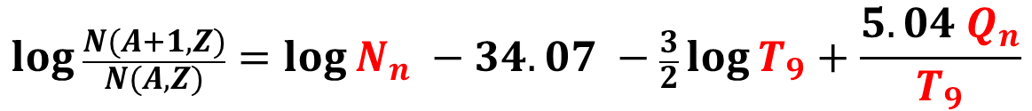
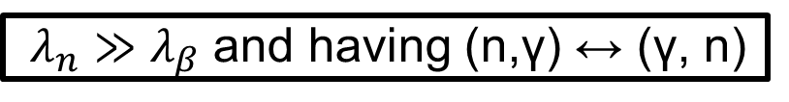
Canonical model
Waiting-point approximation
$λ_{n}≫λ_{β}$ and having (n,γ) ↔ (γ, n)
$$\frac{dN(A, Z)}{dt} = λ_{β}\left(A,Z−1\right)N\left(A,Z−1\right)−λ_{β}\left(A,Z\right)N\left(A,Z\right)$$
$$\log{\frac{N(A+1, Z)}{N(A, Z)}=\log{N_{n} −34.07 −\frac{3}{2}\log{T_{9}+\frac{5.04 Q_{n}}{T_{9}}}}}$$
N_{n} – neutron density; T₉ – temperature in GK; Q_{n} – neutron separation energy

