Slide 1
No Low-Lying Nuclear Vibrations: Configuration Dependent Pairing
and Axial Asymmetry
J. F. Sharpey-Schafer
University of the Western Cape, South Africa

Slide 2
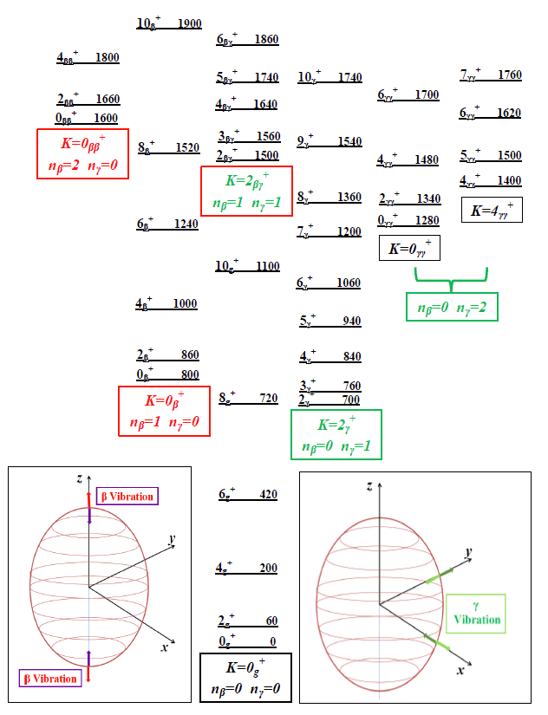
Nuclear Structure
“Standard Model”
for even-even
Deformed nuclei
Intrinsic levels in the pairing gap assumed to be collective vibrations of the nuclear shape.
Bohr & Mottelson
Vol. 2, p363

Slide 3
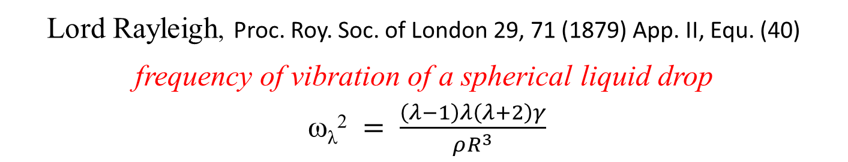
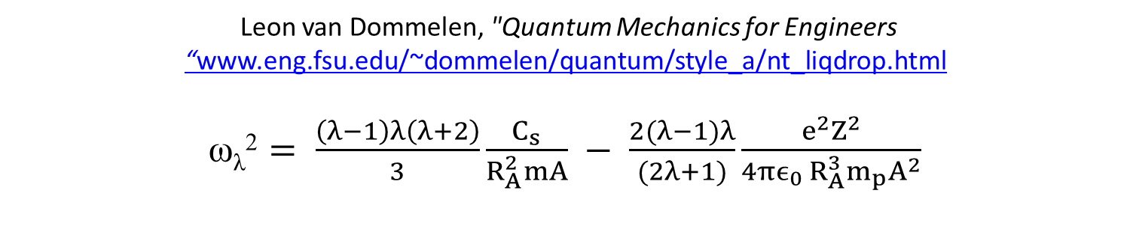
Lord Rayleigh, Proc. Roy. Soc. of London 29, 71 (1879) App. II, Equ. (40)
frequency of vibration of a spherical liquid drop
ω_{λ}² $= \frac{\left(λ−1\right)λ\left(λ+2\right)γ}{ρR^{3}}$
WEIZÄCKER SEMI-EMPIRICAL MASS FORMULA Z. für Phys. 96 (1935) 431
M_{nucleus}(Z,N) = { Zm_{p} + Nm_{n} } – C_{V} A + C_{S} A^{2/3} + C_{C} Z²A^{-1/3} + C_{as} (N-Z)²A⁻¹ ± C_{P} A⁻¹
Leon van Dommelen, "Quantum Mechanics for Engineers “www.eng.fsu.edu/~dommelen/quantum/style_a/nt_liqdrop.html
$\text{ω}\text{λ}\text{2}= \frac{\left(λ−1\right)λ\left(λ+2\right)}{3}\frac{C_{s}}{R_{A}^{2}mA} − \frac{2(λ−1)λ}{(2λ+1)}\frac{e^{2}Z^{2}}{4πϵ_{0 }R_{A}^{3}m_{p}A^{2}}$

Slide 4

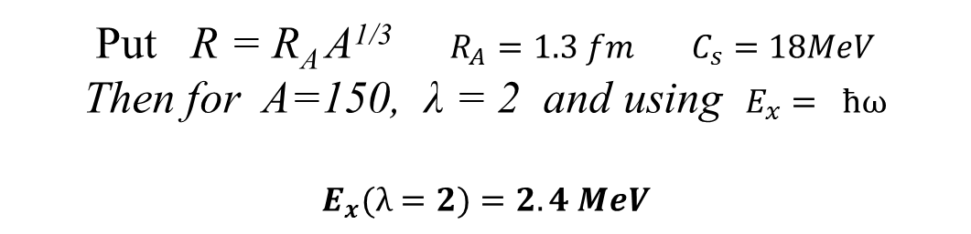
Put R = R_{A} A^{1/3} $R_{A}=1.3 fm$ $C_{s}=18MeV$
Then for A=150, λ = 2 and using $E_{x}= ħω$
$$E_{x}(λ=2)=2.4 MeV$$
$$E_{x}$$
Shell corrections make the nucleus stiffer putting up the vibrational frequency
Shell Correction
Liquid Drop
β
Moments-of-Inertia: Iirr < Iexpt < Irigid
Rayleigh, B&M assume irrotational behaviour of the nuclear “fluid”.
We would expect the experimental value to make the shape stiffer.

Slide 5

40th Anniversary Of the Bohr & Mottelson Nobel Prize (1975)
Ben on his
Bike 2008
Bohr & Mottelson Vol II
“A vibrational mode of excitation is characterized by the property that it can be repeated a large number of times. The nth excited state of a specified mode can thus be viewed as consisting of n individual quanta. The quanta obey Bose statistics…” Page 330
“… but it might be expected that the zero-point oscillations in the γ direction would be of similar magnitude as those in the β direction. The experimentally observed E2-matrix elements for exciting the β vibrations are comparable to those exciting the K^{π}=2⁺ bands….” Page 166
“In view of the systematic occurrence of excited K^{π}=2⁺ bands in the spectra of strongly deformed even-even nuclei, one may consider the possibility of describing these spectra in terms of a rotor deviating slightly from axial symmetry.” Page 186
Ben will be 90
on 9th July 2016

Slide 6
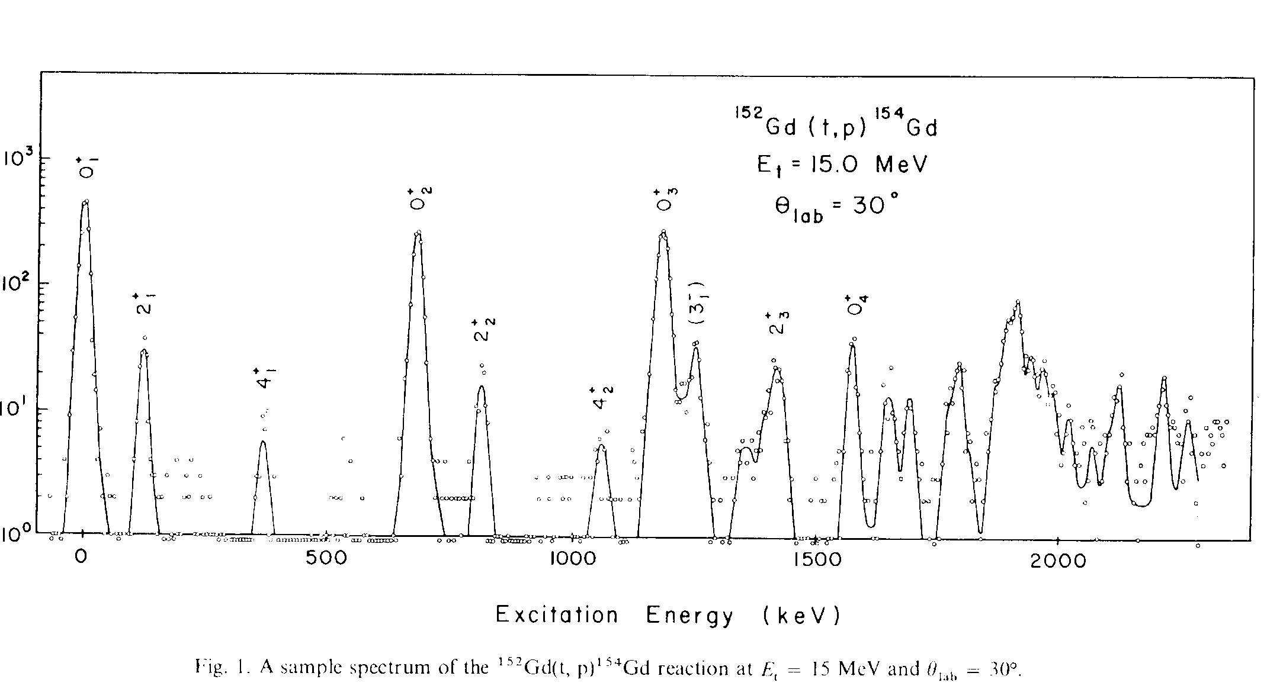
Two Neutron Transfer to ¹⁵⁴Gd (N=90)
0₁⁺
0₂⁺
0₃⁺
K^{π} = 2⁺ Bandhead
0₄⁺
Shahabuddin et al; NP A340 (1980) 109
N.B. Log₁₀ scale

Slide 7
What is the │0₂⁺ > Configuration ?
(t,p) & (p,t) │0₂⁺ > is 2p_{n}- 2h_{n} this gives J^{π} but nothing on the orbit.
Single particle transfer would give l_{n} but does not populate │0₂⁺ >.
In { │0₂⁺ > + neutron }, look to see which orbit does NOT couple to │0₂⁺ >.

Slide 8
K=1/2⁺
=2-Ω
1400
K=15/2⁻
=2+Ω
E_{x}
¹⁵⁵Gd₉₁
1200
(keV)
K=1/2⁻
=2-Ω
996 keV
1000
K_{γ}=2
800
K=3/2⁺
{K=11/2⁻}
BLOCKED
681 keV
600
K=3/2⁻
400
│0₂⁺ >
[400]1/2⁺
200
[532]3/2⁻
[402]5/2⁺
[642]5/2⁺
[651]3/2⁺
[505]11/2⁻
0
Seen by Schmidt et al;
J. Phys. G12(1986)411
in (n,γ) (d,p) & (d,t)
[521]3/2⁻

Slide 9
Configuration Dependent /Quadrupole Pairing
R. E. Griffin, A. D. Jackson and A. B. Volkov, Phys. Lett. 36B, 281 (1971).
Suggested that Δ_{pp} ≈ Δ_{oo} >> Δ_{op}
for Actinide Nuclei where 0₂⁺ states were observed in (p,t) that were not pairing- or β-vibrations.
Suppose there are n prolate and n oblate degenerate levels at the Fermi Surface;
Assume that each pairing matrix element is the same for the same type -a
BUT the prolate-oblate matrix elements are very weak –εa
Then if the prolate n*n matrix is A, the oblate matrix is also A
The matrix for the total system is;
A εA
εA A
Then there are (2n-2) states with ZERO energy and 2 states with energies
E_{1,2} = -(1 ± ε) na
(2n-2)
0₂⁺
0₁⁺

Slide 10
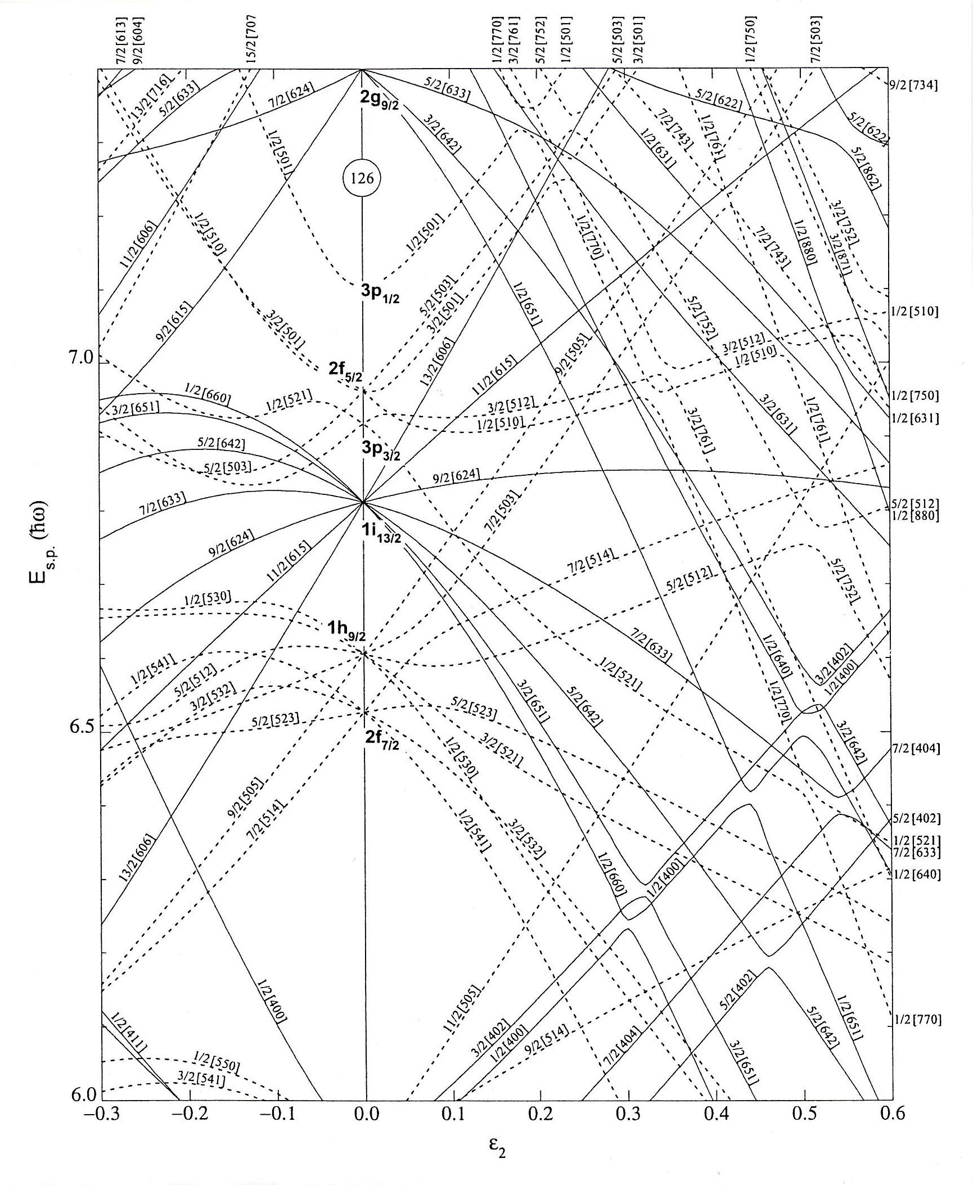

Flying Fish
[505]11/2⁻
orbital
Configuration Dependent or Quadrupole
Pairing;
Assume
Δ_{pp}≈ Δ_{oo}>> Δ_{op}
[660]1/2⁺
“Prolate”
R. E. Griffin, A. D. Jackson and A. B. Volkov, Phys. Lett. 36B, 281 (1971).
W. I. van Rij and S. H. Kahana, Phys. Rev. Lett. 28, 50 (1972).
S. K. Abdulvagabova, S. P. Ivanova and N. I. Pyatov, Phys. Lett. 38B, 251 (1972).
D. R. Bès, R. A. Broglia and B. Nilsson, Phys. Lett. 40B, 338 (1972).
I. Ragnarsson and R. A. Broglia, Nucl. Phys. A263, 315 (1976).
[505]11/2⁻
“Oblate”
82 Neutrons
Prolate Deformation
First Excited 0₂⁺ states in even-even nuclei are NOT β-vibrations.
In N=88,90 nuclei they are “PAIRING ISOMERS”

Slide 11
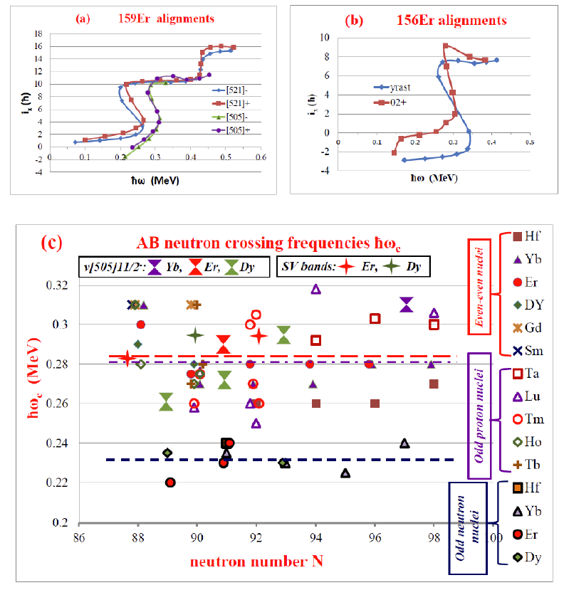
Blocking of Pairing in N=88-98 nuclei

Slide 12
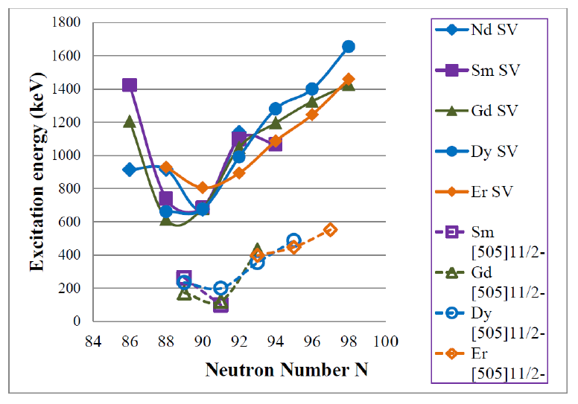
Systematics of Energies of 0₂⁺ and [505]11/2⁻ states
for Z = 60-68 and N = 86-98
0₂⁺ SV
[505]11/2⁻

Slide 13
K^{π}=2⁺ γ “Vibrational” Bands
ħω_{γ}
keV
E_{gnd state} = ½ ħω_{β} + ħω_{γ}
E_{x} (0,0,2,2) = ħω_{γ} + ħ²/I
K = 2 Gamma Vibration Band Head Energy

Slide 14
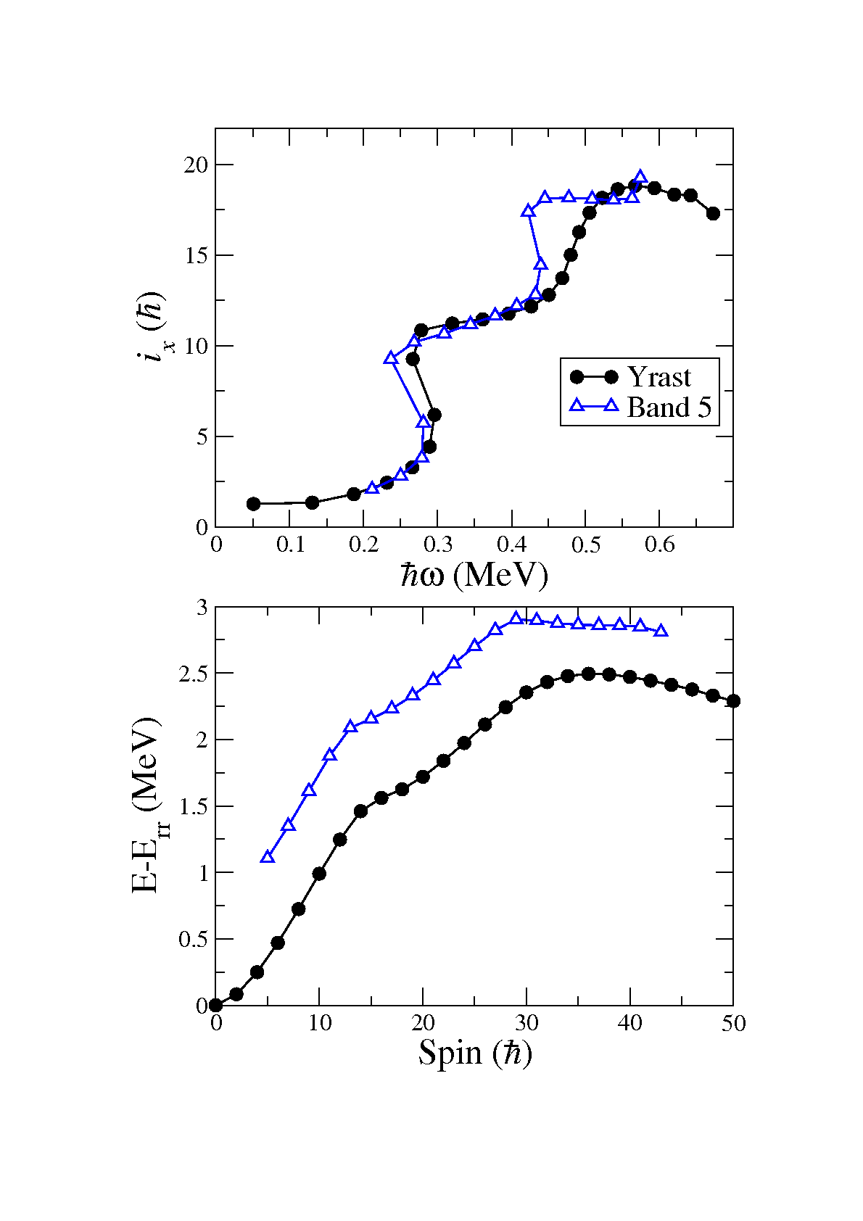
¹⁶⁰₆₈Er₉₂
Odd Spin γ-band in ¹⁶⁰Er
Gammasphere data; Ollier et al., Phys. Rev. C83 (2011) 044309

Slide 15
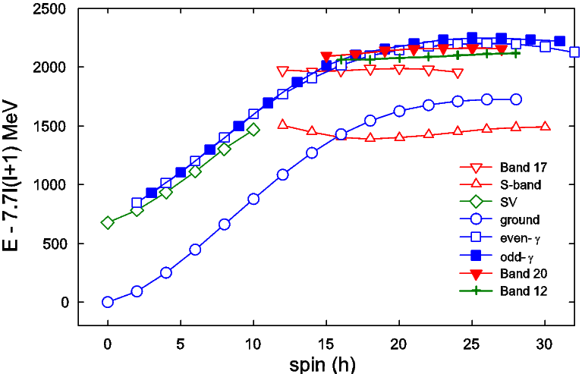
Siyabonga
Majola et al.,
Phys Rev C91,
034330 (2015)
¹⁵⁶₆₄Dy₉₀
positive
parity
states

Slide 16
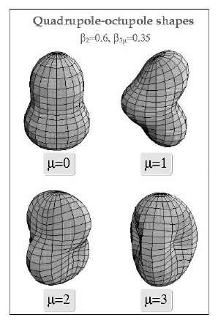
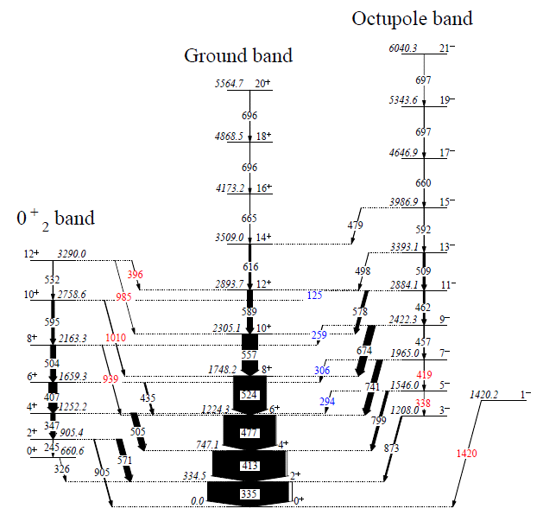
R = R₀(1 + Σa_{2,μ}Y_{2,μ} + Σa_{3,μ}Y_{3,μ} + Σa_{4,μ}Y_{4,μ} + ….)
¹⁵⁴₆₆Dy₈₈
George Zimba et al.

Slide 17
“The Sympletic Shell-Model Theory of Collective States”
Cavalho, Le Blanc, Vassanji, Rowe and McGrory
Nucl Phys A452 (1986) 240
“….the β and γ degrees of freedom are not algebraically linked to the other degrees of freedom… in any simple microscopically recognizeable way.”
“We choose…to think of K=2 bands as triaxial rotor states, rather than γ vibrations,….”

Slide 18
Where have all the Vibrations gone ??
Deformed Rare Earths;
Zawischa, Speth & Pal, Nucl Phys A311(1978)445
QRPA, Deformed Woods-Saxon single particle Basis,
Zero-range density dependent residual interaction.
“…it is more reasonable to identify the high-lying K^{π} = 0⁺ and 2⁺ giant quadrupole resonances with the classical β- and γ-vibrations.”
“This is due to the fact that the energies of the low-lying states are mainly given by the details of the single-particle structure at the Fermi surface whereas the high-lying states are of real collective nature.”
“…the microscopic wave vector of the low-lying K^{π} = 0⁺ states is predominantly of the pairing-vibrational type in agreement with the enhanced two-particle transfer cross sections.”

Slide 19
Conclusions
Our Standard Model for (low energy) Nuclear Excitations is BUST
NO vibrations, phonons, bosons etc.
BUT life is simpler, ONLY complex Deformations
If you break SPHERICAL symmetry,
you get rotational bands.
If you break AXIAL symmetry,
you get K^{π}=2⁺ bands.
If you break REFLECTION symmetry,
you get ODD SPIN NEGATIVE PARITY bands.
If you break HEXADECAPOLE symmetry,
you get K^{π}=4⁺ bands.

