Slide 1


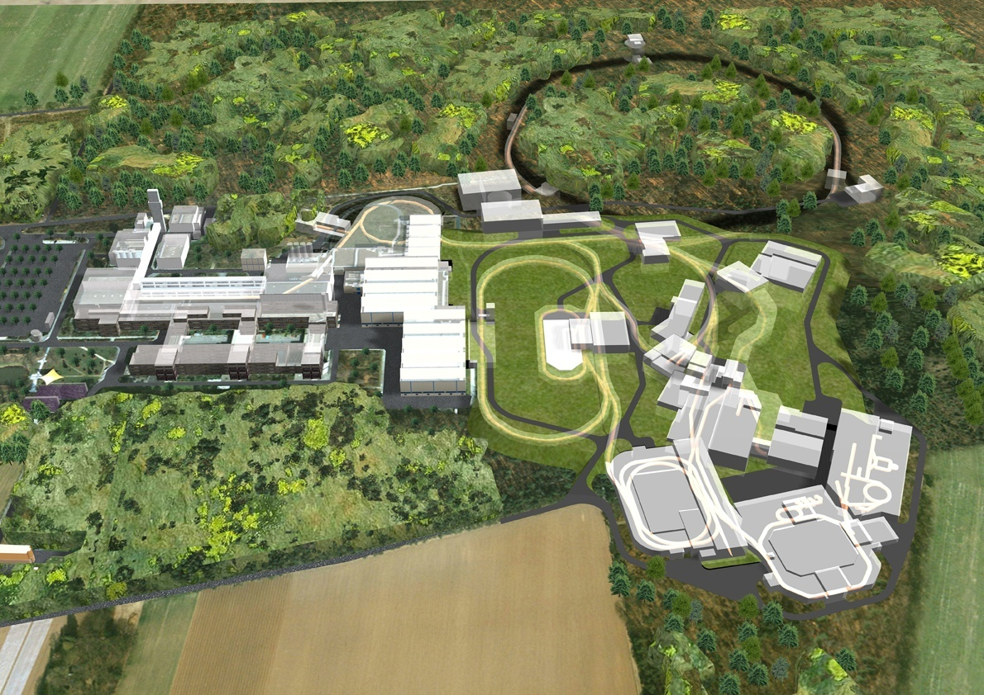
Brilliant pbar -p collider L~3*10^30?
Strange, Charm, Beauty matter!
SIS 100/300
50 MeV
SIS18
p-Linac
30 GeV Protons
p
HESR
_
p
ESR
Cu Target
10⁷ p/s @ 3 GeV
Cry-Ring
FLAIR
PANDA
High to low Energy pbars :
proton Linac 50 MeV
accelerate p in SIS18/SIS100
produce pbar on target
collect pbar in CR, inject simultaneously pbar & p into HESR as Collider :
32 GeV pure glue !
Accelerating
Cooling
Collecting
Accumulating
Precooling
RESR/CR
100m
G.Boca GSI, Germany & U. Pavia, Italy
Courtesy Jim Ritman,FZJuelich

Slide 2
PANDA Detector

Slide 3
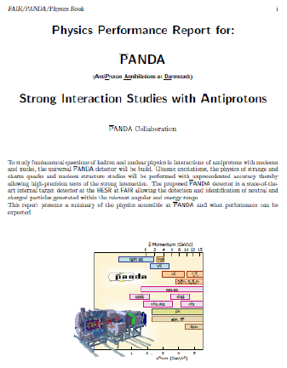

PANDA Program: 2 GeV – 5.5 GeV
I: Hadron spectroscopy
light mesons, baryons, charmonium, open charm,
QCD exotics: glueballs, hybrid states, X,Y,Z
II: Electromagnetic processes
time like form factors, transition distribution
amplitudes, TMDs, …
III:Hadronic interactions:
Hyperons, Hypernuclei,
In medium-effects
PANDA physics workshop in Uppsala, June 8 – 12, 2015

Slide 4
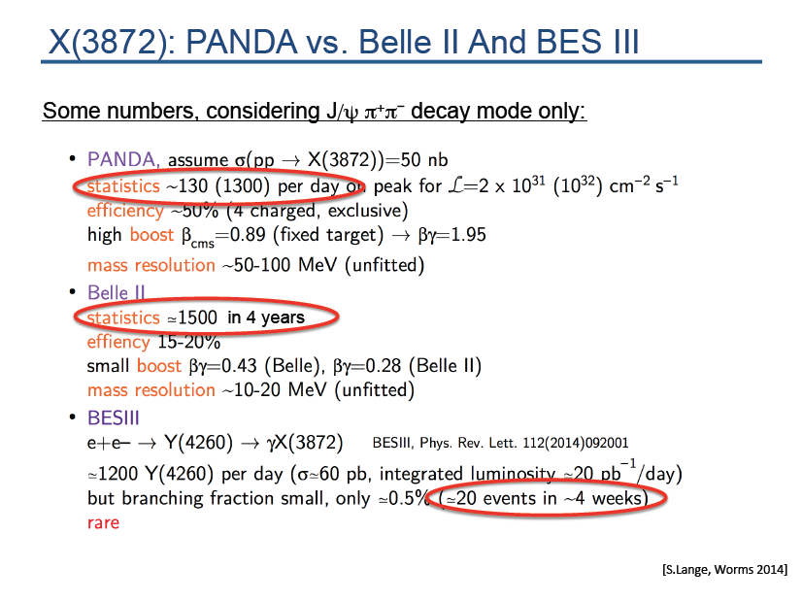
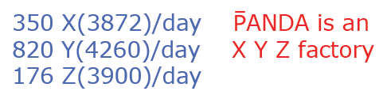

Energy scans

Slide 5
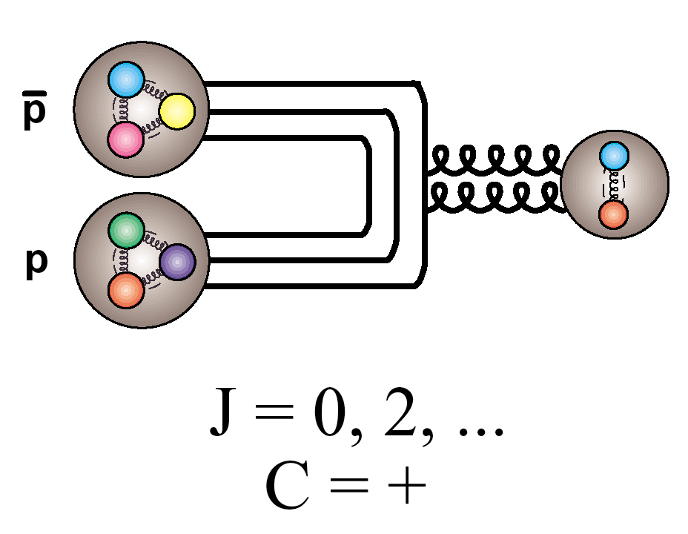
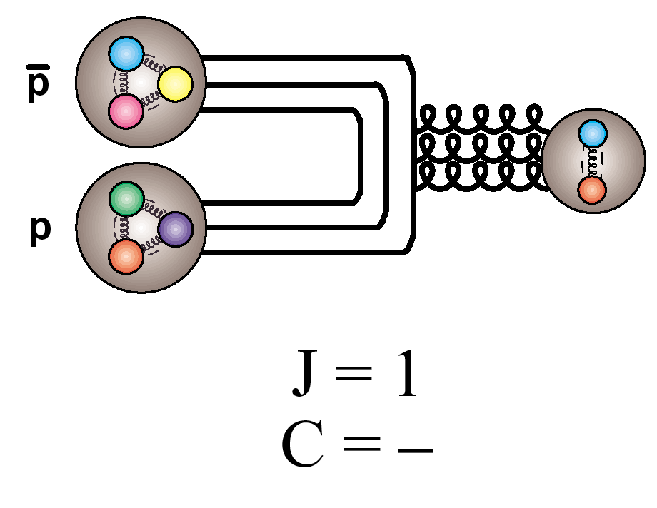
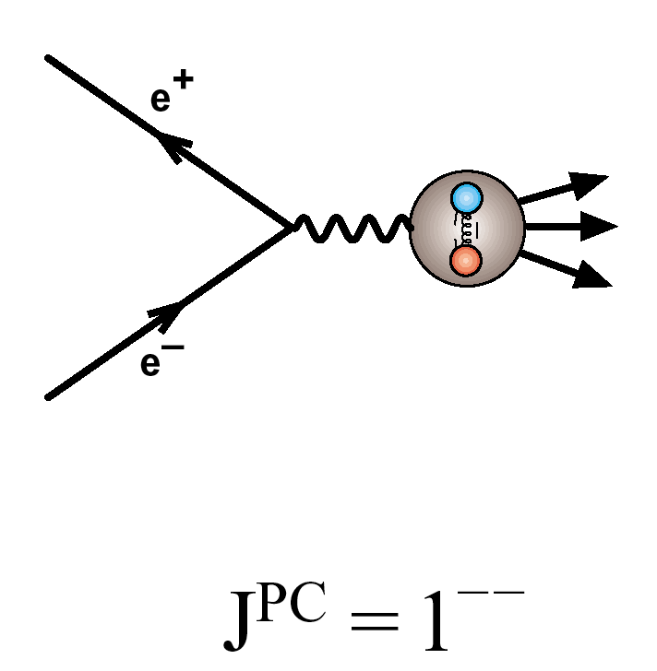
Particle production in pp collisions
_
Formation:
_
_
All J^{PC} allowed for (qq) accessible in p p
c.f.
Only J^{PC} = 1⁻⁻ allowed in e⁺e⁻
(to 1st order)

Slide 6
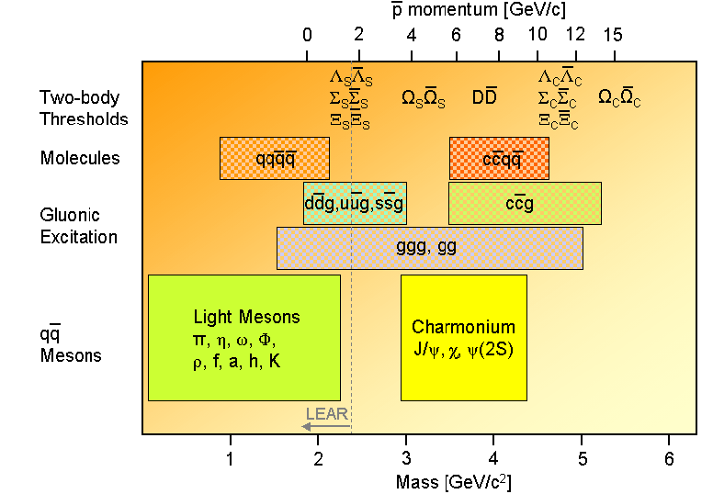
X, Y, Z, Charm-Hybrids, Penta-Quarks, Tetra-quarks, Glue-Balls
- PANDA explores their properties up to masses ~ 5.5 GeV
Notes:
Am SLAC- Babar, Stanford, am KEK-Belle, Japan und am IHEP Peking wurden kürzlich Klassen von neuartigen schweren ‘Charmed Mesons’ entdeckt, PANDA wird dort eine reiche Ernte einfahren:
Dabei insb. charmed baryons, charmed hybrids, heavy glueballs, heavy charmed mesons suchen.
Antiprotonen in Kerne einlagern, multi-Hypernuclei erzeugen und vermessen, dies geht nur mit den brillianten Antiprotonenstrahlen am FAIR - HESR

Slide 7
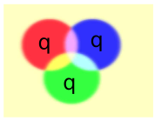
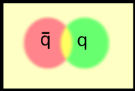
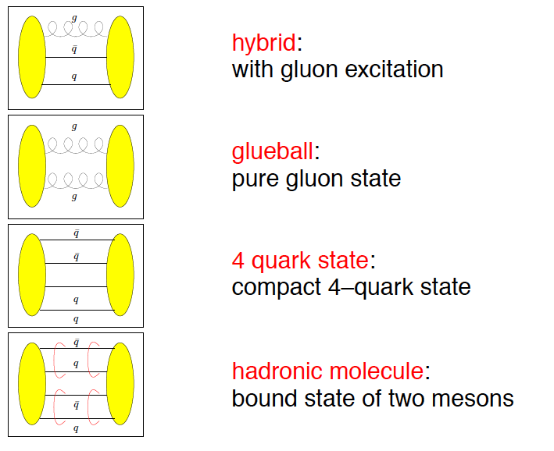
Beyond standard quark configurations
QCD allows much more than what we have observed:
Exotica
Baryons
Mesons
may have J^{PC} not allowed for qq
_
Courtesy C. Hanhart

Slide 8
Lattice QCD vs pure YM: glueballs

Slide 9
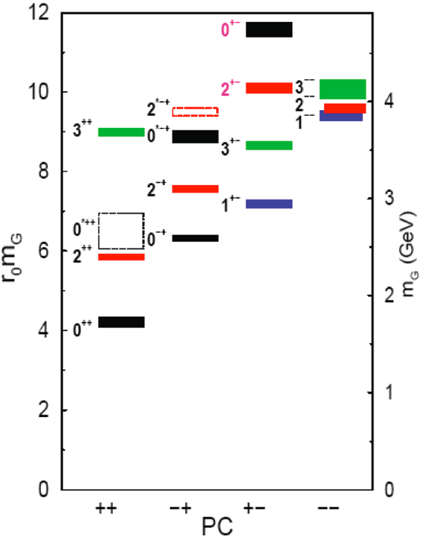
Search for Heavy Glueballs
Charmed Glueballs
  flavour blind decays
    charmed final states
  only a few charmed mesons around 3 - 4 MeV/c²
    less mixing
Exotic glueballs (oddballs), no mixing!
  m(2⁺⁻) = 4140(50)(200) MeV
  m(0⁺⁻) = 4740(70)(230) MeV
  decay modes φφ, φη, J/ψη, J/ψφ
  Narrow widths predicted
Morningstar & Peardon, PRD60(1999)34509
Morningstar & Peardon, PRD56(1997)4043 QUENCHED pure gauge Lattice theory
Wuppertal Bcoll., RBRC-Bielefeld coll, Owe Pilipsen, Goethe Uni Frankfurt

Slide 10

Holographic vs. lattice glueball spectra
Seiji Terashima,YITP,Kyoto, Koji Hashimoto,Riken, Chung-I Tan,Brown, arXiv:0709.2208
Holographic
Pure gauge Lattice SU(3)
Morningstar-Peardon
Brower-Mathur-Tan, 2000
dropped

Slide 11
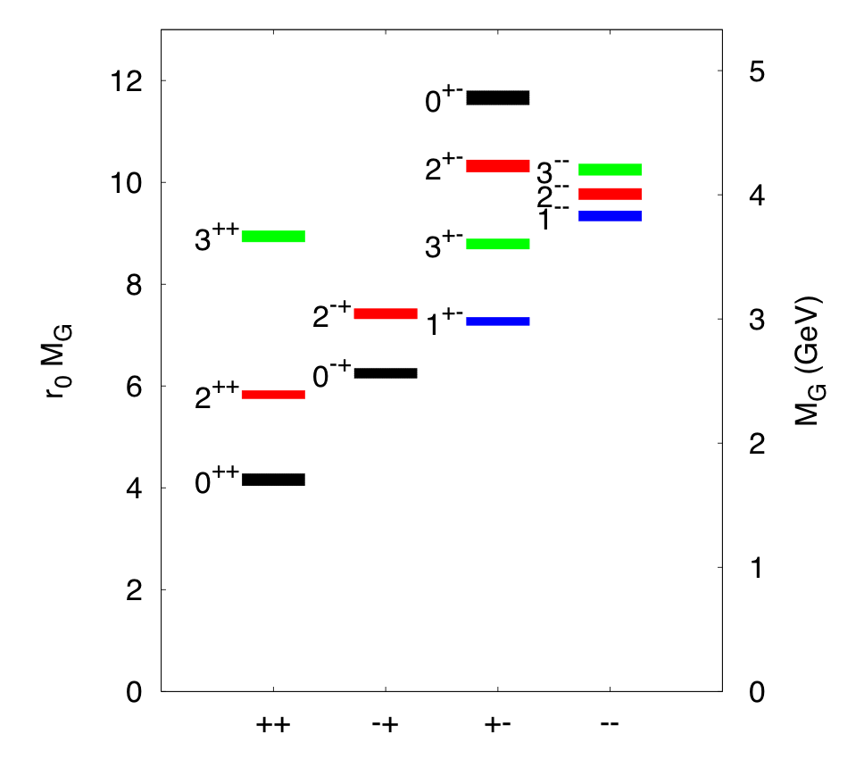
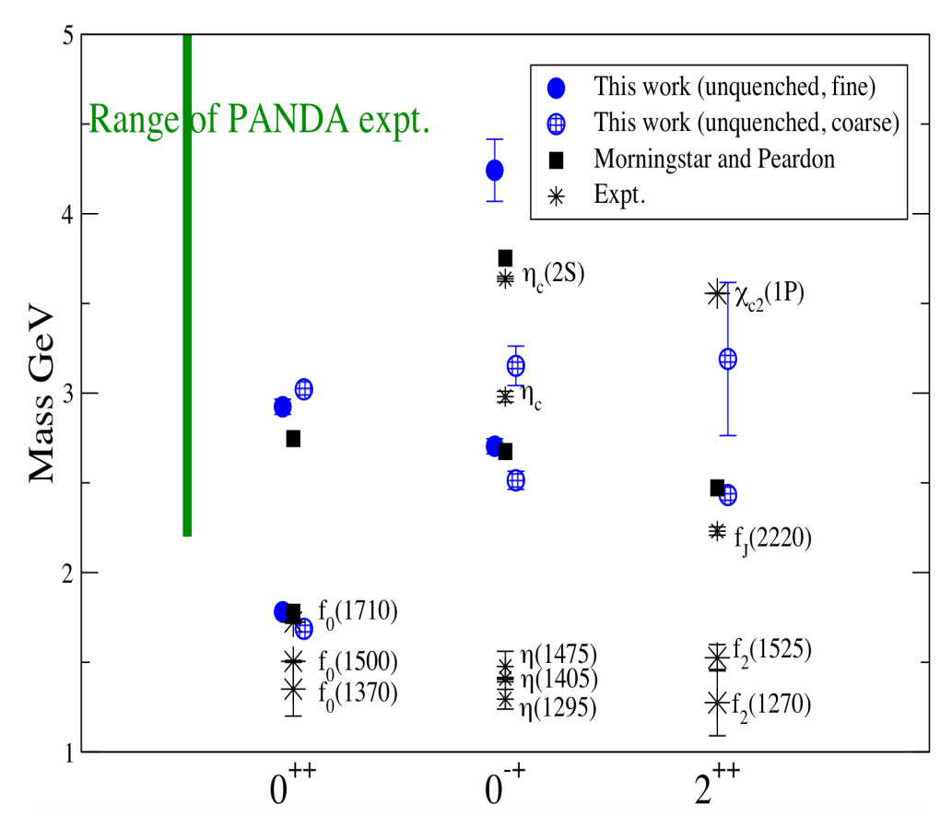
Glueball spectrum
Quenched results:
Morningstar-Peardon
Phys.Rev. D73 014516 (‘06)
First unquenched results:
pion mass 360 MeV
UKQCD coll. PRD82 (‘10) 34501

Slide 12
Pure YM gauge theory on the lattice:
a hot glue plasma
a 1. Order PhaseTransition,
a warm Glueball Fluid ! ?

Slide 13
The early eighties: predictions of QCD phase structure
1. two different phase transitions:
Svetitsky&Yaffe: F.O.P.T. in pure gauge YM theory:
“glueplasma – GlueBall fluid” – no quarks!
Pisarski&Wilczek: chiral massless quarks
F.O.PT QGP-Hadrons, but crossing if quark mass nonzero
2. - two chemical saturation eq. timescales in RHICs:
Raha/Sinha; Shuryak; T. Biro, B. Mueller, X.Y. Wang Transport Theory
Fast chemical saturation: pure glue! But Slow saturation: quarks !
Search for pure gauge YM F.O.P.T. at early times in colliders?
=> Early pp, pA: Glue <=> GlueBall: new QCD phase structure?

Slide 14
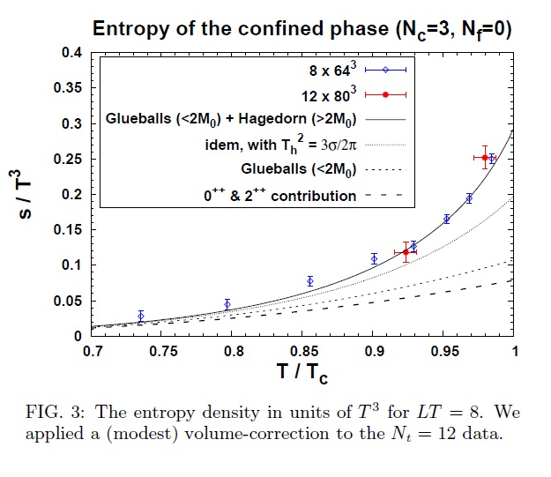
Pure LGT thermal GlueBall-matter observed at RHIC and LHC !?
Harvey Meyer, Univ. Mainz

Slide 15
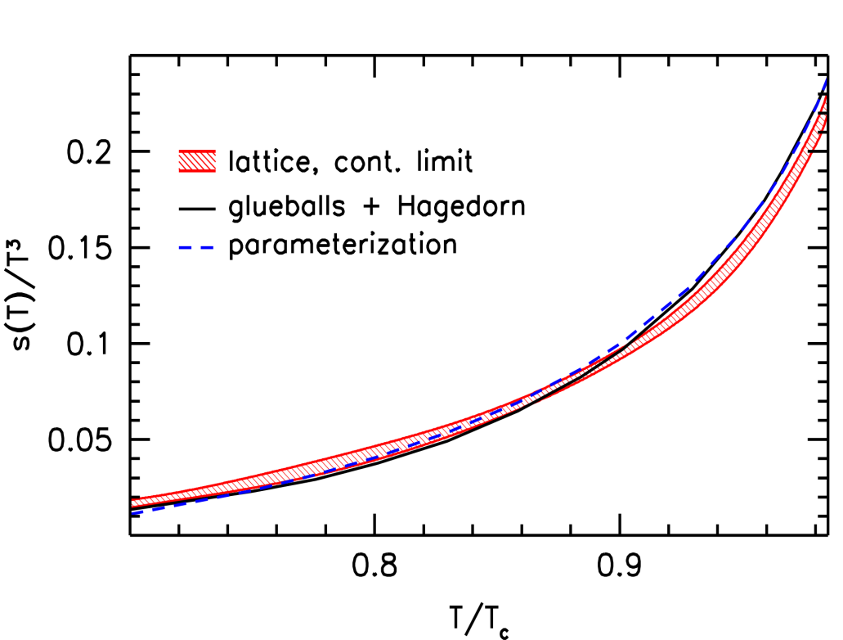
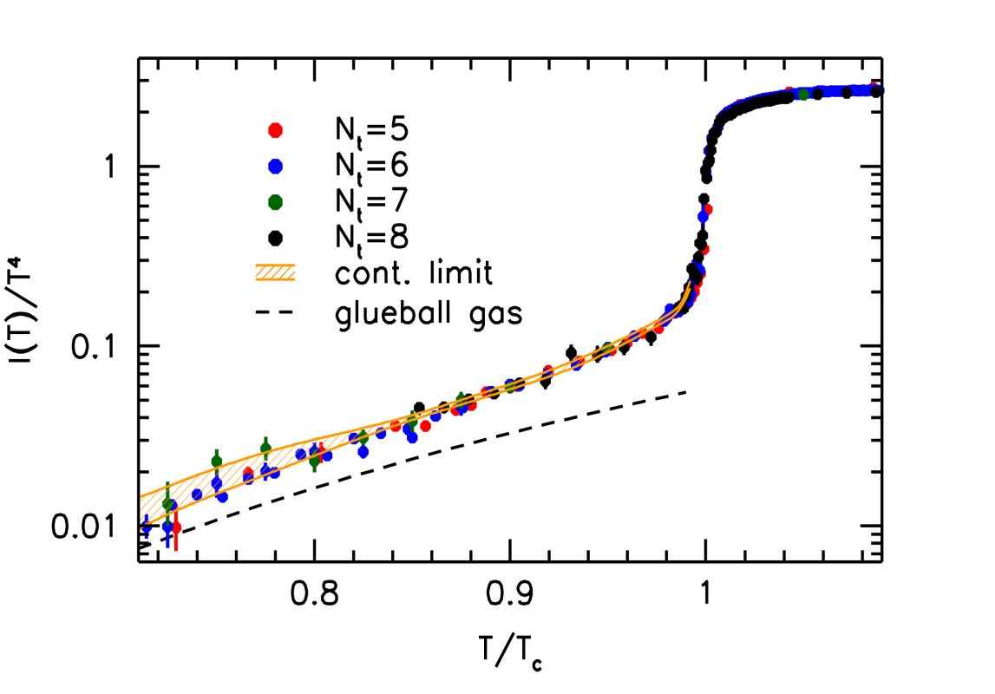
Lattice Gauge Thermodynamics of the GlueBall-matter fluid
Pure YM gauge: Glue Plasma
Glueball-Hagedorn-States
Glueball-Hagedorn-States
12 Glueballs
Wuppertal-Budapest (W.-B.)Collaboration: JHEP 1207 56 (‘12)
High precision continuum result for the quenched equation of state.
Low temperature behavior and phase transition described by Hagedorn-GlueBall spectrum.
W.-B. use 12 GlueBall states (Morningstar-Peardon) plus Hagedorn-GB towers
(as proposed by Harvey Meyer).

Slide 16
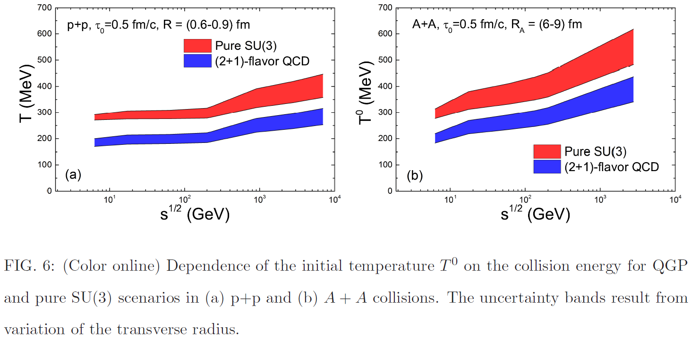
FAIR*:
HESR
p-pBaR
collider
32 GeV

Slide 17
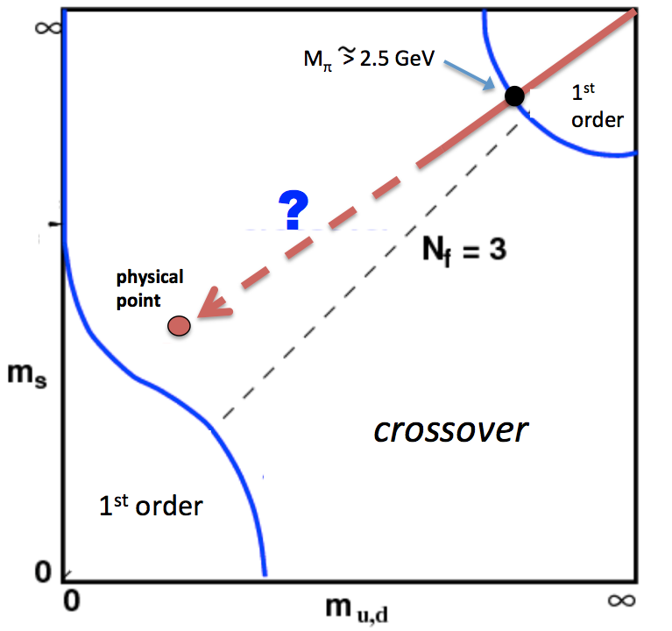
SU(3)_color Lattice Gauge Theory
Columbia Plot: Order of Phase Transitions depends on quark masses
pure gauge: glue only!
t=0.1fm/c : No Quarks !
LHC/RHIC/FAiR*: time evol. in pp & AA
Quenched QCD: glue +GlueBalls
t=1fm/c
few heavy Quarks
T_cp =250 MeV
2fm/c: Quarkdensity
is not yet equilibrated
3fm/c Hadronization?
4fm/c Freeze Out ?

Slide 18
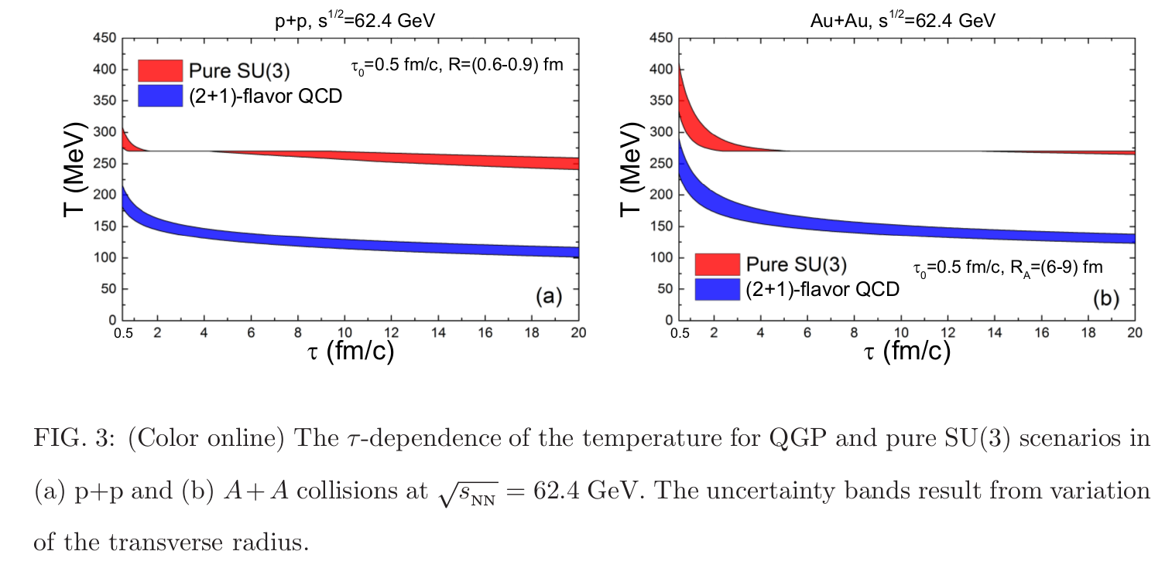
Time evolution T(t) of pp vs AA collisions at RHIC
Pure YM
L~ 0
L~0.3
L~0.5
L~0.7
L~0.9
L~ 0
L~0.3
L~0.5
L~0.7
L~0.9
2+1 flavors
V. Vovchenko et al.

Slide 19

Cosmic GlueBall-Matter at CERN LHC and BNL RHIC

Slide 20
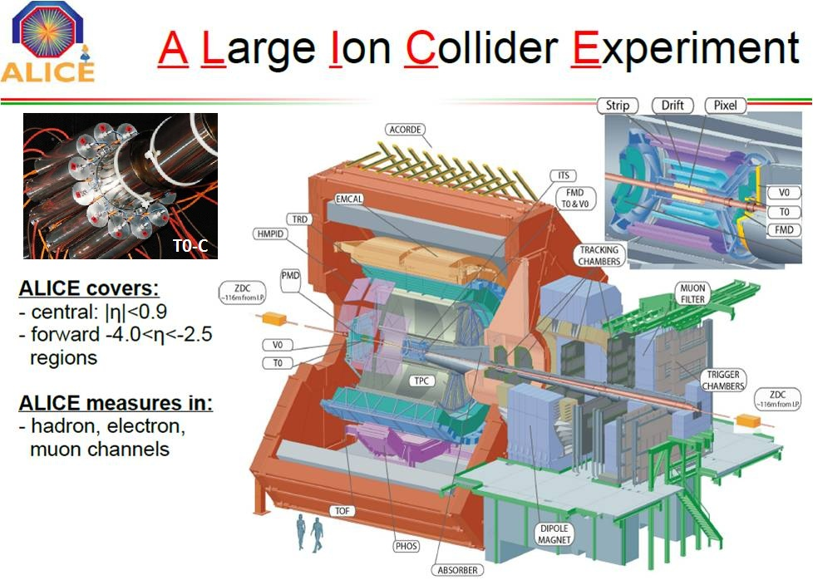
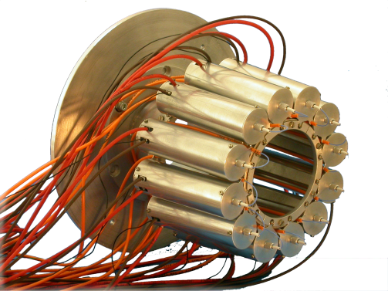
Cosmic GlueBall-Matter at CERN LHC and BNL RHIC

Slide 21
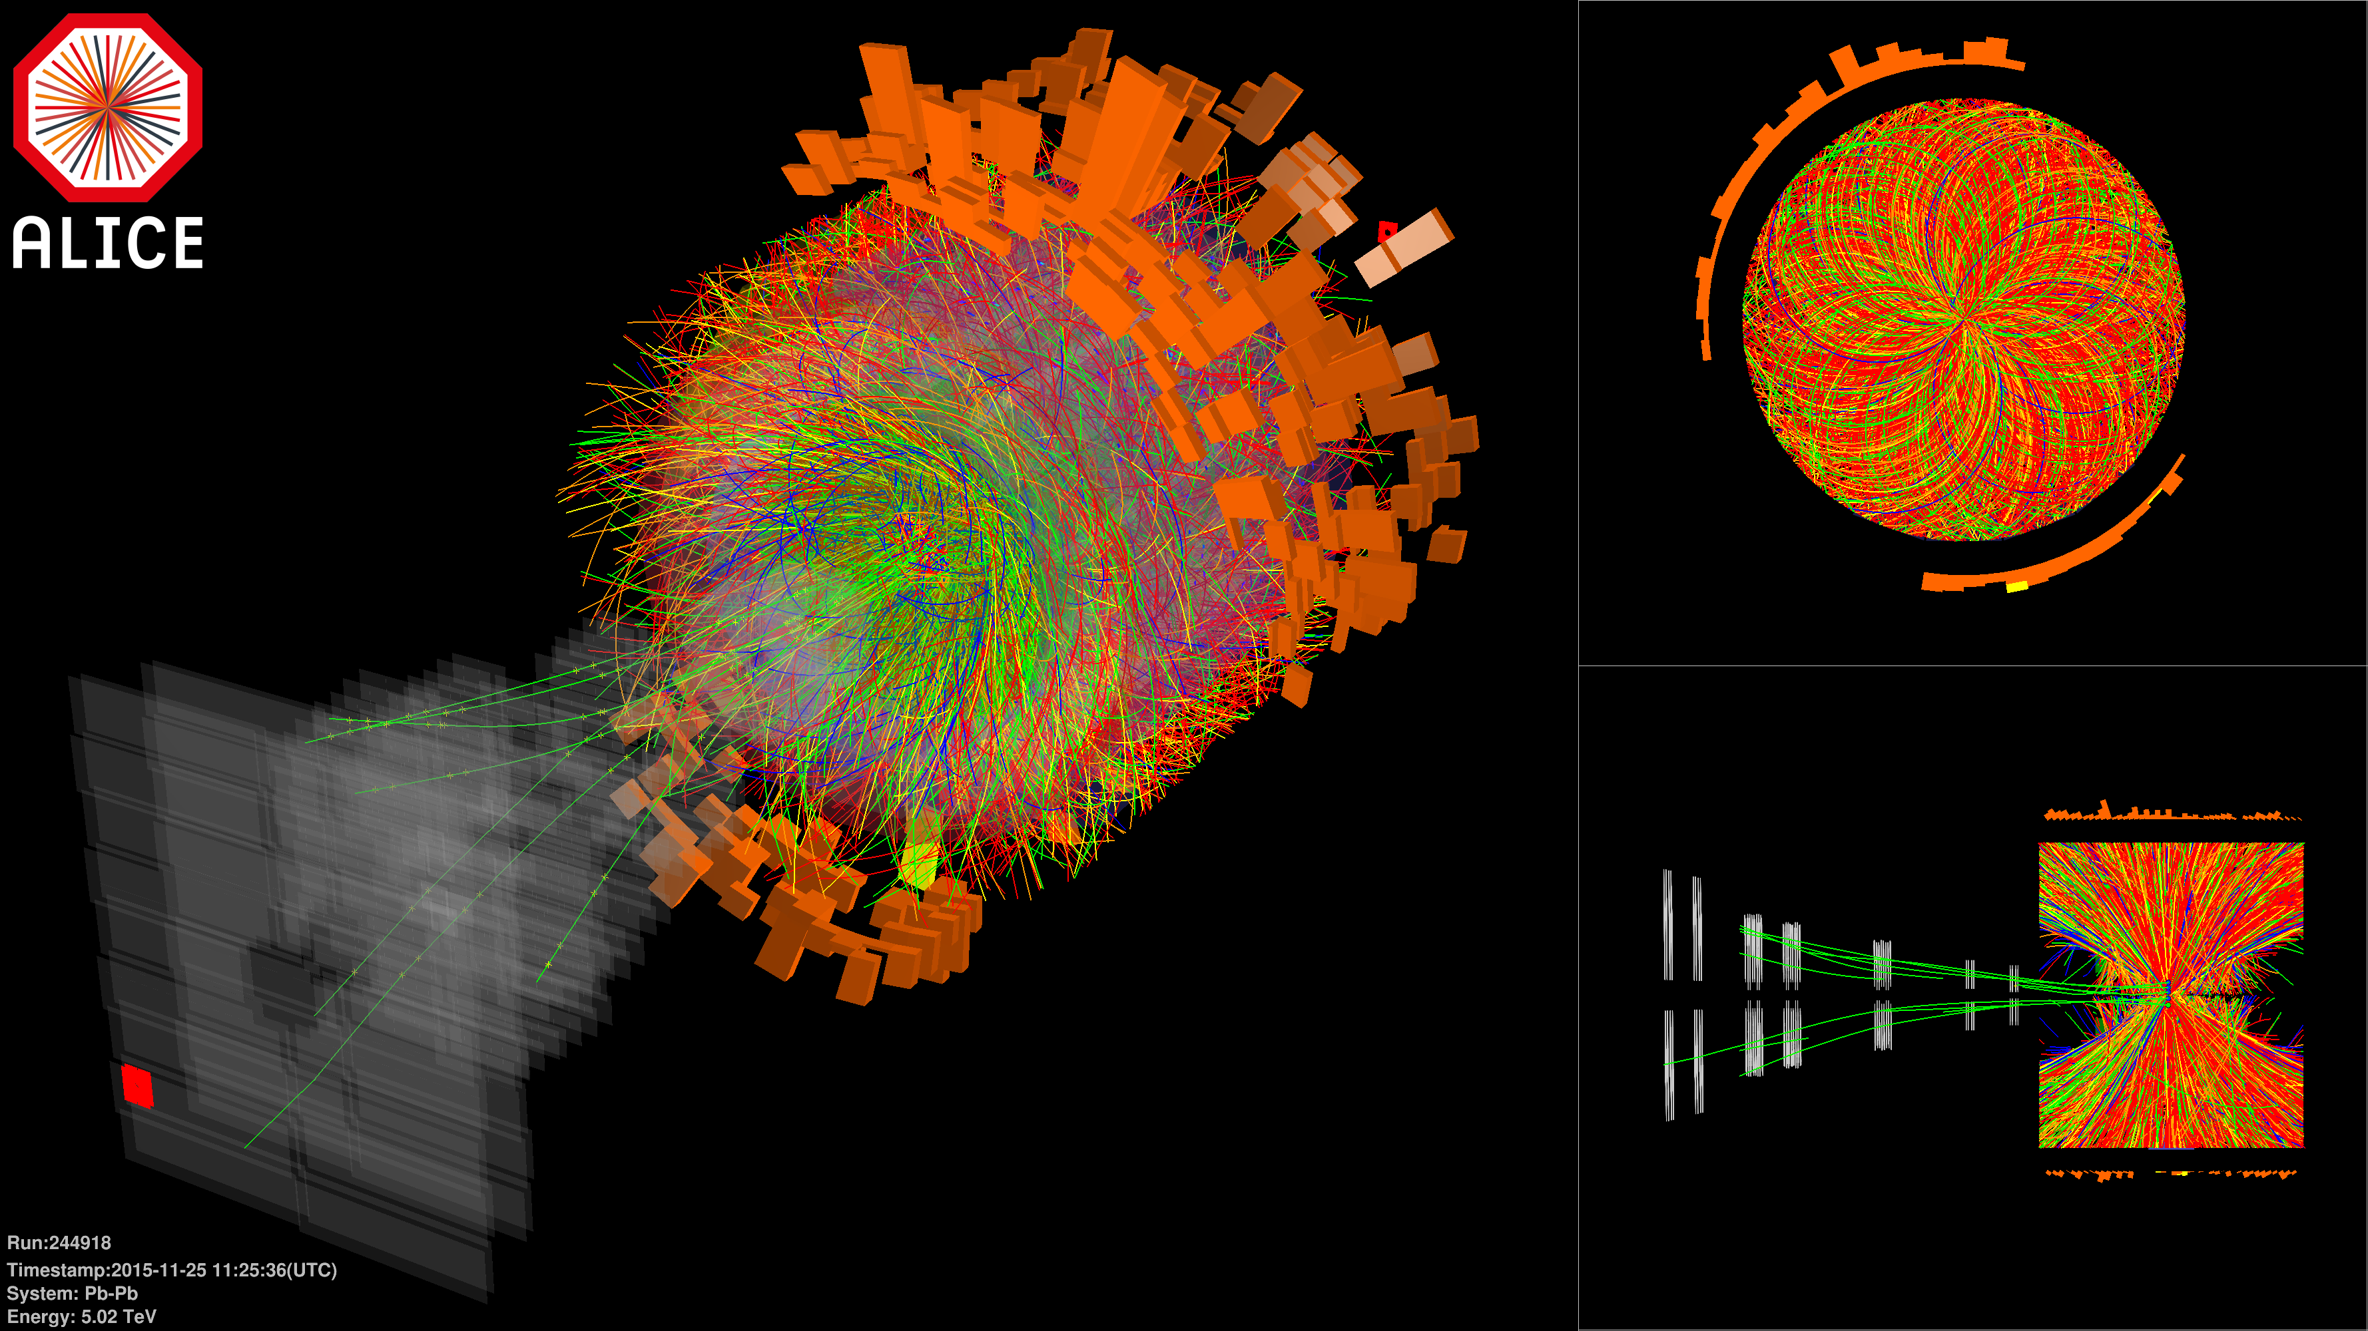
ALICE @ LHC: Pb-Pb collisions √s_{NN} = 5.02 TeV
First Data Nov. 25
LHC design HI luminosity 10²⁷ s⁻¹cm⁻² Dec. 1
Increase of statistics by a factor of 3-10 (centrality, ...)

Slide 22
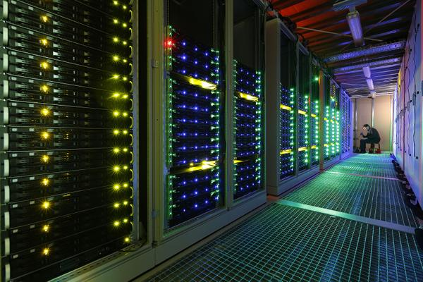
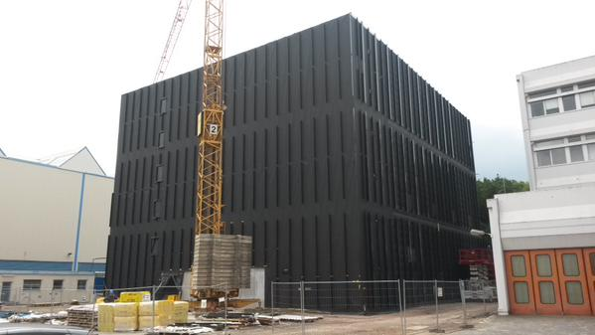
Extreme computing challenges require power efficient high performance computing
data storage & -analysis: Spin-off from Nuclear Physics to Industry & Business
Green Cube at GSI -4- FAIR Nr.1 Green-500: GSI L-CSC Computer
Supercomputer Fair, New Orleans, USA
November 2014
12 MW power consumption, PUE<1.07
T. Kollegger, AIME Big Data, Budapest
5.27 Gflops/watt power consumption
with AMD FirePro GPU

Slide 23
Traditional picture of QCD matter in Heavy Ion Collisions
Initial Color Glass Condensate Glasma thermalizes fast equilibration of Gluons and Light flavor quarks high pressure, entropy hydrodynamic expansion flow v2 as excellent Barometer: probe of QCD matter.
Hadronization @ T=155MeV: crossing of 2+1 flavor QCD
Hadronic yields and v2 at RHIC and LHC measured=> FIT !
Comparison of v2, HRG T= 155 MeV, with LHC data
“understanding” of QCD matter and - dynamics

Slide 24
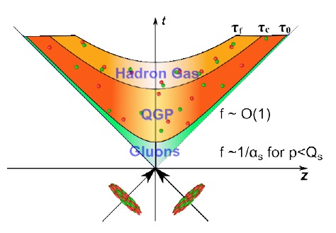
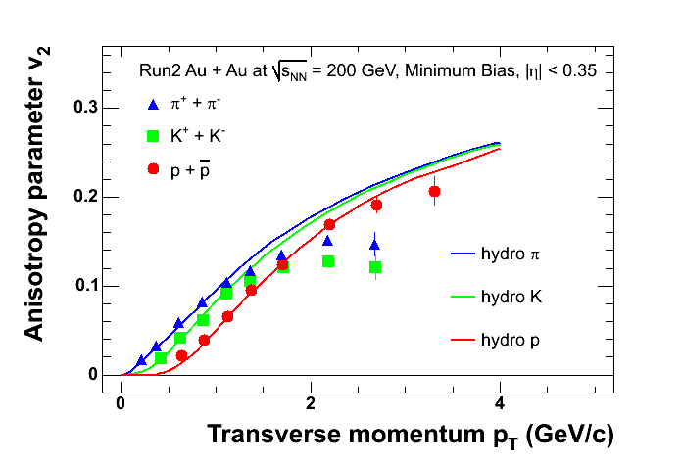
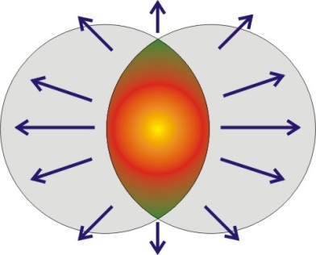
Fast thermalization required for Hydro
how can a system evolve
to thermal equilibrium
in such a very short time?
?
?
Initially: very far from equilibrium !
2+1QCD Hydro-Onset time < 1fm/c ?

Slide 25
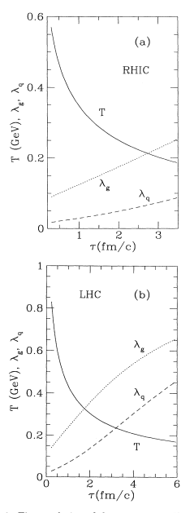
But:
Time evolution of fugacity
of gluons and quarks (g, q)
from pQCD-based rate eq.
Fast gluon saturation,
slow quark saturation
T. S. Biró, B. Mueller, X. N. Wang,
BMW-coll. , PRC48,1275 (1993)
also Kaempfer et al,
also Strickland...

Slide 26
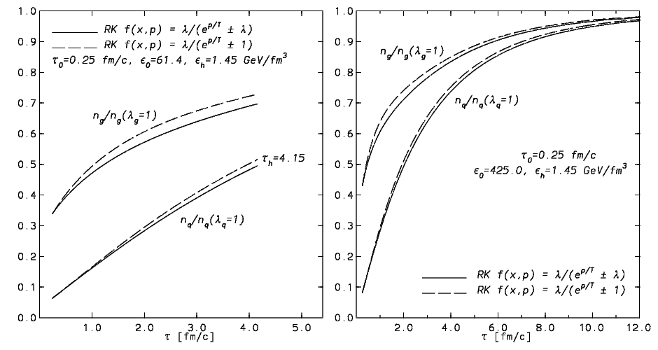
LHC
Fast gluon saturation,
slow quark saturation
Fast gluon saturation,
slow quark saturation
RHIC
Rate equation calculation
D.M. Elliott, D.H. Rischke,Nucl.Phys. A671,583 (2000)

Slide 27
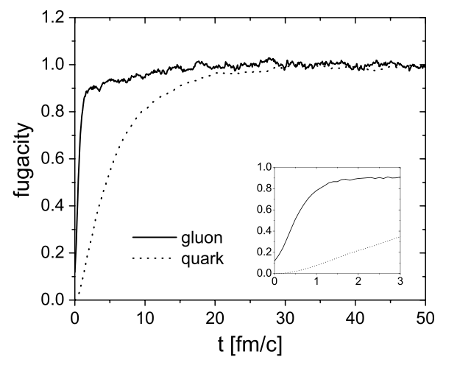
Time evolution of fugacity(g,q) -analogous to Nf (t)
BAMPS Box calculation
Z.Xu, C.Greiner,
PRC71,064901(2005)
fugacity ~ ½ flavor number Nf:
Nf(t)
2
1
0.2
0.1
Fast gluon saturation,
slow quark saturation
t/fm/c

Slide 28
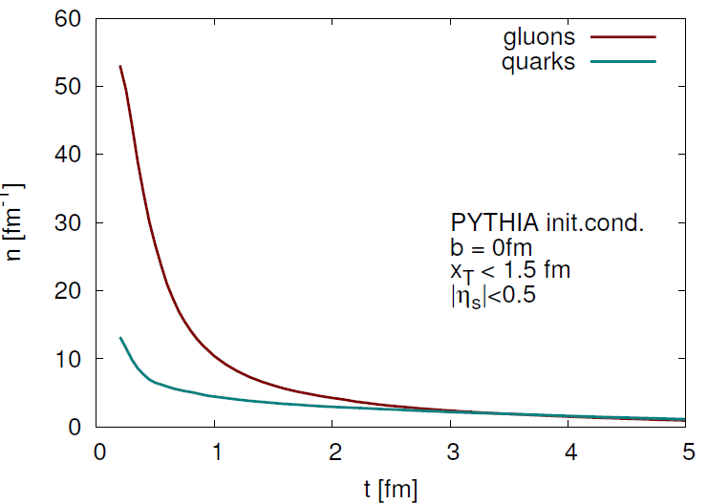
Gluon yields & quark yields F. Senzel, Z. Xu, C. Greiner BAMPS
Gluons
quarks

Slide 29
Pure YM Glue Matter created at FAIR*, RHIC, LHC ?
Early proposals for two phase transitions and two timescales in RHICs:
Svetitsky Yaffe Pisarski Wilczek Raha Sinha Shuryak Biro Kaempfer
1. CGC Gluon Supersaturation – Overoccupied Glue, BEC
2. Fast Gluon Equilibration – slow quark saturation
3. Early 1.Order Phase Trans. in Yang-Mills gauge theory
4. Pure YM Gaugetheory Nf =0 -“physical” Nf=2+1 QCD Nf=fct of time!
5. Second Transition Quarks-Hadrons 2+1-QuarkGluonPlasma”crossing”
6. GlueBalls-HagedornStates, two body sequential decay cascade
7. Hadron yields, <pt> vs. Multiplicity, Flow & Ridge in pp, pA, AA
8. Dileptons, Photons vs. Multiplicity in pp, pA, AA
Horst Stoecker, Judah M. Eisenberg Prof., ITP & FIAS, Goethe Univ. Frankfurt

Slide 30
Time evolution of high multiplicity pp AA
at RHIC and LHC in pure YM scenario

Slide 31
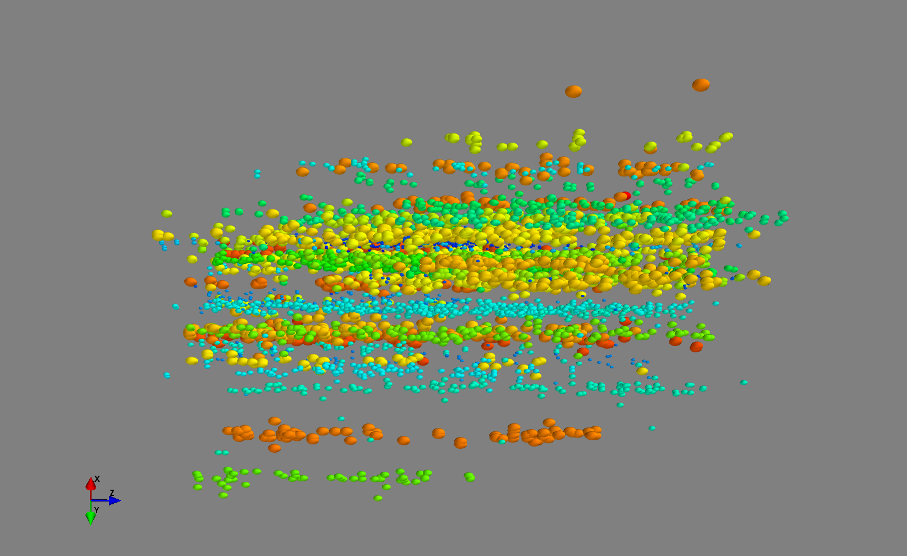
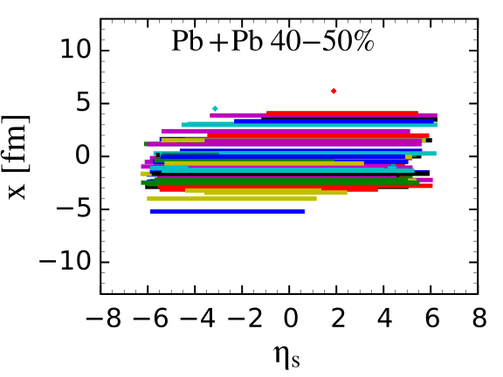
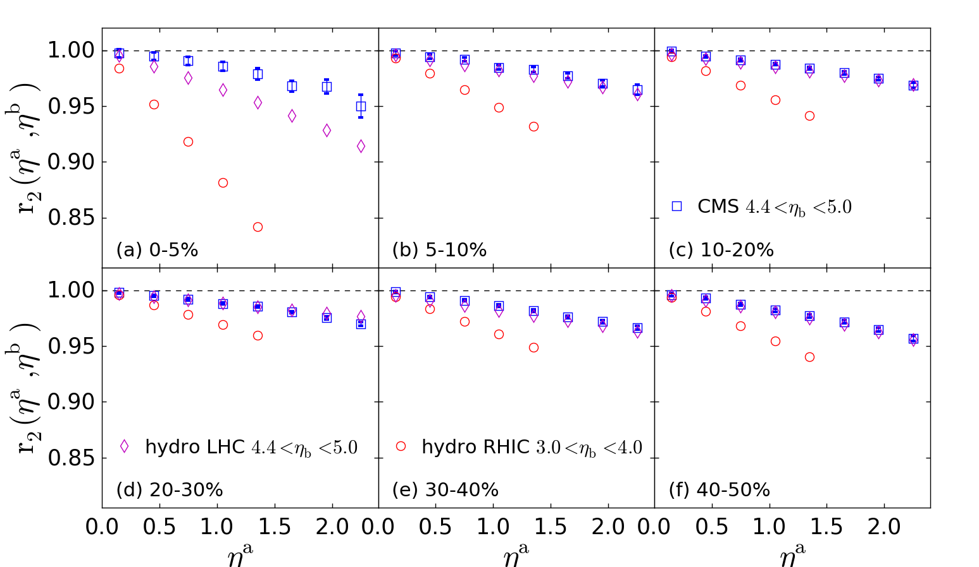
Quark Matter 2015
Event-by-event hydro confirms the de-correlation of anisotropic flow along rapidity
Brain storms for longitudinal structure of QGP
Question flow measurements. (Event planes are different with big pseudo-rapidity gap)
LongGang Pang, Petersen, X.N. Wang

Slide 32
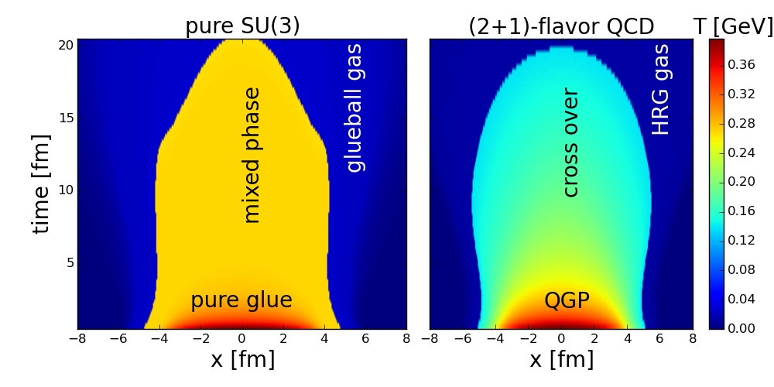
Hydrodynamic expansion of pure glue and QGP with the 2 different EoS
Energy density smaller than 0.15 GeV is masked as HRG or glueball fluid
The mixed phase lasts very long with pure SU(3) gauge EOS
LongGang Pang, V. Vovchenko, H. Nieminen, HST

Slide 33
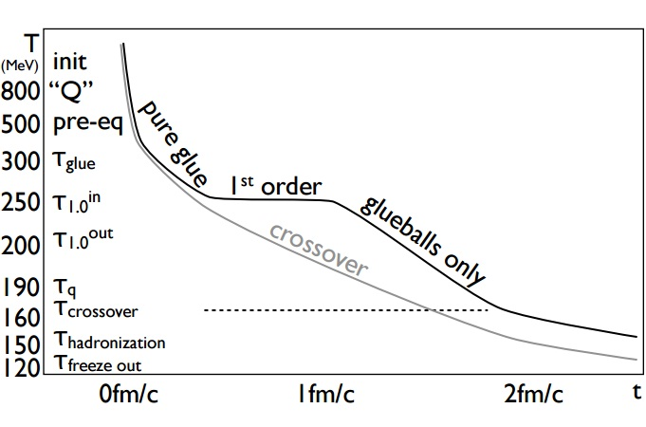
Eff.Nf(t)
0.0
0.1
0.2
0.3
0.6
0.9
GlueBalls decay
Eff. Nf(t): 0 0.1 0.2 0.3 0.6 1.2 ...
Eff. Nf(t) is U.S. – parameter : Nf = 2+1 ~ fugacity = 1

Slide 34
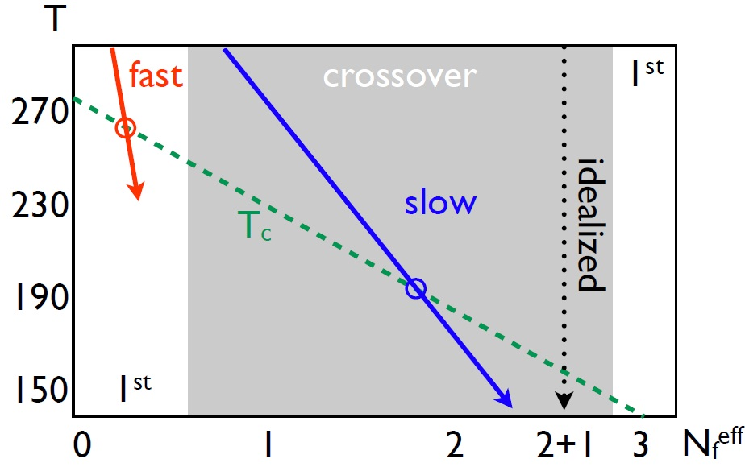
Hadronization
of GlueBalls
- HagedornStates
Hadronization of
GlueBall-Hagedorn
Hadronic Gas?

Slide 35
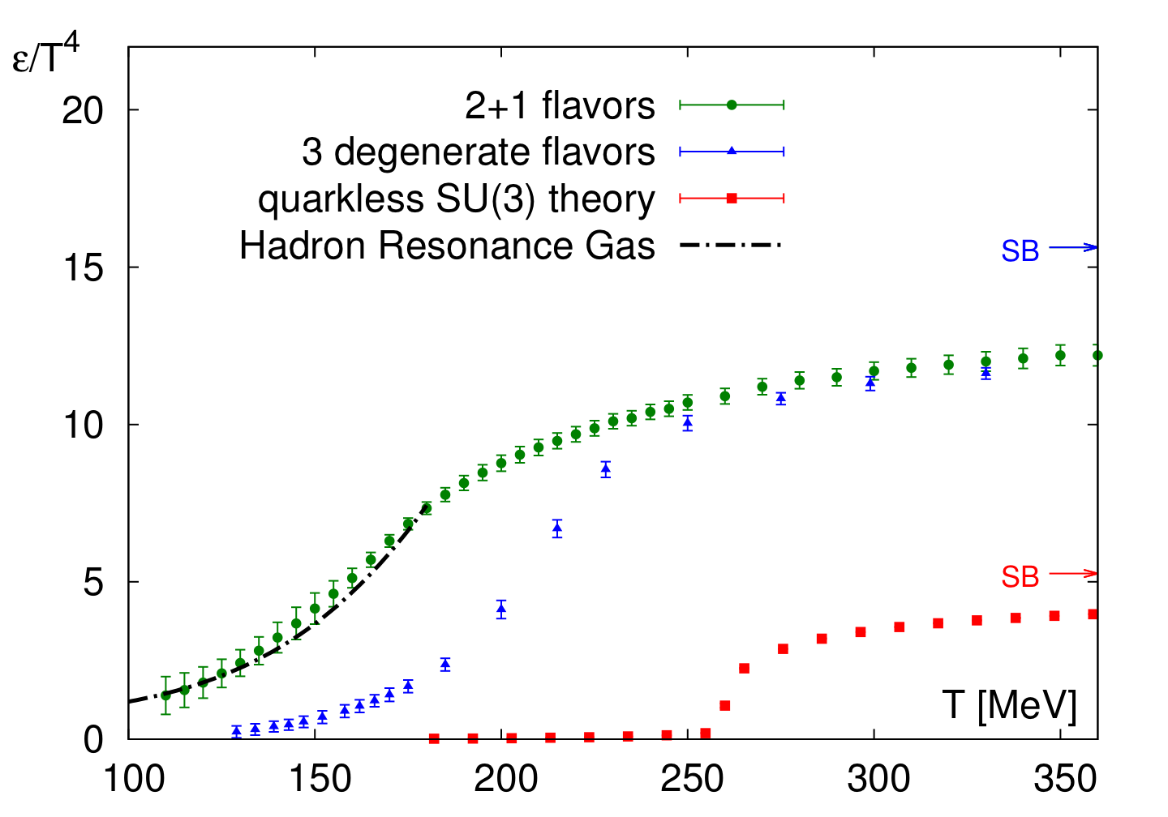
Pure YM LGT vs. 2+1 flavor Lattice QCD
Energy density (EoS) DIFFERENT for different quark masses
Energy density from
Sz. Borsanyi et al., W.P.
Wuppertal-Budapest coll
JHEP 1011, 2010,077;
PLB730, 2014, 99
“physical point” 2+1
T_c.o. = 155 MeV
N_f = 3, m_{u,d} = m_{s}
T_c.o. = 220 MeV
pure gauge YM
T_c = 270 MeV
Quenched: W.B. coll.
JHEP 1207, 2012, 056
1. O.P.Transition from glue-plasma to GlueBall-Hagedorn St.
HagedornStates decay

Slide 36
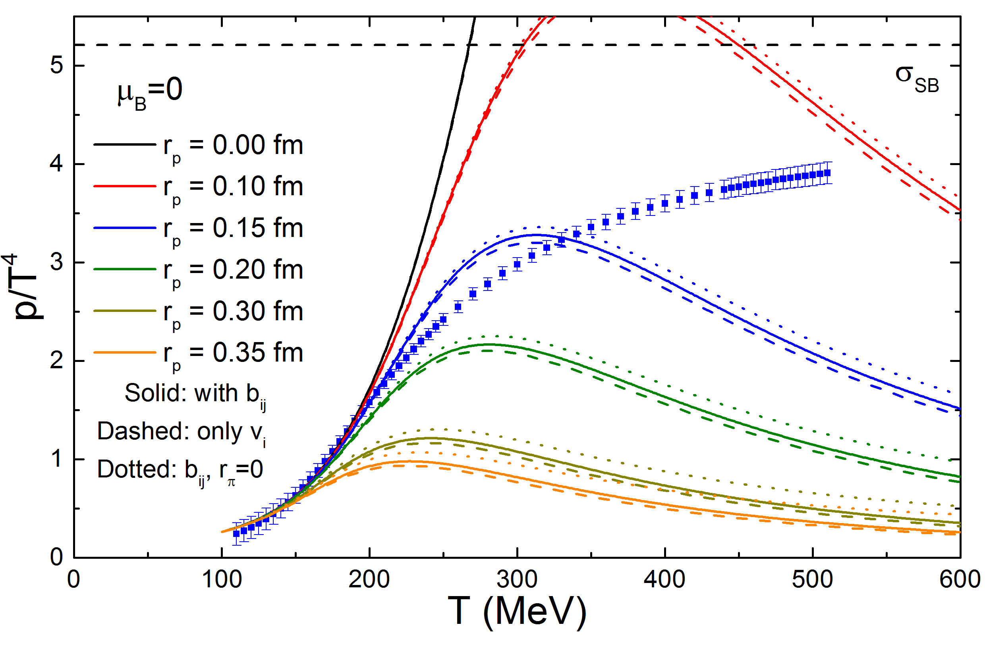
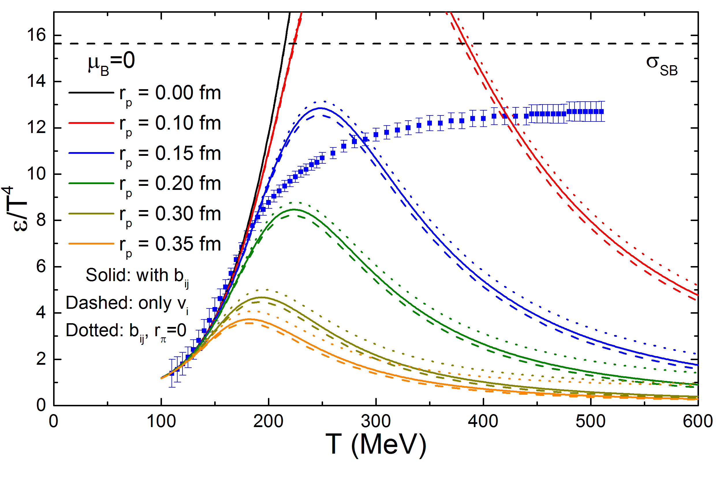
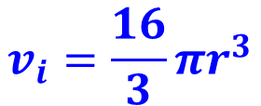
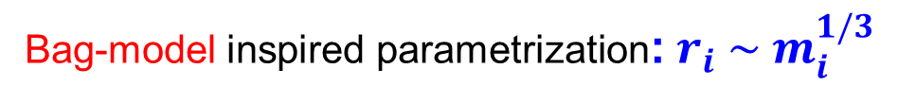
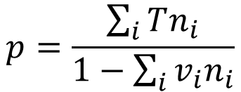
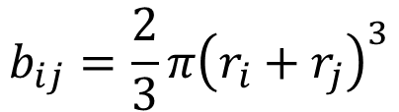
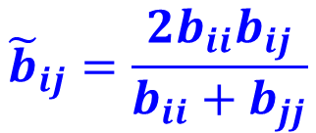
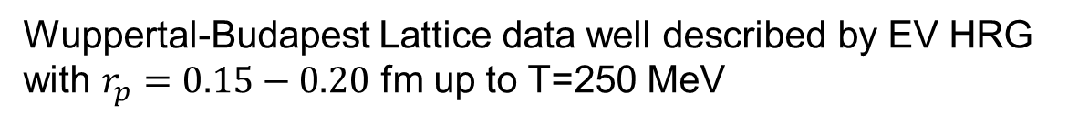
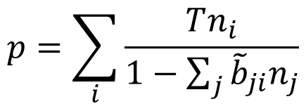
Multi-component eigenvolume HRG vs lattice QCD
“Diagonal” EV model
“Crossterms” EV model
$$p=\sum_{i}{\frac{Tn_{i}}{1−\sum_{j}{{\tilde{b}}_{ji}n_{j}}}}$$
$$b_{ij}=\frac{2}{3}π{\left(r_{i}+r_{j}\right)}^{3}$$
$$p=\frac{\sum_{i}{Tn_{i}}}{1−\sum_{i}{v_{i}n_{i}}}$$
$$v_{i}=\frac{16}{3}πr^{3}$$
$${\tilde{b}}_{ij}=\frac{2b_{ii}b_{ij}}{b_{ii}+b_{jj}}$$
Bag-model inspired parametrization: $r_{i} \sim m_{i}^{1/3}$
pressure
energy density
Wuppertal-Budapest Lattice data well described by EV HRG
with $r_{p}=0.15−0.20$ fm up to T=250 MeV
V. Vovchenko, HST

Slide 37
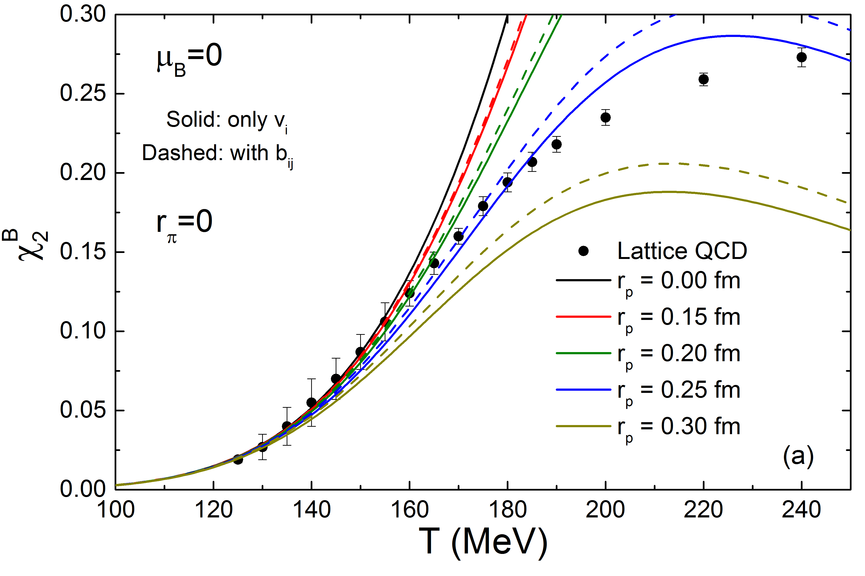
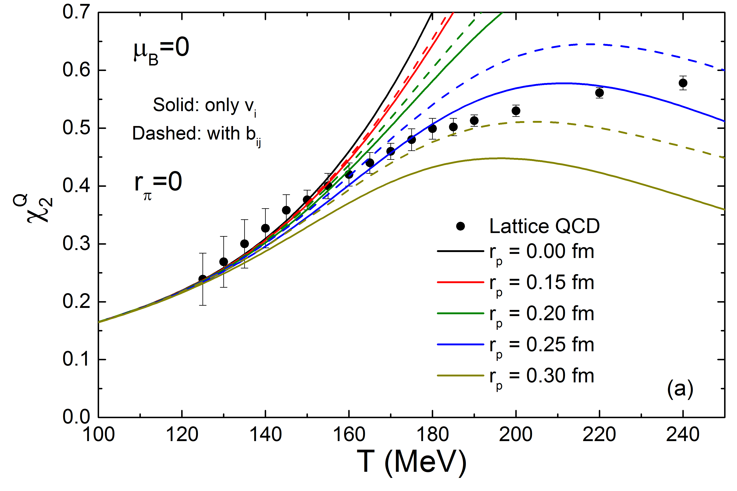




Multi-component bag-eigenvolume HRG vs lattice QCD
Susceptibilities carry information about finer details of the equation of state
$$χ_{2}^{B}$$
$$χ_{2}^{Q}$$
$$χ_{2}^{S}$$
strange vs non-strange hadrons
- different volumes at same mass?
r=0 : HRG of point particles
cannot follow lattice data above T=160 MeV
Finite eigenvolumes of hadron bags:
dramatic improvement towards lattice data
V. Vovchenko, HST, in preparation

Slide 38



Multi-component eigenvolume HRG vs ALICE hadron yield data
Bag-model inspired EV HRG: $r_{i} \sim m_{i}^{1/3}$
ALICE yield data 3x improved fit in wide temperature range T=170-270 MeV
V. Vovchenko, H. Stoecker, arXiv:1512.08046 [hep-ph]

Slide 39
Signatures for pure glue => glueball scenario
New event-class in high multiplicity pp & pA
at FAIR*, RHIC and LHC

Slide 40
Identification of Glueballs
Lightest Glueball predicted near two states of same Q.N..
“Over population” Predict 2, see 3 states
Glueballs should decay in a flavor-blind fashion.
Production Mechanisms:
Certain are expected to by Glue-rich, others are
Glue-poor. Where do you see them?
Proton-antiproton
Central Production
J/ψ decays

Slide 41


Hagedorn hadronization: cascade of sequential 2-body decays: yields/ratios vs ALICE data
data: ALICE @ LHC
M.Beitel, K.Gallmeister, C.Greiner, PRC 90 (2014) 045203

Slide 42


Electromagnetic probes of
pure glue initial scenario
Vovchenko, Karpenko, Gorenstein, Satarov, Mishustin, Csernai, Kämpfer, Stoecker, work in progress
$\overline{q}, q$ undersaturated at the early pure glue stages of the fireball expansion:
suppression of EM radiation from the plasma
Thermal dileptons
Direct photons
Compared to equilibrium QGP scenario,
Thermal dileptons suppressed by a factor of ~10
Thermal photons suppressed by a factor of 2-3

Slide 43
Observation of Glueballs in pp, pA, AA
violent pp (& AA) collisions
initial state at LHC:
Color Glass Condensate
t=0.1fm/c: glue thermalizes
pure glue-plasma created
Quenched Lattice SU(3)_c :
T_c =270MeV
glue plasma -> GlueBall fluid
1. Order Phase Transition
Expansion to critical point
T_cp =240 MeV t~1-2 fm/c
GlueBalls + Hagedorn States Mix
more and more quarks produced: T_c.o. =155MeV crossover transition
Observables from Columbia plot
T>T_cp: Zero e.m. radiation
Measure T~270 MeV Dilepton mass
T_c: Flow collapse as barometer
T_cp: Critical Scattering (MG,WG),
Kurtosis , # fluctuations
T_c ~ 2*T_co =>
P_t(pp) ~ 2*p_t(AA)
M_GlueBalls < 2GeV: „No“ Baryons
p/pi ~ 0 : Yield p+pBar << mesons
Lightest GlueBall decays:
- No decays to 2 Omega, no 2 Rho
Glue Flavor blind !
K/pi=1 Yields: Kaons ~ pions
V. Vovchenko & HAST 2015

Slide 44
Alternate Scenario: pure gauge matter in pp, pA – AA ?
Initial Color Glass Condensate Glasma thermalizes fast equilibration of Gluons, slow equil. of quarks high pressure, entropy gluon plasma fast hydrodynamic expansion of gluon plasma.
1. Order Phase Transition at T_c = 270 MeV of flavorless QCD.
Transition from glue plasma in GlueBall fluid
Glueball-Hagedornstates mix with quarks, decay into Hadrons

Slide 45
Acknowledgements
Transport: Zhou, Seizel, Xu, Nara, Gang, Niemi, C. Greiner...
Hagedorn: Beitel, Gallmeister, N.-Hostler, Vovchenko, C. Greiner...
FIAS: Schramm, Dietrich, Struckmeier, Vasak, ...
Early phase e-m probes colleagues: Raha, Sinha, Gorenstein, Vovchenko, Satarov, Mishustin, Csernai ...
Lattice colleagues: Fodor, Borsanyi, Szabo, Karsch, Philipsen...
Experimentalists: Giubellino, Harris, Oeschler, PBM, Masc..

Slide 46

Time evolution of density at 11.5GeV

Slide 47

JAM
Akira, Nara & HST
Directed Flow v1 protons and pions
STAR data

Slide 48

Multi-component eigenvolume HRG vs NA49 hadron yield data
Bag-model inspired EV model: $r_{i} \sim m_{i}^{1/3}$
NA49 data fitted by two EV-HRGmodels
Eigenvolumes drastically improve fit quality
Correct treatment of cross virial terms
yields further improvement
HRG with bag-eigenvolumes improves
drastically the best fit,
4x better chi squared !
Quite different freeze-out param T, muB
V. Vovchenko, H. Stoecker, in preparation

Slide 49



Multi-component eigenvolume HRG vs NA49 hadron yield data
Bag-model inspired EV model: $r_{i} \sim m_{i}^{1/3}$
Chemical potential and temperature difficult to fix: large uncertainty in T, mu_B
E/N = const. freeze-out criterion holds… const. depends on eigenvolumes
Can freeze-out parameters extraction with HRG be at all conclusive ?
V. Vovchenko, H. Stoecker, in preparation

